Slide 1
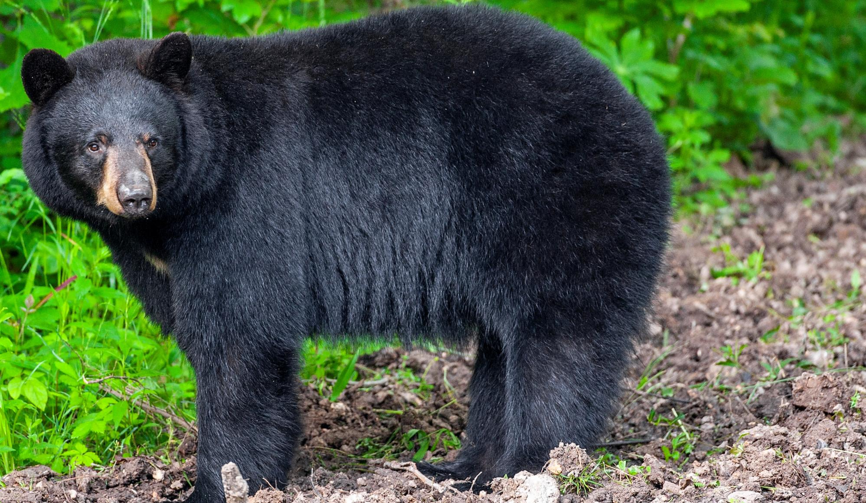

BEARS
Through the Seasons
Lesson 4A: Hello Spring!

Slide 2
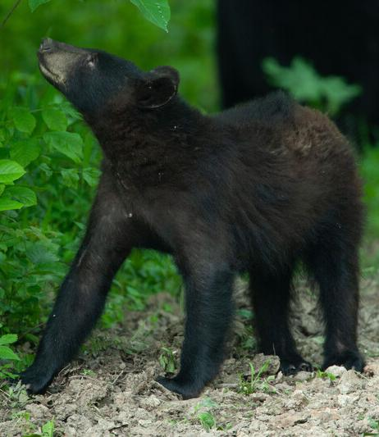

Guiding Question:
What do people and animals do in the spring?
Bears through the Seasons – 4A Hello Spring: Engage
2

Slide 3

Bears through the Seasons – 4A Hello Spring: Engage
3
Notes:
Prepare and display your Noticings and Wonderings Chart for this lesson. Add student observations and/or questions to the chart as the lesson proceeds in reference to the phenomenon studied.

Slide 4

Read the book Hello Spring by Shelley Rotner
Link to Read-Aloud: https://youtu.be/t5hpU6ZbiD0?si=EmyRk_CRcBYah_zg
Bears through the Seasons – 4A Hello Spring: Engage
4

Slide 5
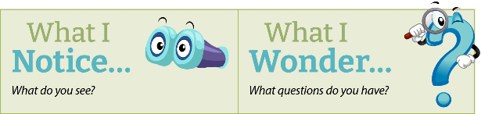
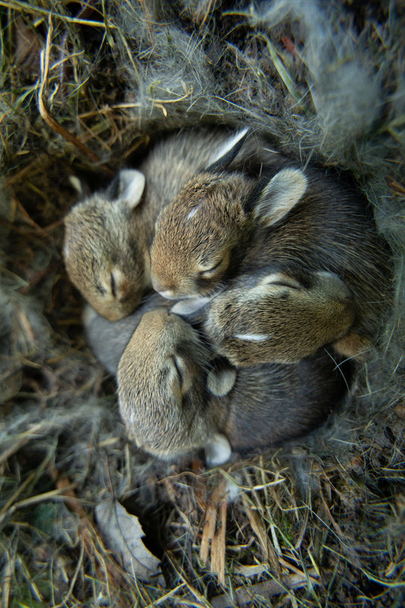
What are the characteristics of spring?
Bears through the Seasons – 4A Hello Spring: Engage
5

Slide 6
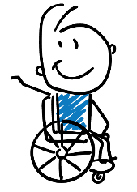
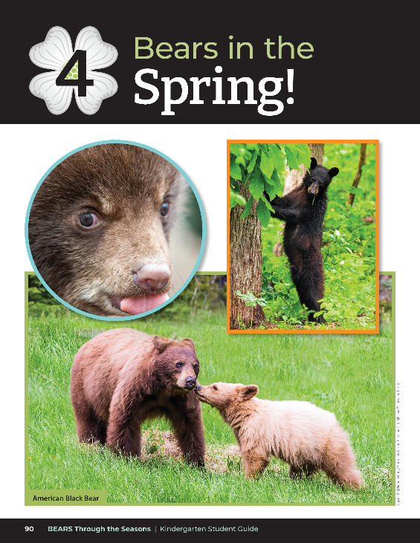
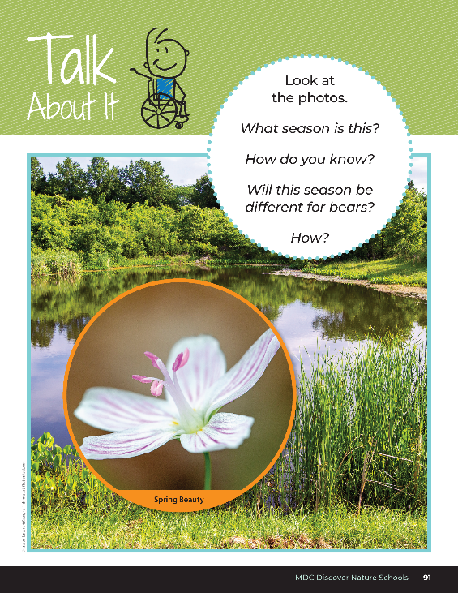
What season is this?
How do you know?
Will this season be different for bears?
How?
Bears through the Seasons – 4A Hello Spring: Engage
6

Slide 7
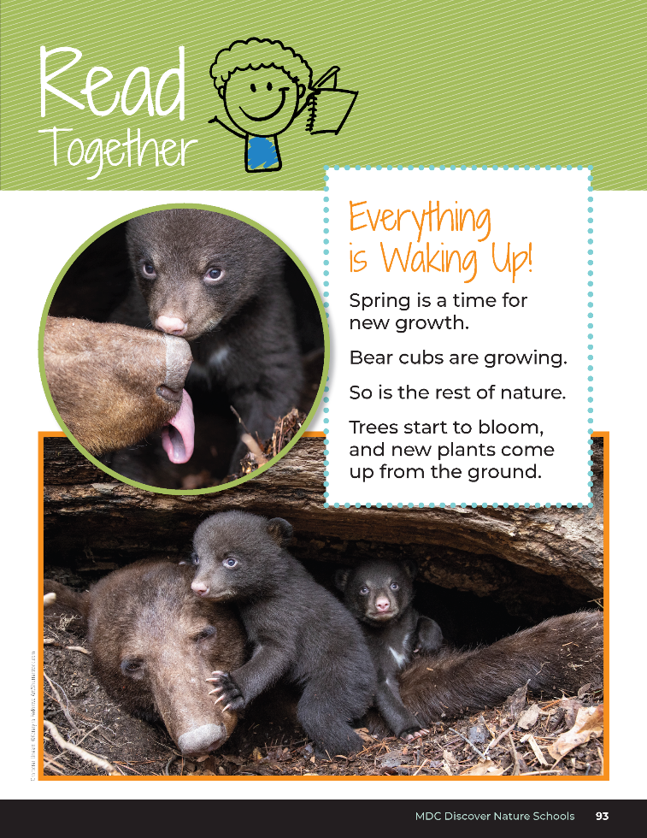

Everything is Waking Up!
Spring is a time for new growth.
Bear cubs are growing.
So is the rest of nature.
Trees start to bloom, and new plants come up from the ground.
Bears through the Seasons – 4A Hello Spring: Engage
7

Slide 8
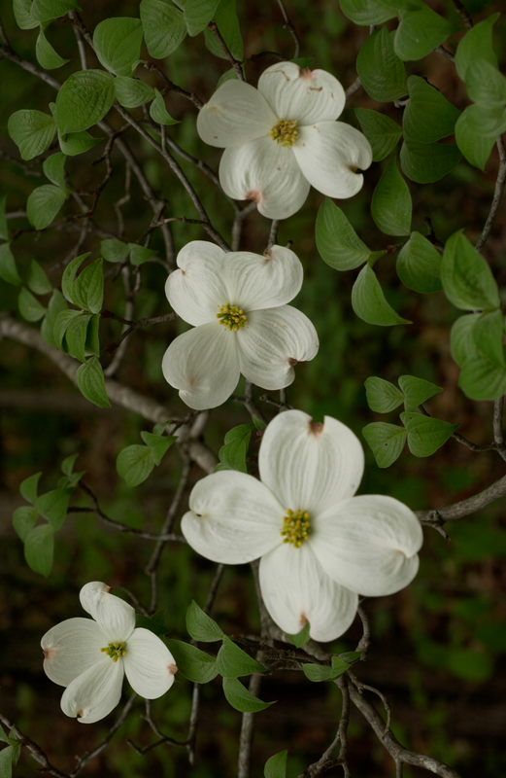
What new things bloom and emerge in spring?
Bears through the Seasons – 4A Hello Spring: Engage
8

Slide 9

What temperature outside helps plants to grow?
Bears through the Seasons – 4A Hello Spring: Engage
9

Slide 10

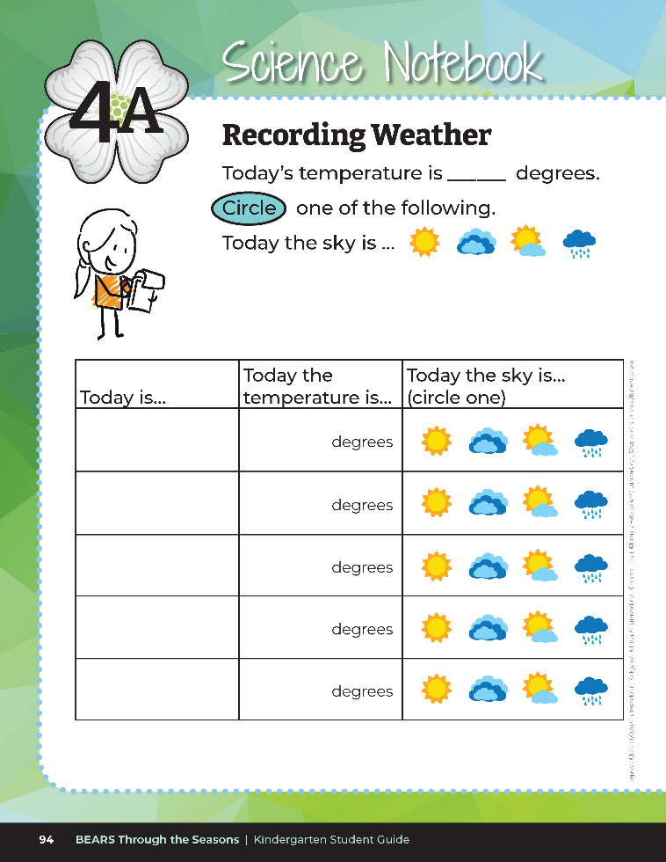
Recording Weather
Bears through the Seasons – 4A Hello Spring: Engage
10
Notes:
It’s time to collect our seasonal weather data. As a class, go outside with the student guides to record the temperature and collect weather data. Record findings in the student guide Science Notebook Recording Weather on Page 94.

Slide 11
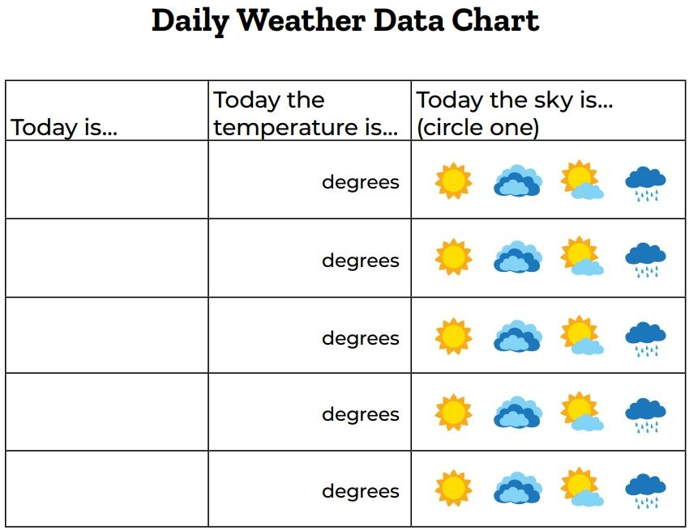
Bears through the Seasons – 4A Hello Spring: Engage
11
Notes:
Refer to the 4A Daily Weather Data Chart. Each day, week, or designated time data is collected as a class, have students record findings on the Daily Weather Data Chart.
Collect additional data and determine when it will be filled out each day.

Slide 12

10
20
X
MINUTES
DAYS
How will days that have some rain or some sun be reported?
Bears through the Seasons – 4A Hello Spring: Engage
12
Notes:
Optional – Collect data for 4 weeks. If this option is chosen, continue to use the Daily Weather Data Chart, a 4-week data collection tool. Students can draw the weather and record the temperature in the boxes – decide what symbols to use for recording. Ask students why they should all use the same symbols to record. After a week of data collection, discuss how the weather has changed over the course of the week.

Slide 13
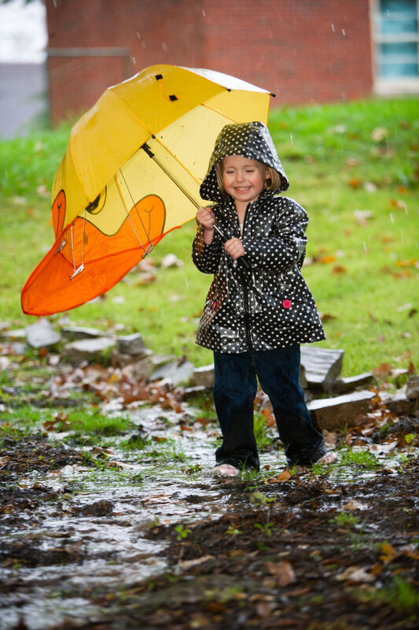
Has there been a lot of change or a little change?
Bears through the Seasons – 4A Hello Spring: Engage
13

Slide 14
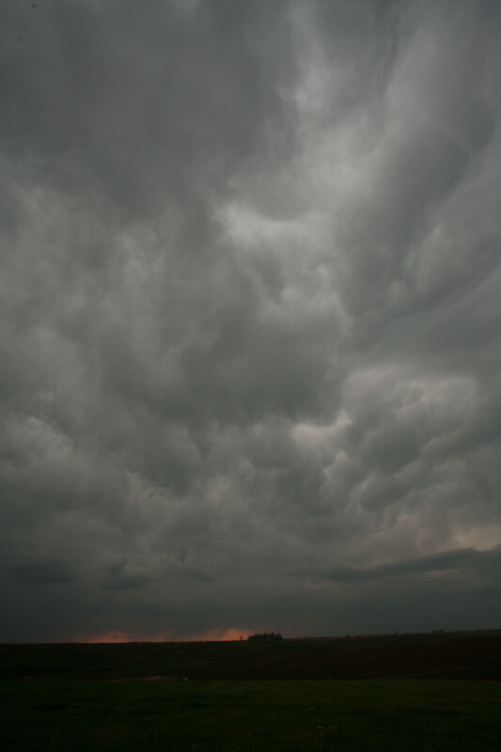
Has it occurred fast or slow?
Bears through the Seasons – 4A Hello Spring: Engage
14
Notes:
There may be rapid change in weather when storm systems come in. Seasonal changes occur more slowly.

Slide 15

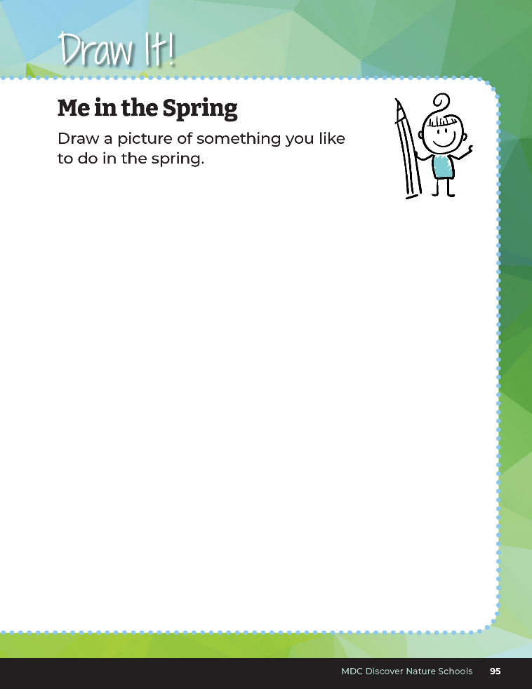
Draw a picture of something you like to do in the spring.
Bears through the Seasons – 4A Hello Spring: Explore
15
Notes:
To further their springtime connections, have students open up their student guide, Draw It! Me in the Spring on Page 95.
On this page, students will draw a picture of something they like to do in the spring. They need to include what they wear and their surroundings including weather.

Slide 16
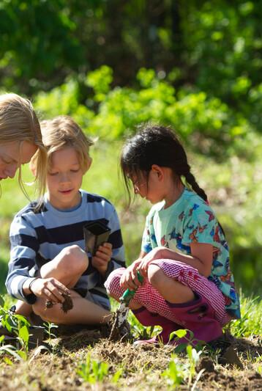
What do we wear in the spring?
Bears through the Seasons – 4A Hello Spring: Explain
16
Notes:
Use student drawings to create a class poster of spring.

Slide 17
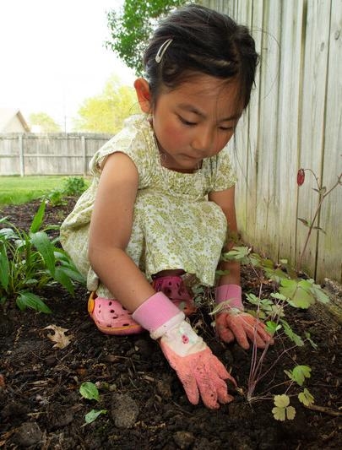
What are activities that we do in spring?
Bears through the Seasons – 4A Hello Spring: Explain
17

Slide 18
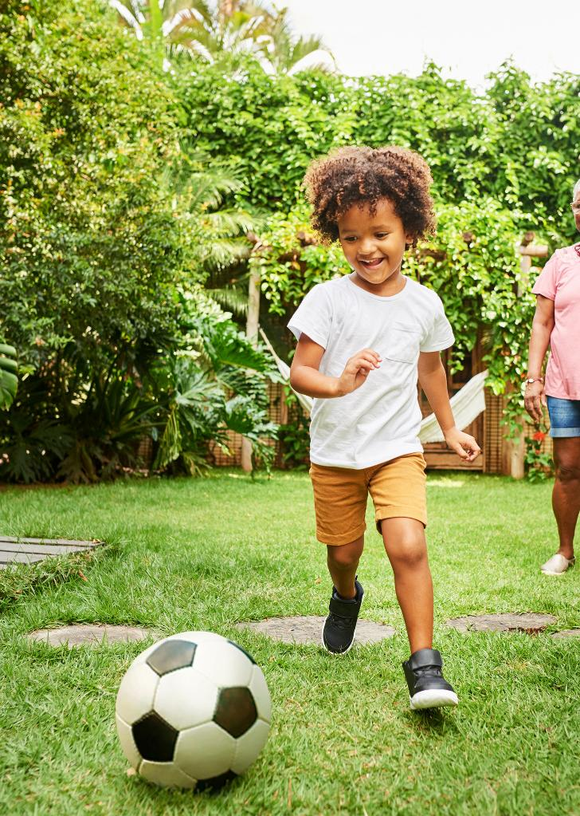
Why do we do those activities in the spring?
Bears through the Seasons – 4A Hello Spring: Explain
18

Slide 19
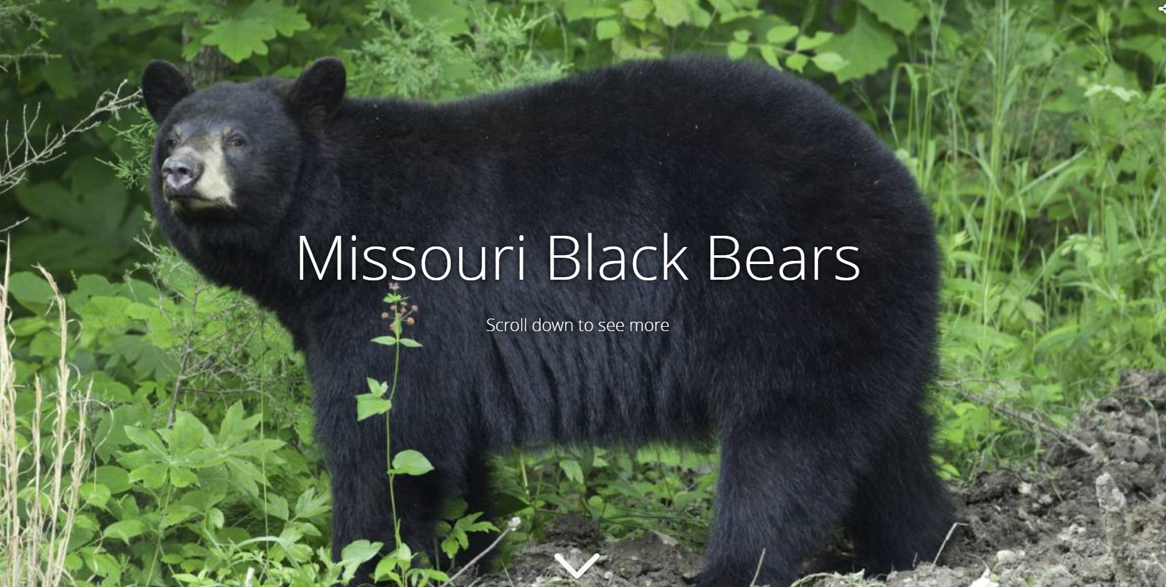
Black Bear Interactive Story Map
Link:
Missouri Black Bears
Bears through the Seasons – 4A Hello Spring: Elaborate
19
Notes:
Open the MDC Teacher Portal to Kindergarten Lesson 4A. Refer to the interactive Missouri Black Bear Story Map. Show the images of bears emerging from their dens.

Slide 20
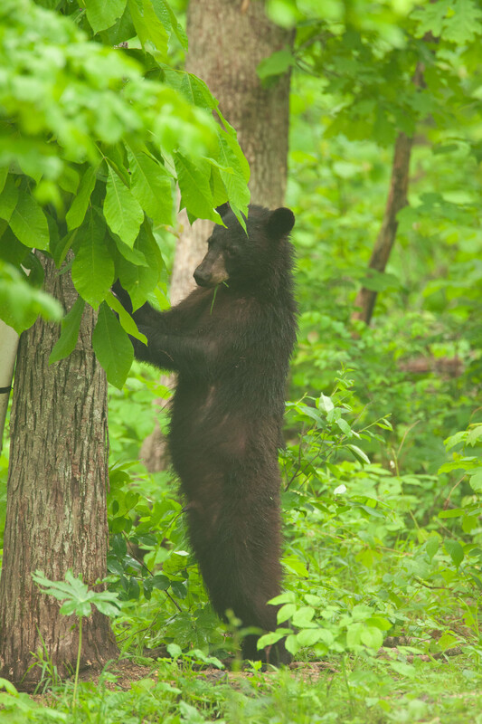
What are bears doing in the spring?
Bears through the Seasons – 4A Hello Spring: Elaborate
20
Notes:
As the weather gets warm and insects become active, bears eat larvae of insects and plants.

Slide 21

Link: Springtime Animal Behavior
Bears through the Seasons – 4A Hello Spring: Elaborate
21
Notes:
Watch the Springtime Animal Behavior video on the MDC Teacher Portal under Kindergarten Lesson 4A.

Slide 22
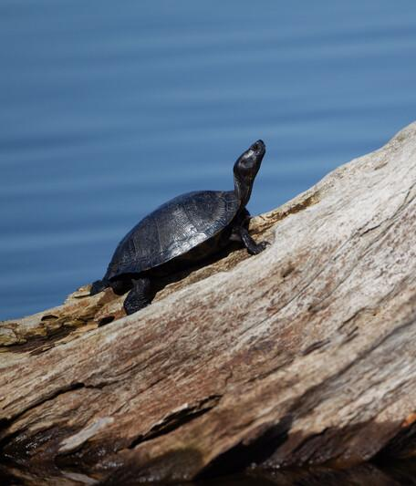
What activities are animals doing in the spring?
Bears through the Seasons – 4A Hello Spring: Elaborate
22

Slide 23
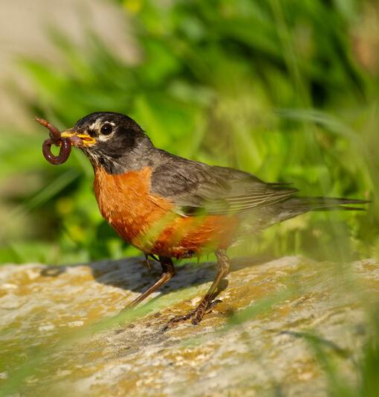
Why do they do these activities?
Bears through the Seasons – 4A Hello Spring: Elaborate
23

Slide 24
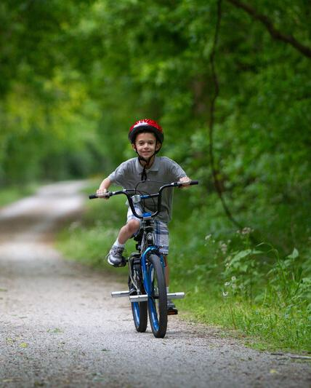
How are animals’ activities like our activities?
Bears through the Seasons – 4A Hello Spring: Elaborate
24

Slide 25
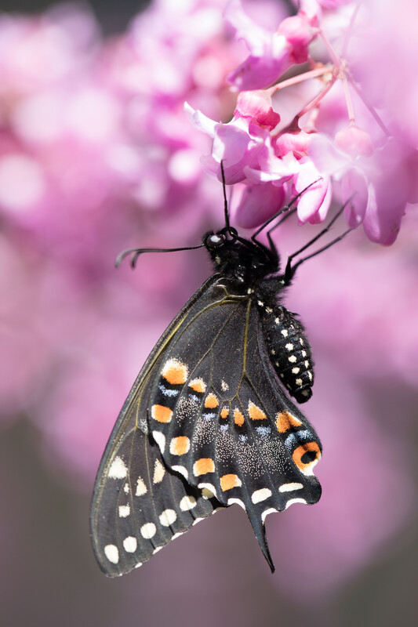
How are they different?
Bears through the Seasons – 4A Hello Spring: Elaborate
25

Slide 26
Bears through the Seasons – 4A Hello Spring: Elaborate
26
Notes:
Add student observations and/or questions to the Noticings and Wonderings Chart as the lesson concludes in reference to the phenomenon studied.

Slide 27
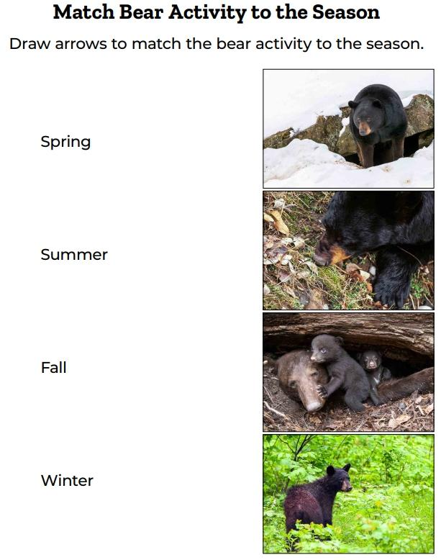
Bears through the Seasons – 4A Hello Spring: Evaluate
27
Notes:
Distribute 4A match Bear Activity to the Season handout.

Slide 28

Optional: Cross-Curricular Extension
Which list is the longest, shortest?
Bears through the Seasons – 4A Hello Spring: Cross-Curricular Extensions
28
Notes:
Review the senses. We learn about the world as we see, hear, smell, and touch what is around us. Have students make four sections on a piece of paper and in each section, record with words or drawings what they notice around them. Afterwards, make a classroom list of their recordings, listing what they heard saw, smelled, and touched.
Which list is the longest, shortest? Graph the results.

