Slide 1
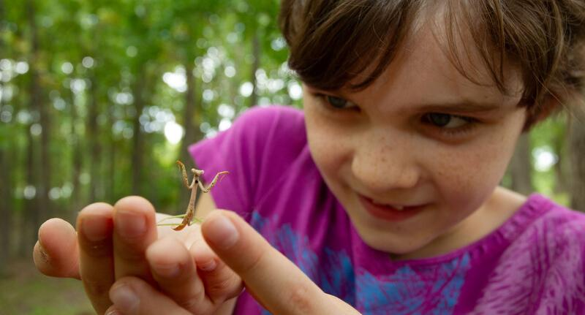

Exploring
MISSOURI
7B: Buffet for the Birds

Slide 2
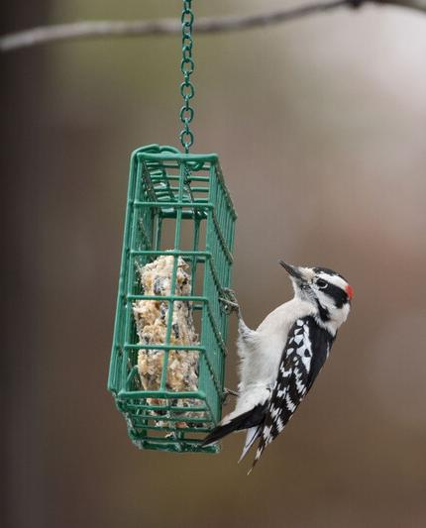
Guiding Question:
Which type of feeder helps the greatest number of birds and why?
7B
Exploring Missouri – 7B Buffet for the Birds: Engage
2
Notes:
Animal in Picture: Downy Woodpecker

Slide 3
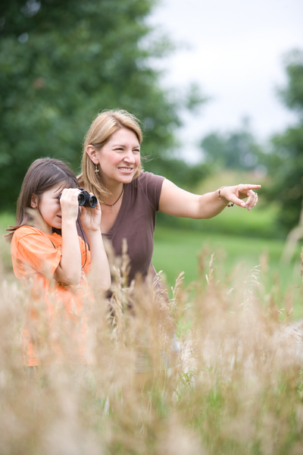
What wildlife did we see today? What were they doing?
7B
Exploring Missouri – 7B Buffet for the Birds: Engage
3
Notes:
As the school year progresses, take time each day to discuss observations of local animal life, noting the times of year (month/season) and what animals are most observed.

Slide 4
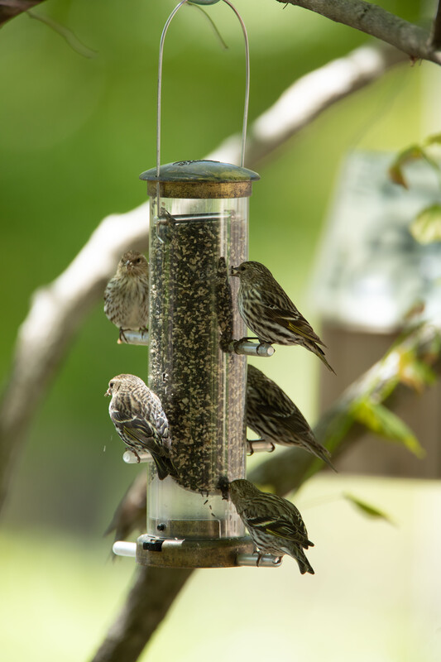
As we move through the year, do we notice any changes in wildlife?
What changes do we see?
7B
Exploring Missouri – 7B Buffet for the Birds: Engage
4
Notes:
Refer to your MDC Natural Events Calendar and compare what you see today with the animal sighting that is predicted on the calendar, such as birds arriving or animal behavior changing.
Optional Activity: Create a classroom mural for each season. Have each student choose one animal to draw in its habitat during each season. Drawings can be grouped into the appropriate season.
Animal in Picture: Pine Siskin

Slide 5
As the season of spring approaches, share observations about some animal groups not being as noticeable.
Why is this?
7B
Exploring Missouri – 7B Buffet for the Birds: Engage
5

Slide 6
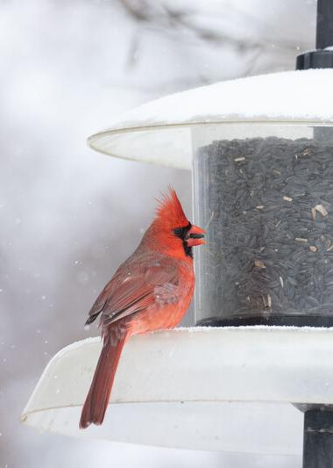
Let's go outside:
After standing for one minute, what do you hear? What do you see?
7B
Exploring Missouri – 7B Buffet for the Birds: Explore
6
Notes:
Now that it is spring, let’s go outside and see what we can see and hear in the birds that are around us.
Animal in Picture: Northern Cardinal

Slide 7
Habitat
7B
Exploring Missouri – 7B Buffet for the Birds: Explore
7
Notes:
Explore the schoolyard for what animals are most observed through sight and sound, noting several bird species are present in Missouri.
Discuss (or review) what a habitat is (a home for a plant or animal).

Slide 8
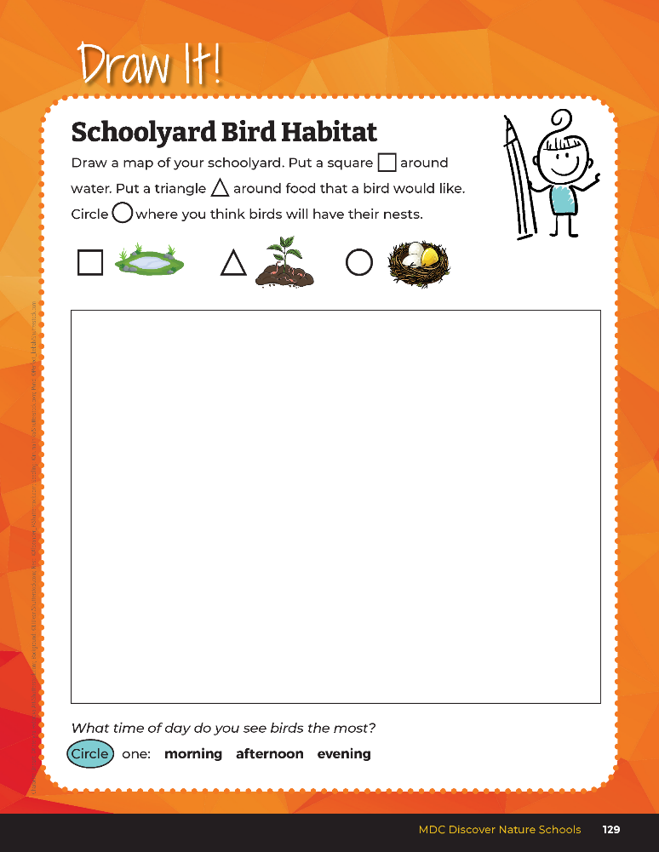

Let’s draw a map of our schoolyard and see if we can locate some pieces that make a habitat.
7B
Exploring Missouri – 7B Buffet for the Birds: Explore
8
Notes:
Have students open their student guide to the Draw It! 7B Schoolyard Bird Habitat on Page 129.
Teacher Note: you can use the school map created in Unit 1 when students mapped out warm locations on the schoolyard.

Slide 9
Do the birds have a shelter?
Where on the map do you think birds stay?
7B
Exploring Missouri – 7B Buffet for the Birds: Explore
9

Slide 10
Is there a water source for them?
Locate the water sources on your map?
7B
Exploring Missouri – 7B Buffet for the Birds: Explore
10

Slide 11
Do they have a way to eat nuts, berries, seeds, or insects?
Locate the food source on the map.
7B
Exploring Missouri – 7B Buffet for the Birds: Explore
11

Slide 12
What time of day do you see the birds most often: morning, afternoon, or evening?
7B
Exploring Missouri – 7B Buffet for the Birds: Explore
12

Slide 13
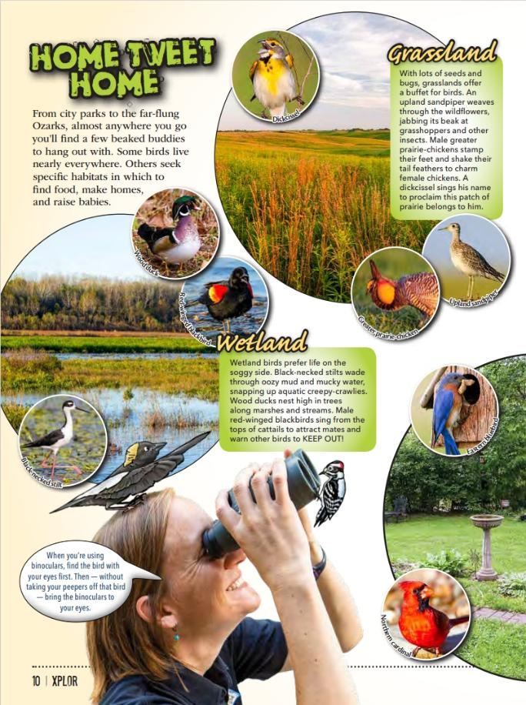
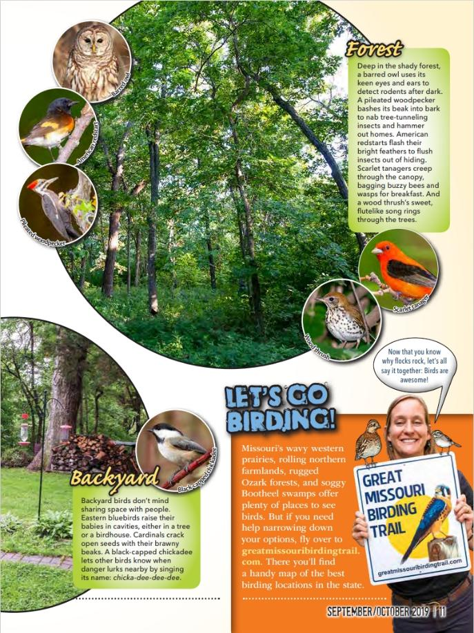
Link to Article:
https://education.mdc.mo.gov/sites/default/files/2023-08/7BSarahsGuideto%20BirdsXplorArticle.pdf
7B
Exploring Missouri – 7B Buffet for the Birds: Explain
13
Notes:
From the MDC Teacher Portal, display Home Tweet Home section from the Xplor article Sarah’s Guide to Birds.

Slide 14
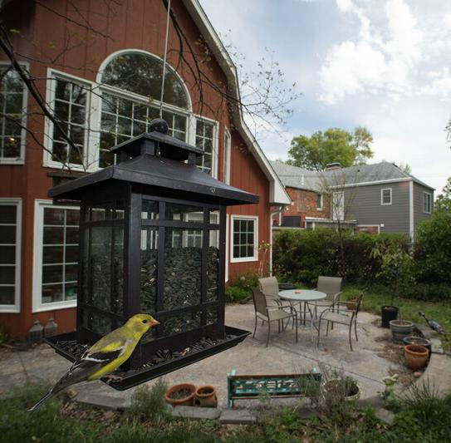
What habitats are available across Missouri for different birds?
7B
Exploring Missouri – 7B Buffet for the Birds: Explain
14
Notes:
Grasslands, wetland, forest, and backya
Animal in Picture: Goldfinch

Slide 15
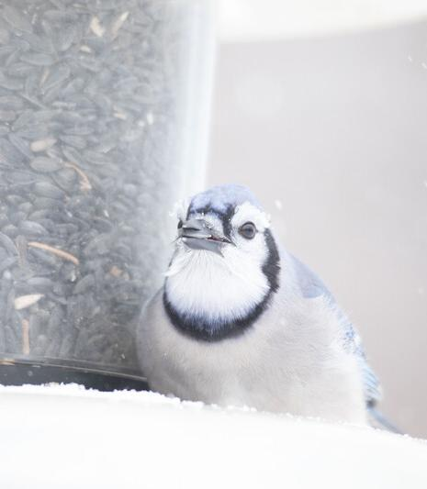
What can we offer in our schoolyard as a habitat for birds?
7B
Exploring Missouri – 7B Buffet for the Birds: Explain
15
Notes:
Identify that winter is the hardest time for local birds to have their habitat needs met, but that spring brings more available food sources with the warming temperatures. To provide migrating birds with food in early spring when natural foods are scarce, bird feeders are often placed in areas to support a habitat need.
Let’s explore some ideas or ways to solve this problem by providing a habitat need, like food, that could be scarce during these months of migration. Our classroom community will work together to welcome and support our wild bird population.
Animal in Picture: Blue Jay

Slide 16
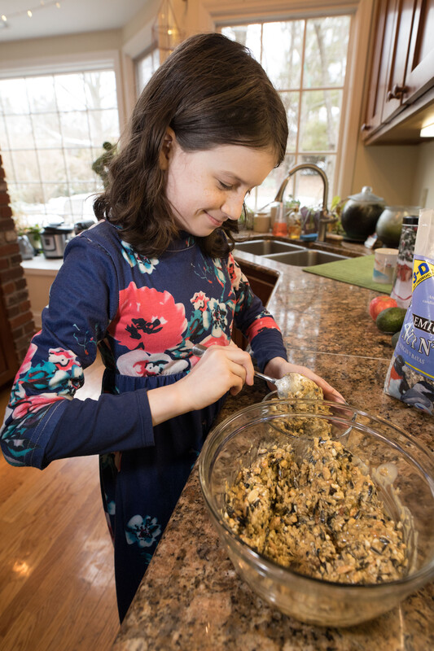
Which one would work better?
7B
Exploring Missouri – 7B Buffet for the Birds: Elaborate
16
Notes:
We have an idea to provide food for birds in our schoolyard, but there are different ways we can do this. We can either use a purchased bird feeder or we can create one ourselves.

Slide 17
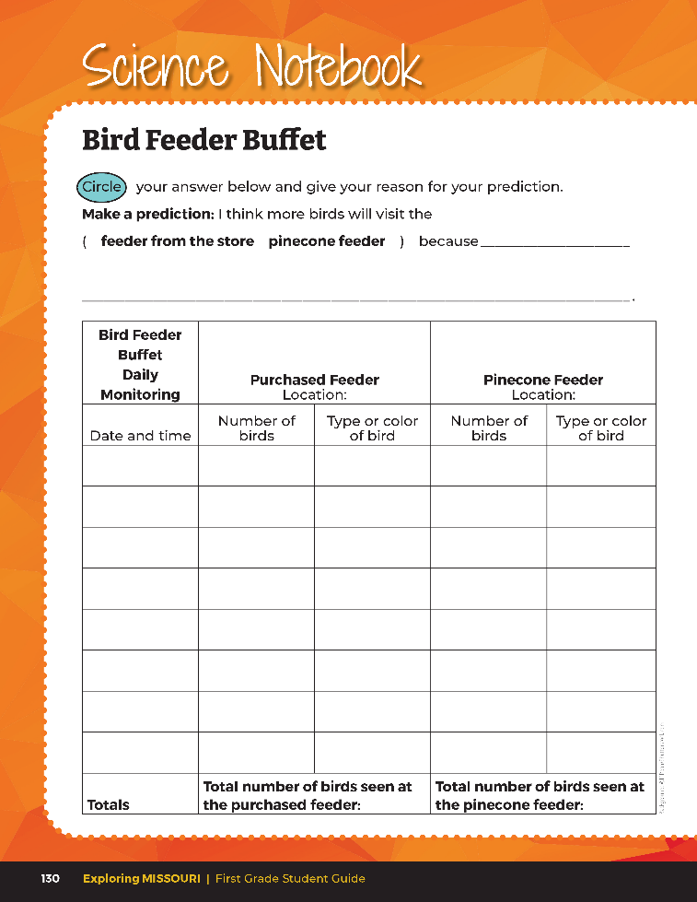
Make a Prediction
7B
Exploring Missouri – 7B Buffet for the Birds: Elaborate
17
Notes:
For this activity, two different bird feeders will be compared: one store-bought feeder and one student-made craft feeder.
Have students complete the Science Notebook 7B Bird Feeder Buffet prediction on Page 130 of the student guide.

Slide 18
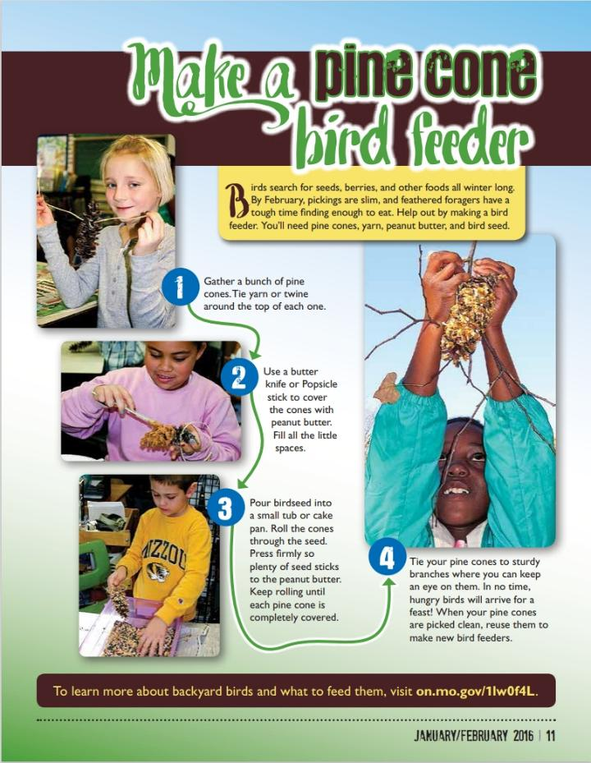
Link to Article:
https://education.mdc.mo.gov/sites/default/files/2023-08/7B%20How%20to%20Make%20a%20Pinecone%20Feeder%20Xplor%20Article.pdf
7B
Exploring Missouri – 7B Buffet for the Birds: Elaborate
18
Notes:
From the MDC Teacher Portal, display the directions from the How to Make a Pinecone Bird Feeder in Xplor. Have each student make a pinecone bird feeder. You will need pinecones, yarn, peanut butter, and black oil sunflower birdseed.
Gather a pinecone per student. Tie yarn or twine around the top of each one.
Use a butter knife or popsicle stick to cover your cones with peanut butter (or sunflower butter if there are allergy concerns). Fill all the little spaces.
Pour birdseed into a small tub or cake pan. Roll your cones through the black oil sunflower seed. Press firmly so plenty of seed sticks to the peanut butter. Keep rolling until each pinecone is completely covered.

Slide 19
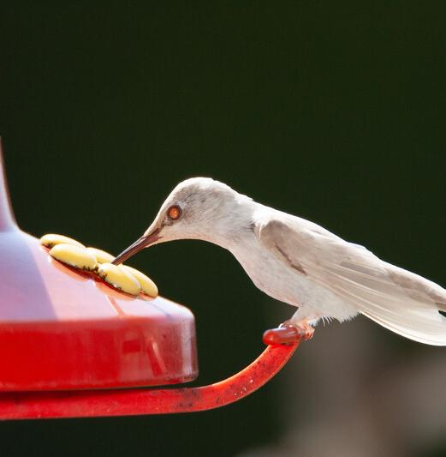
Should we use the same food in each bird feeder?
7B
Exploring Missouri – 7B Buffet for the Birds: Elaborate
19
Notes:
Continuing the investigation, ask students the following.
Animal in Picture: albino Ruby-throated Hummingbird

Slide 20
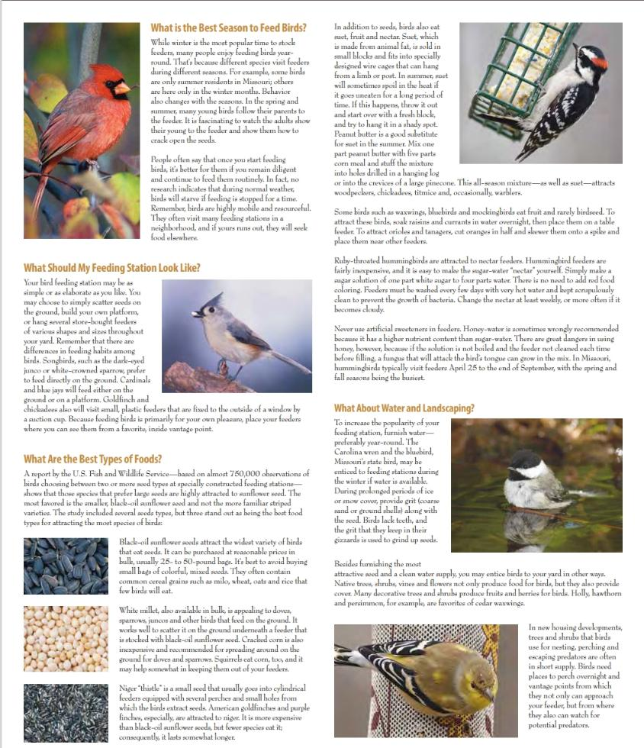
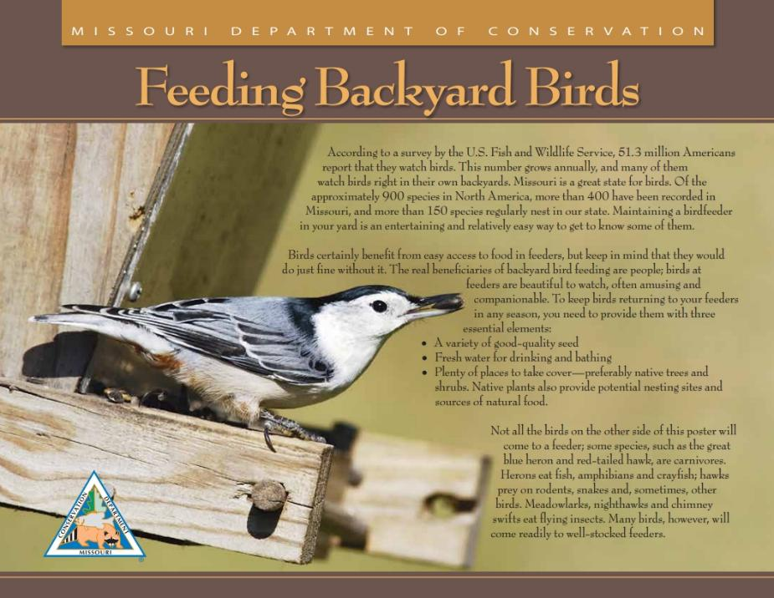
What food should it be?
7B
Exploring Missouri – 7B Buffet for the Birds: Elaborate
20

Slide 21
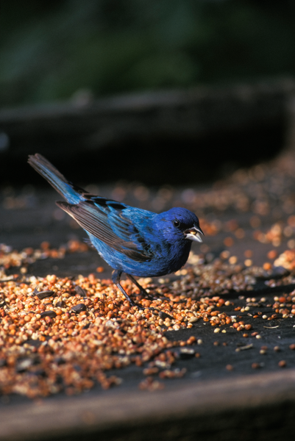
Should we use the same amount of food in each bird feeder?
7B
Exploring Missouri – 7B Buffet for the Birds: Elaborate
21
Notes:
To compare the amount of bird food, make sure only ½ cup of black oil sunflower birdseed is provided for the comparative feeders, noting more than one craft bird feeder may need to be created to fulfill ½ cup birdseed requirement.
Hang both the purchased feeder and pinecone bird feeders on the same day in nearby areas and begin monitoring the type and number of birds that visit the feeders. Use the MDC Feeding Backyard Birds poster or print the You Discover Backyard Birds: A Mini Field Guide from the MDC Teacher Portal to help in identification.
Animal in Picture: Indigo Bunting

Slide 22
Why was this particular place chosen?
Which bird feeder do you predict will be preferred by our visiting birds?
7B
Exploring Missouri – 7B Buffet for the Birds: Elaborate
22
Notes:
Mark the location of the bird feeders on the schoolyard map in the student guide Draw It! 7B Schoolyard Bird Habitat page.

Slide 23
Revisit your prediction and make any changes.
7B
Exploring Missouri – 7B Buffet for the Birds: Elaborate
23
Notes:
Students revisit their prediction in their student guides on Science Notebook 7B Bird Feeder Page 130 and make any changes.

Slide 24
Record the type and number of birds that visited your specific pinecone and the purchased feeder.
7B
Exploring Missouri – 7B Buffet for the Birds: Elaborate
24
Notes:
Students record the type and number of birds that visited their specific pinecone and the purchased feeder in their student guide on Science Notebook 7B Bird Feeder Buffet Page 130.
Go outside and record the number and type of birds you see for 10 days. At the end of each recording period, take the average number of birds recorded from each pinecone feeder and have the students write the number into their student guide. Students also provide the type of birds that visited each of their feeders and write that into their chart. You can also provide a classroom chart on the whiteboard displayed in front of the class.
Teacher Note: The species only needs to be written once. If both bird feeders are running low, students will refill feeders with ½ cup sunflower seed, including repeating the process of rerolling the pinecone bird feeder and rehanging in the same location.
Resources:
https://education.mdc.mo.gov/sites/default/files/2023-08/7B%20MDC%20Feeding%20Backyard%20Bird%20Poster.pdf
https://education.mdc.mo.gov/sites/default/files/2023-08/7B%20PRINTABLE%20Mini%20Field%20Guide-You%20Discover%20Show-Me%20Backyard%20Birds.pdf

Slide 25
Which feeder is being eaten from more often?
7B
Exploring Missouri – 7B Buffet for the Birds: Elaborate
25

Slide 26
Why do you think that feeder has more birds visiting it?
7B
Exploring Missouri – 7B Buffet for the Birds: Elaborate
26

Slide 27
Is there any birdseed that is left? Why or why not?
7B
Exploring Missouri – 7B Buffet for the Birds: Elaborate
27

Slide 28
Work together in small groups to summarize findings and report conclusions.
Summaries may include:
Which bird feeder was the best and why?
What was one strength of the purchased bird feeder compared to the pinecone bird feeder?
What was one weakness of the purchased bird feeder compared to the pinecone bird feeder?
Was this location successful? Why or why not?
7B
Exploring Missouri – 7B Buffet for the Birds: Elaborate
28
Notes:
After completing two weeks of observations, (less time if time is a constraint), have small groups work together to summarize their findings and report their conclusions. Summaries may include:

Slide 29
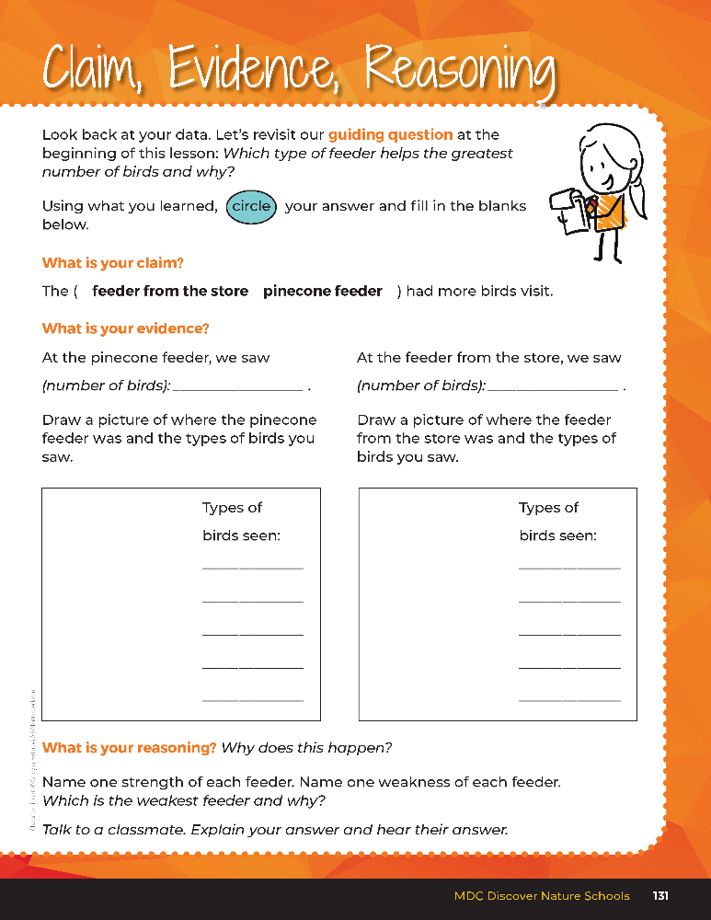

Guiding Question:
Which type of feeder helps the greatest number of birds and why?
7B
Exploring Missouri – 7B Buffet for the Birds: Evaluate
29
Notes:
After comparing the number of bird visits to two different feeders, have students open their student guides to the Claim, Evidence, Reasoning section on Page 131. Discuss the page with the students – read the guiding question and explain what the students need to do to answer the questions (circle their claim, fill in the blanks, make a drawing, discuss which feeder is weakest and why).
Rubric:
4 (Exceeds) – Students write the correct claim and evidence into the blanks and verbalize the correct reason.
3 (Meets) – Students write either the correct claim or evidence into the blanks and/or verbalize the correct reason.
2 (Partially Meets) – Students write either the correct claim or evidence into the blanks and do not verbalize the correct reason.
1 (Doesn’t Meet) – Students do not provide the correct claim or evidence and do not verbalize the correct reason.

Slide 30
Answers
Answers will vary
7B
Exploring Missouri – 7B Buffet for the Birds: Evaluate
30
Notes:
After comparing the number of bird visits to two different feeders, have students open their student guides to the Claim, Evidence, Reasoning section on Page 131. Discuss the page with the students – read the guiding question and explain what the students need to do to answer the questions (circle their claim, fill in the blanks, make a drawing, discuss which feeder is weakest and why).
Rubric:
4 (Exceeds) – Students write the correct claim and evidence into the blanks and verbalize the correct reason.
3 (Meets) – Students write either the correct claim or evidence into the blanks and/or verbalize the correct reason.
2 (Partially Meets) – Students write either the correct claim or evidence into the blanks and do not verbalize the correct reason.
1 (Doesn’t Meet) – Students do not provide the correct claim or evidence and do not verbalize the correct reason.

Slide 31


Explore how community science contributes to scientists’ knowledge of bird populations.
Bird Count Read Aloud:
https://youtu.be/eHHgBSRadcU?si=sXpXyD_wmZcU8VxQ
Counting Birds Read Aloud:
https://youtu.be/08aceCeWwtQ?si=kKVXvyEBFC8L56u7
Epic Link:
https://www.getepic.com/collection/31148895/bird-count
7B
Exploring Missouri – 7B Buffet for the Birds: Extend
31
Notes:
Explore how community science contributes to scientists’ knowledge of bird populations. Investigate one or both of these STEM books: Bird Count by Susan Edwards Richmond and/or Counting Birds: The Idea that Helped Save Our Feathered Friends about the Christmas Bird Count by Heidi E. Y. Stemple.

Slide 32

Optional: Cross-Curricular Extension
Community/Citizen Science
Use free apps to contribute your data to the greater scientific community.
Project Feeder Watch: https://feederwatch.org/
Seek: https://www.inaturalist.org/pages/seek_app
7B
Exploring Missouri – 7B Buffet for the Birds: Cross-Curricular Extension
32
Notes:
Community/Citizen Science
Use free apps to contribute your data to the greater scientific community, including Project FeederWatch and Seek. https://feederwatch.org/ and https://www.inaturalist.org/pages/seek_app

Slide 33

Optional: Cross-Curricular Extension
English Language Arts
Read Ruby’s Birds by Mya Thompson, then go outside and birdwatch in the schoolyard.
Use field guides to identify natural observations. A recommended guide is Stokes Beginner’s Guide to Birds: Eastern Region by Donal Stokes
Read Aloud:
https://youtu.be/Rba0GOsf9eQ?si=PiUCCJwS1-UnaKEH
Epic Link:
https://www.getepic.com/book/84161585/rubys-birds
7B
Exploring Missouri – 7B Buffet for the Birds: Cross-Curricular Extension
33
Notes:
English Language Arts
Read Ruby’s Birds by Mya Thompson, then go outside and birdwatch in the schoolyard.
Use field guides to identify natural observations. A recommended guide is Stokes Beginner’s Guide to Birds: Eastern Region by Donald Stokes

