Slide 1
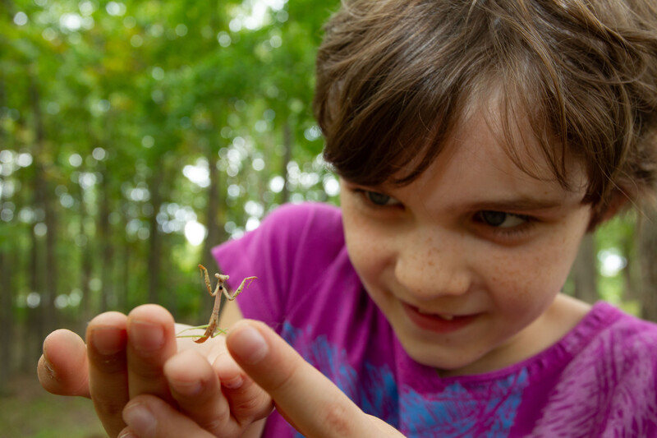

Exploring
MISSOURI
Unit 8 Review

Slide 2
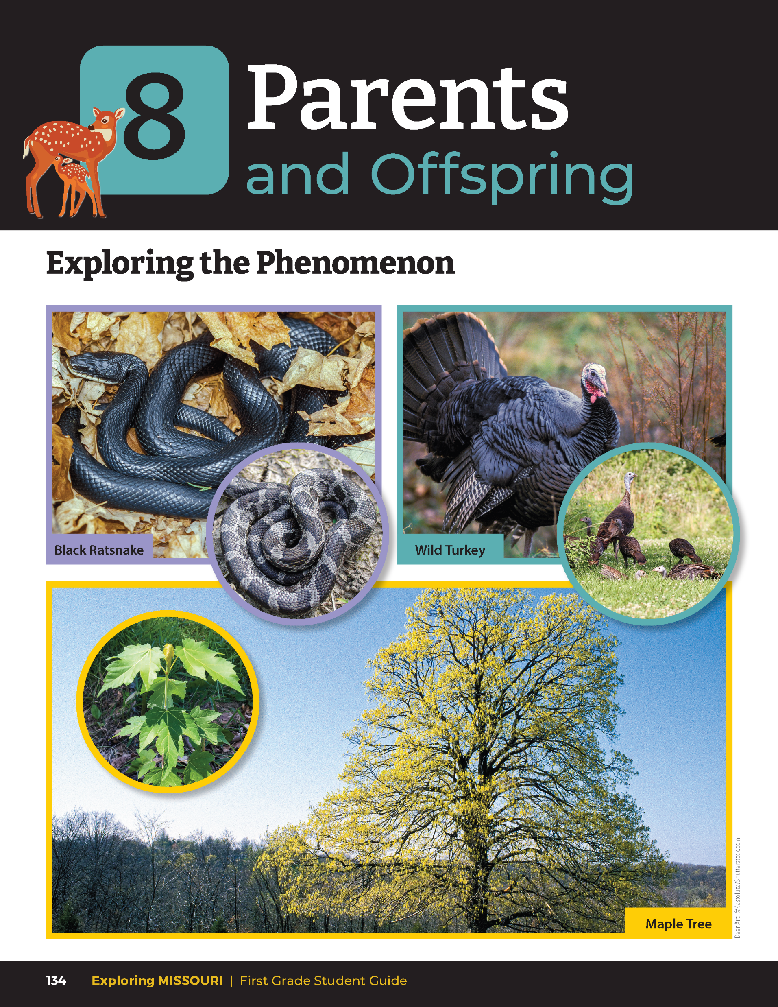
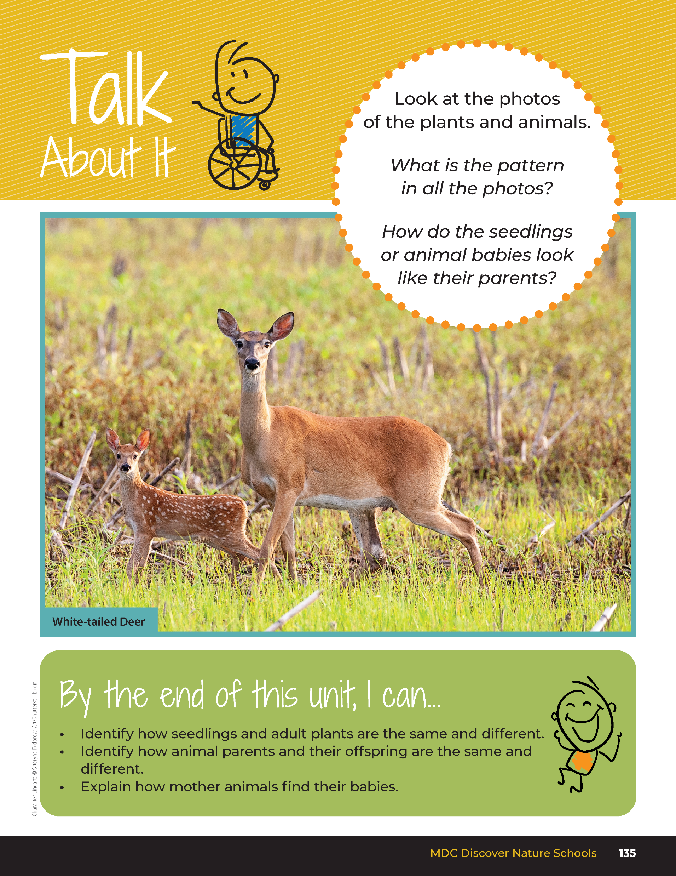
8
Exploring Missouri – Unit 8 Review
2
Notes:
Have students turn to the Unit 8 Exploring the Phenomenon Talk About It section on pages 134 – 135.

Slide 3
Turn and talk to a classmate and discuss the life cycles of the plant and the life cycles of certain animals.
8
Exploring Missouri – Unit 8 Review
3
Notes:
Using the pictures at the beginning of the lesson, have students turn and talk to a classmate and discuss the life cycles of the plant and the life cycles of certain animals.

Slide 4
What is the pattern in all the photos?
8
Exploring Missouri – Unit 8 Review
4

Slide 5
How do the seedlings or animal babies look like their parents?
8
Exploring Missouri – Unit 8 Review
5
Notes:
Rubric:
3 (Meets) – Student explains how some characteristics of plant seedlings are similar to or different from plant parents and the same is true for animals.
2 (Partially meets) – Student explains some of the patterns of how some characteristics of plant seedlings can look similar or different to plant parents and the same about animals.
1 (Doesn’t meet) – Student does not explain the patterns of how some characteristics of plant seedlings can look similar or different to plant parents and the same about animals.

Slide 6
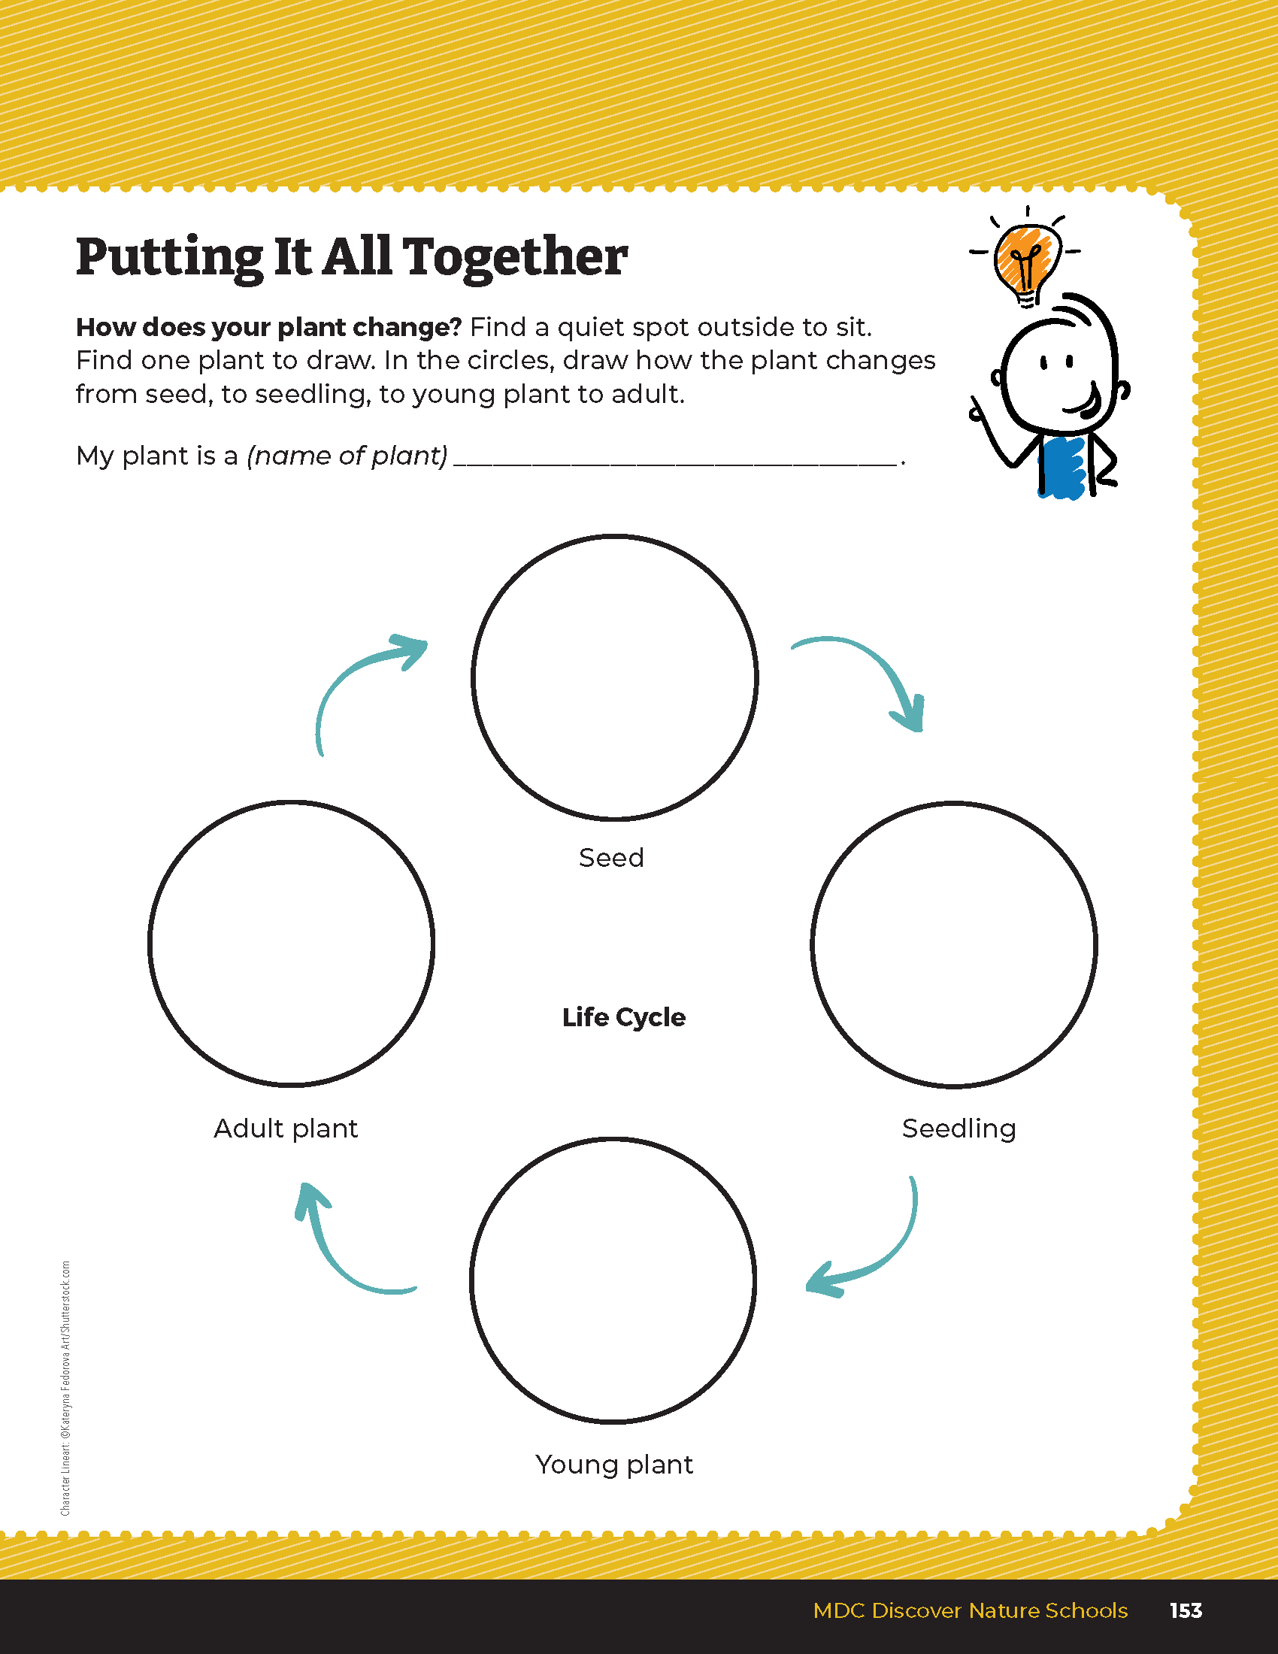
Draw your favorite baby plant and how it changes as it grows.
8
Exploring Missouri – Unit 8 Review
6
Notes:
Have students turn to the Unit 8 Putting It All Together section on Page 153. Draw your favorite baby plant and how it changes as it grows.
Rubric:
4 (Exceeds) – Student drawings incorporate all phases of a plant’s life.
3 (Meets) – Student drawing incorporate three phases of a plant’s life.
2 (Partially Meets) – Student drawings incorporate two phases of a plant’s life.
1 (Doesn’t Meet) – Student drawings incorporate zero or one phase of a plant’s life.

