Slide 1
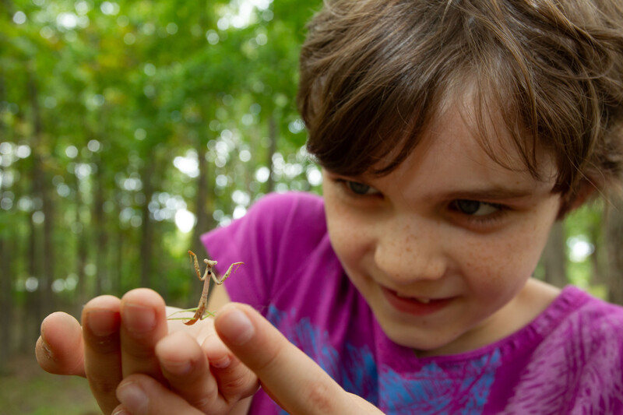

Exploring
MISSOURI
8C: Where is My Mama?

Slide 2
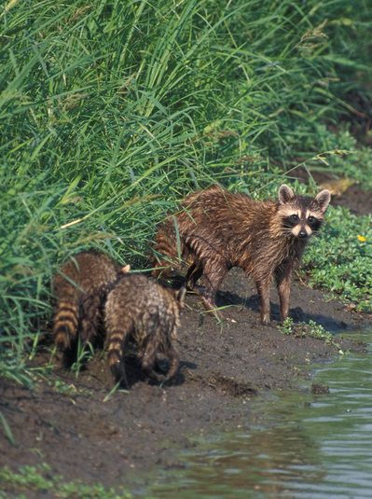
Guiding Question:
How do some animal mothers locate their babies?
8C
Exploring Missouri – 8C Where is My Mama: Engage
2
Notes:
Animal in Picture: Raccoons

Slide 3
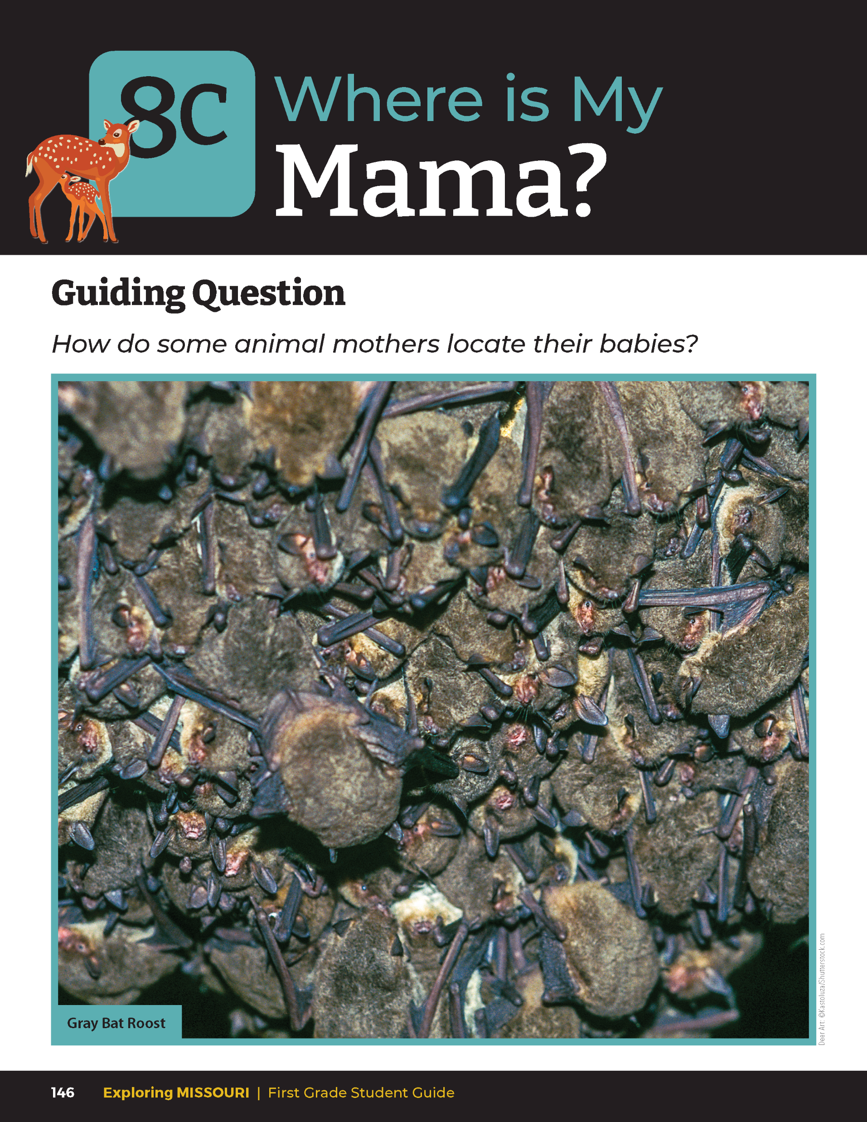
Are animal mothers always with their young?
8C
Exploring Missouri – 8C Where is My Mama: Engage
3
Notes:
Have students look at the photo of the bats in a roost from the student guide Lesson 8C Where is My Mama? Introduction section on Page 146.

Slide 4
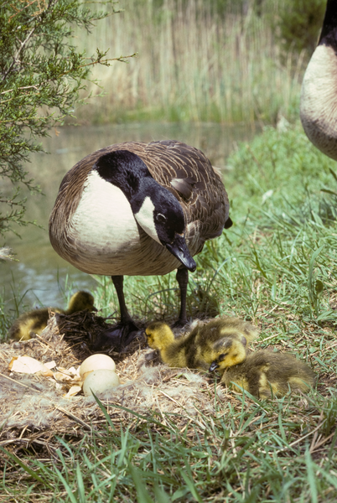
Why would an animal mother need to leave her babies alone?
8C
Exploring Missouri – 8C Where is My Mama: Engage
4
Notes:
Animal in Picture: Canada Goose – adult and chicks

Slide 5
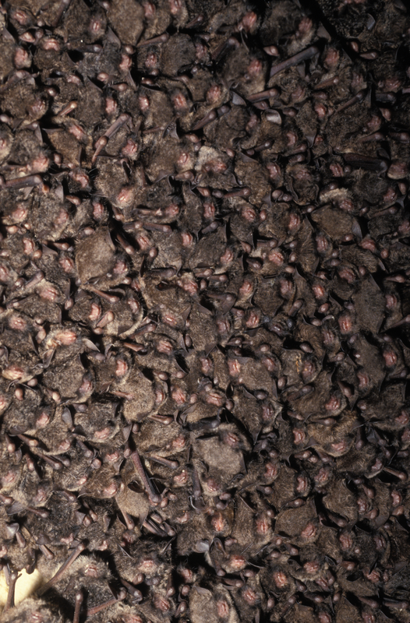
How would a mother bat find her baby in this roost?
How do some animal mothers locate their babies?
8C
Exploring Missouri – 8C Where is My Mama: Engage
5
Notes:
Animal in Picture: Indiana Bats

Slide 6
You are trying to locate your matching sound (mama and baby pair).
You will try to locate each other by listening for the distinct sound of either mama or baby.
Some sounds are very similar, so you must listen closely for sound differences.
Once you locate the person who has the same sound as you, stand next to your partner but do not rattle the Sound Maker any longer.
8C
Exploring Missouri – 8C Where is My Mama: Explore
6
Notes:
This activity will demonstrate how animal mothers can identify their babies and how the babies can identify their mothers by the distinct sound each makes.
Teacher Note: As time allows, repeat this activity over several days to provide multiple learning opportunities for students. It is advisable to initially limit six students/group with three different sounds to make it easier to match as students learn to listen and distinguish various sounds.
Introduce students to the set of Sound Makers that you made prior to this lesson. Discuss that each rattling sound container has one that matches its sound. Show students the matching sound pairs of Sound Makers. Demonstrate that the Sound Makers have different sounds that only are like one other container. Also indicate that each student will be role playing either an animal mother or its baby and they are going to seek out the matching sound, just as an animal mother would locate her young.
Pass out the Sound Makers. Indicate to students that one other student will have a matching sound in their container as well. They are to identify and find their matching sound and try to pair up with their mama. They will be acting as mother and baby pairs trying to locate each other.
You are trying to locate your matching sound (mama and baby pair). You will try to locate each other by listening for the distinct sound of either mama or baby. Some sounds are very similar, so you must listen closely for sound differences. Once you locate the person who has the same sound as you, stand next to your partner but do not rattle the Sound Maker any longer.
Teacher Note: In the event of an uneven number of students for a matching pair, as the teacher, you may participate so that each student will be paired.
Announce to students that once they are signaled with the phrase, “Mamas, find your babies!” that they will wander around the classroom shaking their Sound Makers and try to pair up with the matching partner sound. Also indicate the importance of remaining quiet so that everyone only hears sounds coming from their Sound Makers.

Slide 7
Mamas, find your babies!
8C
Exploring Missouri – 8C Where is My Mama: Explore
7
Notes:
Announce: “Mamas, find your babies!”
Once all students think they’ve found their partner, they will stand next to their partner. Check your 8C Sound Matching Activity Chart to assess.

Slide 8
How did you find your partner?
8C
Exploring Missouri – 8C Where is My Mama: Explore
8

Slide 9
What skills and senses did you have to use?
8C
Exploring Missouri – 8C Where is My Mama: Explore
9

Slide 10
Was it easy or difficult to find your partner?
8C
Exploring Missouri – 8C Where is My Mama: Explore
10

Slide 11
Were all the sounds similar?
8C
Exploring Missouri – 8C Where is My Mama: Explore
11

Slide 12
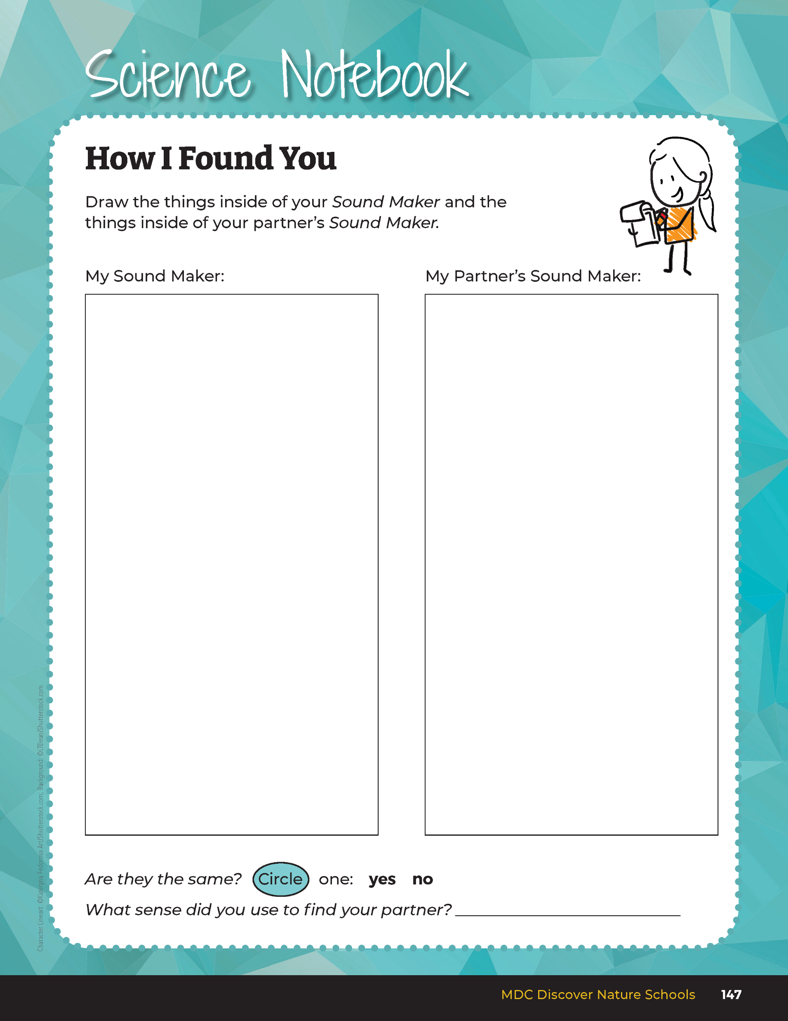

Draw the things inside of your Sound Maker and the things inside of your partner’s Sound Maker.
8C
Exploring Missouri – 8C Where is My Mama: Explore
12
Notes:
Have students open their student guide to the Science Notebook 8C How I Found You section Page 147 and record the results after the matching game.

Slide 13
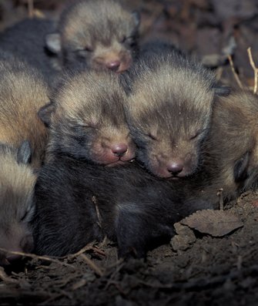
How do you think animal mothers find their babies?
8C
Exploring Missouri – 8C Where is My Mama: Explain
13
Notes:
Some locate by sound while others locate by location. Mothers remember where they leave their babies. Mother birds leave their babies in the nest. Some mammals make nests too. Squirrels and rabbits both make nests. Mother deer make a bed for their babies when they go away to eat.
Animal in Picture: Red Fox litter

Slide 14
Can you think of a time when someone left you someplace and you moved or hid?
When they came back, did they have trouble finding you?
8C
Exploring Missouri – 8C Where is My Mama: Explain
14

Slide 15

Looking – Animal mothers can look for their babies
8C
Exploring Missouri – 8C Where is My Mama: Explain
15

Slide 16

Smelling – Animal mothers know their babies’ smell
8C
Exploring Missouri – 8C Where is My Mama: Explain
16

Slide 17

Sound – Animal mothers know what their babies sound like
8C
Exploring Missouri – 8C Where is My Mama: Explain
17
Notes:
If a bird nest falls from a tree, the mother bird will look for and use sound to call to her babies. Squirrels also respond this way when their babies fall from a nest. When a mama gray bat comes back to the roost, she knows where she left her baby. But if baby bat moves, she can smell for and look for her baby.

Slide 18
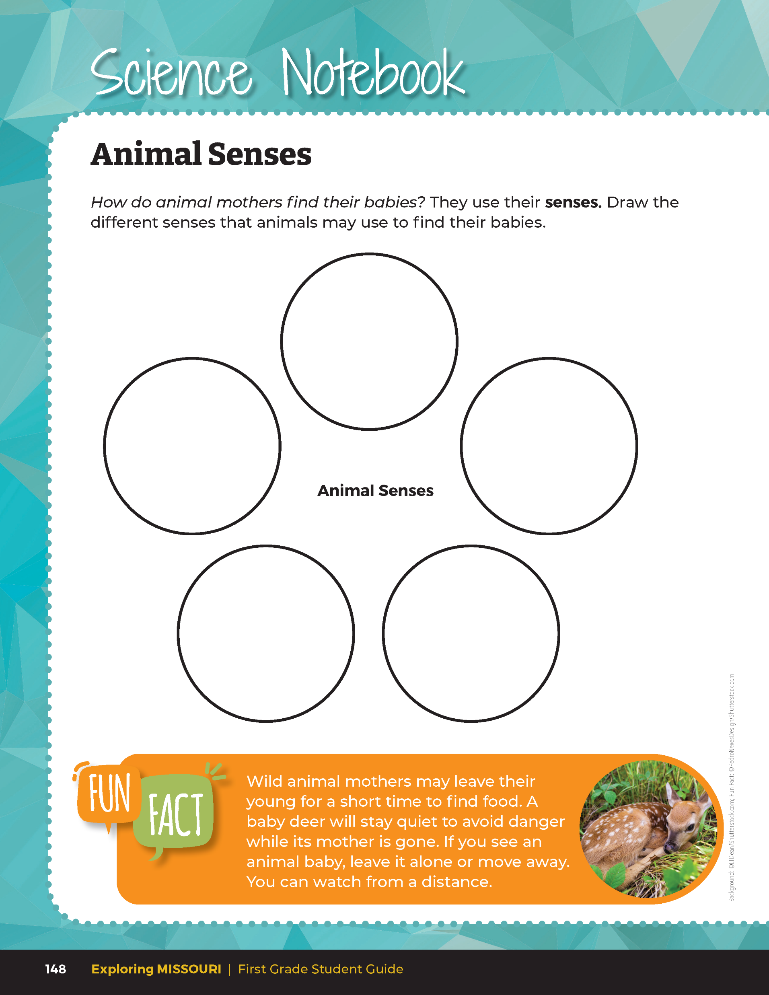
8C
Exploring Missouri – 8C Where is My Mama: Explain
18
Notes:
Read the Fun Fact from the Science Notebook Animal Senses section on Page 148 in the student guide. Wild animal mothers do not abandon their babies or young. They must leave their babies occasionally to go get food but check in with their babies regularly. Unfortunately, wild animals do not have babysitters like humans. Wild animal mothers trust their baby’s ability to hide from things that would hurt them. They baby remains quiet when the mother is gone to avoid being found by a predator. If you find babies in the wild, look but leave them where you find them. While you are in the area, the animal mother will probably not come back until you leave the area, and she knows it is safe.

Slide 19
Draw the different senses that animals may use to find their babies.
8C
Exploring Missouri – 8C Where is My Mama: Explain
19
Notes:
Have students open their student guide to Science Notebook 8C Animal Senses section on Page 148. Have them draw in the five circles the different ways that animals locate their young.

Slide 20
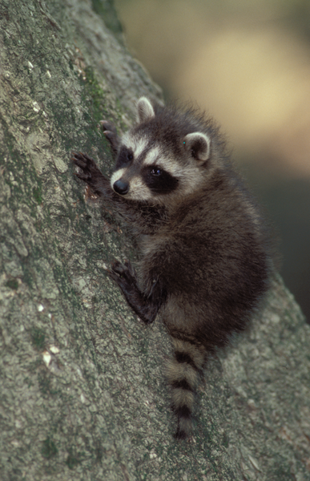
What kinds of sounds do other baby animals make and why?
8C
Exploring Missouri – 8C Where is My Mama: Explain
20
Notes:
Teacher Note: If you have access to technology, incorporate computer or tablets into this lesson. You may want to collaborate with the computer teacher and/or school librarians.
Animal in Picture: Raccoon

Slide 21
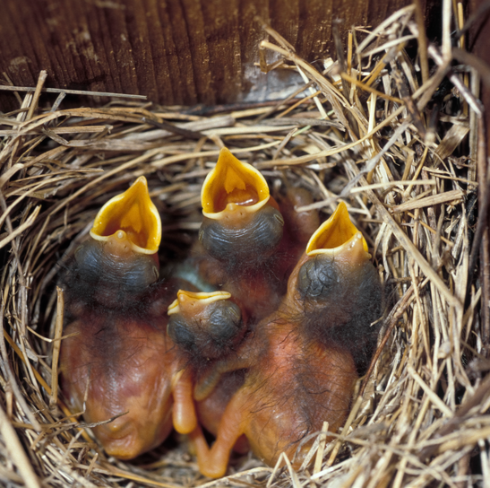
When a mother hears her babies, how does she respond?
8C
Exploring Missouri – 8C Where is My Mama: Explain
21
Notes:
Animal in Picture: Baby birds

Slide 22
Brainstorm and make a list of animal babies and research what kinds of sounds they may make and how the animal mother might respond to them.
8C
Exploring Missouri – 8C Where is My Mama: Explain
22
Notes:
Let’s research a few more animals and see what we can find through our investigations.
Brainstorm and make a list on the classroom board of animal babies and research what kinds of sounds they may make and how the animal mother might respond to them.

Slide 23
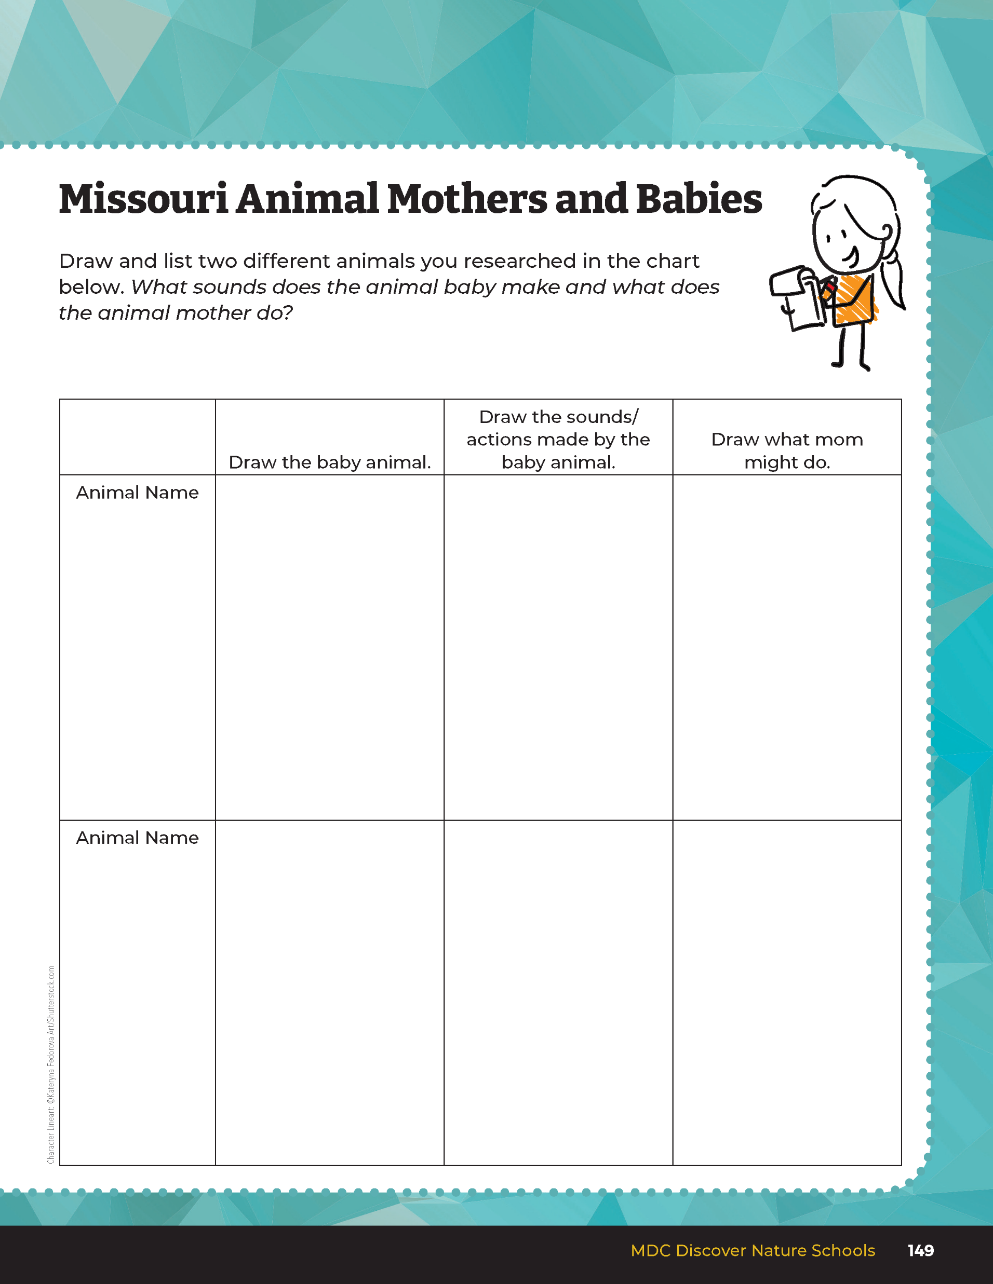
Draw and list two different animals you researched.
What sounds does the animal baby make and what does the animal mother do?
8C
Exploring Missouri – 8C Where is My Mama: Explain
23
Notes:
Have students open their student guide to Science Notebook 8C Missouri Animal Mothers and Babies on page 149 to record student research of different Missouri animals.

Slide 24
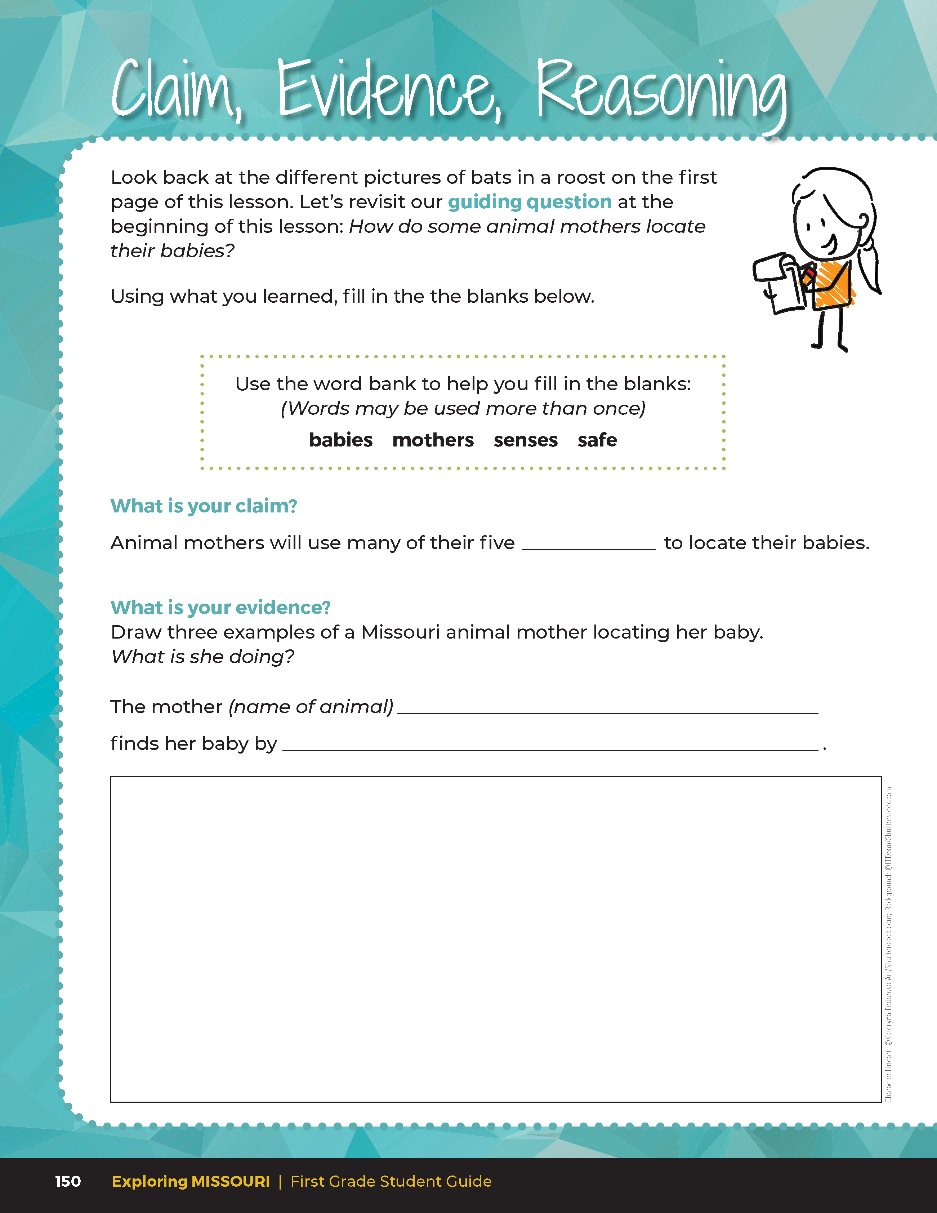
Guiding Question:
How do some animal mothers locate their babies?
8C
Exploring Missouri – 8C Where is My Mama: Evaluate
24
Notes:
After researching how different Missouri animals use their senses to find their offspring, have students open their student guides to the Claim, Evidence, Reasoning section on Page 150. Discuss the page with the students – read the guiding question and explain what the students need to do to answer the questions (fill in the blanks and draw three examples of animal mothers locating their babies).

Slide 25
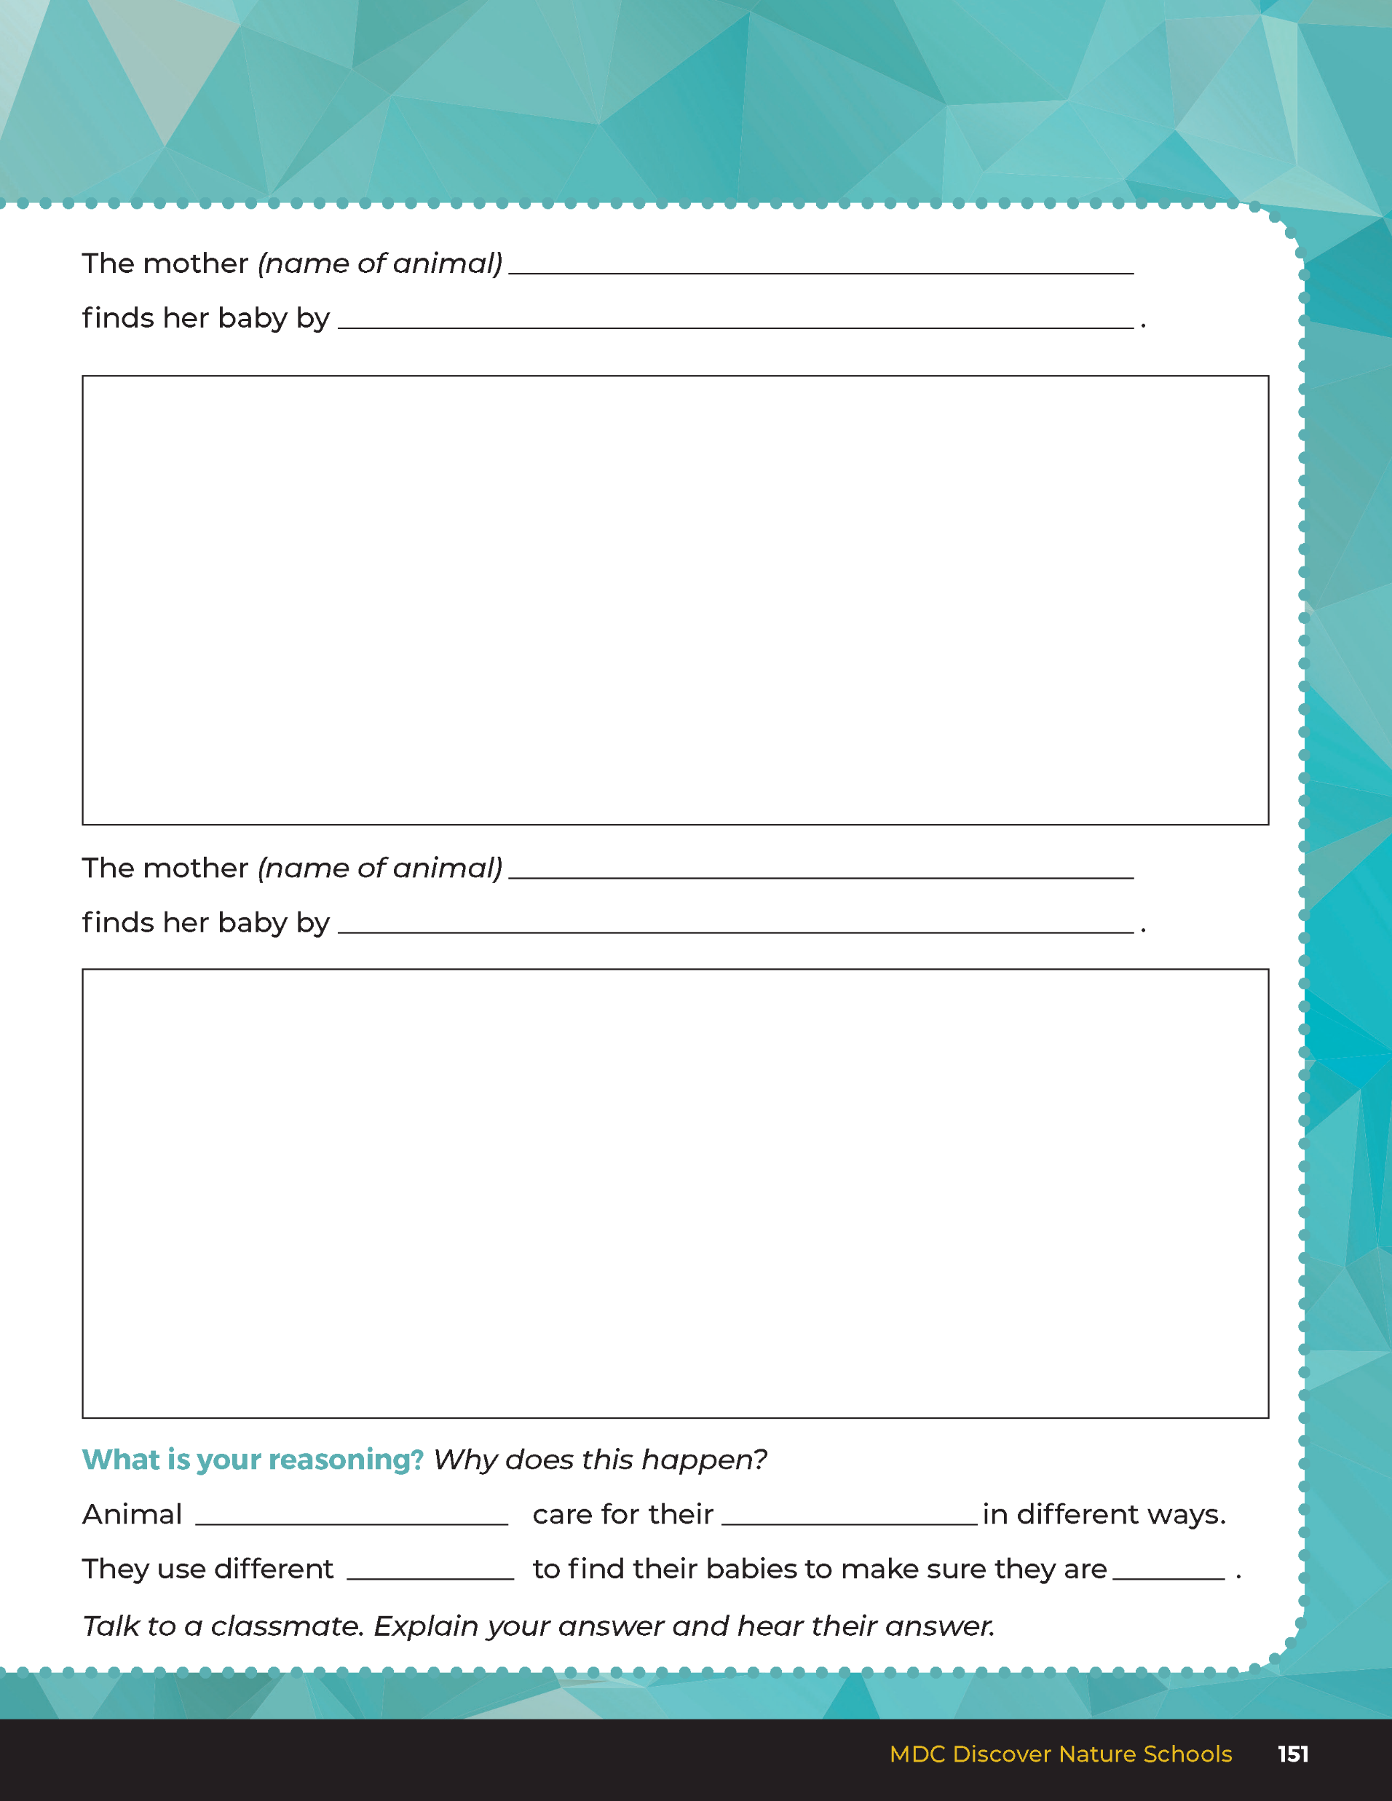
senses
Answers
Students draws and lists 3 examples of a mother finding her baby. Example could be deer smelling her fawn. Bat locating by scent and smell. Squirrel locating by sound using chirps.
8C
Exploring Missouri – 8C Where is My Mama: Evaluate
25
Notes:
Rubric:
4 (Exceeds) – Students write the correct claim and evidence into the blanks and fill in all the blanks with the correct answers for their reasoning,
3 (Meets) – Students write either the correct claim or evidence into the blanks and fill in most of the blanks with the correct answers for their reasoning.
2 (Partially Meets) – Students write either the correct claim or evidence into the blanks and fill in some of the blanks with the correct answers.
1 (Doesn’t Meet) – Students do not provide the correct claim or evidence and do not fill in any of the blanks with the correct answers for their reasoning.

Slide 26

Optional: Cross-Curricular Extension
English
Make an acrostic poem of your favorite plant or animal and in the poem describe how it changes as it grows.
8C
Exploring Missouri – 8C Where is My Mama: Cross-Curricular Extension
26
Notes:
English
Make an acrostic poem of their favorite plant or animal and in the poem describe how it changes as it grows.

Slide 27
Optional: Cross-Curricular Extension
Arts/English
Make a comic book about a series of baby animals growing up in a Missouri habitat. How do they find their parents when they are lost?
8C
Exploring Missouri – 8C Where is My Mama: Cross-Curricular Extension
27
Notes:
Arts/English
Make a comic book about a series of baby animals growing up in a Missouri habitat. How do they find their parents when they are lost?

Slide 28
Optional: Cross-Curricular Extension
Science
Distribute wildflower seeds and small cup of soil to each student. Give them time to plant and water their seed and put cup onto a windowsill. Document the growth every day in a nature journal from seed to first leaves. What changes did they see?
8C
Exploring Missouri – 8C Where is My Mama: Cross-Curricular Extension
28
Notes:
Science
Distribute wildflower seeds and small cup of soil to each student. Give them time to plant and water their seed and put cup onto a windowsill. Document the growth every day in a nature journal from seed to first leaves. What changes did they see?

