Slide 1
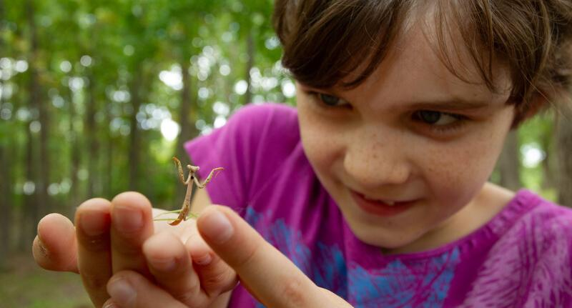

Exploring
MISSOURI
8B: Parents and Offspring

Slide 2
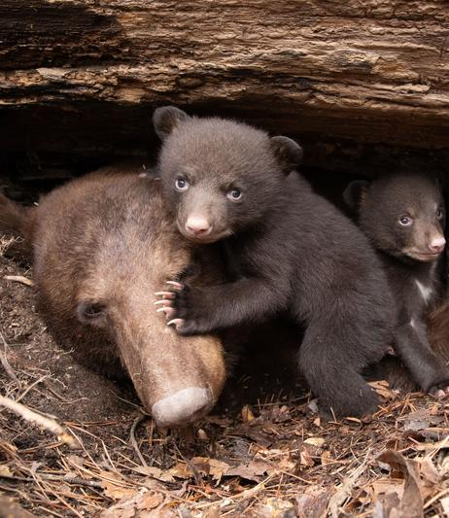
Guiding Question:
Do young animals look like their parents?
8B
Exploring Missouri – 8B Parents and Offspring: Engage
2
Notes:
Animal in Picture: Black Bear

Slide 3
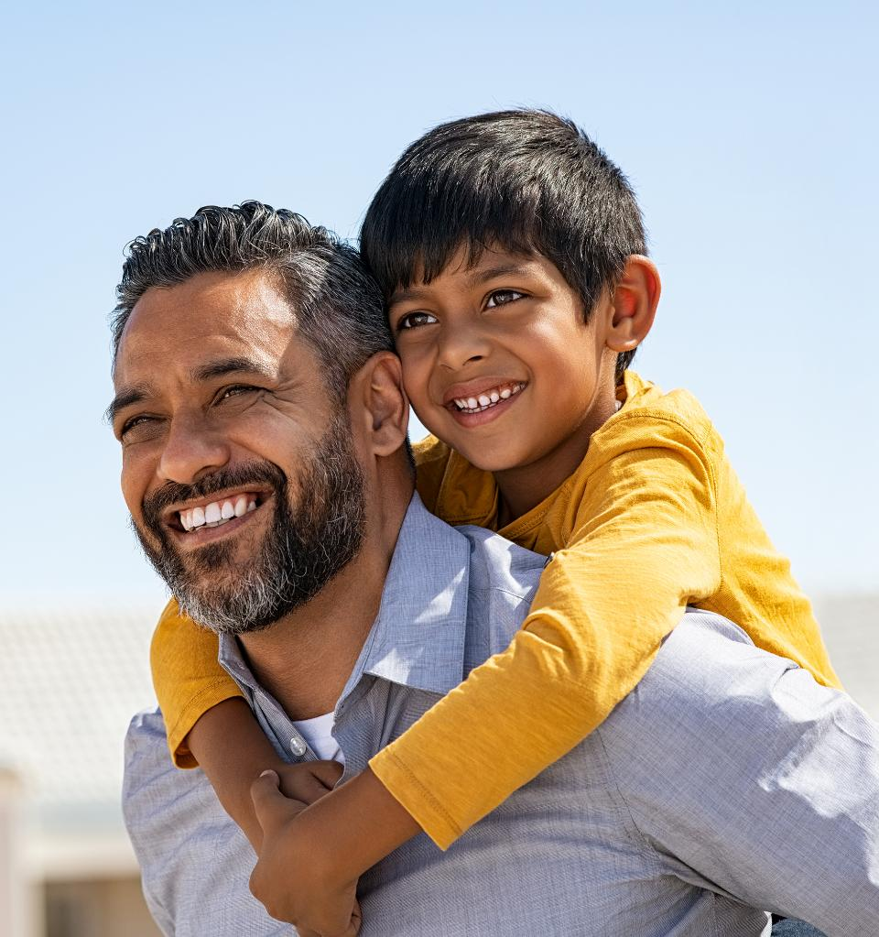
As a group, try to find matching pairs of parent/child matches.
8B
Exploring Missouri – 8B Parents and Offspring: Engage
3
Notes:
Using photographs of parent and child, have a class interactive lesson where students will match photos of children to photos of parents that teacher has taped to a wall prior to beginning this lesson. Parent photos can be placed in one grouping and child photos in another. This can also be done by making cut-out photos as cards and children can play a matching name as they would with a deck of matching pairs.
Whether on a wall or used as cards, make sure that there is only one matching choice per child/parent pair. Teachers may also use discretion when explaining that a child will not always inherit all characteristics of both parents and there may be mere similarities. For this lesson, obvious characteristics in pairs will be most helpful.
Have students as a group try to find matching pairs of parent/child matches.

Slide 4
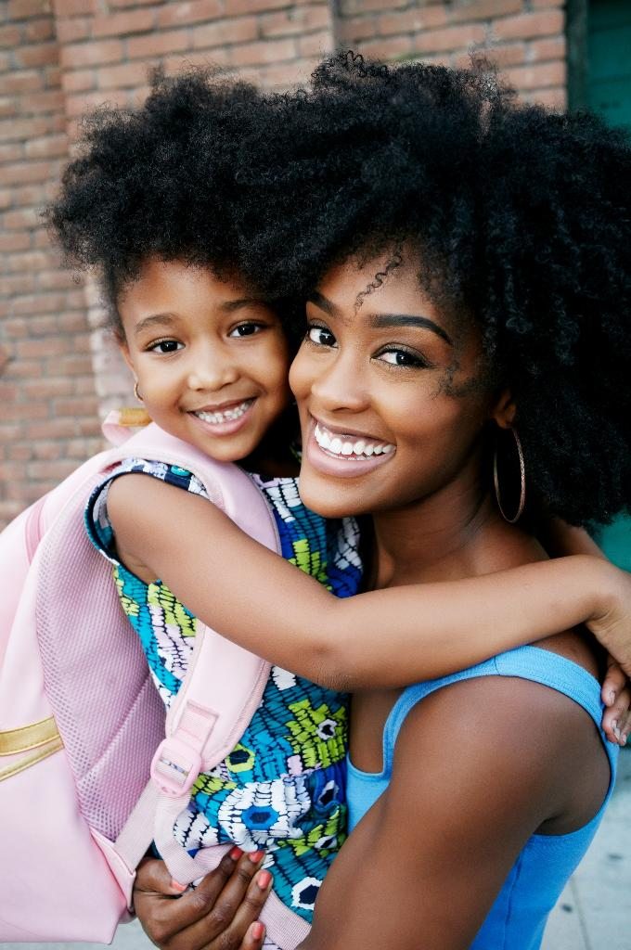
What characteristics are you using to make these matches?
8B
Exploring Missouri – 8B Parents and Offspring: Engage
4

Slide 5
View Mother’s Day Baby Wildlife Video
Link:
https://youtu.be/kkI1DgW1yIM?si=JcIeBMRuJwmB78-k
8B
Exploring Missouri – 8B Parents and Offspring: Explore
5
Notes:
From the MDC Teacher Portal, view the Mother’s Day Baby Wildlife video.

Slide 6
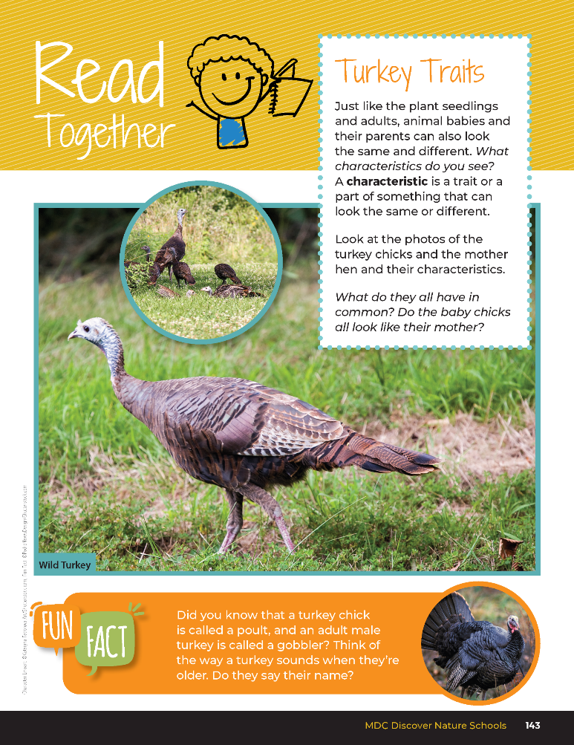

Turkey Traits
Just like the plant seedlings and adults, animal babies and their parents can also look the same and different. What characteristics do you see? A characteristic is a trait or a part of something that can look the same or different.
8B
Exploring Missouri – 8B Parents and Offspring: Explore
6
Notes:
Next have students turn in student guide to Read Together 8B Turkey Traits on Page 143.
Read together from student book and discuss the following as a class.

Slide 7
Turkey Traits
Look at the photos of the turkey chicks and the mother hen and their characteristics.
What do they all have in common? Do the baby chicks all look like their mother?
8B
Exploring Missouri – 8B Parents and Offspring: Explore
7
Notes:
Next have students turn in student guide to Read Together 8B Turkey Traits on Page 143.
Read together from student book and discuss the following as a class.

Slide 8
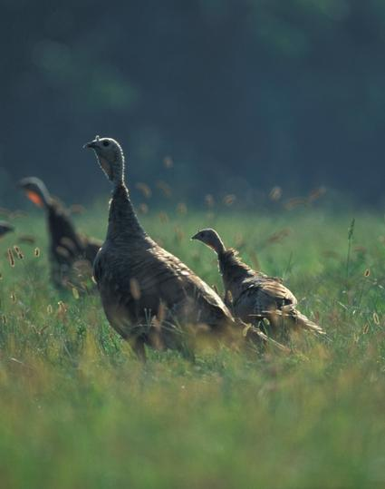
Why do you think the baby turkey chicks look different from the mother hen?
8B
Exploring Missouri – 8B Parents and Offspring: Explore
8
Notes:
Looking for responses such as different parts of lifecycle, etc.
Animal in Picture: Wild Turkey

Slide 9
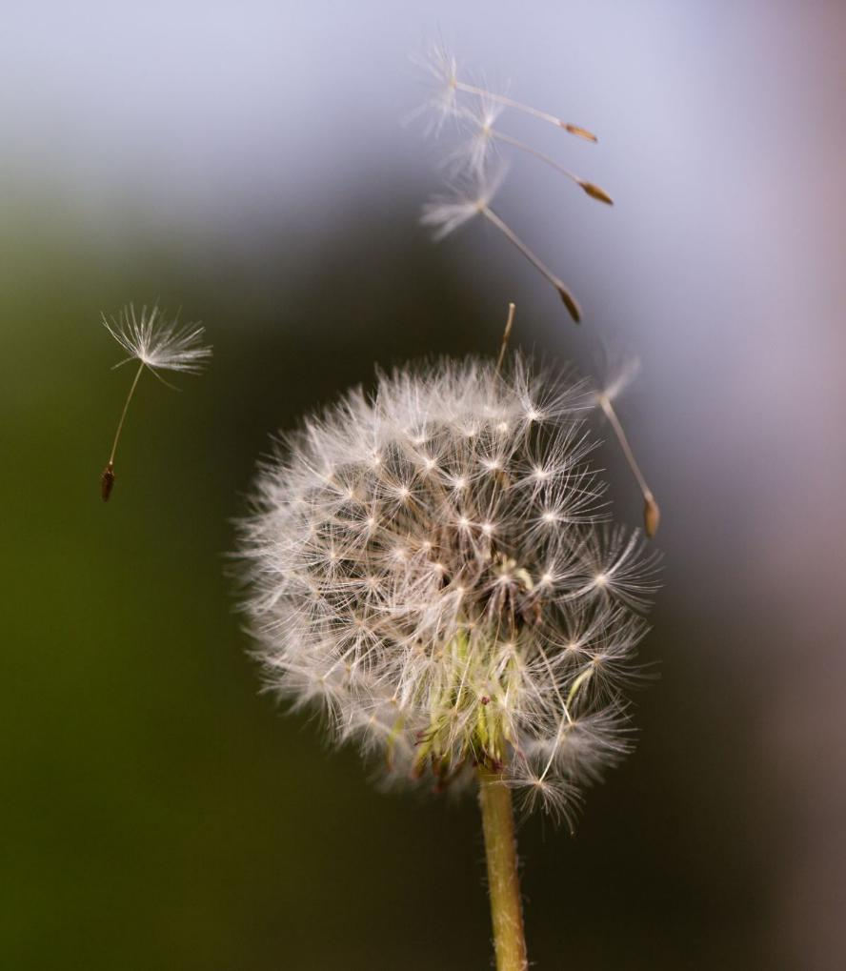
How does this compare to what we learned about plant parents and plant seedlings?
8B
Exploring Missouri – 8B Parents and Offspring: Explore
9
Notes:
Plant in Picture: Common Dandelion (seeds)

Slide 10
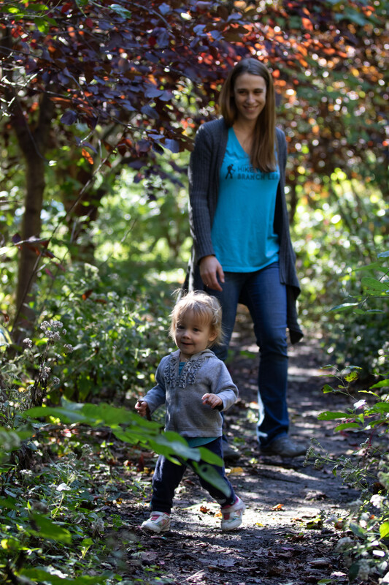
How are human children like their parents?
How are they different?
8B
Exploring Missouri – 8B Parents and Offspring: Explore
10
Notes:
Let’s talk about human mothers and babies and parents and offspring.
How are human children like their parents? How are they different? (smaller, less hair, etc.)

Slide 11
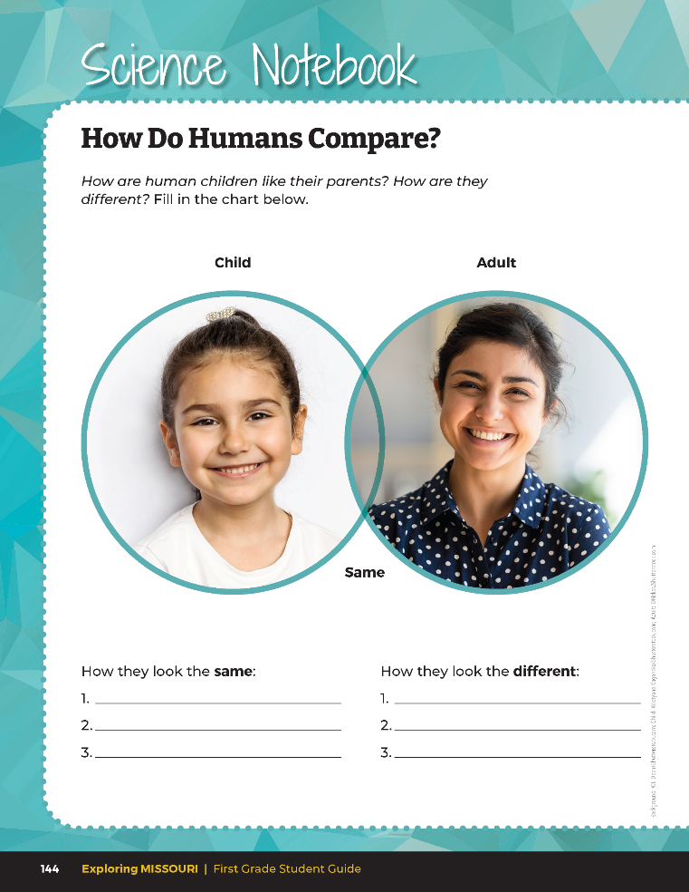
How are human children like their parents?
How are they different?
8B
Exploring Missouri – 8B Parents and Offspring: Explore
11
Notes:
Write ideas on the board in a brainstorming session and have students write in the Venn Diagram in their student guide Science Notebook 8B How do Humans Compare? section on Page 144.

Slide 12
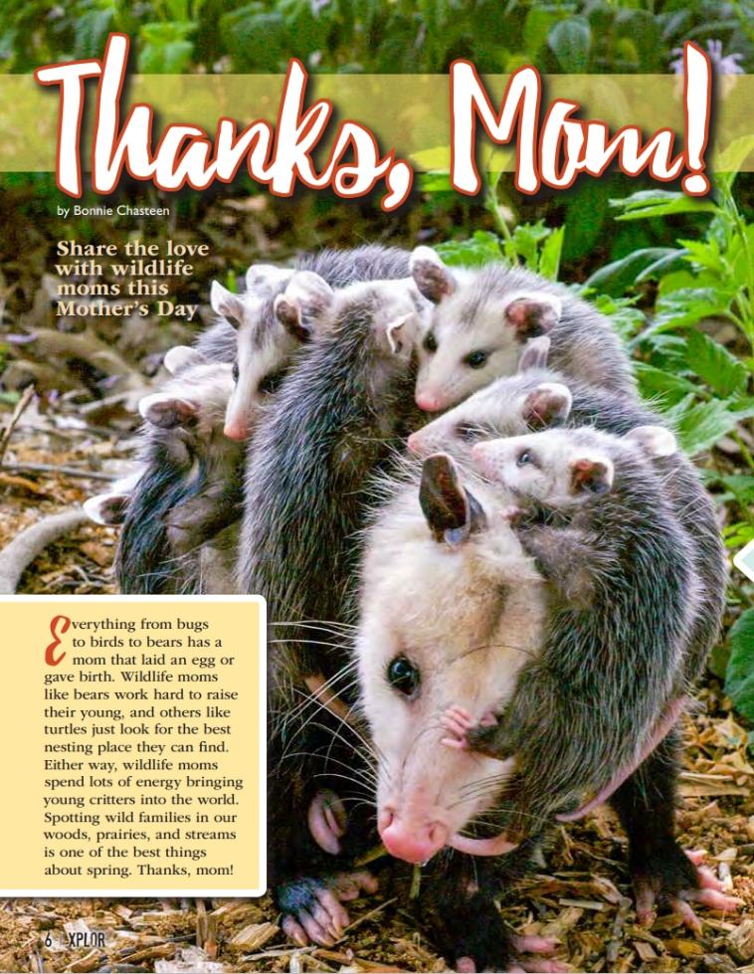
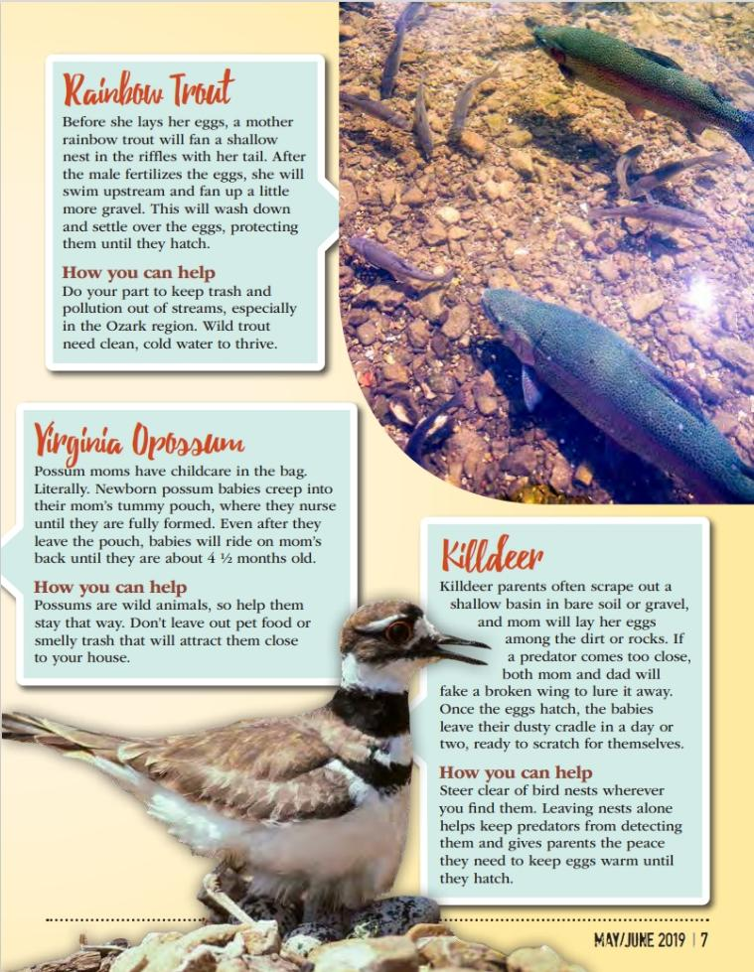
8B
Exploring Missouri – 8B Parents and Offspring: Explain
12
Notes:
From the MDC Teacher Portal, display Thanks, Mom! By Bonnie Chasteen from the May 2019 issue of Xplor. https://education.mdc.mo.gov/sites/default/files/2023-08/8BThanksMomXplorArticle.pdf
Identify animal parents and offspring in the article as a class.

Slide 13
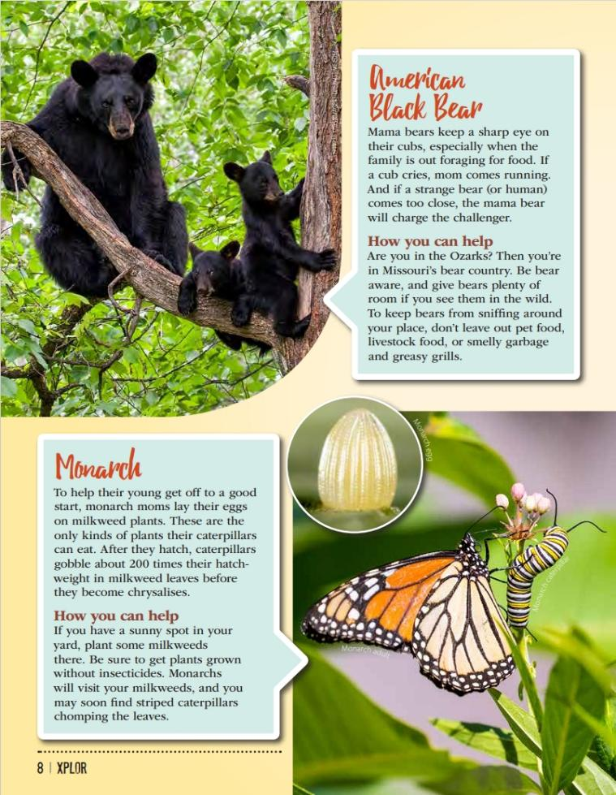
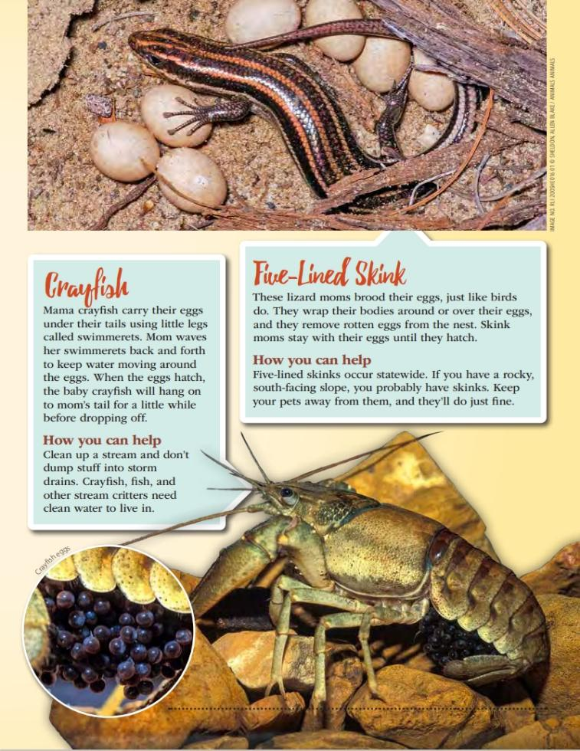
8B
Exploring Missouri – 8B Parents and Offspring: Explain
13
Notes:
Xplor link: Thanks, Mom!

Slide 14
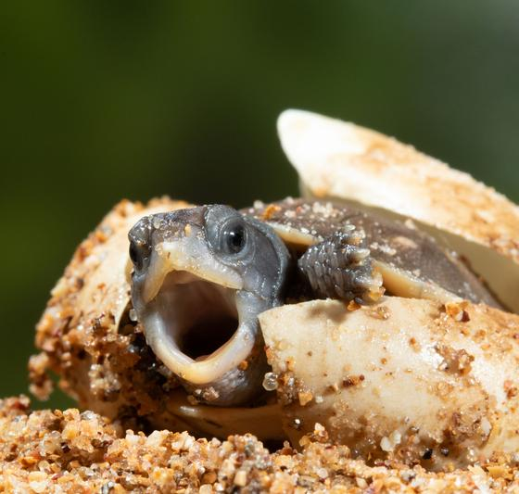
How are animal offspring like their parents?
How are they different?
8B
Exploring Missouri – 8B Parents and Offspring: Explain
14
Notes:
Explain that although some offspring may look like their parents in some ways, they will grow and change through the years.
Animal in Picture: Three-toed Box Turtle

Slide 15
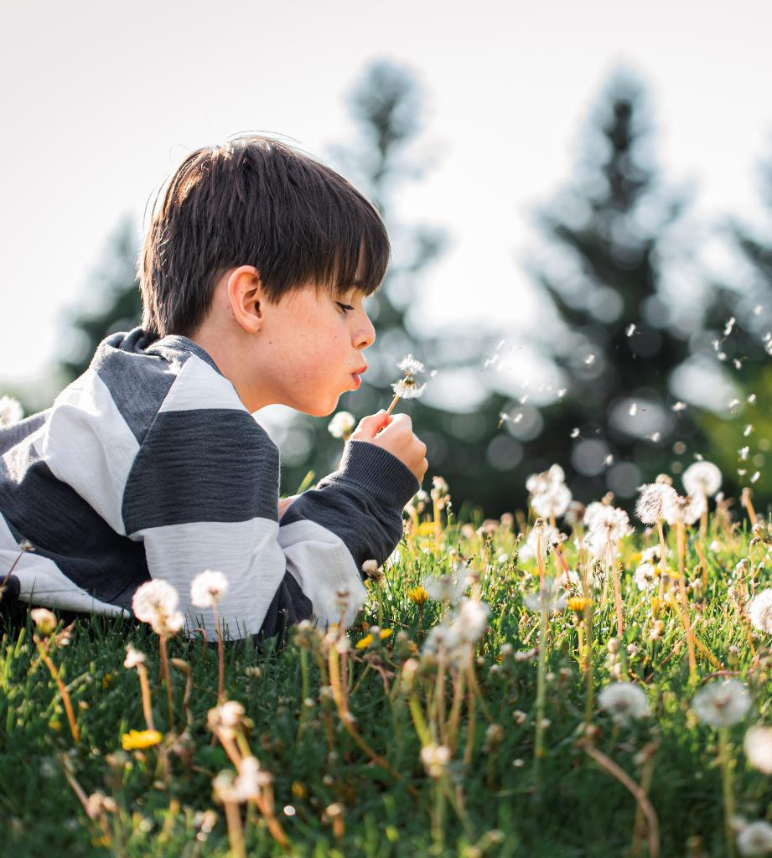
How is this similar to what we learned earlier about the dandelions and the trees?
How did they grow and change?
8B
Exploring Missouri – 8B Parents and Offspring: Explain
15

Slide 16
I am going to distribute groups of cards and you will put them in the order of their life cycle stage.
8B
Exploring Missouri – 8B Parents and Offspring: Elaborate
16
Notes:
Reproducible cards are located on pages 183-191of the Teacher Guide. - 8B Plant and Animal Cards.pdf
We are going to play a game with the Plant and Animal Cards. I am going to distribute groups of cards and you will put them in order of their life cycle stage. Divide students into groups of three and distribute one to two plant and animal card groupings to each group. Challenge children to sequence the plant and animal cards during explorations/lessons.
Card sets include:
Sunflower: sunflower seeds, young plant, and mature plant
Milkweed: milkweed seeds, young plant, and mature plant
Dandelion: seeds, young plant, and mature plant
Sugar Maple: seeds, seedling, and tree
White Oak: acorn, seedling, and tree
Red Fox: newborn babies, kits, juvenile, and adult
Wild Turkey: egg, chick, poult, and gobbler (male tom)
Black Rat Snake: eggs, hatchling, juvenil, and adult

Slide 17
How can you tell which offspring belong to which parents?
8B
Exploring Missouri – 8B Parents and Offspring: Elaborate
17

Slide 18
What characteristics are you noticing between the offspring and parents?
8B
Exploring Missouri – 8B Parents and Offspring: Elaborate
18

Slide 19
Do they have similar characteristics that do not change through the years?
8B
Exploring Missouri – 8B Parents and Offspring: Elaborate
19

Slide 20
Choose one animal card.
8B
Exploring Missouri – 8B Parents and Offspring: Evaluate
20
Notes:
Have students choose one animal card from the Plants and Animal cards found in Teacher Guide on pages 188-190. 8B Plant and Animal Cards.pdf

Slide 21
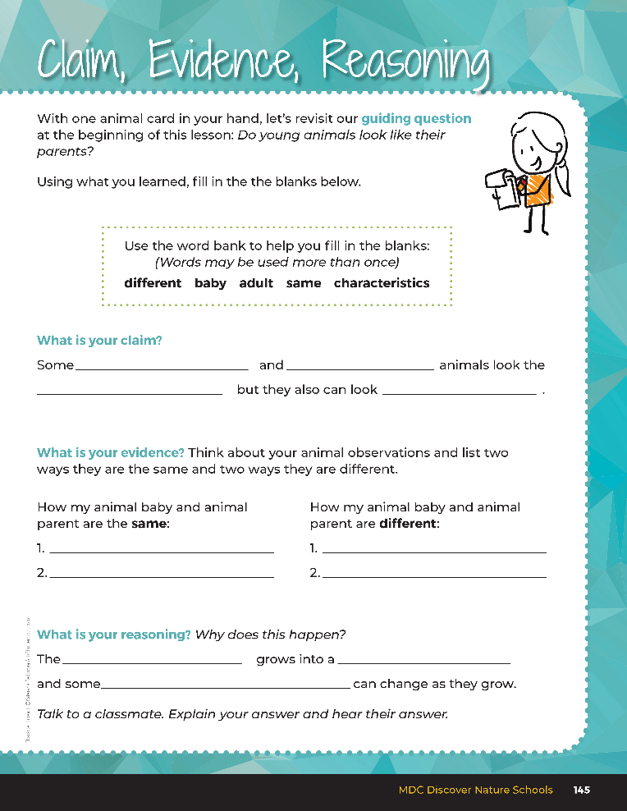

Guiding Question:
Do young animals look like their parents?
8B
Exploring Missouri – 8B Parents and Offspring: Evaluate
21
Notes:
After comparing the similarities and differences of animal babies and their parents, have students open their student guides to the Claim, Evidence, and Reasoning section on Page 145. Discuss the page with the students – read the guiding question and explain what the students need to do to answer the questions (fill in the blanks).

Slide 22
adult
baby
Answers
different
same
Similarities can include:
Differences can include:
fur, nose, eyes, scales, etc.
Size, longer nose, longer tail, color changes, etc.
baby
adult
characteristics
8B
Exploring Missouri – 8B Parents and Offspring: Evaluate
22
Notes:
Rubric:
4 (Exceeds) – Student identifies two or more similarities and two or more differences between animal baby and animal adult and fills in all the blanks correctly under the reasoning.
3 (Meets) – Student identifies one to two similarities and one to two differences between animal baby and animal adult and fills in two or the blanks correctly under the reasoning.
2 (Partially Meets) – Student identifies one similarity and one difference between animal baby and animal adult and fills in one of the blanks correctly under the reasoning.
1 (Doesn’t Meet) – Student identifies zero to one similarity and zero to one difference between the between animal baby and animal adult and does not fill in the blanks correctly under the reasoning.

