Slide 1
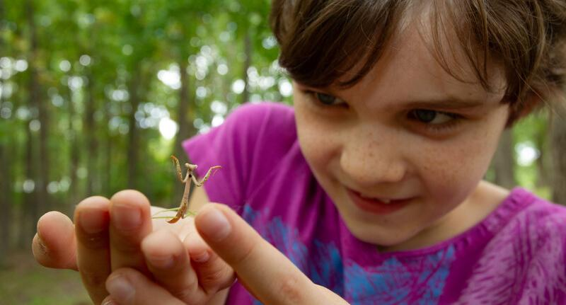

Exploring
MISSOURI
8A: Comparing Dandelions

Slide 2
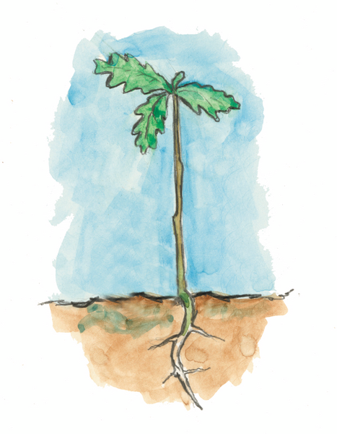
Guiding Question:
Do young plants look like their parents?
8A
Exploring Missouri – 8A Comparing Dandelions: Engage
2

Slide 3
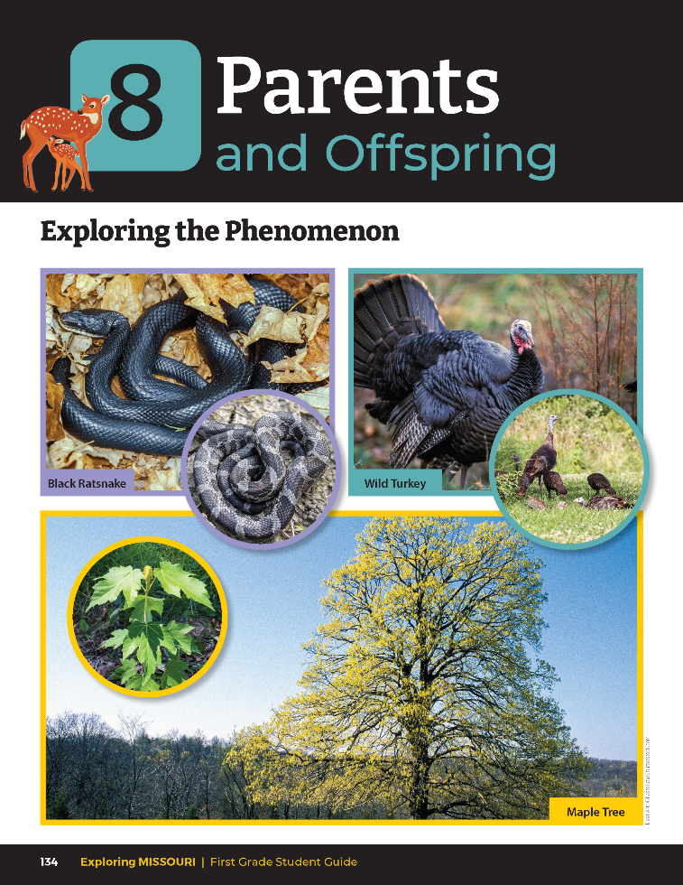
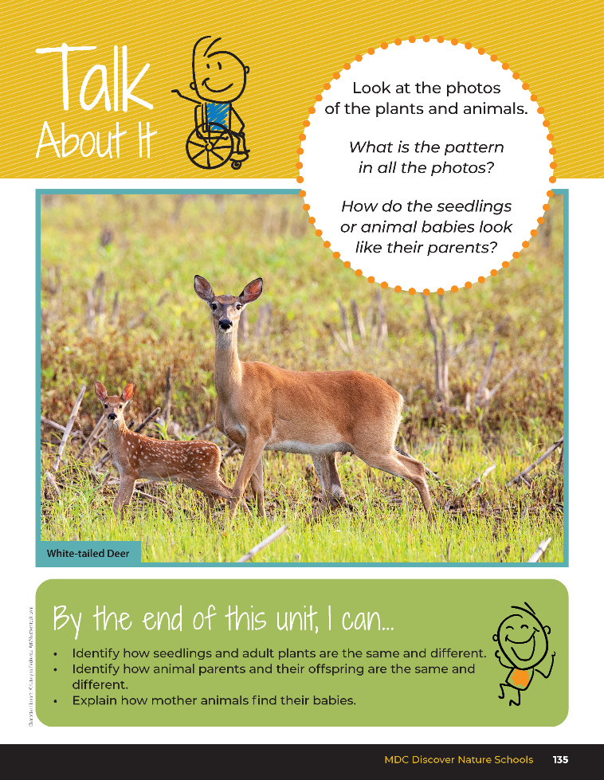
8A
Exploring Missouri – 8A Comparing Dandelions: Engage
3
Notes:
Teacher Note: It is recommended to use blooming dandelions as your focus for this activity, even though these flowers are not native to Missouri. Dandelions are the most widespread non-native flowers across the state, sometimes blooming as early as February but typically blooming in April-early May. Plants with seeds and blooms are often found together.
Read together the student guide Unit 8 Exploring the Phenomenon section on pages 134-135 and discuss the Talk About It portion.

Slide 4
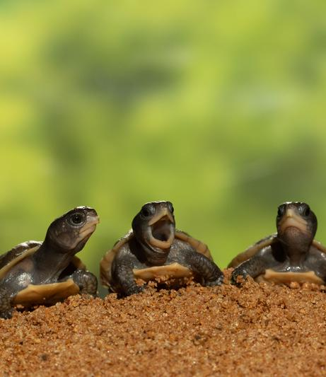
What is the pattern you see in all the photos?
How do the plant seedlings or animal babies look like their parents?
8A
Exploring Missouri – 8A Comparing Dandelions: Engage
4
Notes:
Animal in Picture: Three-toed Box Turtle

Slide 5
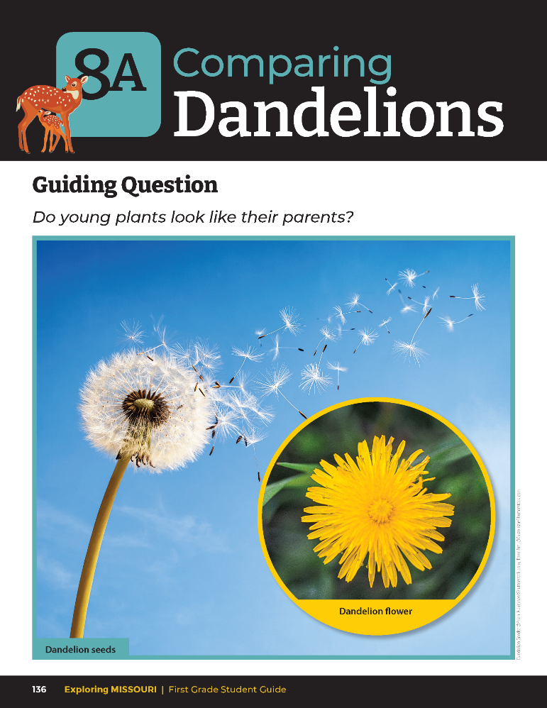
How are these dandelions the same?
How are they different?
8A
Exploring Missouri – 8A Comparing Dandelions: Engage
5
Notes:
Refer to the pictures of the dandelion seeds and the flower in the student guide on Lesson 8A Comparing Dandelions introduction section on Page 136.

Slide 6
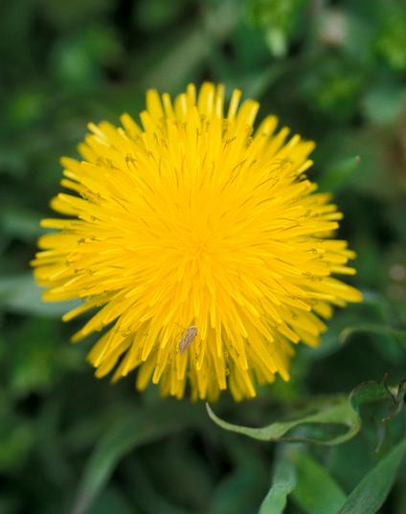
Have you ever seen a dandelion?
How would you describe it to someone who has never seen one?
8A
Exploring Missouri – 8A Comparing Dandelions: Engage
6
Notes:
Plant in Picture: Common Dandelion

Slide 7
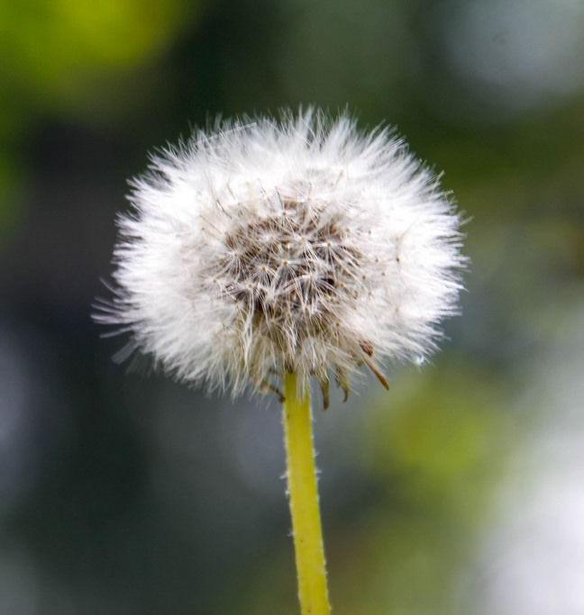
Turn and talk to your neighbor and find five descriptive words to describe a dandelion.
8A
Exploring Missouri – 8A Comparing Dandelions: Engage
7
Notes:
Turn and talk to your neighbor and find five descriptive words to describe a dandelion. As a class, list together the descriptive words students came up with.
Examples might include green, stem, five petals, white or pink, yellow inside of the flower.
Plant in Picture: Common Dandelion

Slide 8
Life Cycle
8A
Exploring Missouri – 8A Comparing Dandelions: Explore
8
Notes:
Discuss that just like animals, plants have a life cycle as well. There are adult or mature species of plants and smaller seedlings or “baby” versions of almost all living things. These are life cycle stages.

Slide 9
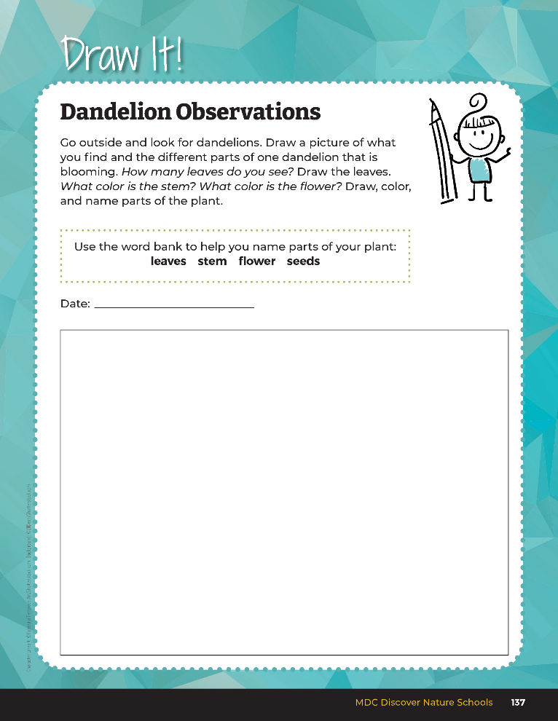

Go outside and look for dandelions. Draw a picture of what you find and the different parts of one dandelion that is blooming.
8A
Exploring Missouri – 8A Comparing Dandelions: Explore
9
Notes:
Take students outside to look for dandelions. As students look at different dandelions, record observations in student book Draw It! 8A Dandelion Observations on Page 137.

Slide 10
How does the dandelion you drew compare to the seeds that we see?
8A
Exploring Missouri – 8A Comparing Dandelions: Explore
10
Notes:
Come back together as a whole group and continue the discussion while you are outside. Let’s look back at our Lesson 8A Comparing Dandelions introduction page.

Slide 11
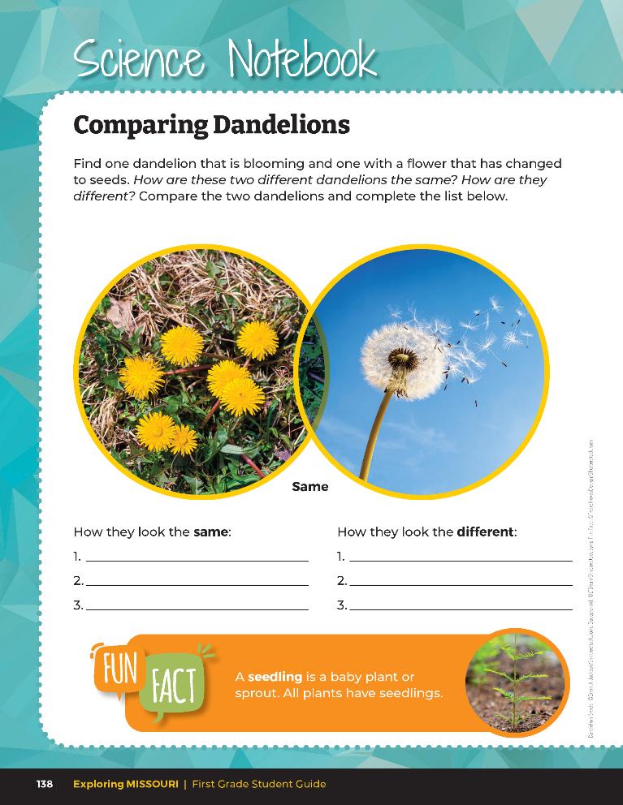
Find one dandelion that is blooming and one with a flower that has changed to seeds. Compare the two dandelions.
8A
Exploring Missouri – 8A Comparing Dandelions: Explore
11
Notes:
Find a dandelion with the seeds showing and use your Science Notebook 8A Comparing Dandelions on Page 138 to draw or write the differences.
Drawings and recorded observations can be noted on these pages through drawings and descriptions, as well as a Venn Diagram.

Slide 12
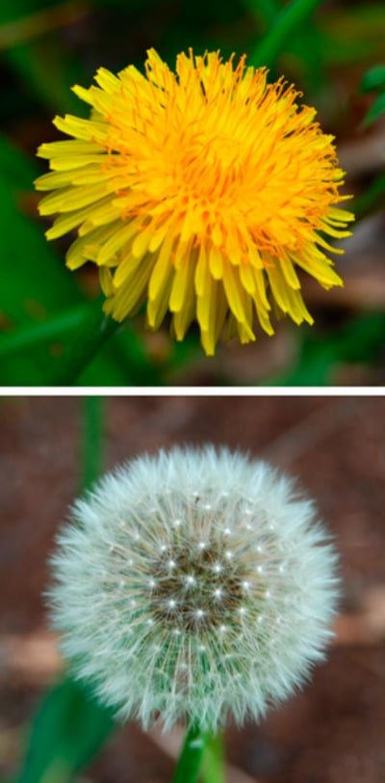
How are dandelions the same and how are they different?
8A
Exploring Missouri – 8A Comparing Dandelions: Explore
12
Notes:
Have students discuss in small groups. Discuss ideas as a whole group while outside.
Plant in Picture: Common Dandelion

Slide 13
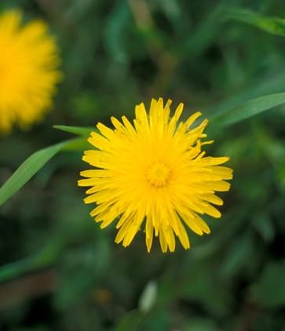
Where do dandelion plants and flowers come from?
8A
Exploring Missouri – 8A Comparing Dandelions: Explore
13
Notes:
As a class, collect a dandelion flower or two to observe in the classroom.
Teacher Note: Typically, when picking flowers, you would remind your students of the 1:10 rule: You may collect one flower for every 10 flowers you see. Remind students about the importance of not collecting all the flowers because it is necessary to leave some flowers so the plants can reproduce. Because they are collecting a nonnative species, this rule does not apply.
Plant in Picture: Common Dandelions

Slide 14

Read the book The Dandelion Seed by Joseph Anthony.
Read Aloud:
https://youtu.be/1NDWopxBy4k?si=AOI29nJ28het9Q_Y
8A
Exploring Missouri – 8A Comparing Dandelions: Explain
14

Slide 15
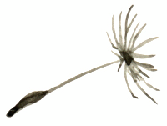
Where do plants, like dandelions, come from?
8A
Exploring Missouri – 8A Comparing Dandelions: Explain
15
Notes:
Write student ideas on the board and discuss where to place the different life cycles of plants.

Slide 16
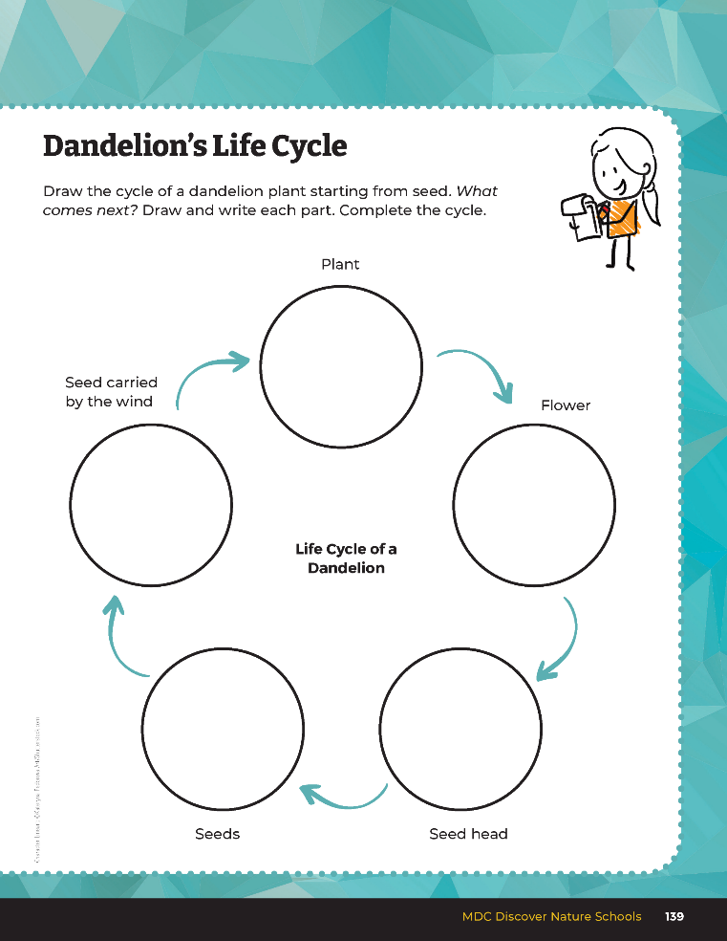
Draw the cycle of a dandelion plant starting from seed.
8A
Exploring Missouri – 8A Comparing Dandelions: Explain
16
Notes:
Using story from The Dandelion Seed to draw the five different parts of a dandelion life cycle, have students complete the life cycle of a dandelion in their student guide Science Notebook 8A Dandelion’s Life Cycle section on Page 139.

Slide 17
Life Cycle of a Plant
Plant with Seed Head
Seeds
Plants with Flowers
Seedlings
Plants with Leaves
8A
Exploring Missouri – 8A Comparing Dandelions: Explain
17
Notes:
Explain the life cycle of a plant. Draw on the classroom board the different stages.
Seeds
Seedlings
Plant with leaves
Plant with flowers
Plant with seed head

Slide 18
Where do dandelions and their flowers come from?
8A
Exploring Missouri – 8A Comparing Dandelions: Explain
18
Notes:
Let’s take a closer look at the dandelion plant with the seeds that we collected and make observations.

Slide 19
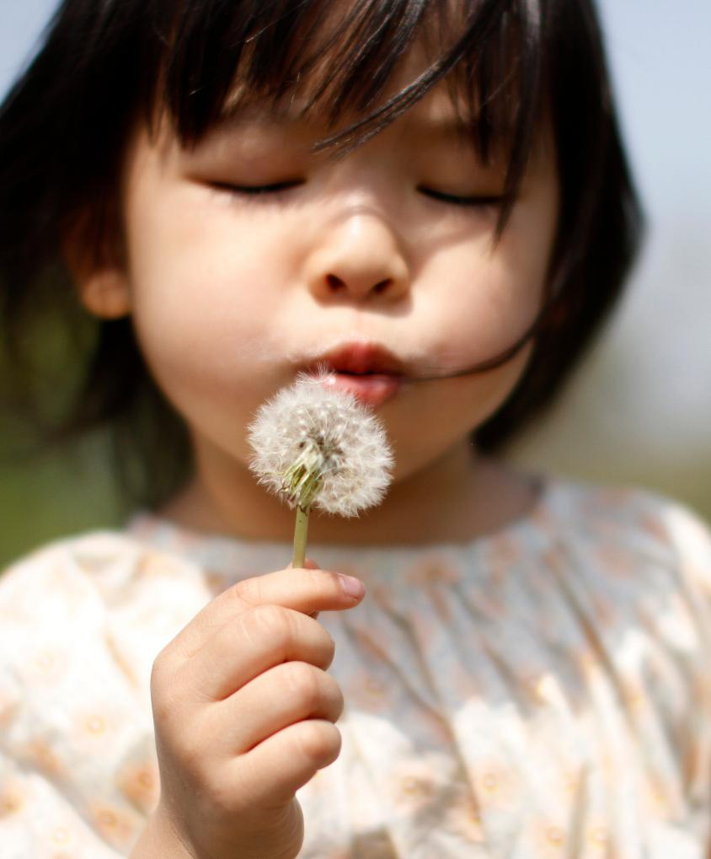
What happens when I blow on the seeds?
8A
Exploring Missouri – 8A Comparing Dandelions: Explain
19
Notes:
Dandelion seeds come from the dandelion flowers, and once the seeds blow in the wind, they are carried to new soil to grow. Show students the dandelion flower.
Plant in Picture: Common Dandelion

Slide 20
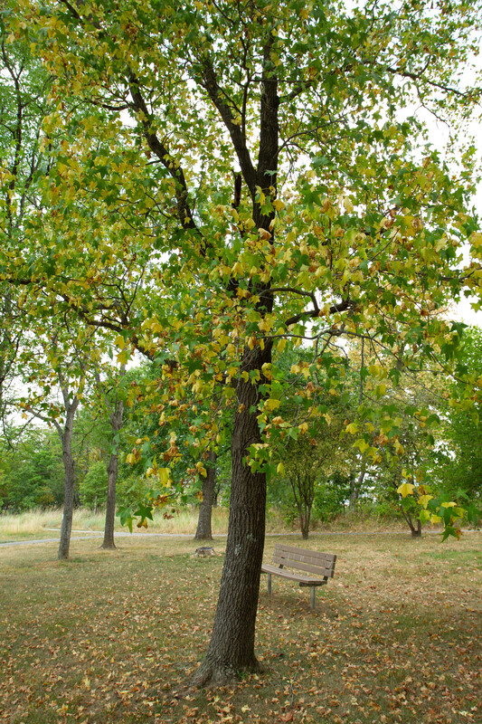
Is this tree a plant too?
What do you notice about this plant?
How is it like our dandelion plant?
8A
Exploring Missouri – 8A Comparing Dandelions: Elaborate
20
Notes:
Examine other plants for similarities and differences. Take students outside to a tree and other plants in the schoolyard.

Slide 21
Does this tree have leaves?
Where do you think this tree comes from?
How is it like the dandelion plant we learned about earlier?
8A
Exploring Missouri – 8A Comparing Dandelions: Elaborate
21

Slide 22
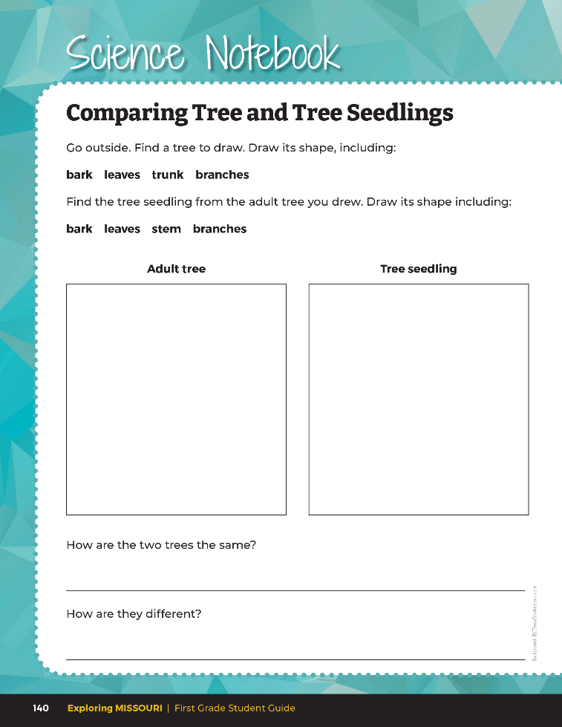
Comparing Tree and Tree Seedlings
8A
Exploring Missouri – 8A Comparing Dandelions: Elaborate
22
Notes:
Look at your student guide Science Notebook 8A Comparing Tree and Tree Seedlings section on Page 140.
As a class, use the MDC Field Guide (Field Guide | Missouri Department of Conservation) or distribute the MDC Show Me Trees book to identify the kind of seed of the tree in your schoolyard. Distribute extra copies of 8A Comparing Tree and Tree Seedlings if students finish early.

Slide 23
How does the seed differ from one picture to the other in the book?
8A
Exploring Missouri – 8A Comparing Dandelions: Elaborate
23

Slide 24
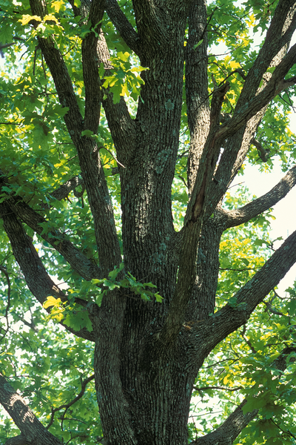
Are the lifecycle stages the same for all trees?
8A
Exploring Missouri – 8A Comparing Dandelions: Elaborate
23
Notes:
Teacher Note: In preparation for the next lesson, please tell students they may bring in special photos from home: one of one parent and another photo of themselves. These need to be individual photos as they will be used in a matching pairs activity.
In the event that a child does not have access to such photos, the teacher can prepare extra sets of generic parent photos and generic child photos to match one parent to one child based on physical similarities or features that look similar. (Generic photos to pair up: such as red-haired mother and red-haired child, blue-eyes pairs, etc.)
Bringing photos from home may not be possible for all students, and the teacher may print off generic photos of parent and child pairs that the students can match. If students can bring the two photos from home, these can be added to the sets of photos the teacher already made.
Tree in Picture: Post Oak

Slide 25
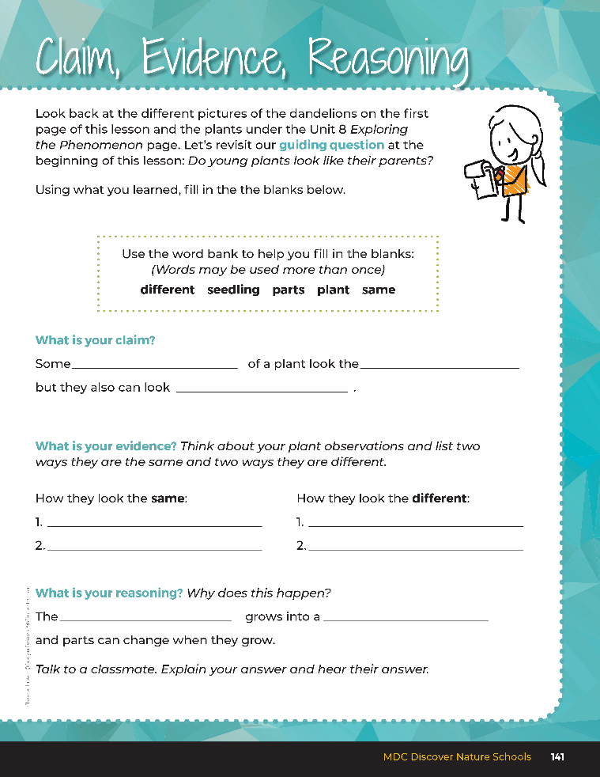

Guiding Question:
Do young plants look like their parents?
8A
Exploring Missouri – 8A Comparing Dandelions: Evaluate
25
Notes:
After comparing the similarities and differences of plant seedlings and plant parents, have students open their student guides to the Claim, Evidence, Reasoning section on Page 141. Discuss with the students – read the guiding question and explain what the students need to do to answer the questions (fill in the blanks).

Slide 26
parts
same
Answers
different
Similarities can include: leaf shape,
Differences can include: size, trunk
roots, grow from the ground
width, more leaves, has flowers, etc.
brown bark
seedling
plant
8A
Exploring Missouri – 8A Comparing Dandelions: Evaluate
26
Notes:
Rubric:
4 (Exceeds) – Student identifies two or more similarities and two or more differences between seedling and adult plant and fills in the blanks correctly under reasoning.
3 (Meets) – Student identifies one or two similarities and one or two differences between the seedling and adult plant and fills in one of the two blanks correctly under reasoning.
2 (Partially Meets) – Student identifies one similarity and one difference between the seedling and adult plant and does not fill in the blanks correctly under reasoning.
1 (Doesn’t Meet) – Student identifies no similarities or differences between the seedling and adult plant and does not fill in the blanks under reasoning.

