Slide 1
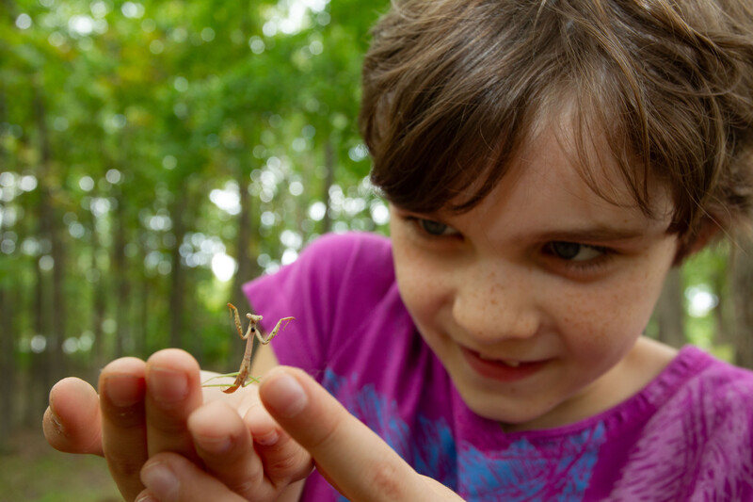
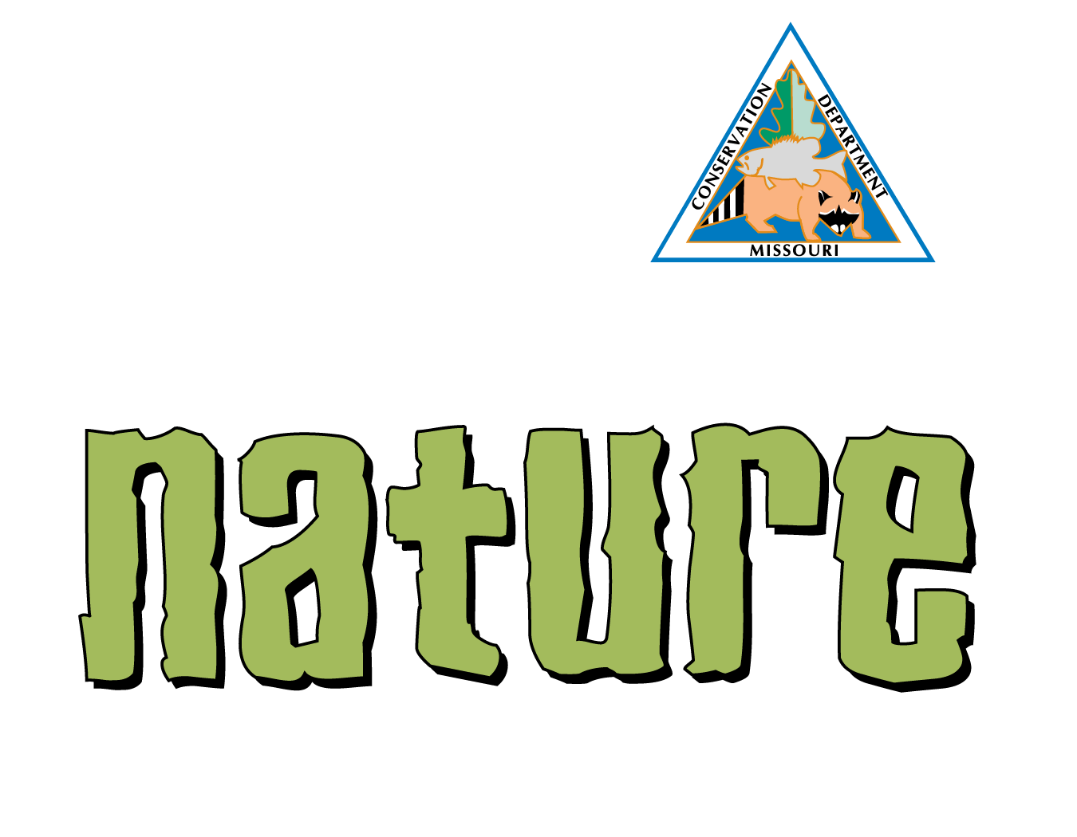
Exploring
MISSOURI
Unit 7 Review

Slide 2
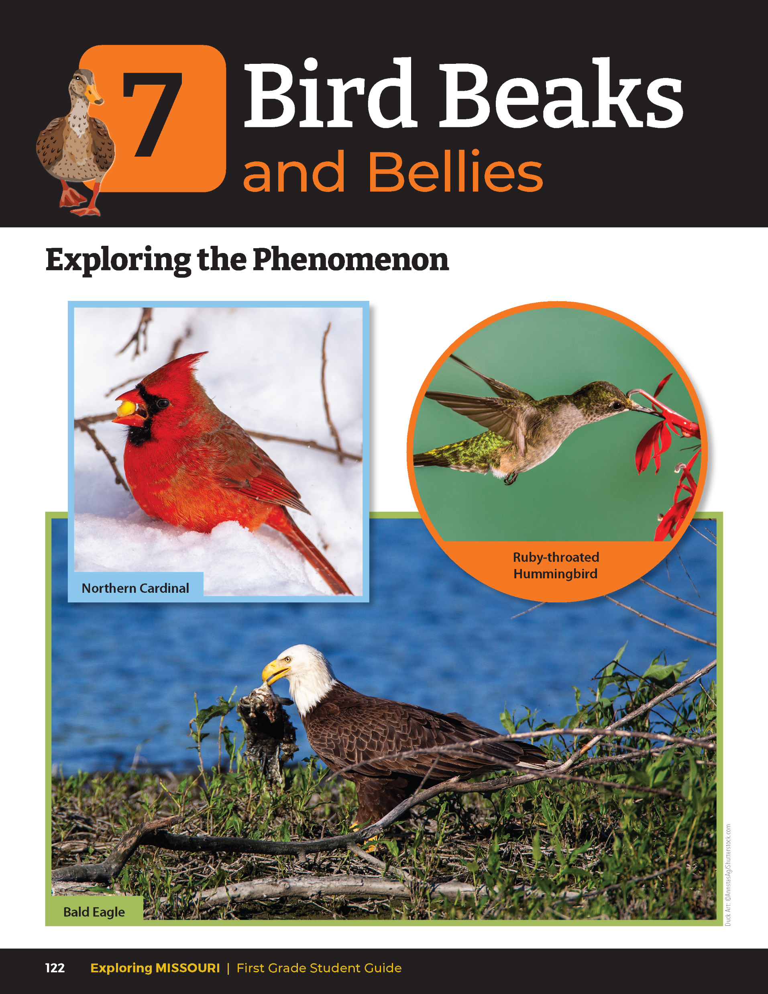
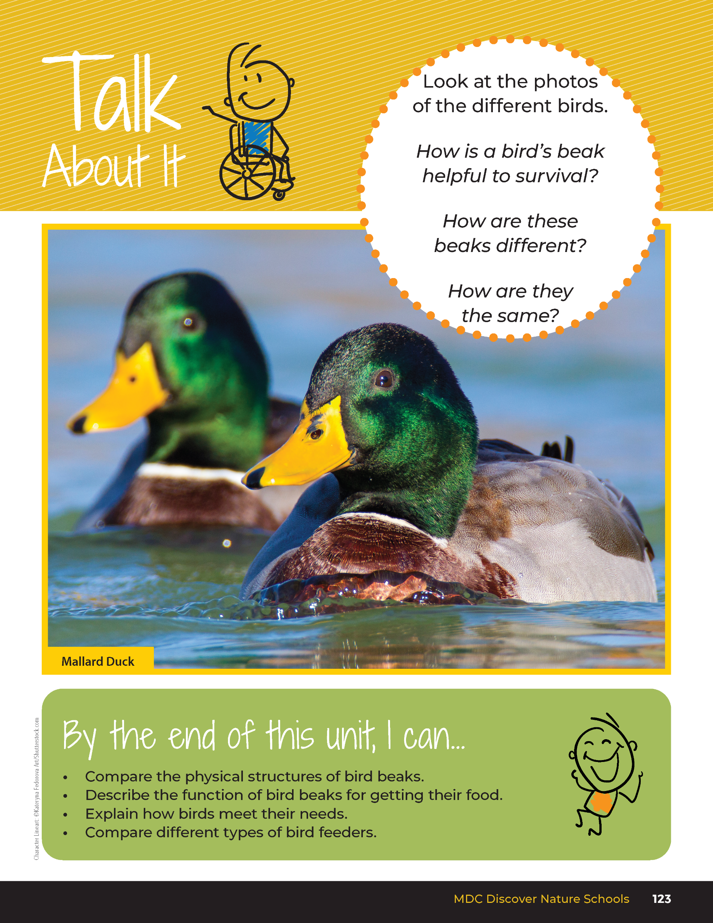
7
Exploring Missouri – Unit 7 Review
2
Notes:
Have students turn to the Unit 7 Exploring the Phenomenon Talk About It section on pages 122-123.

Slide 3
Turn to a classmate and discuss the structure and function of bird beaks in the photos.
7
Exploring Missouri – Unit 7 Review
3
Notes:
Using the pictures at the beginning of the lesson, have students turn and talk to a classmate and discuss the structure and function of bird beaks in the photos.

Slide 4
How is a bird’s beak helpful to survival?
How are these beaks different?
How are they the same?
7
Exploring Missouri – Unit 7 Review
4
Notes:
Rubric:
3 (Meets) – Student explains the patterns of the different birds and their beaks and connects the structure of the beak shape to the food eaten.
2 (Partially meets) – Student explains some of the patterns of the different birds and their beaks and connects the structure of the beak shape to the food eaten.
1 (Doesn’t meet) – Student does not connect of the patterns of the different birds and their beaks and connects the structure of the beak shape to the food eaten.

Slide 5
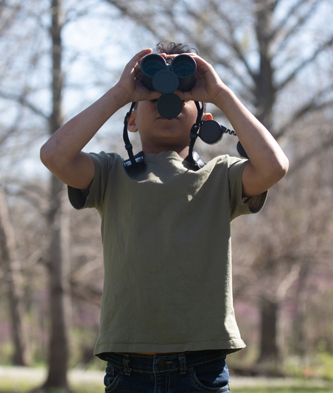
Let’s go birding!
7
Exploring Missouri – Unit 7 Review
5
Notes:
Let’s go birding! Distribute copies of the mini field guide You Discover Backyard Birds from Xplor. This guide is available through the MDC Teacher Portal. https://education.mdc.mo.gov/sites/default/files/2023-08/7B%20PRINTABLE%20Mini%20Field%20Guide-You%20Discover%20Show-Me%20Backyard%20Birds.pdf
Go outside and have students find a quiet spot to sit quietly. You may wish to distribute binoculars during this time. Give students a few minutes to locate several birds to follow with their eyes and ears.

Slide 6
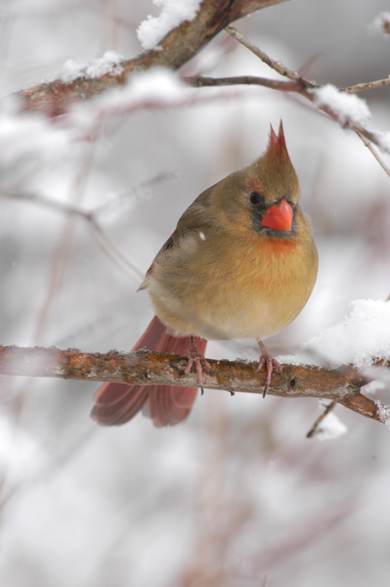
What types of birds are they?
7
Exploring Missouri – Unit 7 Review
6
Notes:
Bring the MDC Feeding Backyard Birds Poster with you or have the students bring their You Discover Backyard Birds mini field guide so students can identify their bird.
Animal in Picture: female Northern Cardinal

Slide 7
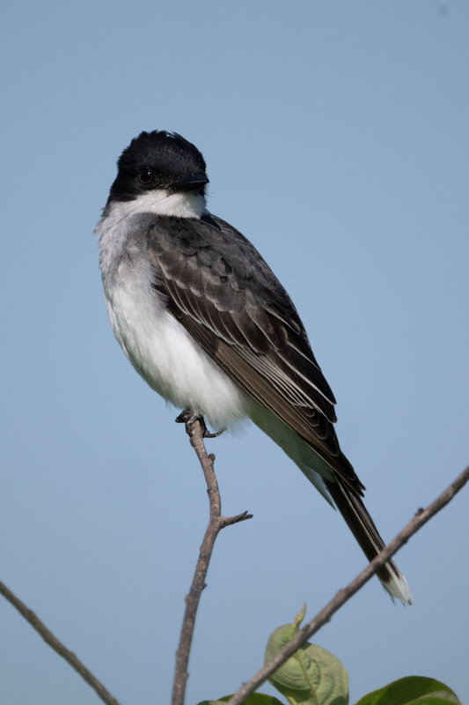
What are the birds doing?
7
Exploring Missouri – Unit 7 Review
7
Notes:
Animal in Picture: Eastern Kingbird

Slide 8
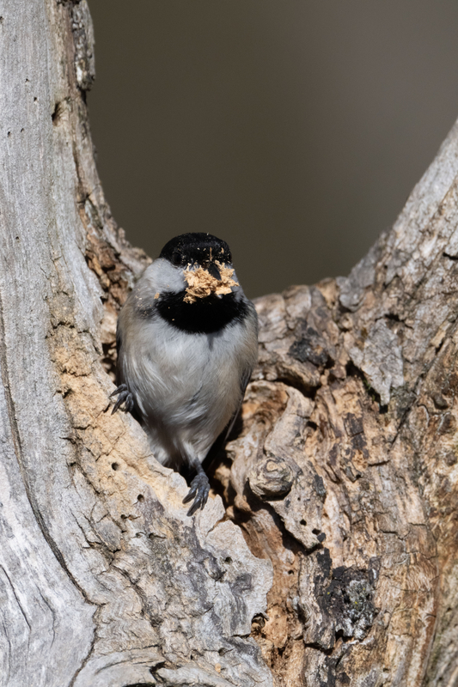
How are they using their beak to survive?
7
Exploring Missouri – Unit 7 Review
8
Notes:
Animal in Picture: Black-capped Chickadee

Slide 9
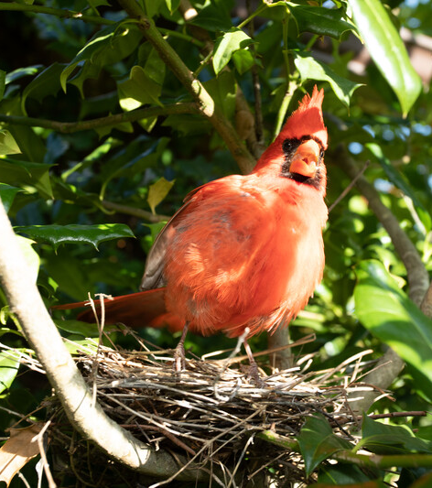
Are they collecting nest material?
Are they collecting food?
7
Exploring Missouri – Unit 7 Review
9
Notes:
Animal in Picture: male Northern Cardinal

Slide 10
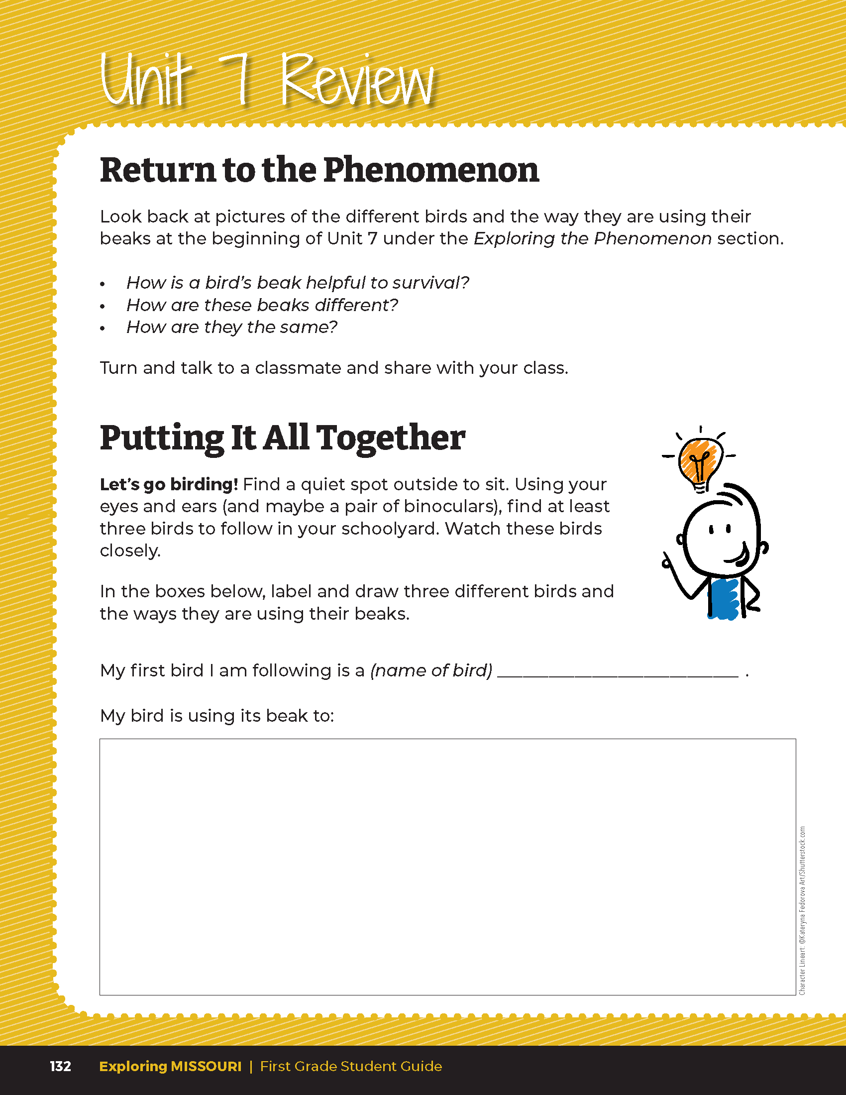
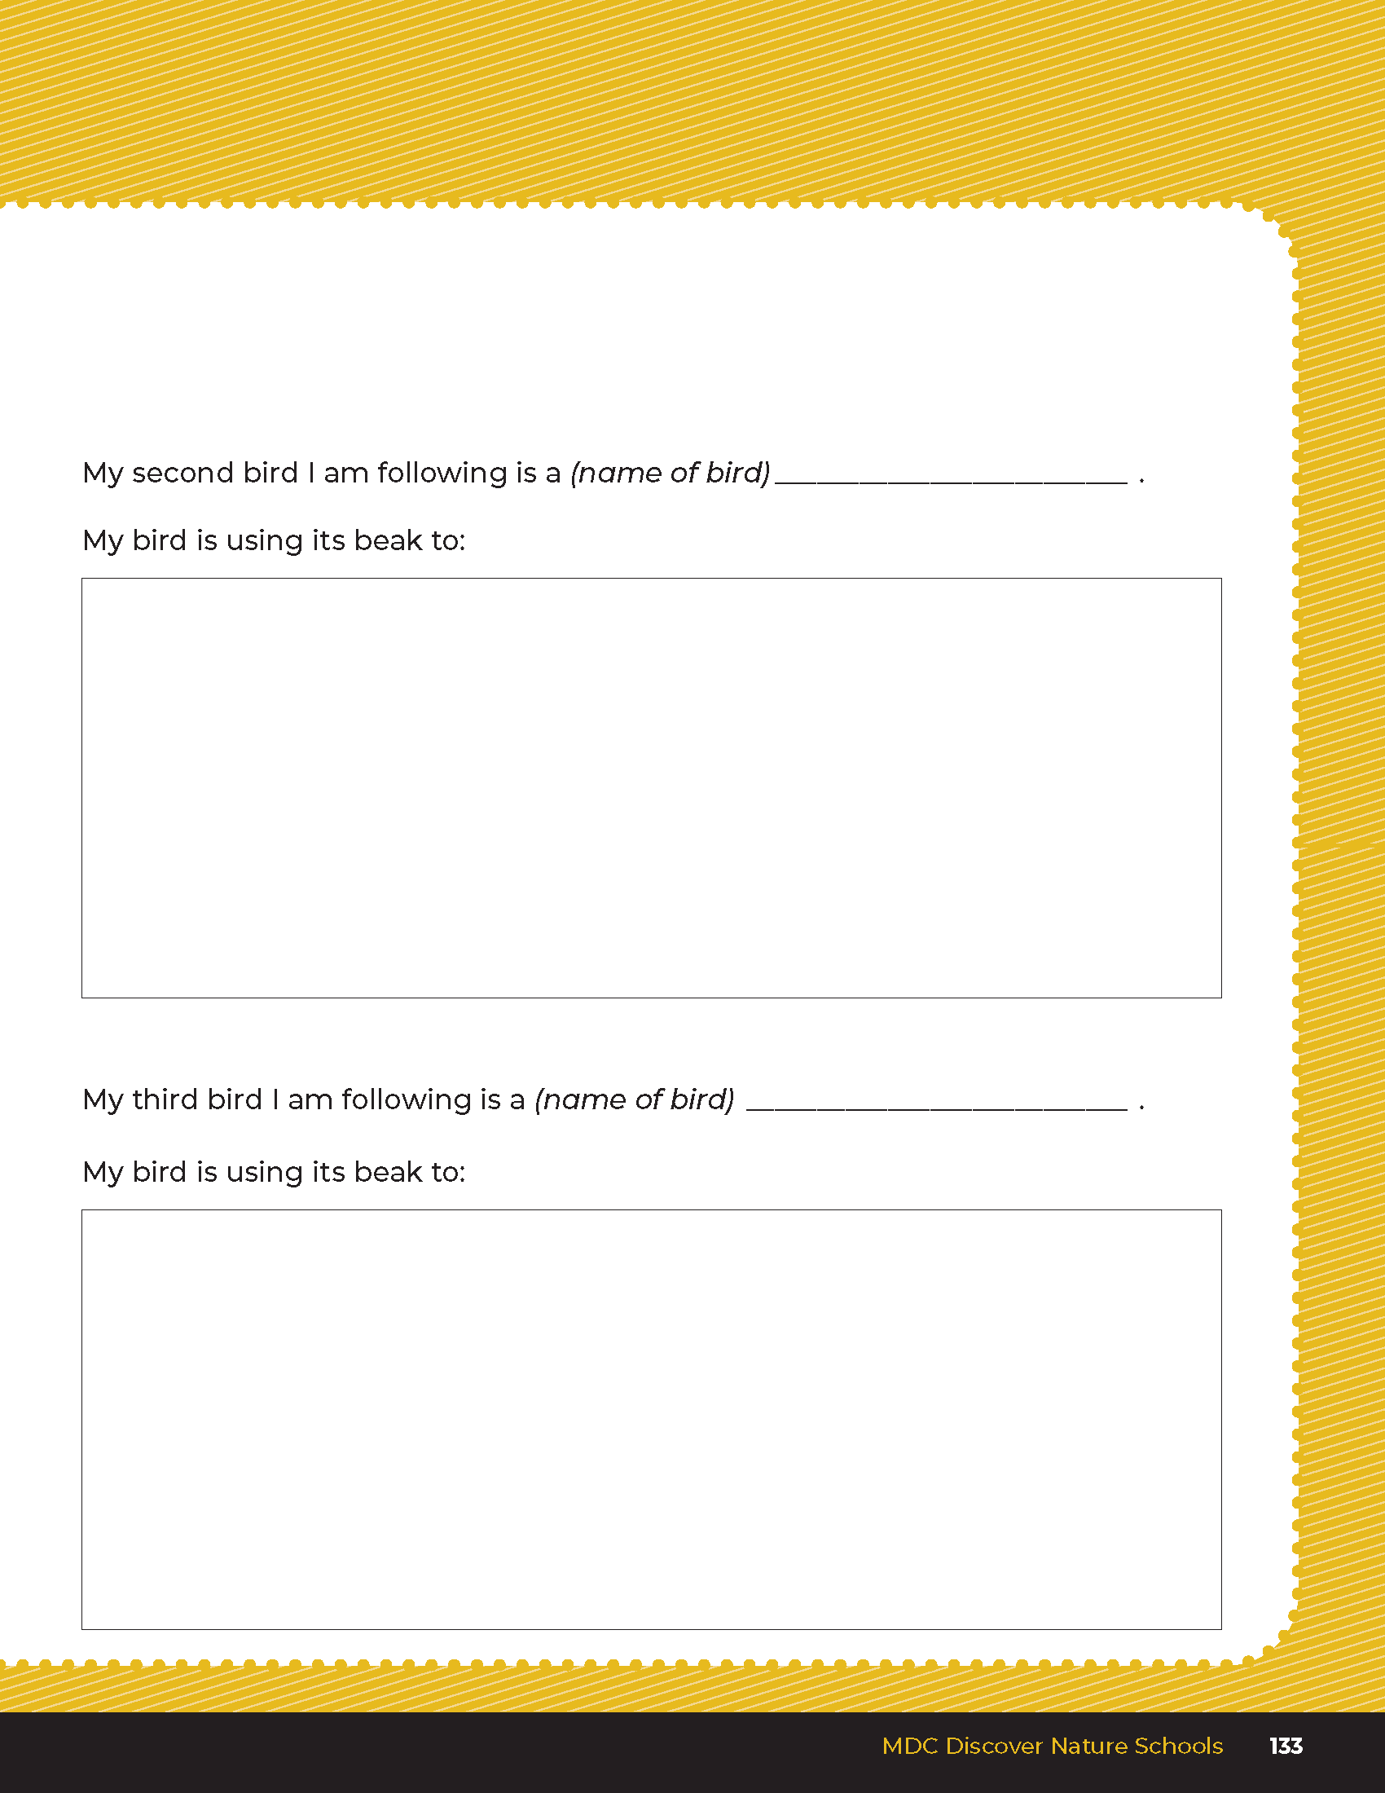
7
Exploring Missouri – Unit 7 Review
10
Notes:
Using student guide Unit 7 Putting It All Together section on pages 132-133, have students draw three different types of birds they are following with there eyes and ears and the different ways the birds are using their beaks in the three different boxes. In each box, have them describe how the bird is using its beak.
Come back inside and give students time to share one bird they followed and what it was doing with its beak.
Rubric:
3 (Meets) – Student labels and draws three different birds showing how the birds use their beaks.
2 (Partially meets) – Student labels and draws two different birds showing how the birds use their beaks.
1 (Doesn’t meet) – Student labels and draws zero to one bird showing how the bird uses its beak.

