Slide 1
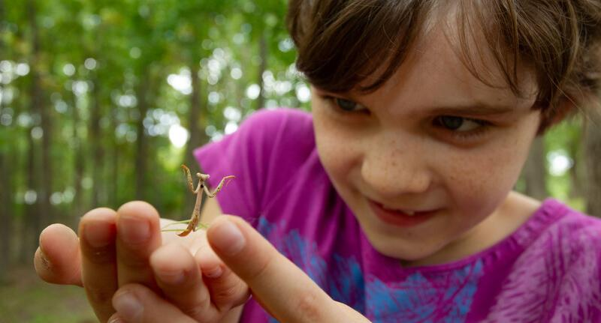
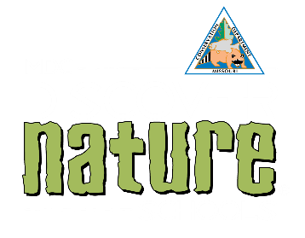
Exploring
MISSOURI
7A: Best Beaks

Slide 2
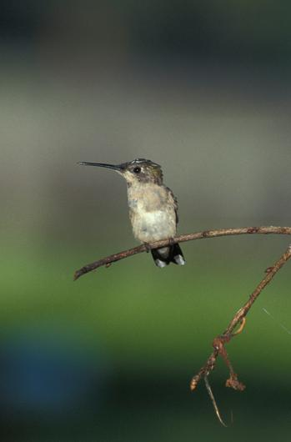
Guiding Question:
How does a bird use its beak to survive?
7A
Exploring Missouri – 7A Best Beaks: Engage
2
Notes:
Animal in Picture: Ruby-throated Hummingbird

Slide 3

Close your eyes and think how you would describe a bird to an alien from another planet.
7A
Exploring Missouri – 7A Best Beaks: Engage
3

Slide 4
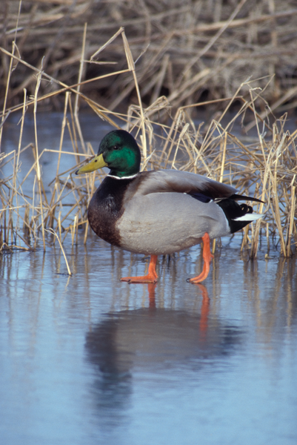
Turn and tell your partner how you would describe what a bird looks like.
7A
Exploring Missouri – 7A Best Beaks: Engage
4
Notes:
Discuss what birds are and characteristics of birds including: covered with feathers, two wings and two legs, eyes, beak (instead of a nose and mouth).
Animal in picture: male Mallard Duck

Slide 5
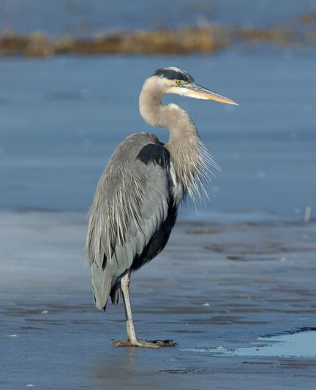
Do all birds have the same types of beaks?
7A
Exploring Missouri – 7A Best Beaks: Engage
5
Notes:
Today, we are going to explore different types of beaks and what they do for that kind of bird in helping it survive.
Animal in Picture: Great Blue Heron

Slide 6
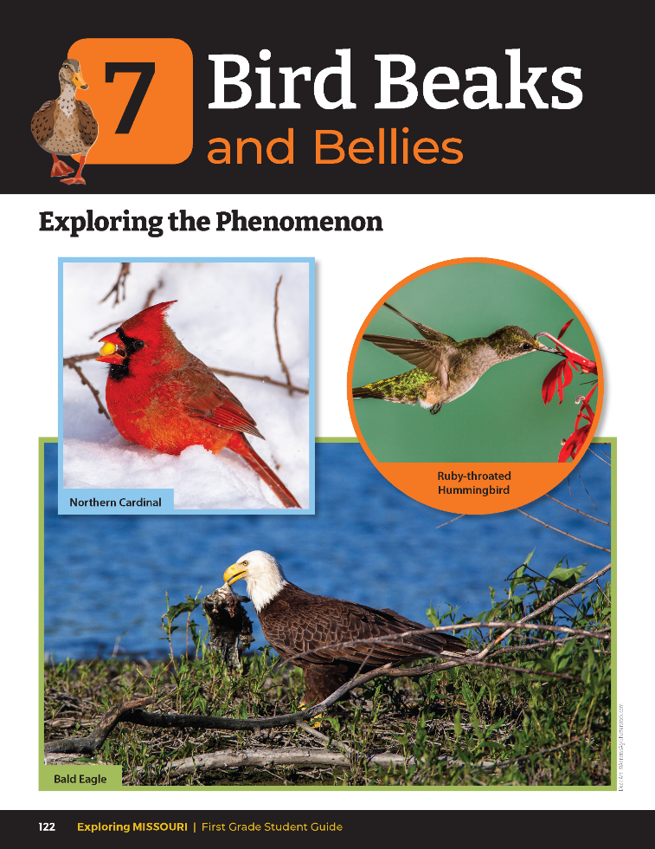
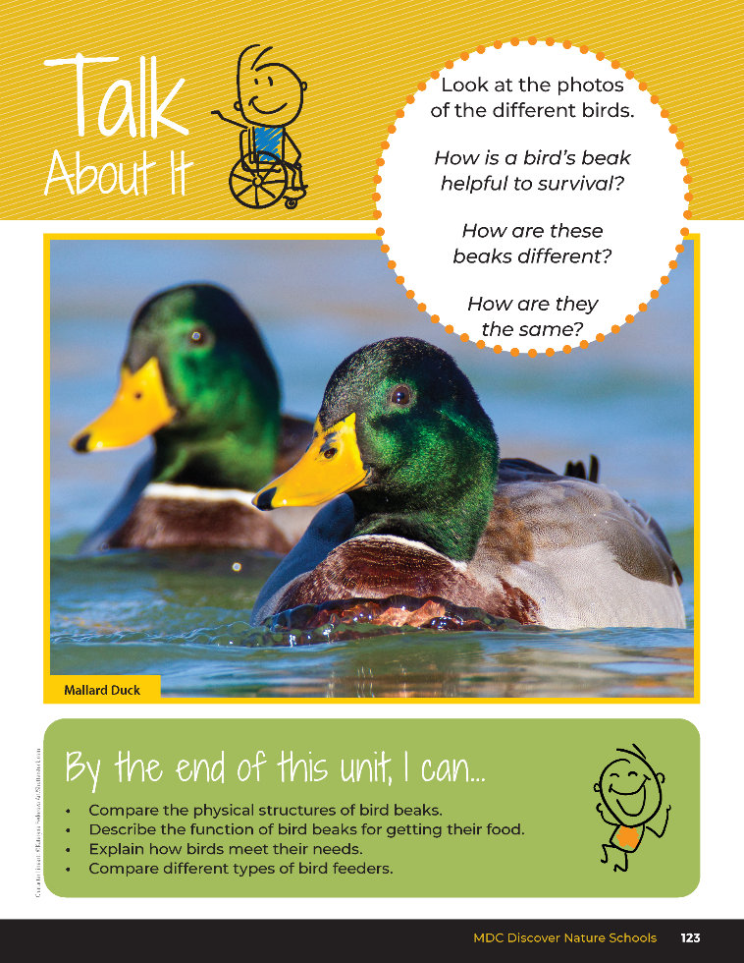
7A
Exploring Missouri – 7A Best Beaks: Engage
6
Notes:
Read together the student guide Unit 7 Exploring the Phenomenon section on pages 122-123 and discuss the Talk About It portion.

Slide 7
How is a bird’s beak helpful to survival?
How are all these beaks different?
How are they the same?
7A
Exploring Missouri – 7A Best Beaks: Engage
7

Slide 8
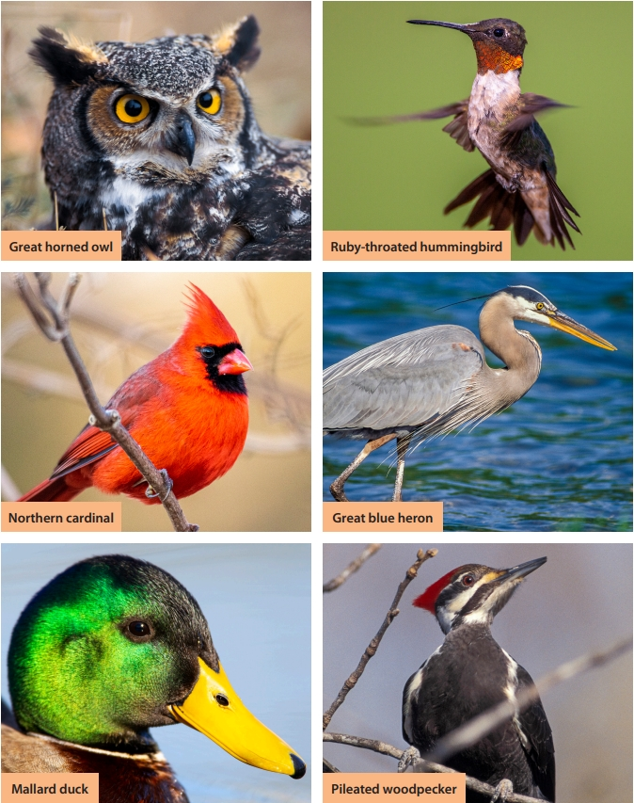
How are all these beaks different?
How are they the same?
7A
Exploring Missouri – 7A Best Beaks: Engage
8
Notes:
Discuss with students that they will be learning about six Missouri birds, what they eat, and how the shape of their beak helps them get certain foods. Missouri birds include great horned owl, great blue heron, northern cardinal, mallard, ruby-throated hummingbird, and pileated woodpecker. Use 7A Bird Beak Cut-Outs from the end of this lesson (7A Bird Beak Cutouts.pdf) and display the birds at the front of your classroom.
Teacher Note: This page will be referenced for the photos of different birds and beaks in the following activity.
Gather and provide all materials, along with pictures of the identified birds for the children to explore during station explorations.

Slide 9
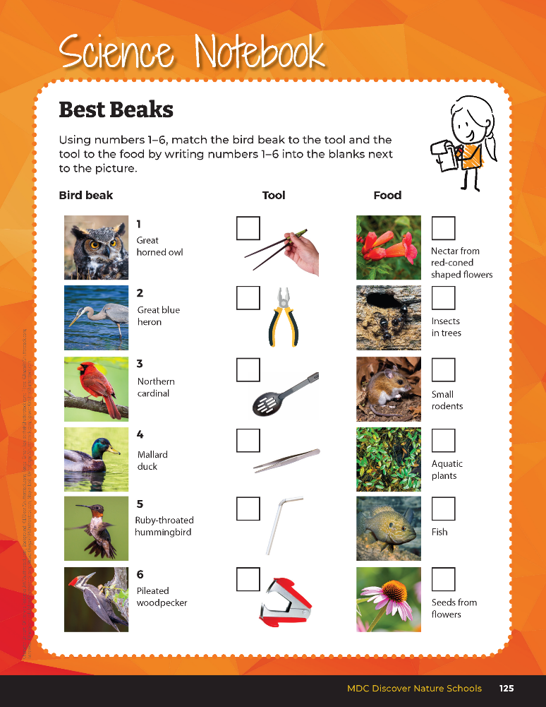
What do you think this tool represents?
7A
Exploring Missouri – 7A Best Beaks: Explore
9
Notes:
Teacher Note: This activity requires 30 minutes to set up.
Imagine you are a bird. You will be going through six stations trying out different bird “beaks” with different types of “foods.”
Reference again the 7A Bird Beak Cut-Outs and have students guess which birds represent which “beak” or tool.
Discuss with students prior to the activity that each type of bird has a preferred food. Discuss which bird eat which items and then have them again try to guess which bird’s beak represents which tool.
Let’s see if you can guess the beak to the tool.

Slide 10
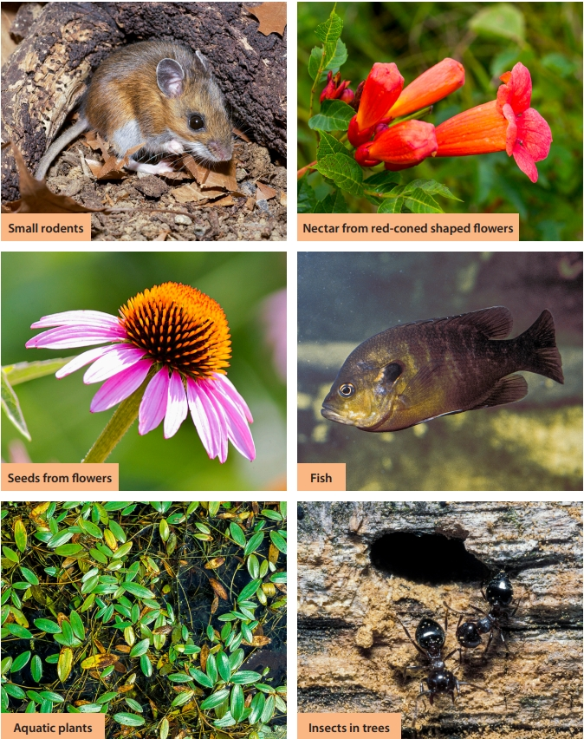
What kinds of beaks, or tools, work best for which type of food?
7A
Exploring Missouri – 7A Best Beaks: Explore
10
Notes:
Station Explorations for Bird Beak Function:
How to set up Best Beak Exploration:
Tub with water and floating plants (parsley or plastic plants)
Tub with water and plastic fish, crayfish, frogs, snakes
Tub with log or box with drilled holes filled with plastic insects
Tub with case/narrow bottle filled with water
Tub with sunflower seeds
Tub with rubber mouse
Place various tools scattered around and allow for student exploration. Encourage students to try different tools to retrieve their food to see how well the tool or “beak” works to get food.
Teacher Note: You may want to set up this activity as stations for students to select between two birds at a time using tools:
Great horned owl and northern cardinal
Mallard duck and great blue heron
Pileated woodpecker and ruby-throated hummingbird
Students will explore how different types of bird beaks help birds survive.

Slide 11


Match the best beak to each bird to the tool and then to the type of food.
7A
Exploring Missouri – 7A Best Beaks: Explore
11
Notes:
In the student guide, students will match the best beak of each bird to the tool and then to the type of food. Have students complete this task in their student guide on the Science Notebook 7A Best Beaks section on Page 125.

Slide 12
What does the data show?
What do the different kinds of food represent?
What kinds of birds do you think the different tools represented?
7A
Exploring Missouri – 7A Best Beaks: Explain
12
Notes:
After time for engagement and exploration has been provided, inquire to see if students know what the different simulated foods represented. Go through each food and ask the children which simulated beak worked best and which bird they thought it represented.

Slide 13
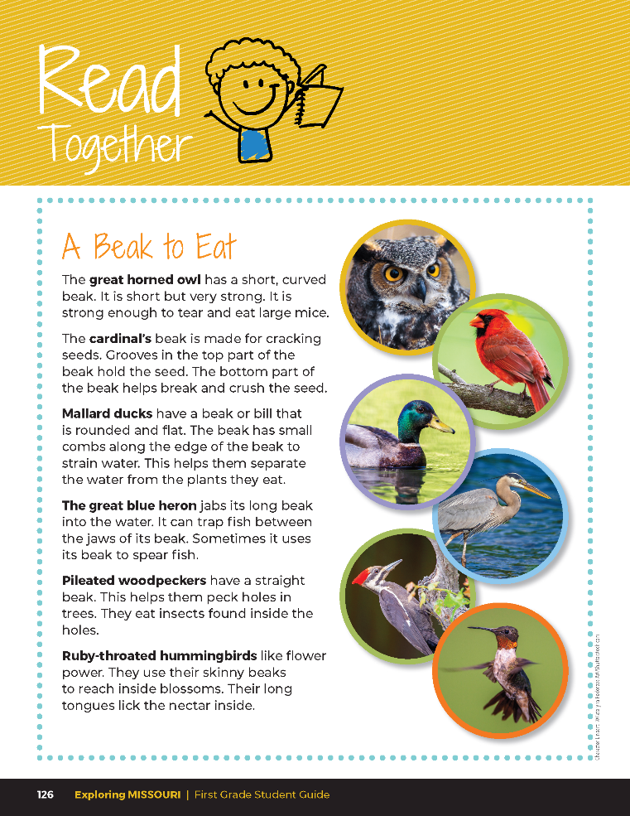

A Beak to Eat
The great horned owl has a short, curved beak. It is short but very strong. It is strong enough to tear and eat large mice.
7A
Exploring Missouri – 7A Best Beaks: Explain
13

Slide 14
A Beak to Eat
The cardinal’s beak is made for cracking seeds. Grooves in the top part of the beak hold the seed. The bottom part of the beak helps break and crush the seed.
7A
Exploring Missouri – 7A Best Beaks: Explain
14

Slide 15
A Beak to Eat
Mallard ducks have a beak or bill that is rounded and flat. The beak has small combs along the edge of the beak to strain water. This helps them separate the water from the plants they eat.
7A
Exploring Missouri – 7A Best Beaks: Explain
15

Slide 16
A Beak to Eat
The great blue heron jabs its long beak into the water. It can trap fish between the jaws of its beak. Sometimes it uses its beak to spear fish.
7A
Exploring Missouri – 7A Best Beaks: Explain
16

Slide 17
A Beak to Eat
Pileated woodpeckers have a straight beak. This helps them peak holes in trees. They eat insects found inside the holes.
7A
Exploring Missouri – 7A Best Beaks: Explain
17

Slide 18
A Beak to Eat
Ruby-throated hummingbirds like flower power. They use their skinny beaks to reach inside blossoms. Their long tongues lick the nectar inside.
7A
Exploring Missouri – 7A Best Beaks: Explain
18

Slide 19
Revisit and make any needed changes.
7A
Exploring Missouri – 7A Best Beaks: Explain
19
Notes:
After reading the Read Together, allow students time to revisit their Science Notebook 7A Best Beaks page again to make any changes.

Slide 20
2
5
3
6
Answers
4
1
6
4
5
2
1
3
7A
Exploring Missouri – 7A Best Beaks: Explain
20
Notes:
Use the 7A Stations Exploration Chart to guide and confirm student answers as they complete the activity.

Slide 21

7A
Exploring Missouri – 7A Best Beaks: Elaborate
21
Notes:
Display the 7A Bird Food Cut-Outs of different kinds of food for each bird species and match the appropriate bird to the appropriate food on the board. Challenge students to figure out which utensil works best for each food by matching the Bird Beak Cut-Out to the Bird Food Cut-Out. Students should explain their reasoning for the match.

Slide 22
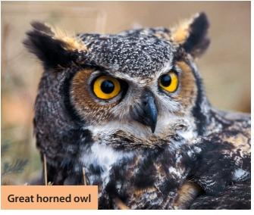
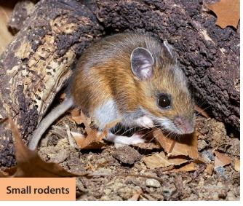
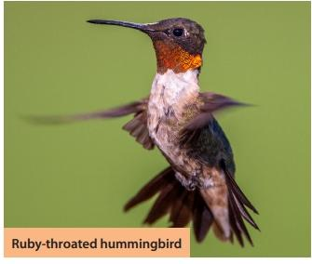
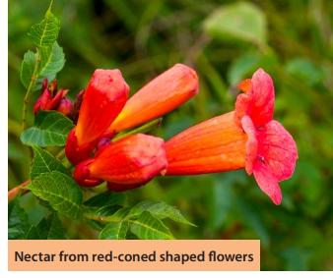
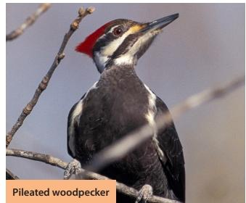
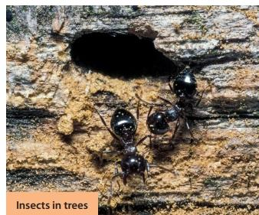
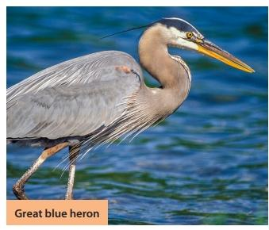
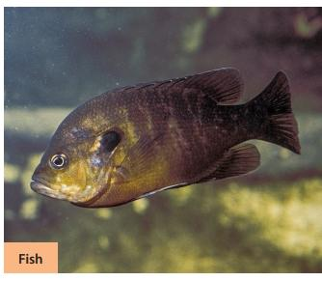
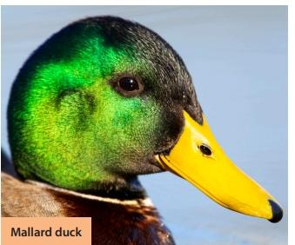
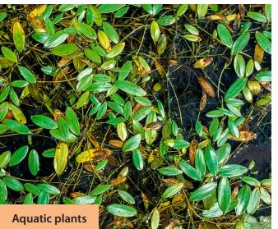
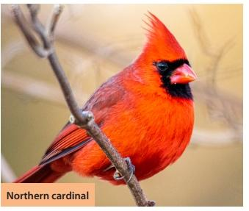
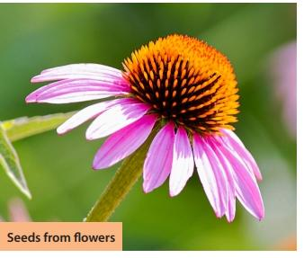
7A
Exploring Missouri – 7A Best Beaks: Elaborate
22
Notes:
Bird matched with it's food.

Slide 23
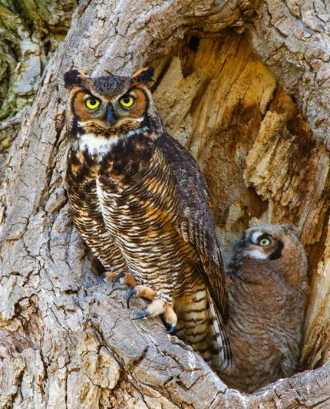
What does a bird use its beak for?
7A
Exploring Missouri – 7A Best Beaks: Elaborate
23
Notes:
Animal in Picture: Great Horned Owl

Slide 24

How is this utensil like a bird beak? Describe the shape of the utensil and how it compares to the birds beak shape.
7A
Exploring Missouri – 7A Best Beaks: Elaborate
24

Slide 25
Which utensil works best for each food? Why?
7A
Exploring Missouri – 7A Best Beaks: Elaborate
25

Slide 26
Which bird has a beak like that?
7A
Exploring Missouri – 7A Best Beaks: Elaborate
26

Slide 27
Where do you think this bird would live with this kind of beak?
7A
Exploring Missouri – 7A Best Beaks: Elaborate
27

Slide 28
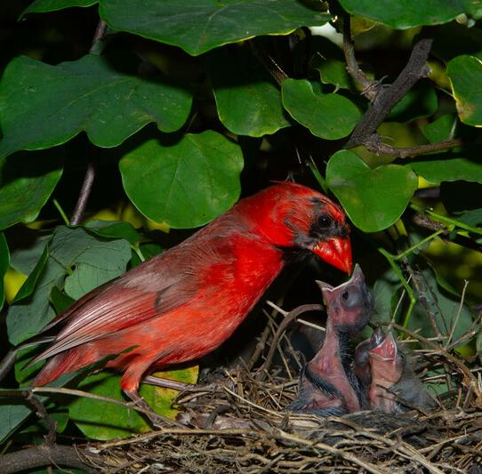
How does the shape of the bird beak help the bird eat to survive?
7A
Exploring Missouri – 7A Best Beaks: Elaborate
28
Notes:
Animal in Picture: Northern Cardinal

Slide 29
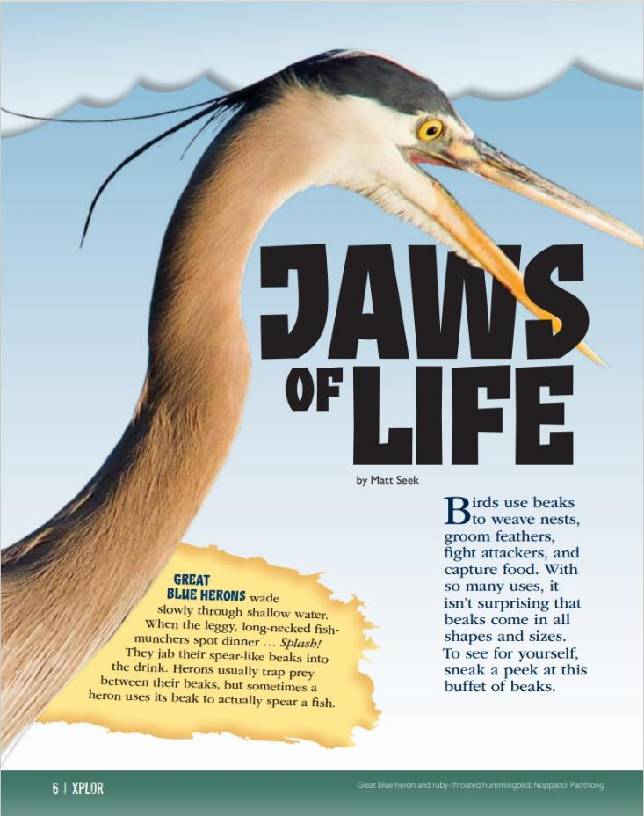
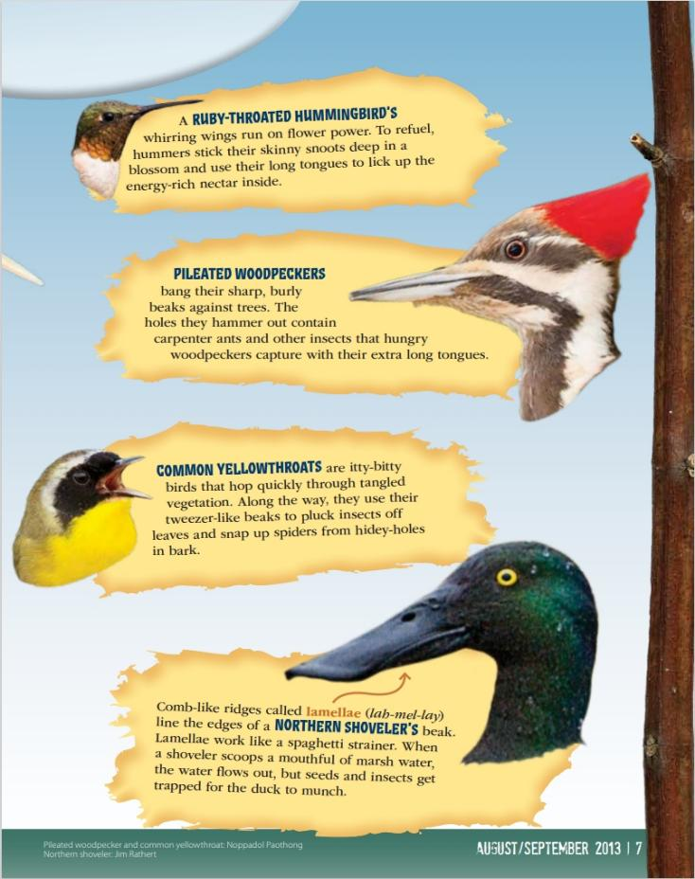
Link to Article:
https://education.mdc.mo.gov/sites/default/files/2023-08/7A%20Jaws%20of%20Life%20Xplor%20Article.pdf
7A
Exploring Missouri – 7A Best Beaks: Elaborate
29
Notes:
From the MDC Teacher Portal, display Jaws of Life section from the Xplor article.

Slide 30
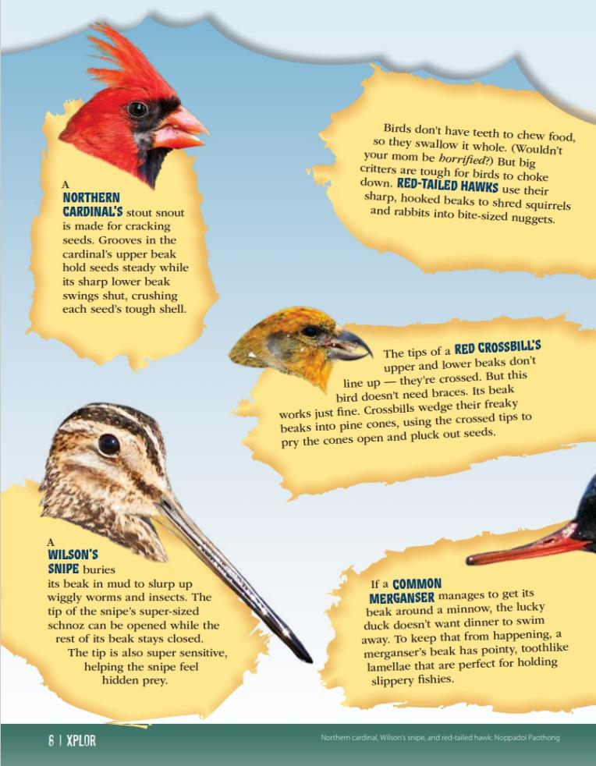
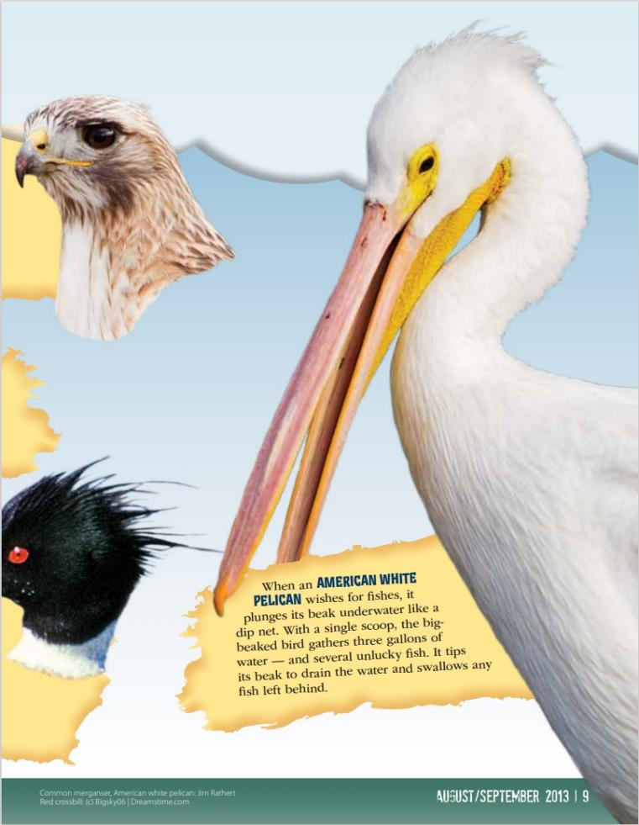
7A
Exploring Missouri – 7A Best Beaks: Elaborate
30

Slide 31
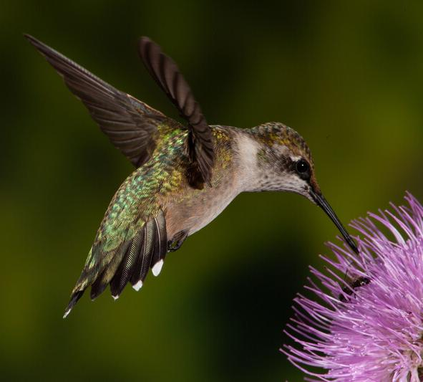
How does this bird use its beak?
7A
Exploring Missouri – 7A Best Beaks: Elaborate
31
Notes:
Animal in Picture: Ruby-throated Hummingbird

Slide 32
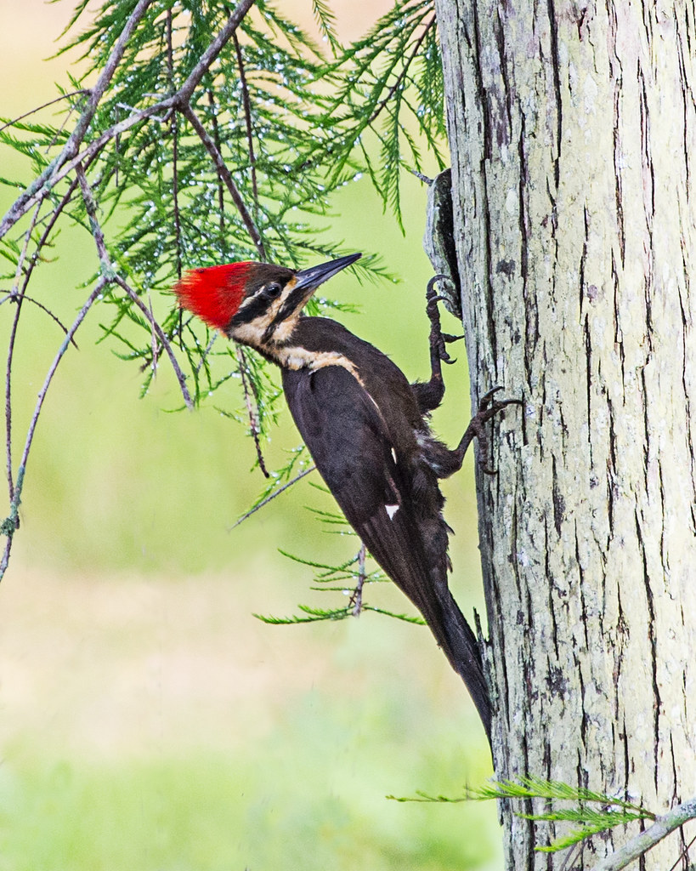
How does this bird use its beak?
7A
Exploring Missouri – 7A Best Beaks: Elaborate
32
Notes:
Animal in Picture: Pleated Woodpecker

Slide 33
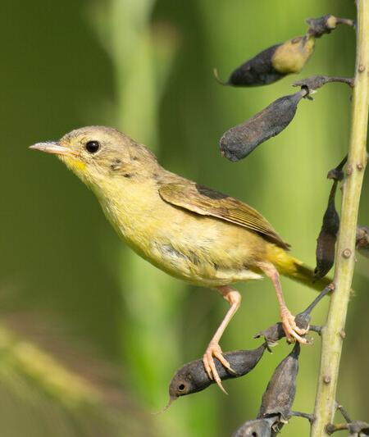
How does this bird use its beak?
7A
Exploring Missouri – 7A Best Beaks: Elaborate
33
Notes:
Animal in Picture: Common Yellowthroat

Slide 34
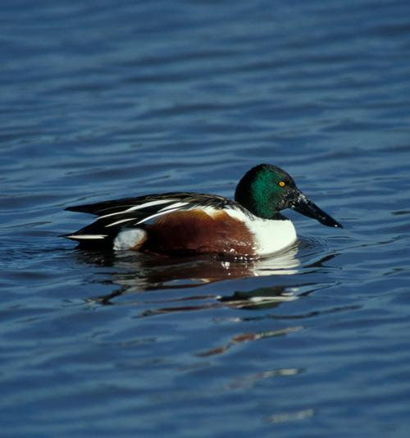
How does this bird use its beak?
7A
Exploring Missouri – 7A Best Beaks: Elaborate
34
Notes:
Animal in Picture: Northern Shoveler

Slide 35
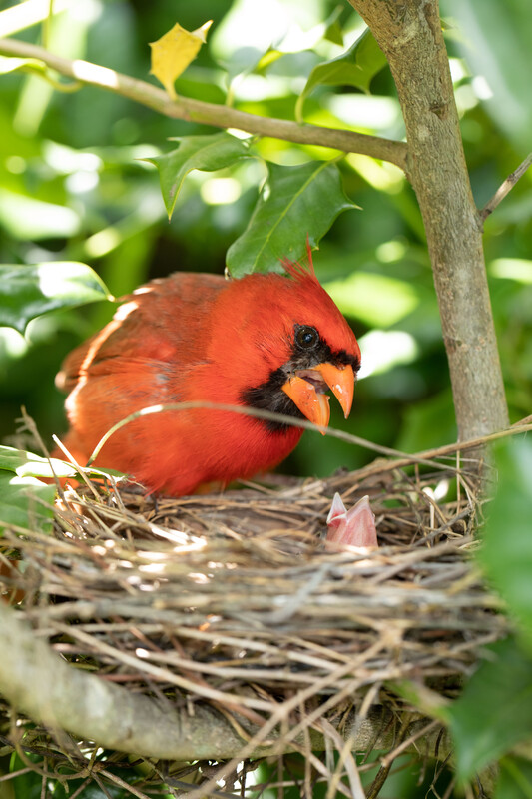
How does this bird use its beak?
7A
Exploring Missouri – 7A Best Beaks: Elaborate
35
Notes:
Animal in Picture: Northern Cardinal

Slide 36
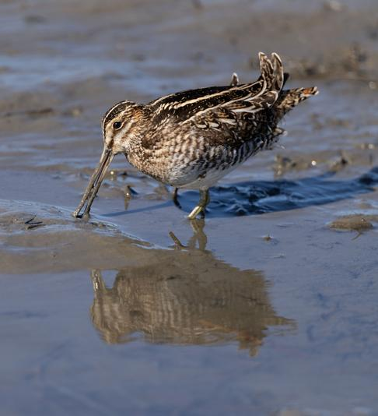
How does this bird use its beak?
7A
Exploring Missouri – 7A Best Beaks: Elaborate
36
Notes:
Animal in Picture: Common Snipe

Slide 37
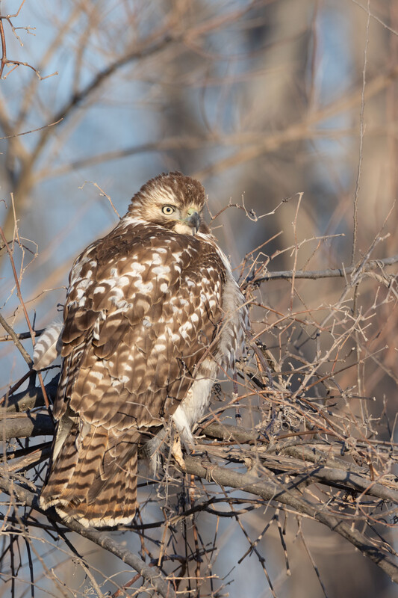
How does this bird use its beak?
7A
Exploring Missouri – 7A Best Beaks: Elaborate
37
Notes:
Animal in Picture: juvenile Red-tailed Hawk

Slide 38
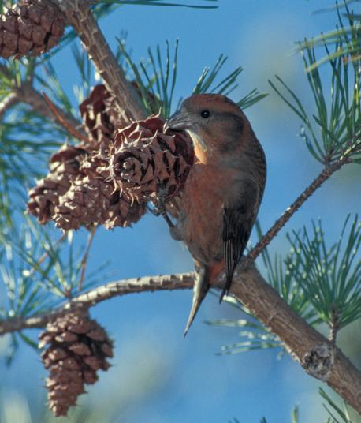
How does this bird use its beak?
7A
Exploring Missouri – 7A Best Beaks: Elaborate
38
Notes:
Animal in Picture: Red Crossbill

Slide 39
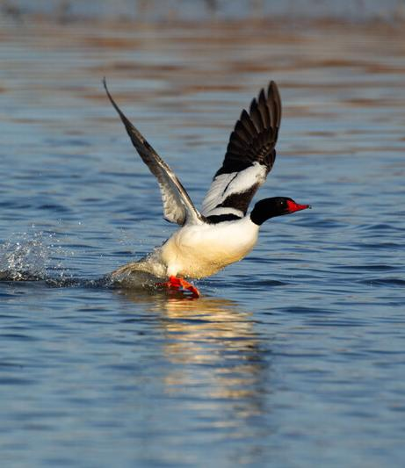
How does this bird use its beak?
7A
Exploring Missouri – 7A Best Beaks: Elaborate
39
Notes:
Animal in Picture: Common Merganser

Slide 40
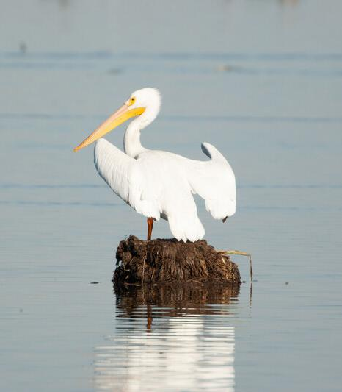
How does this bird use its beak?
7A
Exploring Missouri – 7A Best Beaks: Elaborate
40
Notes:
Animal in Picture: American White Pelican

Slide 41
How does the structure of the beak help it to function, or eat?
7A
Exploring Missouri – 7A Best Beaks: Elaborate
41
Notes:
Choose one beak.

Slide 42
7A
Exploring Missouri – 7A Best Beaks: Evaluate
42
Notes:
Refer to the Lesson 7A Best Beaks introduction page with the pictures of the different Missouri birds.

Slide 43
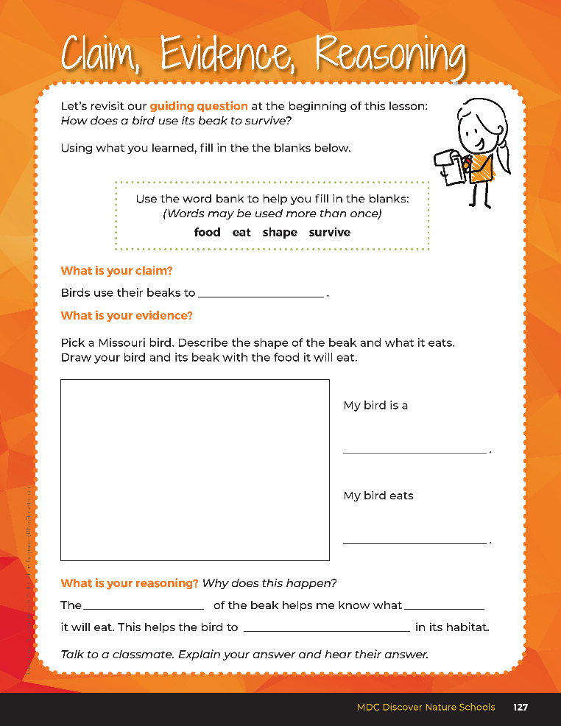
Guiding Question:
How does a bird use its beak to survive?
7A
Exploring Missouri – 7A Best Beaks: Evaluate
43
Notes:
After exploring the structure and function of beak shapes and how this helps birds eat and survive, have students open their student guides to the Claim, Evidence, Reasoning section on Page 127. Discuss the page with the students – read the guiding question and explain what the students need to do to answer the questions (fill in the blanks and make a drawing).

Slide 44
eat
Answers
shape
food
survive
7A
Exploring Missouri – 7A Best Beaks: Evaluate
44
Notes:
Rubric:
4 (Exceeds) – Students write the correct claim and evidence into the blanks and fill in all the blanks with the correct answers for their reasoning.
3 (Meets) – Students write either the correct claim or evidence into the blanks and/or fill in most of the blanks with the correct answers for their reasoning.
2 (Partially Meets) – Students write either the correct claim or evidence into the blanks and fill in some of the blanks with the correct answers for their reasoning.
1 (Doesn’t Meet) – Students do not provide the correct claim or evidence and do not fill in the blanks with the correct answers for their reasoning.

