Slide 1
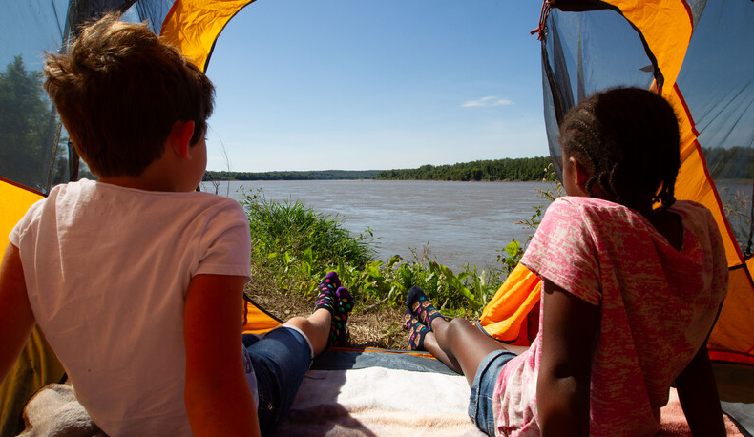

Life and Land in
MISSOURI
Unit 6 Review

Slide 2
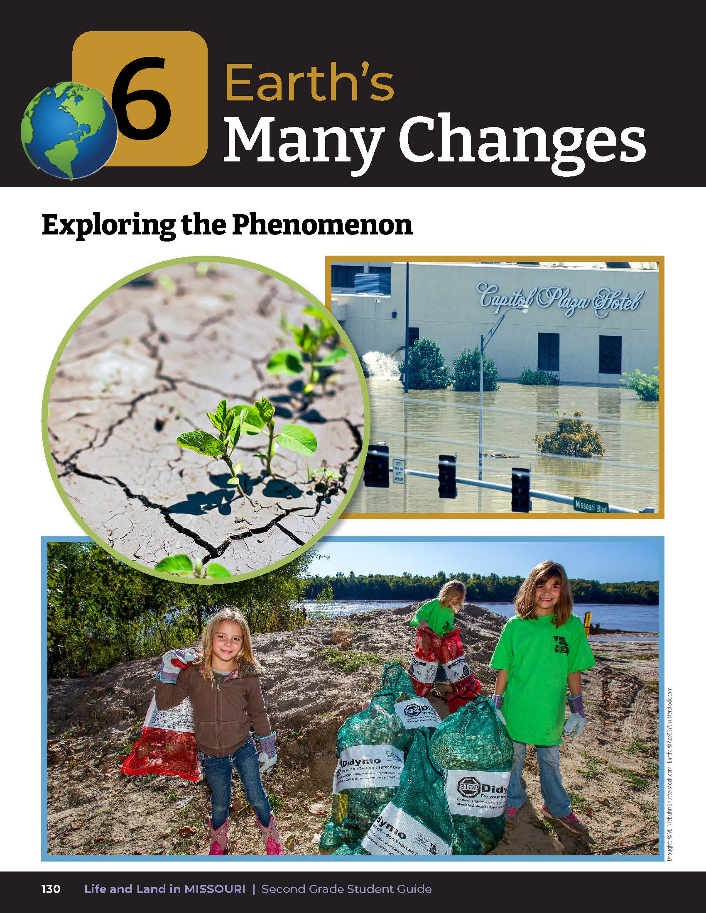
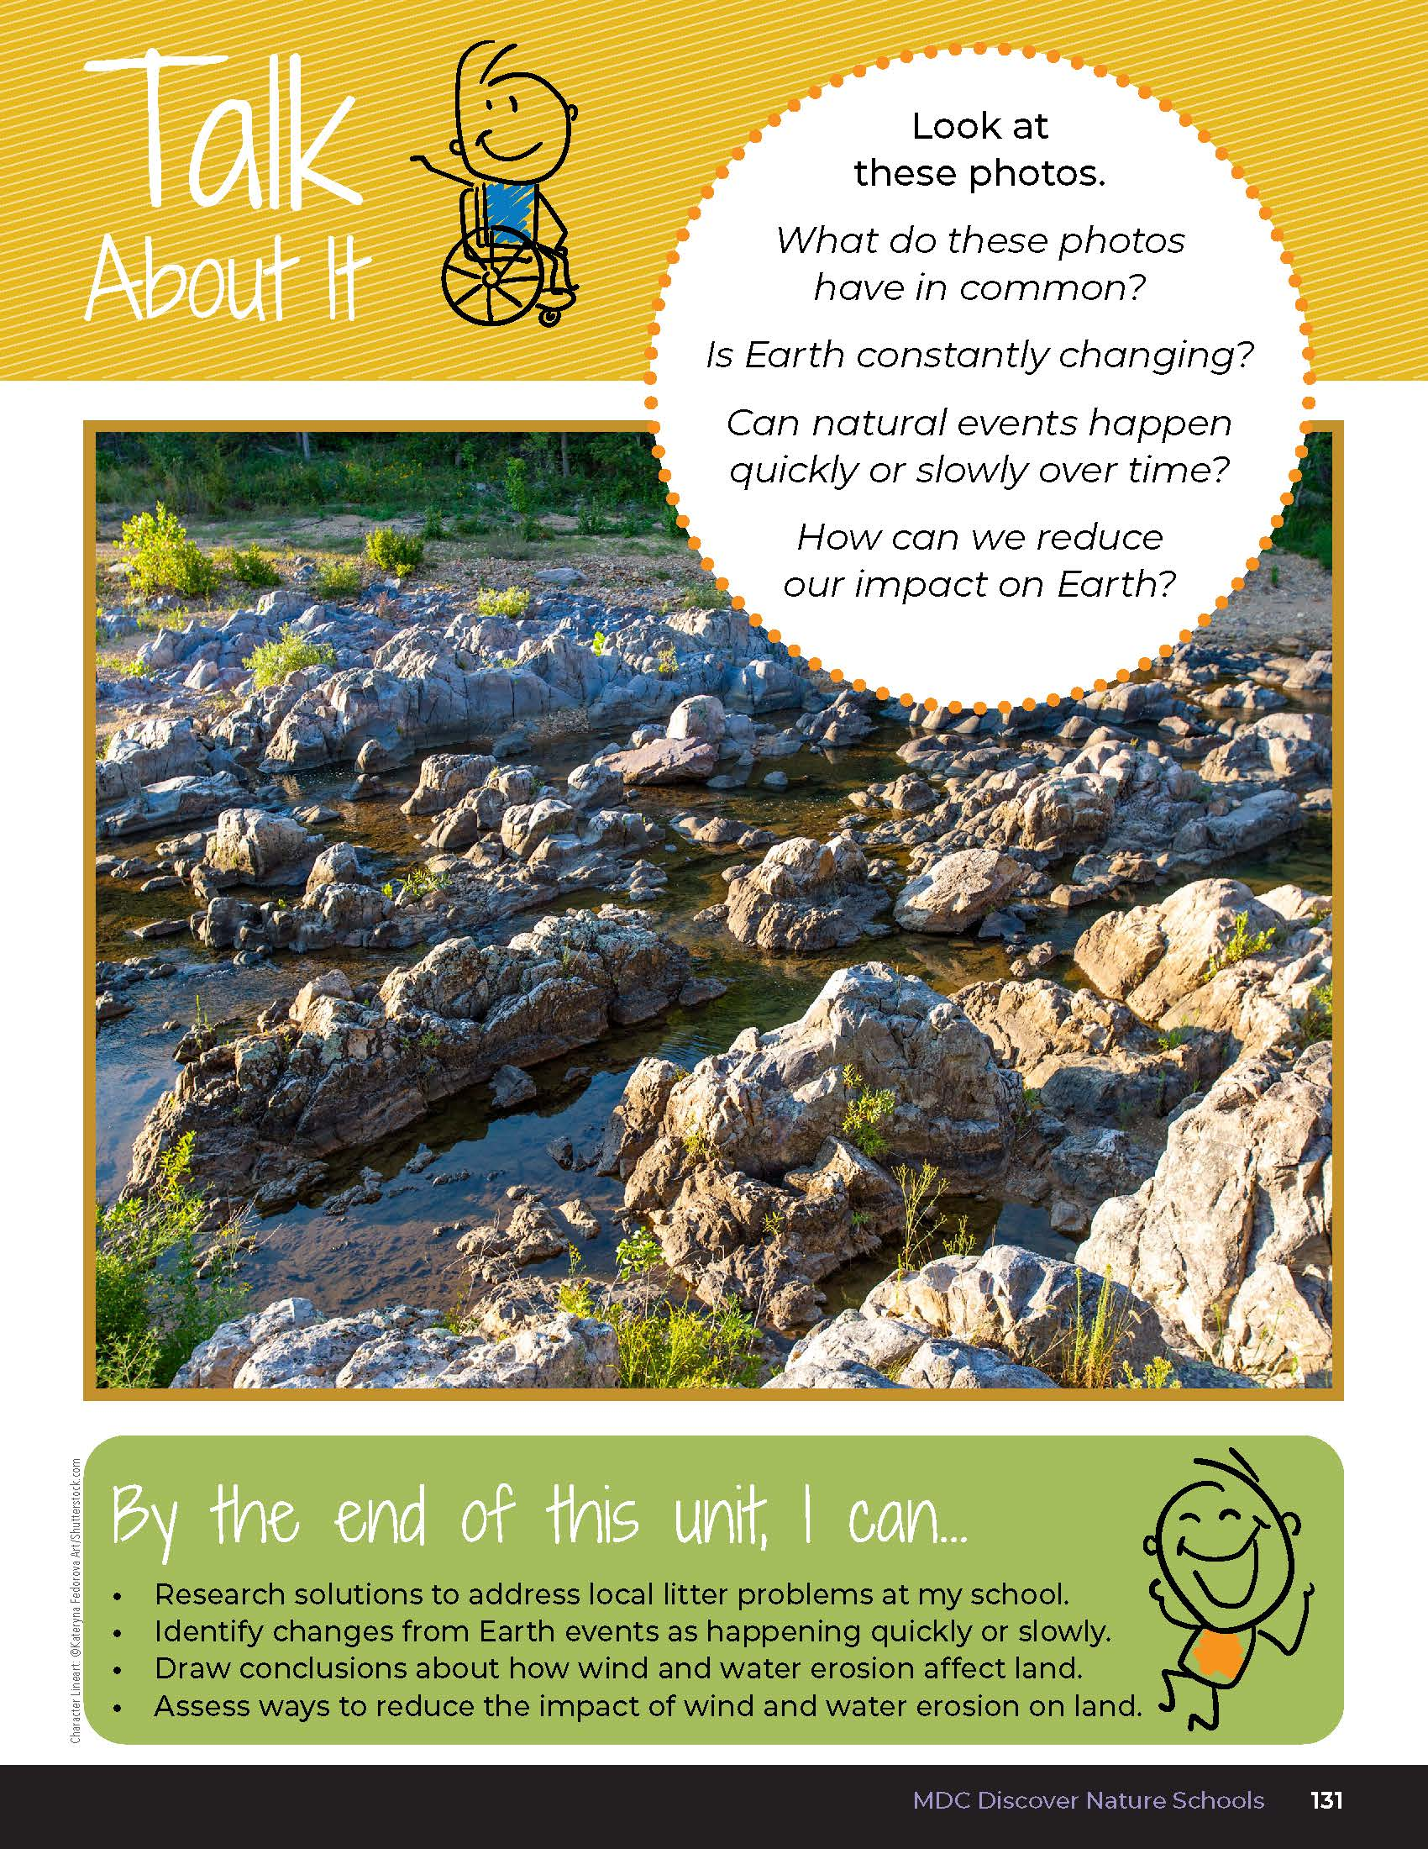
6
Life and Land in Missouri – Unit 6 Review
2
Notes:
Have students turn to the Unit 6 Exploring the Phenomenon and Talk About It on pages 130-131.
What do these photos have in common?

Slide 3
How is Earth constantly changing?
6
Life and Land in Missouri – Unit 6 Review
3

Slide 4
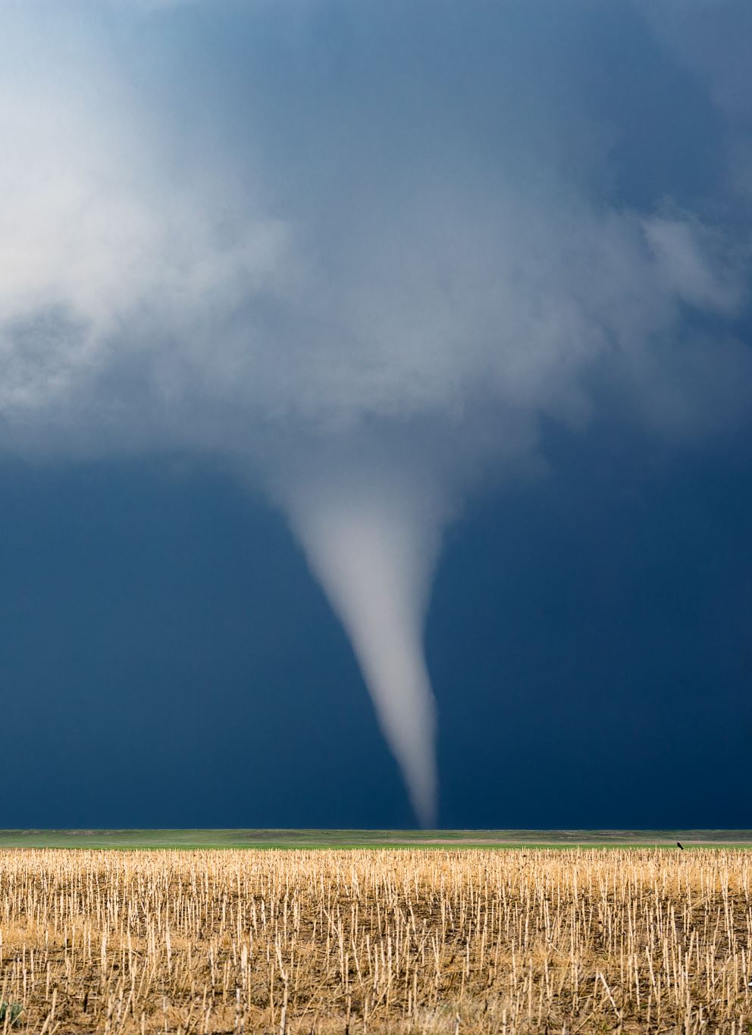
Can natural events happen quickly or slowly over time?
6
Life and Land in Missouri – Unit 6 Review
4

Slide 5
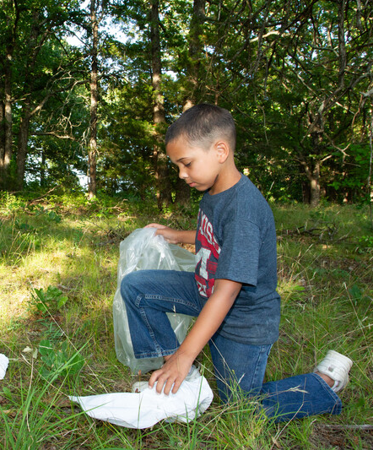
How can we reduce our impact on Earth?
6
Life and Land in Missouri – Unit 6 Review
5
Notes:
Rubric:
3 (Meets) – Student explains the different ways that Earth is changing both slowly and rapidly through natural disasters or erosion. Student offers different ways we can reduce our impact on the Earth.
2 (Partially meets) – Student somewhat explains the different ways that Earth is changing both slowly and rapidly through natural disasters or erosion. Student offers one way we can reduce our impact on Earth.
1 (Doesn’t meet) – Student does not explain a natural disaster or erosion. Student does not offer ideas for how to reduce our impact on the Earth.

Slide 6
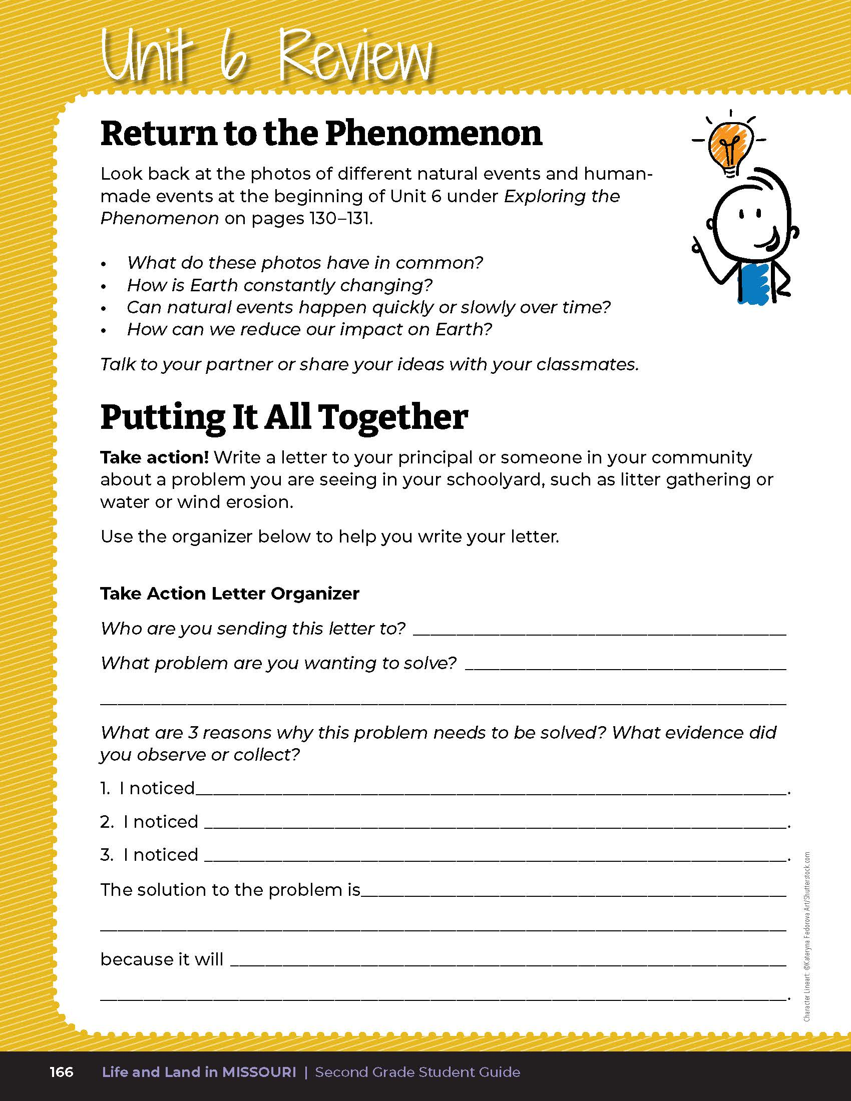
Take action! Write a letter to a leader who can help solve a litter or erosion problem you see.
6
Life and Land in Missouri – Unit 6 Review
6
Notes:
Take action! Students will use the letter organizer in their student guide Putting It All Together section on Page 166 to help them write a letter to a leader who can help solve a litter or erosion problem they see.
Students will define and write 3 reasons with evidence for why it needs to be addressed. Once students have completed the letter organizer in their student guide, distribute the letter template on the next page to them. Students will submit their letters to the person addressed.
Rubric:
3 (Meets) – The student defines the problem, identifies 3 observations they made about the problem, and offers a solution and a reason why their solution will work. Student provides a drawing in their letter.
2 (Partially meets) – The student somewhat defines the problem, identifies 1-2 observations they made about the problem, and offers a solution or a reason why their solution will work. Student provides a drawing in their letter.
1 (Doesn’t meet) – The student does not define the problem, offers a few observations about the problem, and does not provide a solution. The student may or may not provide a drawing in their letter.

Slide 7

Optional: Cross-Curricular Extension
English Language Arts
Read and discuss the storyline of Kate, Who Tamed the Wind. What was the problem and how was it resolved? Have you read other stories where the characters dealt with wind? Write a story about a windy day. Identify the main character, a problem, and the resolution to the problem.
Find an area in your community that has wither wind or water erosion issues. Write a persuasive letter to the mayor or property owner explaining the benefits of planting windbreaks and growing plants to keep soil in place.
Write a fictional account of life along the Mississippi/Missouri River during both a flood event and a drought event.
6
Life and Land in Missouri – Unit 6 Review
7

Slide 8
Optional: Cross-Curricular Extension
Social Studies
To get your students involved in the Trash Can Contest, visit the MDC Teacher Portal for more information. The contest takes place in the month of April. Have students make an impact in their community while learning the real-world lesson of problems and solutions.
What are the physical characteristics of your region in Missouri? Trees/Forest, Grass/Prairies, or something else? How do the plants you see protect the soil from wind and water?
6
Life and Land in Missouri – Unit 6 Review
8

Slide 9
Optional: Cross-Curricular Extension
Art
Plant students around a gym or large area outdoor area. Explain to the students they will pretend to be trees or prairie plants. Teacher will move around the sideline pointing the direction of the wind and students will pretend to blow in the breeze.
Discuss that many artists recycle objects they find by using them in their art. Numerous online searches can yield colorful examples of art created from refuse or litter.
Dance like the wind. Create ribbon streamers and have students “become the wind,” mimicking the movements of wind patterns.
6
Life and Land in Missouri – Unit 6 Review
9

