Slide 1
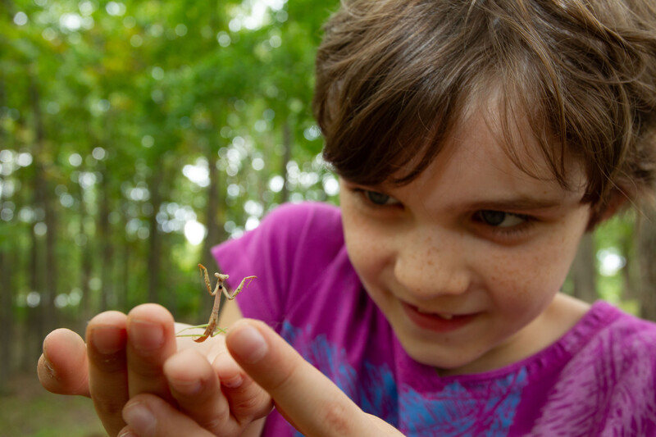

Exploring
MISSOURI
Unit 6 Review

Slide 2
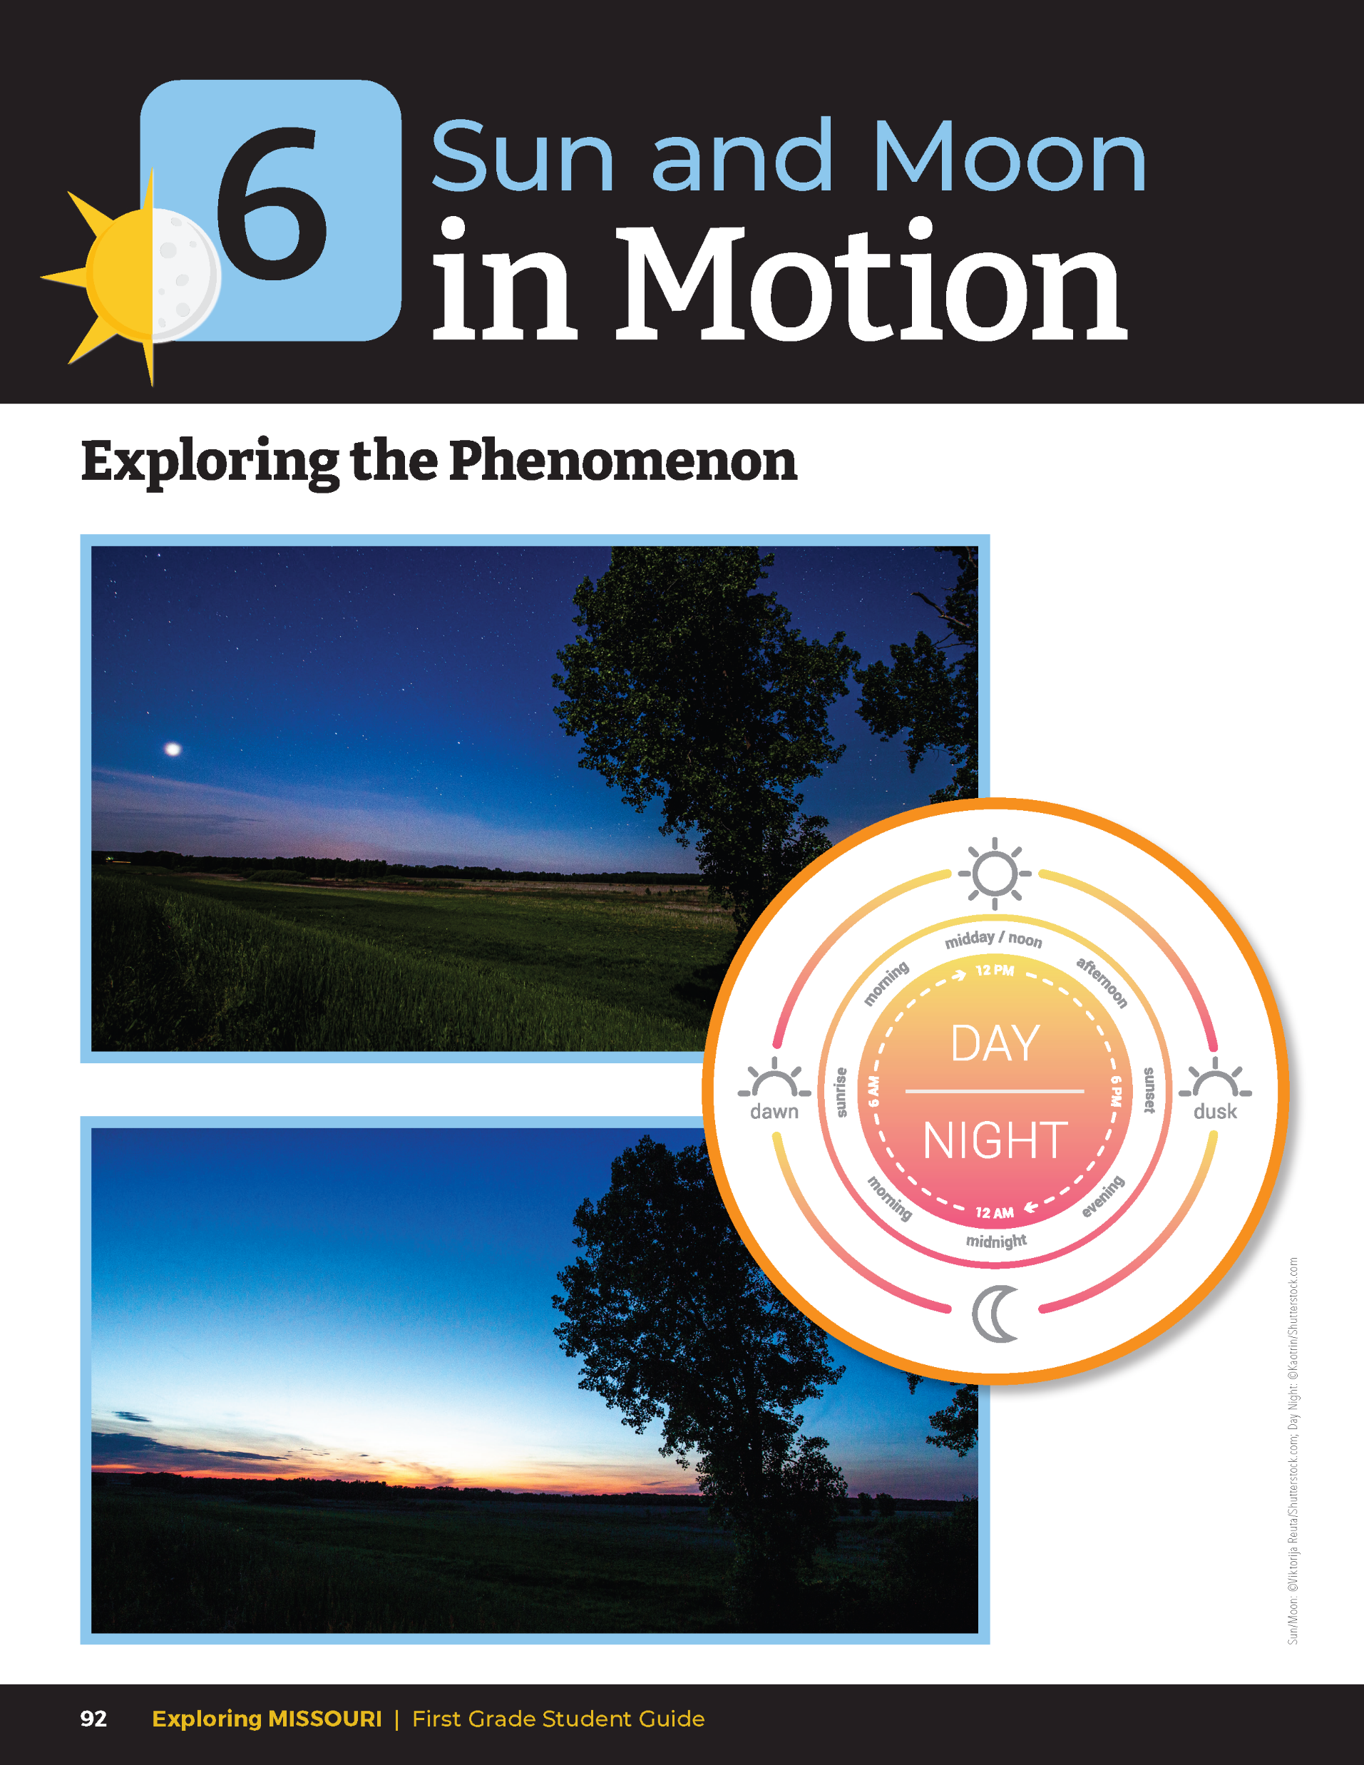
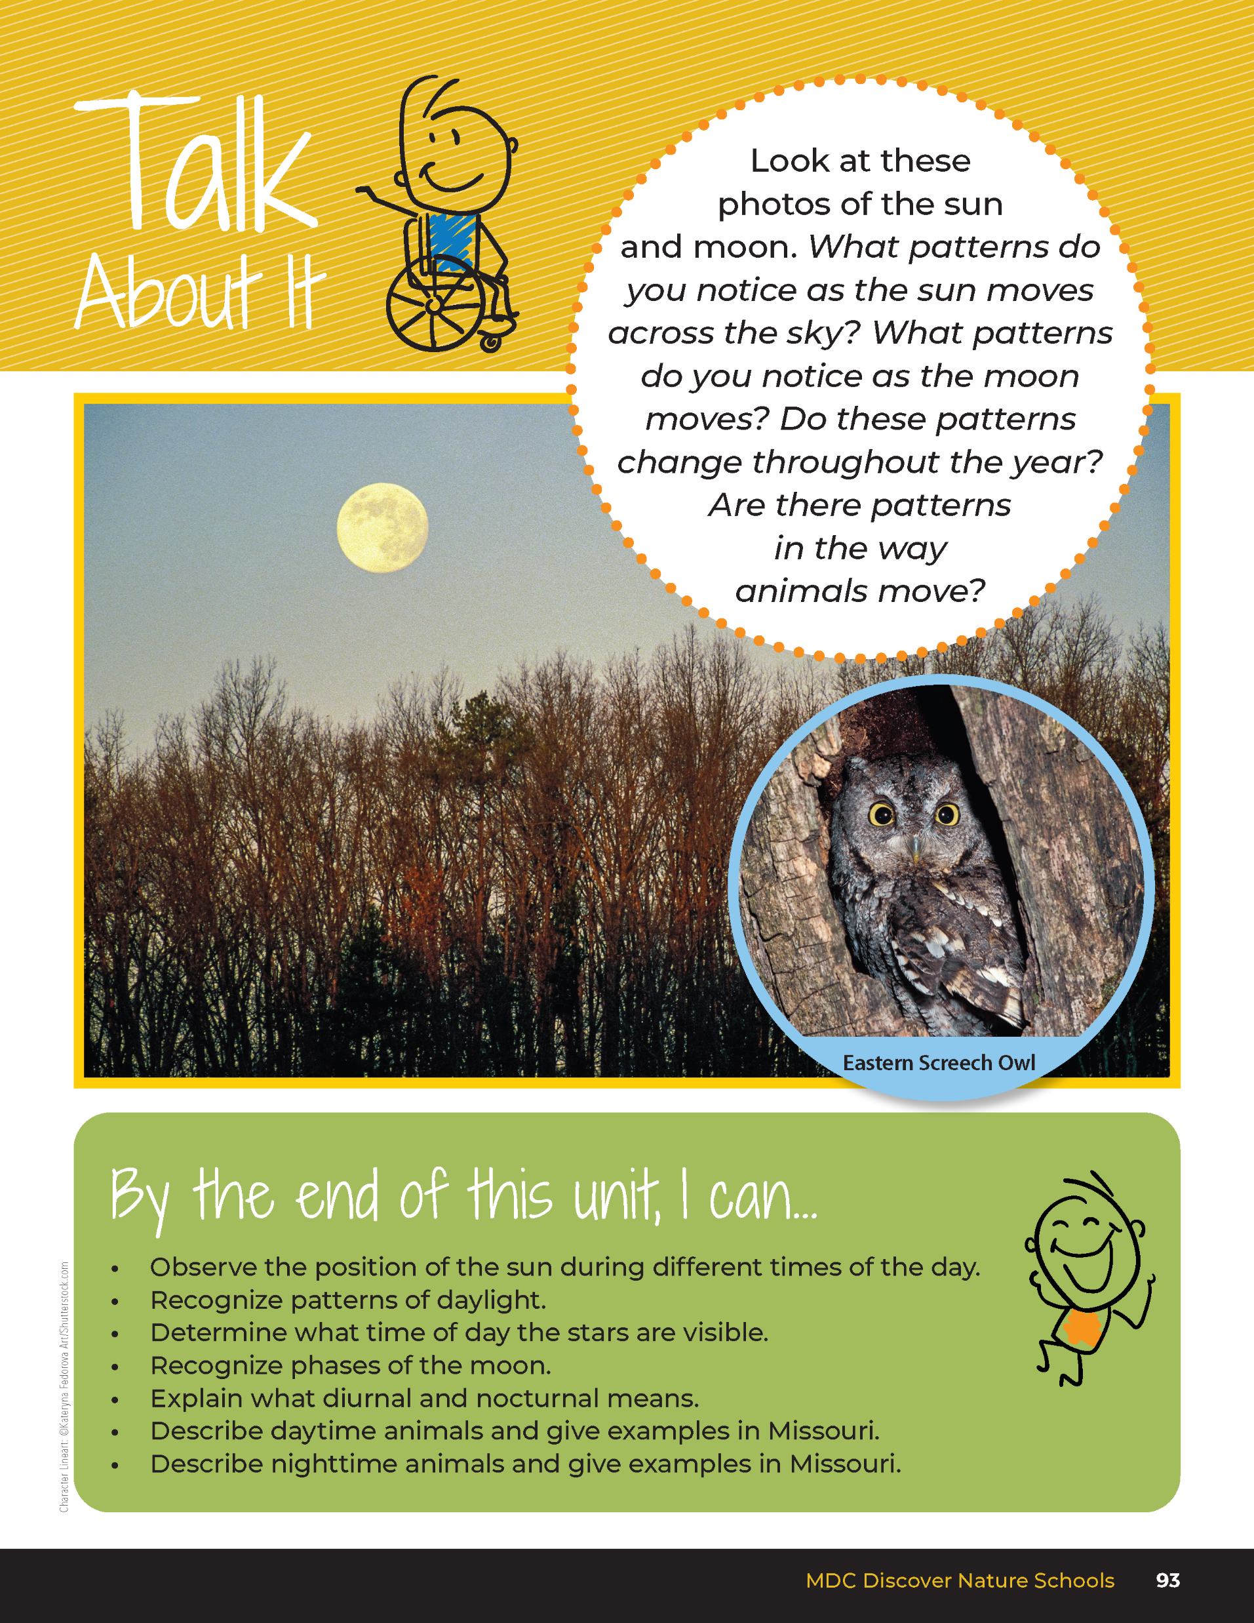
6
Exploring Missouri – Unit 6 Review
2
Notes:
Have students turn to the Unit 6 Exploring the Phenomenon Talk About It section on Page 92-93.

Slide 3
Turn and talk to a classmate and discuss the different patterns we can see in the day and the patterns at night.
6
Exploring Missouri – Unit 6 Review
3
Notes:
Using the pictures at the beginning on the lesson, have students turn and talk to a classmate and discuss the different patterns we can see in the day and the patterns at night.

Slide 4
How do patterns change through the year?
Do animals move around based on these patterns?
6
Exploring Missouri – Unit 6 Review
4
Notes:
Rubric:
3 (Meets) – Student explains patterns in how the sun moves across the sky as does the moon at night and the stars come out. Student explains the amount of daylight changes through the year and how the moon changes shape. Student explains how this affects animals in how they move to survive.
2 (Partially meets) – Student explains some patterns in how the sun moves across the sky as does the moon at night and the stars come out. Student may or may not explain the amount of daylight changes through the year and how the moon changes shape. Student may or may not explain how this affects animals in how they move to survive.
1 (Doesn’t meet) – Student does not explain any patterns or how this affects animal movement.

Slide 5
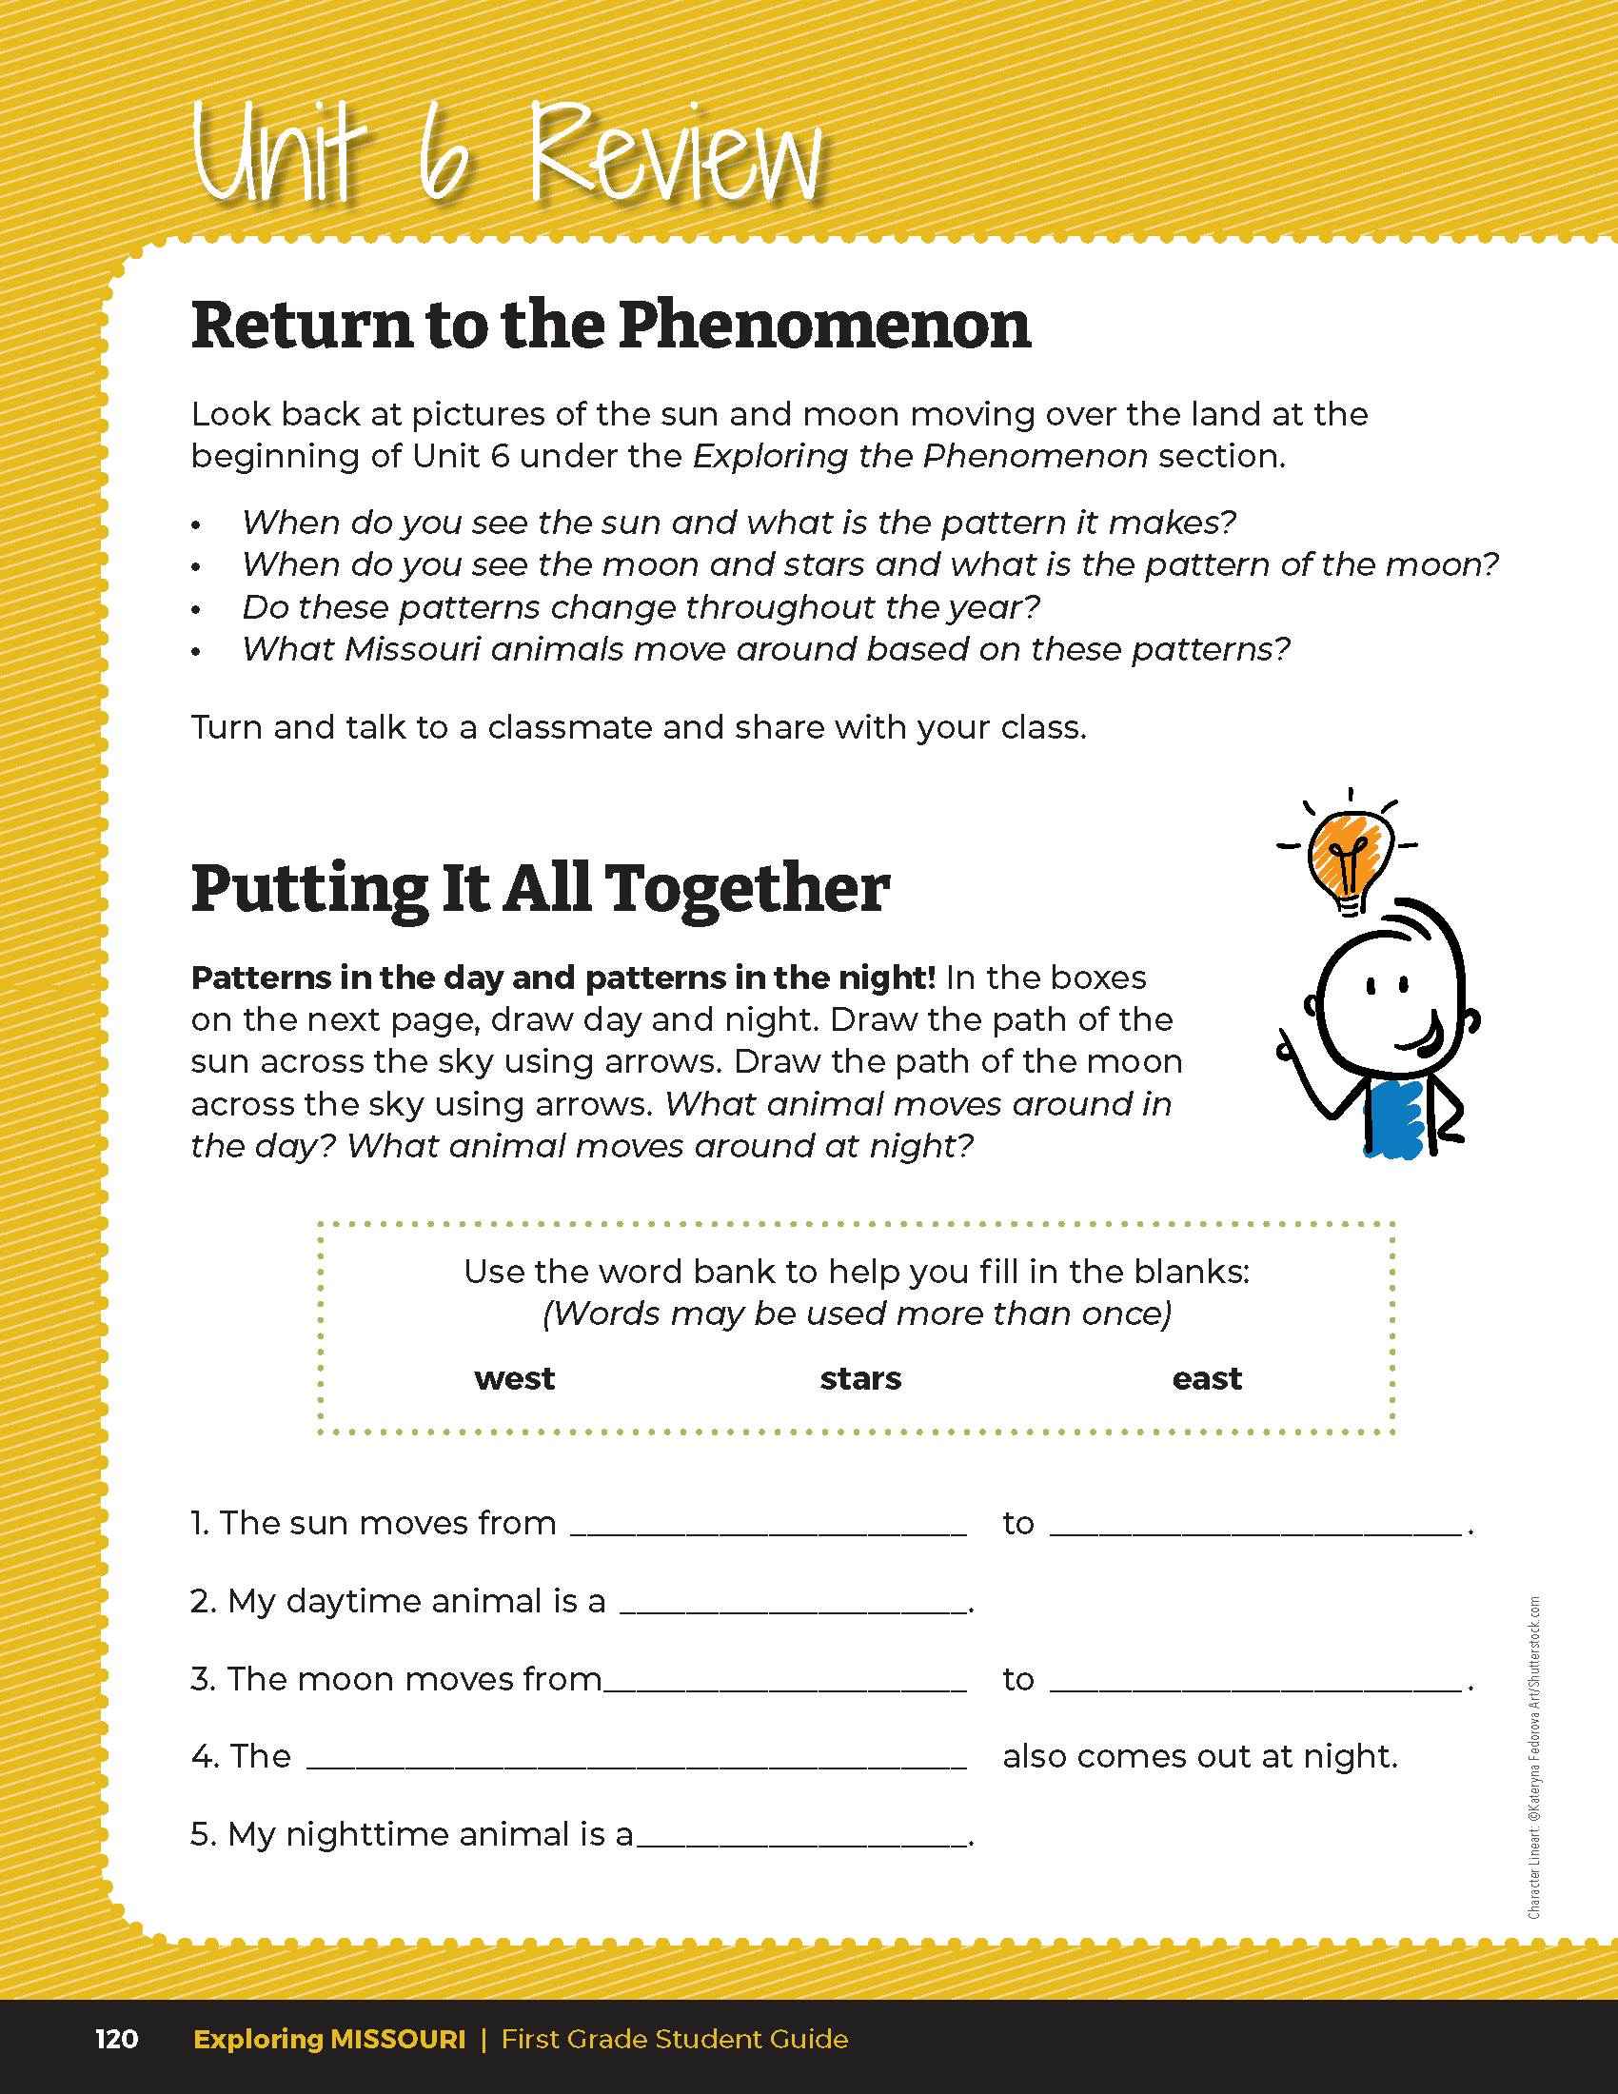

What moves around in the day?
What moves around at night?
6
Exploring Missouri – Unit 6 Review
5
Notes:
Students will make two drawings with one showing the day and one showing night. Draw the path of the moon across the sky using arrows.
Rubric:
3 (Meets) – Student drawing shows each of the components: day (sun with arrow moving from left to right or east to west, and the correct daytime animal) and night (stars and moon with arrow moving from left to right or east to west). All blanks are filled in.
2 (Partially meets) – Student drawing shows some of the components: day (sun with arrow moving from left to right or east to west, and the correct daytime animals) and night (stars and moon with arrow moving from left to right or east to west). Some blanks are filled in.
1 (Doesn’t meet) – Student drawing shows very few of the components: day (sun with arrow moving left to right or east to west, and the correct daytime animal) and night (stars and moon with arrow moving from left to right or east to west). Little to no blanks are filled in.

