Slide 1
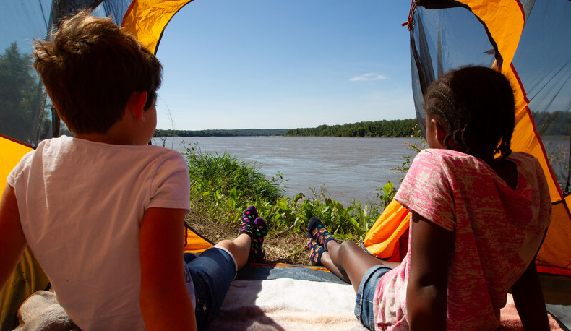

Life and Land in
MISSOURI
6E: Testing Wind’s Movement

Slide 2
What else besides water can cause the soil to erode or be moved?
6E
Life and Land in Missouri – 6E Testing Wind’s Movement: Engage
2
Notes:
Have students think back to how water changed the land in the previous lesson.

Slide 3
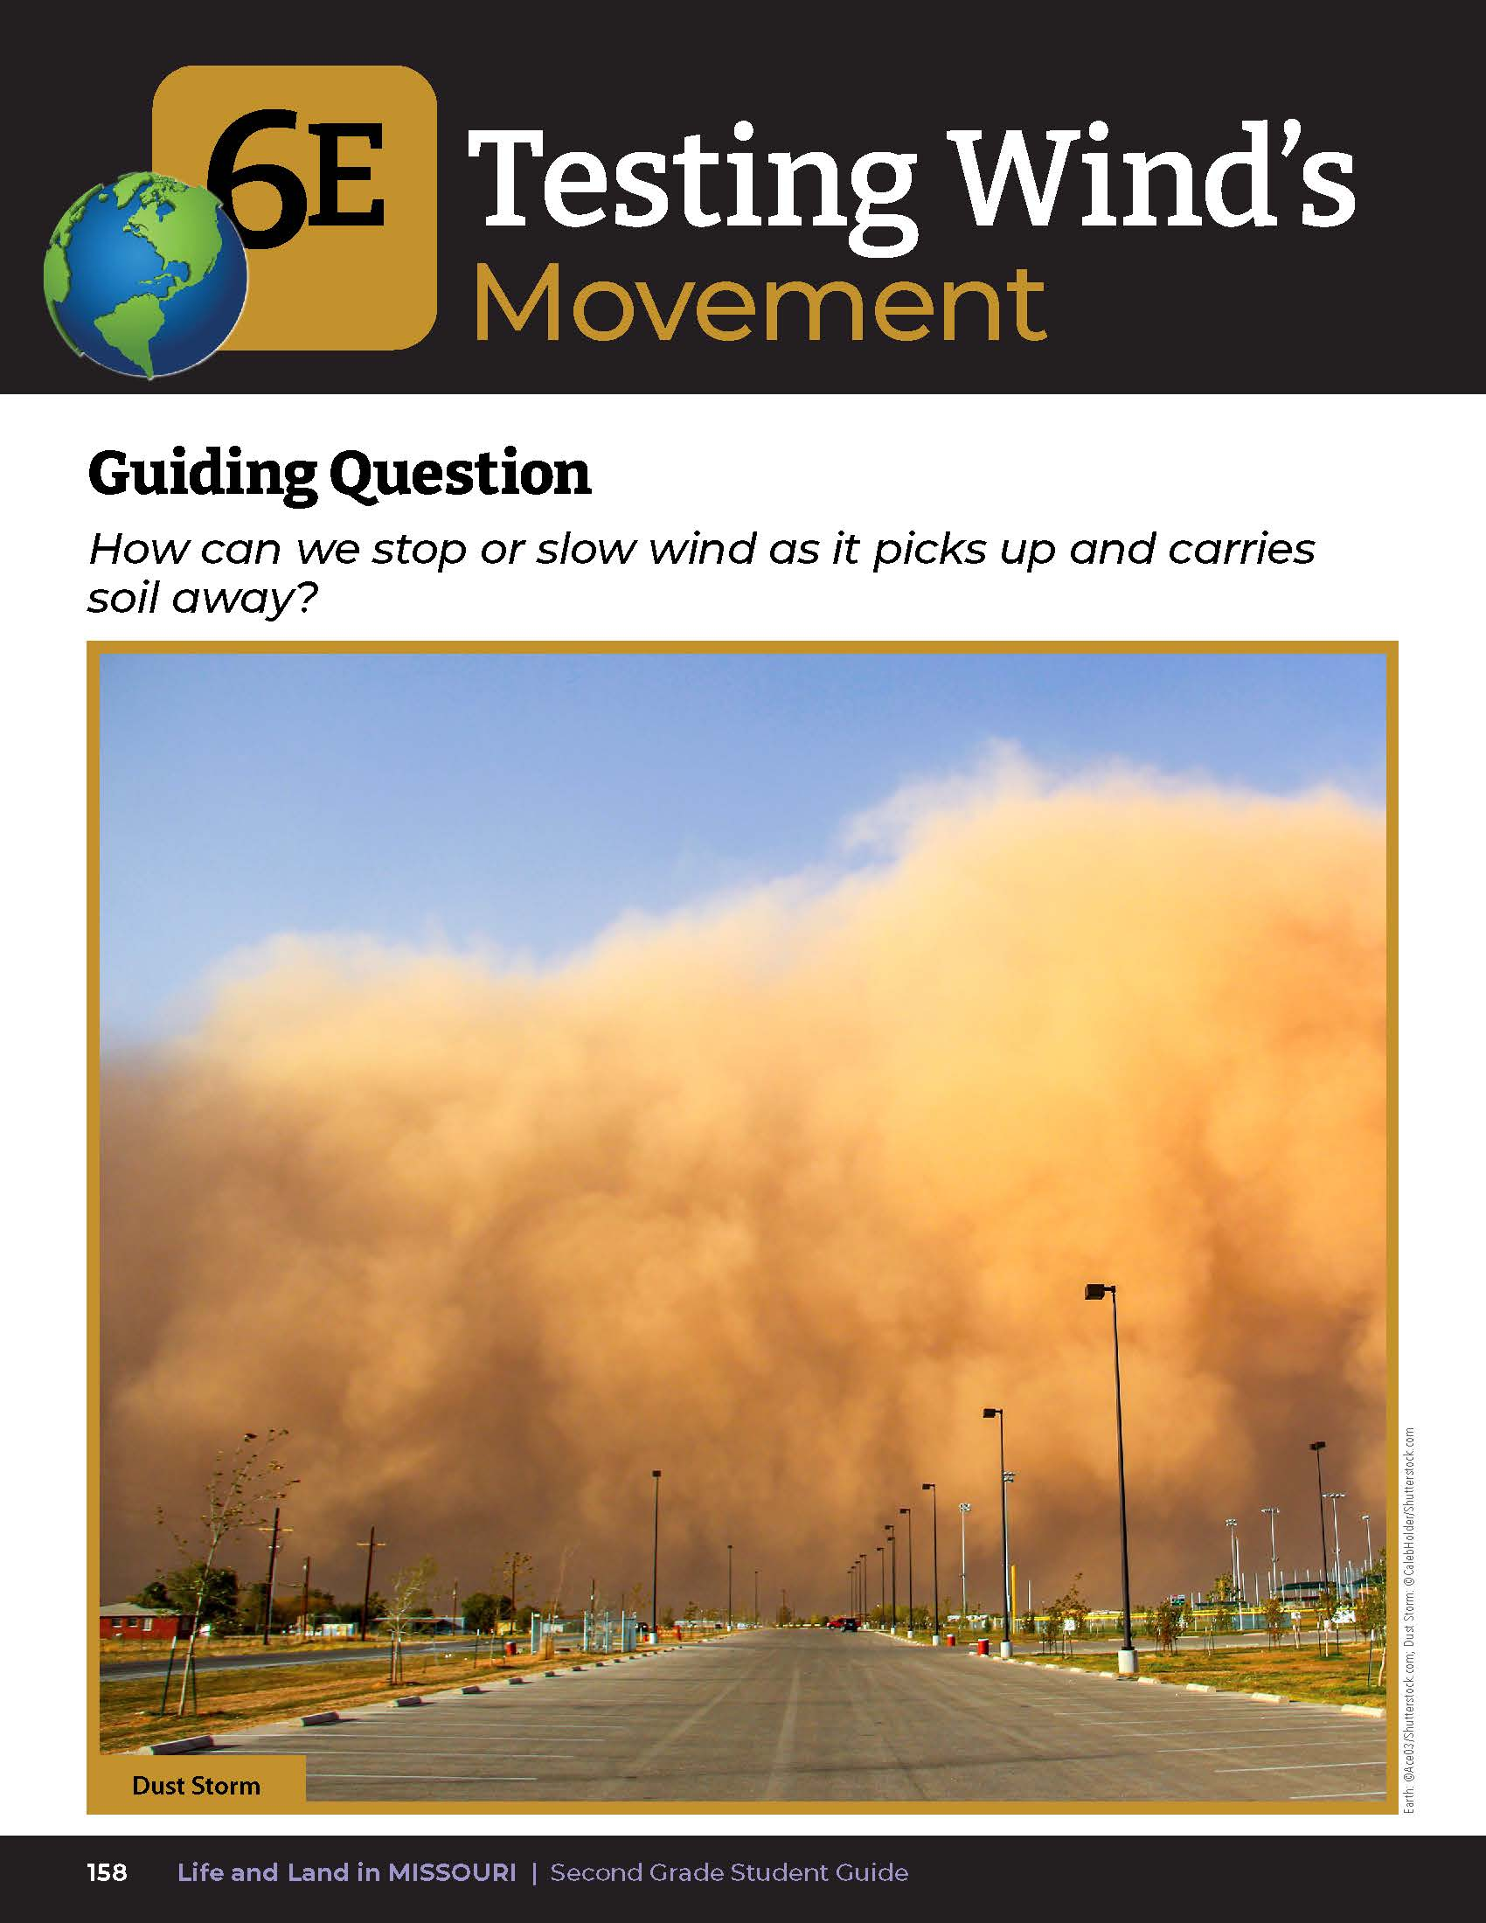

6E
Life and Land in Missouri – 6E Testing Wind’s Movement: Engage
3
Notes:
Have students read from student guide Lesson 6E Testing Wind’s Movement introduction on pages 158-159. Read the guiding question together.
Guiding Question: How can we stop or slow wind as it picks up and carries soil away?

Slide 4
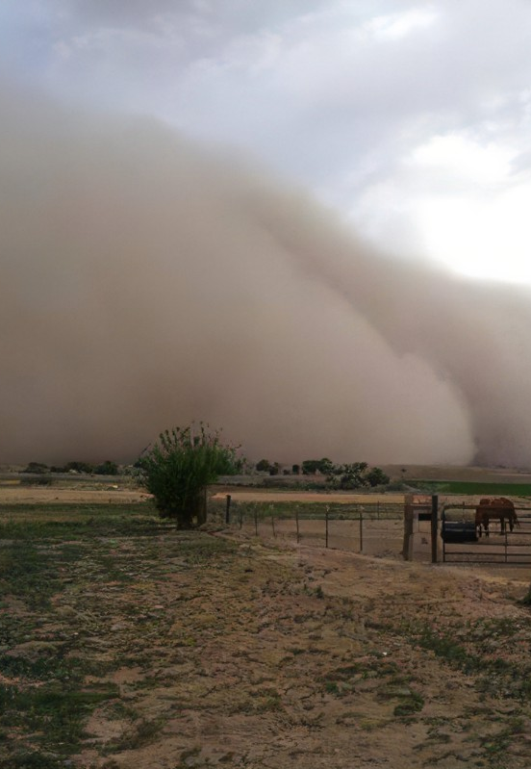
What problems does erosion create?
What helps to solve some of those issues?
6E
Life and Land in Missouri – 6E Testing Wind’s Movement: Engage
4
Notes:
Discuss the Talk About It and photos from both pages. Record ideas on the board.

Slide 5
What do you see covering the soil in the photos?
How does not having anything on the soil of different types of things covering the soil help with this issue?
6E
Life and Land in Missouri – 6E Testing Wind’s Movement: Engage
5
Notes:
Guide students to the idea of testing different types of soil coverage such as bare soil, soil with rocks, and soil with plants. Today and the next week, we are going to become engineers and explore ideas to solve these issues of erosion that is caused by wind.

Slide 6
Guiding Question:
How can we stop or slow wind as it picks up and carries soil away?
To start solving the problem we need to perform a few tests to compare the best results. Let’s explore the idea of what happens if we have nothing on top of the soil, to rocks on the soil, or plants growing from the soil.
6E
Life and Land in Missouri – 6E Testing Wind’s Movement: Explore
5
Notes:
Revisit the guiding question or the problem to solve.

Slide 7
Build a hill of soil at the end of each soil tray.
1st Tray – See how bare soil is affected by wind
2nd Tray – Cover the hill with rocks
3rd Tray – Cover the hill with straw or grass
6E
Life and Land in Missouri – 6E Testing Wind’s Movement: Explore
7
Notes:
For the class activity, put equal amounts of soil into your 3 demonstration trays. Have students build a hill of soil at the end of each soil tray. In the first tray, students will see how bare soil is affected by wind (symbolizes hill with bare soil). In the second tray, cover the hill with rocks (symbolizes hill of soil and rocks). In the third tray, cover the hill with straw or grass (symbolizes hill with grass or plants).
Teacher Note: You may consider teaching this activity outside instead of inside the classroom. To show how roots help keep soil in place, instead of straw and grass, you can grow plants in the third tray. If you plant seeds, you will need to plant several weeks before you teach the lesson – this tray of plants could be kept and reused year after year.

Slide 8
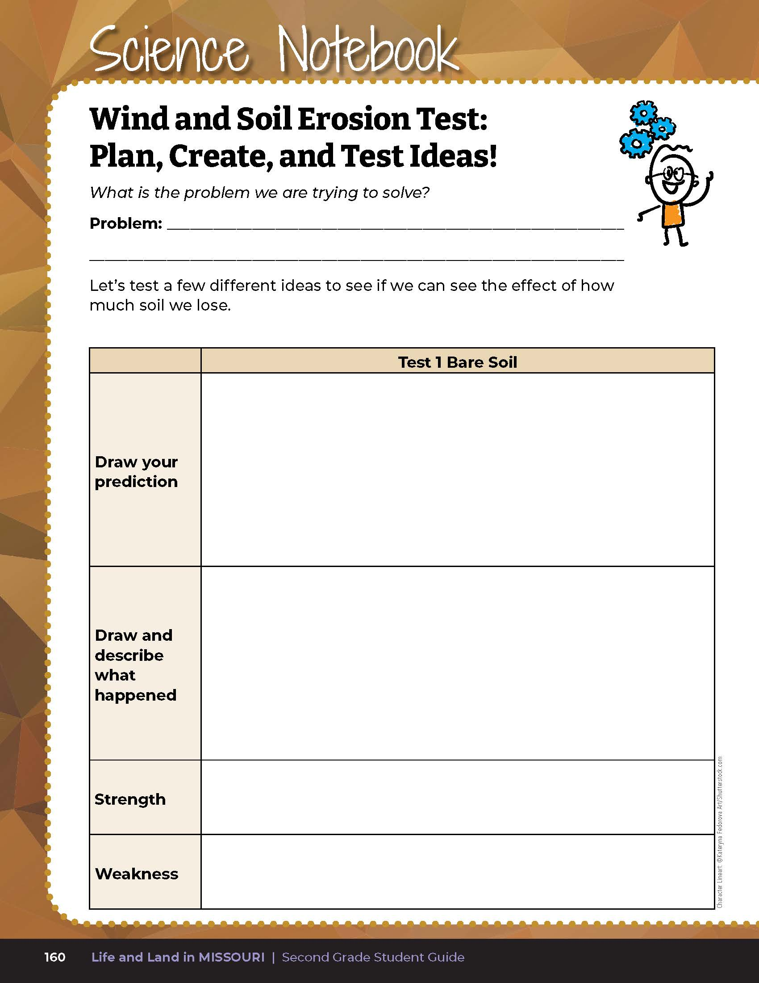

Draw your prediction of what you think will happen when wind blows over the soil.
6E
Life and Land in Missouri – 6E Testing Wind’s Movement: Explore
8
Notes:
Wind and Soil Erosion Demonstration:
Start with the tray of soil only. Prop the tray on an angle using books or other materials. Check that the angles are the same for each tray.
Have students draw their prediction of what they think will happen when wind blows over the soil. Drawing space is provided in their student guide on Science Notebook 6E Wind and Soil Erosion Test: Plan, Create, and Test Ideas! On Page 160 in the first box under Test 1 Bare Soil.
Teacher Note: The teacher may instruct students to measure and record the height of the hill before and after wind is introduced to compare just how much soil was eroded.

Slide 9
Draw a second picture – the “after” picture of how the wind changed the soil.
6E
Life and Land in Missouri – 6E Testing Wind’s Movement: Explore
9
Notes:
3. To create wind, use a small fan or hair dryer set to no-heat. Discuss with your students the methods on how to make the wind the same for each tray. Discuss how far away students should be from the tray when air is blown and how long the air should blow. Write directions on the board.
4. Have the students blow air over the hill. Have students watch closely how the wind affects their soil.
5. Have students draw a second picture – the “after” picture of how the wind changed the soil. Have students write sentence(s) to describe what happened, include at least one strength and one weakness and how the model could be improved to solve the problem.

Slide 10
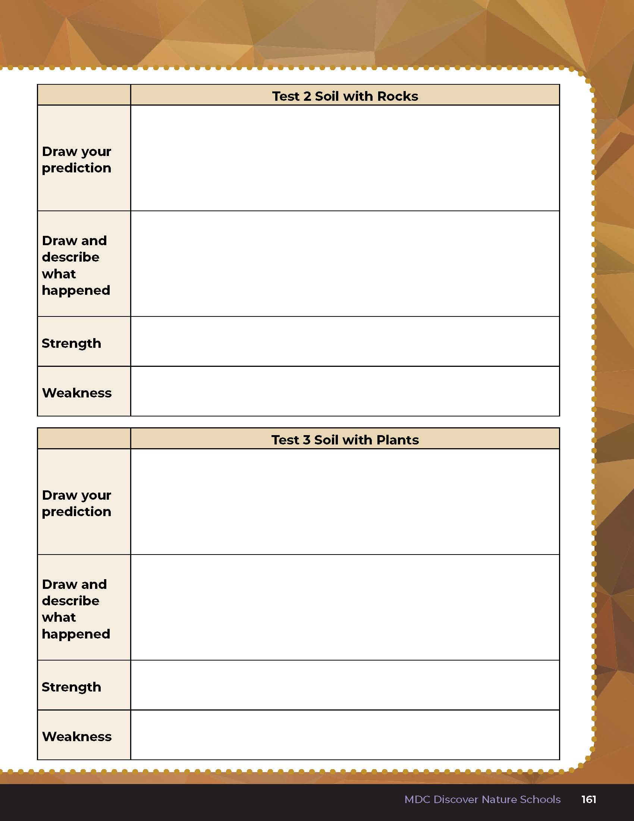
Complete the charts.
6E
Life and Land in Missouri – 6E Testing Wind’s Movement: Explore
10
Notes:
6. Repeat steps 1-5 with both the soil covered by rocks and then the soil covered in straw and/or grass clippings, or seedlings. Have students complete the chart on Science Notebook 6E Wind and Soil Erosion Test: Plan, Create, and Test Ideas! Page 161.

Slide 11
Let’s discuss how the soil was affected in each tray!
Soil only?
Soil covered by rock?
Soil covered by plant materials?
6E
Life and Land in Missouri – 6E Testing Wind’s Movement: Explore
10

Slide 12
How did wind change the shape of the soil?
Was it the same change as for the water test we conducted?
6E
Life and Land in Missouri – 6E Testing Wind’s Movement: Explore
12

Slide 13
Can these changes happen quickly or slowly? How?
6E
Life and Land in Missouri – 6E Testing Wind’s Movement: Explore
13

Slide 14
What was the same in all 3 trials?
What was different?
6E
Life and Land in Missouri – 6E Testing Wind’s Movement: Explore
14

Slide 15
Which trial kept the most soil in place? Why is that?
6E
Life and Land in Missouri – 6E Testing Wind’s Movement: Explore
15

Slide 16
When looking at the 3 trays, which tray of soil was most like pavement?
6E
Life and Land in Missouri – 6E Testing Wind’s Movement: Explain
15

Slide 17

Do sidewalks or pavement reduce soil erosion when it is windy?
Why or why not?
6E
Life and Land in Missouri – 6E Testing Wind’s Movement: Explain
15

Slide 18
Where is the soil? How would wind affect the soil where these trees are growing? How do the trees help with wind erosion?
6E
18
Life and Land in Missouri – 6E Testing Wind’s Movement: Engage
Notes:
Have students look at the photos again from the Lesson 6E introduction on pages 158-159. Discuss these questions:
Where is the soil?
How would wind affect the soil where these trees are growing?
How do the trees help with wind erosion?

Slide 19
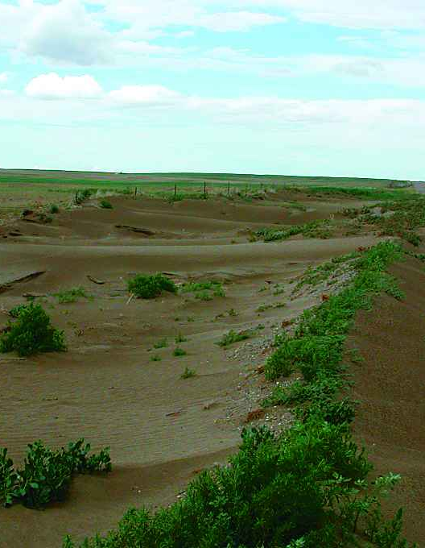
How does wind erosion affect ecosystems?
6E
Life and Land in Missouri – 6E Testing Wind’s Movement: Explain
19
Notes:
(A lot of wind can be harmful and cause soils in fields to dry and then erode or pile soil elsewhere, causing issues for both plants and wildlife. Many nutrients in the soil are lost when the soil is dry and gone, making plant growth difficult.)

Slide 20
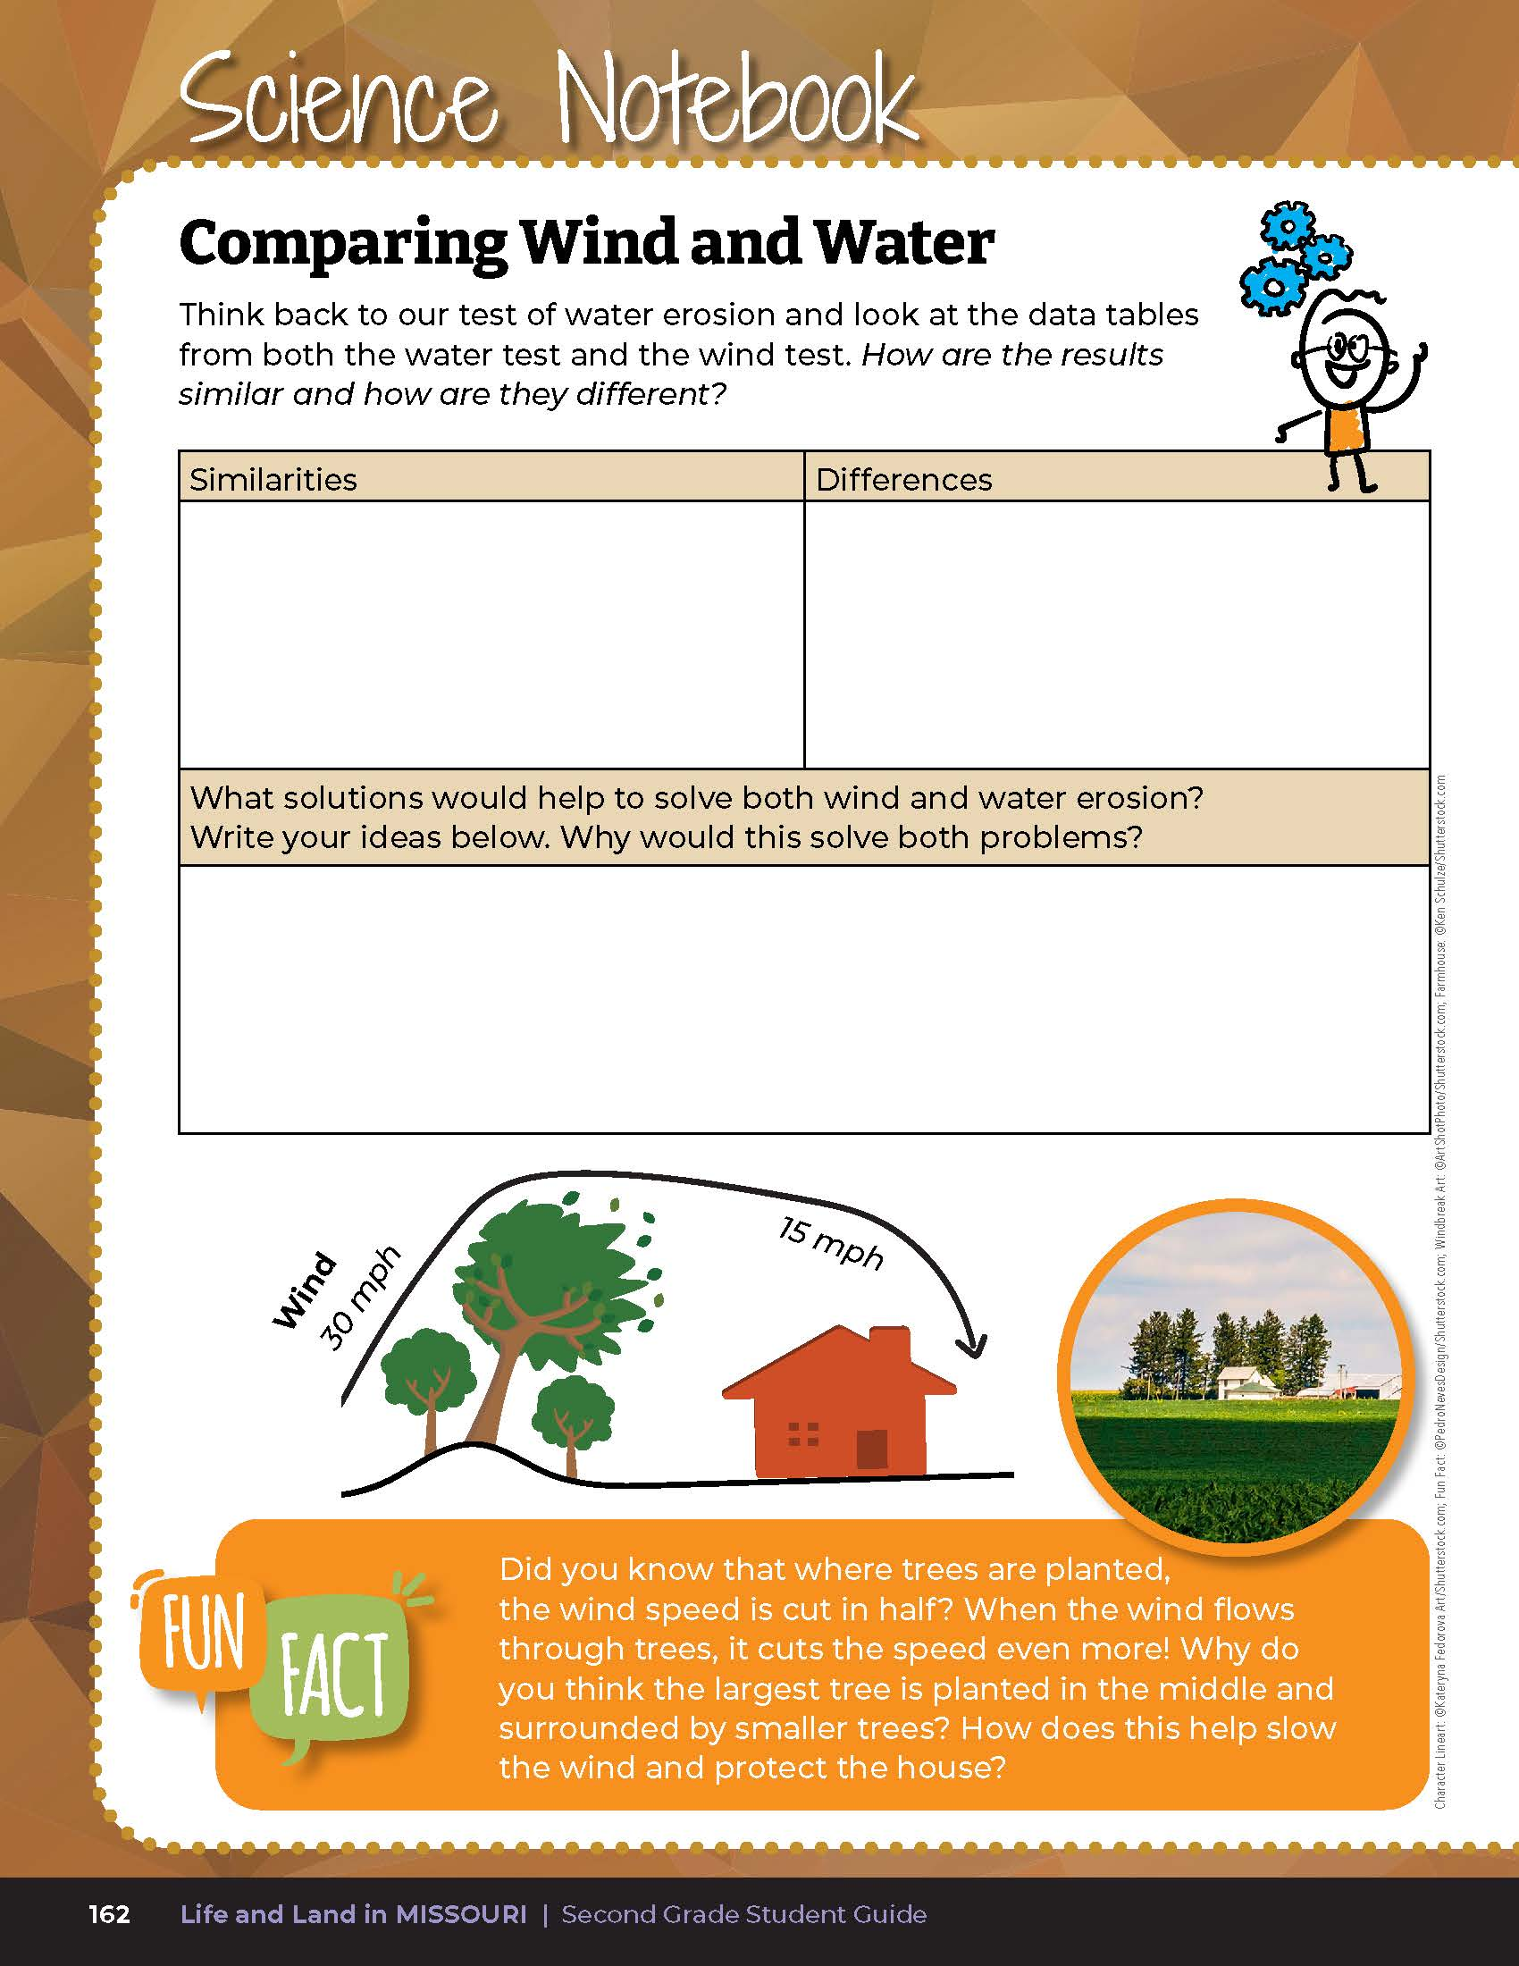
How are our results similar?
How are they different?
6E
Life and Land in Missouri – 6E Testing Wind’s Movement: Explain
20
Notes:
Compare the test results of this test with the results from the water erosion test. Have students work in small groups to complete their own comparison chart in the Science Notebook 6E Comparing Wind and Water section on page 162. Draw the chart on the board and allow students time to write their ideas.

Slide 21
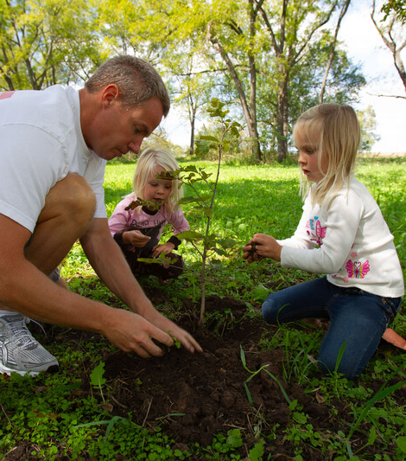
What solutions would help to solve both wind and water erosion?
6E
Life and Land in Missouri – 6E Testing Wind’s Movement: Explain
21

Slide 22

6E
Life and Land in Missouri – 6E Testing Wind’s Movement: Explain
22
Notes:
Read and discuss the Fun Fact together on student guide Page 162.

Slide 23
Write your ideas for solutions that would help to solve both wind and water erosion.
6E
Life and Land in Missouri – 6E Testing Wind’s Movement: Explain
23
Notes:
Give students time to discuss again in a small group and write their own ideas on the bottom section of the Science Notebook 6E Comparing Wind and Water page. Write student ideas on the board.

Slide 24
Did you know wind and water erosion are real-world problems that many people have faced in the past and even today it is still a problem for many people?
6E
Life and Land in Missouri – 6E Testing Wind’s Movement: Explain
24
Notes:
People are always trying to solve the problem of wind and water erosion. Let’s see how people in the past dealt with a 10-year drought of little to no rain.

Slide 25
The Dust Bowl
Issues
Causes
Solutions
6E
Life and Land in Missouri – 6E Testing Wind’s Movement: Explain
25
Notes:
Write “The Dust Bowl” on the board and underneath that write “Issues,” “Causes,” and “Solutions.”

Slide 26

Read Turning Points in U.S. History: Dust Bowl by Veronica B. Wilkens.
Read Aloud:
https://www.youtube.com/watch?v=Vs3JyKyKMqc
6E
Life and Land in Missouri – 6E Testing Wind’s Movement: Explain
26
Notes:
Read Turning Points in U.S. History: Dust Bowl by Veronica B. Wilkens.

Slide 27
The Dust Bowl
Issues
Causes
Solutions
6E
Life and Land in Missouri – 6E Testing Wind’s Movement: Explain
27

Slide 28
What issues did the people of the Midwest face during that 10-year time period and how did this change shape the land?
6E
Life and Land in Missouri – 6E Testing Wind’s Movement: Explain
28

Slide 29
What were some of the causes that led to those issues?
What were some of the solutions?
Was this a quick change or a slow change?
6E
Life and Land in Missouri – 6E Testing Wind’s Movement: Explain
29

Slide 30
How do the shapes of the plants on the ground impact where the wind moves?
6E
Life and Land in Missouri – 6E Testing Wind’s Movement: Elaborate
30
Notes:
Have students revisit the Lesson 6E Testing Wind’s Movement introduction on Page 159 and look at the drawing of wind movement over the trees.

Slide 31
How would you design a tray that prevents the most wind erosion?
6E
Life and Land in Missouri – 6E Testing Wind’s Movement: Elaborate
30

Slide 32
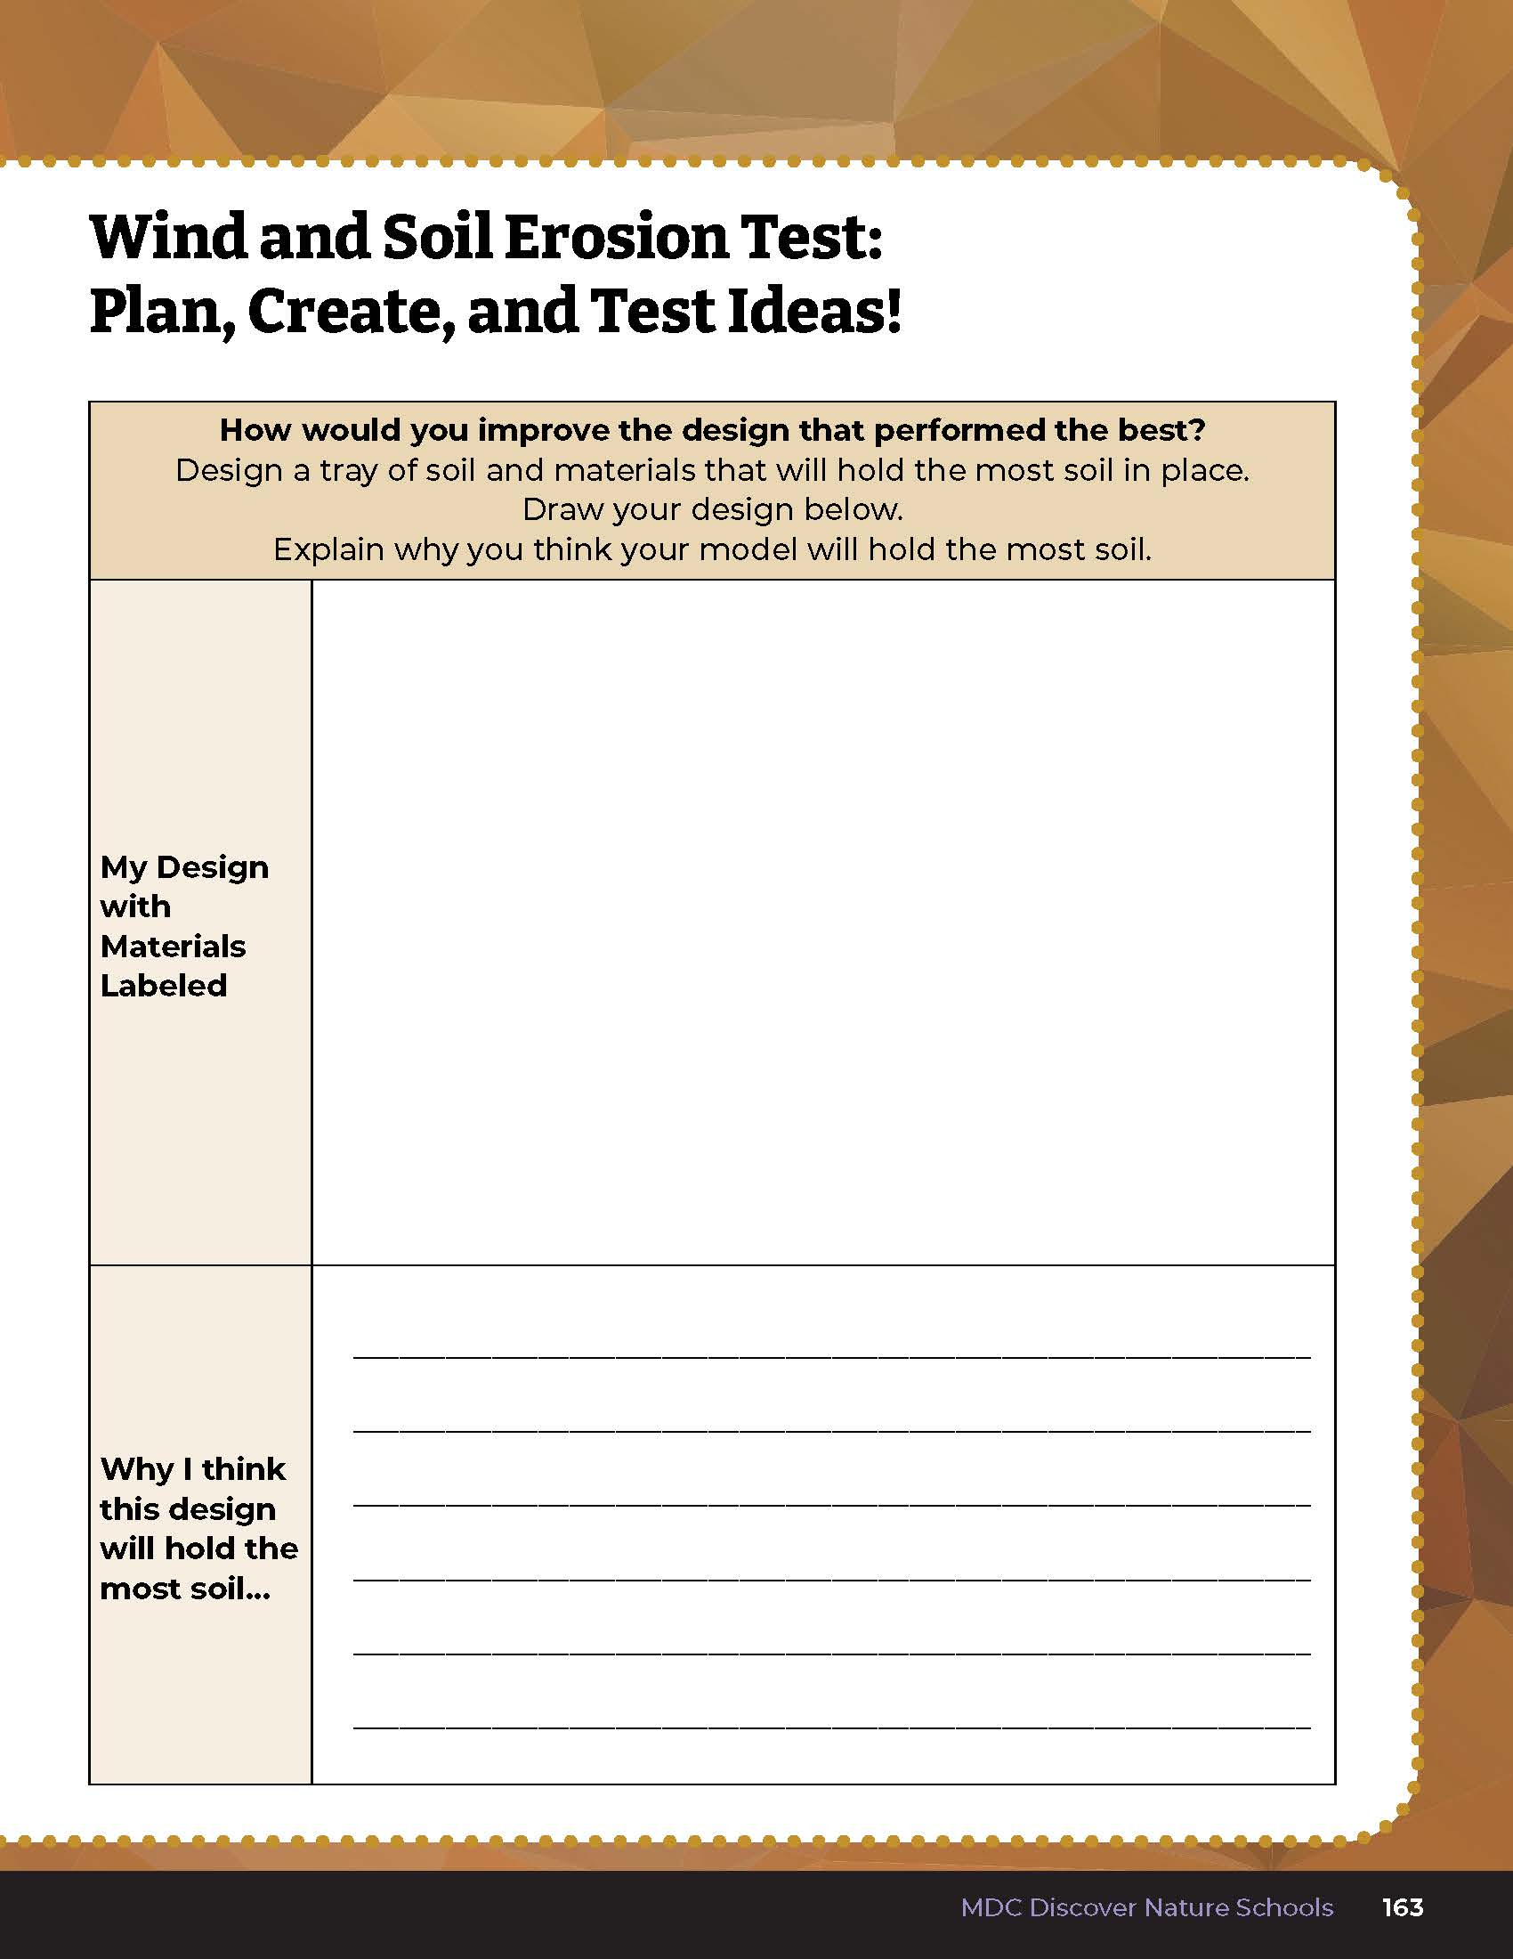
Draw a model of an improved design based on the three tests and explain why you think this model will hold the most soil in place.
6E
Life and Land in Missouri – 6E Testing Wind’s Movement: Elaborate
32
Notes:
Have students turn to Science Notebook 6E Wind and Soil Erosion Test: Plan, Create, and Test Ideas! On Page 163. Students will draw a model of an improved design based on the three tests and explain why they think this model will hold the most soil in place.

Slide 33

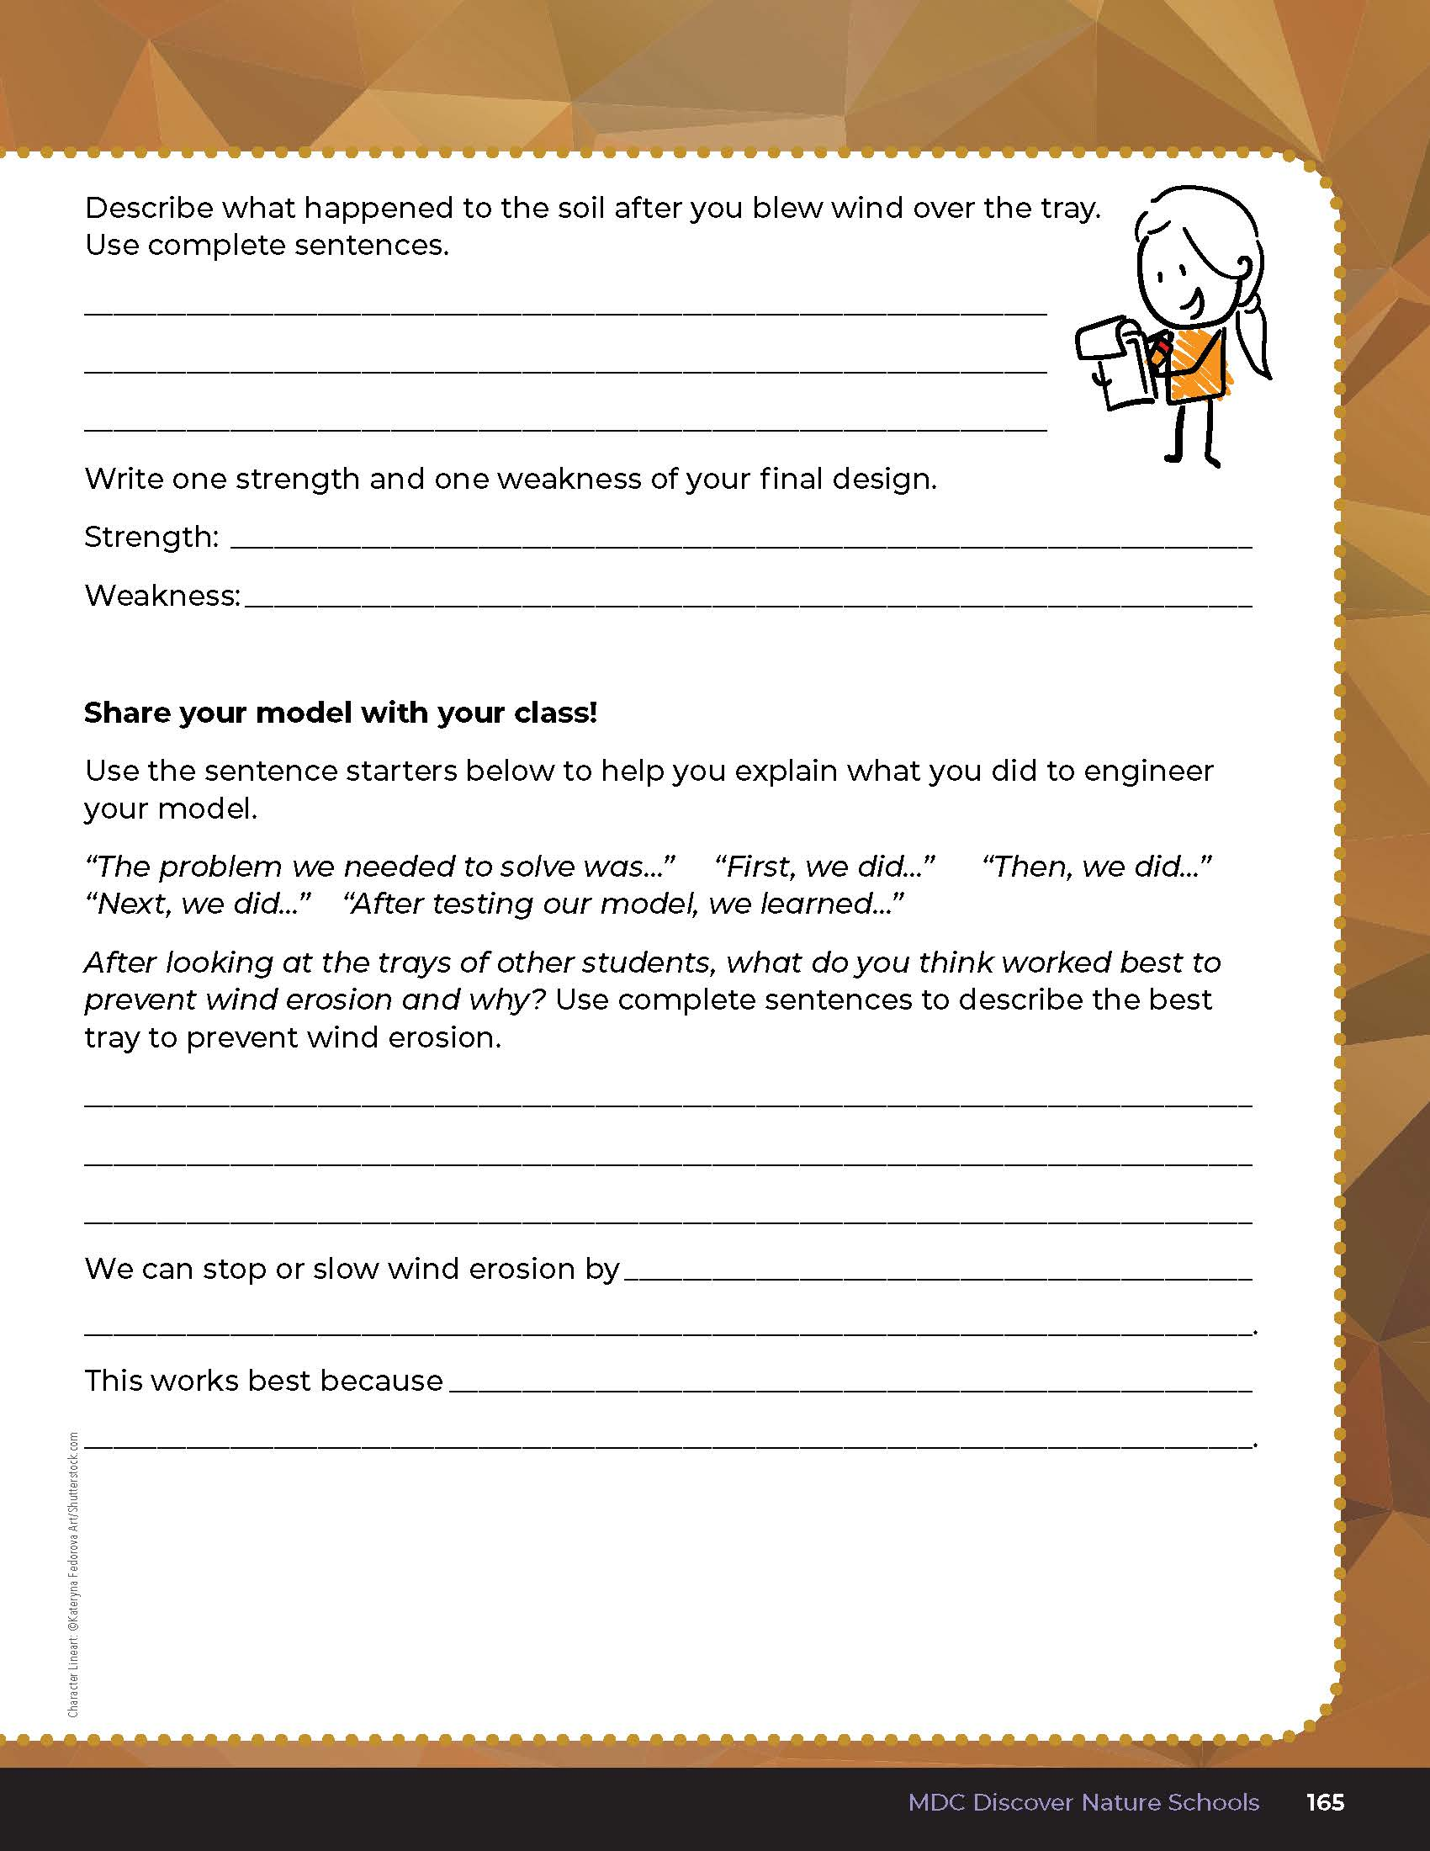
Write your results!
6E
Life and Land in Missouri – 6E Testing Wind’s Movement: Elaborate
33
Notes:
Have students take what they learned in their investigations to design their own tray to prevent wind erosion. In small groups, have students work together to brainstorm how they will design their trays. They can start with the tray of grass and change as desired to meet their design, or teacher may wish to start with a new tray. Have each group share their design and get feedback from peers, sharing strengths and weaknesses of the design. Give students time to redesign their trays after they receive feedback.
Using the fan or blow dryer, have students blow air across their landscape. Do this one group at a time, so everyone can see the results of each landscape.
Have students write their results in Science Notebook 6E Wind and Soil Test: Evaluate and Share on page 164 and the first half of Page 165 of the student guide.

Slide 34
What were the strengths and weaknesses?
Did any design stop all wind from coming through?
Did your water erosion solution work for wind as well?
6E
Life and Land in Missouri – 6E Testing Wind’s Movement: Evaluate
34
Notes:
After exploring the concept of wind erosion, have students open their student guides to the Science Notebook 6E Wind and Soil Test: Evaluate and Share section on page 165. Discuss how their trial compared to their classmates’ trials. Complete this with one group at a time, so everyone can hear the results of each landscape.
Discuss as a class which tray worked best and why.

Slide 35
Evaluate and share!
6E
Life and Land in Missouri – 6E Testing Wind’s Movement: Evaluate
35
Notes:
After the class discussion, have students complete Page 165.
Rubric:
4 (Exceeds) – Student writes the problem the group needed to solve, draws a picture, and describes what happened to the soil during the test. Student circles if they solved the problem. Student provides at least 1 strength and 1 weakness. Each group member speaks about the design. Student uses complete sentences to describe the best tray to prevent wind erosion and why. Student explains how we can stop or slow wind erosion and why that method works best.
3 (Meets) – Student somewhat writes the problem the group needed to solve, draws a picture, and describes what happened to the soil during the test. Student circles if they solved the problem. Student may provide 1 strength or 1 weakness. Most group members speak. Student may or may not use complete sentences to describe the best tray to prevent wind erosion and why. Student somewhat explains how we can stop or slow wind erosion and why that method works best.
2 (Partially meets) – Student may or may not write the problem the group needed to solve, may or may not draw a picture, and somewhat describes what happened to the soil during the test. Student may or may not circle if they solved the problem. Student may or may not provide 1 strength or 1 weakness. Half of the group members speak. Student may or may not use complete sentences to describe the best tray to prevent wind erosion and why. Student may or may not explain how we can stop or slow wind erosion and why that method works best.
1 (Does not meet) – Student does not write the problem, may or may not draw a picture and describe what happened to the soil during the test. Student does not provide a strength or weakness. Only one group member speaks. Student does not use complete sentences to describe the best tray to prevent wind erosion ad why. Student does not explain how to stop or slow wind erosion.
Using the fan or blow dryer, have students blow air across their landscape. Do this one group at a time, so everyone can see the results of each landscape.
Have students write their results in Science Notebook 6E Wind and Soil Test: Evaluate and Share on page 164 and the first half of Page 165 of the student guide.

