Slide 1
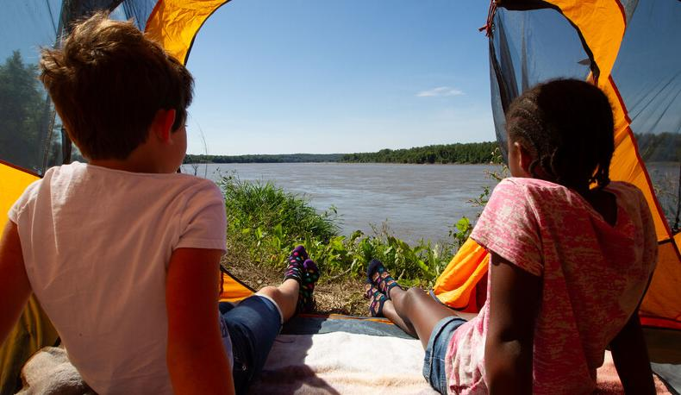

Life and Land in
MISSOURI
6D: Testing Water’s Movement

Slide 2
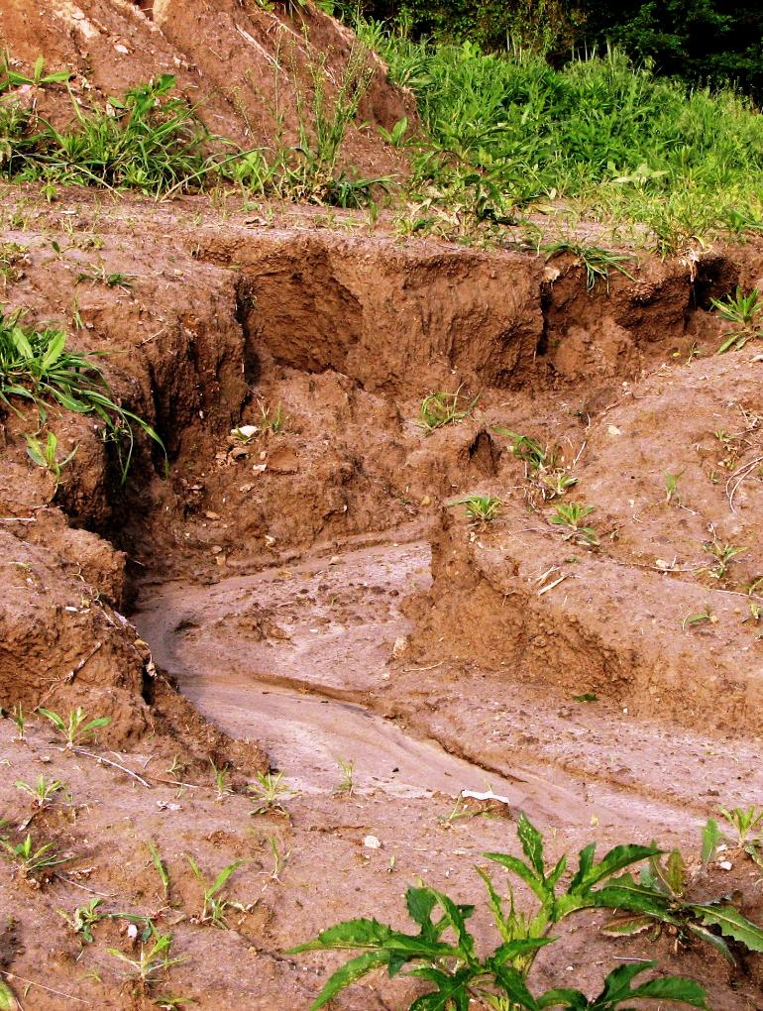
What problems did water erosion create?
6D
Life and Land in Missouri – 6D Testing Water’s Movement: Engage
2
Notes:
Have students think back to how water and wind changes the land in the previous lesson.

Slide 3
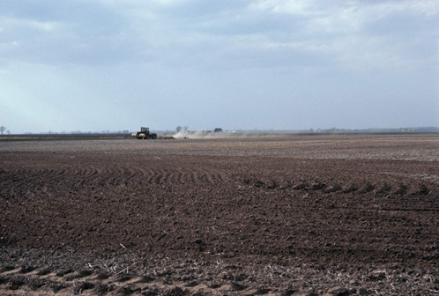
What problems can wind erosion create?
6D
Life and Land in Missouri – 6D Testing Water’s Movement: Engage
3

Slide 4
When we walked outside last lesson, did we see potential problems with wind and water?
6D
Life and Land in Missouri – 6D Testing Water’s Movement: Engage
4

Slide 5
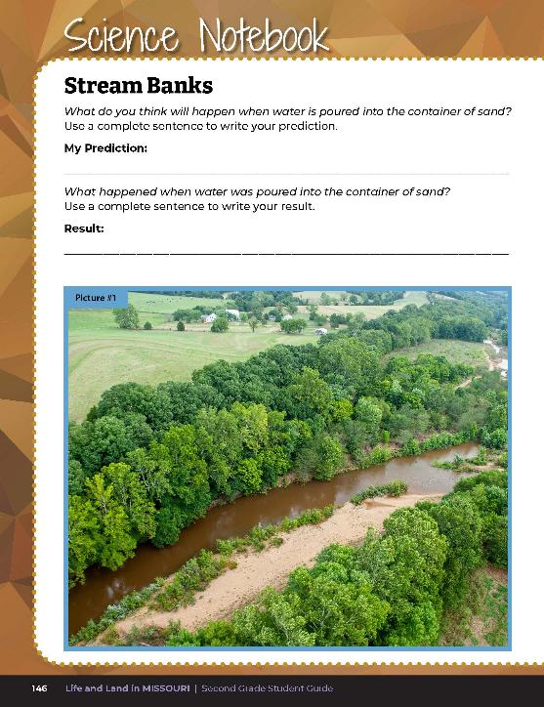
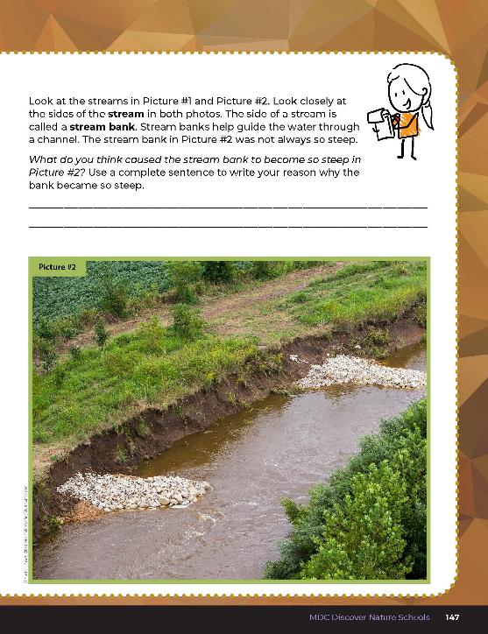
Were the photos a slow or fast change? Why or why not?
6D
Life and Land in Missouri – 6D Testing Water’s Movement: Engage
5
Notes:
Have students review photos in the student guide in the previous lesson about weathering and erosion.

Slide 6
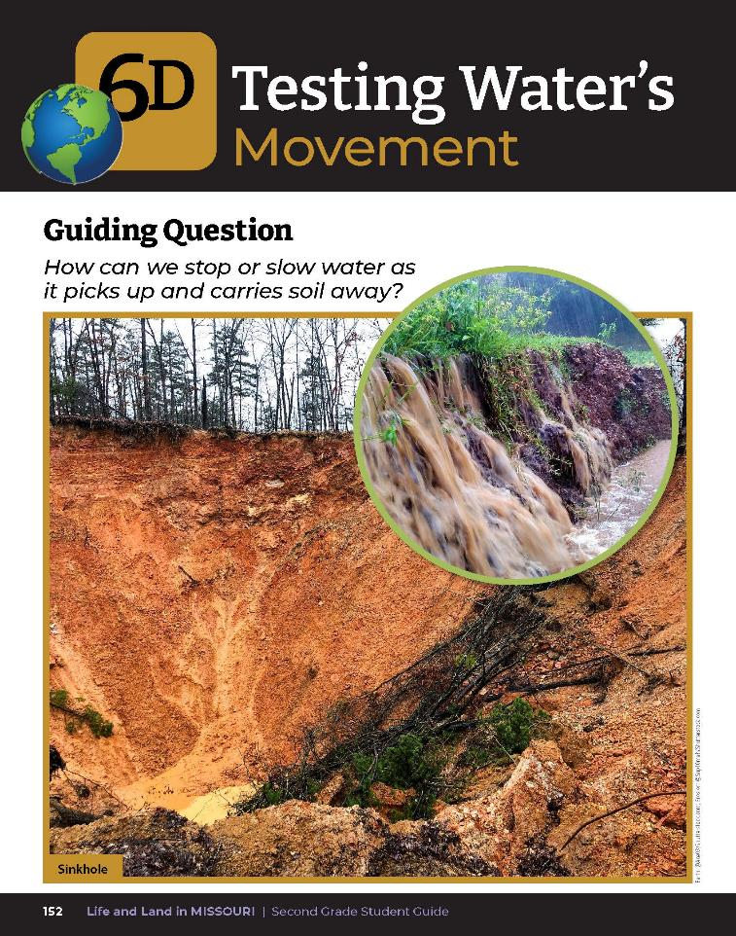
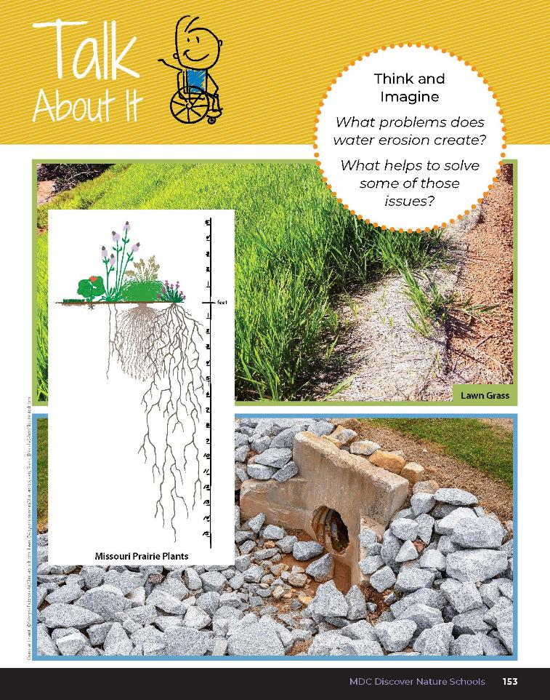
6D
Life and Land in Missouri – 6D Testing Water’s Movement: Engage
6
Notes:
Have students read from the student guide Lesson 6D Testing Water’s Movement introduction on pages 152-153. Read the guiding question together.
Guiding Question: How can we stop or slow water as it picks up and carries soil away?

Slide 7

What problems does water erosion create?
What helps to solve some of those issues?
6D
Life and Land in Missouri – 6D Testing Water’s Movement: Engage
7
Notes:
Discuss the Talk About It and the photos from both pages. Record ideas on the board.

Slide 8
What do you see covering the soil?
How does not having anything on the soil or different types of things covering the soil help with this issue?
6D
Life and Land in Missouri – 6D Testing Water’s Movement: Engage
8
Notes:
Guide students to the idea of testing different types of soil coverage such as bare soil, soil with rocks, and soil with plants. Today and next week, we are going to become engineers and explore ideas to solve these issues.

Slide 9
How can we stop or slow water as it picks up and carries soil away?
To start solving this problem, we need to perform a few tests to compare the results.
Let’s explore the idea of what happens if we have nothing on top of the soil, rocks on the soil, or plants growing from the soil.
6D
Life and Land in Missouri – 6D Testing Water’s Movement: Explore
9
Notes:
Teacher Note: You may consider teaching the following activity outside instead of inside the classroom. This lesson focus will be to demonstrate how soil in affected by moving water and determine if there are ways to stop, slow, or reduce soil erosion and to study how plants’ and trees’ root systems help stabilize soil and potentially reduce erosion. The activity calls for 3 demonstration trays. Consider preparing 6 trays total if you are conducting the wind erosion experiment for Lesson 6E at the same time.
Revisit the guiding question or the problem to solve: How can we stop or slow water as it picks up and carries soil away? To start solving this problem, we need to perform a few tests to compare the results. Let’s explore the idea of what happens if we have nothing on top of the soil, to rocks on the soil, or plants growing from the soil.

Slide 10
Build a hill of soil at the end of each soil tray.
1st Tray – See how bare soil is affected by water
2nd Tray – Cover the hill with rocks
3rd Tray – Cover the hill with straw or grass clippings, or seedlings
6D
Life and Land in Missouri – 6D Testing Water’s Movement: Explore
10
Notes:
For the class activity, put equal amounts of soil into your 3 demonstration trays. Have students build a hill of soil at the end of each soil tray. In the first tray, students will see how bare soil is affected by water (symbolizes hill with bare soil). In the second tray, cover the hill with rocks (symbolizes hill of soil and rocks). In the third tray, cover the hill with straw or grass clippings, or seedlings (symbolizes hill with grass or plants.)
Teacher Note: To show how roots help keep soil in place, instead of straw and grass, you can grow plants in the third tray. If you plant seeds, you will need to plant several weeks before you teach the lesson – this tray of plants could be kept and reused year after year.

Slide 11
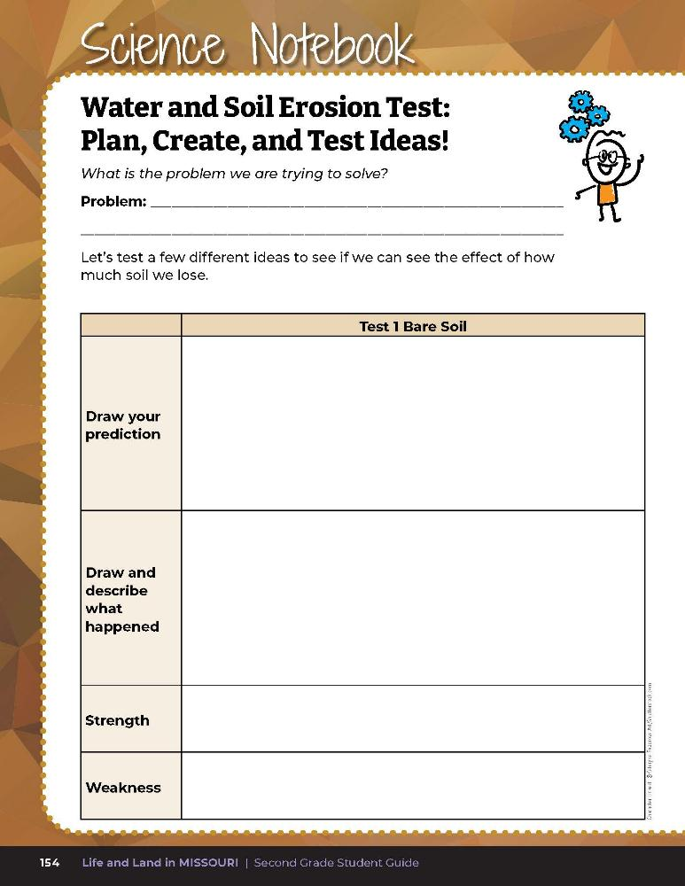

Draw your prediction of what you think will happen when water is poured on the soil.
6D
Life and Land in Missouri – 6D Testing Water’s Movement: Explore
11
Notes:
Water and Soil Erosion Demonstration:
Start with the tray of soil only. Prop the tray on an angle using books or other materials. Check that the angles are the same for each tray.
Have students draw their prediction of what they think will happen when water is poured on the soil. Drawing space is provided in their student guide on Science Notebook 6D Water and Soil Erosion Test: Plan, Create, and Test Ideas! On Page 154 in the first box under Test 1 Bare Soil.

Slide 12
Draw a second picture – the “after” picture of how the water changed the soil.
6D
Life and Land in Missouri – 6D Testing Water’s Movement: Explore
12
Notes:
3. To create water erosion, use 1-2 cups of water to pour down the hill of soil. Water should be poured in the same way for each tray.
4. Slowly pour 1-2 cups of water down the hill of soil. Discuss with students that this is like a sudden rain and that overabundance of water can impact land with bare soil.
5. When all the water is gone, have students draw a second picture – the “after” picture of how the water changed the soil. Have students write sentence (s) to describe what happened; they should include at least one strength and one weakness.

Slide 13
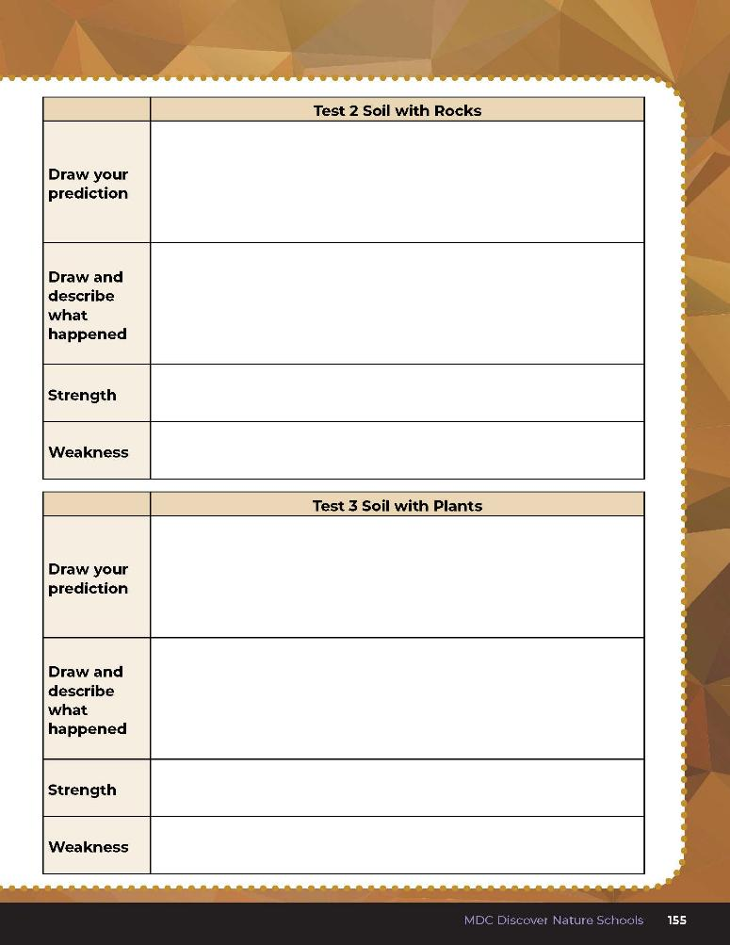
Complete the charts.
6D
Life and Land in Missouri – 6D Testing Water’s Movement: Explore
13
Notes:
6. Repeat steps 1-5 with both the soil covered by rocks and then the soil covered in straw and/or grass clippings, or plant seedlings. Have students complete the chart on Science Notebook 6D Water and Soil Erosion Test: Plan, Create, and Test Ideas! Page 155.

Slide 14
Let’s discuss how the soil was affected in each tray!
Soil only?
Soil covered by rock?
Soil covered by plant materials?
6D
Life and Land in Missouri – 6D Testing Water’s Movement: Explore
14
Notes:
Teacher Note: The teacher may instruct students to measure and record the height of the hill before and after water is introduced to compare just how much soil was eroded.
As a class, discuss how the soil was affected in each tray. Write answers on the board:
Soil only?
Soil covered by rock?
Soil covered by plant material?

Slide 15
How did water change the shape of the soil?
Did this happen quickly or slowly?
6D
Life and Land in Missouri – 6D Testing Water’s Movement: Explore
15

Slide 16
What was the same in all three trials?
What was different?
6D
Life and Land in Missouri – 6D Testing Water’s Movement: Explore
16

Slide 17
Which trial kept the most soil in place?
Why is that?
6D
Life and Land in Missouri – 6D Testing Water’s Movement: Explore
17

Slide 18
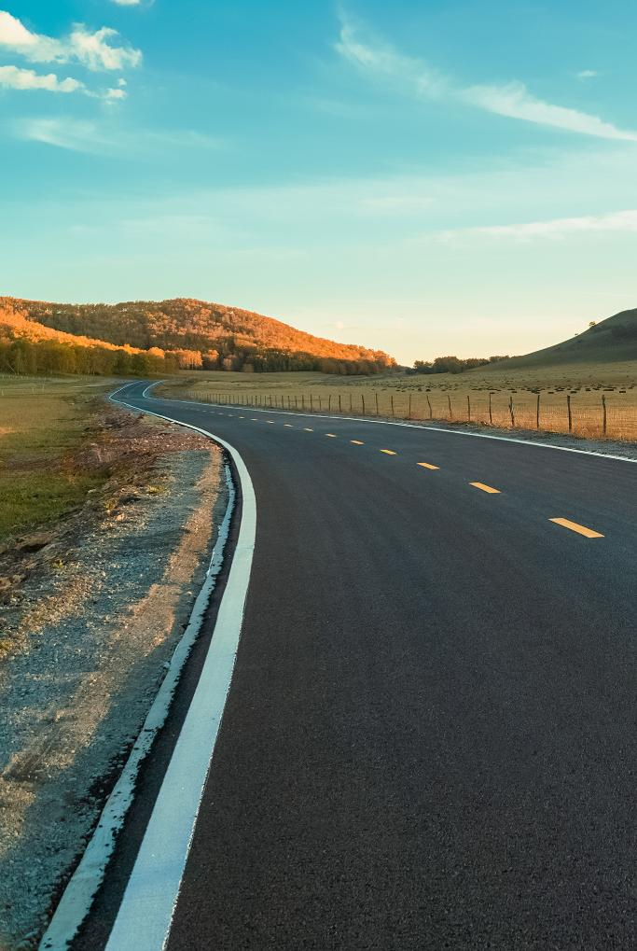
When looking at the 3 trays, which tray of soil was most like pavement?
6D
Life and Land in Missouri – 6D Testing Water’s Movement: Explain
18
Notes:
Discuss the outcome of the Water and Soil Erosion Demonstration with the class.

Slide 19

Do sidewalks or pavement reduce soil erosion?
Why or why not?
6D
Life and Land in Missouri – 6D Testing Water’s Movement: Explain
19
Notes:
(Hard surfaces like pavement may keep soil in place if on flat areas of land, but can increase erosion if a large amount of water flows through all at once and goes into nearby streams. A small storm in a city area may produce floods in city streams.)

Slide 20

Where is the soil?
How would water affect soil growing these plants?
What do these plants have that would hold soil in place?
6D
Life and Land in Missouri – 6D Testing Water’s Movement: Explain
20

Slide 21
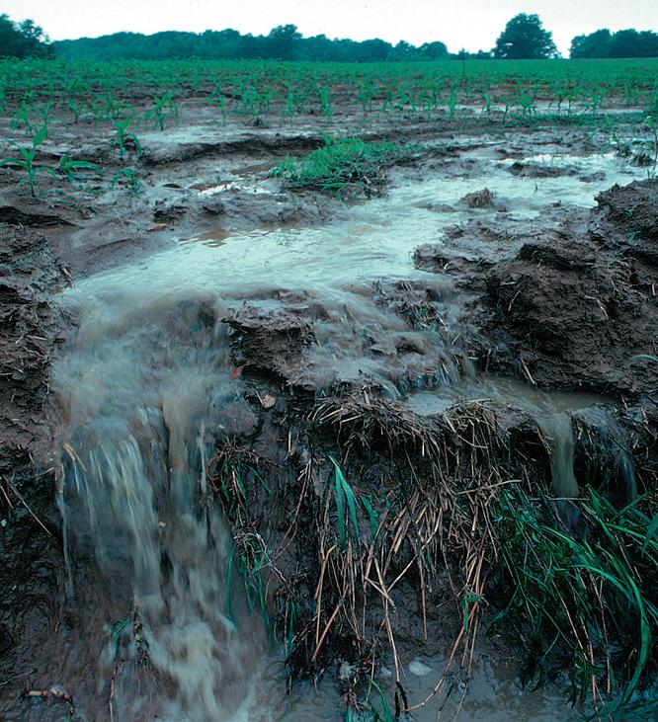
How does water erosion affect ecosystems?
6D
Life and Land in Missouri – 6D Testing Water’s Movement: Explain
21
Notes:
(A lot of water can be harmful and cause streambank to erode, causing issues for both plants and wildlife. Some issues for aquatic wildlife could be clogged gills, smothered nests so the eggs will not hatch, and pollutants entering the water. Water can also cause flooding.)

Slide 22
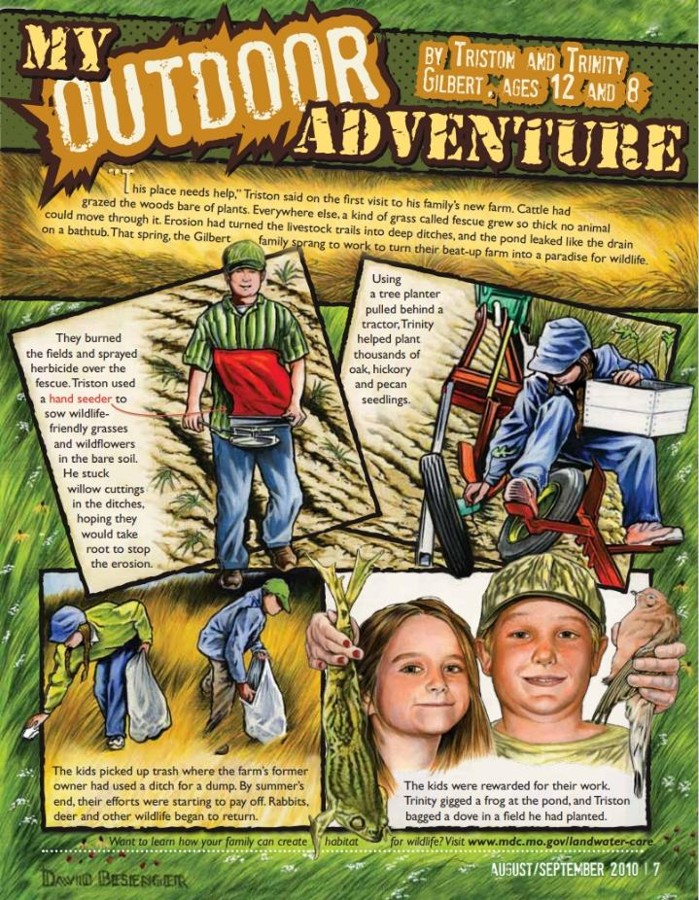
Link:
AugSep_2010_0.pdf
6D
Life and Land in Missouri – 6D Testing Water’s Movement: Explain
22
Notes:
From the MDC Teacher Portal, display or distribute copies of the My Outdoor Adventure article from the August/September 2010 issue of Xplor, Page 7.

Slide 23
What was the problem that Trinity and Triston faced?
How was it solved?
How does this relate to what we did in our experiment?
6D
Life and Land in Missouri – 6D Testing Water’s Movement: Explain
23

Slide 24
How would you design a tray to prevent water from eroding the soil?
6D
Life and Land in Missouri – 6D Testing Water’s Movement: Elaborate
24
Notes:
Have students think about what they’ve learned so far about water erosion.

Slide 25
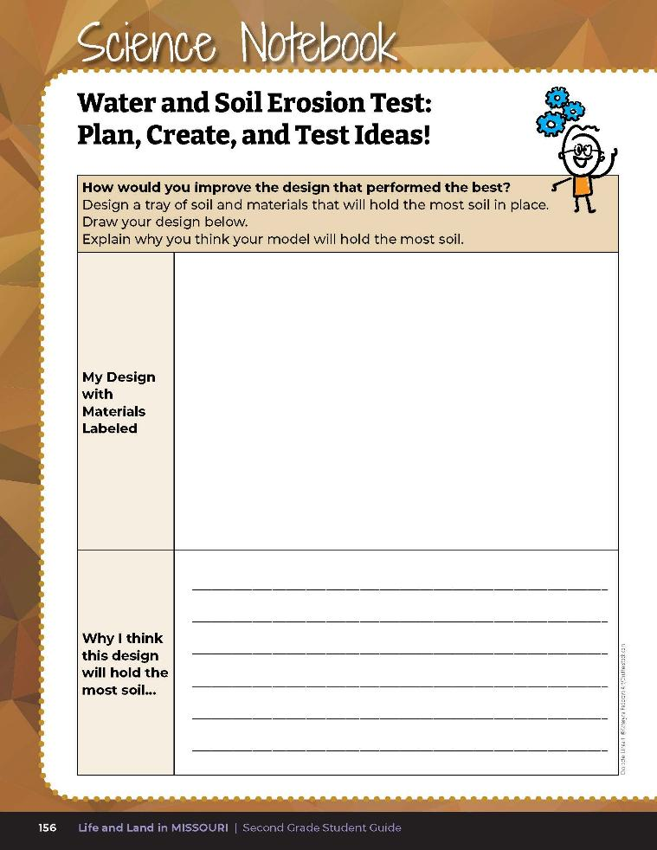
Draw a model of an improved design based on the three tests and explain why you think this model will hold the most soil in place.
6D
Life and Land in Missouri – 6D Testing Water’s Movement: Elaborate
25
Notes:
Have students open their student guides to Science Notebook 6D Water and Soil Erosion Test: Plan, Create, and Test Ideas! On Page 156. Students will draw a model of an improved design based on the three tests and explain why they think this model will hold the most soil in place.

Slide 26
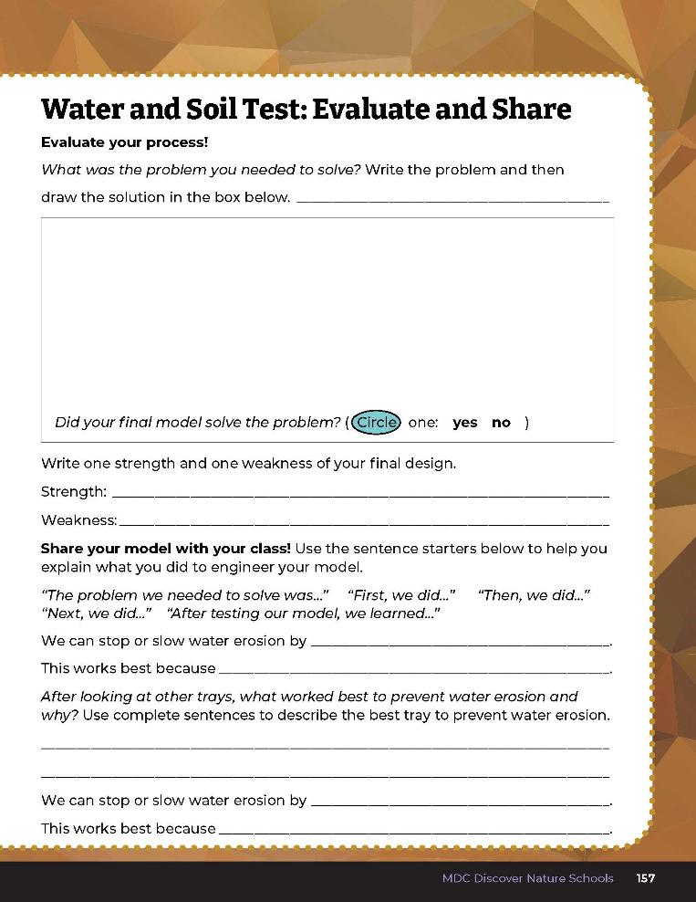
Evaluate your process!
6D
Life and Land in Missouri – 6D Testing Water’s Movement: Elaborate
26
Notes:
Have students take what they learned in their investigations to design their own tray to prevent water erosion. In small groups, have students work together to brainstorm how they will design their trays. They can start with the tray with grass and change as desired to meet their design, or teacher may wish to start with a new tray. Have each group share their design and get feedback from peers, sharing strengths and weaknesses of the design. Give students time to redesign their trays after they receive feedback.
Have students set up their trays and have each group pour the same amount of water into their landscape. Then have students complete the first half of Science Notebook 6D Our Soil and Water Design: Evaluate and Share on Page 157 of the student guide.

Slide 27
What were the strengths and weaknesses?
Did any of the designs stop all water from coming through?
6D
Life and Land in Missouri – 6D Testing Water’s Movement: Evaluate
27
Notes:
After exploring the concept of water erosion, have students open their student guides to Science Notebook 6D Water and Soil Test: Evaluate and Share on Page 157. Discuss how their trial compared to their classmates’ trials. Complete this with one group at a time, so everyone can hear the results of each landscape. Discuss as class which tray worked best and why.

Slide 28
Fill in the questions on the second half of the page.
6D
Life and Land in Missouri – 6D Testing Water’s Movement: Evaluate
28
Notes:
After everyone has shared their results, have students fill in the questions on the second half of the page.

Slide 29
Answers will vary
6D
Life and Land in Missouri – 6D Testing Water’s Movement: Evaluate
29
Notes:
Rubric:
4 (Exceeds) – Student writes the problem the group needed to solve, draws a picture, and describes what happened to the soil during the test. Student circles if they solved the problem. Student provides at least 1 strength and 1 weakness. Each group member speaks about the design. Student uses complete sentences to describe the best tray to prevent water erosion and why. Student explains how we can stop or slow water erosion and why that method works best.
3 (Meets) – Student somewhat writes the problem the group needed to solve, draws a picture, and describes what happened to the soil during the test. Student circles if they solved the problem. Student may provide 1 strength or 1 weakness. Most group members speak. Student may or may not use complete sentences to describe the best tray to prevent water erosion and why. Student somewhat explains how we can stop or slow water erosion and why that method works best.
2 (Partially meets) – Student may or may not write the problem the group needed to solve, may or may not draw a picture, and somewhat describes what happened to the soil during the test. Student may or may not circle if they solved the problem. Student may or may not provide 1 strength or 1 weakness. Half of the group members speak. Student may or may not use complete sentences to describe the best tray to prevent water erosion and why. Student may or may not explain how we can stop or slow water erosion and why that method works best.
1 (Does not meet) – Student does not write the problem, may or may not draw a picture and describe what happened to the soil during the test. Student does not provide a strength or weakness. Only one group member speaks. Student does not use complete sentences to describe the best tray to prevent water erosion ad why. Student does not explain how to stop or slow water erosion.

