Slide 1
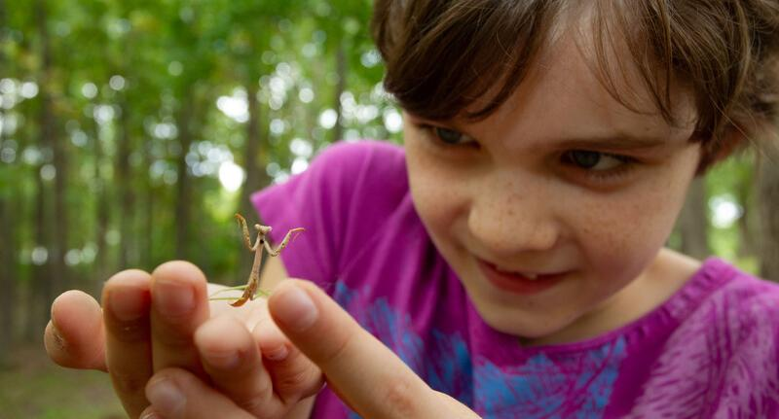

Exploring
MISSOURI
6D: Good Morning, Good Night

Slide 2
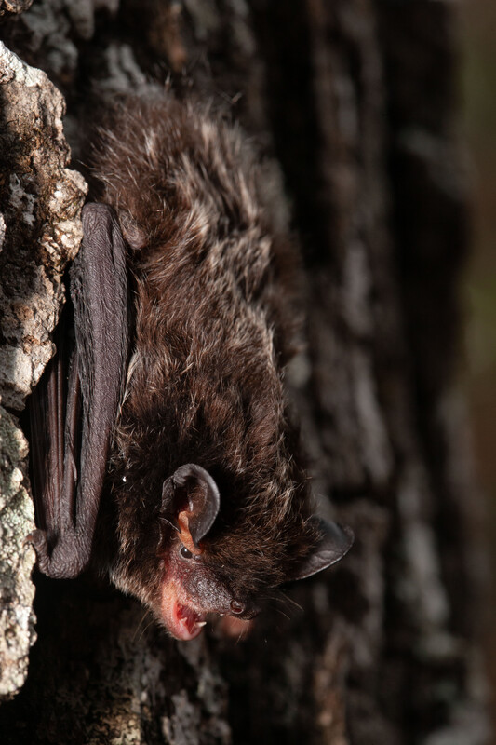
Guiding Question:
Why do I come out in the day and bats come out at night?
6D
Exploring Missouri – 6D Good Morning, Good Night: Engage
2
Notes:
Animal in picture: Silver Hair Bat

Slide 3
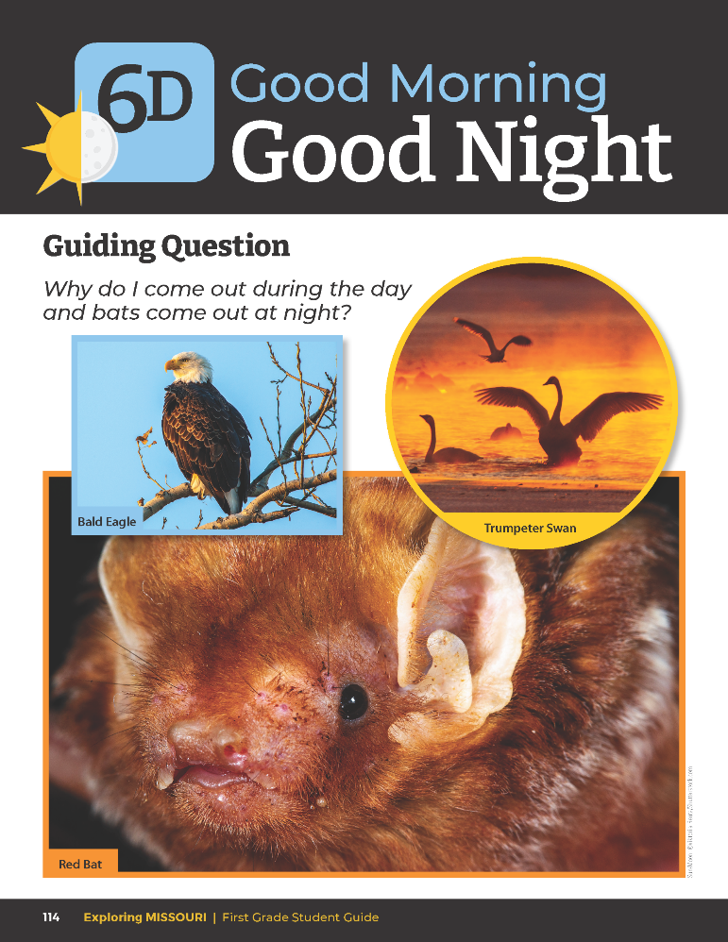
How are these animals alike?
How are they different?
When are they most active?
6D
Exploring Missouri – 6D Good Morning, Good Night: Engage
3
Notes:
Refer to the pictures of the different Missouri animals in the student guide on Lesson 6D Good Morning, Good Night introduction section on Page 114.

Slide 4
Daytime
Nighttime
Bees Buzzing
https://youtu.be/GV1Z2Pcxohk?si=F3n80LQ4XmkGzLg8
Barred Owl Hooting
https://youtu.be/4bPFw7FFdUQ?si=h3eDqRr5A-VrXGcq
Children Playing
https://youtu.be/qBj-snfMWVE?si=VsZl7UjDj3A8A77Q
Bats Flying
https://youtu.be/6CVEkGSVBRg?si=5Apnpj7weYu1yarm
Coyotes Howling
https://youtu.be/K6OQpbbBJtQ?si=R_vKMx7ZvYTvAblJ
Robin Chirping
https://youtu.be/NkJcBYSLKAU?si=MH0lg4thRgQgO_Hx
6D
Exploring Missouri – 6D Good Morning, Good Night: Engage
4
Notes:
From the MDC Teacher Portal, play audio links and compare daytime sounds to nighttime sounds.

Slide 5
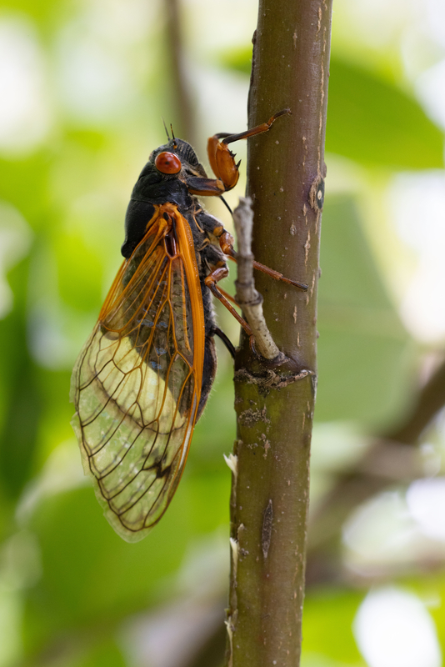
What sounds do you hear?
What other sounds have you heard during the day? At night?
6D
Exploring Missouri – 6D Good Morning, Good Night: Engage
5
Notes:
Animal in picture: Periodic Cicada

Slide 6

What do you do at night versus during the day?
6D
Exploring Missouri – 6D Good Morning, Good Night: Explore
6

Slide 7
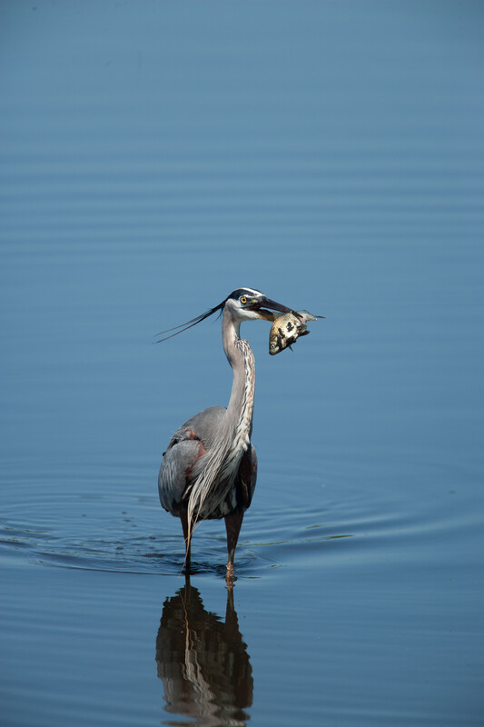
What do you think animals do during the day or during the night?
6D
Exploring Missouri – 6D Good Morning, Good Night: Explore
7
Notes:
Animal in picture: Great Blue Heron

Slide 8
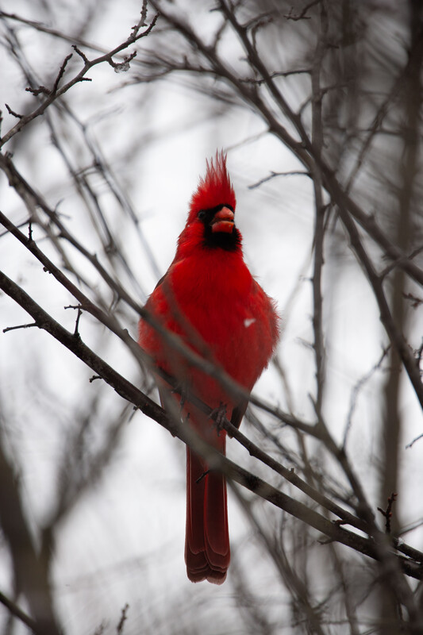
Who or what might be awake during the day?
Who or what might be awake during the night?
6D
Exploring Missouri – 6D Good Morning, Good Night: Explore
8
Notes:
Animal in picture: Northern Cardinal

Slide 9

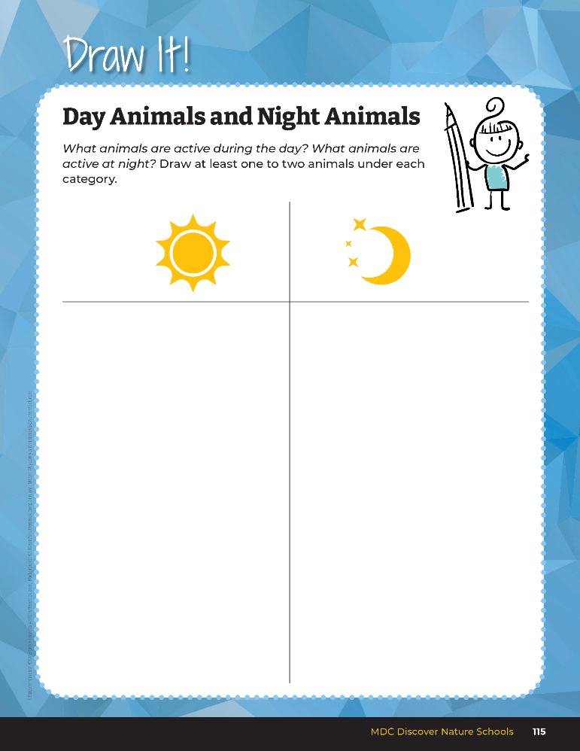
What animals are active during the day?
What animals are active at night?
6D
Exploring Missouri – 6D Good Morning, Good Night: Explore
9
Notes:
Have students brainstorm a list of Missouri animals and complete the T-chart in their student guide, Draw It! 6D Day Animals and Night Animals section on Page 115.

Slide 10


6D
Exploring Missouri – 6D Good Morning, Good Night: Explore
10
Notes:
Create a T-chart on the board. Use a picture of the sun on one side and a picture of the moon on the other side. Distribute the 6D Missouri Animal Cards to the students. Ask them to group the animals under the category on the board by which ones are awake during the day and which ones are awake at night.

Slide 11
Why did you decide to group your animal under the day or night category?
6D
Exploring Missouri – 6D Good Morning, Good Night: Explore
11
Notes:
Accept all student answers.

Slide 12
When are these animals the most active?
6D
Exploring Missouri – 6D Good Morning, Good Night: Explore
12
Notes:
Let’s see if we can use some clues from our resources to figure out the correct answers. Display the MDC Field Guide from the link in the MDC Teacher Portal. Field Guide | Missouri Department of Conservation

Slide 13
Cardinal
Robin
Eagle
Rabbit
Squirrel
Turtle
Deer
Turkey
Big Brown Bat
Great Horned Owl
Coyote
Deer
Racoon
Skunk
Bobcat
Flying Squirrel
6D
Exploring Missouri – 6D Good Morning, Good Night: Explore
13
Notes:
Let’s check to make sure our animals are under the correct categories as we learn about them.
Deer are an example of an animal that can be seen both day and night. Some animals are active more during sunrise and sunset. These animals include beaver, muskrat, and black bear.

Slide 14


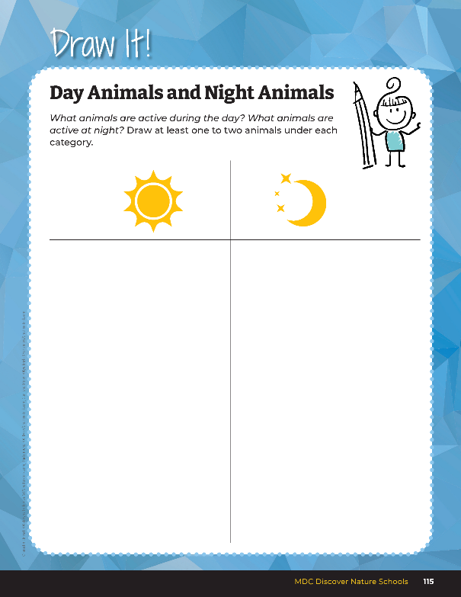
Cardinal
Robin
Eagle
Rabbit
Squirrel
Turtle
Deer
Turkey
Big Brown Bat
Great Horned Owl
Coyote
Deer
Racoon
Skunk
Bobcat
Flying Squirrel
6D
Exploring Missouri – 6D Good Morning, Good Night: Explore
14
Notes:
Have students record the class list of Missouri animals and complete the T-chart in their student guide, Science Notebook 6D Day Animals and Night Animals section on Page 115.

Slide 15
What is a pattern?
6D
Exploring Missouri – 6D Good Morning, Good Night: Explore
15
Notes:
Something that happens over and over.

Slide 16
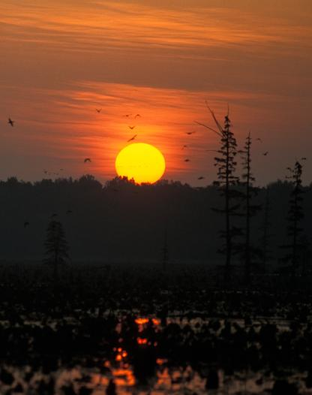
What are day and night, and sunrise and sunset, examples of?
6D
Exploring Missouri – 6D Good Morning, Good Night: Explore
16
Notes:
A pattern.

Slide 17
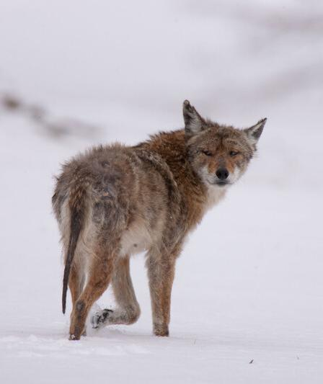
Can animal activity also be a pattern that we can predict?
6D
Exploring Missouri – 6D Good Morning, Good Night: Explore
17
Notes:
Yes.
Animal in picture: Coyote

Slide 18
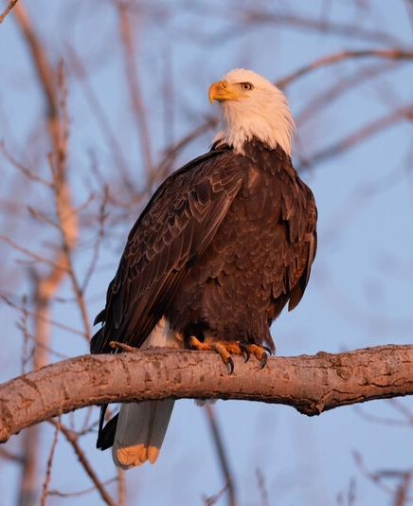
What do you think diurnal means?
Why do you think this?
6D
Exploring Missouri – 6D Good Morning, Good Night: Explain
18
Notes:
Introduce students to the terms diurnal and nocturnal.
Animal in picture: Bald Eagle

Slide 19
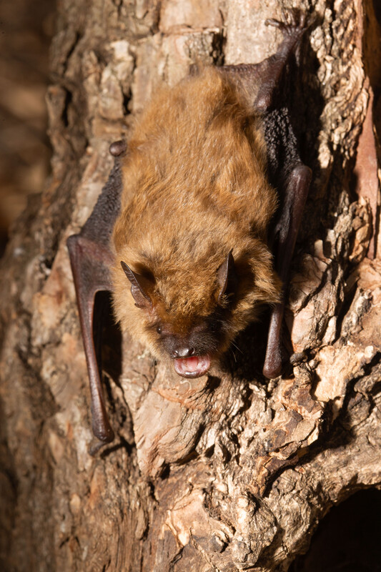
What do you think nocturnal means?
Why do you think this?
6D
Exploring Missouri – 6D Good Morning, Good Night: Explain
19
Notes:
Animal in picture: Big Brown Bat

Slide 20
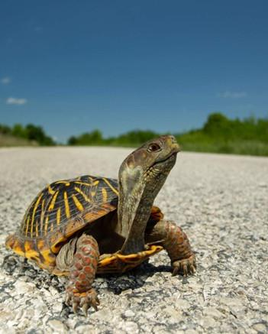
Diurnal starts with D…D is for Day. These animals are awake during the day.
6D
Exploring Missouri – 6D Good Morning, Good Night: Explain
20
Notes:
A pneumonic device or memory strategy that can be used is:
Animal in picture: ornate box turtle

Slide 21
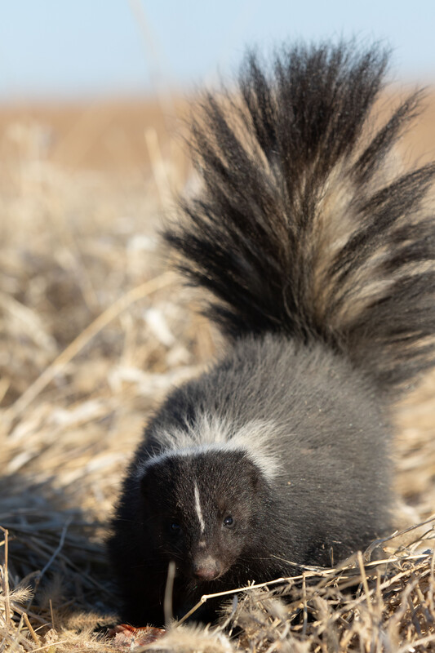
Nocturnal starts with N…N is for Night. These animals are awake during the night.
6D
Exploring Missouri – 6D Good Morning, Good Night: Explain
21
Notes:
Animal in picture: Striped Skunk

Slide 22

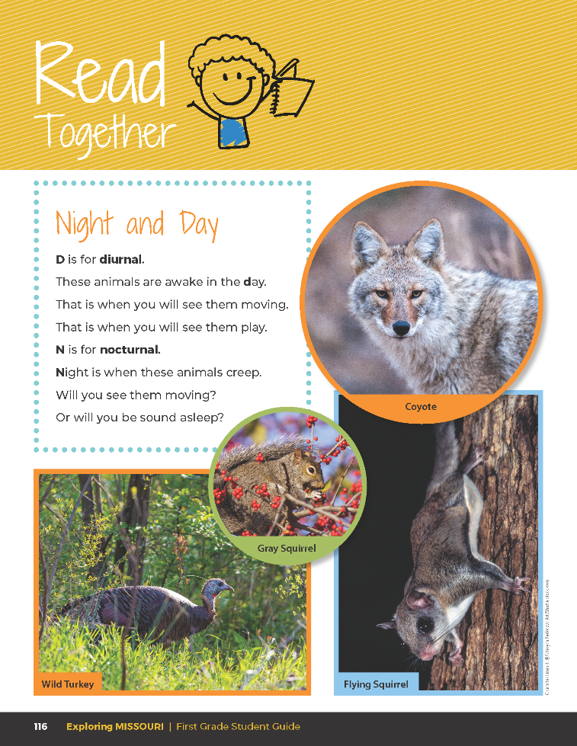
Night and Day
D is for diurnal.
Those animals are awake in the day.
That is when you will see them moving.
N is for nocturnal.
Night is when these animals creep.
Will you see them moving?
Or will you be sound asleep?
6D
Exploring Missouri – 6D Good Morning, Good Night: Explain
22
Notes:
In the student guide, read the Read Together 6D Night and Day on Page 116.

Slide 23
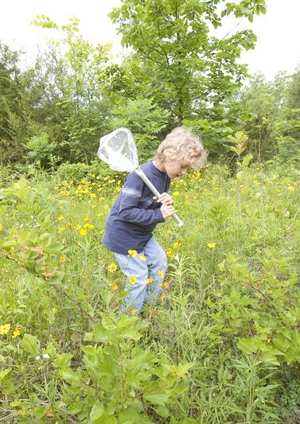
Are we diurnal or nocturnal? Why?
6D
Exploring Missouri – 6D Good Morning, Good Night: Explain
23
Notes:
Let’s think about humans.

Slide 24

What do we do when we are awake?
6D
Exploring Missouri – 6D Good Morning, Good Night: Explain
24
Notes:
Discuss what people and animals do when they are awake.

Slide 25
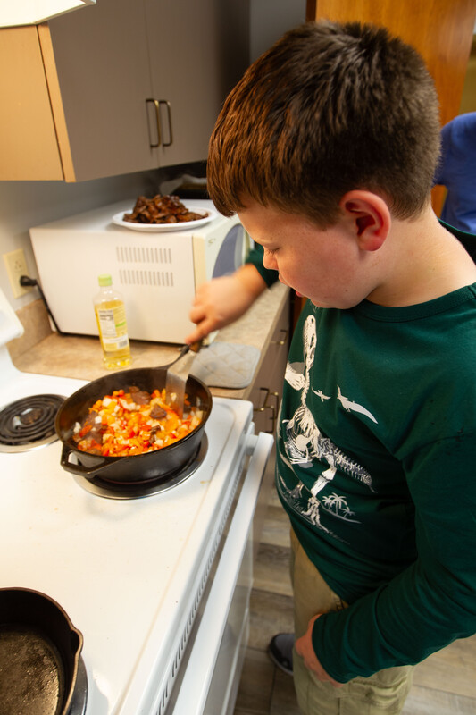
What do we do each day to help us survive?
6D
Exploring Missouri – 6D Good Morning, Good Night: Explain
25

Slide 26
Could we do these things at night or is it easier to do them during the daytime? Why?
6D
Exploring Missouri – 6D Good Morning, Good Night: Explain
26

Slide 27
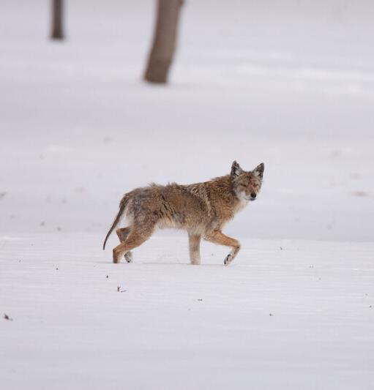
How do animals find food, water, and shelter so they can survive?
6D
Exploring Missouri – 6D Good Morning, Good Night: Explain
27
Notes:
Animal in picture: Coyote

Slide 28
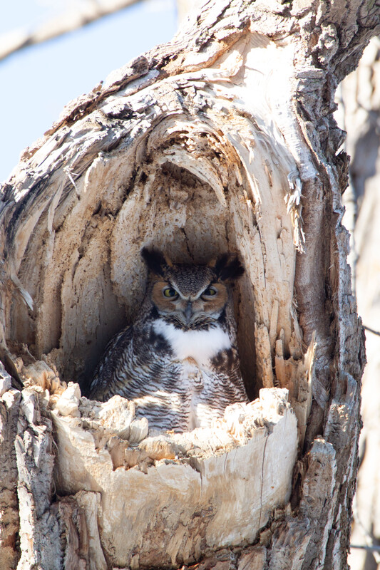
Do you think a bald eagle hunts for its prey in the same way an owl hunts for its prey? Why? Why not?
6D
Exploring Missouri – 6D Good Morning, Good Night: Explain
28
Notes:
Highlight how behaviors for finding food change for diurnal and nocturnal animals. For example, a bald eagle hunts a rabbit mostly by seeing it, but a great horned owl hunts for a rabbit in the darkness mostly by hearing it.
Animal in picture: Great Horned Owl

Slide 29

What things do we notice that tell us it is daytime?
6D
Exploring Missouri – 6D Good Morning, Good Night: Explain
29
Notes:
Discuss characteristics of daytime including sunlight.

Slide 30
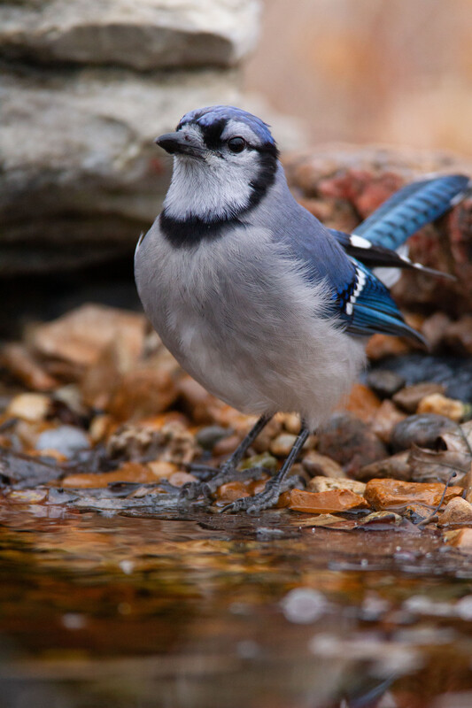
What animals do we usually see during the daytime? What do they usually look like?
6D
Exploring Missouri – 6D Good Morning, Good Night: Explain
30
Notes:
Discuss the colorful daytime birds, highlighting familiar birds, including cardinals, robins, and blue jays.
Animal in picture: Blue Jay

Slide 31
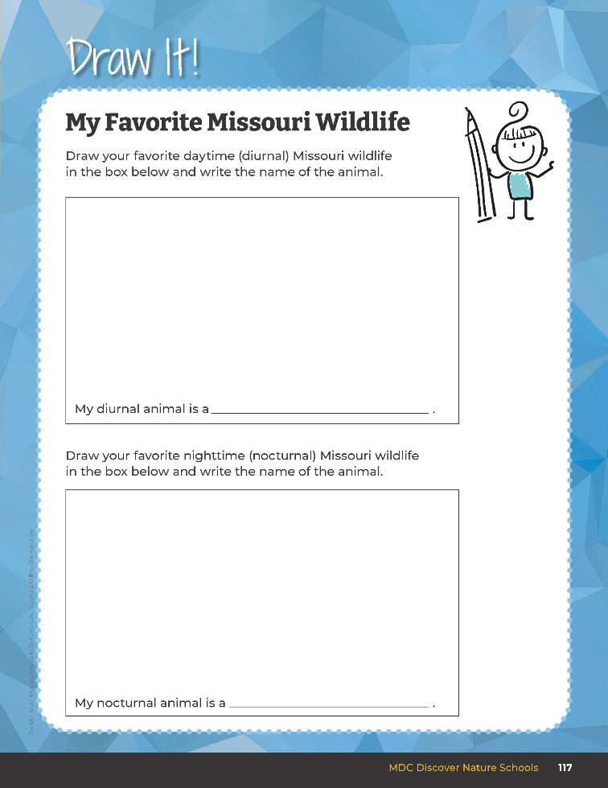
What is your favorite daytime, or diurnal, Missouri animal?
6D
Exploring Missouri – 6D Good Morning, Good Night: Explain
31
Notes:
Have students open their student guide to Draw It! 6D My Favorite Missouri Wildlife section on Page 117 and draw their animal in the box labeled “diurnal” and write the animal name in the blank.

Slide 32
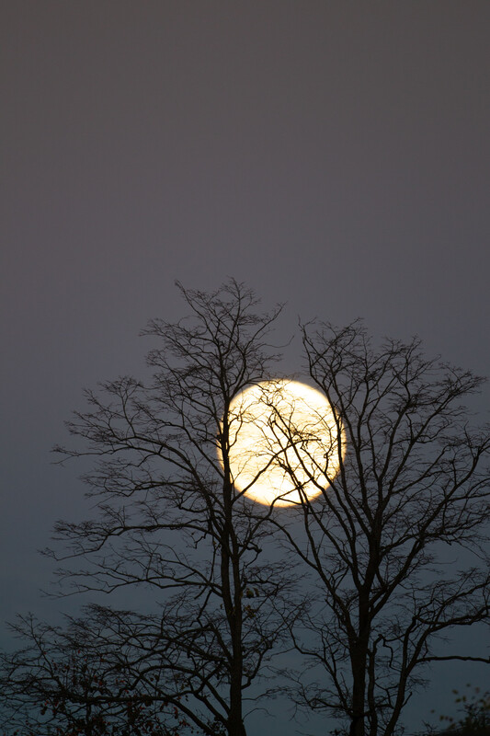
What things do we notice that tell us it is night?
6D
Exploring Missouri – 6D Good Morning, Good Night: Explain
32
Notes:
Discuss characteristics of daytime including the moon and stars.

Slide 33
What animals do we usually see or read about that move in the nighttime?
What senses do they use?
What do they usually look like?
6D
Exploring Missouri – 6D Good Morning, Good Night: Explain
33
Notes:
Discuss the less colorful nighttime birds, highlighting the different species of owls and nighthawks.

Slide 34
What is your favorite nighttime, or nocturnal, Missouri animal?
6D
Exploring Missouri – 6D Good Morning, Good Night: Explain
34
Notes:
On the same page of the student guide, Draw It! 6D My Favorite Missouri Wildlife on Page 117, have students draw their nocturnal animal in the box labeled “nocturnal” and write the animal name in the blank.

Slide 35
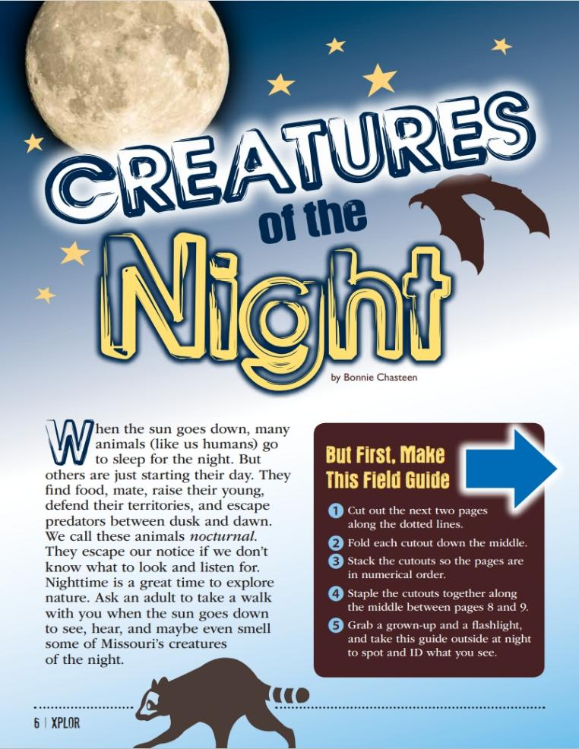
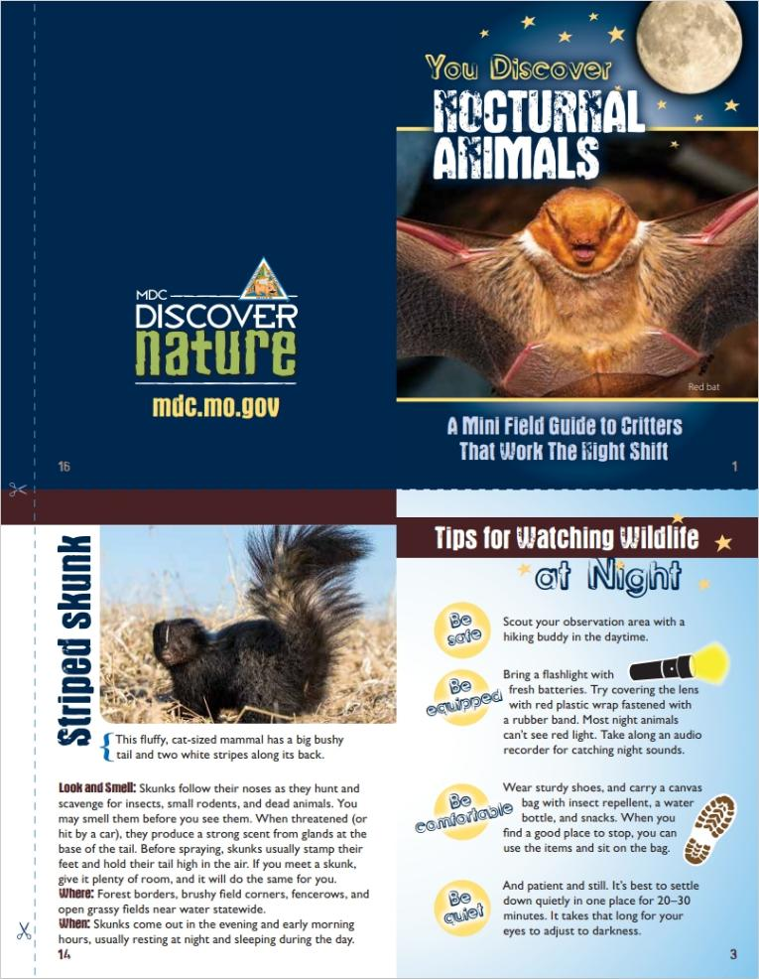
6D
Exploring Missouri – 6D Good Morning, Good Night: Explain
35
Notes:
From the MDC Teacher Portal, display and distribute copies of Creatures of the Night by Bonnie Chasteen from the January 2017 issue or Xplor.
Teacher Note: If time allows, have students create their own nocturnal animal field guide by following directions in the article. Print pages 9-12 of the article.

Slide 36
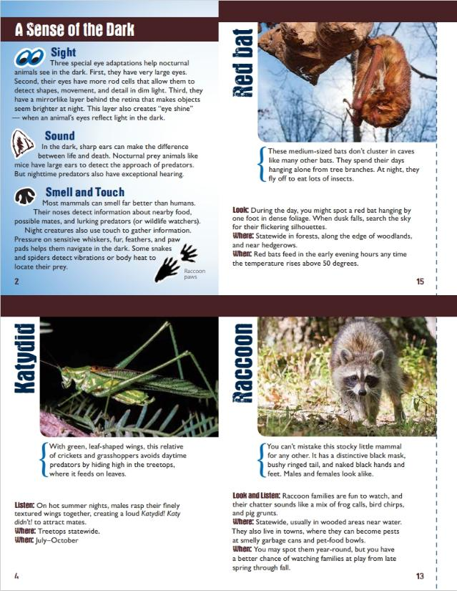
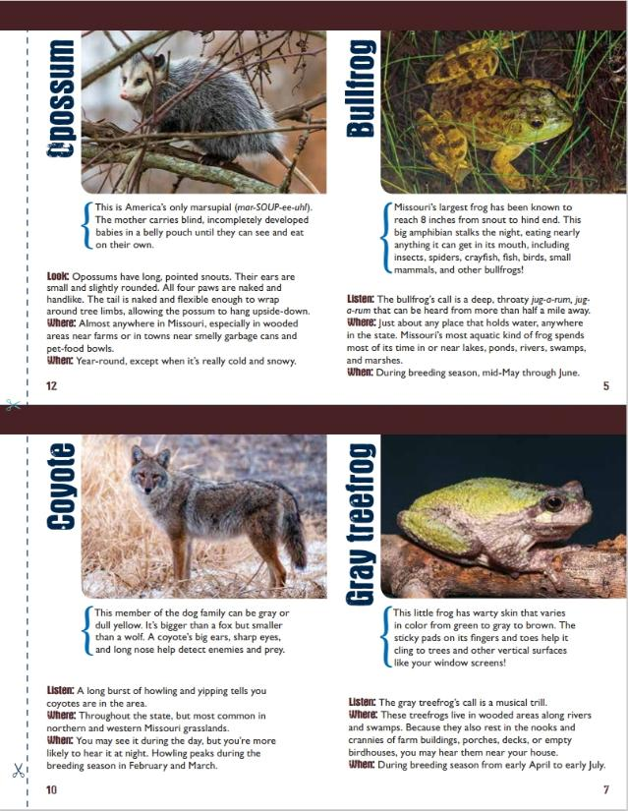
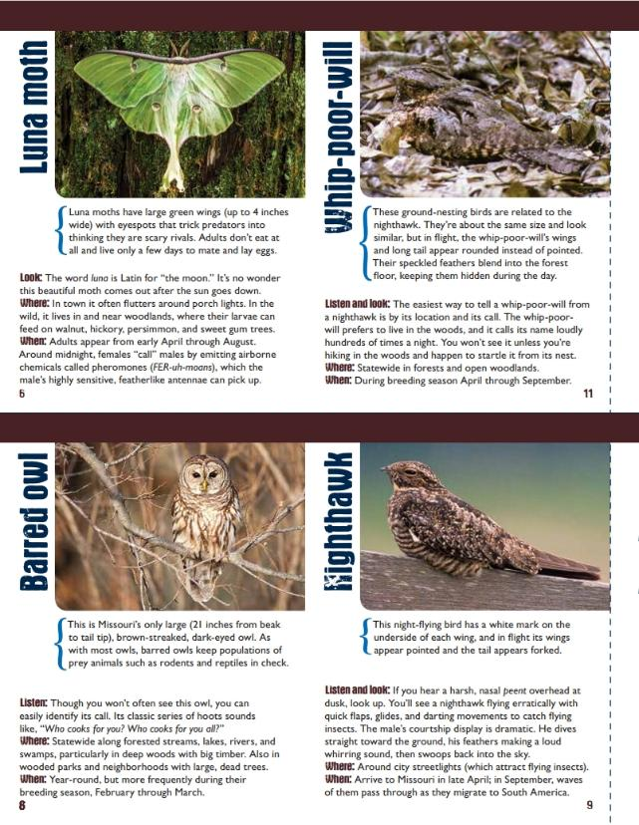
6D
Exploring Missouri – 6D Good Morning, Good Night: Explain
35

Slide 37
What does the animal look like?
How does it use its senses?
When does it move around to look for food, shelter, and water?
6D
Exploring Missouri – 6D Good Morning, Good Night: Elaborate
37
Notes:
You are going to choose on native Missouri animal to learn about. Think about the characteristics of that animal.

Slide 38
Investigate:
Coloration
Size and location of the eyes
Shape, size, and location of the ears
Shape and size of the nose
Time when animal is active
6D
Exploring Missouri – 6D Good Morning, Good Night: Elaborate
38
Notes:
Have students investigate aspects of their selected animal.

Slide 39
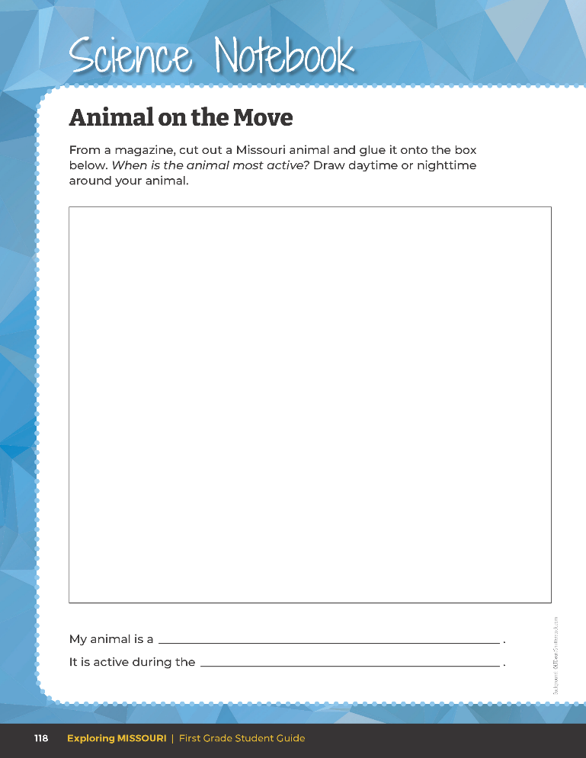
From a magazine, cut out a Missouri animal and glue it into the box. Then, draw a background picture depicting what it looks like in surrounding when your animal is usually awake.
6D
Exploring Missouri – 6D Good Morning, Good Night: Elaborate
39
Notes:
Teacher Note: Students will need access to classroom readers, the internet, and/or Xplor or Missouri Conservationist magazines from MDC to gather animal pictures and as reference materials.
Each student selects a native Missouri animal and glues/tapes a picture of this animal into the center of the page in the student guide Science Notebook 6D Animal on the Move section on Page 118.
Use websites and/or magazines to print or cut photos from for this activity and to learn more about the animal. Once students have gathered evidence of animal needs and characteristics and have cut out and/or printed their animal and placed it into the book, have them draw a background picture depicting what it looks like in surroundings when their animal is usually awake.
Have students explain their picture, sharing the animal name and when it is active. Evaluate student explanations and answers to questions as they share their student book work.

Slide 40

When are these animals active? Why?
6D
Exploring Missouri – 6D Good Morning, Good Night: Evaluate
40
Notes:
Refer to the Lesson 6D Good Morning, Good Night introduction page with pictures of the different Missouri animals.

Slide 41
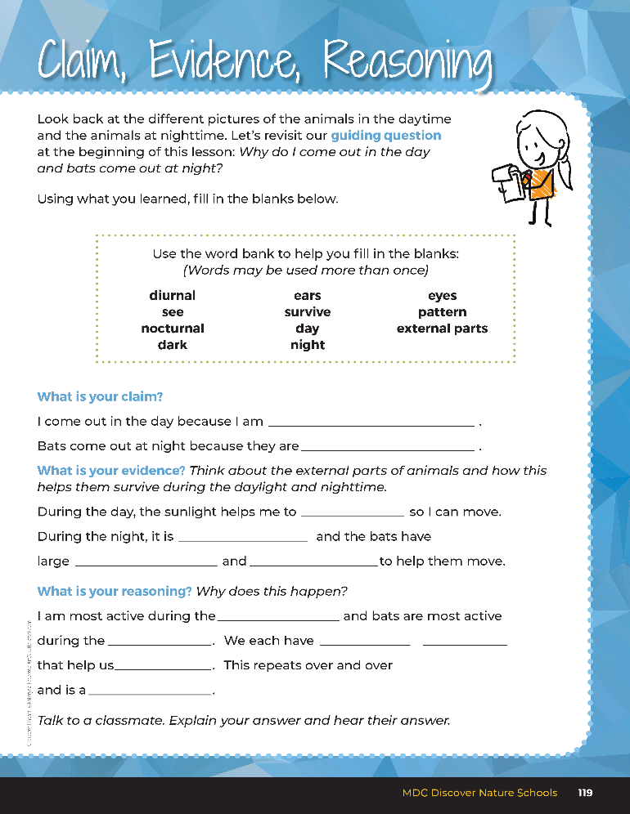

Guiding Question:
Why do I come out in the day and bats come out at night?
6D
Exploring Missouri – 6D Good Morning, Good Night: Evaluate
41
Notes:
After exploring the different external parts of the animals and how this helps them eat and survive during certain parts of the day and night, have students open their student guides to the Claim, Evidence, Reasoning section on Page 119. Discuss the page with the students – read the guiding question and explain that students need to fill in the blanks to answer the questions.

Slide 42
Answers
diurnal
nocturnal
see
dark
eyes
ears
day
night
parts
external
survive
pattern
6D
Exploring Missouri – 6D Good Morning, Good Night: Evaluate
42
Notes:
Rubric:
4 (Exceeds) – Students write the correct claim, evidence, and reasoning into the blanks.
3 (Meets) – Students write either the correct claim or evidence into the blanks and/or the correct reasoning.
2 (Partially Meets) – Students write either the correct claim or evidence into the blanks and do not write the correct reasoning.
1 (Doesn’t Meet) – Students do not provide the correct claim, evidence, or reasoning.

Slide 43

Optional: Cross-Curricular Extension
Art
Create “shadow people”
Create a 3-D diorama of the sky (habitat) for your animal
Create a mask of your animal and create a play of what various classroom animals do throughout a 24-hour day
6D
Exploring Missouri – 6D Good Morning, Good Night: Cross-Curricular Extension
43
Notes:
Art
Use a long roll of paper, go outside, and trace each other’s shadows. Note the time and create “shadow people.” Compare the different shadows at different times of day. Teacher Note: These would make excellent hallway decorations to celebrate sun and shadow observations.
Using a shoebox or piece of cardboard, create a 3-D diorama of the sky (habitat) for your animal. Use your drawing as a guide as you create your diorama. You may choose to decorate the outside of your box. Draw, cut out, and decorate any pieces that you need for your landscape and glue or tape them into your box. Students may create trees, people, or other natural objects into their scene.
Create a mask of your animal and create a play of what various classroom animals do throughout a 24-hour day. Use a sun to represent daytime and a moon to represent nighttime.
Create a classroom mural. Part of the mural will have blue paper to represent day and the other half black paper for night. Have students use pastels or tempera paint to draw animals on the mural. Utilize recycled materials to add dimension, including grass, trees, nests, etc.

Slide 44
Optional: Cross-Curricular Extension
Math
Have students begin tracking moon phases during the calendar time and recording it among data collected on the calendar.
6D
Exploring Missouri – 6D Good Morning, Good Night: Cross-Curricular Extension
44
Notes:
Math
Have students begin tracking moon phases during calendar time and recording it among data collected on the calendar.

Slide 45
Optional: Cross-Curricular Extension
Social Studies
Use the Native American story, discussing what the animals learned and how we can use these lessons and apply them to our classroom and how we interact with our classmates.
6D
Exploring Missouri – 6D Good Morning, Good Night: Cross-Curricular Extension
45
Notes:
Social Studies
Use the Native American story, discussing what the animals learned and how we can use these lessons and apply them to our classroom and how we interact with our classmates.

