Slide 1
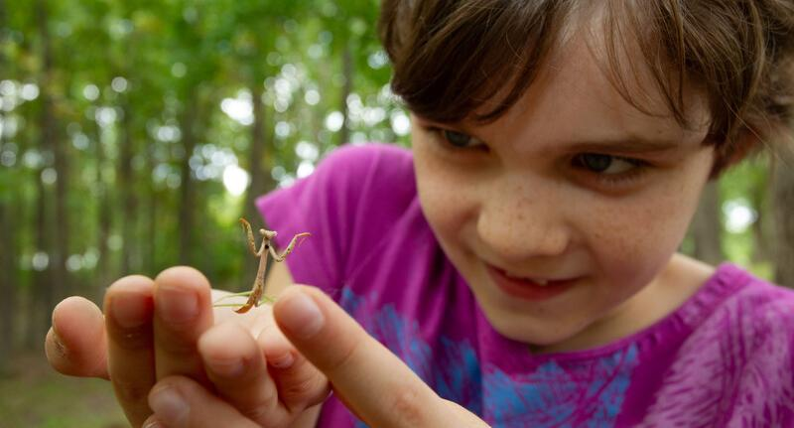

Exploring
MISSOURI
6C: How the Moon Changes

Slide 2
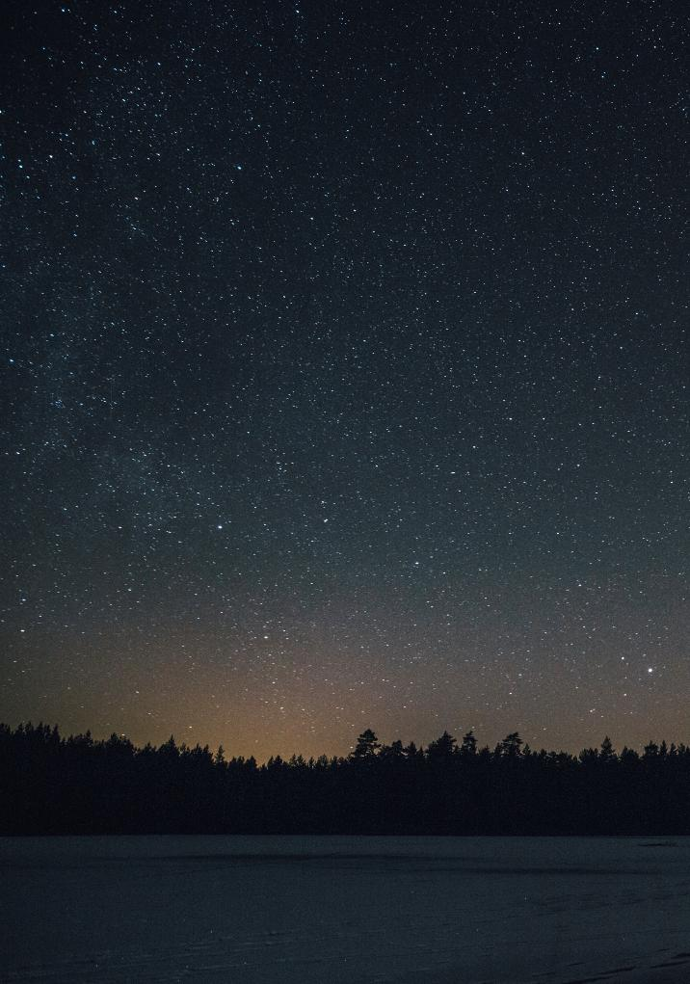
Guiding Question:
When is the best time to see stars?
6C
Exploring Missouri – 6C How the Moon Changes: Engage
2

Slide 3
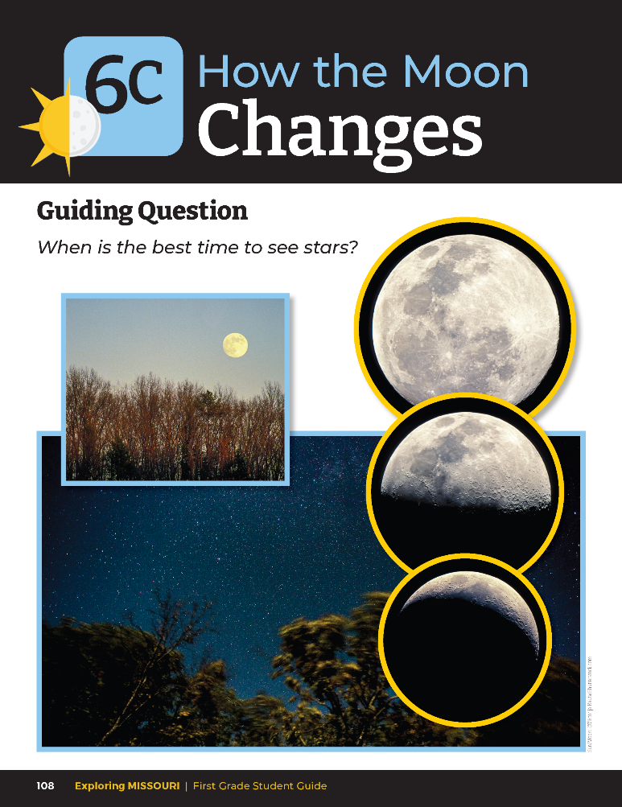
Does the moon always look the same?
Does it always follow the same path across the sky?
What else can we see at night?
6C
Exploring Missouri – 6C How the Moon Changes: Engage
3
Notes:
Refer to the pictures of the moon in the student guide on Lesson 6C How the Moon Changes introduction section on Page 108.

Slide 4
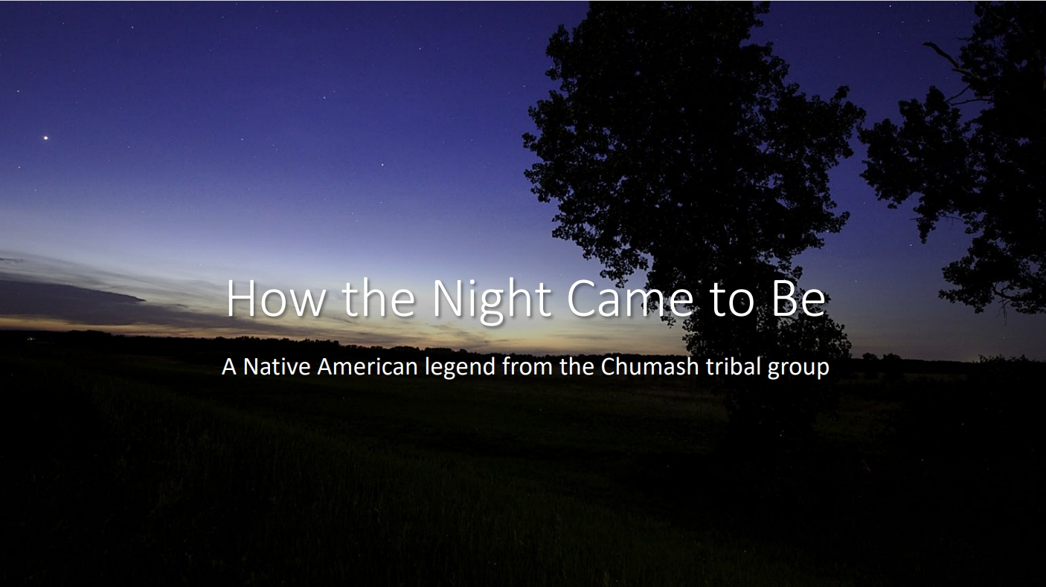
6C
Exploring Missouri – 6C How the Moon Changes: Engage
4
Notes:
Display the How the Night Came to Be Presentation. Read aloud the story. It is the Native American story Hole in the Blanket/How the Night Sky Came to Be legend from the Chumash tribal group.

Slide 5
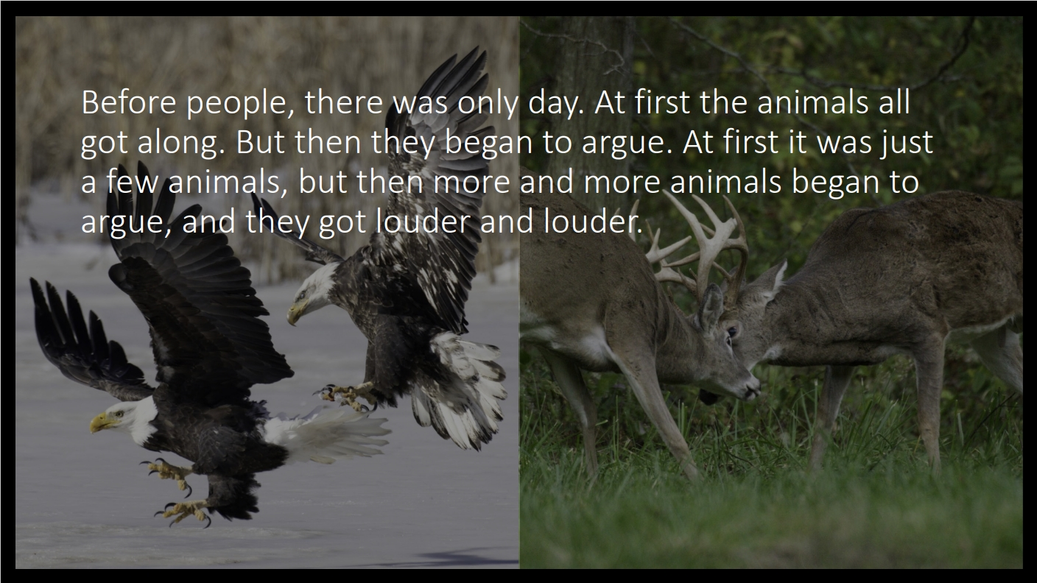
6C
Exploring Missouri – 6C How the Moon Changes: Engage
5
Notes:
Animals in Pictures: Bald Eagle and White-tailed Deer

Slide 6
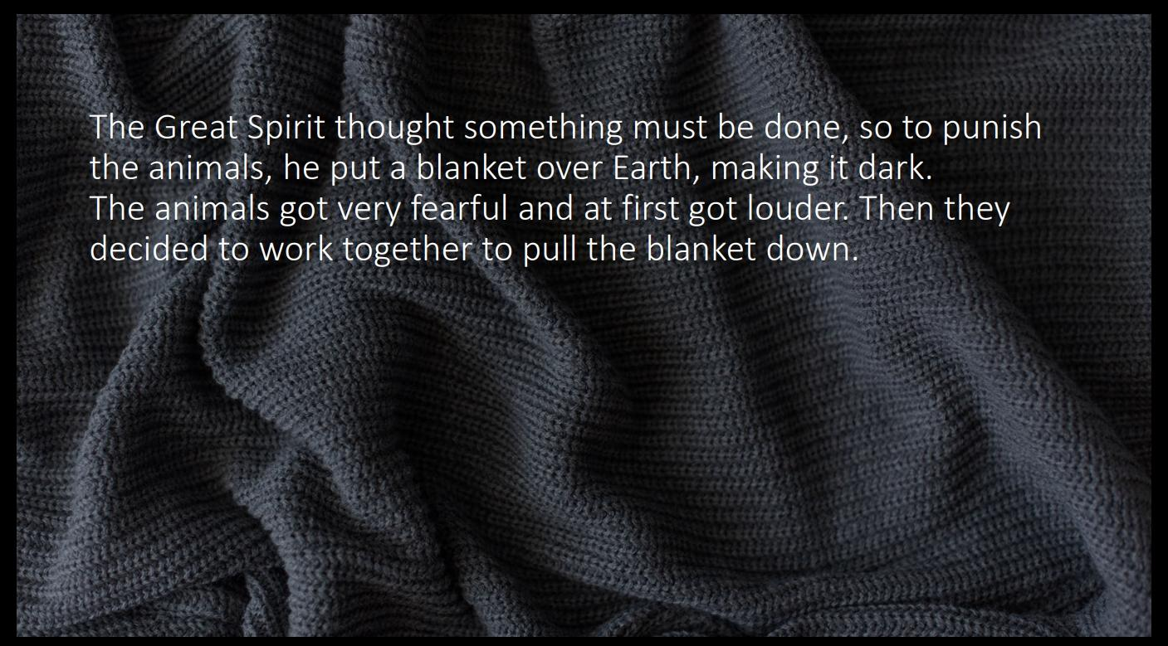
6C
Exploring Missouri – 6C How the Moon Changes: Engage
6

Slide 7
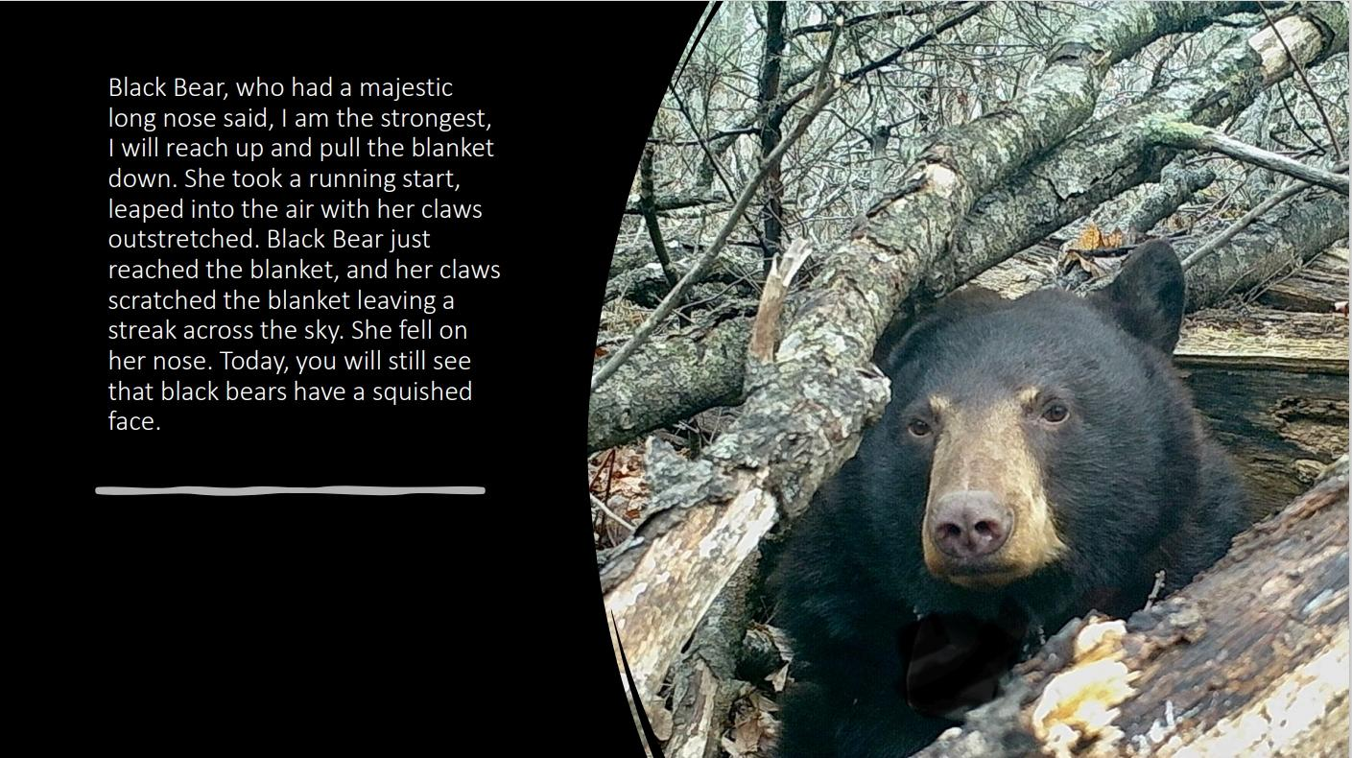
6C
Exploring Missouri – 6C How the Moon Changes: Engage
7
Notes:
Animal in picture: Black bear

Slide 8
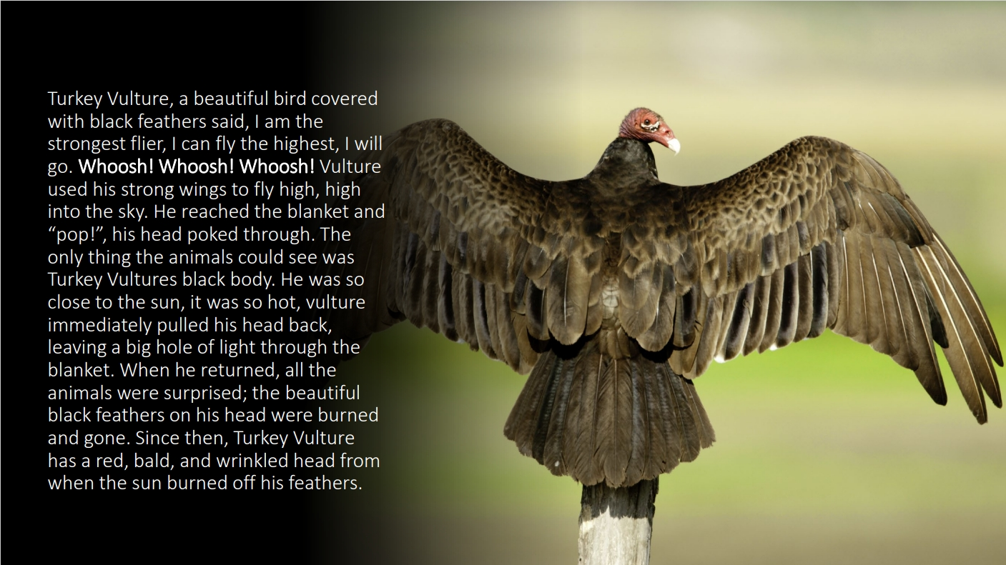
6C
Exploring Missouri – 6C How the Moon Changes: Engage
8
Notes:
Animal in Picture: Turkey Vulture

Slide 9
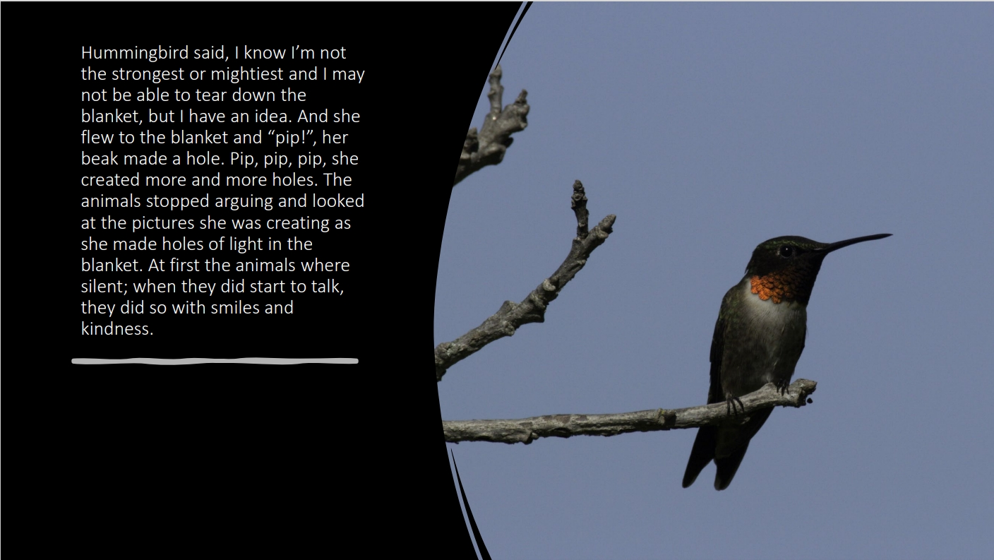
6C
Exploring Missouri – 6C How the Moon Changes: Engage
9
Notes:
Animal in Picture: Ruby-throated Hummingbird

Slide 10
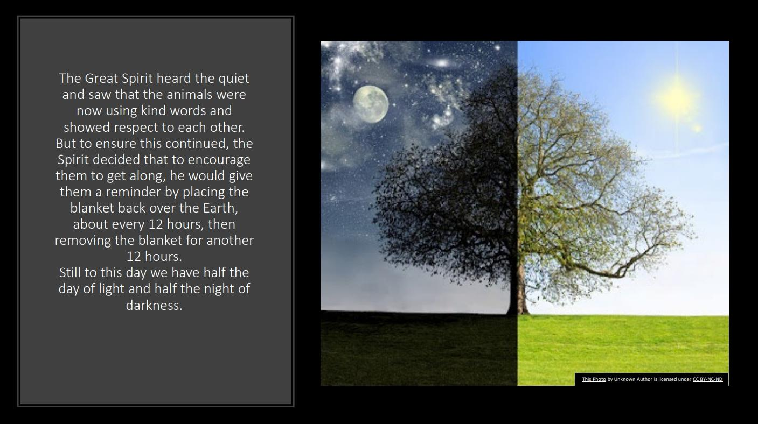
6C
Exploring Missouri – 6C How the Moon Changes: Engage
10

Slide 11
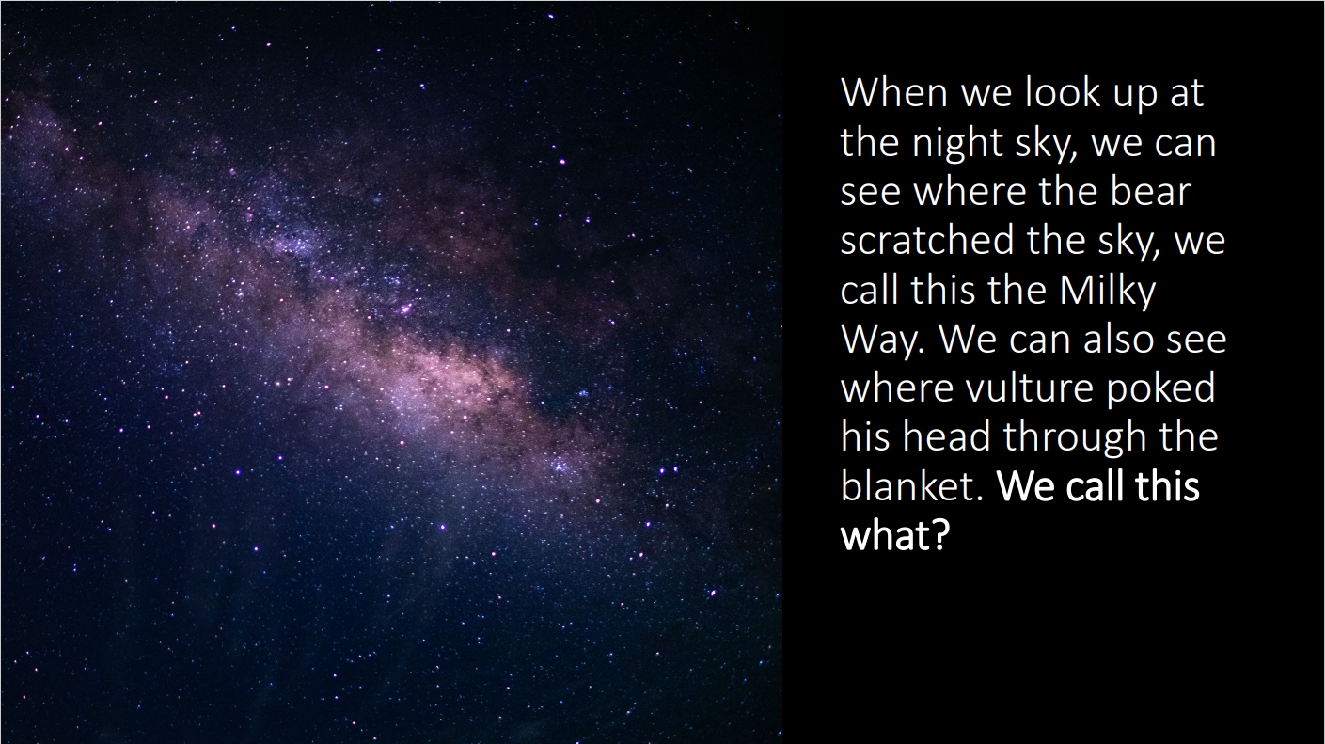
6C
Exploring Missouri – 6C How the Moon Changes: Engage
11

Slide 12
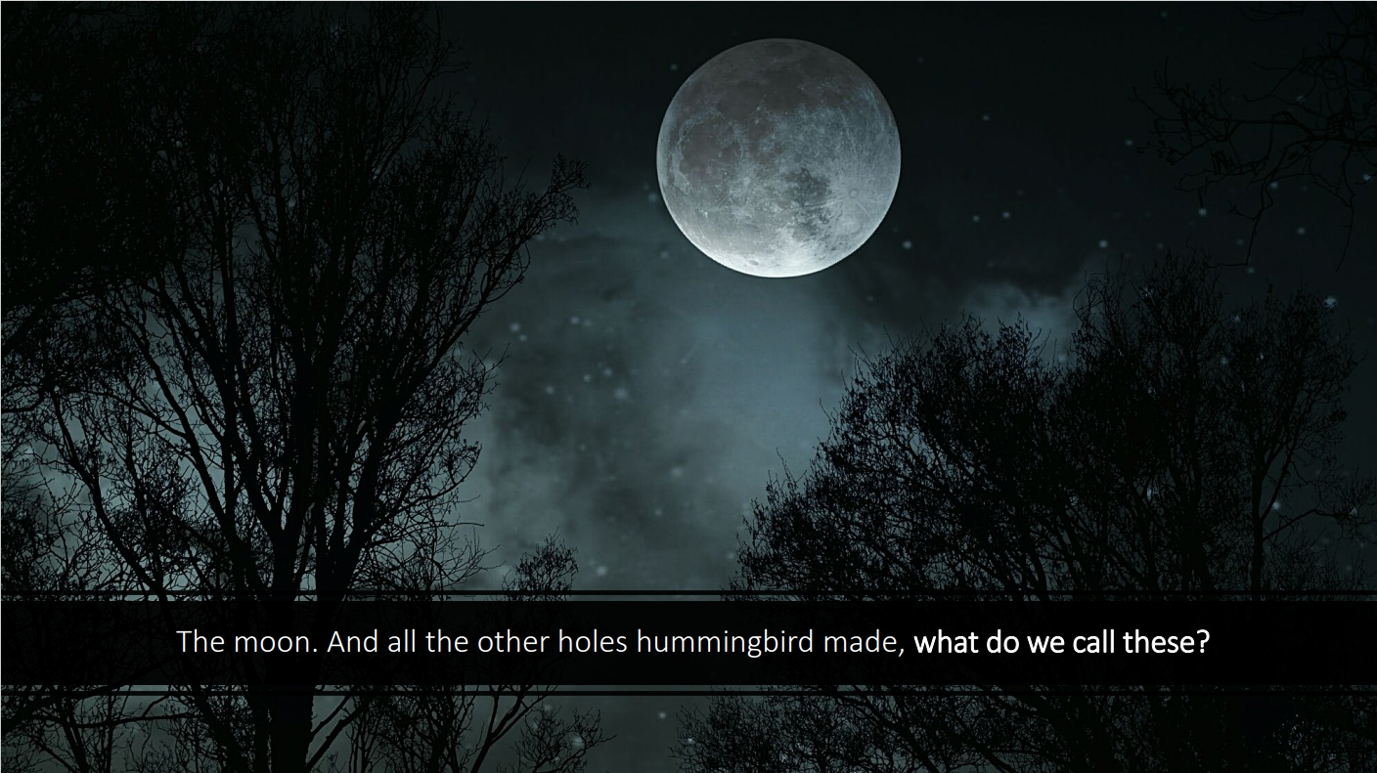
6C
Exploring Missouri – 6C How the Moon Changes: Engage
12

Slide 13
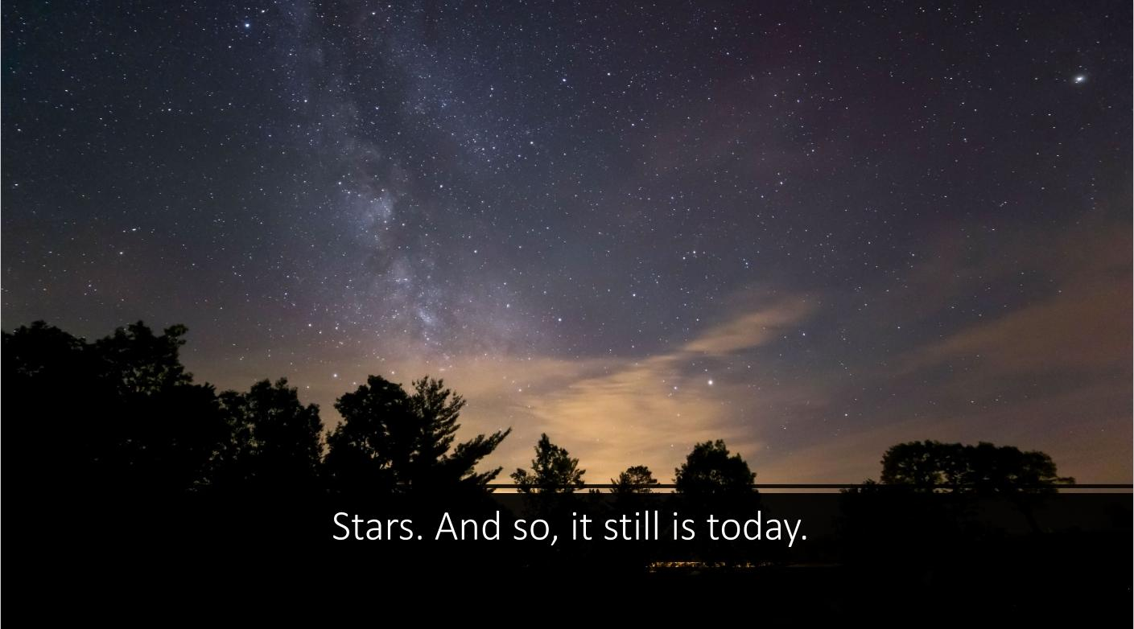
6C
Exploring Missouri – 6C How the Moon Changes: Engage
13

Slide 14
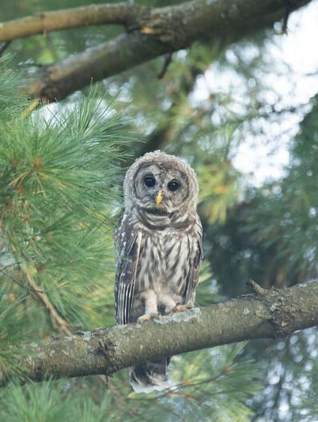
What do we know about what animals come out at night?
6C
Exploring Missouri – 6C How the Moon Changes: Explore
14
Notes:
Animal in picture: Barred owl

Slide 15
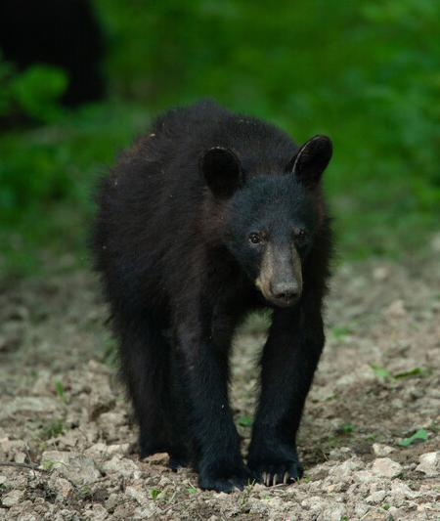
What parts of the story are factual or real?
6C
Exploring Missouri – 6C How the Moon Changes: Explore
15
Notes:
Black bears have a squished face, turkey vultures have a bald head, there is night and day, the Milky Way, moon and stars come out at night.
Animal in Picture: Black Bear

Slide 16
What facts do we know about when the moon comes out?
Does it come out every evening no matter what?
Does it follow the same path as the sun?
What about when the moon disappears?
6C
Exploring Missouri – 6C How the Moon Changes: Explore
16

Slide 17
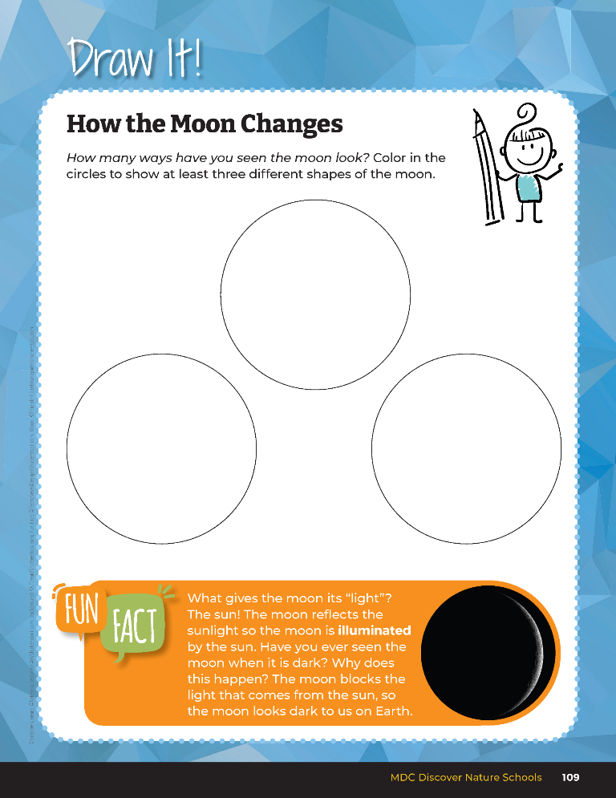

What shapes have you seen of the moon?
6C
Exploring Missouri – 6C How the Moon Changes: Explore
17
Notes:
Have students complete the student guide Draw It! 6C How the Moon Changes on Page 109. On this page, students will draw the different shapes or ways they have seen the moon look.

Slide 18
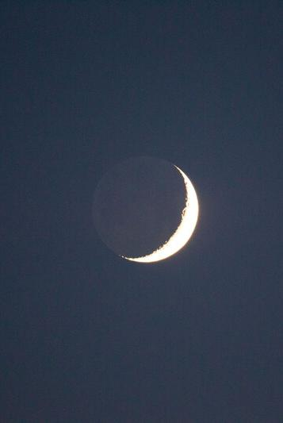
Why do you think the moon changes in so many ways?
6C
Exploring Missouri – 6C How the Moon Changes: Explore
18
Notes:
After students have completed this notebook activity, discuss the following:

Slide 19
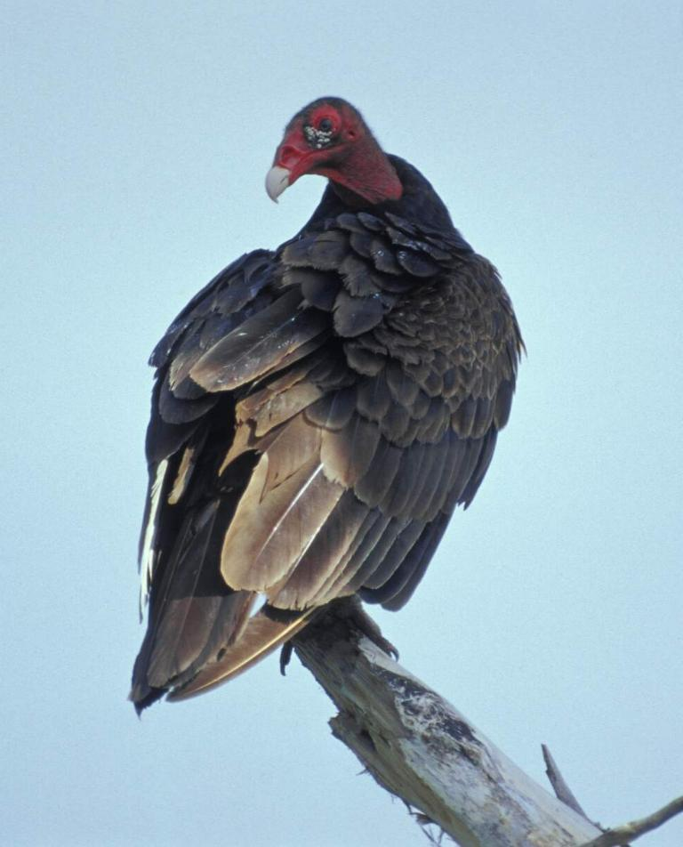
In the story, what animal creates the moon?
6C
Exploring Missouri – 6C How the Moon Changes: Explore
19
Notes:
Vulture.
Animal in Picture: Turkey Vulture

Slide 20
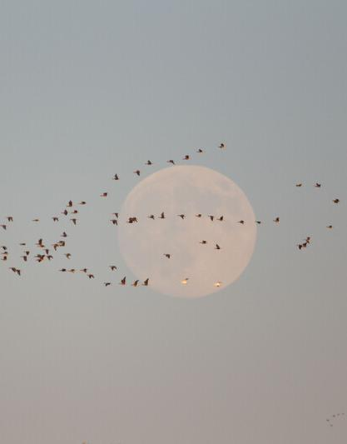
What shape is the moon then?
6C
Exploring Missouri – 6C How the Moon Changes: Explore
20
Notes:
Round, full moon.

Slide 21
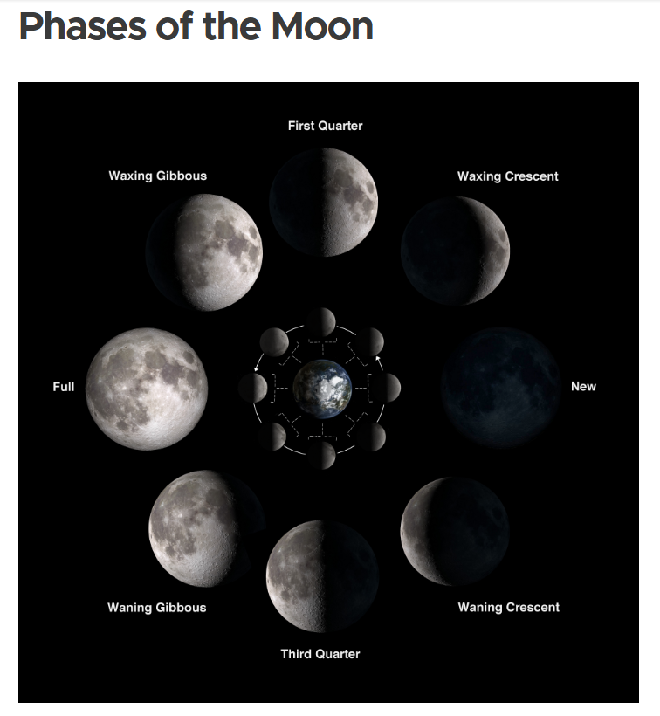
6C
Exploring Missouri – 6C How the Moon Changes: Explore
21
Notes:
From the link in the MDC Teacher Portal, display the February and March Moon Phase Calendars. In small groups (about four students/group), look at two months of the moon phase calendars. Link: Phases of the Moon - Moon: NASA Science

Slide 22
What do you notice is happening to the moon each night?
6C
Exploring Missouri – 6C How the Moon Changes: Explore
22

Slide 23
What do you notice about your drawings and the moon pictures we are looking at?
6C
Exploring Missouri – 6C How the Moon Changes: Explore
23

Slide 24
Illumination
6C
Exploring Missouri – 6C How the Moon Changes: Explain
24
Notes:
Demonstrate how the moon moves around Earth and the only part of the moon that can be seen is the part lit up by the sun. We call this illumination.

Slide 25

Demonstration
Link:
https://youtu.be/EQAhX4ff7m0
6C
Exploring Missouri – 6C How the Moon Changes: Explain
25
Notes:
Use a flashlight to represent the sun and a basketball to represent the moon. You represent the Earth. Turn off the lights. Hold the basketball up high in the air. Have one student stand on a chair with the flashlight pointing directly at the basketball. The student will need to be at the same height as you. The student never leaves their station and always points the light at the basketball. With your back to the student and the basketball held high so the light is shining directly on the basketball (full moon), start turning slowly in a counterclockwise direction so the basketball is orbiting around you. As you turn your body, you will notice the light fade on the moon. When you are fully facing the student with the basketball high in your hand, the light is blocked by the moon (new moon).

Slide 26
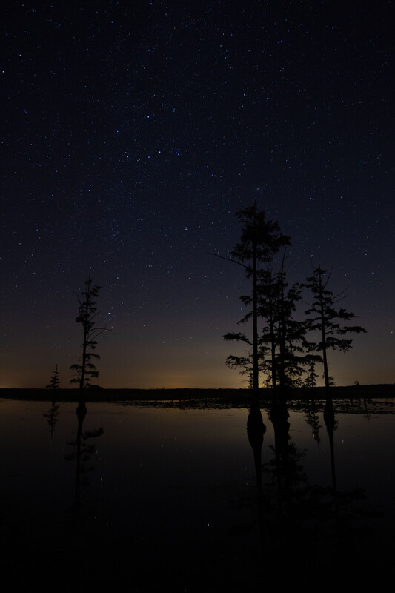
So, when do you think the stars are most visible? Why?
6C
Exploring Missouri – 6C How the Moon Changes: Explain
26
Notes:
When the moon is darkest because that is when the sky is at its darkest.
As you continue to turn, the light will start to show, or illuminate, on the other side of the moon. As you come back full circle with your back to the student, you will see another full moon.
Have students take turns with the flashlight and basketball to ensure they personally see how the shadow of the moon changes as the moon rotates around Earth (The student holding the ball).

Slide 27
Moon Phases Demonstration Video
https://youtu.be/wz01pTvuMa0?si=iUJDbE27TZj7qSLK
Link:
6C
Exploring Missouri – 6C How the Moon Changes: Explain
27

Slide 28
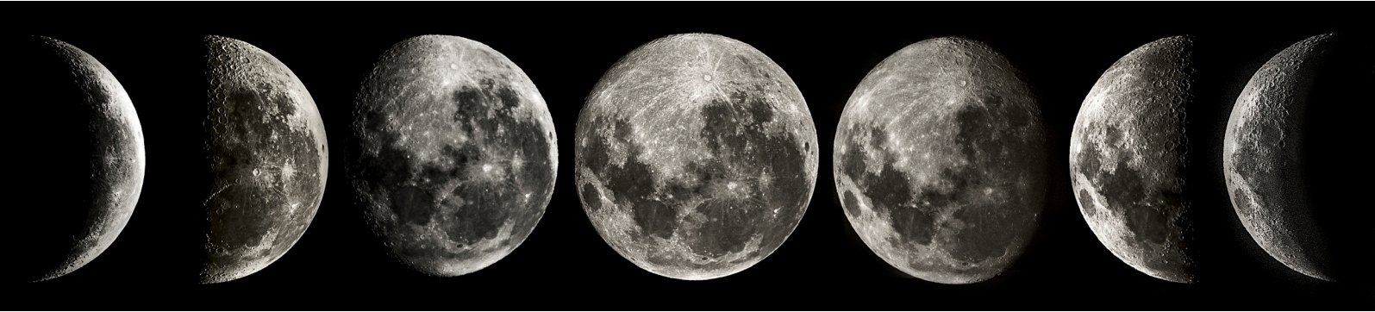
6C
Exploring Missouri – 6C How the Moon Changes: Explain
28
Notes:
Share Moon Phase Photos to help students begin to recognize various views of the moon. As you model the moon’s orbit of the Earth and corresponding light reflected, use these vocabulary terms.

Slide 29
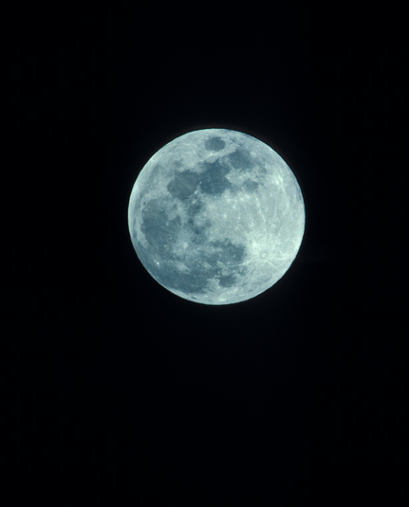
Full moon – a moon where all parts visible from Earth are reflecting sunlight
6C
Exploring Missouri – 6C How the Moon Changes: Explain
29
Notes:
As you model the moon’s orbit of the Earth and corresponding light reflected, use these vocabulary terms.

Slide 30
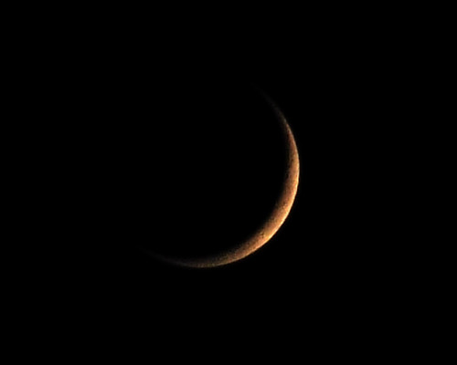
New moon – a moon where all parts visible from Earth are shaded
6C
Exploring Missouri – 6C How the Moon Changes: Explain
30

Slide 31
What illuminates the moon and makes it bright?
What is the moon reflecting?
6C
Exploring Missouri – 6C How the Moon Changes: Explain
31
Notes:
Sunlight

Slide 32

When is it the best time to see the stars? Why?
6C
Exploring Missouri – 6C How the Moon Changes: Explain
32
Notes:
When is it the best time to see the stars? (When the whole moon is dark/New Moon) Why? (The sky is at its darkest.)

Slide 33
Do the stars come out every night though?
6C
Exploring Missouri – 6C How the Moon Changes: Explain
33
Notes:
Yes.

Slide 34
How long do you think it takes for the moon to do one full rotation around the Earth?
6C
Exploring Missouri – 6C How the Moon Changes: Explain
34
Notes:
(Answers will vary.) It takes one full month for us to see the different phases and shapes of the moon.

Slide 35
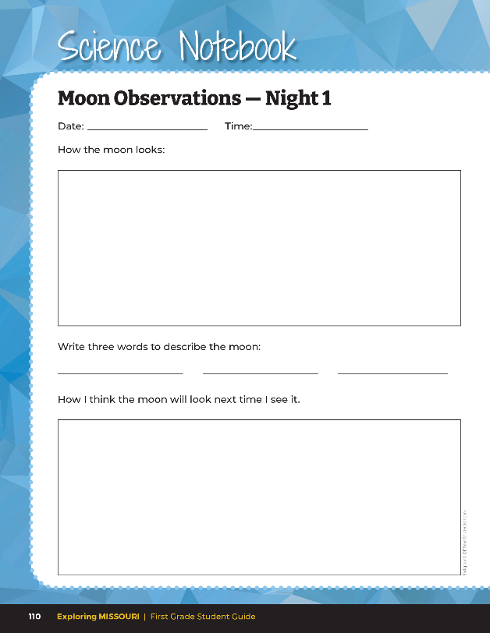
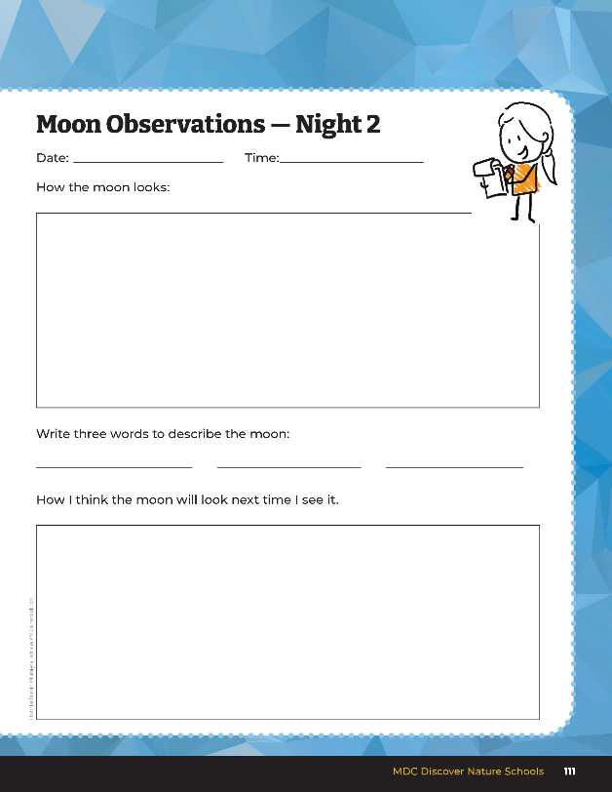
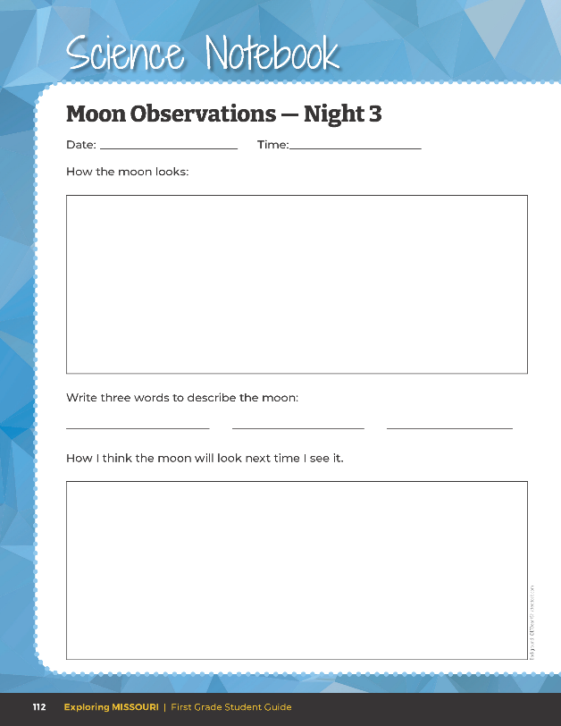
6C
Exploring Missouri – 6C How the Moon Changes: Elaborate
35
Notes:
Begin with a new or full moon, select one to three days of the week for students to observe at the same time each night and have students draw the way the moon looks that night in their student guide Science Notebook 6C Moon Observations Night 1, Night 2, and Night 3 pages 110-112.
Teacher Note: Ideally allow several days between each moon observation students make. If the teacher prefers, copies can be made of 6C Moon Observations Student Page and given to students to take home rather than taking home the student book. Upon returning to school, students can staple the completed take-home sheets onto the observation page in the student guide.
After three days of observations, discuss what they notice. Using what they know about patterns of the moon, ask students what they predict will happen next.
In the classroom, during calendar time, add a picture of what the moon looks like. Discuss the pictures of the changing moon.
Teacher Note: If time allows, you may want to expand student observations over a long period, preferably a full month, so students can see a complete moon cycle.

Slide 36

When is the best time to see stars?
6C
Exploring Missouri – 6C How the Moon Changes: Evaluate
36
Notes:
Refer to the Lesson 6C How the Moon Changes introduction page with the pictures of the moon and stars and night.

Slide 37
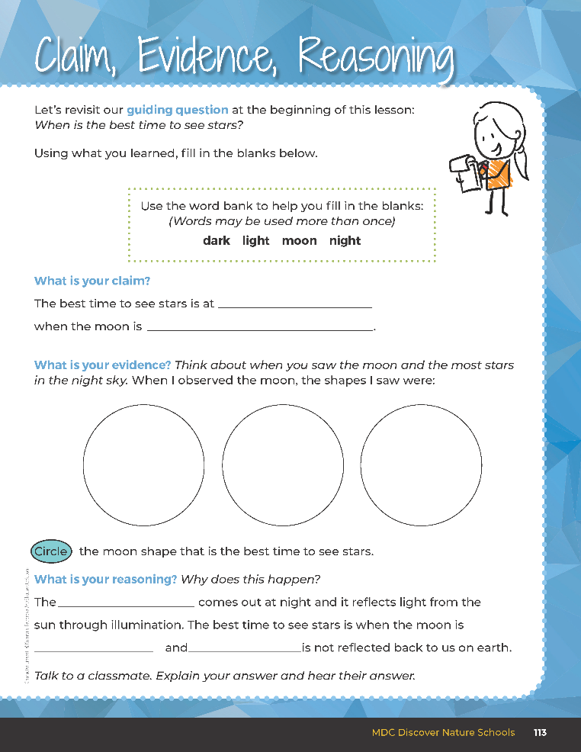

Guiding Question:
When is the best time to see stars?
6C
Exploring Missouri – 6C How the Moon Changes: Evaluate
37
Notes:
After exploring that moon and stars can be seen at night and that the moon takes on different shapes, have students open their student guides to the Claim, Evidence, Reasoning section on Page 113. Discuss the page with the students – read the guiding question and then explain what the students need to do to answer the questions (fill in the blanks, draw the moon shapes, and circle the moon phase that is best for seeing stars).

Slide 38

night
dark
Answers
moon
dark
light
6C
Exploring Missouri – 6C How the Moon Changes: Evaluate
38
Notes:
Rubric:
4 (Exceeds) – Students write the correct claim and draw the three shapes of the moon into the blanks and fill in all the blanks correctly for their reasoning.
3 (Meets) – Students write either the correct claim or draw some of the three shapes of the moon into the blanks and fill in most of the blanks correctly for their reasoning.
2 (Partially Meets) – Students do not write the correct claim or draw some of the three shapes of the moon into the blanks and fill in most of the blanks correctly for their reasoning.
1 (Doesn’t Meet) – Students do not write the correct claim or draw the three shapes of the moon into the blanks and do not fill in any of the blanks correctly for their reasoning.

Slide 39

What do we do at night?
How do our nighttime activities compare to what we do in the daytime?
6C
Exploring Missouri – 6C How the Moon Changes: Extend
39
Notes:
Teacher Note: Day and night animals will be discussed in the next lesson, Lesson 6D Good Morning, Good Night.
Let’s apply this idea to how the moon and night change and how we might change our own behavior.

Slide 40
How do our behaviors at night change throughout the year?
Are we doing the same activities, or do they change?
6C
Exploring Missouri – 6C How the Moon Changes: Extend
40
Notes:
Think about how these changes may apply to some of our wildlife in Missouri and if they also do something different at night. Keep this in mind for our next lesson.

