Slide 1
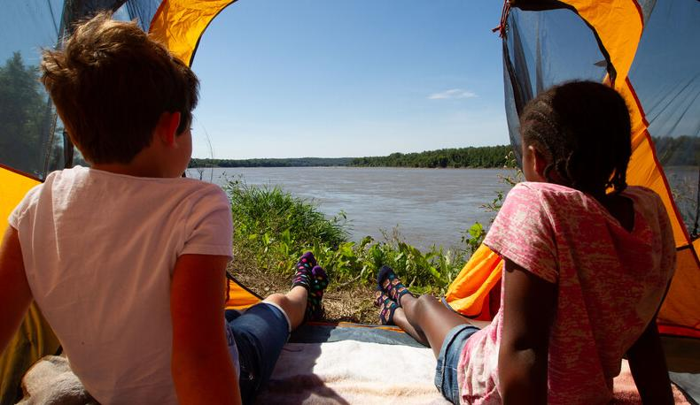

Life and Land in
MISSOURI
6C: Earth’s Natural Events

Slide 2
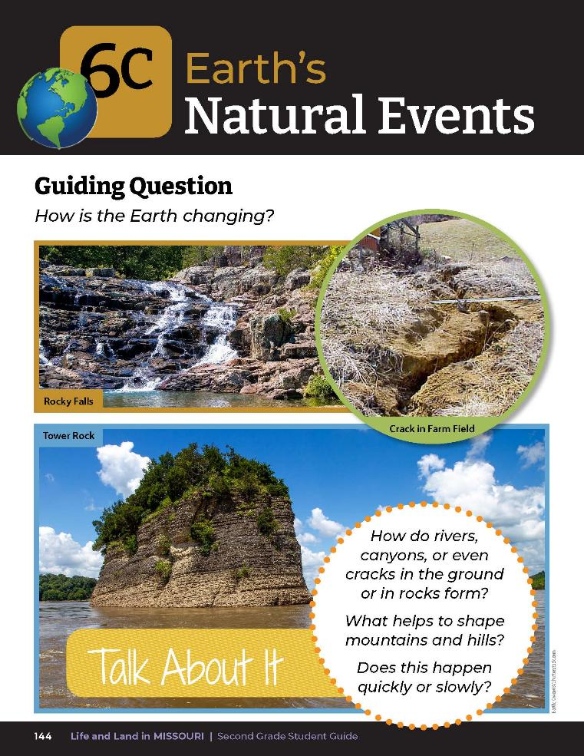
Guiding Question:
How is the Earth changing?
6C
Life and Land in Missouri – 6C Earth’s Natural Events: Engage
2
Notes:
Have students open their student guide to the Lesson 6C Earth’s Natural Events introduction on Page 144. Read the guiding question together.

Slide 3
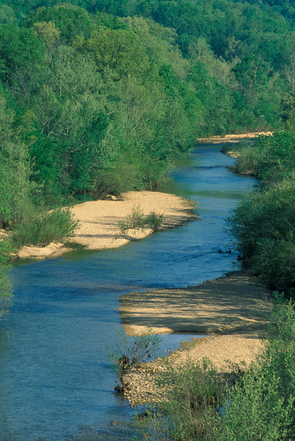
How do rivers, canyons, or even little ditches or cracks in rocks form?
6C
Life and Land in Missouri – 6C Earth’s Natural Events: Engage
3
Notes:
Discuss the Talk About It. Record ideas on the board.

Slide 4
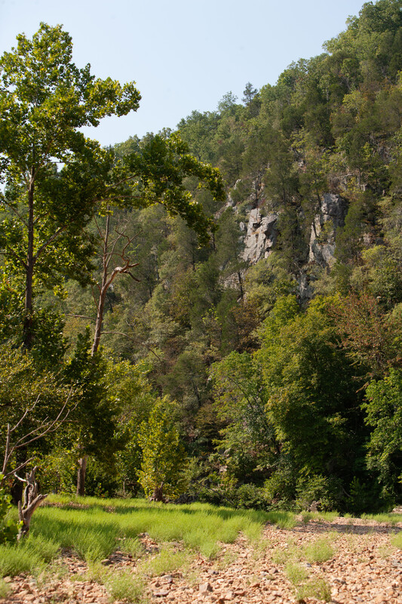
What helps to shape mountains and hills?
Does this happen quickly or slowly?
6C
Life and Land in Missouri – 6C Earth’s Natural Events: Engage
4

Slide 5
Watch the Nature’s Calling: Castor River, Mill Stream Gardens, and Hughes Mountain video.
Link:
https://youtu.be/FiXYjIkL3VU
6C
Life and Land in Missouri – 6C Earth’s Natural Events: Engage
5
Notes:
From the MDC Teacher Portal, watch the Nature’s Calling: Castor River, Mill Stream Gardens, and Hughes Mountain video which describes each natural area.

Slide 6
How is water changing the Earth in the video?
Were the changes in the video fast or slow?
6C
Life and Land in Missouri – 6C Earth’s Natural Events: Engage
6

Slide 7
Let’s go on a walk outside around the school!
While on the walk, refer to the photos of erosion.
6C
Life and Land in Missouri – 6C Earth’s Natural Events: Explore
7
Notes:
Take students on a walk outside around the school with their student guides. While on the walk, have students refer to the photos of erosion at the beginning of the lesson.

Slide 8
Do you see anything like this around your school?
What could be causing this?
Do you think this change happened quickly or slowly?
6C
Life and Land in Missouri – 6C Earth’s Natural Events: Explore
8

Slide 9

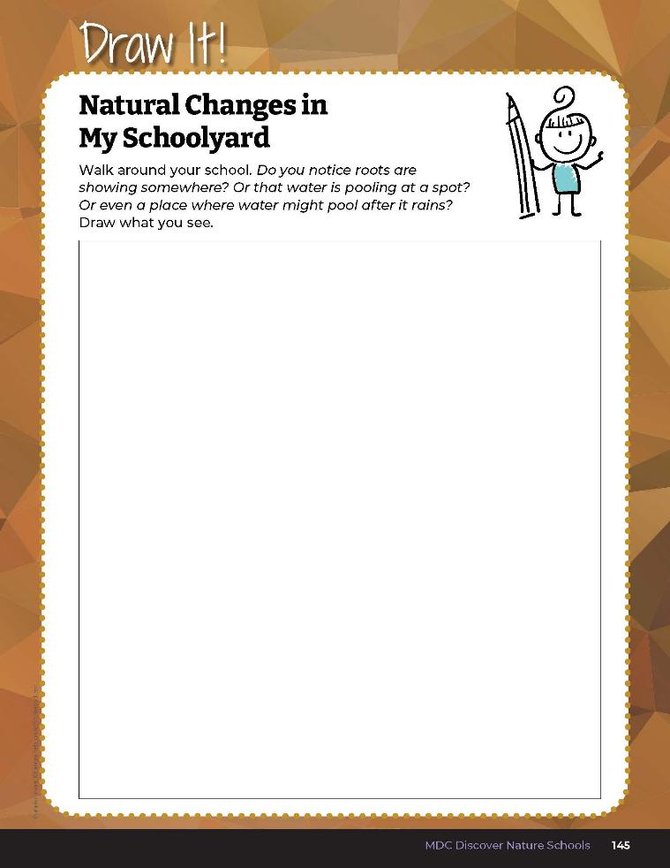
Draw what you see outside!
6C
Life and Land in Missouri – 6C Earth’s Natural Events: Explore
9
Notes:
Have student draw what they see outside on Draw It! 6C Natural Changes in My Schoolyard on Page 145.

Slide 10
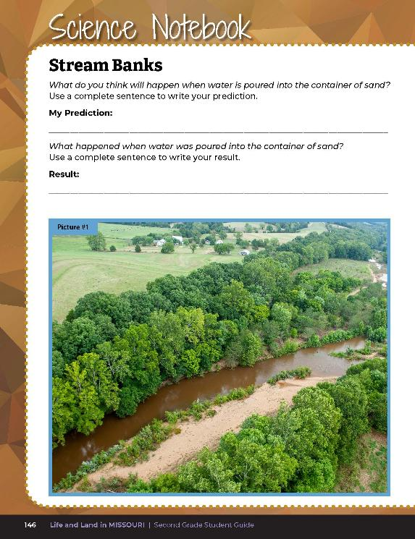
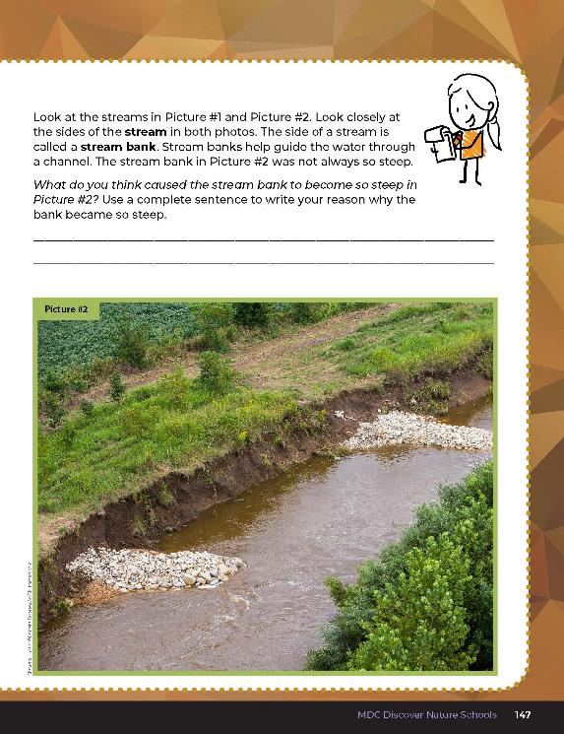
What happened to the stream in Picture #2?
Was it always that steep?
6C
Life and Land in Missouri – 6C Earth’s Natural Events: Explore
10
Notes:
Have students open to Science Notebook 6C Stream Banks on pages 146-147 in the student guide. Let’s investigate possible reasons why this could have happened.

Slide 11
What do you think will happen when I pour the water into the container?
Why do you think so?
6C
Life and Land in Missouri – 6C Earth’s Natural Events: Explore
11
Notes:
Stream Table Activity
Drill three holes into the bottom of one end of a plastic show box container. Fill the container with sand. Place the container on a desk with a side of the container with the holes over the edge and a cup or container underneath the holes. This is where the water will drain. Prop the container up on one side with a few books so the water will drain.
Have students gather in a circle around you.

Slide 12
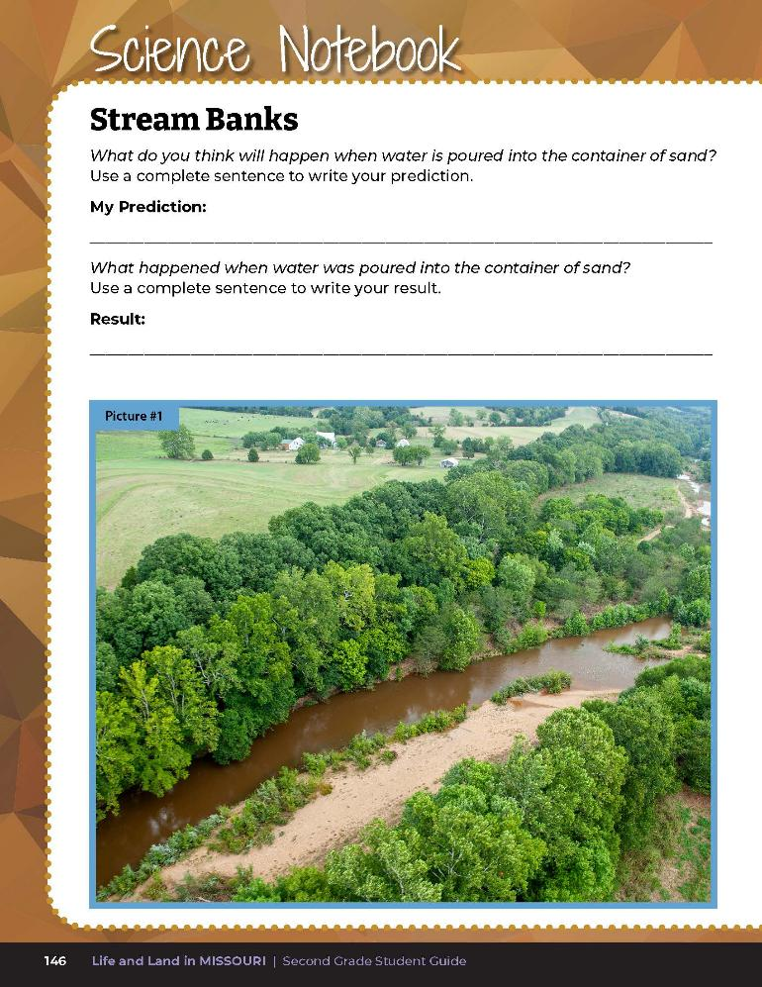
Write your predictions!
6C
Life and Land in Missouri – 6C Earth’s Natural Events: Explore
12
Notes:
Give students time to write their prediction into the Science Notebook 6C Stream Banks section on Page 146.

Slide 13
What is happening to the sand?
6C
Life and Land in Missouri – 6C Earth’s Natural Events: Explore
13
Notes:
Watch the sand as I pour the water into the container. What is happening to the sand? (Water is picking up the sand or pushing the sand.)

Slide 14
Where do you think the sand is going?
6C
Life and Land in Missouri – 6C Earth’s Natural Events: Explore
14
Notes:
Where do you think the sand is going? (The sand is going downstream.)

Slide 15
Describe and write the result of water being poured into the container of sand.
6C
Life and Land in Missouri – 6C Earth’s Natural Events: Explore
15
Notes:
Give students time to describe and write the result of water being poured into the container of sand.

Slide 16

What do you think caused the stream bank to become so steep?
Discuss as a group and answer this question in student guide.
6C
Life and Land in Missouri – 6C Earth’s Natural Events: Explore
16
Notes:
Allow students time to discuss as a group and answer this question in their student guide.

Slide 17
How does this compare to the photos of natural disasters you saw earlier as we studied? Would the river form quickly or slowly?
6C
Life and Land in Missouri – 6C Earth’s Natural Events: Explore
17
Notes:
Have students turn to the Science Notebook 6C Stream Banks pages again and view photos of the river.

Slide 18
How are these pictures like what we found in the schoolyard?
6C
Life and Land in Missouri – 6C Earth’s Natural Events: Explore
18

Slide 19
What is happening to the soil in the photos and on our schoolyard? What is moving the soil?
6C
Life and Land in Missouri – 6C Earth’s Natural Events: Explore
19

Slide 20
Water, wind, and ice can cause changes to the land.
It can occur quickly or slowly depending on the event.
6C
Life and Land in Missouri – 6C Earth’s Natural Events: Explain
20
Notes:
Give student discussion to help students conclude that water, wind, and ice can cause changes to the land and it can occur quickly or slowly depending on the event.

Slide 21
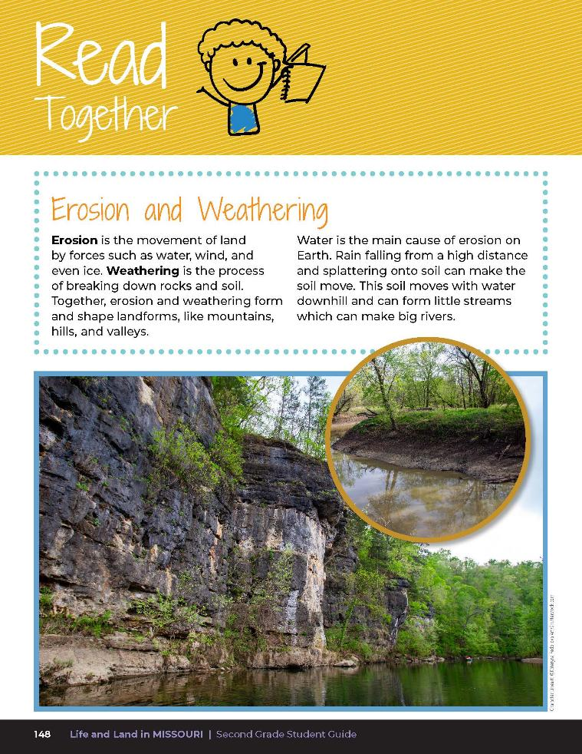
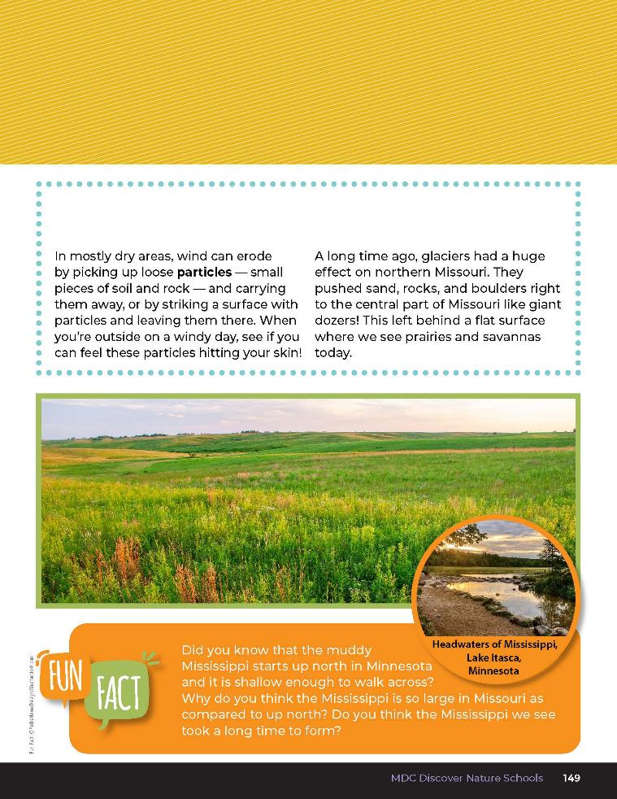
6C
Life and Land in Missouri – 6C Earth’s Natural Events: Explain
21
Notes:
Have students open their student guide to Read Together 6C Erosion and Weathering on pages 148-149.

Slide 22
What types of weathering and erosion do we see?
6C
Life and Land in Missouri – 6C Earth’s Natural Events: Explain
22

Slide 23
What do you think caused what you drew to happen? Why?
6C
Life and Land in Missouri – 6C Earth’s Natural Events: Explain
23
Notes:
Let’s revisit our drawing from earlier while we were outside.

Slide 24
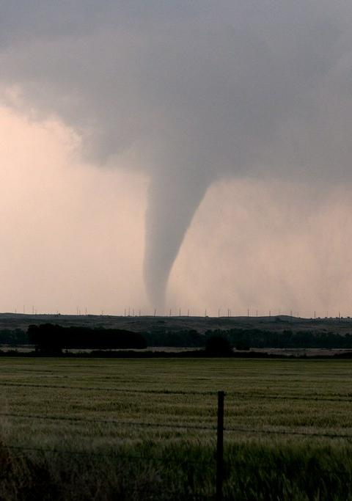
What did we study in the last lesson?
6C
Life and Land in Missouri – 6C Earth’s Natural Events: Elaborate
24
Notes:
(Natural disasters.)

Slide 25
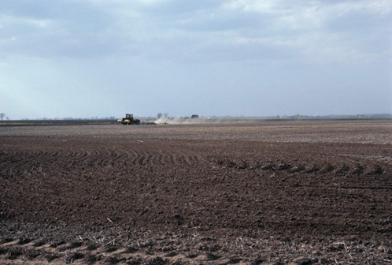
And this lesson?
6C
Life and Land in Missouri – 6C Earth’s Natural Events: Elaborate
25
Notes:
(Erosion and weathering.)

Slide 26
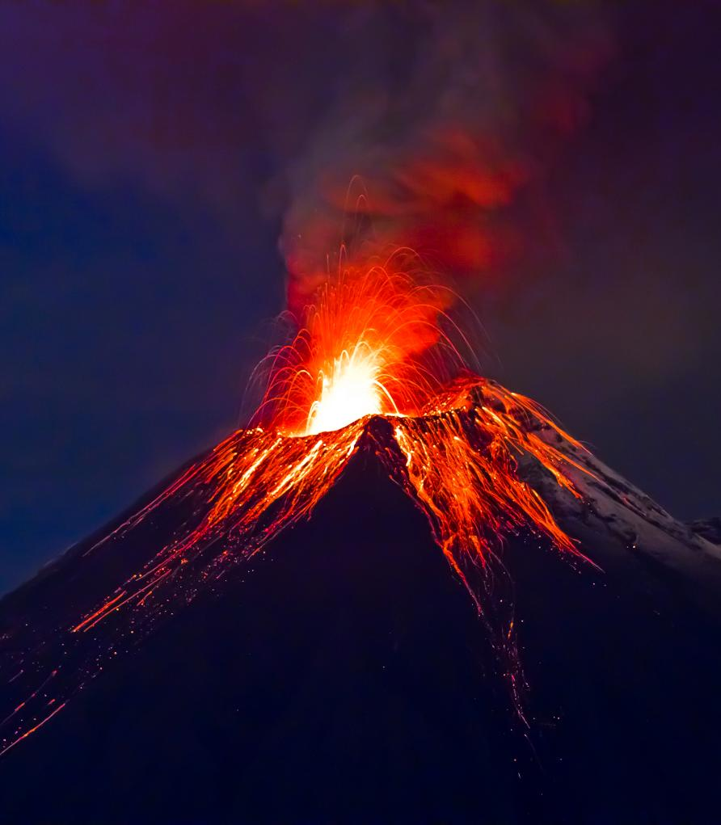
Which one can happen quickly?
6C
Life and Land in Missouri – 6C Earth’s Natural Events: Elaborate
26
Notes:
(Natural disasters like volcanic eruptions, tornadoes, earthquakes, floods, etc.)

Slide 27
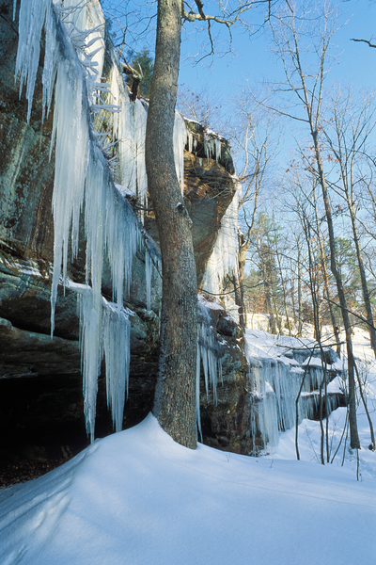
Which one can happen slowly?
6C
Life and Land in Missouri – 6C Earth’s Natural Events: Elaborate
27
Notes:
(Erosion and weathering that form rivers and canyons and shape mountains and hills, etc.)

Slide 28
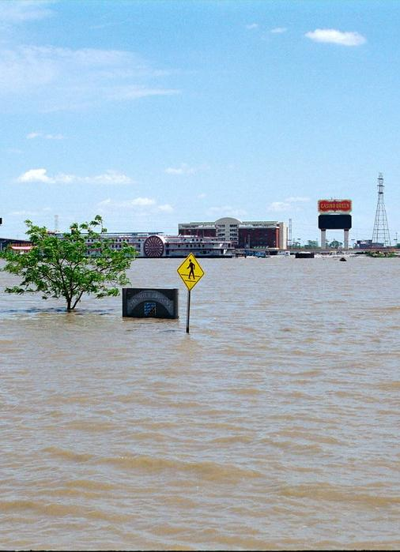
Can erosion happen quickly as well as slowly? What is an example?
6C
Life and Land in Missouri – 6C Earth’s Natural Events: Elaborate
28
Notes:
(Yes. Flooding events can cause erosion to happen quickly. [Students may give other examples.])

Slide 29
Let’s see if we can make a time scale comparing different natural events.
6C
Life and Land in Missouri – 6C Earth’s Natural Events: Elaborate
29
Notes:
Let’s see if we can make a time scale comparing different natural events. Brainstorm all natural events studied including:
Volcanic eruptions
Tsunamis
Hurricanes
Tornadoes
Floods
Avalanches
Landslides
Wildfires
Blizzards
Earthquakes
Droughts
And the formation of:
Canyons
Rivers
Prairies
Hills
Caves
Lakes

Slide 30
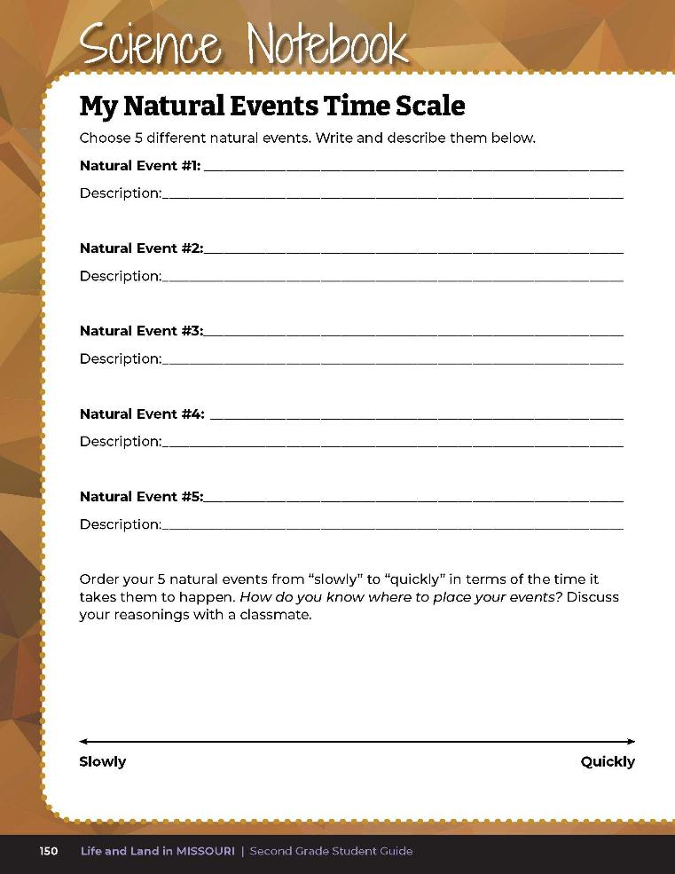
Choose 5 different natural events and order them from “slowly” to “quickly” in terms of the time it takes them to happen.
6C
Life and Land in Missouri – 6C Earth’s Natural Events: Elaborate
30
Notes:
Have students open their student guide to Science Notebook 6C My Natural Events Time Scale on Page 150. Students will write at least 5 items from the list and place each on the spectrum ranging from “slowly” to “quickly.” Have students define what “slowly” and “quickly” mean and write definitions on their time scale. Then have students transfer the natural events from the board to the time scale.

Slide 31
How do you know where to place certain natural events?
6C
Life and Land in Missouri – 6C Earth’s Natural Events: Elaborate
31

Slide 32
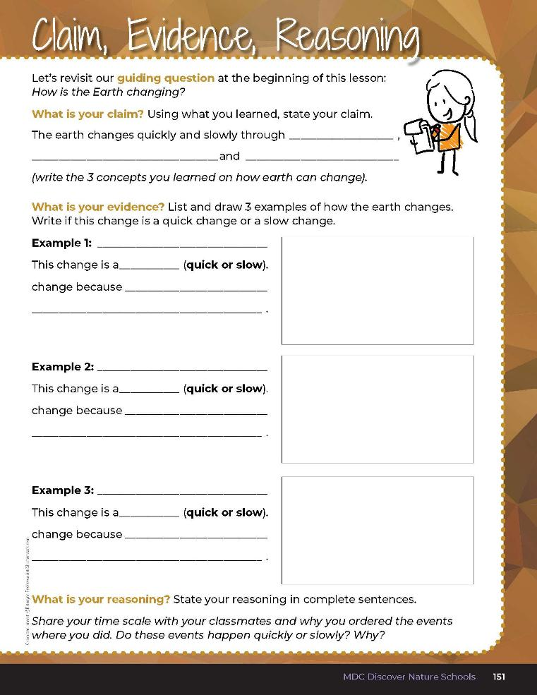

6C
Life and Land in Missouri – 6C Earth’s Natural Events: Evaluate
32
Notes:
Guiding Question: How is the Earth changing?
After exploring the concept of natural events and if they happen quickly or slowly, have students open their student guides to the Claim, Evidence, Reasoning section on Page 151. Guide students through the page by reviewing each section as a class and revisiting the scientific concepts learned to help answer each section.
Rubric:
4 (Exceeds) – Student fills in all blanks correctly under claim and provides accurate examples with appropriate reasons for the changes. The student clearly displays at least 3 natural events and correctly describes each event as a quick or slow event and the reason for the rate of change.
3 (Meets) – Student fills in most of the blanks correctly under claim and provides somewhat accurate examples with somewhat defined reasons for the changes. The student clearly displays at least 2 natural events and somewhat correctly describes each event as a quick or slow event and the reason for the rate of change.
2 (Partially meets) – Student fills in less than half of the blanks correctly under claim and may or may not provide examples with reasons for the changes. The student clearly displays at 1 natural event and may or may not describe as a quick or slow event and may or may not provide the reason for the rate of change.
1 (Doesn’t meet) – Student does not fill in any blanks or provide any evidence of learned concepts.

Slide 33

6C
Life and Land in Missouri – 6C Earth’s Natural Events: Evaluate
33
Notes:
Rubric:
4 (Exceeds) – Student fills in all blanks correctly under claim and provides accurate examples with appropriate reasons for the changes. The student clearly displays at least 3 natural events and correctly describes each event as a quick or slow event and the reason for the rate of change.
3 (Meets) – Student fills in most of the blanks correctly under claim and provides somewhat accurate examples with somewhat defined reasons for the changes. The student clearly displays at least 2 natural events and somewhat correctly describes each event as a quick or slow event and the reason for the rate of change.
2 (Partially meets) – Student fills in less than half of the blanks correctly under claim and may or may not provide examples with reasons for the changes. The student clearly displays at 1 natural event and may or may not describe as a quick or slow event and may or may not provide the reason for the rate of change.
1 (Doesn’t meet) – Student does not fill in any blanks or provide any evidence of learned concepts.

