Slide 1
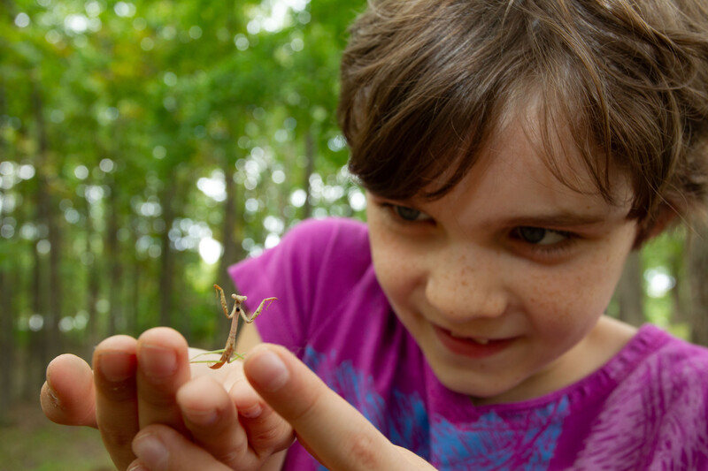

Exploring
MISSOURI
6B: Sun Predictions

Slide 2
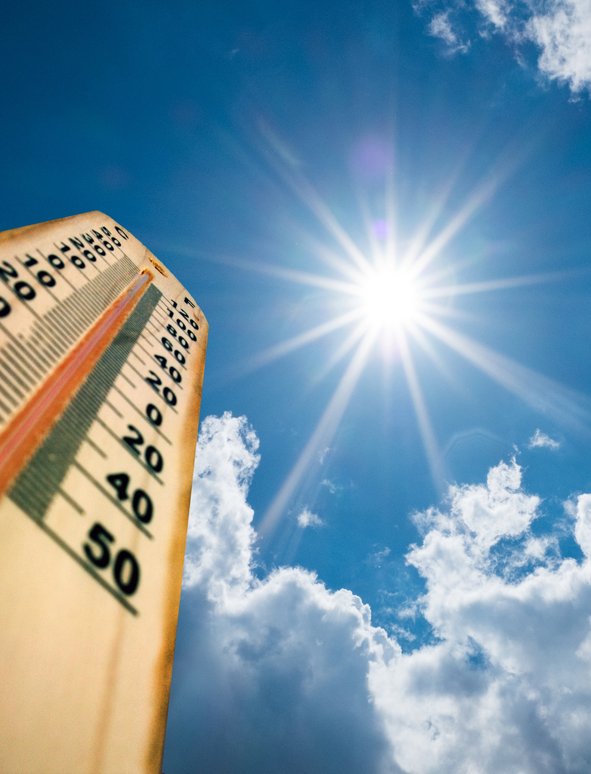
Guiding Question:
When is sunlight the strongest?
6B
Exploring Missouri – 6B Sun Predictions: Engage
2

Slide 3
When do you feel it is the hottest part of the day?
When do you feel it is the coolest part of the day?
6B
Exploring Missouri – 6B Sun Predictions: Engage
3
Notes:
In the last lesson, we explored the sun and different times of the day.
Have students think about their own experiences in the sun throughout the day and share with a partner their experiences.

Slide 4

When is the temperature the hottest?
6B
Exploring Missouri – 6B Sun Predictions: Engage
4
Notes:
Noon.

Slide 5
When the temperature is the hottest, where is the sun in the sky?
6B
Exploring Missouri – 6B Sun Predictions: Engage
5

Slide 6
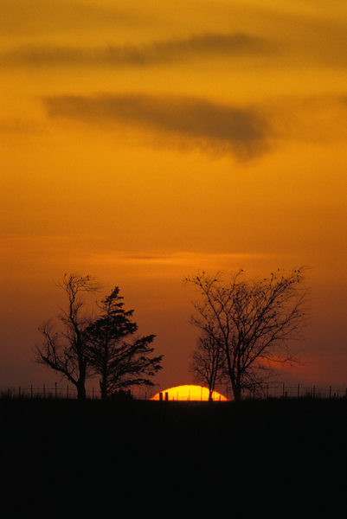
When do you think it would be cooler?
6B
Exploring Missouri – 6B Sun Predictions: Engage
6
Notes:
Sunrise or sunset.

Slide 7
What happens when we are outside in the sun during the hottest part of the day for too long?
6B
Exploring Missouri – 6B Sun Predictions: Engage
7
Notes:
We sweat, we can get a sunburn, etc.
Today, we are going to explore the sun’s energy and when it is at its strongest.

Slide 8
Go outside:
Gather various natural objects from the schoolyard and place your objects on a darkly colored construction paper.
6B
Exploring Missouri – 6B Sun Predictions: Explore
8
Notes:
Teacher Note: The more inexpensive varieties of construction paper fade easier and work best for this activity.
Take students outside. Have students gather various natural objects from the schoolyard, such as leaves with various shapes, sticks, etc. Teachers may also include items, such as washers, nuts, bolts, and pennies or coins, as flat items create more of a crisp edge and barrier. Have each student place their objects on a piece of darkly colored construction paper.

Slide 9
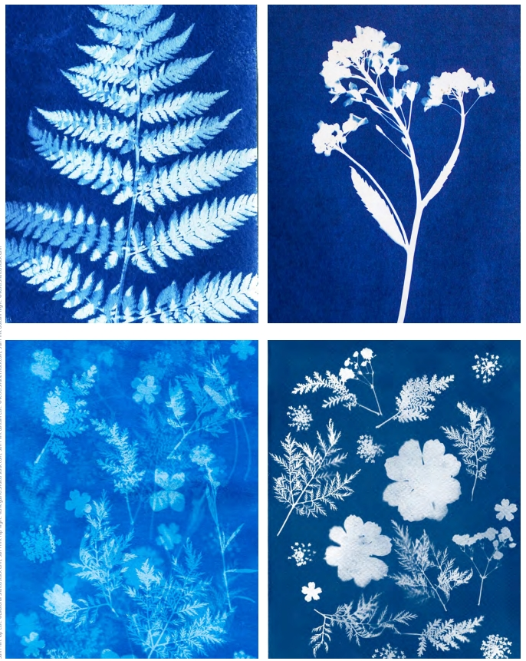
Create sun print art!
6B
Exploring Missouri – 6B Sun Predictions: Explore
9
Notes:
Create sun print art by placing found items on paper in full sun. To ensure that items stay in place, either tape them down (you can use removable tape, or painter’s tape) or lay a piece of plexiglass on top of items so they don’t blow away.
Times needed will vary for the print to effectively fade by the sun’s rays, leaving contrast to areas under objects protected from fading. Generally, this activity will work in one school day of sun exposure. If no precipitation or strong wind is expected, prints can be left out overnight, but this is not necessary.

Slide 10
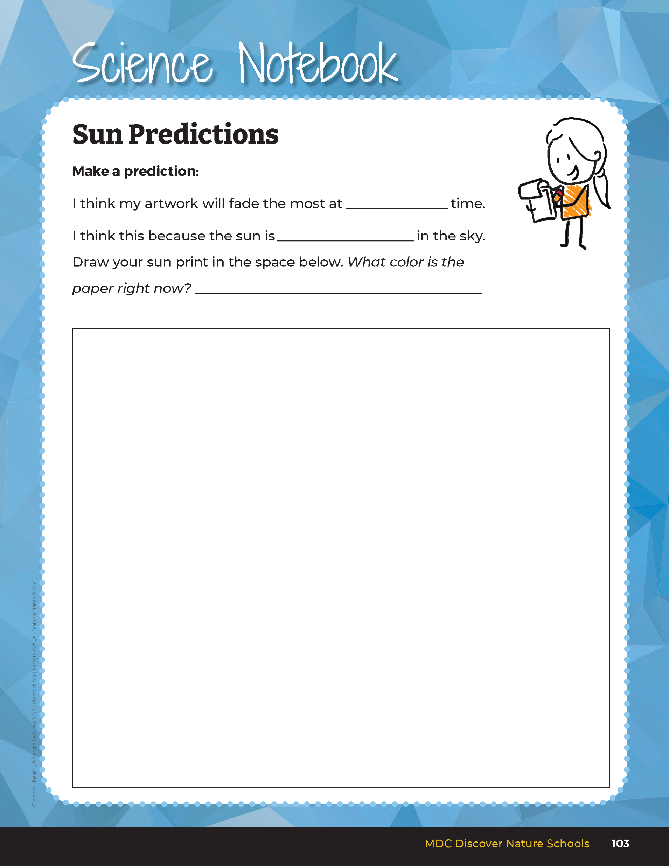

Make a prediction as to when you believe the sun prints might create prints with the largest contrast and record your predictions.
6B
Exploring Missouri – 6B Sun Predictions: Explore
10
Notes:
Have students make a prediction as to when they believe their sun prints might create prints with the largest contrast and have them record their predictions in student guide, Science Notebook 6B Sun Predictions Page 103. Have students draw this phenomenon in the space indicated on this Science Notebook page.

Slide 11
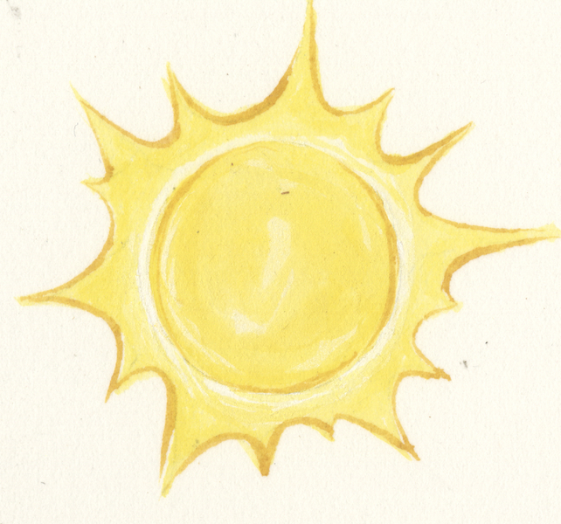
What do we already know about the pattern of the sun?
6B
Exploring Missouri – 6B Sun Predictions: Explain
11
Notes:
Review how the sun seems to rise and set each day because Earth is spinning. This creates the sunrise in the east each morning and the sunset in the west each evening.

Slide 12

Reflect on the book Summer Sun Risin’
6B
Exploring Missouri – 6B Sun Predictions: Explain
12
Notes:
You may reflect on the book Summer Sun Risin’ (Read Aloud link: https://youtu.be/GvyAh0G0lAw?si=zDvapj1UarU7QEF6) as the boy tracked the sun during the day and how the class did the same thing in the schoolyard.

Slide 13
What time of day might create the strongest light?
6B
Exploring Missouri – 6B Sun Predictions: Explain
13

Slide 14
How do we define “strongest” light? What do we mean by this?
6B
Exploring Missouri – 6B Sun Predictions: Explain
14

Slide 15

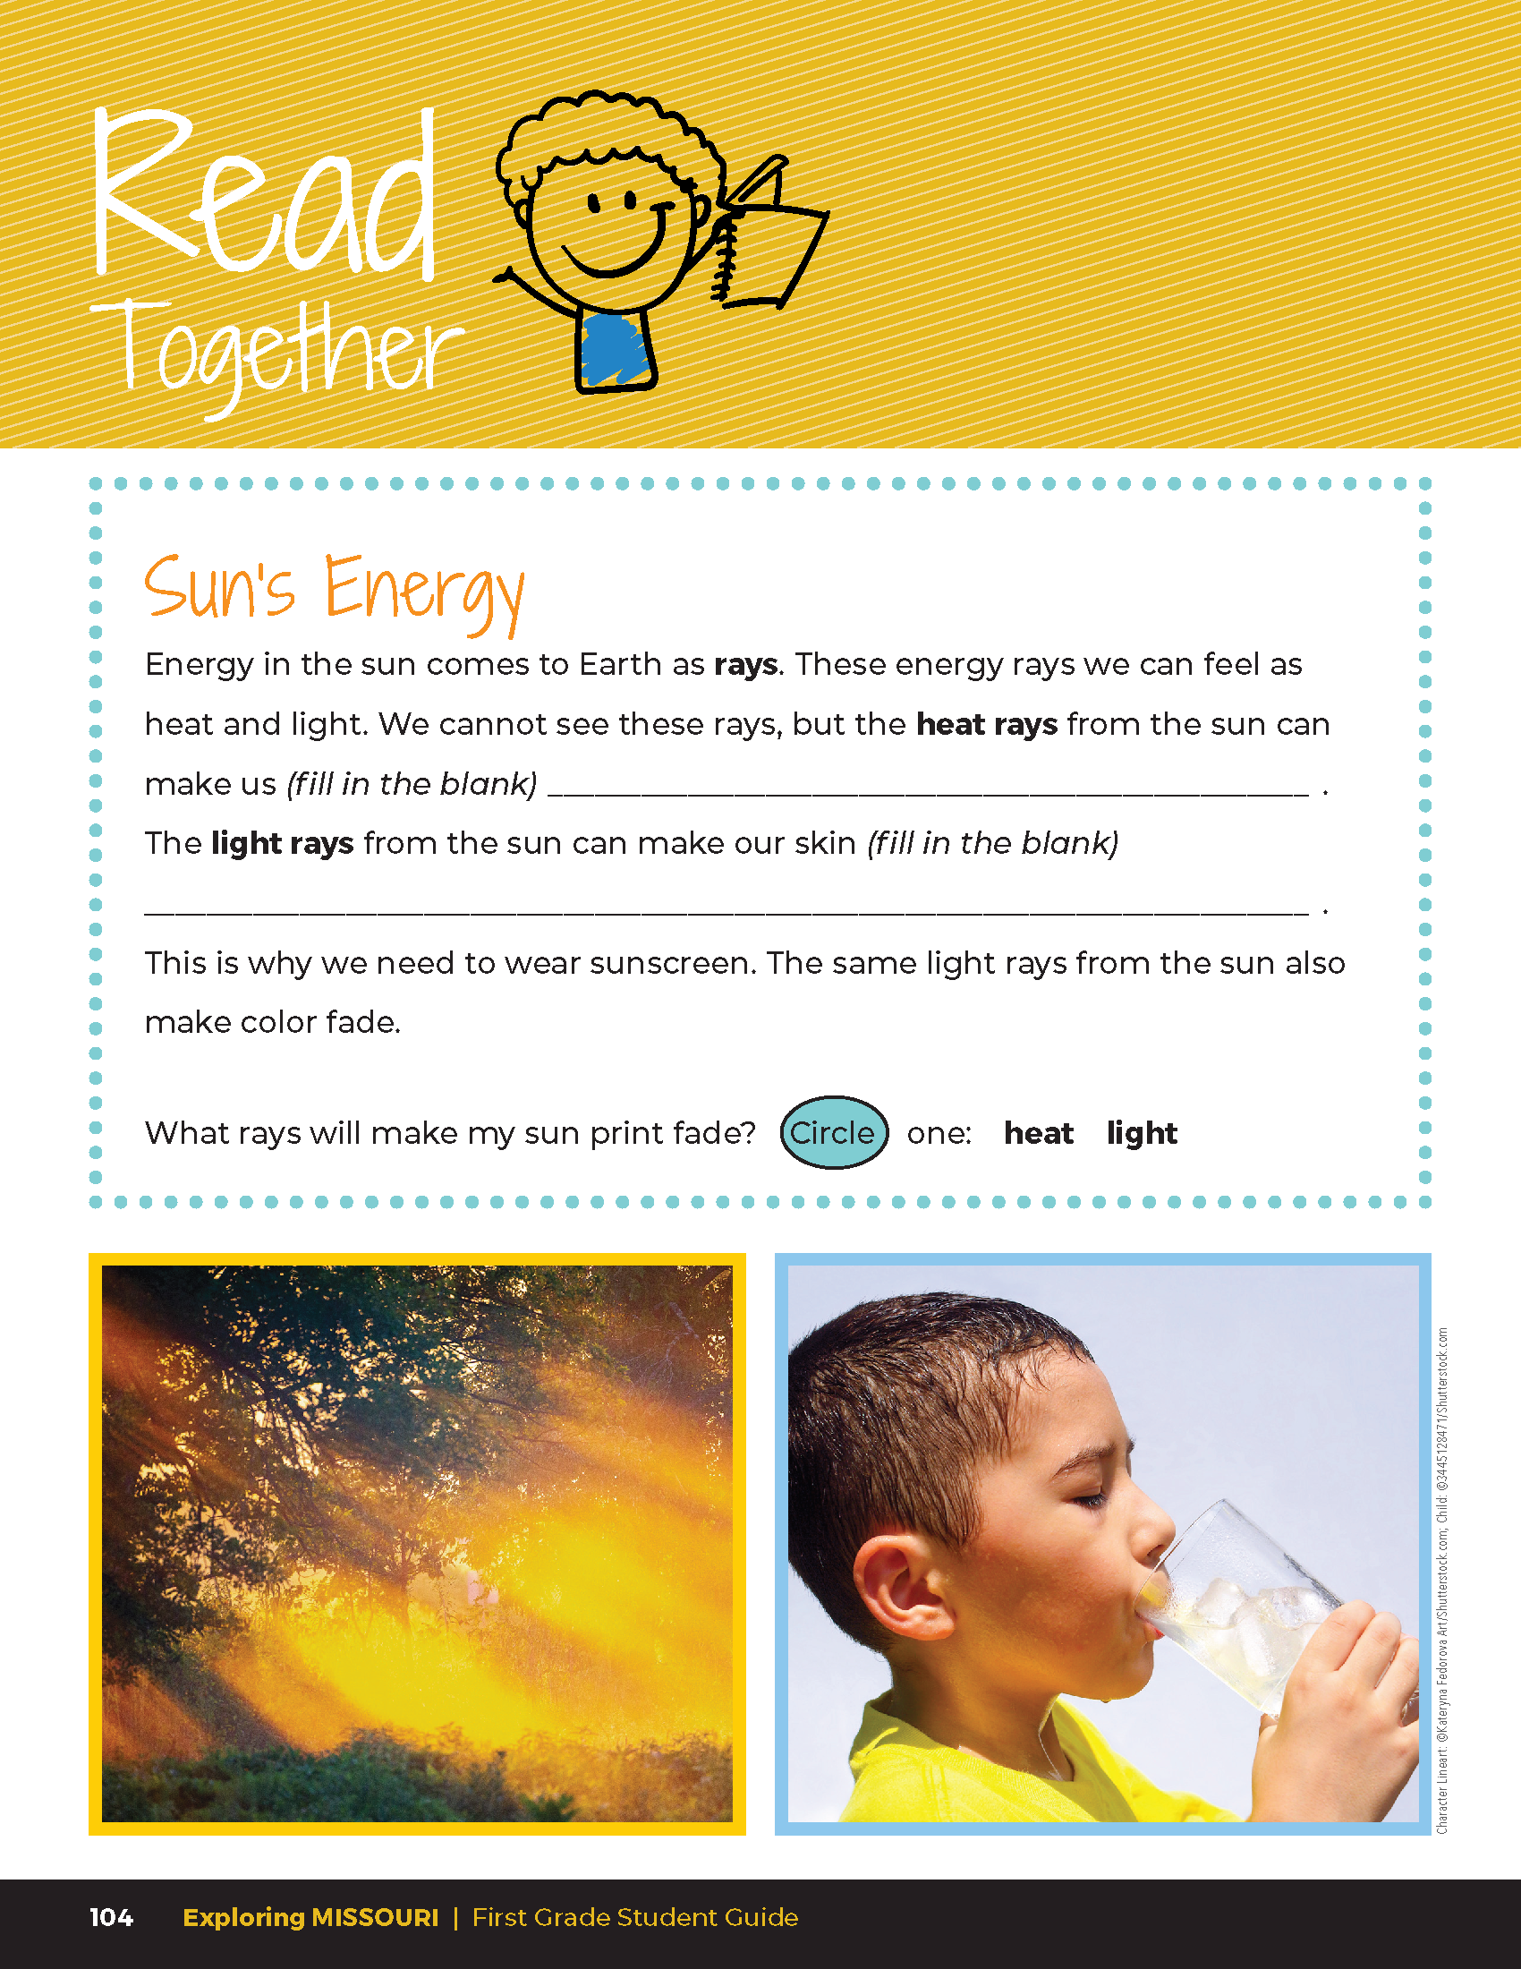
Sun’s Energy
Energy in the sun comes to Earth as rays. These energy rays we can feel as heat and light. We cannot see these rays, but the heat rays from the sun can make us ___________.
The light rays from the sun can make our skin ___________________.
This is why we need to wear sunscreen. The same light rays from the sun also make color fade.
6B
Exploring Missouri – 6B Sun Predictions: Explain
15
Notes:
Read the Read Together 6B Sun’s Energy section on Page 104.

Slide 16
What rays will make my sun print fade?
6B
Exploring Missouri – 6B Sun Predictions: Explain
16
Notes:
Students should circle “light.”

Slide 17
Share your artwork and describe results with your class. Discuss their observations, predictions, and results of your experiment.
6B
Exploring Missouri – 6B Sun Predictions: Elaborate
17
Notes:
Go back outside and check the sun prints throughout the day. After the experiment, have students share their artwork and describe the results with their class. Students should discuss their observations, including a discussion of their predictions and the results of their experiment.

Slide 18
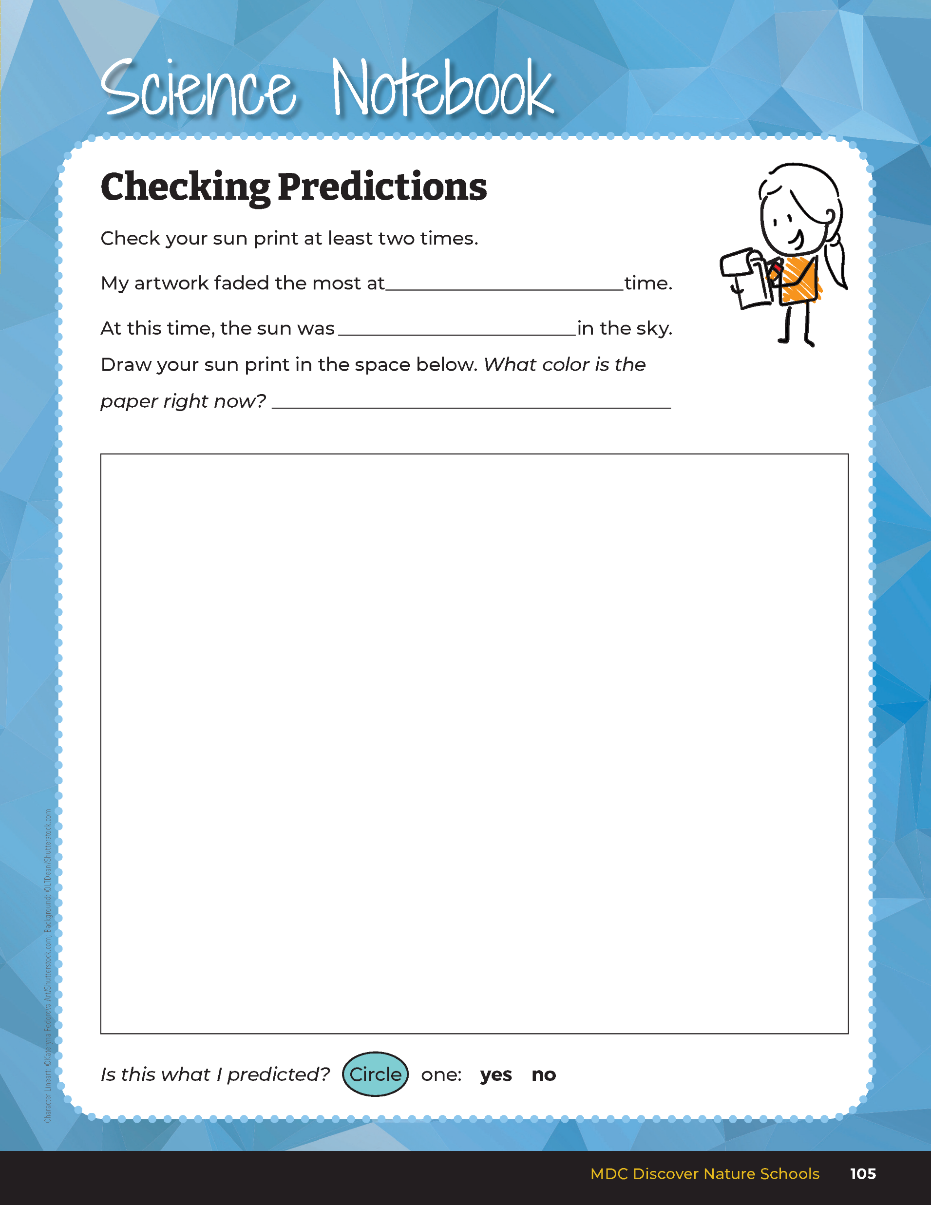
Checking Predictions
6B
Exploring Missouri – 6B Sun Predictions: Elaborate
18
Notes:
In their student guide, have students record their conclusion on Science Notebook 6B Checking Predictions Page 105. On this page, students will be able to note what occurred in comparison to their predictions.
Teacher Note: You may choose to share the following information with your students depending on their level of understanding. The reason why sunlight is the strongest at noon is the UV rays (light rays) from the sun travel the shortest distance to earth at this time versus at longer angles during sunrise or sunset.

Slide 19
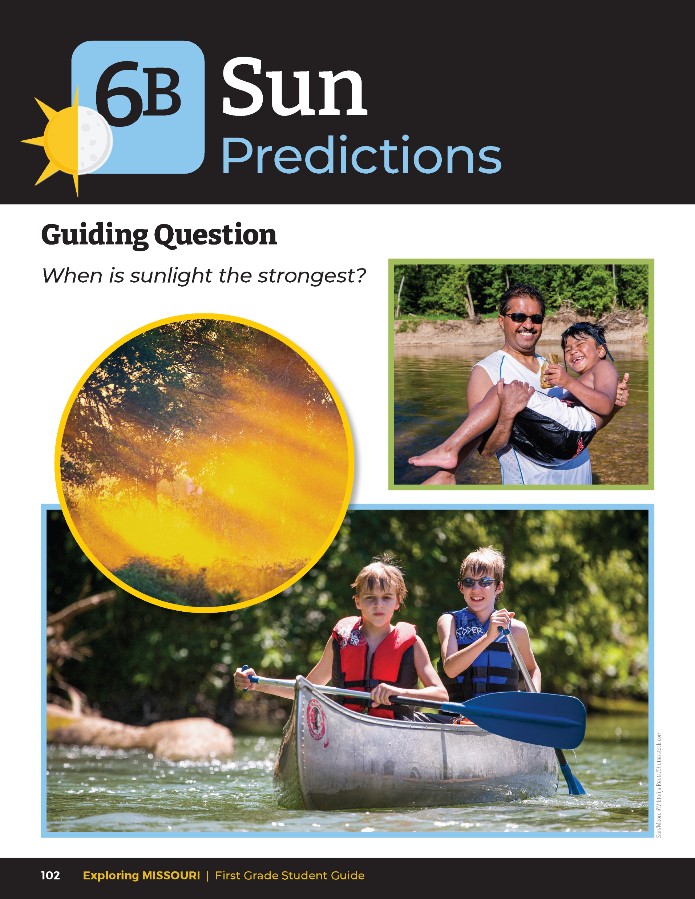
When is sunlight the strongest?
6B
Exploring Missouri – 6B Sun Predictions: Evaluate
19
Notes:
Refer to the Lesson 6B Sun Predictions introduction page with the pictures of the children outside in the sun.

Slide 20
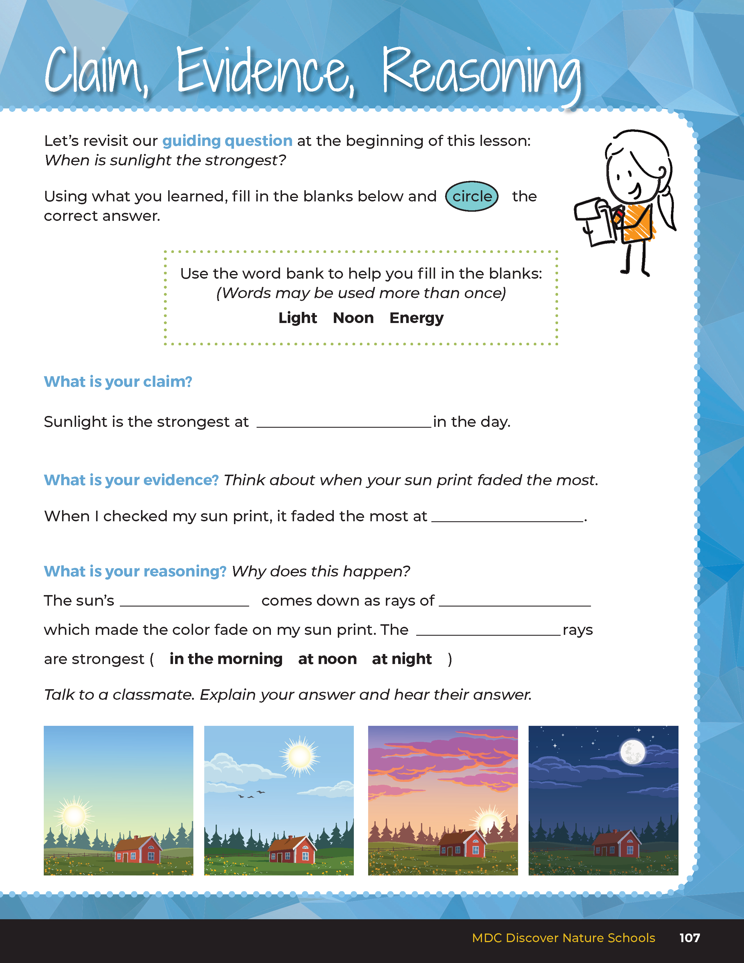
Guiding Question:
When is sunlight the strongest?
6B
Exploring Missouri – 6B Sun Predictions: Evaluate
20
Notes:
After exploring when sunlight is the strongest and hottest, have students open their student guides to the Claim, Evidence, Reasoning section on Page 107. Discuss the page with the students – read the guiding question and then explain what the students need to do to answer the questions (fill in the blanks and circle the correct answer).

Slide 21
noon
Answers
noon
energy
light
light
6B
Exploring Missouri – 6B Sun Predictions: Evaluate
21
Notes:
Rubric:
4 (Exceeds) – Students write the correct claim and evidence into the blanks and fill in and circle the all correct answers for the reasoning.
3 (Meets) – Students write either the correct claim or evidence into the blanks and/or fill in and circle most of the correct answers for the reasoning.
2 (Partially Meets) – Students write either the correct claim or evidence into the blanks and fill in and circle the some of the correct answers for the reasoning.
1 (Doesn’t Meet) – Students do not provide the correct claim or evidence and do not fill in or circle the correct answers for the reasoning.

