Slide 1
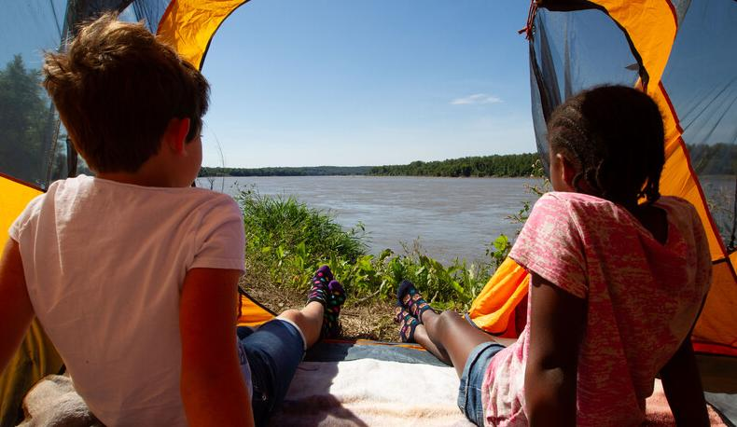

Life and Land in
MISSOURI
6B: Earthquakes and Natural Disasters

Slide 2
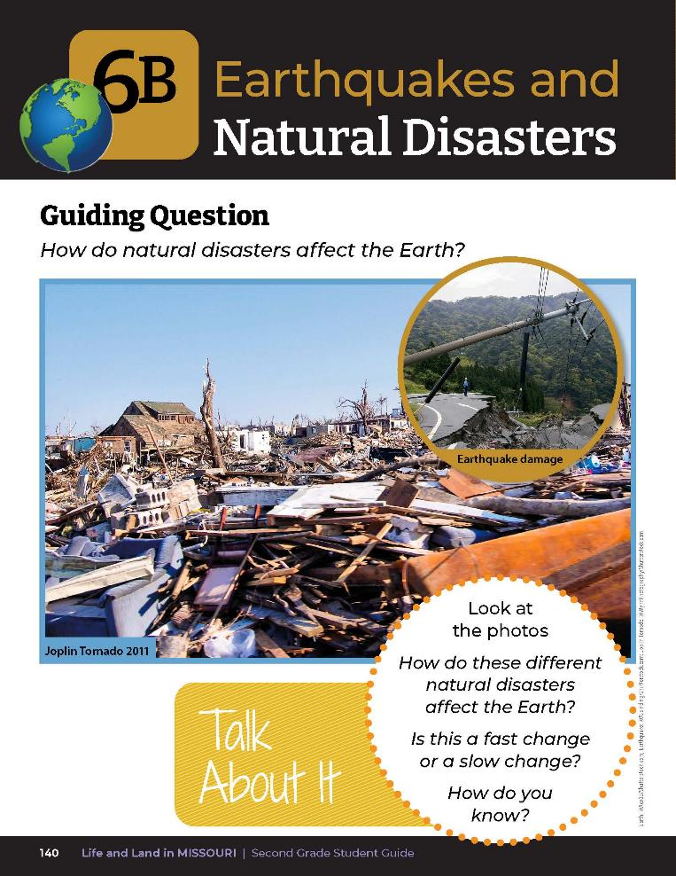
What do you know about earthquakes?
Have you ever heard of an earthquake in Missouri?
6B
Life and Land in Missouri – 6B Earthquakes and Natural Disasters: Engage
2
Notes:
Refer to the photos of different natural disasters in the student guide Lesson 6B Earthquakes and Natural Disasters introduction on Page 140. Allow students time to share what they know and record observations.

Slide 3
Guiding Question:
How do natural disasters affect the Earth?
6B
Life and Land in Missouri – 6B Earthquakes and Natural Disasters: Engage
3
Notes:
Read the guiding question together.

Slide 4
How do these different natural disasters affect the Earth?
Is this a fast change or a slow change? How do you know?
6B
Life and Land in Missouri – 6B Earthquakes and Natural Disasters: Engage
4
Notes:
Discuss the Talk About It.

Slide 5
In groups, shape the sand into a landform using water from the spray bottle to help shape it and hold it together.
6B
Life and Land in Missouri – 6B Earthquakes and Natural Disasters: Explore
5
Notes:
Divide students into groups of 3-4. Give each group a tray with a pile of sand and a spray bottle filled with water. Have students shape the sand into a landform (mountain, hill, canyon, etc.), using water from the spray bottle to help shape it and hold it together.

Slide 6
Earthquakes occur over a short period of time.
6B
Life and Land in Missouri – 6B Earthquakes and Natural Disasters: Explore
6
Notes:
Inform your students that earthquakes can occur over a short period of time such as 30 seconds, or even several minutes.

Slide 7
Gently shake your tray with the sand landform for 10 seconds.
6B
Life and Land in Missouri – 6B Earthquakes and Natural Disasters: Explore
7
Notes:
Tell them that they are going to gently shake their tray with the sand landform for 10 seconds. Teacher Note: Demonstrate what is meant by a gentle shake before the students begin.

Slide 8
What happened to your landform?
Was this a quick change or a slow change?
6B
Life and Land in Missouri – 6B Earthquakes and Natural Disasters: Explore
8

Slide 9
What if we left your landform to dry?
Would that be a quick change or a slow change?
6B
Life and Land in Missouri – 6B Earthquakes and Natural Disasters: Explore
9

Slide 10
Does the event occur quickly or slowly?
How do you know?
6B
Life and Land in Missouri – 6B Earthquakes and Natural Disasters: Explain
10
Notes:
From the MDC Teacher Portal, share with your students the online encyclopedia link to the term Natural Disasters and share the description of different types of natural disasters.

Slide 11
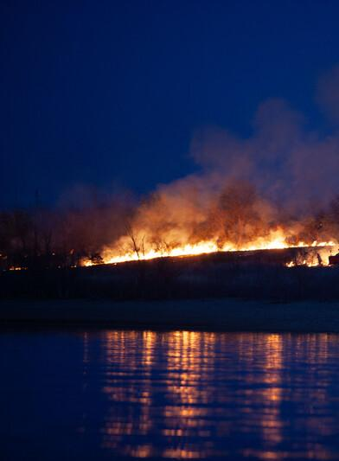
What are other ways the Earth changes naturally and quickly?
6B
Life and Land in Missouri – 6B Earthquakes and Natural Disasters: Explain
11
Notes:
Brainstorm a list on the board. Your list can include:
Volcanic eruptions
Tsunamis
Hurricanes
Tornadoes
Floods
Avalanches
Landslides
Wildfires
Blizzards
Droughts

Slide 12
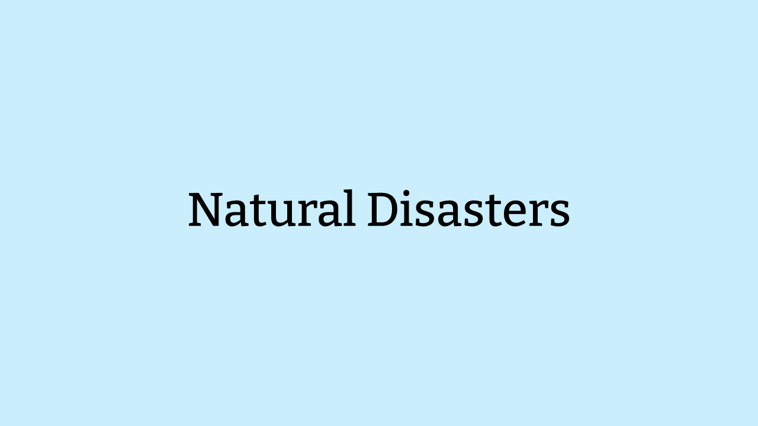
6B
Life and Land in Missouri – 6B Earthquakes and Natural Disasters: Engage
12

Slide 13
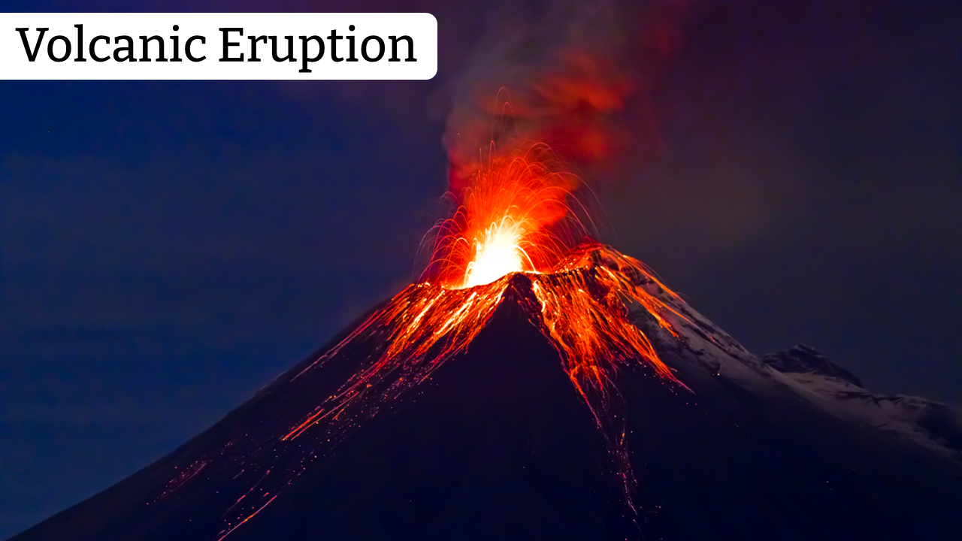
6B
Life and Land in Missouri – 6B Earthquakes and Natural Disasters: Engage
13

Slide 14
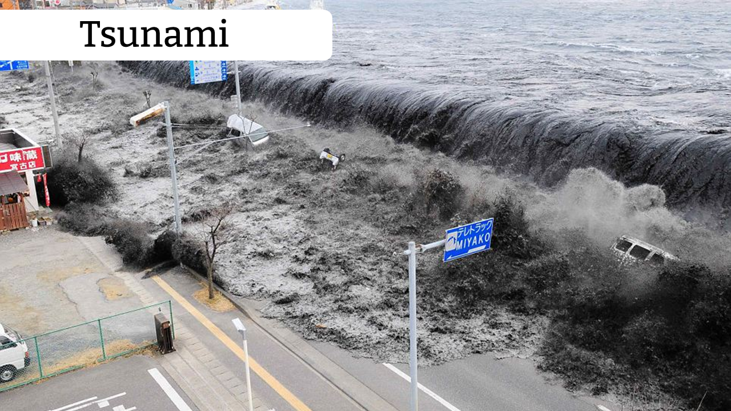
6B
Life and Land in Missouri – 6B Earthquakes and Natural Disasters: Engage
14

Slide 15
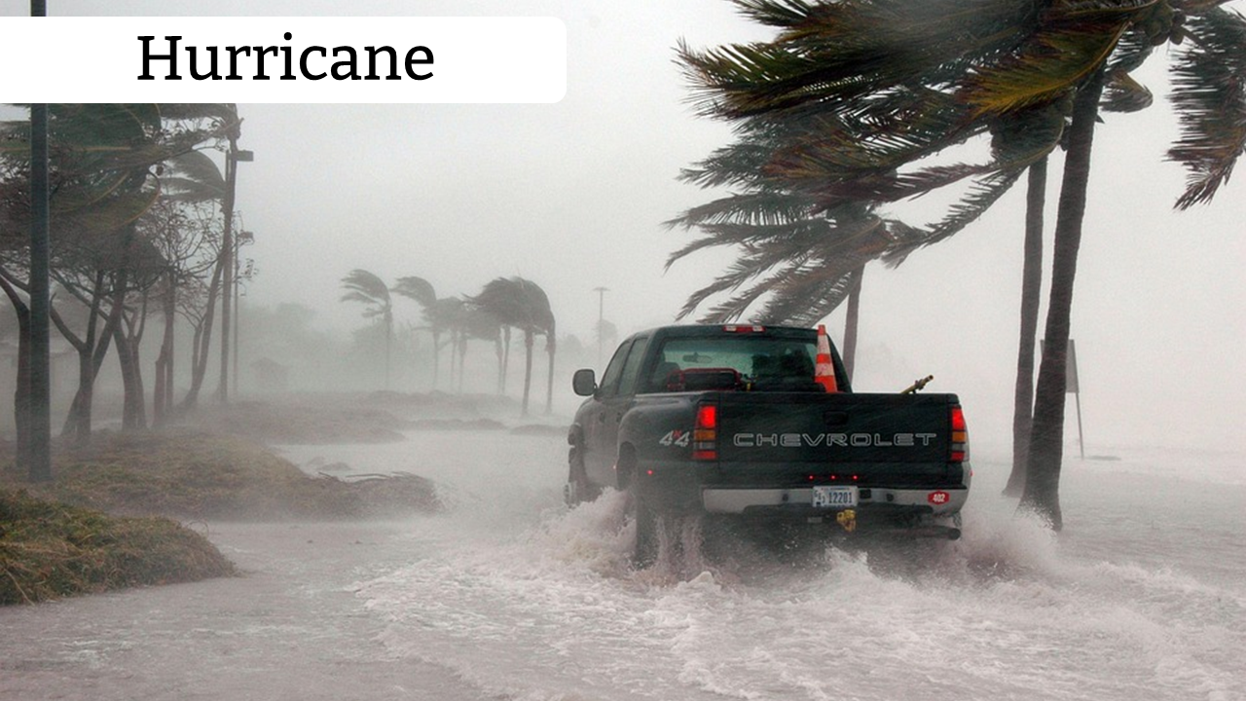
6B
Life and Land in Missouri – 6B Earthquakes and Natural Disasters: Engage
15

Slide 16
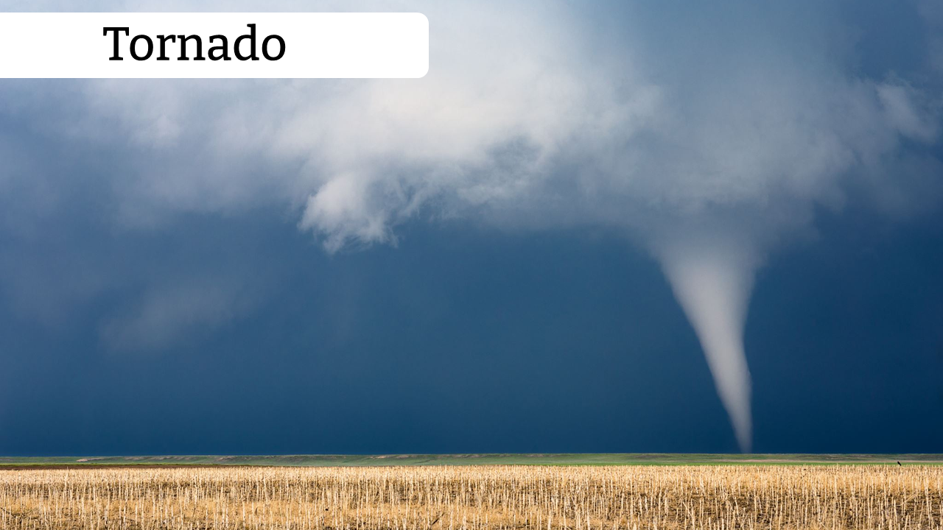
6B
Life and Land in Missouri – 6B Earthquakes and Natural Disasters: Engage
16

Slide 17
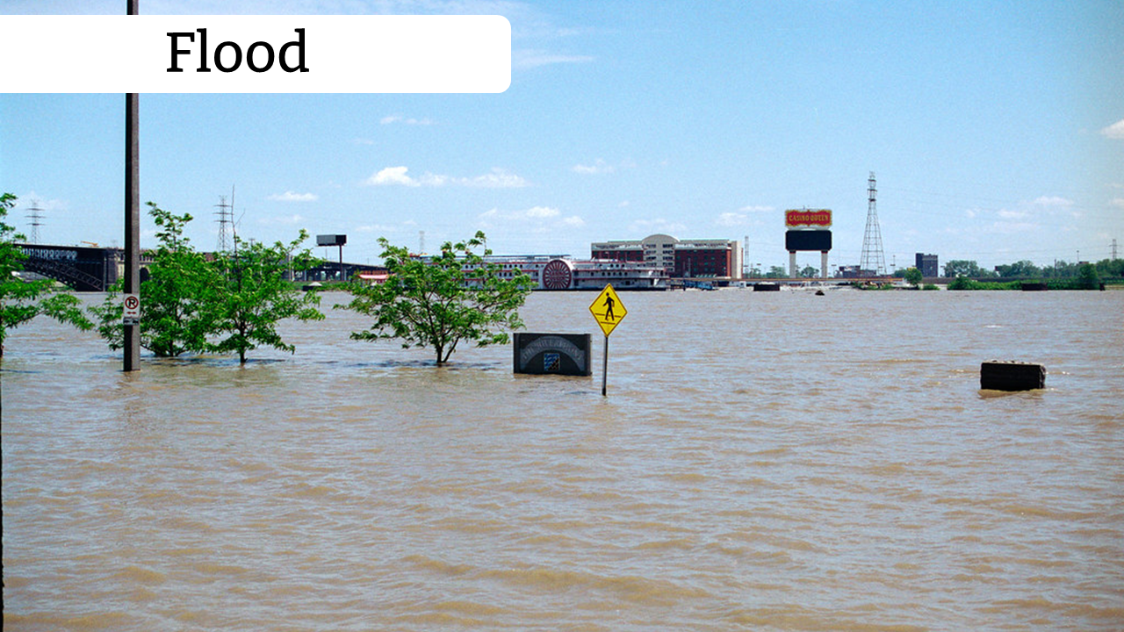
6B
Life and Land in Missouri – 6B Earthquakes and Natural Disasters: Engage
17

Slide 18
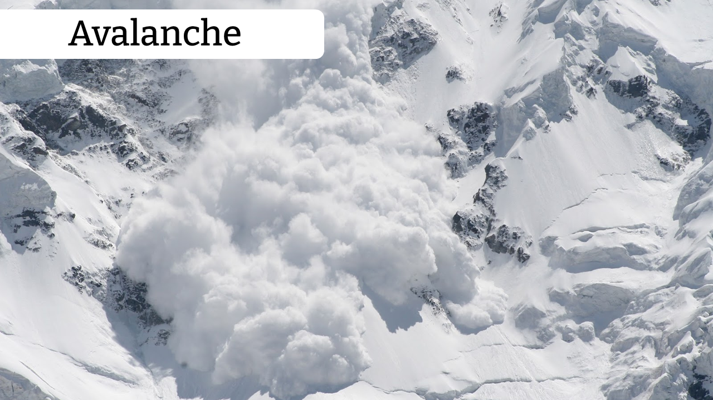
6B
Life and Land in Missouri – 6B Earthquakes and Natural Disasters: Engage
18

Slide 19
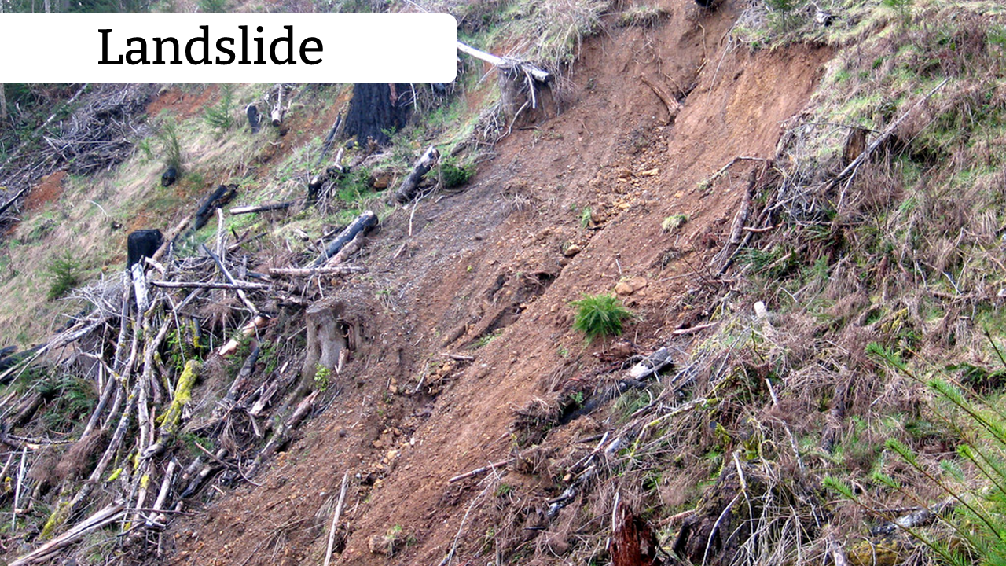
6B
Life and Land in Missouri – 6B Earthquakes and Natural Disasters: Engage
19

Slide 20
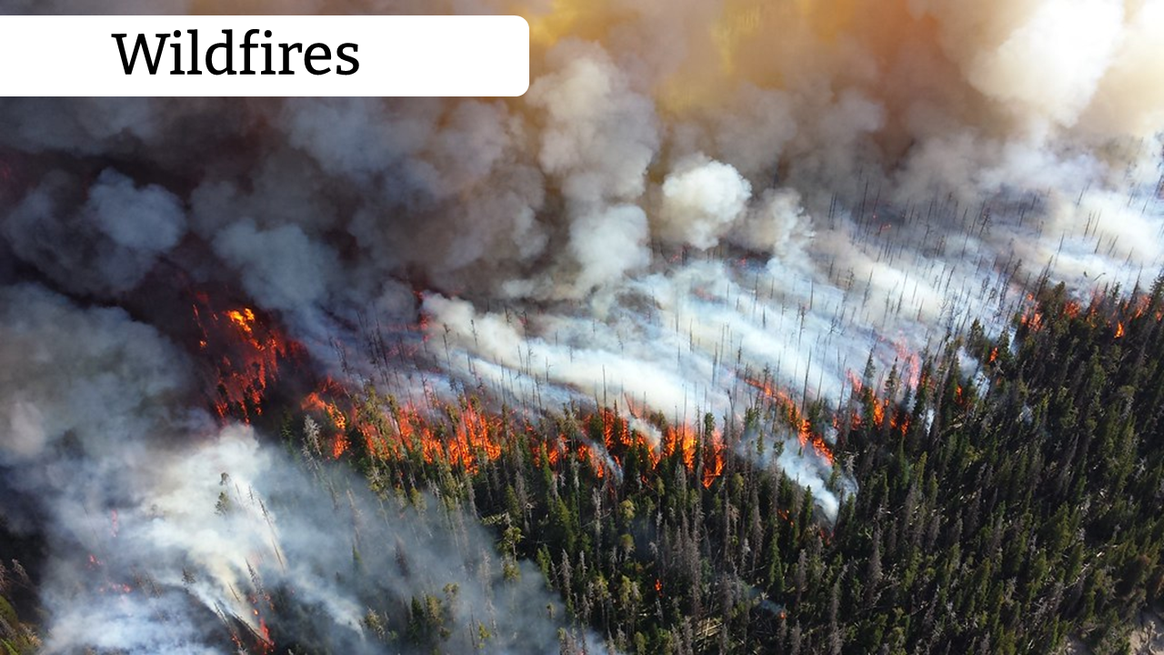
6B
Life and Land in Missouri – 6B Earthquakes and Natural Disasters: Engage
20

Slide 21
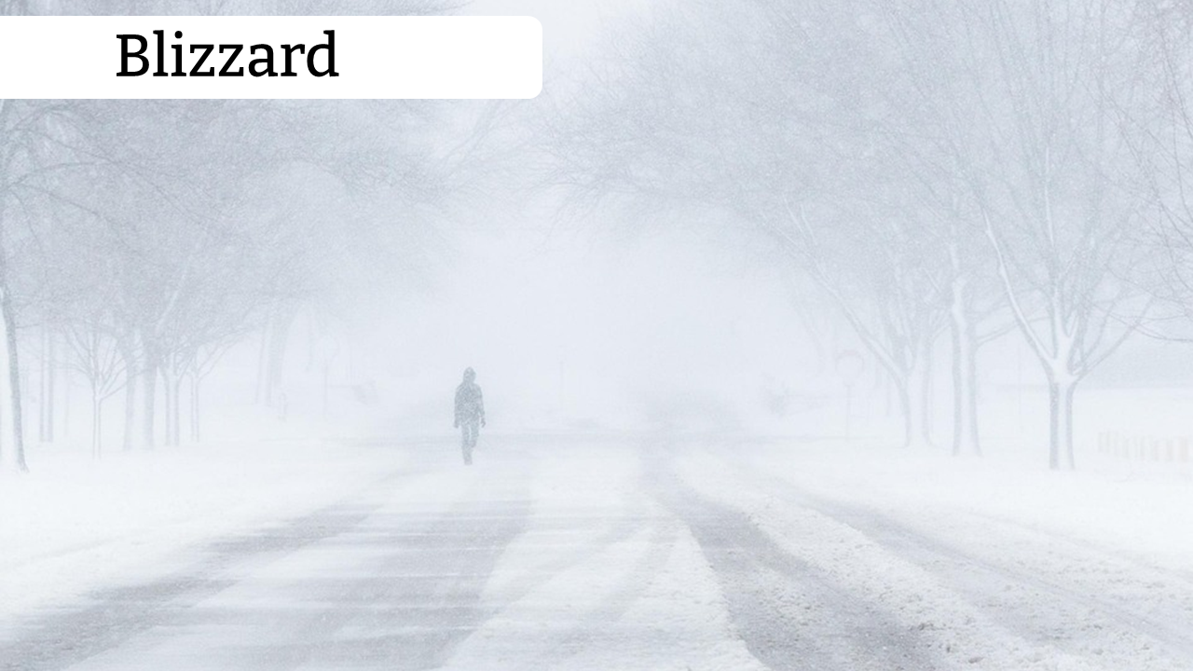
6B
Life and Land in Missouri – 6B Earthquakes and Natural Disasters: Engage
21

Slide 22
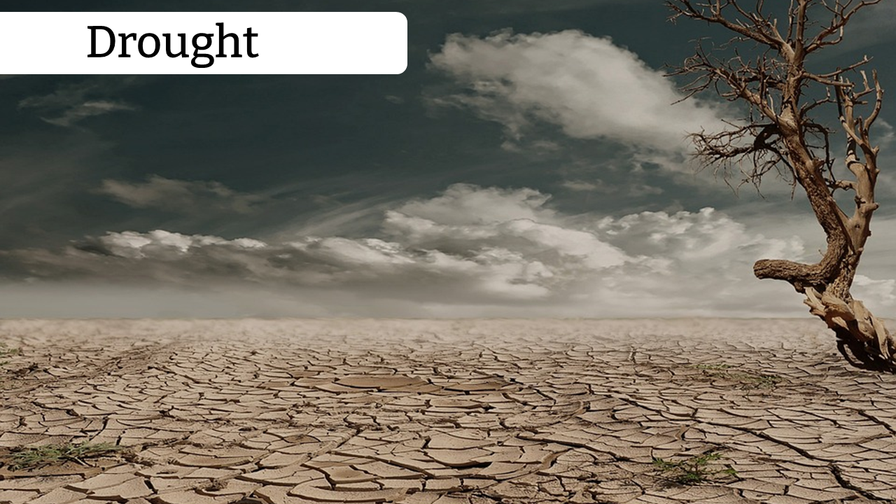
6B
Life and Land in Missouri – 6B Earthquakes and Natural Disasters: Engage
22

Slide 23
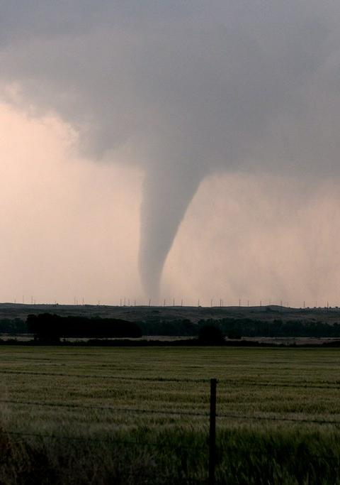
What events happen locally in our state?
6B
Life and Land in Missouri – 6B Earthquakes and Natural Disasters: Explain
23
Notes:
Allow students time to review the list and circle the natural events that happen in Missouri.

Slide 24
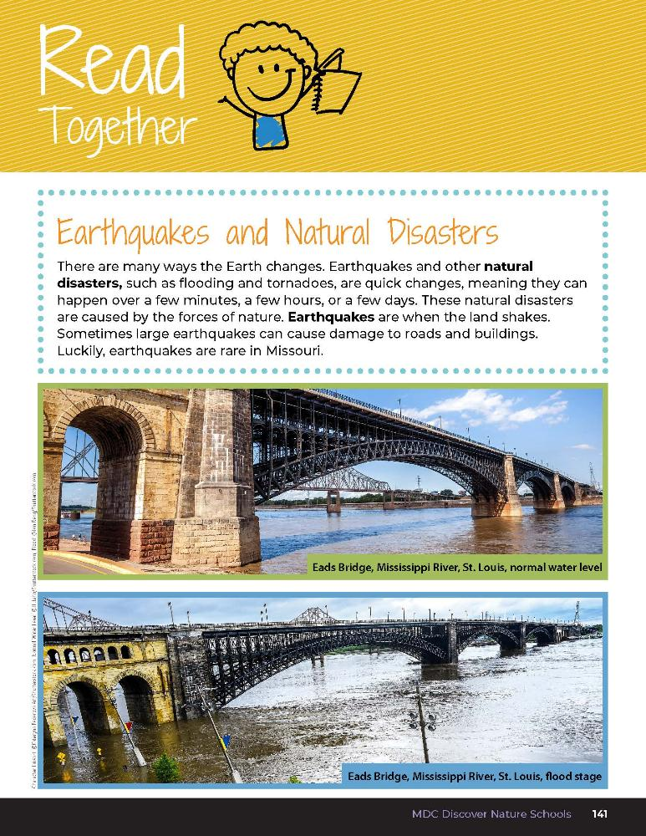

Earthquakes and Natural Disasters
There are many ways the Earth changes. Earthquakes and other natural disasters, such as flooding and tornadoes, are quick changes, meaning they can happen over a few minutes, a few hours, or a few days. These natural disasters are caused by the forces of nature.
6B
Life and Land in Missouri – 6B Earthquakes and Natural Disasters: Explain
24
Notes:
Read together from the student guide Read Together 6B Earthquakes and Natural Disasters section on Page 141.

Slide 25
Earthquakes and Natural Disasters
Earthquakes are when the land shakes. Sometimes large earthquakes can cause damage to roads and buildings. Luckly, earthquakes are rare in Missouri.
6B
Life and Land in Missouri – 6B Earthquakes and Natural Disasters: Explain
25
Notes:
Read together from the student guide Read Together 6B Earthquakes and Natural Disasters section on Page 141.

Slide 26
What do we mean when we say the term “quickly”?
6B
Life and Land in Missouri – 6B Earthquakes and Natural Disasters: Explain
26
Notes:
(Quickly is a relative term to describe changes that can happen over a few minutes, hours, or days. Flooding can be fast [i.e., flash flooding] or slow flooding.)

Slide 27
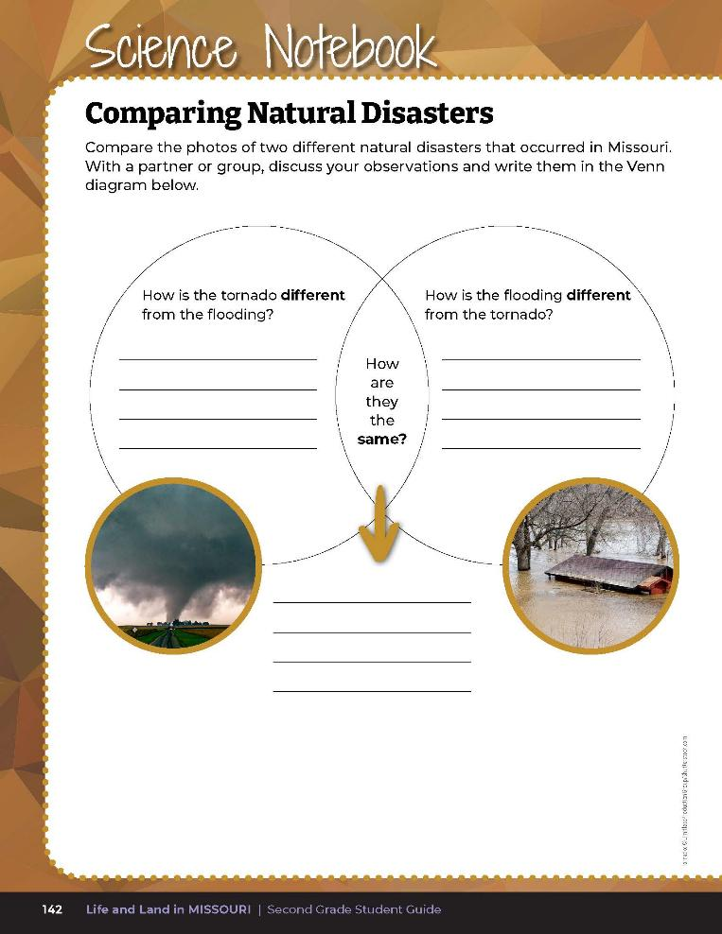
How are the photos of each natural disaster alike?
How are the photos of each natural disaster different?
6B
Life and Land in Missouri – 6B Earthquakes and Natural Disasters: Elaborate
27
Notes:
Have students discuss with a partner or group mates and record observations on their Venn diagram on Science Notebook 6B Comparing Natural Disasters on Page 142.

Slide 28
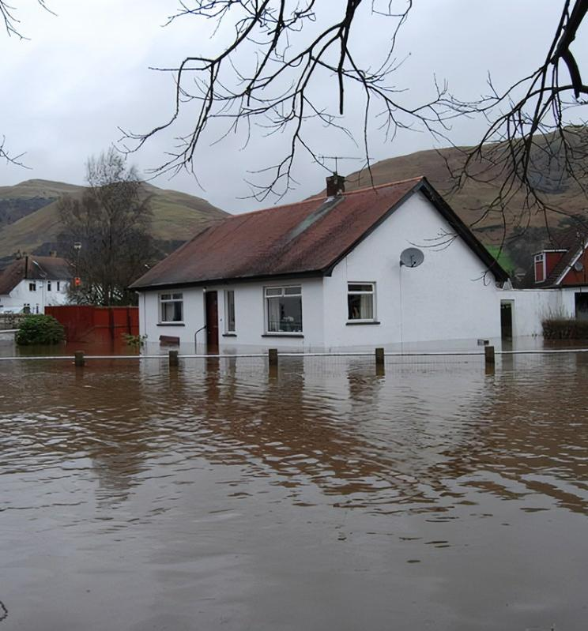
What dangers are natural disasters to people and animals?
6B
Life and Land in Missouri – 6B Earthquakes and Natural Disasters: Elaborate
28
Notes:
Have a class discussion about the following questions:
What dangers are natural disasters to people and animals? (Floods and fire displace wildlife. Drought reduces drinking water and kills fish stranded in stream pools.)

Slide 29
What can we do to be safe during an earthquake? A flood? A tornado?
6B
Life and Land in Missouri – 6B Earthquakes and Natural Disasters: Elaborate
29

Slide 30
What does our school do to prepare if there is an earthquake?
6B
Life and Land in Missouri – 6B Earthquakes and Natural Disasters: Elaborate
30
Notes:
(Teacher Note: Discuss with school administration if it is appropriate to conduct a classroom earthquake drill during this lesson.)

Slide 31
Natural Disaster Posters
You will create an informative poster about one natural disaster from our list.
Include:
Pictures with captions
Description of the natural event and an explanation of why it is either a quick or slow change
How to prepare before or during a natural event
6B
Life and Land in Missouri – 6B Earthquakes and Natural Disasters: Elaborate
31
Notes:
Natural Disaster Posters
Refer to the list of natural disasters brainstormed as a class. Have students create an informative poster about one natural disaster from that list. Students will research their chosen natural disaster, describe the dangers to people and animals and ways that humans prepare for it. Provide books from your school or local library on different types of natural disasters. You can also share the online links to free Children’s Encyclopedia websites from the MDC Teacher Portal.
The poster needs to include:
Pictures (can be printed, drawn, or cut out) with captions
Description of the natural event and an explanation of why it is either a quick or slow change.
How to prepare before or during a natural event
Display posters outside your classroom to share information with other students.

Slide 32
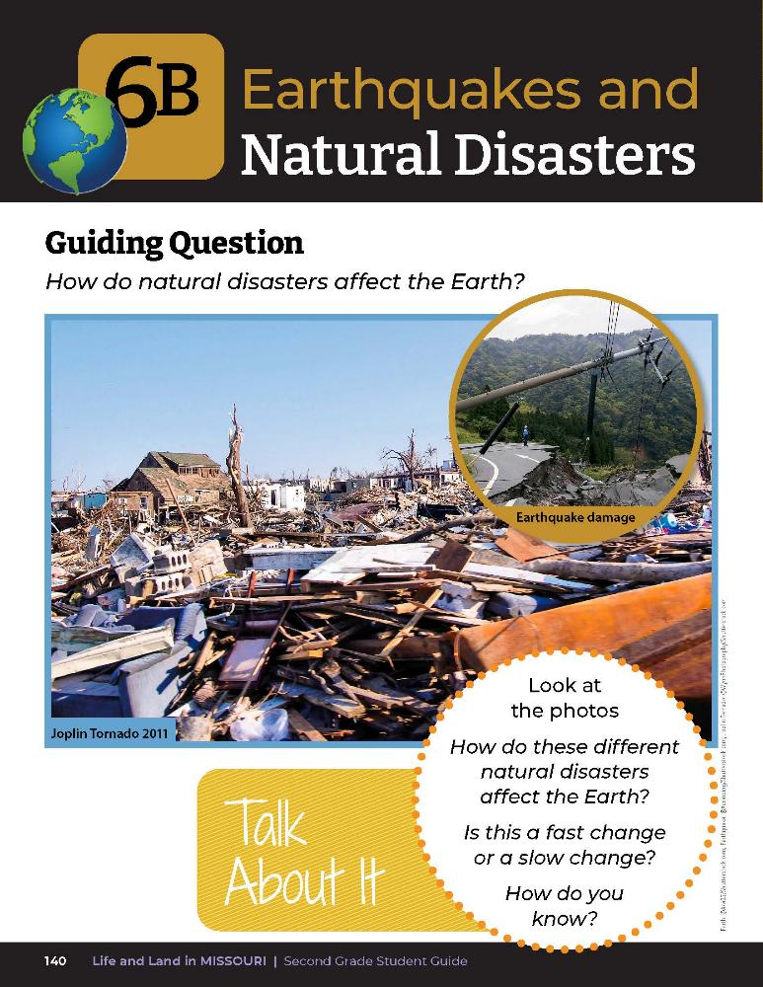
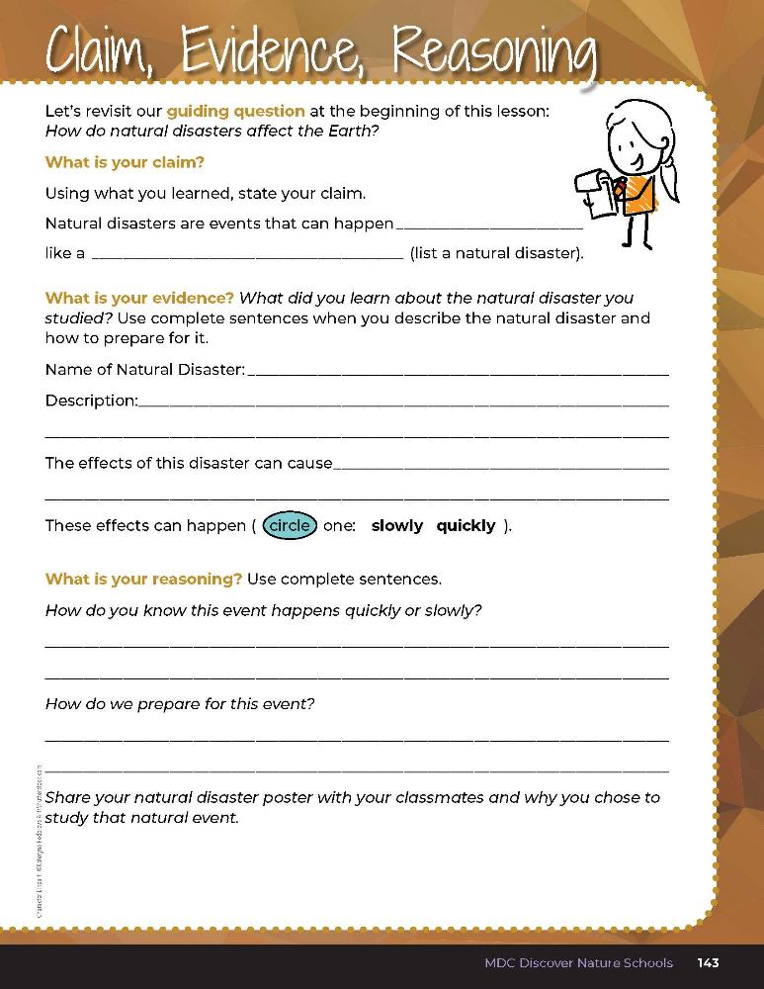

6B
Life and Land in Missouri – 6B Earthquakes and Natural Disasters: Evaluate
32
Notes:
Guiding Question: How do natural disasters affect the Earth?
After exploring the concept of different natural disasters and if they happen quickly or slowly, have students open their student guides to the 6B Claim, Evidence, Reasoning section on Page 143. Guide students through the page by reviewing each section as a class and revisiting the scientific concepts learned to help answer each section.

Slide 33
quickly
This event happens quickly because it can happen over a few minutes, a few hours or just a few days.
Students will summarize what they wrote on their posters.
6B
Life and Land in Missouri – 6B Earthquakes and Natural Disasters: Evaluate
33
Notes:
Rubric:
4 (Exceeds) — Through the poster and CER statement, student clearly displays the natural disaster and
describes the changes that happen to the Earth with pictures, captions, explanations, etc.
3 (Meets) — Through the poster and CER statement, student somewhat displays the natural disaster and
somewhat describes the changes that happen to the Earth with pictures, captions, explanations, etc.
2 (Partially meets) — Through the poster and CER statement, student somewhat displays the natural disaster
and hardly describes the changes that happen to the Earth with pictures, captions, explanations, etc.
1 (Doesn’t meet) — Student poster or CER statement does not display the natural disaster or offer any
information.

