Slide 1
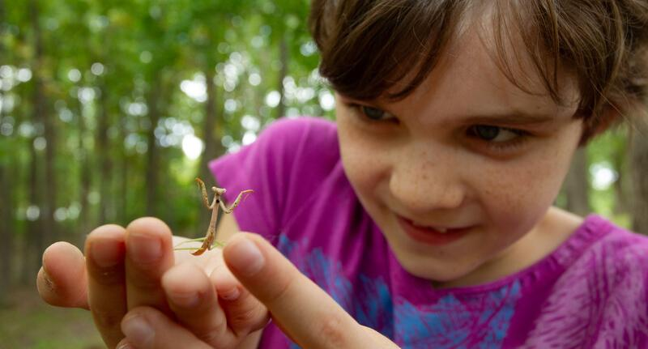

Exploring
MISSOURI
6A: Sun Stroll
Notes:
Teacher Note: This lesson includes both a winter and spring component. The spring slides are 36-47. Plan to revisit this lesson in the slide. The timeline calendar on page 11 of the Teacher Guide can assist you in planning when to teach each lesson ensuing time through the schoolyear.

Slide 2
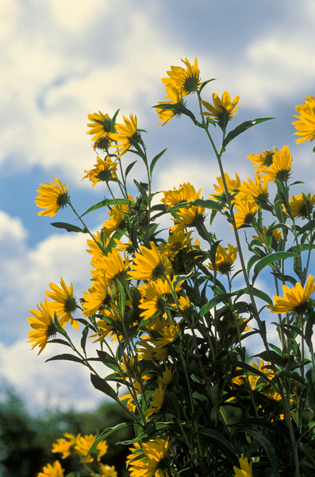
Guiding Question:
Why does the flower of a sunflower move throughout the day?
6A
Exploring Missouri – 6A Sun Stroll: Engage
2
Notes:
Plant in Picture: Sunflower

Slide 3
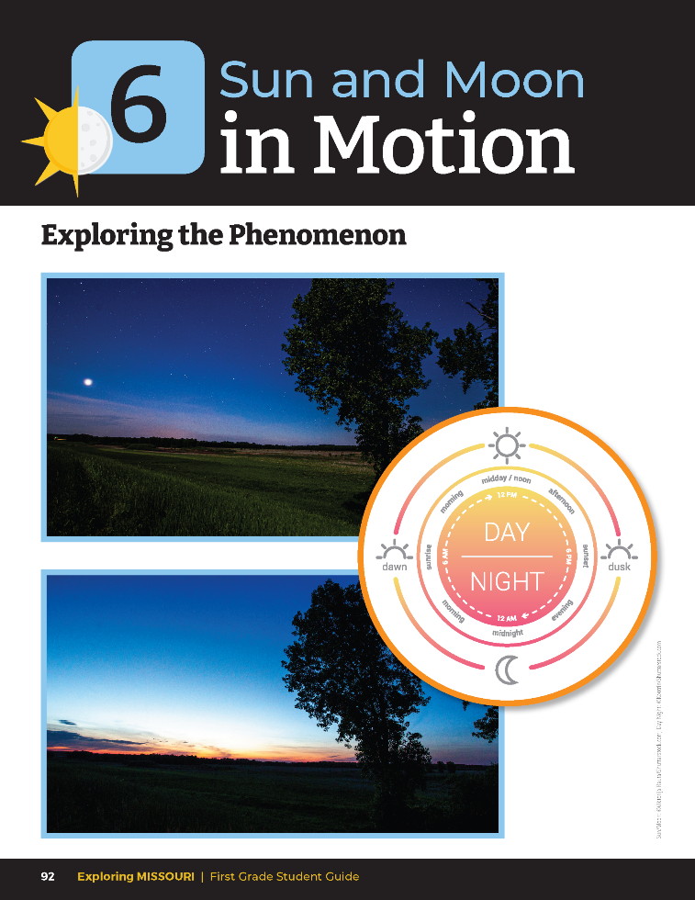
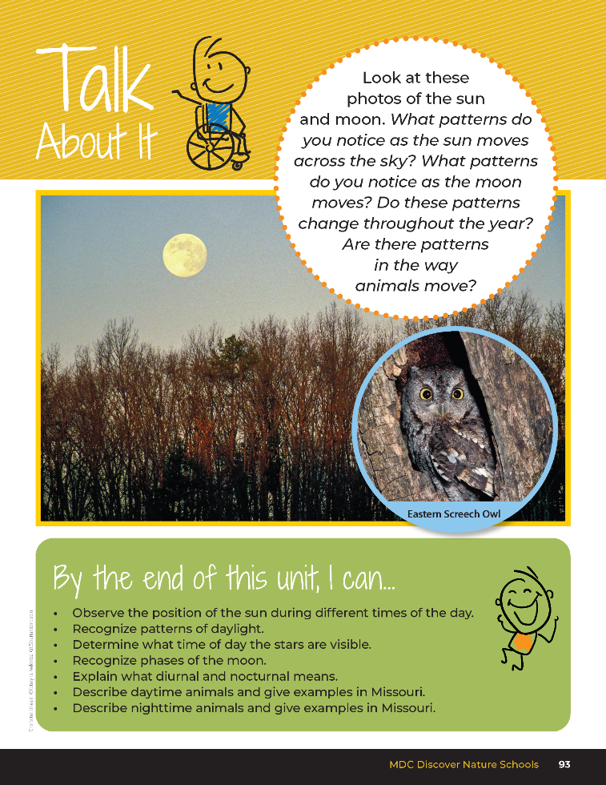
6A
Exploring Missouri – 6A Sun Stroll: Engage
3
Notes:
Read together the student guide Unit 6 Exploring the Phenomenon section on pages 92 – 93 and discuss the Talk About It portion.

Slide 4
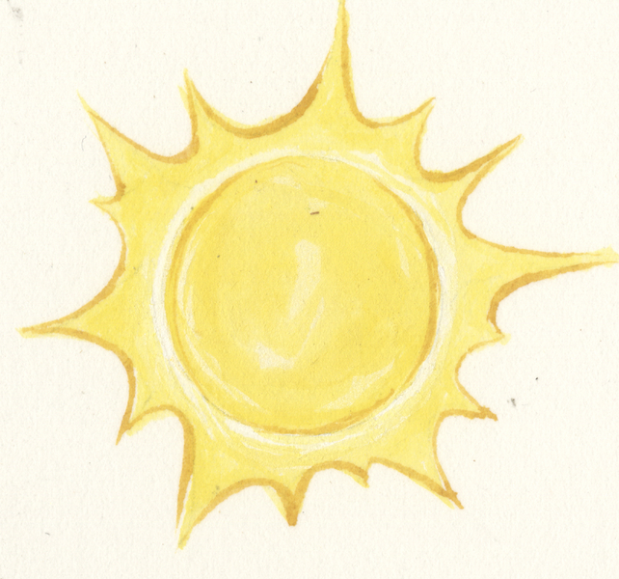
What patterns do you notice as the sun moves across the sky every day?
6A
Exploring Missouri – 6A Sun Stroll: Engage
4

Slide 5
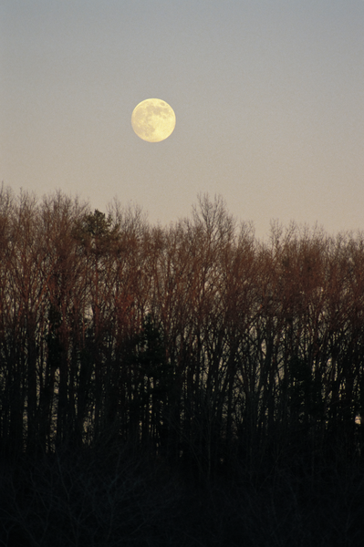
What patterns do you notice as the moon moves every night?
6A
Exploring Missouri – 6A Sun Stroll: Engage
5

Slide 6
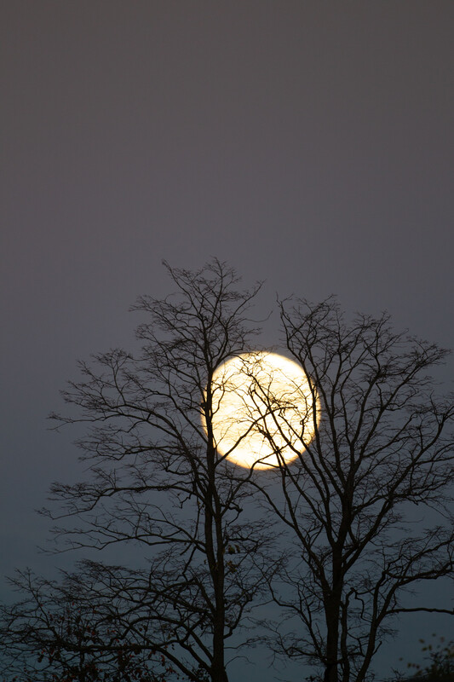
Do these patterns change through the year?
6A
Exploring Missouri – 6A Sun Stroll: Engage
6

Slide 7

Read book Summer Sun Risin’ by S. Nikola-Lisa.
Read Aloud:
https://youtu.be/GvyAh0G0lAw?si=zDvapj1UarU7QEF6
6A
Exploring Missouri – 6A Sun Stroll: Engage
7
Notes:
Discuss what the child in the book experiences and what he observes during the day.

Slide 8
What do you notice about the boy in the book and how he interacts with the sun?
6A
Exploring Missouri – 6A Sun Stroll: Engage
8

Slide 9
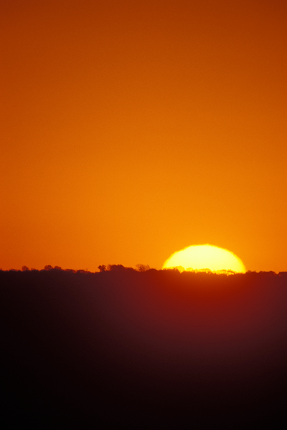
How does this apply to our own experience when we go outside in the morning?
6A
Exploring Missouri – 6A Sun Stroll: Engage
9

Slide 10
What about in the afternoon? Evening?
6A
Exploring Missouri – 6A Sun Stroll: Engage
10

Slide 11
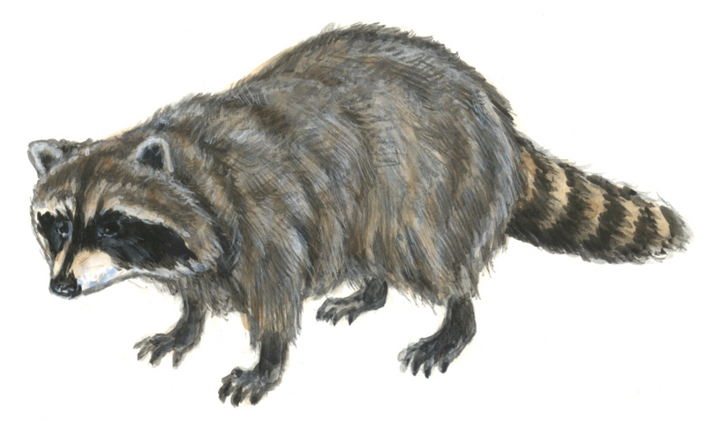
How does this affect plants or animals?
6A
Exploring Missouri – 6A Sun Stroll: Engage
11
Notes:
Animal in picture: raccoon

Slide 12
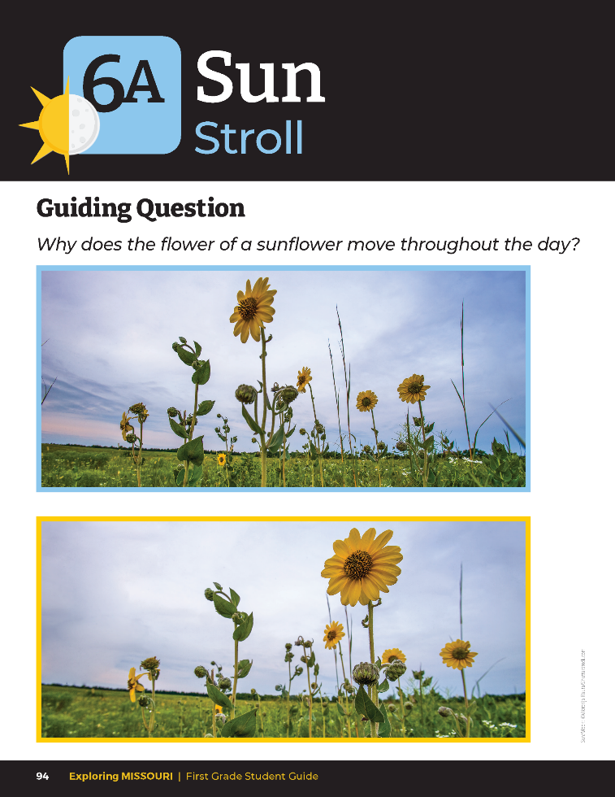
What do you notice about the shape of the plant?
What is the plant facing?
Why do you think it is facing this direction?
6A
Exploring Missouri – 6A Sun Stroll: Engage
12
Notes:
Let’s look at the sunflower. Refer to the picture of the sunflower on student guide Lesson 6A Sun Stroll introduction section on Page 94.

Slide 13
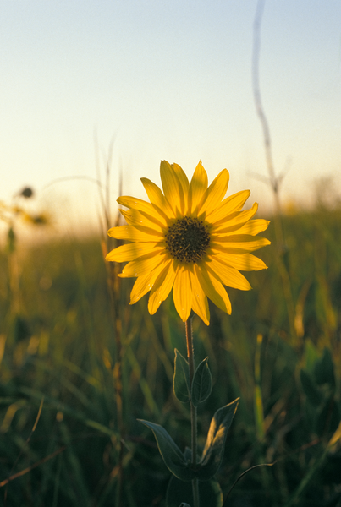
How do you think the sunflower may be like the story we just read?
6A
Exploring Missouri – 6A Sun Stroll: Engage
13
Notes:
Explore ideas why the plant might be named sunflower and how the plant might relate to the story Summer Sun Risin’.
Plant in Picture: Sunflower

Slide 14
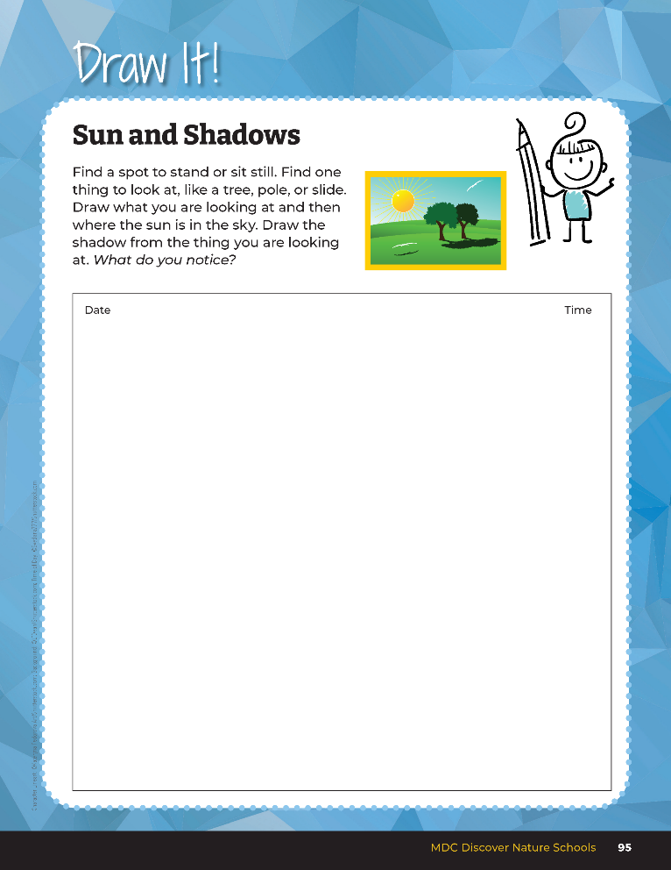

Draw what you are looking at and then where the sun is in the sky.
Draw the shadow from the thing you are looking at.
6A
Exploring Missouri – 6A Sun Stroll: Explore
14
Notes:
Teacher Note: Instruct students to avoid looking directly at the sun as this could permanently damage their eyes even if they look at the sun only briefly. To help students accomplish this, encourage them to look at and focus on the blue parts of the sky. They will then only see the sun in their peripheral vision.
Take children outside to record observations about the location of the sun in student guide, Draw It! 6A Sun and Shadows section on Page 95. Make sure they record the time of day and the date.

Slide 15
Where do you think the sun will be tomorrow at the exact same time? Why?
6A
Exploring Missouri – 6A Sun Stroll: Explore
15

Slide 16

What do you think the flashlight represents?
6A
Exploring Missouri – 6A Sun Stroll: Explain
16
Notes:
Take a flashlight and the globe of Earth. Show students where they are located on the globe and mark with dry erase marker. Turn off the lights. Shine the light onto the globe where they are located.
What do you think the flashlight represents? (The sun.)

Slide 17
Do you think it is nighttime or daytime for us?
What about people on the other side of the globe?
6A
Exploring Missouri – 6A Sun Stroll: Explain
17
Notes:
It is pointed directly at the globe right now.
Do you think it is nighttime or daytime for us? What about people on the other side of the globe? (Nighttime.)

Slide 18
As I spin the Earth, what do you notice about the light and where we are located on the globe?
6A
Exploring Missouri – 6A Sun Stroll: Explain
18
Notes:
Start spinning Earth counterclockwise while keeping the flashlight on the globe.
As I spin the Earth, what do you notice about the light and where we are located on the globe? (It starts to go to the other side of the globe). This is called sunset.

Slide 19
What is it called for us when the light is on the other side of the globe?
6A
Exploring Missouri – 6A Sun Stroll: Explain
19
Notes:
What is it called for us when the light is on the other side of the globe? (Nighttime)

Slide 20
And what is it called when the light begins to shine on where we live?
6A
Exploring Missouri – 6A Sun Stroll: Explain
20
Notes:
And what is it called when the light begins to shine on where we live? (Sunrise)

Slide 21

How long do you think it takes for Earth to spin once?
6A
Exploring Missouri – 6A Sun Stroll: Explain
21
Notes:
How long do you think it takes for Earth to spin once? (24 hours)

Slide 22
Do we see this every day?
What do we call something that repeats over and over?
6A
Exploring Missouri – 6A Sun Stroll: Explain
22
Notes:
A patterns or a cycle.

Slide 23
Did the sun or flashlight move while I was spinning the globe?
6A
Exploring Missouri – 6A Sun Stroll: Explain
23
Notes:
No

Slide 24
So, what spins?
6A
Exploring Missouri – 6A Sun Stroll: Explain
24
Notes:
Earth.

Slide 25
Does the spin of Earth ever change direction?
6A
Exploring Missouri – 6A Sun Stroll: Explain
25
Notes:
No. Earth spins in one direction which means the sun will always rise in the east and set in the west.

Slide 26
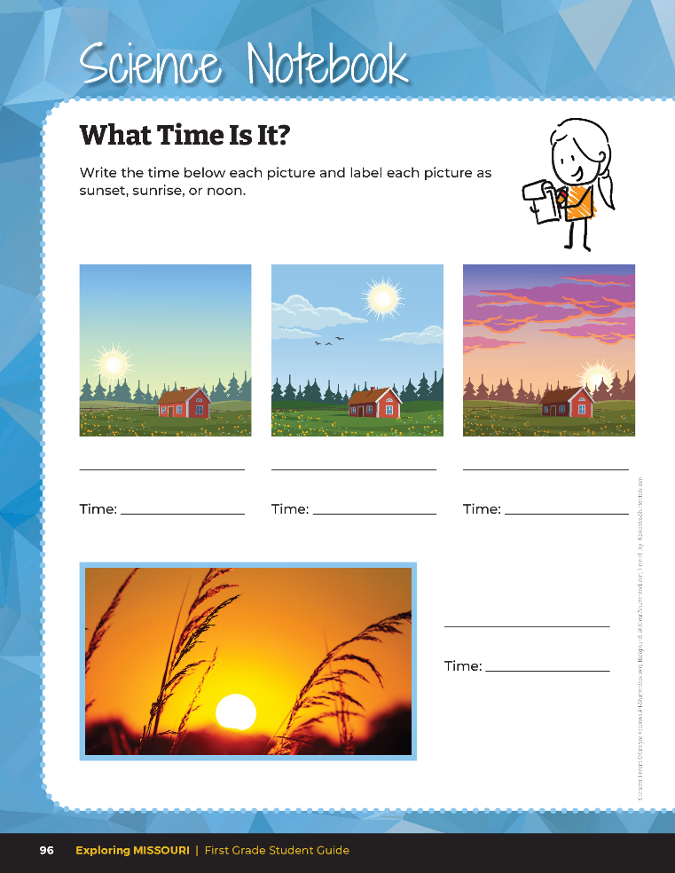

Write the time below each picture and label each picture as sunset, sunrise, or noon.
6A
Exploring Missouri – 6A Sun Stroll: Explain
26
Notes:
Have students complete the Science Notebook 6A What Time Is It? section on Page 96. Students will write the correct time of sunrise, noon, and sunset for today’s date. Students will label each photo as sunrise, noon, or sunset.

Slide 27
6A Sunrise and Sunset Calculator Link: https://www.timeanddate.com/sun/
Insert zip code into Search
Click Enter
Display the Sun Graph for your area
Click “Day/Night” Length to display hours of daylight versus hours of night throughout the year
6A
Exploring Missouri – 6A Sun Stroll: Explain
27
Notes:
To assist students with the time for sunrise and sunset for that day, display the Sunrise and Sunset Calculator on the webpage from the link on the MDC Teacher Portal.

Slide 28
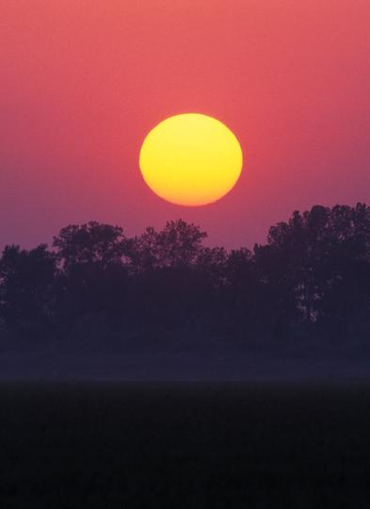
Does the time of our sunrises and sunsets stay the same or do they also change through the year?
6A
Exploring Missouri – 6A Sun Stroll: Explain
28
Notes:
Make a T-Chart at the front of the class to compare summer and winter. Gather student ideas onto the chart.

Slide 29
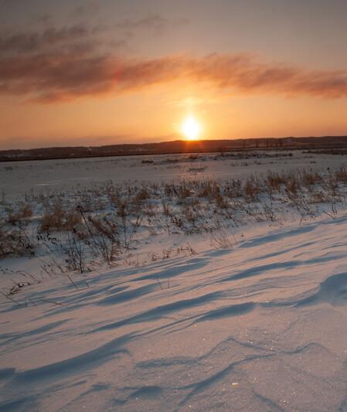
What about how much sunlight we experience in the summer versus in the winter?
Do we experience more sunlight in the summer or in the winter? What about the least amount?
6A
Exploring Missouri – 6A Sun Stroll: Explain
29

Slide 30
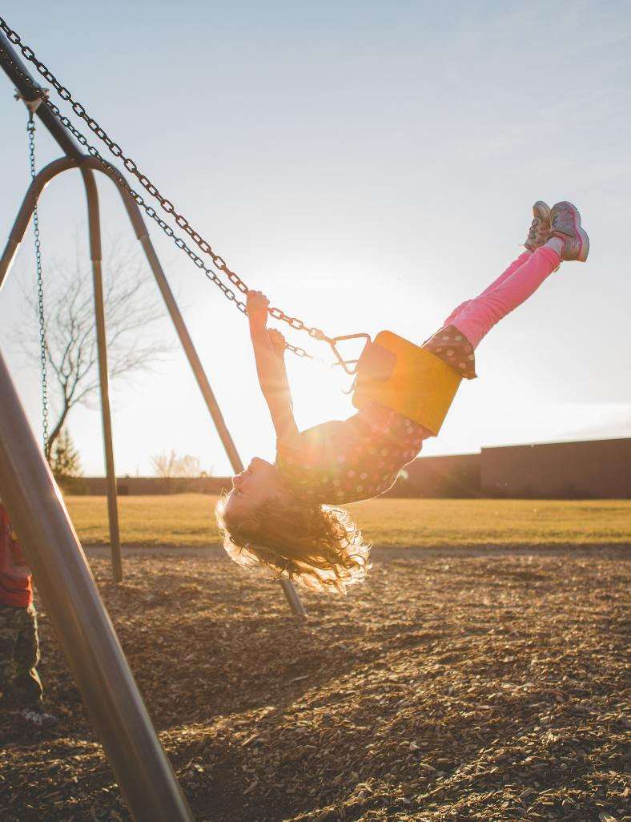
How does this affect what we can do in the different seasons?
6A
Exploring Missouri – 6A Sun Stroll: Explain
30

Slide 31
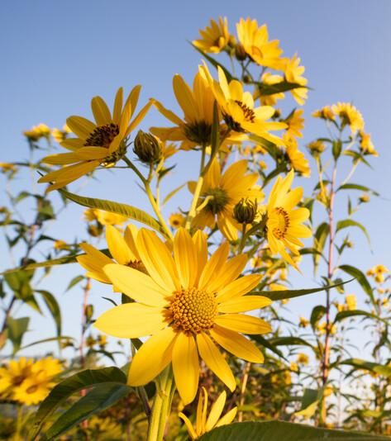
How does the amount of daylight affect the sunflower?
6A
Exploring Missouri – 6A Sun Stroll: Explain
31
Notes:
Plant in Picture: Sunflower

Slide 32
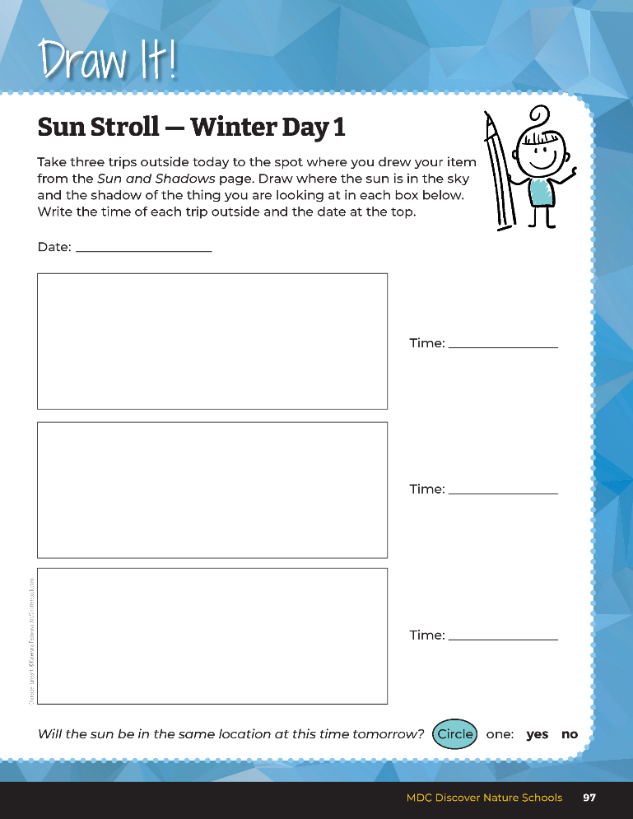
Draw where the sun is in the sky and the shadow of the thing you are looking at.
6A
Exploring Missouri – 6A Sun Stroll: Elaborate - Winter
32
Notes:
Teacher Note: On each visit to observe the sun, again remind students to always look only at the blue parts of the sky. Ensure they do not look directly at the sun as this will permanently damage their eyes.
Take students outside at three different times on the same day: at the beginning of the school day, in the middle of the day, and at the end of the day. Have students observe where the sun is in the sky and resulting shadows, record both the time and their observations in the student guide, Draw It! 6A Sun Stroll – Winter Day 1 section on Page 97.

Slide 33
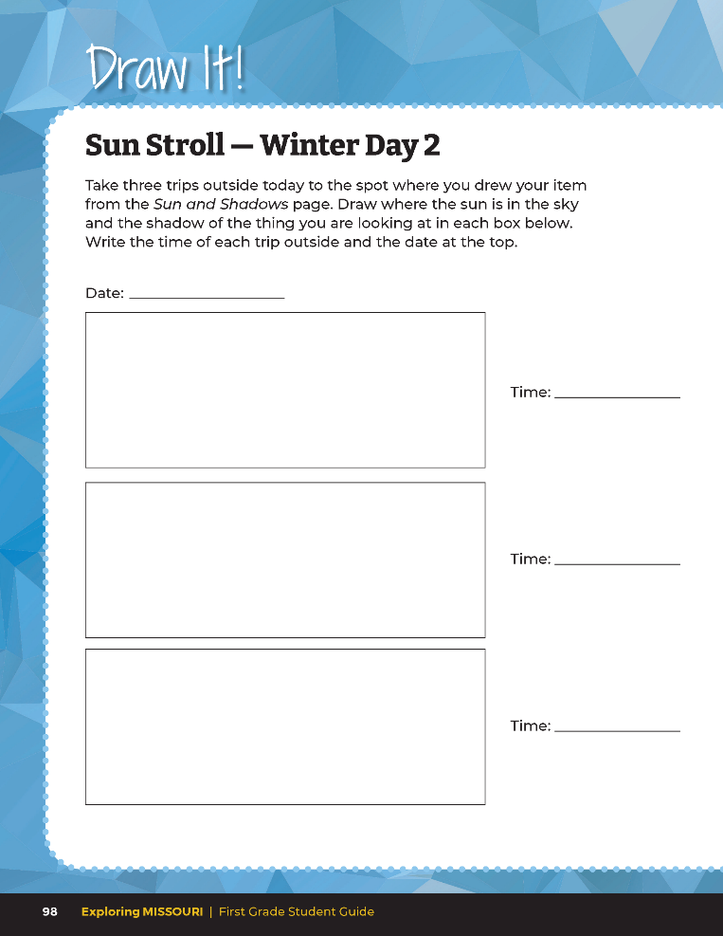
Draw where the sun is in the sky and the shadow of the thing you are looking at.
6A
Exploring Missouri – 6A Sun Stroll: Elaborate - Winter
33
Notes:
Return over the next several days and repeat Draw It! Sun Stroll – Winter Day 2 on Page 98.
Teacher Note: Copies of Sun Stroll can be made and distributed for additional days if needed. If you are tracing a student’s shadow, first trace their shoes the first time to ensure the student stands in the exact same location each time. By drawing shadows, the children can see that the plant, tree, or student doesn’t move, but that Earth does.

Slide 34
Compare the data.
What do you notice?
6A
Exploring Missouri – 6A Sun Stroll: Elaborate - Winter
34
Notes:
Have students note the data they recorded during different times/days. Compare the data. What do you notice? They should see a pattern. If a pattern is not observed, it is recommended to repeat this activity.

Slide 35

Place small figurines on the ledge of a window to observe the shadow as the figurines are exposed to different directions of sunlight throughout the day.
6A
Exploring Missouri – 6A Sun Stroll: Elaborate - Winter
35
Notes:
If there is a classroom window available, place small figurines on the ledge to allow students to observe the shadow as the figurines are exposed to different directions of sunlight throughout the day. (Optional: students may bring a figurine from home to place on ledge to record shadows.)

Slide 36
Discuss and predict where the sun will be at the same times tomorrow.
6A
Exploring Missouri – 6A Sun Stroll: Elaborate - Winter
36
Notes:
Have students discuss and predict where the sun will be at the same times the following day. Return the next day to test if student’s prediction were accurate.

Slide 37
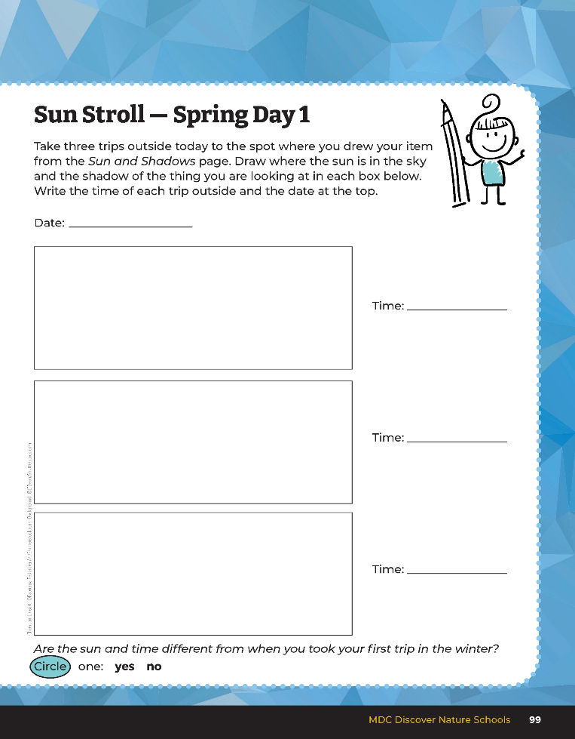
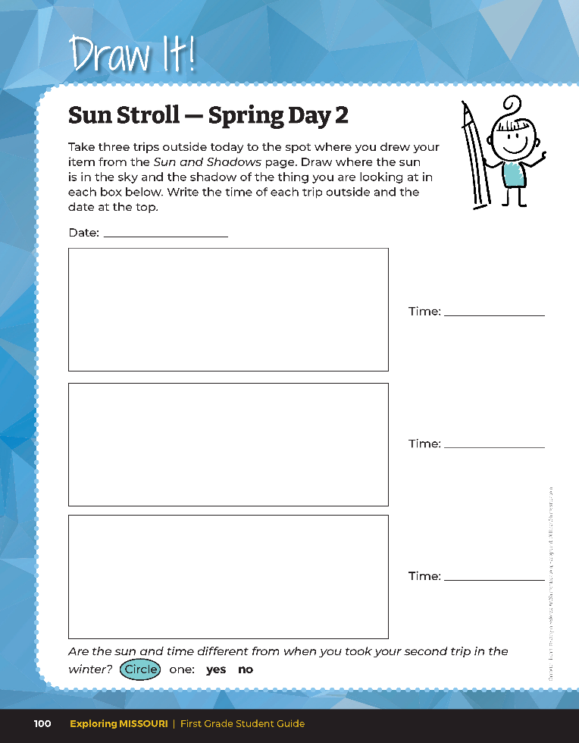
6A
Exploring Missouri – 6A Sun Stroll: Elaborate - Spring
37
Notes:
You will repeat this portion of the lesson in spring season the meet the standard of comparing the amount of daylight between seasons. There are two extra Sun Stroll pages.
Have students remember what they noticed about the sun’s place in the sky during winter. Next, have students predict what they expect they’ll find related to the sun’s location now in the spring.

Slide 38
Remember what you noticed about the sun’s place in the sky during winter.
Predict what you expect to find related to the sun’s location now in the spring.
6A
Exploring Missouri – 6A Sun Stroll: Elaborate - Spring
38
Notes:
Have students remember what they noticed about the sun’s place in the sky during winter. Next, have students predict what they expect they’ll find related to the sun’s location now in the spring.

Slide 39
Just like the globe, the Earth is spinning, and like the flashlight, the sun is not moving.
6A
Exploring Missouri – 6A Sun Stroll: Elaborate - Spring
39
Notes:
As students observations of the sun moving across the sky, discuss that Earth makes a full rotation each day causing night and day. Remind them that just like the globe in the classroom, Earth is spinning, and like the flashlight, the sun is not moving. To help students visualize the sun’s changing location, trace the shadow of a plant, tree, or student in the same location during different times of day for a visual representation of shadows and sun position based on time of day.

Slide 40
Explain why it is important for the sunflower to follow the sun in a predictable pattern from east to west.
6A
Exploring Missouri – 6A Sun Stroll: Elaborate - Spring
40
Notes:
The sunflower gets its name because the flower follows the sun across the sky. Have students revisit the pictures on Lesson 6A Sun Stroll introduction page, and using what they learned about how Earth rotates, have students use words or drawings to explain why it is important for the sunflower to follow the sun in a predictable pattern from east to west.

Slide 41
What do you notice about the amount of daylight on one day in January?
6A
Exploring Missouri – 6A Sun Stroll: Elaborate - Spring
41
Notes:
If completing spring section comparison:
Let’s review our data we collected. Compare the data from early January and after Spring Break.

Slide 42
What about the amount of daylight after Spring Break?
6A
Exploring Missouri – 6A Sun Stroll: Elaborate - Spring
42

Slide 43
Was your prediction correct about the daylight you found after Spring Break?
6A
Exploring Missouri – 6A Sun Stroll: Elaborate - Spring
43

Slide 44
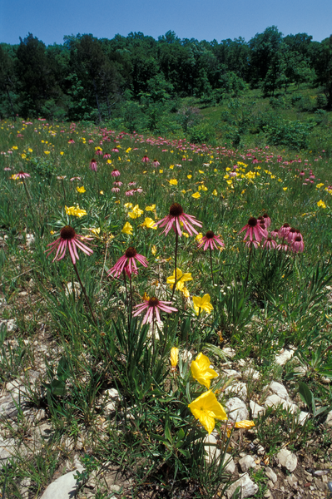
What time of year is daylight the longest?
6A
Exploring Missouri – 6A Sun Stroll: Elaborate - Spring
44
Notes:
Plant in Picture: Purple Coneflower and Missouri Primrose

Slide 45
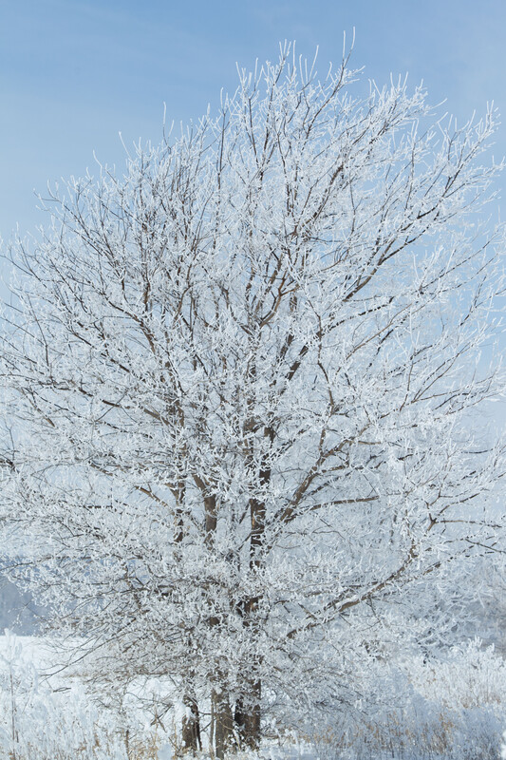
When is it the shortest?
6A
Exploring Missouri – 6A Sun Stroll: Elaborate - Spring
45

Slide 46
How does the amount of daylight affect our own activities during these months?
6A
Exploring Missouri – 6A Sun Stroll: Elaborate - Spring
46

Slide 47
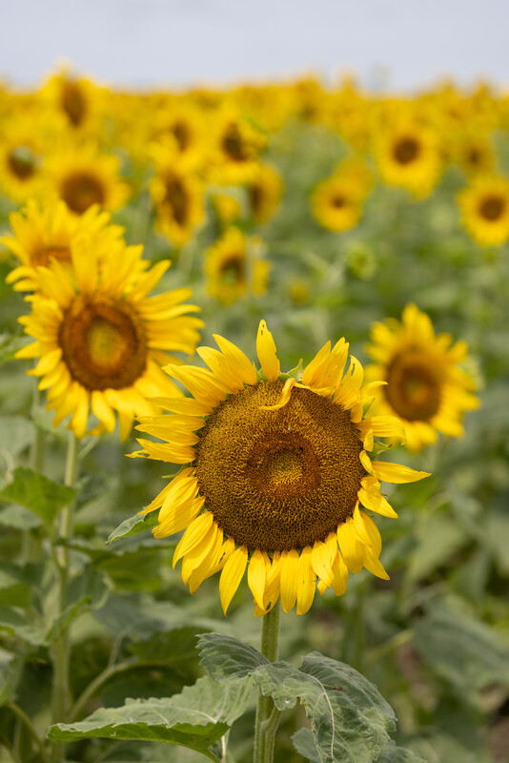
How does daylight affect the sunflower?
6A
Exploring Missouri – 6A Sun Stroll: Elaborate - Spring
47
Notes:
Plant in Picture: Sunflower

Slide 48
6A Sunrise and Sunset Calculator Link: https://www.timeanddate.com/sun/
What happens when I place my cursor over June or July? What is the amount of daylight? When is it the sunrise or sunset?
What happens when I place my cursor over January? What is the amount of daylight?
When is the sunrise and sunset?
In what month do I see the most amount of daylight? The least?
What about in the fall and spring?
6A
Exploring Missouri – 6A Sun Stroll: Elaborate - Spring
48
Notes:
Optional: Display the Sunrise and Sunset Calculator webpage from the link on the MDC Teacher Portal. Follow the instructions to locate the Sun graph for your location. As you move your mouse back and fourth across the graph, the total daylight hours will change as shown below the graph.

Slide 49
Why does the flower of the sunflower move throughout the day?
6A
Exploring Missouri – 6A Sun Stroll: Evaluate
49
Notes:
Refer to the Lesson 6A Sun Stroll introduction page with the pictures of the sunflower.

Slide 50
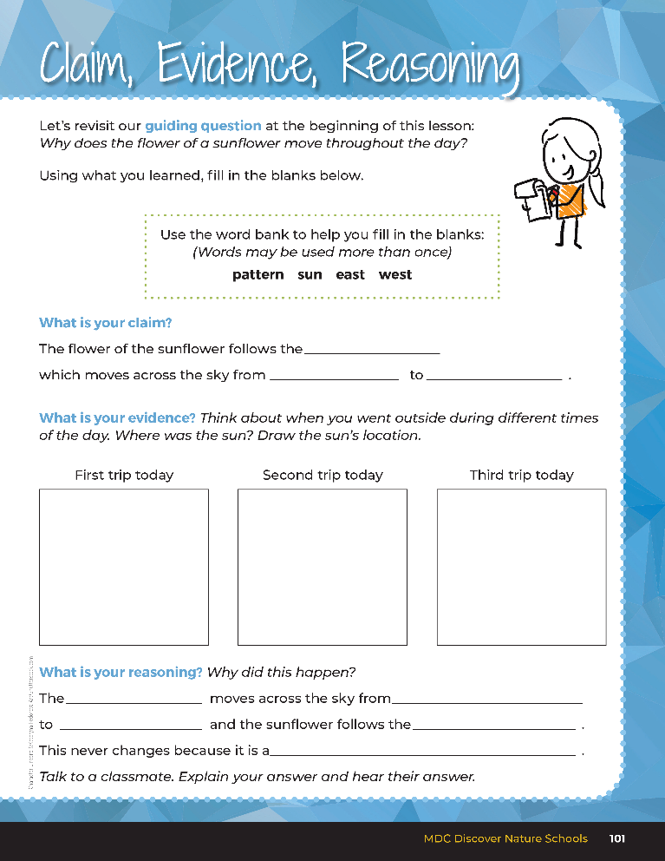
Guiding Question:
Why does the flower of a sunflower move throughout the day?
6A
Exploring Missouri – 6A Sun Stroll: Evaluate
50
Notes:
After exploring how the sun moves across the sky in a predictable pattern from east to west, have students open their student guides to the Claim, Evidence, Reasoning section on Page 101. Discuss the page with the students – read the guiding question and then explain what the students need to do to answer the questions (fill in the blanks and draw the sun’s location in the boxes.)

Slide 51

sun
east
west
Answers
Students should have drawn the sun on the left in the first box.
Students should have drawn the sun high in the middle box.
Students should have drawn the sun on the right in the third box.
sun
east
west
sun
pattern
6A
Exploring Missouri – 6A Sun Stroll: Evaluate
51
Notes:
Rubric:
4 (Exceeds) – Students write the correct claim and draw the different locations of the sun into the blanks and fill in all five blanks under reasoning correctly.
3 (Meets) – Students write either the correct claim or draw some of the different locations of the sun into the blanks and fill in three to four blanks under reasoning correctly.
2 (Partially Meets) – Students do not write the correct claim or draw some of the different locations of the sun into the blanks and fill in one to two blanks under reasoning correctly.
1 (Doesn’t Meet) – Students do not write the correct claim or draw the locations of the sun into the blanks and do not fill in any blanks under reasoning correctly.

