Slide 1
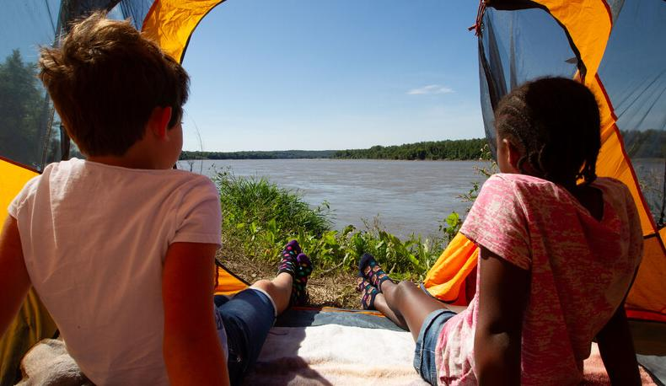

Life and Land in
MISSOURI
6A: A Little Less Litter

Slide 2
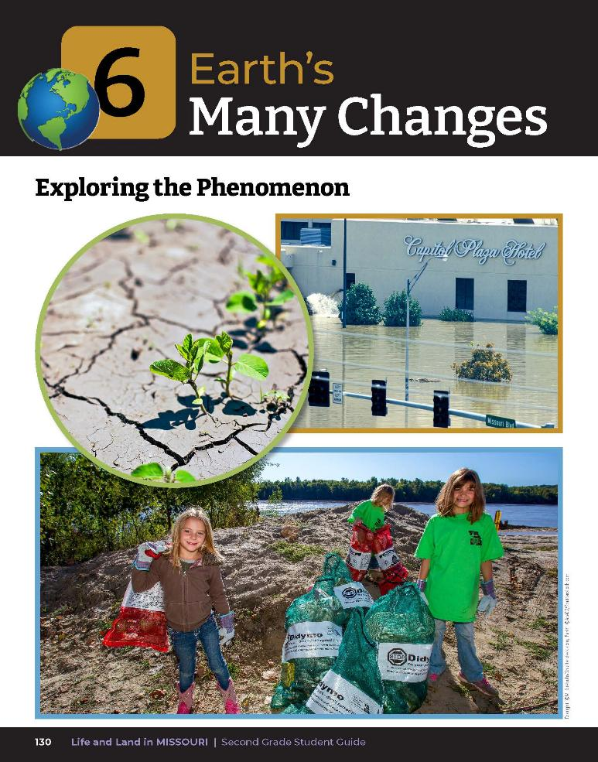
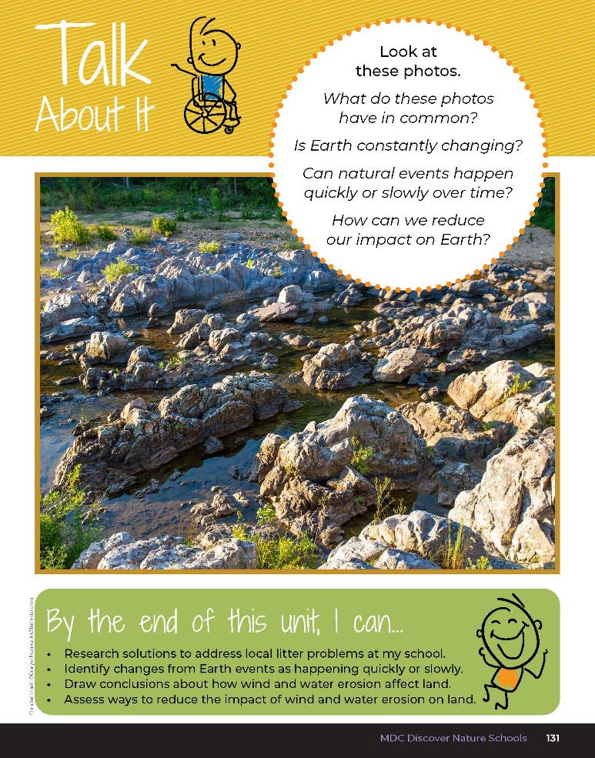
6A
Life and Land in Missouri – 6A A Little Less Litter: Engage
2
Notes:
Have students open their student guide to the Unit 6 Exploring the Phenomenon section on pages 130-131. Discuss the Talk About It.
What do these photos in common?
Is the Earth constantly changing?
Can natural events happen quickly or slowly over time?
How can we reduce our impact on Earth?

Slide 3
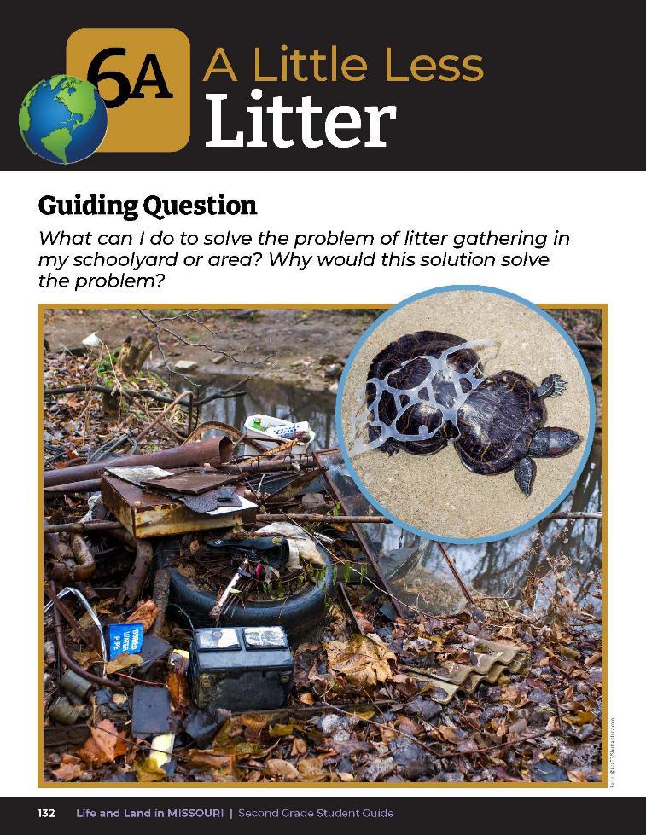
Guiding Question:
What can I do to solve the problem of litter gathering in my schoolyard or area? Why would this solution solve the problem?
6A
Life and Land in Missouri – 6A A Little Less Litter: Engage
3
Notes:
Have students open their student guide to the Lesson 6A A Little Less Litter introduction on Page 132. Read the guiding question together.

Slide 4
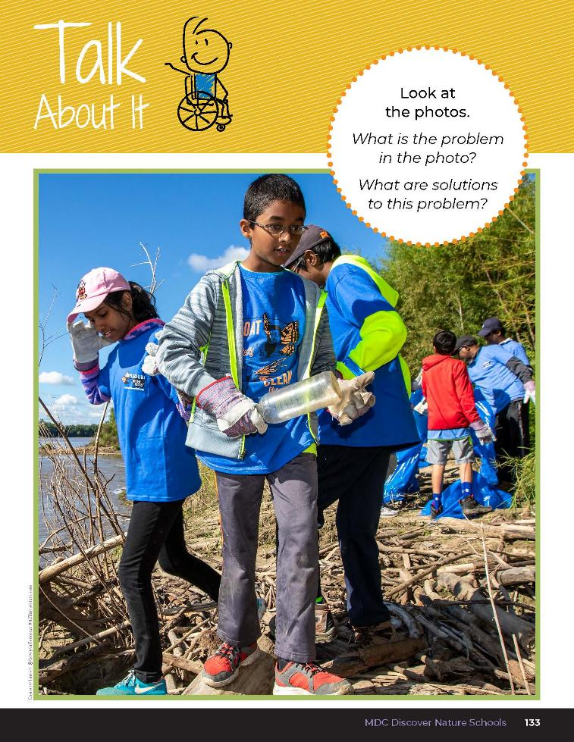

What is the problem in the photo?
What are solutions to this problem?
6A
Life and Land in Missouri – 6A A Little Less Litter: Engage
4
Notes:
Discuss the Talk About It on Page 133. Write student ideas on the board.

Slide 5
Today we are going to identify a problem and propose different solutions to that problem.
6A
Life and Land in Missouri – 6A A Little Less Litter: Explore
5

Slide 6
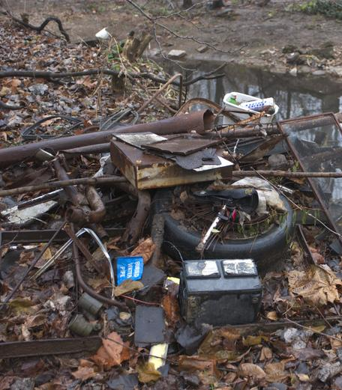
Do we see any problems in this area?
Why does the litter gather here?
6A
Life and Land in Missouri – 6A A Little Less Litter: Explore
6
Notes:
Go outside and take students to a nearby area where litter may gather, such a fence line or parking lot. Allow students to share their thoughts about how the litter gathered here.

Slide 7
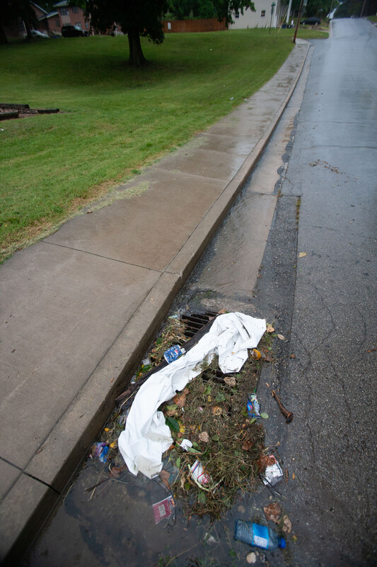
What would happen to the trash on the ground if there was a heavy rain or strong wind?
Where would it go and what problems would it cause?
6A
Life and Land in Missouri – 6A A Little Less Litter: Explore
7
Notes:
(Students should give predictions such as the water would wash the trash away, the trash would flow to a stream, the trash would pollute the water and the wildlife and plants would suffer. Wind would carry the trash to a nearby area.)

Slide 8
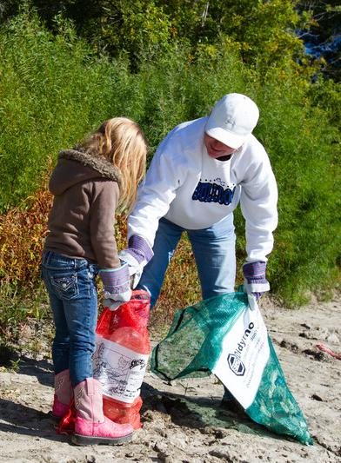
Let’s gather all the litter we can find into trash bags.
6A
Life and Land in Missouri – 6A A Little Less Litter: Explore
8
Notes:
Allow students time to gather as much litter as they can find into trash bags. You can distribute rubber gloves for students if they prefer not to touch litter found on the ground. For a fun extension and feeling of student ownership and achievement, you can weigh the amount of litter collected.

Slide 9
We are going to think like engineers and define the problem and think of solutions about the litter situation.
Let’s get into groups!
6A
Life and Land in Missouri – 6A A Little Less Litter: Explore
9
Notes:
Now we are going to think like engineers and define (or explain) the problem and think of solutions. We will not create a model today but we are going to present our ideas and revise our ideas so we can develop better solutions.
Students will define the problem, ask questions, and make observations to gather information about the litter situation and how people can make changes. Teacher Note: The following activity can be done individually, in small groups, or as a class.
Place students into groups of 3-4.

Slide 10
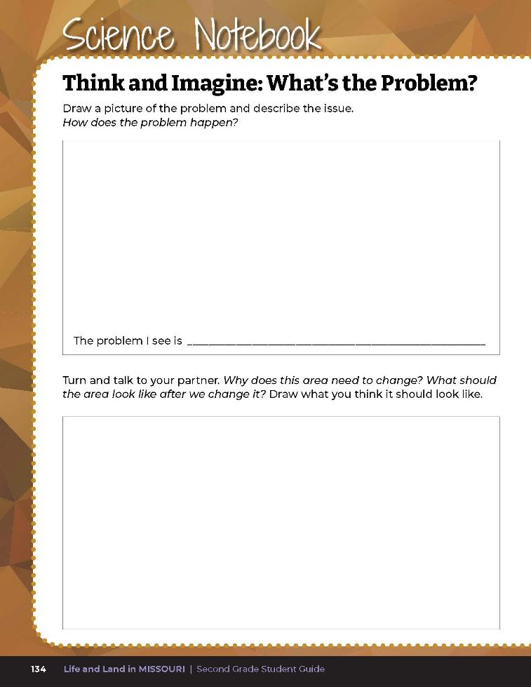
Answer the following questions:
The problem I see is __________.
Why does this area need to change?
What should the area look like after we change it?
6A
Life and Land in Missouri – 6A A Little Less Litter: Explore
10
Notes:
Have each group open their student guide to Science Notebook 6A Think and Imagine: What’s the Problem? on Page 134. Have students work together in their group to answer the following questions in the student guide:
The problem I see is __________________________.
Why does this area need to change?
What should the area look like after we change it?

Slide 11
Are there a variety of different problems or is there a theme of the same problem?
6A
Life and Land in Missouri – 6A A Little Less Litter: Explore
11
Notes:
Allow students have had a chance to work individually or in groups, allow students to share their answers. If students give a variety of problems, allow their group to find a solution to that particular problem.

Slide 12
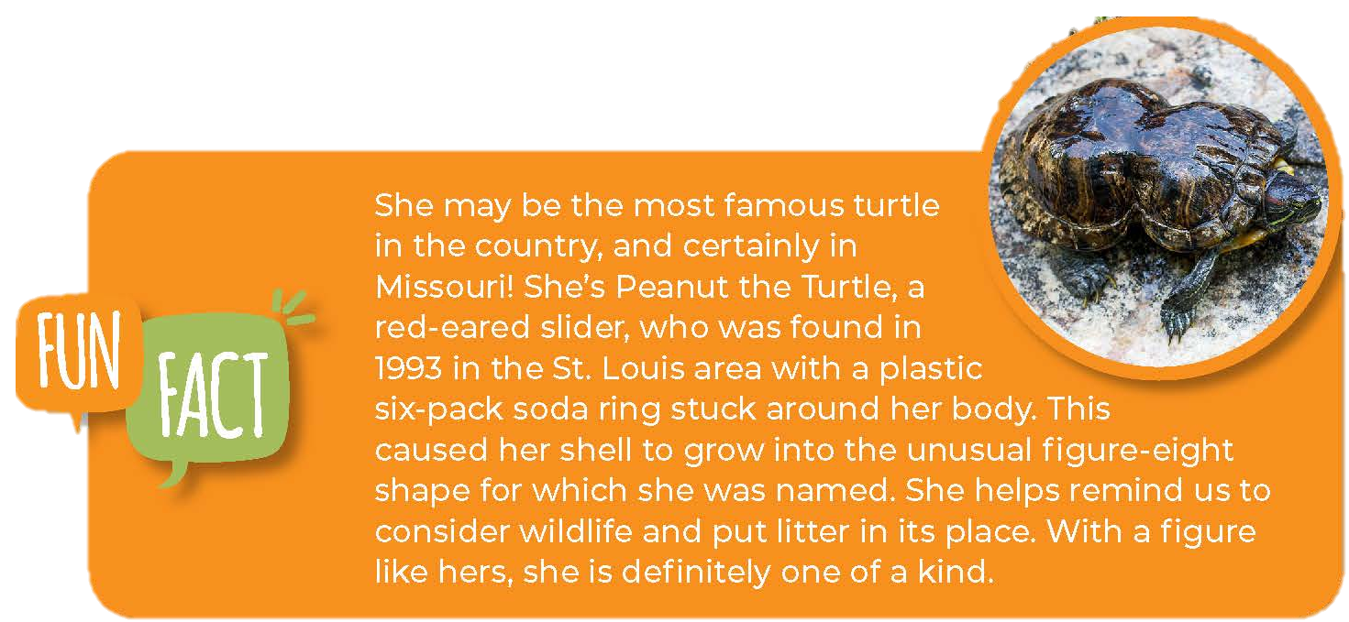
6A
Life and Land in Missouri – 6A A Little Less Litter: Explain
12
Notes:
Now that we understand the problem, let’s research and design solutions. Here is an example of a problem that our wildlife faced and the solution presented.
Read the Fun Fact about Peanut the red-eared slider on Page 135.

Slide 13
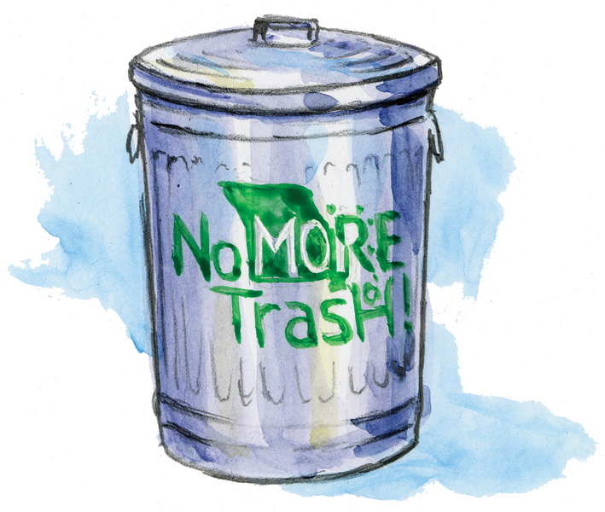
What was the problem that Peanut faced?
What solutions were presented to protect wildlife like Peanut?
6A
Life and Land in Missouri – 6A A Little Less Litter: Explain
13
Notes:
Explain to students that the Missouri Department of Conservation (MDC) and the Missouri Department of Transportation (MoDOT) developed a program called the Trash Can Contest. The campaign was created to raise awareness and discourage littering. The contest encourages students from kindergarten through eighth grade to join the fight against litter by decorating and displaying large trash can with the “No MOre Trash!” logo and a litter prevention message using a variety of creative mediums. This solution resulted in students sharing the message of trash pick-up and keeping our state clean.

Slide 14
Watch the No MOre Trash! Video
Link:
https://www.youtube.com/watch?v=BCN52ZHg50U
6A
Life and Land in Missouri – 6A A Little Less Litter: Explain
14
Notes:
If you would like to join the campaign, click on the Trash Can Contest link in the MDC Teacher Portal. https://www.modot.org/trash-can-contest
Watch the No MOre Trash! Video from the MDC Teacher Portal.

Slide 15
What is the solution to the problem in the video?
6A
Life and Land in Missouri – 6A A Little Less Litter: Explain
15

Slide 16
Research solutions for preventing litter and share ideas with your group!
6A
Life and Land in Missouri – 6A A Little Less Litter: Explain
16
Notes:
Tell students to discuss in their group a possible solution to the problem discovered outside. Give students the opportunity to research solutions for preventing litter by sharing the online children’s encyclopedia links or gathering books from your local or school library. As students gather information, tell them to share ideas with their group as they research.

Slide 17
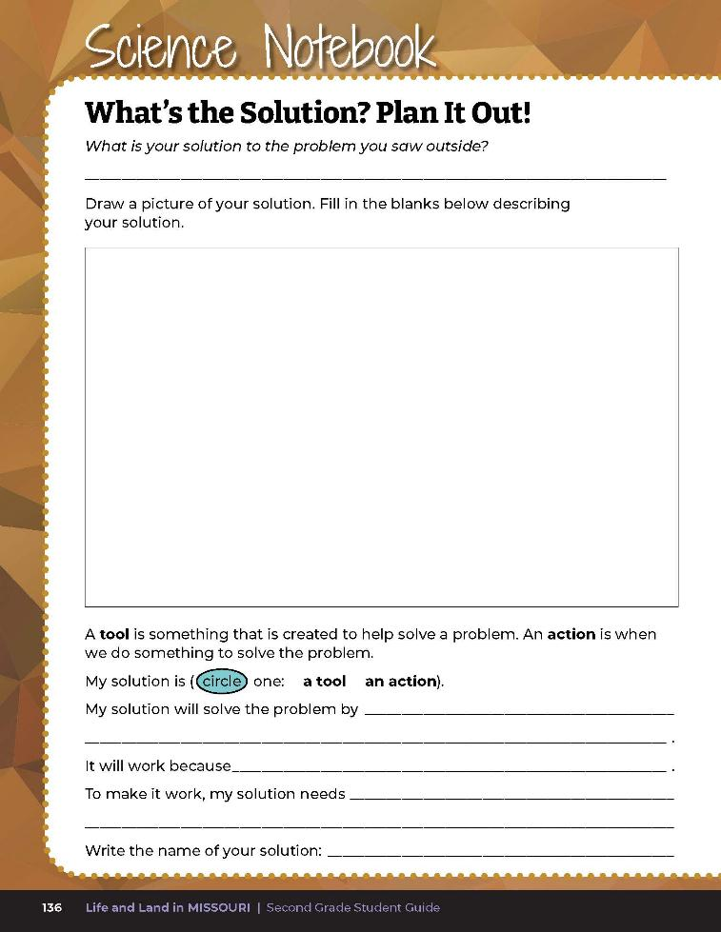
Name your solution
Draw a picture of your solution to the problem
Circle whether your solution is a tool or action
Explain how your solution solves the problem
Describe what your solution needs to work
6A
Life and Land in Missouri – 6A A Little Less Litter: Explain
17
Notes:
Have students fill out Science Notebook 6A What’s the Solution? Plan It Out! on student guide Page 136 to describe their solution.
Students will do the following in their student guide:
Name their solution
Draw a picture of their solution to the problem
Circle whether their solution is a tool or action. (Teacher Note: Discuss with your students what is meant by “tool” and “action.” The definitions are found on the student guide page.)
Fill in the blanks explaining how their solution solves the problem.
Describe what their solution needs to work. If it is a tool, then materials would be needed. If it is an action, then students will need to write the tasks that need to be completed.

Slide 18
Transfer your ideas to a poster!
Draw and give a description of the problem and the solution!
6A
Life and Land in Missouri – 6A A Little Less Litter: Explain
18
Notes:
Allow students time to transfer their ideas to a poster. They will draw the problem and the solution, giving a description from their student guide.
Examples of possible solutions:
Make signs or paint messages on storm drains to encourage people not to litter. (Storm drain stenciling in some areas needs to be approved by the local municipalities.)
Put trash cans at various places for people to put their trash.
Pick up trash at certain times during the year.
Tell people not to litter.
Make a poster to hang up or hand out telling people not to litter.
Volunteer to sweep trash off parking lots so when it rains the trash won’t get washed in drainage ditches.
Put trash cans with tight sealing lids around your schoolyard or city so people have a place to put their trash.
Construct drain covers to put over the drainage ditches so trash can’t be carried to streams or rivers.
Modify a drain cover so it keeps out more trash.
Make lids that fit trash cans better so that wind can’t blow trash out.

Slide 19

Welcome to Solving Schoolyard Scraps Symposium
A symposium is a gathering of people who come together to discuss the same topic.
6A
Life and Land in Missouri – 6A A Little Less Litter: Elaborate
19
Notes:
Students will post their posters around the room for a Solving Schoolyard Scraps Symposium. Write “Welcome to Solving Schoolyard Scraps Symposium” on the board. Tell students that a symposium is a gathering of people who come together to discuss the same topic.

Slide 20
What is our topic for this symposium?
6A
Life and Land in Missouri – 6A A Little Less Litter: Elaborate
20

Slide 21
You will be identifying strengths and weaknesses of each other’s design.
A strength is something that works better or best for our goal.
A weakness is something that does not work as well for the goal.
6A
Life and Land in Missouri – 6A A Little Less Litter: Elaborate
21
Notes:
Tell students that they will consider and discuss the different solutions and how each solution helps to solve the problem. Explain to students that when they discuss other groups’ ideas, they will be identifying strengths and weaknesses of each other’s designs. A strength is something that works better or best for our goal. A weakness is something that does not work as well for the goal.

Slide 22
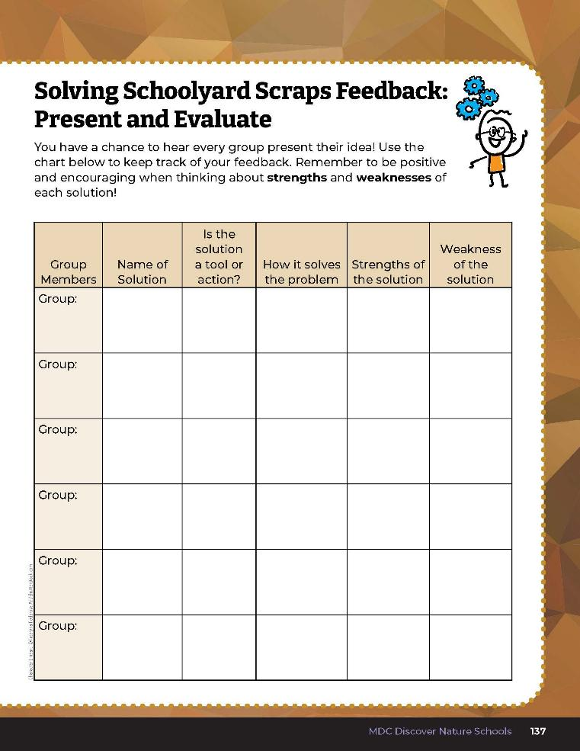
Discuss the strengths and weakness of your own design with your small group.
6A
Life and Land in Missouri – 6A A Little Less Litter: Elaborate
22
Notes:
Before sharing ideas, have students work in their small groups and discuss what they think are the strengths and weaknesses of their own design. They can use the Science Notebook 6A Solving Schoolyard Scraps Feedback: Present and Evaluate section on student guide Page 137 to evaluate their own design, or for more space, you can have students develop their own graphic organizer to keep notes during the presentations.
Remind students to be very positive and encouraging as others share their ideas.

Slide 23
One group at a time, share your poster and ideas with the class.
After each group shares their idea, discuss the pros and cons of that solution.
6A
Life and Land in Missouri – 6A A Little Less Litter: Elaborate
23
Notes:
Allow students, one group at a time, to share their poster and their ideas with the class. After each group shares their idea, allow the rest of the class to discuss in small groups the pros and cons of that solution. They can use the chart on Science Notebook 6A Solving Schoolyard Scraps Feedback: Present and Evaluate on Page 137 as a guide. When the small groups are done discussing the solutions, have them share their feedback with the whole class. Write their feedback on the board.
Students need to be kind, even when they are pointing out weaknesses. Likewise, when a group’s idea is being evaluated, students in that group should be open-minded if someone points out a way their idea might not work. If students are having challenges giving appropriate verbal feedback, ask students to write down their feedback first.

Slide 24
Fill out the chart.
6A
Life and Land in Missouri – 6A A Little Less Litter: Elaborate
24
Notes:
After each group is finished presenting and discussing each proposal, give students about 5 minutes to fill out the chart for evaluating proposals in their student guide Science Notebook 6A Solving Schoolyard Scraps Feedback: Present and Evaluate page.

Slide 25

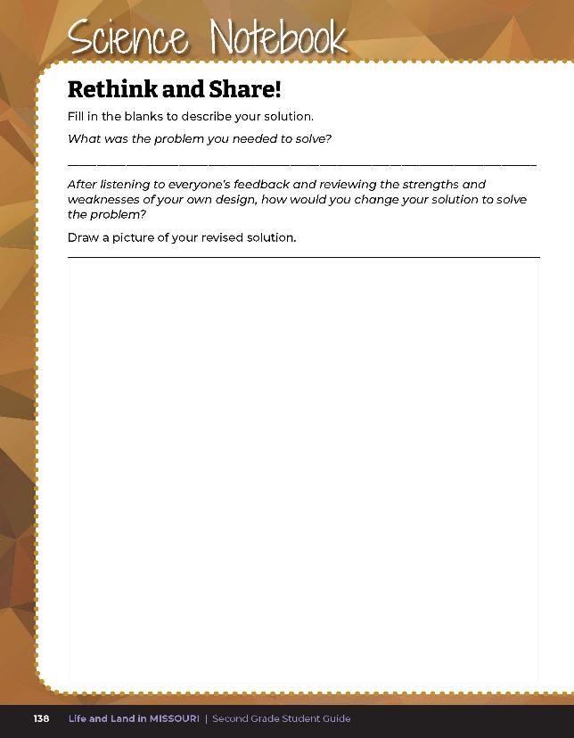
Reevaluate and revise your solution.
6A
Life and Land in Missouri – 6A A Little Less Litter: Elaborate
25
Notes:
Give students time to reevaluate and revise their solution a second time using Science Notebook 6A Rethink and Share on Page 138 of their student guide. If they have time, they can revise their posters and present either to the entire class or to another group.

Slide 26

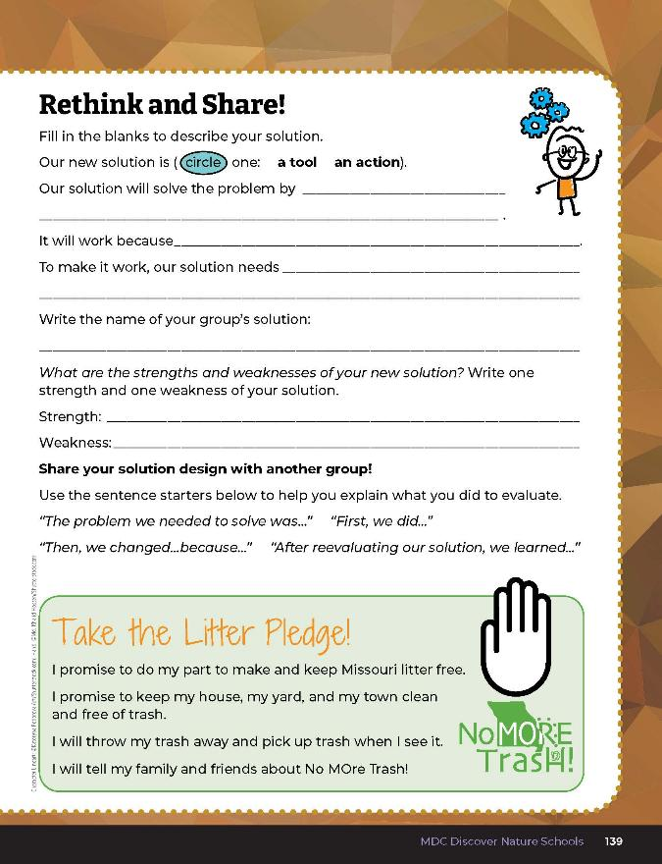
Fill in the blanks and describe your solution!
6A
Life and Land in Missouri – 6A A Little Less Litter: Evaluate
26
Notes:
After exploring the concept of evaluating problems and solutions to litter, have students complete the Science Notebook 6A Rethink and Share section on Page 139 of their student guide.
Teacher Note: If time allows, give students another opportunity to re-create their poster to post and share around the school.
Rubric:
4 (Exceeds) – Student writes the problem the group needed to solve and draws a picture. Student circles if the solution is a tool or action. Student fills in all blanks and shows the changes made from their previous idea. Student provides at least 1 strength and 1 weakness.
3 (Meets) – Student somewhat writes the problem the group needed to solve and draws a picture. Student circles if the solution is a tool or action. Student fills in most of the blanks but may or may not show any changes from their previous idea. Student provides at least 1 strength and 1 weakness.
2 (Partially meets) – Student may or may not write the problem the group needed to solve and may or may not draw a picture. Student may or may not circle if the solution is a tool or action. Student fills only one of the blanks but may or may not show any changes from their previous idea. Student may or may not provide a strength or weakness.
1 (Does not meet) – Student does not complete most of the components on the page.

Slide 27

6A
Life and Land in Missouri – 6A A Little Less Litter: Evaluate
27
Notes:
After everyone has reevaluated and presented (if time) their new solution, have students take the Litter Pledge by repeating the words in their student guide under the Rethink and Share on Page 139 as a class.

