Slide 1
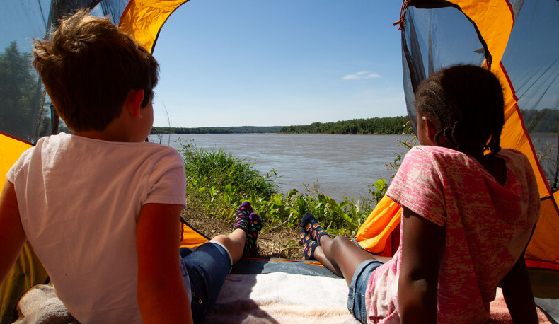

Life and Land in
MISSOURI
Unit 5 Review

Slide 2
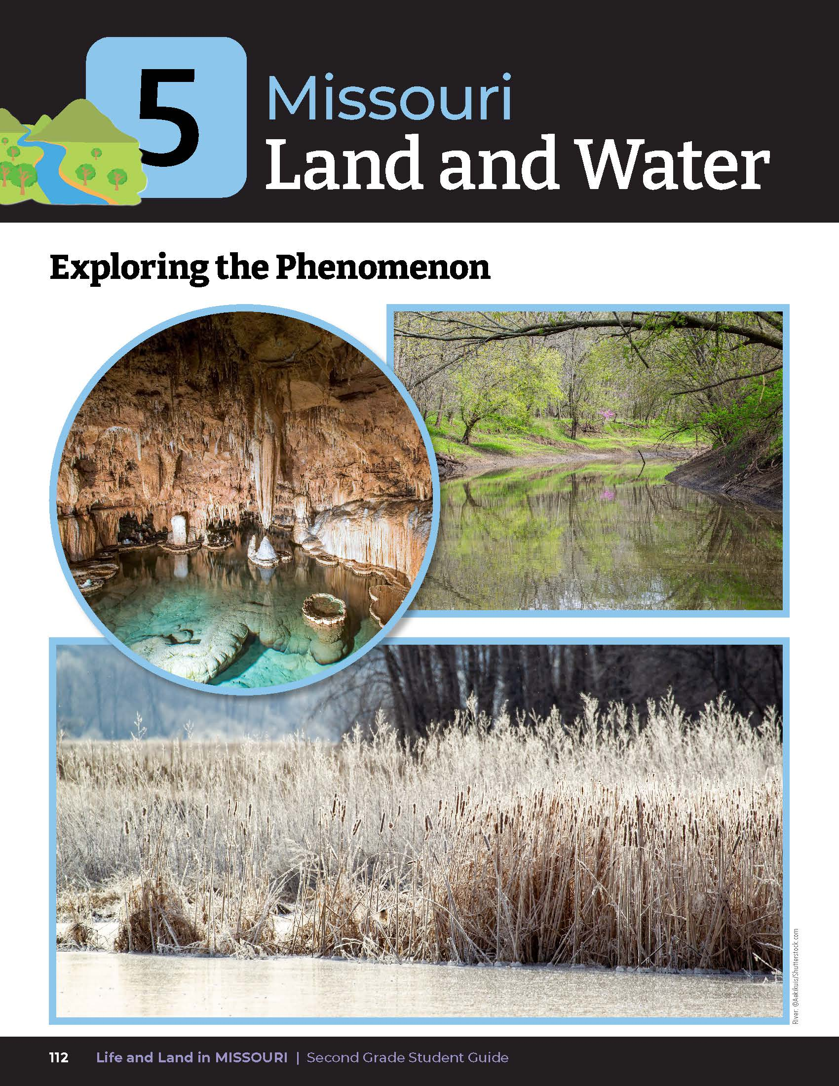
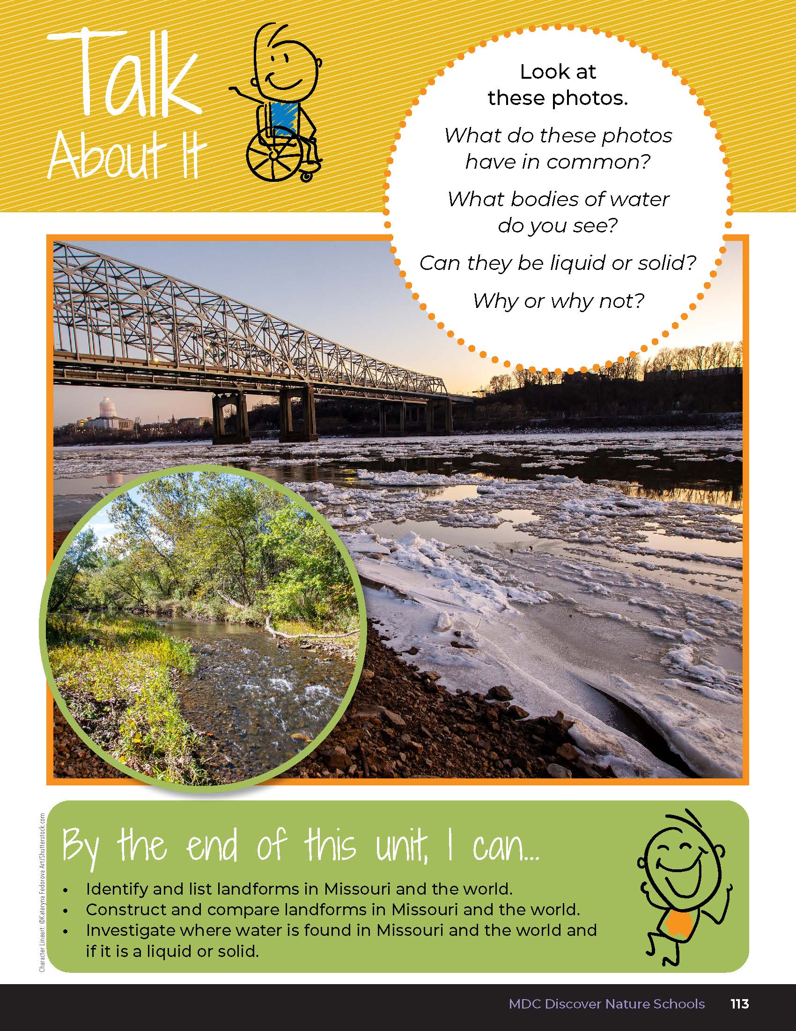
Look at these photos.
What do these photos have in common?
5
Life and Land in Missouri – Unit 5 Review
2
Notes:
Have students turn to the Unit 5 Exploring the Phenomenon and Talk About It section on pages 112-113.
Using the pictures at the beginning of the lesson, have students turn and talk to a classmate and describe the different landform features and characteristics.
Look at these photos. What do these photos have in common? (These are all landforms with water in Missouri.)

Slide 3
What bodies of water do you see?
5
Life and Land in Missouri – Unit 5 Review
3
Notes:
(River, stream, pond, and cave water.)

Slide 4
Can they be liquid or solid?
Why or why not?
5
Life and Land in Missouri – Unit 5 Review
4
Notes:
They can be liquid or solid depending on the temperature.
Rubric:
3 (Meets) – Student explains that all photos are of landforms. Student lists river, stream, and pond as the bodies of water and that they can be both liquid and solid depending on the climate.
2 (Partially meets) – Student somewhat explains that all photos are of landforms. Student lists some of the bodies of water in the photos and whether they can be both liquid and solid depending on the climate.
1 (Doesn’t meet) – Student does not explain that all photos are of landforms. Student does not list some of the bodies of water in the photos and whether they can be both liquid and solid depending on the climate.

Slide 5
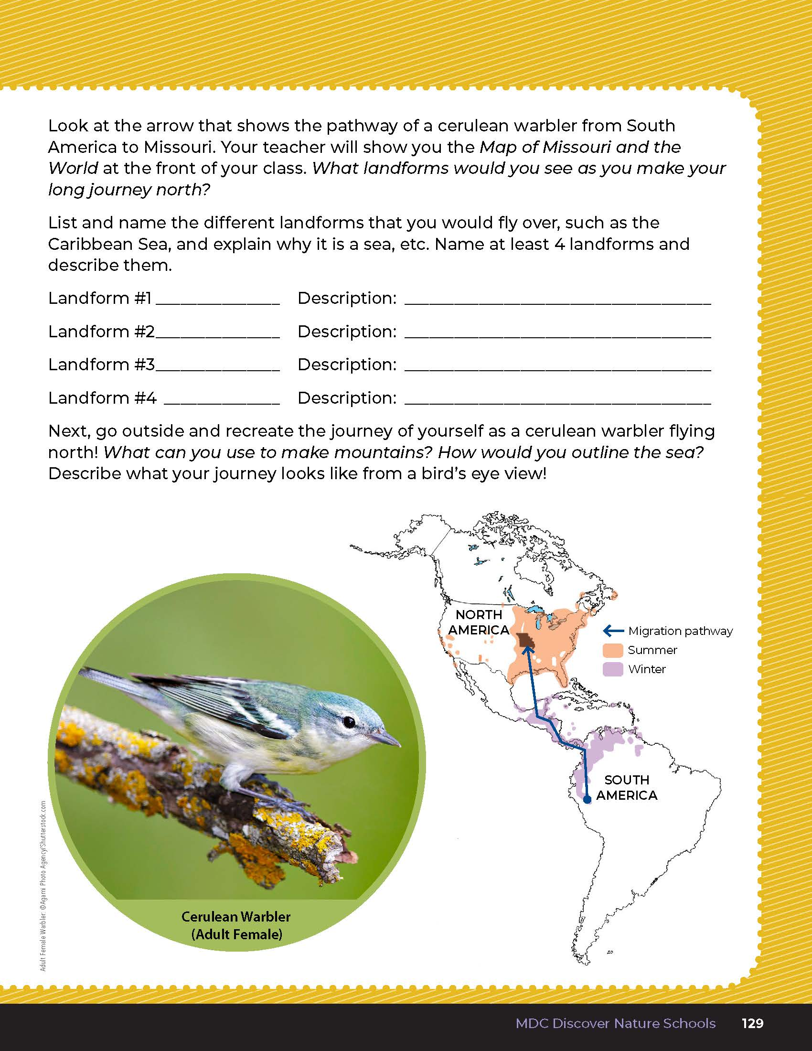
Discuss the map of migration of the Cerulean Warbler.
5
Life and Land in Missouri – Unit 5 Review
5
Notes:
Students will map out the pathway of the cerulean warbler from the Putting It All Together section on Page 129. Have students open this page and discuss the map of migration of the cerulean warbler. The birds are migrating from their winter home, which ranges in the Andes Mountains from Bolivia to Columbia in South America. Then, they migrate all the way through Central America, with some of the population flying across the Gulf of Mexico and then following the Mississippi River.

Slide 6
Display the Map of Missouri and the World map.
Link:
https://www.google.com/maps/@38.36789,-92.4759172,7.49z/data=!5m1!1e4
Let’s look at the landforms that the Cerulean Warbler may experience!
5
Life and Land in Missouri – Unit 5 Review
6
Notes:
Display the Map of Missouri and the World link from Lesson 5B and show students the landforms that the cerulean warbler may experience. Review the different colors and how to determine mountains based on the imagery of the map.

Slide 7
What can we infer from this map?
What landforms can you find?
5
Life and Land in Missouri – Unit 5 Review
7

Slide 8
What do the dark spots mean on the map?
5
Life and Land in Missouri – Unit 5 Review
8
Notes:
(Mountains.)

Slide 9
What do the areas with no black spots mean?
5
Life and Land in Missouri – Unit 5 Review
9
Notes:
(Flatter land.)

Slide 10
List and name the different landforms that these warblers fly over on their journey from South America to Missouri.
5
Life and Land in Missouri – Unit 5 Review
10
Notes:
Have students list and name the different landforms that these warblers fly over on their journey from South America to Missouri. An example answer key is below.
Example Answer Key:
Landform #1: Andes Mountains
Description: Landform that rises high above its surroundings
Landform #2: Yucatan Peninsula
Description: Piece of land surrounded by water on three sides
Landform #3: Gulf of Mexico
Description: Body of ocean surrounded by land on three sides
Landform #4: Mississippi River
Description: A ribbon-like body of water that flows downhill

Slide 11
Let’s re-create landforms outside!
5
Life and Land in Missouri – Unit 5 Review
11
Notes:
Next go outside and have students re-create the journey of the cerulean warbler using what they have around them. Students can re-create mountains from rocks, use rope to outline bodies of water, etc. Students describe their journey as they complete it outside, stating the mountains they may see, the sea and gulf they fly over, or the stop they make at one of the islands along the way. Students can discuss how they use the Mississippi River to guide them north to Missouri.
Rubric:
3 (Meets) – Student lists and describes at least 4 landforms that a cerulean warbler may see. Student participates in recreating landforms outside.
2 (Partially meets) – Student lists and describes 2-3 landforms that a cerulean warbler may see. Somewhat participates in recreating landforms outside.
1 (Doesn’t meet) – Student lists and describes 0-1 landform that a cerulean warbler may see. Student does not participate in recreating landforms outside.

Slide 12

Optional: Cross-Curricular Extension
English Language Arts
Have students create poetry inspired by water. Introduce haiku to students as this will not require students to have to find rhyming words.
5
Life and Land in Missouri – Unit 5 Review
12

Slide 13
Optional: Cross-Curricular Extension
Math
Gather 3-5 containers of different shapes and sizes that will hold water. Pour the same amount of water into each container. Using a ruler, measure the depth of water in each container. Graph your results. Is the depth the same or different among containers? If we have two mud puddles that are each 2 feet across, will they be the same depth? Why or why not?
Visit a pond. Discuss the shape, and why the pond is here. What lives in a pond? Go fishing. As you catch fish, measure each fish and record the lengths. Graph the results.
5
Life and Land in Missouri – Unit 5 Review
13

Slide 14
Optional: Cross-Curricular Extension
Social Studies
Look at a map of Missouri. Find your county. Identify lakes and streams near you. Make a list of the lakes and streams. Go outside and draw a map of your schoolyard. In pencil, make a prediction on where you think water will flow in the schoolyard by lightly drawing arrows in the direction you think water will run off. After a rain, check your predictions.
5
Life and Land in Missouri – Unit 5 Review
14

