Slide 1
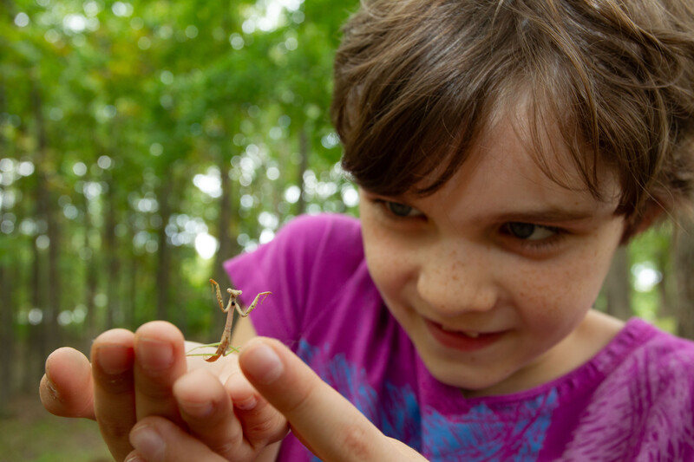

Exploring
MISSOURI
Unit 5 Review

Slide 2
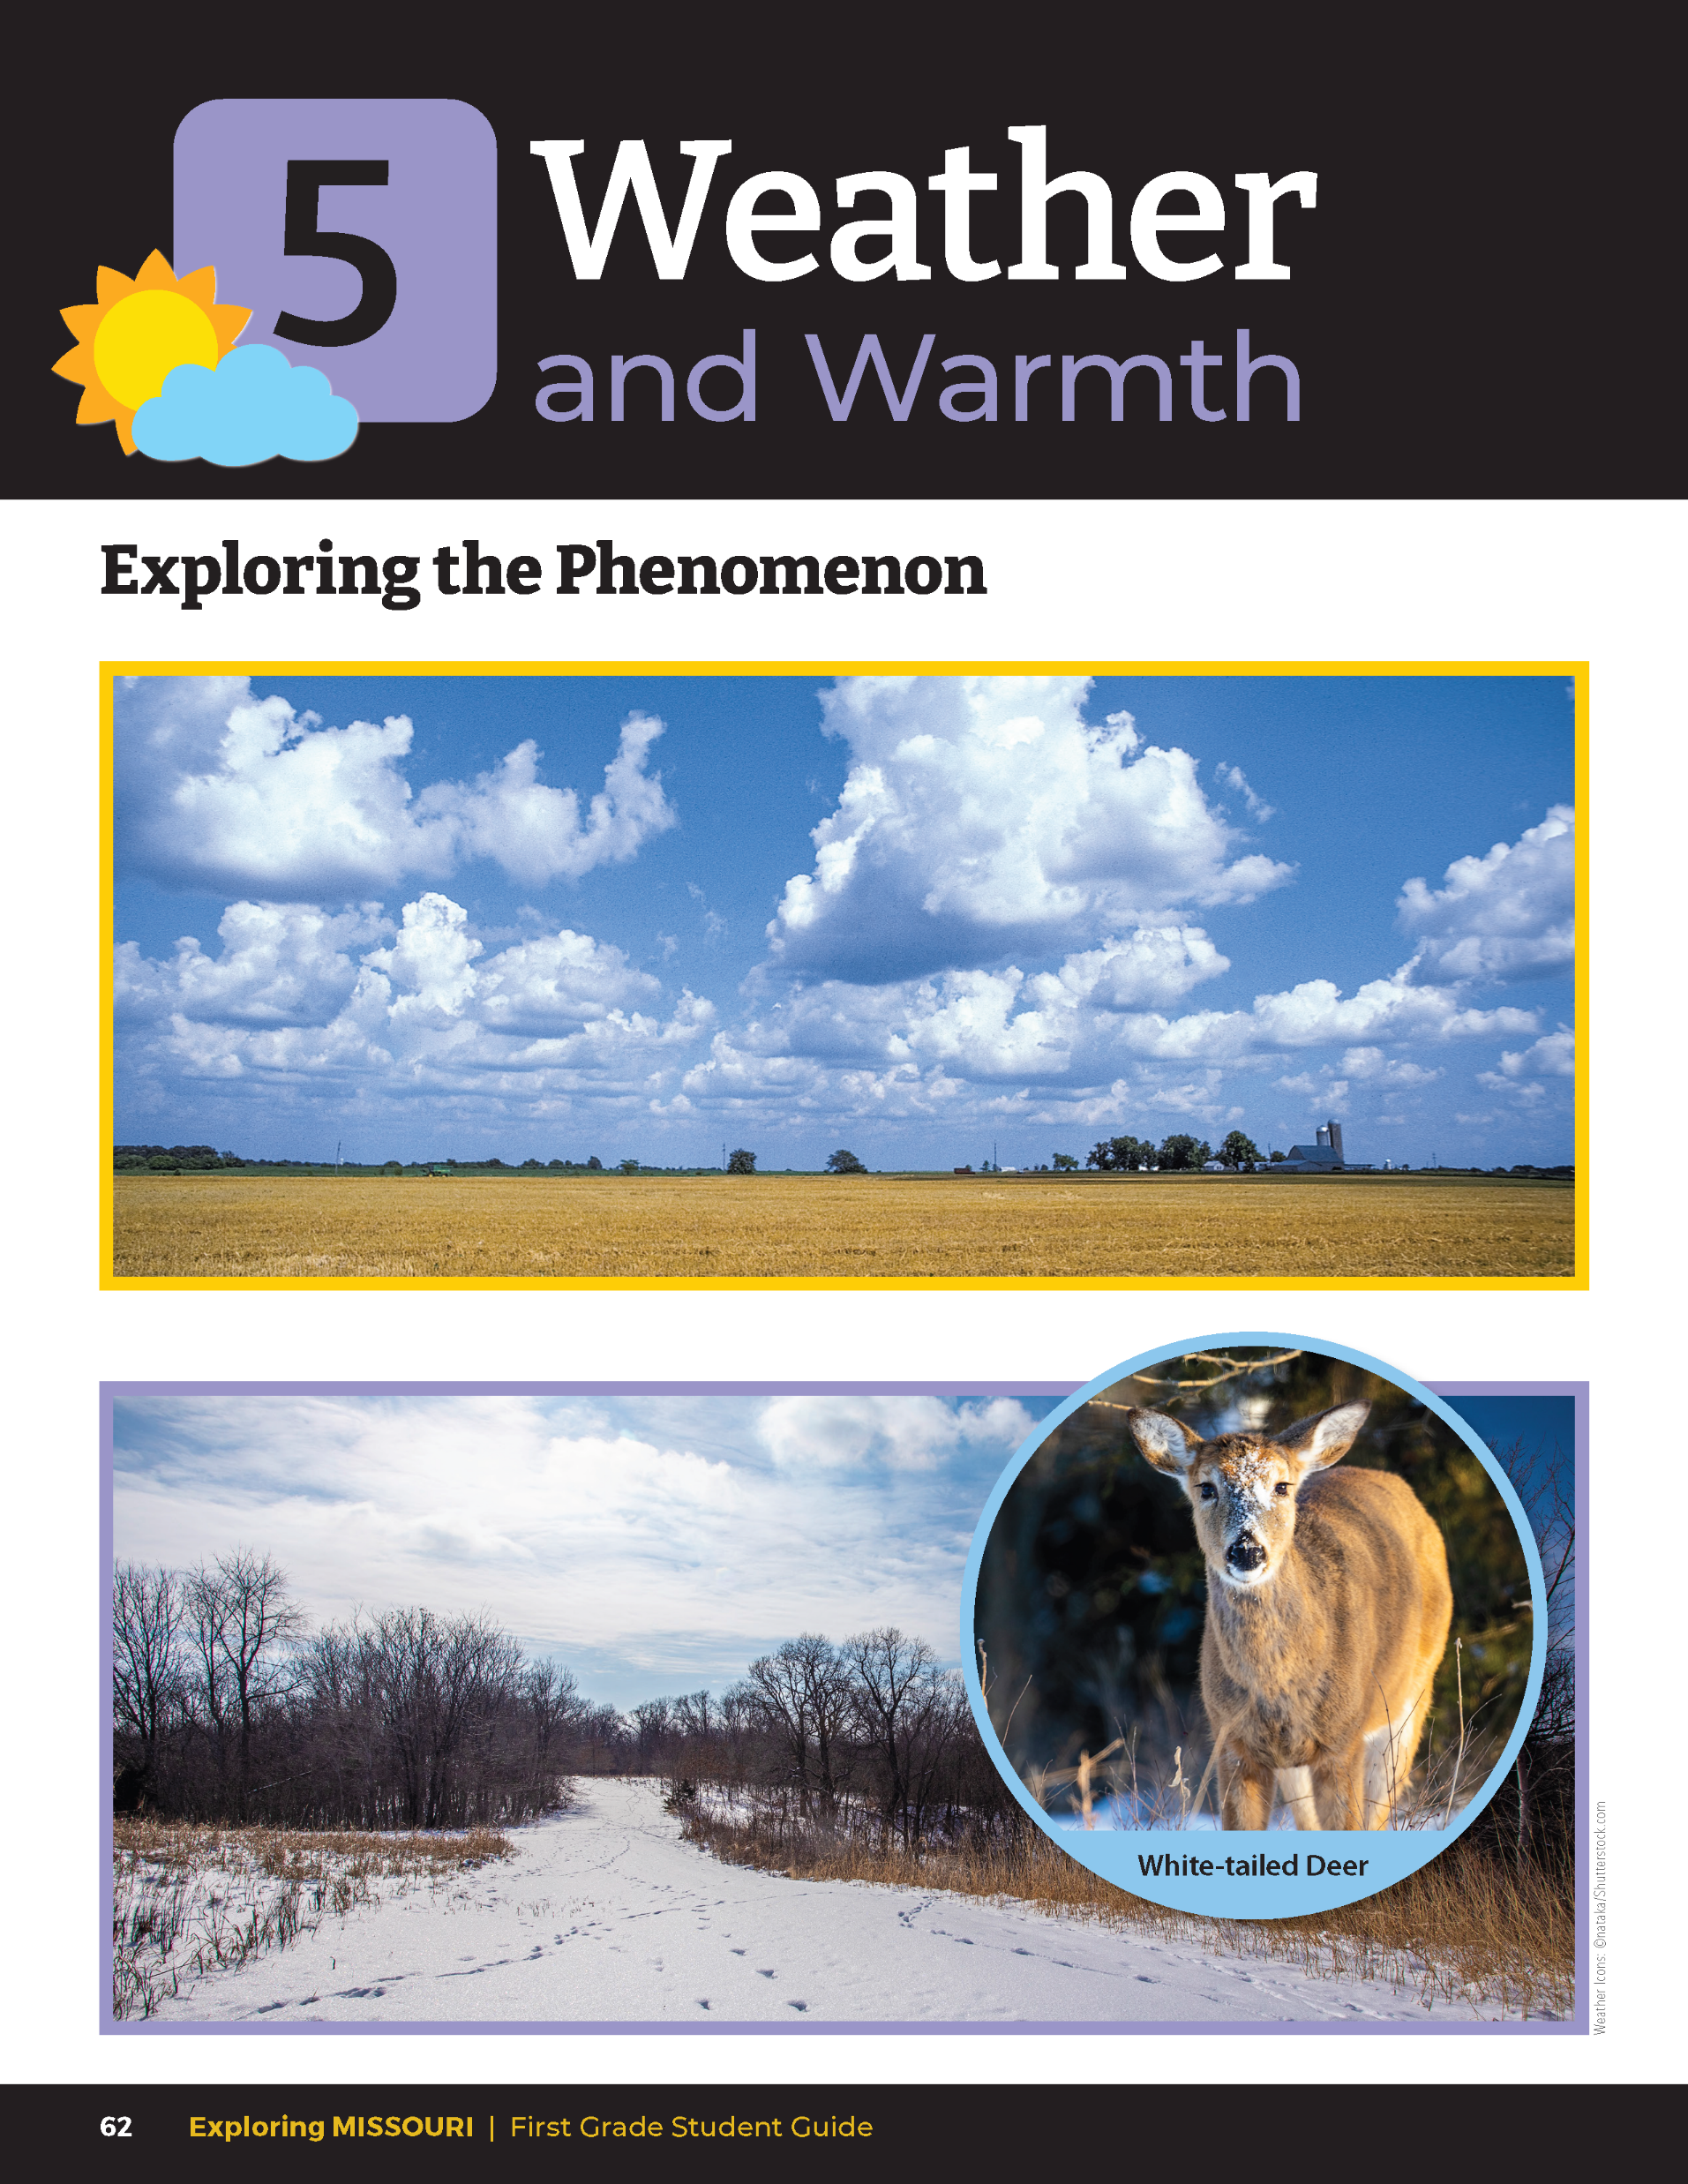
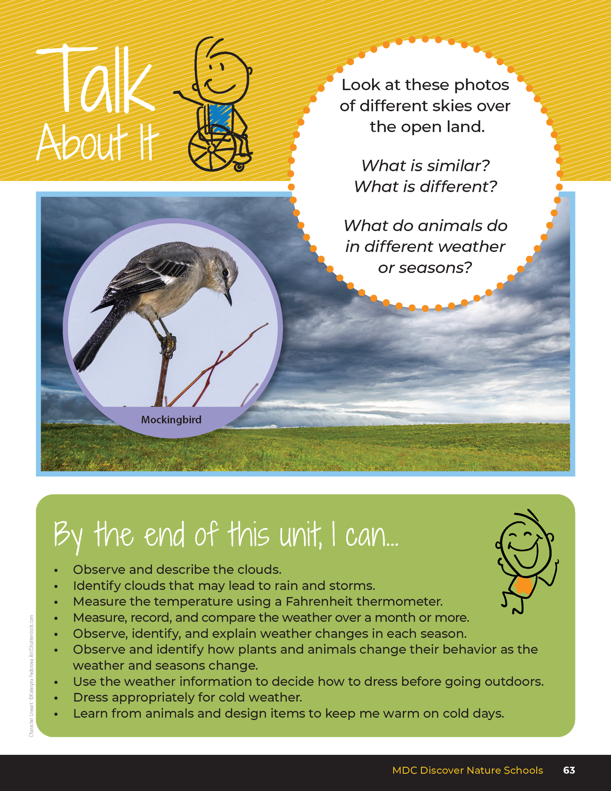
5
Exploring Missouri – Unit 5 Review
2
Notes:
Have students turn to the Unit 5 Exploring the Phenomenon Talk About It section on pages 62–63.

Slide 3
Turn and talk to a classmate and describe the weather by cloud types, the amount of precipitation, and your best guess at the temperature.
5
Exploring Missouri – Unit 5 Review
3
Notes:
Using the pictures at the beginning of the unit, have students turn and talk to a classmate and describe the weather by cloud types, the amount of precipitation, and their best guess at the temperature. Have them discuss behaviors of both plants and animals in both pictures and why they may behave that way.

Slide 4
How would you dress in both photos? Why?
5
Exploring Missouri – Unit 5 Review
4
Notes:
Rubric:
3 (Meets) – Student explains weather through cloud types, precipitation, temperature in both photos. Student describes and explains a plant or animal behavior in each photo. Student offers what they would wear in each photo and why.
2 (Partially meets) – Student explains some weather through cloud types, precipitation, temperature in both photos. Student somewhat describes or explains plant or animal behavior in each photo. Student does not offer what they would wear in each photo and why.
1 (Doesn’t meet) – Student does not offer weather types, animal or plant behavior or what they would wear and why from each photo.

Slide 5
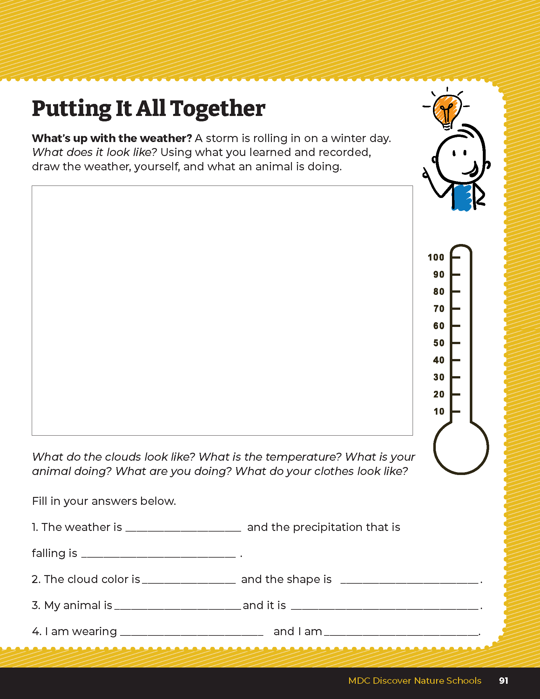
Draw the weather, yourself, and what an animal is doing.
5
Exploring Missouri – Unit 5 Review
5
Notes:
Students will draw and describe a picture of a winter day with a storm coming in using the Putting It All Together What’s Up with the Weather? On Page 91. Using their previous observations, they will also fill in the approximate temperature in the thermometer graphic. They will also draw an animal and themselves and show what they are doing to survive the weather. Students will fill in the blanks with descriptions.
Rubric:
3 (Meets) Student drawing shows each of the components: weather (cloud type, temperature, precipitation) and human and animal behavior. All blanks are filled in.
2 (Partially meets) - Student drawings shows some of the components: weather (cloud type, temperature, precipitation) and human and animal behavior. Some blanks are filled in.
1 (Doesn’t meet) – Student drawing shows very few of the components: weather (cloud type, temperature, precipitation) and human and animal behavior. Little to no blanks are filled in.

