Slide 1
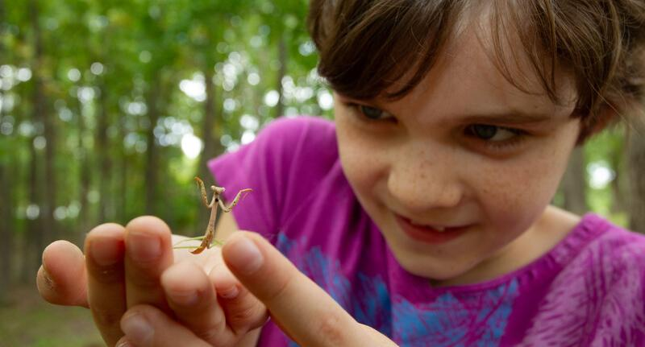

Exploring
MISSOURI
5D: How Animals and I Stay Warm

Slide 2
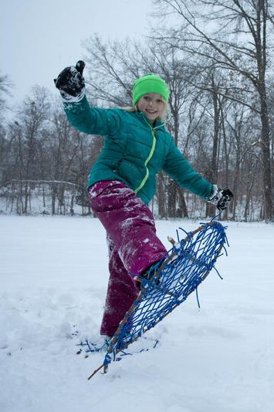
Guiding Question:
How do humans and animals stay warm in winter?
5D
Exploring Missouri – 5D How Animals and I Stay Warm: Engage
2

Slide 3
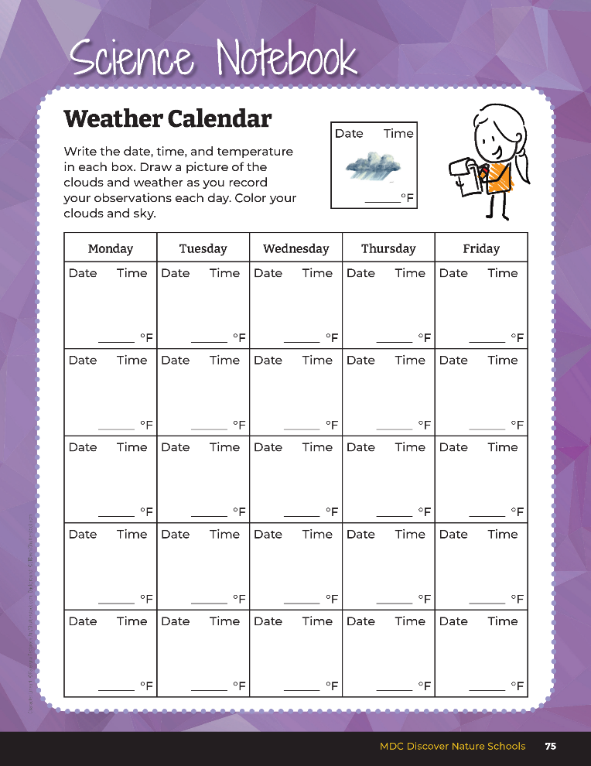
Were there any big changes in temperature over two or more days? Changes in wind – was it stronger? Was there a lot of precipitation that fell that day?
5D
Exploring Missouri – 5D How Animals and I Stay Warm: Engage
3
Notes:
Let’s look back at our weather data we collected from our Science Notebook 5B Weather Calendar section on Page 75.

Slide 4

How do we as humans prepare for extreme weather conditions like thunderstorms or blizzards? What do we wear?
5D
Exploring Missouri – 5D How Animals and I Stay Warm: Engage
4

Slide 5
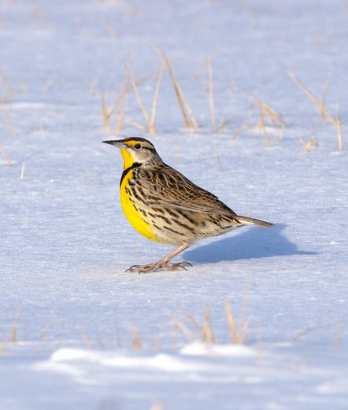
Let’s think about wintertime now.
What is the temperature like outside?
How do you think animals stay warm in winter?
5D
Exploring Missouri – 5D How Animals and I Stay Warm: Engage
5
Notes:
Animal in Picture: Eastern Meadowlark

Slide 6
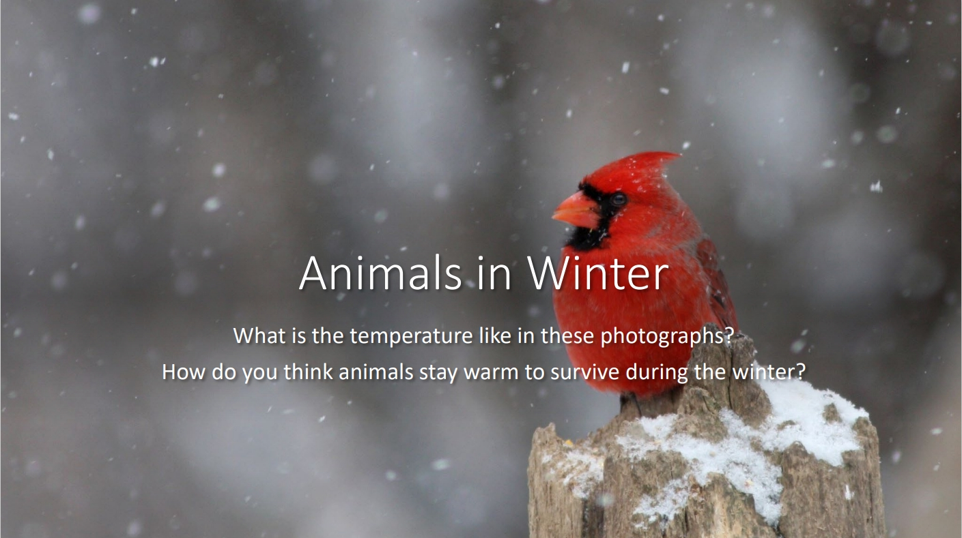
5D
Exploring Missouri – 5D How Animals and I Stay Warm: Engage
6
Notes:
Display the Animals in Winter Presentation from the MDC Teacher Portal.
Animal in Picture: Northern Cardinal

Slide 7
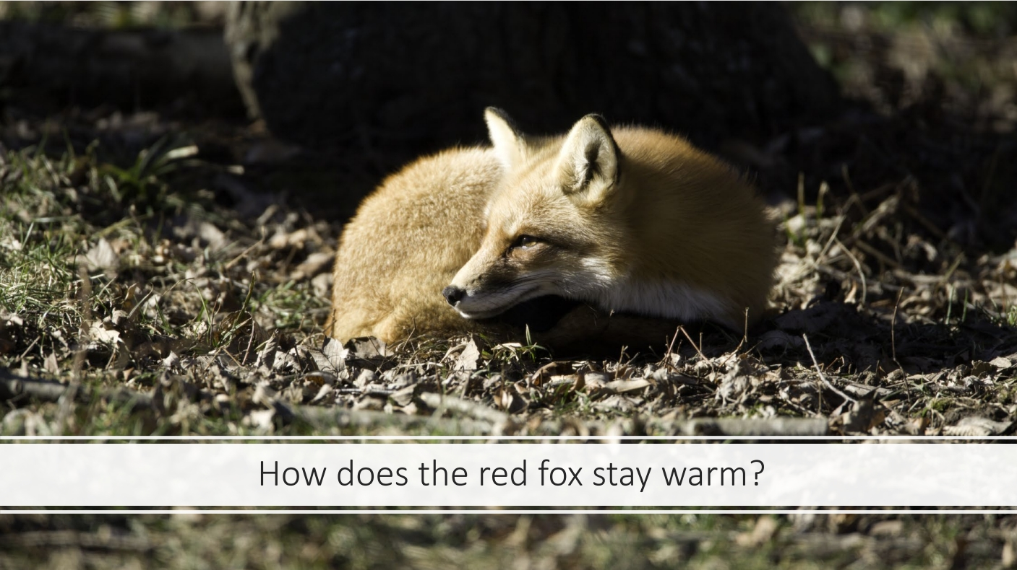
5D
Exploring Missouri – 5D How Animals and I Stay Warm: Engage
7
Notes:
Animal in Picture: Red Fox

Slide 8
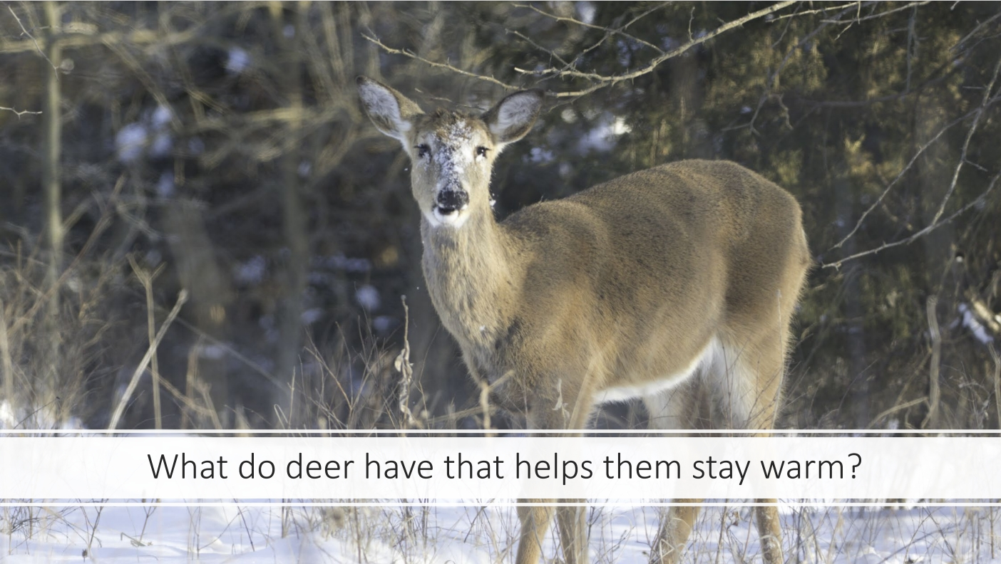
5D
Exploring Missouri – 5D How Animals and I Stay Warm: Engage
8
Notes:
Animal in picture: White-tailed Deer

Slide 9
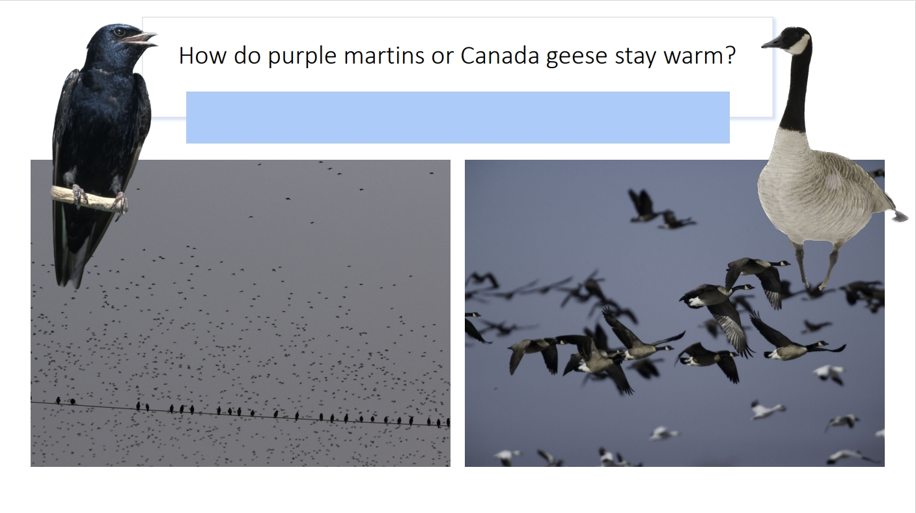
5D
Exploring Missouri – 5D How Animals and I Stay Warm: Engage
9
Notes:
Animals in picture: Purple Martin and Canada Goose

Slide 10
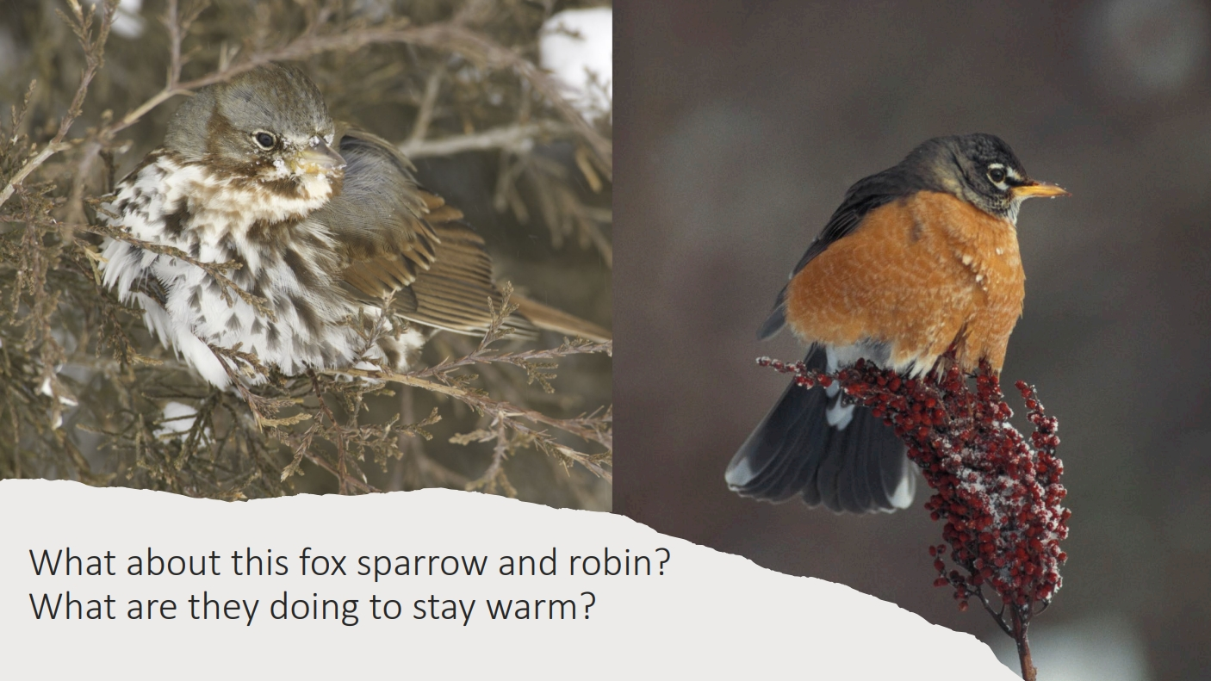
5D
Exploring Missouri – 5D How Animals and I Stay Warm: Engage
10
Notes:
Animals in picture: Fox Sparrow and American Robin

Slide 11
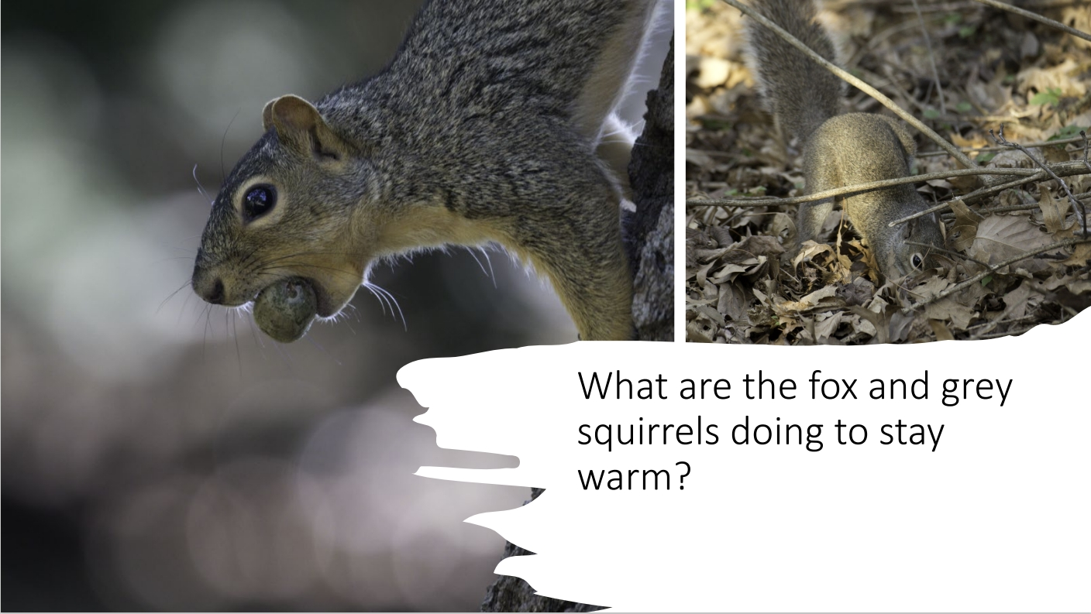
5D
Exploring Missouri – 5D How Animals and I Stay Warm: Engage
11
Notes:
Animal in picture: Fox Squirrel

Slide 12
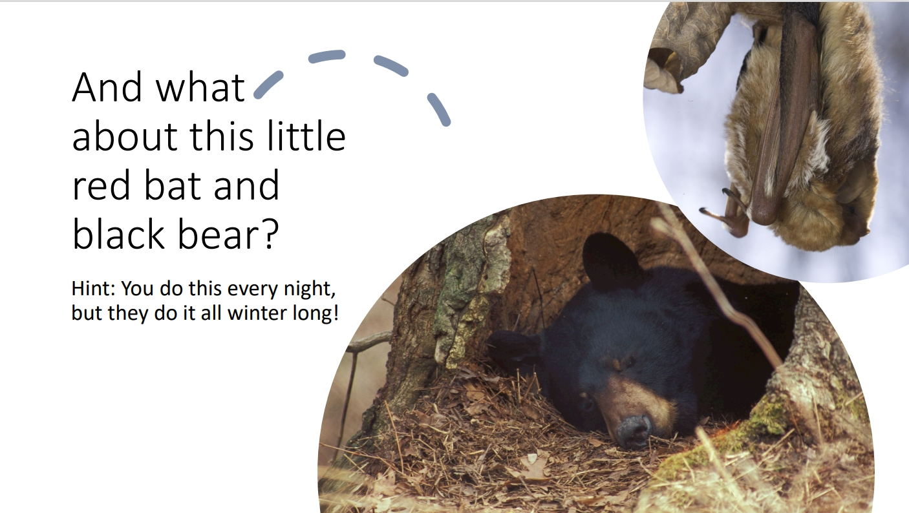
5D
Exploring Missouri – 5D How Animals and I Stay Warm: Engage
12
Notes:
Animals in picture: Black Bear and red bat

Slide 13
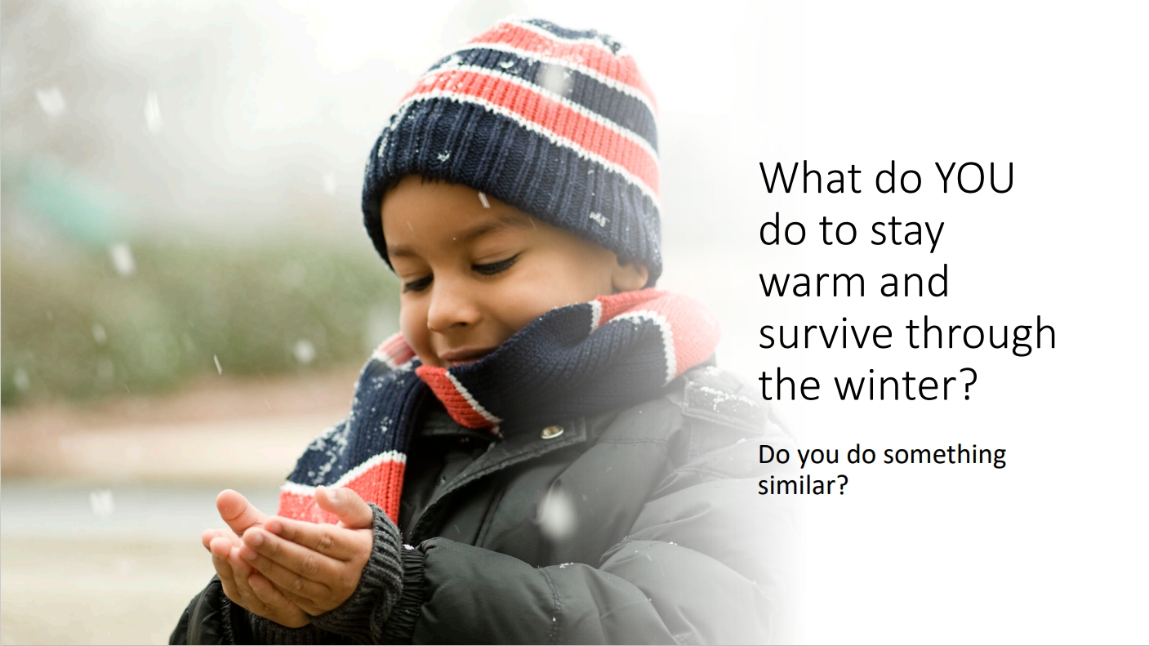
5D
Exploring Missouri – 5D How Animals and I Stay Warm: Engage
13

Slide 14
What are these animals doing to stay warm?
5D
Exploring Missouri – 5D How Animals and I Stay Warm: Engage
14

Slide 15
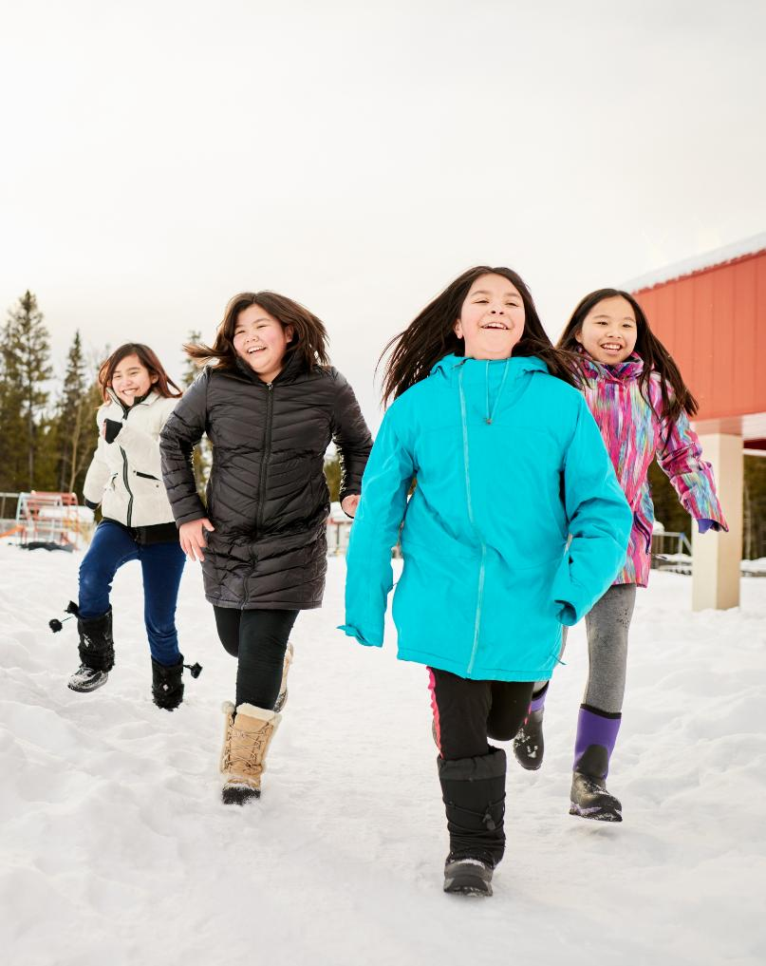
What do we do to stay warm in the winter?
5D
Exploring Missouri – 5D How Animals and I Stay Warm: Explore
15

Slide 16
What is the same between these items?
What is different between these items?
What other things did students wear?
5D
Exploring Missouri – 5D How Animals and I Stay Warm: Explore
16
Notes:
On a cold day, have students share what they wore to school to stay warm. Discuss different features of coats and outerwear.

Slide 17
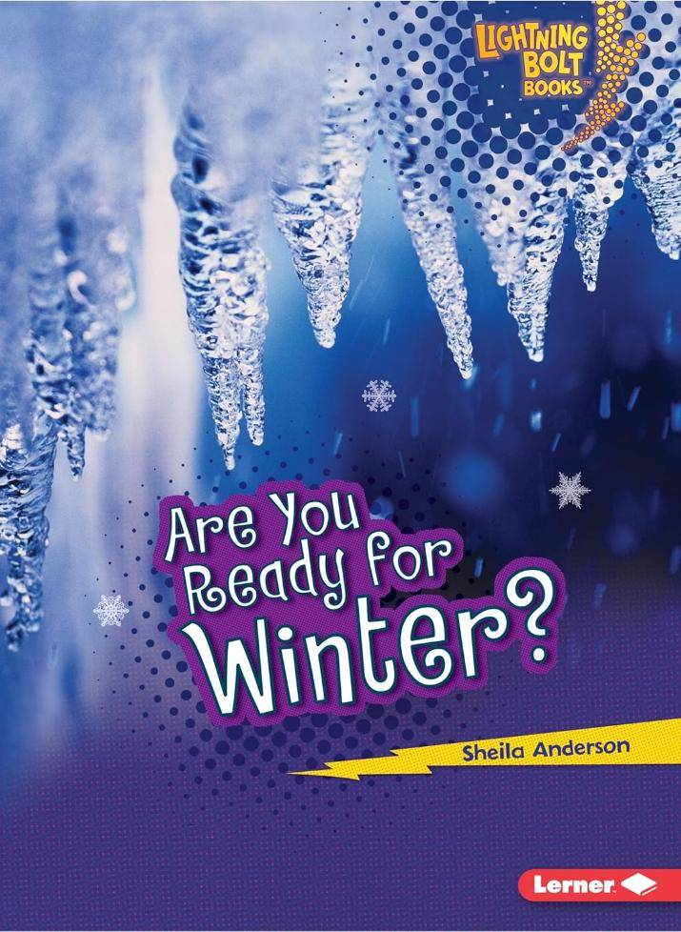
Read Are You Ready for Winter? By Sheila Anderson
Read Aloud:
https://youtu.be/9-T9h1xeEls?si=iQBJ6IPHbL5-wENu
Epic Link:
https://www.getepic.com/book/53756848/are-you-ready-for-winter
5D
Exploring Missouri – 5D How Animals and I Stay Warm: Explore
17

Slide 18
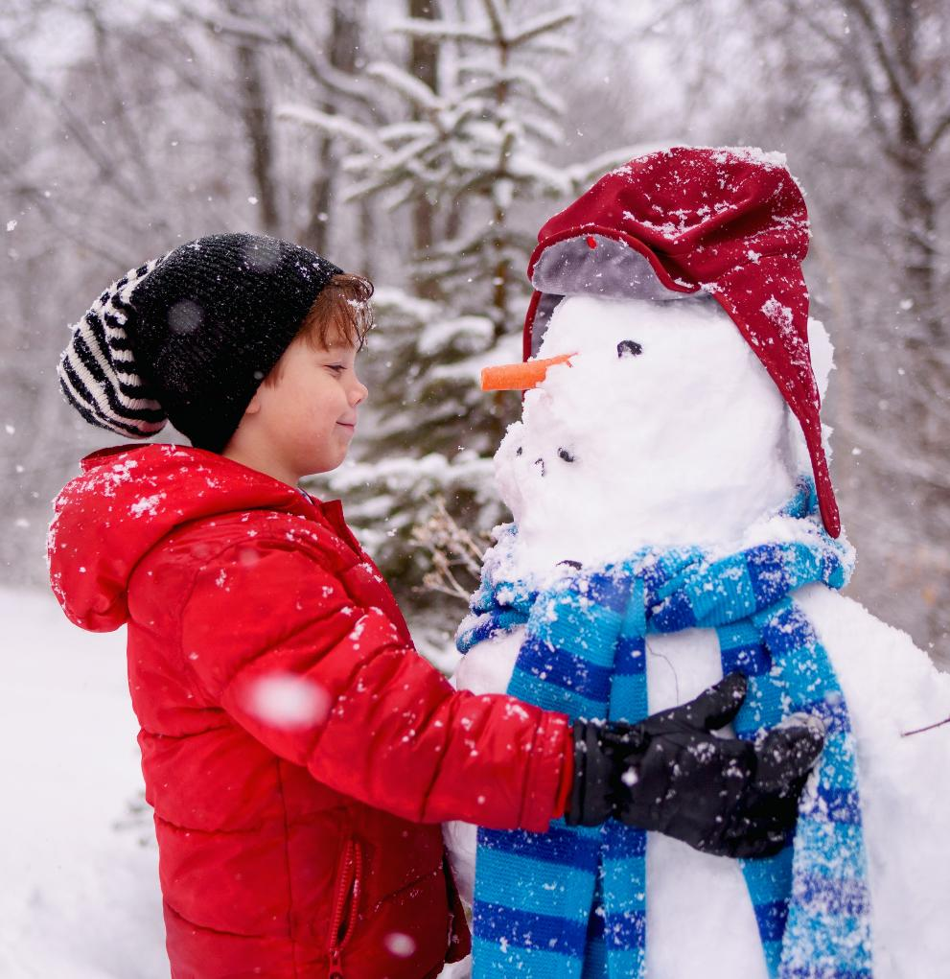
How do we get ready for winter?
What do we wear?
How do we protect ourselves?
5D
Exploring Missouri – 5D How Animals and I Stay Warm: Explore
18

Slide 19
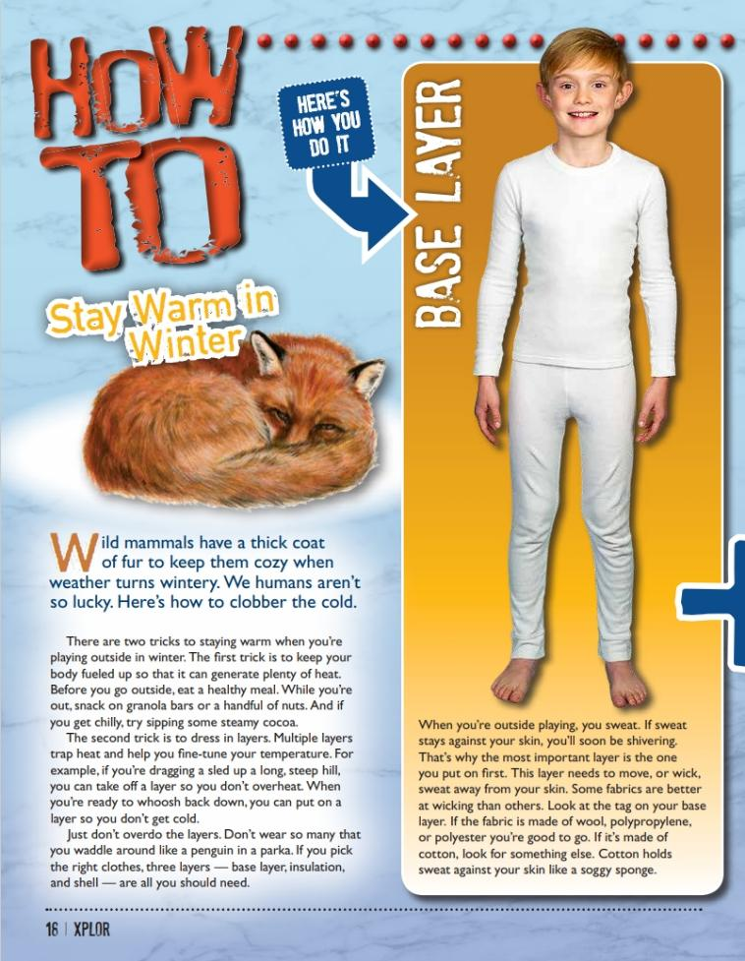
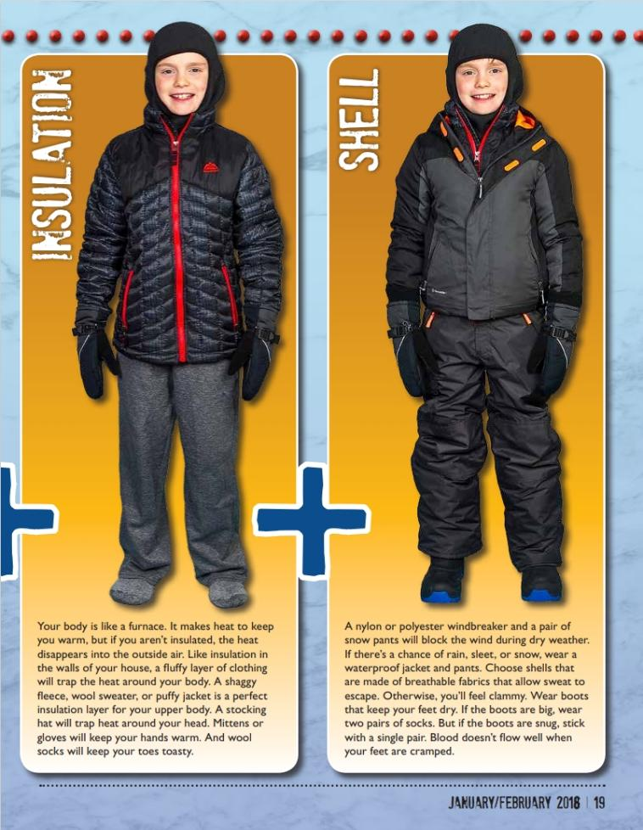
5D
Exploring Missouri – 5D How Animals and I Stay Warm: Explain
19
Notes:
From the MDC Teacher Portal, display How To: Stay Warm in Winter from the January 2018 issue of Xplor.

Slide 20
What do we do to stay warm?
5D
Exploring Missouri – 5D How Animals and I Stay Warm: Explore
20
Notes:
Discuss how to dress to stay warm in winter.

Slide 21
5D
Exploring Missouri – 5D How Animals and I Stay Warm: Explain
21
Notes:
Display pictures from the magazine to help students visualize the layers discussed. Encourage students to discuss when they wear certain layers, including what they are doing and what the weather is like.

Slide 22
Dressing in Layers
5D
Exploring Missouri – 5D How Animals and I Stay Warm: Explain
22
Notes:
Helps trap heat and allows you to make changes as needed.

Slide 23
Base Layer
5D
Exploring Missouri – 5D How Animals and I Stay Warm: Explain
23
Notes:
If you get too warm, your body sweats to cool down. This will in fact make you cold in the winter, especially if you’re wearing cotton. It’s best to wear a fabric made from wool, polypropylene, or polyester to keep your skin dry.

Slide 24
Insulation (Middle Layer)
5D
Exploring Missouri – 5D How Animals and I Stay Warm: Explain
24
Notes:
Your body makes heat (you are warm-blooded after all), but you need to trap the air. Wearing a fleece, wool sweater, or puffy jacket allows you to keep the warmth next to your skin to stay warm. Mittens and wool socks keep fingers and toes warm. A hat and scarf trap heat around your head and neck.

Slide 25
Shell (Outer Layer)
5D
Exploring Missouri – 5D How Animals and I Stay Warm: Explain
25
Notes:
Helps break the wind and provides waterproofing from rain or snow. Jacket and pants are often nylon or polyester; boots need to be big, so toes have wiggle room, even when wearing two pairs of socks.

Slide 26
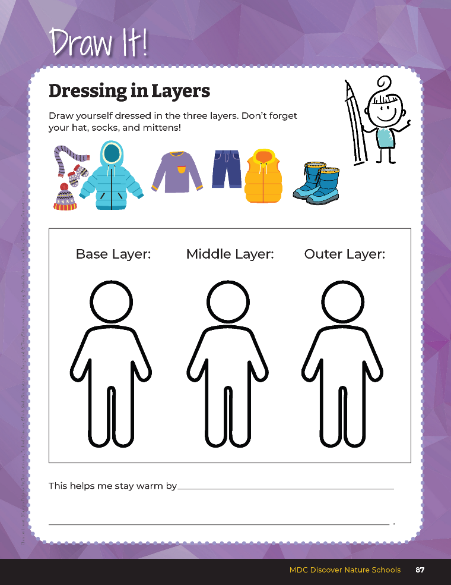

Draw yourself dressed in the three layers.
How does this help you stay warm?
5D
Exploring Missouri – 5D How Animals and I Stay Warm: Explain
26
Notes:
Using this concept, draw what you would wear in winter in your student guide Draw It! 5D Dressing in Layers section on Page 87. Students will draw themselves in the three layers discussed. How does this help you to stay warm? Students will fill in their answers.

Slide 27
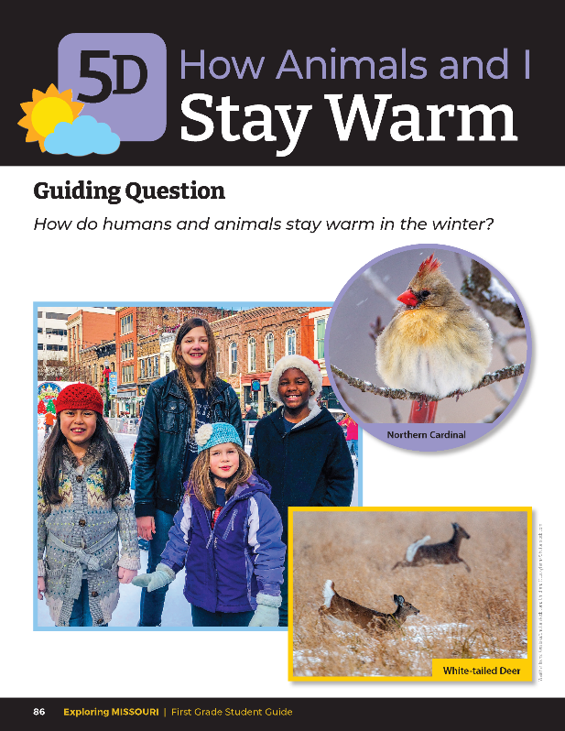
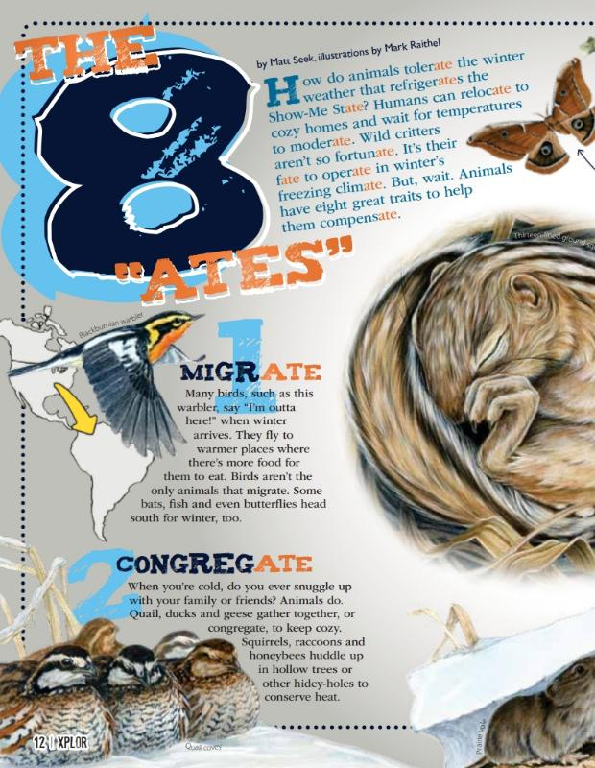
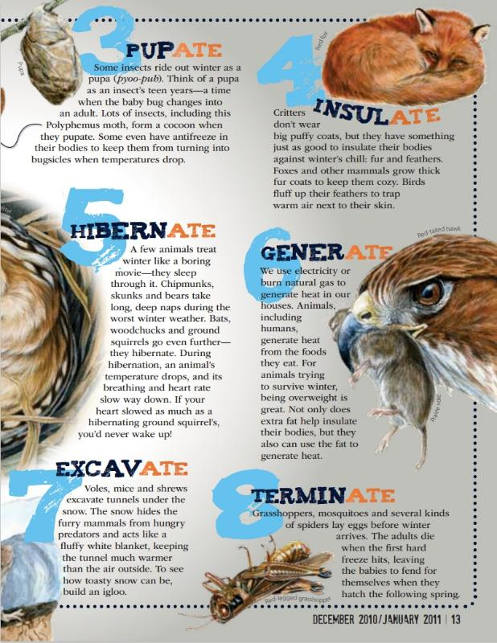
5D
Exploring Missouri – 5D How Animals and I Stay Warm: Elaborate
27
Notes:
Take time to revisit the weather events, noting any recent severe weather and/or what perhaps caused the change in weather, such as extreme temperature changes, strong winds, or significant precipitation.
Have students open their student guides to the Lesson 5D How Animals and I Stay Warm introduction page and look at the photos of how animals are staying warm in the outside world. Refer back to The 8 “Ates” by Matt Seek from the December 2010/January 2011 issue of Xplor.

Slide 28
How can we use what they are doing to stay warm ourselves?
5D
Exploring Missouri – 5D How Animals and I Stay Warm: Elaborate
28

Slide 29

List ideas of how animals stay warm in the winter.
5D
Exploring Missouri – 5D How Animals and I Stay Warm: Elaborate
29
Notes:
Ideas can include:
Warm-blooded animals make their own heat
Puffing out feathers
Warm fur
Eating more and moving constantly
Thick layer of fat to insulate
Huddling together

Slide 30
Are there methods that we as humans already use in the winter?
5D
Exploring Missouri – 5D How Animals and I Stay Warm: Elaborate
30

Slide 31
Can you think of a better solution to staying warmer?
5D
Exploring Missouri – 5D How Animals and I Stay Warm: Elaborate
31
Notes:
From these ideas, instruct students that they will be looking to animals for clues to help them invent to create something to keep themselves or other humans warm. Remember we are not replacing any of our body parts with animal parts.

Slide 32
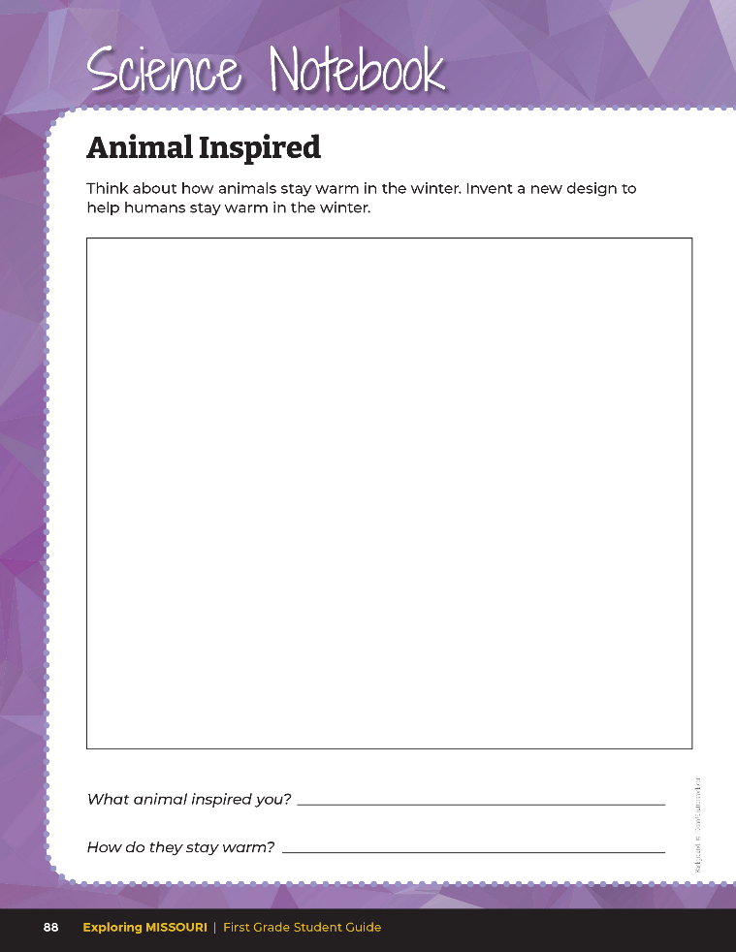
Invent a new design to help humans stay warm in the winter.
5D
Exploring Missouri – 5D How Animals and I Stay Warm: Elaborate
32
Notes:
On student guide Science Notebook 5D Animal Inspired Page 88, have students draw their design.
Depending on resources available, students will either draw a picture or use craft materials to create a model of their new invention to keep them warm.
Design Rubric: Have students share their item with their class. Have students transferred their observation of animal behavior to some aspect of their design? Would the item help the student stay warm?
4 (Exceeds) – Item integrate two or more ideas that animals use to stay warm.
3 (Meets) – Item integrates one idea that animals use to stay warm.
2 (Partially Meets) – Item has new or improved components but does not incorporate learning about how animals stay warm.
1 (Doesn’t Meet) – Item shows no new or improved component.

Slide 33

How do humans and animals stay warm in the winter?
5D
Exploring Missouri – 5D How Animals and I Stay Warm: Evaluate
33
Notes:
Refer to the photos on the student guide introduction page of Lesson 5D How Animals and I Stay Warm.

Slide 34
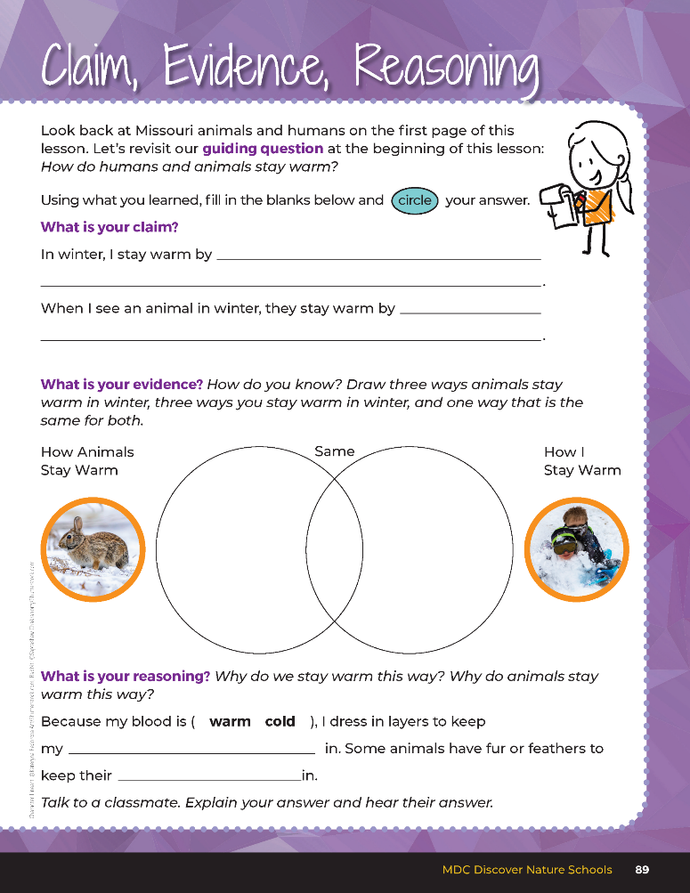

Guiding Question:
How do humans and animals stay warm?
5D
Exploring Missouri – 5D How Animals and I Stay Warm: Evaluate
34
Notes:
After exploring the connection of animal survival and how that relates to human survival, have students open their student guides to the Claim, Evidence, Reasoning section on Page 89. Discuss the page with the students – read the guiding question and then explain what the students need to do to answer the questions (fill in the blanks, draw pictures, circle the answer).

Slide 35

Wearing layers such as coats, hats and
Gloves, building fires, drinking hot cocoa, moving, staying inside home
Animals eating, grouping together, fur, moving fast, bird flying south,
mice digging under the snow, birds puffing up feathers
Answers
heat
heat
5D
Exploring Missouri – 5D How Animals and I Stay Warm: Evaluate
35
Notes:
Rubric:
4 (Exceeds) – Students draw or list three ways that animals stay warm in winter, three ways that humans stay warm in the winter, and one way that is the same. Students provide direct observations of claims.
3 (Meets) – Students draw or list two ways that animals stay warm in the winter, two ways that humans stay warm in the winter, and zero or one way that is the same. Students provide some direct observations of claims.
2 (Partially Meets) – Students draw or list one way that animals stay warm in the winter, and no way that is the same. Students provide little direct observations of claims.
1 (Doesn’t Meet) – Students do not complete the graphic and do not provide direct observations of claims.

Slide 36


Optional: Cross-Curricular Extension
Create the sound of a thunderstorm.
5D
Exploring Missouri – 5D How Animals and I Stay Warm: Cross-Curricular Extension
36
Notes:
Music
Create the sound of a thunderstorm from the first raindrops, then growing in sound as the storm intensifies, then back to the last drops. Have students stand in a circle. First practice the sounds, then put them all together. As you point to the children, have them add to the sounds:
Rain drops – hit the first two fingers of each hand together
Louder rain drops – snap (if students are able)
Rub hands together (palms and fingers rubbing back and fourth)
Clap hands together (keep hands close together, keeping hands about two inches apart)
Stomp feet on ground
Build in volume as you move from one type of sound to the next until everyone is stomping their feet, then quiet the storm as you go backward through the list ending with the rain drops.

