Slide 1
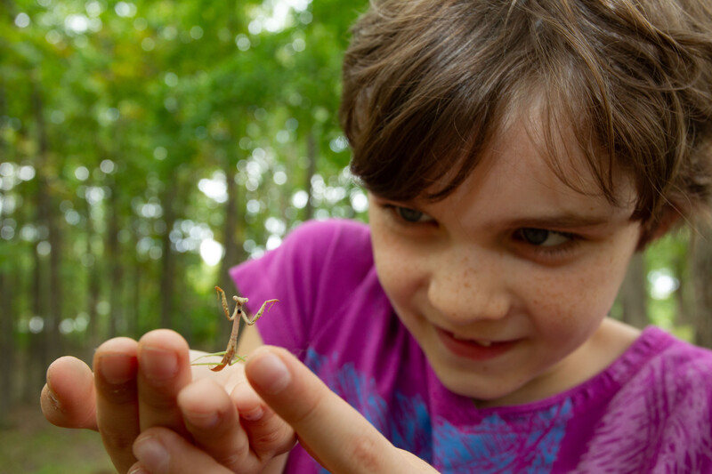

Exploring
MISSOURI
5C: Nature Events

Slide 2
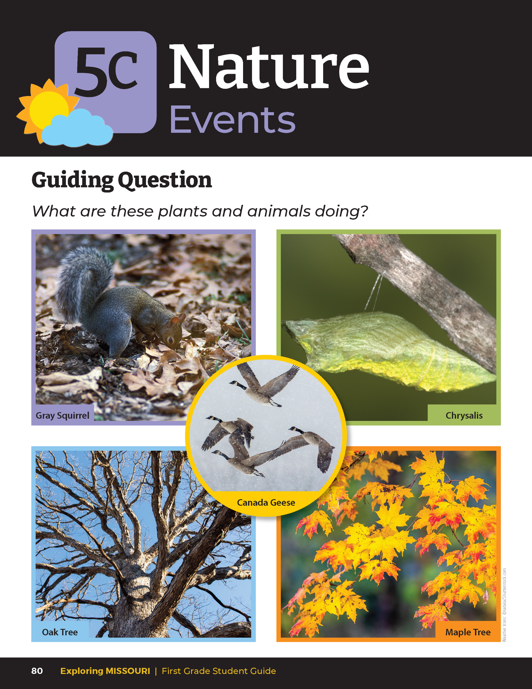
Guiding Question:
What are these plants and animals doing?
5C
Exploring Missouri – 5C Nature Events: Engage
2

Slide 3
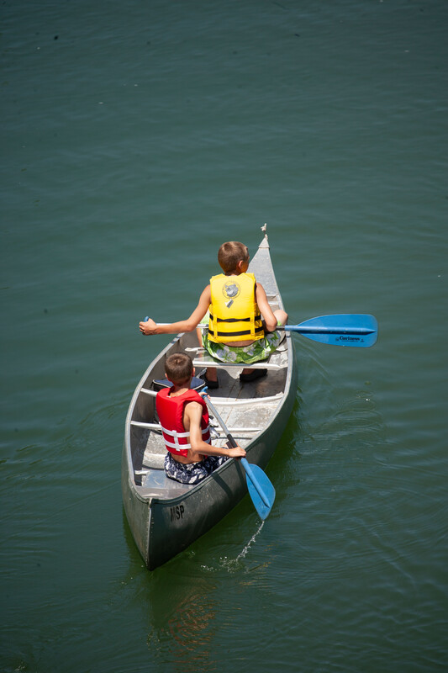
Brainstorm activities you do in the summer, then contrast this with winter activities.
5C
Exploring Missouri – 5C Nature Events: Engage
3
Notes:
As weather changes, plants and animals respond. We also respond. We dress differently and do different types of activities. Have students brainstorm activities they do in summer, then contrast this with winter activities.

Slide 4

How do you dress for each of those activities?
5C
Exploring Missouri – 5C Nature Events: Engage
4

Slide 5
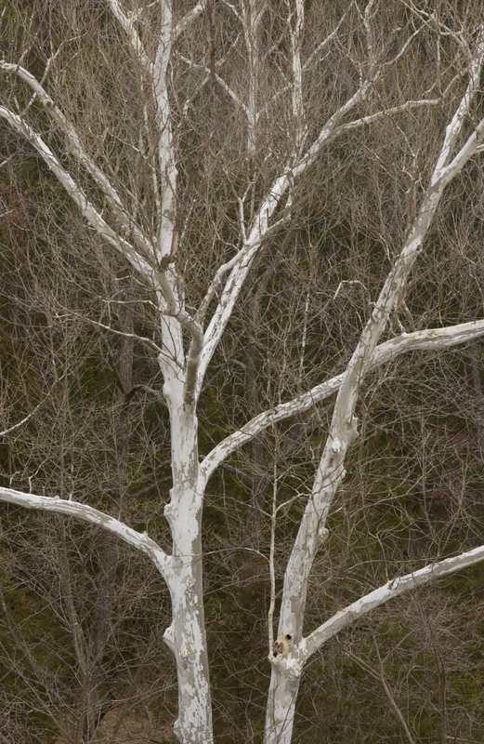
How do you think plants and animals change their behavior throughout the year? In spring? Summer? Winter?
5C
Exploring Missouri – 5C Nature Events: Engage
5
Notes:
Plant in picture: Sycamore tree

Slide 6

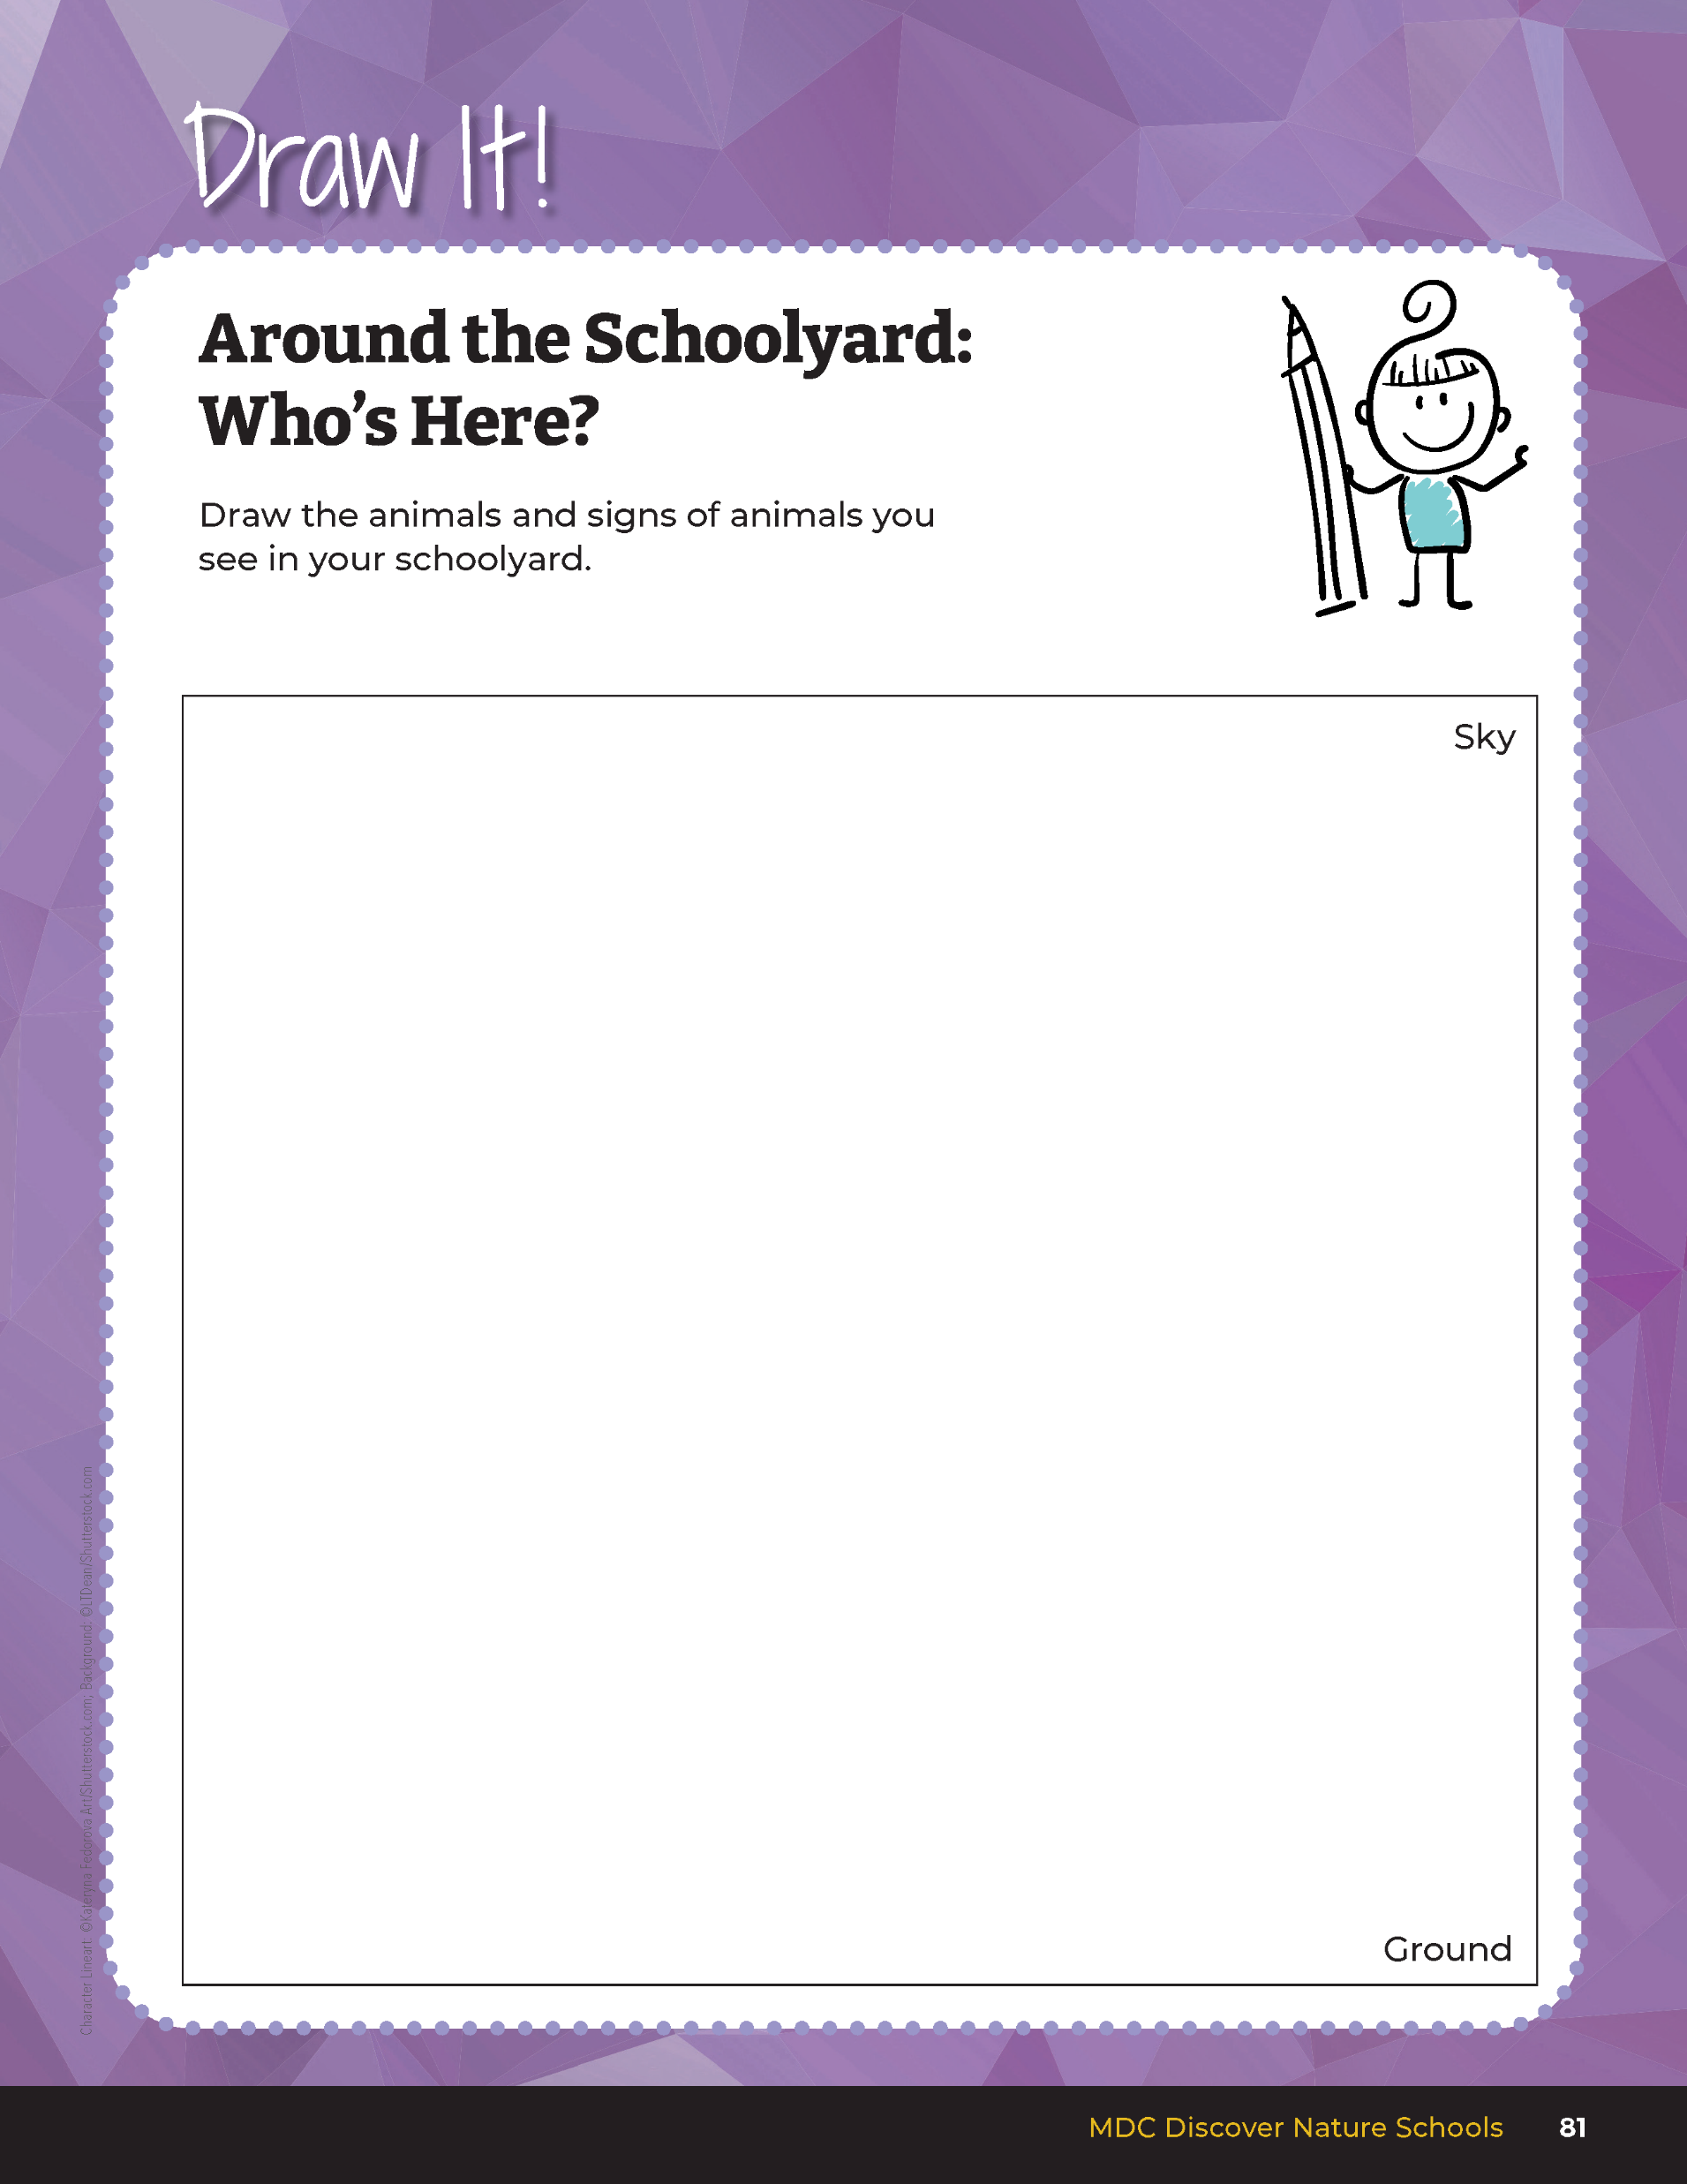
Find a spot to observe and listen quietly. Draw the animals that they saw or heard and what they were doing.
5C
Exploring Missouri – 5C Nature Events: Explore
6
Notes:
As scientists, we can record these changes. We need to first practice observing and recording what we see outside. Let’s use our eyes like a detective and look for different plants and animals, or look for signs of different plants and animals.
Have students open their student guides to Draw It! 5C Around the Schoolyard: Who’s Here? on Page 81. Students will draw the plants and animals they find, or the signs left behind by plants or animals in the schoolyard.
Give the students a boundary when you go outside. Tell them to find a spot to observe and listen quietly. Tell them to look in three areas: high, at eye level, and at the ground. Give them at least one minute to look in a high direction. After one minute, give them time to draw the plants or animals that they saw or heard and what they were doing. Repeat this for things found at eye level and again at ground level.

Slide 7


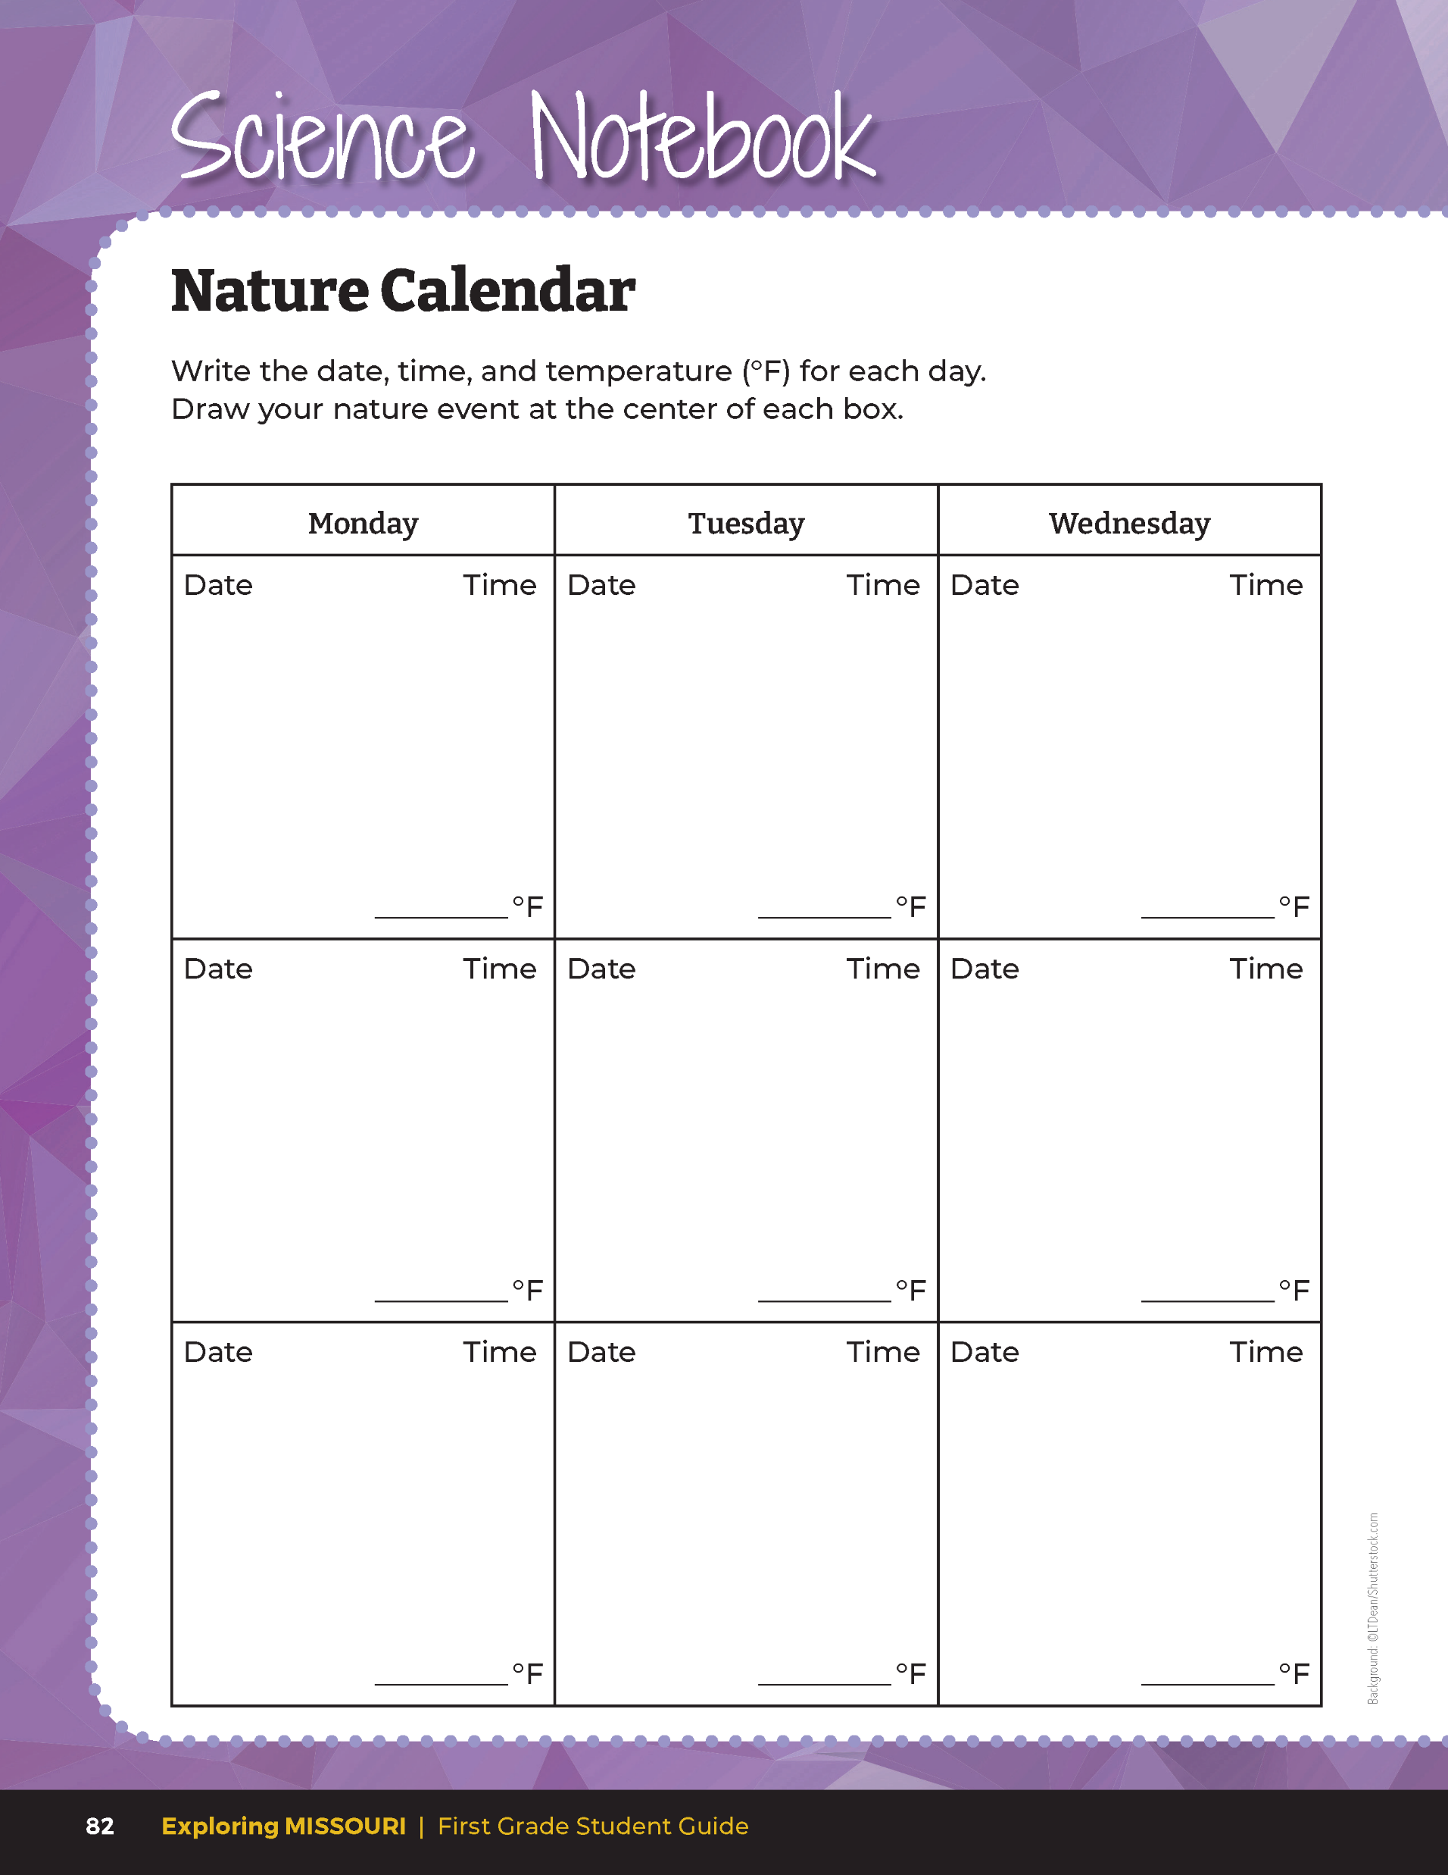
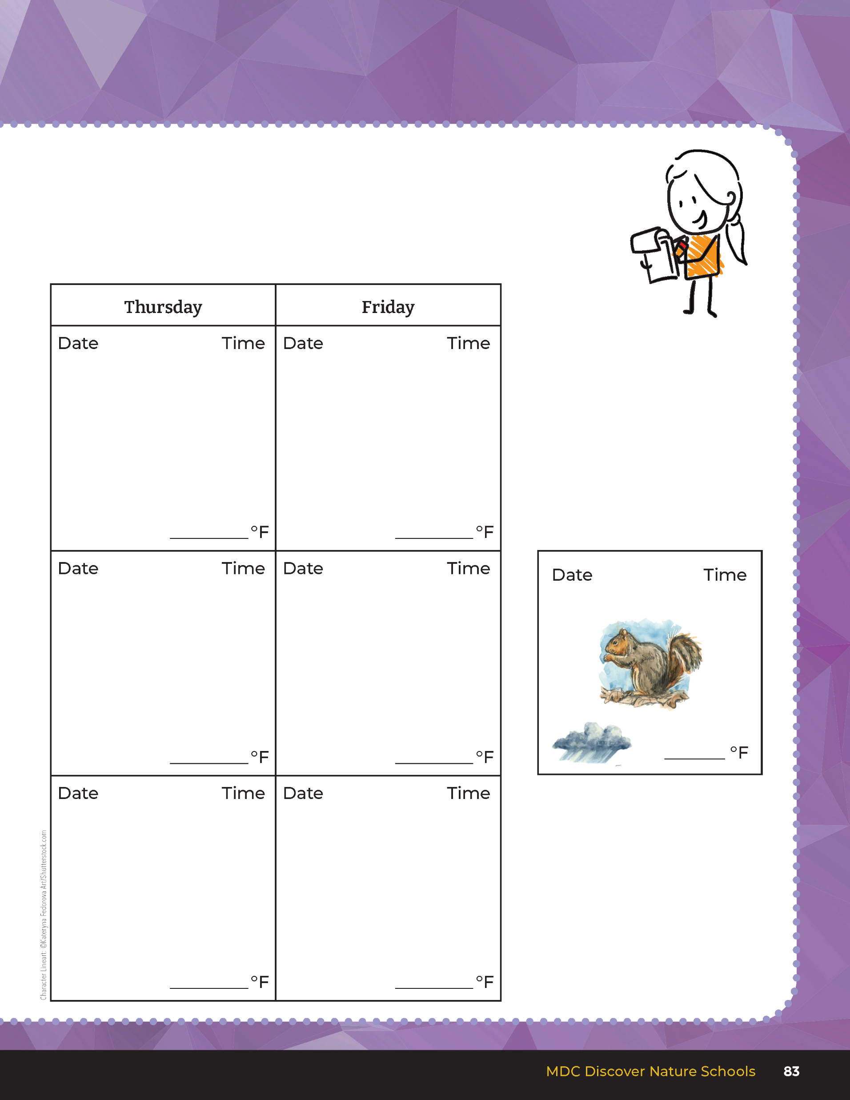
20
15
X
MINUTES
DAYS
5C
Exploring Missouri – 5C Nature Events: Explore
7
Notes:
Go back inside the classroom. Have the students open their student guide to the Science Notebook 5C Nature Calendar section on pages 82 – 83.
We’ll be going outside several times over the next month. Each time you’ll go back to the same spot and draw a natural event entry for that data in your calendar. Draw what you saw that plant or animal doing. Remember to label your drawings.
Teacher Note: Keeping a nature journal is a great method to document seasonal changes and will give students a diary of their drawings and observations in the Nature Calendar, you may choose to use a nature journal. Give your students ownership of their journal and allow them to create their own booklet. From the MDC Teacher Portal, play the Creating a Simple Nature Journal video for your students. Instruct students to write the same information below for entry as they would have in their Nature Calendar.

Slide 8














Date
Time
12/14
11:15 a.m.
What is the plant or animal doing?
43
______
F
5C
Exploring Missouri – 5C Nature Events: Explore
8
Notes:
Introduce through modeling how to data box in the Nature Calendar. Draw an empty box on the board and write the following into the box:
Date in upper left-hand corner
Time in upper right-hand corner
Record the outside temperature
Draw the nature event in the center

Slide 9
Draw your nature event.
5C
Exploring Missouri – 5C Nature Events: Explore
9
Notes:
Allow students time to draw their nature event from the Draw It! 5C Around the Schoolyard: Who’s Here? on Page 81. They may use colored pencils or crayons to color their entry.
Students can continue their nature observations using the 5C Blank Nature Calendar. Calendars can be kept in a folder with the Weather Calendars or taped into their student guides.
Based on individual observations, have each student draw their own nature picture for the month. Students fill in the date, weather for that day, and a description of what the plant or animal is doing. To help ensure an understanding of seasonal change, repeat monthly as time allows.

Slide 10
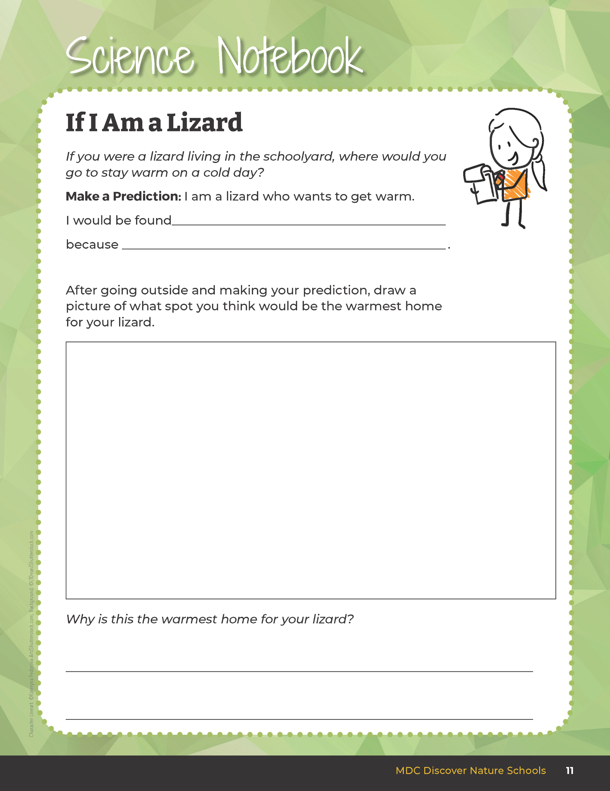
How do cold-blooded animals get warm?
5C
Exploring Missouri – 5C Nature Events: Explain
10
Notes:
Review Unit 1, Lesson 1B: If I Am a Lizard on student guide Page 11. We learned cold-blooded animals get warm from the sun and warm air. You won’t see cold-blooded animals during winter in Missouri. Birds are warm-blooded, so they create their own warmth. However, they along with insects, will change their behavior during the winter to stay alive.

Slide 11
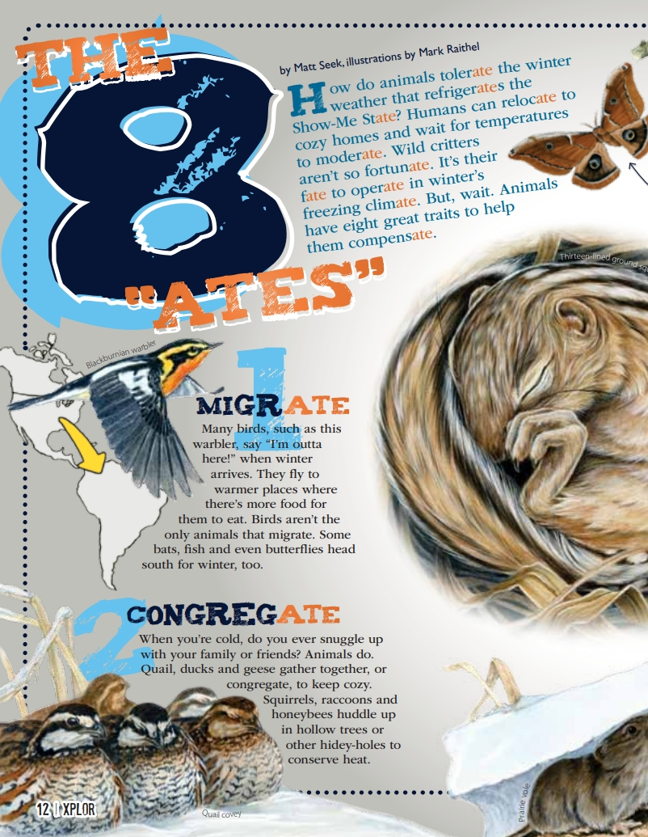
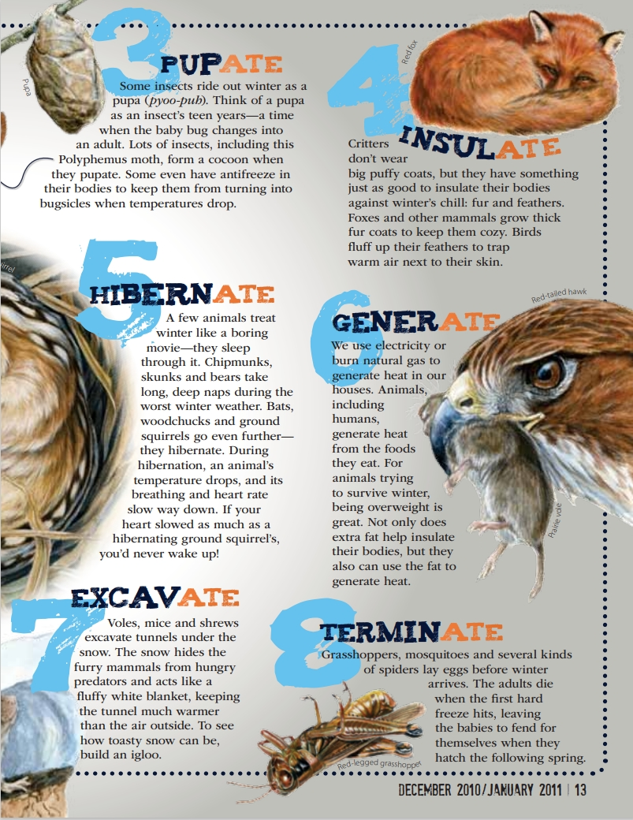
5C
Exploring Missouri – 5C Nature Events: Explain
11
Notes:
From the MDC Teacher Portal, display at the front of your classroom The 8 “Ates” 5C The 8 Ates Article.pdf by Matt Seek from the December 2010/January 2011 issue of Xplor. Let’s look at the pictures.

Slide 12
What are these animals doing? Why?
5C
Exploring Missouri – 5C Nature Events: Explain
12

Slide 13
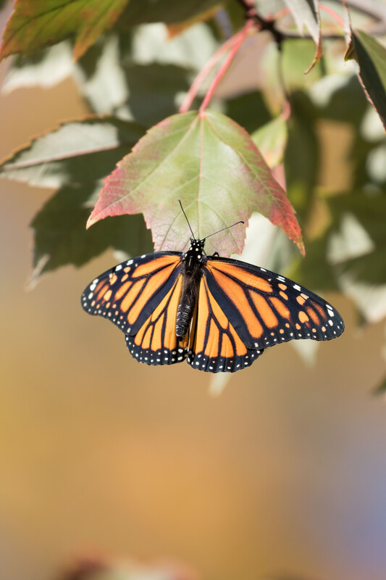
Migrate – some types of birds will fly south; monarch butterflies fly to Mexico to survive winter
5C
Exploring Missouri – 5C Nature Events: Explain
Notes:
Teacher Note: You may select a few survival strategies to focus on or, if time allows, you may want to discuss two or three methods each day completing the list over several days. Suggested survival strategies that are the easiest for students to understand: migrate, hibernate and insulate (hide slides that you are not going to use).
Animal in picture: monarch butterfly

Slide 14
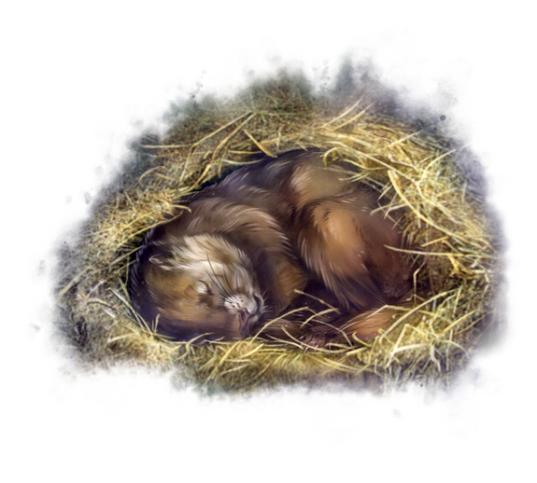
Hibernate – bats, woodchucks, and ground squirrels will sleep all winter
5C
Exploring Missouri – 5C Nature Events: Explain
14
Notes:
Teacher Note: You may select a few survival strategies to focus on or, if time allows, you may want to discuss two or three methods each day completing the list over several days. Suggested survival strategies that are the easiest for students to understand: migrate, hibernate and insulate (hide slides that you are not going to use).
Animal in Picture: Woodchuck

Slide 15
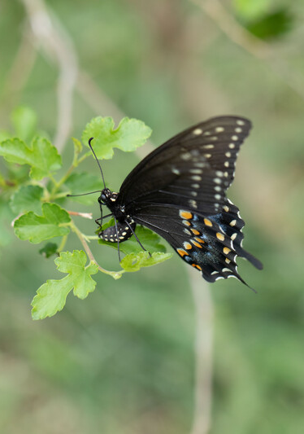
Terminate – grasshoppers and mosquitoes cannot survive the cold winter, but before they die, they lay eggs that will hatch when it warms up in spring and summer
5C
Exploring Missouri – 5C Nature Events: Explain
15
Notes:
Teacher Note: You may select a few survival strategies to focus on or, if time allows, you may want to discuss two or three methods each day completing the list over several days. Suggested survival strategies that are the easiest for students to understand: migrate, hibernate and insulate (hide slides that you are not going to use).
Animal in Picture: Swallowtail Butterfly

Slide 16
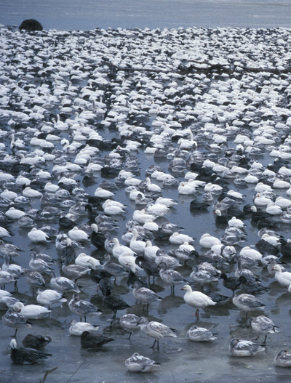
Congregate – ducks, geese gather; squirrels, racoons, and honeybees stay close together in trees
5C
Exploring Missouri – 5C Nature Events: Explain
16
Notes:
Teacher Note: You may select a few survival strategies to focus on or, if time allows, you may want to discuss two or three methods each day completing the list over several days. Suggested survival strategies that are the easiest for students to understand: migrate, hibernate and insulate (hide slides that you are not going to use).
Animal in picture: Snow Geese

Slide 17
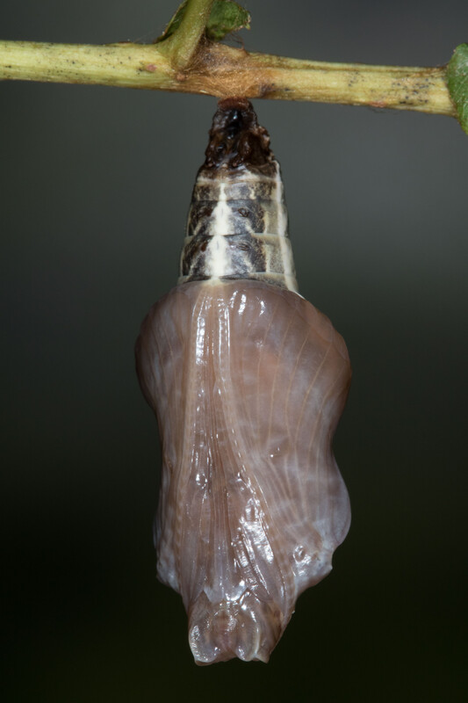
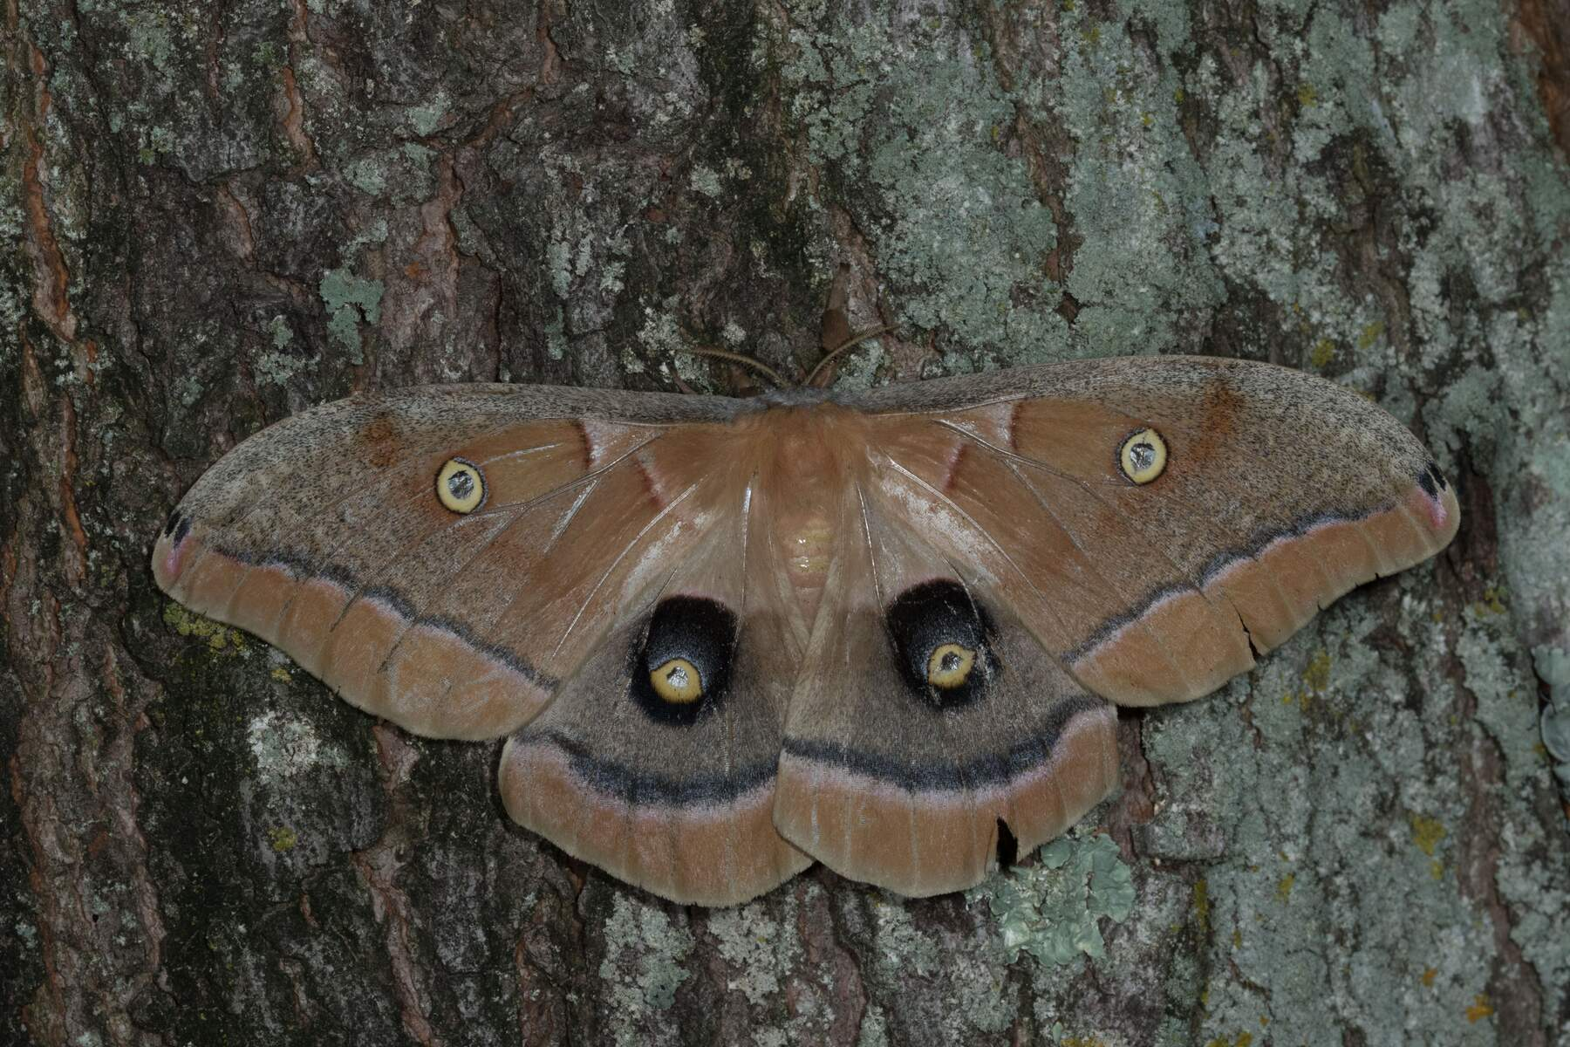
Pupate – several moths like the Polyphemus moth will survive winter as a cocoon
5C
Exploring Missouri – 5C Nature Events: Explain
17
Notes:
Teacher Note: You may select a few survival strategies to focus on or, if time allows, you may want to discuss two or three methods each day completing the list over several days. Suggested survival strategies that are the easiest for students to understand: migrate, hibernate and insulate (hide slides that you are not going to use).
Animal in Picture: Polyphemus moth

Slide 18
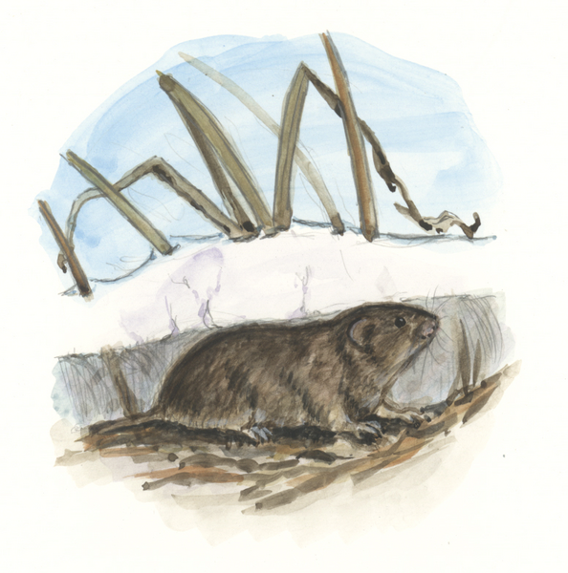
Evacuate – voles, mice, and shrews will avoid air temperatures below freezing by creating tunnels through the snow
5C
Exploring Missouri – 5C Nature Events: Explain
18
Notes:
Teacher Note: You may select a few survival strategies to focus on or, if time allows, you may want to discuss two or three methods each day completing the list over several days. Suggested survival strategies that are the easiest for students to understand: migrate, hibernate and insulate (hide slides that you are not going to use).
Animal in Picture: Prairie Vole Snow

Slide 19
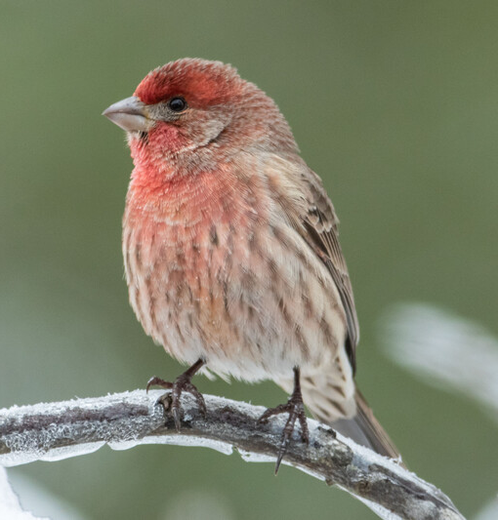
Insulate – fox grow think, warm fur; birds will fluff up their feathers
5C
Exploring Missouri – 5C Nature Events: Explain
19
Notes:
Teacher Note: You may select a few survival strategies to focus on or, if time allows, you may want to discuss two or three methods each day completing the list over several days. Suggested survival strategies that are the easiest for students to understand: migrate, hibernate and insulate (hide slides that you are not going to use).
Animal in Picture: House Finch

Slide 20
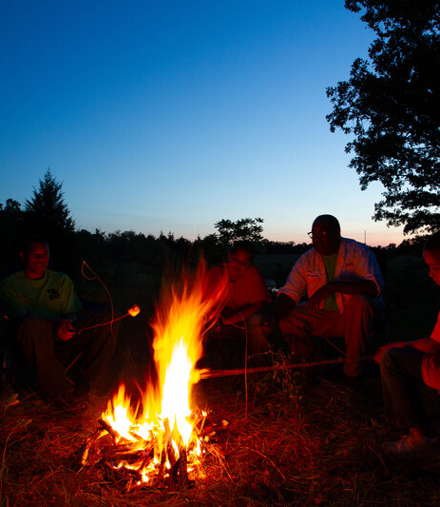
Generate – people will build warm fires; bears eat during the fall, building a layer of fat that helps give them energy as they sleep through winter
5C
Exploring Missouri – 5C Nature Events: Explain
20

Slide 21
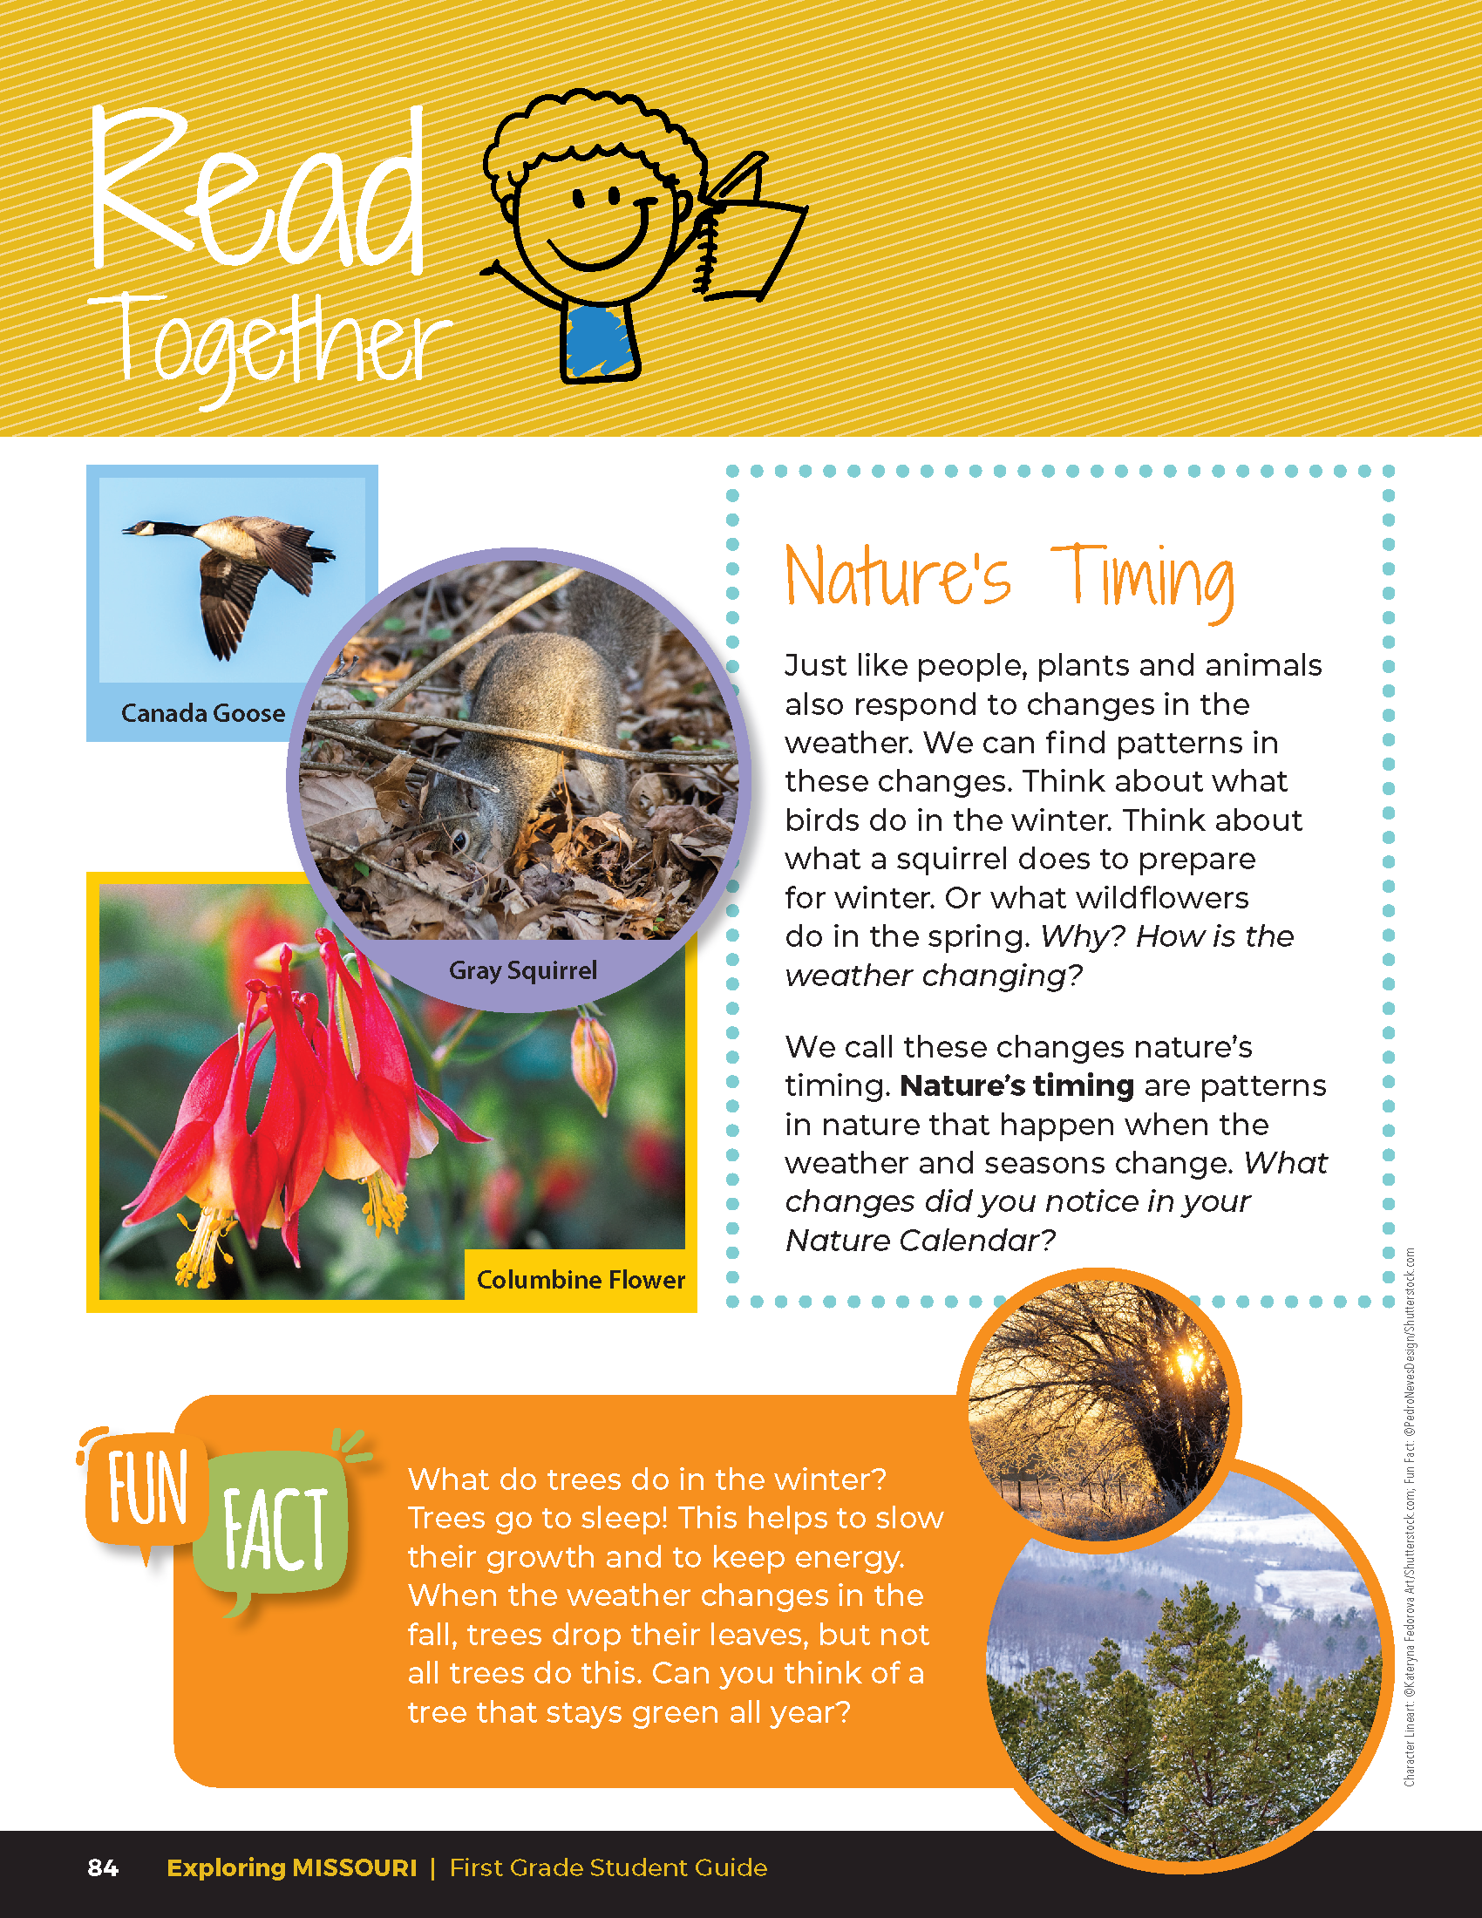

Nature’s Timing
Just like people, plants and animals also respond to changes in the weather. We can find patterns in these changes. Think about what birds do in the winter. Think about what a squirrel does to prepare for winter. Or what wildflowers do in the spring. Why? How is the weather changing?
5C
Exploring Missouri – 5C Nature Events: Elaborate
21
Notes:
Read the Read Together 5C Nature’s Timing section on student guide Page 84.

Slide 22
Nature’s Timing
We call these changes nature’s timing. Nature’s timing are patterns in nature that happen when the weather and seasons change. What changes did you notice in your Nature Calendar?
5C
Exploring Missouri – 5C Nature Events: Elaborate
22
Notes:
Read the Read Together 5C Nature’s Timing section on student guide Page 84.

Slide 23
How does nature’s timing change through the year?
5C
Exploring Missouri – 5C Nature Events: Elaborate
23

Slide 24
What is happening in Missouri today?
5C
Exploring Missouri – 5C Nature Events: Elaborate
24
Notes:
Let’s review our MDC Natural Events Calendar for this year. Refer to the event for today.

Slide 25
What is happening in Missouri tomorrow?
5C
Exploring Missouri – 5C Nature Events: Elaborate
25
Notes:
Refer to the event for tomorrow.

Slide 26

Whose birthday is in the spring? Summer? fall?
What is happening on those dates?
5C
Exploring Missouri – 5C Nature Events: Elaborate
26

Slide 27

Why are we seeing these changes in animals and plants?
5C
Exploring Missouri – 5C Nature Events: Elaborate
27

Slide 28
What can we expect to start happening in the next month? What should we be looking for?
5C
Exploring Missouri – 5C Nature Events: Elaborate
28

Slide 29

Write at least five natural events that will start happening next on the board with a blank check box next to it.
5C
Exploring Missouri – 5C Nature Events: Elaborate
29
Notes:
Review the natural events that will start happening next month. Write at least five natural events on the board with a blank check box next to it.

Slide 30
Create a Nature’s Timing Report similar to the weather report.
5C
Exploring Missouri – 5C Nature Events: Elaborate
30
Notes:
Create a Nature’s Timing Report similar to the weather report. As time allows, show students how a weather forecaster reports the weather. Encourage groups to create and have a weekly Nature’s Timing Report and weather report. Have small student groups take turns having different teams present their reports. If the natural event occurs, place a checkmark next to the event with the data observed.

Slide 31
What are these plants and animals doing?
5C
Exploring Missouri – 5C Nature Events: Evaluate
31
Notes:
Refer to the student guide Lesson 5C Nature Events introduction page with the different Missouri plants and animals in winter.

Slide 32
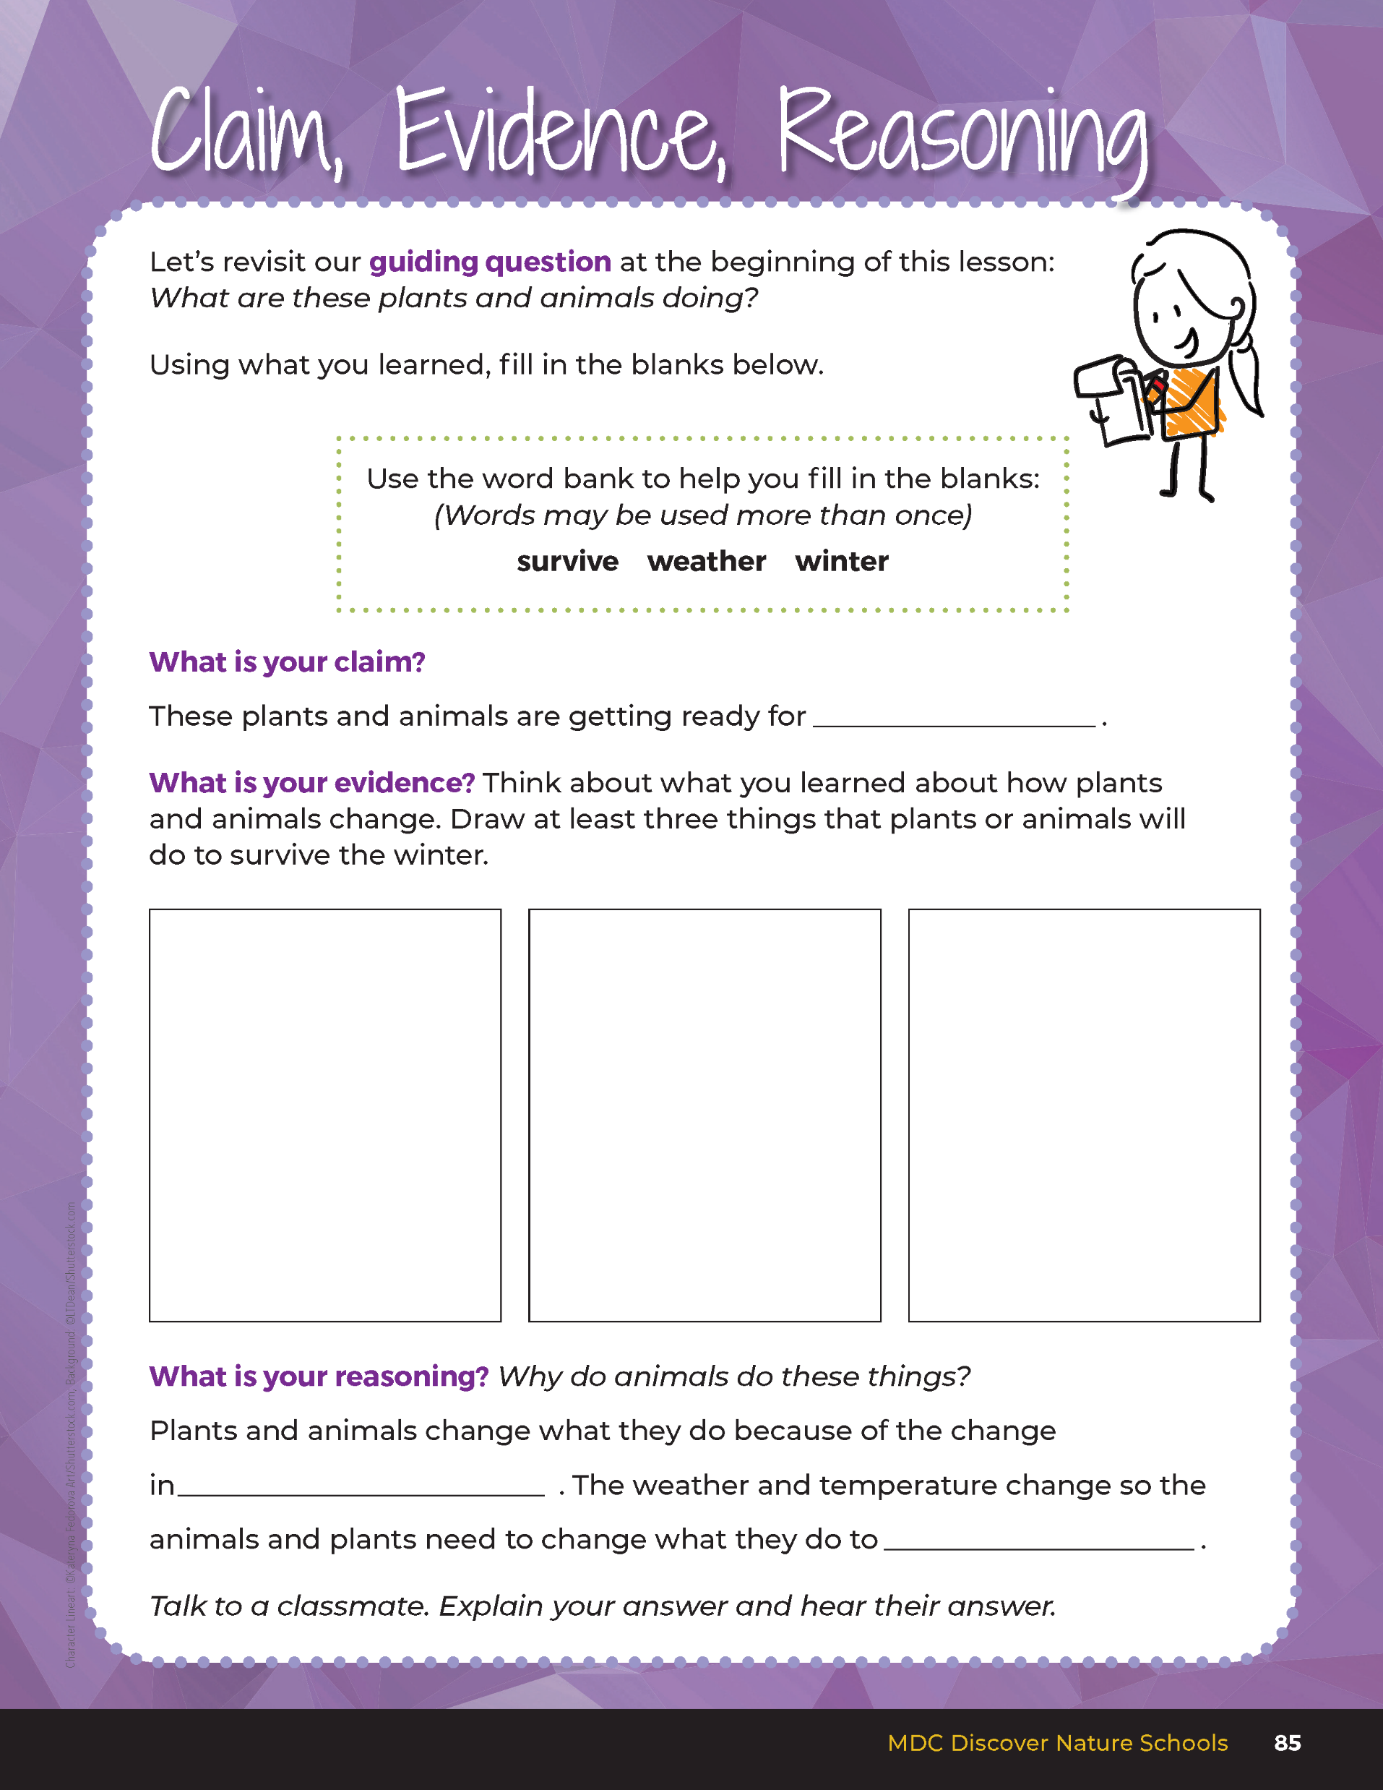
Guiding Question:
What are these plants and animals doing?
5C
Exploring Missouri – 5C Nature Events: Evaluate
32
Notes:
After exploring the connection between weather changes and changes in the behavior of plants and animals, have students open their student guides to the Claim, Evidence, Reasoning section on Page 85. Discuss the page with the students - read the guiding question and then explain what the students need to do to answer the questions (fill in the blanks and draw three ways that plants and animals survive winter).

Slide 33
winter
Answers
Birds fly south.
The fox curls into a ball.
Some animals eat a lot.
A vole digs under the snow.
weather
survive
5C
Exploring Missouri – 5C Nature Events: Evaluate
33
Notes:
Rubric:
4 (Exceeds) – Students draw three methods that plants or animals use to survive winter.
3 (Meets) – Students draw two methods that plants or animals use to survive the winter.
2 (Partially Meets) – Students draw one method that a plant or animal uses to survive the winter.
1 (Doesn’t Meet) – Students do not provide a method for a plant or animal survival in winter.

