Slide 1


Exploring
MISSOURI
5B: Weather Observations

Slide 2
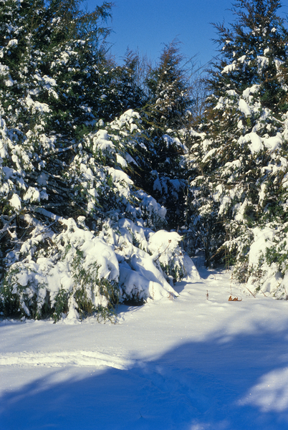
Guiding Question:
How does weather change overtime?
5B
Exploring Missouri – 5B Weather Observations: Engage
2

Slide 3
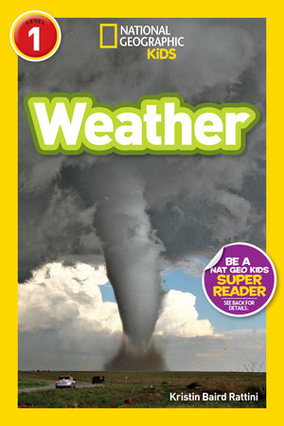
Read National Geographic Readers Series: Weather by Kristin Baird Rattini
Read Aloud:
https://youtu.be/bbEbF6zsbUo?si=ddn2MK8C5XOntRai
Epic Link:
https://www.getepic.com/book/48629583/national-geographic-readers-weather
5B
Exploring Missouri – 5B Weather Observations: Engage
3
Notes:
Read National Geographic Readers Series: Weather by Kristin Baird Rattini.

Slide 4
How do you think scientists learned so much about the weather?
How do you think they learned how it can change over time?
5B
Exploring Missouri – 5B Weather Observations: Engage
4
Notes:
Answers will vary. We are going to be recording the weather for the next three to four weeks.

Slide 5

Record Following Information Each Day on Classroom Board
15
15
X
MINUTES
DAYS
Month
What day of the week is: yesterday, today, and tomorrow
The numeric day of the month
The number of days your class has been in school
The weather is:
  Cloudy/overcast, windy, rainy, snowy, sunny, partly sunny
  Temperature
Personal classroom news: birthdays, special events, holidays, lost tooth
5B
Exploring Missouri – 5B Weather Observations: Engage
5
Notes:
At the beginning of each day, complete daily calendar lessons with you class by recording the following information on the classroom board.

Slide 6
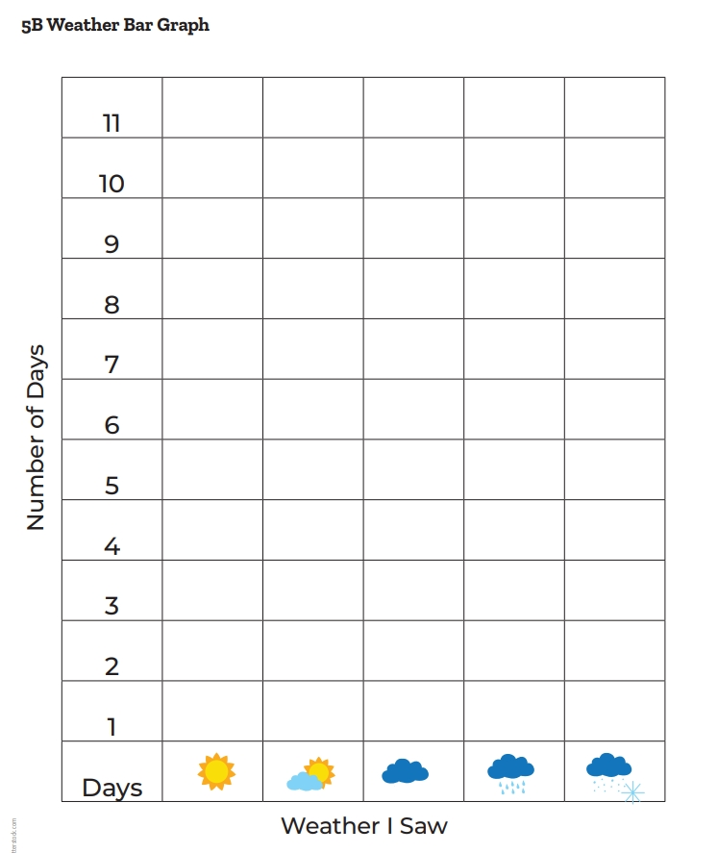
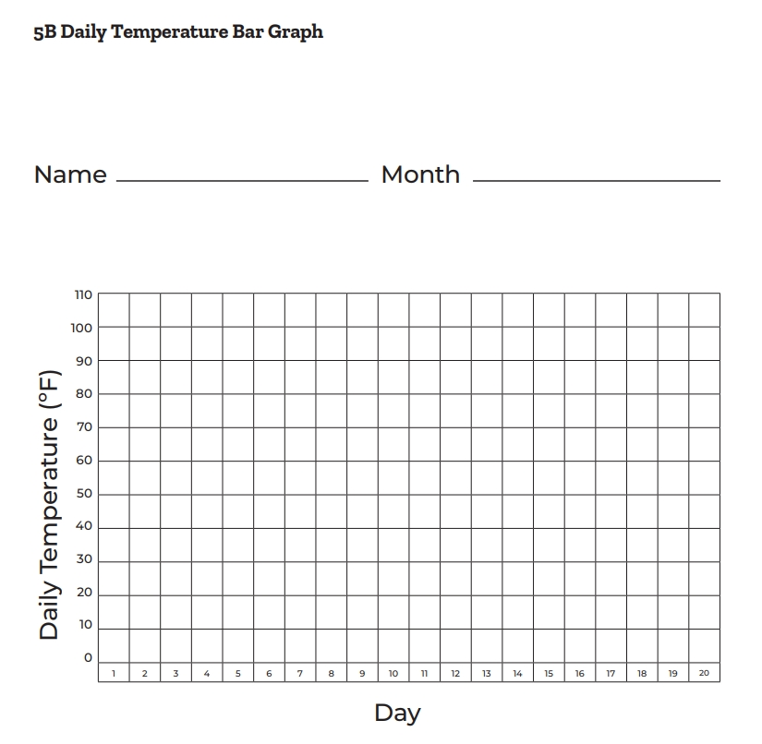
5B
Exploring Missouri – 5B Weather Observations: Engage
6
Notes:
Record the weather data onto the two separate and blank vertical bar graphs: 5B Weather Bar Graph (cloud/overcast, windy, rainy, snowy, sunny, partly sunny) and 5B Daily Temperature Bar Graph. Use sticky notes when adding a data point to the graphs with one sticky note under the appropriate temperature for that day and the other to show the weather. Count the number of sticky notes under each category at the end of the lesson when students analyze their data.

Slide 7
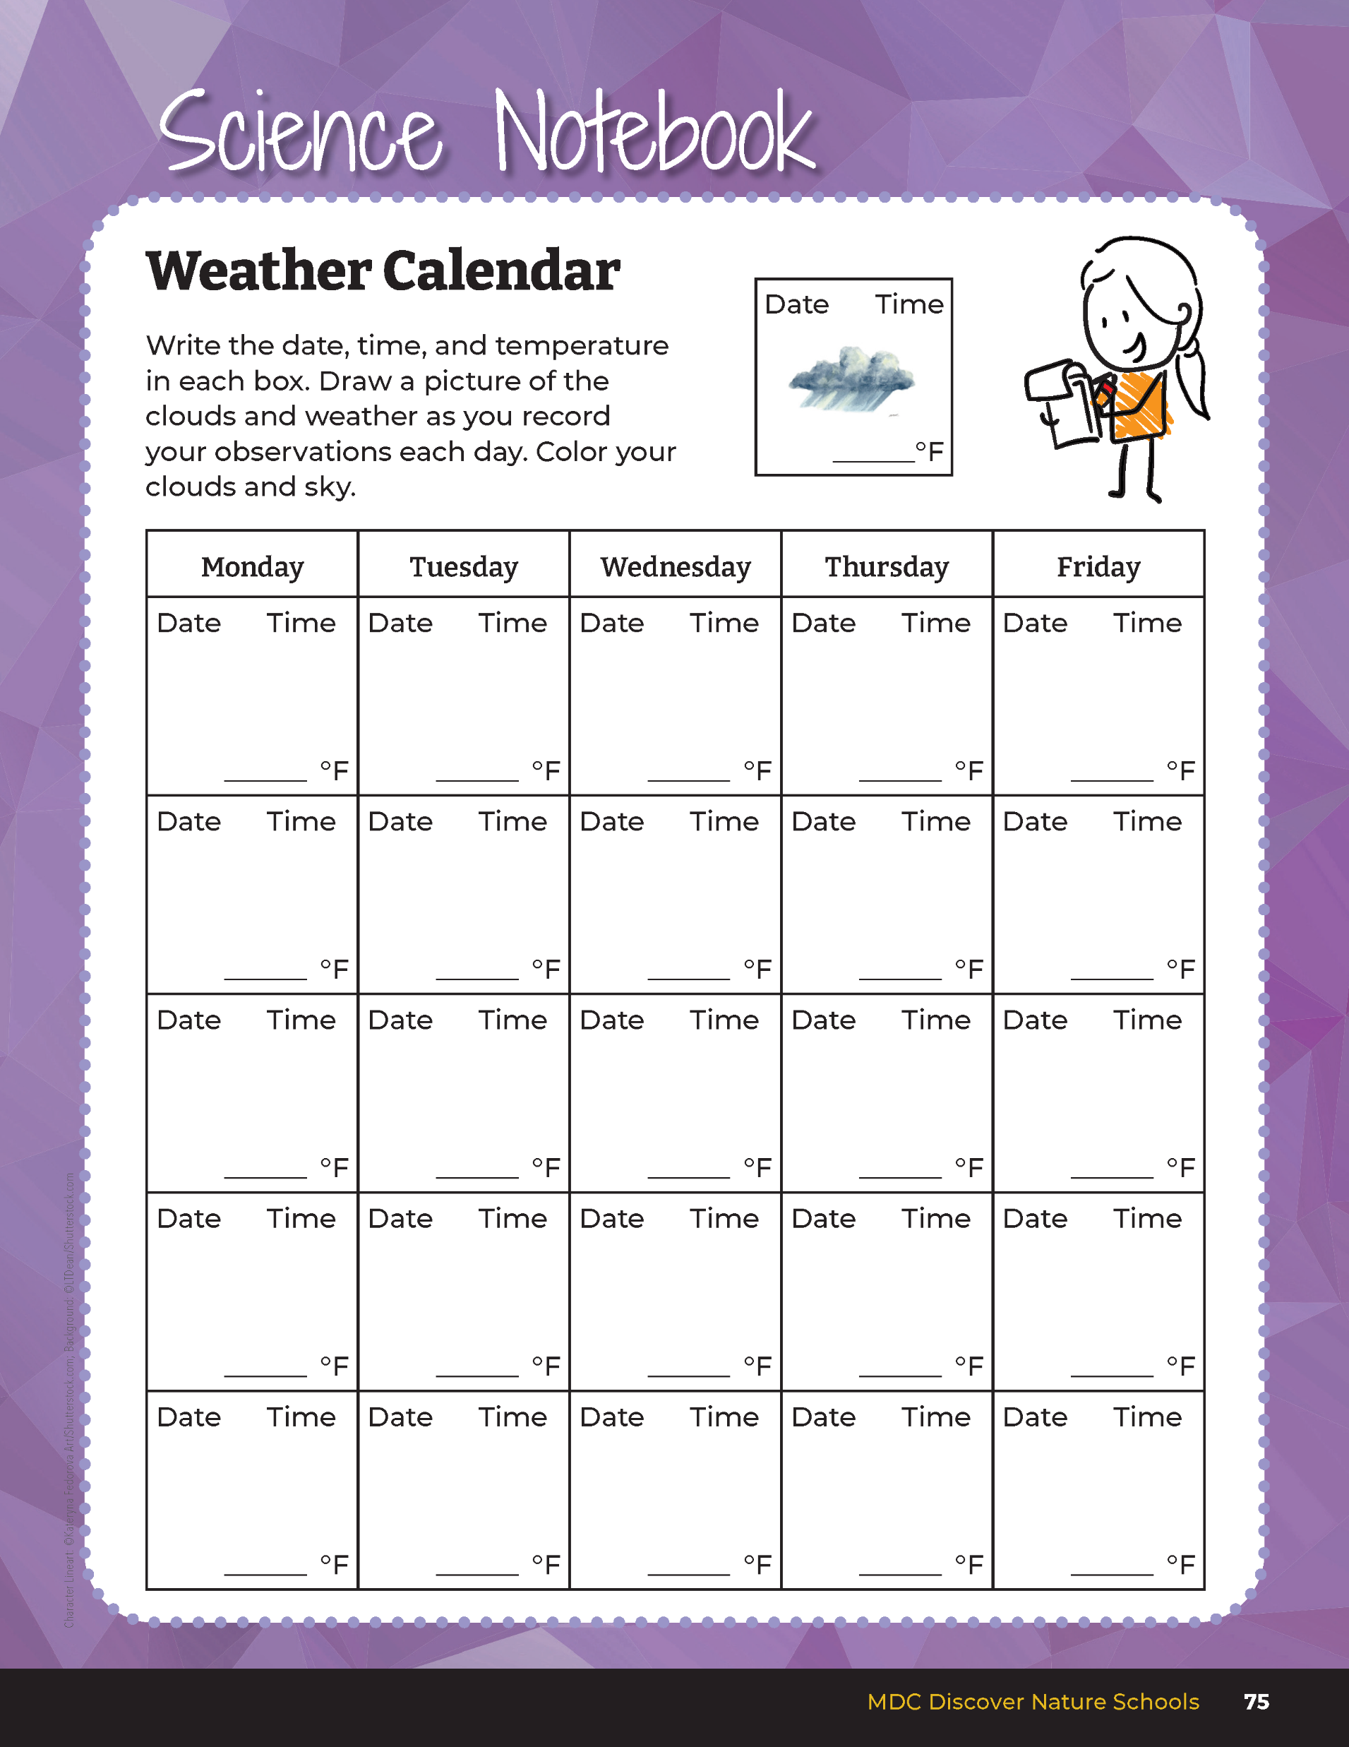



Date
Time
11/26
9:15 a.m.
52
______
F
5B
Exploring Missouri – 5B Weather Observations: Explore
7
Notes:
During winter season, introduce the weather logbook in student guide Science Notebook 5B Weather Calendar section on Page 75.
Introduce through modeling how to complete a date box in the blank calendar template. Draw an empty box on the board and write the following into the box:
Date in upper left-hand corner
Time in upper right-hand corner
Record the outside temperature
Draw the clouds in box and color the clouds or sky
Continue to monitor the weather across each day of school. Use the 5B Blank Weather Calendar to continue to make observations over time. Distribute one calendar for each student. You may choose to keep these in a separate folder, binder, or tape inside of student guides. Record and keep the classroom 5B Weather Bar Graph and 5B Daily Temperature Bar Graph to analyze later in the lesson.

Slide 8

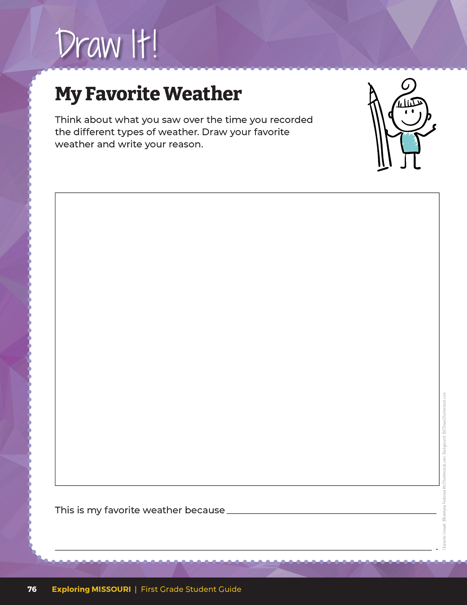
Draw your favorite weather and write your reason.
5B
Exploring Missouri – 5B Weather Observations: Explain
8
Notes:
In their student guide Draw It! 5B My Favorite Weather section on Page 76, students will create a writing/drawing response about their favorite season or month, based upon the weather data gathered, identifying reasons they choose this time as favorite.
The choice can be based upon specific weather providing a favorite activity, memory, or experience in the community, as well. Encourage students to include temperature, clouds, and wind references.

Slide 9
5B
Exploring Missouri – 5B Weather Observations: Explain
9
Notes:
After a period of monitoring the weather and recording daily observations into the Science Notebook 5B Weather Calendar, have a class lesson summarizing what the observations have shown using the 5B Weather and Daily Temperature Bar Graphs and Weather Calendars.
Teacher Note: This can be done weekly, monthly, or even each season, depending on the observation schedule you choose to implement.

Slide 10
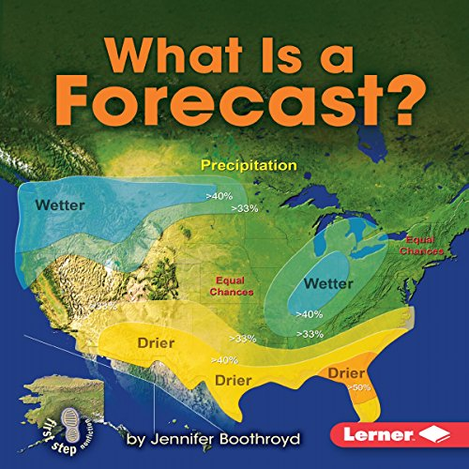
Read What Is a Forecast? By Jennifer Boothroyd
Read Aloud:
https://www.youtube.com/watch?v=OCSVCXlYYAI
Epic Link:
https://www.getepic.com/book/10034554/what-is-a-forecas
5B
Exploring Missouri – 5B Weather Observations: Explain
10
Notes:
Read What Is a Forecast? by Jennifer Boothroyd.

Slide 11
How do scientists predict weather?
What patterns do you think they look for?
5B
Exploring Missouri – 5B Weather Observations: Explain
11

Slide 12
What patterns do we notice?
5B
Exploring Missouri – 5B Weather Observations: Explain
12
Notes:
Let’s review our Weather Calendars again.

Slide 13
What types of weather was most/least experienced these past months/season?
5B
Exploring Missouri – 5B Weather Observations: Explain
13

Slide 14
How many more types of _________ weather days were there compared to __________ weather?
5B
Exploring Missouri – 5B Weather Observations: Explain
14

Slide 15
Did the temperature increase or decrease overall across this time period? Were there any severe weather days?
5B
Exploring Missouri – 5B Weather Observations: Explain
15

Slide 16
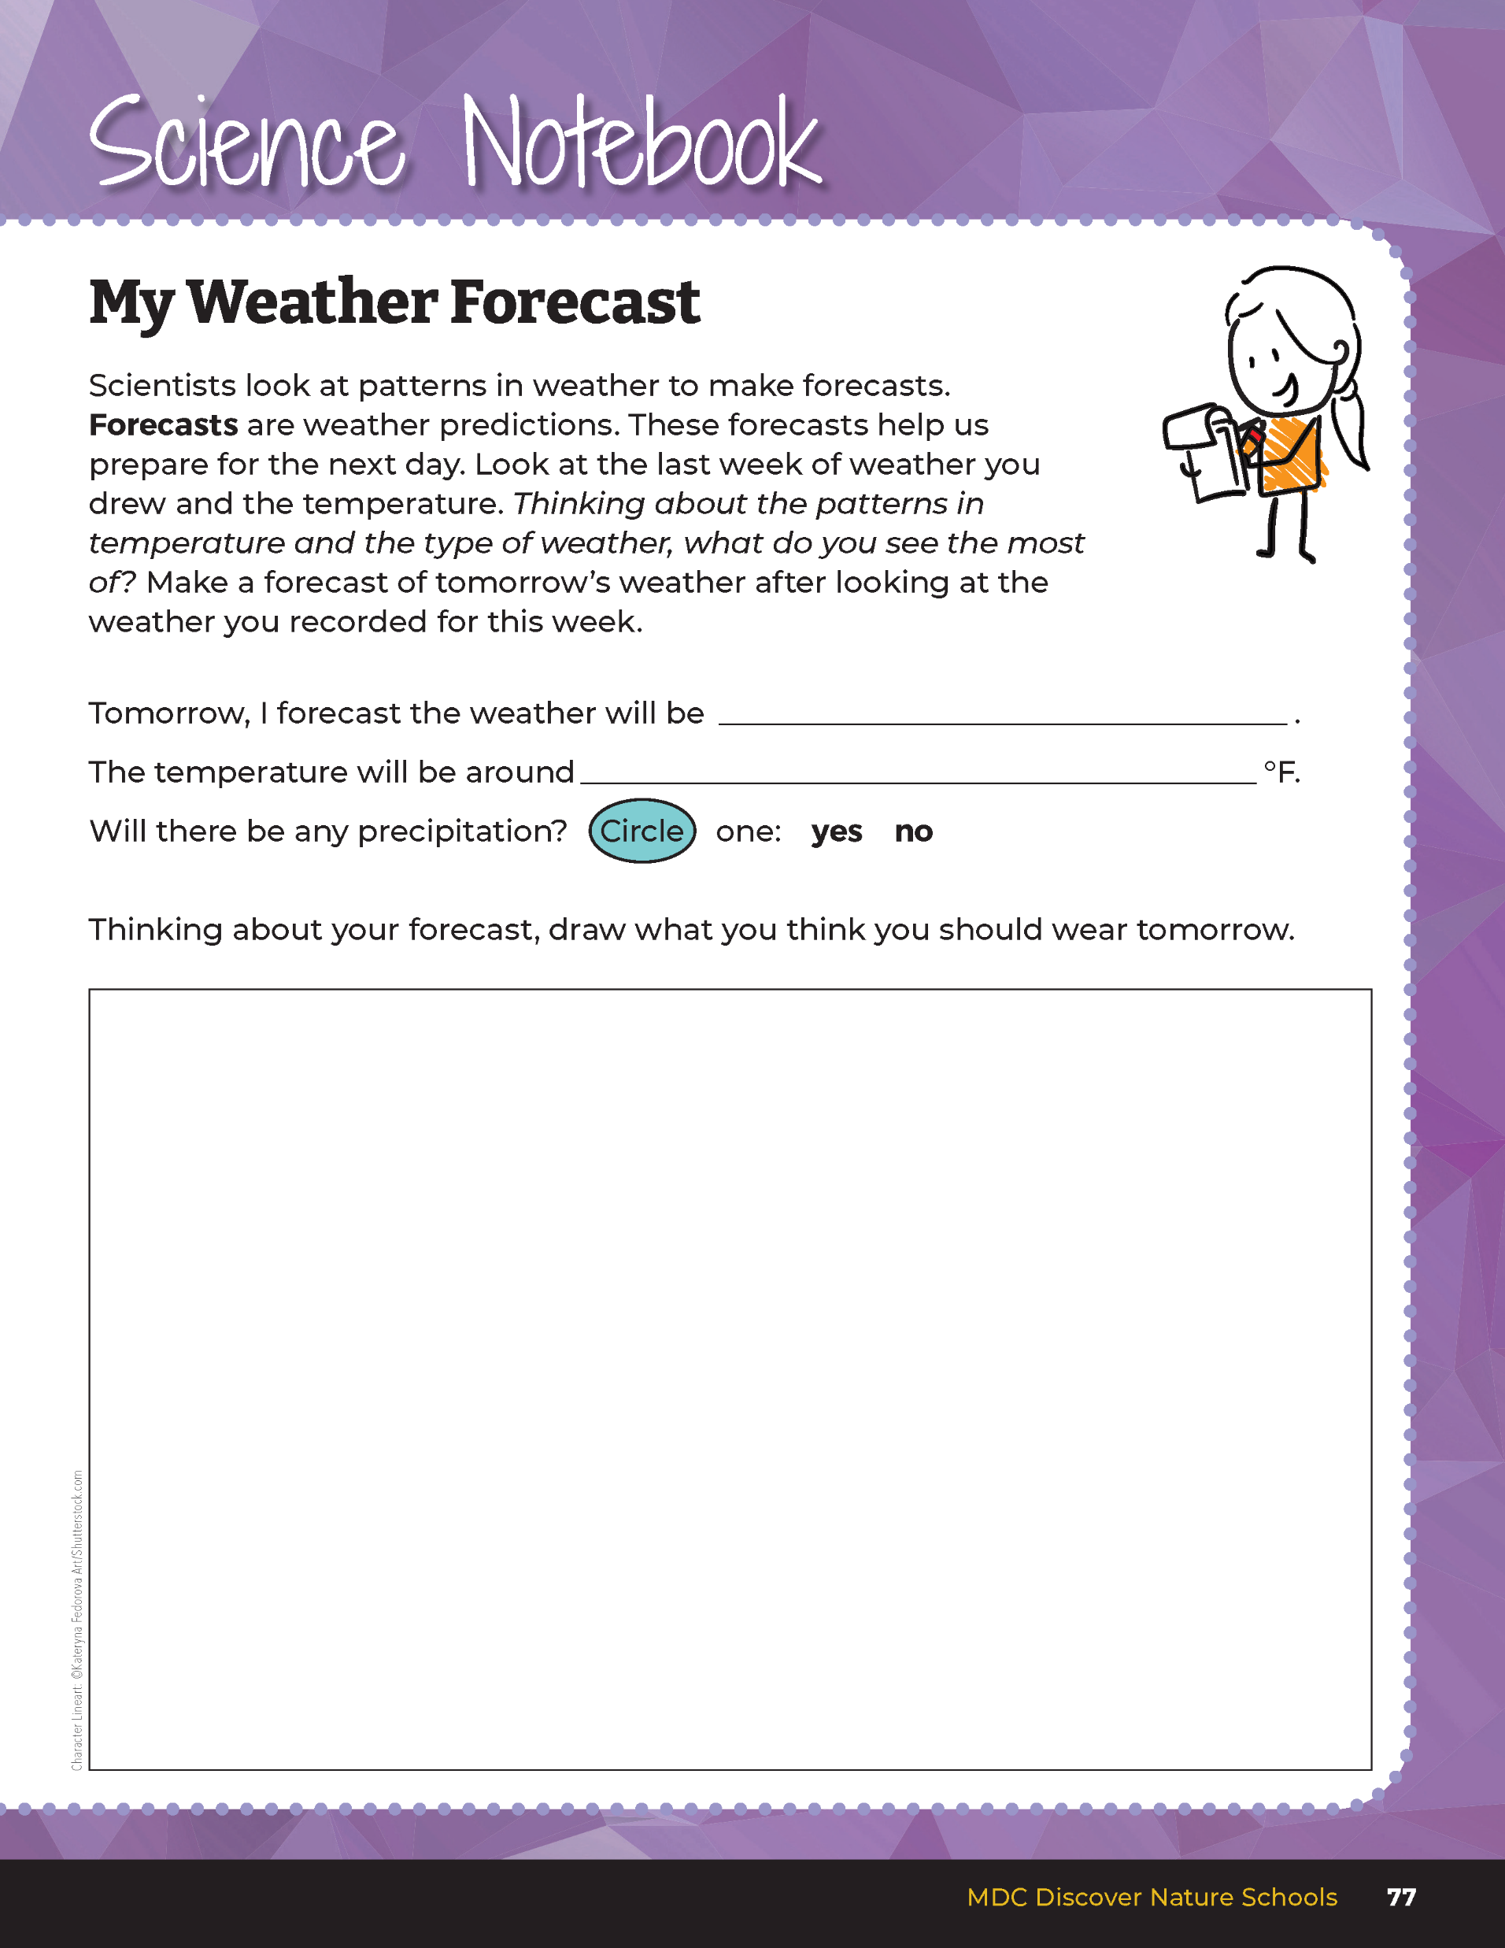
Make a forecast of tomorrow’s weather after looking at the weather you recorded for this week.
5B
Exploring Missouri – 5B Weather Observations: Elaborate
16
Notes:
Students will make their own weather forecasts based on what they observed and recorded in their Science Notebook 5B Weather Calendars. Read the Science Notebook 5B My Weather Forecast on page 77. Display and discuss weather over the last two weeks and discuss patterns in temperature and types of weather and precipitation. Without researching the weather forecast for the next day, allow students time to write their forecasts.
Students can create their own Weather Report and share their forecasts with their class. On the classroom board, tally the weather and temperature forecasts to show what most students are predicting.

Slide 17
Why are you making that forecast?
What data do you see in your calendars?
5B
Exploring Missouri – 5B Weather Observations: Elaborate
17

Slide 18
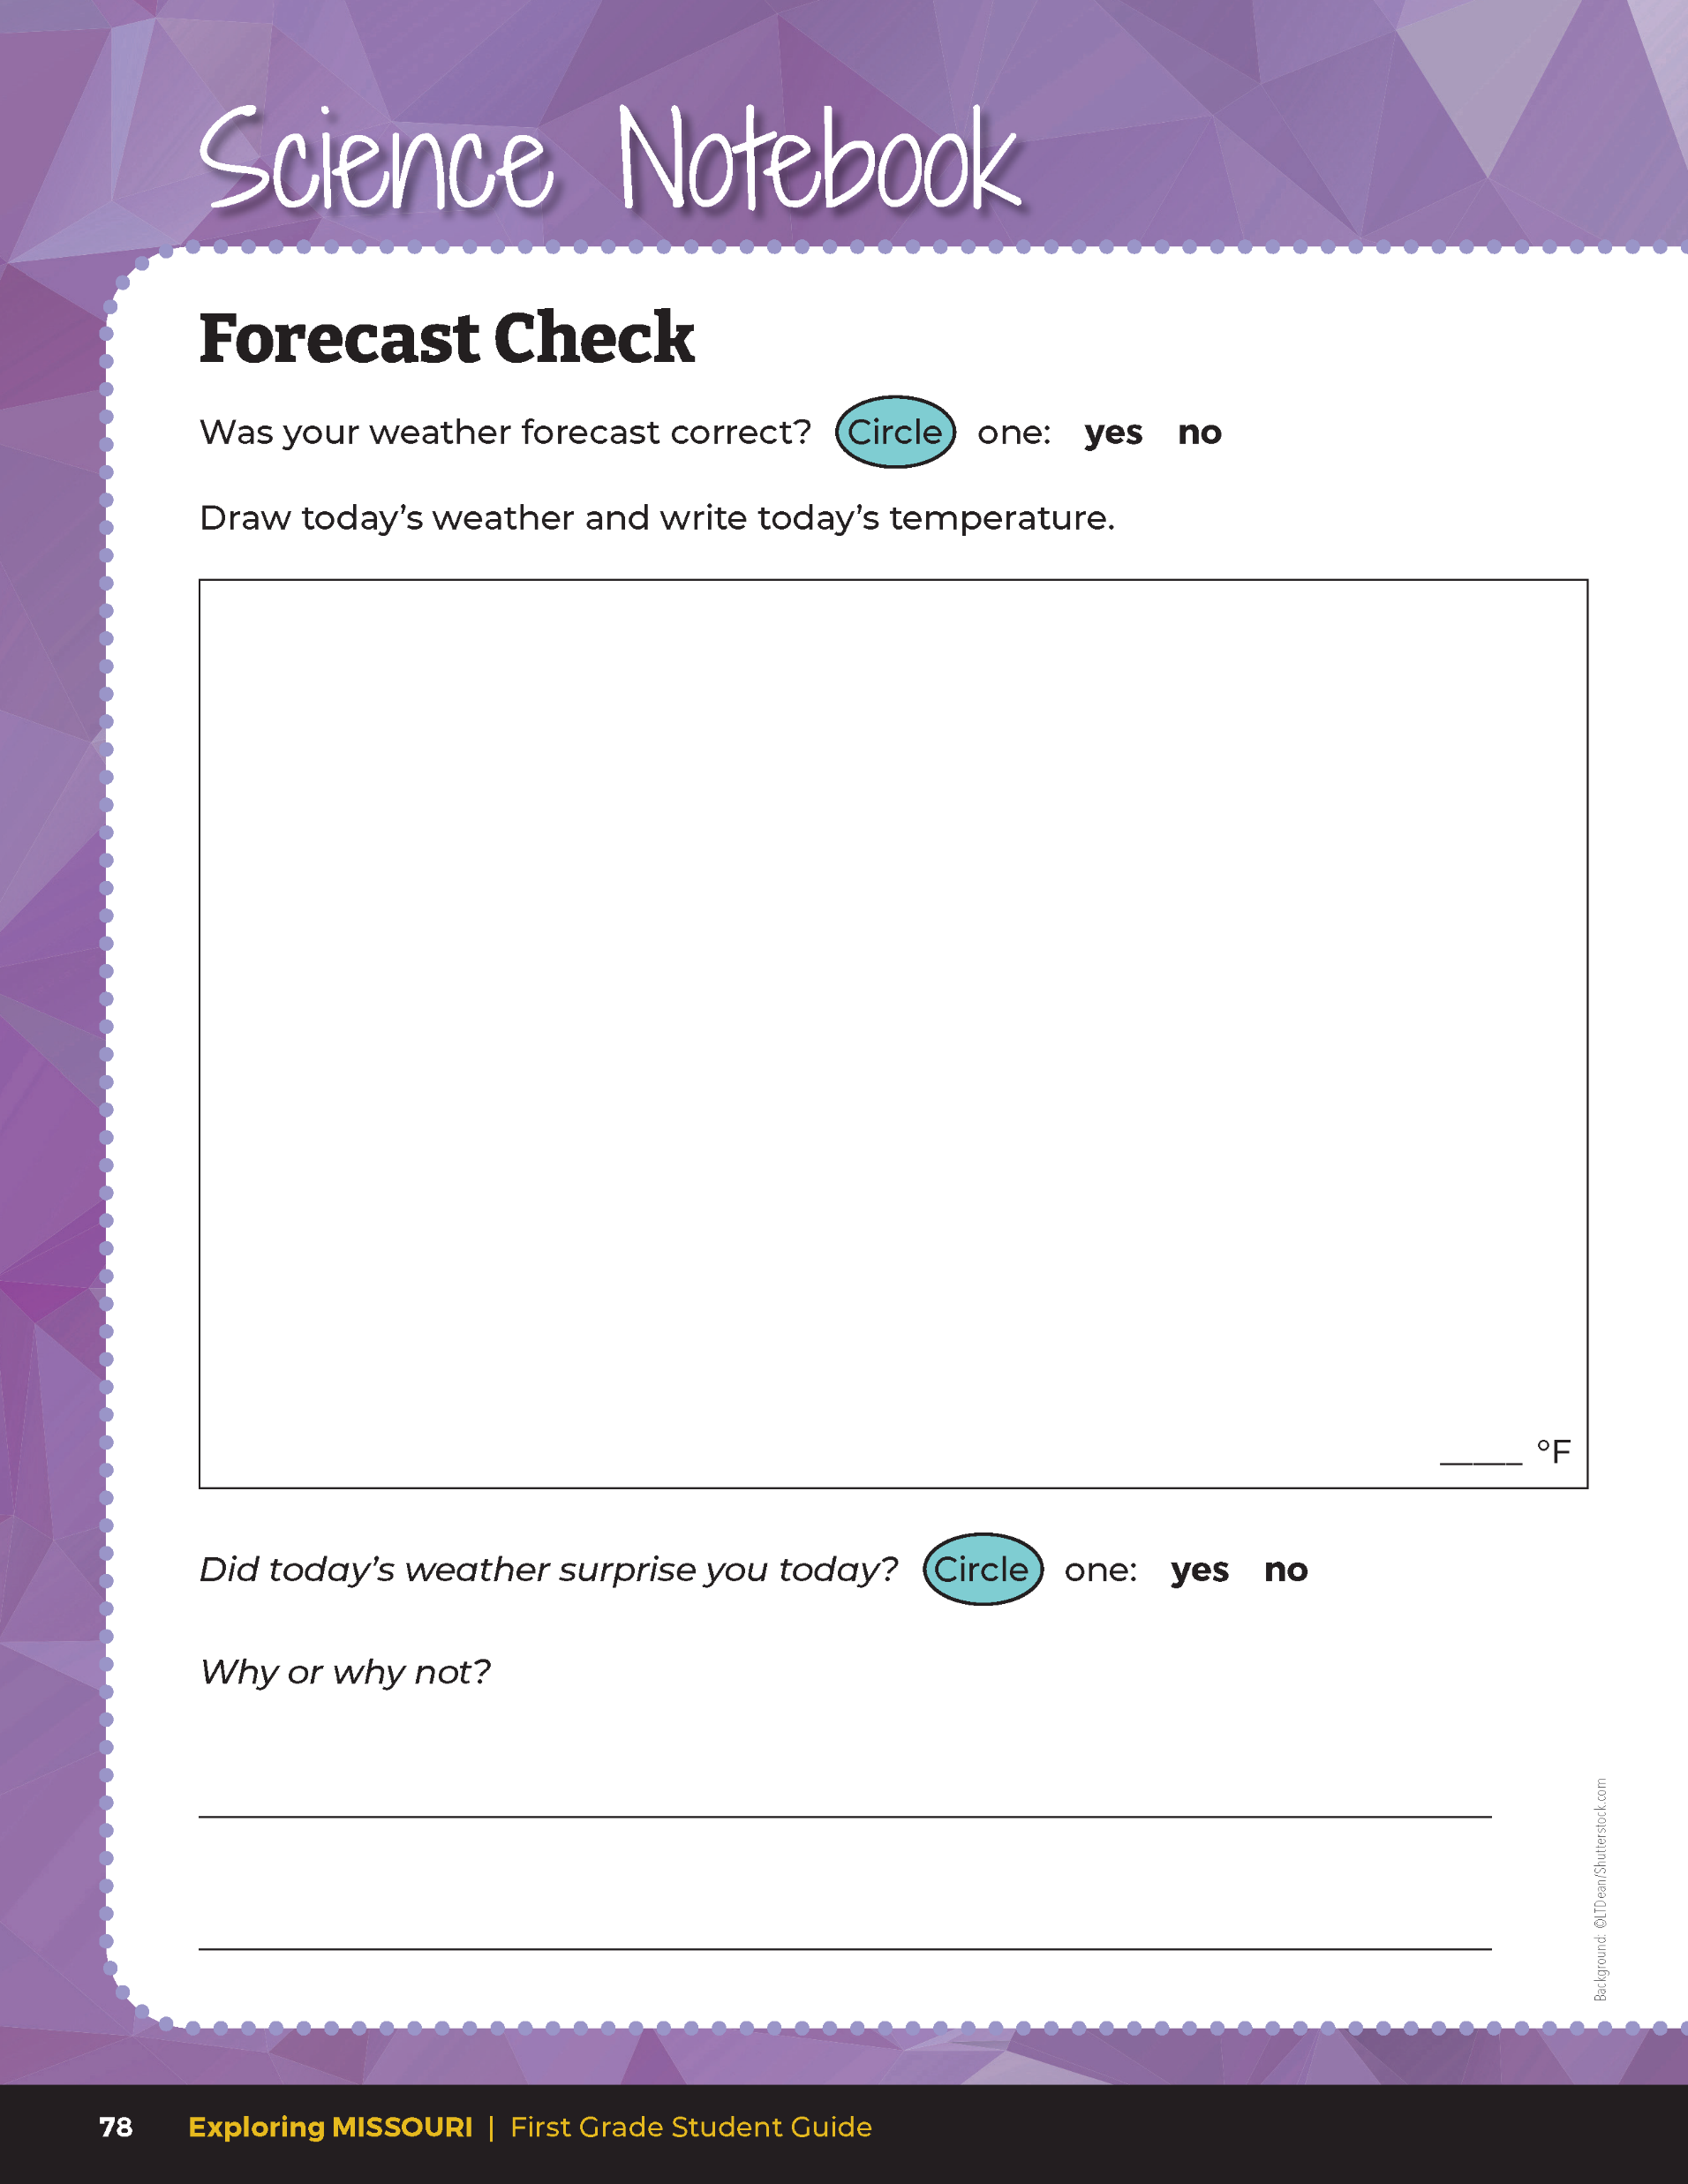
Was your weather forecast correct?
Draw today’s weather and write today’s temperature.
Did today’s weather surprise you today?
5B
Exploring Missouri – 5B Weather Observations: Elaborate
18
Notes:
The following day, have students revisit their predictions and circle if there forecast was correct under Forecast Check section on Page 78. Next, have them draw the weather and write the temperature for today. Ask them if today’s weather surprised them and have them circle “yes” or “no” in their student guide.

Slide 19
Why or why not did the weather surprise you for the day?
5B
Exploring Missouri – 5B Weather Observations: Elaborate
19

Slide 20
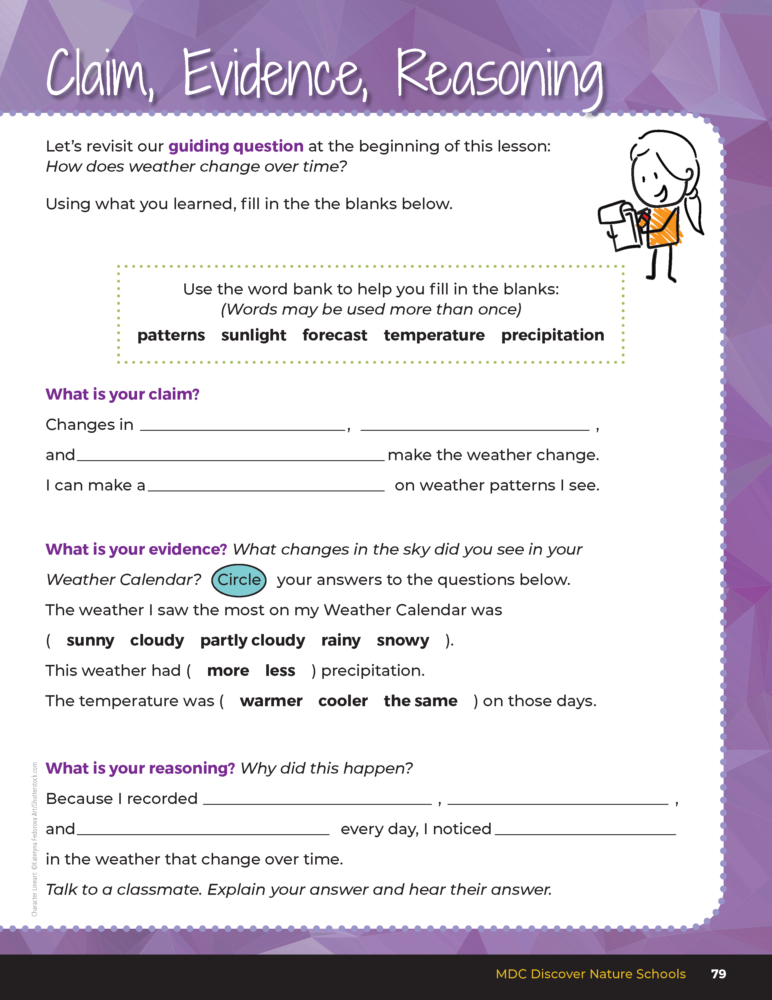
Guiding Question:
How does weather change over time?
5B
Exploring Missouri – 5B Weather Observations: Evaluate
20
Notes:
After exploring the concept of weather and some of the factors of how it changes, have students open their student guides to the Claim, Evidence, Reasoning section on Page 79. Discuss the page with the students – read the guiding question and then explain what the students need to do to answer the questions (fill in the blanks and circle the answers.)

Slide 21
sunlight
temperature
precipitation
Answers
forecast
sunlight
temperature
precipitation
patterns
5B
Exploring Missouri – 5B Weather Observations: Evaluate
21
Notes:
Rubric:
4 (Exceeds) – Students circle and write the correct terms to describe weather changes over time. Students write forecast as a pattern to predict weather changes. Students provide evidence from their own weather calendar.
3 (Meets) – Students circle and write one of the correct terms to describe weather changes over time. Students do not write forecast. Students provide evidence from their own weather calendar.
2 (Partially Meets) – Students circle one or none of the correct terms to describe weather changes over time. Students provide little evidence to support their claim.
1 (Doesn’t Meet) – Students circle none of the correct terms to describe weather changes over time. Students provide no evidence to support their claims.

