Slide 1
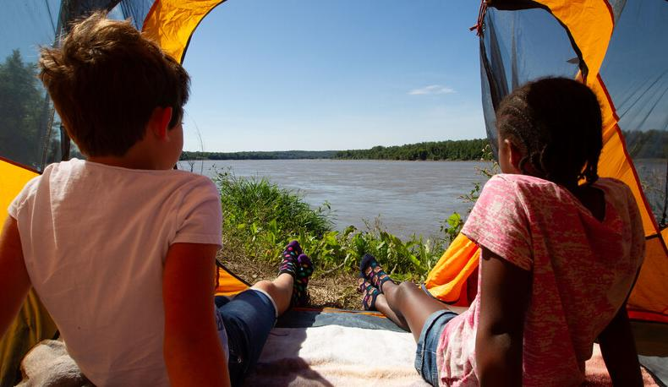

Life and Land in
MISSOURI
5B: Water Here and There

Slide 2
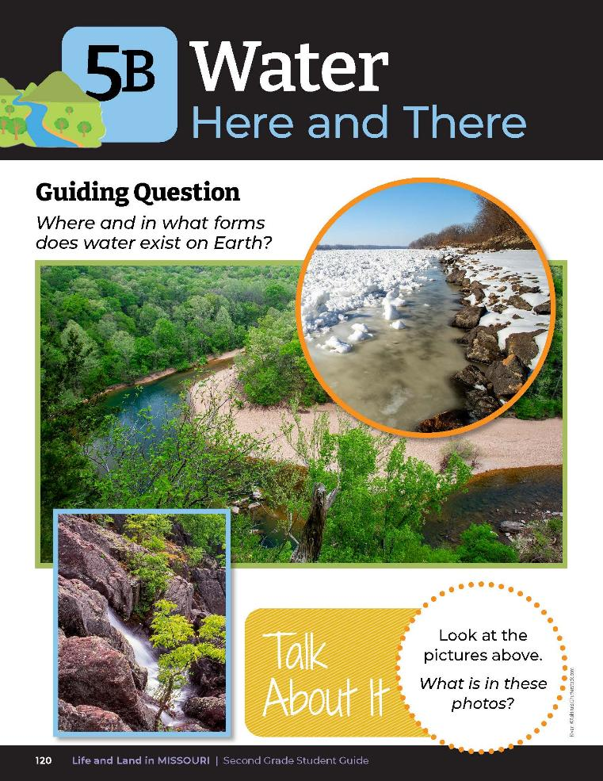
Guiding Question:
Where and in what forms does water exist on Earth?
5B
Life and Land in Missouri – 5B Water Here and There: Engage
2
Notes:
Have students turn to their Lesson 5B Water Here and There introduction Page 120. Read the guiding question together.

Slide 3
What is in these photos?
5B
Life and Land in Missouri – 5B Water Here and There: Engage
3
Notes:
Discuss the Talk About It. Write student ideas on the board.

Slide 4
Water
Land
When you catch the Earth, where is your right thumb? Is it on land or water?
Place sticky note with your name on it in the correct column.
5B
Life and Land in Missouri – 5B Water Here and There: Engage
4
Notes:
Create a T-Chart on board or chart paper to be hung on the wall. T-Chart should have two categories: water and land.
Distribute a sticky note to each student and direct them to write their name on it.
Use an inflatable globe and toss it to a student and have them pay attention to where their right thumb lands.
When you catch the Earth, where is your right thumb? Is it on land or water? Have students remember if their thumb was on land or water. Have students place sticky notes with their name onto the correct column of either land or water on the T-Chart.
Complete rotation until all students have had a turn.

Slide 5
Water
Land
Tally the number of sticky notes in each column!
5B
Life and Land in Missouri – 5B Water Here and There: Engage
5
Notes:
Tally the number of sticky notes in each column and place totals on the same chart for the class to see.

Slide 6
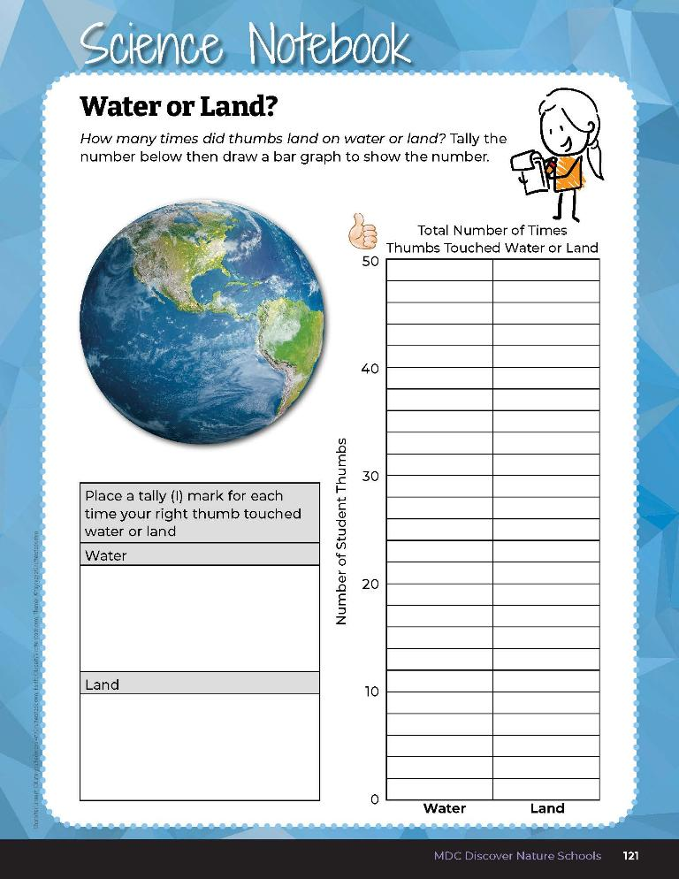

Fill in the bar graph to represent water and land class totals.
5B
Life and Land in Missouri – 5B Water Here and There: Engage
6
Notes:
Have students write these totals in their student guides on the Science Notebook 5B Water or Land? section on Page 121. Have students fill in the bar graph to represent water and land class totals.

Slide 7
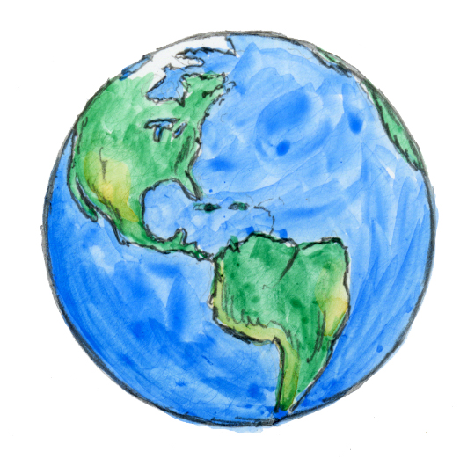
Where is water found on the Earth?
5B
Life and Land in Missouri – 5B Water Here and There: Explore
7
Notes:
Now take a closer look at the Earth. Where is water found on the Earth? Make a classroom list of student answers on the board.

Slide 8
We are going to research 3 different bodies of water and share our information!
What bodies of water would you like to research?
5B
Life and Land in Missouri – 5B Water Here and There: Explore
8
Notes:
Using a globe, discuss all the places where water is found on Earth. Write these names on the list. We are going to research 3 different bodies of water and share our information. What bodies of water would you like to research?

Slide 9
Suggestions of water types to explore:
Ocean
Lake
River
Pond
Stream
Glacier
Aquifer
Wetlands
5B
Life and Land in Missouri – 5B Water Here and There: Explore
9
Notes:
Distribute books about different bodies of water and share websites from the MDC Teacher Portal and allow students time to research the different kinds of water and where it is found. Suggestions of water types to explore include but are not limited to:
Ocean
Lake
River
Pond
Stream
Glacier
Aquifer
Wetlands

Slide 10
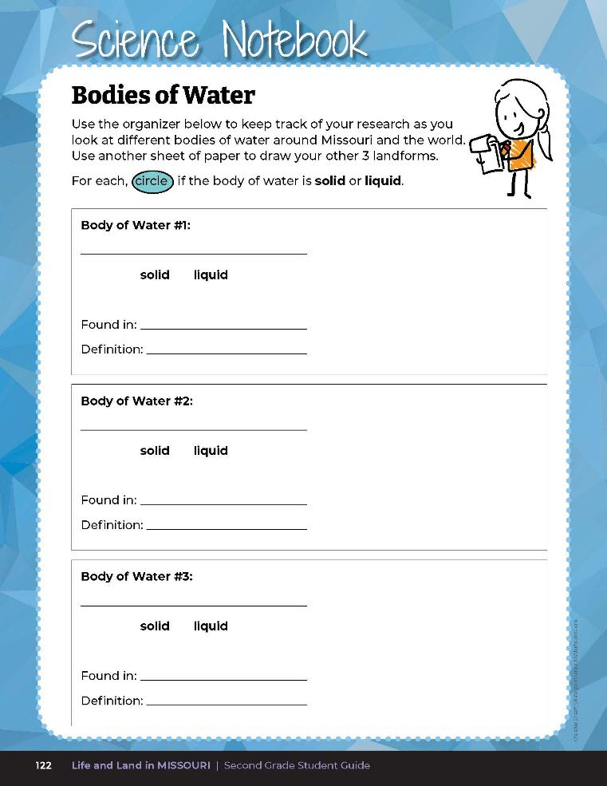
Write the name of the
body of water
Circle if it is a solid or liquid
Write where it can be found
Write the definition
Make a drawing
5B
Life and Land in Missouri – 5B Water Here and There: Explore
10
Notes:
Have students turn to Science Notebook 5B Bodies of Water on Page 122 to record their research. After researching 3 bodies of water, students will first name the body of water, circle if it is a solid or liquid, write where it can be found (such as Missouri and/or the world), write the definition, and make a drawing. Teacher Note: This research activity can last over 2 time periods. If students desire or finish early, 5B Bodies of Water: Extra Copy (found on Page 155 of the teacher guide) can be distributed for additional research notes.

Slide 11
What did your research show you?
What bodies of water did we learn about and how would we describe the different bodies of water?
5B
Life and Land in Missouri – 5B Water Here and There: Explore
11

Slide 12
Are some bodies of water fresh or salt water?
How do we know?
5B
Life and Land in Missouri – 5B Water Here and There: Explore
12

Slide 13
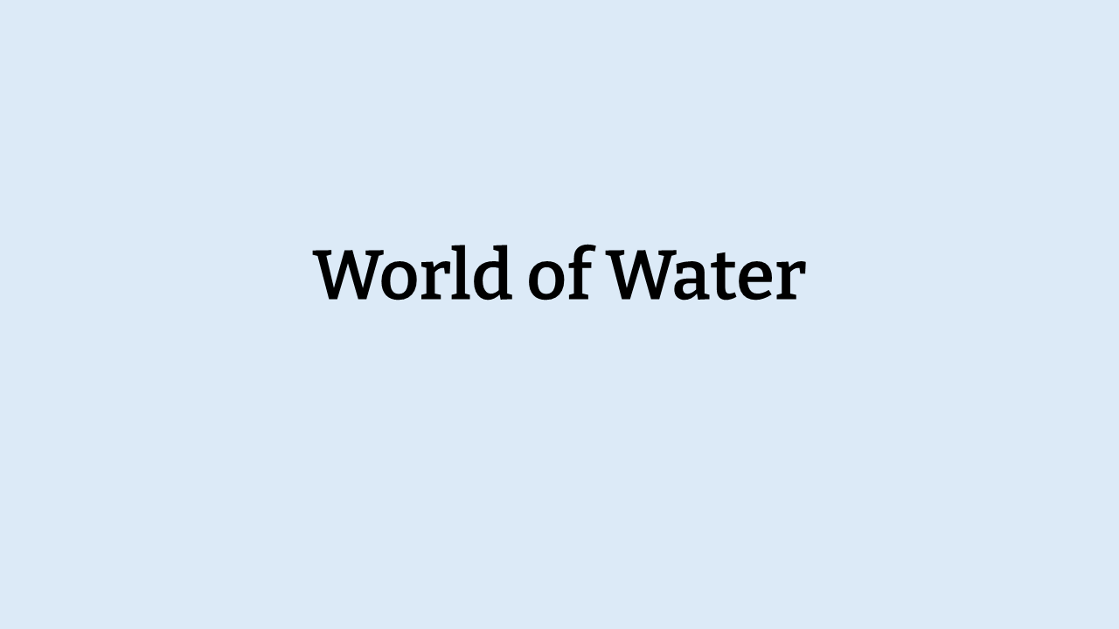
5B
Life and Land in Missouri – 5B Water Here and There: Explain
13
Notes:
From the MDC Teacher Portal, display A World of Water on the board and display the Missouri photos of ponds, lakes, wetlands, and rivers and the world photos of the ocean, rivers, lakes, and glaciers.

Slide 14
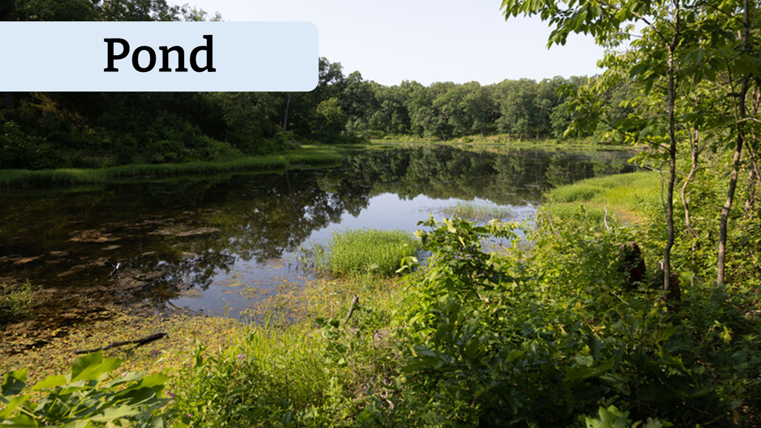
5B
Life and Land in Missouri – 5B Water Here and There: Explain
14

Slide 15
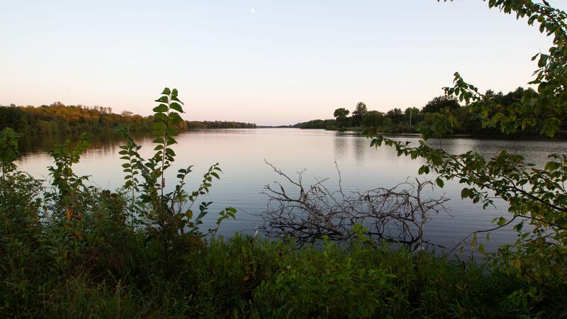
Lake
5B
Life and Land in Missouri – 5B Water Here and There: Explain
15

Slide 16
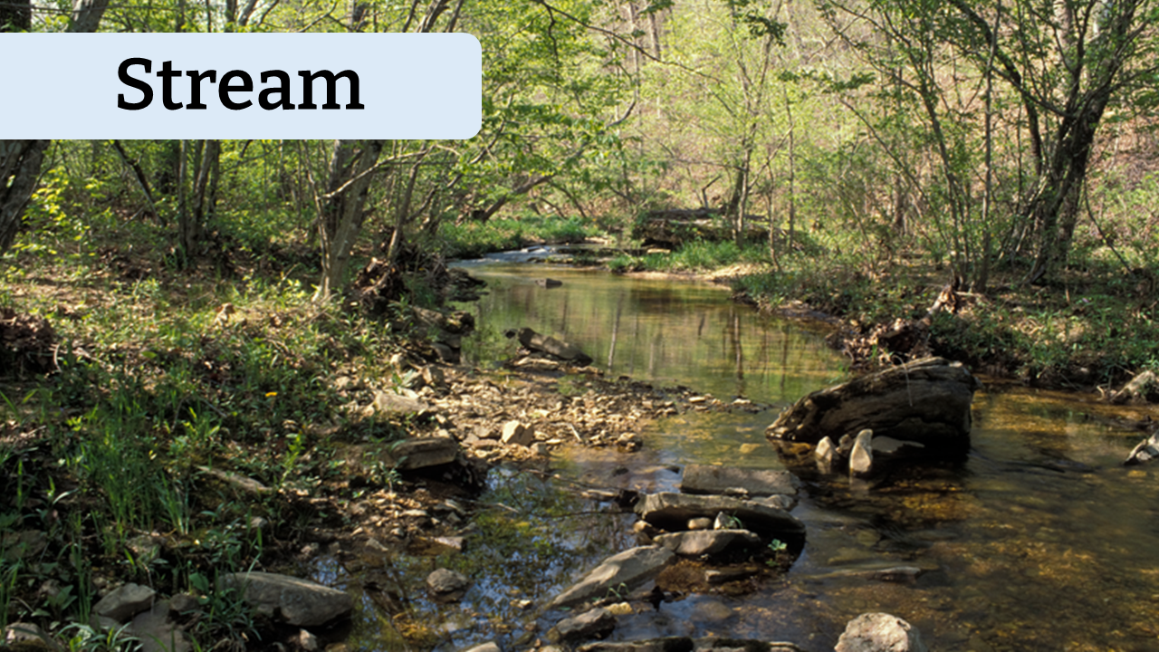
5B
Life and Land in Missouri – 5B Water Here and There: Explain
16

Slide 17
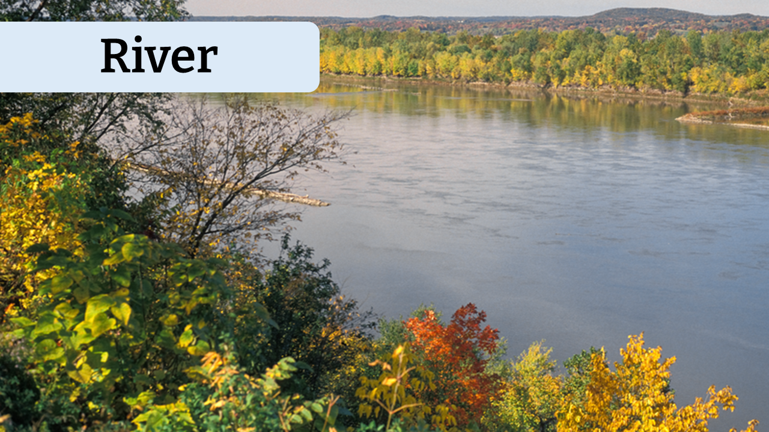
5B
Life and Land in Missouri – 5B Water Here and There: Explain
17

Slide 18
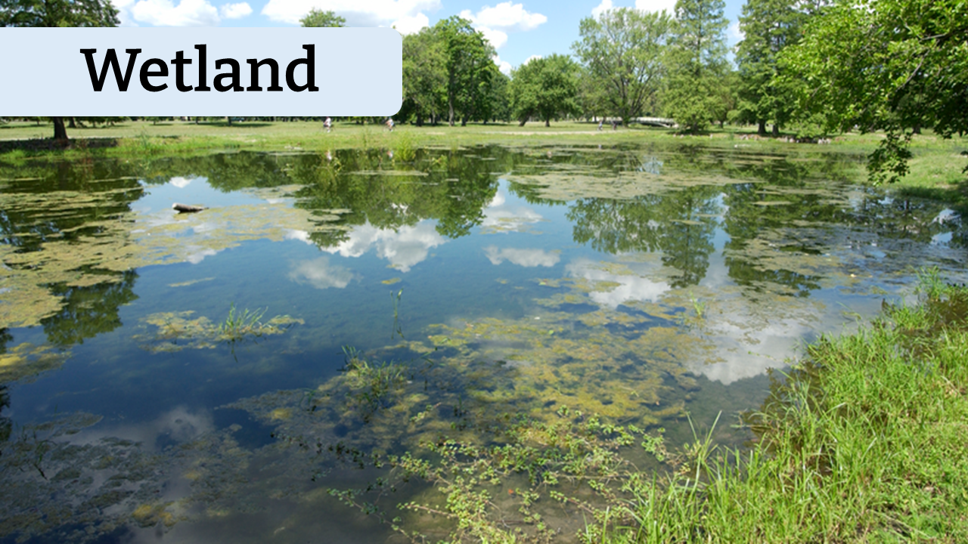
5B
Life and Land in Missouri – 5B Water Here and There: Explain
18

Slide 19
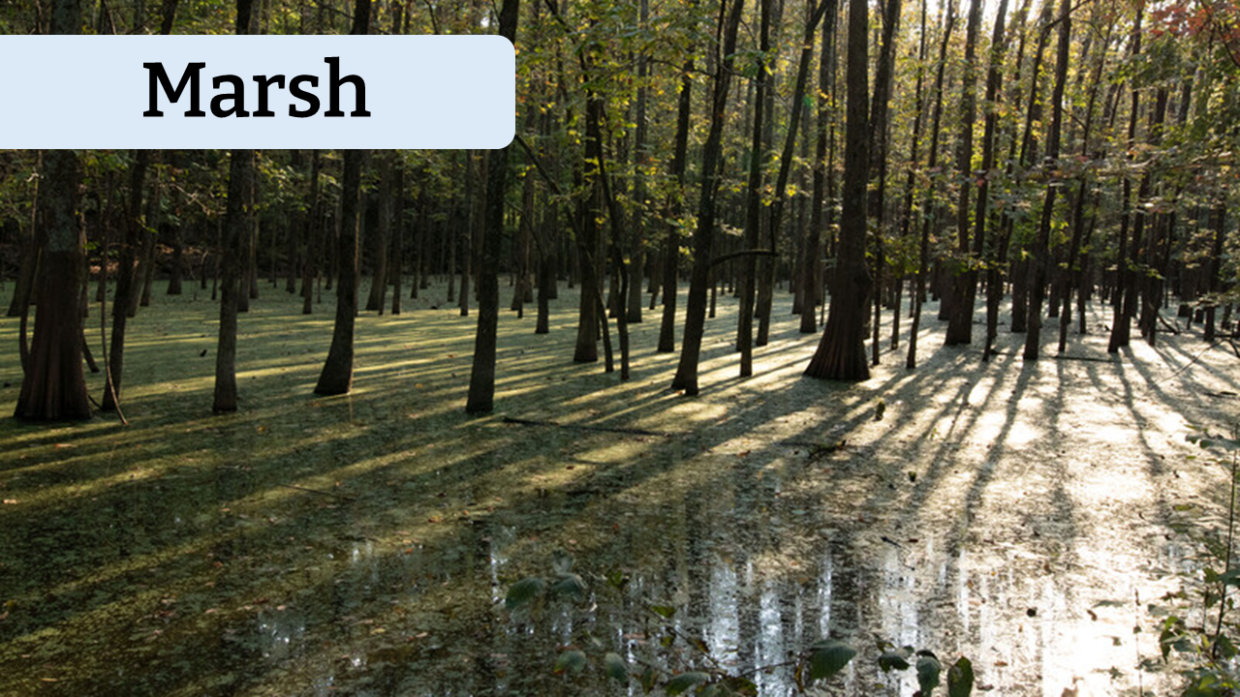
5B
Life and Land in Missouri – 5B Water Here and There: Explain
19

Slide 20
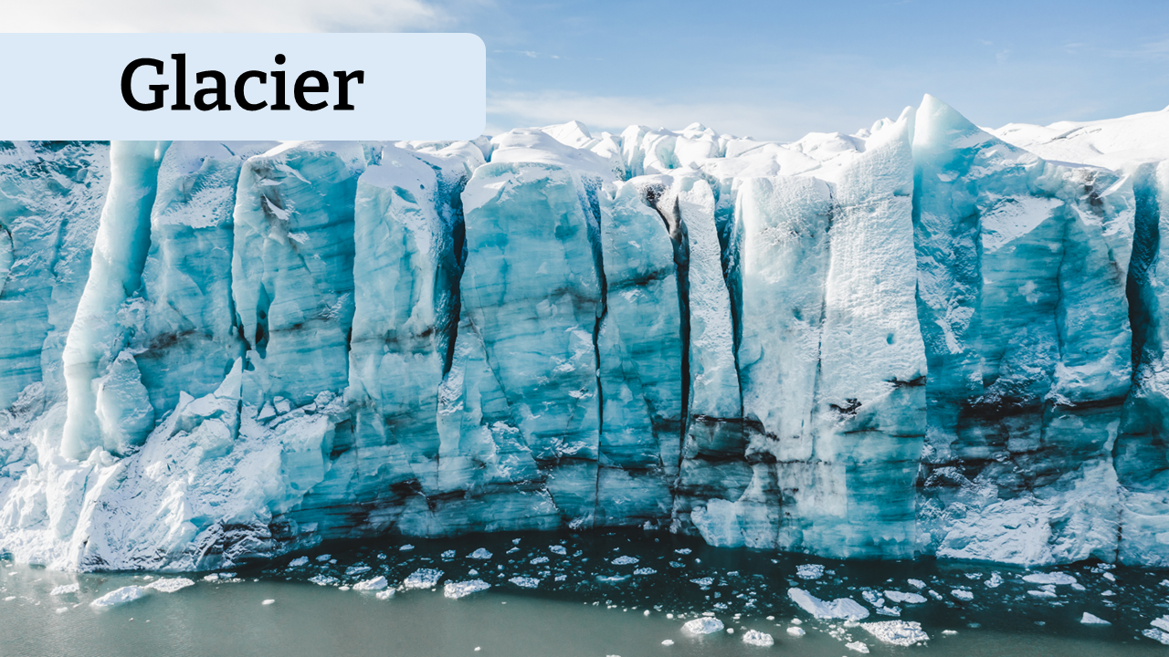
5B
Life and Land in Missouri – 5B Water Here and There: Explain
20

Slide 21
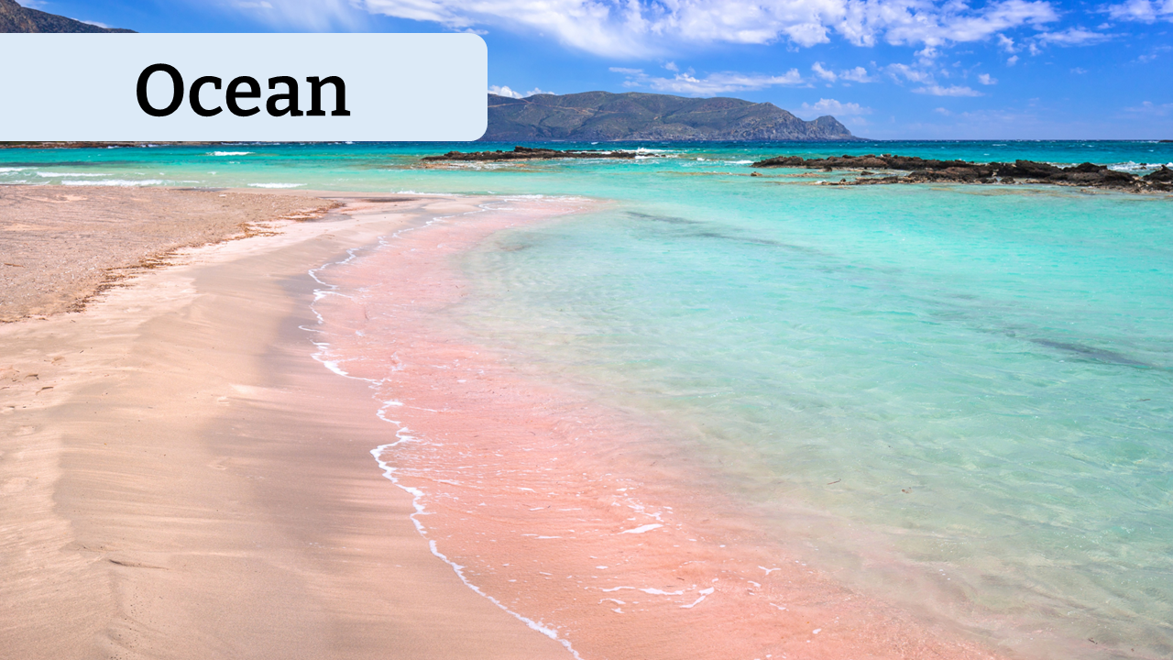
5B
Life and Land in Missouri – 5B Water Here and There: Explain
21

Slide 22
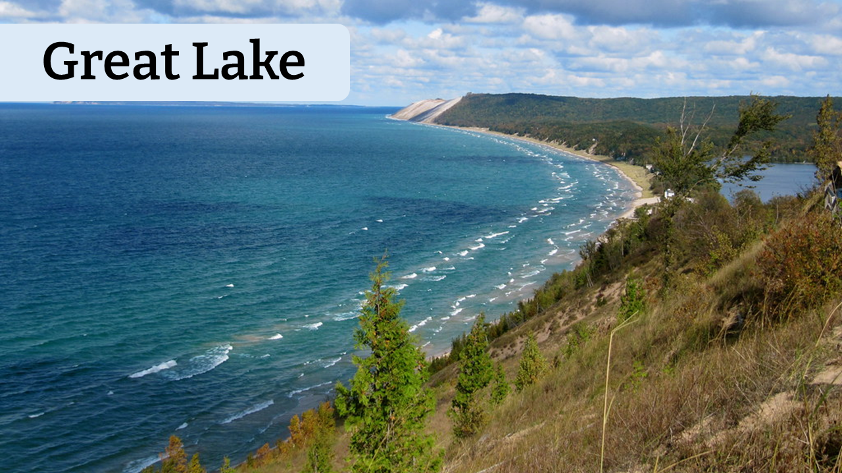
5B
Life and Land in Missouri – 5B Water Here and There: Explain
22

Slide 23
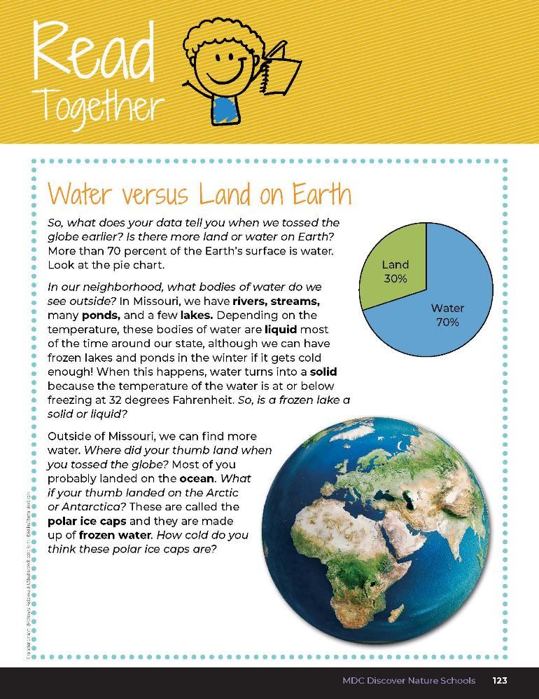

Water versus Land on Earth
So what does your data tell you when we tossed the globe earlier? Is there more land or water on Earth? More than 70 percent of the Earth’s surface is water. Look at the pie chart.
5B
Life and Land in Missouri – 5B Water Here and There: Explain
23
Notes:
Read the Read Together 5A Water vs. Land on Earth section on Page 123.

Slide 24
Water versus Land on Earth
In our neighborhood, what bodies of water do we see outside? In Missouri, we have rivers, streams, many ponds, and a few lakes. Depending on the temperature, these bodies of water are liquid most of the time around out state, although we can have frozen lakes and ponds in the winter if it gets cold enough! When this happens, water turns into a solid because the temperature of the water is at or below freezing at 32 degrees Fahrenheit. So, is a frozen lake a solid or liquid?
5B
Life and Land in Missouri – 5B Water Here and There: Explain
24
Notes:
Read the Read Together 5A Water vs. Land on Earth section on Page 123.

Slide 25
Water versus Land on Earth
Outside of Missouri, we can find more water. Where did your thumb land when you tossed the globe? Most of you probably landed on the ocean. What if your thumb landed on the Artic or Antarctica? These are called the polar ice caps and they are made up of frozen water. How cold do you think these polar ice caps are?
5B
Life and Land in Missouri – 5B Water Here and There: Explain
25
Notes:
Read the Read Together 5A Water vs. Land on Earth section on Page 123.

Slide 26
Is there a pattern in our data that we collected to support the fact that approximately 70 percent of the Earth’s surface is water?
5B
Life and Land in Missouri – 5B Water Here and There: Explain
26
Notes:
More than 70 percent of the Earth’s surface is water.

Slide 27
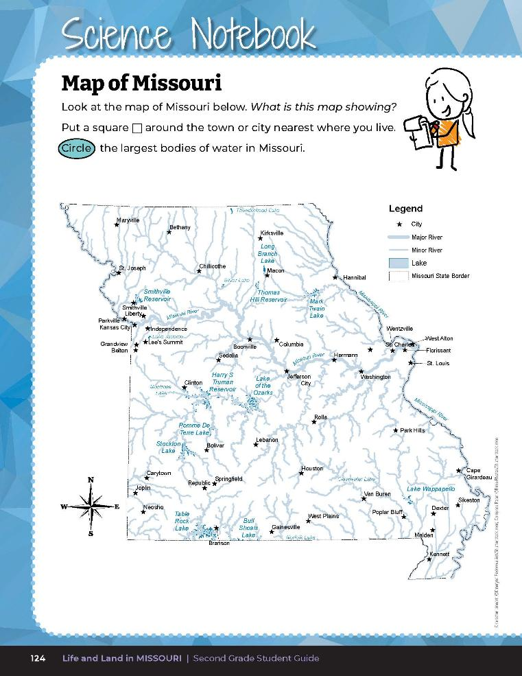
Locate and place a square around the town or city in which you live.
5B
Life and Land in Missouri – 5B Water Here and There: Elaborate
27
Notes:
Have students turn to the Science Notebook 5B Map of Missouri section on Page 124. This map shows the major waterways and cities of Missouri.
Looking at the Map of Missouri, have students locate and place a square around the town or city in which they live.

Slide 28
Circle the largest bodies of water in Missouri and label them as lake, river, stream, ocean, or glacier.
5B
Life and Land in Missouri – 5B Water Here and There: Elaborate
28
Notes:
Have them identify what bodies of water are near them. Then have them circle the largest bodies of water in Missouri and label them as lake, river, stream, ocean, or glacier.

Slide 29
Can these waterways be both liquid and solid?
How and when?
5B
Life and Land in Missouri – 5B Water Here and There: Elaborate
29
Notes:
Make note of the Mississippi and Missouri river systems. Can these waterways be both liquid and solid? How and when? Justify your answer. Remind students of climate and how it can affect what landforms we see in our neighborhood and around the world.

Slide 30
Display the Map of Missouri and the World map.
Link:
https://www.google.com/maps/@38.36789,-92.4759172,7.49z/data=!5m1!1e4
Zoom in to find where you live in Missouri.
5B
Life and Land in Missouri – 5B Water Here and There: Elaborate
30
Notes:
From the MDC Teacher Portal, display the Map of Missouri and the World map. Zoom in to find where you live in Missouri.

Slide 31
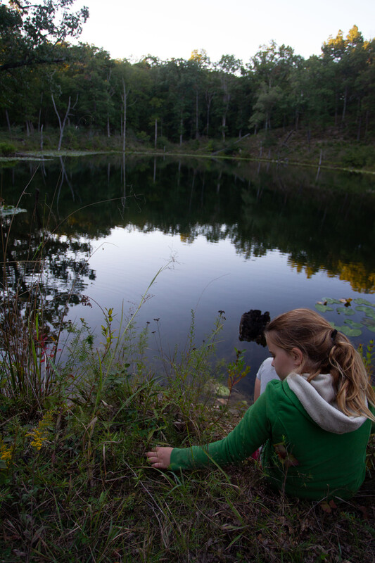
What bodies of water do you see that are close to where you live?
5B
Life and Land in Missouri – 5B Water Here and There: Elaborate
31

Slide 32
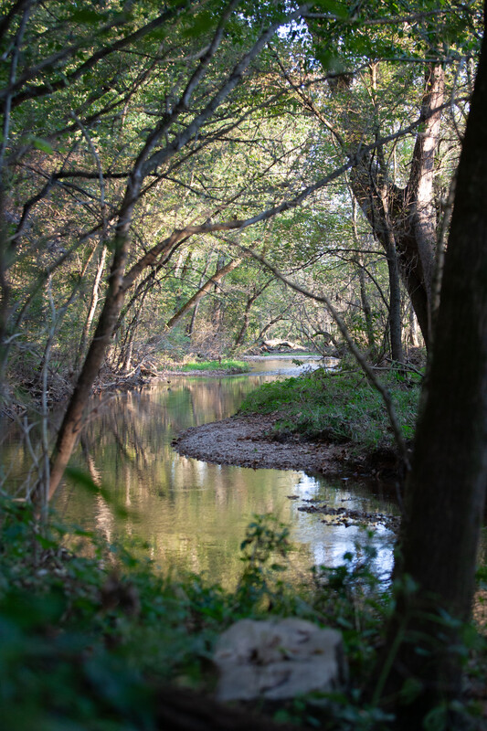
Are there more lakes, streams, glaciers (or polar ice caps) or oceans your area?
5B
Life and Land in Missouri – 5B Water Here and There: Elaborate
32

Slide 33
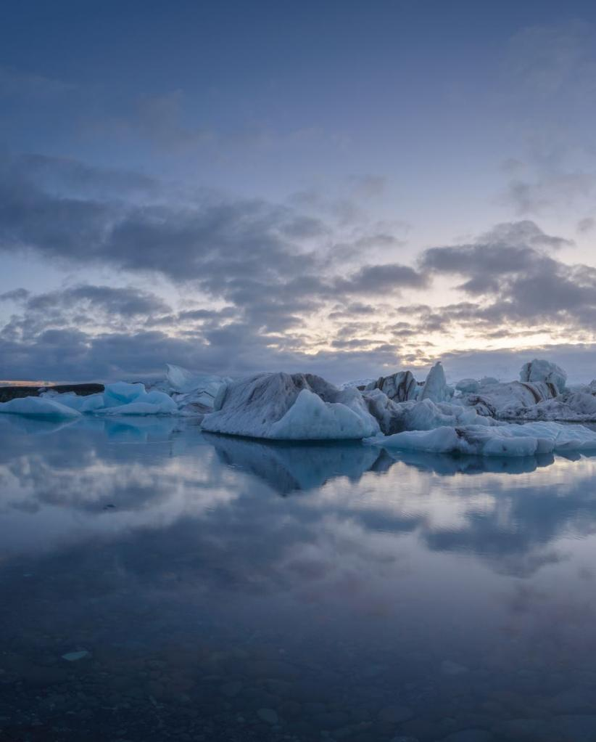
Why do you think we do not have glaciers in our area?
5B
Life and Land in Missouri – 5B Water Here and There: Elaborate
33

Slide 34
In relation to Missouri, where is the nearest polar ice cap?
Nearest ocean?
Where is the farthest?
5B
Life and Land in Missouri – 5B Water Here and There: Elaborate
34
Notes:
Now zoom out on the Map of Missouri and the World link. Allow students to find the ocean and glaciers.

Slide 35
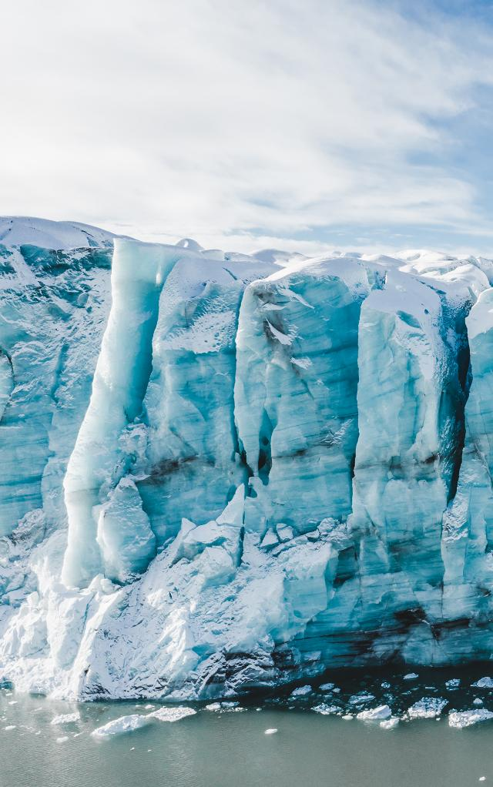
What is the form of water in a glacier?
Why is it solid and not liquid?
5B
Life and Land in Missouri – 5B Water Here and There: Elaborate
35
Notes:
Now zoom out on the Map of Missouri and the World link. Allow students to find the ocean and glaciers.

Slide 36

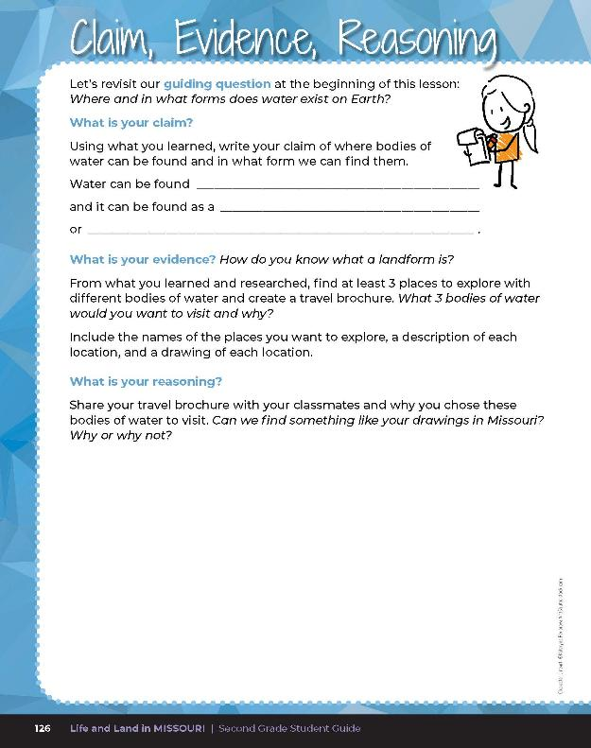
Guiding Question: Where and in what forms does water exist on Earth?
5B
Life and Land in Missouri – 5B Water Here and There: Evaluate
36
Notes:
After exploring the concept of different landforms and bodies of water, have students open their student guides to the 5B Claim, Evidence, Reasoning section on Page 126. Guide students through the page. Students will create a travel brochure of at least 3 places they want to explore with different bodies of water and their reason for wanting to visit. Students should include the name of each place, a description including the body of water of that place, and a drawing. Students will share their travel brochure with their classmates and explain if they can find similar bodies of water in Missouri. Students can attach their brochure to their student notebook on Page 126.

Slide 37

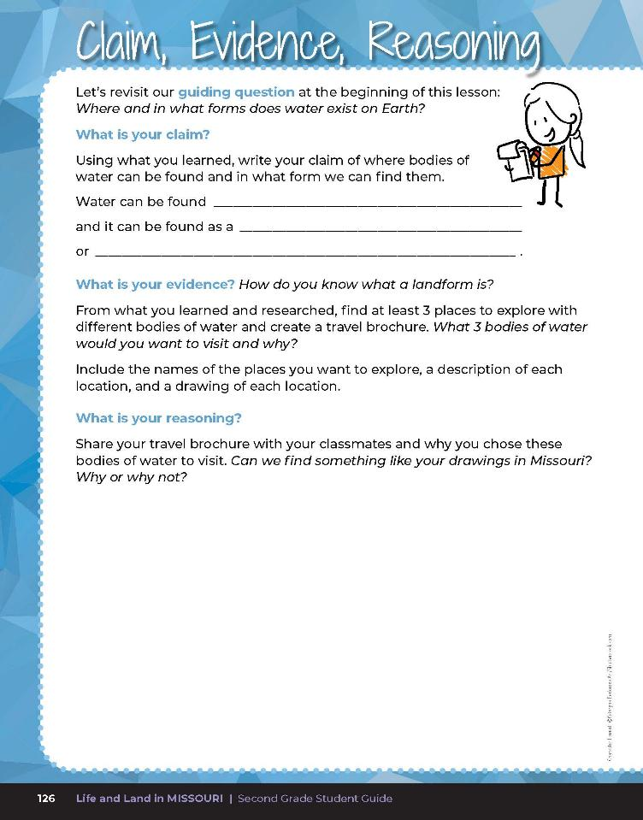
everywhere
liquid
solid
Discuss reasons you chose your bodies of water to visit.
5B
Life and Land in Missouri – 5B Water Here and There: Evaluate
36
Notes:
After exploring the concept of different landforms and bodies of water, have students open their student guides to the 5B Claim, Evidence, Reasoning section on Page 126. Guide students through the page. Students will create a travel brochure of at least 3 places they want to explore with different bodies of water and their reason for wanting to visit. Students should include the name of each place, a description including the body of water of that place, and a drawing. Students will share their travel brochure with their classmates and explain if they can find similar bodies of water in Missouri. Students can attach their brochure to their student notebook on Page 126.

Slide 38
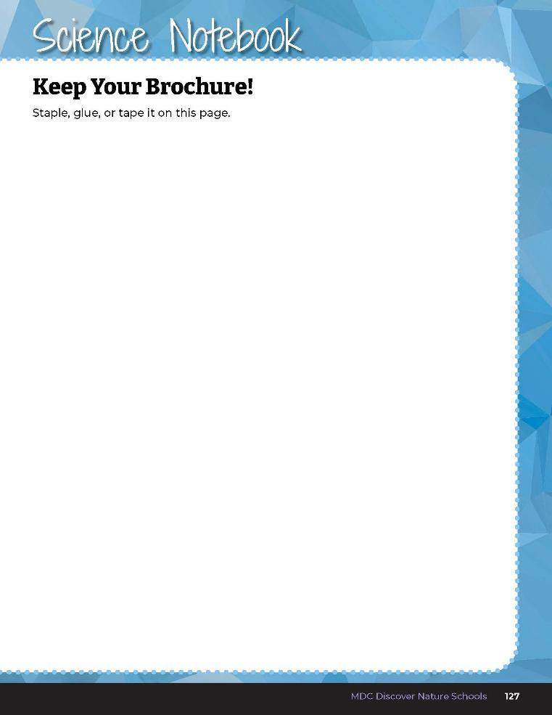
Attach your brochure to your student book.
5B
Life and Land in Missouri – 5B Water Here and There: Evaluate
38
Notes:
Students can attach their brochure to their student notebook on Page 126.
Rubric:
4 (Exceeds) – Student lists and describes 3 bodies of water, including the name of each place, a description of each place, and a drawing of each place. Student accurately explains why some bodies of water are in Missouri and others in another part of the world.
3 (Meets) – Student lists and describes 2 bodies of water, including the name of each place, a description of each place, and a drawing of each place. Student somewhat explains why some bodies of water are in Missouri and others in another part of the world.
2 (Partially meets) – Student lists and describes 1 body of water, including the name, a description, and a drawing. Student inaccurately explains why some bodies of water are in Missouri and others in another part of the world.
1 (Doesn’t meet) – Student does not list or describe any body of water. Student does not explain why bodies of water are in Missouri or in another part of the world.

