Slide 1
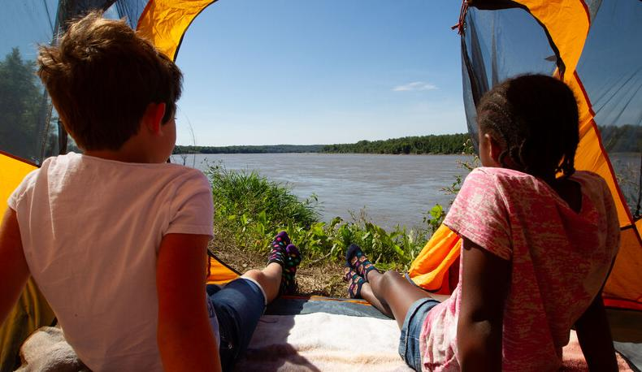

Life and Land in
MISSOURI
5A: Shapes of Land and Water

Slide 2
View the Nature’s Calling: Natural Areas video.
Link:
https://youtu.be/Ypj9QKE7ZtA
5A
Life and Land in Missouri – 5A Shapes of Land and Water: Engage
2
Notes:
From the MDC Teacher Portal, play the Nature’s Calling: Natural Areas video.

Slide 3
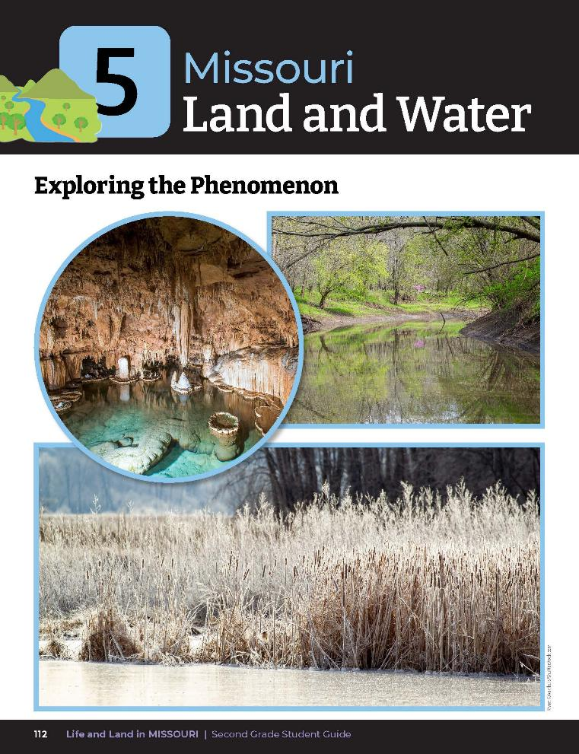
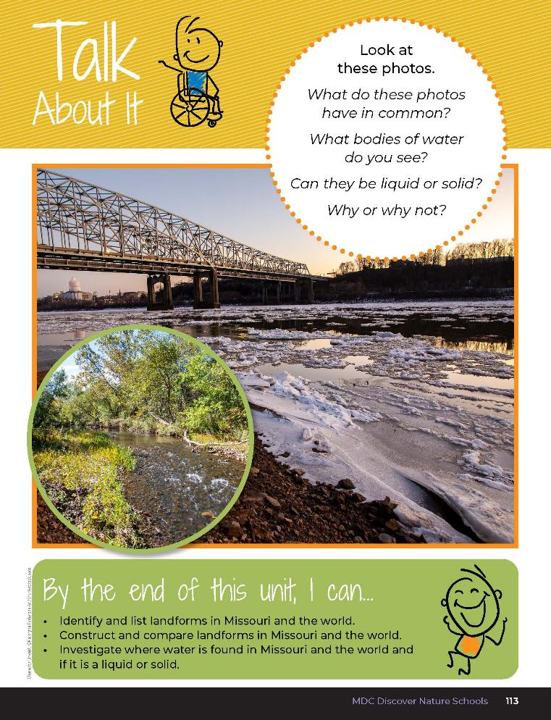
5A
Life and Land in Missouri – 5A Shapes of Land and Water: Engage
3
Notes:
Have students open their student guide to the Unit 5 Exploring the Phenomenon section on pages 112-113. Discuss the Talk About It.
What do these photos have in common?
What bodies of water can you see?
Can they be liquid or solid? Why or why not?

Slide 4
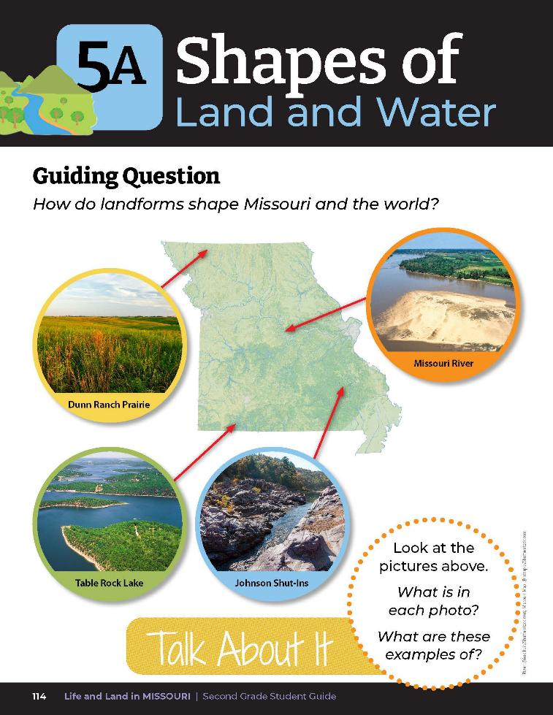
What is in each photo?
What are these examples of?
5A
Life and Land in Missouri – 5A Shapes of Land and Water: Engage
4
Notes:
Have students turn to their Lesson 5A Shapes of Land and Water introduction on Page 114. Read the guiding question together.
Guiding Question: How do landforms shape Missouri and the world?
Discuss the Talk About It. Write student ideas on the board.

Slide 5
What does the green in the map tell you?
What about the blue lines?
5A
Life and Land in Missouri – 5A Shapes of Land and Water: Engage
5

Slide 6
Go outside
5A
Life and Land in Missouri – 5A Shapes of Land and Water: Engage
6
Notes:
Take students outside to the schoolyard for a nature walk. As we walk around our schoolyard, what do you see in terms of shape of the land and how does it compare to what we saw in the video? What do we not see in our area? Think about when you ride home or if you go on a little trip somewhere. Does the shape of the land change? Do you see rivers and streams here or somewhere else?

Slide 7
Talk to a partner about what you see where a relative may live that is different from where you live.
5A
Life and Land in Missouri – 5A Shapes of Land and Water: Engage
7

Slide 8


Draw the shape of the land of the schoolyard and another area.
5A
Life and Land in Missouri – 5A Shapes of Land and Water: Engage
8
Notes:
Have students draw the shape of the land of the schoolyard and another area in their student guide Draw It! Lesson 5A What Do I See? Section on Page 115.
Allow students time to share their observations and what they have seen, either in small groups or as a whole class.

Slide 9
Landform Gallery Walk
Each student will receive 2 index cards and a pencil, colored pencils, or crayons.
5A
Life and Land in Missouri – 5A Shapes of Land and Water: Explore
9
Notes:
Landform Gallery Walk Activity
This portion can be done in the classroom or an outdoor area with picnic tables or benches.
1. Give each student 2 index cards and a pencil, colored pencils, or crayons.

Slide 10
Missouri Landforms
Choose an area of land or body of water you saw outside and draw a colored picture of that area or body of water on the first index card.
5A
Life and Land in Missouri – 5A Shapes of Land and Water: Explore
10
Notes:
2. (Missouri Landforms) Ask each student to choose an area of land or body of water they saw during their walk outside and draw a colored picture of that area or body of water on the first index card. Tell them to only draw a picture, not any words.

Slide 11
World Landforms
On the second index card, draw either a picture of either a body of water or a type of landform they have seen near their house or even on a trip when they have gone somewhere far away.
5A
Life and Land in Missouri – 5A Shapes of Land and Water: Explore
11
Notes:
3. (World Landforms) Next, on the second index card, ask them to draw a picture of either a body of water or a type of landform they have seen near their house or even on a trip when they have gone somewhere far away.

Slide 12
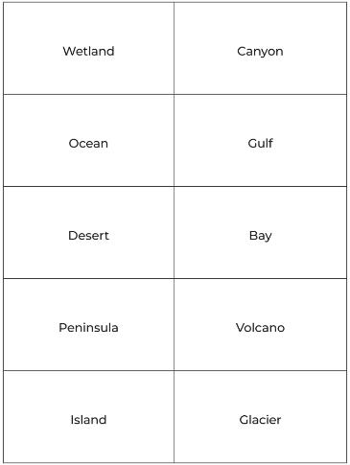
Walk to the sign that identifies the picture you drew.
5A
Life and Land in Missouri – 5A Shapes of Land and Water: Explore
12
Notes:
4. Either on the classroom wall or in the outdoor area, hang posters or signs listing the various types of landforms and bodies of water. Do not draw the landform. Use 5A Landform Signs Cutouts handout on pages 146-147 as your guide for creating the posters or signs.
5. When all the students have their cards completed, instruct the students to walk to the sign that identifies the picture they drew. For example, a student who drew a picture of a hill would go stand by the sign labeled “hill.” A student who drew a picture of a river would go the sign labeled “river.” Teacher Note: There may or may not be students at every sign.

Slide 13
Why did you choose to draw this land shape?
How do you know that it is the correct shape?
5A
Life and Land in Missouri – 5A Shapes of Land and Water: Explore
13
Notes:
6. Tell students they can show their picture card and discuss what they drew with the other students in their group. Ask the students the following questions:

Slide 14
Display the Show-Me Natural Communities booklet.
Link:
Show Me Natural Communities
5A
Life and Land in Missouri – 5A Shapes of Land and Water: Explain
14
Notes:
Display the Show-me Natural Communities booklet on the MDC Teacher Portal or look at the booklet with your class. As you flip through the book, have students shout out what types of landforms they see.

Slide 15
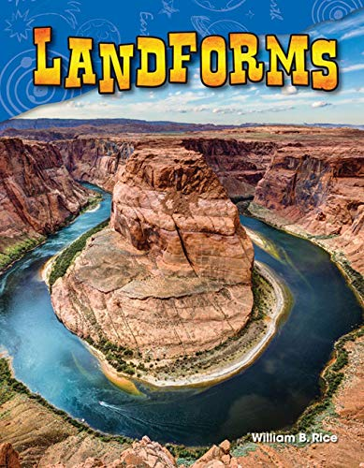
Read the book Landforms by William B. Rice.
Epic Link:
https://www.getepic.com/book/47200837/landforms
5A
Life and Land in Missouri – 5A Shapes of Land and Water: Explain
15
Notes:
Next, read the book Landforms by William B. Rice.

Slide 16
What types of landforms do you notice in this book versus in the other book?
Are they the same? Are they different?
5A
Life and Land in Missouri – 5A Shapes of Land and Water: Explain
16

Slide 17
Revisit signs and index card drawings and classify the landforms and bodies of water based on characteristics learned!
5A
Life and Land in Missouri – 5A Shapes of Land and Water: Explain
17
Notes:
Students will revisit their signs and index card drawings and classify the landforms and bodies of water based on characteristics learned.

Slide 18

Raise your hand when the description of the landform or body of water on the sign you are standing under is read.
5A
Life and Land in Missouri – 5A Shapes of Land and Water: Explain
18
Notes:
The teacher will read the descriptions of all the landforms and bodies of water which are listed below as Landforms in Missouri and Landforms in the World. Ask students to raise their hand when the description of the landform or body of water on the sign they are standing under is read.

Slide 19
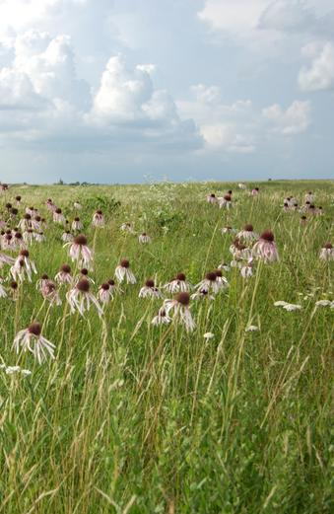
Plains – large area of flat land with few trees
5A
Life and Land in Missouri – 5A Shapes of Land and Water: Explain
19

Slide 20
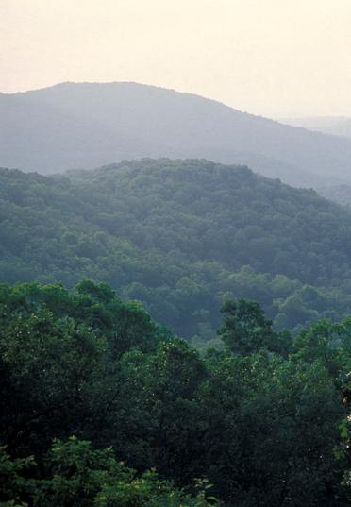
Mountain – landform that rises high above its surroundings
5A
Life and Land in Missouri – 5A Shapes of Land and Water: Explain
20

Slide 21
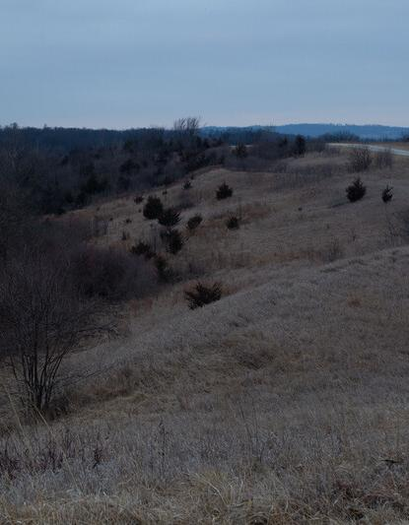
Hill – raised land smaller than a mountain
5A
Life and Land in Missouri – 5A Shapes of Land and Water: Explain
21

Slide 22
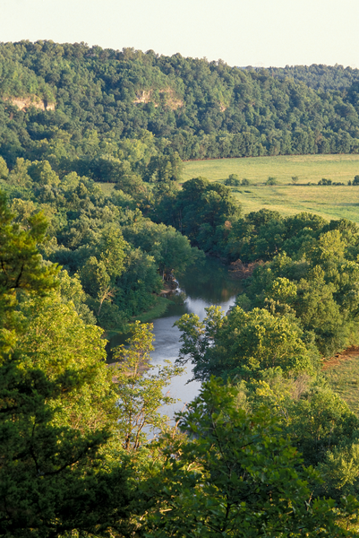
Valley – area of low land between two mountains or hills
5A
Life and Land in Missouri – 5A Shapes of Land and Water: Explain
22

Slide 23
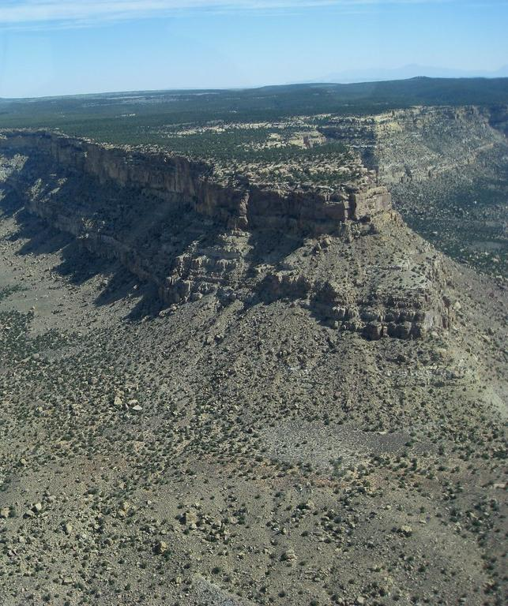
Plateau – large area of mostly flat land that is raised higher than land around it
5A
Life and Land in Missouri – 5A Shapes of Land and Water: Explain
23

Slide 24
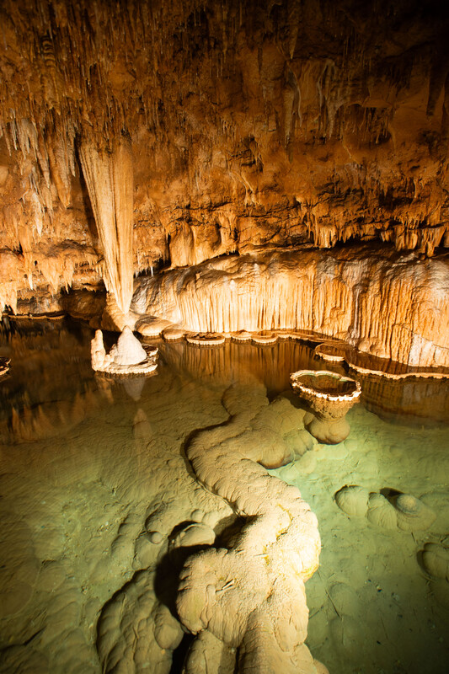
Cave – hollow place under the ground
5A
Life and Land in Missouri – 5A Shapes of Land and Water: Explain
24

Slide 25
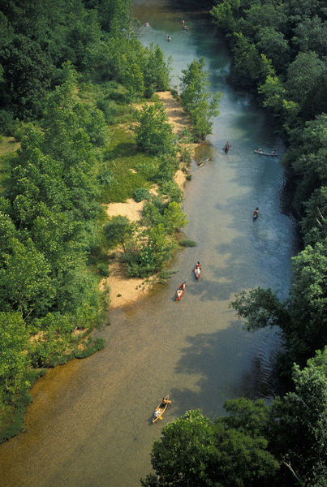
River – a ribbon-like body of freshwater that flows downhill
5A
Life and Land in Missouri – 5A Shapes of Land and Water: Explain
25

Slide 26
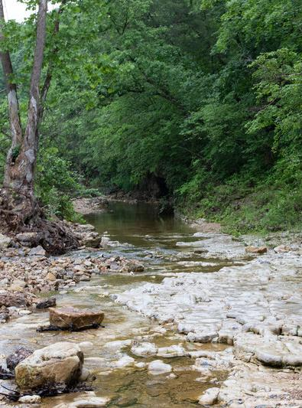
Stream – a flowing body of freshwater smaller than a river
5A
Life and Land in Missouri – 5A Shapes of Land and Water: Explain
26

Slide 27
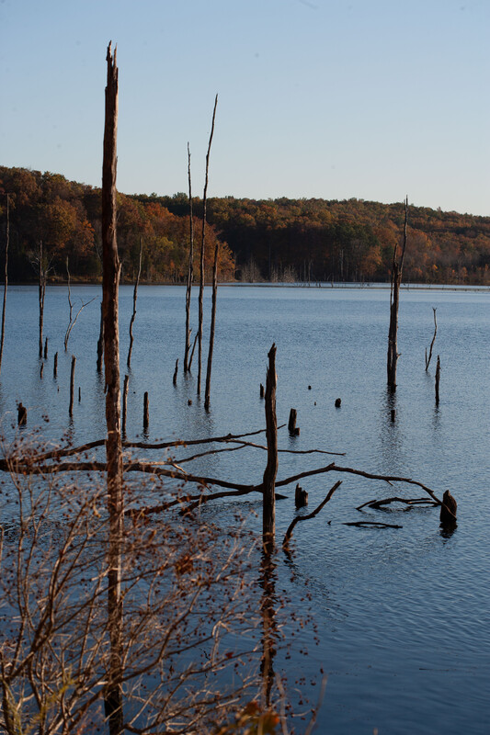
Lake – large body of water surrounded by land and not part of an ocean
5A
Life and Land in Missouri – 5A Shapes of Land and Water: Explain
27

Slide 28
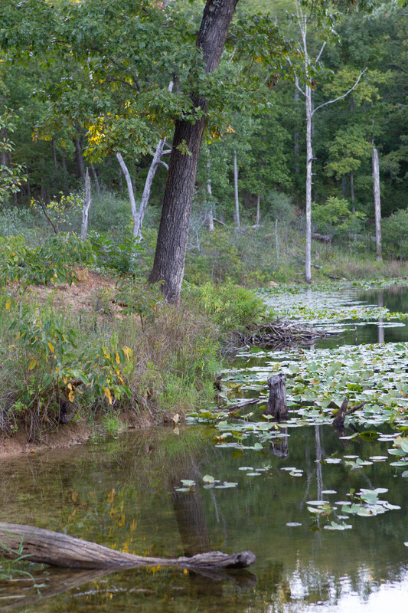
Pond – small body of water surrounded by land
5A
Life and Land in Missouri – 5A Shapes of Land and Water: Explain
28

Slide 29
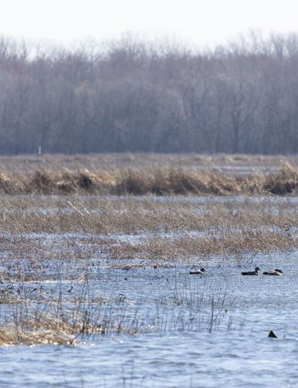
Wetlands – area of land covered by shallow water or that has soils that are saturated with water either sometimes or all the time
5A
Life and Land in Missouri – 5A Shapes of Land and Water: Explain
29

Slide 30
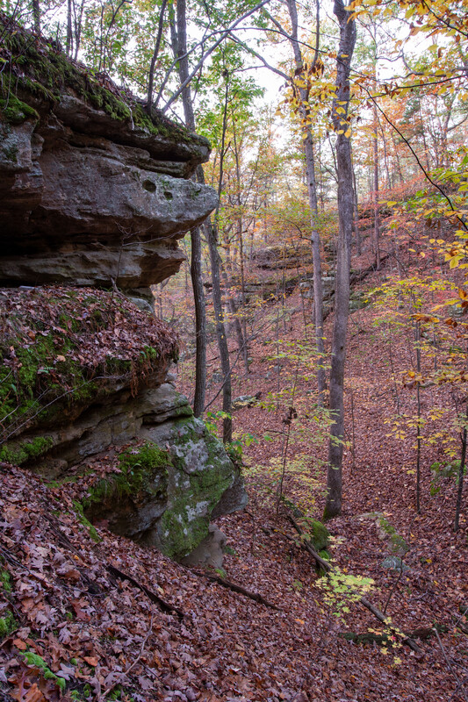
Canyon – a deep valley with steep sides usually formed by a river
5A
Life and Land in Missouri – 5A Shapes of Land and Water: Explain
30

Slide 31

Ocean – huge body of salt water covering most of the Earth
5A
Life and Land in Missouri – 5A Shapes of Land and Water: Explain
31

Slide 32
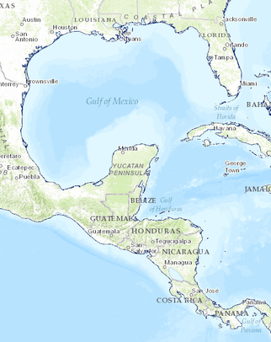
Gulf – body of ocean surrounded by land on three sides
5A
Life and Land in Missouri – 5A Shapes of Land and Water: Explain
32

Slide 33
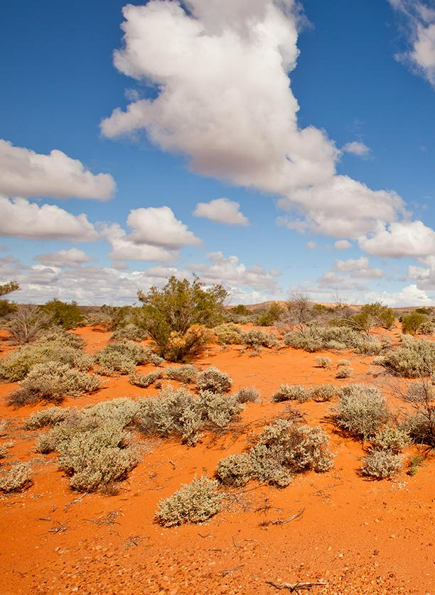
Desert – very dry place that gets little rain
5A
Life and Land in Missouri – 5A Shapes of Land and Water: Explain
33

Slide 34

Bay – a small part of ocean surrounded on many sides by land
5A
Life and Land in Missouri – 5A Shapes of Land and Water: Explain
34

Slide 35
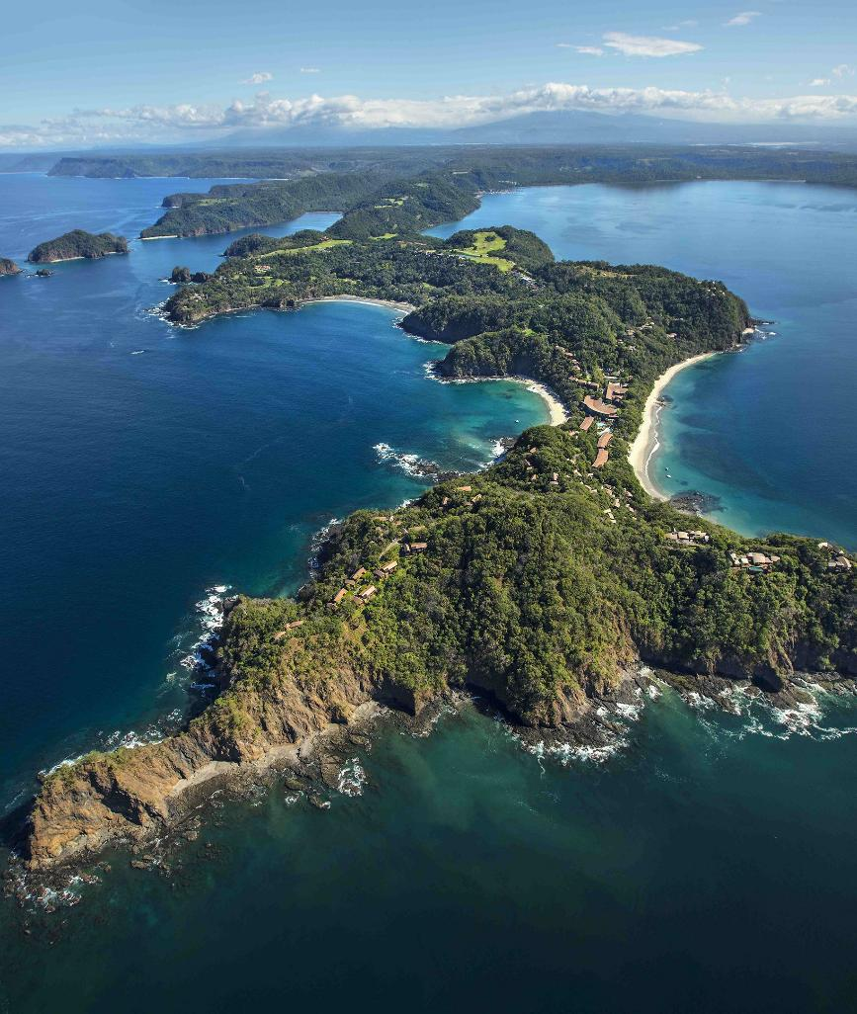
Peninsula – piece of land surrounded by water on three sides
5A
Life and Land in Missouri – 5A Shapes of Land and Water: Explain
35

Slide 36
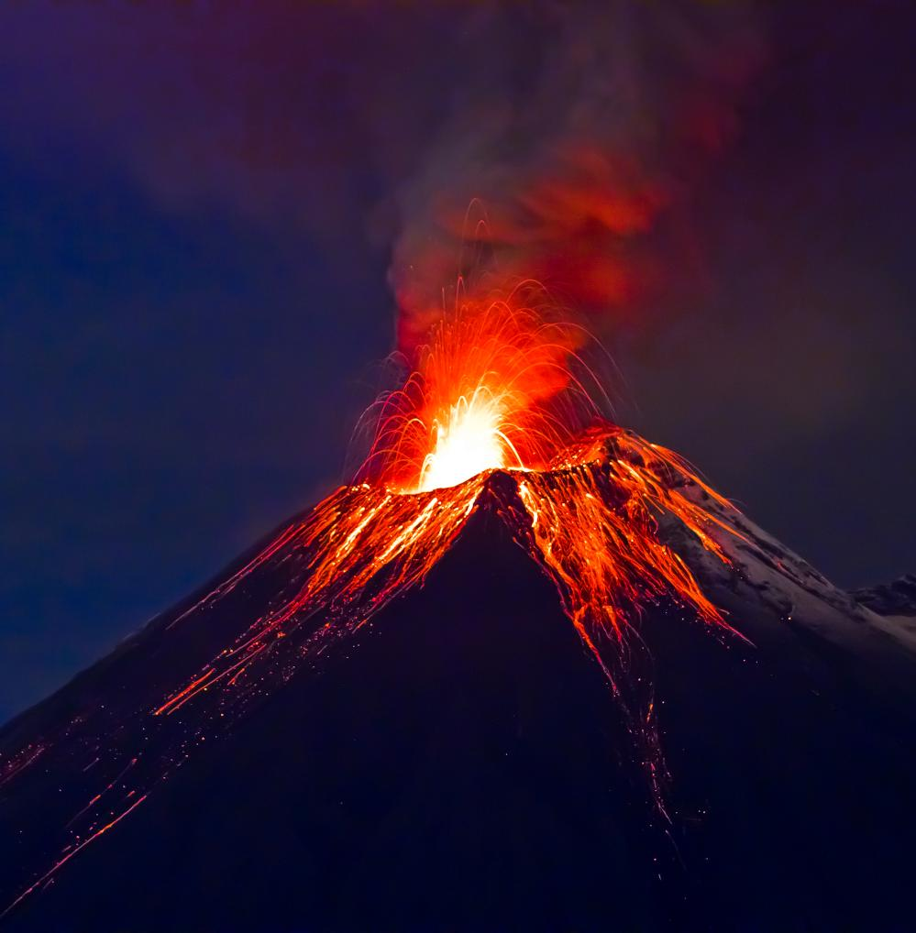
Volcano – opening in the Earth’s crust where lava or ash escape
5A
Life and Land in Missouri – 5A Shapes of Land and Water: Explain
36

Slide 37
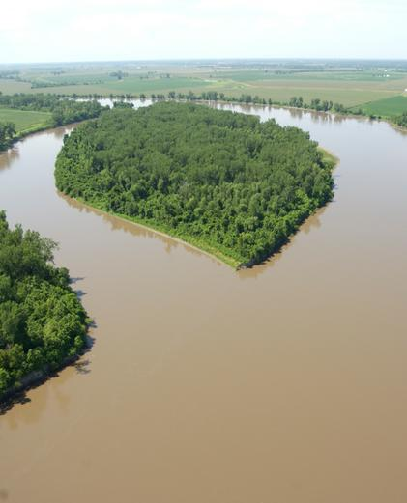
Island – land completely surrounded by water
5A
Life and Land in Missouri – 5A Shapes of Land and Water: Explain
37

Slide 38

Glacier – large area of thick ice that remains frozen from year to year
5A
Life and Land in Missouri – 5A Shapes of Land and Water: Explain
38

Slide 39
Explain:
What you drew
Where you saw this landform or body of water
Why you stood under the sign you chose
5A
Life and Land in Missouri – 5A Shapes of Land and Water: Explain
39
Notes:
After students in a group raise their hand to identify the type of landform or body of water they are, have the students individually show their pictures and explain the following:
What they drew.
Where they saw this landform or body of water.
Why they stood under the sign they chose.
If a student is in the wrong group, as a class, discuss where that student should go and have them relocate to the appropriate poster or sign. If there are no students standing under a sign when you read the description, then ask a student to tell you which sign matches that description.

Slide 40
Optional Activity: I Have, Who Has? Landforms Game
5A
Life and Land in Missouri – 5A Shapes of Land and Water: Explain
40
Notes:
Optional Activity: I Have, Who Has? Landforms Game Game cards are in the Teacher Guide pages 146-149 and in the Teacher Portal SecondTeacherV5.pdf
Directions for gameplay are below. I Have, Who Has? Landforms Game Cards follow this lesson.
Each student gets a card. If there are not enough cards for each student, put students in pairs.
The teacher begins by asking a question from a card, then the student who has the correct answer gets the next turn.
Play until every student has read a card. If same student continually answers correctly, optional play is to call on students who have not yet gotten a card.
If more explanation time is desired, collect and shuffle cards and play again.

Slide 41
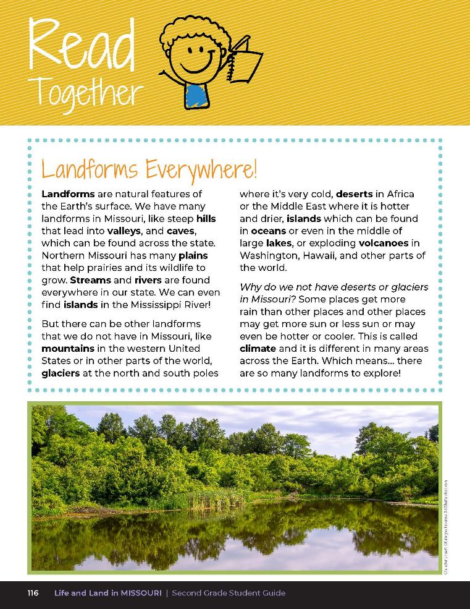

Landforms Everywhere!
Landforms are natural features of the Earth’s surface. We have many landforms in Missouri, like steep hills that lead into valleys, and caves, which can be found across the state. Northern Missouri has many plains that help prairies and its wildlife to grow. Streams and rivers are found everywhere in our state.
5A
Life and Land in Missouri – 5A Shapes of Land and Water: Elaborate
42
Notes:
Have students read the Read Together 5A Landforms Everywhere! section on Page 116, and then view the map on Page 117.

Slide 42
Landforms Everywhere!
We can even find islands in the Mississippi River!
But there can be other landforms that we do not have in Missouri, like
mountains in the western United States or in other parts of the world,
glaciers at the north and south poles where it’s very cold, deserts in Africa
5A
Life and Land in Missouri – 5A Shapes of Land and Water: Elaborate
42
Notes:
Have students read the Read Together 5A Landforms Everywhere! section on Page 116, and then view the map on Page 117.

Slide 43
Landforms Everywhere!
or the Middle East where it is hotter and drier, islands which can be found in oceans or even in the middle of large lakes, or exploding volcanoes in Washinton, Hawaii, and other parts of the world.
5A
Life and Land in Missouri – 5A Shapes of Land and Water: Elaborate
43
Notes:
Have students read the Read Together 5A Landforms Everywhere! section on Page 116, and then view the map on Page 117.

Slide 44
Landforms Everywhere!
Why do we not have deserts or glaciers in Missouri? Some places get more rain than other places and other places may get more sun or less sun or may even be hotter or cooler. This is called climate and it is different in many areas across the Earth. Which means…there are so many landforms to explore!
5A
Life and Land in Missouri – 5A Shapes of Land and Water: Elaborate
44
Notes:
Have students read the Read Together 5A Landforms Everywhere! section on Page 116, and then view the map on Page 117.

Slide 45
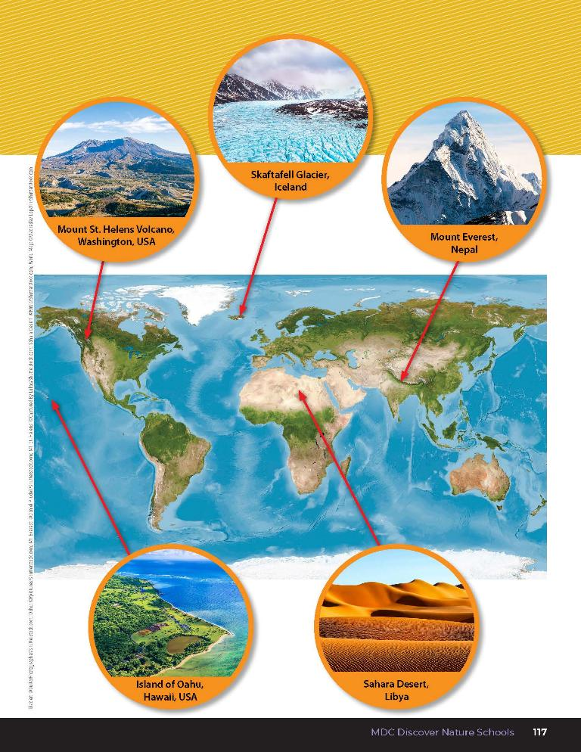
What patterns do you see in this map?
What can you infer about the different colors?
5A
Life and Land in Missouri – 5A Shapes of Land and Water: Elaborate
45
Notes:
View the map on Page 117. Tell students that they will be creating their own landforms.

Slide 46
Make a model out of clay or sand to represent at least 3 different landforms.
Share with a partner after each landform you make.
5A
Life and Land in Missouri – 5A Shapes of Land and Water: Elaborate
46
Notes:
Landform and Body of Water Model Creations:
Below you will find two ways in which students can build models of various landforms and water bodies. One option is using clay and the other option is using sand.
Instruct students to make a model out of clay or sand to represent at least 3 different landforms. If using sand, distribute spray bottles to wet and form the sand. Give each child a paper plate to make their first model on. After they have created their first model, have students share with a partner. After sharing, have students create the next model. Repeat until students have each created at least three models.

Slide 47
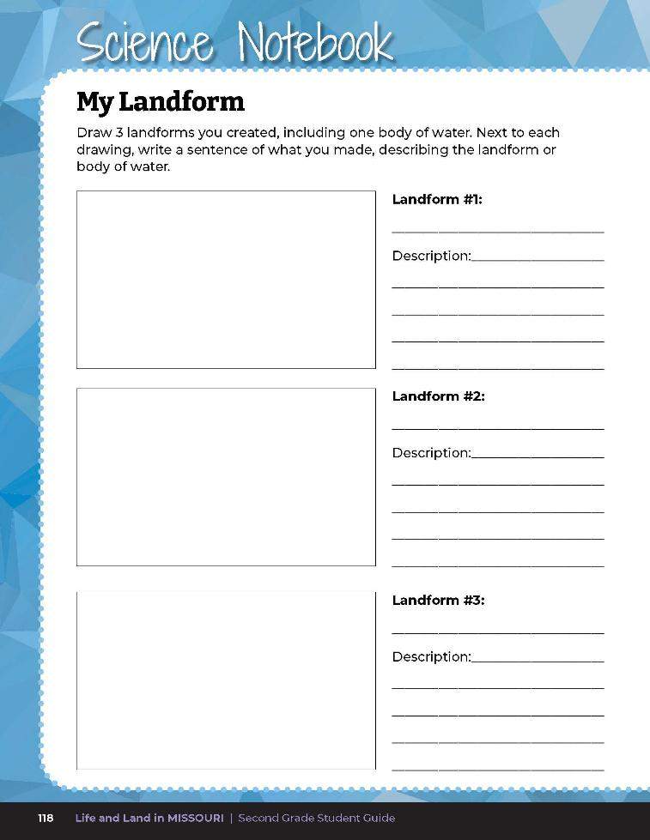
Write a paragraph explaining the landforms you created and draw the models.
5A
Life and Land in Missouri – 5A Shapes of Land and Water: Elaborate
47
Notes:
After creating Landform and Water Body Models, have students complete the student guide Science Notebook 5A My Landform section on Page 118.
Students write a paragraph using complete sentences explaining the landforms they created and draw the models in the provided space on the Science Notebook page. Students should keep their final model in front of them for the Formative Assessment.

Slide 48
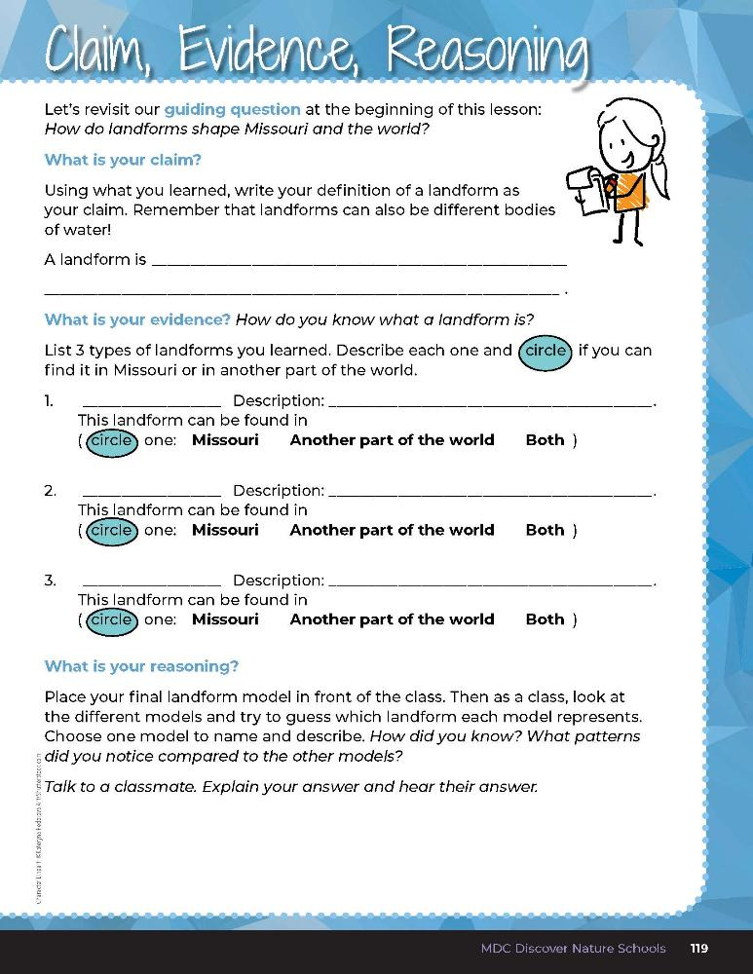

Guiding Question:
How do landforms shape Missouri and the world?
5A
Life and Land in Missouri – 5A Shapes of Land and Water: Evaluate
48
Notes:
After exploring the concept of different landforms and bodies of water, have students open their student guides to the 5A Claim, Evidence, Reasoning section on Page 119. Guide students through the page by reviewing each section as a class and revisiting the scientific concepts learned to help answer each section.

Slide 49
A natural feature of the Earth's surface
Guiding Question:
How do landforms shape Missouri and the world?
5A
Life and Land in Missouri – 5A Shapes of Land and Water: Evaluate
48
Notes:
Rubric:
4 (Exceeds) – My Landform page has at least 3 landforms with complete sentences. Student lists and describes 3 other landforms and correctly circles the location of the landform. Student accurately names and describes a final landform to the class.
3 (Meets) – My Landform page has at least 2 landforms with complete sentences. Student lists and describes 2 other landforms and may or may not correctly circle the location of each landform. Student somewhat names and describes a final landform to the class.
2 (Partially meets) – My Landform page has at least 1 landform with a complete sentence. Student lists and describes 1 other landform and may or may not correctly circle the location of the landform. Student struggles to accurately name and describe a final landform to the class.
1 (Doesn’t meet) – Student does not create any models or describe other landforms. Student does not name or describe a final landform to the class.

