Slide 1
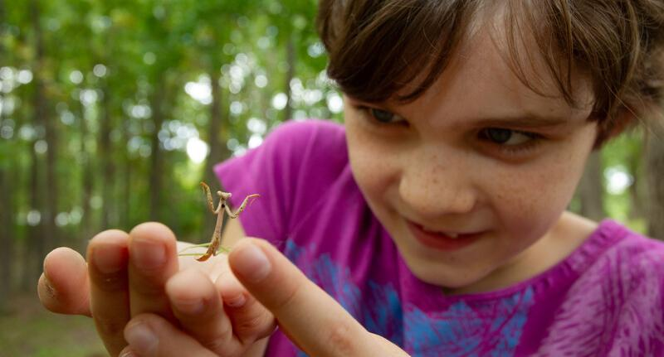

Exploring
MISSOURI
5A: Cloud Watching

Slide 2
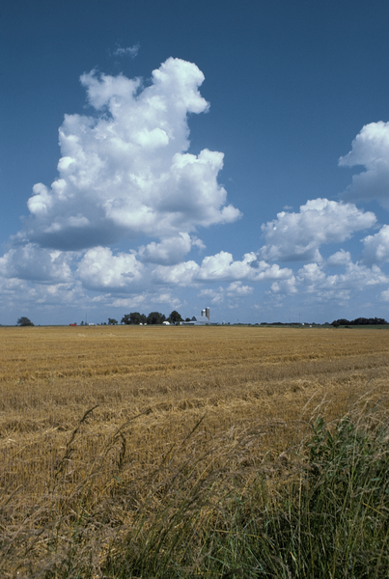
Guiding Question:
What are clouds made of and what do they tell us?
5A
Exploring Missouri – 5A Cloud Watching: Engage
2

Slide 3
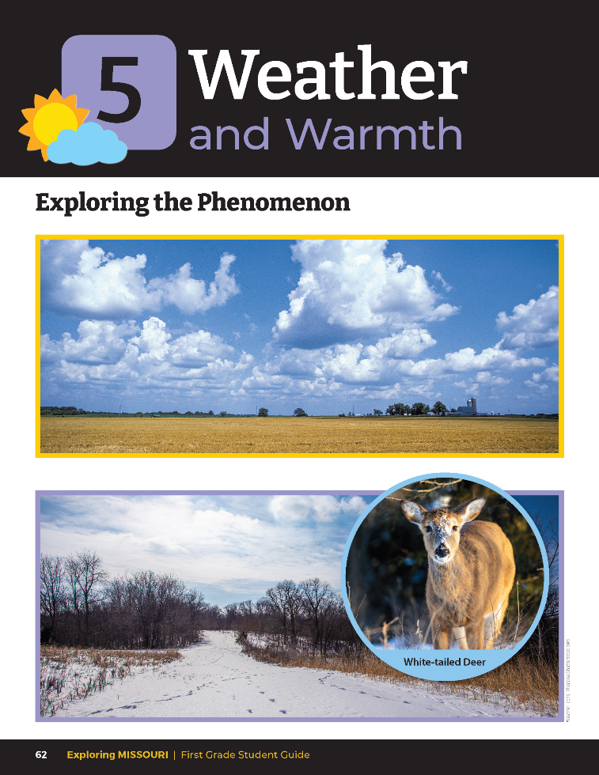
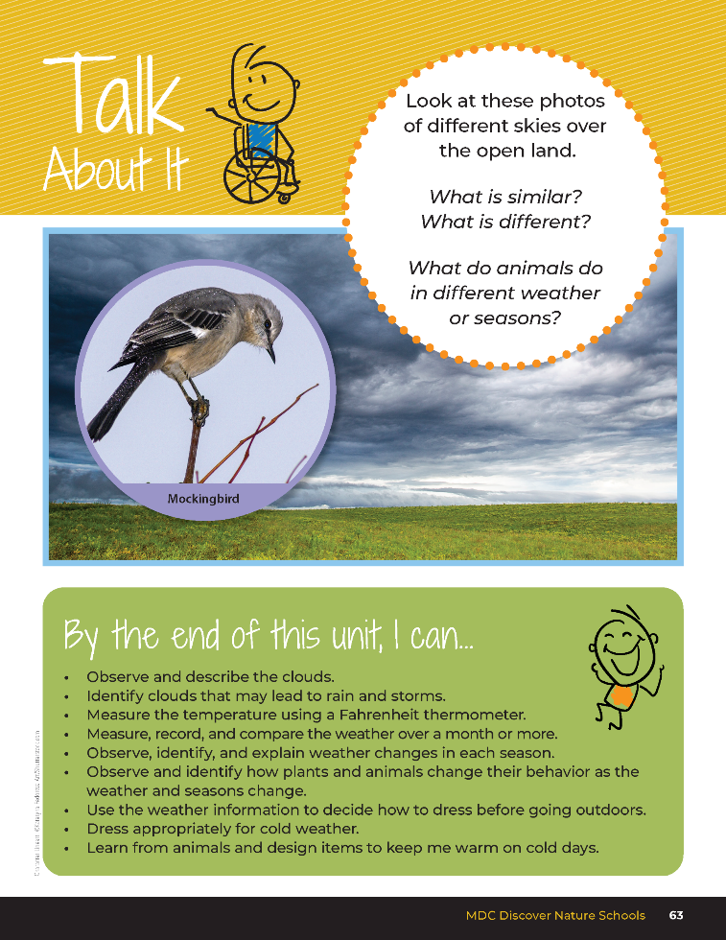
5A
Exploring Missouri – 5A Cloud Watching: Engage
3
Notes:
Read together the student guide Unit 5 Exploring the Phenomenon section on pages 62-63 and discuss the Talk About It portion.

Slide 4
What is the same in those skies?
What is different?
5A
Exploring Missouri – 5A Cloud Watching: Engage
4

Slide 5
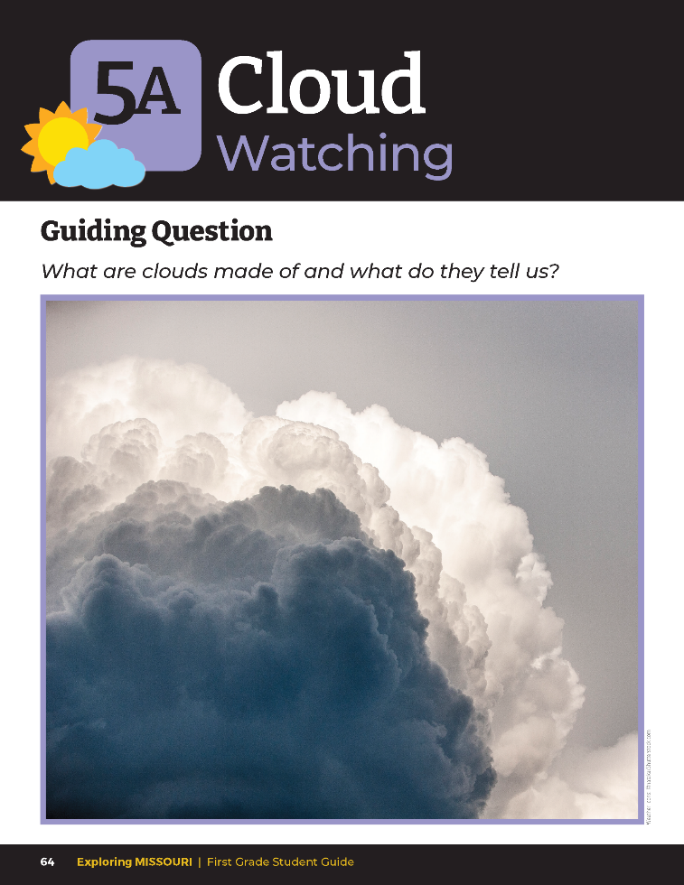
What do you think clouds are made of?
5A
Exploring Missouri – 5A Cloud Watching: Engage
5
Notes:
Look at the different photos of clouds on the Lesson 5A Cloud Watching introduction section on Page 64. What do you think clouds are made of? This is what we are going to explore today.

Slide 6


What Am I?
Look up in the sky.
Tell me what you see.
I float high up above you,
floating higher than a tree.
There are many shapes of me to see.
I help predict the weather.
I might look bigger than a school bus, but am lighter than a feather.
5A
Exploring Missouri – 5A Cloud Watching: Engage
6
Notes:
Next, as a class, read aloud the Read Together 5A What Am I? section on Page 65.

Slide 7
Display the Cloud Watching video.
Link:
https://www.youtube.com/watch?v=sguft6VusqY&t=14s
5A
Exploring Missouri – 5A Cloud Watching: Engage
7
Notes:
Teacher Note: If you do not have a day with cumulus clouds, display the Cloud Watching video from the MDC Teacher Portal.

Slide 8
Go outside:
Look for various shapes in the clouds!
5A
Exploring Missouri – 5A Cloud Watching: Engage
8
Notes:
Take students outside on a day with many puffy white clouds (cumulus) and have students look for various shapes in the clouds. Partner students and encourage them to notice the size and movement in the clouds by asking the following questions:

Slide 9
Describe to your partner the size of the clouds.
What shapes do you see?
How are they moving? In what direction? Point in the direction they are moving.
5A
Exploring Missouri – 5A Cloud Watching: Engage
9
Notes:
Partner students and encourage them to notice the size and movement in the clouds by asking the following questions:
Describe to your partner the size of the clouds.
What shapes do you see?
How are they moving? In what direction? Point in the direction they are moving.

Slide 10
Do you notice a pattern in our observations?
5A
Exploring Missouri – 5A Cloud Watching: Explore
10
Notes:
Scientists use observations to learn about the world. As scientists, we will study the clouds and we will use our student notebook page and make accurate drawings of the clouds.
Take students outside with their student guides and pencil.
Look closely at the sky, notice the shapes, light, and colors. Have students share their observations with a classmate and compare what they each notice. Do you notice a pattern in our observations? Hold your thumb and forefinger of each hand up in the sky and make a photo-like frame with your thumb and fingers. (Teacher models for students.)

Slide 11
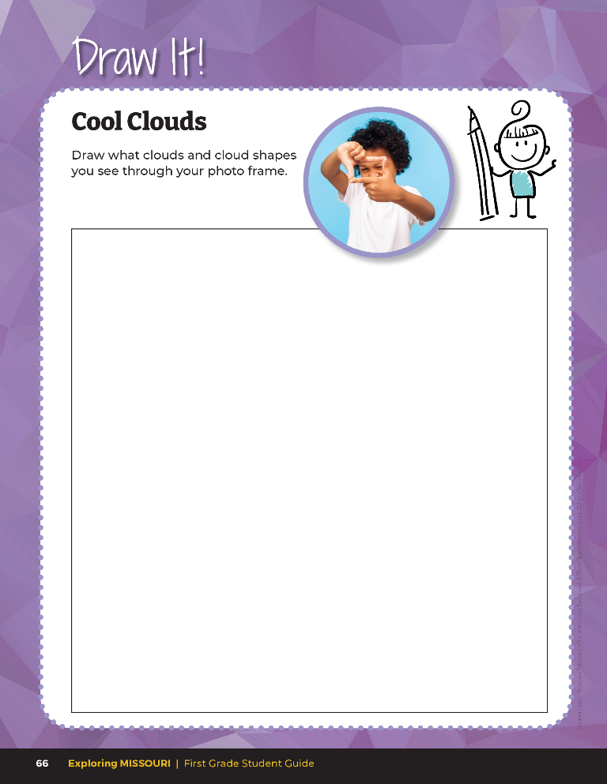

Draw what clouds and cloud shapes you see through your photo frame.
5A
Exploring Missouri – 5A Cloud Watching: Explore
11
Notes:
Open student guide to Draw It! 5A Cool Clouds on Page 66.

Slide 12
What color/s did you see in the clouds?
What shapes?
5A
Exploring Missouri – 5A Cloud Watching: Explain
12
Notes:
Once back in the classroom, discuss what the students drew.

Slide 13
What words can we use to describe the clouds?
5A
Exploring Missouri – 5A Cloud Watching: Explain
13

Slide 14
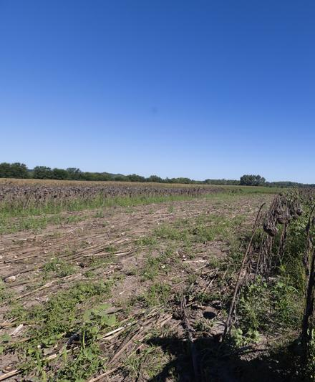
What does the sky look like when there are no clouds?
5A
Exploring Missouri – 5A Cloud Watching: Explain
14
Notes:
Blue

Slide 15
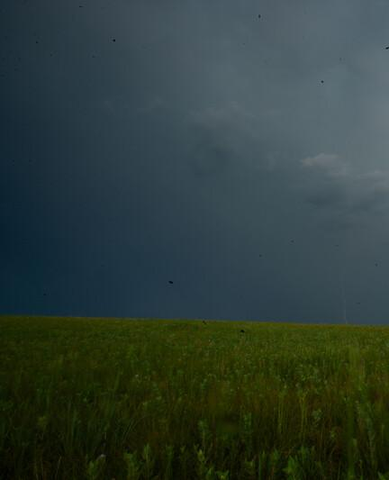
What if the whole sky looks gray?
5A
Exploring Missouri – 5A Cloud Watching: Explain
15
Notes:
There is a layer of clouds.

Slide 16
Why are clouds formed?
What do we know about clouds?
5A
Exploring Missouri – 5A Cloud Watching: Explain
16

Slide 17
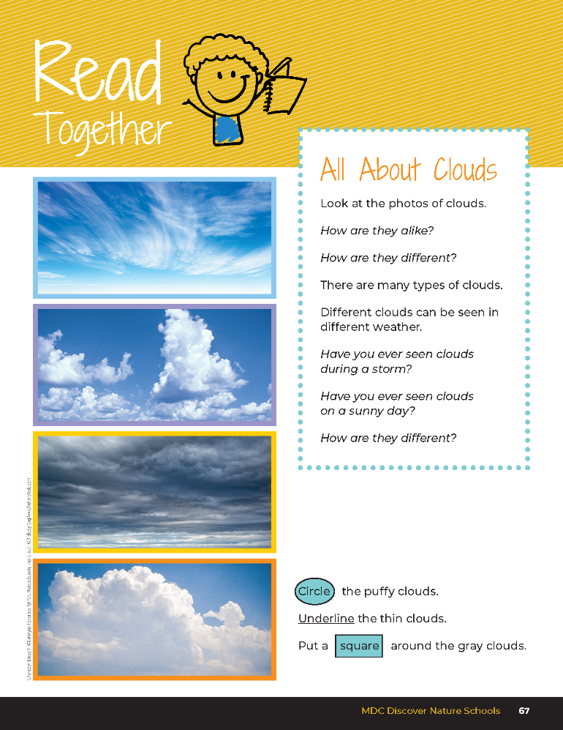
All About Clouds
Look at the photos of clouds.
How are they alike?
How are they different?
There are many types of clouds?
Different clouds can be seen in different weather.
Have you ever seen clouds during a storm?
Have you ever seen clouds on a sunny day?
How are they different?
5A
Exploring Missouri – 5A Cloud Watching: Explain
17
Notes:
Have students open and read from student guide Read Together 5A All About Clouds section on Page 67.
Discuss the questions in the Read Together. Have students circle the puffy clouds, underline the thin clouds, and put a square around the gray clouds.

Slide 18

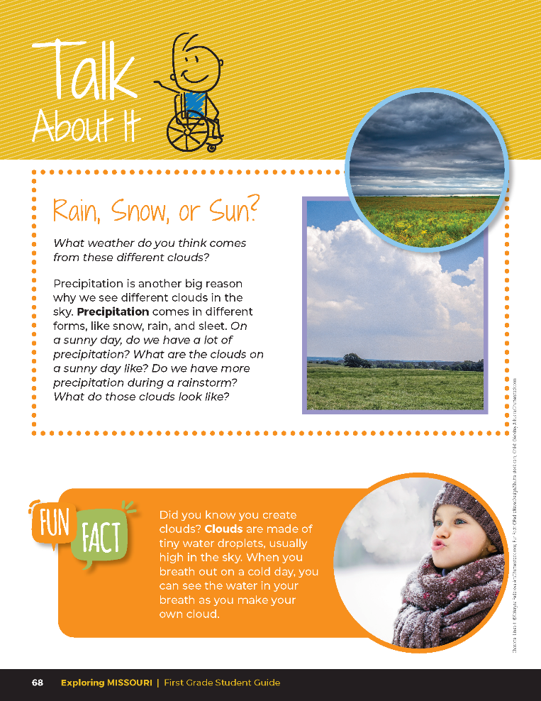
Rain, Snow, or Sun?
What weather do you think comes from these different clouds?
Precipitation is another big reason why we see different clouds in the sky. Precipitation comes in different forms, like snow, rain, and sleet. On a sunny day, do we have a lot of precipitation? What are the clouds on a sunny day like? Do we have more precipitation during a rainstorm? What do those clouds look like?
5A
Exploring Missouri – 5A Cloud Watching: Explain
18
Notes:
Discuss the first question in the Talk About It on Page 68 as a class and what weather they think may come from these different clouds. Teacher Note: You can share the following cloud types with your students or use student descriptions to describe the different types of clouds, such as gray feathery, white, puffy, etc.

Slide 19

Cumulus – white puffy clouds with rounded edges - indicates fair or good weather
5A
Exploring Missouri – 5A Cloud Watching: Explain
19
Notes:
Teacher Note: You can share the following cloud types with your students or use student descriptions to describe the different types of clouds, such as gray feathery, white, puffy, etc.

Slide 20
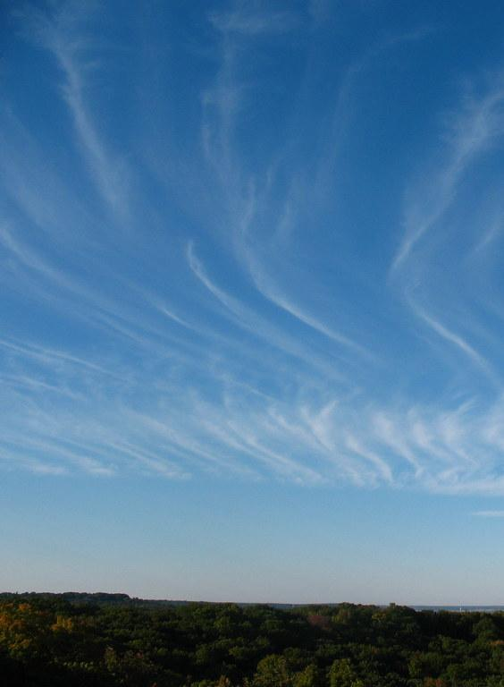
Cirrus – thin, wispy, white clouds high in the sky made of ice crystals - indicate fair weather
5A
Exploring Missouri – 5A Cloud Watching: Explain
20

Slide 21
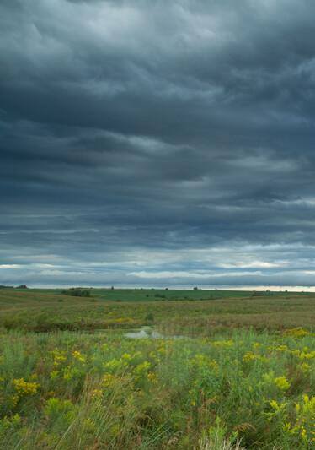
Stratus – large, gray low clouds that cover large areas - can lead to a steady rain or snow
5A
Exploring Missouri – 5A Cloud Watching: Explain
21

Slide 22
What kind of weather are we experiencing today? Is it raining?
Is it sunny and not raining?
5A
Exploring Missouri – 5A Cloud Watching: Explain
22

Slide 23
What kinds of clouds did we notice from what we just discussed?
5A
Exploring Missouri – 5A Cloud Watching: Explain
23

Slide 24
What kinds of clouds would we see if it were raining outside?
5A
Exploring Missouri – 5A Cloud Watching: Explain
24
Notes:
Let’s see if we can match our clouds to the weather!

Slide 25
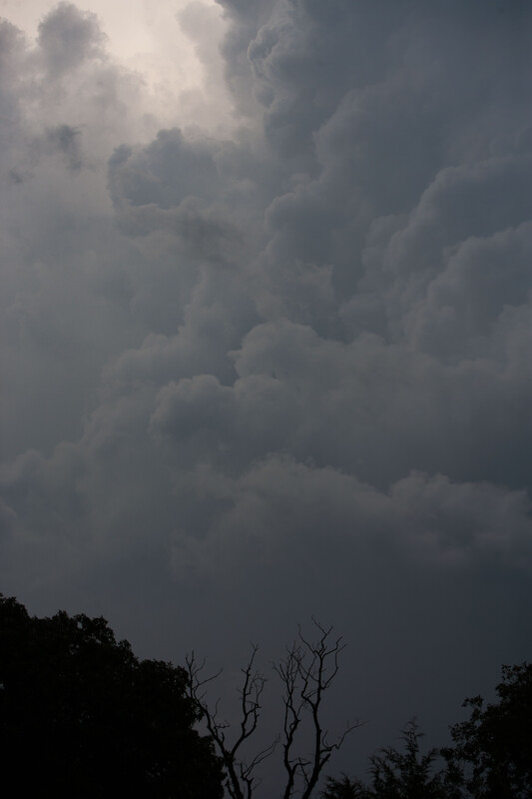
What kinds of clouds do you think we usually see in storm?
Why do you think these clouds are so different?
5A
Exploring Missouri – 5A Cloud Watching: Explain
25

Slide 26
Rain, Snow, or Sun?
Precipitation – liquid and solid water falling from clouds
5A
Exploring Missouri – 5A Cloud Watching: Explain
26
Notes:
Discuss the second part of the Talk About It section and introduce the term precipitation, which is defined as liquid and solid water falling from clouds (rain and snow and all the variations)

Slide 27
Do you think there is a pattern between the color and shape of clouds and the kinds of precipitation we may see?
5A
Exploring Missouri – 5A Cloud Watching: Explain
27
Notes:
Discuss the correlation between the color and shape of the clouds and the corresponding weather. Focus on large gray clouds that cover the sky and can bring rain and storms.

Slide 28

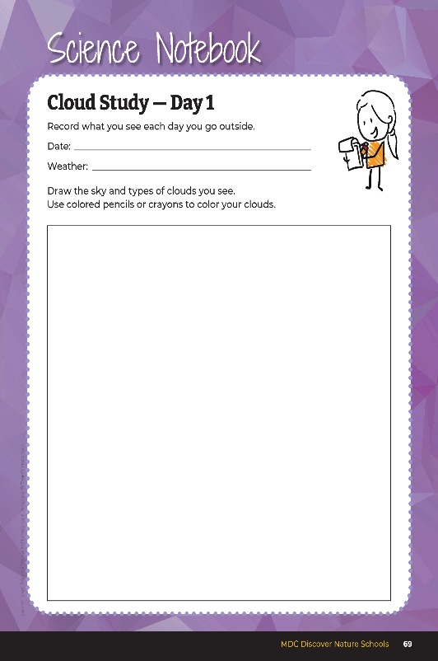
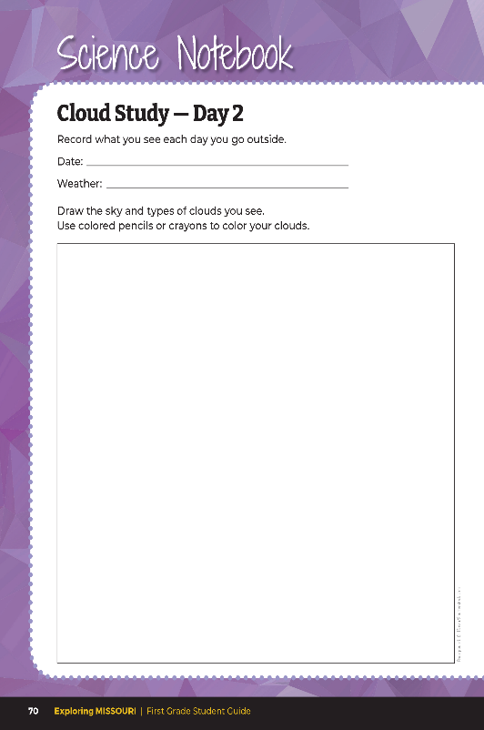

15
3
X
MINUTES
DAYS
5A
Exploring Missouri – 5A Cloud Watching: Elaborate
28
Notes:
Take students outside for three days in a row to record observations of different types of clouds. They will need their student guide Science Notebook 5A Cloud Study on pages 69 – 71.
Teacher prompt for each trip: Clouds look different each day because of the precipitation in the weather that day. Using your student book, draw the way clouds look each day using the photo-frame method we practiced earlier. Record what weather you are experiencing that day and if it is raining or not.

Slide 29
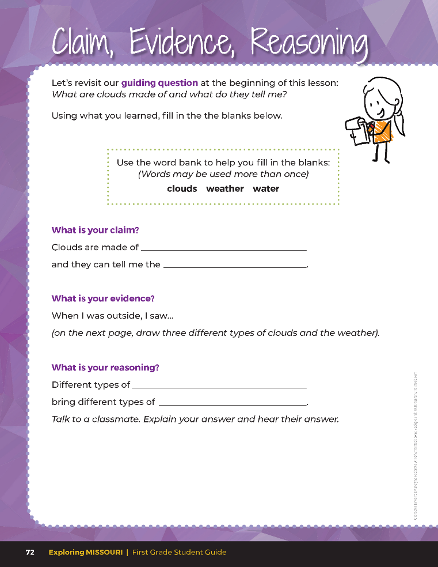

Guiding Question:
What are clouds made of and what do they tell me?
5A
Exploring Missouri – 5A Cloud Watching: Evaluate
29
Notes:
After exploring the concept of clouds and weather, have students open their student guides to the Claim, Evidence and Reasoning section on Page 72. Discuss the page with students – read the guiding question and explain what the students need to do to answer the questions (fill in the blanks and draw three types of clouds).

Slide 30
water or precipitation
Answers
weather
clouds
weather
5A
Exploring Missouri – 5A Cloud Watching: Evaluate
30
Notes:
Rubric:
4 (Exceeds) – Students drew three different types of clouds, correctly drawn by shape and color.
3 (Meets) – Students drew two different types of clouds, correctly drawn by shape and color.
2 (Partially Meets) – Students drew one type of cloud, correctly drawn by shape and color.
1 (Doesn’t Meet) – Students did not draw a cloud type correctly.

