Slide 1
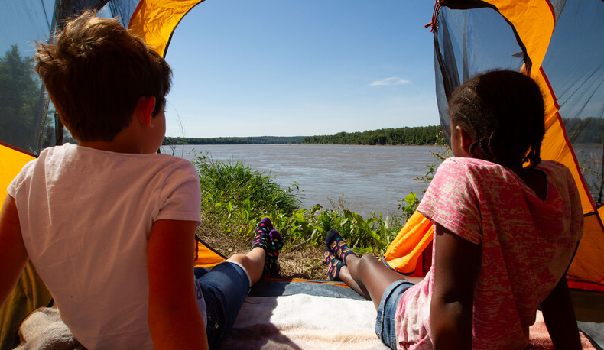

Life and Land in
MISSOURI
Unit 4 Review

Slide 2
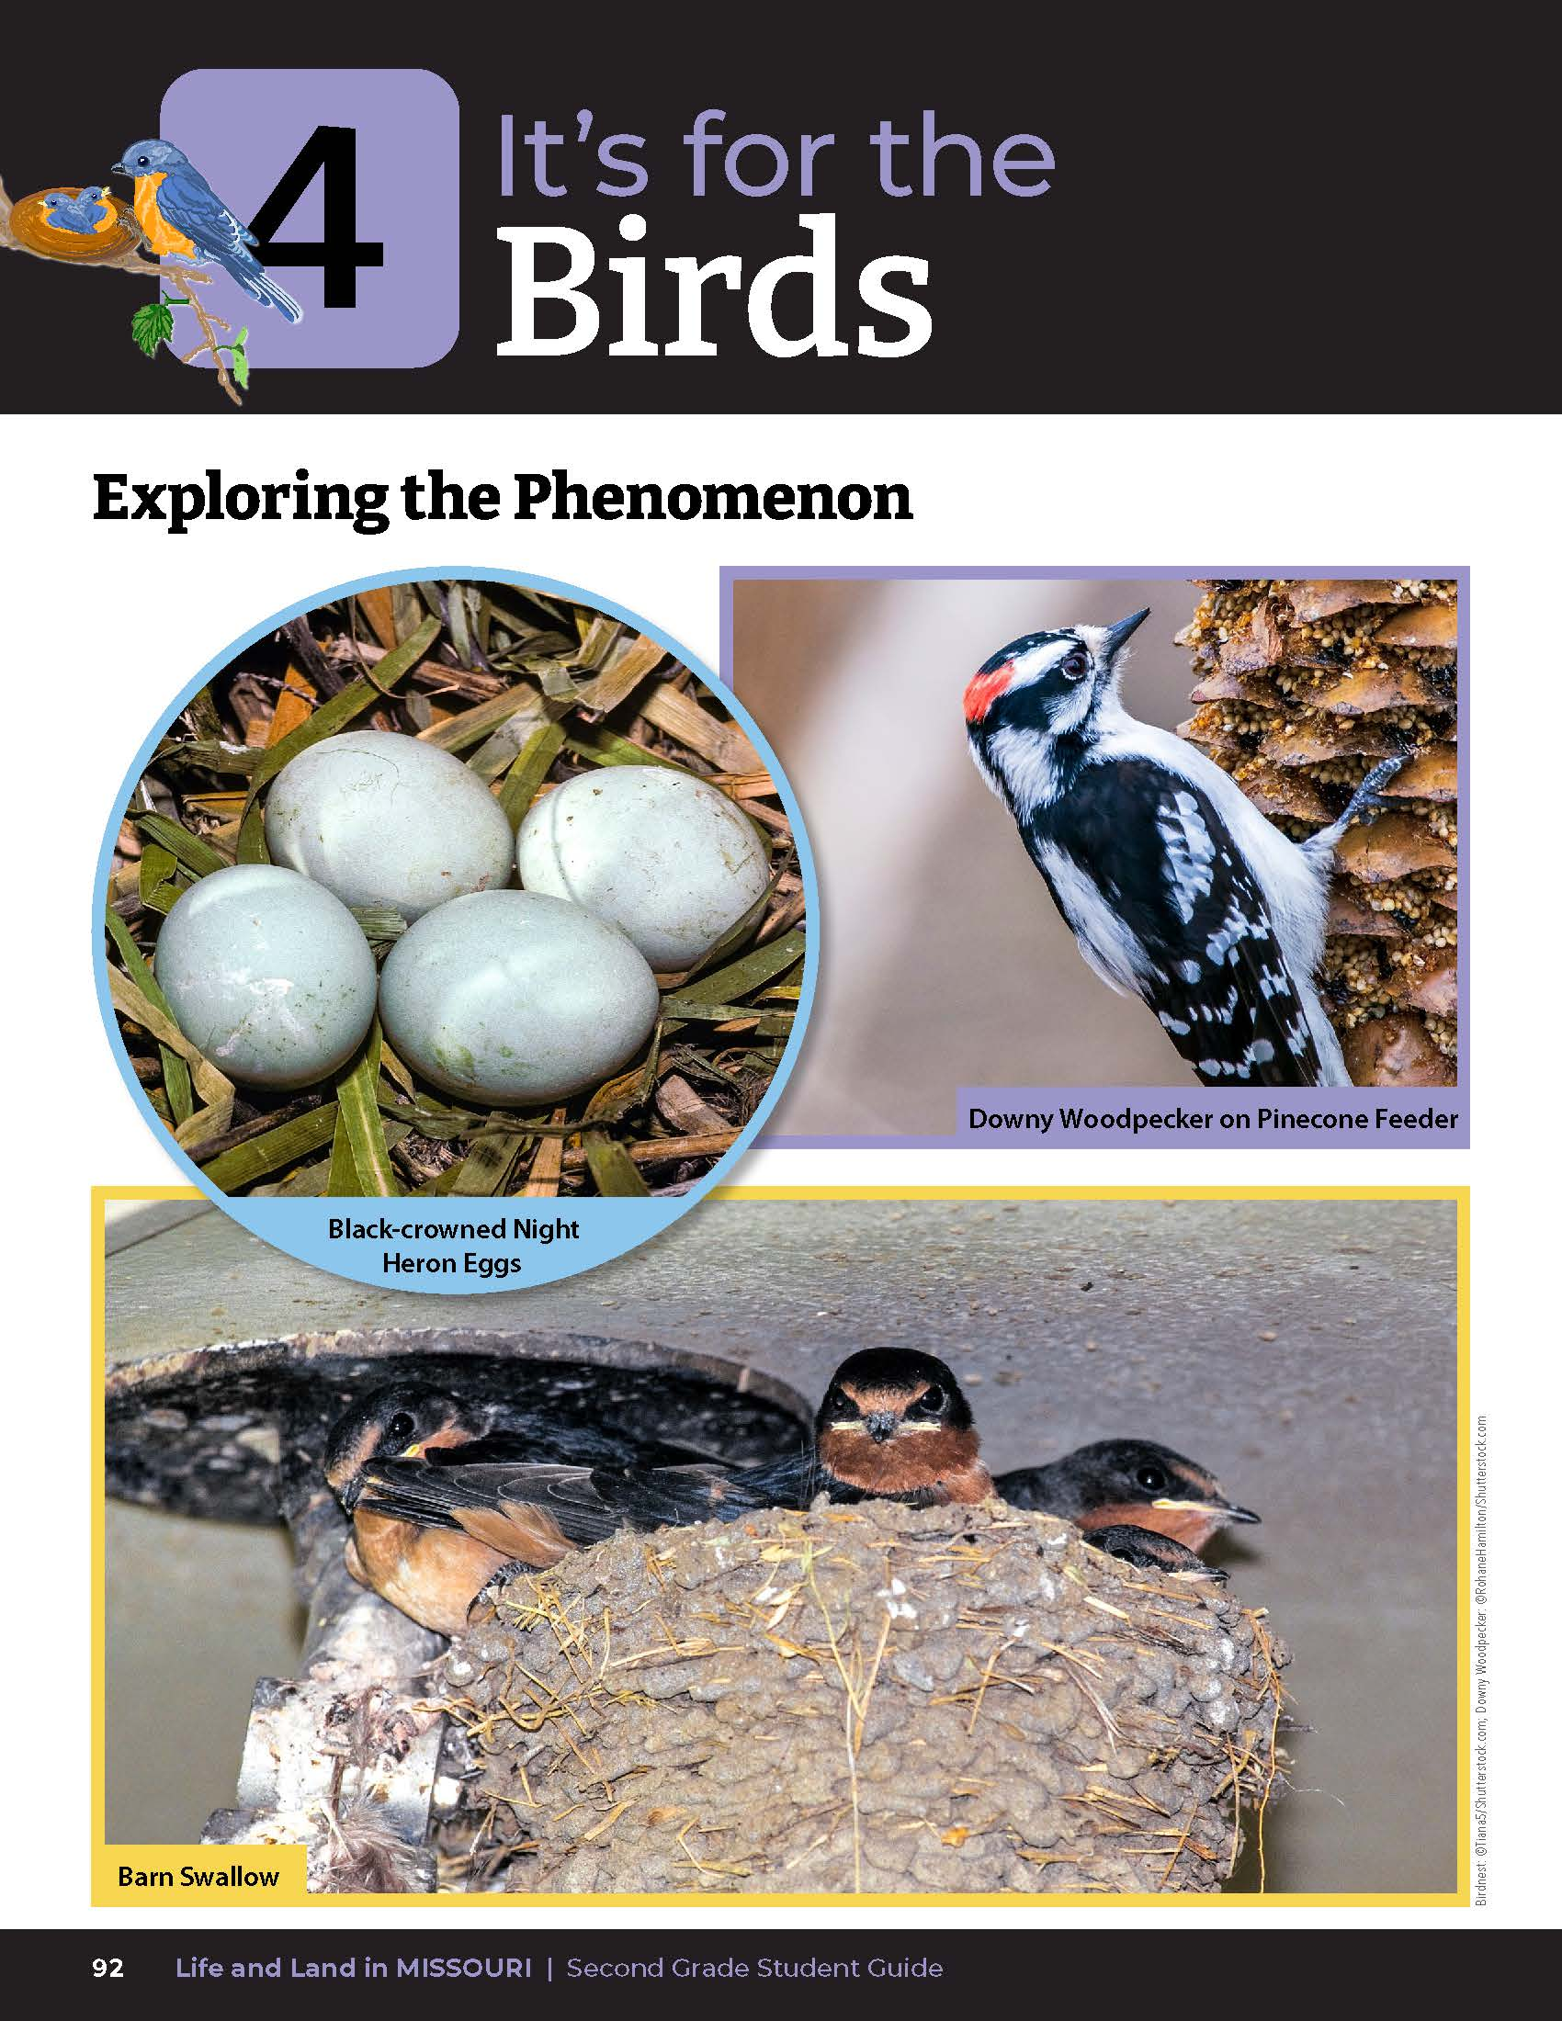
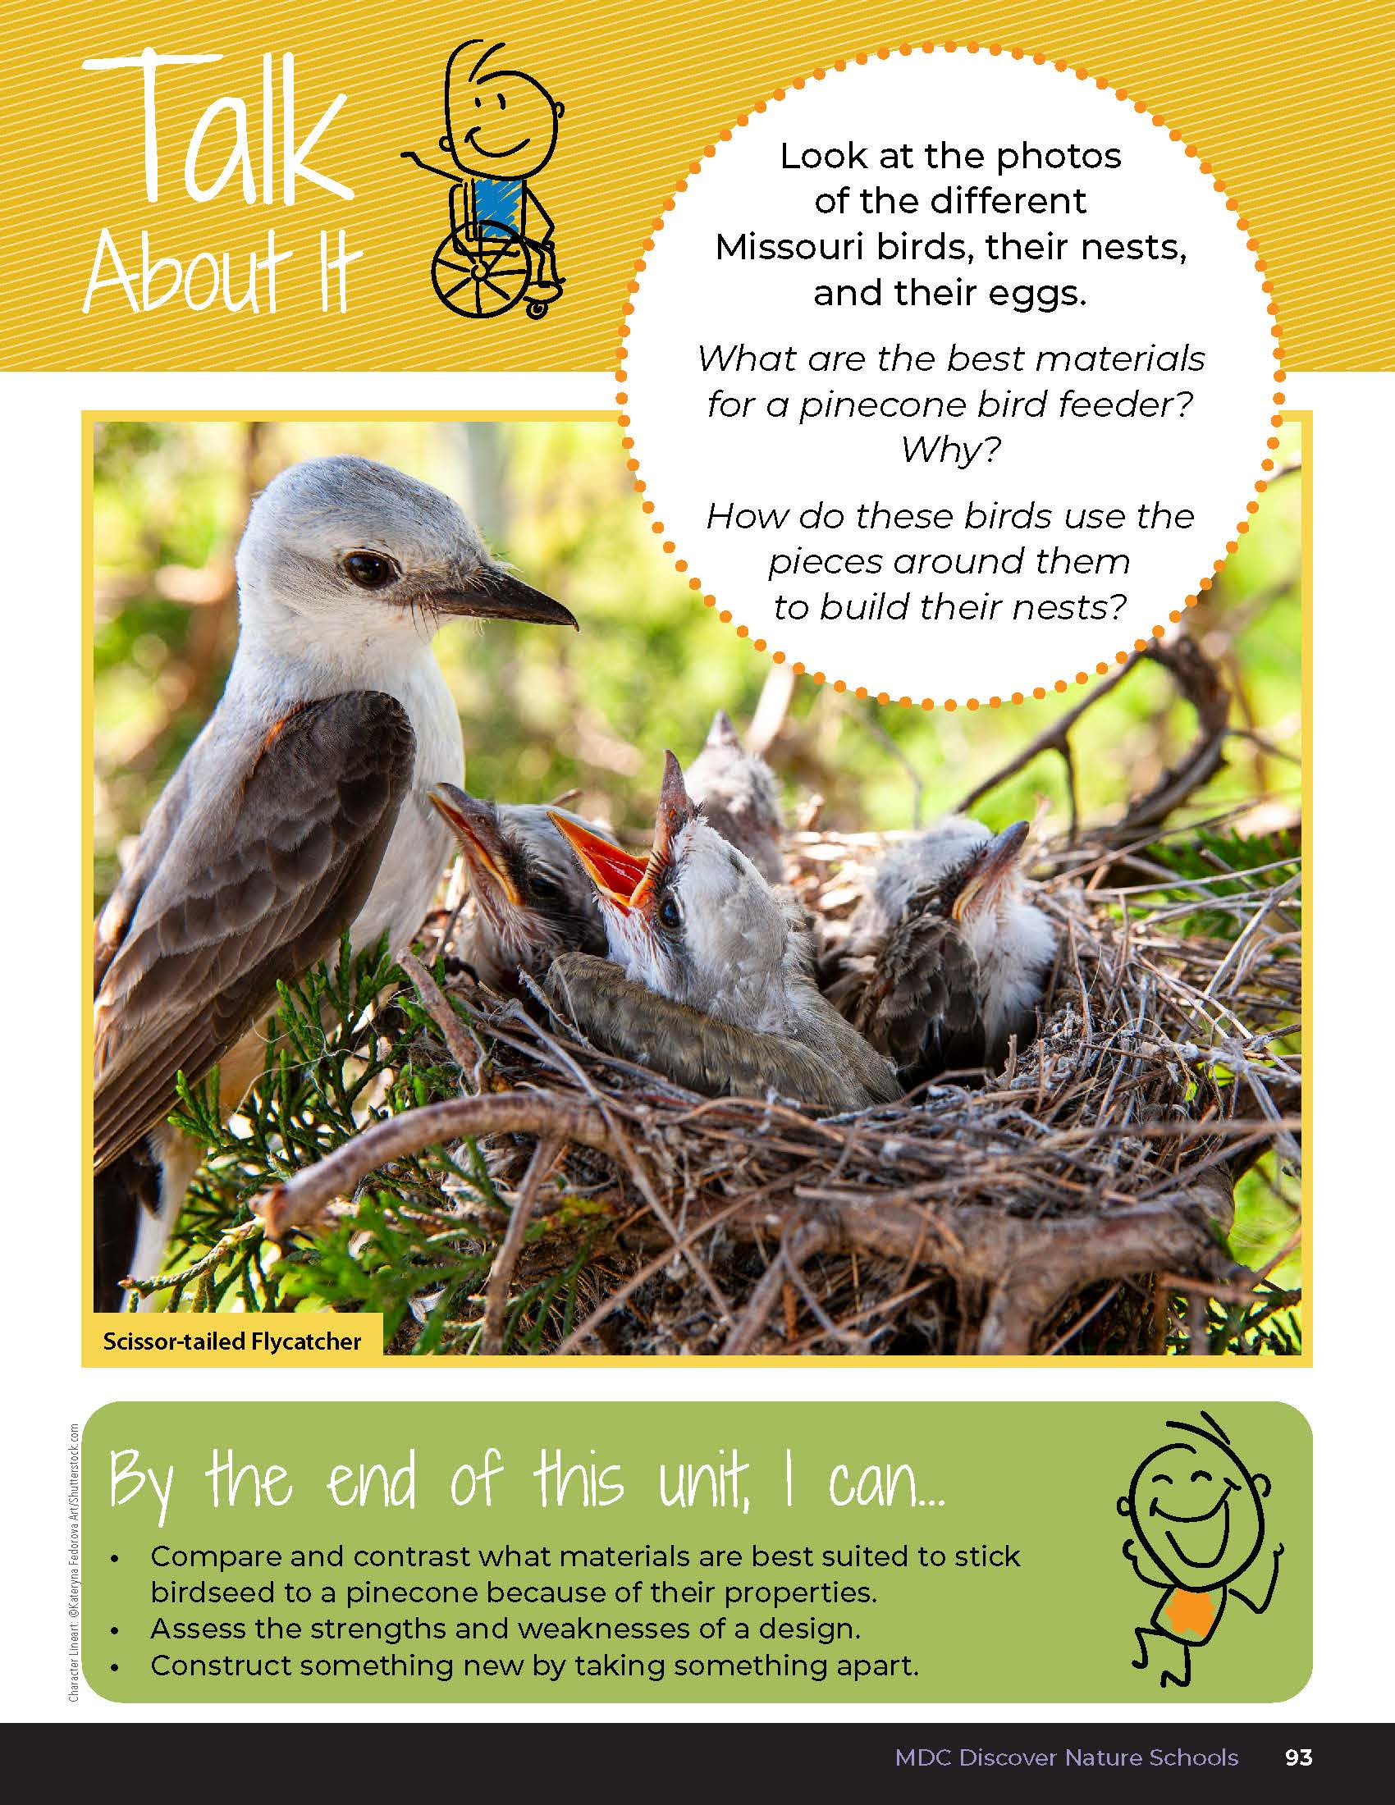
4
Life and Land in Missouri – Unit 4 Review
2

Slide 3
What are the best materials for a pinecone bird feeder? Why?
4
Life and Land in Missouri – Unit 4 Review
3
Notes:
(Peanut butter or any materials used that were sticky are the best because more seeds stuck on.)

Slide 4
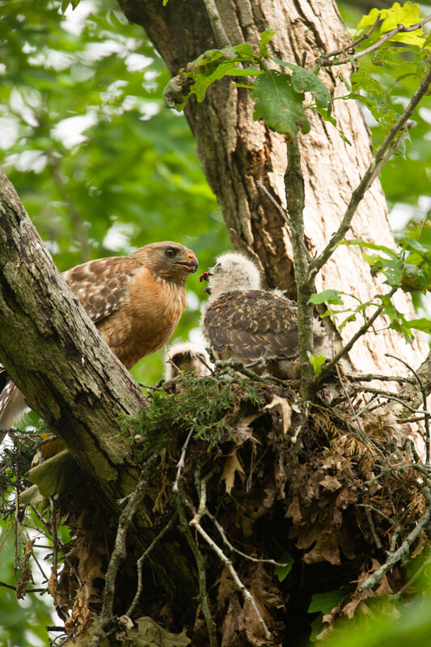
How do these birds use the pieces around them to build their nests in different ways if the nest fails?
4
Life and Land in Missouri – Unit 4 Review
4
Notes:
(Student describe the pieces used such as twigs, sticks, grass, mud, and whatever else may be around. If the nest fails, the bird will rebuild using similar pieces in a better way.)
Rubric:
3 (Meets) – Using evidence, student explains the best materials to build a pinecone feeder have sticky properties so that more seed will stick to it. Student describes the different pieces the birds in the photos will use to build a strong nest and provides a different way the bird may build that nest if it fails, using the same pieces.
2 (Partially meets) – Using evidence, student somewhat explains the best materials to build a pinecone feeder have sticky properties so that more seed will stick to it. Student somewhat describes the different pieces the birds in the photos will use to build a strong nest and provides a different way the bird may build that nest if it fails, using the same pieces.
1 (Doesn’t meet) – Student does not offer any explanation of any of the concepts.
Animal in Picture: Red Shouldered Hawk

Slide 5
Let’s create a new pinecone bird feeder!
4
Life and Land in Missouri – Unit 4 Review
5
Notes:
Students will each create a new pinecone bird feeder from materials used. The class should agree on a spot in the schoolyard that is easily accessible to hang their feeders. All feeders should be placed on the same on or two trees so they are grouped closer together. Be sure feeders are hung above a limb or branch, so a bird has a place to perch when eating the seeds. Keep an eye on the activity as you may not see anything for a few hours, or a few days.

Slide 6
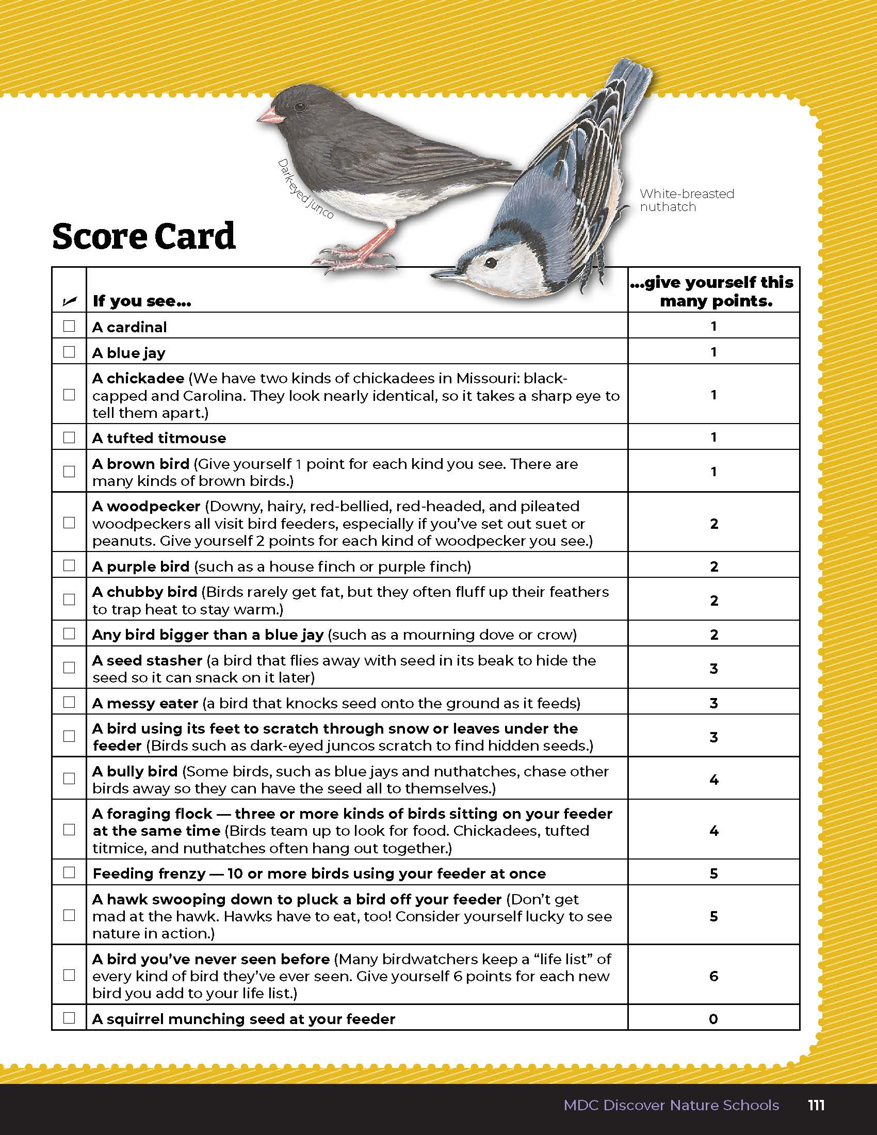
Observe the feeder for 15 minutes and fill out your scorecard.
4
Life and Land in Missouri – Unit 4 Review
6
Notes:
Once feeding picks up, have students observe the feeders for 15 minutes and fill our their scorecard on Page 111 in the Putting It All Together section.

Slide 7
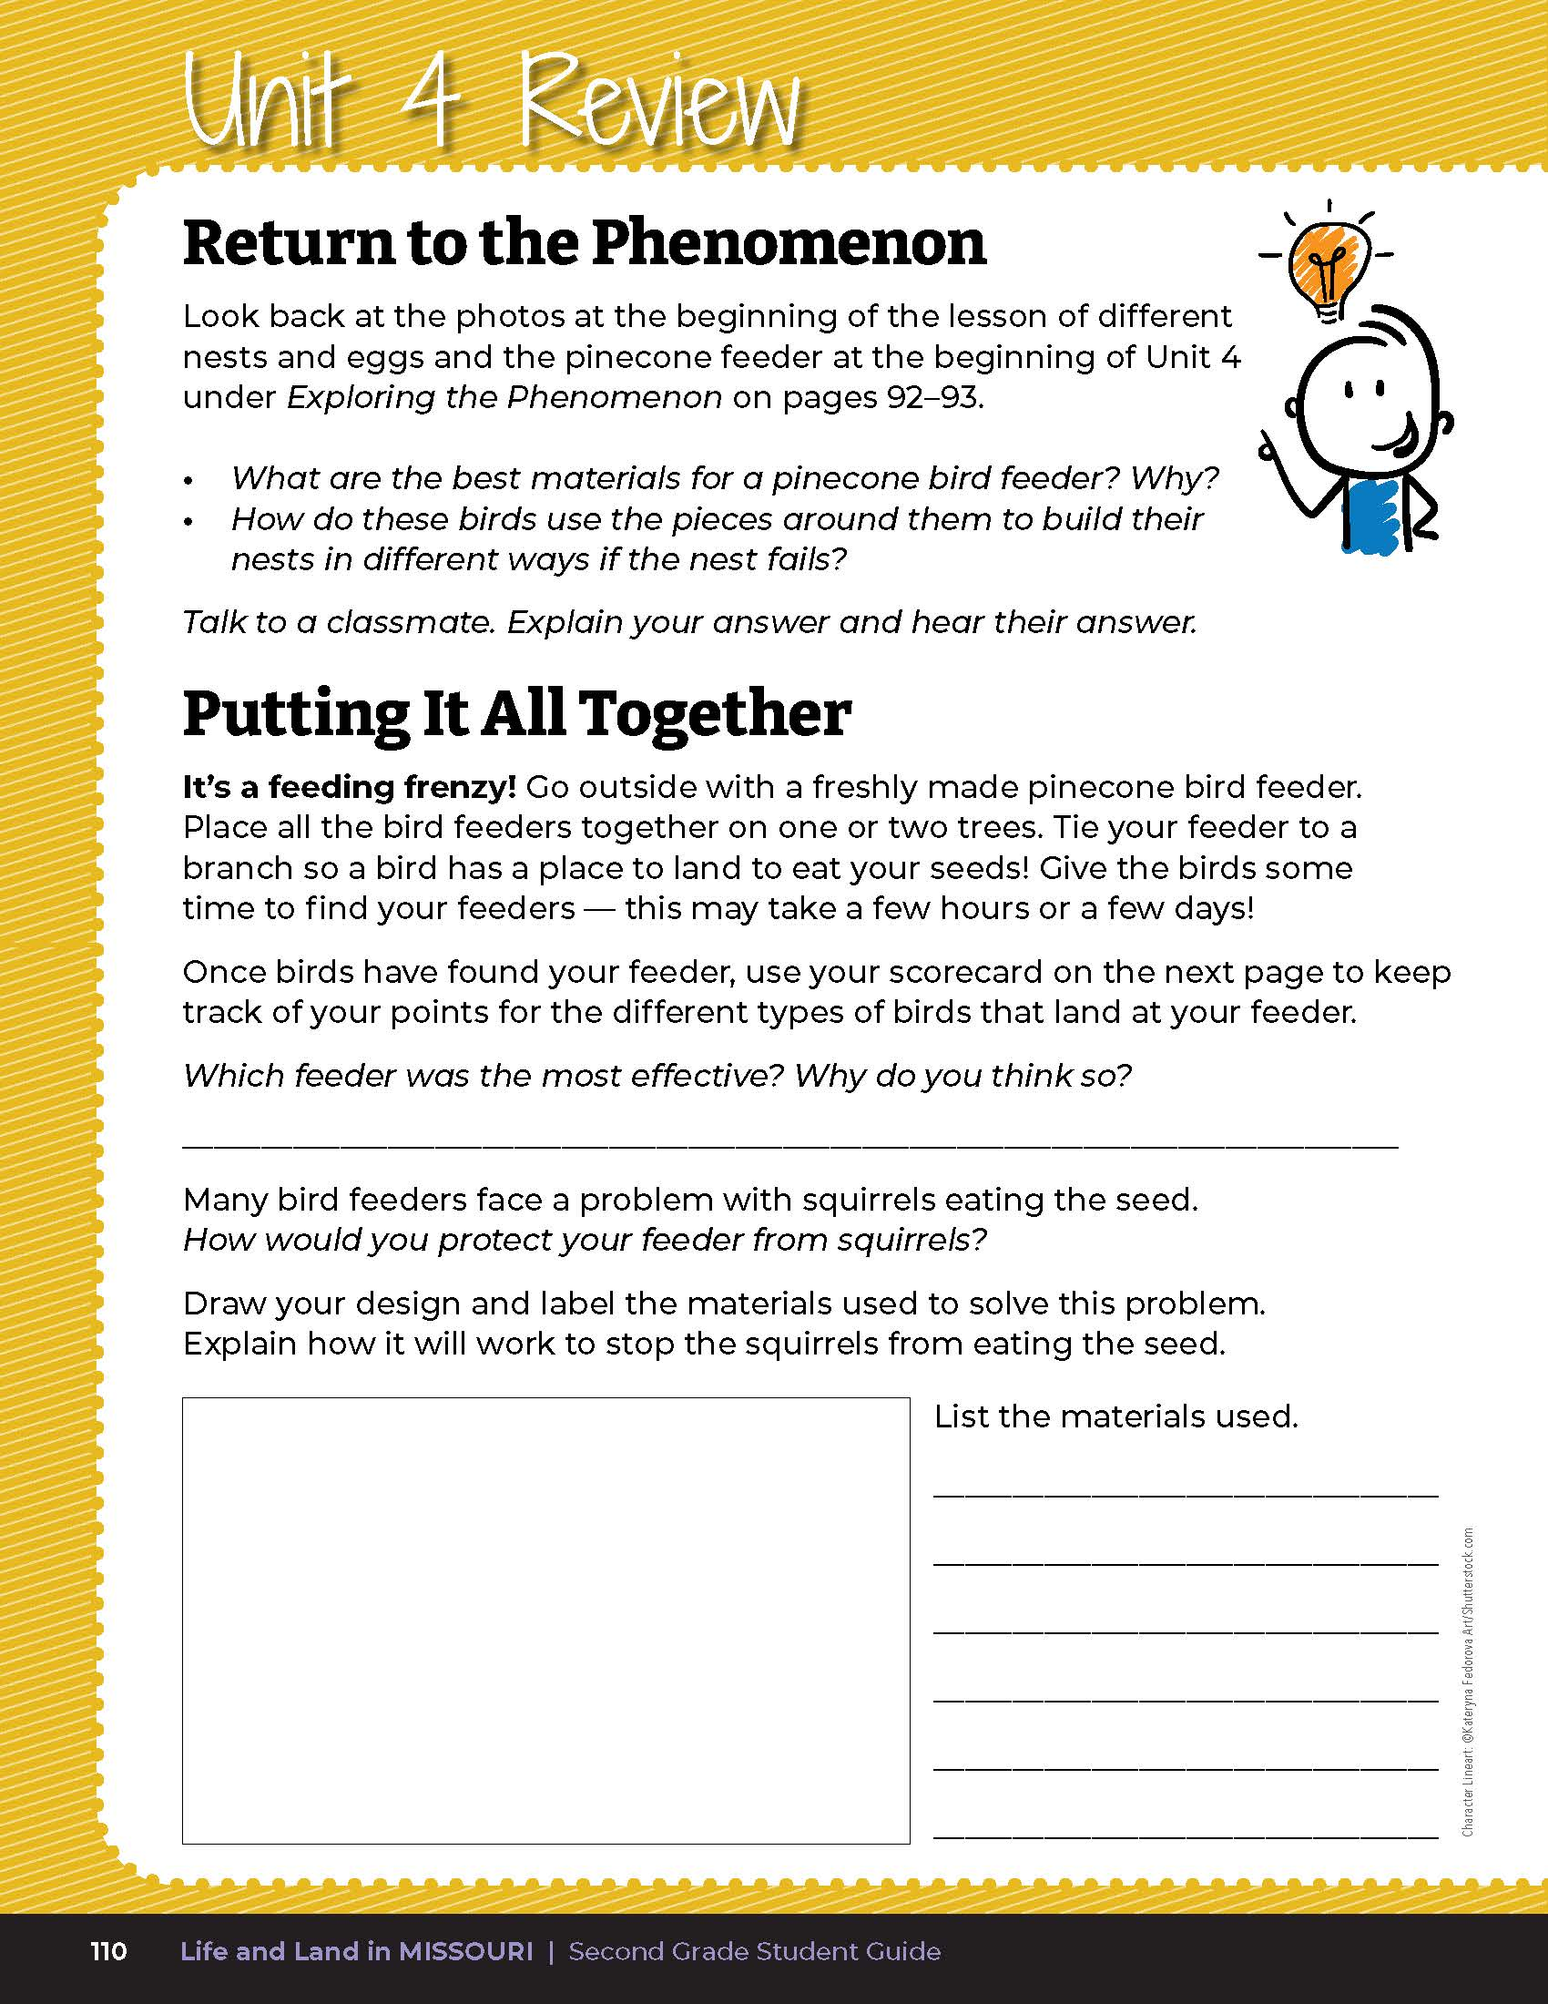
Assess which feeder was the most active and provide a reason based on your observations.
4
Life and Land in Missouri – Unit 4 Review
7
Notes:
On Page 110, have students assess which feeder was the most active and provide a reason based on their observations of location and the materials and seeds used. Students should also provide a drawing and explanation of a solution to prevent squirrels from eating seeds at their feeders.
Rubric:
3 (Meets) – Student creates a new pinecone feeder based on the materials used during their test. Student observes the feeding station for 15 minutes and complete their scorecard. Student assesses which feeder is most active and provides a reason. Student provides a sensible solution to the problem of squirrels eating their seed with a drawing and explanation of the new design.
2 (Partially meets) – Student creates a new pinecone feeder based on the materials used during their test. Student observes the feeding station for 5-10 minutes and somewhat completes their scorecard. Student somewhat assesses which feeder is most active and provides a reason. Student provides a somewhat sensible solution to the problem of squirrels eating their seed with a drawing or explanation of the new design.
1 (Doesn’t meet) – Student may or may not create a new pinecone feeder based on the materials used during their test. Student observes the feeding station for less than 5 minutes and does not complete most of their scorecard. Student does not assess which feeder is most active and does not provide a reason. Student does not provide a sensible solution to the problem of squirrels eating their seed with a drawing or explanation of the new design.

Slide 8

Optional: Cross-Curricular Extension
English Language Arts
Gather sticks. Build a model bald eagle nest. Build a second nest from other materials you found (grass, mud, leaves, vines, trash, etc.). You might want to study other birds’ nests and what materials they use. When your nests are complete, compare the strength of both by placing chicken eggs in them. Which held up better? Do you think that was because of the design or from materials used? Explain. If both nests can hold the eggs, see what other, heavier, items you can find to test the nest’s strength, such as bottles of water.
Bald eagles build their nests in the tallest trees in an area. What are some advantages of having a “bird’s eye view” of the neighborhood? What are some potential disadvantages to building a heavy nest in the tallest tree in an area? Create a real estate flyer using a computer to describe why this is the ideal location for an eagle couple to nest.
4
Life and Land in Missouri – Unit 4 Review
8

Slide 9
Optional: Cross-Curricular Extension
Math
Look at your constructed eagle’s nest. Can you see geometric shapes among the sticks (triangles, hexagons, etc.)? Find one and measure the sides of the shape in centimeters and inches.
4
Life and Land in Missouri – Unit 4 Review
9

Slide 10
Optional: Cross-Curricular Extension
Citizen Science
Participate in Project FeederWatch and have students observe daily the birds that visit their feeders. Submit their data and contribute their observations to the greater scientific community. For more information, visit the Project FeederWatch website at feederwatch.org.
4
Life and Land in Missouri – Unit 4 Review
10

Slide 11
Optional: Cross-Curricular Extension
Outdoor Skills
Learn to tie knots. Compare 2 knots. Which knot would be better for hanging bird feeder? Why? Which would be best for securing a birdhouse to a tree? Why? Which one would be better for typing a hook on your line for fishing? Why?
Compare the strength of each (knot, item to be tested) by hanging paper clips on it until if falls. Which item was stronger? Why? Based upon your results, which design would be more appropriate. Why? How many more paper clips will it hold?
4
Life and Land in Missouri – Unit 4 Review
11

