Slide 1
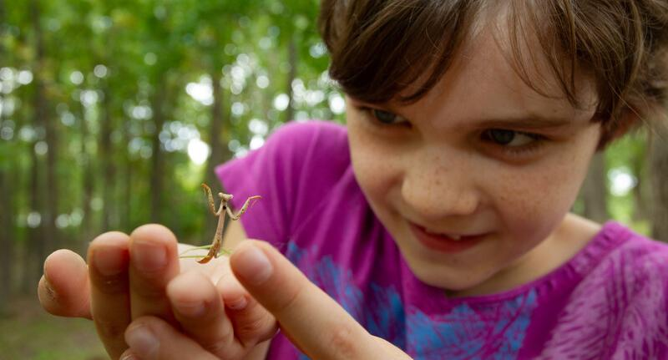

Exploring
MISSOURI
4B: Inspired by Animals

Slide 2
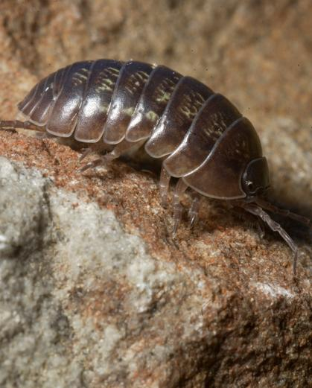
Guiding Question:
What external parts in isopods inspire us?
4B
Exploring Missouri – 4B Inspired by Animals: Engage
2
Notes:
Animal in Picture: Roly-Poly

Slide 3
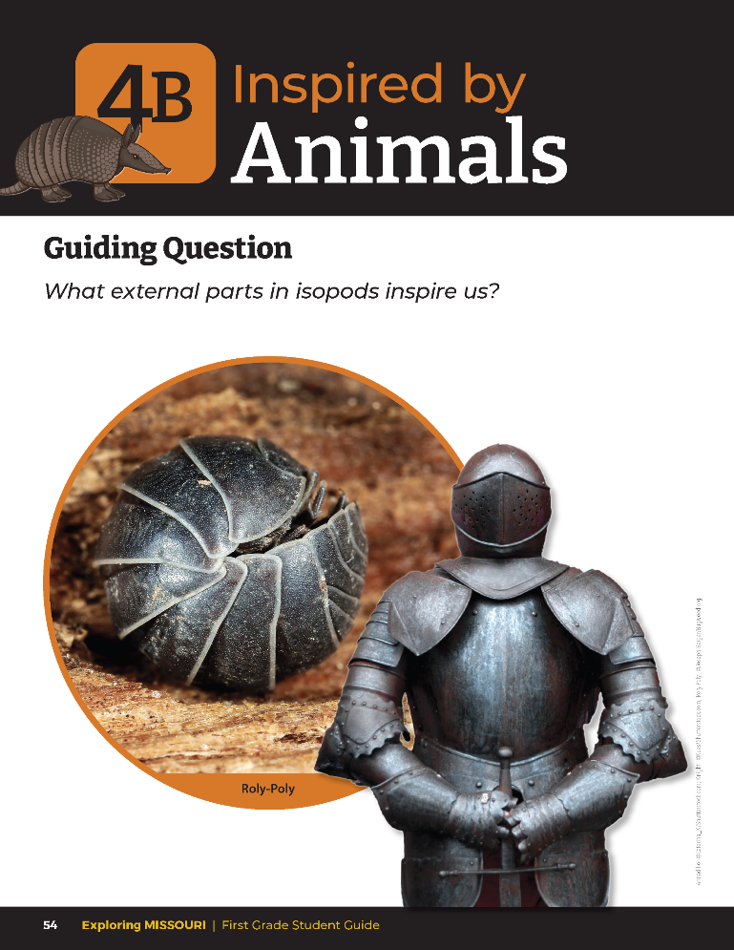
How do these two things use their armor?
How does the isopod armor compare to the knight?
4B
Exploring Missouri – 4B Inspired by Animals: Engage
3
Notes:
Have students look at the pictures of the knight in armor and the isopod, or roly-poly, from the student guide Lesson 4B Inspired by Animals section on Page 54. In the last lesson, we talked about a kind of external part called armor. Let’s compare two examples of armor. How do these two things use their armor? (Both use their armor for protection.) How does the isopod armor compare to the knight? (Isopods have segmented shells or outer coverings like how a knight has outer coverings.)

Slide 4
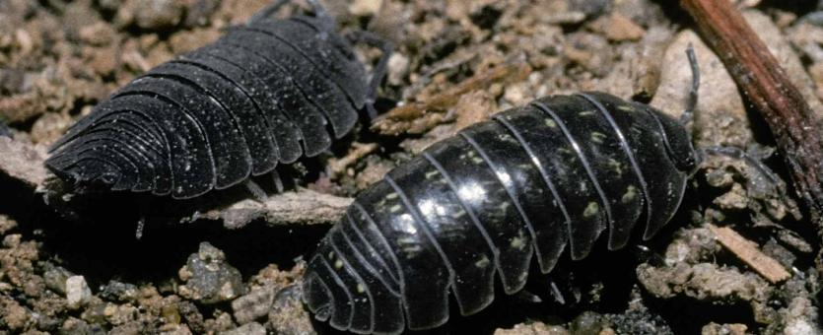
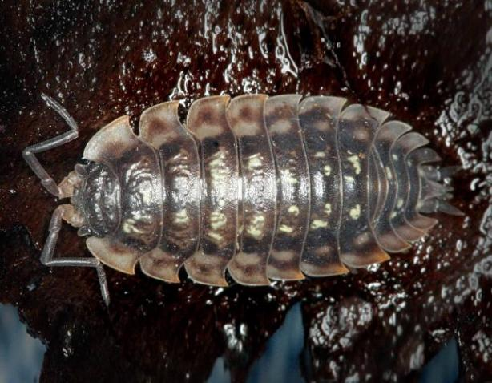
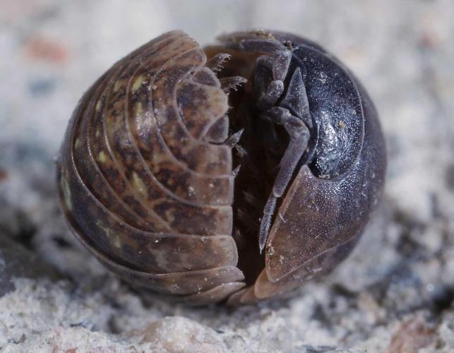
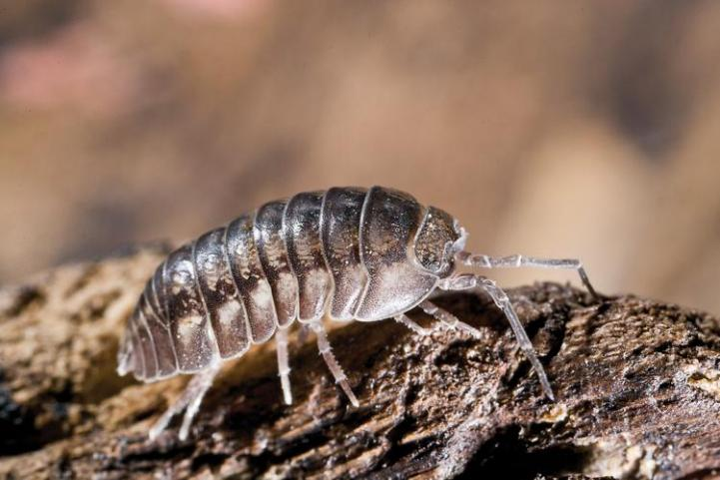
4B
Exploring Missouri – 4B Inspired by Animals: Engage
4
Notes:
Display photos of ispods (pill bugs, sow bugs, roly-poly) to the students from the MDC Field Guide. Pillbugs and Sowbugs (Land Isopods) | Missouri Department of Conservation
Animal in Picture: Roly-Poly

Slide 5
What is a roly-poly and how does it protect itself?
4B
Exploring Missouri – 4B Inspired by Animals: Engage
5

Slide 6

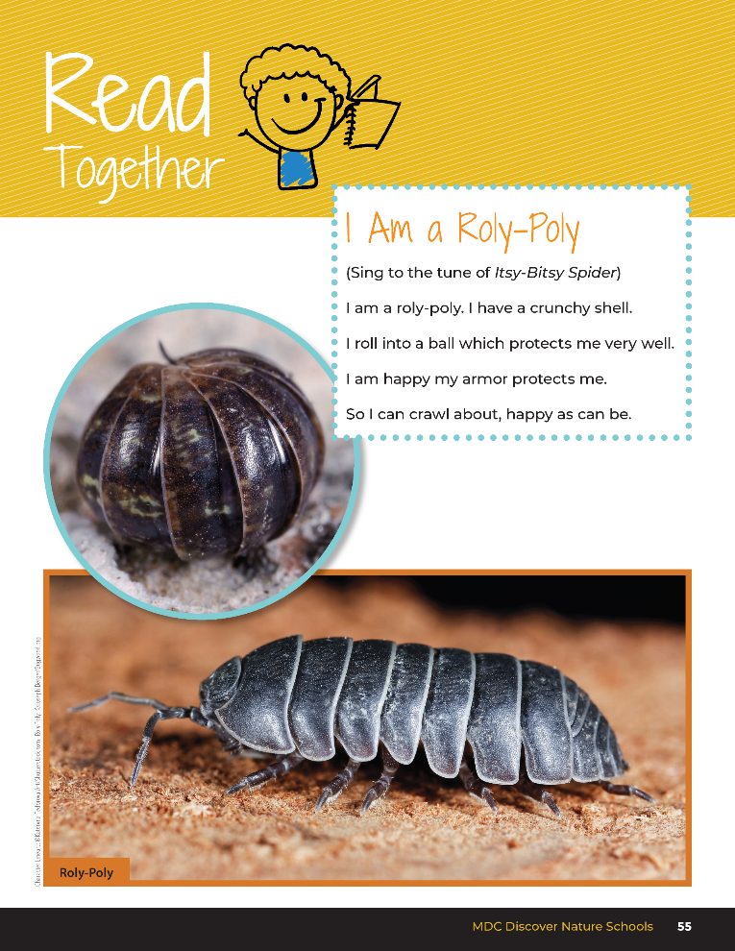
I Am a Roly-Poly
(Sing to the tune of Itsy-Bitsy Spider)
I am a roly-poly, I have a crunchy shell.
I roll into a ball which protects me very well.
I am happy my armor protects me.
So I can crawl about, happy as can be.
4B
Exploring Missouri – 4B Inspired by Animals: Engage
6
Notes:
In the student guide, Read Together 4B I Am a Roly-Poly on Page 55:
(Sing to the tune of Itsy-Bitsy Spider)
I am a roly-poly. I have a crunchy shell.
I roll into a ball which protects me very well.
I am happy my armor protects me.
So I can crawl about, happy as can be.

Slide 7
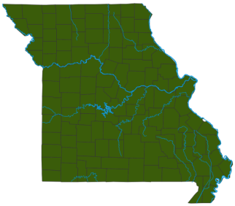
4B
Exploring Missouri – 4B Inspired by Animals: Explore
7
Notes:
Displaying the Missouri map of land isopods, point out to students that these isopods are found everywhere.

Slide 8
After looking at the photos, where would you look for isopods that live on the land?
What is their habitat?
4B
Exploring Missouri – 4B Inspired by Animals: Explore
8

Slide 9
Go outside:
Look for isopods!
We can find them in cool, moist, dark environments.
4B
Exploring Missouri – 4B Inspired by Animals: Explore
9
Notes:
Take the class outside. Have students look in any cool, moist, dark environment around your school. Look under flowerpots, boards, rocks, bricks, fallen logs, anything in contact with the soil, etc. Collect at least one isopod for each student group in small dishes or magnifying containers for students to make observations. Use a moist paper towel to keep isopods alive and comfortable. Use magnifiers to aid observations.

Slide 10
What directions do isopods turn?
Right or left, and how often?
4B
Exploring Missouri – 4B Inspired by Animals: Explore
10
Notes:
Encourage students to observe isopod behavior and discuss observations.

Slide 11
After you touched the isopod, what happened?
Why do you think the isopod reacted this way?
4B
Exploring Missouri – 4B Inspired by Animals: Explore
11
Notes:
Allow students to gently touch them with a finger and discuss what happens.

Slide 12
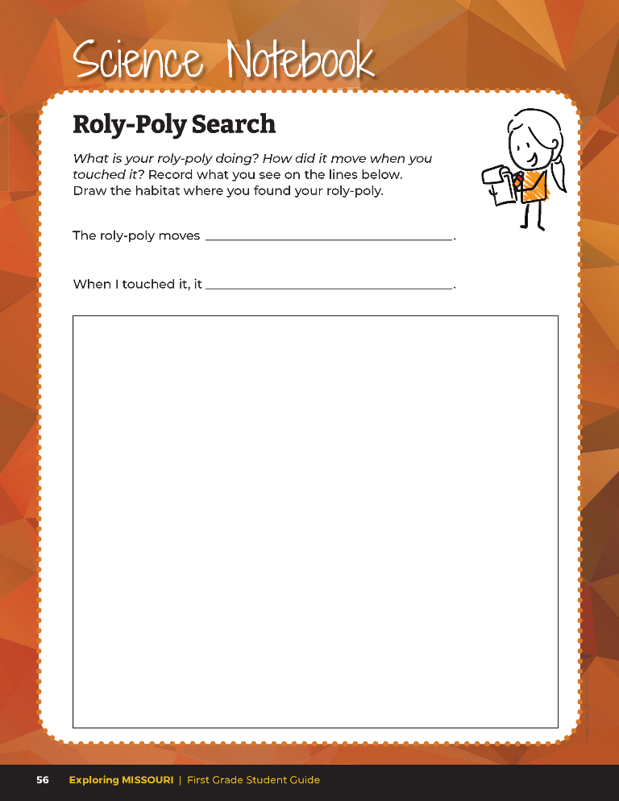

What is your roly-poly doing? How did it move when you touched it?
Draw the habitat where you found your roly-poly.
4B
Exploring Missouri – 4B Inspired by Animals: Explore
12
Notes:
Have students record their observations and draw a roly-poly in their habitat in the student guide Science Notebook 4B Roly-Poly Search section on Page 56.
When finishes, return all isopods to their homes, modeling to students to return specimens exactly where they were found.

Slide 13
How do isopods use their armor to survive?
4B
Exploring Missouri – 4B Inspired by Animals: Explain
13
Notes:
Revisit the picture of the knight in armor from the student guide Lesson 4B Inspired by Animals section on Page 54. Have students identify the body parts where the armor protects the knight.

Slide 14
If I gave you a problem a human might have, could you use what you know about the animal your group studied in the first lesson to help solve the human problem?
4B
Exploring Missouri – 4B Inspired by Animals: Explain
14
Notes:
Refer to the Missouri Armored Animals book your class made in previous lessons.

Slide 15
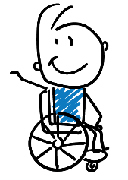
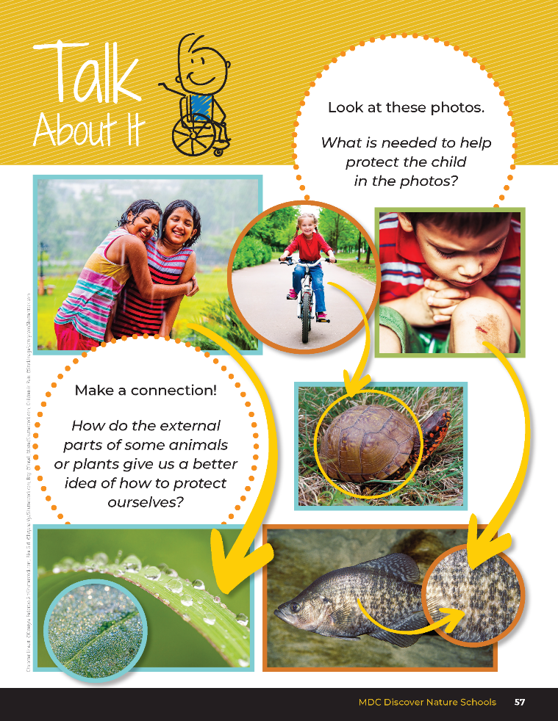
What is needed to help protect the child in the photos?
How do the external parts of some animals or plants give us a better idea of how to protect ourselves?
4B
Exploring Missouri – 4B Inspired by Animals: Explain
15
Notes:
Have students open their student guide to the Talk About It 4B section on Page 57.

Slide 16
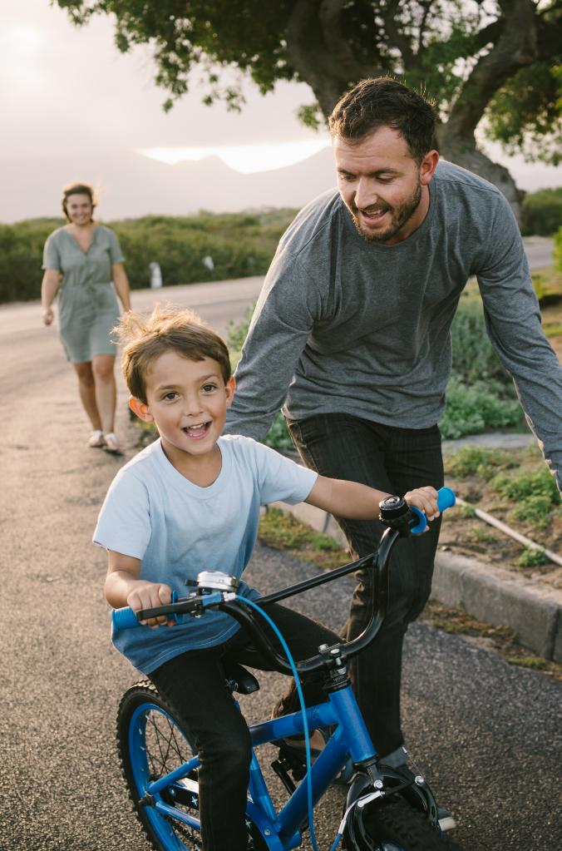
What do you need to protect yourselves in these scenarios?
4B
Exploring Missouri – 4B Inspired by Animals: Explain
16

Slide 17
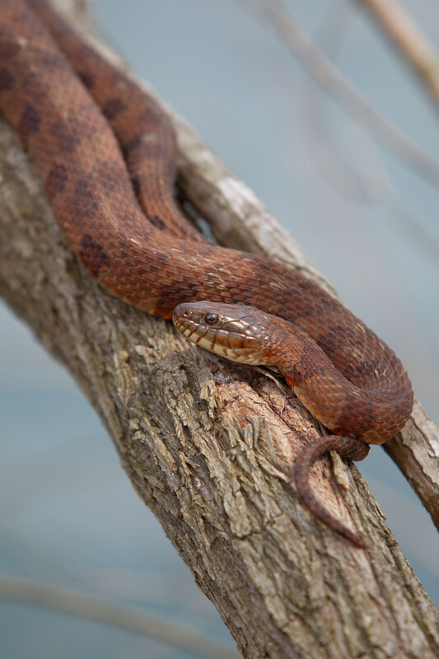
In the last lesson, what other external parts did you learn about from your research that provide protection?
4B
Exploring Missouri – 4B Inspired by Animals: Explain
17
Notes:
(Claws, tails, scales, etc.)
Animal in Picture: Water Moccasin

Slide 18
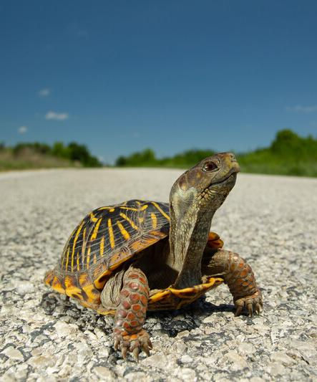
How do these abilities help animals survive?
Do they help with things other than protection?
4B
Exploring Missouri – 4B Inspired by Animals: Explain
18
Notes:
Choose one of the books of the series What If You Had… by Sandra Markle.
After reading the book, discuss the different external parts of animals. Animals have some amazing abilities and body parts that humans do not have.
Animal in Picture: Ornate Box Turtle

Slide 19
What problems do you sometimes run into when you are outside?
What do you wish you could do better?
4B
Exploring Missouri – 4B Inspired by Animals: Elaborate
19
Notes:
Teacher Note: As time allows, you may want to repeat this lesson over several days allowing students the opportunity to explore a variety of different animals and human problem solving scenarios. You may want to model this with your classroom together, then have students work in small groups or individually.
Discuss and list different scenarios or human problems. The list can include:
Protecting our hands or bodies from cold weather
Trying to pick up very small objects with our fingers
Not being able to grip the monkey bars
Running slowly
Avoiding a sunburn
Balancing on rocks or logs
Balancing while running
Being able to see underwater
Being able to breath underwater
Standing still without moving
Seeing further
Being able to glide or fly
Climbing a tree

Slide 20
Seeing further
4B
Exploring Missouri – 4B Inspired by Animals: Elaborate
20
Notes:
Let’s take “seeing further” as a class example. Write “seeing further” on the board.

Slide 21
What animal can see very far and why?
4B
Exploring Missouri – 4B Inspired by Animals: Elaborate
21
Notes:
(The eyes of eagles and hawks help them to see far because they are shaped differently from our eyes, which are more round like a marble. Eagle eyes are shaped like a grape and not as round, which gives them better vision to see farther.)

Slide 22
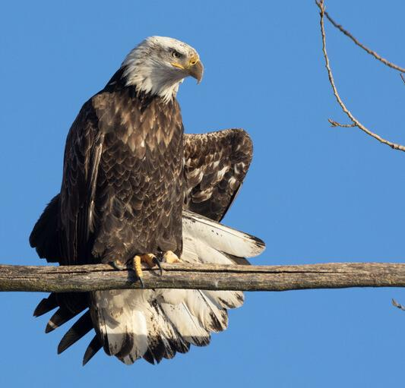
4B
Exploring Missouri – 4B Inspired by Animals: Elaborate
22
Notes:
Draw a picture of an eagle and circle the eyes.
Animal in picture: Bald Eagle

Slide 23
What invention could help you see further like a hawk or eagle?
4B
Exploring Missouri – 4B Inspired by Animals: Elaborate
23
Notes:
(Binoculars)

Slide 24
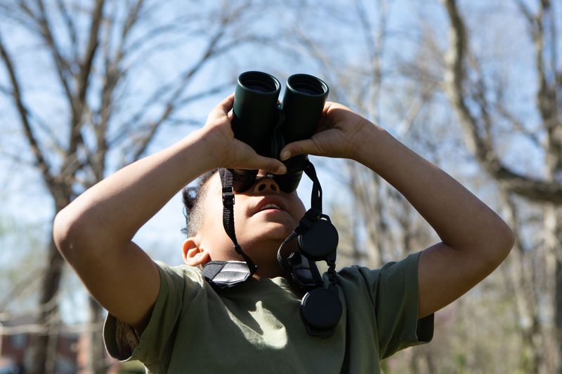
4B
Exploring Missouri – 4B Inspired by Animals: Elaborate
24

Slide 25
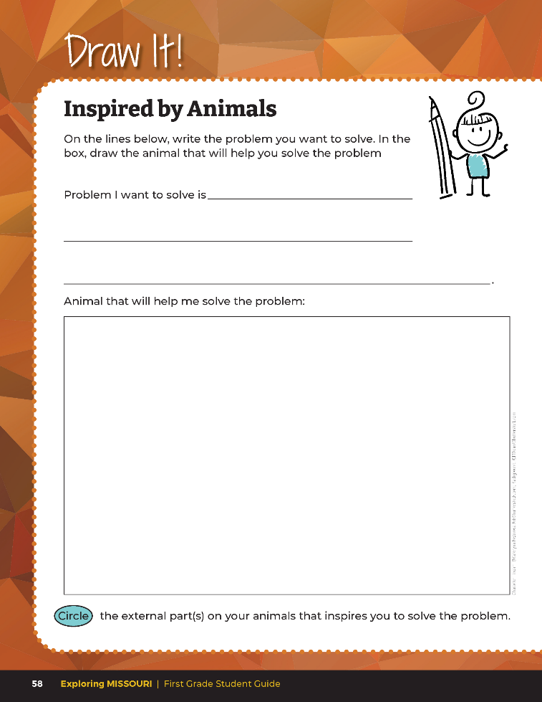
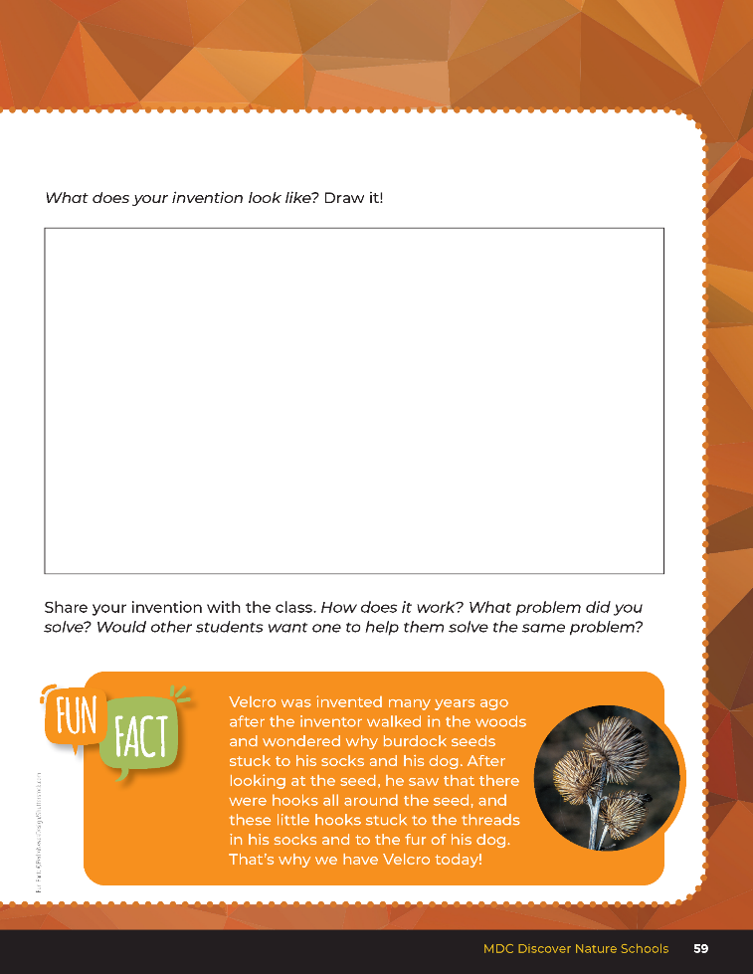
4B
Exploring Missouri – 4B Inspired by Animals: Elaborate
25
Notes:
Students will choose one animal to inspire a solution of the human problems listed on the board. Teachers could also leave this open-ended and have students provide their own scenario. Refer to the Missouri Armored Animals Class Book for ideas.
Students will design a solution for the scenario based on the animal’s external parts. Have students draw plans for their solutions in their student book, using sketches and descriptions. Space for this is in student guide Draw It! Inspired by Animals section on pages 58-59.
Teacher Note: Students should not replace their own body parts with parts from the animal, but design an invention based on the external part of the animal.
After students receive feedback, allow them to adjust their model. Have students build or carry out the solution. This can be presented as a 3-D model, sketch, picture, or something else. Allow students to be creative in how they create the final project.

Slide 26
Time to share our inventions with the class!
4B
Exploring Missouri – 4B Inspired by Animals: Elaborate
26
Notes:
Allow students time to share their inventions with the class. Use the Design Rubric on Page 80 to evaluate student ideas. Students should define external part used and how it addresses the problem presented.
Design Rubric:
4 (Exceeds) – Explanations indicated a clear and accurate understanding of external parts that were used.
3 (Meets) – Explanations indicated a relatively accurate understanding of external parts that were used.
2 (Partially meets) – Explanations indicated a partial understanding of external parts that were used.
1 (Doesn’t meet) – Explanations did not indicate much of an understanding of external parts that were used.

Slide 27
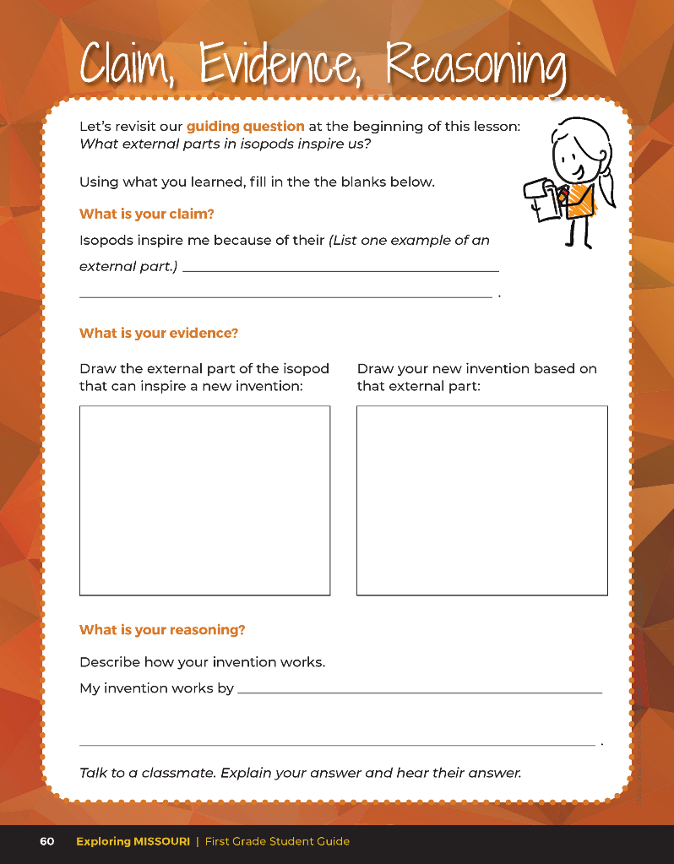
Guiding Question:
What external parts in isopods inspire us?
4B
Exploring Missouri – 4B Inspired by Animals: Evaluate
27
Notes:
After exploring the concept of how external parts of animals can inspire human inventions, have students open their student guides to the Claim, Evidence, Reasoning section on Page 60. Discuss the page with the students – read the guiding questions by filling in the blanks and drawings pictures.
Rubric:
3 (Meets) – Students can define and identify one external part of an isopod. Students provide an idea of how the external part can help to solve a human problem. Students fill in the blank for the correct claim, draw the correct evidence statement, and identify the correct reason.
2 (Partially meets) – Students can define and identify one external part of an isopod. Students do not provide an idea of how the external part can help to solve a human problem. Two of the three CER are correct.
1 (Doesn’t meet) – Students cannot answer the above questions. One of the three components of CER is correct.

Slide 28
Answers
Answers will vary
4B
Exploring Missouri – 4B Inspired by Animals: Evaluate
28
Notes:
After exploring the concept of how external parts of animals can inspire human inventions, have students open their student guides to the Claim, Evidence, Reasoning section on Page 60. Discuss the page with the students – read the guiding questions by filling in the blanks and drawings pictures.
Rubric:
3 (Meets) – Students can define and identify one external part of an isopod. Students provide an idea of how the external part can help to solve a human problem. Students fill in the blank for the correct claim, draw the correct evidence statement, and identify the correct reason.
2 (Partially meets) – Students can define and identify one external part of an isopod. Students do not provide an idea of how the external part can help to solve a human problem. Two of the three CER are correct.
1 (Doesn’t meet) – Students cannot answer the above questions. One of the three components of CER is correct.

Slide 29

Optional: Cross-Curricular Extension
English Language Arts
Write a short story where you pretend to be an armored animal. Tell about how your armor protects you from danger and other experiences within your day. Add pictures to help tell your story.
4B
Exploring Missouri – 4B Inspired by Animals: Cross-Curricular Extensions
29
Notes:
English Language Arts
Write a short story where you pretend to be an armored animal. Tell about how your armor protects you from danger and other experiences within your day. Add pictures to help tell your story.

Slide 30
Optional: Cross-Curricular Extension
Art
Collaborate or involve the art teacher. Make vest using large paper grocery bags and have each student create their own armor.
4B
Exploring Missouri – 4B Inspired by Animals: Cross-Curricular Extensions
30
Notes:
Art
Collaborate or involve the art teacher. Make vests using large paper grocery bags and have each student create their own armor.

