Slide 1
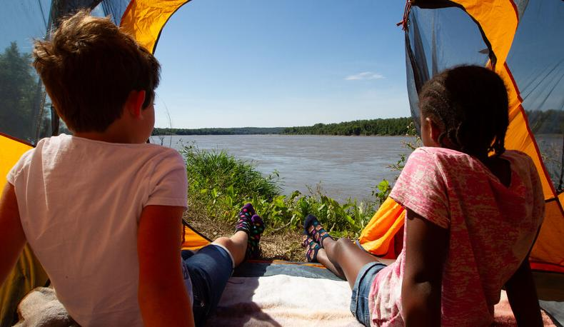

Life and Land in
MISSOURI
4B: Building a Nice Nest

Slide 2
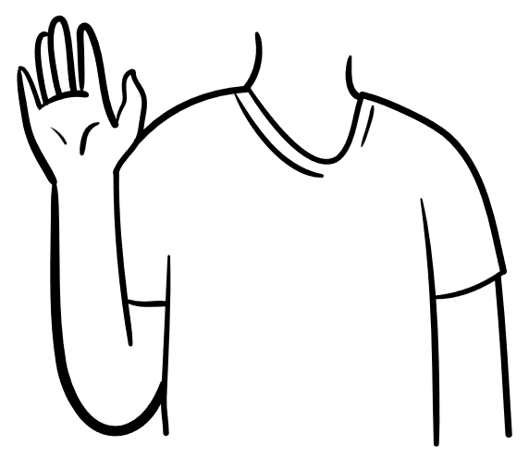
Raise your hand if you have seen a bird’s nest!
4B
Life and Land in Missouri – 4B Building a Nice Nest: Engage
2
Notes:
Raise your hand if you have seen a bird’s nest.

Slide 3
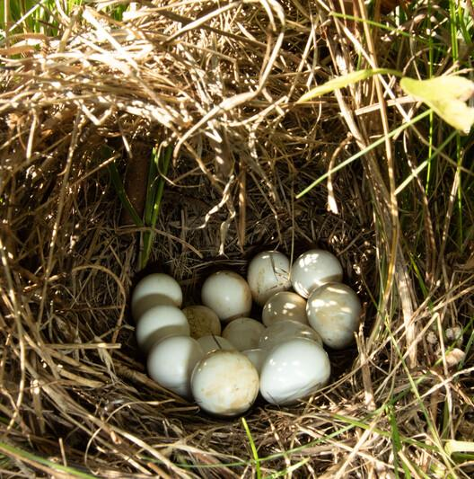
What did it look like?
What was it made from?
4B
Life and Land in Missouri – 4B Building a Nice Nest: Engage
3
Notes:
Eggs in Picture: bobwhite quail

Slide 4
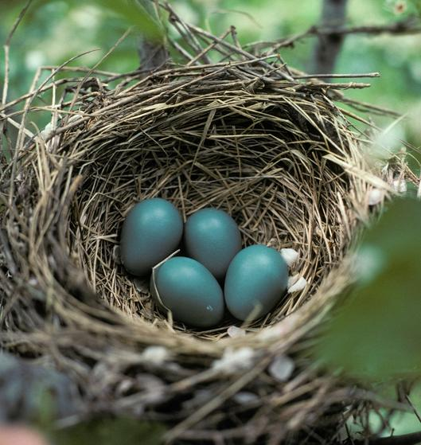
Why do you think birds make nests?
4B
Life and Land in Missouri – 4B Building a Nice Nest: Engage
4
Notes:
Allow students time to share their experiences and predictions.
Eggs in Picture: American robin

Slide 5
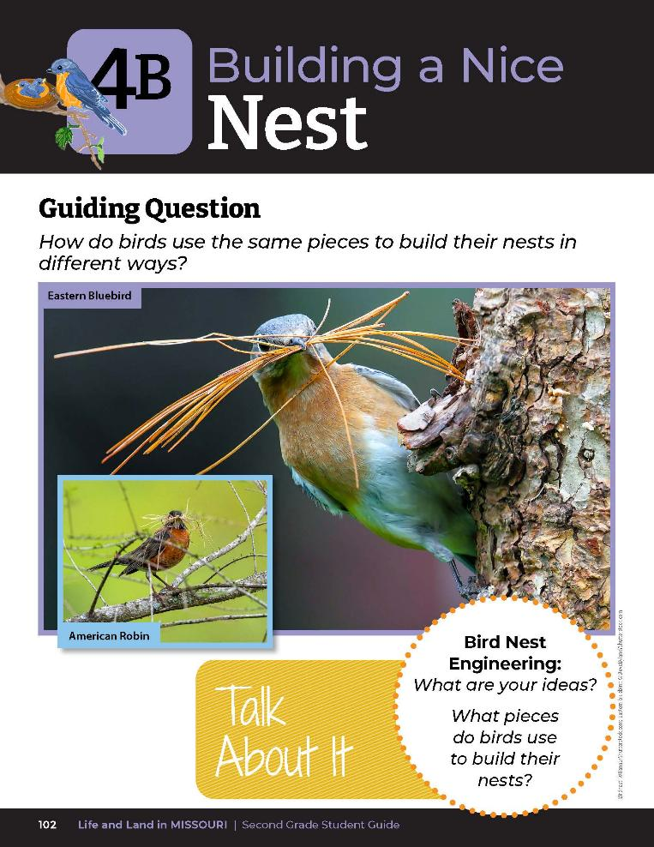
How do birds use the same pieces to build their nests in different ways?
What pieces do birds use to build their nest?
4B
Life and Land in Missouri – 4B Building a Nice Nest: Engage
5
Notes:
Discuss the Talk About It!
Guiding Question: How do birds use the same pieces to build their nests in different ways?

Slide 6
American Robin
Barn Swallow
Ruby-throated Hummingbird
Baltimore Oriole
Carolina Wren
Great Blue Heron
Wild Turkey
4B
Life and Land in Missouri – 4B Building a Nice Nest: Explore
6
Notes:
Write the following bird species on the board:
American robin
Barn swallow
Ruby-throated hummingbird
Baltimore oriole
Carolina wren
Great blue heron
Wild turkey
(Teacher Note: The pileated woodpecker and the peregrine falcon are not on this list as students will not have the capabilities to create a cavity or scrape a surface for their Build a Nest activity.)

Slide 7
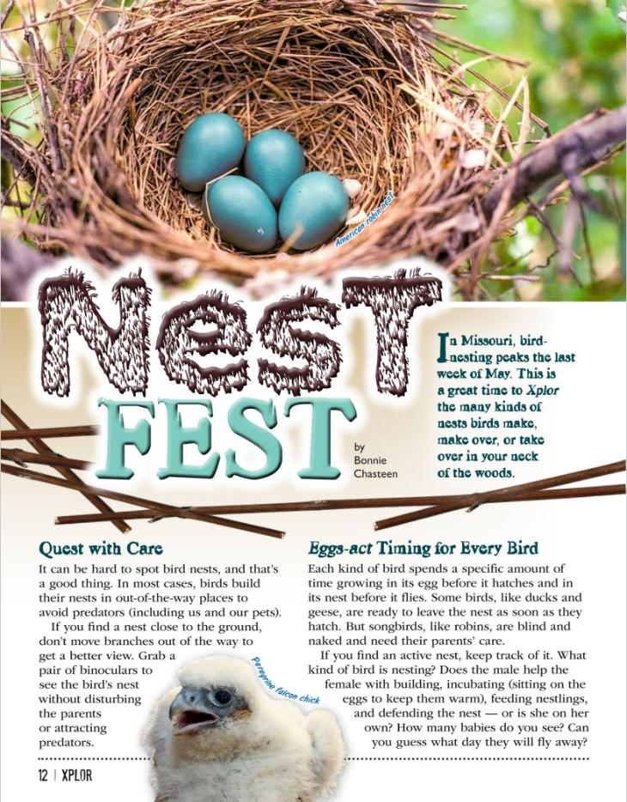
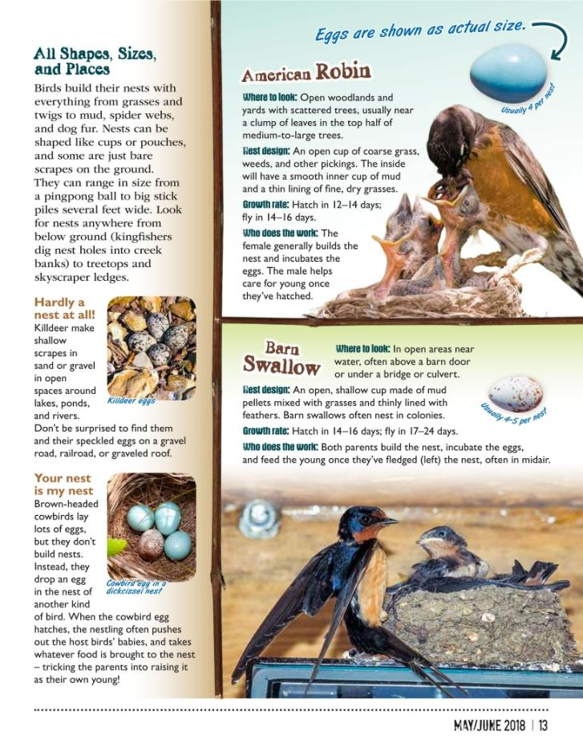
Link to Article:
Xplor Magazine May_June 2018
4B
Life and Land in Missouri – 4B Building a Nice Nest: Explore
7
Notes:
From the MDC Teacher Portal, display Nest Fest by Bonnie Chasteen from May/June 2018 issue of Xplor.

Slide 8
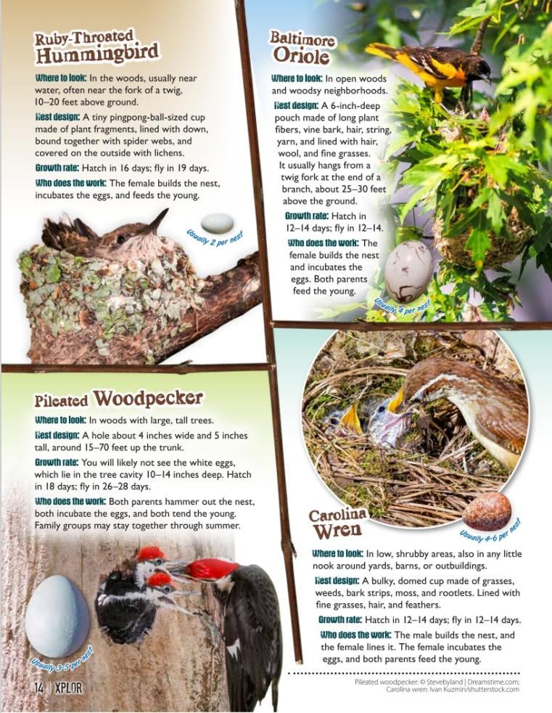
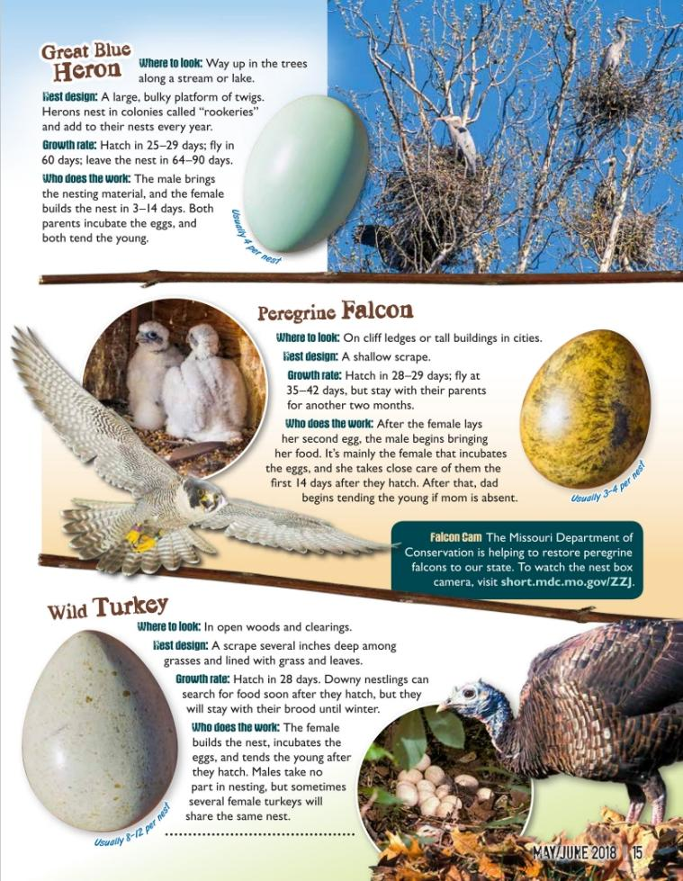
4B
Life and Land in Missouri – 4B Building a Nice Nest: Explore
8
Notes:
.

Slide 9
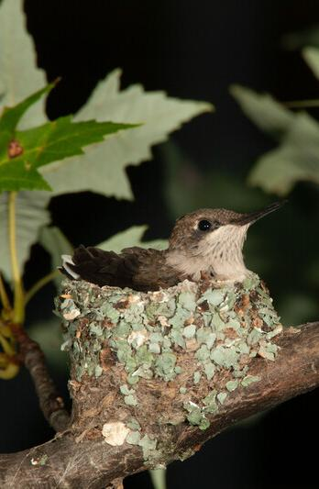
What materials did the different birds use to build their different nests?
How did the birds shape the materials into a nest?
4B
Life and Land in Missouri – 4B Building a Nice Nest: Explore
9
Notes:
Animal in Picture: ruby-throated hummingbird

Slide 10

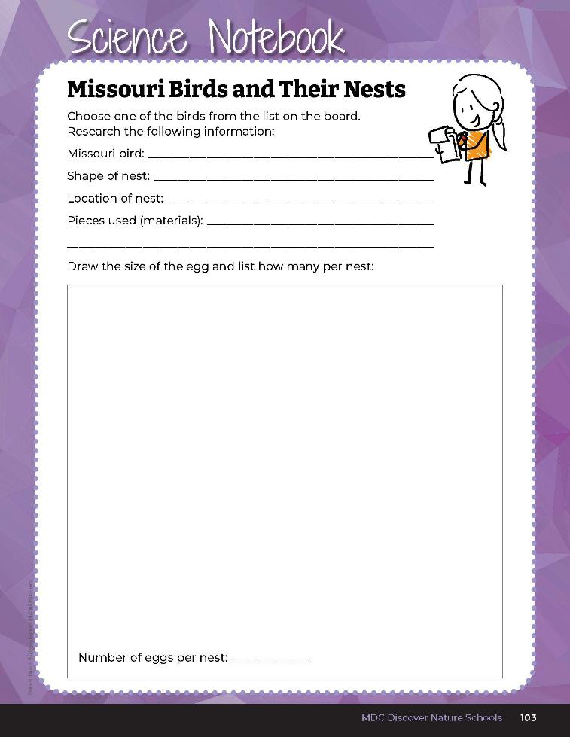
Research one bird to study and record information.
4B
Life and Land in Missouri – 4B Building a Nice Nest: Explore
10
Notes:
Allow students time to choose one bird to study from the list and answer the question, using the information from the Xplor article. Students can record information in the Science Notebook 4B Missouri Birds and Their Nests section on Page 103.

Slide 11
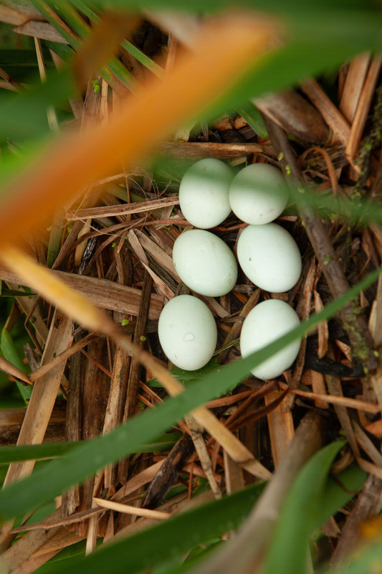
Which design do you think would keep the eggs from blowing out in a storm best?
4B
Life and Land in Missouri – 4B Building a Nice Nest: Explore
11
Notes:
Refer to previously read pages in student guide for photos of different nest types found in nature.
Eggs in Picture: Least Bittern

Slide 12
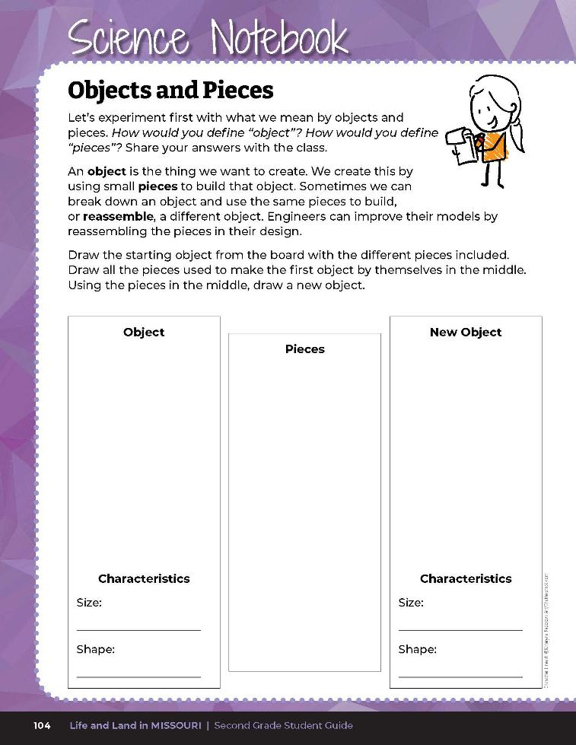
How would you define “object”?
How would you define “pieces”?
4B
Life and Land in Missouri – 4B Building a Nice Nest: Explain
12
Notes:
As we research bird nest, we need to identify what we mean by objects and pieces. Have students turn to their Science Notebook 4B Objects and Pieces diagram on Page 104.
Write students answers on the board. An object is the thing we are wanting to create. We create this by using small pieces to build that object. Sometimes we can break down an object and use the same pieces to build, or reassemble, a different object. Engineers can improve their models by reassembling the pieces in their design.

Slide 13
Draw your shape, outlining and numbering the different blocks.
4B
Life and Land in Missouri – 4B Building a Nice Nest: Explain
13
Notes:
Distribute 7-8 different sized blocks to students. Have them assemble their blocks into a shape. Have them draw their shape, outlining and numbering the different blocks, in the Object box of the Science Notebook Objects and Pieces diagram.

Slide 14
How would you describe the size and shape of the object?
4B
Life and Land in Missouri – 4B Building a Nice Nest: Explain
14
Notes:
Allow students time to draw and write their observations and share.

Slide 15
How would you describe the size and shape of your new object?
4B
Life and Land in Missouri – 4B Building a Nice Nest: Explain
15
Notes:
Now we are going to disassemble the object into pieces. Have students draw the different pieces from the first object they drew in the Pieces box. Now have them reassemble those same pieces into a new shape and draw and number their pieces. How would you describe the size and shape of your new object? Use the 4B Objects and Pieces Example Answer Key as a guide.

Slide 16
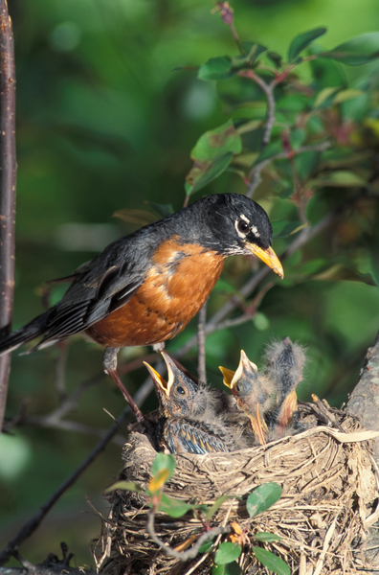
How is this activity like when a bird builds its nest?
What does the bird need to have to build its nest – or its object?
4B
Life and Land in Missouri – 4B Building a Nice Nest: Explain
16
Notes:
Animal in Picture: American robin

Slide 17
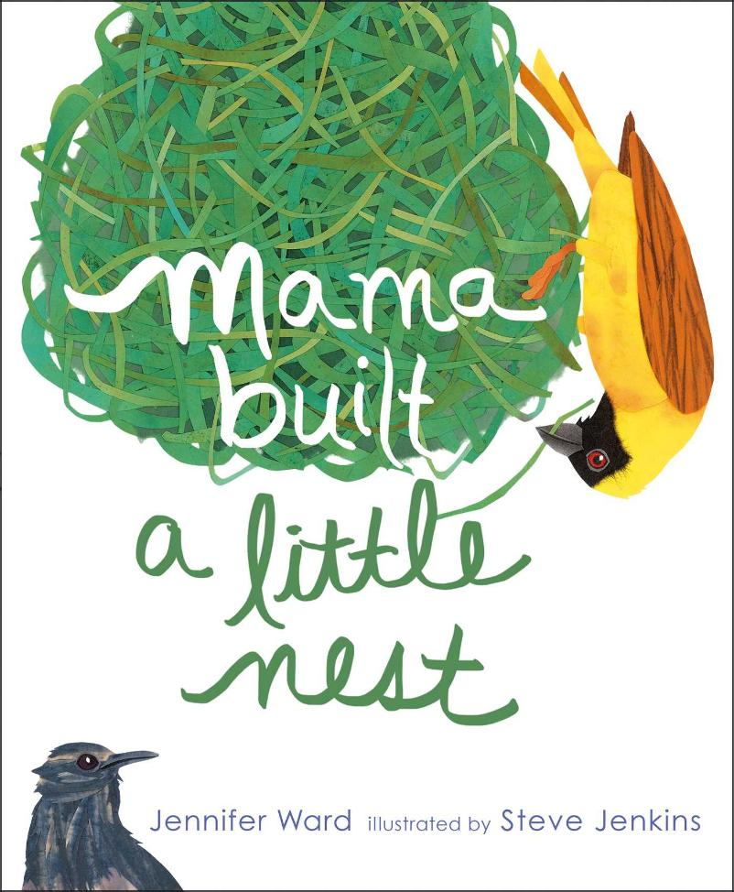
Read the book Mama Built a Little Nest by Jennifer Ward.
Read Aloud:
https://www.youtube.com/watch?v=xrcPzjgRuIg
4B
Life and Land in Missouri – 4B Building a Nice Nest: Explain
17
Notes:
Read the book Mama Built a Little Nest by Jennifer Ward. Discuss the different types of nest that the birds built.

Slide 18
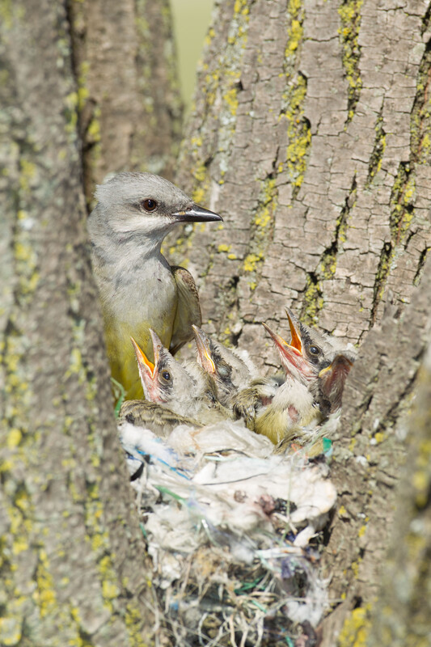
What is the object the birds are building?
4B
Life and Land in Missouri – 4B Building a Nice Nest: Explain
18
Notes:
Animal in Picture: Western Kingbird

Slide 19
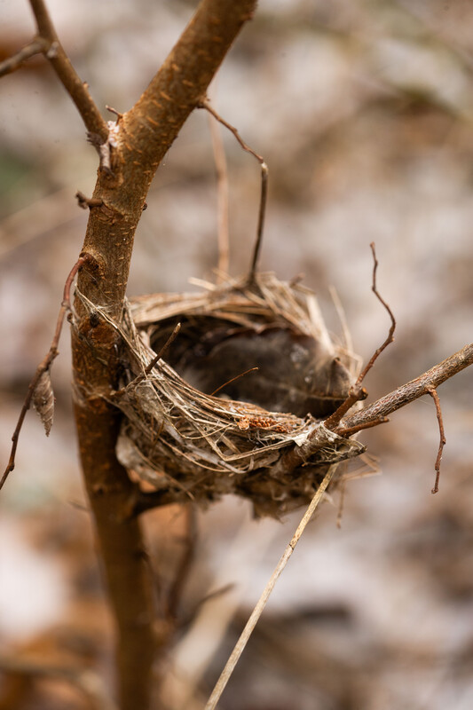
What pieces are they using in the book to build their object?
4B
Life and Land in Missouri – 4B Building a Nice Nest: Explain
19
Notes:
Bird Nest

Slide 20
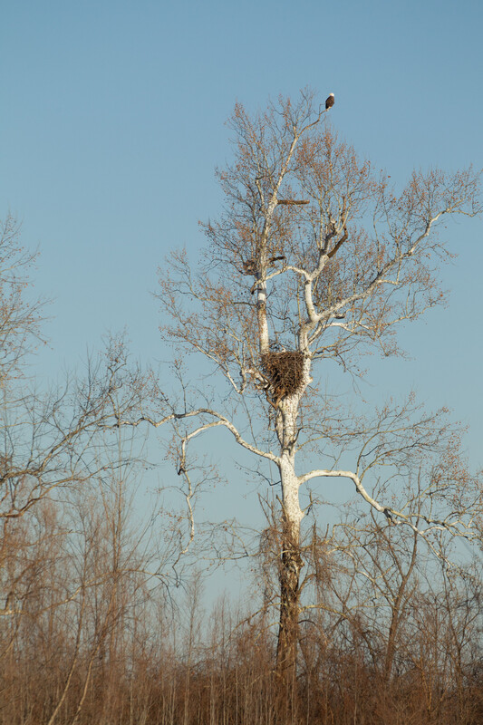
Can you find any nests?
4B
Life and Land in Missouri – 4B Building a Nice Nest: Explain
20
Notes:
Go outside and talk a walk in an area with trees. Have your students look above them.
Animal and nest in Picture: Bald Eagle; Plant in Picture: Sycamore tree

Slide 21
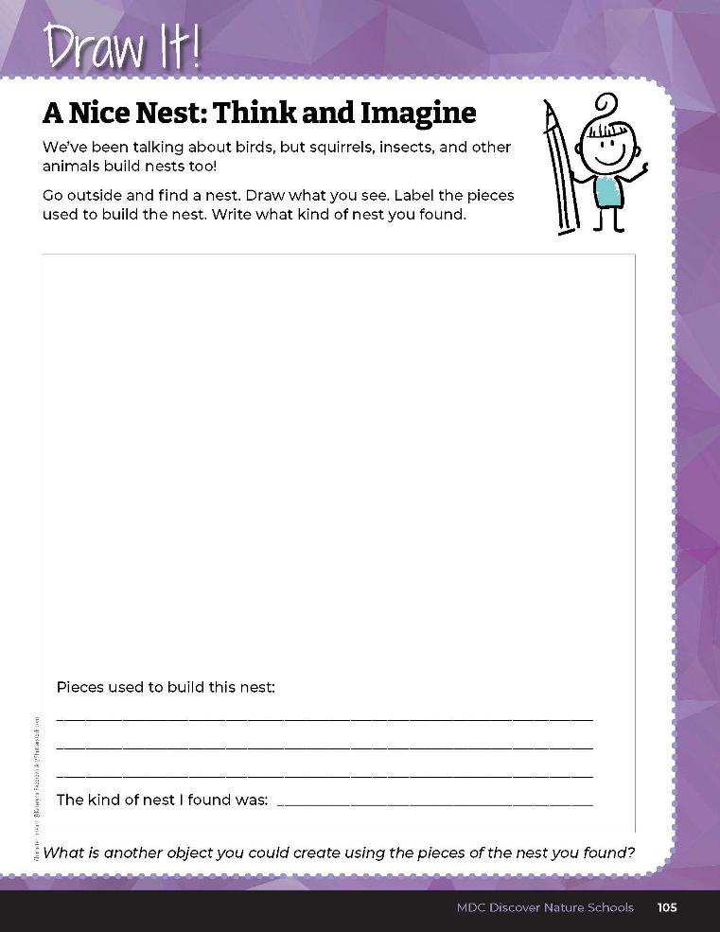

Draw the nest you found and label the pieces used to build the nest.
4B
Life and Land in Missouri – 4B Building a Nice Nest: Explain
21
Notes:
If you find one, sketch it in the student guide Draw It! 4B A Nice Nest: Think and Imagine section on Page 105 and label the pieces used.

Slide 22
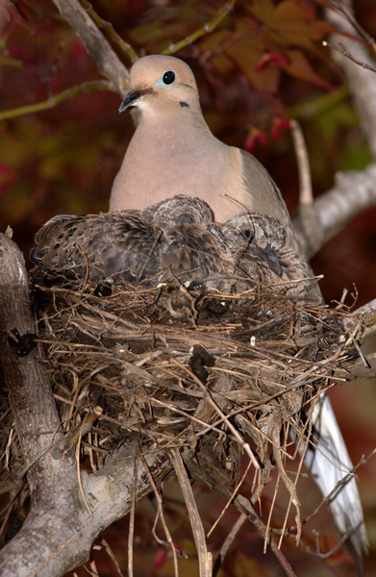
What materials, or pieces, were used to build the nest?
4B
Life and Land in Missouri – 4B Building a Nice Nest: Explain
22
Notes:
Animal in Picture: Mourning Dove on nest

Slide 23
Could the pieces be reassembled into another object?
4B
Life and Land in Missouri – 4B Building a Nice Nest: Explain
23

Slide 24
Designing a Nest Activity!
Decide on which bird to model your nest after and determine the number of eggs.
4B
Life and Land in Missouri – 4B Building a Nice Nest: Explain
24
Notes:
Designing a Nest Activity
Have students look at their Science Notebook: Missouri Birds and Their Nests page and divide students into groups of 3-4. Once in their groups, they will need to decide on which bird to model their nest and determine number of eggs. You will want to give them plenty of time to conduct the wind test and improve their nest design at least 3 times using the same materials or pieces for each nest design.

Slide 25
Design Goals:
You must first design your egg(s).
The egg(s) must fit in the nest.
You can only use the materials collected or provided.
The design needs to keep the eggs in the nest in our windstorm.
4B
Life and Land in Missouri – 4B Building a Nice Nest: Explain
25
Notes:
Your group is going to design a nest for your bird’s eggs. The size and shape should resemble your chosen bird’s actual nest and it should resemble your chosen bird’s actual nest and it should hold the number of eggs your bird usually lays. For eggs, you can use wads of paper or anything else similar in size and shape to your bird’s real eggs.
Write design goals on the board:
You must first design your egg(s).
The egg(s) must fit in the nest.
You can only use the materials collected or provided. (Allow time for students to go outside and collect the appropriate materials for their nest.)
The design needs to keep the eggs in the nest in our windstorm. (Show students what you are going to use to create the wind, such as a blow dryer on low setting or a fan, and let them feel how hard the wind is going to blow.)
You can set any other design parameters you need for this to work in your classroom, such as time.

Slide 26
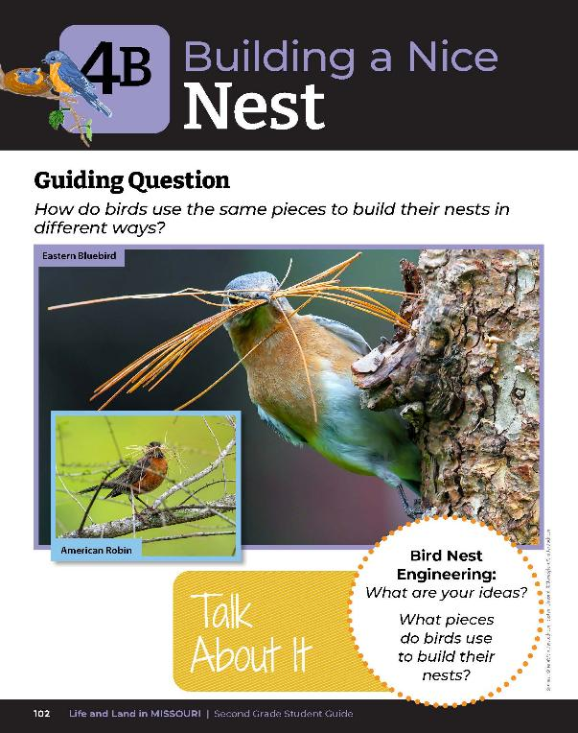
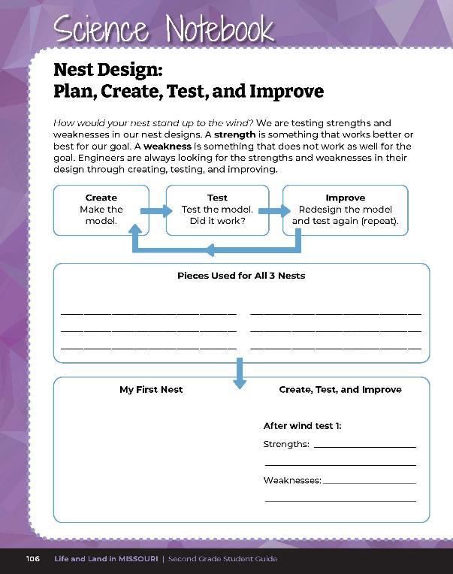
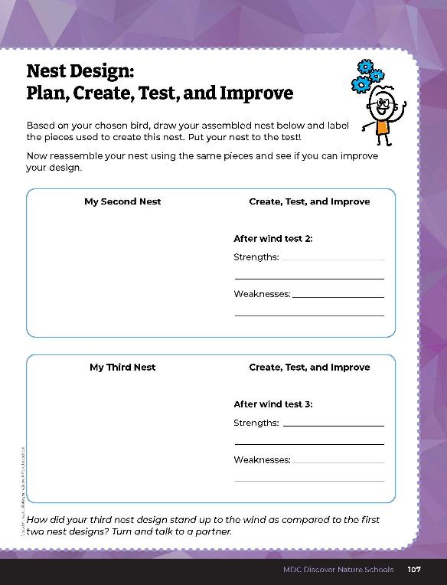
Test the nest and identify the strengths and weaknesses for the goal and improvements you made!
4B
Life and Land in Missouri – 4B Building a Nice Nest: Explain
26
Notes:
Test the nests so everyone can see the results. Have the students record this information and identify the strengths (what worked well) and the weaknesses (what didn’t work as well) for the goal and the improvements they made on student guide Science Notebook 4B Nest Design: Plan, Create, Test, and Improve pages 106-107. Allow students time to share the comparisons of each nest design and how each withstood the wind test.

Slide 27
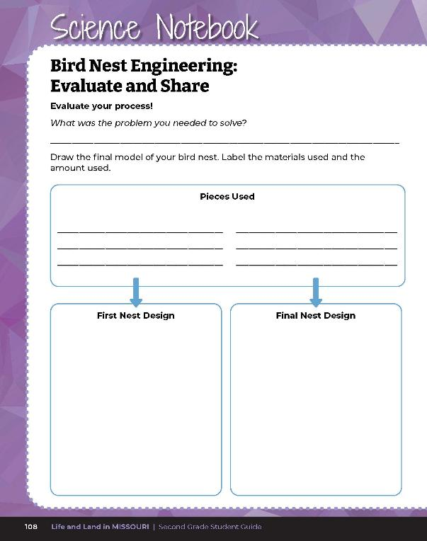
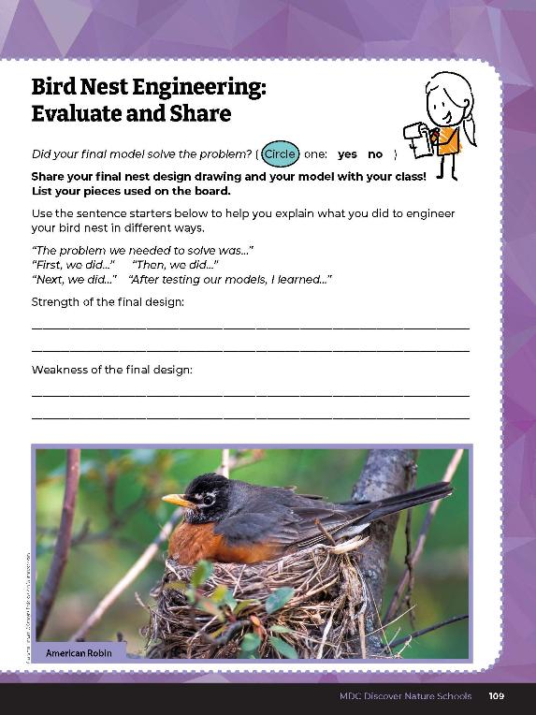
Guiding Question: How do birds use the same pieces to build their nests in different ways?
4B
Life and Land in Missouri – 4B Building a Nice Nest: Explain
27
Notes:
After exploring the concept of breaking objects into small pieces and reassembling into new objects using the same pieces, have students open their student guides to the Science Notebook 4B Bird Nest Engineering: Evaluate and Share section on pages 108-109 and complete the exercises.

Slide 28
Answers will vary
Guiding Question: How do birds use the same pieces to build their nests in different ways?
4B
Life and Land in Missouri – 4B Building a Nice Nest: Explain
28
Notes:
Rubric:
3 (Exceeds) – Student group correctly explains the problem they needed to solve and draws their first design on the board. Group lists the pieces used and displays and demonstrates the bird nest they built. Each group member presents. Each student draws their first next design and their final nest design and lists the materials used. Student shares 1 strength of the final design and 1 weakness of the final design.
2 (Meets) – Student group somewhat correctly explains the problem they needed to solve and may or may not draw their first design on the board. Group lists some of the pieces used and displays and demonstrates the bird nest they built. Hald of the group members presents. Each student somewhat draws their first next design and their final nest design and may or may not list the materials used. Student may or may not share 1 strength of the final design or 1 weakness of the final design.
1 (Doesn’t meet) – Student group does not correctly explain the problem they needed to solve and does not draw their first design on the board. Group does not list the pieces used and does not display or demonstrate the bird nest they built. One group member presents. Student does not complete their drawing or list materials used. Student does not share a strength or weakness of their final design.

