Slide 1
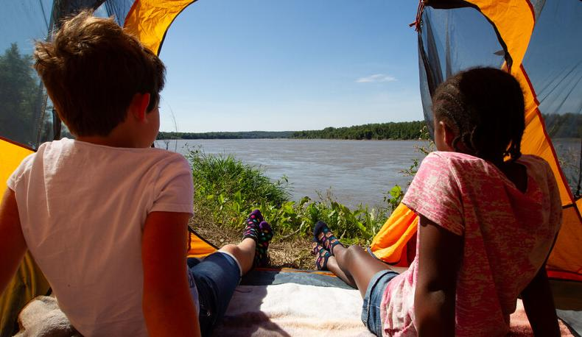

Life and Land in
MISSOURI
4A: Building a Better Bird Feeder

Slide 2
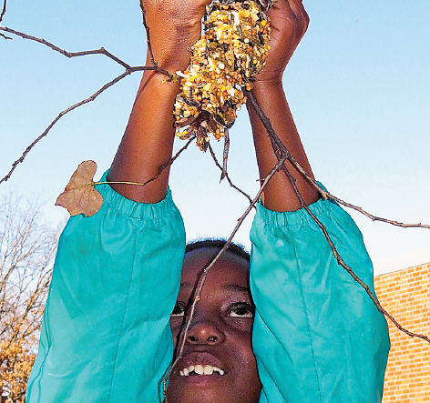
Guiding Question:
How do materials in a pinecone feeder affect the amount of birdseed that sticks to it?
4A
Life and Land in Missouri – 4A Building a Better Bird Feeder: Engage
2

Slide 3
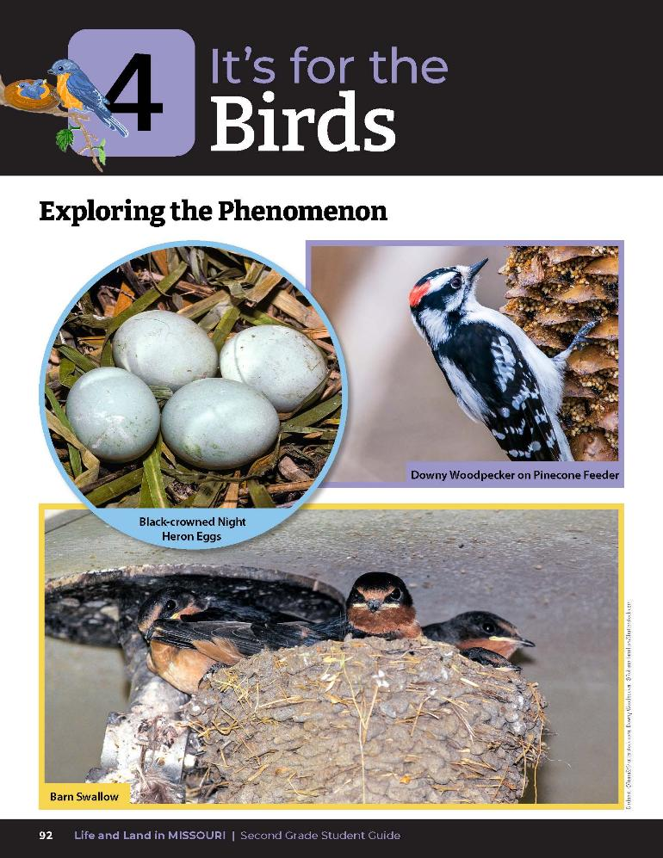
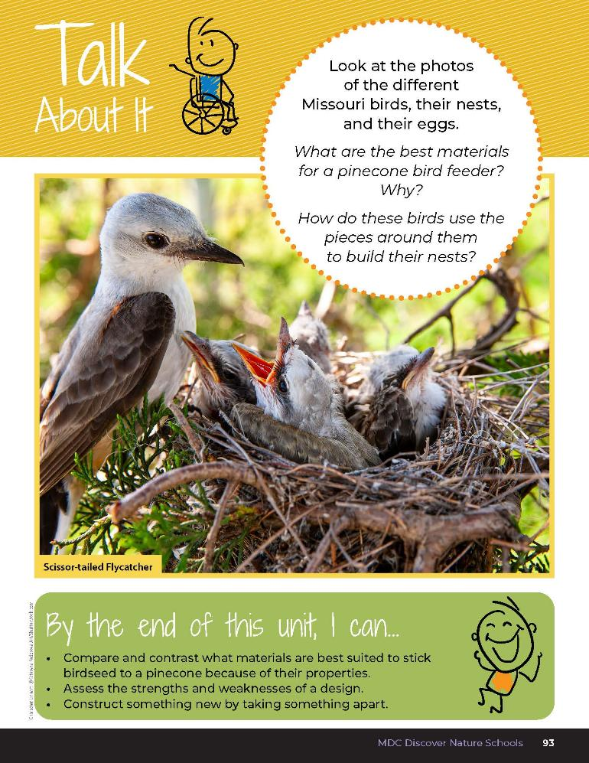
4A
Life and Land in Missouri – 4A Building a Better Bird Feeder: Engage
3
Notes:
Have students open their student guide to the Unit 4 Exploring the Phenomenon section on pages 92-93. Discuss the Talk About It. Look at the photos of the different Missouri birds, their nests, and their eggs.

Slide 4
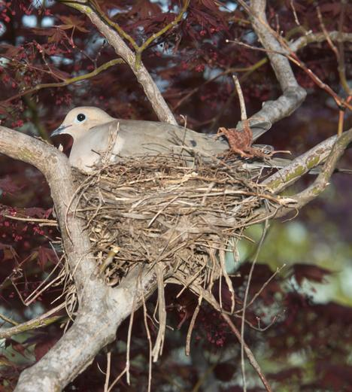
How do you know it is a bird’s nest?
What helps them build a strong nest?
Why are they shaped that way?
4A
Life and Land in Missouri – 4A Building a Better Bird Feeder: Engage
4
Notes:
Animal in Picture: Mourning dove on nest

Slide 5
Watch the Backyard Bird Feeding Video.
Link:
https://www.youtube.com/watch?v=FbRpxnvvsD0
4A
Life and Land in Missouri – 4A Building a Better Bird Feeder: Engage
5
Notes:
Teacher Note: This activity works best in winter when the weather has turned cold. Repeat this activity in the schoolyard or on a field experience throughout fall, winter, and spring. Have students make the same observations of birds and write and draw the types and number of birds they observe. Watch the Backyard Bird Feeding Video from the MDC Teacher Portal.

Slide 6
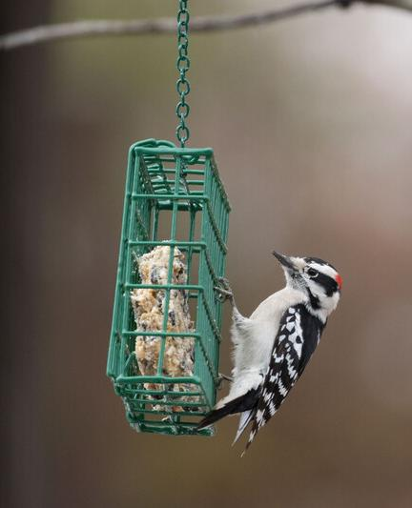
After watching the video, what kinds of foods did you notice in the feeders?
4A
Life and Land in Missouri – 4A Building a Better Bird Feeder: Engage
6
Notes:
Animal in Picture: downy woodpecker

Slide 7
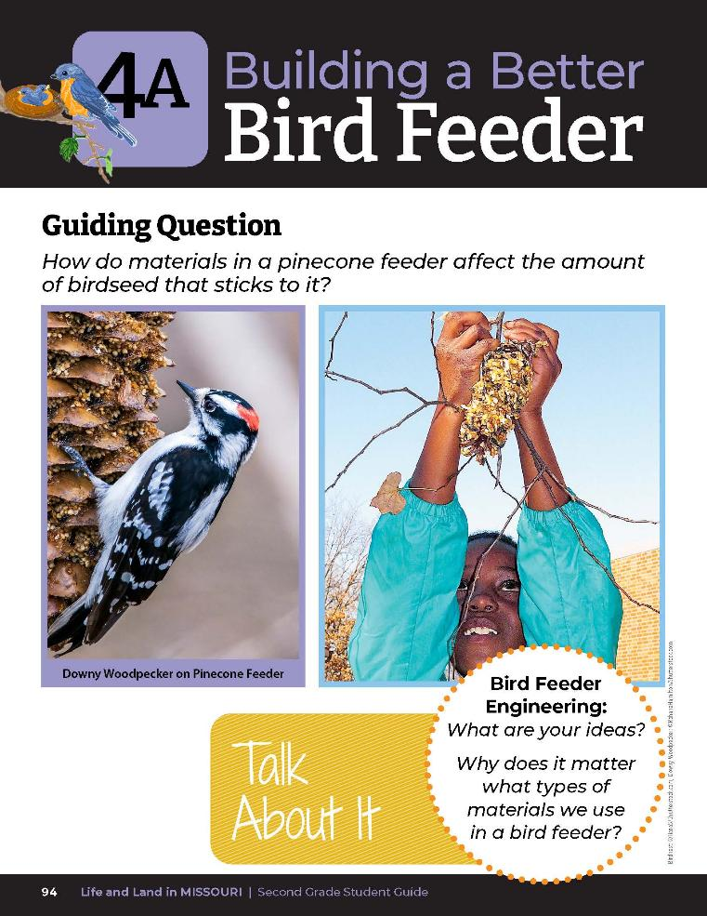
What is the question we are asking or the problem we are trying to solve?
4A
Life and Land in Missouri – 4A Building a Better Bird Feeder: Engage
7
Notes:
Today we will become engineers and build a pinecone feeder to attract birds by testing materials first. Have students turn to their Lesson 4A Building a Better Bird Feeder introduction on Page 94. What is the question we are asking or the problem we are trying to solve? (How do materials in a pinecone feeder affect the amount of birdseed that sticks to it?) Bird feeder activity continues under Explore on next page.

Slide 8
Optional Birdwatching Activity
10
6
X
MINUTES
DAYS
4A
Life and Land in Missouri – 4A Building a Better Bird Feeder: Engage
8

Slide 9
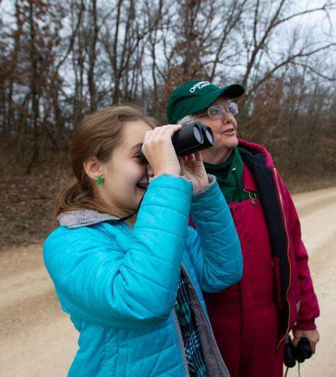
Let’s learn to bird!
First, we need field guides to help us identify different types of birds we may see.
4A
Life and Land in Missouri – 4A Building a Better Bird Feeder: Engage
8
Notes:
Let’s learn to bird! First, we need field guides to help us identify different types of birds we may see. Provide the You Discover Backyard Birds Field Guide Booklet from the MDC Teacher Portal and a Feeding backyard Birds poster to identify birds.

Slide 10
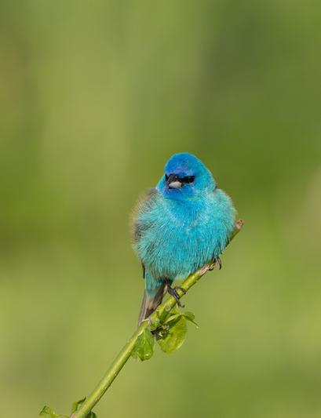
Are all birds the same or different?
How are they different?
What characteristics can we look for?
4A
Life and Land in Missouri – 4A Building a Better Bird Feeder: Engage
9
Notes:
Animal in Picture: indigo bunting

Slide 11
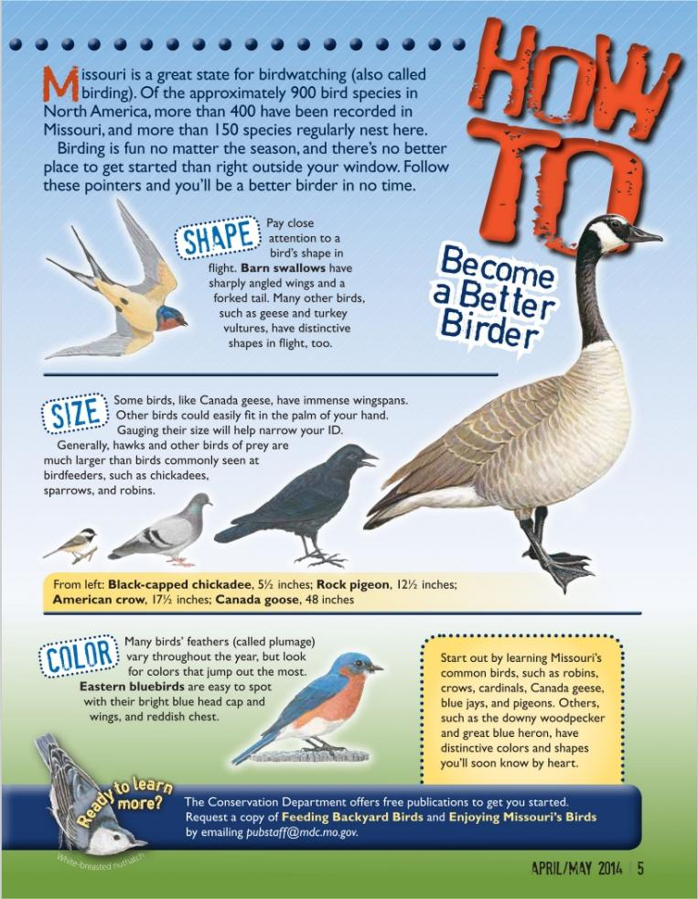
4A
Life and Land in Missouri – 4A Building a Better Bird Feeder: Engage
10
Notes:
Provide the handout of the How to Become a Better Birder article from Xplor magazine, link on Teacher Portal: Xplor Magazine April_May 2014. Review that good birders look for shape, size, and color of birds.

Slide 12
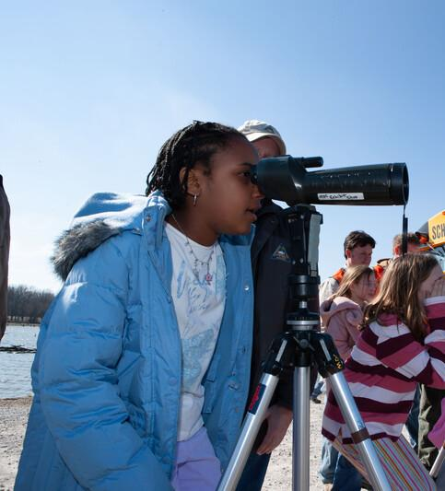
What other tools do birders use?
4A
Life and Land in Missouri – 4A Building a Better Bird Feeder: Engage
9

Slide 13
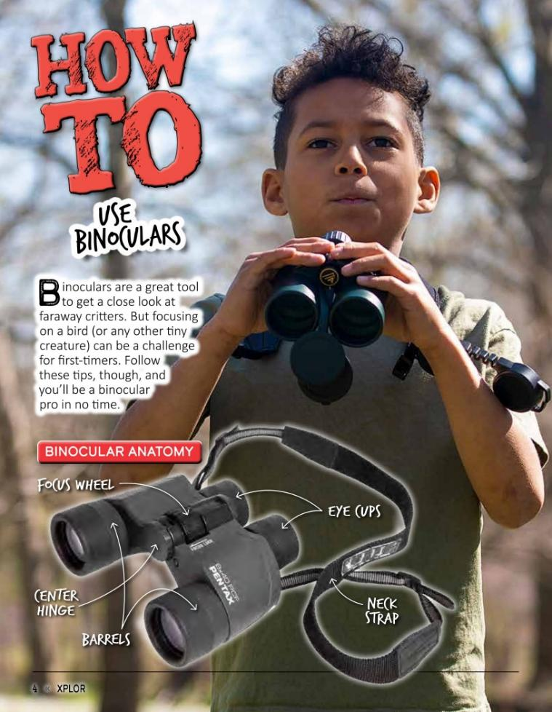
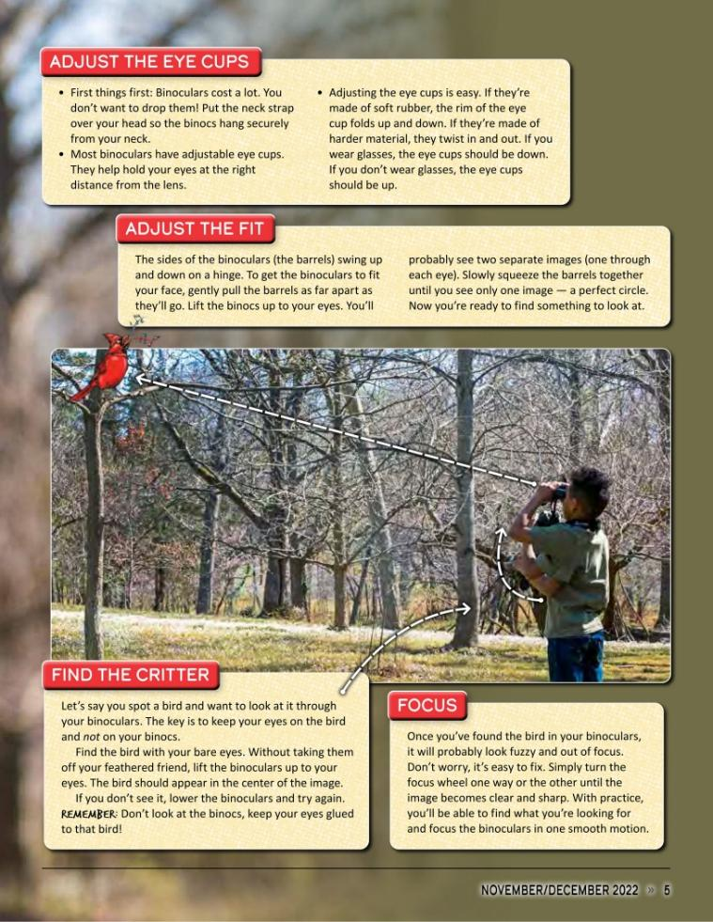
4A
Life and Land in Missouri – 4A Building a Better Bird Feeder: Engage
13
Notes:
Distribute binoculars to student groups. Display the How to Use Binoculars article from Xplor magazine and practice using binoculars in the classroom.

Slide 14
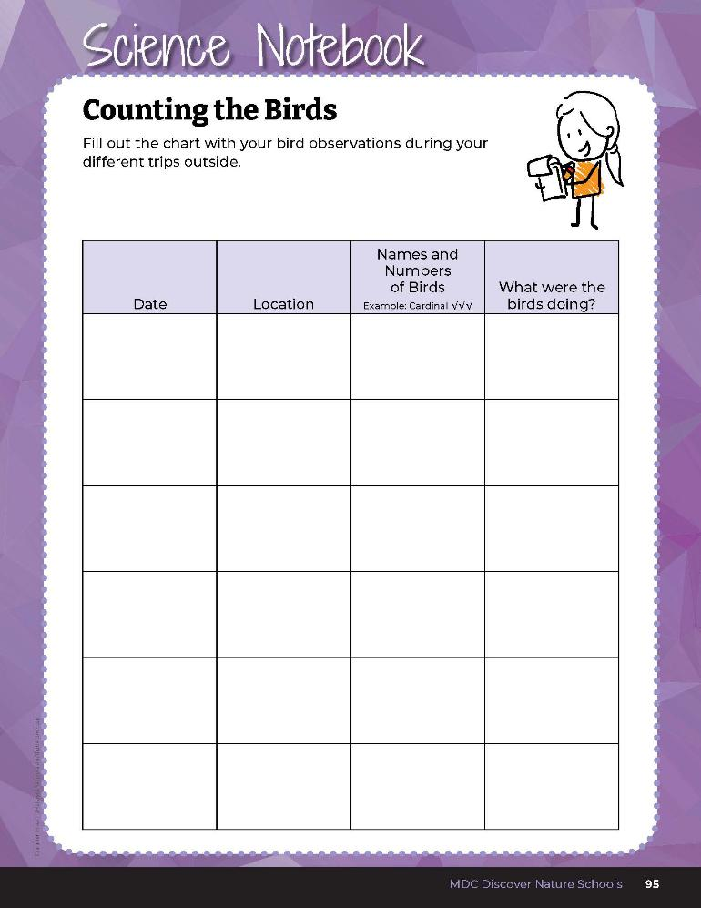

Record your observations.
4A
Life and Land in Missouri – 4A Building a Better Bird Feeder: Engage
14
Notes:
Go outside to your schoolyard or to you field experience, Have students use Science Notebook 4A Counting the Birds on Page 95 to record their observations.

Slide 15
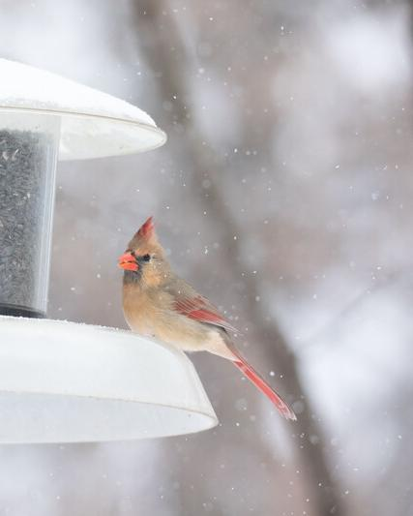
So how can we attract Missouri birds to our area?
What materials and seed should we use?
4A
Life and Land in Missouri – 4A Building a Better Bird Feeder: Engage
15
Notes:
Animal in Picture: northern cardinal (female)

Slide 16
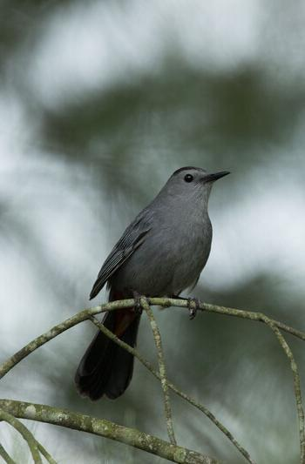
What birds did you see and record?
Were there any kinds of birds that you saw on the previous field experience that you did not see now?
4A
Life and Land in Missouri – 4A Building a Better Bird Feeder: Engage
16
Notes:
Discussion questions to ask after seasonal observations in the winter and spring:
Animal in Picture: Gray Cat Bird

Slide 17
Was the weather different during the different seasons?
How will this affect the birds or even the types of birds we may see in different months?
4A
Life and Land in Missouri – 4A Building a Better Bird Feeder: Engage
17
Notes:
Possible reasons:
Students may observe fewer birds in the winter because some of the Missouri birds have migrated south for the winter. Some examples of birds that migrate south from Missouri in winter are killdeer, sandpipers, easter phoebes, ruby-throated hummingbirds, purple martins, brown thrashers, and pine warblers.
Students may observe more birds because some birds from the northern U.S. and Canada migrate to Missouri during the winter. Birds that come to Missouri for the winter are ducks, snipe, short-eared owls, some finches, sparrows, dark-eyed juncos, and hawks.
Students will observe more birds at the field experience area if there are bird feeders. Birds that are permanent residents of Missouri do not migrate during winter; these include the cardinal, blue jay, Carolina wren, and different species of finches, sparrows, and woodpeckers.

Slide 18
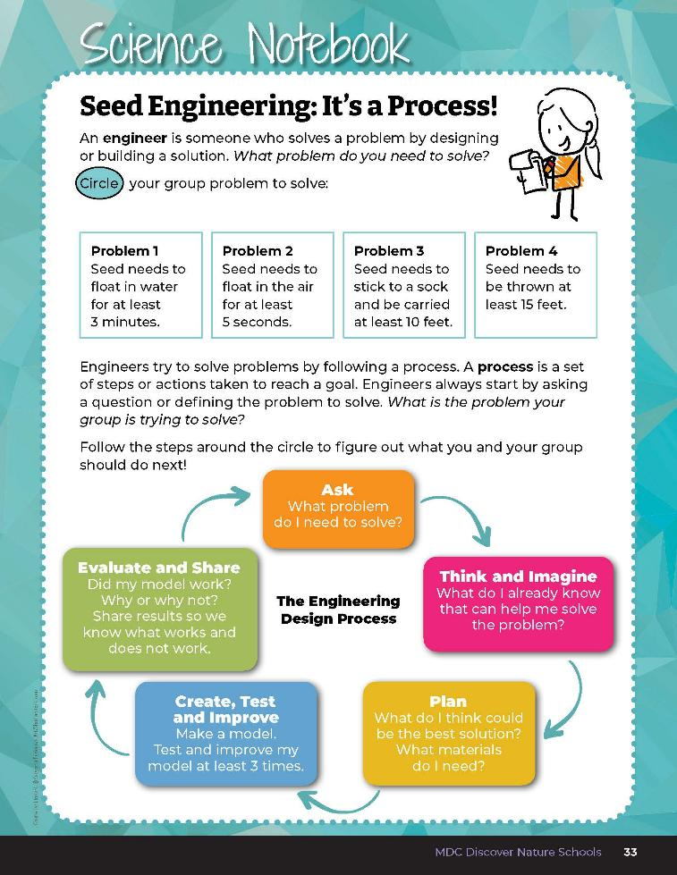
How do bird feeders work?
Because we are bird feeder engineers, let’s review the Engineering Design Process and walk through the engineering steps.
4A
Life and Land in Missouri – 4A Building a Better Bird Feeder: Explore
18
Notes:
Teacher Note: Preparation may be done the day prior to this activity (10-15 minutes). Encourage students to brainstorm their own ideas and allow them to bring in materials to test by telling them about the activity a day or two before actually making the pinecone bird feeders.
How do bird feeders work? Because we are bird feeder engineers, let’s review the Engineering Design Process and walk through the engineering steps again. Have students turn to Seed Engineering: It’s a Process in their student guides on page 33 and refer to the graphic. Students can also turn to The Engineering Design Process on Page 34.

Slide 19
What is the question we are asking or the problem we are trying to solve?
4A
Life and Land in Missouri – 4A Building a Better Bird Feeder: Explore
19
Notes:
Have students turn again to their Lesson 4A Building a Better Bird Feeder introduction on Page 94. What is the question we are asking or the problem we are trying to solve? (How do materials in a pinecone feeder affect the amount of birdseed that stick to it?). We are going to make pinecone bird feeders to feed the birds that are currently in Missouri.

Slide 20
Why does it matter what types of materials we use in a bird feeder?
4A
Life and Land in Missouri – 4A Building a Better Bird Feeder: Explore
20
Notes:
Let’s move to the next part of the Engineering Design Process and think and imagine our ideas first. Have students turn to the Talk About It 4A Bird Feeder Engineering: What Are Your Ideas? Section on Page 94. Why does it matter what types of materials we use in a bird feeder? We will write our ideas on the board about which materials would be best to use. Create a class list on the board of student ideas.

Slide 21
What materials could you use that would stick to the birdseed?
4A
Life and Land in Missouri – 4A Building a Better Bird Feeder: Explore
21
Notes:
Our task is to test various materials to determine what material will make the most birdseed stick to the pinecone. You will use the best material(s) to make feeders to feed birds in your neighborhood or schoolyard. Pass around and let the students feel the different pinecones. Pass around a cup or bowl of birdseed for students to feel.
Have students verbally share materials they could use that would stick to the birdseed. Remind students that materials need to be edible and safe for birds to eat. Make a list of the materials on the board. Record student observations, discussions, and questions.
Set all teacher-provided materials and materials that the students brought in on a table in the classroom so students can see them.
Students can conduct the test individually or in groups. Students may choose the material they want to test, or the teacher can assign it.
Give each student or group:
2 plastic spoons
2 sticky materials to compare

Slide 22
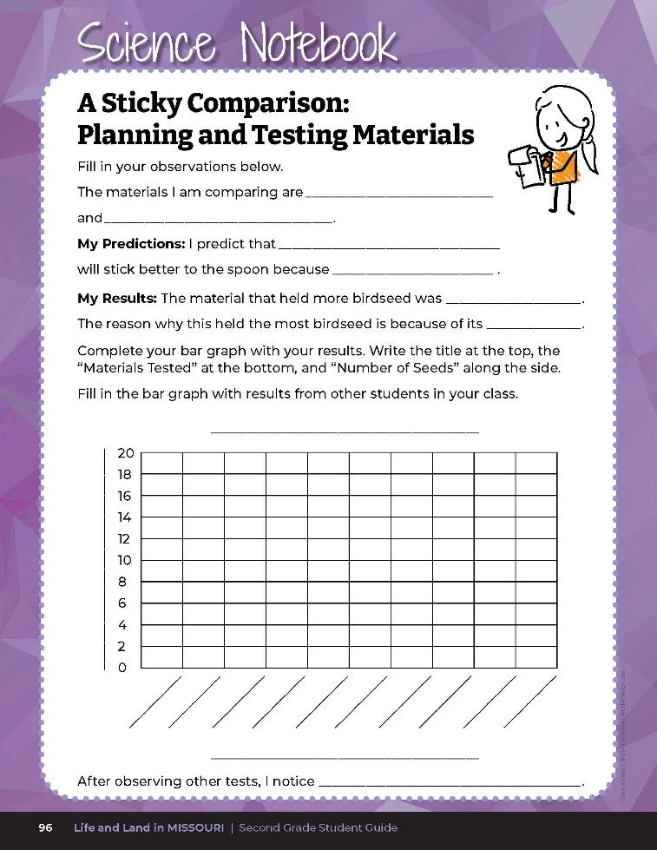
Record which two materials you are testing and make a prediction.
4A
Life and Land in Missouri – 4A Building a Better Bird Feeder: Explore
22
Notes:
Have students open their student guide to the Science Notebook 4A A Sticky Comparison: Planning and Testing Materials section on Page 96 and record which two materials they are testing and make a prediction.

Slide 23
Procedure:
Dip the back of a plastic spoon in the first sticky material you are assigned to and then in the bowl of sunflower seed
Turn the spoon over and place it on your plate. Count the number of seeds on your spoon.
Repeat steps one and two with the second sticky material.
4A
Life and Land in Missouri – 4A Building a Better Bird Feeder: Explore
23

Slide 24
Record which material held more bird seed. Graph your results.
4A
Life and Land in Missouri – 4A Building a Better Bird Feeder: Explore
24
Notes:
Have students record which material held more birdseed in their student guide Science Notebook 4A A Sticky Comparison: Planning and Testing Materials page. Have students graph their results on the bar graph in their student guide. Have students write the title at the top such as “Stickiest Material for Bird Feeder,” the “Materials Tested” at the bottom and “Number of Seeds” along the side.
Allow students an opportunity to see other students’/groups’ test results and record results on the bar graph in their Science Notebook 4A A Sticky Comparison page.

Slide 25
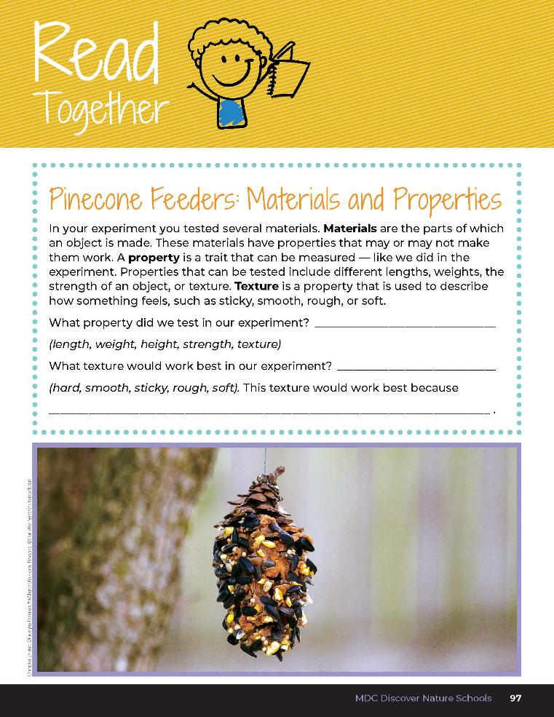

Pinecone Feeders: Materials and Properties
In your experiment you tested several materials. Materials are the parts of which an object is made. These materials have properties that may or may not make them work. A property is a trait that can be measured – like we did in the experiment. Properties that can be tested include different lengths, weights, the strength of an object, and its texture. Texture is a property that is used to describe how something feels, such as a sticky, smooth, rough, or soft.
4A
Life and Land in Missouri – 4A Building a Better Bird Feeder: Explain
25
Notes:
Have students read the Read Together 4A Pinecone Feeders: Materials and Properties section on Page 97.

Slide 26
What property made the seeds stick?
What were the strengths of that property?
What were the weaknesses of the other materials tested?
4A
Life and Land in Missouri – 4A Building a Better Bird Feeder: Explain
26
Notes:
Have students take turns and explain which materials was best suited for sticking to the birdseed.

Slide 27
Were there other factors that might have made the seed stick better?
4A
Life and Land in Missouri – 4A Building a Better Bird Feeder: Explain
27
Notes:
(Such as how well you pushed the spoons into the Seeds, how much seed was on the plate, the mount of material used, etc.)
After all students have shared, lead a class discussion for students to evaluate which material(s) worked the best and give evidence why they think that material worked the best.

Slide 28
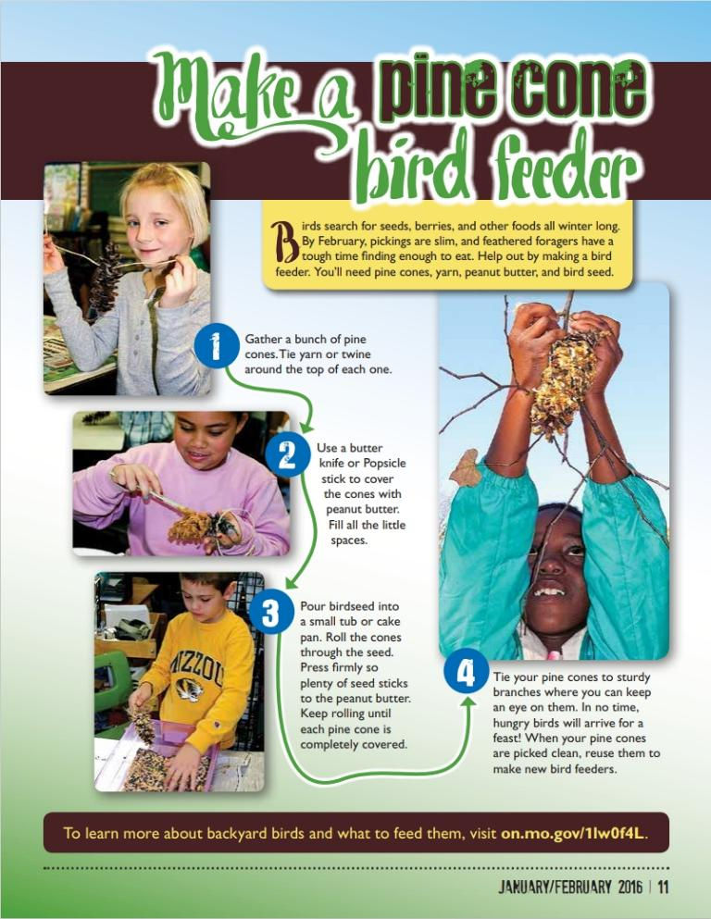
Bird Feeder Engineering Activity
Based on the results, use the sticky material that you found best.
4A
Life and Land in Missouri – 4A Building a Better Bird Feeder: Elaborate
28
Notes:
Bird Feeder Engineering Activity
Each student will receive:
Pinecone
Bowl or plate
Spoon to spread the sticky material
36 inches of yarn or string
Sticky material the students found worked best
½ cup of birdseed per student or group
Based on classroom results, students will choose the material they want to stick the birdseed to the pinecone. Only make available the materials with properties best suited to stick to the birdseed based on the testing and that are safe for birds to eat.
You can either work verbally through the instructions below, or you can distribute the Make a Pinecone Bird Feeder from Xplor and out but remind students that they are to use their sticky material that they found best. Students should follow these directions.
Tie the middle of a piece of cotton string or yarn around the top of the pinecone so it cannot be pulled off. The ends of the cotton string or yarn will later be tied around a tree branch. Note: Tying pinecone feeders snugly against a tree branch allows birds to perch on the branch to take seeds from the feeder. If the feeder hangs down below the branch, birds will have trouble landing to remove the seed. You can also tie a stick to the bottom of the pinecone feeder at this first stage of the bird feeder building process to allow birds to land.
Use the spoon to spread the sticky material on the pinecone evenly.
Pour a small cup of birdseed on a plate and roll the pinecone on the plate until it sticks to all the birdseed it can.
Leave the pinecone bird feeder on the plate for several hours for the material to harden.

Slide 29

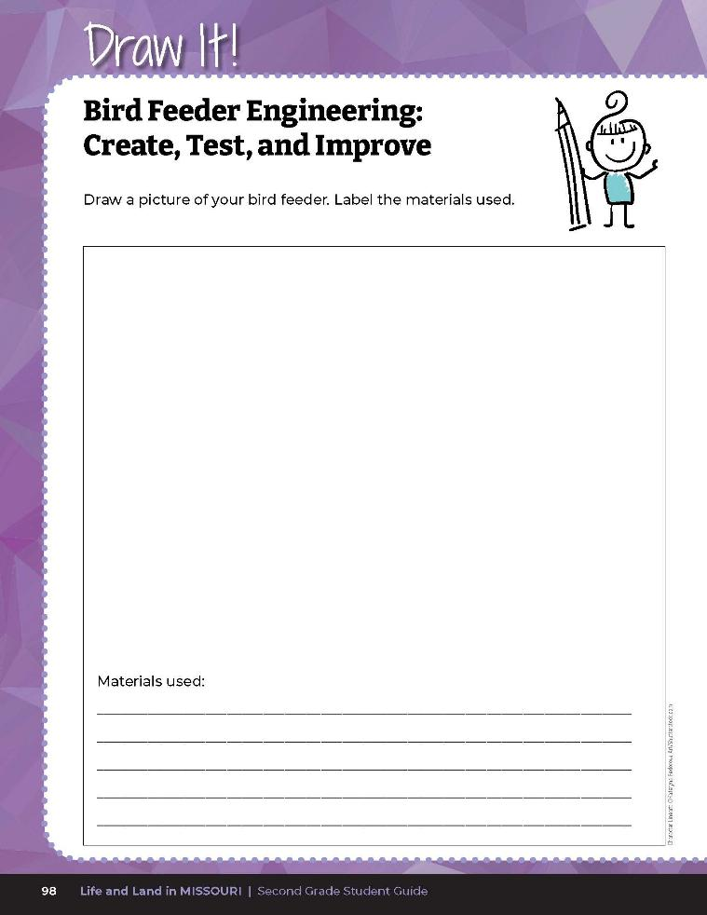
Draw a picture of your pinecone bird feeder and then label the materials used.
4A
Life and Land in Missouri – 4A Building a Better Bird Feeder: Elaborate
29
Notes:
5. Instruct students to draw a picture of their pinecone bird feeder and then label the materials used in their student guide Draw It! 4A Bird Feeder Engineering: Create, Test, Improve section on Page 98.

Slide 30
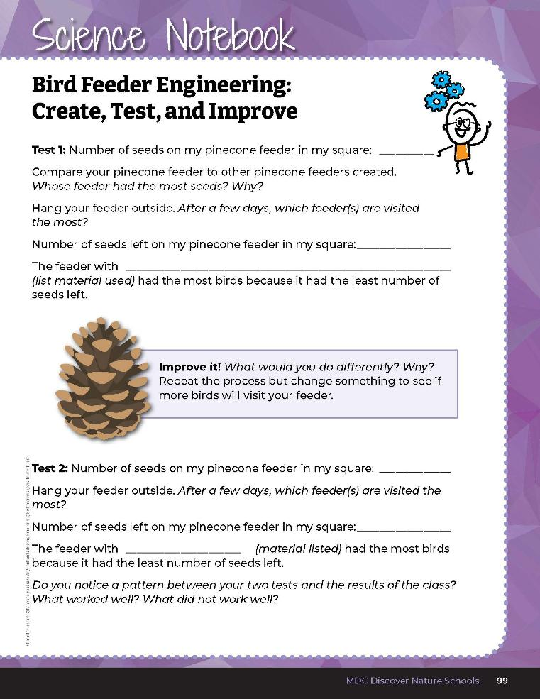
Record the number of seeds.
4A
Life and Land in Missouri – 4A Building a Better Bird Feeder: Elaborate
30
Notes:
6. Distribute 2-inch by 2-inch Square Cutouts handout to each student. Have them cut out the square, leaving the hole of the square, then have them hold the paper to the feeder and count the number of seeds in the 2-inch by 2-inch square hold. Students should record the number of seeds under Test 1 in their student guide Science Notebook 4A Bird Feeder Engineering: Create, Test, Improve on Page 99.

Slide 31
How many seeds stuck to your feeder within your 2-inch by 2–inch square?
Why?
4A
Life and Land in Missouri – 4A Building a Better Bird Feeder: Elaborate
31
Notes:
7. How many seeds stuck to your feeder within your 2-inch by 2-inch square? Write the number on the board and determine who had the most seeds stick to their feeder. Why?

Slide 32
Record the number of seeds left on your feeder.
4A
Life and Land in Missouri – 4A Building a Better Bird Feeder: Elaborate
32
Notes:
8. Students can place the pinecone feeders outside by tying the directly to a low tree branch or hanging them from the branch if the student tied a small stick to the bottom of the pinecone. This can be done in the schoolyard, outdoor classroom, local park (if permission is granted), or students can take their pinecone bird feeders home to tie to a tree branch.
9. Allow students to observe and record different birds that come to the feeder.
10. After 3 days, have students record the number of seeds left on their feeder within their 2-inch by 2-inch square into their student guide Science Notebook 4A Bird Feeder Engineering: Create, Test, Improve page. Have students compare their results. Record the numbers on the board.

Slide 33
What pinecone feeder had the least number of seeds?
What material was used to stick seeds to that feeder?
What is that texture like?
Are there any materials with different textures for sticking seeds to a feeder?
4A
Life and Land in Missouri – 4A Building a Better Bird Feeder: Elaborate
33
Notes:
Based on this information, allow students time to build another feeder, conduct the same test, and record the results.

Slide 34

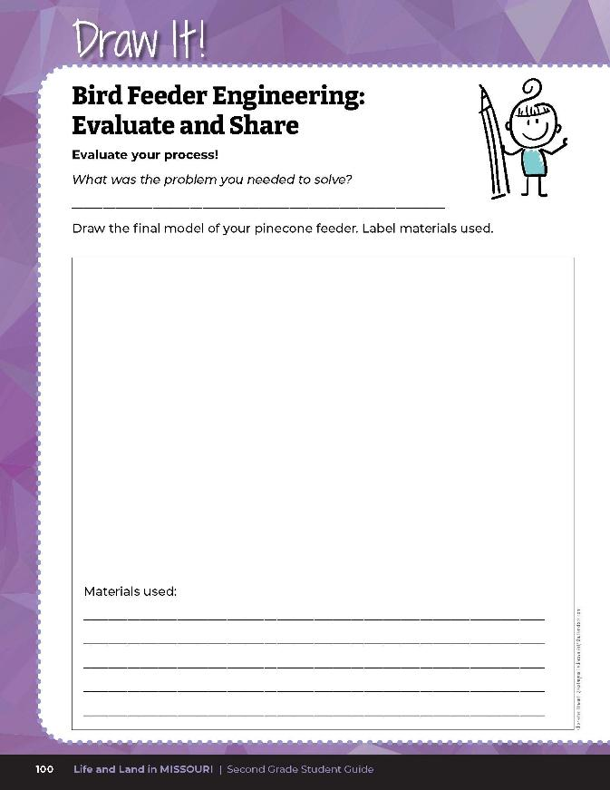
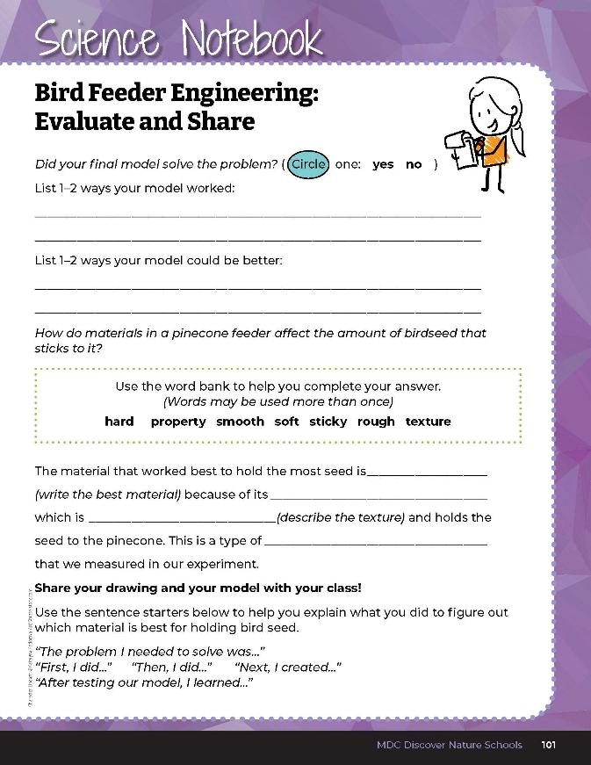
4A
Life and Land in Missouri – 4A Building a Better Bird Feeder: Evaluate
34
Notes:
Guiding Question: How do materials in a pinecone feeder affect the amount of birdseed that sticks to it?
After exploring the concept of assessing the best materials for bird feeders to hold seeds, have students open their student guides to the Draw It! And Science Notebook 4A Bird Feeder Engineering: Evaluate and Share section on pages 100-101 and complete the exercises.

Slide 35
Answers will vary
texture
property
4A
Life and Land in Missouri – 4A Building a Better Bird Feeder: Evaluate
35
Notes:
Rubric:
3 (Exceeds) – Student correctly explains the problem they needed to solve, displays and demonstrates the bird feeder they built, explains 1-2 ways they their model worked and 1-2 ways why their model did not work. Student fills in all the blanks correctly.
2 (Meets) – Student somewhat correctly explains the problem they needed to solve, somewhat displays and demonstrates the bird feeder they built, somewhat explains 1-2 ways why their model worked and 1-2 ways why their model did not work. Student fills in some of the blanks correctly.
1 (Doesn’t Meet) – Student does not correctly explain the problem they needed to solve, does not display or demonstrate the bird feeder they built, does not explain 1-2 ways why their model worked and 1-2 ways why their model did not work. Student does not fill in the blanks correctly.

