Slide 1
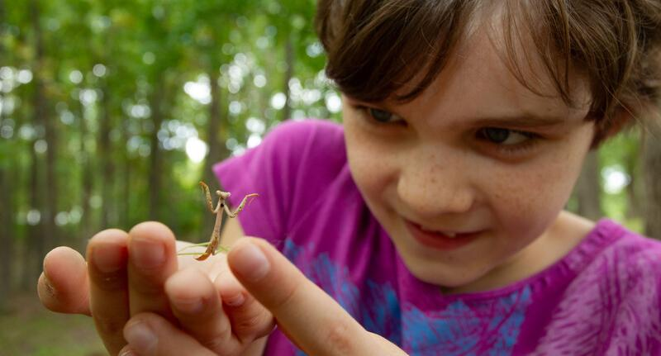

Exploring
MISSOURI
4A: Animal Armor

Slide 2
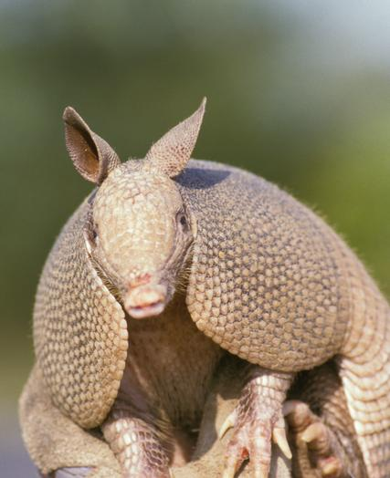
Guiding Question:
What is armor and how does armor protect an animal?
4A
Exploring Missouri – 4A Animal Armor: Engage
2
Notes:
Animal in picture: Nine-banded Armadillo

Slide 3
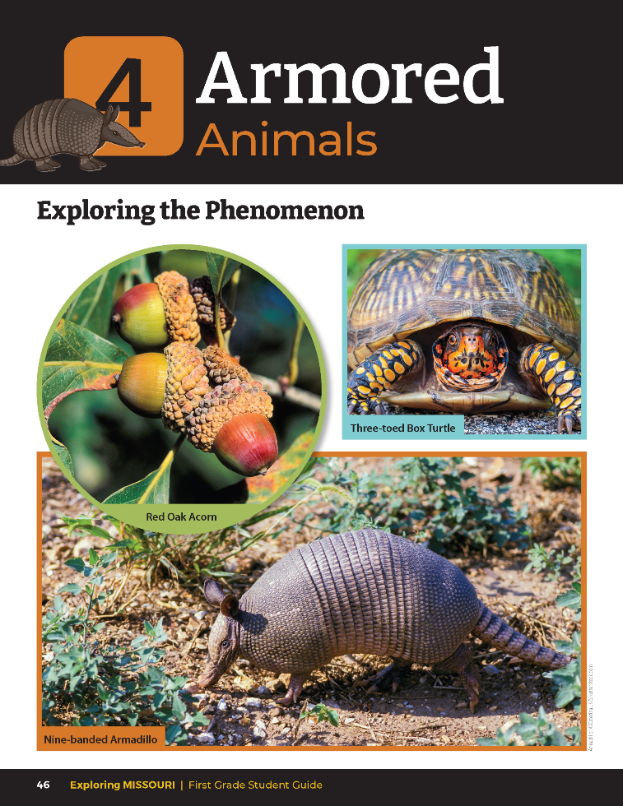
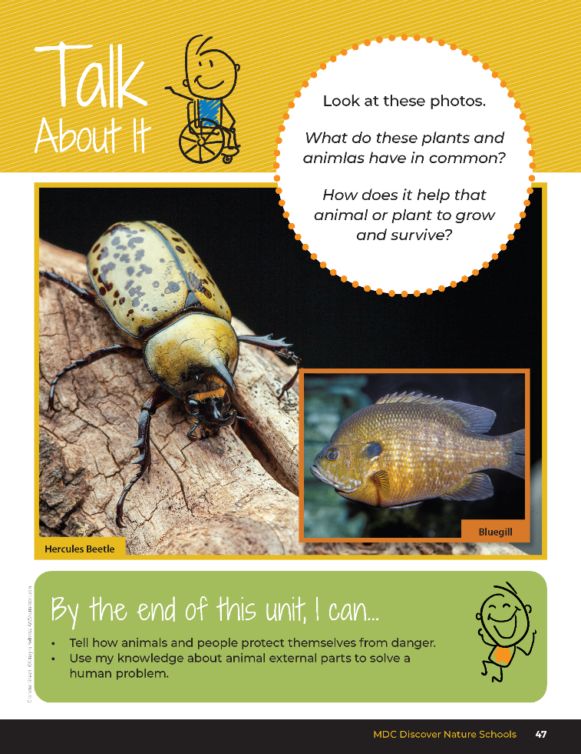
4A
Exploring Missouri – 4A Animal Armor: Engage
3
Notes:
Read together the student guide Unit 4 Exploring the Phenomenon section on pages 46-47 and discuss the 4A Talk About It portion.

Slide 4
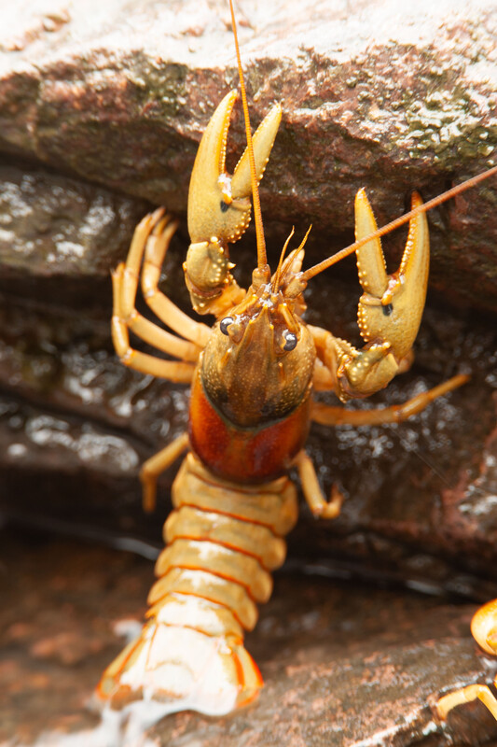
What do all those plants and animals have in common?
4A
Exploring Missouri – 4A Animal Armor: Engage
4
Notes:
Animal in picture: Spothanded Crayfish

Slide 5

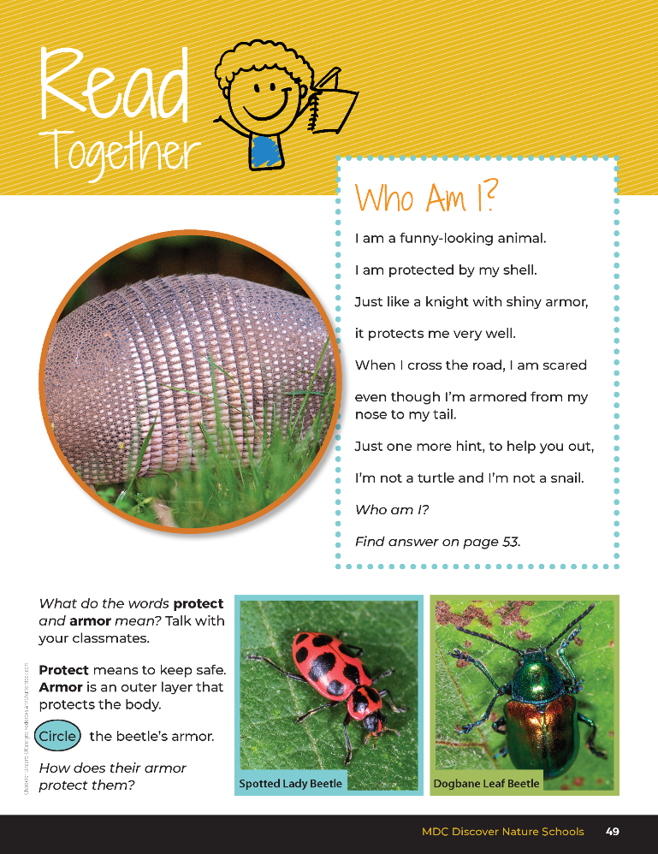
Who Am I?
I am a funny-looking animal.
I am protected by my shell.
Just like a knight with shiny armor, it protects me very well.
When I cross the road, I am scared even though I'm armored from my nose to my tail.
Just one more hint, to help you out, I am not a turtle and I'm not a snail.
Who am I? Find answer on page 53.
4A
Exploring Missouri – 4A Animal Armor: Engage
5
Notes:
Read Together 4A Who Am I? section on Page 49.
I am a funny-looking animal. I am protected by my shell. Just like a knight with shiny armor, it protects me very well. When I cross the road, I am scared even though I'm armored from my nose to my tail. Just one more hint, to help you out, I am not a turtle and I'm not a snail.
Who am I? Find answer on page 53.

Slide 6
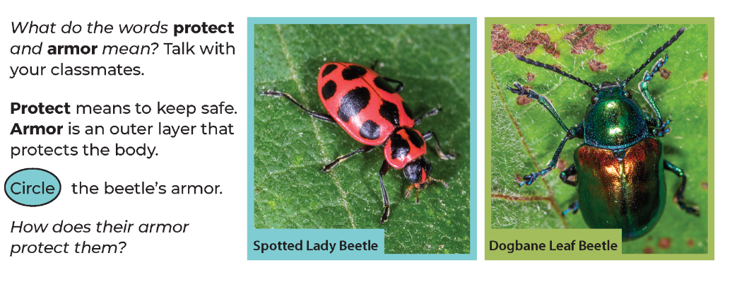
What do the words protect and armor mean?
Talk with your classmates.
4A
Exploring Missouri – 4A Animal Armor: Engage
6
Notes:
Read Together 4A Who Am I? section on Page 49.
What do the words protect and armor mean? Talk with your classmates.

Slide 7
Protect means to keep safe.
Armor is an outer layer that protects the body.
4A
Exploring Missouri – 4A Animal Armor: Engage
7
Notes:
Read Together 4A Who Am I? section on Page 49.
Protect means to keep safe. Armor is an outer layer that protects the body.

Slide 8
Circle the beetle's armor.
How does their armor protect them?
4A
Exploring Missouri – 4A Animal Armor: Engage
8
Notes:
Read Together 4A Who Am I? section on Page 49.
Circle the beetle's armor. How does their armor protect them?

Slide 9
Wildlife
Non-Wildlife
4A
Exploring Missouri – 4A Animal Armor: Engage
9
Notes:
Today, we will be writing a book called Missouri’s Armored Animals. Each of you will research and write about a Missouri animal that has armor.
Let’s create a list of wildlife and non-wildlife animals. Create a T-chart and list animals on the board. Once complete, have students compare and contrast the listed animals.

Slide 10
Wildlife
What does this word mean?
Is it the same as our pets that we have at home?
4A
Exploring Missouri – 4A Animal Armor: Engage
10
Notes:
Wildlife means the animals or organisms that grow up in the wild and are not our pets. We do not take care of the wildlife because it takes care of itself.

Slide 11
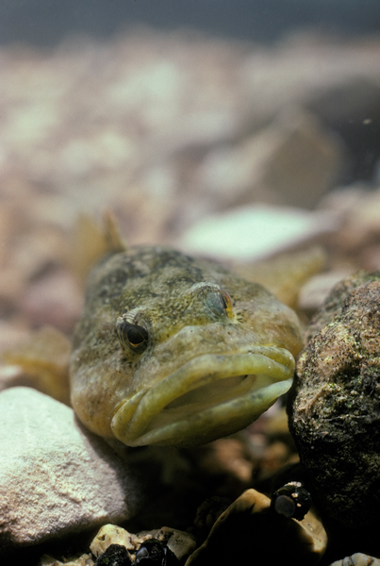
Can you give examples of wildlife that lives in Missouri?
4A
Exploring Missouri – 4A Animal Armor: Engage
11
Notes:
Answers will vary.
Animal in Picture: Sculpin

Slide 12
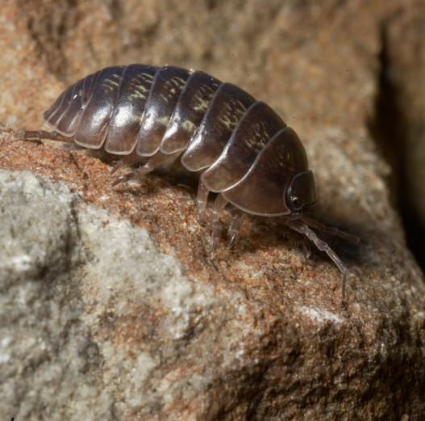
Looking at our list, what do animals have that help them protect themselves?
4A
Exploring Missouri – 4A Animal Armor: Engage
12
Notes:
Write examples that students list. Discuss the different external parts that these wild animals have to protect themselves and help them survive.
Animal in Picture: Roly-Poly

Slide 13
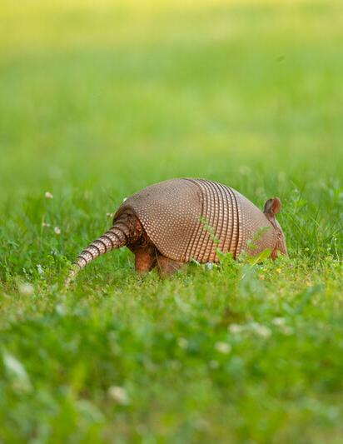
What does the armor for the armadillo do to help it survive?
4A
Exploring Missouri – 4A Animal Armor: Engage
13
Notes:
Animal in Picture: Nine-banded Armadillo

Slide 14
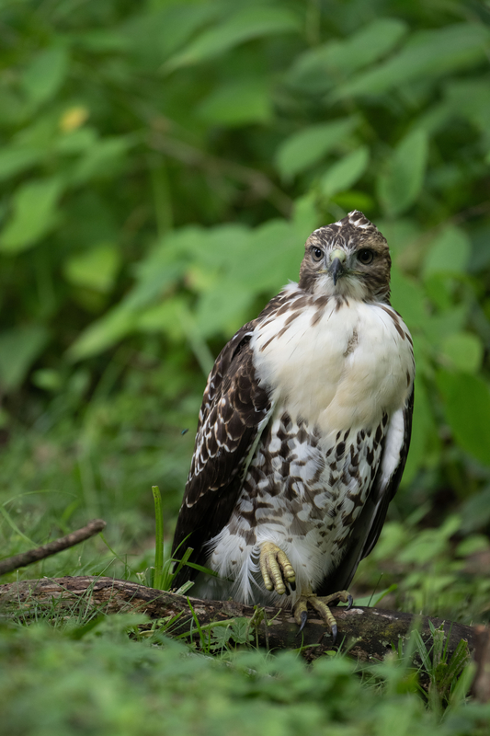
What other wildlife can you think of that has protection like armor to keep that animal safe?
4A
Exploring Missouri – 4A Animal Armor: Engage
14
Notes:
Start to create a class list on the board.
Animal in Picture: Red-tailed Hawk

Slide 15
Brainstorm and record research questions and ideas about wildlife that have armor.
4A
Exploring Missouri – 4A Animal Armor: Engage
15
Notes:
Let’s look through a few examples of wildlife that have armor, or protection, to keep them safe. We will add to our class list as we research. Distribute MDC field booklets and posters. Display the MDC Field Guide from the MDC Teacher Portal on the board. Field Guide | Missouri Department of Conservation Brainstorm and record research questions and ideas in a classroom list.
List may include:
Armadillos (shells)
Snails (shells)
Turtles (shells)
Mussels (outer shells)
Fish (scales)
Mammals (fur)
Lake sturgeon (outer bony plates like a shell)
Macroinvertebrates, such as caddisfly larvae (build their own shelter)
Crustaceans, such as crayfish, or roly-polys (exoskeleton)
Some insects, such as beetles (exoskeleton)
Birds (Feathers deflect branches when flying through trees. Feather also protect them from the cold, heat, and getting a sunburn.)
After the class is finished compiling a list, have the students pile the resources together to remove distractions. These resources will be distributed again during their own research time.

Slide 16
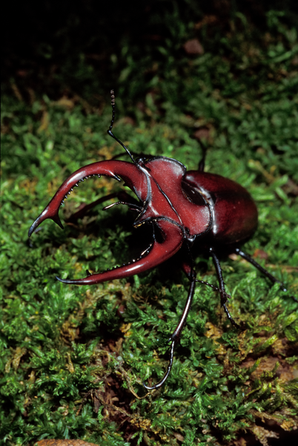
Have you ever seen or held a beetle?
What do these animals look like?
4A
Exploring Missouri – 4A Animal Armor: Explore
16
Notes:
Model the expectations of researching wildlife and its armor. Write the word “insect” then “beetle” on the list.
Animal in Picture: Elephant Stag Beetle

Slide 17
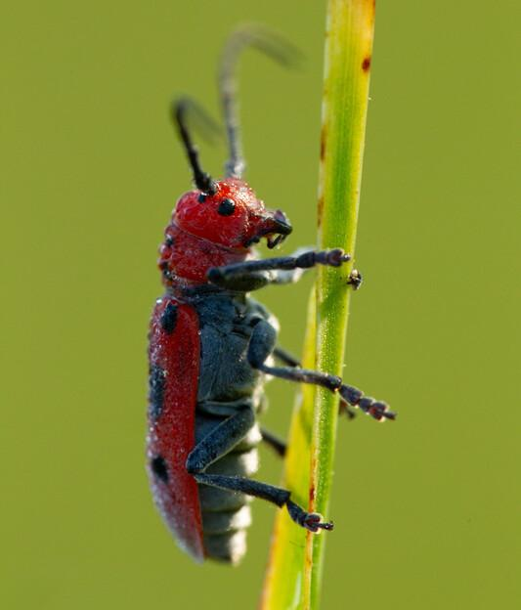
4A
Exploring Missouri – 4A Animal Armor: Explore
17
Notes:
Draw or place a photo of a beetle, such as a ladybug or June bug, at the center of a large sheet of paper.
Animal in Picture: Milkweed Borer

Slide 18
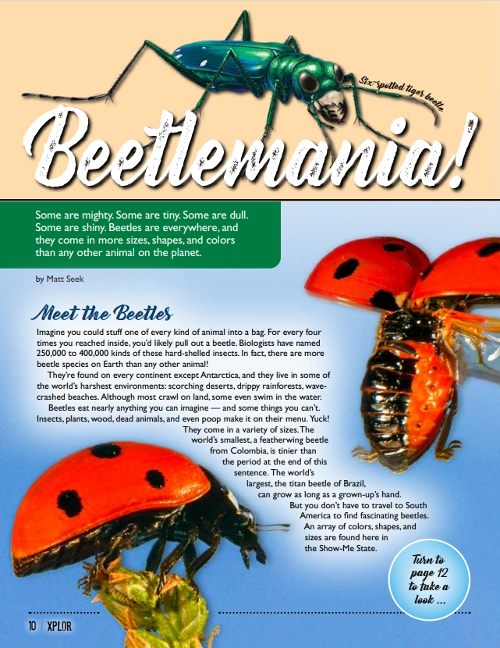
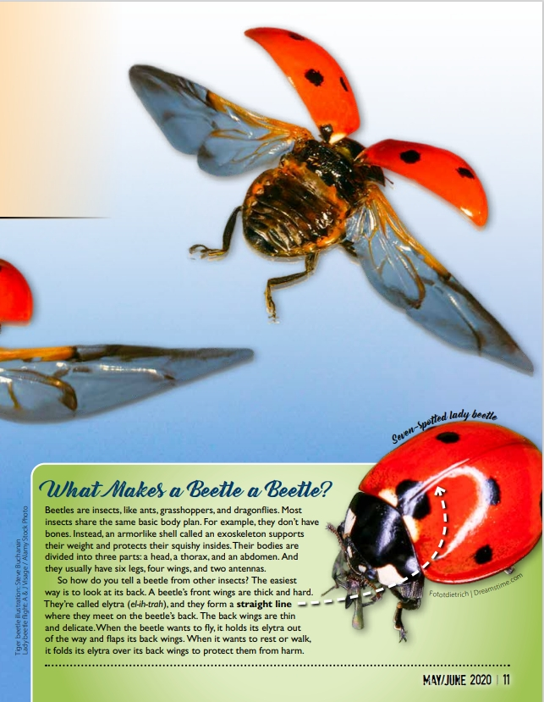
4A
Exploring Missouri – 4A Animal Armor: Explore
18
Notes:
From the MDC Teacher Portal, display or distribute copies of Beetlemania! by Matt Seek from the May/June 2020 issue of Xplor.

Slide 19
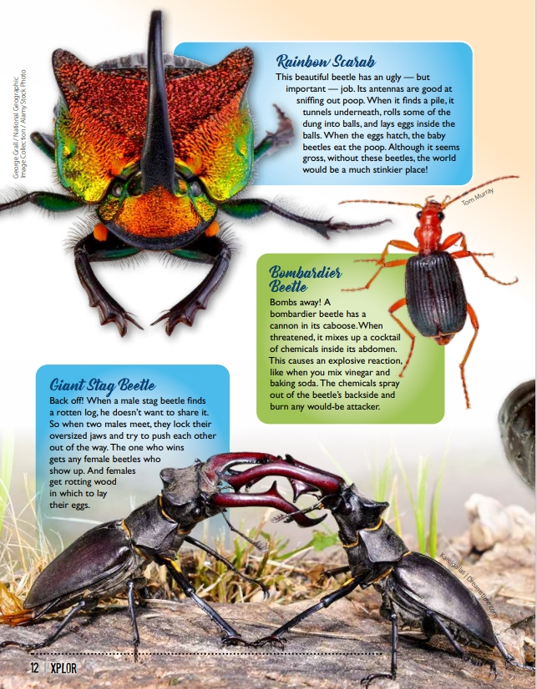
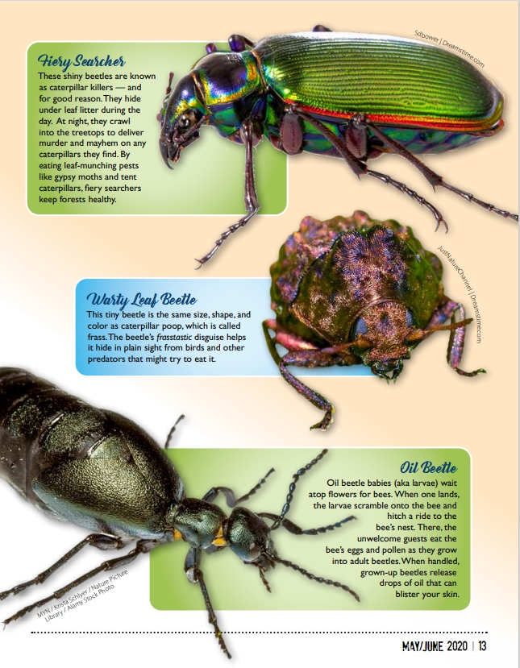
4A
Exploring Missouri – 4A Animal Armor: Explore
19

Slide 20
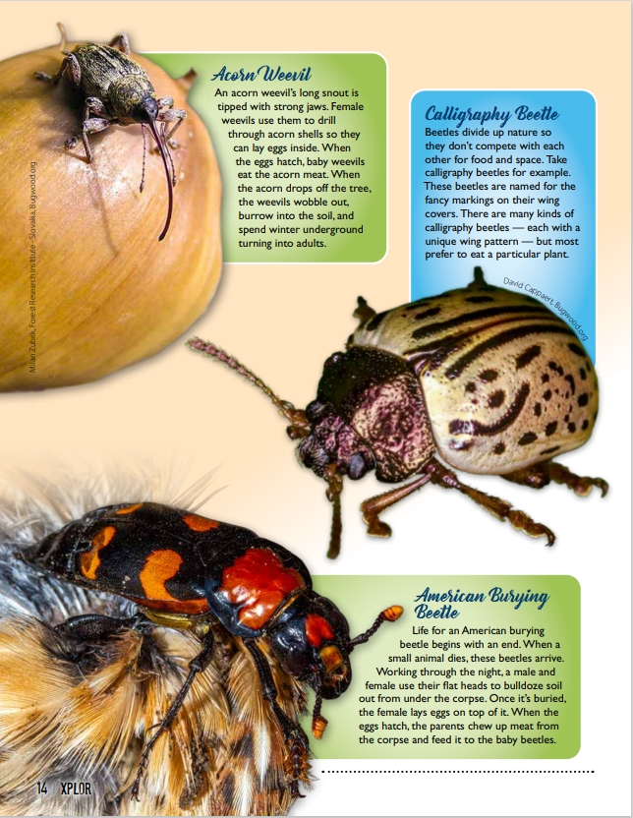
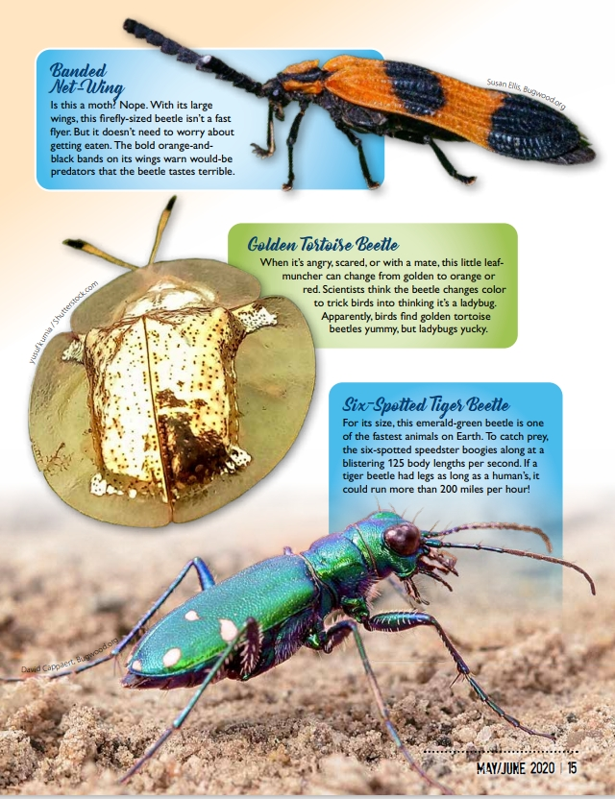
4A
Exploring Missouri – 4A Animal Armor: Explore
20

Slide 21
What animals are these?
Is it wildlife?
Where do you think these animals live?
How do you think it stays safe and uses armor to survive?
4A
Exploring Missouri – 4A Animal Armor: Explore
21

Slide 22
4A
Exploring Missouri – 4A Animal Armor: Explore
22
Notes:
Write the answers around the picture of the beetle. You can use the following prompts from the student guide to write your sentences next to the photo:
My animal is a beetle.
It lives under rocks and logs.
It stays safe and uses its armor to protect its wings and insides.
Draw your animal in its home.
Animal in Picture: Milkweed Borer

Slide 23
Where would you find information to research your Missouri animal?
What did we use to research beetles?
4A
Exploring Missouri – 4A Animal Armor: Explore
23
Notes:
Allow each group time to review the classroom list on the board and, as a group, choose or assign a Missouri animal for each group to research.
Where would you find information to research your Missouri animal? What did we use to research beetles? (Students can reference the MDC Field Guide Field Guide | Missouri Department of Conservation, the Beetlemania! Article, field guides, etc.)
We will use the same resources we used to write our class list.

Slide 24
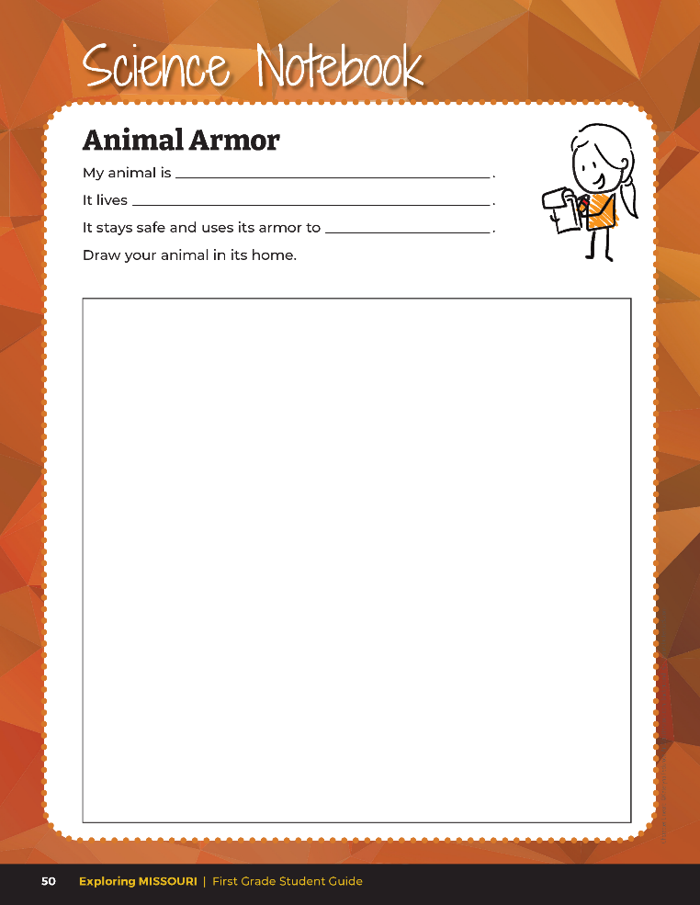

Record information about your animal.
4A
Exploring Missouri – 4A Animal Armor: Explore
24
Notes:
As you research, use your student guide Science Notebook 4A Animal Armor section on Page 50 to record the information about your animal. Have students open their student guides to the page and review that it is the same information that will also be recorded onto their group poster.
From the MDC Teacher Portal, print and distribute the appropriate mini field guides to each student group that aligns with that will also be recorded onto their group poster.
Teacher Note: If you have tablets or computers available, have student utilize these research tools. Consider collaborating with you computer science and/or school librarian.
My animal is _________________________________.
It lives ______________________________.
It stays safe and uses its armor to _________________________.
Draw your animal in its home.

Slide 25
Each group creates a Missouri Armored Animal poster!
4A
Exploring Missouri – 4A Animal Armor: Explore
25
Notes:
Have students groups create their Missouri Armored Animal poster similar to the one done. Hang the group posters around the classroom.
Now it’s time to share our research with everyone. As you visit each poster, think about how that animal uses armor for protection to keep it safe.

Slide 26
Share your research with everyone!
As you visit each poster, think about how that animal uses armor for protection to keep it safe.
4A
Exploring Missouri – 4A Animal Armor: Explore
26
Notes:
Now it’s time to share our research with everyone. As you visit each poster, think about how that animal uses armor for protection to keep it safe.
Allow time for students to do a gallery walk and see other students’ animals and ideas.

Slide 27
Are there other parts of the animal that allow it to grow and survive?
4A
Exploring Missouri – 4A Animal Armor: Explore
27

Slide 28
What else do you see on this beetle that helps it live and survive in its habitat?
4A
Exploring Missouri – 4A Animal Armor: Explain
28
Notes:
Let’s take a look at our beetle again. What else do you see on this beetle that helps it to live and survive in its habitat? (Antennae for sensing, the small size so it can crawl into the soil to escape predators, the wings are used to flying, etc.)
Animal in Picture: Milkweed Borer

Slide 29
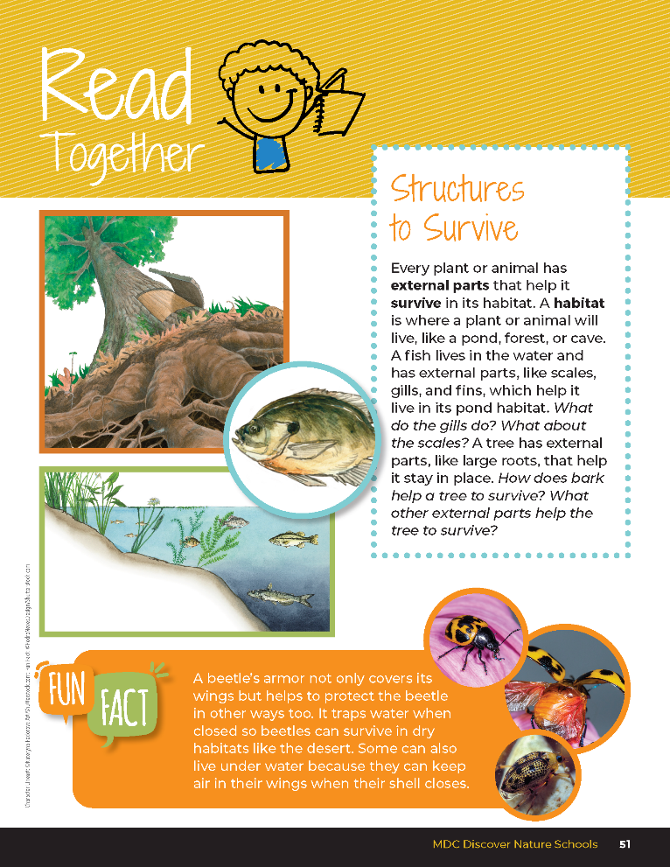
Structures to Survive
Every plant or animal has external parts that help it survive in its habitat. A habitat is where a plant or animal will live like a pond, forest, or cave. A fish lives in the water and has external parts, like scales, gills and find, which help it live in its pond habitat.
What do gills do? What about scales?
4A
Exploring Missouri – 4A Animal Armor: Explain
29
Notes:
Read the Read Together 4A Structures to Survive section on Page 51. Discuss how animals have many external parts for protection. Discuss how an animal’s external parts provide protection and what kinds of things animals need protection from.

Slide 30
Structures to Survive
A tree has external parts, like large roots, that help it stay in place.
How does bark help a tree survive? What other external parts help the tree to survive?
4A
Exploring Missouri – 4A Animal Armor: Explain
30
Notes:
Read the Read Together 4A Structures to Survive section on Page 51. Discuss how animals have many external parts for protection. Discuss how an animal’s external parts provide protection and what kinds of things animals need protection from.

Slide 31
Answer the following questions in your report:
Does you animal have more than one way to protect itself?
How does the animal use its external parts to stay safe?
How does the animal use its external parts to survive in its habitat?
4A
Exploring Missouri – 4A Animal Armor: Explain
31

Slide 32
Let’s share with the class what we added to our posters!
4A
Exploring Missouri – 4A Animal Armor: Elaborate
32
Notes:
Have students revisit their group posters and add any additional external parts they found from their animal. They can use their field guides and online resources to add to their poster. Allow time for students to prepare their final version of their poster. Allow time for students to prepare their final version of their poster and report to share with the class.
Let’s share with the class what we added to our posters. Give students time to share with the class two to three external parts that were added.
Compile the posters together into a large class book called Missouri’s Armored Animals. Keep the book in your classroom library for any reference to external parts in later lessons.

Slide 33
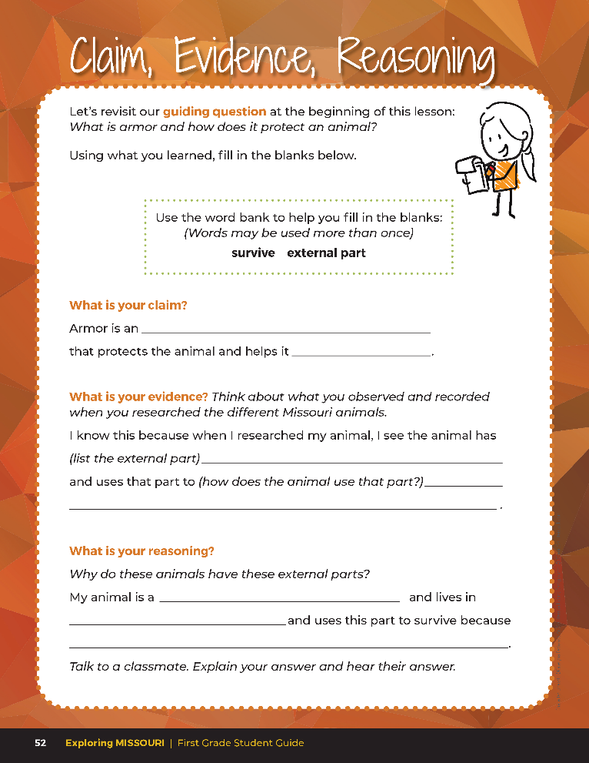
Guiding Question:
What is armor and how does it protect and animal?
4A
Exploring Missouri – 4A Animal Armor: Evaluate
33
Notes:
After exploring the concept of external parts, have students open their students to the Claim, Evidence, Reasoning section on Page 52. Discuss the page with the students – read the guiding questions and then explain that students need to answer the questions by filling in the blanks.

Slide 34
external part
Answers
survive
answers will vary
4A
Exploring Missouri – 4A Animal Armor: Evaluate
34
Notes:
Rubric:
3 (Meets) – Students can define and identify that armor is an external part that helps their Missouri animal survive in its habitat. Students fill in the blank for the correct claim, write the correct evidence statement, and identify the correct reason.
2 (Partially meets) – Students can define an external part but do not connect how it helps the animal to survive. Two of the three components of CER are correct.
1 (Doesn’t meet) – Students cannot answer the above questions. One of the three components of CER is correct.

