Slide 1
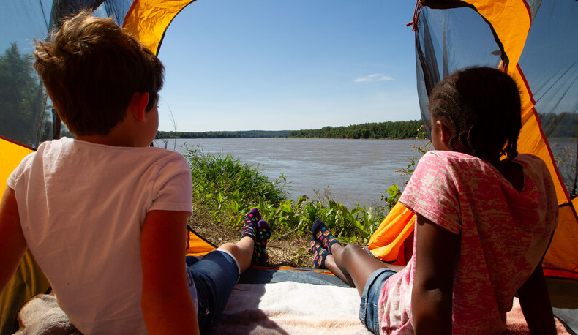

Life and Land in
MISSOURI
Unit 3 Review

Slide 2
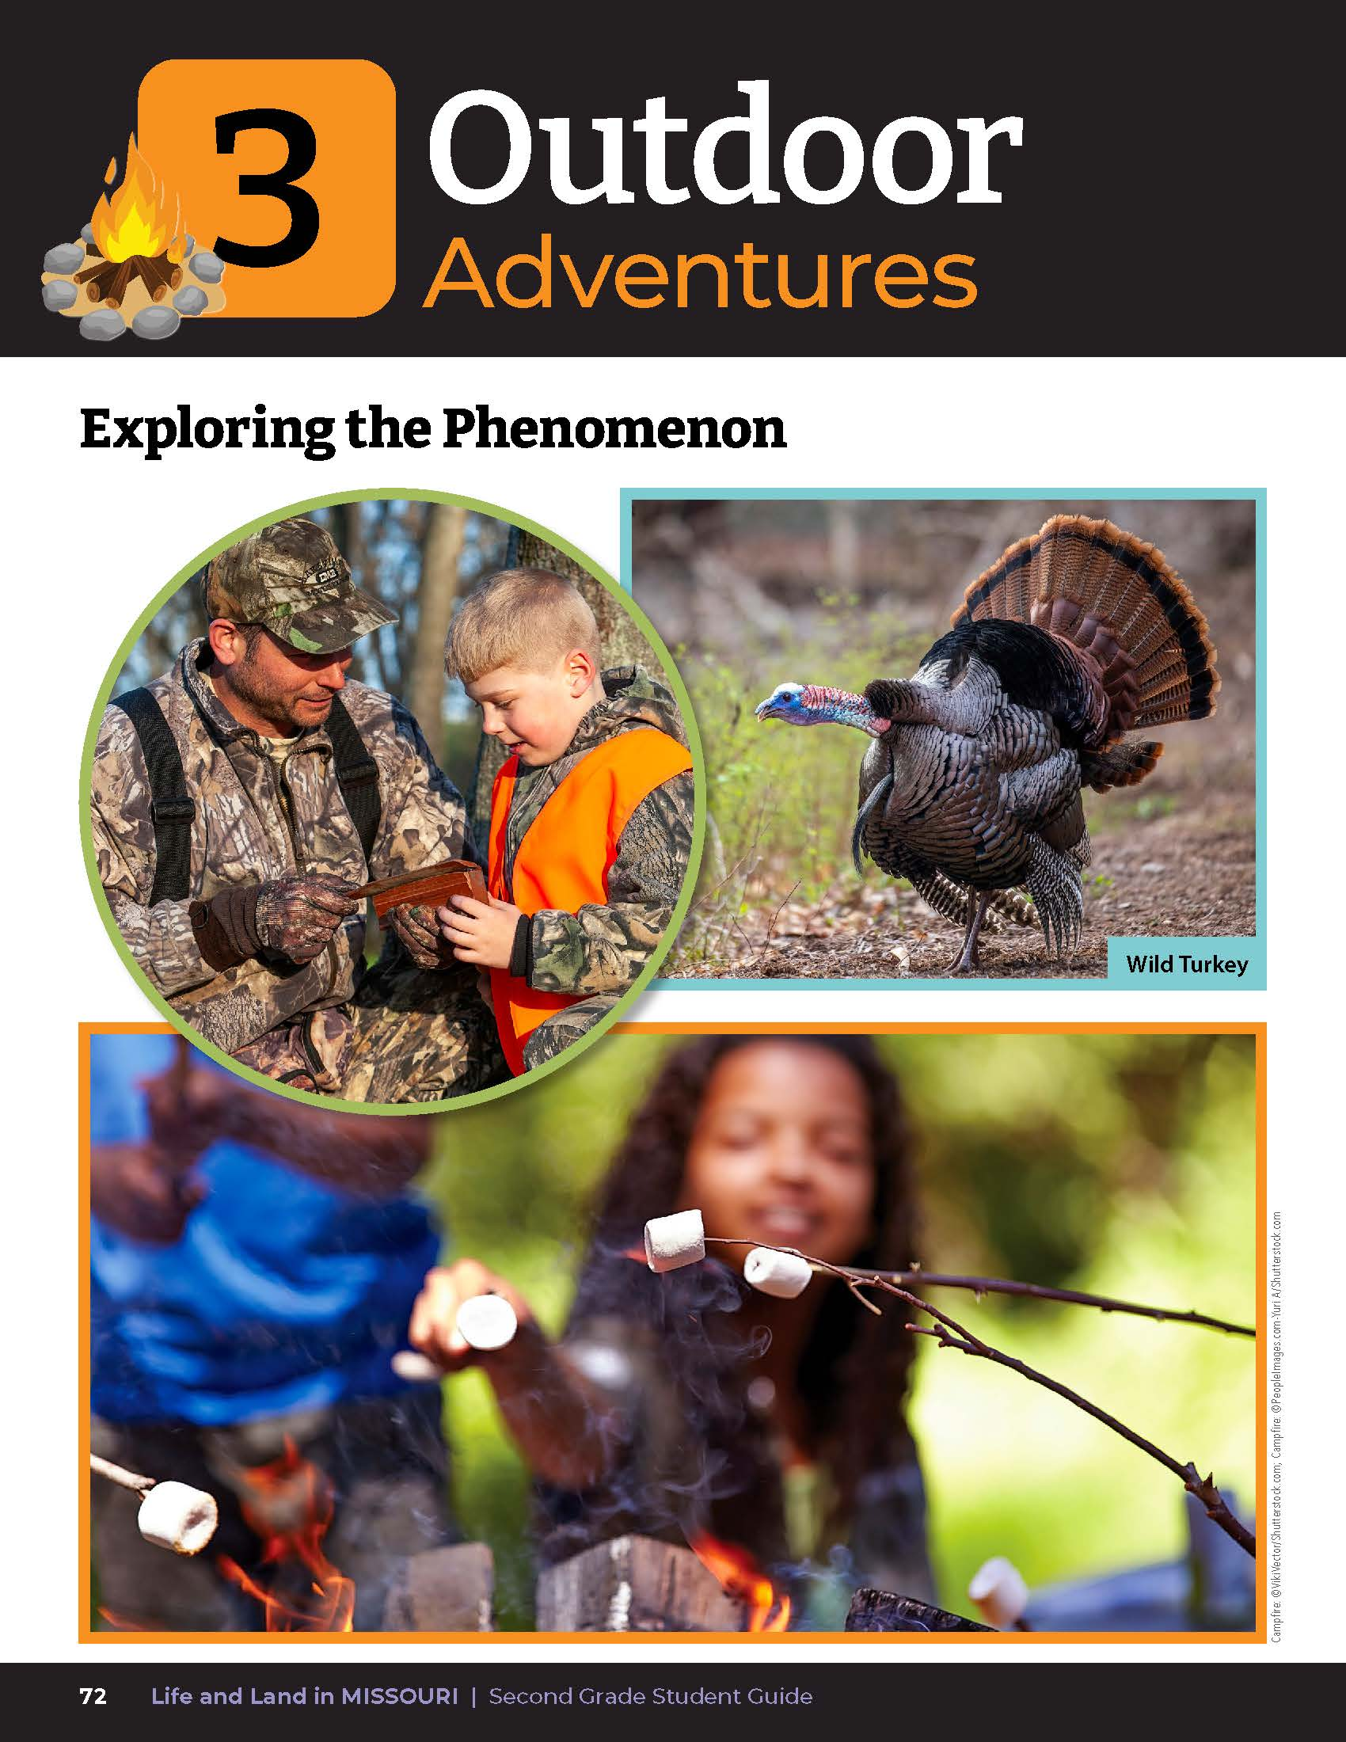
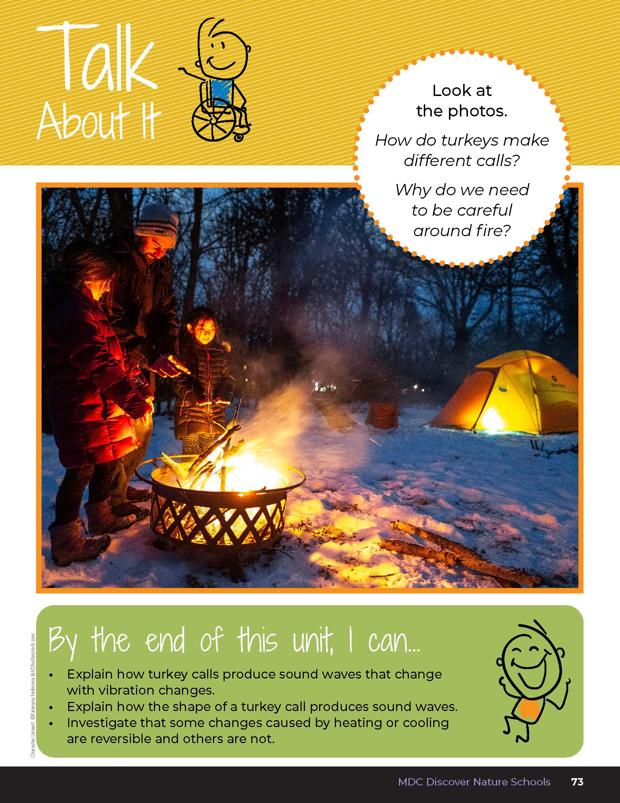
3
Life and Land in Missouri – Unit 3 Review
2
Notes:
Have students turn to the Unit 3 Exploring the Phenomenon and Talk About It section on pages 72-73.

Slide 3
Turn and talk to a classmate and describe how turkeys make different calls, and why we need to be careful around fire.
3
Life and Land in Missouri – Unit 3 Review
3

Slide 4
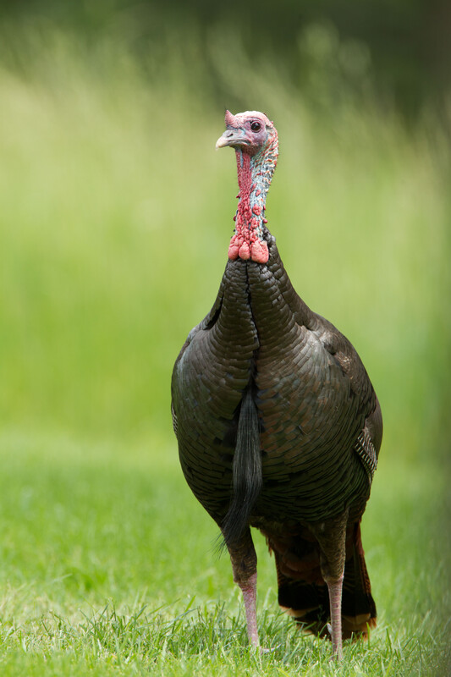
How do turkeys make different calls?
3
Life and Land in Missouri – Unit 3 Review
4
Notes:
(Sounds change based on vibrations. Low sounds are made by long vibrations. High sounds are made by short vibrations.)
Animal in Picture: wild turkey

Slide 5
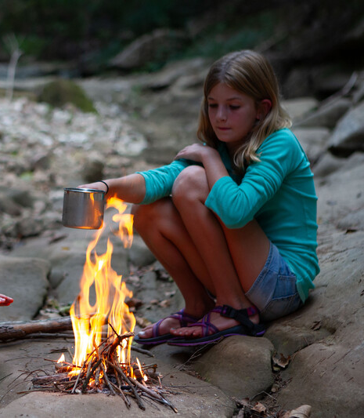
Why do we need to be careful around fire?
3
Life and Land in Missouri – Unit 3 Review
5
Notes:
(Fire makes irreversible and permanent changes because it burns hot and at a high temperature, which is why we need to be careful around fire.)
Rubric:
3 (Meets) – Student explains how sounds change based on low or high vibrations in a turkey call, and that fire can make irreversible changes to things which is why we need to be careful around fire.
2 (Partially meets) – Student somewhat explains how sounds change based on low or high vibrations in a turkey call, and that fire can make irreversible changes to things which is why we need to be careful around fire.
1 (Doesn’t meet) – Student does not offer any explanation of any of the concepts.

Slide 6
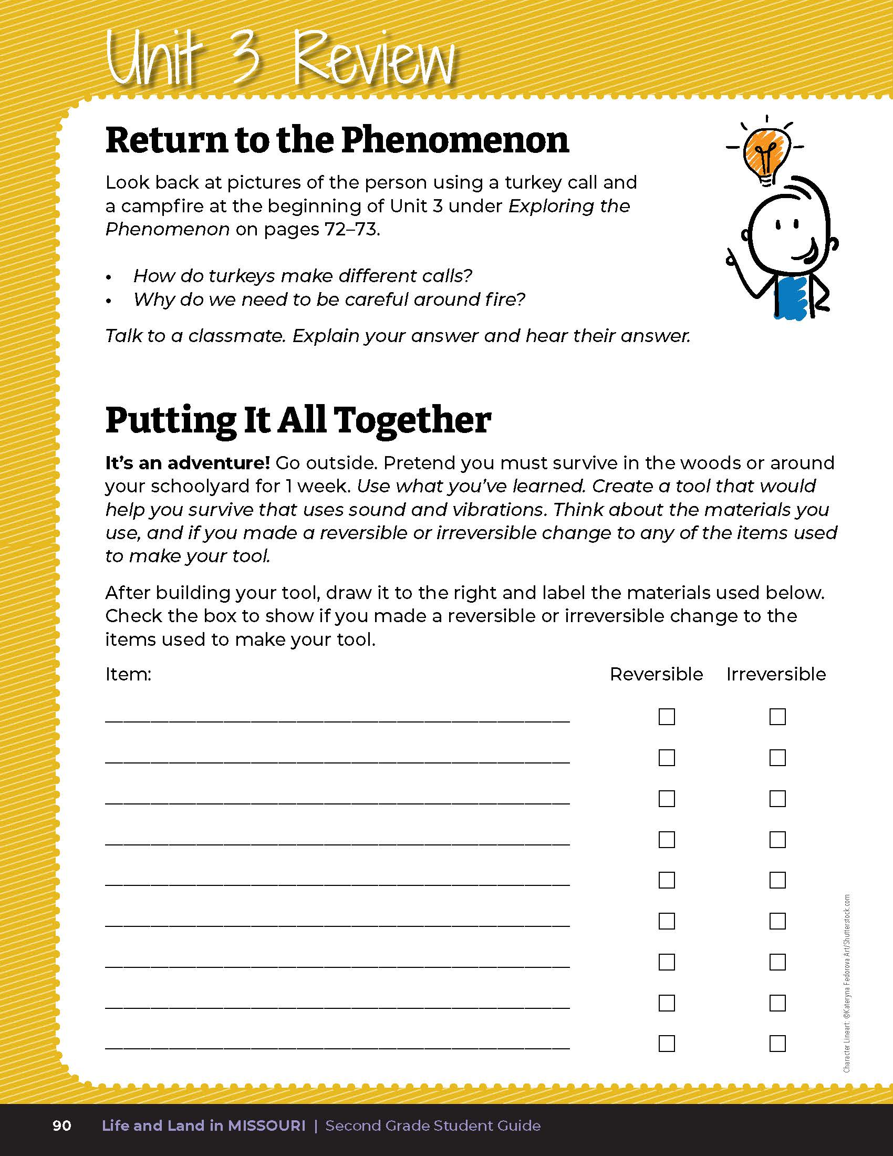
Create a tool that would help you survive that uses sound and vibrations.
3
Life and Land in Missouri – Unit 3 Review
6
Notes:
Have students read Putting It All Together on Page 90. Students will go outside and pretend that they need to survive in the schoolyard without access to the building for 1 week. Use what you’ve learned. Create a tool that would help you survive that uses sound and vibrations. Think about the materials you use, and if you made a reversible or irreversible change to any of the items used to make your tool. Students need to explain how their new tool would work using sound and vibration.

Slide 7
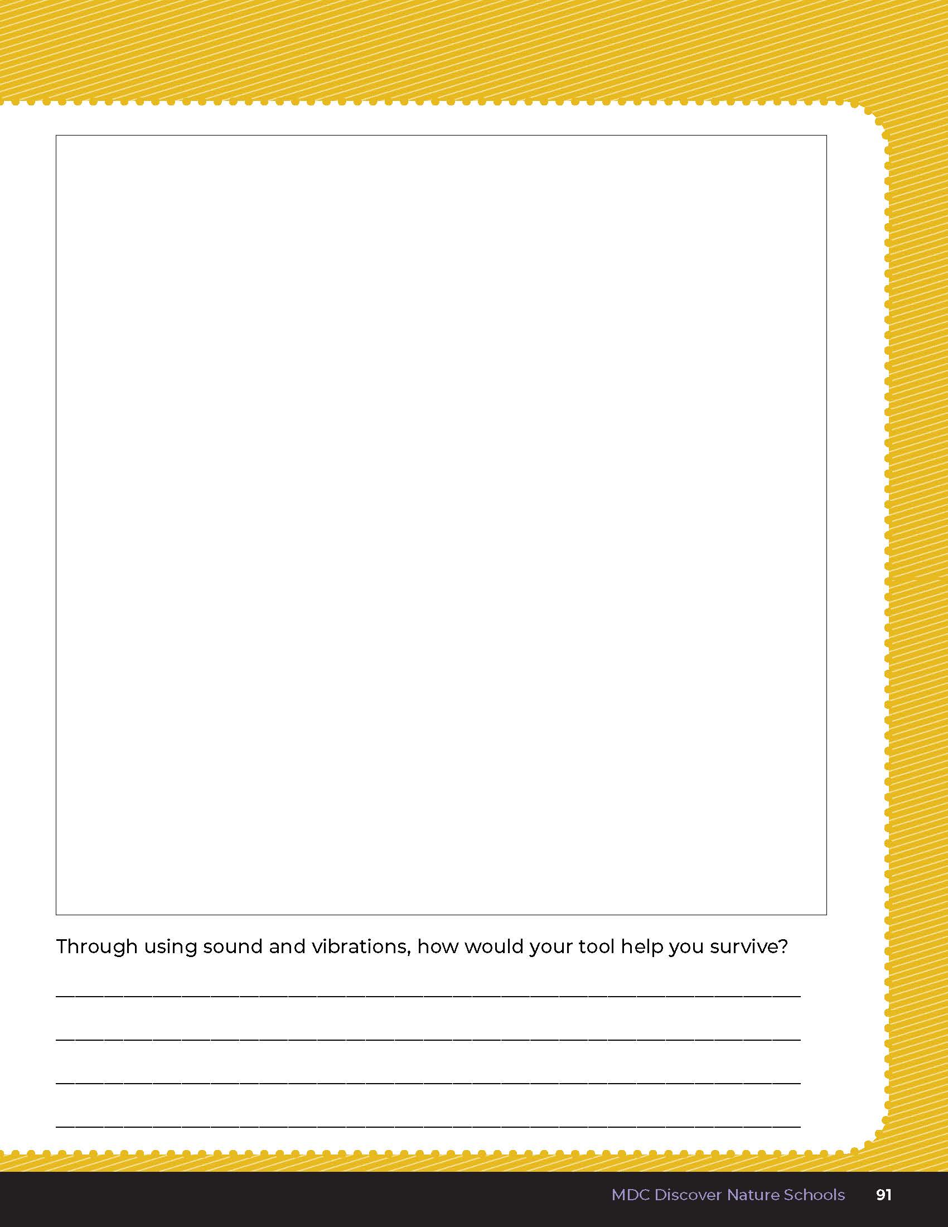
Draw what you made and list each item used.
3
Life and Land in Missouri – Unit 3 Review
7
Notes:
After building their tool, students will draw what they made and will list each item used. Students will disassemble their tool and check mark if they made a reversible or irreversible change to any of the items, such as breaking a stick in half, cutting an item, etc.
Rubric:
3 (Meets) – Student drawing is labeled with materials used. Student accurately explains how sounds and vibrations are used in the function of the tool, and each item is listed and checked as either a reversible or irreversible change made to the original item when assembled.
2 (Partially meets) – Student drawing is somewhat labeled with materials used. Student partially explains how sounds and vibrations are used in the function of the tool, and some items are listed and may or may not be checked as either a reversible or irreversible change made to the original item when assembled.
1 (Doesn’t meet) – Student drawing is incomplete or not labeled with materials used. Student does not explain the function of the tool as it relates to sound and vibration. Student does not list the items used to create the tool or check the boxes if items represent reversible or irreversible changes.

Slide 8

Read the book Fatima’s Great Outdoors by Ambreen Tariq.
Read Aloud:
https://youtu.be/x__4-Om4kO4?si=Jxyy2eb9LmsUckXi
3
Life and Land in Missouri – Unit 3 Review
8

Slide 9
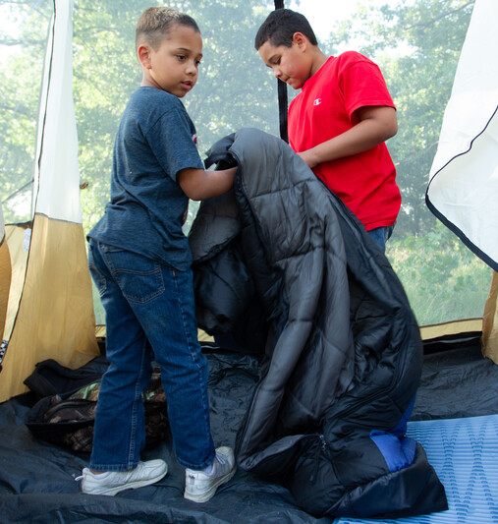
What activities did the family do during their adventure?
3
Life and Land in Missouri – Unit 3 Review
9
Notes:
(They set up a tent, made dinner, told stories while in the tent, slept, gathered firewood, made a campfire, made breakfast, and hiked and played in the water.)

Slide 10
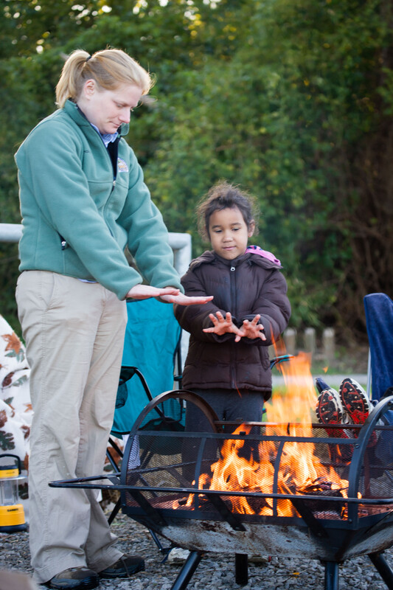
What tools did they use?
3
Life and Land in Missouri – Unit 3 Review
10
Notes:
(A tent, cooler, plates, camp stove, fire pit, sleeping bags, sticks, and leaves for the fire, picnic table.)

Slide 11
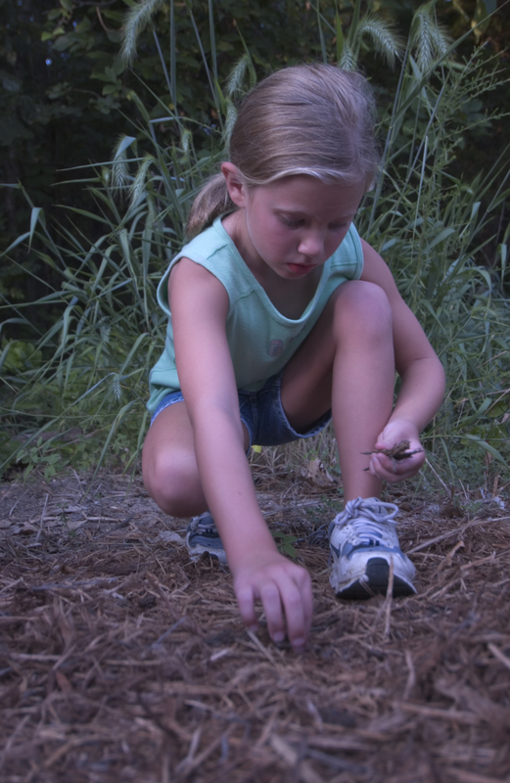
How did Fatima’s mother start the campfire?
3
Life and Land in Missouri – Unit 3 Review
11
Notes:
(She made the girls gather twigs and leaves for kindling, and bigger sticks for the tinder. She laid out the twigs, leaves, and sticks and blew air into the fire after it started.)

Slide 12

Optional: Cross-Curricular Extension
English Language Arts and Math
Write a poem discussing sounds crickets, birds, or other animals make. Consider themes such as nocturnal nature sounds, or diurnal nature sounds.
Write a comic strip with the title “The Adventures of ______” and have students draw and write their outdoor adventures.
Create and write your own s’more recipe. Add measurements for a math standards connection.
3
Life and Land in Missouri – Unit 3 Review
12

Slide 13
Optional: Cross-Curricular Extension
Art
Many projects opportunities exist for art-related experiences with objects found in nature. Collaborate with the art teacher to incorporate objects found in nature with various other mixed media to create pieces or art or even functional items incorporating items found on a nature walk.
3
Life and Land in Missouri – Unit 3 Review
13

Slide 14
Optional: Cross-Curricular Extension
Music
Create a dance to nature noises, like coyote howls or owls hooting. Listen to the song Habitune on Critter Rock. Critter Rock audio is available on the MDC Teacher Portal.
3
Life and Land in Missouri – Unit 3 Review
14

Slide 15
Optional: Cross-Curricular Extension
Outdoor Skills
How do you stay warm? How do you build a quality shelter? Give students the opportunity to research different survival methods and present to the class.
Bring shelters outside and have students explain the structure of each shelter. Test the shelter against water and wind experiments.
3
Life and Land in Missouri – Unit 3 Review
15

