Slide 1
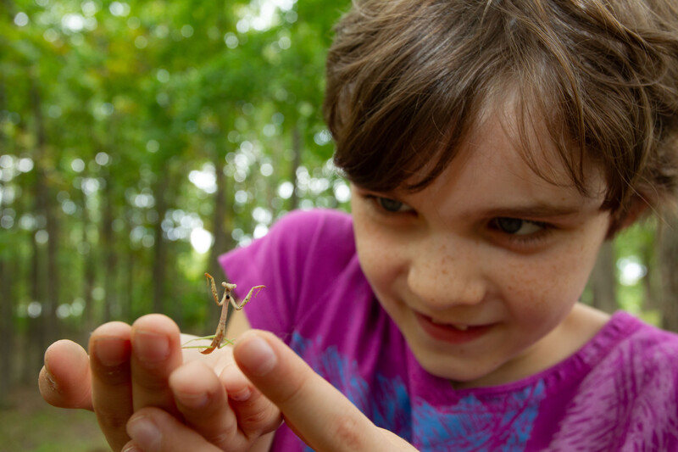

Exploring
MISSOURI
Unit 3 Review

Slide 2
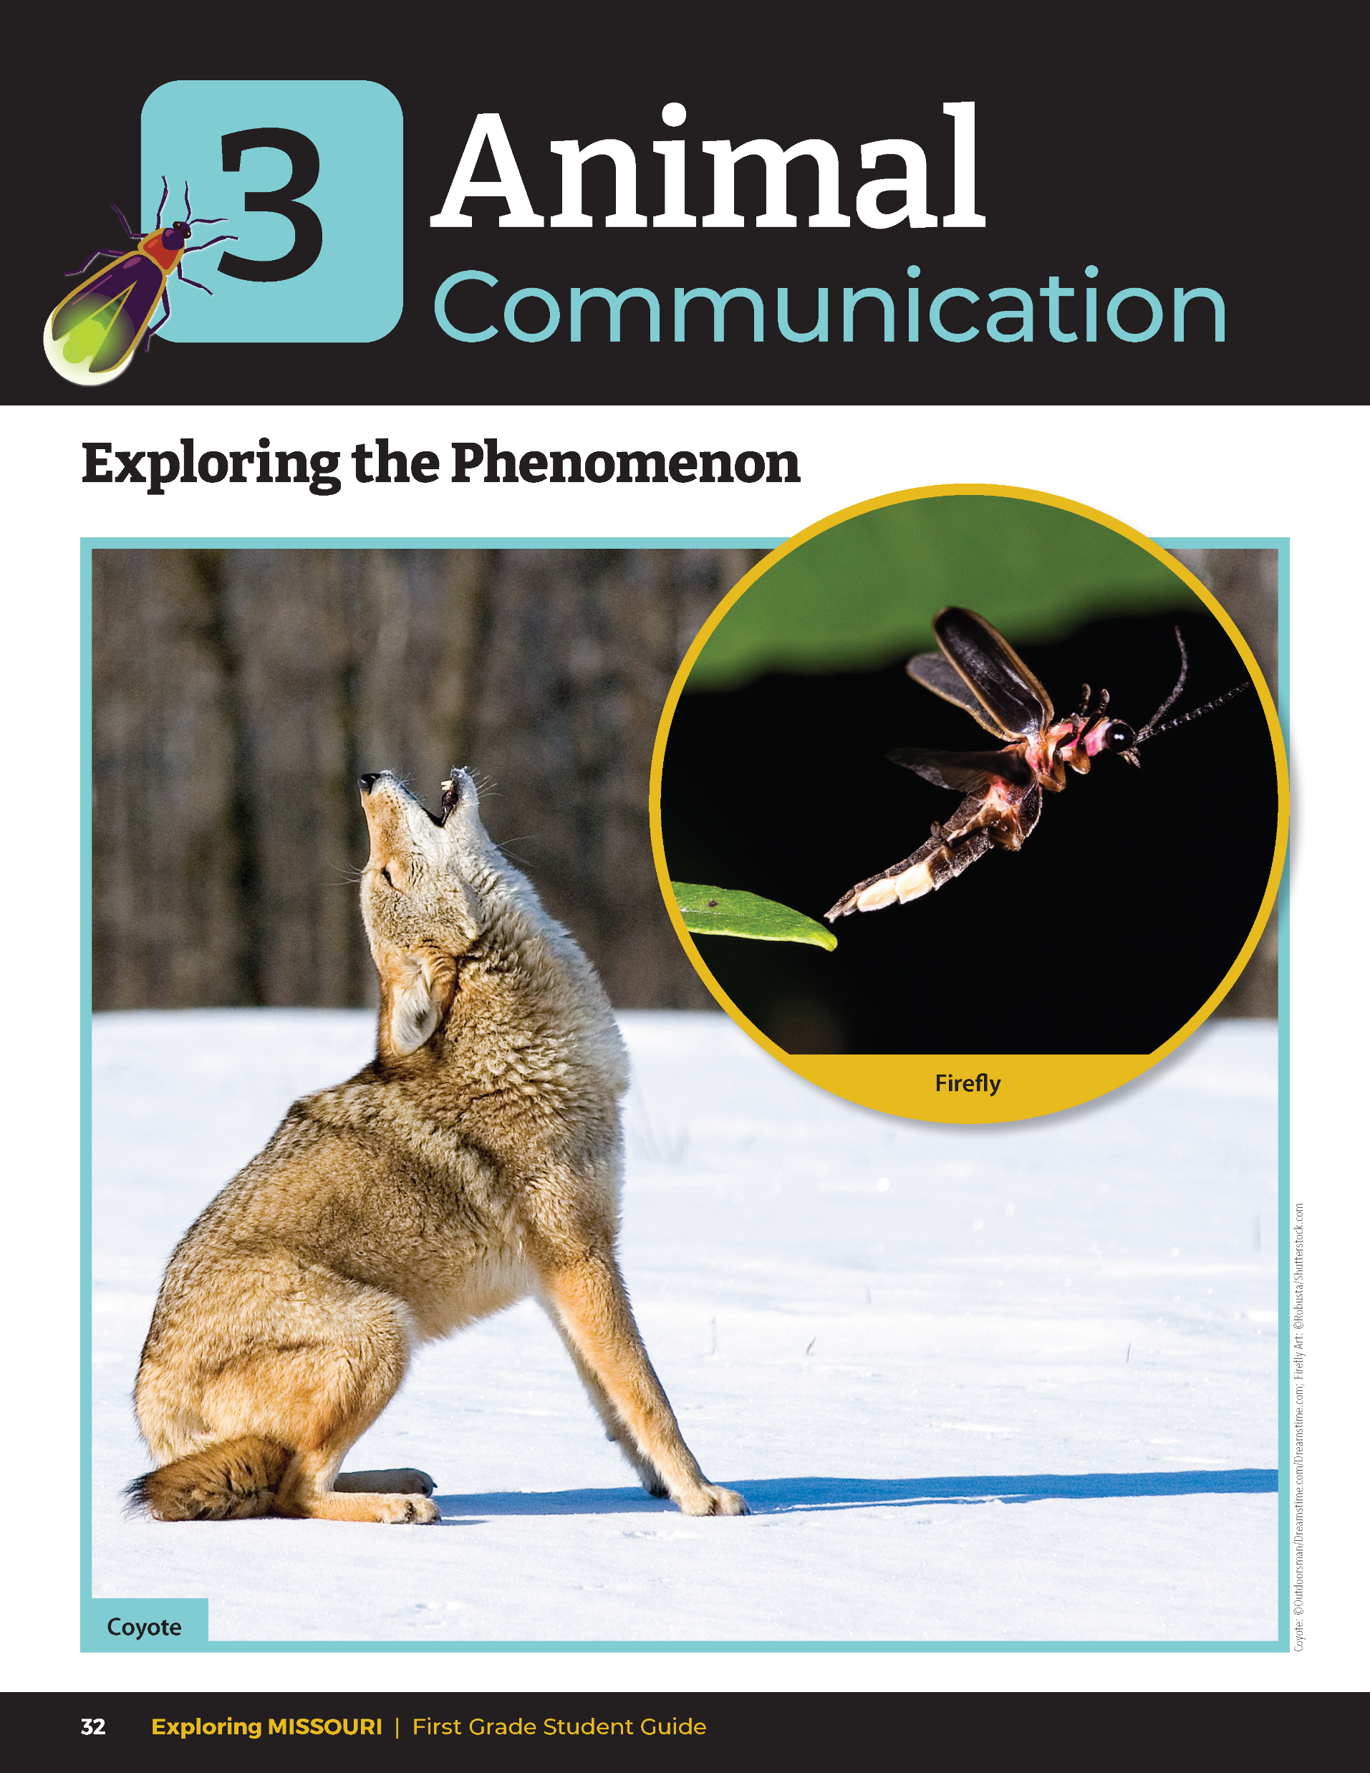
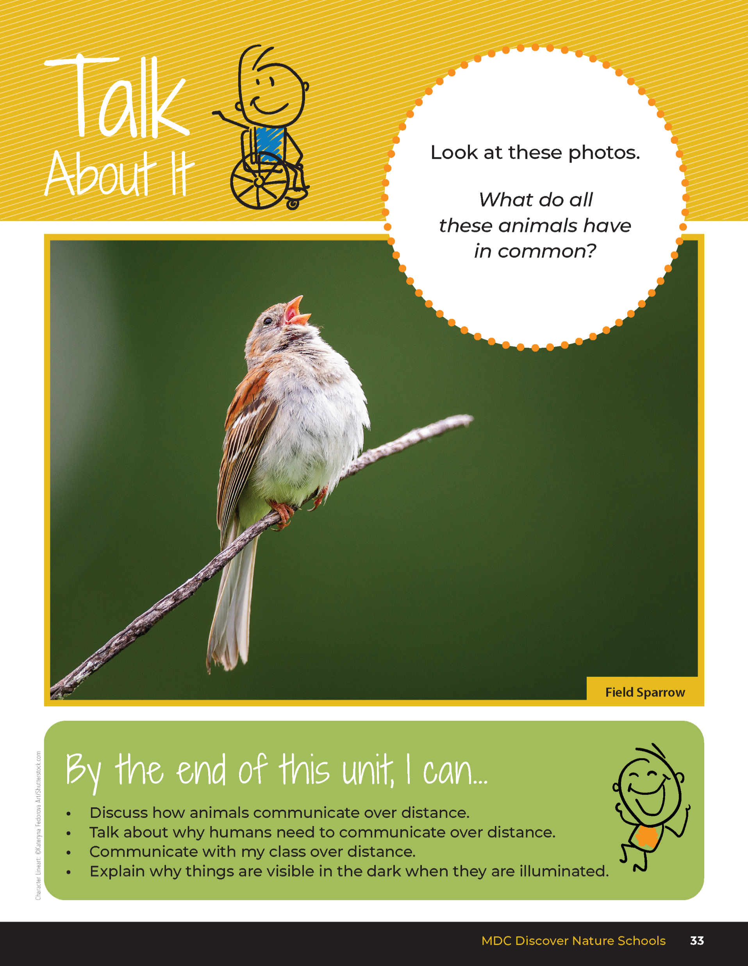
3
Exploring Missouri – Unit 3 Review
2
Notes:
Have students turn to the Unit 3 Exploring the Phenomenon Talk About It section on pages 32-33. Using the pictures at the beginning of the lesson, have students turn and talk to a classmate about what the coyote, bird, and fireflies are doing.

Slide 3
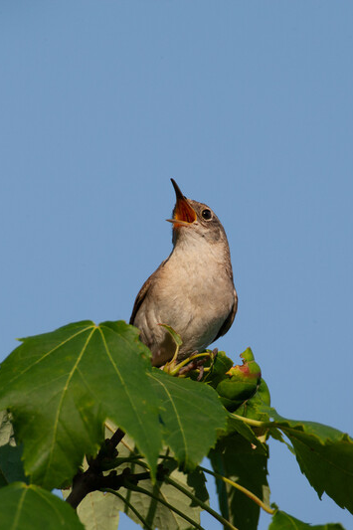
What are all these animals doing?
How are they doing it?
3
Exploring Missouri – Unit 3 Review
3
Notes:
Animal in Picture: House Wren
Rubric:
3 (Meets) – Student explains the coyote and bird are communicating through sound and the firefly is communicating through light.
2 (Partially meets) – Student explains coyote and/or bird are communicating through sound or the firefly is communicating through light.
1 (Doesn’t meet) – Student does not explain that the animals are communicating or how they are communicating.

Slide 4
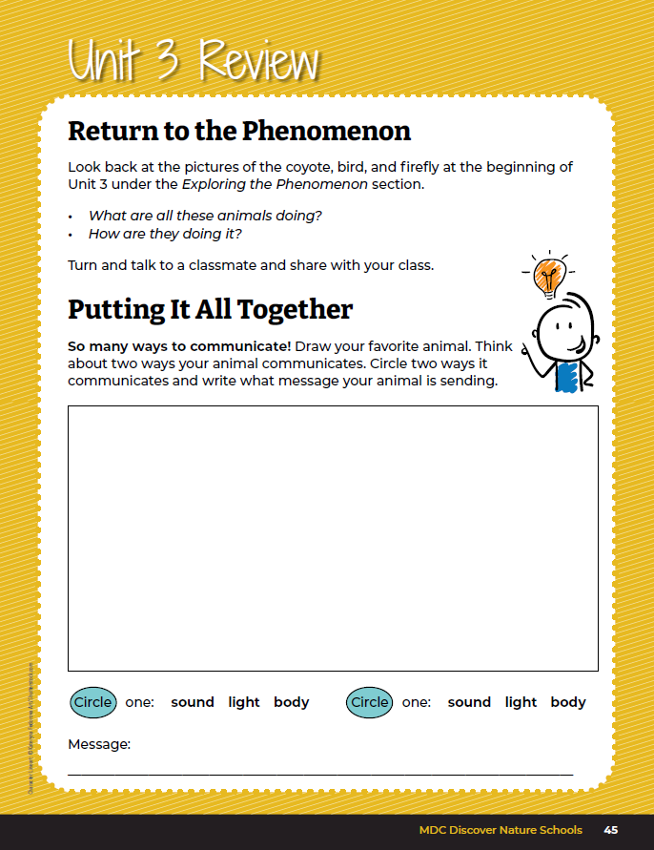
Draw your favorite animal. Think about two ways your animal communicates.
Circle two ways it communicates and write what message your animal is sending.
3
Exploring Missouri – Unit 3 Review
3
Notes:
Using the student guide Unit 3 Putting It All Together section on Page 45, students will draw their favorite animal and two ways it communicates messages through sound, light, or by body language.
Rubric:
3 (Meets) – Student drawing shows each of the components: a drawing of an animal, two ways it communicates, and two communication methods circled.
2 (Partially meets) – Student drawing shows some of the components: a drawing of an animal, one way it communicates, and the one communication method circled.
1 (Doesn’t meet) – Student drawing shows very few of the components: a drawing of an animal, no way it communicates, and no communication method circled.

