Slide 1
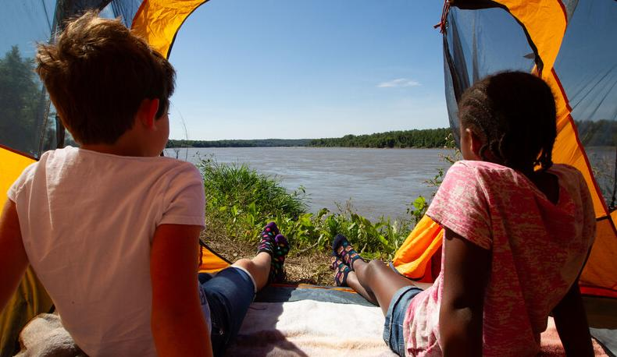

Life and Land in
MISSOURI
3B: Hot and Cold Changes

Slide 2
View the Campfire video.
Link:
https://youtu.be/pNXutCj3TH8
3B
Life and Land in Missouri – 3B Hot and Cold Changes: Engage
2
Notes:
From the MDC Teacher Portal, display the Campfire video.

Slide 3
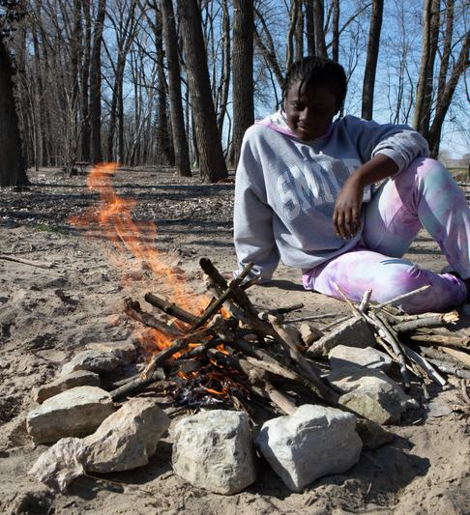
What changes to the wood do you see?
3B
Life and Land in Missouri – 3B Hot and Cold Changes: Engage
3

Slide 4
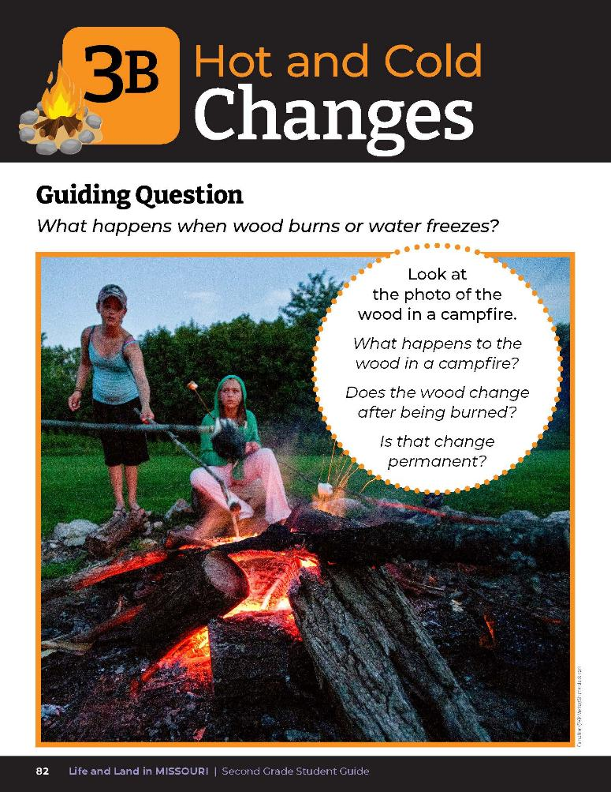
Guiding Question:
What happens when wood burns or water freezes?
3B
Life and Land in Missouri – 3B Hot and Cold Changes: Engage
4
Notes:
Have students turn to the Lesson 3B Hot and Cold Changes introduction on pages 82-83. Read the guiding question together. Brainstorm a few ideas as a class first. This is what we are going to research and explore today.

Slide 5

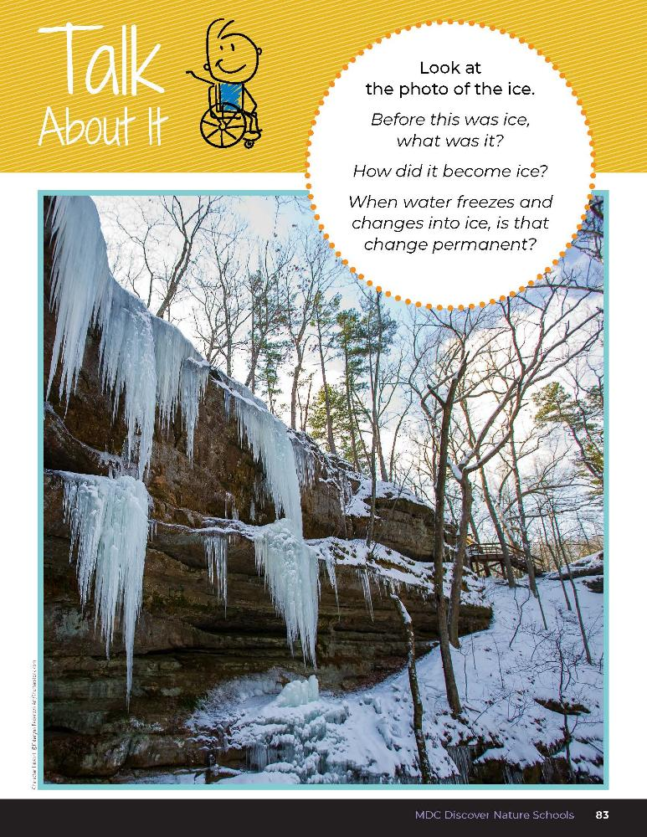
How do you think the heat from the fire is changing the firewood?
What about the ice along the rock wall?
3B
Life and Land in Missouri – 3B Hot and Cold Changes: Engage
5
Notes:
Read the Talk About It.
Bring a piece of charred wood from a fireplace and a piece of fresh wood for comparison.
In this lesson, we will be exploring how heating and cooling can affect certain things.

Slide 6
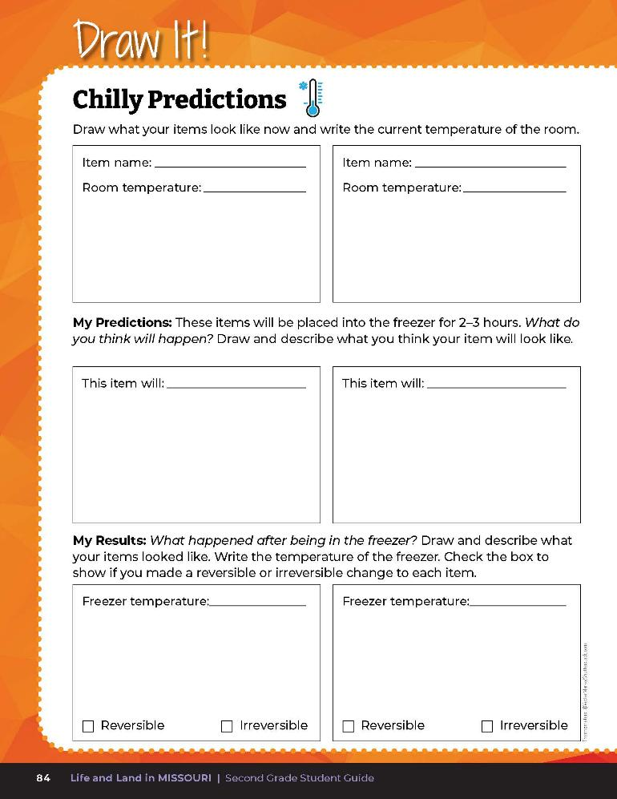
Complete your predictions.
3B
Life and Land in Missouri – 3B Hot and Cold Changes: Explore
6
Notes:
We will be preparing things to put in the freezer. We will be predicting what effects freezing might have and how the items might change when they return to room temperature.
Prepare items for freezing. Items include green leaves, water, a match, popcorn. Place on trays and put in the freezer with a thermometer. Let freeze for 2-3 hours.
In their student guide, have students complete their predictions for each item in their Draw It! 3B Chilly Predictions section on Page 84.

Slide 7
What was the temperature of the freezer?
3B
Life and Land in Missouri – 3B Hot and Cold Changes: Explore
7

Slide 8
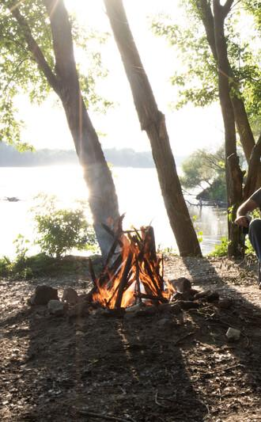
When we watched the campfire and looked at the firewood, what caused the wood to change?
3B
Life and Land in Missouri – 3B Hot and Cold Changes: Explore
8
Notes:
(Possible student answers: heat, fire, warmth.)

Slide 9

Will the sun’s heat be enough to cause items to change?
3B
Life and Land in Missouri – 3B Hot and Cold Changes: Explore
9
Notes:
We will also be preparing things to heat up.

Slide 10
How much heat do you think we will we need to create a change in these items?
What is the safest way to heat up these items?
3B
Life and Land in Missouri – 3B Hot and Cold Changes: Explore
10
Notes:
Take a second tray of the same items, such as a water, popcorn, and green leaves. Leave items in full sun for several hours, especially over the hottest part of the day, with a thermometer on the tray. Teacher Note: If there is not a warm day, place items into an oven. Heat the items, except the match, for 8 minutes at 400 Fahrenheit.

Slide 11
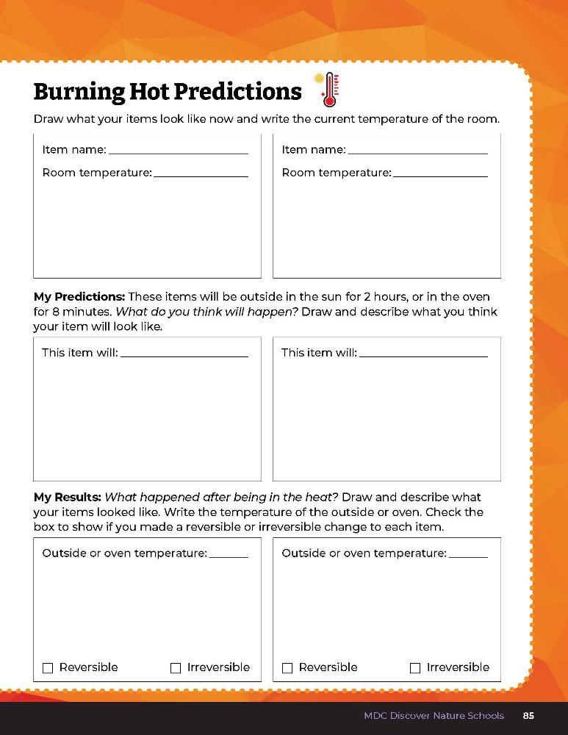
Complete your predictions.
3B
Life and Land in Missouri – 3B Hot and Cold Changes: Explore
11
Notes:
In their student guide, have students complete their predictions for each items in their Draw It! 3B Burning Hot Predictions Page 85.

Slide 12
What was the temperature outside and how is it different from the temperature in the freezer?
How do we know the sun produces heat?
3B
Life and Land in Missouri – 3B Hot and Cold Changes: Explore
12
Notes:
Place items in the sun to heat and see if there is any change.
(We can feel warmth on our face and skin.) The sun provides enough heat to cause some changes in some things but not others.

Slide 13
How much heat do you think we will need to create a change in these items?
3B
Life and Land in Missouri – 3B Hot and Cold Changes: Explore
13
Notes:
Strike the match in front of the students while you are outside. Allow it burn for 5-10 seconds.

Slide 14
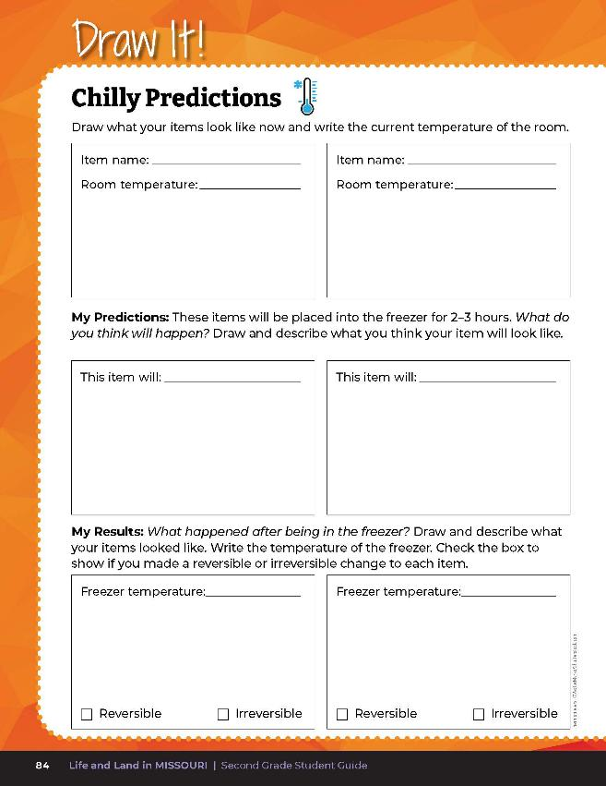
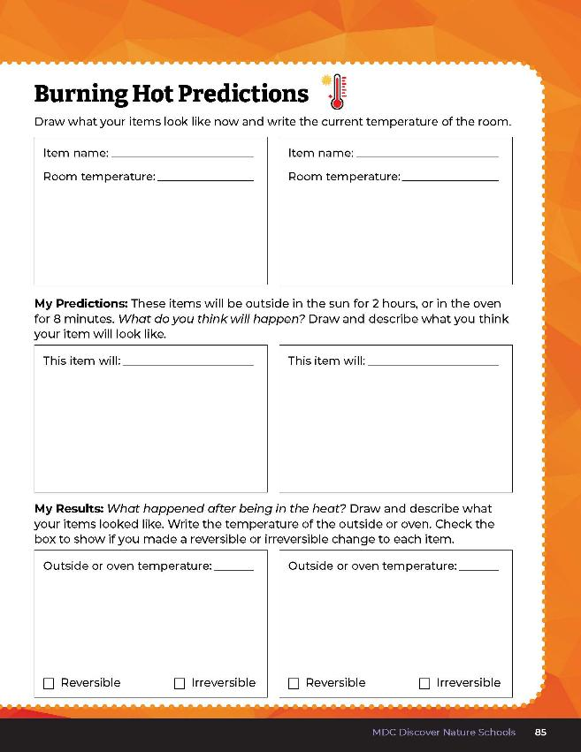
Complete the My Results section.
3B
Life and Land in Missouri – 3B Hot and Cold Changes: Explore
14
Notes:
Have students fill in their observations of items in the sun and items in the freezer and compare them with items on the room temperature tray. Students complete the My Results section under Draw It! 3B Chilly Predictions on Page 84 and Draw It! 3B Burning Hot Predictions on page 85.

Slide 15
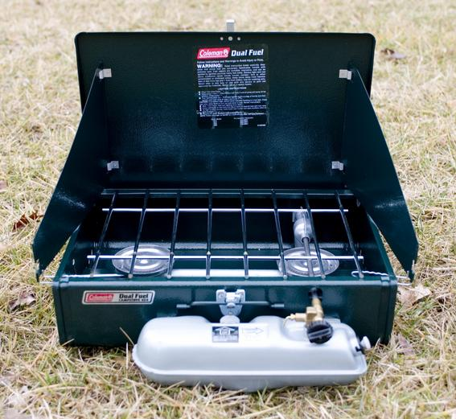
Brainstorm some other safe ways to heat items.
3B
Life and Land in Missouri – 3B Hot and Cold Changes: Explore
15
Notes:
Write student responses on the board. Suggestions can include:
Leaves in the sun should wither and dry out.
Pop popcorn in the microwave.
Heat water on a burner or in a microwave.
Wood could burn in a fire put or fireplace.
Observe marshmallows in the microwave for 10 seconds.
Melt chocolate with microwave or burner.

Slide 16
What are a few patterns you are noticing about the heated items?
What are the results of they are heated?
3B
Life and Land in Missouri – 3B Hot and Cold Changes: Explore
16

Slide 17
Once our items returned to room temperature, were they the same as before the freezing process or different?
How were they the same?
How were they different?
3B
Life and Land in Missouri – 3B Hot and Cold Changes: Explain
17
Notes:
Let’s look at the observations we made of the items we cooled by freezing. Remove frozen items and allow them to return to room temperature and bring out for students to observe.

Slide 18
Which items were the same after freezing?
3B
Life and Land in Missouri – 3B Hot and Cold Changes: Explain
18

Slide 19
Which items were different, or changed permanently, after freezing?
3B
Life and Land in Missouri – 3B Hot and Cold Changes: Explain
19

Slide 20
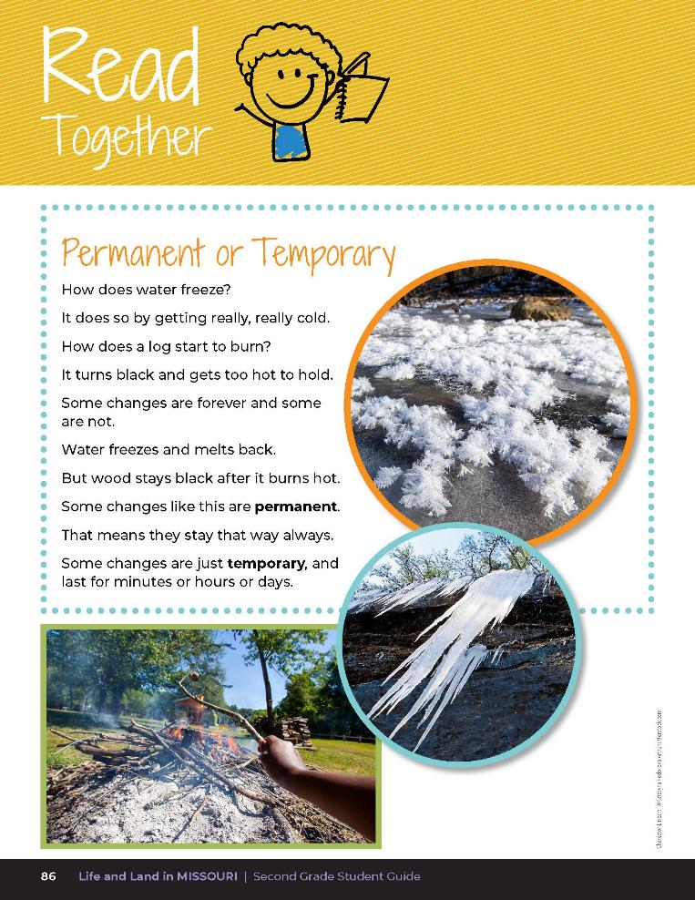

Permanent or Temporary
How does water freeze?
It does do by getting really, really cold.
How does a log start to burn?
It turns black and gets too hot to hold.
Some changes are forever and some are not.
Water freezes and melts back.
Some changes like this are permanent.
That means they stay that way always.
Some changes are just temporary, and last for minutes or hours or days.
3B
Life and Land in Missouri – 3B Hot and Cold Changes: Explain
20
Notes:
Read the Read Together 3B Permanent or Temporary? Section on Page 86.

Slide 21
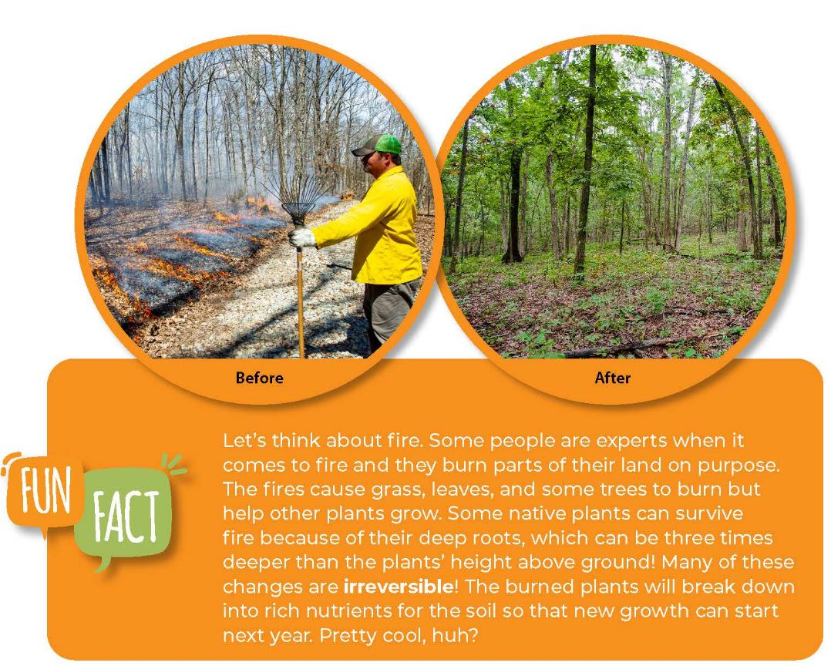
3B
Life and Land in Missouri – 3B Hot and Cold Changes: Explain
21
Notes:
Then read the Fun Fact together about controlled burns on the Talk About It 3B Looking Closer section on Page 87.

Slide 22
Reversible is when something changes back to how it was before so its change was temporary.
3B
Life and Land in Missouri – 3B Hot and Cold Changes: Explain
22

Slide 23
Did anything in our experiment return to its previous condition after freezing and returning to room temperature?
3B
Life and Land in Missouri – 3B Hot and Cold Changes: Explain
23

Slide 24
What did not return to its previous condition after freezing and returning to room temperature?
3B
Life and Land in Missouri – 3B Hot and Cold Changes: Explain
24
Notes:
These changes are irreversible, or permanent.

Slide 25
So why do changes happen at all when something is warm or cold?
3B
Life and Land in Missouri – 3B Hot and Cold Changes: Explain
25
Notes:
(It is because of the temperature. If we had a big temperature change like what happens when we burn paper or wood, that would make a big change to the paper or wood.)

Slide 26
Once our items returned to room temperature, were they the same as before the heating process or different?
How were they different?
3B
Life and Land in Missouri – 3B Hot and Cold Changes: Explain
26
Notes:
Let’s look at the observations we made of the items we heated.

Slide 27
Did heating in the sun cause any changes?
What items were the same/different after heating?
3B
Life and Land in Missouri – 3B Hot and Cold Changes: Explain
27

Slide 28
What changes are reversible or temporary? What temperature was needed to make these types of changes?
What changes are irreversible or permanent?
3B
Life and Land in Missouri – 3B Hot and Cold Changes: Explain
28

Slide 29
Discuss the items that were irreversible through the hot or cold changes and the items that were reversible.
Place a check mark next to either reversible or irreversible for each item.
3B
Life and Land in Missouri – 3B Hot and Cold Changes: Explain
29
Notes:
After the items have returned to room temperature, have students make their final observations. Allow students time to discuss the items that were irreversible through the hot or cold changes and the items that were reversible. Students will place a check mark next to either reversible or irreversible for each item.

Slide 30
Optional: Sing the Permanent or Temporary song.
(Sing to the tune of Here We Go Round the Mulberry Bush.)
Some changes that happen are permanent,
Permanent, permanent.
Some changes that happen are permanent,
Which means they last forever.
Some changes that happen are temporary,
Temporary, temporary.
Some changes that happen are temporary,
and return back whenever.
3B
Life and Land in Missouri – 3B Hot and Cold Changes: Explain
30

Slide 31
In small groups, you will create your own freezing and heating experiments.
3B
Life and Land in Missouri – 3B Hot and Cold Changes: Elaborate
31
Notes:
In small groups, allow students to create their own freezing and heating experiments. Students will brainstorm ideas, make and record their predictions, and argue from evidence based on their observations earlier in the lesson.

Slide 32
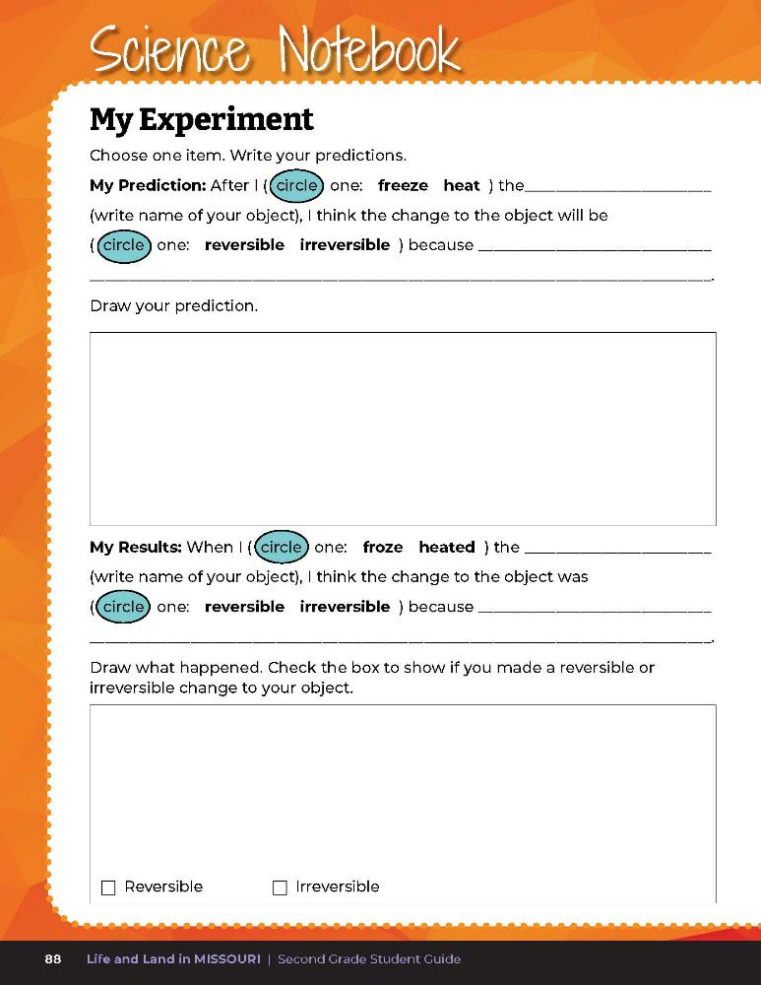
Record your experimental design and results.
3B
Life and Land in Missouri – 3B Hot and Cold Changes: Elaborate
32
Notes:
Once approved by the teacher, have students record their experimental design in their student guide and perform their experiment. Their experimental design and results should be recorded in Science Notebook 3B My Experiment on Page 88. Students will place a check mark next to reversible or irreversible for each item.

Slide 33
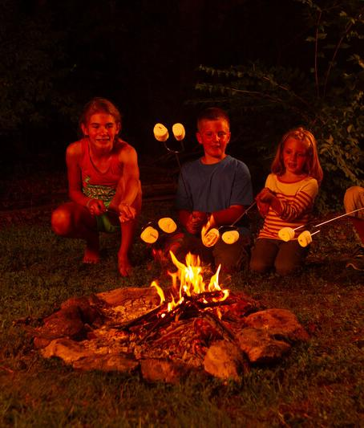
Optional Elaborate Activity: S’mores!
3B
Life and Land in Missouri – 3B Hot and Cold Changes: Elaborate
33
Notes:
Optional Elaborate Activity (1 session for 30-60 min):
If possible bring in a fire pit and firewood to build a small fire outside on concrete. Roast marshmallows over the fire and discuss how the wood and marshmallows change when heated. Use your roasted marshmallows to build s’mores (graham cracker, chocolate candy bar, and melted marshmallow sandwiches). How does the chocolate candy bar react when the hot marshmallow contacts with it? (Chocolate melts but it can be cooled again into a solid. This is a reversible change.)
What is the heat from the fire changing? What changes to items around the fire are reversible? What changes to items around or in the fire are not reversible?

Slide 34
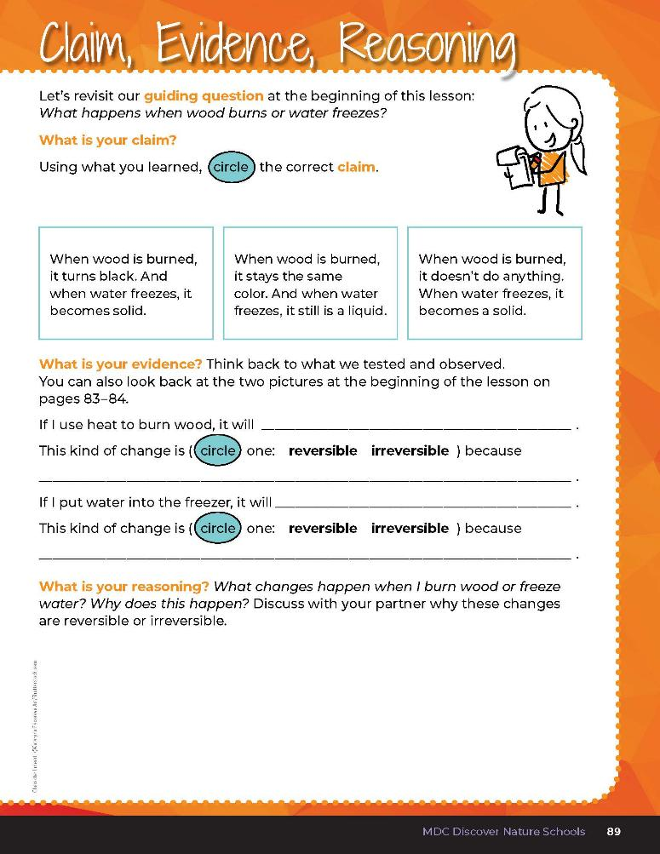

3B
Life and Land in Missouri – 3B Hot and Cold Changes: Evaluate
34
Notes:
Guiding Question: What happens when wood burns and water freezes?
After exploring the concept of reversible and irreversible changes to certain objects, have students open their students open their student guides to the 3B Claim, Evidence, Reasoning section on Page 89. Guide students through the page by reviewing each section as a class and revisiting the scientific concepts learned to help answer each section.

Slide 35
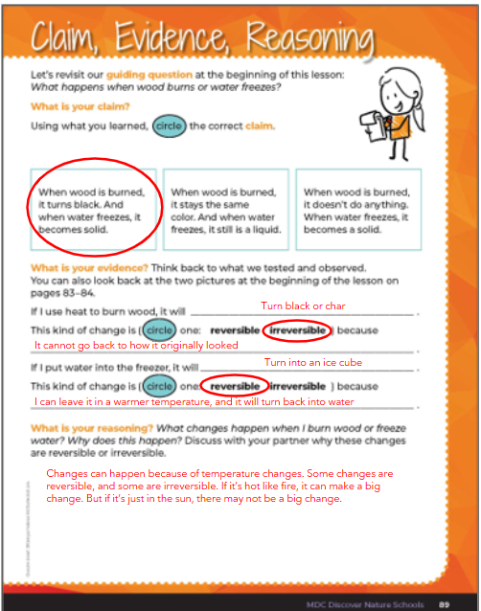
3B
Life and Land in Missouri – 3B Hot and Cold Changes: Evaluate
35
Notes:
Rubric:
4 (Exceeds) – Student circles the correct claim and writes the correct evidence into the blanks and verbalizes the correct reason.
3 (Meets) – Student circles either the correct claim or writes the correct evidence into the blanks and/or verbalizes the correct reason.
2 (Partially meets) – Student circles either the correct claim or somewhat writes the correct evidence into the blanks and does not verbalize the correct reason.
1 (Doesn’t meet) – Student does not provide the correct claim or evidence and does not verbalize the correct reason.

