Slide 1
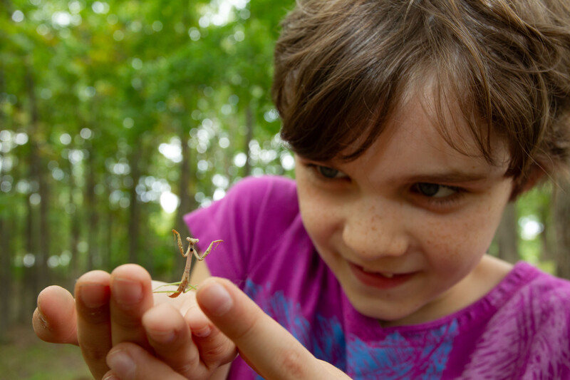

Exploring
MISSOURI
3B: Crack the Code

Slide 2
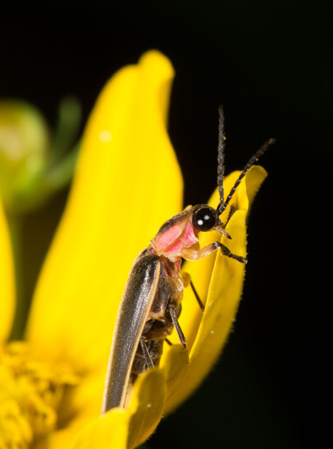
Guiding Question:
How do fireflies communicate?
3B
Exploring Missouri – 3B Crack the Code: Engage
2
Notes:
Animal in picture: firefly

Slide 3

Raise your hand if you have ever seen fireflies. Where were you?
3B
Exploring Missouri – 3B Crack the Code: Engage
3
Notes:
Have students raise their hand if they’ve ever seen fireflies. Have students share when and where they saw fireflies. Where were you?

Slide 4
Play the Fireflies at Night video!
Link: Fireflies at Night
3B
Exploring Missouri – 3B Crack the Code: Engage
4
Notes:
From the MDC Teacher Portal, display the Fireflies at Night video.
This video shows fireflies flashing at night.

Slide 5
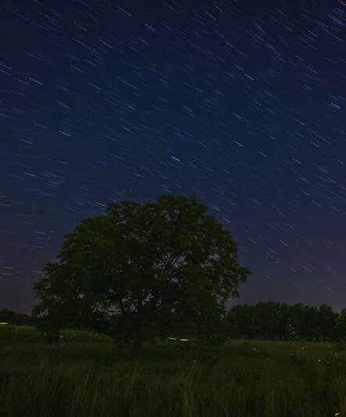
Can you see the fireflies all the time or just some of the time?
3B
Exploring Missouri – 3B Crack the Code: Engage
5
Notes:
Notice that the fireflies seem to disappear into the night sky when they are not flashing. Watch the pattern of flashes of fireflies.

Slide 6
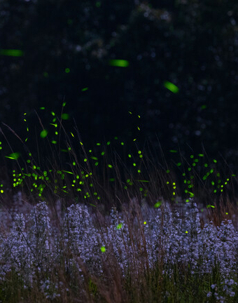
Do they flash the same pattern or different ones?
3B
Exploring Missouri – 3B Crack the Code: Engage
6
Notes:
Today we are going to explore why we see fireflies so well at night, and how they communicate with one another.

Slide 7
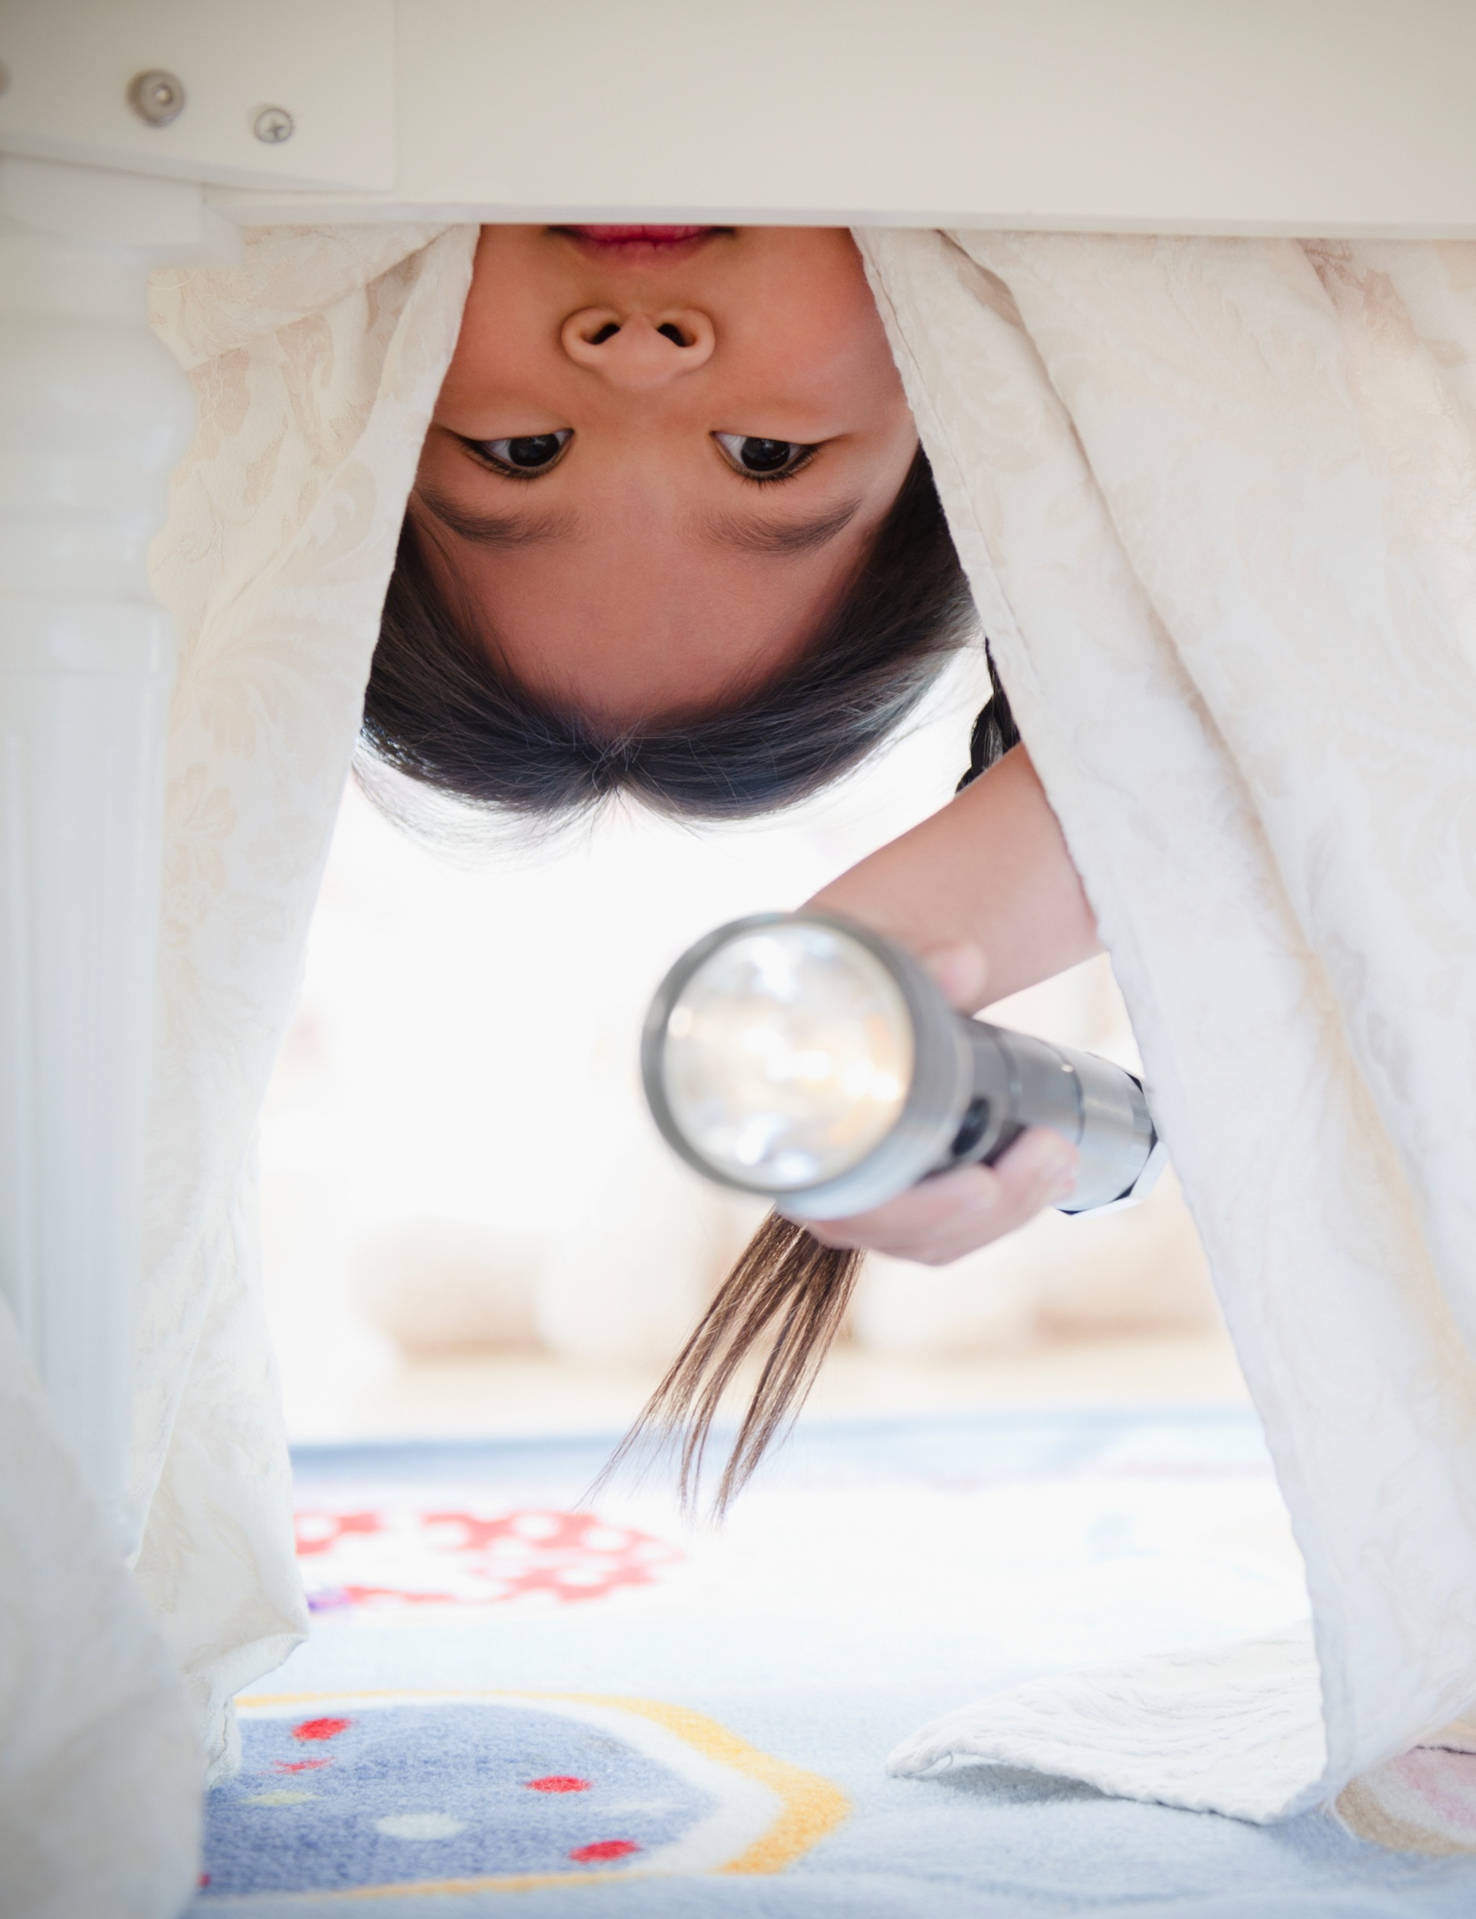
What tools do you use to see in the dark?
3B
Exploring Missouri – 3B Crack the Code: Explore
7
Notes:
Brainstorm a list of tools.

Slide 8
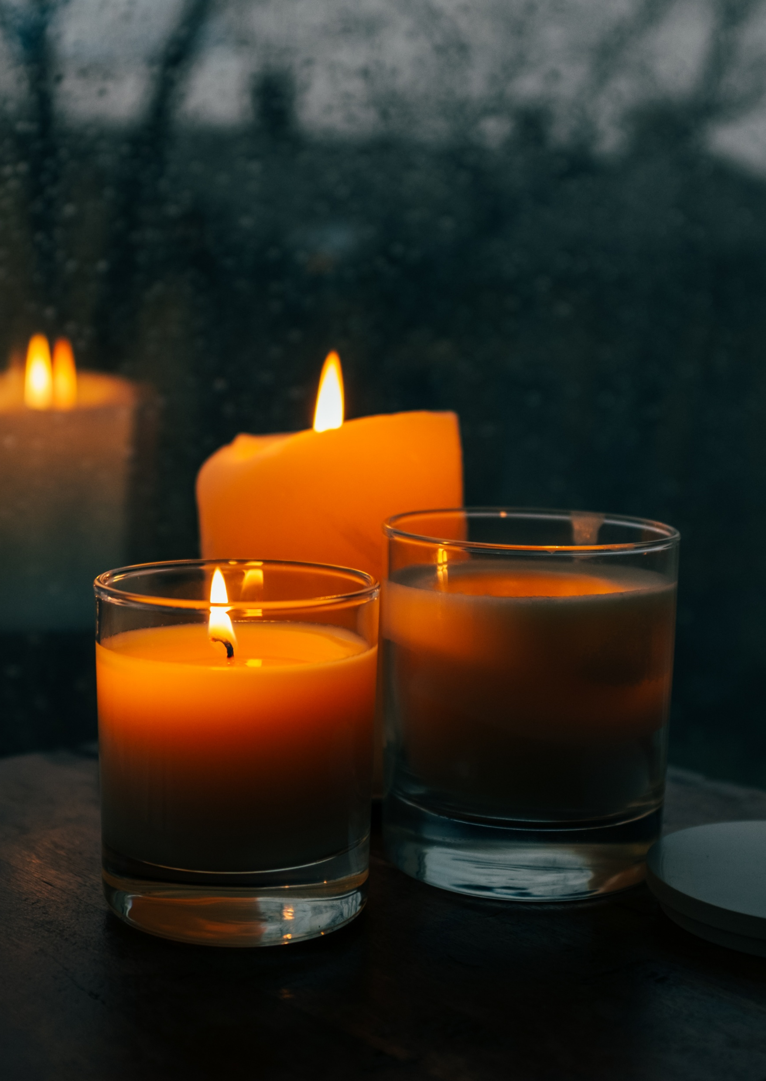
How well does each tool help you see the object?
3B
Exploring Missouri – 3B Crack the Code: Explore
8
Notes:
Place an object at the front of the room such as a basketball. (This will later be the object students true to illuminate when the room is dark.)
Now place a collection of light “tools” on a table. (Examples below.)
Several small flashlights
Glow sticks
Glow-in-the-dark stars
Tea light candles (or battery-powered tea light candles)
String of holiday lights
Headlamps
Refer students’ attention once again to the object placed at the front of the room. Provide light tools for students to use to illuminate the object and allow them to explore and make observations using each tool and the light each produces by shining each tool on the object in front of the room.

Slide 9
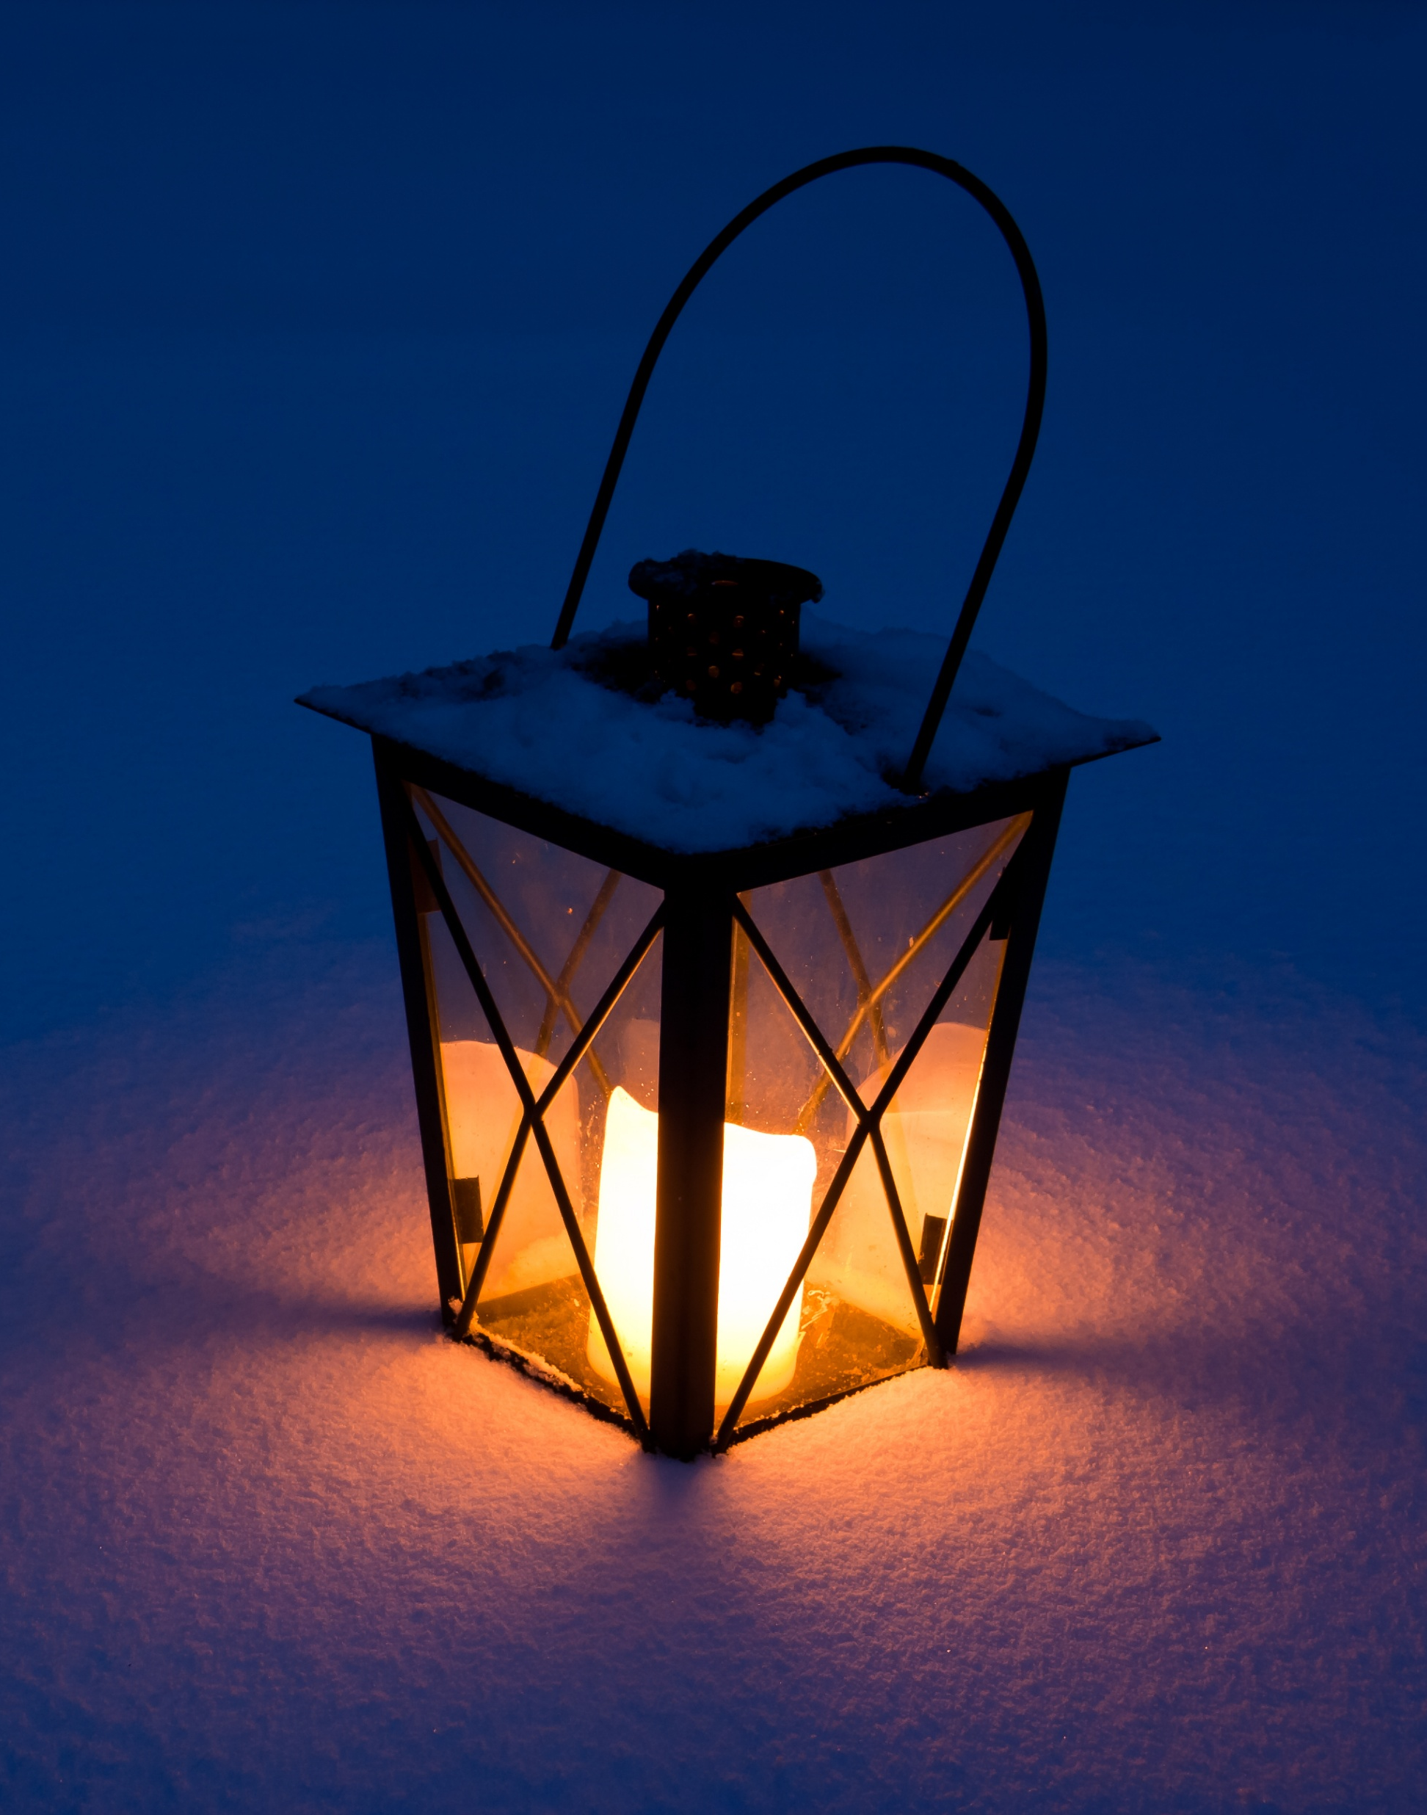
How well do the tools help you see the object now?
3B
Exploring Missouri – 3B Crack the Code: Explore
9
Notes:
Now turn off the lights in the classroom and close the shades. Using the same tools, shine the light on the object again. (Repeat this step with students till all have explored using all tools in both light and dark conditions.)

Slide 10

How are these tools different?
How are they the same?
3B
Exploring Missouri – 3B Crack the Code: Explore
10

Slide 11

Is there one tool that helps us see better than another?
3B
Exploring Missouri – 3B Crack the Code: Explore
11

Slide 12
Was it better for us to see the object using the tools when the room was lighter or darker? Why?
3B
Exploring Missouri – 3B Crack the Code: Explore
12

Slide 13
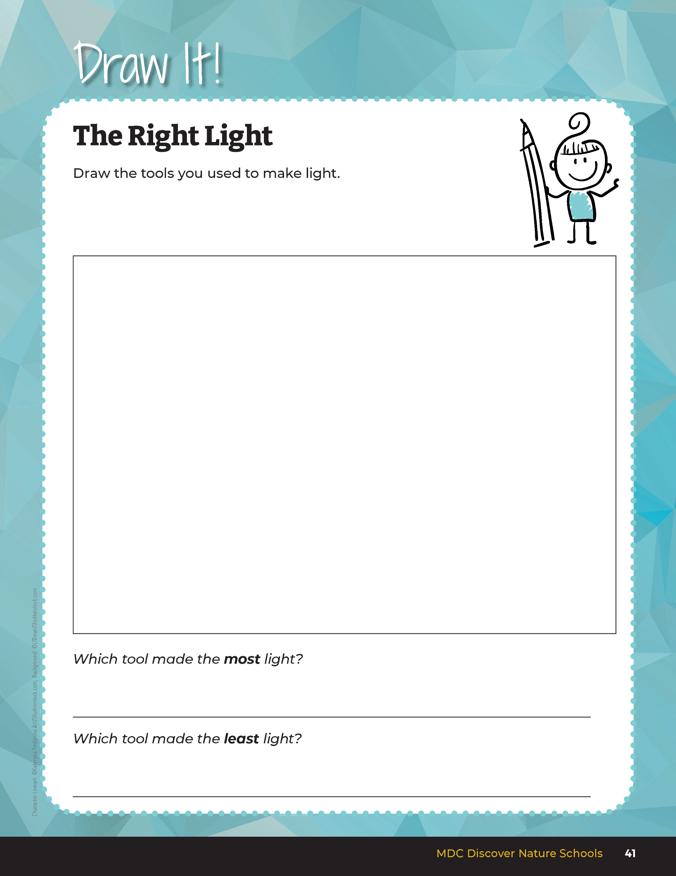

Draw the tools you used to make light.
3B
Exploring Missouri – 3B Crack the Code: Explore
13
Notes:
Have students describe the light produced by each object and record this in their student guide Draw It! 3B The Right Light section on Page 41.
Discuss student ratings of the best light source and describe why that is the best light source.

Slide 14
What does it mean to illuminate?
3B
Exploring Missouri – 3B Crack the Code: Explain
14
Notes:
Explain that some things make their own light while other things give off light. Light illuminates objects. What does it mean to illuminate? (made bright with light shining on it or by making light)

Slide 15
When is illumination more useful? In the light or in the darkness?
3B
Exploring Missouri – 3B Crack the Code: Explain
15
Notes:
Think about our experiment we just completed with the object at the front of the room.

Slide 16
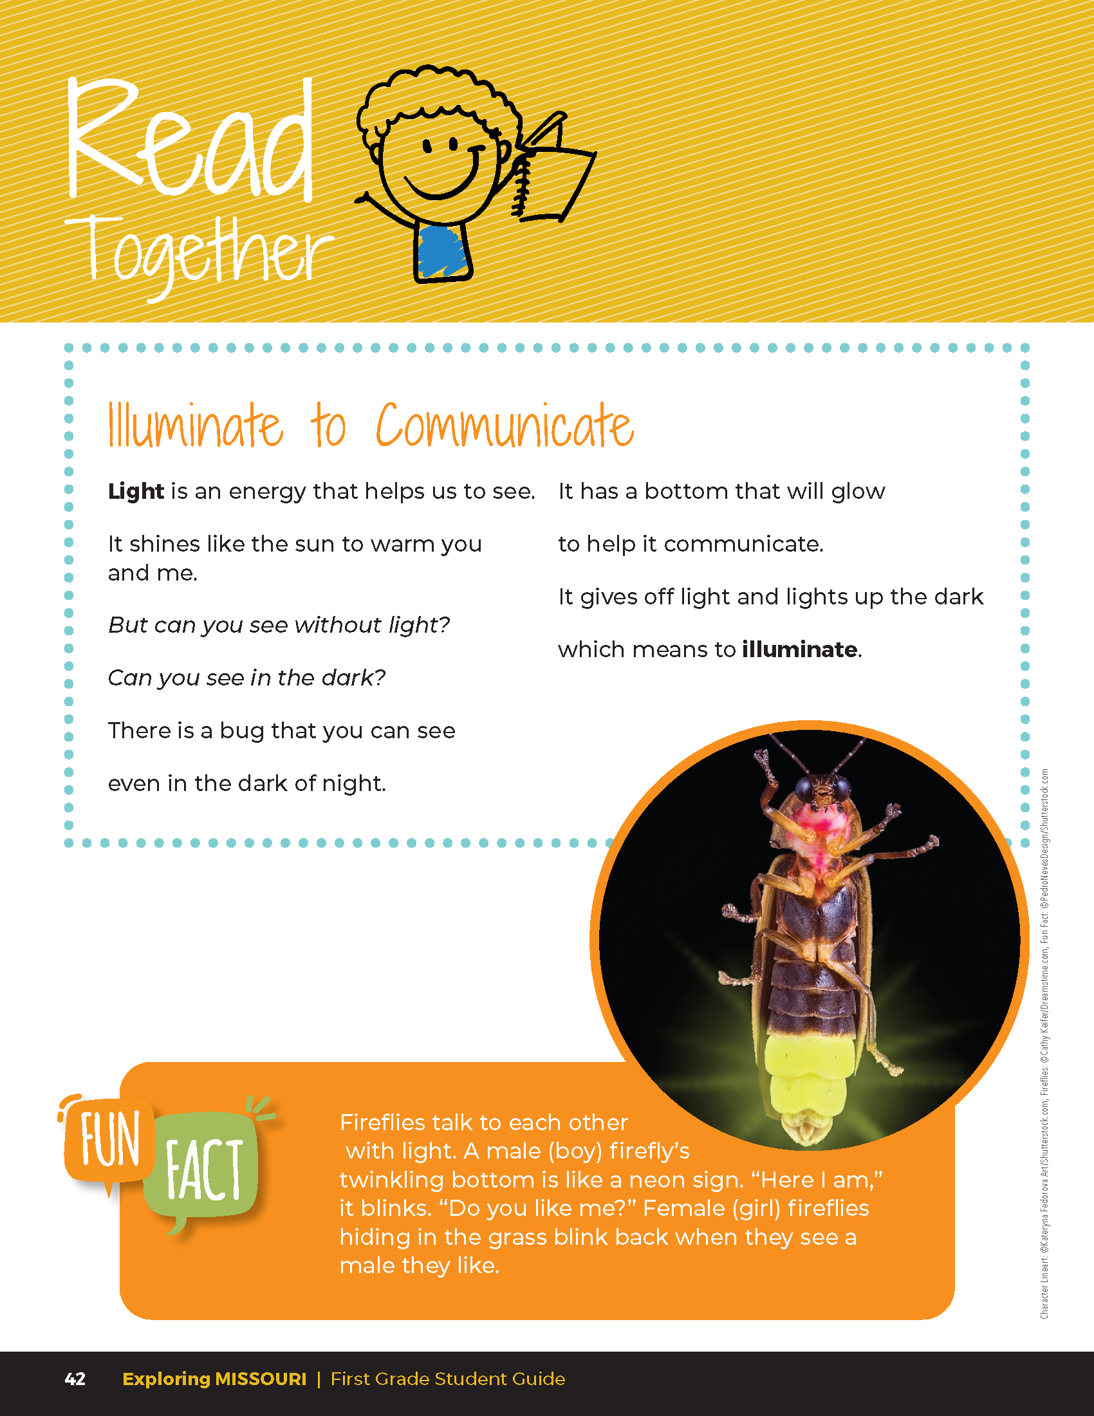

Illuminate to Communicate
Light is an energy that helps us to see.
It shines like the sun to warm you and me.
But can you see without light?
Can you see in the dark?
There is a bug that you can see even in the dark of night.
It has a bottom that will glow to help it communicate.
It gives off light and lights up the dark which means to illuminate.
3B
Exploring Missouri – 3B Crack the Code: Explain
16
Notes:
Read together the student guide Read Together 3B Illuminate to Communicate section on Page 42.

Slide 17
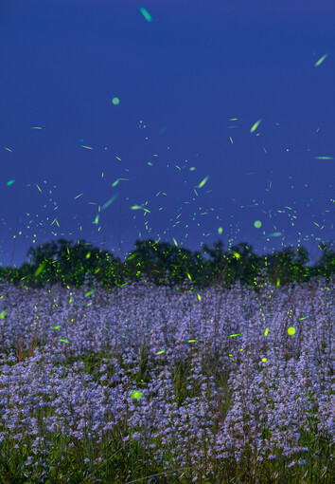
Why do we see fireflies better at night?
3B
Exploring Missouri – 3B Crack the Code: Explain
17

Slide 18
Play the Fireflies at Night video again!
https://www.youtube.com/watch?v=HP9ASHDWQKI
Link:
3B
Exploring Missouri – 3B Crack the Code: Explain
18
Notes:
Display the Fireflies at Night video again from the MDC Teacher Portal.

Slide 19
Why do you think fireflies flash?
3B
Exploring Missouri – 3B Crack the Code: Explain
19
Notes:
Fireflies are a type of beetle that we can see at night when they flash light from their abdomen.

Slide 20
What do you think these fireflies are saying?
3B
Exploring Missouri – 3B Crack the Code: Explain
20
Notes:
Fireflies communicate at night by flashing signals to one another. Let’s think back to our last lesson about animal communication over longer distances. What do you think these fireflies are saying? How could they say different things? (By using different flashing rates and patterns.)

Slide 21
Can you see fireflies when their abdomens are not flashing? Why or why not?
3B
Exploring Missouri – 3B Crack the Code: Explain
21
Notes:
Without the illumination of their abdomens, they seem to disappear into the night.

Slide 22
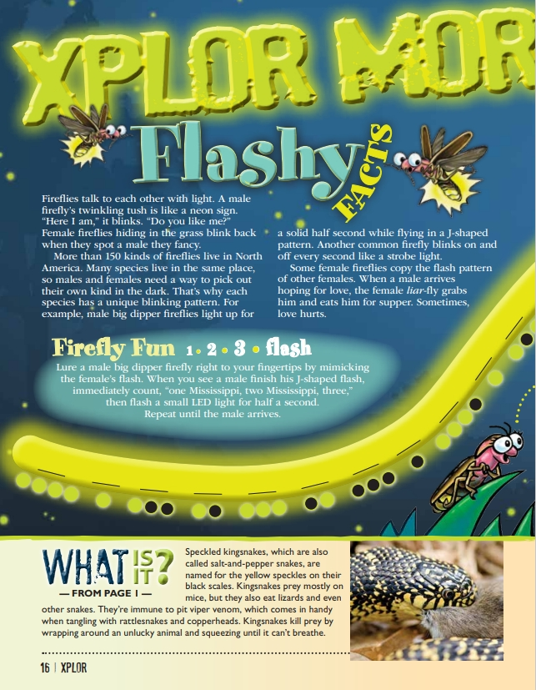
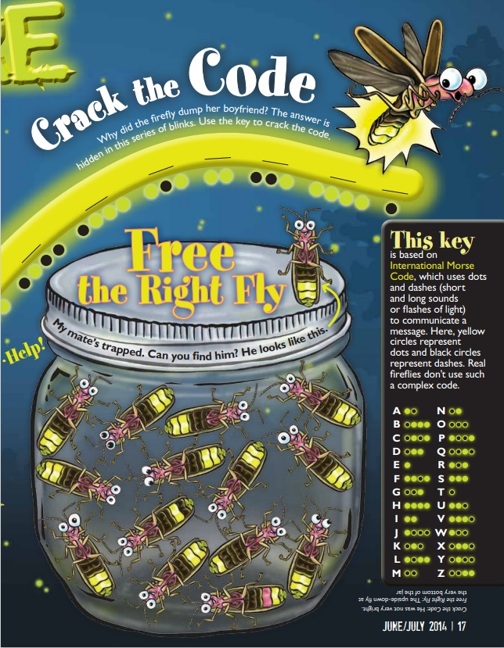
3B
Exploring Missouri – 3B Crack the Code: Elaborate
22
Notes:
After observing fireflies in the video, you will now work with a partner to share a firefly message in darkness using flashlights. From the MDC Teacher Portal, display the Flashy Facts: Crack the Code article from June 2014 issue of Xplor.
Look at pages 16 and 17 of the article. Can you crack the code? Follow the pathway of the dots to see why the firefly dumped her boyfriend. Use the key on Page 17. (Answer is under the key.)

Slide 23
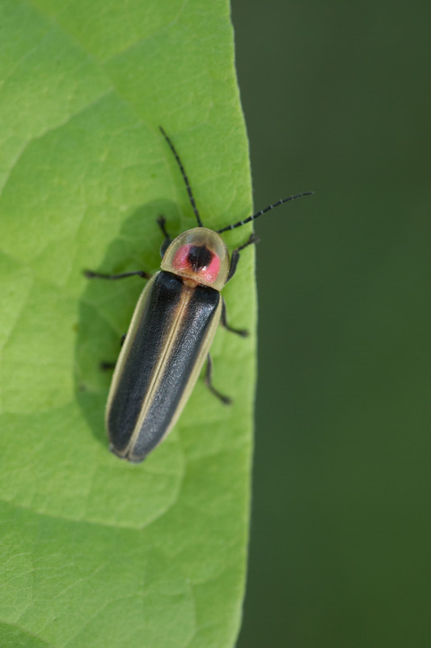
How do fireflies communicate?
3B
Exploring Missouri – 3B Crack the Code: Elaborate
23
Notes:
They flash their illuminated abdomens at different times.
Animal in picture: firefly

Slide 24

You and your firefly partner will each come up with 3 messages to share with each other using flashlights.
3B
Exploring Missouri – 3B Crack the Code: Elaborate
24
Notes:
You and your firefly partner will each come up with 3 messages to share with each other using flashlights. Each message should be 5 seconds long. (Have students count “one Mississippi” for each second.) For example, one message may be alternating one-second flashes on and off. Another message may be shared by rapidly turning the flashlight on and off 5 times.

Slide 25

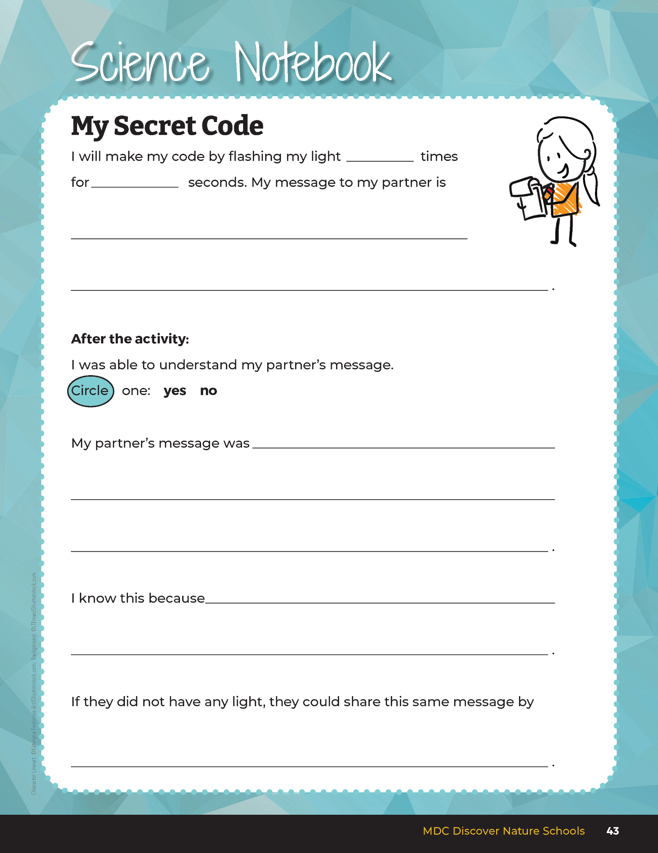
My Secret Code
3B
Exploring Missouri – 3B Crack the Code: Elaborate
25
Notes:
In the student guide Science Notebook 3B My Secret Code section on Page 43, have students complete the page to record their message in words and how it will be communicated by flashes.

Slide 26
Can you see your partner on the other side of the curtain?
Can you see your partner in the dark?
Can you see your partner when you turn on your flashlight?
3B
Exploring Missouri – 3B Crack the Code: Elaborate
26
Notes:
While students are working out their messages, hang a sheet or curtain in the room using a rope. Once students are ready, line up students across from their partners on opposite sides of the sheet/curtain. Dim the lights in room.

Slide 27
Explain why you can or cannot see your partner’s message.
3B
Exploring Missouri – 3B Crack the Code: Elaborate
27
Notes:
Allow students the time to communicate their message using the flashlight. Have student explain why they can or cannot see their partner’s message, using the definition of illumination.

Slide 28
My Secret Code
3B
Exploring Missouri – 3B Crack the Code: Elaborate
28
Notes:
Have students finish completing questions in the student guide Science Notebook 3B My Secret Code section on Page 43. If students finish early, they may create another code with their partner using the 3B My Secret Code Handout.

Slide 29
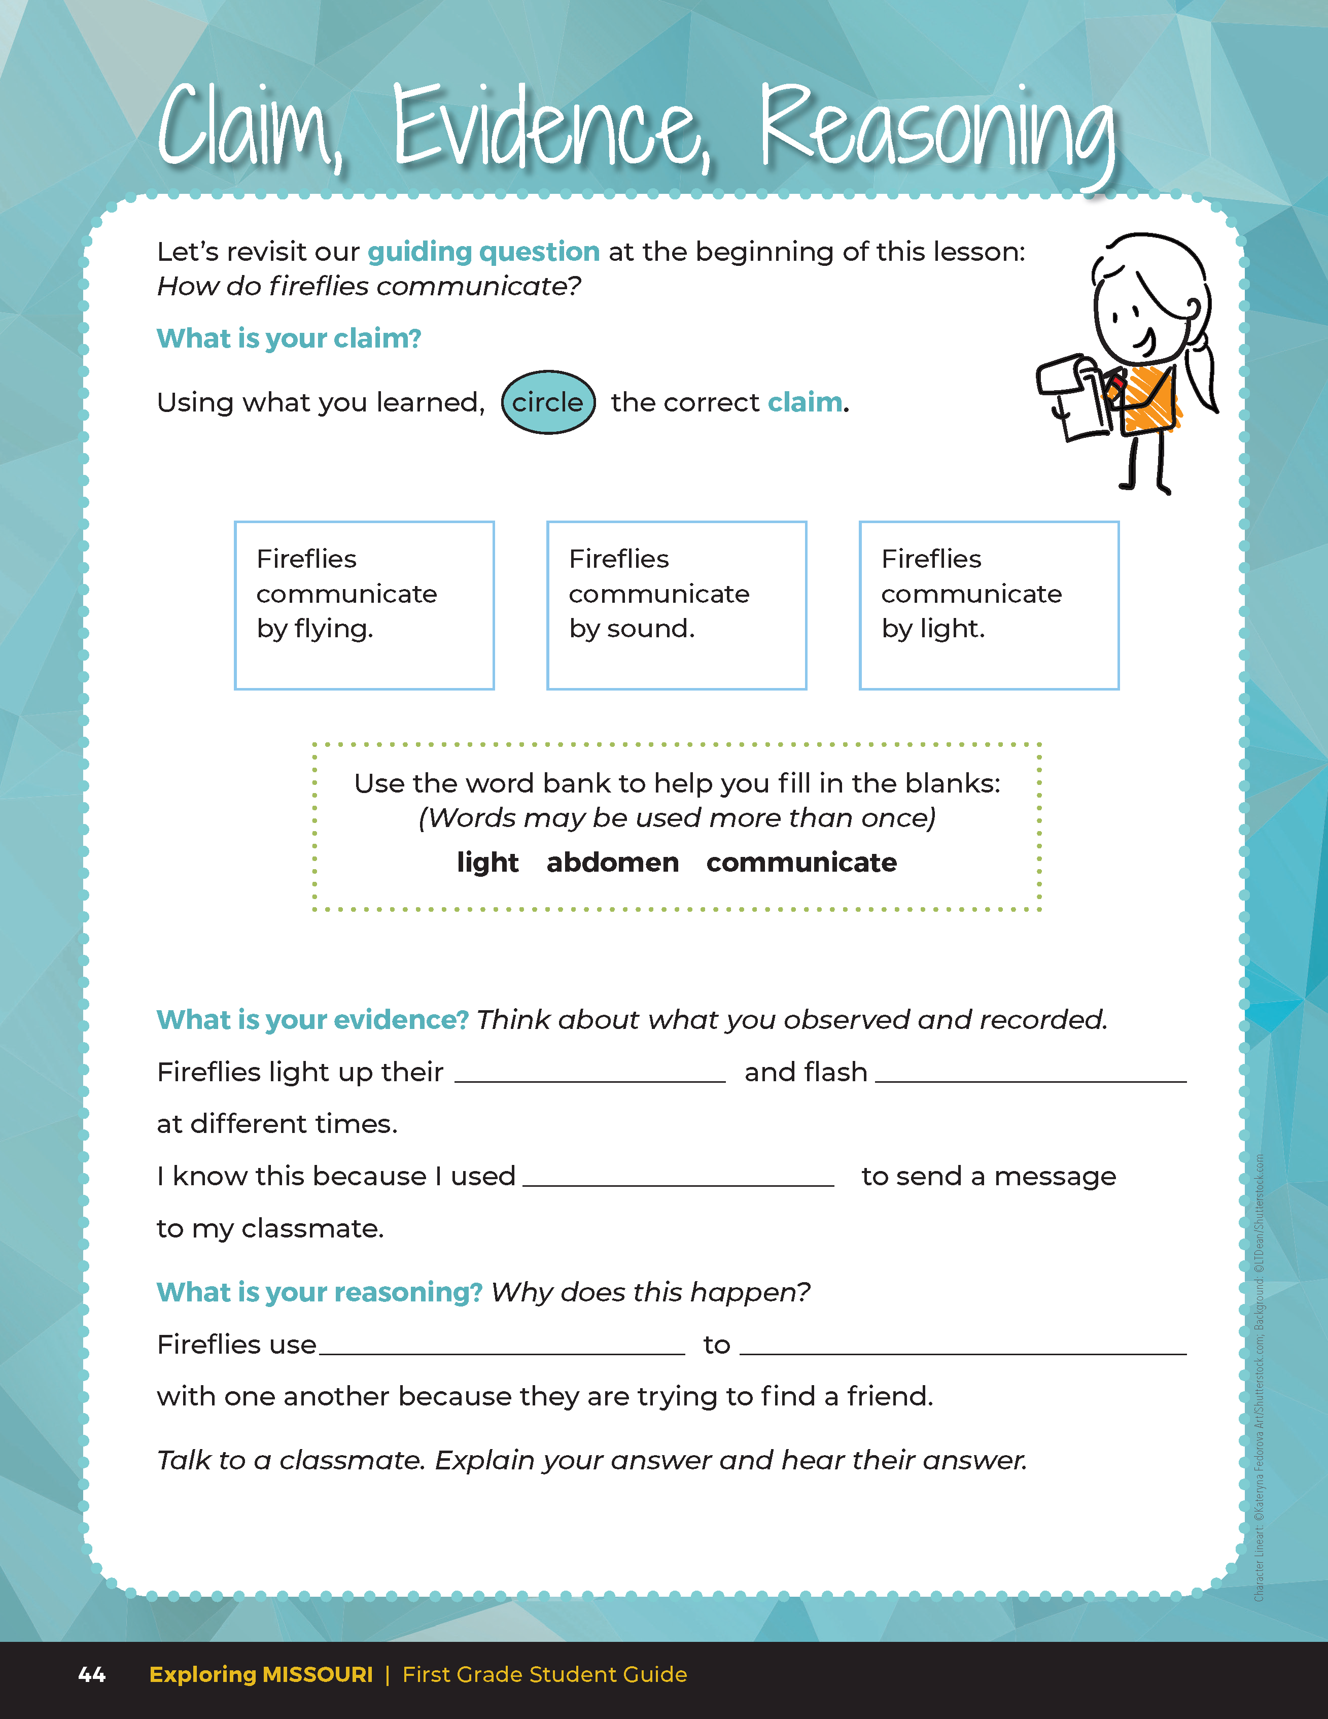
Guiding Question:
How do fireflies communicate?
3B
Exploring Missouri – 3B Crack the Code: Evaluate
29
Notes:
After exploring the concept of how fireflies communicate, have students open their student guides to the Claim, Evidence, Reasoning section on Page 44. Discuss the page with students – read the guiding question and then explain what the students need to do to answer the questions (circle the correct claim and fill in the blanks). It may be helpful to display the student guide page from the MDC Teacher Portal as you discuss the page.

Slide 30
Answers
abdomen
light
light
light
communicate
3B
Exploring Missouri – 3B Crack the Code: Evaluate
30
Notes:
Rubric:
4 (Exceeds) – Students write the correct claim and evidence into the blanks and identify the correct reason.
3 (Meets) – Students write either the correct claim or evidence into the blanks and/or identify the correct reason.
2 (Partially Meets) – Students write either the correct claim or evidence into the blanks and do not identify the correct reason.
1 (Doesn’t Meet) – Students do not provide the correct claim or evidence and do not identify the correct reason.

Slide 31

Optional: Cross-Curricular Extension
Fireflies are less common in some areas. Help scientists learn more about firefly populations by observing fireflies for 10 minutes a week through the Firefly Watch Citizen Science program.
3B
Exploring Missouri – 3B Crack the Code: Cross-Curricular Extension
31
Notes:
Learn more about fireflies and join the program from the link - Firefly Watch

