Slide 1


Life and Land in
MISSOURI
3A: Turkey Yelpers

Slide 2
Play the Turkey Calls video.
Link:
https://youtu.be/8f5W8z_BtJU
3A
Life and Land in Missouri – 3A Turkey Yelpers: Engage
2
Notes:
From the MDC Teacher Portal, play the Turkey Calls video.

Slide 3
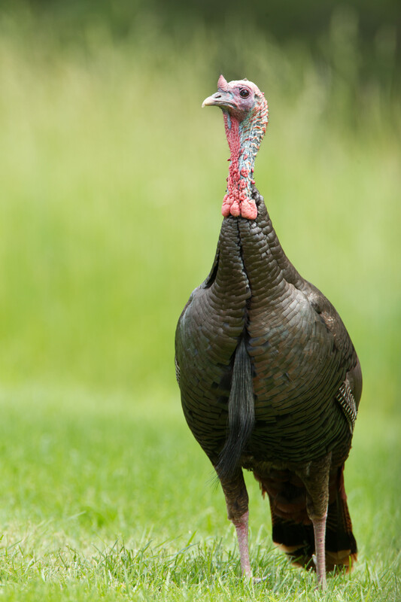
What do you hear?
Why can we hear these different calls from the turkeys in the video?
3A
Life and Land in Missouri – 3A Turkey Yelpers: Engage
3
Notes:
Animal in Picture: wild turkey

Slide 4
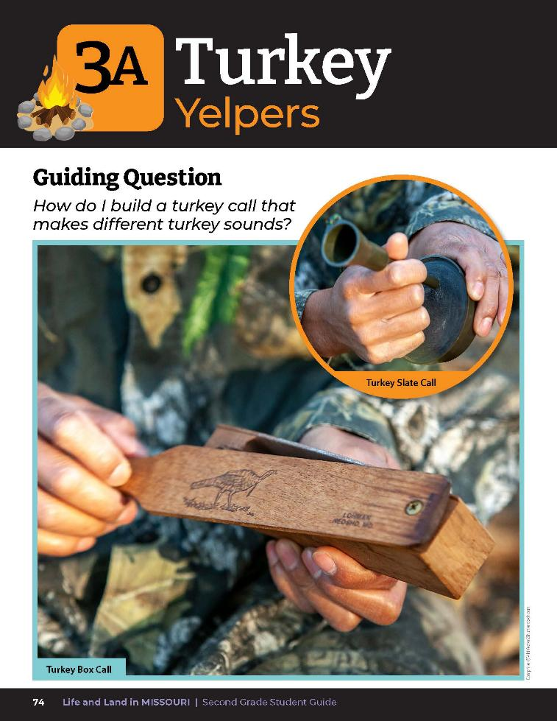
Guiding Question:
How do I build a turkey call that makes different turkey sounds?
3A
Life and Land in Missouri – 3A Turkey Yelpers: Engage
4
Notes:
Have students turn to the Lesson 3A Turkey Yelpers introduction on pages 74-75. Brainstorm a few ideas a class first. This is what we are going to research and engineer today.

Slide 5
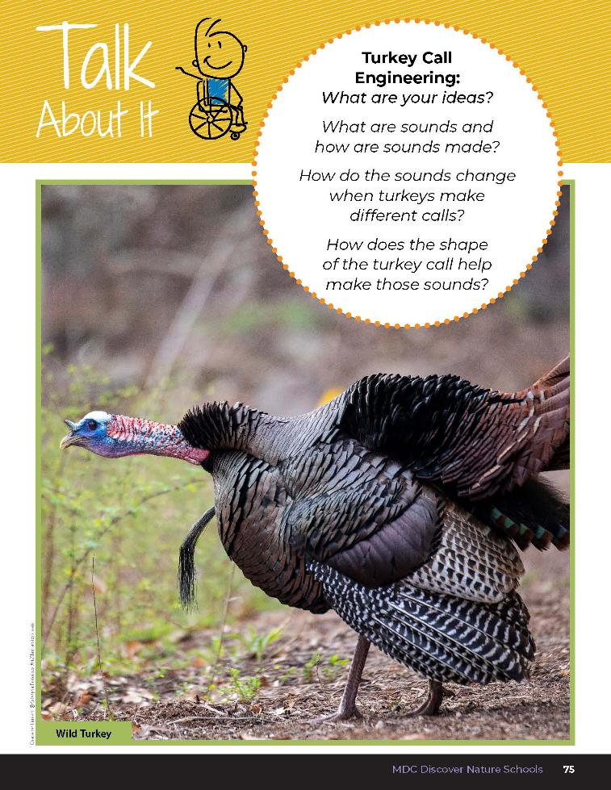

What are sounds and how are sounds made?
How do the sounds change when turkeys make different calls?
How does the shape of the turkey call help make those sounds?
3A
Life and Land in Missouri – 3A Turkey Yelpers: Engage
5
Notes:
Read the Talk About It and discuss the questions as a class.

Slide 6
Let’s go outside to explore and practice making turkey sounds using the box call and slate call.
You can reference the How to Use Turkey Calls videos.
Link:
https://youtu.be/ab8ZGc-KMXw
Link:
https://youtu.be/vIFfTPlI7RQ
3A
Life and Land in Missouri – 3A Turkey Yelpers: Explore
6
Notes:
Take students outside to explore and practice making turkey sounds using the box call and slate call. You can reference the How to Use Turkey Calls videos from the MDC Teacher Portal.

Slide 7
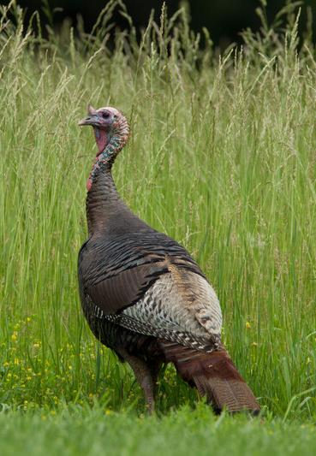
How do turkey calls work?
3A
Life and Land in Missouri – 3A Turkey Yelpers: Explore
6
Notes:
Animal in Picture: wild turkey

Slide 8
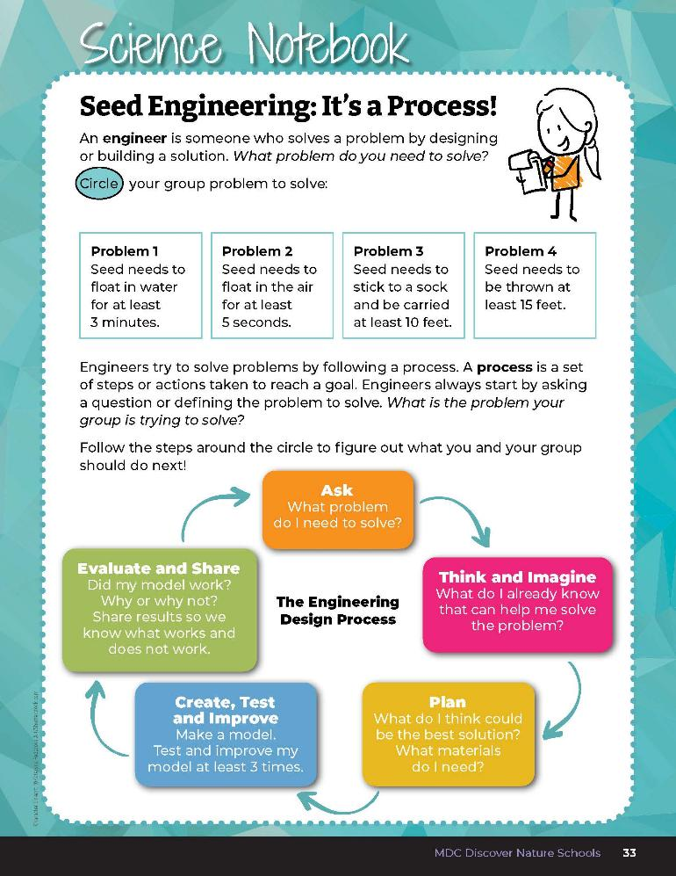
What is the question we are asking or the problem we are trying to solve?
3A
Life and Land in Missouri – 3A Turkey Yelpers: Explore
8
Notes:
Because we are turkey call engineers, let’s review the Engineering Design Process and walk through the engineering steps again. Have students turn to Seed Engineering: It’s a Process in their student guides on page 33 and refer to the graphic. Students can also turn to The Engineering Design Process on Page 34. What is the question we are asking or the problem we are trying to solve? (How do I build a turkey call that makes different turkey sounds?).

Slide 9

Let’s imagine our ideas first!
We will write our ideas on the board.
3A
Life and Land in Missouri – 3A Turkey Yelpers: Explore
9
Notes:
Let’s move to the next part of the Engineering Design Process and think and imagine our ideas first. We will write our ideas on the board. Create a class list on the board of student ideas.

Slide 10
How can you make sounds with these call?
What is the movement we are making with the box call?
What is the movement we are making with the slate call?
3A
Life and Land in Missouri – 3A Turkey Yelpers: Explore
10

Slide 11
Rest your fingertips on your throat.
Say something out loud or hum.
3A
Life and Land in Missouri – 3A Turkey Yelpers: Explore
11
Notes:
Have students rest their fingertips on their throat. Have them say something out loud or hum. Have them make a variety of different sounds while they keep their fingers on their throat.

Slide 12
What do you feel?
3A
Life and Land in Missouri – 3A Turkey Yelpers: Explore
12
Notes:
(Vibrations.)

Slide 13
Now put your fingertips on your throat and whisper.
Did you feel vibrations? Why or why not?
3A
Life and Land in Missouri – 3A Turkey Yelpers: Explore
13
Notes:
Add student ideas to the class list.

Slide 14
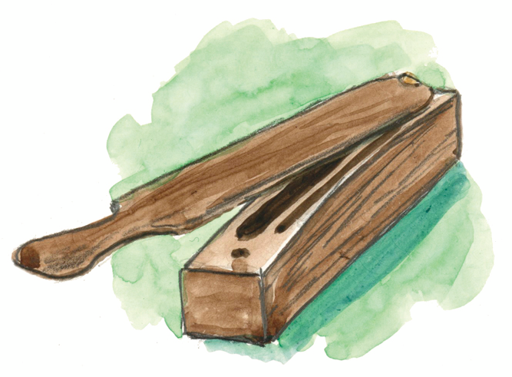
How does the shape of the call help the sound to travel?
What is the difference in sound?
3A
Life and Land in Missouri – 3A Turkey Yelpers: Explore
14

Slide 15
Why does the shape of our hands around our mouth help the sound to travel further?
3A
Life and Land in Missouri – 3A Turkey Yelpers: Explore
14
Notes:
Have students cup their hands around their mouth and say something loudly to you. Have them say the same thing but without cupping their hands around their mouth.

Slide 16
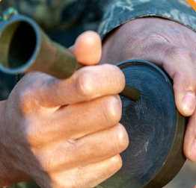
How are these shaped to help the sound travel?
3A
Life and Land in Missouri – 3A Turkey Yelpers: Explore
16
Notes:
Compare the two turkey calls. How are these shaped to help the sound travel? Add ideas to the class list. The key concept is movement makes sound, and shape helps the sound to travel further.

Slide 17
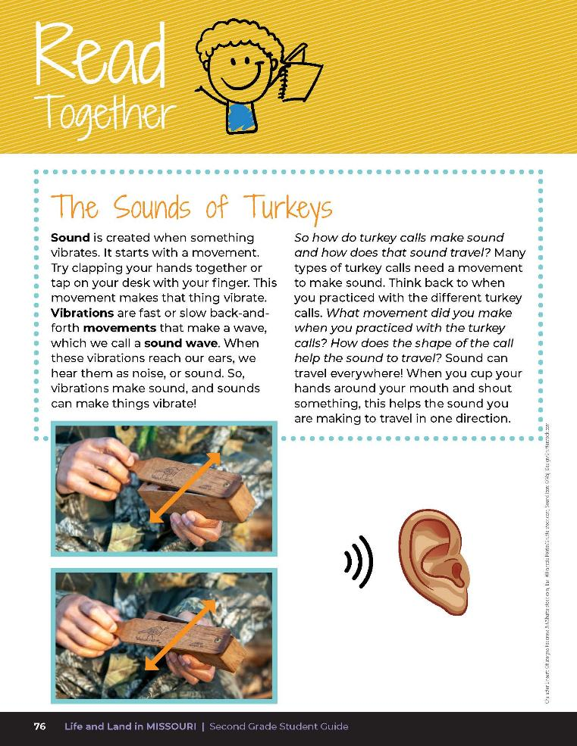

The Sounds of Turkeys
Sound is created when something vibrates. It starts with a movement. Try clapping your hands together or tap on your desk with your finger. This movement makes that thing vibrate.
3A
Life and Land in Missouri – 3A Turkey Yelpers: Explain
17
Notes:
Before we take our ideas and apply them, let’s first do some research. Have students open their student guide to Read Together 3A The Sounds of Turkeys on Page 76 and follow along as a class.

Slide 18
The Sounds of Turkeys
Vibrations are fast or slow back-and-forth movements that make a wave, which we call a sound wave. When these vibrations reach our ears, we hear them as noise, or sound. So, vibrations make sound, and sounds can make things vibrate.
3A
Life and Land in Missouri – 3A Turkey Yelpers: Explain
18
Notes:
Before we take our ideas and apply them, let’s first do some research. Have students open their student guide to Read Together 3A The Sounds of Turkeys on Page 76 and follow along as a class.

Slide 19
The Sounds of Turkeys
So how do turkey calls make sound and how does that sound travel? Many types of turkey calls need a movement to make sound. Think back to when you practiced with the different turkey calls. What movement did you make when you practiced with the turkey call?
3A
Life and Land in Missouri – 3A Turkey Yelpers: Explain
19
Notes:
Before we take our ideas and apply them, let’s first do some research. Have students open their student guide to Read Together 3A The Sounds of Turkeys on Page 76 and follow along as a class.

Slide 20
The Sounds of Turkeys
How does the shape of the call help the sound to travel? Sound can travel everywhere! When you cup your hands around your mouth and shout something, this helps the sound you are making to travel in one direction.
3A
Life and Land in Missouri – 3A Turkey Yelpers: Explain
20
Notes:
Before we take our ideas and apply them, let’s first do some research. Have students open their student guide to Read Together 3A The Sounds of Turkeys on Page 76 and follow along as a class.

Slide 21
Sound is created by vibrations.
3A
Life and Land in Missouri – 3A Turkey Yelpers: Explain
21
Notes:
Explain to your students that sound is created by vibrations.
Different vibrations create different sounds. We can hear because our ears “catch” sound. Sound vibrates our eardrums and tells out brains there is a sound. Vibrations are fast or slow back-and-forth movements that make a sound wave. We felt vibrations in our throat when we made noise.

Slide 22
Sound moves through the air in all directions from a vibrating object.
3A
Life and Land in Missouri – 3A Turkey Yelpers: Explain
22
Notes:
Have students speak or hum again and notice how the vibrations of their throats makes their fingers feel. Explain that sound moves through the air in all directions from a vibrating object.
Sound vibration bumps into nearby air which bumps into the air beside and so on, all the way from the source (turkey call) to your ear. When we cup out hands around our mouths and shout something, we can help the sound travel in one direction. This shape helps the sound to travel further.
Sound briefly compresses together packs of air that expand as they push together the next packet of air that push together the next packet of air. This is how sound got from the turkey call to your ear.

Slide 23
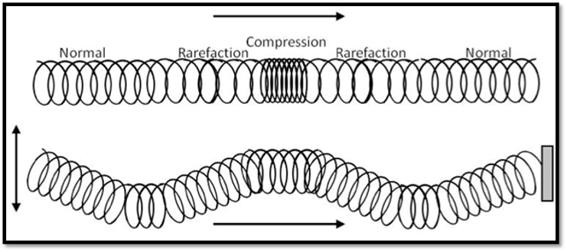
3A
Life and Land in Missouri – 3A Turkey Yelpers: Explain
23
Notes:
Use a slinky to demonstrate. Loosely pull the slinky across a table or the floor. Push one end. Watch how a compression wave travels down the slinky.

Slide 24
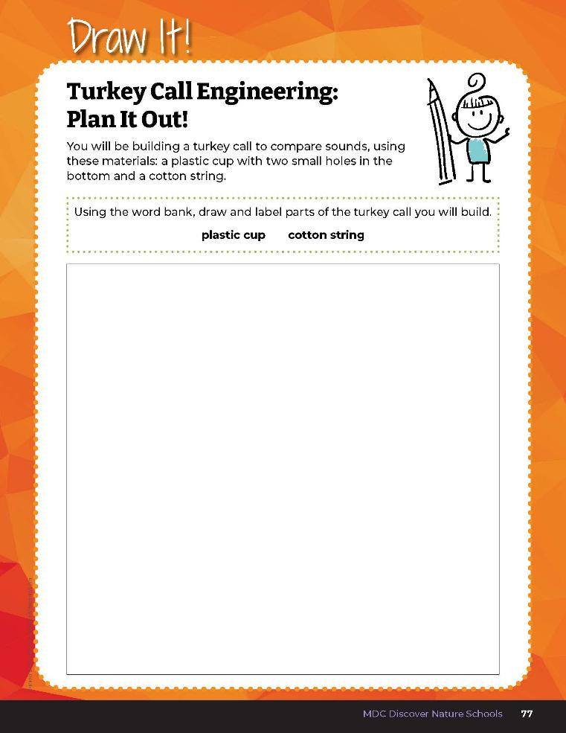

Draw a picture of a turkey call made with the materials you will use to create your call: a plastic cup and a cotton string.
3A
Life and Land in Missouri – 3A Turkey Yelpers: Explain
24
Notes:
Using the Draw It! Turkey Call Engineers: Plan It Out! Section on Page 77, students will draw a picture of a turkey call made with the materials that they will use to create their call: a plastic cup and a cotton string.

Slide 25
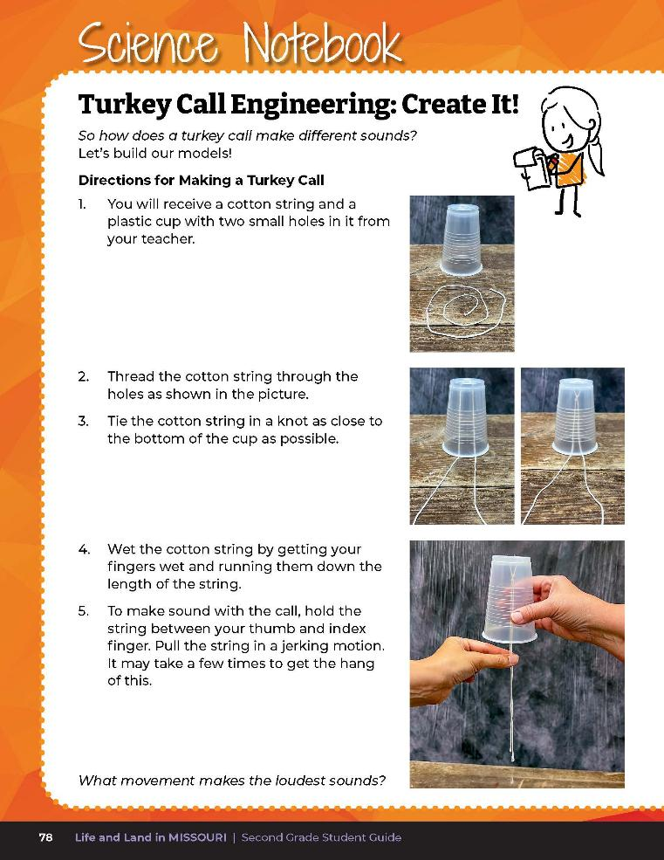

Let’s build out models!
3A
Life and Land in Missouri – 3A Turkey Yelpers: Elaborate
25
Notes:
Have students open their student guide to Science Notebook 3A Turkey Call Engineers: Create It! on Page 78 and follow along as a class.
Directions for Making a Turkey Call
Each student will need a cup with 2 pin holes in the bottom (the holes should be about 1 inch apart) and a 24-inch length of cotton string.
Have students thread the string through the holes.
Have students tie the string in a knot as close to the inside bottom of the cup as possible.
Have students wet the thread (getting fingers wet and running them down the length of the string works best).
To make the call, have students hold the string between their thumb and index finger and pull the string in a jerking motion. It may take a few times to get the hang of this.

Slide 26
Can you feel the vibrations when you pull on the string?
3A
Life and Land in Missouri – 3A Turkey Yelpers: Elaborate
26
Notes:
Have the students demonstrate different sounds produced by using different movements, such as short pulls versus long pulls on the string.

Slide 27
How does the shape of the cup help the sound to travel?
What would happen if we removed the sides of the cup?
3A
Life and Land in Missouri – 3A Turkey Yelpers: Elaborate
27

Slide 28
Play the Turkey Calls video again.
Link:
https://youtu.be/8f5W8z_BtJU
3A
Life and Land in Missouri – 3A Turkey Yelpers: Elaborate
28
Notes:
Watch the Turkey Calls video again from the MDC Teacher Portal.

Slide 29
How do turkeys make different sounds?
3A
Life and Land in Missouri – 3A Turkey Yelpers: Elaborate
29

Slide 30
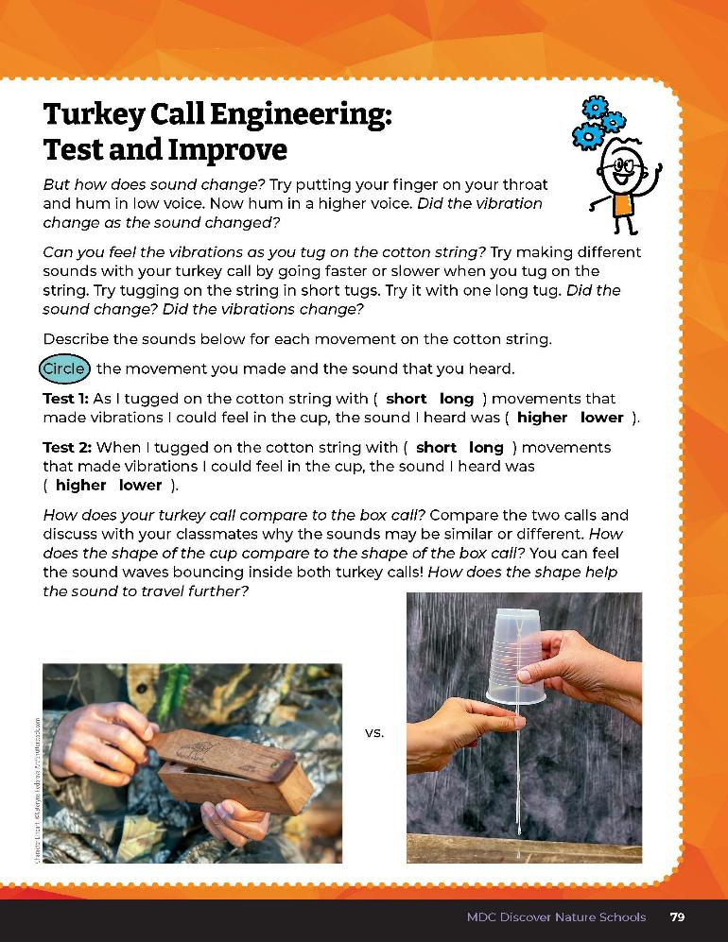
How do short of long movements change the sound?
3A
Life and Land in Missouri – 3A Turkey Yelpers: Elaborate
30
Notes:
Have students complete the Science Notebook 3A Turkey Call Engineering: Test and Improve section on Page 79.

Slide 31
Answers
3A
Life and Land in Missouri – 3A Turkey Yelpers: Elaborate
31

Slide 32
How does your turkey call compare to the box call?
3A
Life and Land in Missouri – 3A Turkey Yelpers: Elaborate
32

Slide 33
How does the shape of the cup compare to the shape of the box call?
Can you feel the sound bounding inside of the calls?
How does the shape help the sound to travel further?
3A
Life and Land in Missouri – 3A Turkey Yelpers: Elaborate
33
Notes:
Compare the two calls and discuss with the class why the sounds may be similar or different.

Slide 34
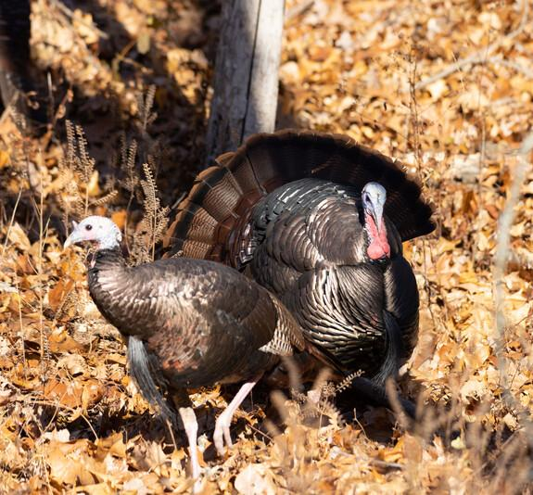
What are turkeys saying to one another?
3A
Life and Land in Missouri – 3A Turkey Yelpers: Elaborate
34
Notes:
Animal in Picture: wild turkey

Slide 35
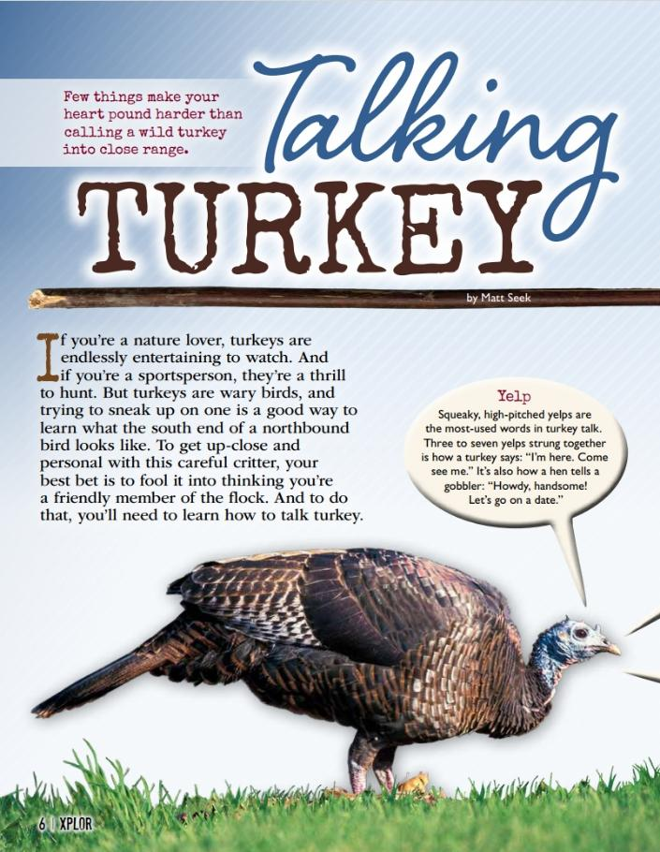
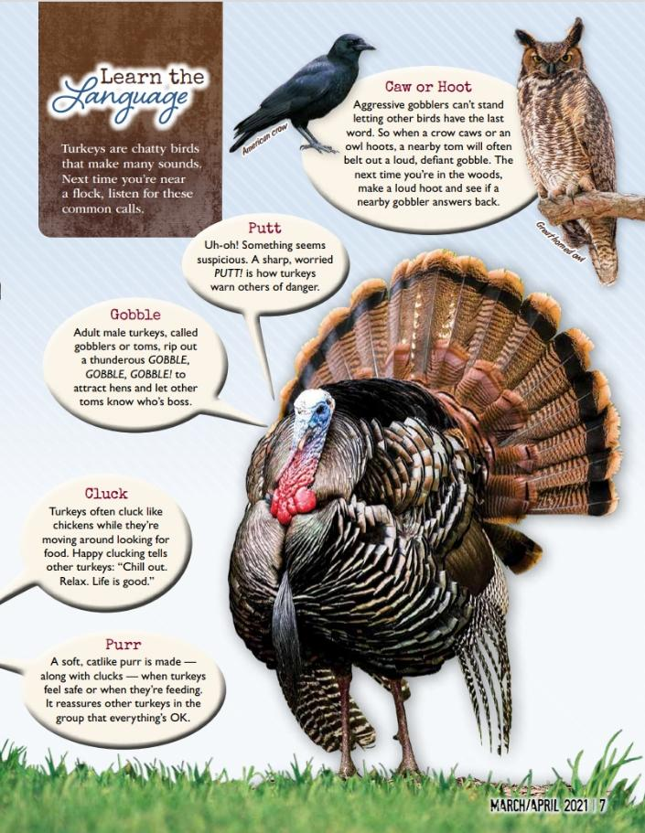
Link to Article:
https://education.mdc.mo.gov/sites/default/files/2025-04/3A%20Talking%20Turkey%20Xplor%20Article%20%281%29.pdf
3A
Life and Land in Missouri – 3A Turkey Yelpers: Elaborate
35
Notes:
From the MDC Teacher Portal, display the Talking Turkey article by Matt Seek from the March/April 2021 issue of Xplor. See if your students can mimic the calls on their own calls and translate what they are saying if they were a turkey.

Slide 36
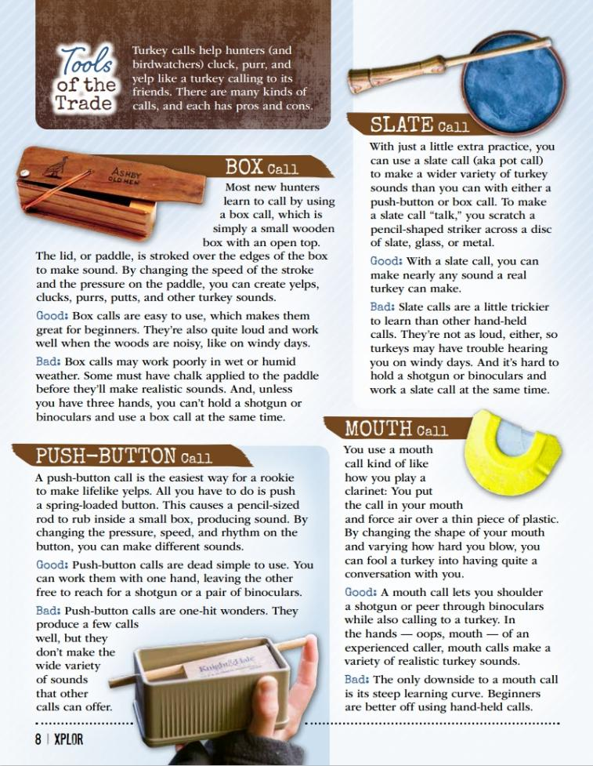
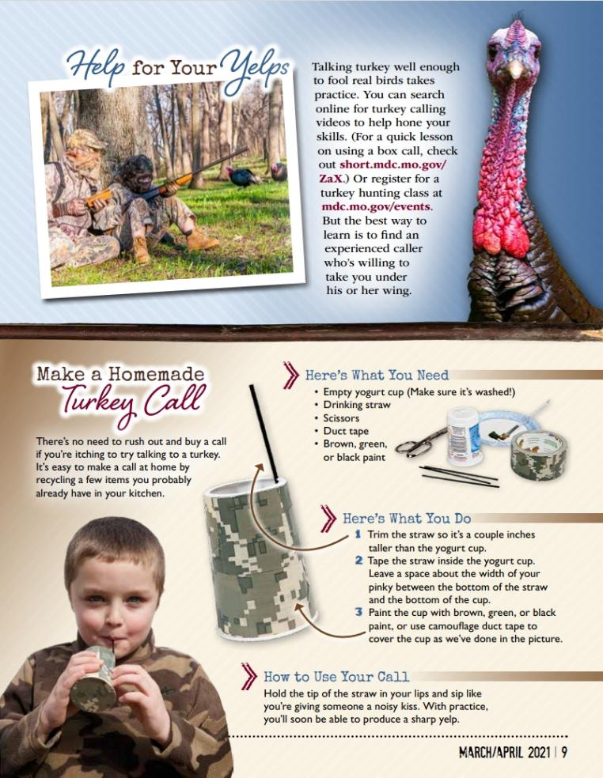
3A
Life and Land in Missouri – 3A Turkey Yelpers: Elaborate
36

Slide 37

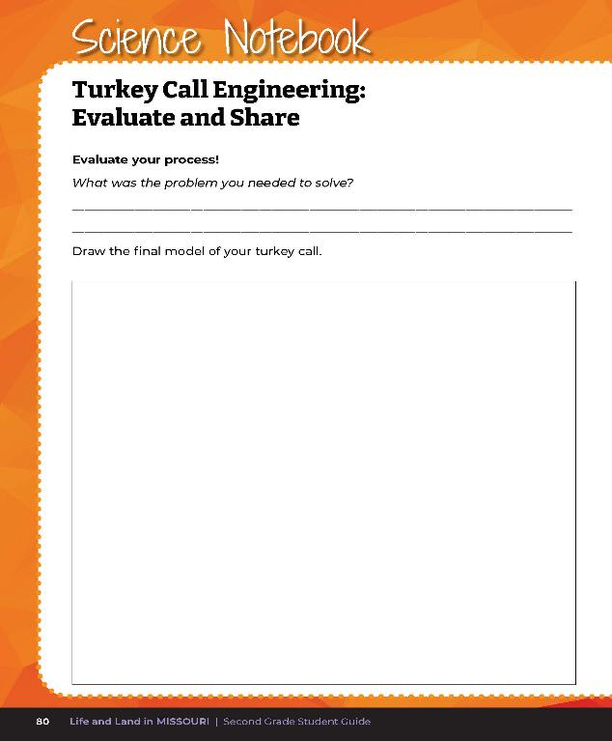
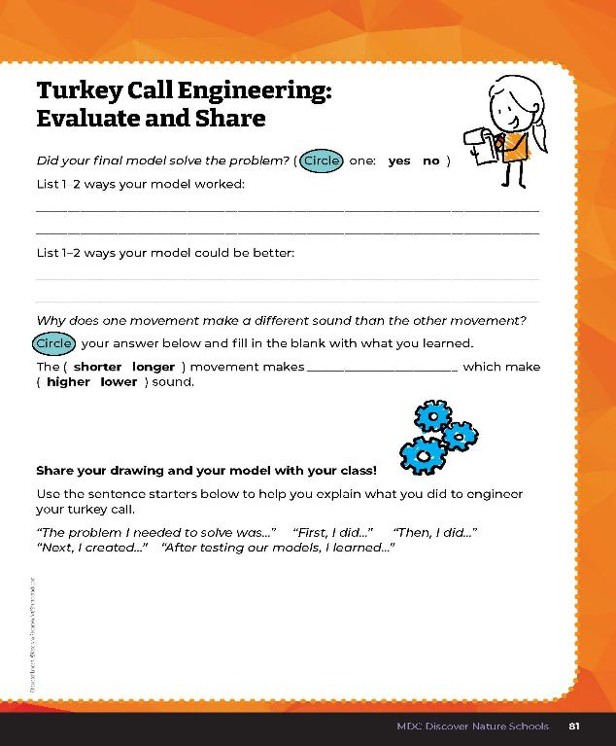
3A
Life and Land in Missouri – 3A Turkey Yelpers: Evaluate
37
Notes:
Guiding Question: How do I build a turkey call that makes different turkey sounds?
After exploring the concept of how turkey calls can make different sounds, have students open their student guides to the Science Notebook 3A Turkey Call Engineering: Evaluate and Share section on pages 80-81 and complete the exercise.
Rubric:
3 (Exceeds) – Student correctly explains the problem they needed to solve, displays and demonstrates the turkey call they built, explains 1-2 ways why their model worked and 1-2 ways why their model did not work. Student circles the correct answers and fills in the blank correctly.
2 (Meets) – Student somewhat correctly explains the problem they needed to solve, somewhat displays and demonstrates the turkey call they built, somewhat explains 1-2 ways why their model worked and 1-2 ways why their model did not work. Student may circle one answer and/or may fill in the blank correctly.
1 (Doesn’t meet) – Student does not correctly explain the problem they needed to solve, does not display or demonstrate the turkey call they built, does not explain 1-2 ways why their model worked and 1-2 ways why their model did not work. Student does not circle the correct answers or fill in the blank correctly.

Slide 38
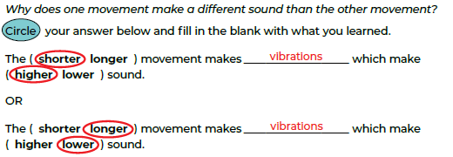
3A
Life and Land in Missouri – 3A Turkey Yelpers: Evaluate
38
Notes:
Rubric:
3 (Exceeds) – Student correctly explains the problem they needed to solve, displays and demonstrates the turkey call they built, explains 1-2 ways why their model worked and 1-2 ways why their model did not work. Student circles the correct answers and fills in the blank correctly.
2 (Meets) – Student somewhat correctly explains the problem they needed to solve, somewhat displays and demonstrates the turkey call they built, somewhat explains 1-2 ways why their model worked and 1-2 ways why their model did not work. Student may circle one answer and/or may fill in the blank correctly.
1 (Doesn’t meet) – Student does not correctly explain the problem they needed to solve, does not display or demonstrate the turkey call they built, does not explain 1-2 ways why their model worked and 1-2 ways why their model did not work. Student does not circle the correct answers or fill in the blank correctly.

