Slide 1
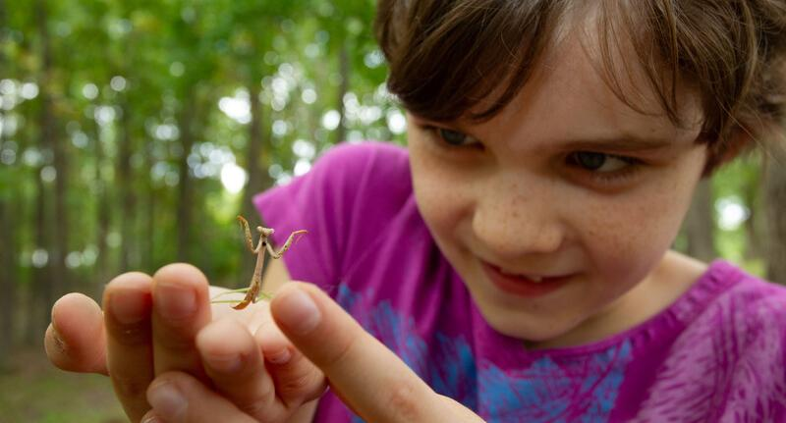

Exploring
MISSOURI
3A: Sounds Like a Plan

Slide 2
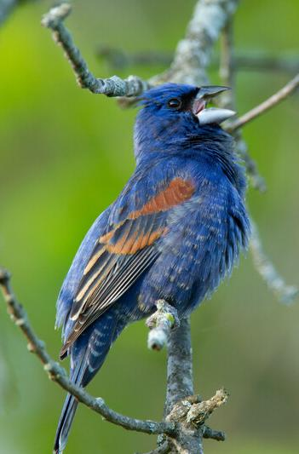
Guiding Question:
How do animals communicate?
3A
Exploring Missouri – 3A Sounds Like a Plan: Engage
2
Notes:
Animal in Picture: Indigo Bunting

Slide 3
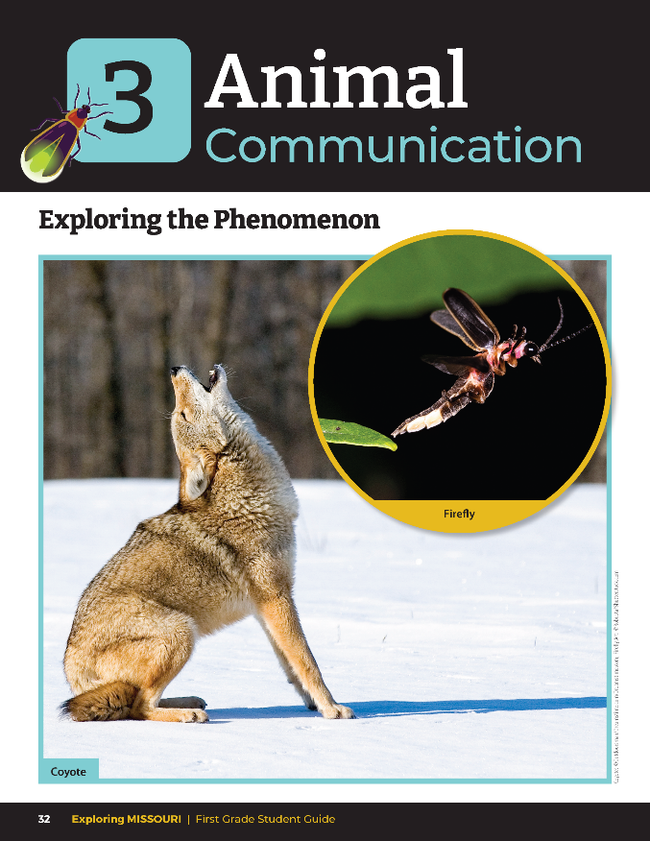
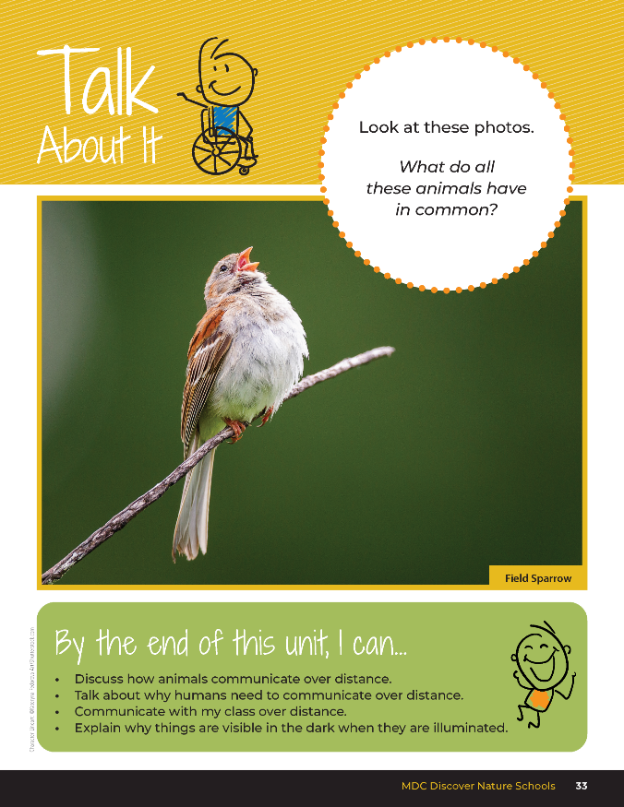
3A
Exploring Missouri – 3A Sounds Like a Plan: Engage
3
Notes:
Read together the student guide Unit 3 Exploring the Phenomenon section on pages 32-33 and discuss the Talk About It portion.

Slide 4
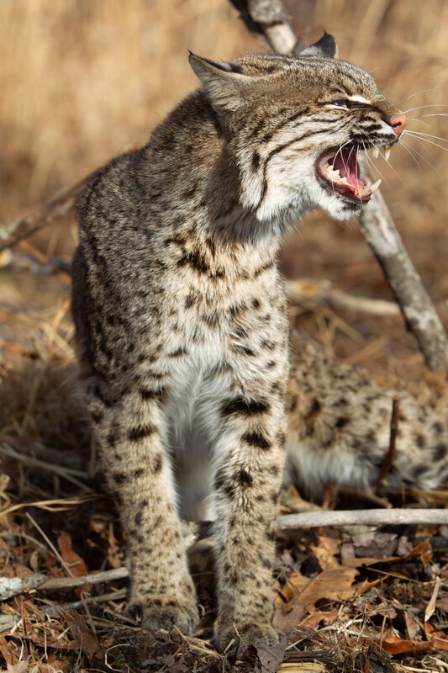
What do all those animals have in common?
3A
Exploring Missouri – 3A Sounds Like a Plan: Engage
4
Notes:
Animal in Picture: Bobcat

Slide 5
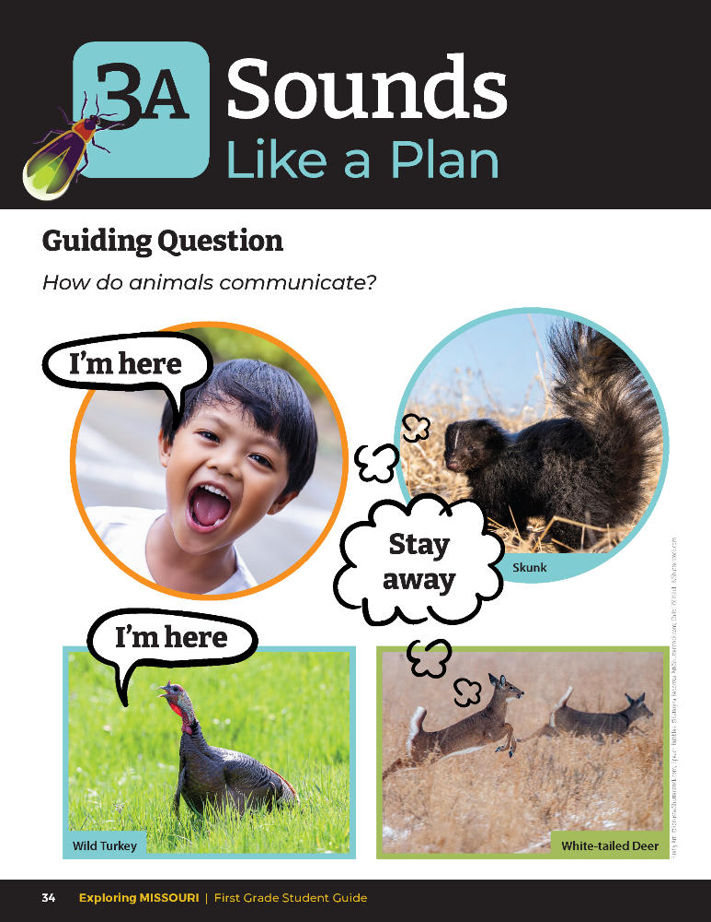
How do animals communicate?
3A
Exploring Missouri – 3A Sounds Like a Plan: Engage
5
Notes:
Have students look at the pictures of animals and the child from the student guide Lesson 3A Sounds Like a Plan introduction section on Page 34.

Slide 6
Play the Critter Rock Jabber Jaws Song!
Critter Rock - Jabber Jaws - YouTube
Link:
3A
Exploring Missouri – 3A Sounds Like a Plan: Engage
2
Notes:
Play the Critter Rock Song Jabber Jaws from the MDC Teacher Portal. Animal Communication | MISSOURI DEPARTMENT OF CONSERVATION

Slide 7
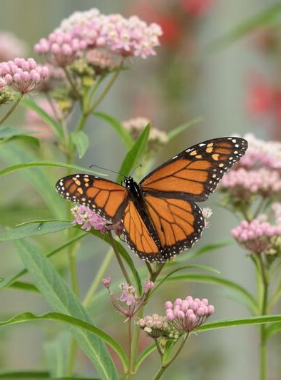
What does communicate mean?
After listening to the song, what are some examples of communication you can think of?
3A
Exploring Missouri – 3A Sounds Like a Plan: Engage
7
Notes:
Today, we are going to explore why people and wildlife communicate over longer distances.
Animal in picture: monarch butterfly; plant in picture: common milkweed

Slide 8

Let’s first look at how different materials are used to communicate.
What are some that you can think of already.
3A
Exploring Missouri – 3A Sounds Like a Plan: Explore
8
Notes:
Teacher Note: If time allows, you may want to do this activity over two days, sharing different tools each day. Plan your set-up depending on time availability.

Slide 9

What senses do we use to communicate?
Is it only by sight?
What about sound?
3A
Exploring Missouri – 3A Sounds Like a Plan: Explore
9

Slide 10
Go outside:
Practice using the different tools to communicate.
3A
Exploring Missouri – 3A Sounds Like a Plan: Explore
10
Notes:
In the classroom, explore different devices that students could use light or sound to communicate across a distance. Provide drums, flashlights, plastic cups and strings, cups and rubber bands, cups with the bottoms cut out for megaphones, empty clean soup can, and pencils, etc.
Go outside and allow students to practice with the different tools. Then pair students and have them collaborate on how to use one of these tools to communicate over the distance of 20 yards.

Slide 11
Which one do you think would help animals and plants communicate over a longer distance? Why?
3A
Exploring Missouri – 3A Sounds Like a Plan: Explore
11
Notes:
Let’s discuss what sound tools we’ve experimented with, look at our tools, and determine which sounds and sight wouldn’t travel over a long distance.

Slide 12
Out of all the tools we’ve experimented with, what would you want to use to communicate with your friend who is across the schoolyard?
3A
Exploring Missouri – 3A Sounds Like a Plan: Explore
12

Slide 13

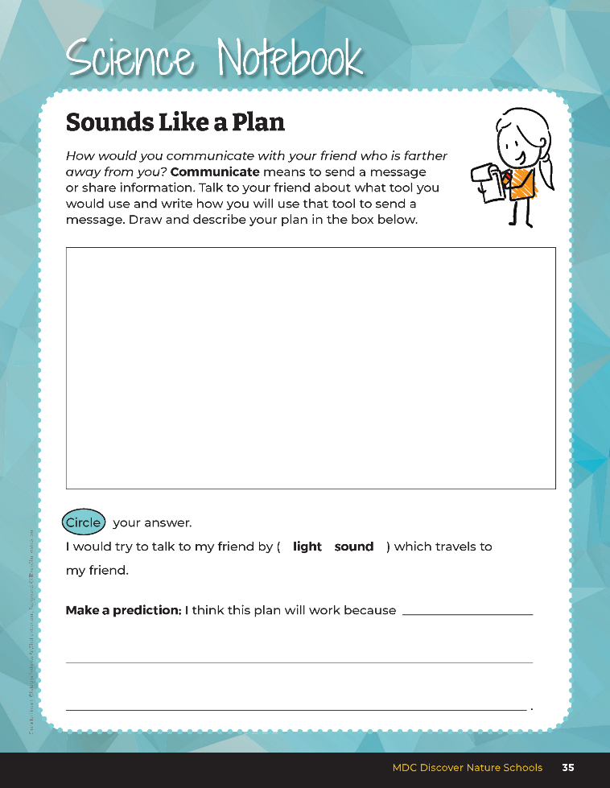
Create a communication plan for how you would communicate with your friend who is outside and 20 yards away from you.
3A
Exploring Missouri – 3A Sounds Like a Plan: Explore
13
Notes:
In their student guide, on Science Notebook 3A Sounds Like a Plan Page 35, have students create a communication plan for how they would communicate with their friend who is outside and 20 yards away from them.

Slide 14
Did your prediction work? Why or why not?
3A
Exploring Missouri – 3A Sounds Like a Plan: Explore
14
Notes:
Take students outside to test predictions either individually or as partners.

Slide 15
Let’s look at the other tools that our classmates used and look at the patterns of who was successful in their communication and what tools for communication didn’t travel as far.
What do we notice?
3A
Exploring Missouri – 3A Sounds Like a Plan: Explore
15
Notes:
Let’s look at other tools that our classmates used and look at the patterns of who was successful in their communication and what tools for communication didn’t travel as far.

Slide 16
Why do you think animals and people need to communicate across longer distances?
3A
Exploring Missouri – 3A Sounds Like a Plan: Explore
16

Slide 17
Let's listen to the Critter Rock Jabber Jaws Song again!
Why do we need to communicate across distances?
Link:
Critter Rock - Jabber Jaws - YouTube
3A
Exploring Missouri – 3A Sounds Like a Plan: Explore
17
Notes:
Let’s listen to the song again to pick out some reasons why we need to communicate across further distances. (Territory, find a mate, and warnings.)

Slide 18
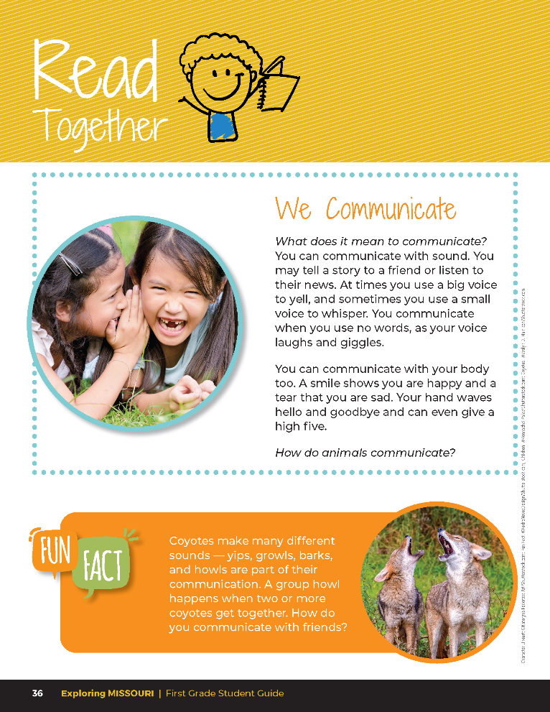

We Communicate
What does it mean to communicate? You can communicate with sound. You may tell a story to a friend or listen to their news. At times you use a big voice to yell, and sometimes you use a small voice to whisper. You communicate when you use no words, as your voice laughs and giggles.
3A
Exploring Missouri – 3A Sounds Like a Plan: Explain
18

Slide 19
We Communicate
You can communicate with your body too. A smile shows you are happy and a tear that you are sad. Your hand waves hello and goodbye and can even give a high five.
How do animals communicate?
3A
Exploring Missouri – 3A Sounds Like a Plan: Explain
19

Slide 20
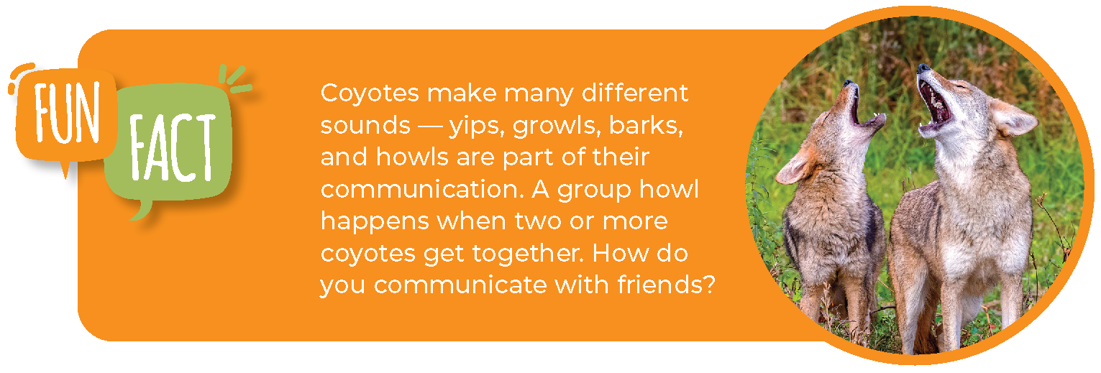
3A
Exploring Missouri – 3A Sounds Like a Plan: Explain
20

Slide 21
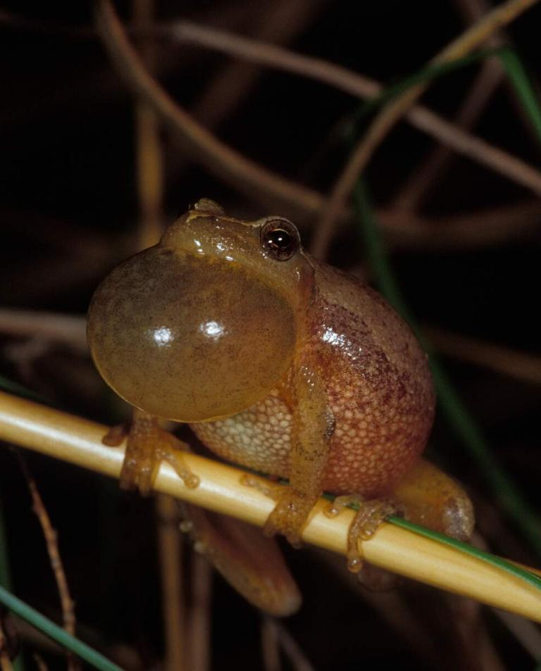
How do animals communicate?
3A
Exploring Missouri – 3A Sounds Like a Plan: Explain
21
Notes:
They communicate in many ways. Many animals communicate through sound.
Animal in picture: Spring Peeper frog

Slide 22
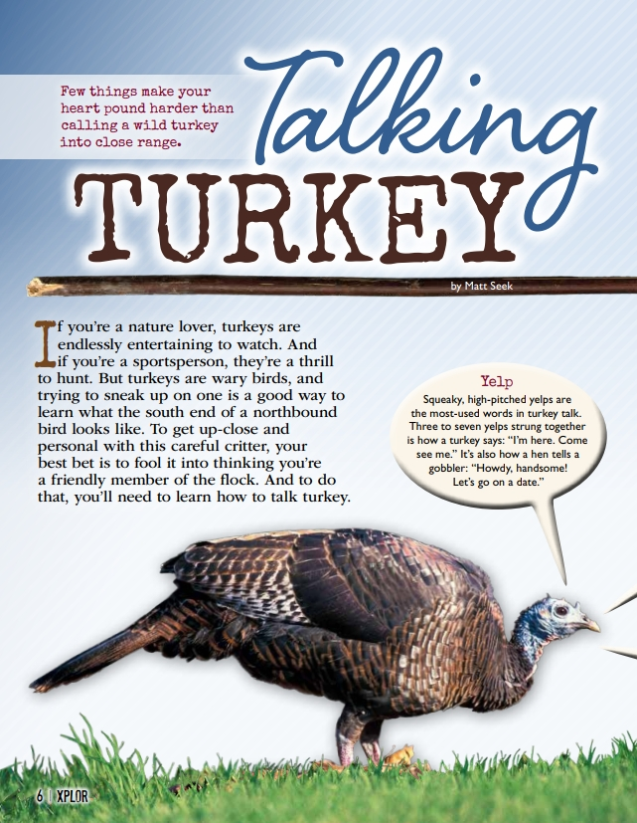
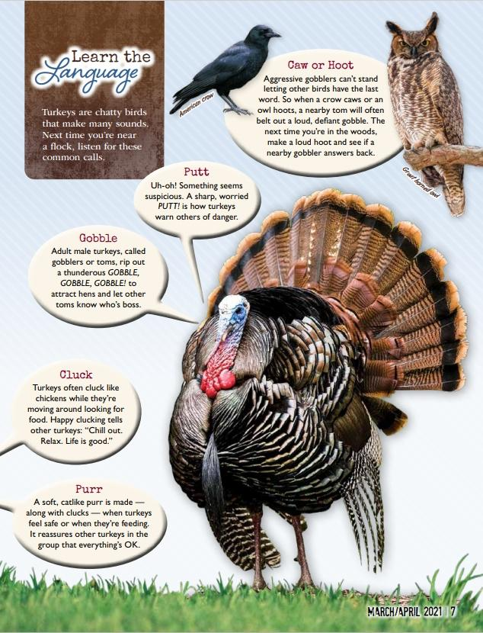
3A
Exploring Missouri – 3A Sounds Like a Plan: Explain
22
Notes:
From the MDC Teacher Portal, display Talking Turkey by Matt Seek from the March 2021 issue of Xplor.

Slide 23
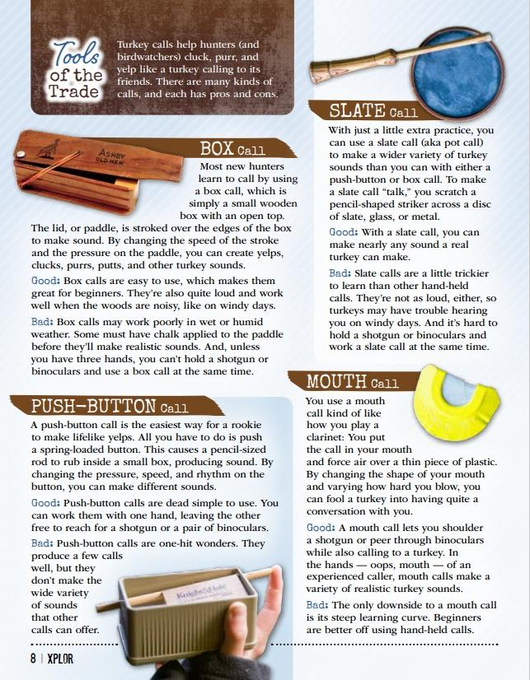
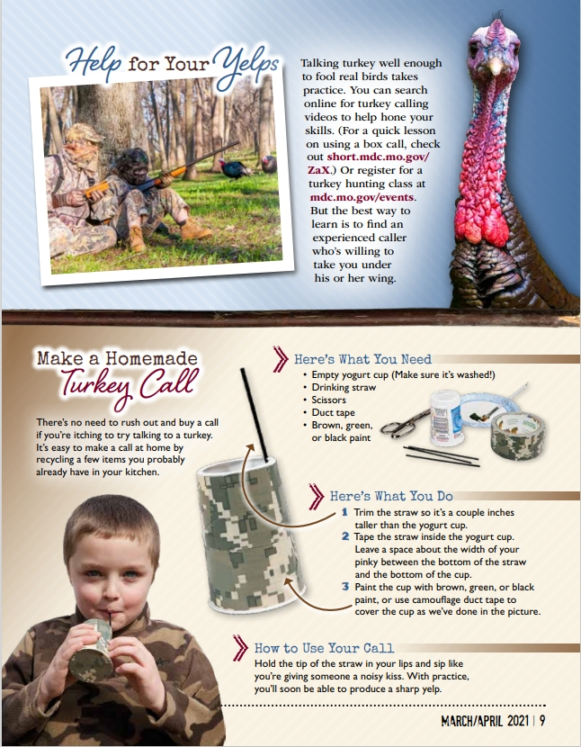
3A
Exploring Missouri – 3A Sounds Like a Plan: Explain
23

Slide 24
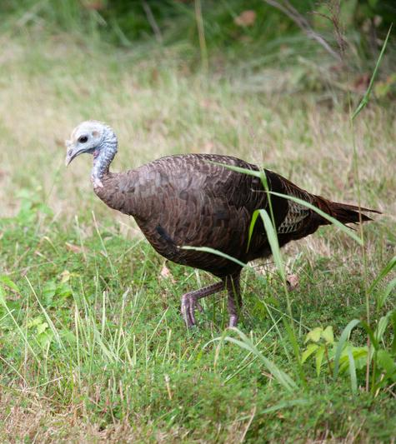
How do the turkeys communicate with one another?
3A
Exploring Missouri – 3A Sounds Like a Plan: Explain
24
Notes:
Through sound.
Animal in picture: Wild Turkey

Slide 25
Can you make a few of their calls?
3A
Exploring Missouri – 3A Sounds Like a Plan: Explain
25

Slide 26

What about across longer distances.
Why do people need to communicate across longer distances?
3A
Exploring Missouri – 3A Sounds Like a Plan: Explain
26
Notes:
Share good news, emergency warnings like tornados and fire, fire trucks and emergency vehicles, etc.

Slide 27

Do we use light to communicate, too?
3A
Exploring Missouri – 3A Sounds Like a Plan: Explain
27
Notes:
Yes.

Slide 28
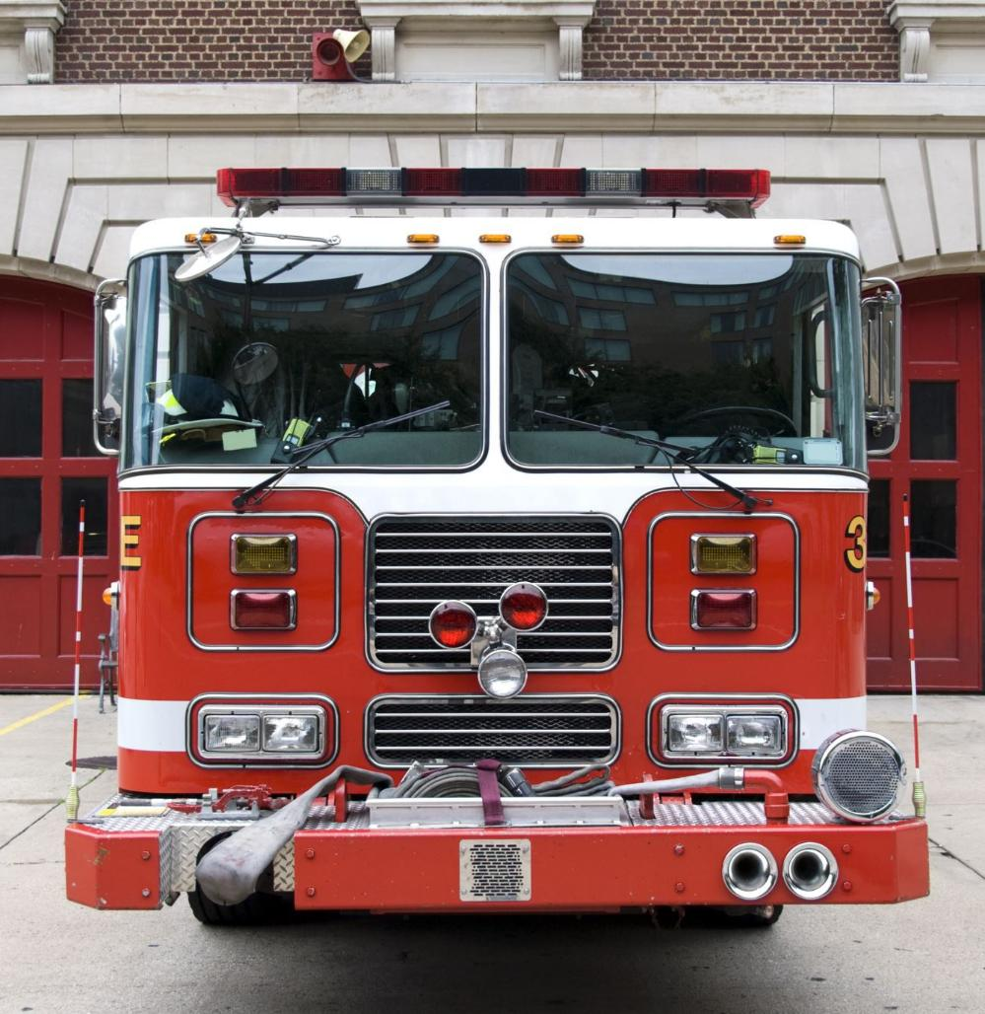
When a fire truck rolls by, what do we hear and see?
3A
Exploring Missouri – 3A Sounds Like a Plan: Explain
28
Notes:
Sound from the horn and flashing lights.

Slide 29

How do people communicate using light and sound across longer distances today?
3A
Exploring Missouri – 3A Sounds Like a Plan: Explain
29
Notes:
Phones, computers, video conferences, alarms, lights and sirens, yelling.

Slide 30
What scenarios could we come up with to notify everyone in the class to do something, like getting quiet to listen to the teacher.
3A
Exploring Missouri – 3A Sounds Like a Plan: Explain
30
Notes:
Use this as a perfect exercise to get the class to create their own classroom management attention-getting scheme, like claps, stomps, and finger snaps, lights on/off etc.

Slide 31
With your partner use light and sound to create a secret code to send a message. Create three different messages that you can use, and have your partner identify the messages.
3A
Exploring Missouri – 3A Sounds Like a Plan: Elaborate
31
Notes:
Teacher Note: If time allows, you may want to do this activity over two days. Plan your lesson depending on time availability.
Have each student and their partner use light and sound to create a secret code to send a message. Have them create three different messages that they can use, then have their partner identify the messages. Share some examples, including the international code of whistle blasts in groups of three – repeating means “Help!” Other examples could include “Hello” and “Goodbye.” Animals communicate information like “I am strong” and “I am hungry.”

Slide 32
What three coded messages are you sending to your partner?
3A
Exploring Missouri – 3A Sounds Like a Plan: Elaborate
32
Notes:
Talk to your partner so they know what to expect in your messages and can reply to you.

Slide 33
Are you going to use light or sound, or even body language, to communicate your message?
3A
Exploring Missouri – 3A Sounds Like a Plan: Elaborate
33
Notes:
Talk to your partner so they know what to expect in your messages and can reply to you.

Slide 34
Are there other codes that you would want to create to communicate more?
3A
Exploring Missouri – 3A Sounds Like a Plan: Elaborate
34
Notes:
Have students split into partners. Now let’s go outside and see if our codes work.
Teacher Note: You may first want to practice inside the classroom with students sitting back-to-back. Once students are successful, then go outside and have them communicate their message over a greater distance.

Slide 35
Go Outside!
3A
Exploring Missouri – 3A Sounds Like a Plan: Elaborate
35
Notes:
Have students split into partners. Now let’s go outside and see if our codes work.
Teacher Note: You may first want to practice inside the classroom with students sitting back-to-back. Once students are successful, then go outside and have them communicate their message over a greater distance.

Slide 36

Make a list of important words or ideas that need to be communicated.
3A
Exploring Missouri – 3A Sounds Like a Plan: Elaborate
36
Notes:
As a class, make a list of important words or ideas that need to be communicated.

Slide 37
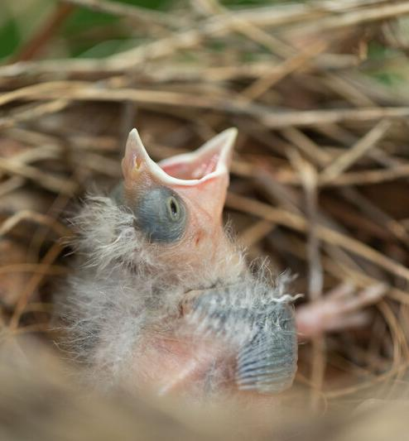
What messages would animals use to communicate to one another?
3A
Exploring Missouri – 3A Sounds Like a Plan: Elaborate
37
Notes:
Now let’s think about the animal world.
Animal in Picture: Northern cardinal chick

Slide 38
Message
Animal Example
3A
Exploring Missouri – 3A Sounds Like a Plan: Elaborate
38
Notes:
Let’s make a list of animal messages on the board. Make a T-chart and write “Message” on one side and “Animal Example” on the other.
Message – Animal Example
Where are you? – Chick chirping, squirrel whimpering
I’m here – Turkey yelping, deer swishing tail
I am hungry. – Chicks in nest chirping
I’m warning you. – Daw pawing at the ground, cat hissing, skunk with tail up
I’m the boss. – Deer with head lowered to another deer, alpha dog with tail up
I’m happy. – Dog wagging tail, cat purring.

Slide 39
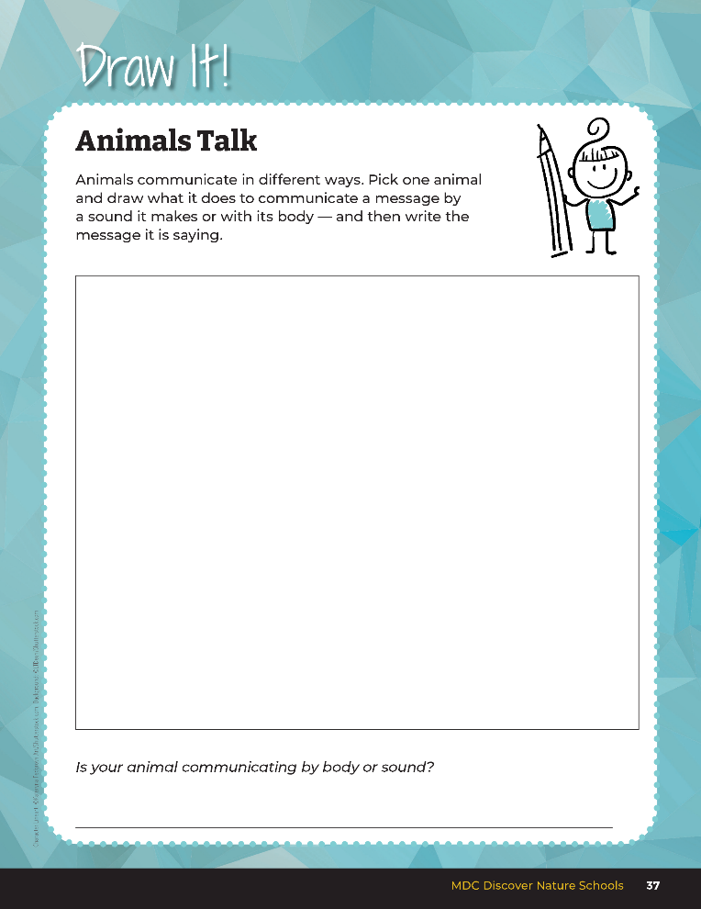

Pick one example from the board, then write the message and draw the animal behavior.
3A
Exploring Missouri – 3A Sounds Like a Plan: Elaborate
39
Notes:
Have students pick one example from the board, then write the message and draw the animal behavior in their student guide, Draw It! 3A Animals Talk section on Page 37.

Slide 40
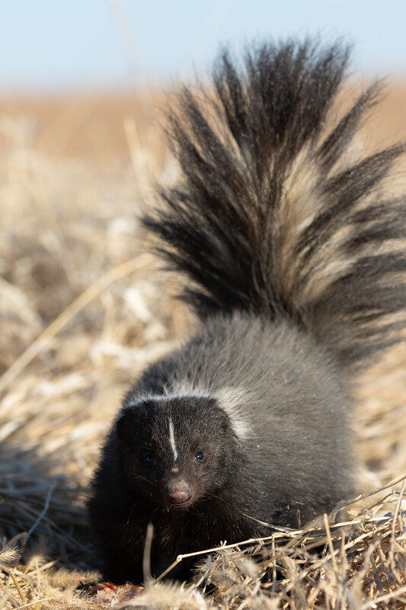
What is this animal using to communicate?
Body or sound?
3A
Exploring Missouri – 3A Sounds Like a Plan: Elaborate
40
Notes:
Animal in Picture: Stripped Skunk

Slide 41
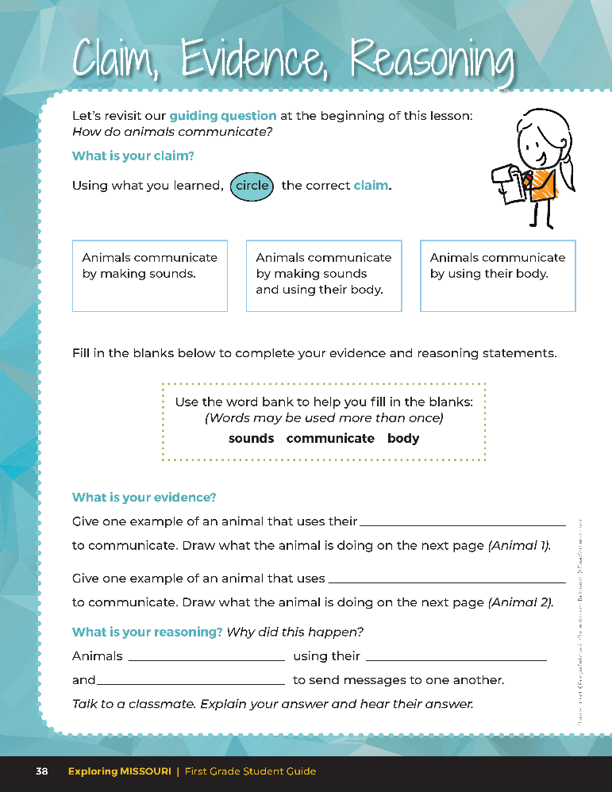
Guiding Question:
How do animals communicate?
3A
Exploring Missouri – 3A Sounds Like a Plan: Evaluate
41
Notes:
After exploring the concept of how humans and animals communicate, have students open their student guides to the Claim, Evidence, Reasoning section on Page 38. Discuss the page with the students – read the guiding question and then explain what the students need to do to answer the questions (circle the correct claim, fill in the blanks, and draw how their animals is communicating).

Slide 42
Answers
body
sound
communicate
body
sounds
3A
Exploring Missouri – 3A Sounds Like a Plan: Evaluate
42
Notes:
Rubric:
4 (Exceeds) – Students circle the correct claim, provide evidence with examples of animals communicating with their body and by sound, and fill in the blank to show the correct reasoning.
3 (Meets) – Students either circle the correct claim or provide evidence with examples of animals communicating with their body and by sound and fill in the blanks to show the correct reasoning. Two of the three components are correct.
2 (Partially Meets) – Students either circle the correct claim or provide evidence with examples of animals communicating with their body and by sound or fill in the blanks to show the correct reasoning. One of the three components is correct.
1 (Doesn’t Meet) – Students do not circle the correct claim and do not provide the correct evidence and reasoning. None of the three components is correct.

