Slide 1
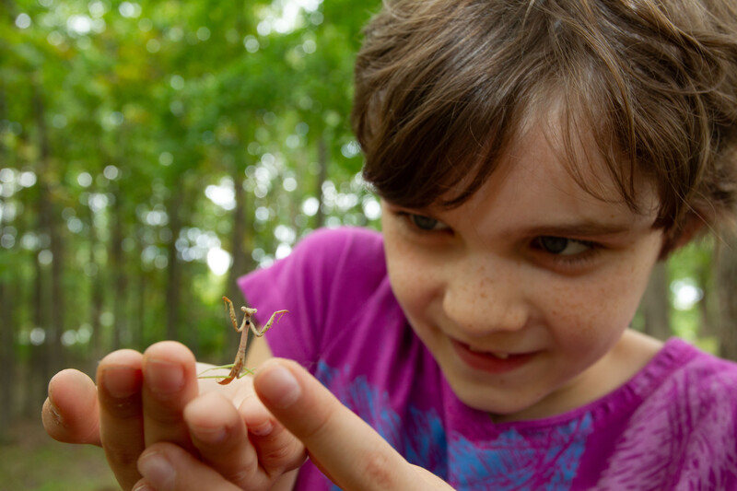

Exploring
MISSOURI
Unit 2 Review

Slide 2
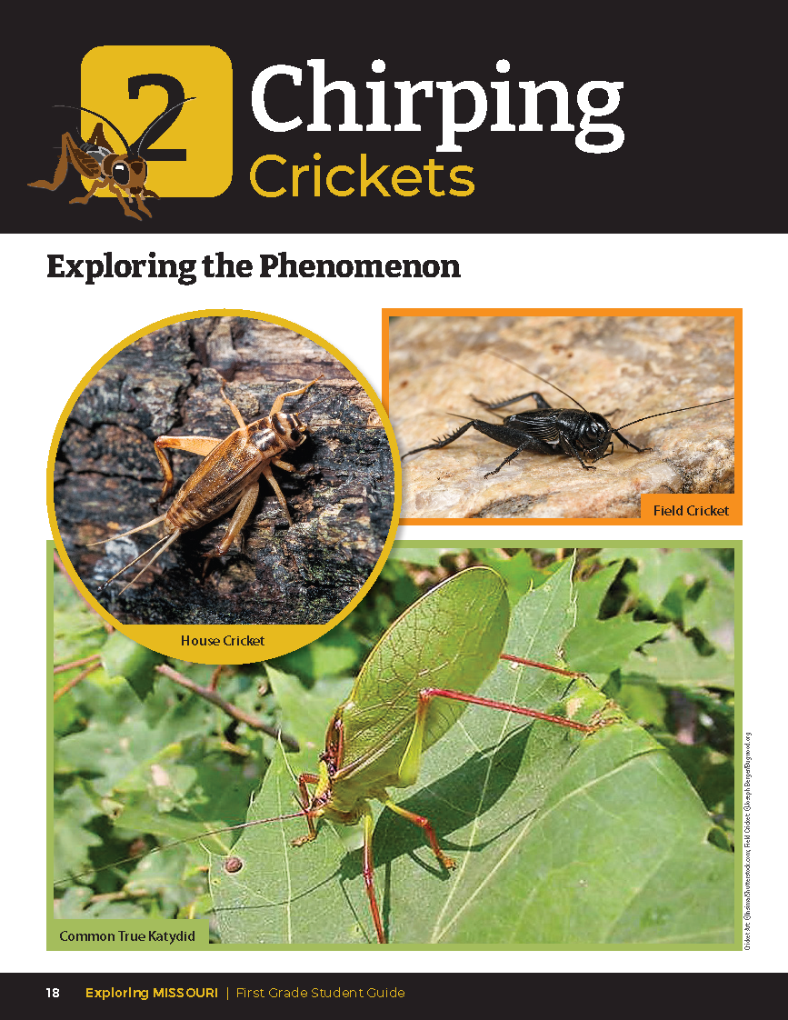
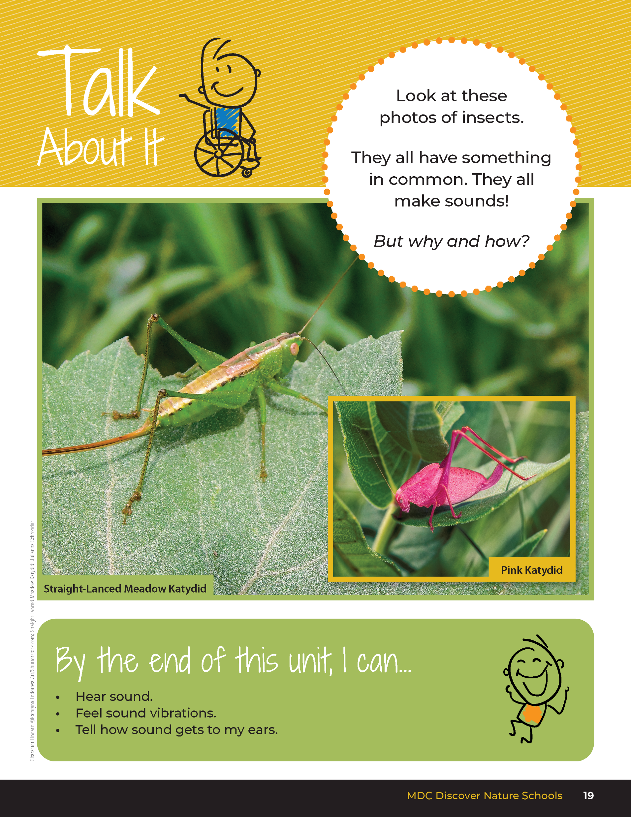
2
Exploring Missouri – Unit 2 Review
2
Notes:
Have students turn to the Unit 2 Exploring the Phenomenon Talk About It section on pages 18-19.

Slide 3

Turn and talk to a classmate and discuss why insects may make sounds.
2
Exploring Missouri – Unit 2 Review
3
Notes:
Using the pictures at the beginning of the lesson, have students turn and talk to a classmate and discuss why insects may make sounds. Share answers as a class.
Rubric:
3 (Meets) – Student references that all the insects use sound to communicate and call to one another. Student references that they use their wings to make the sounds which causes vibrations and creates sound waves that travel everywhere.
2 (Partially meets) – Student either references that insects communicate or references how sound travels.
1 (Doesn’t meet) – Student does not reference insect communication and does not refer to how sound travels through vibrations in all directions.

Slide 4
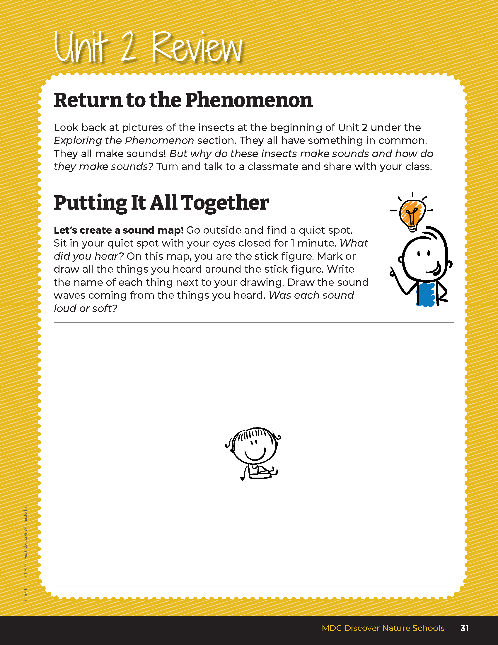
Go outside:
Let’s create a sound map!
2
Exploring Missouri – Unit 2 Review
4
Notes:
Students will create a sound map in their student guides. With their guides and a pencil, go outside to the schoolyard again. Designate boundaries of where the students can sit. Allow students time to find a spot for themselves somewhere in the boundary. In their spot, they will close their eyes for one minute and listen to all of the sounds around them. After one minute, they will open their eyes and use student guide Unit 2 Putting It All Together section on Page 31 to draw their sound map. Have them mark, draw, and label where they heard a sound. They can either draw a sound wave from that sound to them or they can write if it was loud or soft.
Rubric:
3 (Meets) – Student shows at least three drawings of different organisms or sources of sound with all sound waves drawn toward the cartoon student or loud/soft words written next to the source.
2 (Partially meets) – Student shows at least two drawings of different organisms or sources of sound with two sound waves drawn towards the cartoon student or loud/soft words written next to the source.
1 (Doesn’t meet) – Student shows at least one drawing of an organism or source of sound with one sound eave drawn towards the cartoon student or loud/soft words written next to the source.

