Slide 1


Life and Land in
MISSOURI
Unit 2 Review

Slide 2
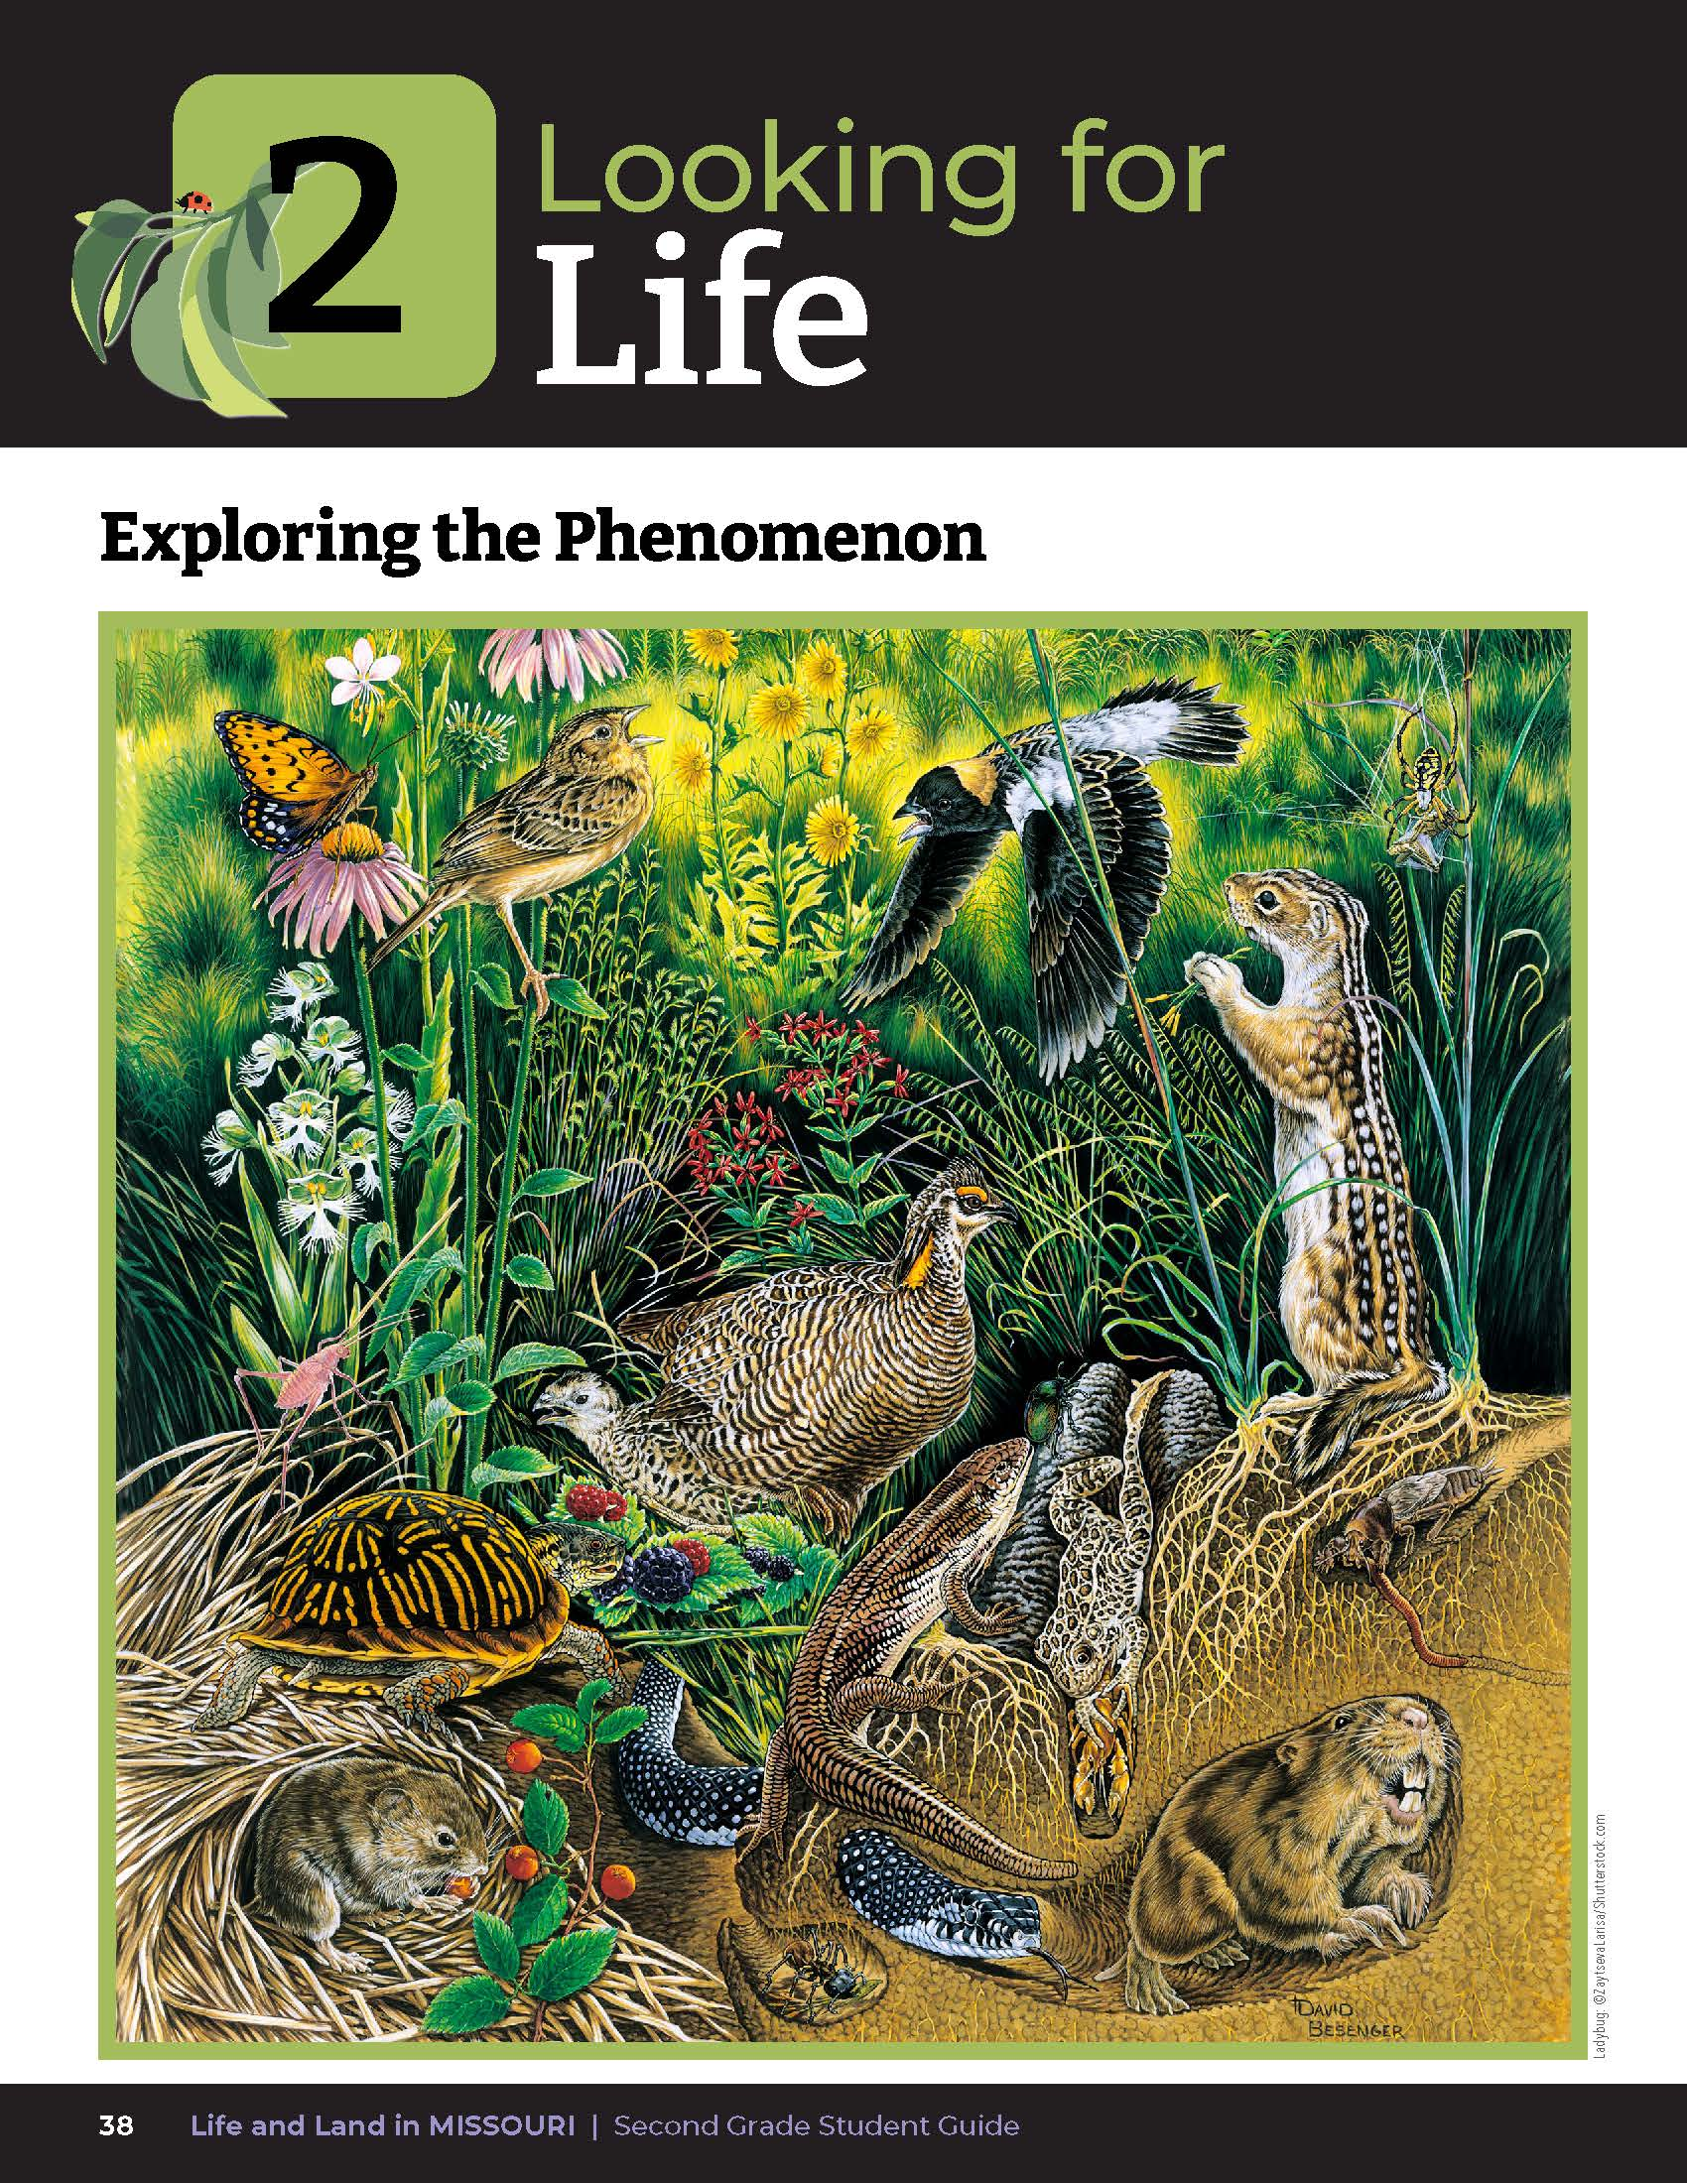
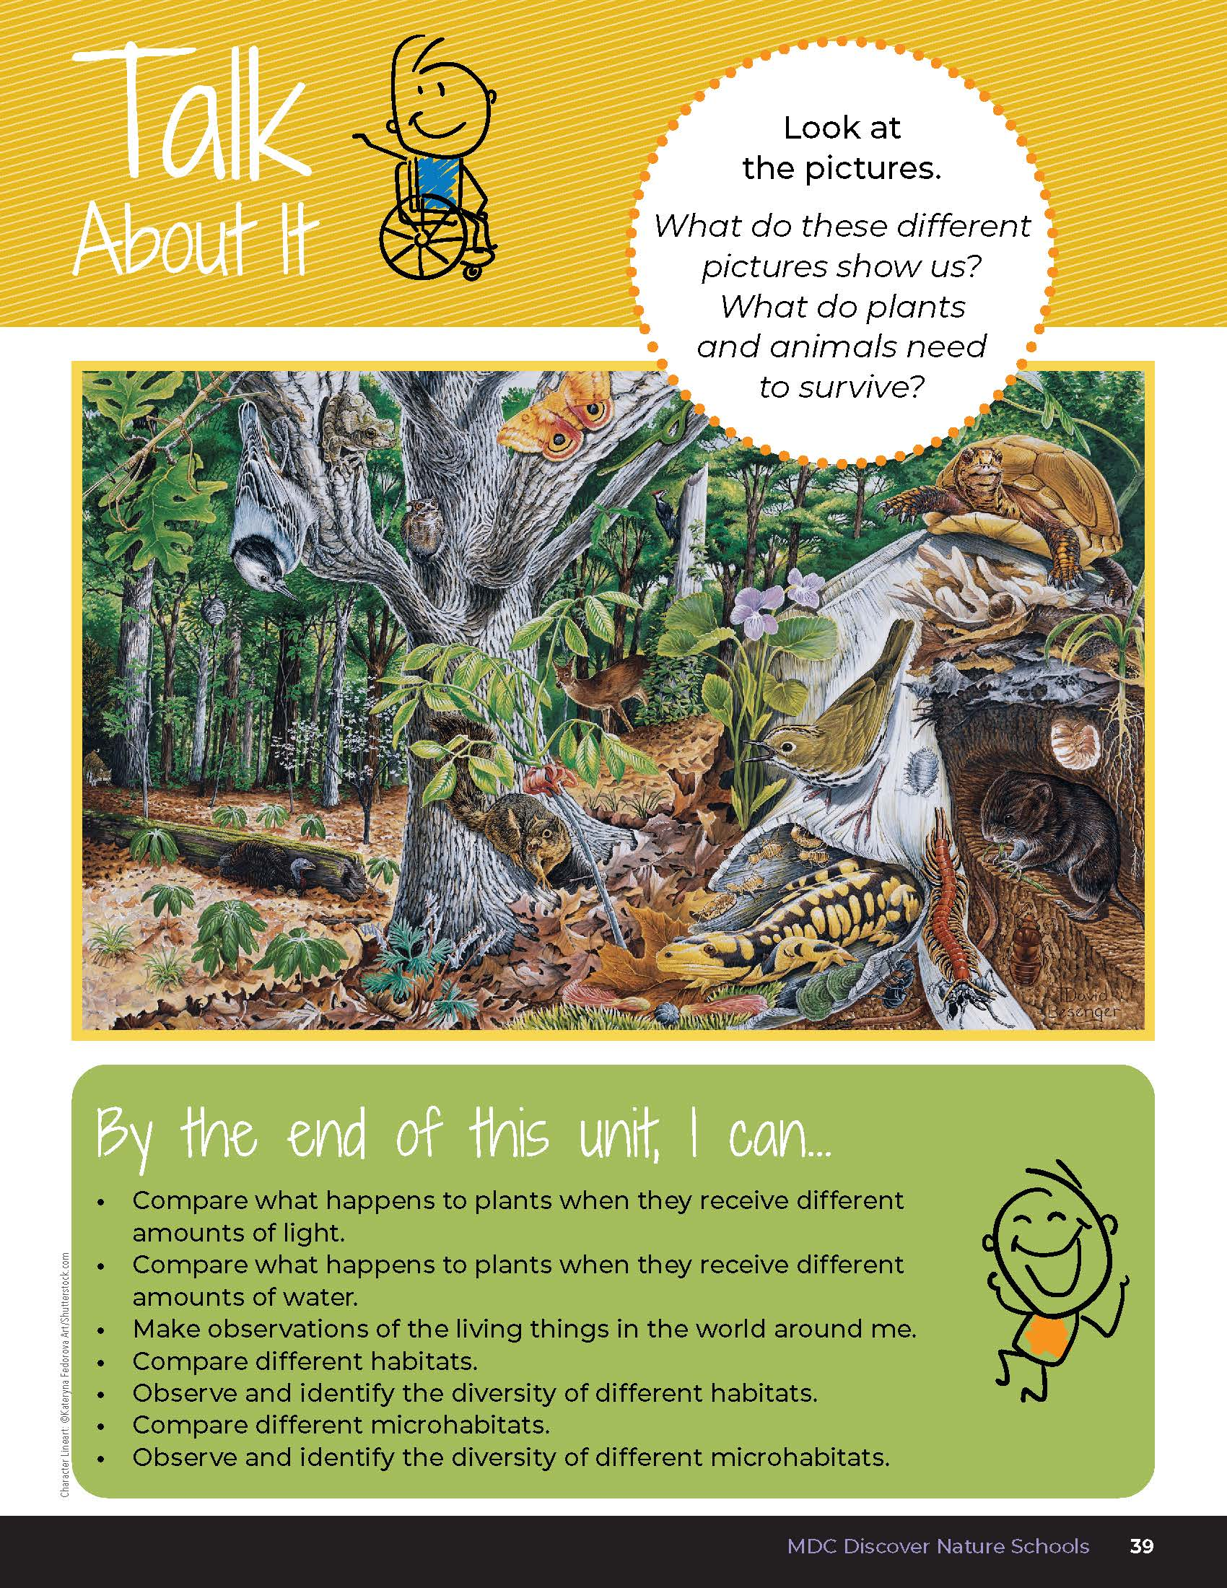
2
Life and Land in Missouri – Unit 2 Review
2
Notes:
Have students turn to the Unit 2 Exploring the Phenomenon and Talk About It section on pages 38-39.

Slide 3
Turn and talk to a classmate and describe the different habitat types.
2
Life and Land in Missouri – Unit 2 Review
3
Notes:
Using the pictures at the beginning of the lesson, have students turn and talk to a classmate and describe the different habitat types.

Slide 4
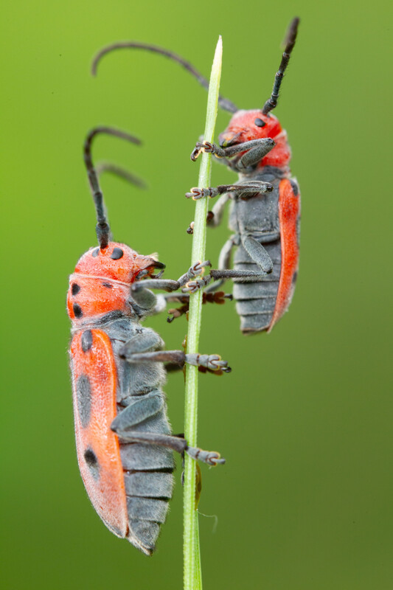
What plants and animals (including insects and tiny creatures) would live here? Why?
2
Life and Land in Missouri – Unit 2 Review
4
Notes:
(Student mentions a variety of types of plants and animals in each habitat. The animals and plants live here because this is where their needs are met, like water, food, shelter, and space.)
Animals in Picture: Red milkweed beetle

Slide 5
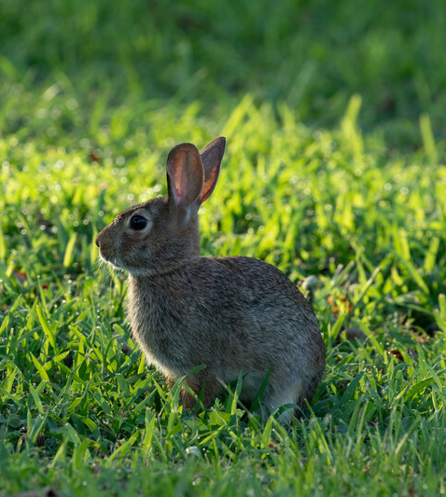
Is this a healthy diversity of plants and animals? Why or why not?
2
Life and Land in Missouri – Unit 2 Review
5
Notes:
(Both habitats show a healthy diversity of plants and animals because there are many different types of plants and animals in each habitat. Students can share their total numbers from the evidence section on 2C Claim, Evidence, Reasoning on Page 63 of the student guide.)
Rubric:
3 (Meets) – Student explains the types of habitats in the illustrations and offers ideas of plants and animals that would live there and why. Student explains that the pictures show a healthy diversity of plants and animals and explains that they can see many different types of plants and animals in each habitat. Student gives details from the picture to support their claim.
2 (Partially meets) – Student explains 1 of the 2 types of habitats in the illustrations and offers ideas of plants and animals that would live there and why. Student somewhat explains that the pictures show a healthy diversity of plants and animals in each habitat. Student gives some details from the picture to support their claim.
1 (Doesn’t meet) – Student does not provide an explanation of habitat types or does not describe the diversity of plants and animals that are living there.
Animal in Picture: Eastern cottontail rabbit

Slide 6
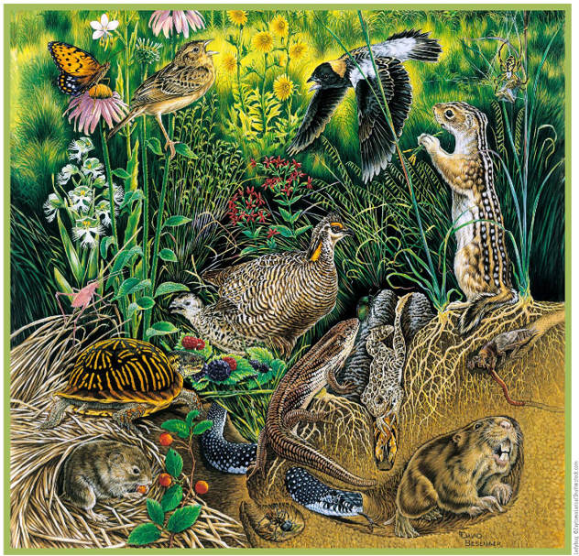
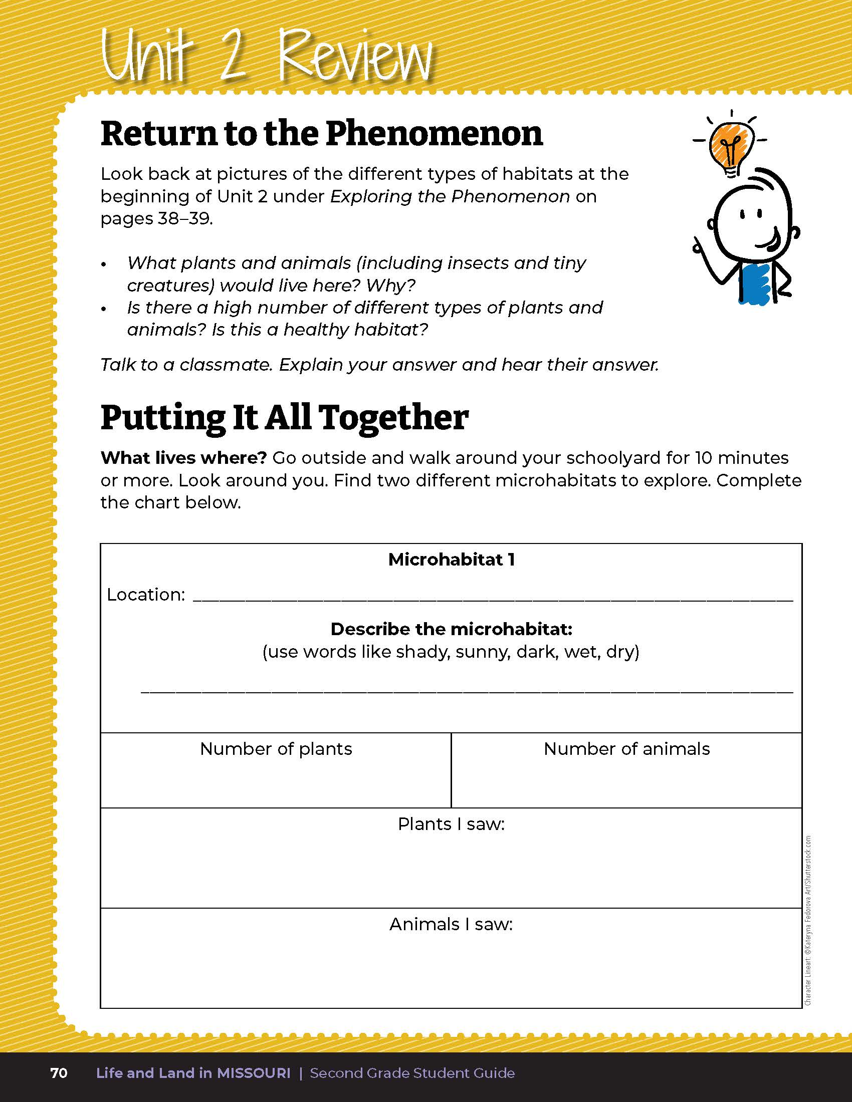
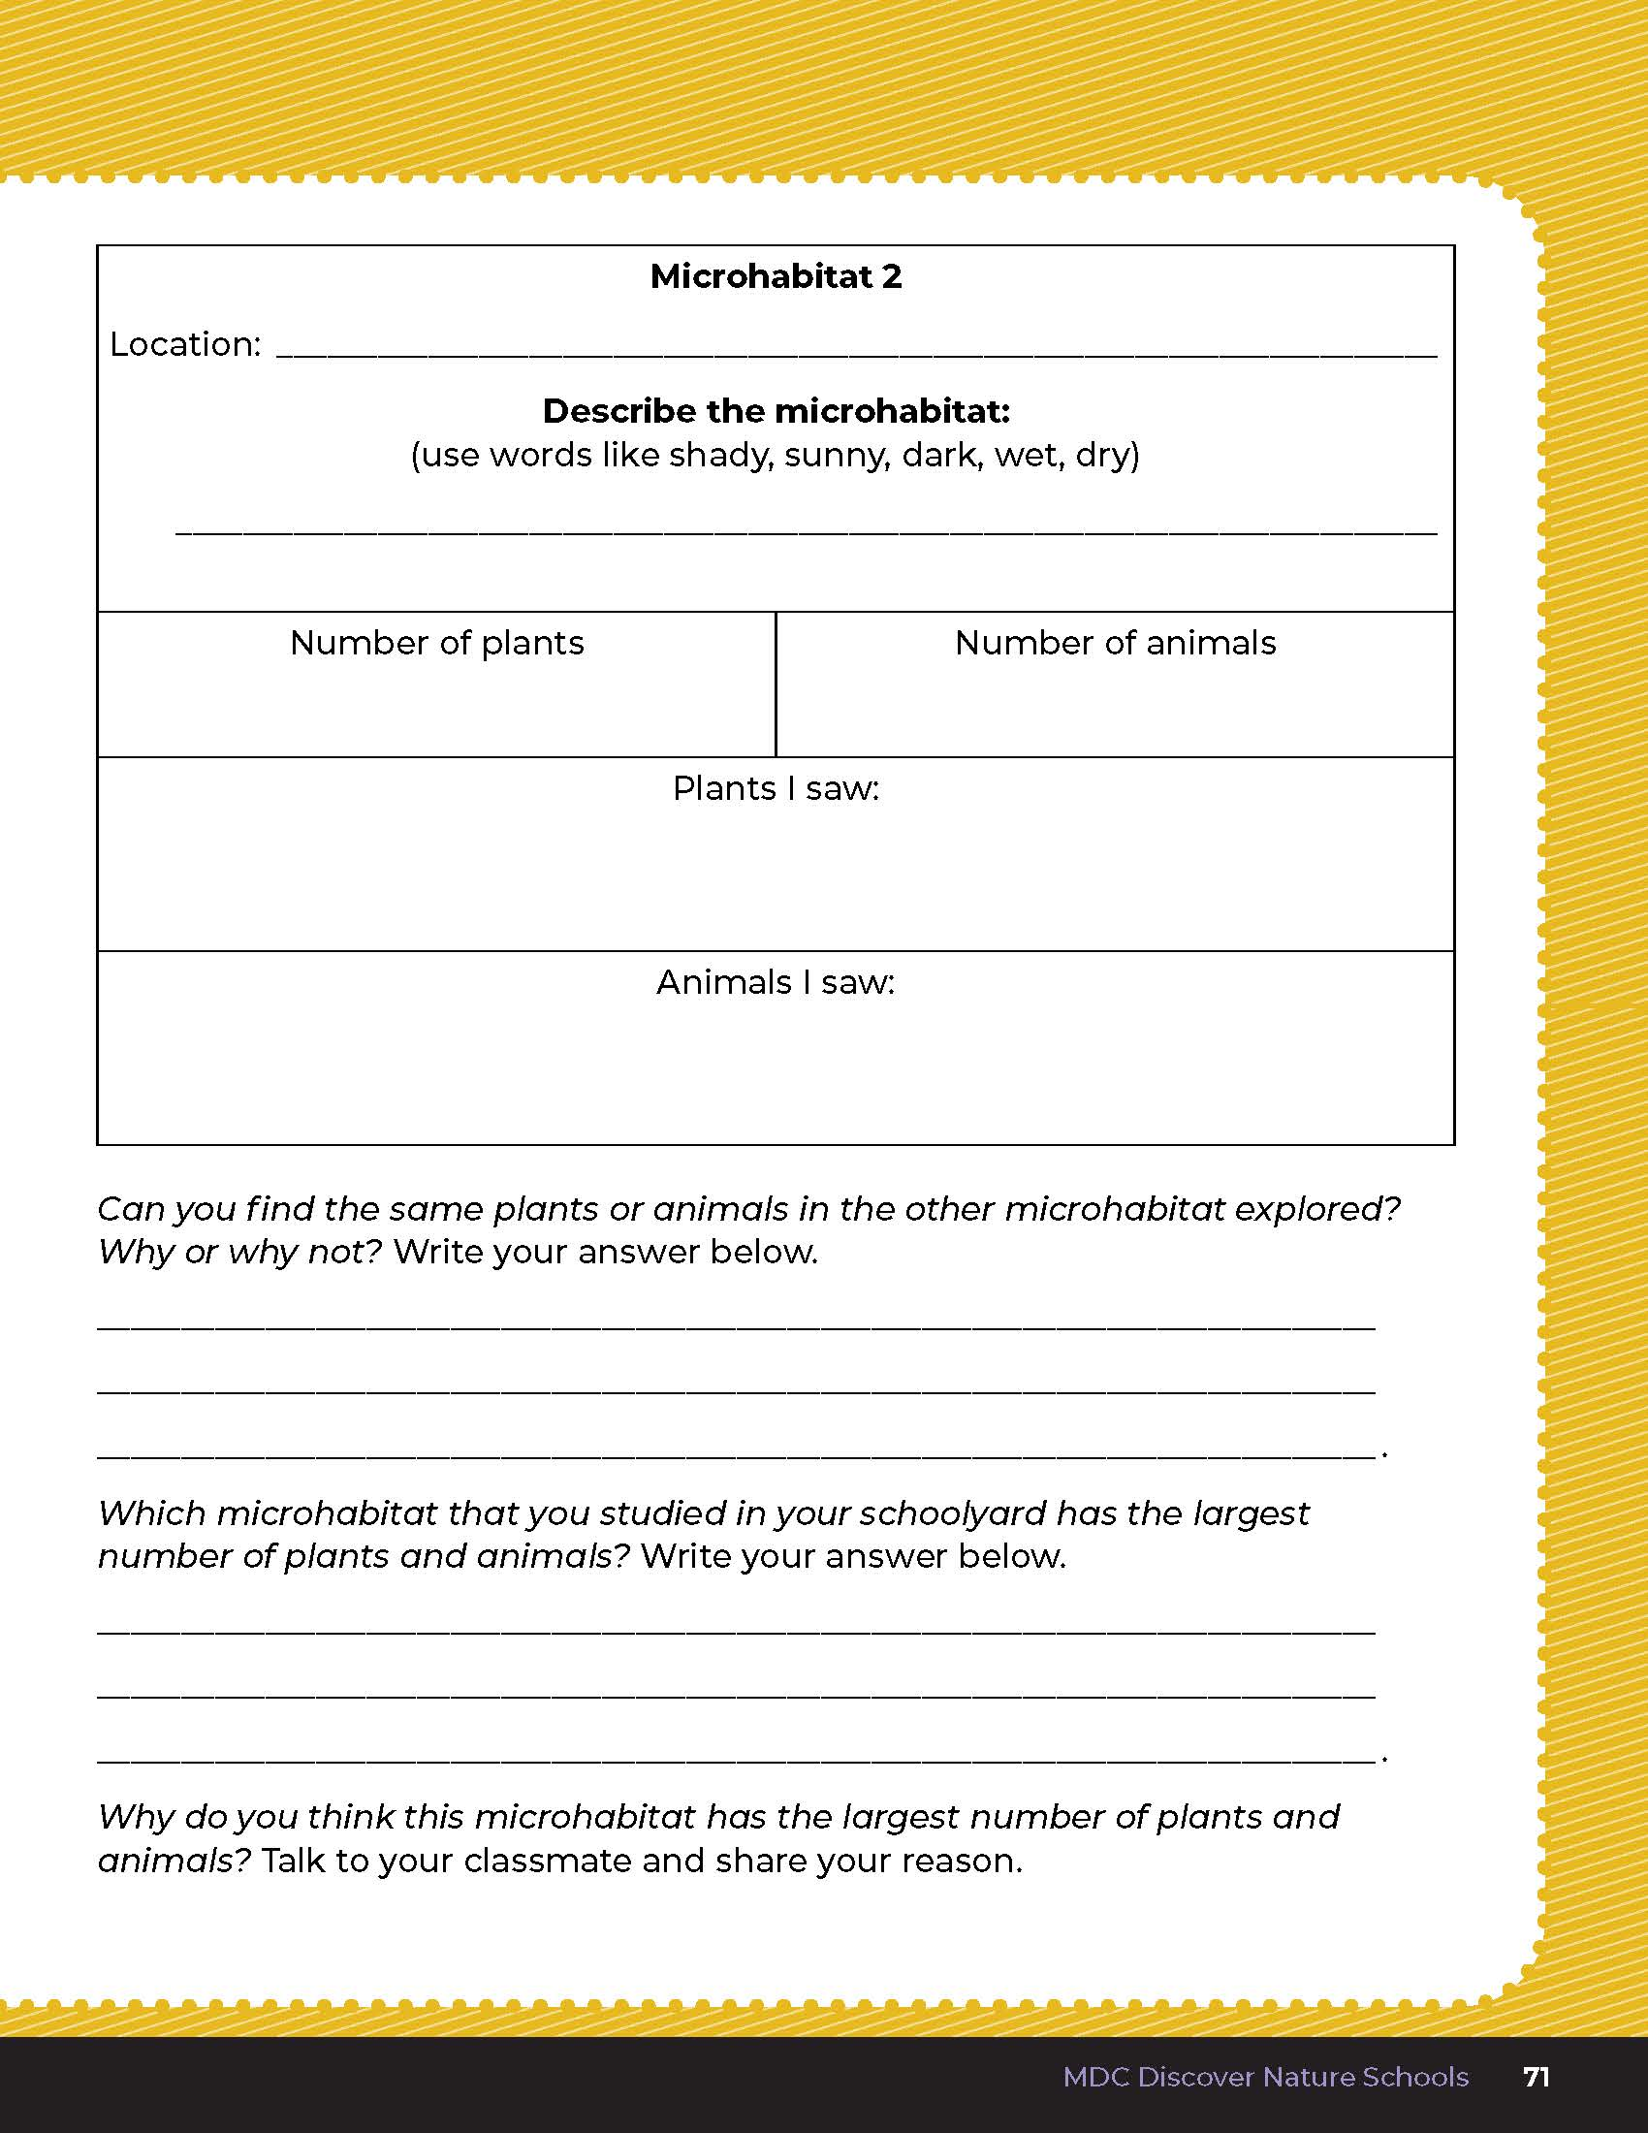
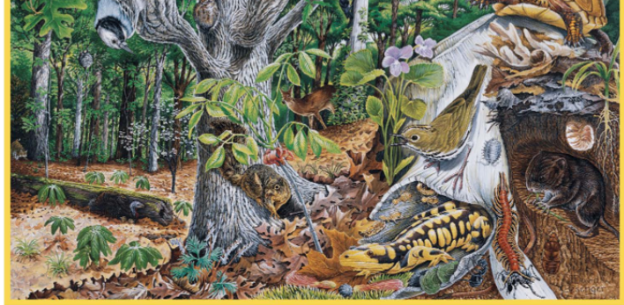
Compare two different types of microhabitats in your schoolyard
2
Life and Land in Missouri – Unit 2 Review
6
Notes:
Have students go outside for 10-15 minutes. Students will locate two different types of microhabitats in their schoolyard to compare. Using the Putting It All Together on pages 70-71 of the student guide, students will write the location of the two microhabitats, a description of both, the numbers of plants and animals in each habitat, and will list or draw the plants or animals found.
Rubric:
3 (Meets) – Student writes and describes both microhabitats. Student writes the number of plants and animals found in each microhabitat. Student lists or draws the plants or animals found in each microhabitat. Student writes the correct microhabitat with the highest diversity and answers the discussion questions correctly, referencing the definition of habitat.
2 (Partially meets) – Student may or may not write and describe both microhabitats. Student may or may not write the number of plants and animals found in each microhabitat. Student may or may not write list or draw the plants or animals found in each microhabitat. Student may or may not write the correct microhabitat with the highest diversity and answers the discussion questions correctly, referencing the definition of habitat.
1 (Doesn’t meet) – Student does not complete the chart and does not participate in discussion.

Slide 7
Can you find the same plant or animal in the other microhabitat you explored? Why or why not?
2
Life and Land in Missouri – Unit 2 Review
7
Notes:
(Student answers will vary.)

Slide 8
Which microhabitat has the biggest amount of diversity of the plants and animals you studied in your schoolyard?
2
Life and Land in Missouri – Unit 2 Review
8
Notes:
(Student lists the microhabitat). (Student should reference that the habitat has food, water, shelter, and space needed for the plants or animals to survive and grow.)

Slide 9

Optional: Cross-Curricular Extension
English Language Arts
Write a story “the day in the life of a seedling.” Using vivid language to describe how the seedling takes up water, grows roots, extends its leaves toward the sun.
What might your seedling see outside the window while it grows?
Create a list of open-ended questions to determine how growing conditions affect plants. Record detailed notes as you carry out your experiment. Gather evidence. Evaluate results. Present information in a written report and/or display.
2
Life and Land in Missouri – Unit 2 Review
9

Slide 10
Optional: Cross-Curricular Extension
Math
Measure the seedlings once a week and plot seedlings growth by height on a graph.
2
Life and Land in Missouri – Unit 2 Review
10

Slide 11
Optional: Cross-Curricular Extension
Outdoor Skills
Show students a picture of poison ivy and teach them how to identify poison ivy. Note the smooth surface of the leaves, the irregular shape of the leaves, how hair-like the root system is. Refer to the poison ivy information on Page 9 to sing a song about poison ivy with your students. Go outside and identify poison ivy with your students.
2
Life and Land in Missouri – Unit 2 Review
11

Slide 12
Optional: Cross-Curricular Extension
Music
Plan an experiment to play music for seedlings.
Does music affect growth?
2
Life and Land in Missouri – Unit 2 Review
12

Slide 13
Optional: Cross-Curricular Extension
Art
Draw pictures in your science journal of changes in plant growth.
Create a poster of a Missouri habitat of your choice.
2
Life and Land in Missouri – Unit 2 Review
13

Slide 14
Optional: Cross-Curricular Extension
Physical Education/Dance
With your students, brainstorm a list of growing conditions and alterations. Take students outside and stand in the sun. Students plant their feet (roots) to stay in place. Giving students directions, have students stretch arms toward the sun as if growing then wilt from lack of water. As you pretend to water students, they spring back to life, pretending to slurp water up through their roots. Have students act out all the different conditions on the brainstormed list.
2
Life and Land in Missouri – Unit 2 Review
14

