Slide 1
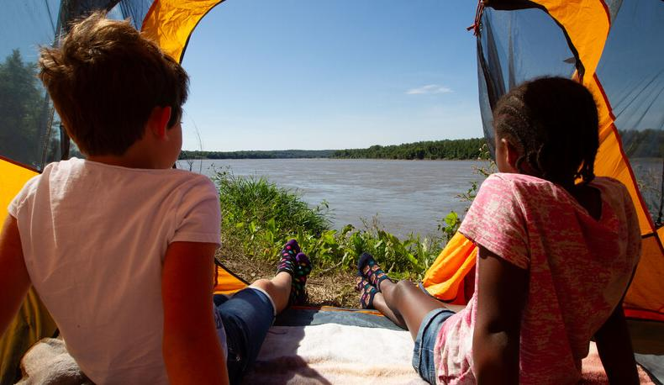

Life and Land in
MISSOURI
2D: Tiny Worlds Tiny Animals

Slide 2
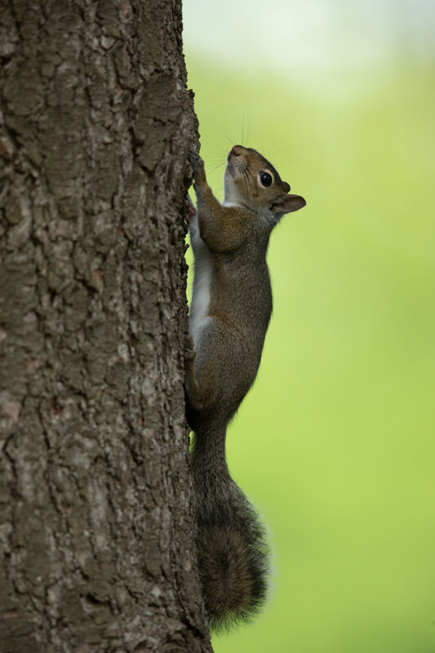
What animals live in your schoolyard or neighborhood?
2D
Life and Land in Missouri – 2D Tiny Worlds Tiny Animals: Engage
2
Notes:
Let’s review.
Animal in Picture: Gray squirrel

Slide 3
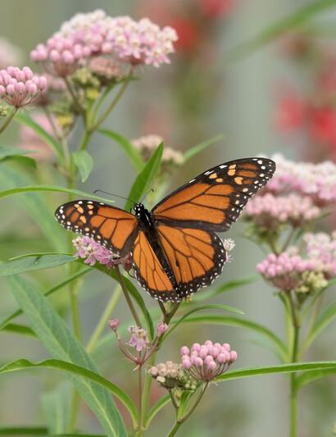
Now let’s think on a smaller scale.
What insects and tiny creatures live in your schoolyard or neighborhood?
Where would we go to look?
2D
Life and Land in Missouri – 2D Tiny Worlds Tiny Animals: Engage
3
Notes:
Make a list of places students would look if they were told to collect insects and tiny creatures like ants, snails, roly-polys, dragonflies, butterflies, spiders, moths, crickets, or grasshoppers.
Examples may include grass, flowers, alongside buildings, in the weeds, under rocks, on trees, under logs, in leaves, flying in the air, on the sidewalks, etc.
Animal in Picture: Monarch butterfly, Plant in Picture: Common milkweed

Slide 4
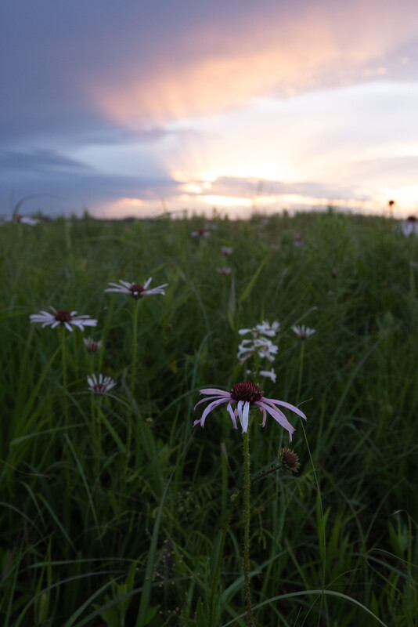
What is a habitat?
What does an animal need to survive in its habitat?
2D
Life and Land in Missouri – 2D Tiny Worlds Tiny Animals: Engage
4
Notes:
(A habitat is where an animal lives. It provides an animal with food, water, shelter, space, and air to survive.)
Allow students time to share their definition and the needs that a habitat provides. Some insects, spiders, and other tiny creatures are found in many different areas while others are only found in very limited habitats. For example, some insects are only found on one type of tree.
Plant in Picture: pale purple coneflower

Slide 5
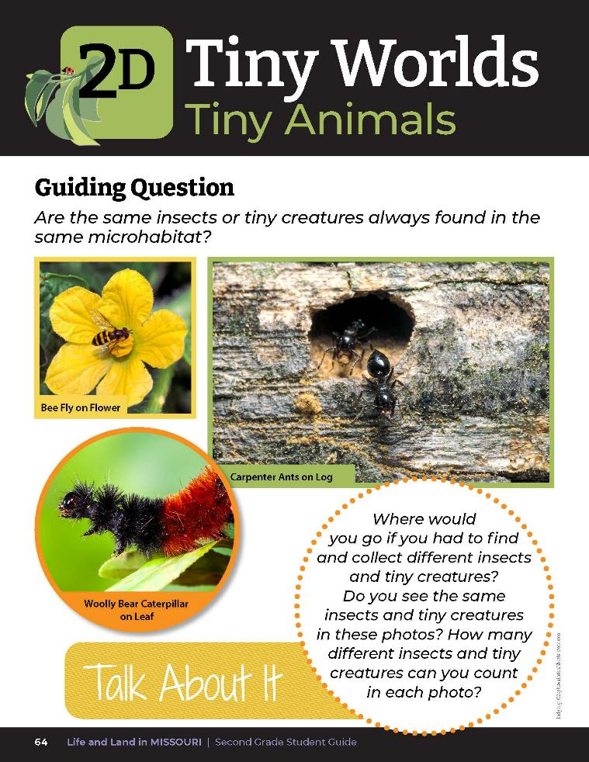
Guiding Question:
Are the same insects or tiny creatures always found in the same microhabitat?
2D
Life and Land in Missouri– 2D Tiny Worlds Tiny Animals: Engage
5
Notes:
Have students open their student guides to the Lesson 2D Tiny Worlds, Tiny Animals introduction on Page 64. Read the guiding question together. Brainstorm ideas as a class.

Slide 6
Scientists classify plants and animals based on their characteristics.
They place plants and animals into groups based on how similar they look.
2D
Life and Land in Missouri– 2D Tiny Worlds Tiny Animals: Explore
6
Notes:
Display and share the Big Book of Bugs. After flipping through the book, explain to the students that scientists classify plants and animals based on their characteristics. That is, they place plants and animals into groups based on how similar they look. So beetles are grouped together because they all have wings that are covered by a hard shell and grasshoppers are a group because they have a similar body shape and leg structure.

Slide 7
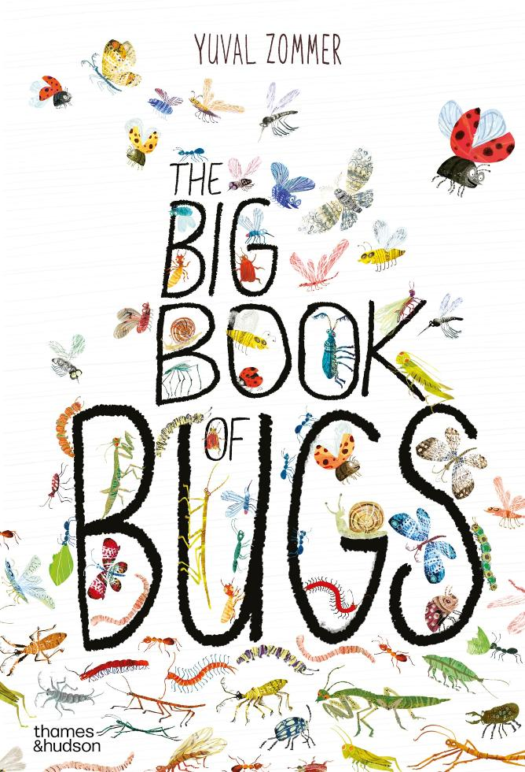
Read the book The Big Book of Bugs by Yuval Zommer.
Read Aloud:
https://www.youtube.com/watch?v=G4QCUGtw4uo
Notice what characteristics different groups of insects have in common.
2D
Life and Land in Missouri– 2D Tiny Worlds Tiny Animals: Explore
7
Notes:
Read through the Big Book of Bugs together. Ask students to notice what characteristics different groups of insects have in common.

Slide 8
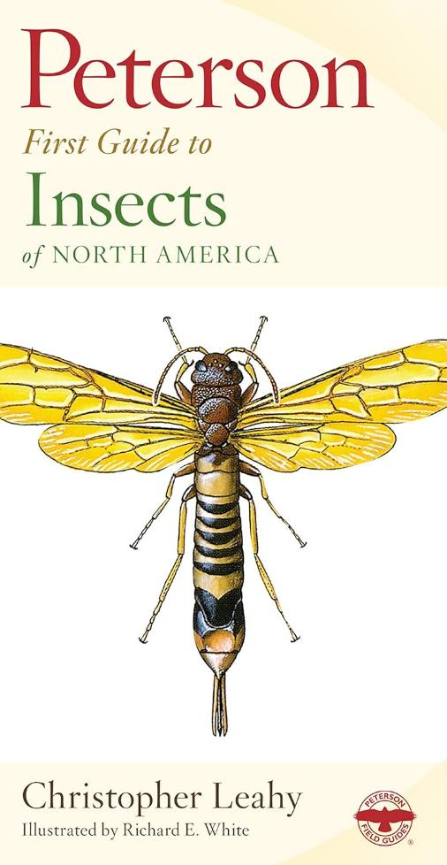
Explore Peterson’s First Field Guide to Insects
This field guide is divided into insect groups.
Notice what characteristics different groups of insects have in common.
2D
Life and Land in Missouri– 2D Tiny Worlds Tiny Animals: Explore
8
Notes:
You will need a copy of Peterson's First Field Guide to Insects. Display and share Peterson’s First Field Guide to Insects. Show students how this field guide is divided into insect groups.

Slide 9
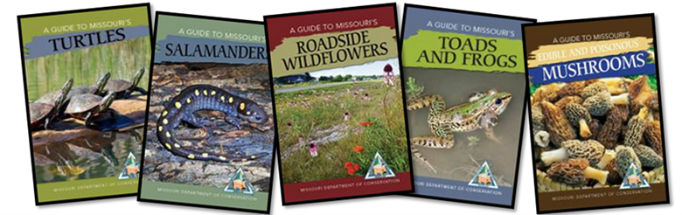
Field guides are book that help us identify what we are specifically look at, or observing, outside in nature.
2D
Life and Land in Missouri– 2D Tiny Worlds Tiny Animals: Explore
9
Notes:
Show how this book is also divided into groups like dragonflies and damselflies, grasshoppers and crickets, beetles, butterflies and moths, flies, wasps and ants.
Field Guide | Missouri Department of Conservation

Slide 10
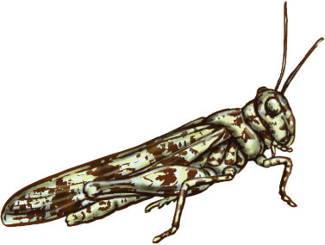
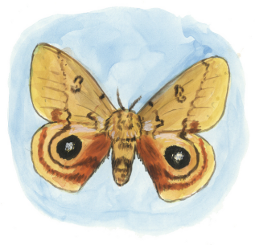
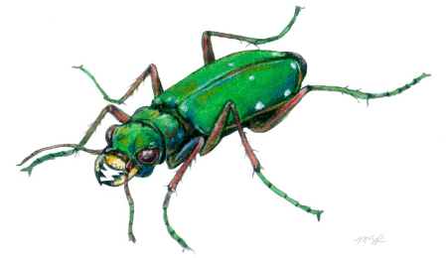
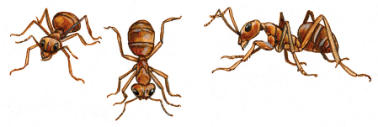
Where are the grasshoppers in our guide?
How many kinds of grasshoppers are there?
Where are the butterflies and moths in our guide?
How many different kinds can you count?
Where are the beetles in our guide?
How many beetles do you see?
Where are the ants?
How many kinds of ants do you see?
2D
Life and Land in Missouri– 2D Tiny Worlds Tiny Animals: Explore
10
Notes:
Turn to the grasshopper section on Page 23. This section shows many types of grasshoppers. So, if they find a grasshopper outside, then they should flip to where the grasshoppers are in the book.
Illustrations:
Lichen grasshopper
IO Moth

Slide 11
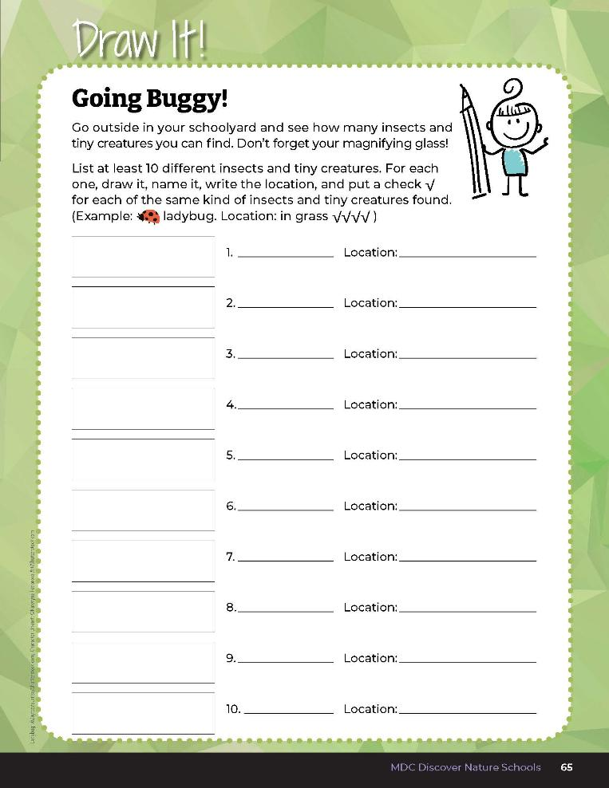

Go outside in your schoolyard and see how many insects and tiny creatures you can find!
Count and record the numbers of different types of insects and tiny creatures.
2D
Life and Land in Missouri– 2D Tiny Worlds Tiny Animals: Explore
11
Notes:
Divide class into groups of 3-5 students. Distribute magnifying glasses and any collection bags such as paper bags.
Distribute magnifying glasses and bug jars to partners or a group of students. With the two guides in hand, take students out to the schoolyard again and look at the diversity and habitats of insects and tiny creatures. Count and record the numbers of different types of insects and tiny creatures in the Draw It! 2D Going Buggy! section Page 65. Have students look for at least 10 different types of insects or tiny creatures. If they need help in identifying which type of insect or tiny creatures they have found, they can refer to the two guides, Peterson’s First Guide to Insects and the Big Book of Bugs. Have each group explore a minimum of 2-3 different habitats to compare (such as a log, tree, alongside the building, in the weeds, under rocks, in leaves, flying in the air, on the sidewalk, etc.)
Teacher Note: Remind students to return all tiny creatures to their original habitat prior to coming back inside the classroom.

Slide 12
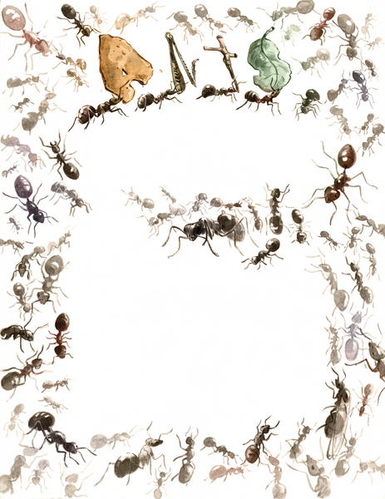
Write a list of the different types of insects or tiny creatures found.
2D
Life and Land in Missouri– 2D Tiny Worlds Tiny Animals: Explore
12
Notes:
Once back in the classroom initiate a discussion of student findings. Write a list on the board of the different types of insects or tiny creatures students found. Put a checkmark per each of the same insect or tiny creatures found.

Slide 13
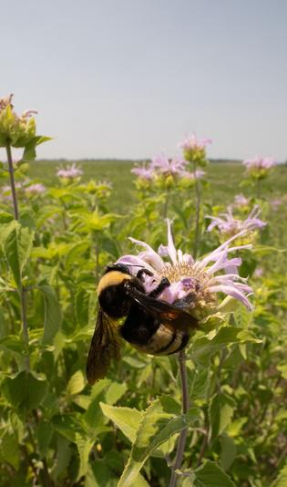
How many different types of insects or tiny creatures did you find in the schoolyard?
Was there a lot of diversity in our schoolyard?
2D
Life and Land in Missouri– 2D Tiny Worlds Tiny Animals: Explore
13
Notes:
Notice how two habitats are different from one another. Have students draw the habitat where they found their insect or tiny creature next to the list of what was found on the board.
Animal in Picture: Bumble bee

Slide 14
Number of Insects
Habitat
2D
Life and Land in Missouri– 2D Tiny Worlds Tiny Animals: Explain
14
Notes:
Make a bar graph on the board and write “Habitat” below on the x-axis and ‘Number of Insects” on the y-axis.

Slide 15
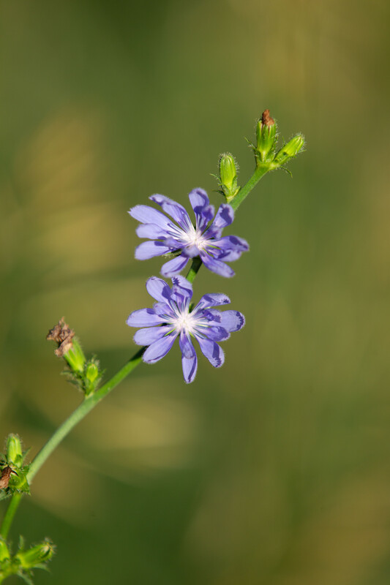
After looking at our bar graph, which locations have the biggest variety of tiny creatures?
Which had the fewest?
How are the locations different?
2D
Life and Land in Missouri– 2D Tiny Worlds Tiny Animals: Explain
15
Notes:
(Consider temperature, moisture, sunlight, actual temperature if it was taken, shade, etc.)
Plant in Picture: Chickory

Slide 16
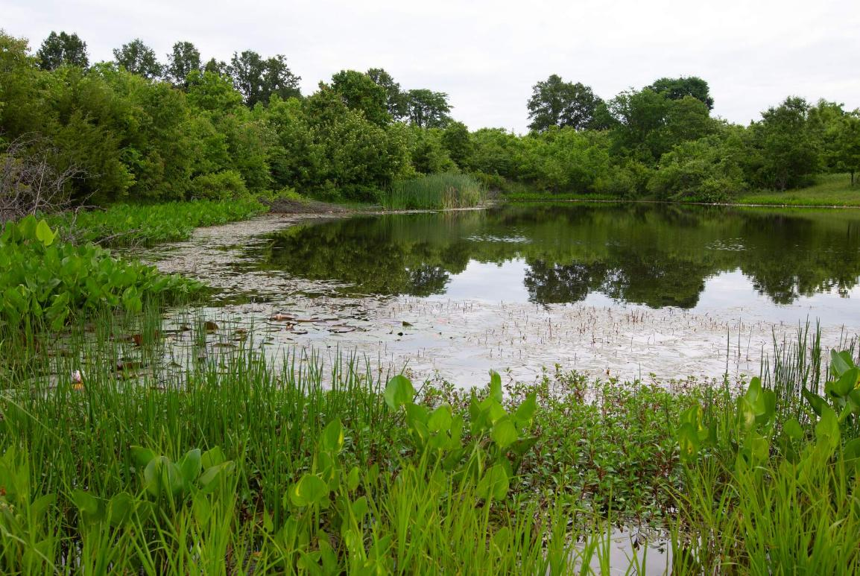
What is a habitat?
2D
Life and Land in Missouri– 2D Tiny Worlds Tiny Animals: Explain
16
Notes:
Discuss and remind students the scientific concepts learned from the last lesson. What is a habitat? Habitats are where plants and animals live. This is where plants and animal find their food, water, shelter, and space.

Slide 17
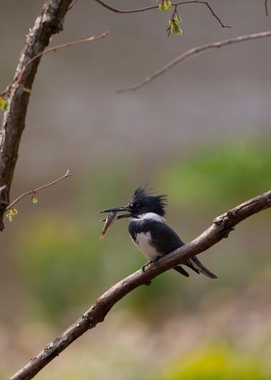
How do we know if a habitat is healthy?
2D
Life and Land in Missouri– 2D Tiny Worlds Tiny Animals: Explain
17
Notes:
Healthy habitats have a large diversity of different plants and animals using them. Diversity is lots of different kinds of plants and animals.
Animal in Picture: Belted kingfisher

Slide 18
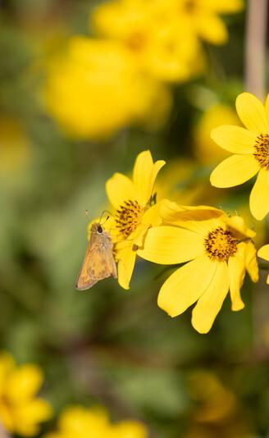
Were the same insects and tiny creatures found in each habitat?
2D
Life and Land in Missouri– 2D Tiny Worlds Tiny Animals: Explain
18
Notes:
Let’s revisit out guiding question.
Animal in Picture: Skipper; Plant in Picture: Beggartick flower

Slide 19
Are there places in our schoolyard where you found more types of insects or tiny creatures than in other places?
Why do you think that is?
2D
Life and Land in Missouri– 2D Tiny Worlds Tiny Animals: Explain
19

Slide 20
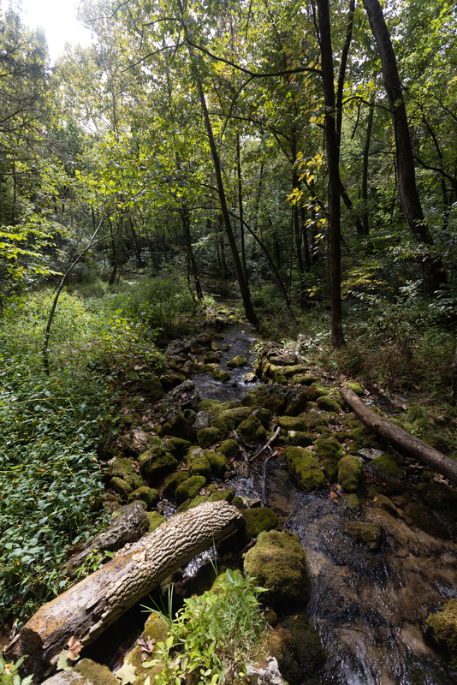
What did the different habitats look like?
2D
Life and Land in Missouri – 2D Tiny Worlds Tiny Animals: Explain
20

Slide 21
Let’s circle which insects and tiny creatures were found everywhere and put an “x” next to the insects and tiny creatures found only in one location.
2D
Life and Land in Missouri – 2D Tiny Worlds Tiny Animals: Explain
21

Slide 22
How were these locations the same?
2D
Life and Land in Missouri – 2D Tiny Worlds Tiny Animals: Explain
22

Slide 23
Were there any locations with no insects and tiny creatures? Why?
2D
Life and Land in Missouri – 2D Tiny Worlds Tiny Animals: Explain
23

Slide 24
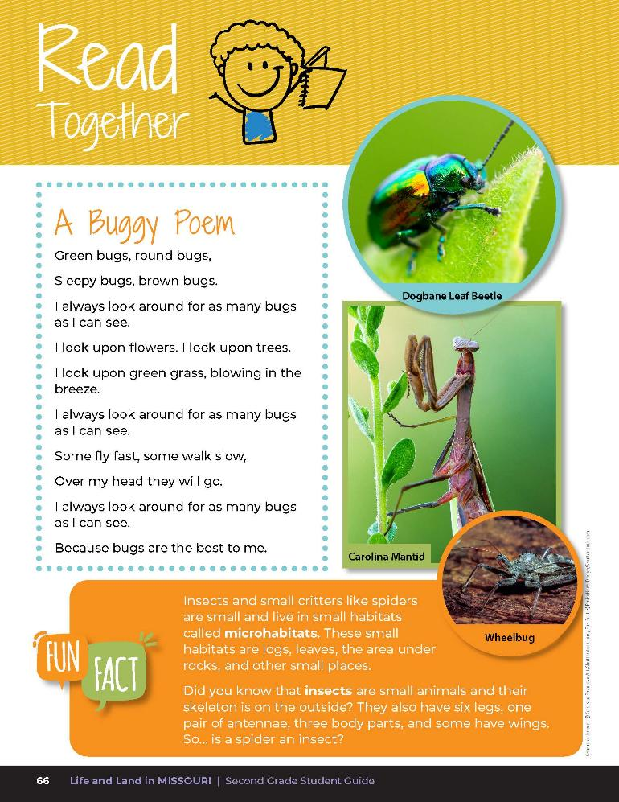

A Buggy Poem
Green bugs, round bugs,
Sleepy bugs, brown bugs.
I always look around for as many bugs as a I can see.
I look upon flowers. I look upon trees.
I look upon green grass, blowing in the breeze.
I always look around for as many bugs as I can see.
Some fly fast, some walk slow,
Over my head they will go.
I always look around for as many bugs as I can see.
Because bus are the best for me.
2D
Life and Land in Missouri – 2D Tiny Worlds Tiny Animals: Explain
24
Notes:
Have students open their guides to Read Together 2D A Buggy Poem on Page 66.

Slide 25
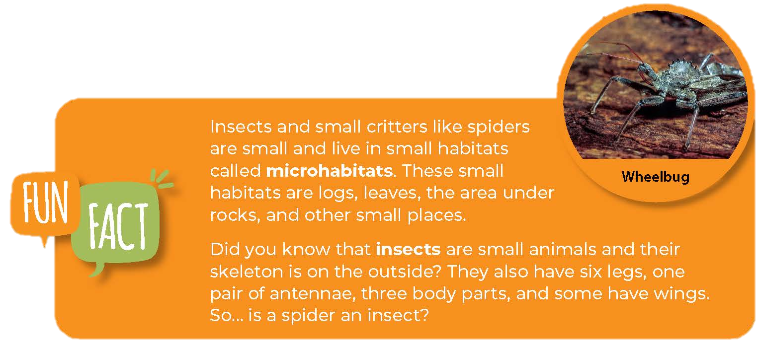
2D
Life and Land in Missouri – 2D Tiny Worlds Tiny Animals: Explain
25
Notes:
Read the poem and Fun Fact on that page and introduce the term microhabitats, which are small habitats like logs, leaves, or the area under a rock where smaller animals like insects and tiny creatures and spiders may live.

Slide 26
Make a sketch of a small area in your backyard or neighborhood that has some of the same small microhabitats as your schoolyard.
2D
Life and Land in Missouri – 2D Tiny Worlds Tiny Animals: Elaborate
26
Notes:
Have students make a sketch of a small area in their backyard or neighborhood that has some of the same small microhabitats.

Slide 27
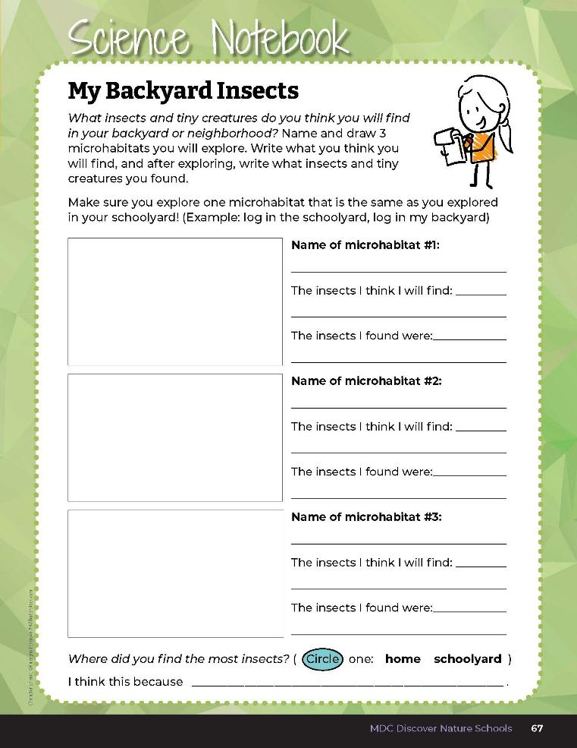

Name and draw 3 microhabitats you will explore in your backyard or neighborhood. Write what insects and tiny creatures you think you will find.
2D
Life and Land in Missouri – 2D Tiny Worlds Tiny Animals: Elaborate
27
Notes:
Using the student guide, Science Notebook 2D My Backyard Insects, have students draw or list what they predict they can find in these locations. Have students explore these locations over the weekend, and share their findings the next day or week.

Slide 28
How do the locations and insects and tiny creatures found compare to the schoolyard?
Are they the same or different?
2D
Life and Land in Missouri – 2D Tiny Worlds Tiny Animals: Elaborate
28

Slide 29
Write what insects and tiny creatures you found.
2D
Life and Land in Missouri – 2D Tiny Worlds Tiny Animals: Elaborate
29
Notes:
Allow students time to share their reasonings and write it into their student guide Science Notebook 2D My Backyard Insects page.

Slide 30

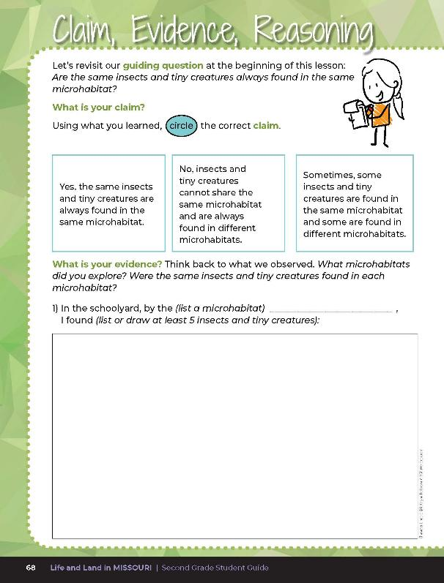
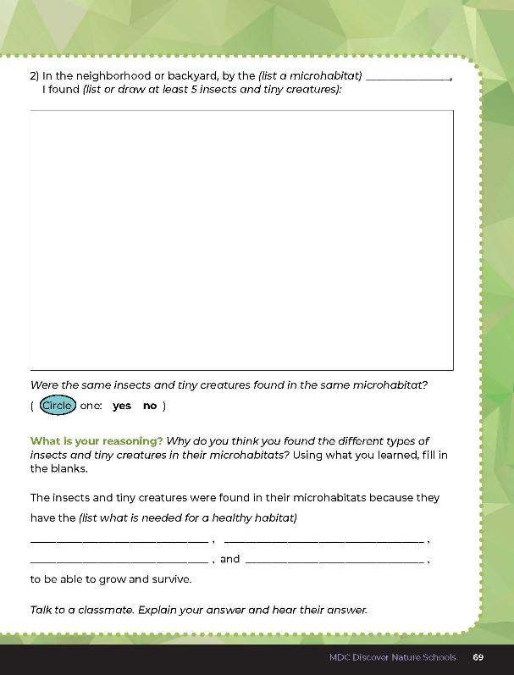
2D
Life and Land in Missouri – 2D Tiny Worlds Tiny Animals: Evaluate
30
Notes:
Guiding Question: Are the same insects and tiny creatures always found in the same microhabitat?
After exploring habitats and diversity through lesson activities, have students complete the 2D Claim, Evidence, Reasoning questions on student guide pages 68-69.

Slide 31
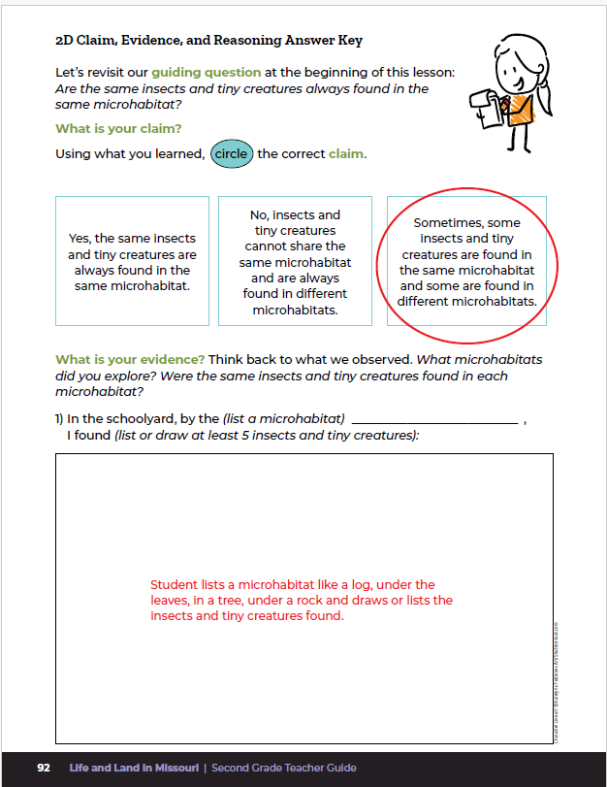
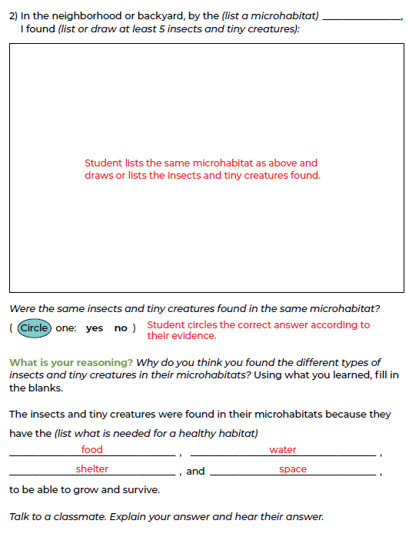
2D
Life and Land in Missouri – 2D Tiny Worlds Tiny Animals: Evaluate
31
Notes:
Rubric:
4 (Exceeds) – Student circles the correct claim. Under evidence, the student writes the same microhabitat twice, lists at least 4-5 insects and tiny creatures found in each microhabitat, and circles the correct yes or no answer. Under reasoning, the student writes at least 2-3 correct words into the blanks.
3 (Meets) – Student circles the correct claim. Under evidence, the student writes the same microhabitat twice, lists at least 2-3 insects and tiny creatures found in each microhabitat, and circles the correct yes or no answer. Under reasoning, the student writes at least 2-3 correct words into the blanks.
2 (Partially meets) – Student may or may not circle the correct claim. Under evidence, the student lists a microhabitat once, lists at least 1-2 insects and tiny creatures found in each microhabitat, and may or may not circle the correct yes or no answer. Under reasoning, the student writes at least 1-2 correct words into the blanks.
1 (Doesn’t meet) – Student does not circle the correct claim. Under evidence, the student lists a microhabitat once, lists only 1 or no insects and tiny creatures for only one microhabitat, and does not circle the correct yes or no answer. Under reasoning, the student does not fill in the blanks with the correct answer.

