Slide 1
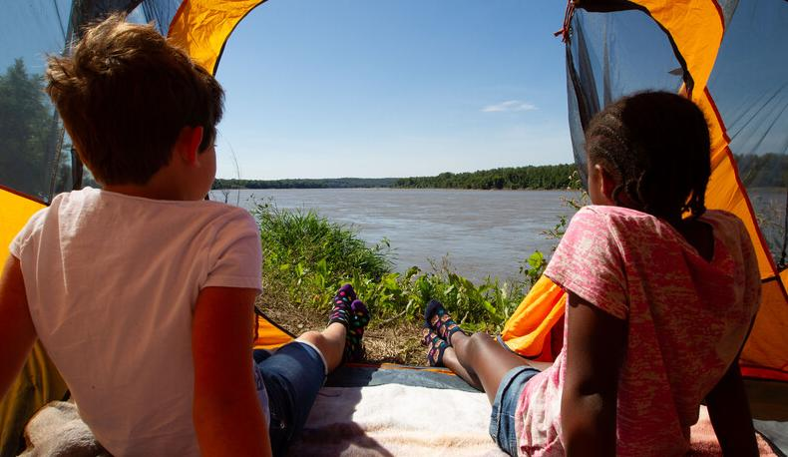

Life and Land in
MISSOURI
2C: Habitat is Where It’s At!

Slide 2
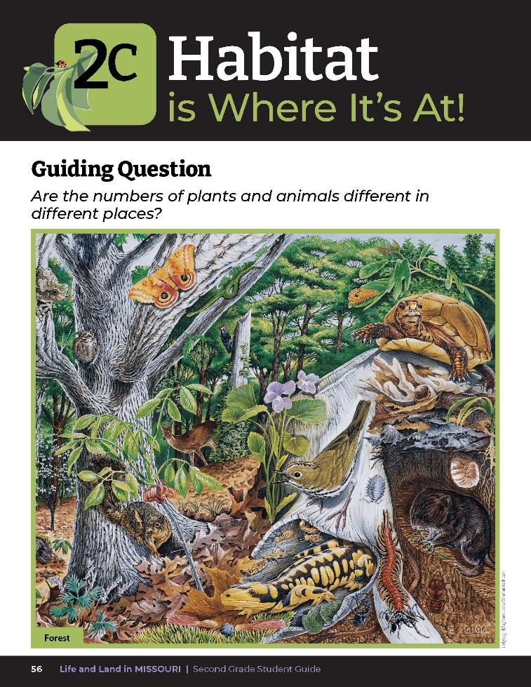
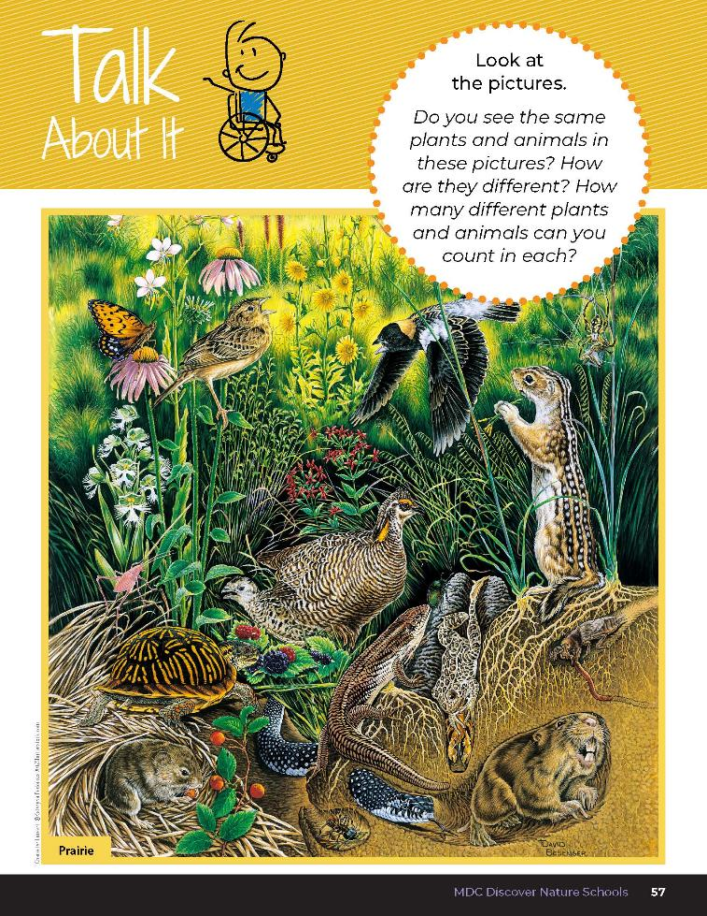
2C
Life and Land in Missouri – 2C Habitat is Where It’s At: Engage
2
Notes:
Have students open their student guides to the Lesson 2C Habitat Is Where It’s At! Introduction on pages 56-57.
Guiding Question: Are the numbers of plants and animals different in different places?
What do you notice about these photos? Do you see the same plants and animals in each? How many plants and animals can you find in both pictures?

Slide 3
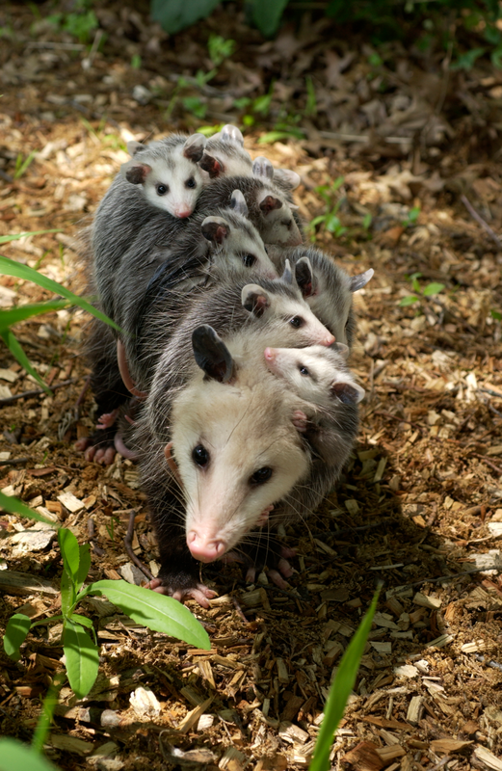
A living thing can grow and reproduce.
2C
Life and Land in Missouri – 2C Habitat is Where It’s At: Explore
3
Notes:
Take the class outside to explore their schoolyard. Have them bring their student guides. Discuss the difference between a living thing and a nonliving thing. A living thing can grow and reproduce.
Animal in Picture: Virginia opossum

Slide 4
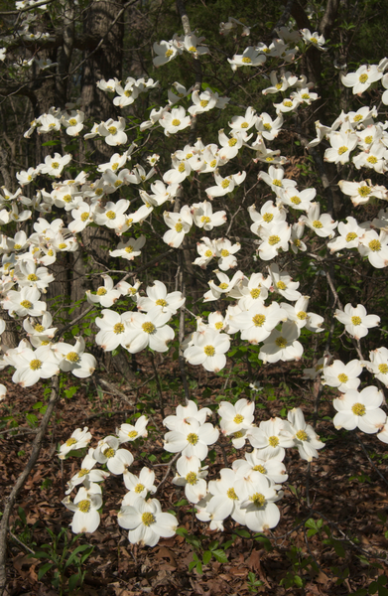
What three examples can you think of that are living?
2C
Life and Land in Missouri – 2C Habitat is Where It’s At: Explore
4
Notes:
(Examples would be types of plants, animals, insects, birds, spiders, worms, etc.)
Plant in Picture: Dogwood tree flowers

Slide 5
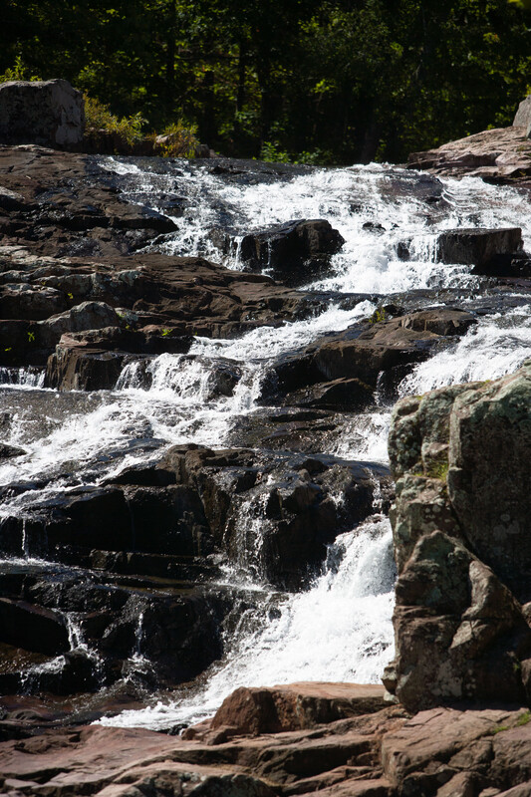
A nonliving thing cannot grow and reproduce but is an important part of a habitat by helping living things survive.
2C
Life and Land in Missouri – 2C Habitat is Where It’s At: Explore
5

Slide 6

Can you think of at least three examples of nonliving things and how they help a living thing to grow and survive?
2C
Life and Land in Missouri – 2C Habitat is Where It’s At: Explore
6
Notes:
(Examples would be air, water, rocks, sticks found on the ground, any human-made thing, etc. Sunlight should also be listed and emphasized since no living thing could survive without the sun. Soil can fall into both categories as the bacteria in soil is living and will break material down, but the minerals within soil are nonliving.)

Slide 7
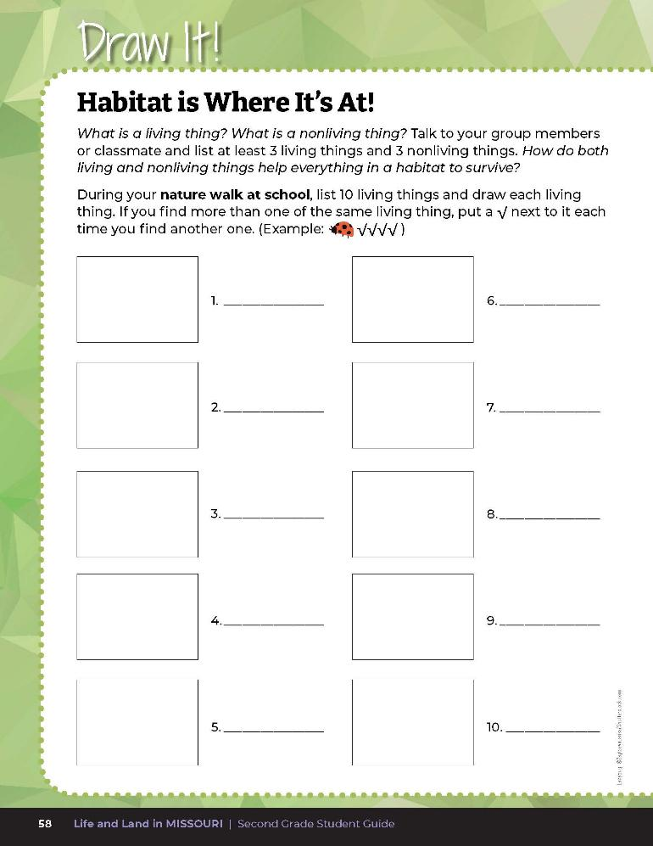
During your nature walk at school, list 10 living things and draw each living thing.
2C
Life and Land in Missouri – 2C Habitat is Where It’s At: Explore
7
Notes:
In their student guide Draw It! 2C Habitat is Where It’s At! section on Page 58, have students list and draw 10 living things they find outside. Have students place a checkmark if they find more than one of the same living thing.
Example: Ladybug XXXX
Once back in the classroom, ask students to share. Combine and record observations in a chart.

Slide 8
How should the class categorize the chart of living things?
By plants and animals? Another way?
2C
Life and Land in Missouri – 2C Habitat is Where It’s At: Explore
8

Slide 9
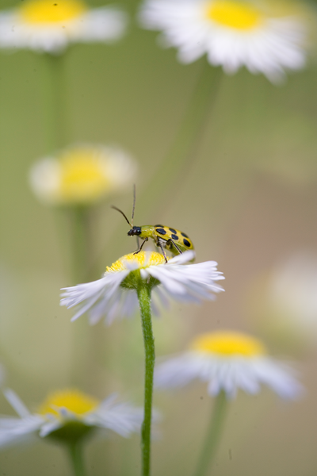
How many different plants and animals did you see?
2C
Life and Land in Missouri – 2C Habitat is Where It’s At: Explore
9
Notes:
Animal in Picture: Spotted Cucumber beetle on Daisy fleabane

Slide 10
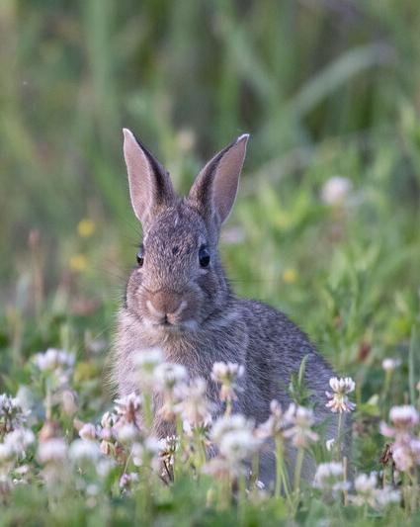
What kinds of living things did you find in your schoolyard?
2C
Life and Land in Missouri – 2C Habitat is Where It’s At: Explore
10
Notes:
Animal in Picture: Eastern cottontail rabbit

Slide 11
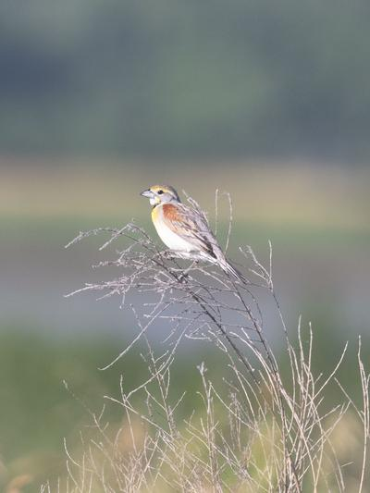
Where are living things found in your neighborhood?
2C
Life and Land in Missouri – 2C Habitat is Where It’s At: Explore
11
Notes:
Animal in Picture: Dickcissel

Slide 12
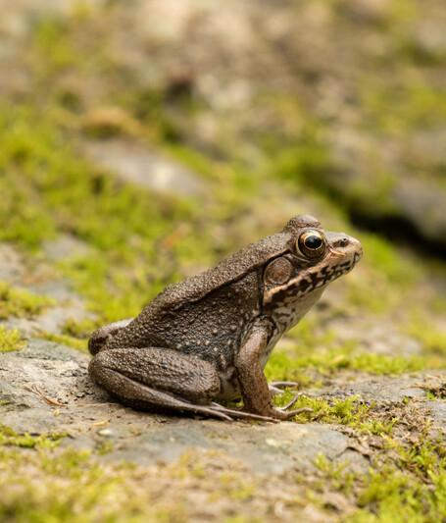
Where can you find plants and animals between your school and home?
2C
Life and Land in Missouri – 2C Habitat is Where It’s At: Explore
12
Notes:
Animal in Picture: Bull frog

Slide 13
Predict what you might find in your neighborhood or backyard.
List and draw 10 living things in your neighborhood or backyard tonight.
Bring your drawings to school tomorrow.
2C
Life and Land in Missouri – 2C Habitat is Where It’s At: Explore
13
Notes:
Take Home Activity:
Predict what you might find in your neighborhood or backyard and repeat this exercise in your neighborhood or backyard tonight and bring your drawings to school tomorrow.

Slide 14
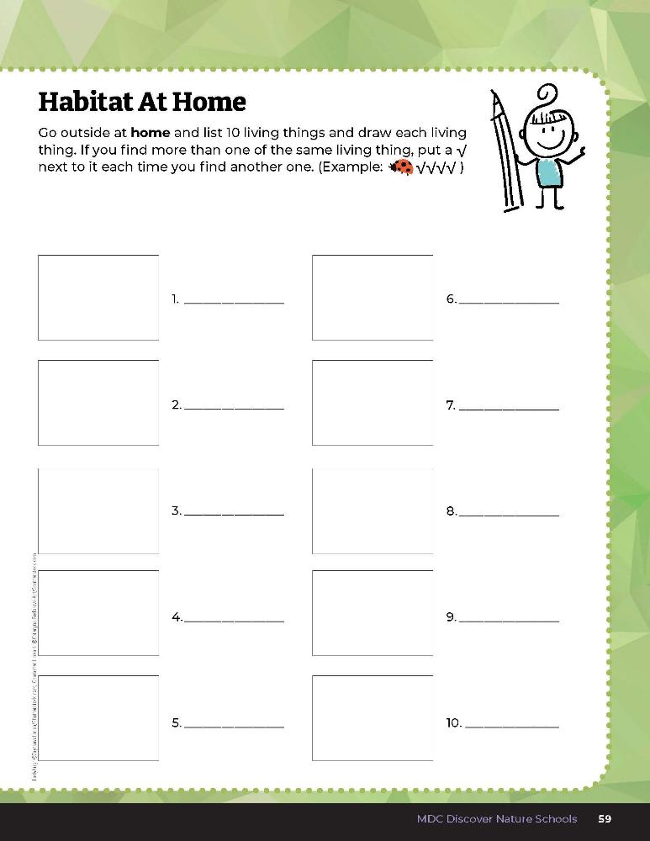

Add observations!
2C
Life and Land in Missouri – 2C Habitat is Where It’s At: Explore
14
Notes:
Add observations to the student guide Draw It! 2C Habitat At Home section on Page 59.

Slide 15
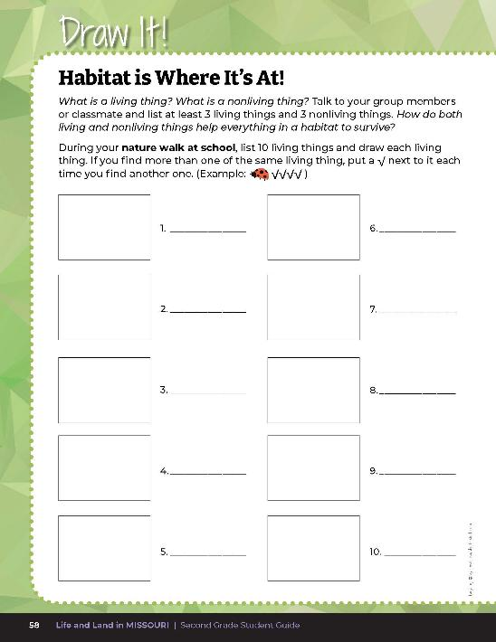

Label each drawing as a plant or animal by writing “A” for animal or “P” for plant next to your drawing.
2C
Life and Land in Missouri – 2C Habitat is Where It’s At: Explain
15
Notes:
The next day, ask the class to describe what they saw outside in the schoolyard and at home. Have them label each drawing as a plant or animals by writing “A” for animal or “P” for plant next to their drawing.

Slide 16
Which area had the higher number of plants and animals? Why?
2C
Life and Land in Missouri – 2C Habitat is Where It’s At: Explain
16

Slide 17
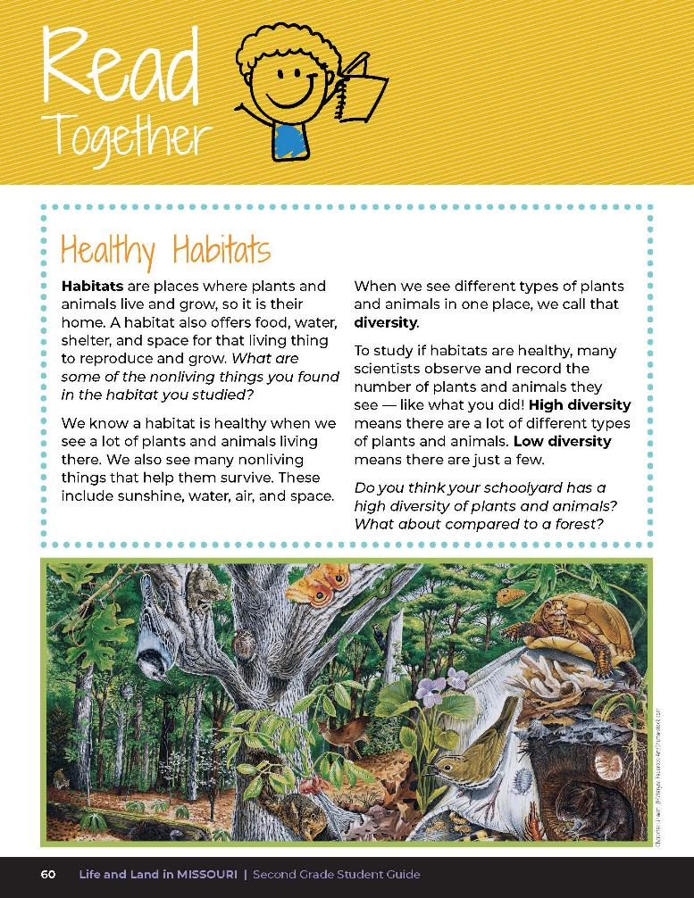

Healthy Habitats
Habitats are places where plants and animals live and grow, so it is their home. A habitat also offers food, water, shelter, and space for that living thing to reproduce and grow. What are some of the nonliving things you found in the habitat you studied?
2C
Life and Land in Missouri – 2C Habitat is Where It’s At: Explain
17
Notes:
Read the Read Together 2C Healthy Habitats section on Page 60.

Slide 18
Healthy Habitats
We know a habitat is healthy when we see a lot of plants and animals living there. We also see many nonliving things that help them survive. These include sunshine, water, air and space.
2C
Life and Land in Missouri – 2C Habitat is Where It’s At: Explain
18
Notes:
Read the Read Together 2C Healthy Habitats section on Page 60.

Slide 19
Healthy Habitats
When we see different types of plants and animals in one place, we call that diversity.
To study if habitats are healthy, many scientists observe and record the number of plants and animals they see – like what you did!
2C
Life and Land in Missouri – 2C Habitat is Where It’s At: Explain
19
Notes:
Read the Read Together 2C Healthy Habitats section on Page 60.

Slide 20
Healthy Habitats
High diversity means there are a lot of different types of plants and animals. Low diversity means there are just a few.
Do you think your schoolyard has a high diversity of plants and animals? What about compared to a forest?
2C
Life and Land in Missouri – 2C Habitat is Where It’s At: Explain
20
Notes:
Read the Read Together 2C Healthy Habitats section on Page 60.

Slide 21
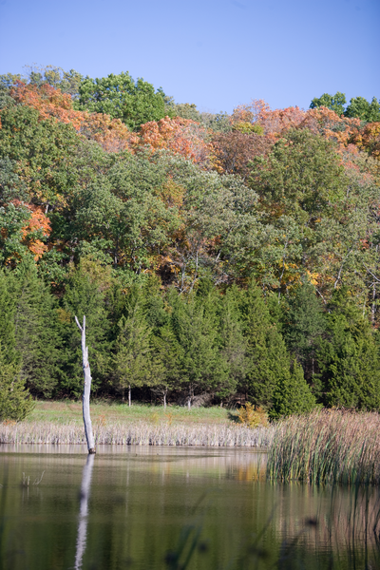
Which area was higher in diversity? Why?
2C
Life and Land in Missouri – 2C Habitat is Where It’s At: Explain
21
Notes:
(Because it offers food, water, shelter, and space for all those things to be able to survive. Describe the type of food, water, shelter, and space found in the habitat with higher diversity that can support the living things found.)

Slide 22
Why do you think it may have been lower in another area?
2C
Life and Land in Missouri – 2C Habitat is Where It’s At: Explain
22
Notes:
(Possible answer: there was not enough food, water, shelter, or space for those plants and animals. Describe the type of food, water, shelter, and space found in the habitat with lower diversity that may be lacking to support the living things found.)

Slide 23
We are going to look at three different habitats and the plants and animals that live there: a glade, a prairie, and a pond.
2C
Life and Land in Missouri – 2C Habitat is Where It’s At: Elaborate
23
Notes:
We are going to look at three different habitats and the plants and animals that live there: a glade, a prairie, and a pond. We are also going to make a chart on the board of each habitat and write the different plant and animals that we will see.

Slide 24
A glade is a habitat that is rocky and dry, gets a lot of sunlight, and may have small shrubby trees or no trees. It looks like a desert.
2C
Life and Land in Missouri – 2C Habitat is Where It’s At: Elaborate
24
Notes:
A glade is a habitat that is rocky and dry, gets a lot of sunlight, and may have small shrubby trees or no trees. It looks like a desert.

Slide 25
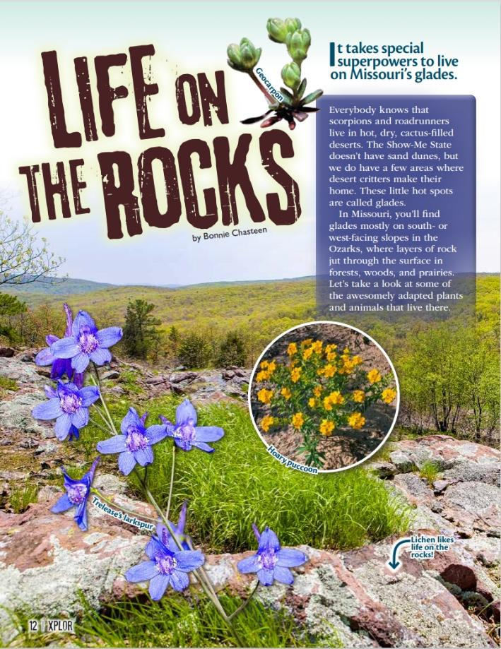
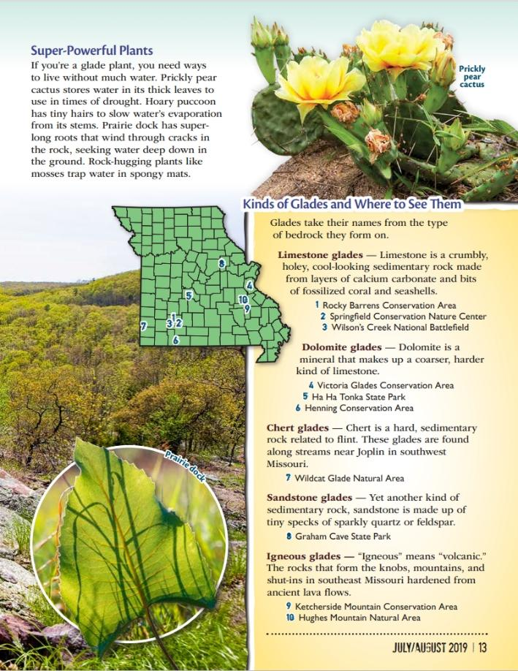
Link to Article: https://education.mdc.mo.gov/sites/default/files/2025-04/2C%20Life%20on%20the%20Rocks%20Xplor%20Article.pdf
2C
Life and Land in Missouri – 2C Habitat is Where It’s At: Elaborate
25
Notes:
From the MDC Teacher Portal, display Life on the Rocks by Bonnie Chasteen from the July/August 2019 issue of Xplor. Display and scroll through the entire article for the class.

Slide 26
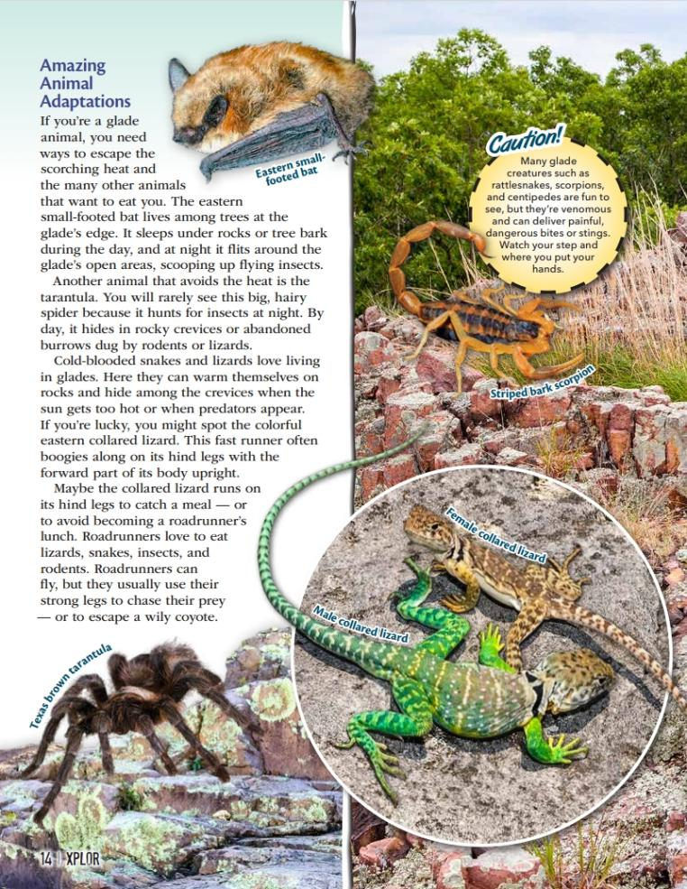
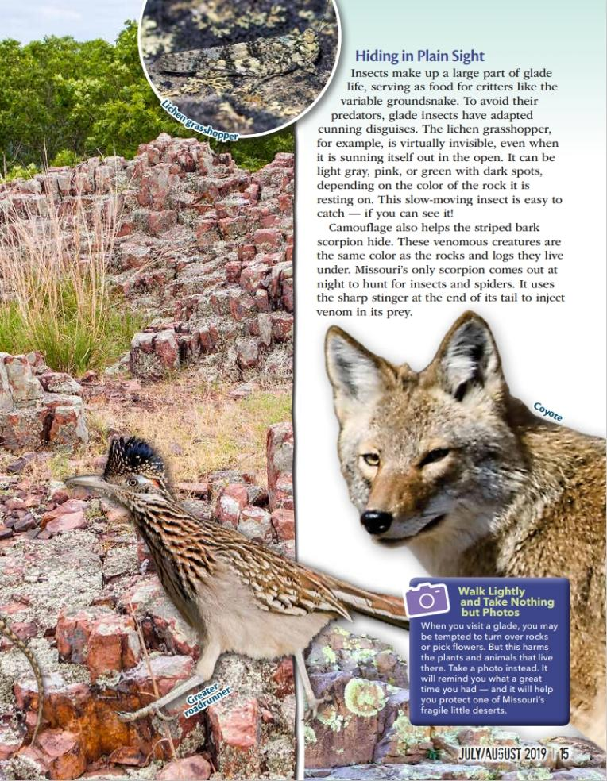
2C
Life and Land in Missouri – 2C Habitat is Where It’s At: Elaborate
26

Slide 27
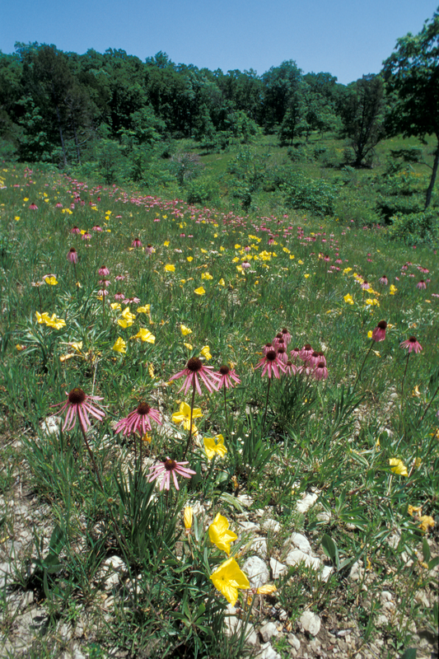
What plants and animals can we find in the glade?
2C
Life and Land in Missouri – 2C Habitat is Where It’s At: Elaborate
27
Notes:
Create a class list of the different kinds of plants and animals found in the glade. (Teacher Note: There are approximately 7 animals and 5 plants in the article.)

Slide 28
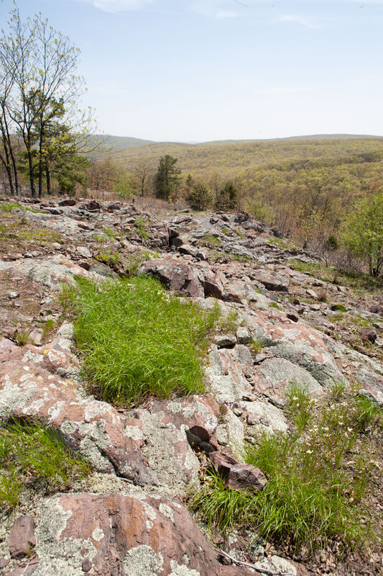
How would you describe this habitat to someone?
2C
Life and Land in Missouri – 2C Habitat is Where It’s At: Elaborate
28
Notes:
(Rocky, lots of sun, not a lot of soil, almost like a desert.)

Slide 29
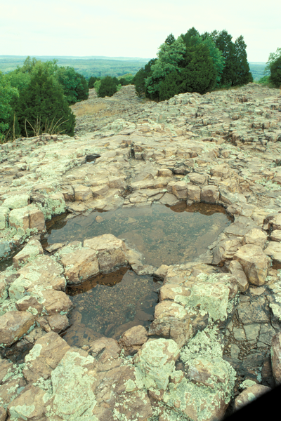
What are some nonliving things you see?
2C
Life and Land in Missouri – 2C Habitat is Where It’s At: Elaborate
29

Slide 30
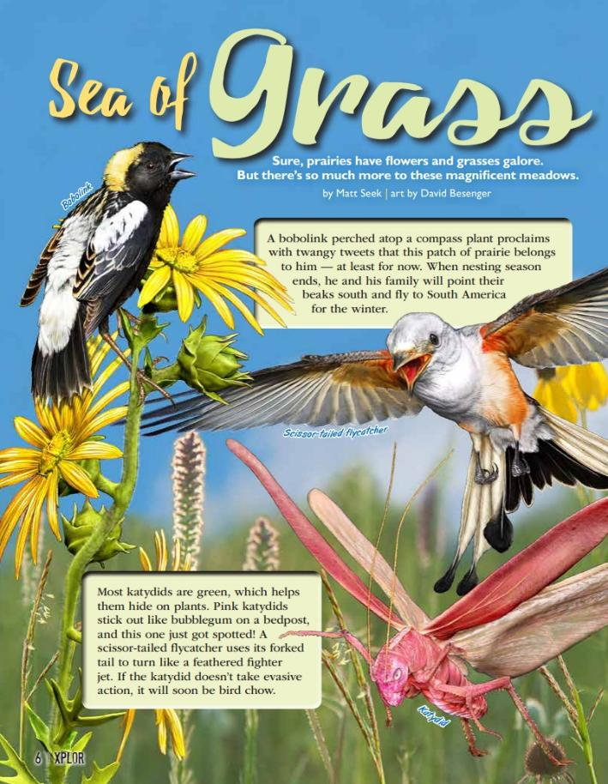
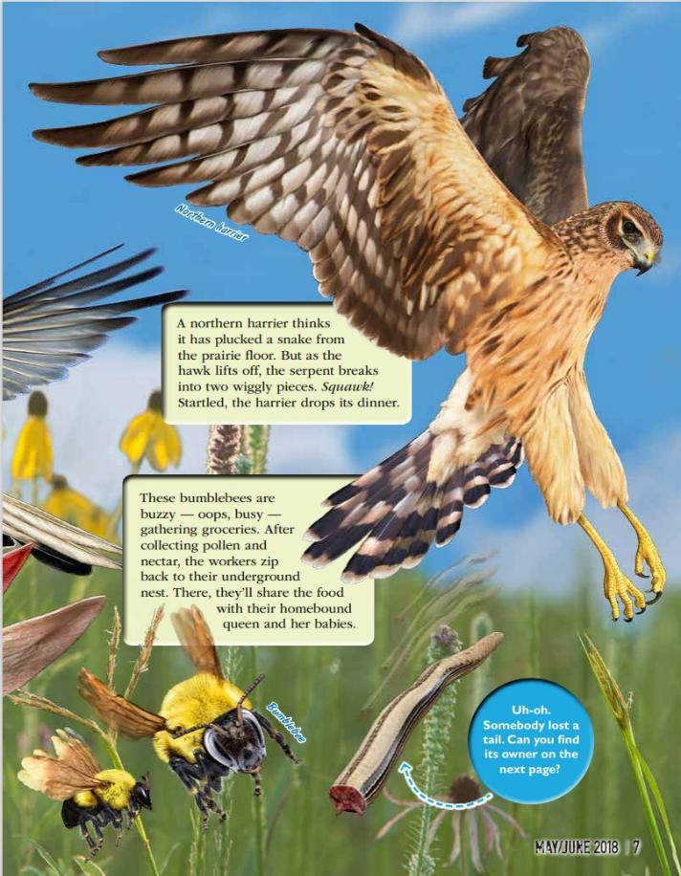
Link to Article: https://education.mdc.mo.gov/sites/default/files/2025-04/2C%20Sea%20of%20Grass%20Xplor%20Article%20%281%29.pdf
2C
Life and Land in Missouri – 2C Habitat is Where It’s At: Elaborate
30
Notes:
From the MDC Teacher Portal, display the Sea of Grass by Matt Seek from the May/June 2018 issue of Xplor. Display and scroll through the entire article for the class.

Slide 31
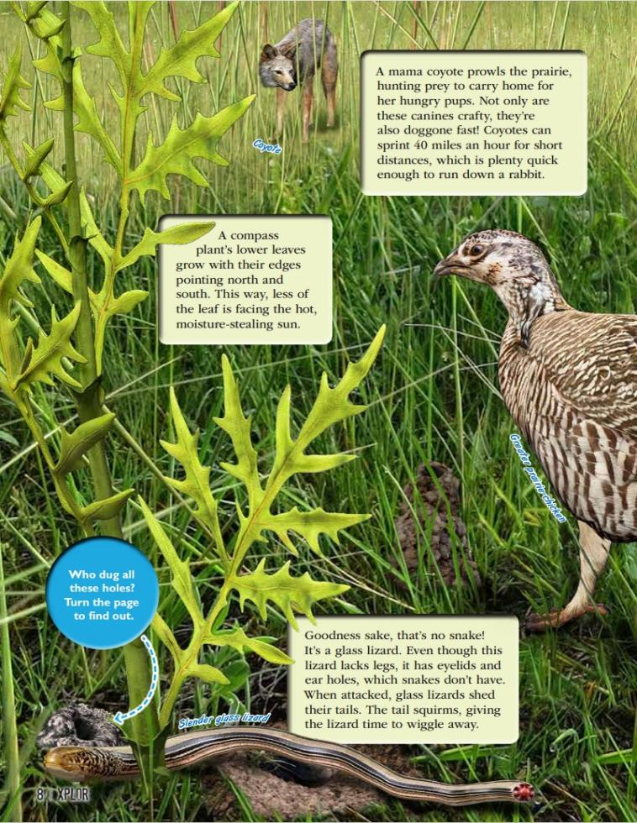
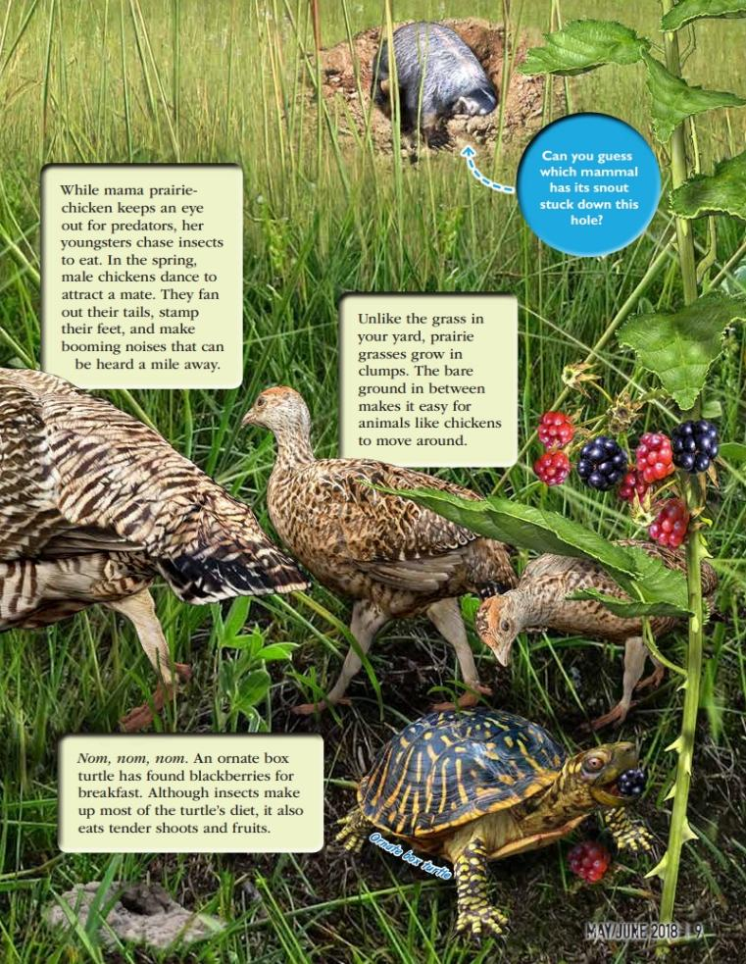
2C
Life and Land in Missouri – 2C Habitat is Where It’s At: Elaborate
31

Slide 32
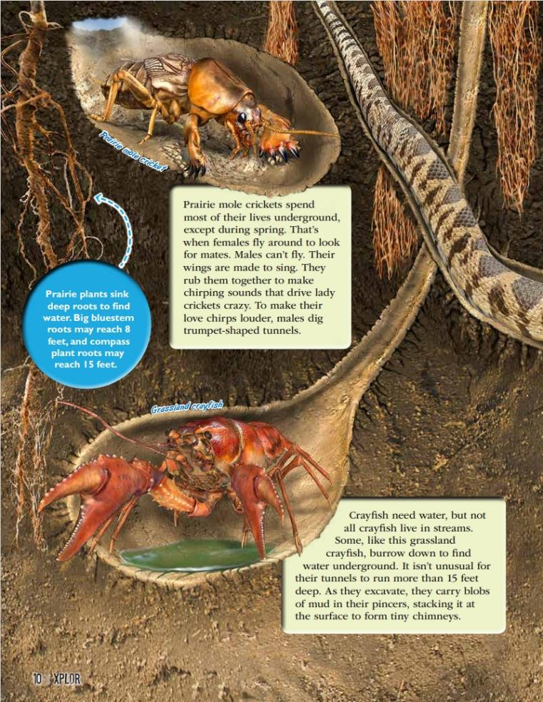
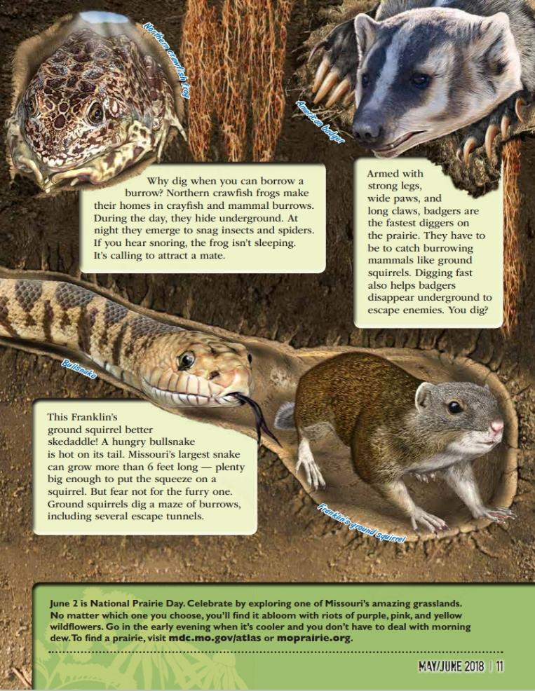
2C
Life and Land in Missouri – 2C Habitat is Where It’s At: Elaborate
32

Slide 33
The next habitat we are going to explore is called a prairie.
A prairie is a habitat with mostly grass and some flowering plants.
2C
Life and Land in Missouri – 2C Habitat is Where It’s At: Elaborate
33

Slide 34
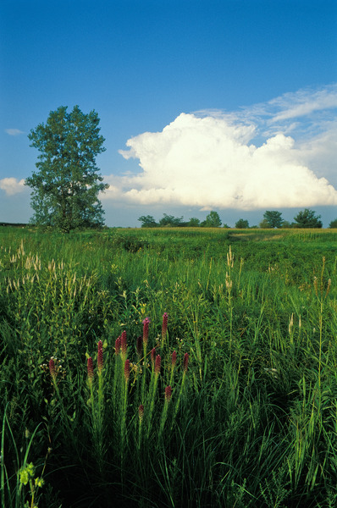
What plants and animals can we find in the prairie?
2C
Life and Land in Missouri – 2C Habitat is Where It’s At: Elaborate
34
Notes:
Create a class list of the different kinds of plants and animals found in the prairie. (Teacher Note: There are approximately 15 animals and 5 plants in the article.)

Slide 35
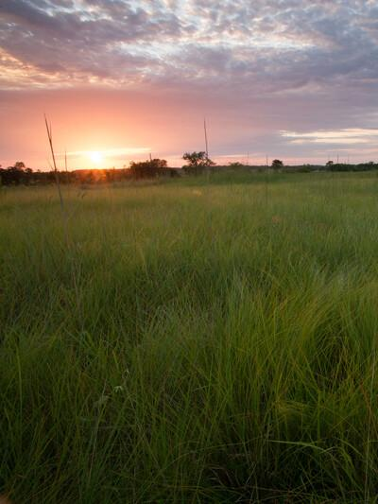
How would you describe the habitat to someone?
What are some of the nonliving things you see?
2C
Life and Land in Missouri – 2C Habitat is Where It’s At: Elaborate
35
Notes:
(Large open area of grassland, not very many trees)

Slide 36
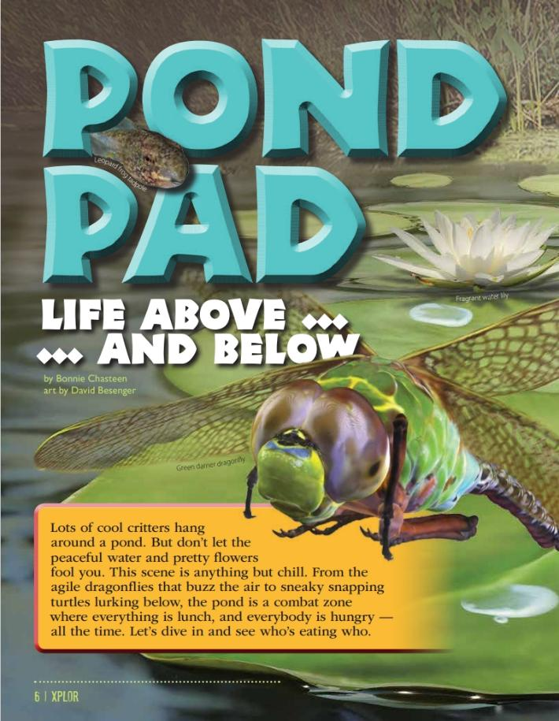
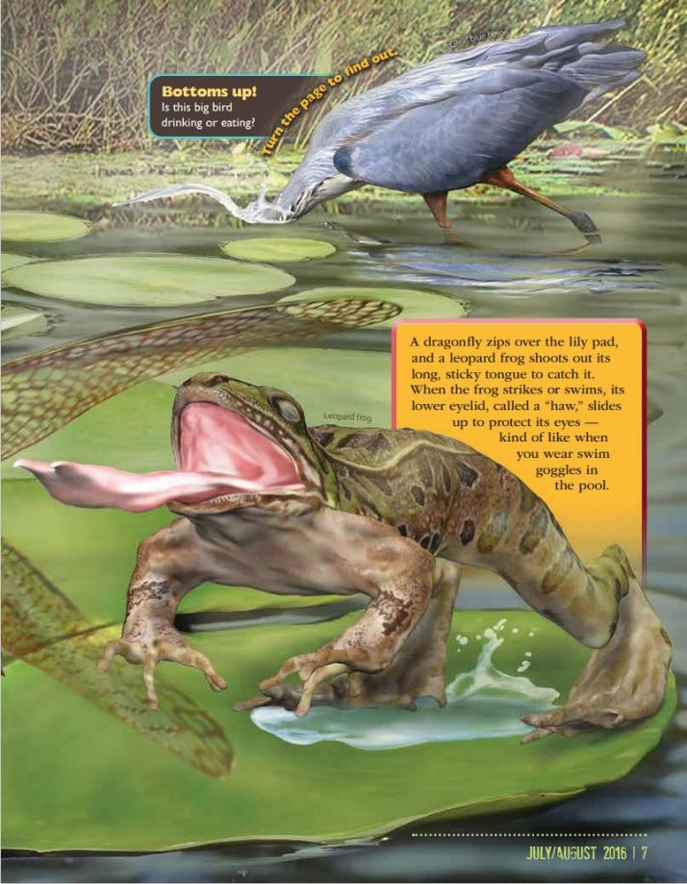
Link to Article: https://education.mdc.mo.gov/sites/default/files/2025-04/2C%20Pond%20Pad%20%20Xplor%20Article.pdf
2C
Life and Land in Missouri – 2C Habitat is Where It’s At: Elaborate
36
Notes:
From the MDC Teacher Portal, display the Pond Pad by Bonnie Chasteen from the July/August 2016 issue of Xplor. Display and scroll through the entire article for the class.

Slide 37
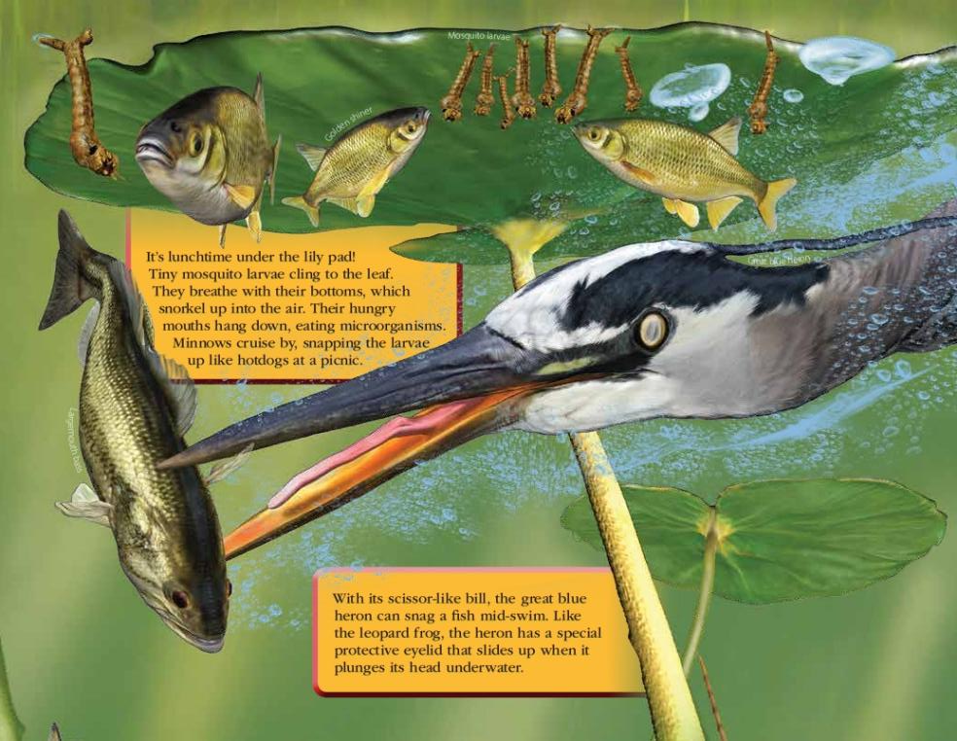
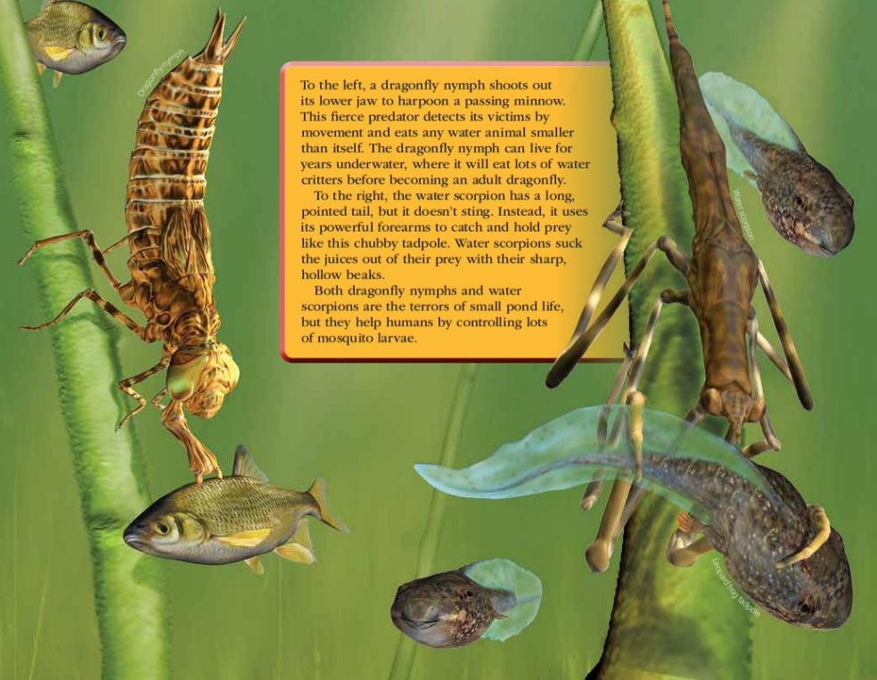
2C
Life and Land in Missouri – 2C Habitat is Where It’s At: Elaborate
37

Slide 38
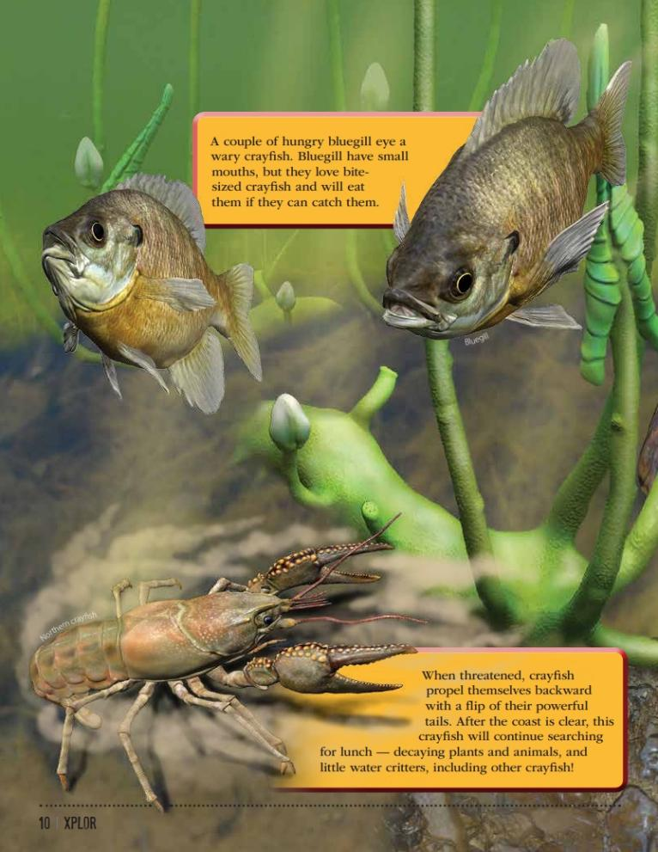
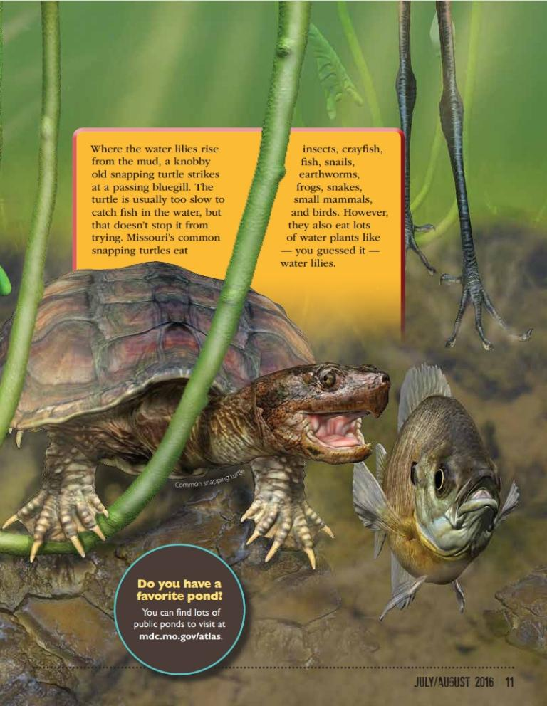
2C
Life and Land in Missouri – 2C Habitat is Where It’s At: Elaborate
38

Slide 39
The next habitat we are going to explore is called a pond.
A pond is a small body of water surrounded by land.
2C
Life and Land in Missouri – 2C Habitat is Where It’s At: Elaborate
39

Slide 40
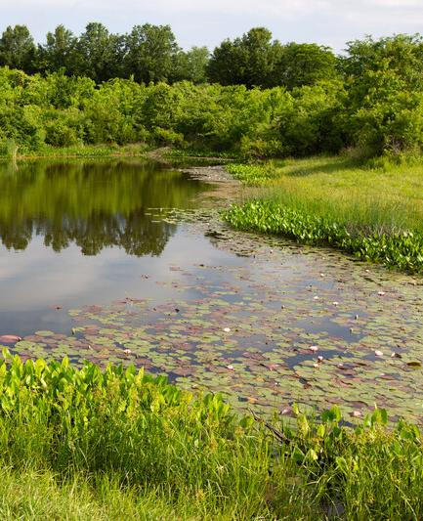
What plants and animals can we find in the pond?
2C
Life and Land in Missouri – 2C Habitat is Where It’s At: Elaborate
40
Notes:
Create a class list of the different kinds of plants and animals found in the pond. (Teacher Note: There are approximately 12 animals and 1 plant in the article.)

Slide 41
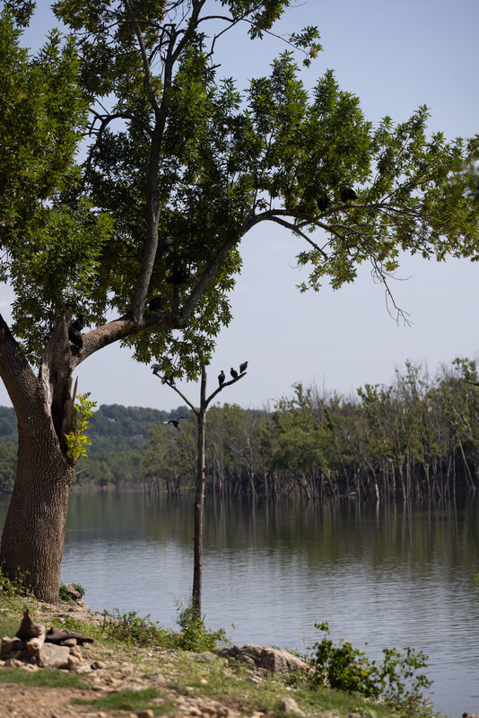
How would you describe this habitat to someone?
What are some of the nonliving things you see?
2C
Life and Land in Missouri – 2C Habitat is Where It’s At: Elaborate
41
Notes:
(Small body of water.)

Slide 42
How many plants do you see in each habitat?
2C
Life and Land in Missouri – 2C Habitat is Where It’s At: Elaborate
42
Notes:
Look at your class list again.

Slide 43
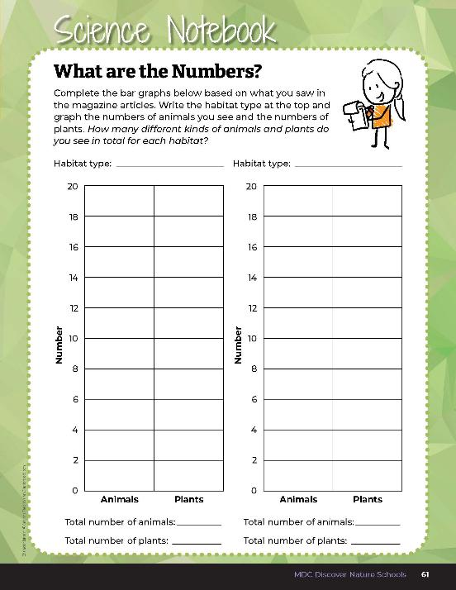
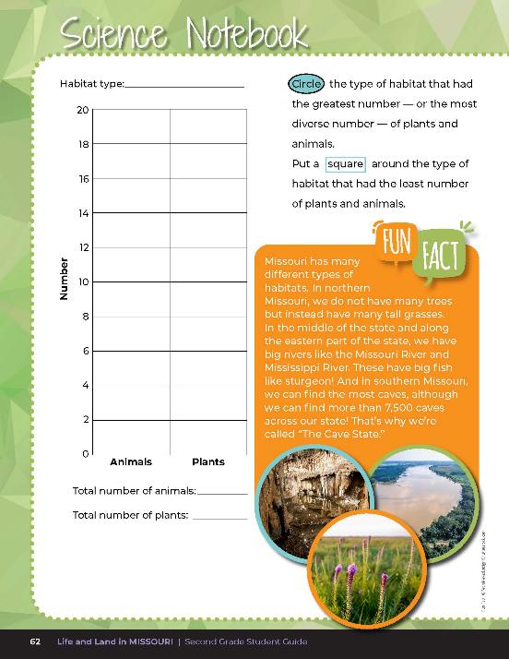
Complete the bar graphs for each habitat by recording the numbers of plants and animals.
2C
Life and Land in Missouri – 2C Habitat is Where It’s At: Elaborate
43
Notes:
Have students complete the bar graphs for each habitat and the numbers of plants and animals using Science Notebook 2C What are the Numbers? on student guide pages 61-62.

Slide 44
How many animals do you see? How many plants?
Which habitat had the greatest number – or the most diversity? And which had the least?
2C
Life and Land in Missouri – 2C Habitat is Where It’s At: Elaborate
44

Slide 45
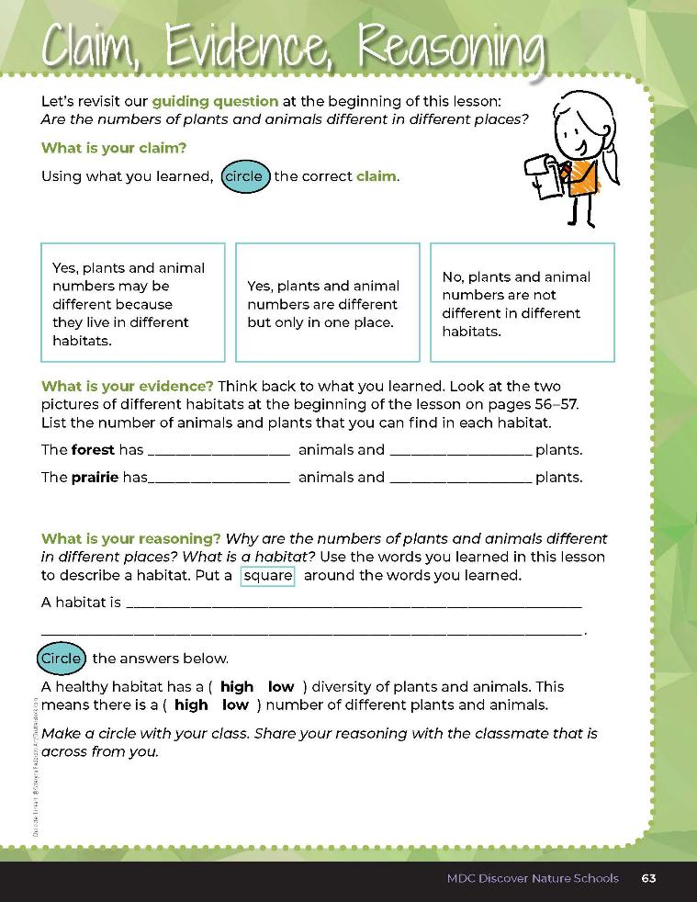

2C
Life and Land in Missouri – 2C Habitat is Where It’s At: Evaluate
45
Notes:
Guiding Question: Are the numbers of plants and animals different in different places?
After exploring the concept of habitats and diversity, have students open their student guides to the 2C Claim, Evidence, Reasoning section on Page 63. Guide students through the page by reviewing each section as a class and revisiting the scientific concepts learned to help answer each section.

Slide 46
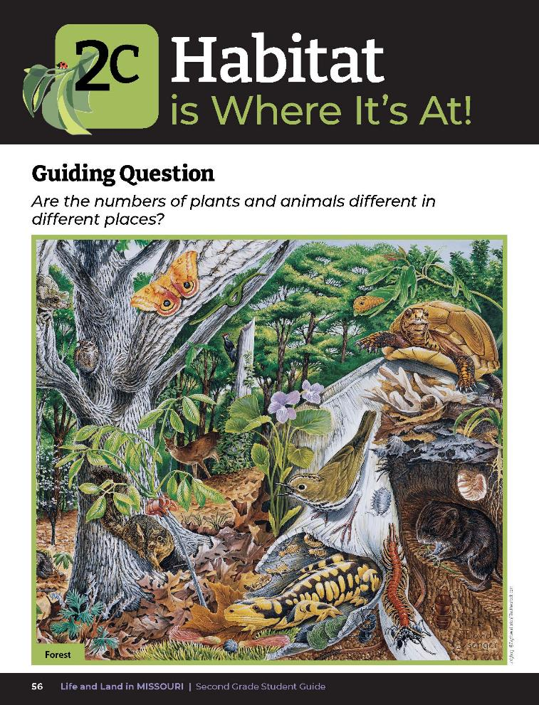
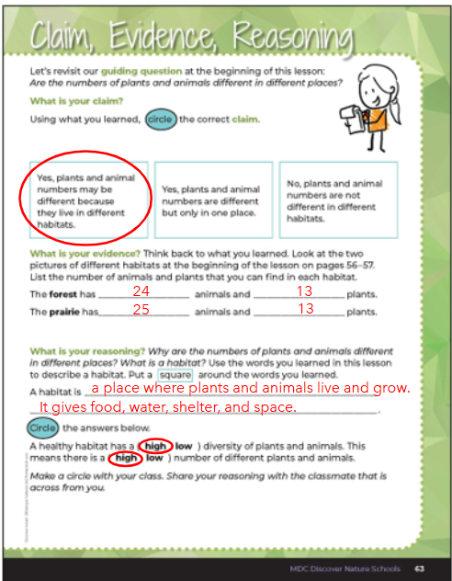

2C
Life and Land in Missouri – 2C Habitat is Where It’s At: Evaluate
46
Notes:
Rubric:
4 (Exceeds) – Student circles the correct claim, writes the number of plants and animals for each habitat into the blanks within 3 or less of the correct number, defines habitat correctly and lists the essential components of a habitat, and circles the correct diversity answers.
3 (Meets) – Student circles the correct claim and writes the number of plants and animals for each habitat somewhat correctly and may or may not list the correct habitat components. They circle the correct diversity answers.
2 (Partially Meets) – Student may or may not circle the correct claim. Student writes the number of plants and animals for each habitat within 10 of the correct number. Student defines habitat somewhat correctly and may or may not list the correct habitat components. Student may or may not circle the correct diversity answers.
1 (Doesn’t Meet) – Student does not circle the correct claim, does not write any evidence into the blanks, and does not define habitat correctly or circle the correct diversity answers.

