Slide 1
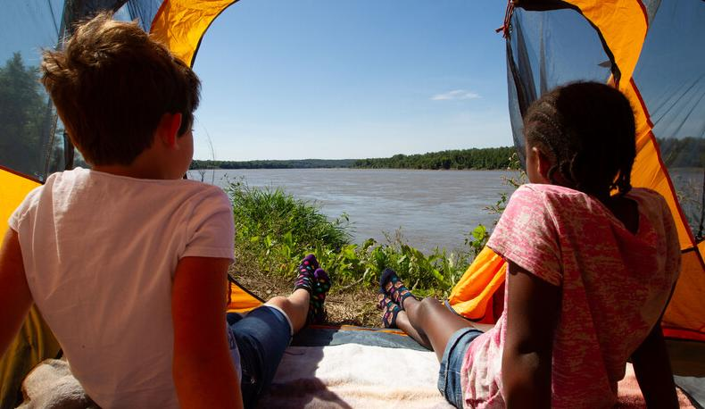

Life and Land in
MISSOURI
2B: Sprouts and Water

Slide 2

Think back to your last experiment and your results.
What were you trying to find out?
2B
Life and Land in Missouri – 2B Sprouts and Water: Engage
2
Notes:
Have students think back to their last experiment and their results. What were you trying to find out? (Do plants need sunlight to grow?)

Slide 3
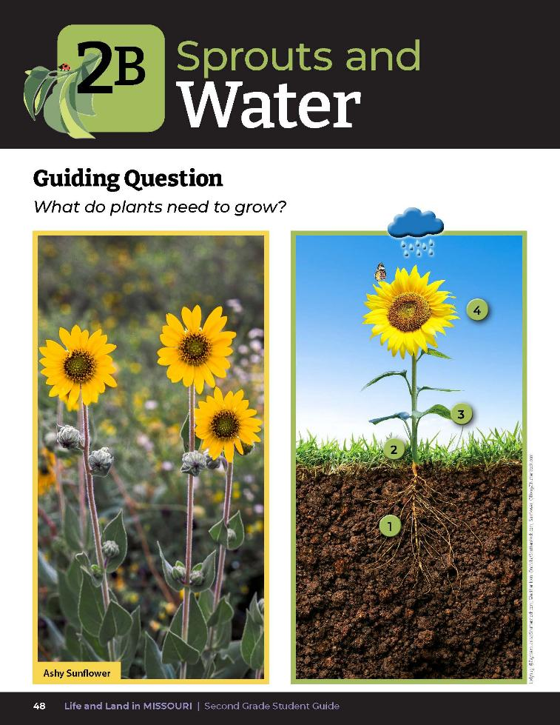
Guiding Question:
What do plants need to grow?
2B
Life and Land in Missouri – 2B Sprouts and Water: Engage
3
Notes:
Have students open their student guides to the Lesson 2B Sprouts and Water introduction on Page 48. Read the guiding question together. What do plants need to grow? Look at the photos together.

Slide 4


What is helping the plants in these photos to grow?
2B
Life and Land in Missouri – 2B Sprouts and Water: Engage
4
Notes:
Discuss the Talk About It on the next page. What is helping the plants in these photos to grow?

Slide 5
What if we wanted to test if plants need water?
What materials will you need?
How many plants do you need?
How will you measure the amount of water you put onto your plant?
2B
Life and Land in Missouri – 2B Sprouts and Water: Engage
5
Notes:
What if we wanted to test if plants need water? (Have students help plan the investigation by asking the following questions:
What materials will you need?
How many plants do you need? (The student guide has space for an investigation with 2 plants)
How will you measure the amount of water you put onto your plant?

Slide 6
Let’s set up your investigation!
Each group needs 2 cups with seeds or
2 cups with sprouts.
You have already determined plants need sunlight, so cups should be placed in a sunny spot indoors.
2B
Life and Land in Missouri – 2B Sprouts and Water: Explore
6
Notes:
Set up your investigation.
This activity can be done with seeds or with sprouts. If planting sunflower seeds, plant seeds 1.5 inches into the soil. If planting plains coreopsis seeds, plant seeds just below the surface of the soil. Or students can use sprouts that were planted 10-12 days earlier. Each group will need 2 cups with seeds or 2 cups with sprouts of the same species used for Lesson 2A.
Students have already determined that plants need sunlight, so cups with seeds or sprouts should be placed in a sunny spot indoors in the same location with the same amount of light.

Slide 7
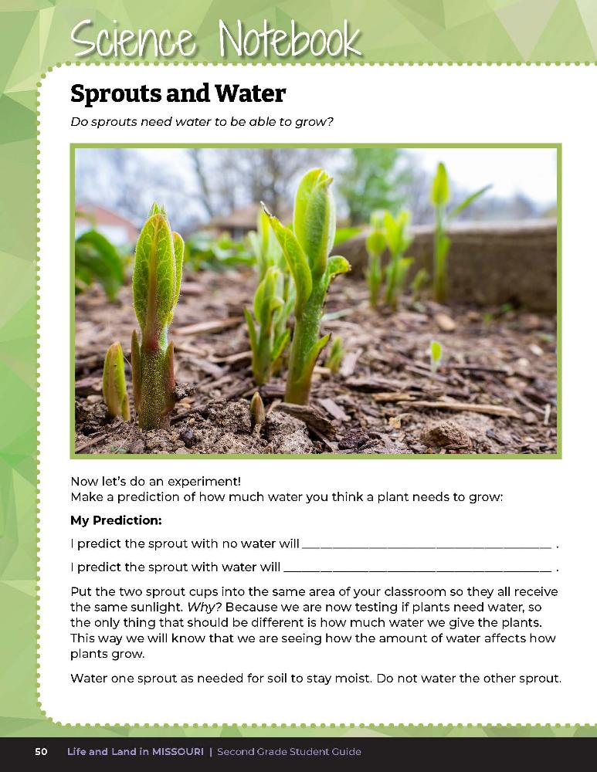
Make predictions about what will happen to each seed or sprout.
2B
Life and Land in Missouri – 2B Sprouts and Water: Explore
7
Notes:
One cup should be watered with the same amount each time, such as -2 teaspoons per observation period, and the other cup should receive no water. Have students make predictions about what will happen to each seed or sprout. Predictions can be made on Science Notebook 2B Sprouts and Water on Page 50.

Slide 8

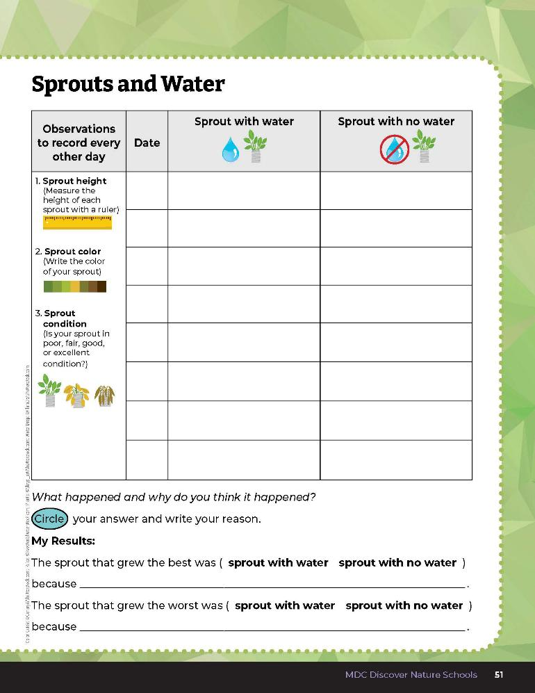
10
6
X
MINUTES
DAYS
Observe the plants for 2 weeks and record observations every other day.
2B
Life and Land in Missouri – 2B Sprouts and Water: Explore
8
Notes:
Collect data every other day for 2 weeks. Encourage students to make drawings each time they observe their plants. Have them measure the height and describe the color and condition of the plant. Observations can be recorded in the student guide Science Notebook 2B Sprouts and Water section on Page 51. Students can use magnifying glasses to enhance their observations. If you choose to collect data for longer than 2 weeks, you can add more data pages to the students’ guides using the Sprouts and Water Data Sheet from the MDC Teacher Portal.

Slide 9
Complete the My Results section.
2B
Life and Land in Missouri – 2B Sprouts and Water: Explain
9
Notes:
When the 2 weeks are over, have students compare their predictions to the results and complete the My Results section of the Science Notebook 2B Sprouts and Water page.

Slide 10
Did your plants grow how you expected them to grow?
2B
Life and Land in Missouri – 2B Sprouts and Water: Explain
10

Slide 11
What do you think would happen if none of the plants were watered?
2B
Life and Land in Missouri – 2B Sprouts and Water: Explain
11

Slide 12
What do you think would happen if all the plants were watered?
2B
Life and Land in Missouri – 2B Sprouts and Water: Explain
12

Slide 13
What would have happened if you watered all the plants but gave them different amounts of water?
2B
Life and Land in Missouri – 2B Sprouts and Water: Explain
13

Slide 14
Based on your observations of both plant experiments, what can you say that plants need?
2B
Life and Land in Missouri – 2B Sprouts and Water: Explain
14
Notes:
Make a list on the classroom board.

Slide 15

Read the book Cooking with Sunshine: How Plants Make Food by Ellen Lawrence.
Read Aloud:
https://www.youtube.com/watch?v=nprRfJIe8fs
2B
Life and Land in Missouri – 2B Sprouts and Water: Explain
15

Slide 16
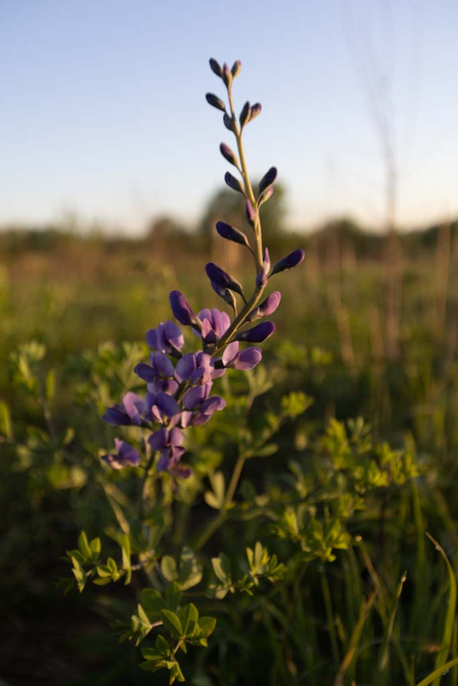
What else do plants need to survive?
2B
Life and Land in Missouri – 2B Sprouts and Water: Explain
16
Notes:
Revisit the list on the board. What else do plants need to survive? Add student observations to the classroom list.
Optional: Bring in a few plants from the outside that have all the parts that class has discussed. Divide the plants among different groups of students. Allow students time to take magnifiers and look closely at each plant part, including the leaves. Teacher Note: With permission, plants can be picked on private property. Only conduct this optional activity in the schoolyard or with a plant from your own home. If exploring plants and their different parts while on a field experience on public lands, it is important that students observe and record through drawings or taking pictures rather than picking the plant itself so others can also enjoy the plants and to follow regulations set by the public area.
Plant in Picture: Blue false indigo

Slide 17
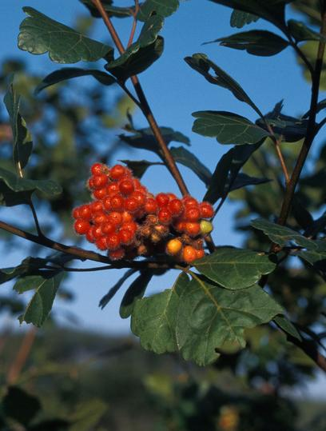
What are the basic needs of plants?
2B
Life and Land in Missouri – 2B Sprouts and Water: Explain
17
Notes:
Plant in Picture: Fragrant sumac

Slide 18
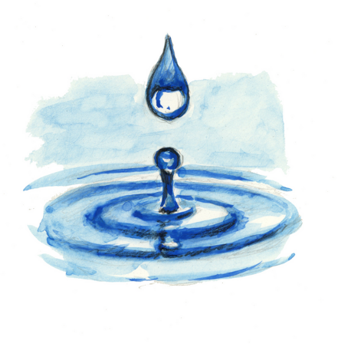
What are the basic needs of plants?
Water and Sunlight!
2B
Life and Land in Missouri – 2B Sprouts and Water: Explain
18

Slide 19
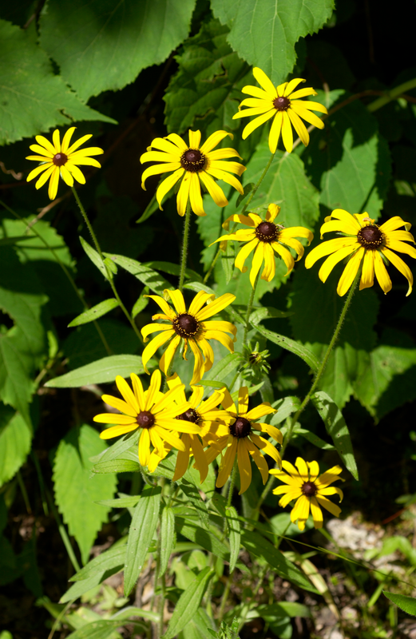
How do the parts of the plant help it to meet its needs?
2B
Life and Land in Missouri – 2B Sprouts and Water: Explain
19
Notes:
Plant in Picture: Black-eyed Susan

Slide 20
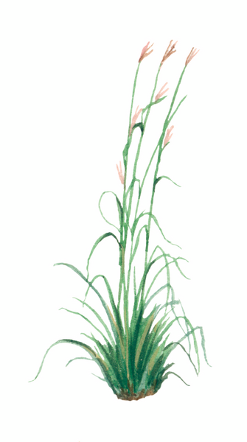
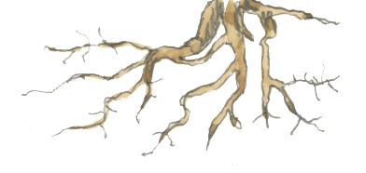
How do the parts of the plant help it to meet its needs?
Roots take in water and nutrients from the soil and help hold the plant in place. The water travels up the roots to the stem and into the leaves.
2B
Life and Land in Missouri – 2B Sprouts and Water: Explain
20
Notes:
Draw arrows of water moving up the roots to the stem to the leaves.

Slide 21
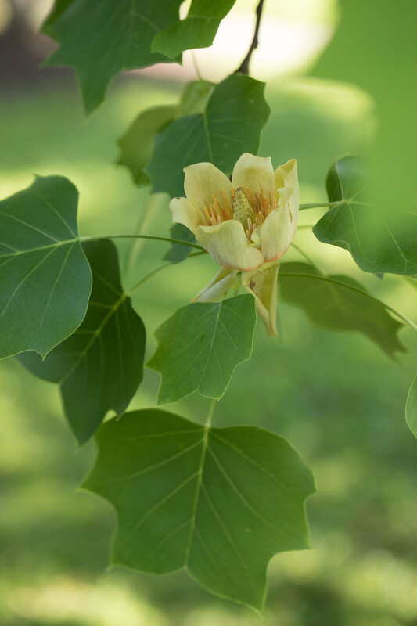
What do the leaves do?
They collect sunlight to make food, which gives energy to the plant.
2B
Life and Land in Missouri – 2B Sprouts and Water: Explain
21
Notes:
Teacher Note: You can refer to pages 20 and 21 of Cooking with Sunshine.
Plant in Picture: Tulip tree (Yellow Poplar) flower

Slide 22
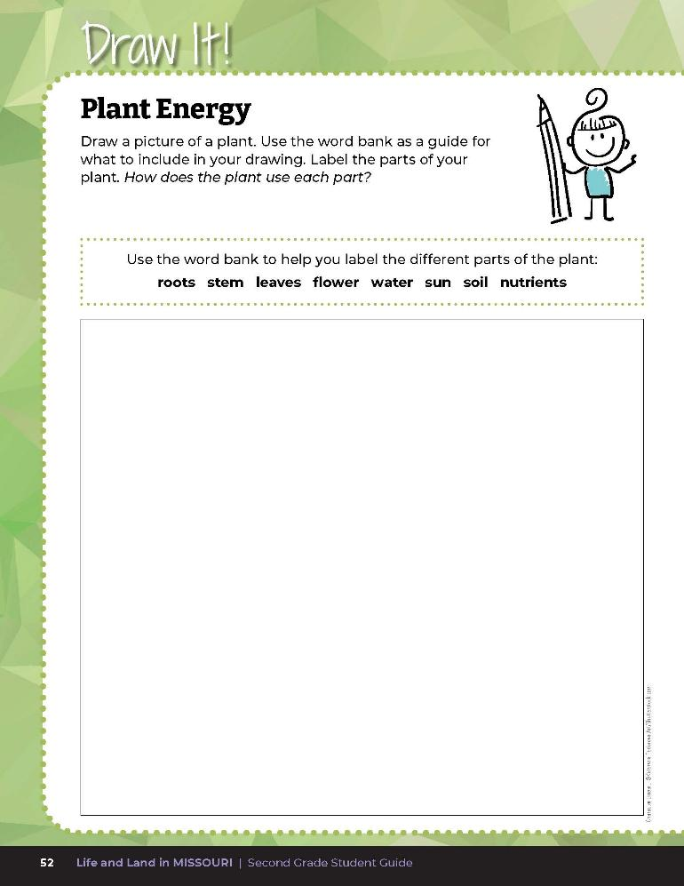

Draw a picture of a plant.
Label the parts of your plant.
2B
Life and Land in Missouri – 2B Sprouts and Water: Explain
22
Notes:
Have students label their own plants in their student guide on the Draw It! 2B Plant Energy section on Page 52. Allow students time to complete their own drawings.

Slide 23
What could you change about the experiment to test something different about plant growth?
2B
Life and Land in Missouri – 2B Sprouts and Water: Elaborate
23

Slide 24
Do all plants require the same amount of sun and water?
2B
Life and Land in Missouri – 2B Sprouts and Water: Elaborate
24

Slide 25
As a class, let’s pick two plants from the Field Guide | Missouri Department of Conservation to research and compare.
2B
Life and Land in Missouri – 2B Sprouts and Water: Elaborate
25
Notes:
In small groups, research the needs of a plant that lives in Missouri. On the board, display MDC Field Guide Field Guide | Missouri Department of Conservation from the MDC Teacher Portal. As a class, pick two plants from the MDC Field Guide to research and compare, such as the ashy sunflower and columbine.

Slide 26
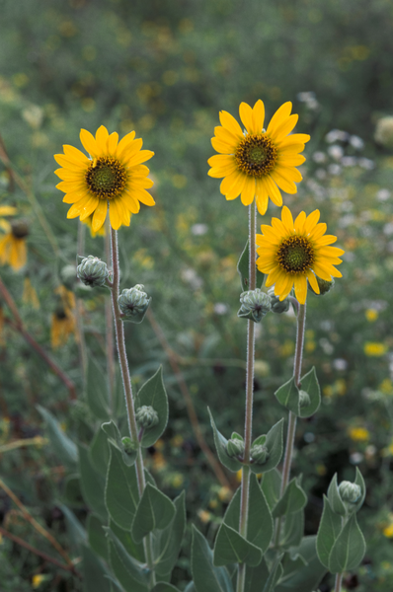
What does the ashy sunflower need to be able to grow?
2B
Life and Land in Missouri – 2B Sprouts and Water: Elaborate
26
Notes:
(Sunlight, water, and nutrients from the soil.)
Plant in Picture: Ashy sunflower

Slide 27
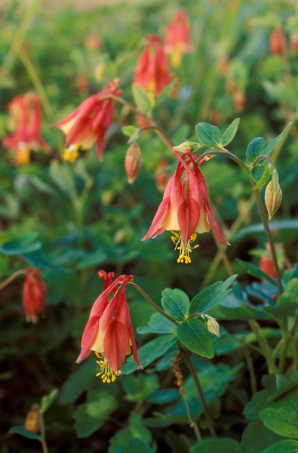
What about the columbine?
2B
Life and Land in Missouri – 2B Sprouts and Water: Elaborate
27
Notes:
Plant in Picture: Columbine

Slide 28
Do both plants need these things in the same amount?
Why or why not?
2B
Life and Land in Missouri – 2B Sprouts and Water: Elaborate
28

Slide 29
Let’s go outside and look at two different plants that are growing outside!
2B
Life and Land in Missouri – 2B Sprouts and Water: Elaborate
29
Notes:
Take students outside and have them look at two different plants of their choosing that are growing outside. Use the free Seek app (https://www.inaturalist.org/pages/seek_app) to help identify the different plants.

Slide 30
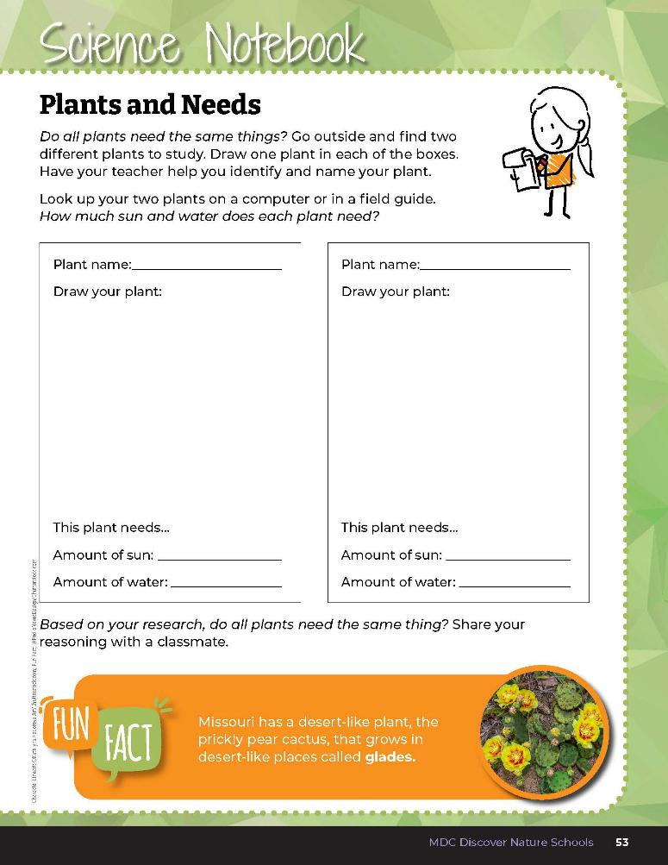

Draw one plant in each of the boxes.
How much sun and water does each plant need?
2B
Life and Land in Missouri – 2B Sprouts and Water: Elaborate
30
Notes:
Once back inside, allow students time to research and compare the needs of the plants they found outside, using the MDC Field Guide. Have students fill in their data sheet on the Science Notebook 2B Plants and Needs section on Page 53.
Have students share with the class what they found out about their plant.

Slide 31
Do all your plants have the same needs?
What was different?
What was the same?
2B
Life and Land in Missouri – 2B Sprouts and Water: Elaborate
31

Slide 32


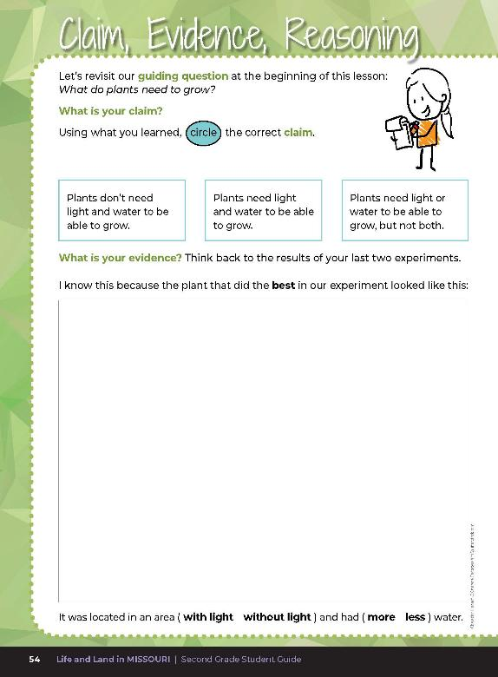
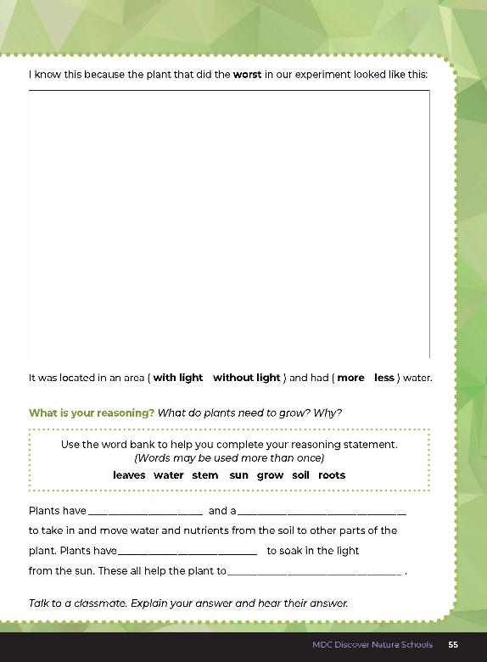
2B
Life and Land in Missouri – 2B Sprouts and Water: Evaluate
32
Notes:
Guiding Question: What do plants need to grow?
After exploring all plant needs, including light and water, have students open their student guides to the 2B Claim, Evidence, Reasoning section on pages 54-55. Guide students through the pages by reviewing each section as a class and revisiting the scientific concepts learned to help answer each section.
Rubric:
4 (Exceeds) – Student circles the correct claim and circles and draws the correct evidence into both spaces and provides the correct reasoning by filling in all the blanks correctly.
3 (Meets) – Student either circles the correct claim or circles and draws the correct evidence into one of the spaces and/or provides most of the correct reasoning by filling in 3 of the blanks correctly.
2 (Partially meets) – Student either circles the correct claim or circles and draws the correct evidence into one of the spaces and/or provides half of the correct reasoning by filling in 2 of the blanks correctly.
1 (Doesn’t meet) – Student does not provide the correct claim or provides any evidence and does not fill in the blanks with the correct reasoning.

Slide 33

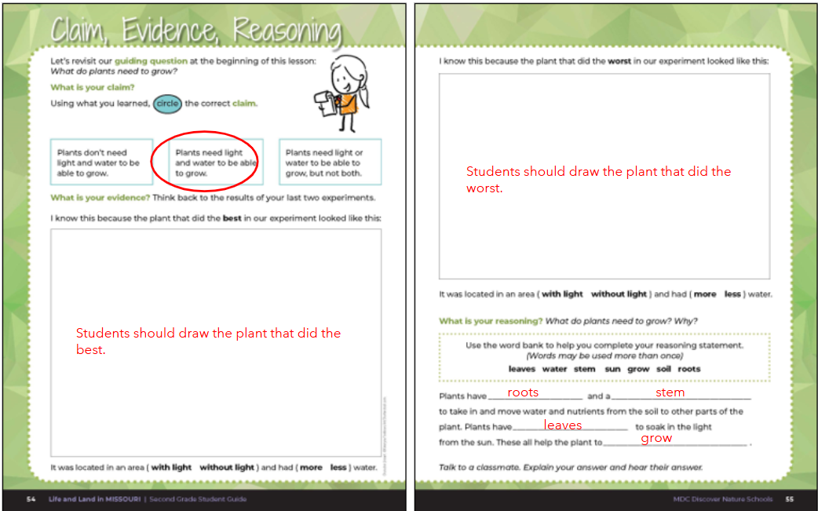
2B
Life and Land in Missouri – 2B Sprouts and Water: Evaluate
33
Notes:
Rubric:
4 (Exceeds) – Student circles the correct claim and circles and draws the correct evidence into both spaces and provides the correct reasoning by filling in all the blanks correctly.
3 (Meets) – Student either circles the correct claim or circles and draws the correct evidence into one of the spaces and/or provides most of the correct reasoning by filling in 3 of the blanks correctly.
2 (Partially meets) – Student either circles the correct claim or circles and draws the correct evidence into one of the spaces and/or provides half of the correct reasoning by filling in 2 of the blanks correctly.
1 (Doesn’t meet) – Student does not provide the correct claim or provides any evidence and does not fill in the blanks with the correct reasoning.

