Slide 1
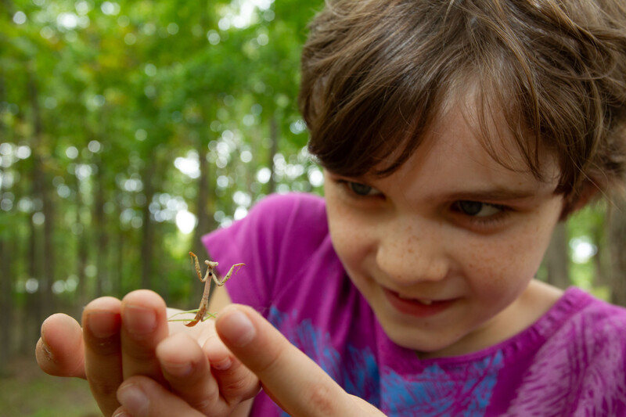

Exploring
MISSOURI
2B: Mapping Crickets

Slide 2
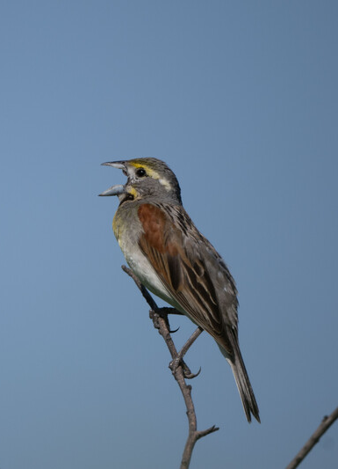
Guiding Question:
How does sound travel?
2B
Exploring Missouri – 2B Mapping Crickets: Engage
2
Notes:
Animal in Picture: Dickcessel

Slide 3

If vibrations make sound, how does sounds travel to our ears?
2B
Exploring Missouri – 2B Mapping Crickets: Engage
3
Notes:
In the last lesson we learned that vibrations make sound.

Slide 4
I wonder….?
2B
Exploring Missouri – 2B Mapping Crickets: Engage
4
Notes:
Create an “I Wonder” chart on the board. Allow students time to brainstorm I wonder questions such as, “I wonder how sound travels to our ears?” Have students share their questions and write student ideas on the board to reference later.

Slide 5
Everyone stand in a circle with your eyes closed.
One student stand in the center of the circle and make “cricket noises.”
Give a thumbs up if you can hear the cricket noise.
2B
Exploring Missouri – 2B Mapping Crickets: Explore
5
Notes:
Have students stand in a circle with their eyes closed. Have a student stand in the center of the circle and make “cricket noises” with a dog clicker or canning jar lid to make a clicking sound. Ask students for thumbs up if they can hear the cricket noise.

Slide 6
Where is the sound coming from?
2B
Exploring Missouri – 2B Mapping Crickets: Explore
6
Notes:
Point to the sound.

Slide 7
Where did the sound travel from to get to your ears?
2B
Exploring Missouri – 2B Mapping Crickets: Explore
7
Notes:
Students should point to the center of the circle.

Slide 8
What is between the cricket and your ears?
2B
Exploring Missouri – 2B Mapping Crickets: Explore
8
Notes:
Answers will vary but may include air, space, nothing.

Slide 9
Is something vibrating between the cricket sound and your ears?
How many directions does the sound travel?
2B
Exploring Missouri – 2B Mapping Crickets: Explore
9
Notes:
Answers will vary.

Slide 10
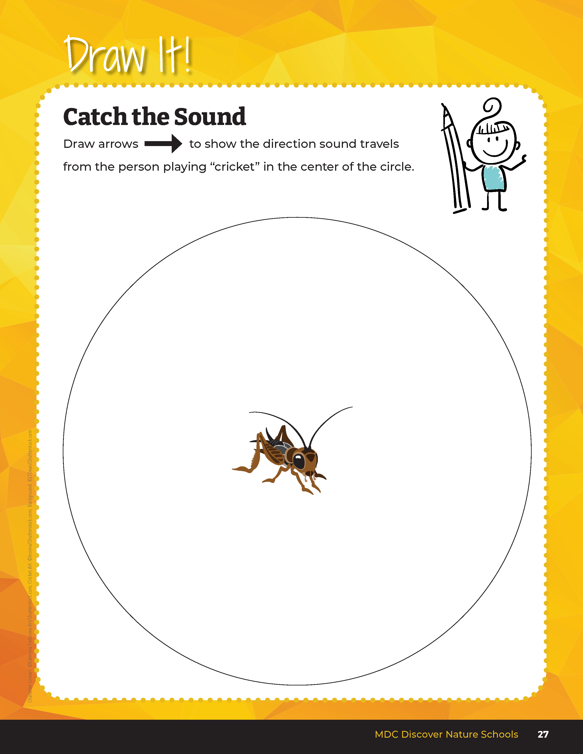

Draw arrows to show the direction sound travels from the person playing “cricket” in the center of the circle.
2B
Exploring Missouri – 2B Mapping Crickets: Explore
10
Notes:
In their student guide, Draw It! 2B Catch the Sound section on Page 27, have students draw a picture of the student “playing” cricket in the center of their student book page. Instruct students to add arrows in all the directions the cricket’s sound traveled outward.

Slide 11
In your group, tap the tuning fork onto the desk or table and then place into a cup of water.
2B
Exploring Missouri – 2B Mapping Crickets: Explain
11
Notes:
Distribute tuning forks to three or four students per group. Have them tap the tuning fork onto the desk or table and then place into a cup of water.

Slide 12
What happens when the tuning fork touches the water?
2B
Exploring Missouri – 2B Mapping Crickets: Explain
12
Notes:
The water inside the cup vibrates and splashes.

Slide 13
Can you see the waves made in the water?
What caused this to happen?
2B
Exploring Missouri – 2B Mapping Crickets: Explain
13
Notes:
Vibrations from the tongs of the tuning fork.

Slide 14
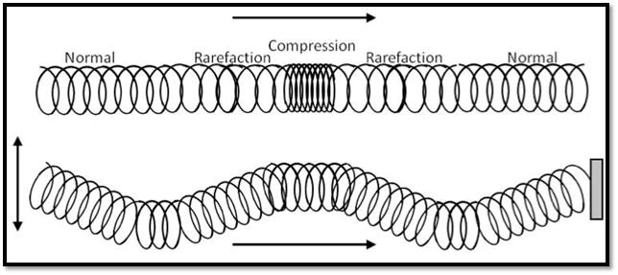
What do you notice?
2B
Exploring Missouri – 2B Mapping Crickets: Explain
14
Notes:
Loosely pull the slinky across a table or the floor. Push one end. Watch how a compression wave travels down the slinky.
What do students notice? (A repeating wave.)

Slide 15
How does the slinky and the tuning fork help us know how sound travels to our ears?
2B
Exploring Missouri – 2B Mapping Crickets: Explain
15
Notes:
Sound moves through the air in all directions from a vibrating object (the class cricket). Sound vibration bumps into nearby air, which bumps into more air and so on, all the way from the source (cricket) to your ear.
Teacher Note: Another way to explain this phenomenon is that sound briefly compresses together packets of air that then expand and push together the next packet of air that pushes together the next packet of air. Similar to the slinky movement, this is ho sound got from the cricket to your ear.

Slide 16

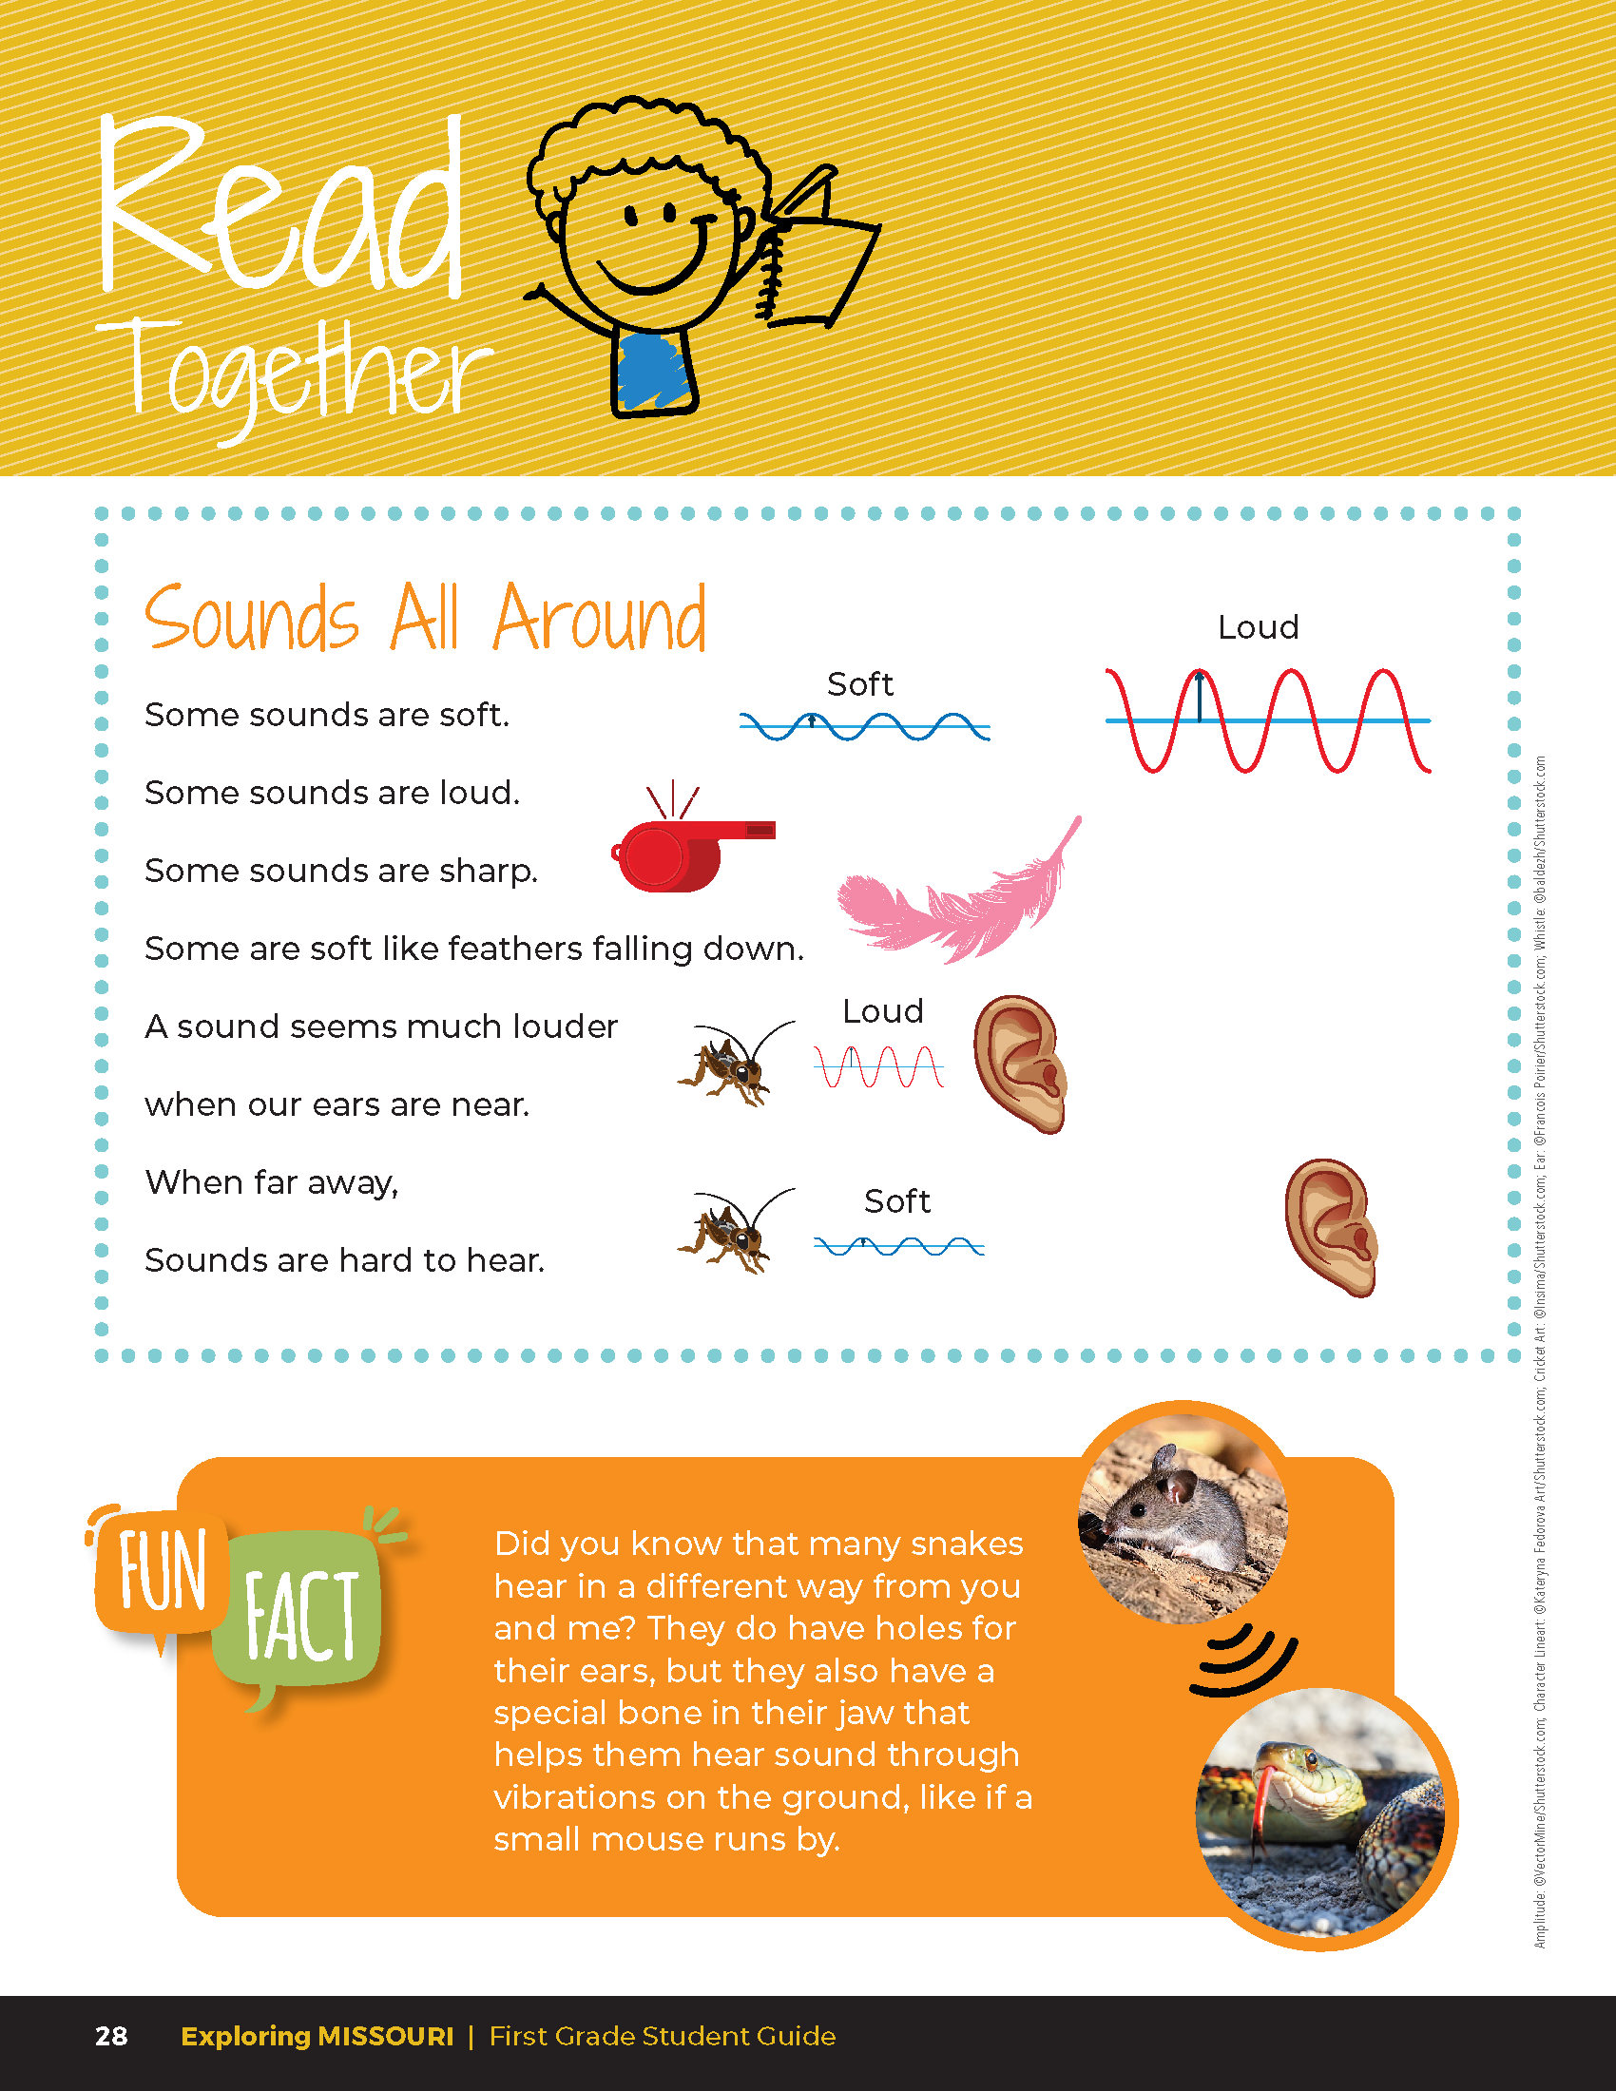
Sounds All Around
Sounds are soft.
Some sounds are loud.
Some sounds are sharp.
Some are soft like feathers falling down.
A sound seems much louder when our eats are near.
When far away,
Sounds are hard to hear.
2B
Exploring Missouri – 2B Mapping Crickets: Explain
16
Notes:
Have students open their student guides to Read Together 2B Sounds All Around on Page 28. Read the Fun Fact together about how snakes hear sound through vibrations.

Slide 17
Practice tapping the tuning fork against the desk, turning the tuning fork over, and touching the handle to your chin.
2B
Exploring Missouri – 2B Mapping Crickets: Explain
17
Notes:
Distribute tuning forks to groups of three to four students. Let them practice tapping the tuning fork against the desk, turning the tuning fork over, and touching the handle to their chins.

Slide 18

Can you hear the note from the tuning fork?
2B
Exploring Missouri – 2B Mapping Crickets: Explain
18
Notes:
Can you hear the note from the tuning fork? Sound travels not just through the air but through solid matter like bone, too!

Slide 19
Did you know this is how snakes "hear"?
Watch this cool video describing how snakes hear, even though they do not have ears!
Link:
https://youtu.be/1xO0BXxBrGs
2B
Exploring Missouri – 2B Mapping Crickets: Explain
19
Notes:
Can you hear the note from the tuning fork? Sound travels not just through the air but through solid matter like bone, too!

Slide 20

Have you heard something really loud or really quiet?
2B
Exploring Missouri – 2B Mapping Crickets: Elaborate
20
Notes:
Have students share about different sounds they’ve heard.

Slide 21
Go outside:
Is the sound louder or softer now?
2B
Exploring Missouri – 2B Mapping Crickets: Elaborate
21
Notes:
Go outside and have students disperse to different areas of the schoolyard. Remind students to stay within the boundaries you set. Encourage students to station themselves at a variety of different distances like standing or sitting on a hill, bleachers, or playground equipment. Some students can turn their back to you.
Using the clicker, have the “class cricket” make sounds again.
Tell students to raise their hand if they hear the sound.

Slide 22

Raise your hand if you hear the sound while walking.
2B
Exploring Missouri – 2B Mapping Crickets: Elaborate
22
Notes:
Have students slowly walk around while the cricket continues to call. Ask them to raise their hand if they hear the sound while they are walking.

Slide 23
Is the sound softer or louder when you are closer to the class cricket?
What about further from the class cricket?
2B
Exploring Missouri – 2B Mapping Crickets: Elaborate
23
Notes:
Bring students back into a circle.

Slide 24
Would you hear the cricket on the other side of the building? Why or why not?
2B
Exploring Missouri – 2B Mapping Crickets: Elaborate
24
Notes:
Ask students how far they think they would have to move to stop hearing the cricket.
Would you hear the cricket on the other side of the building? Why or why not?
The further away we are from the sound, the farther sound must travel. Sound loses energy as it travels and becomes softer. The sound waves are farther apart. When we are closer, the sound waves are closer together. It’s important to remember that sound travels in all directions, not just in the direction of our ears.

Slide 25
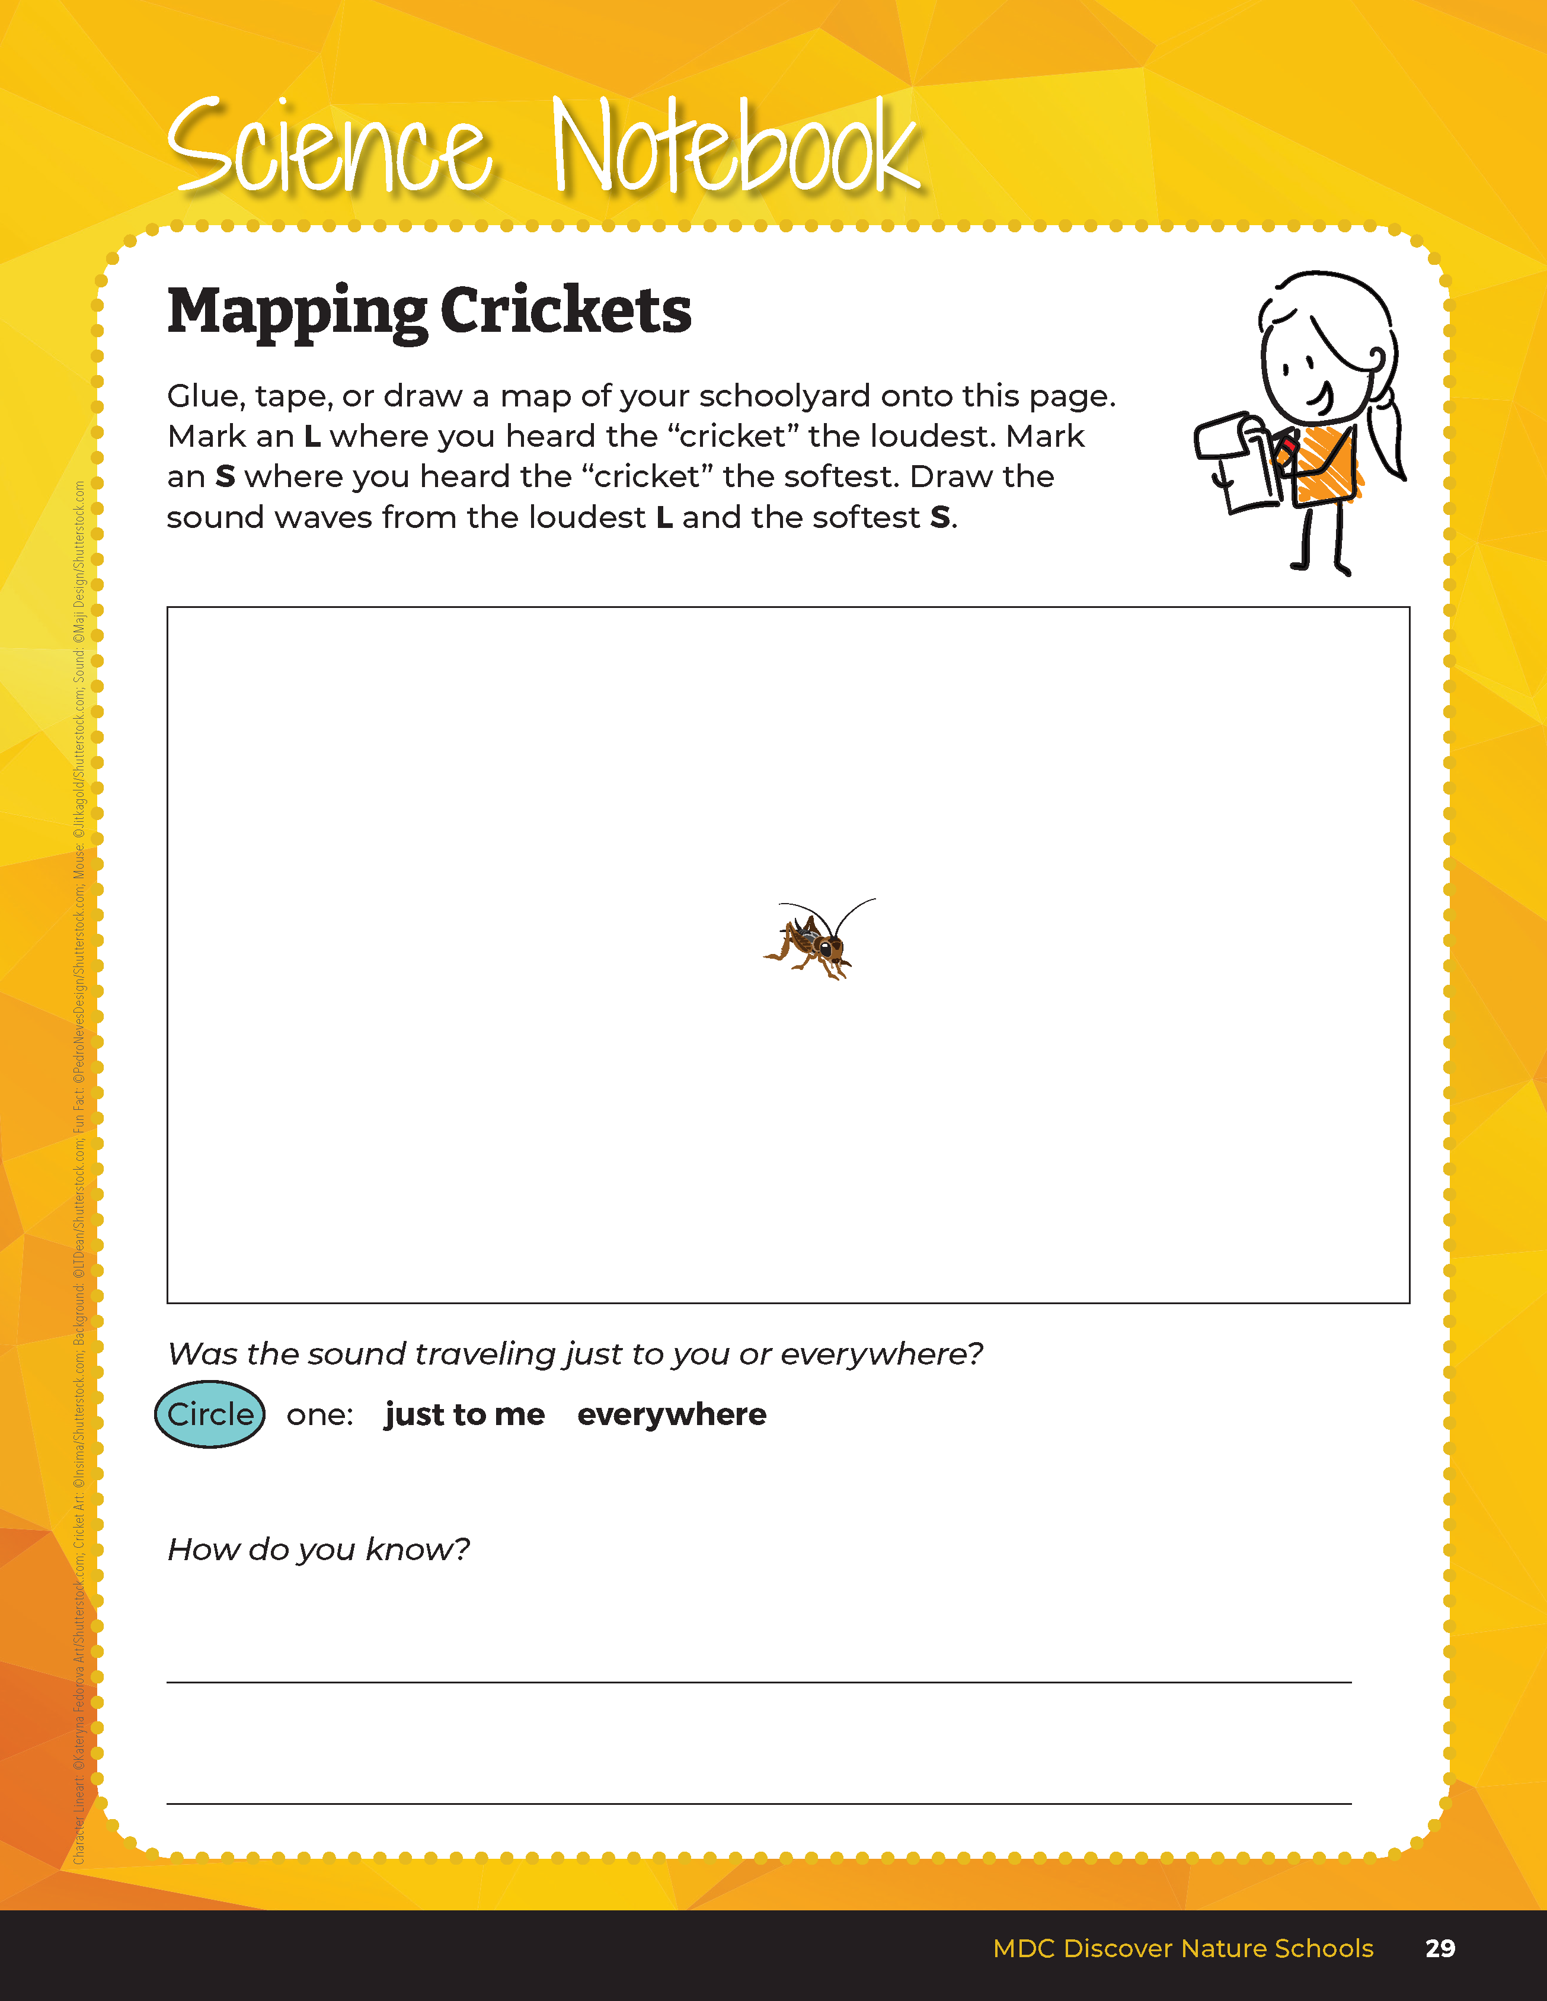

Glue, tape, or draw the schoolyard map.
Mark an L where you heard the “cricket” the loudest.
Mark an S where you heard the “cricket” the softest.
Draw the sound waves from the loudest L and the softest S.
2B
Exploring Missouri – 2B Mapping Crickets: Elaborate
25
Notes:
Have students glue, tape, or draw the schoolyard map into their student guide, Science Notebook 2B Mapping Crickets on Page 29.

Slide 26
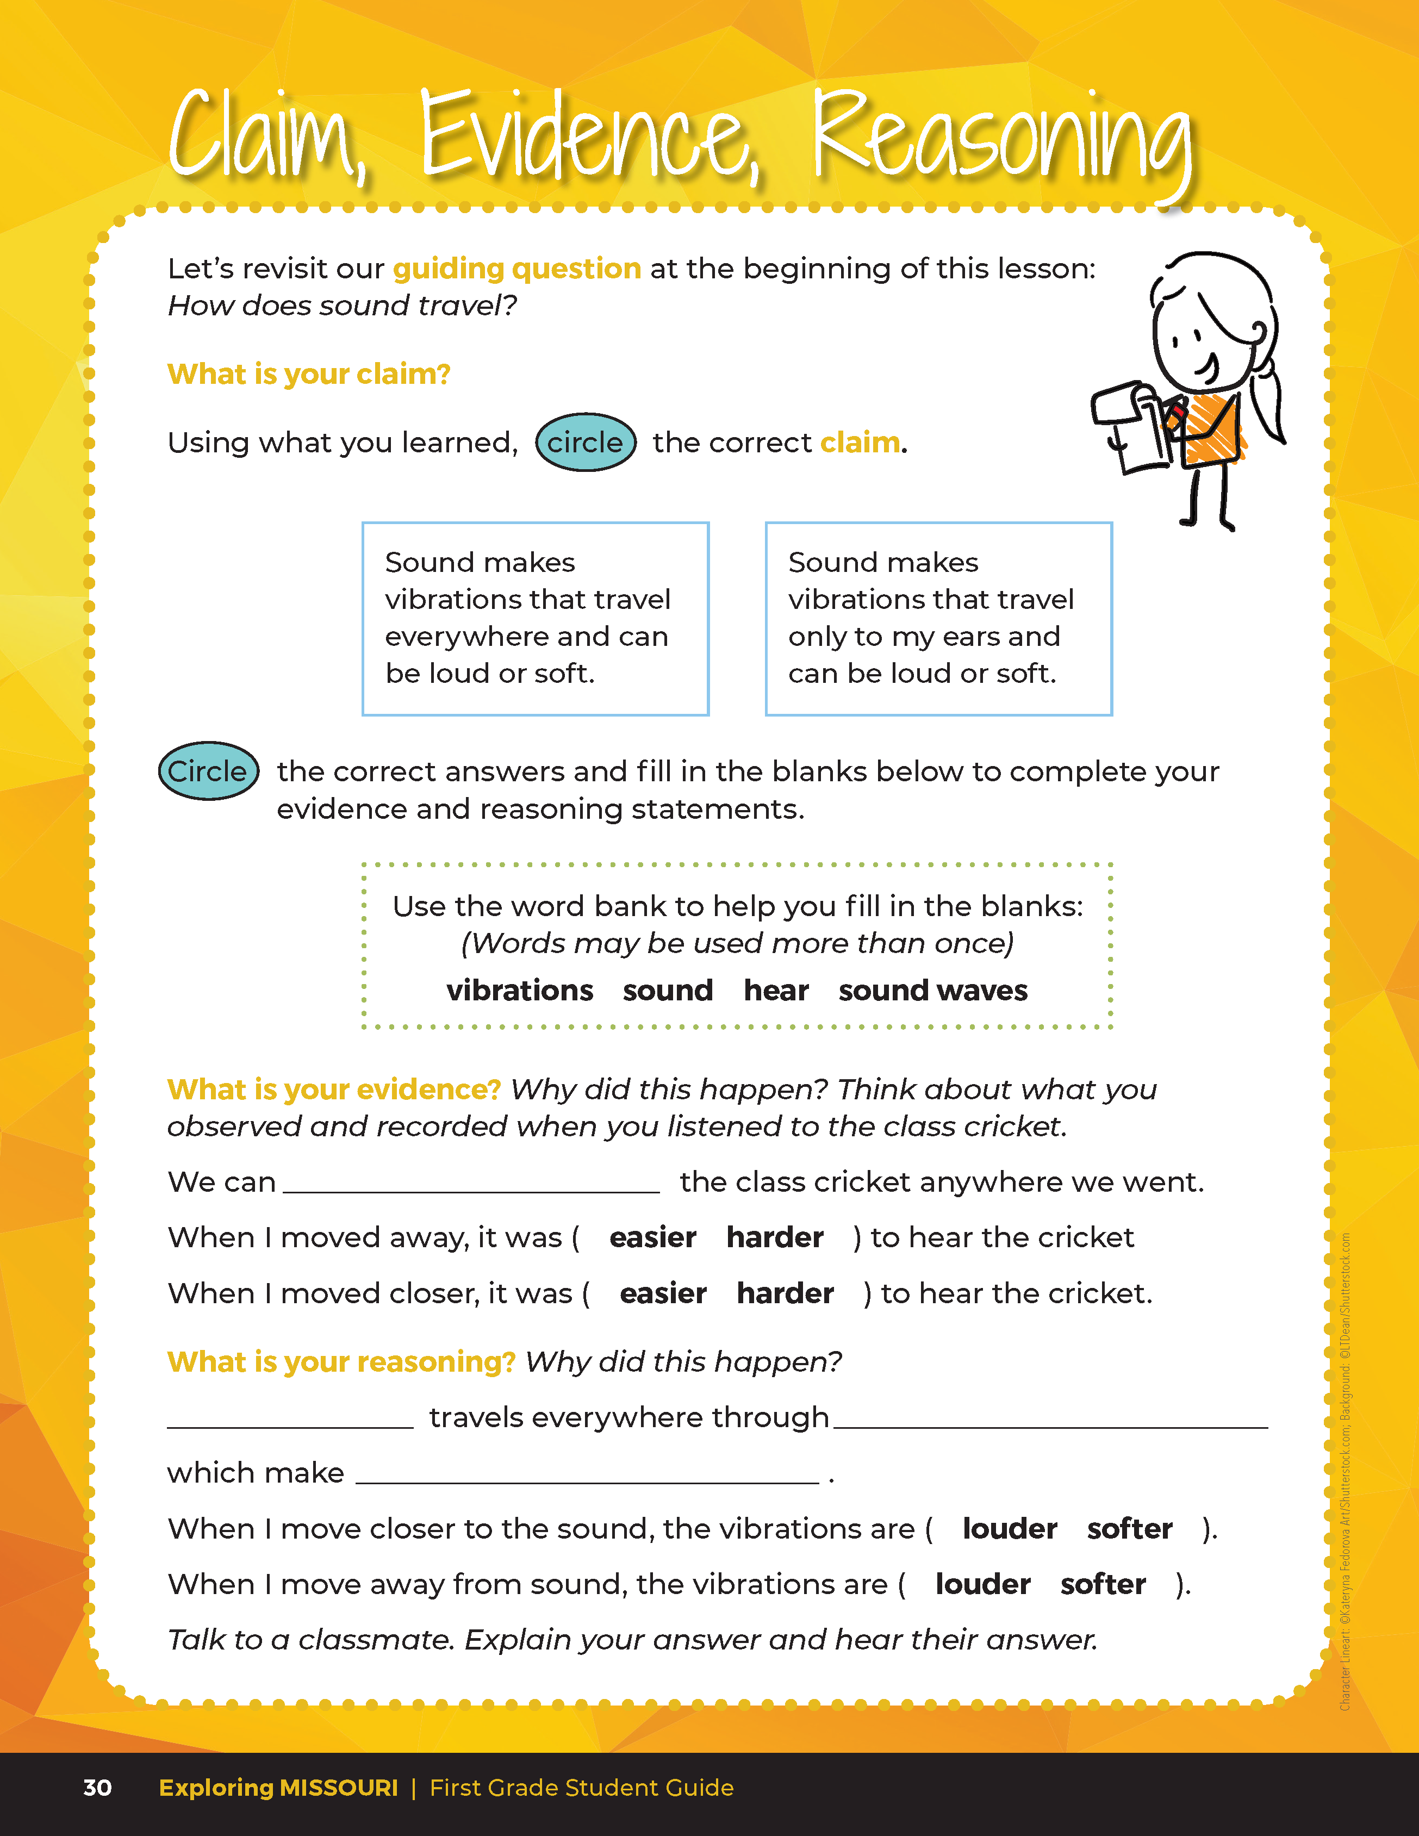
Guiding Question:
How does sound travel?
2B
Exploring Missouri – 2B Mapping Crickets: Evaluate
26
Notes:
After exploring the concept of how sound travels, have students open their student guides to the Claim, Evidence, Reasoning section on Page 30. Discuss the page with the students – read the guiding question and then explain what the students need to do to answer the questions (circle the correct claim, fill in the blanks, and circle the correct answers).

Slide 27
Answers
hear
Sound
vibrations
sound waves
2B
Exploring Missouri – 2B Mapping Crickets: Evaluate
26
Notes:
Rubric:
3 (Meets) – Students can define and identify that sound produces vibrations that can travel everywhere and can be loud and soft. Students circle the correct claim, write the correct evidence statement, and identify the correct reason.
2 (Partially meets) – Students can define that sound travels but it may only travel in one direction and will only be loud or soft. Two of the three components of CER are correct.
1 (Doesn’t meet) – Students cannot answer the above questions. One of the three components of CER are correct.

Slide 28

Optional: Cross-Curricular Extension
Math
The loudest insect song in Missouri (and North America) is produced by the robust conehead katydid. It can be heard up to 500 meters (or 1640 feet) away! How long is your schoolyard/school building? Take your students outside to measure the length of the building. Students can count their steps. How many more building lengths would it take to get to 1640 feet? (Give an estimate to your students such as 5 more building lengths.) Could you hear a robust katydid calling from one end of your schoolyard to the other? One a warm summer night, these katydids can move their wings over 200 times per second to produce these loud calls! The warmer the night, the more they rub.
2B
Exploring Missouri – 2B Mapping Crickets: Cross-Curricular Extension
28
Notes:
Math
The loudest insect song in Missouri (and North America) is produced by the robust conehead katydid. It can be heard up to 500 meters (or 1640 feet) away! How long is your schoolyard/school building? Take your students outside to measure the length of the building. Students can count their steps. How many more building lengths would it take to get to 1640 feet? (Give an estimate to your students such as 5 more building lengths.) Could you hear a robust katydid calling from one end of your schoolyard to the other? One a warm summer night, these katydids can move their wings over 200 times per second to produce these loud calls! The warmer the night, the more they rub.

Slide 29
Optional: Cross-Curricular Extension
Music
Ask the music teacher to demonstrate sound and vibrations using drums or cymbals. How do these instruments make sound? Can you feel the vibrations from the instrument(s)? Talk about how they make sound.
2B
Exploring Missouri – 2B Mapping Crickets: Cross-Curricular Extension
29
Notes:
Music
Ask the music teacher to demonstrate sound and vibrations using drums or cymbals. How do these instruments make sound? Can you feel the vibrations from the instrument(s)? Talk about how they make sound.

Slide 30
Optional: Cross-Curricular Extension
Art
Collaborate with the art teacher to have students draw a map of the schoolyard. Students can also use art materials such as clay to build a model.
2B
Exploring Missouri – 2B Mapping Crickets: Cross-Curricular Extension
27
Notes:
Art
Collaborate with the art teacher to have students draw a map of the schoolyard. Students can also use art materials such as clay to build a model.

