Slide 1
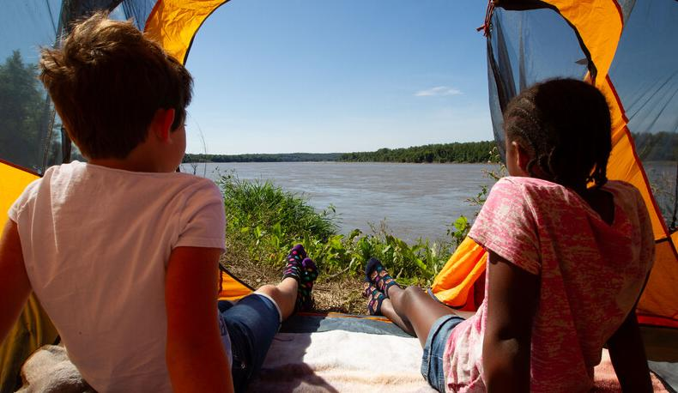

Life and Land in
MISSOURI
2A: Sprouts and Light

Slide 2
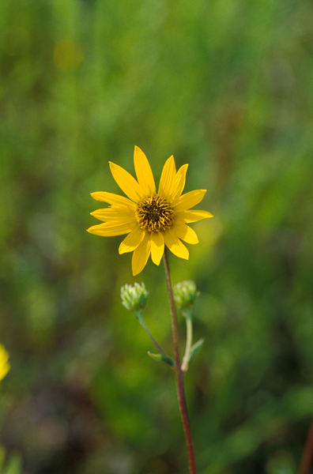
Guiding Question:
Where would a sunflower grow best in your schoolyard?
2A
Life and Land in Missouri – 2A Sprouts and Light: Engage
2
Notes:
Plant in Picture: Camphorweed

Slide 3
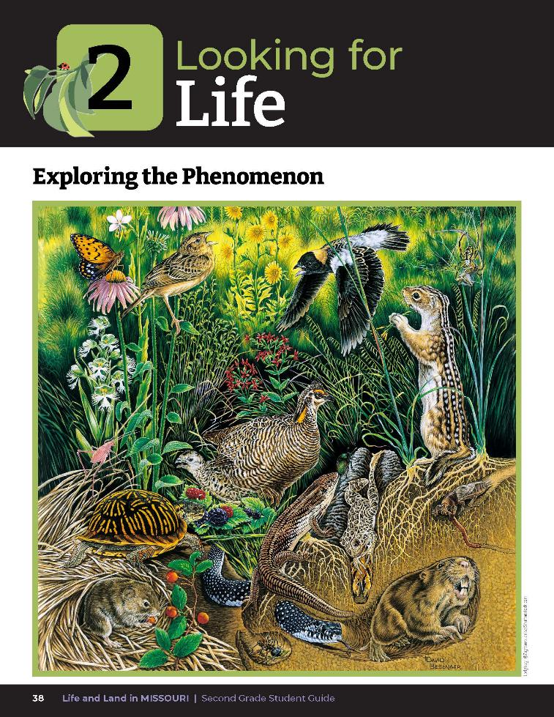
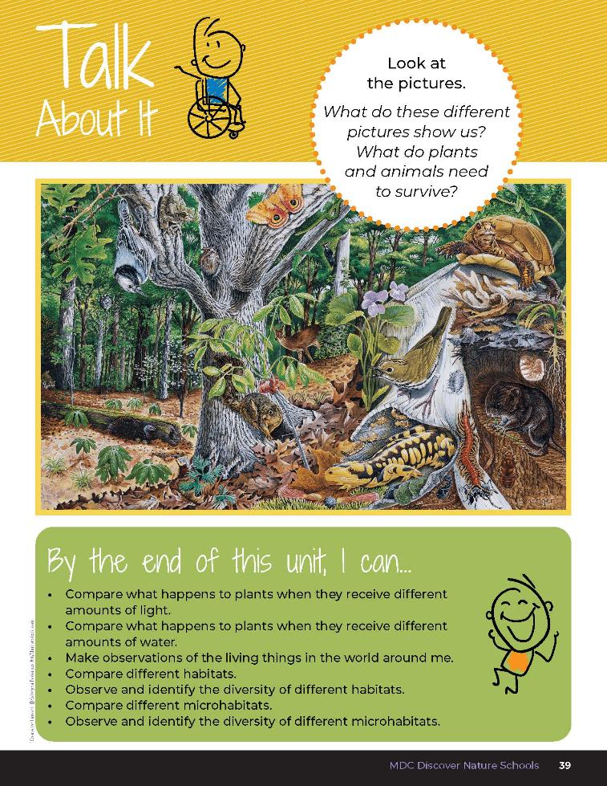
2A
Life and Land in Missouri – 2A Sprouts and Light: Engage
3
Notes:
Have students open their student guide to the Unit 2 Exploring the Phenomenon section on Page 38.
Discuss the Talk About It Questions: What do these different pictures show us? What do plants and animals need to survive?

Slide 4
View the Prairie, Forest, and Pond video
Link:
https://youtu.be/P6_FJlBUNIw
2A
Life and Land in Missouri – 2A Sprouts and Light: Engage
4
Notes:
Show students the Prairie, Forest, and Pond video from the MDC Teacher Portal.

Slide 5
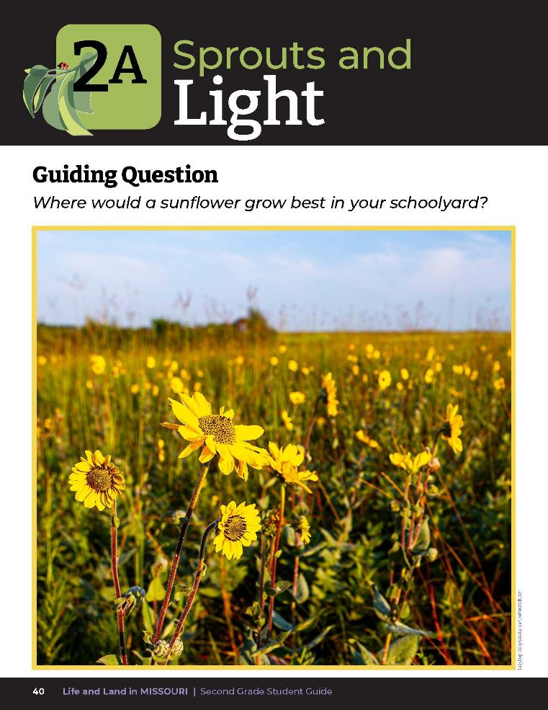
Where would a sunflower grow best in your schoolyard?
2A
Life and Land in Missouri – 2A Sprouts and Light: Engage
5
Notes:
Have students turn to the Lesson 2A Sprouts and Light introduction on Page 40. Discuss the guiding question.

Slide 6
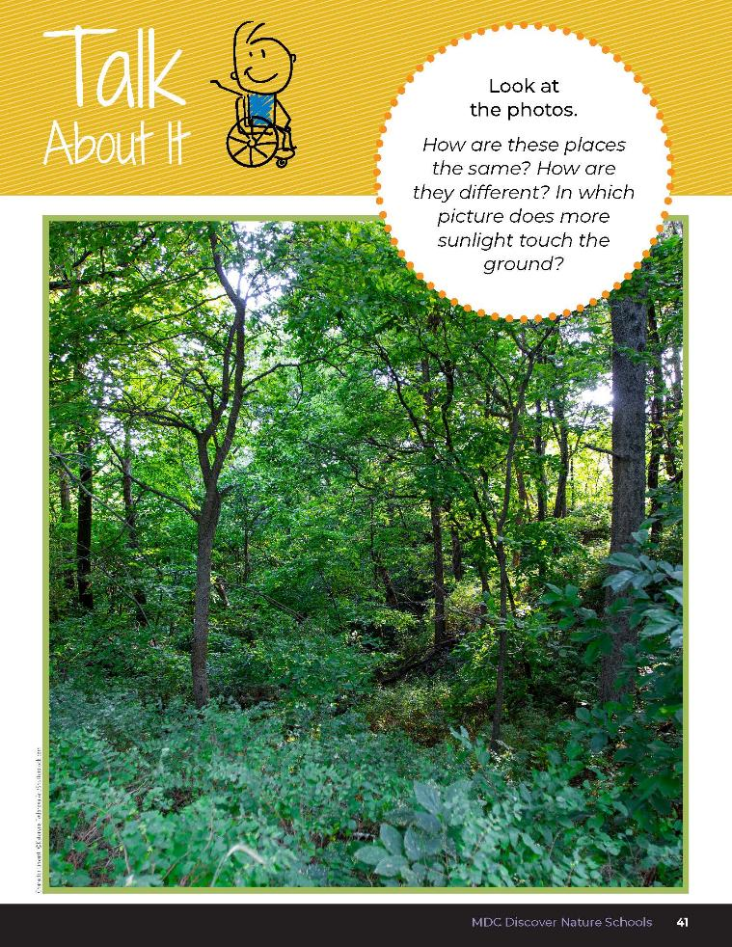

2A
Life and Land in Missouri – 2A Sprouts and Light: Engage
6
Notes:
Discuss the Talk About It for this lesson. How are these places the same? How are they different? In which picture does more sunlight touch the ground?

Slide 7
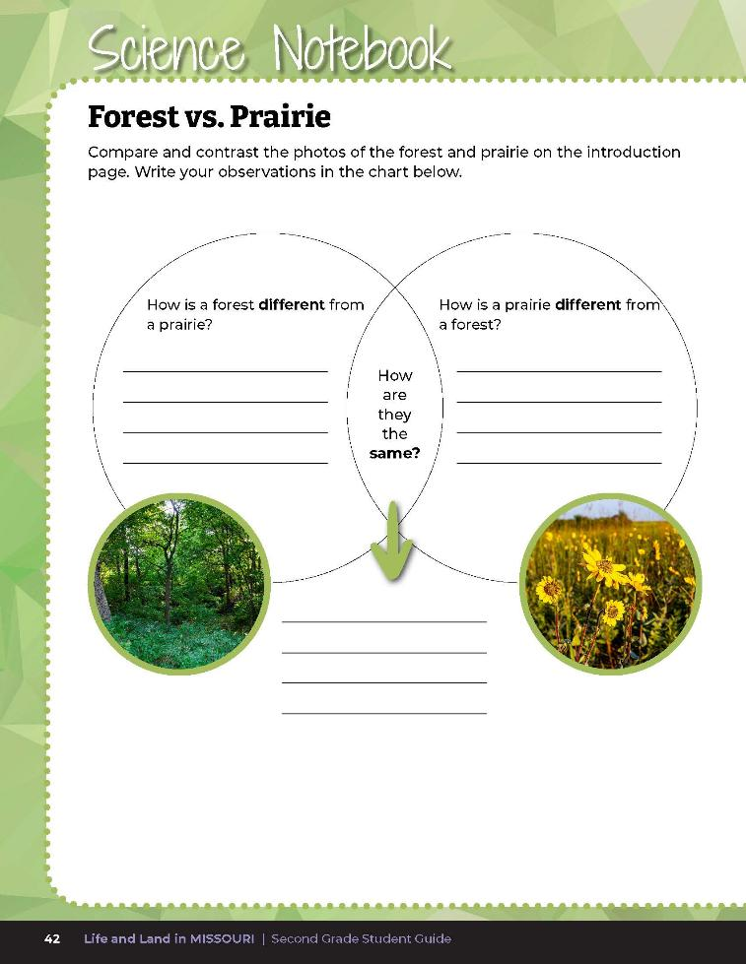
Compare and contrast the photos of the forest and prairie using a Venn diagram.
2A
Life and Land in Missouri – 2A Sprouts and Light: Engage
7
Notes:
Have students complete Science Notebook 2A Forest vs. Prairie on student guide Page 42 and compare and contrast the photos using a Venn diagram. Assist students with where to place written information into the diagram.

Slide 8
Each group will get 3 sprout cups. Place a sprout in the following areas:
Full sun (like a prairie)
Little sun (like the forest floor)
No sun (like under a rock)
2A
Life and Land in Missouri – 2A Sprouts and Light: Explore
8
Notes:
Give 3 sprout cups of the same plant species to each group. Have them label their cups with their class or group name and then place their sprouts in each of the following areas:
Full sun (like a prairie)
Little sun (like the forest floor)
No sun (like under a rock)

Slide 9
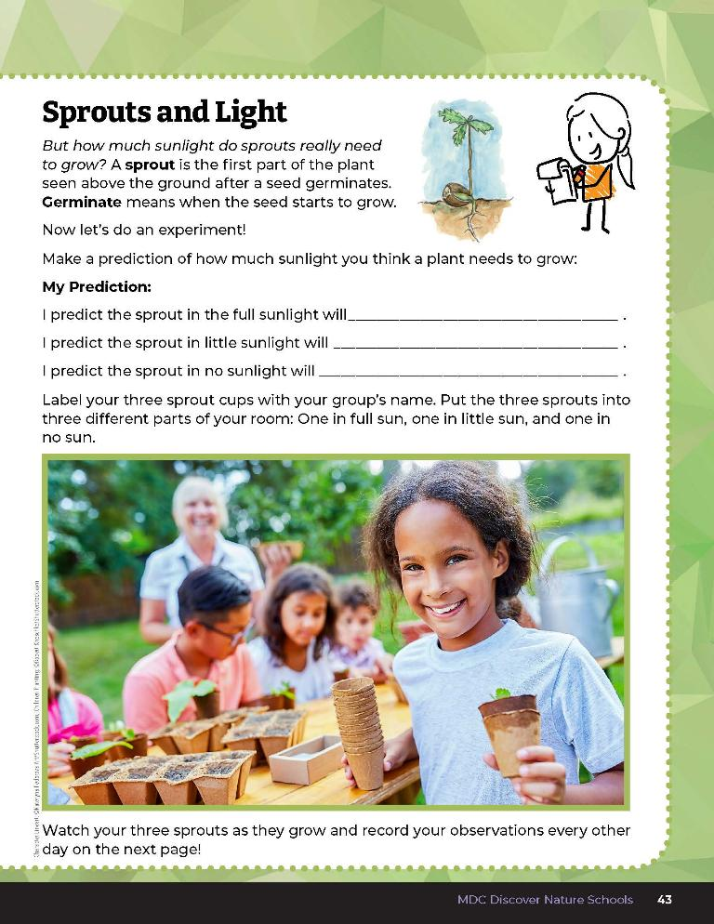

Make a prediction about what will happen to each plant.
2A
Life and Land in Missouri – 2A Sprouts and Light: Explore
9
Notes:
Using Science Notebook 2A Sprouts and Light on Page 43, have students make predictions about what will happen to each plant. Each cup should be watered with the same amount each time, such as 1-2 teaspoons of water per observation period.

Slide 10

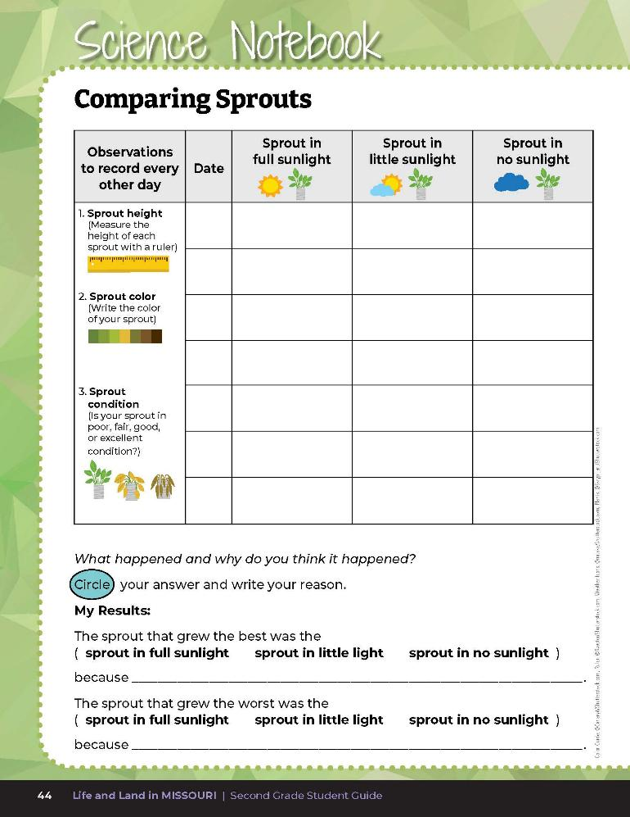
10
6
X
MINUTES
DAYS
Observe the plants for 2 weeks and record observations every other day.
2A
Life and Land in Missouri – 2A Sprouts and Light: Explore
10
Notes:
Collect data every other day for 2 weeks. If you choose to collect data for longer, you can add more data pages to the students’ guides using the 2A Sprouts and Light Data Sheet. Have students observe the plants over the next 2 weeks and record observations every other day on student guide Science Notebook 2A Comparing Sprouts Page 44. Observations should include plant height, color, and condition using the words “poor,” “fair,” “good,” or “excellent.” When recording plant condition, students can write P, F, G, or E to save space. Students can use magnifying glasses to enhance their observations.

Slide 11
Complete the My Results section.
2A
Life and Land in Missouri – 2A Sprouts and Light: Explain
11
Notes:
When the 2 weeks are over, have students compare their predictions to the results and complete the My Results section of the Science Notebook 2A Comparing Sprouts page.

Slide 12
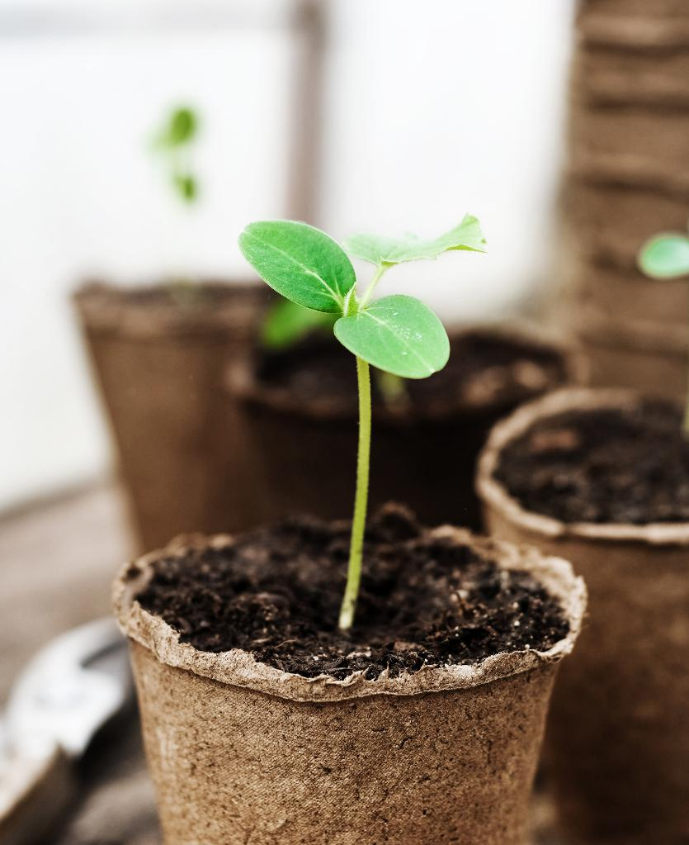
Did your plants grow how you expected them to grow?
2A
Life and Land in Missouri – 2A Sprouts and Light: Explain
12

Slide 13

Based on your observations, what can you say that plants need?
2A
Life and Land in Missouri – 2A Sprouts and Light: Explain
13

Slide 14
What do you think would happen if all plants were left in the sun/dark/partial sun?
2A
Life and Land in Missouri – 2A Sprouts and Light: Explain
14

Slide 15

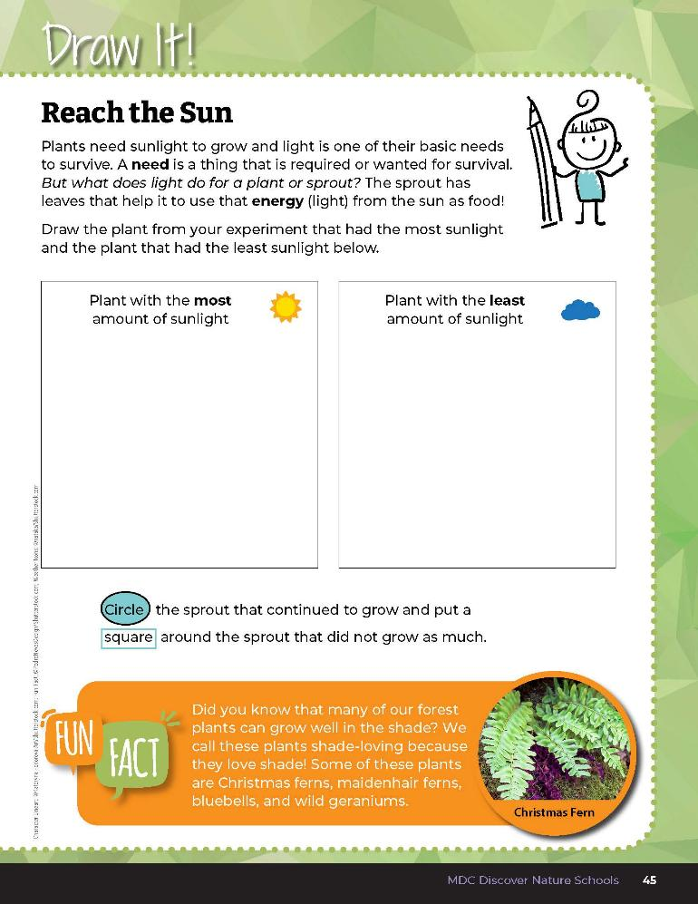
Draw the sprout with the most sunlight and the sprout with the least sunlight into the boxes.
Circle the sprout that did well and place a square around the sprout that did not.
2A
Life and Land in Missouri – 2A Sprouts and Light: Explain
15
Notes:
Have students open their guides to Draw It! 2A Reach the Sun on Page 45. Explain the concept of a need for a plant and how plants have leaves to absorb sunlight which helps them have energy. Students will draw the sprout with the most sunlight and the sprout with the least sunlight into the boxes and will circle the sprout that did well and place a square around the sprout that did not.

Slide 16
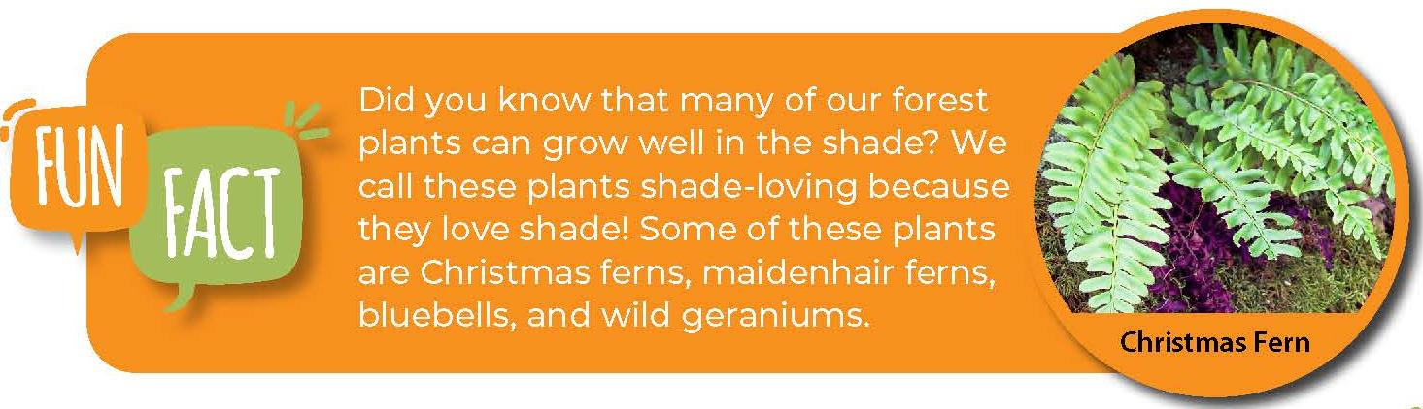
2A
Life and Land in Missouri – 2A Sprouts and Light: Explain
16
Notes:
Read the Fun Fact from the Draw It! page about shade-loving plants.

Slide 17


Where do you think this sunflower (or coneflower) plant would grow best? Why?
2A
17
Life and Land in Missouri – 2A Sprouts and Light: Elaborate
Notes:
Look at the results of your experiment and then look back at the prairie and forest ecosystem on the Lesson 2A Sprouts and Light introduction page.

Slide 18
These plants are growing in both ecosystems.
How is that possible?
2A
Life and Land in Missouri – 2A Sprouts and Light: Elaborate
18

Slide 19
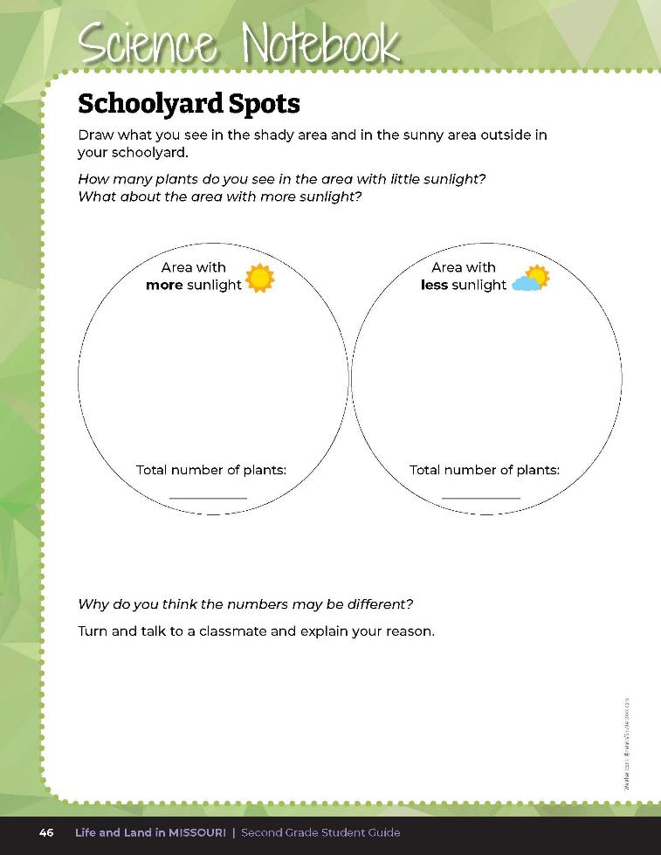
Draw what you see in the shady area and in the sunny area outside in your schoolyard.
2A
Life and Land in Missouri – 2A Sprouts and Light: Elaborate
19
Notes:
Take the class outside. Find areas in your schoolyard that replicate the amount of light used in your experiment.
Compare areas using the same size using a ruler or hula hoop. Count the number of plants in these areas with the class. Have the students record their observations in their student guide Science Notebook 2A Schoolyard Spots section on Page 46.

Slide 20
Are plants present in all of these areas, including sunny, partial sun, and shaded location? Why?
2A
Life and Land in Missouri – 2A Sprouts and Light: Elaborate
20
Notes:
Have students compare the number of plants in sun and shade and discuss why they think numbers may be different. Explain that different plants have different needs. Some plants like all shade and do not grow well in the sun, like the plants we may find on a forest floor. Some like all sun and do not grow well in the shade, like the plants we may find in a prairie or glade. And some like some shade and some sun, like the plants we may find in a park or around our houses if there are buildings nearby to block the sun a part of the time.

Slide 21
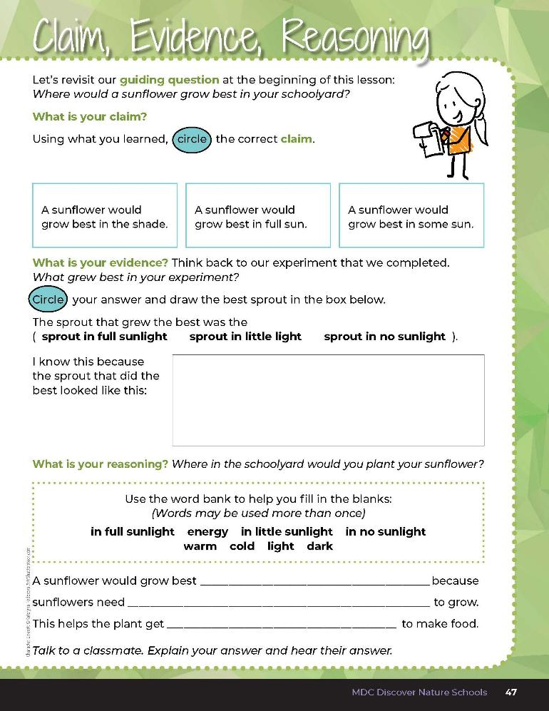
2A
Life and Land in Missouri – 2A Sprouts and Light: Evaluate
21
Notes:
Guiding Question: Where would a sunflower grow best in your schoolyard?
After exploring the concept of light as an essential need for a plant, have students open their student guides to the 2A Claim, Evidence, Reasoning section on Page 47. Guide students through the page by reviewing each section as a class and revisiting the scientific concepts learned to help answer each section.

Slide 22
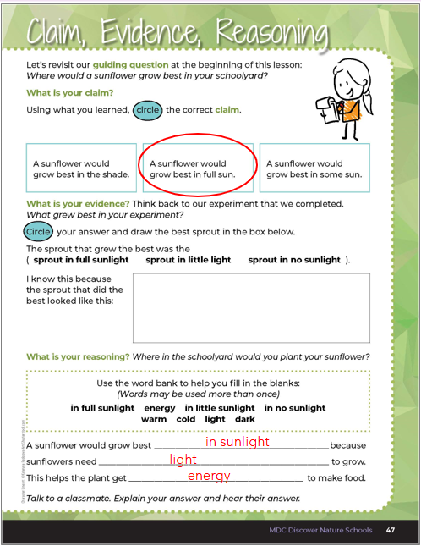
2A
Life and Land in Missouri – 2A Sprouts and Light: Evaluate
22
Notes:
Rubric:
4 (Exceeds) – Student circles the correct claim and writes the correct evidence into the blanks and provides the correct reasoning by filling in all the blanks correctly.
3 (Meets) – Student circles either the correct claim or writes the correct evidence into the blanks and/or provides mostly the correct reasoning by filling in 2 of the blanks correctly.
2 (Partially meets) – Student circles either the correct claim or somewhat writes the correct reasoning by filling in 1 of the blanks correctly.
1 (Doesn’t meet) – Student does not provide the correct claim or evidence and does not write any words into the blanks to complete the correct reasoning.

