Slide 1
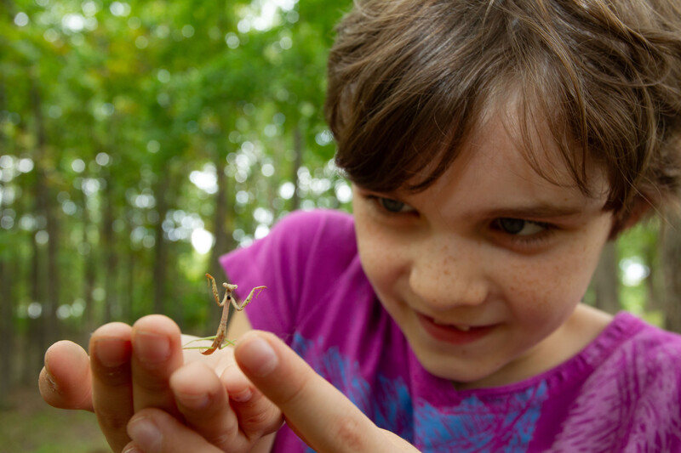

Exploring
MISSOURI
2A: Cricket Calls

Slide 2
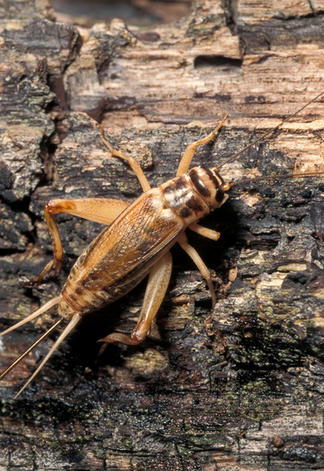
Guiding Question:
How do crickets make sound?
2A
Exploring Missouri – 2A Cricket Calls: Engage
2
Notes:
Animal in Picture: House Cricket

Slide 3
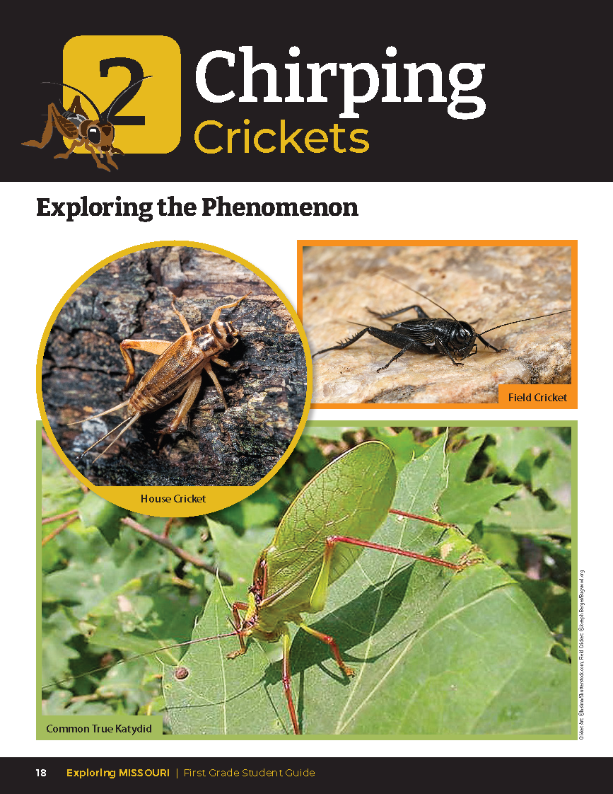
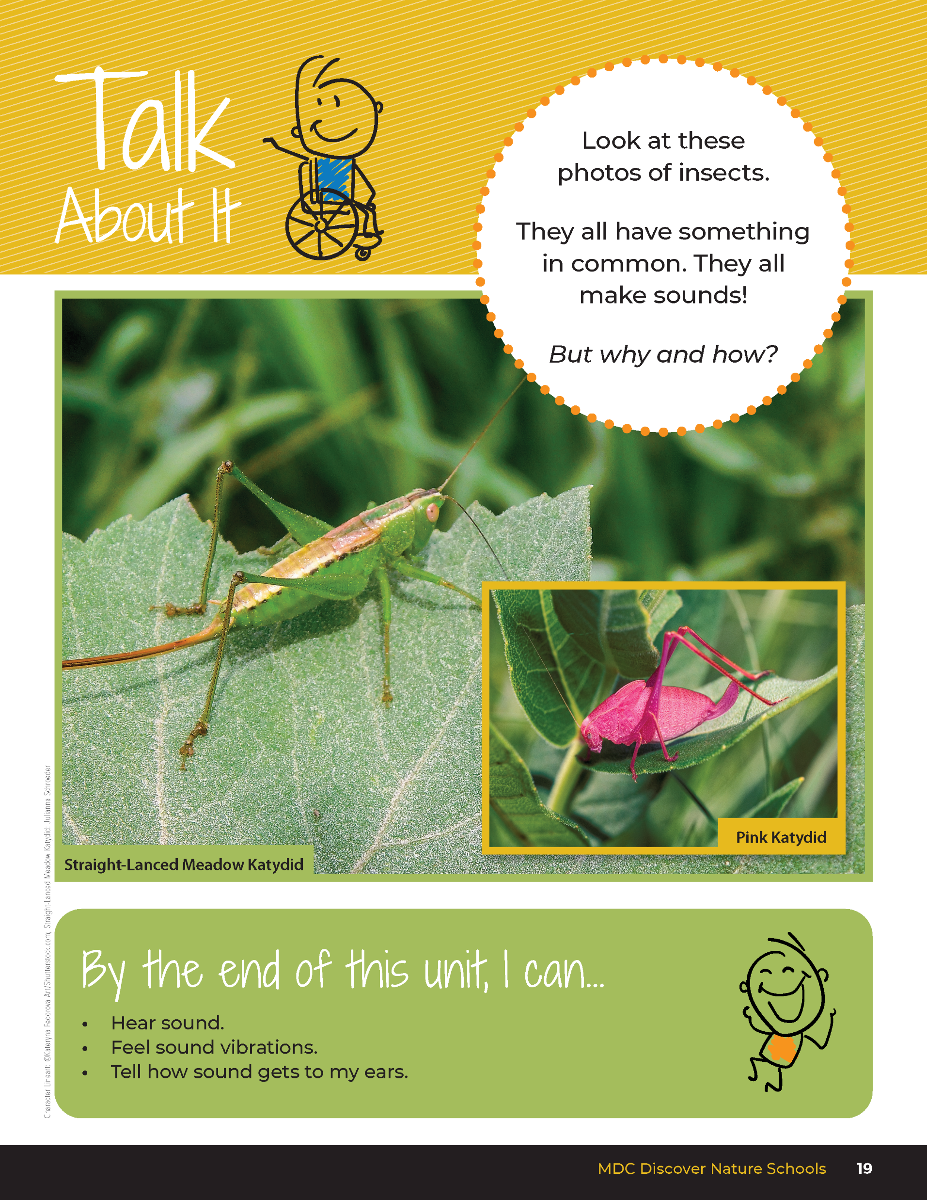
2A
Exploring Missouri – 2A Cricket Calls: Engage
3
Notes:
Have students look at the pictures of the crickets and katydids on the Unit 2 Exploring the Phenomenon section on pages 18-19.

Slide 4
Insects Chirping
Bush Cricket: Bush Cricket
House Cricket: House Crickets
Tree Cricket: Tree Cricket
2A
Exploring Missouri – 2A Cricket Calls: Engage
4
Notes:
From the MDC Teacher Portal, play at least three different tracks of insects chirping. Chirping Crickets | MISSOURI DEPARTMENT OF CONSERVATION

Slide 5
How many different sounds did you hear the insects make?
2A
Exploring Missouri – 2A Cricket Calls: Engage
5

Slide 6
How do insects make these sounds?
2A
Exploring Missouri – 2A Cricket Calls: Engage
6

Slide 7
Watch the Crickets Chirping Video: https://www.youtube.com/watch?v=s4noWAYNIN8
2A
Exploring Missouri – 2A Cricket Calls: Engage
7
Notes:
Watch the Crickets Chirping video found on the MDC Teacher Portal. Chirping Crickets | MISSOURI DEPARTMENT OF CONSERVATION

Slide 8
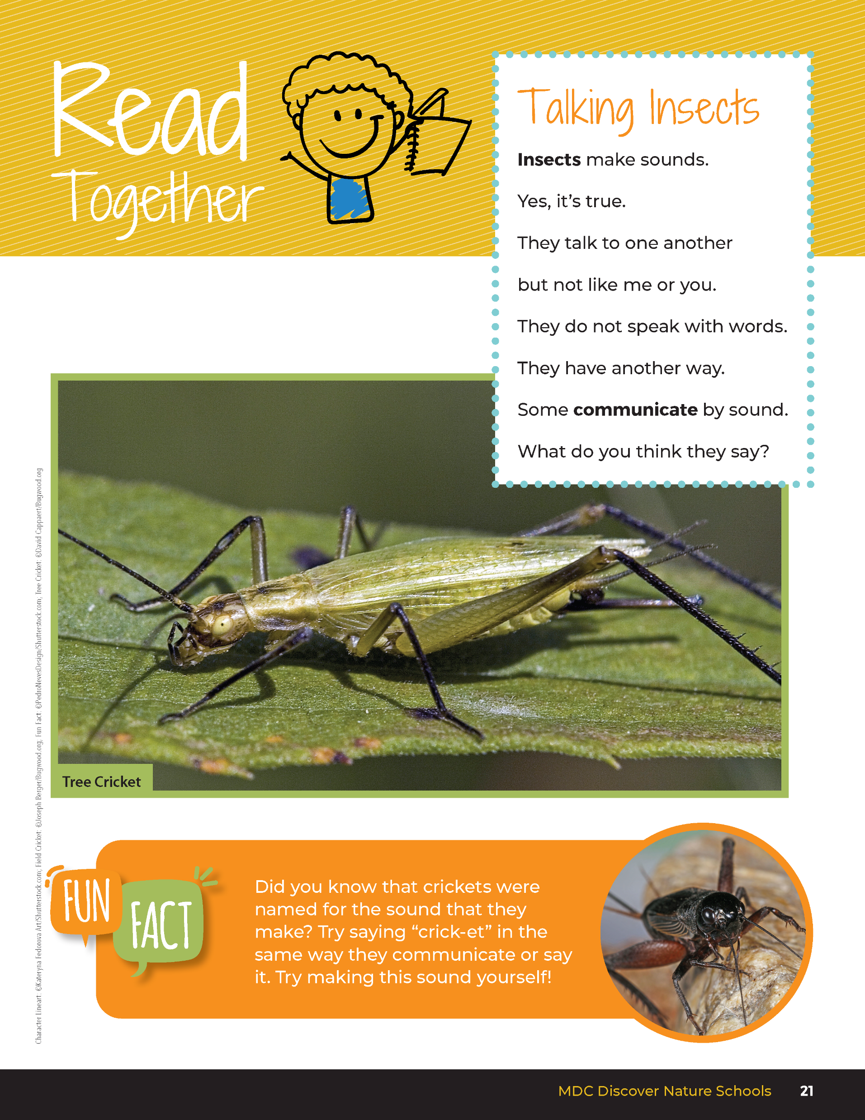

Talking Insects
Insects make sounds.
Yes, it’s true.
They talk to one another
but not like me or you.
They do not speak with words.
They have another way.
Some communicate by sound.
What do you think they say?
2A
Exploring Missouri – 2A Cricket Calls: Engage
8
Notes:
Have students read the Read Together 2A Talking Insects section from student guide Page 21.

Slide 9
2A
Exploring Missouri – 2A Cricket Calls: Engage
9

Slide 10
How do you think crickets make sounds?
2A
Exploring Missouri – 2A Cricket Calls: Engage
10
Notes:
Today we are going to explore how insects make different sounds.
Teacher Note: At this point in lesson, do not clarify right or incorrect observations.
Explanation and clarification of phenomena will occur in the Explain portion. Allowing for incorrect assumptions will engage students to make claims and seek evidence for reasoning explained later.

Slide 11
Let's take a closer look at the video of crickets chirping!
Link:
https://www.youtube.com/watch?v=s4noWAYNIN8
2A
Exploring Missouri – 2A Cricket Calls: Explore
11
Notes:
Because we are looking to answer the question, “How do crickets make sounds?”, let’s discuss how we think this happens.
Let’s take a closer look at the video of crickets chirping. Chirping Crickets | MISSOURI DEPARTMENT OF CONSERVATION

Slide 12
What do you notice?
How would you describe the movement of the crickets?
2A
Exploring Missouri – 2A Cricket Calls: Explore
12

Slide 13
Can we mimic the sound a cricket makes?
2A
Exploring Missouri – 2A Cricket Calls: Explore
13
Notes:
Allow students to try to mimic the sounds of crickets heard.

Slide 14
Are the sounds the same or different?
How would describe the sound?
Are the sounds higher or lower?
Louder or softer?
2A
Exploring Missouri – 2A Cricket Calls: Explore
14
Notes:
Have students rub their hands together to see if they make a sound.
Have students rub their hands on other their arms or legs.

Slide 15
Are the sounds the same or different?
2A
Exploring Missouri – 2A Cricket Calls: Explore
15
Notes:
Have students stand next to a partner and both rub their hands together.

Slide 16
Let’s see if we can make different kinds of sounds using different materials!
Rub the different items against cans.
2A
Exploring Missouri – 2A Cricket Calls: Explore
16
Notes:
Now let’s see if we can make different kinds of sounds using different materials.
Distribute empty soup or vegetable cans with ridges and combs. Using pencils, crayons, rulers, popsicle sticks, and other found items, students will rub these different items against the cans and combs.

Slide 17
How are the sounds the same?
How are sounds different?
How do the objects feel when making sounds?
2A
Exploring Missouri – 2A Cricket Calls: Explore
17

Slide 18
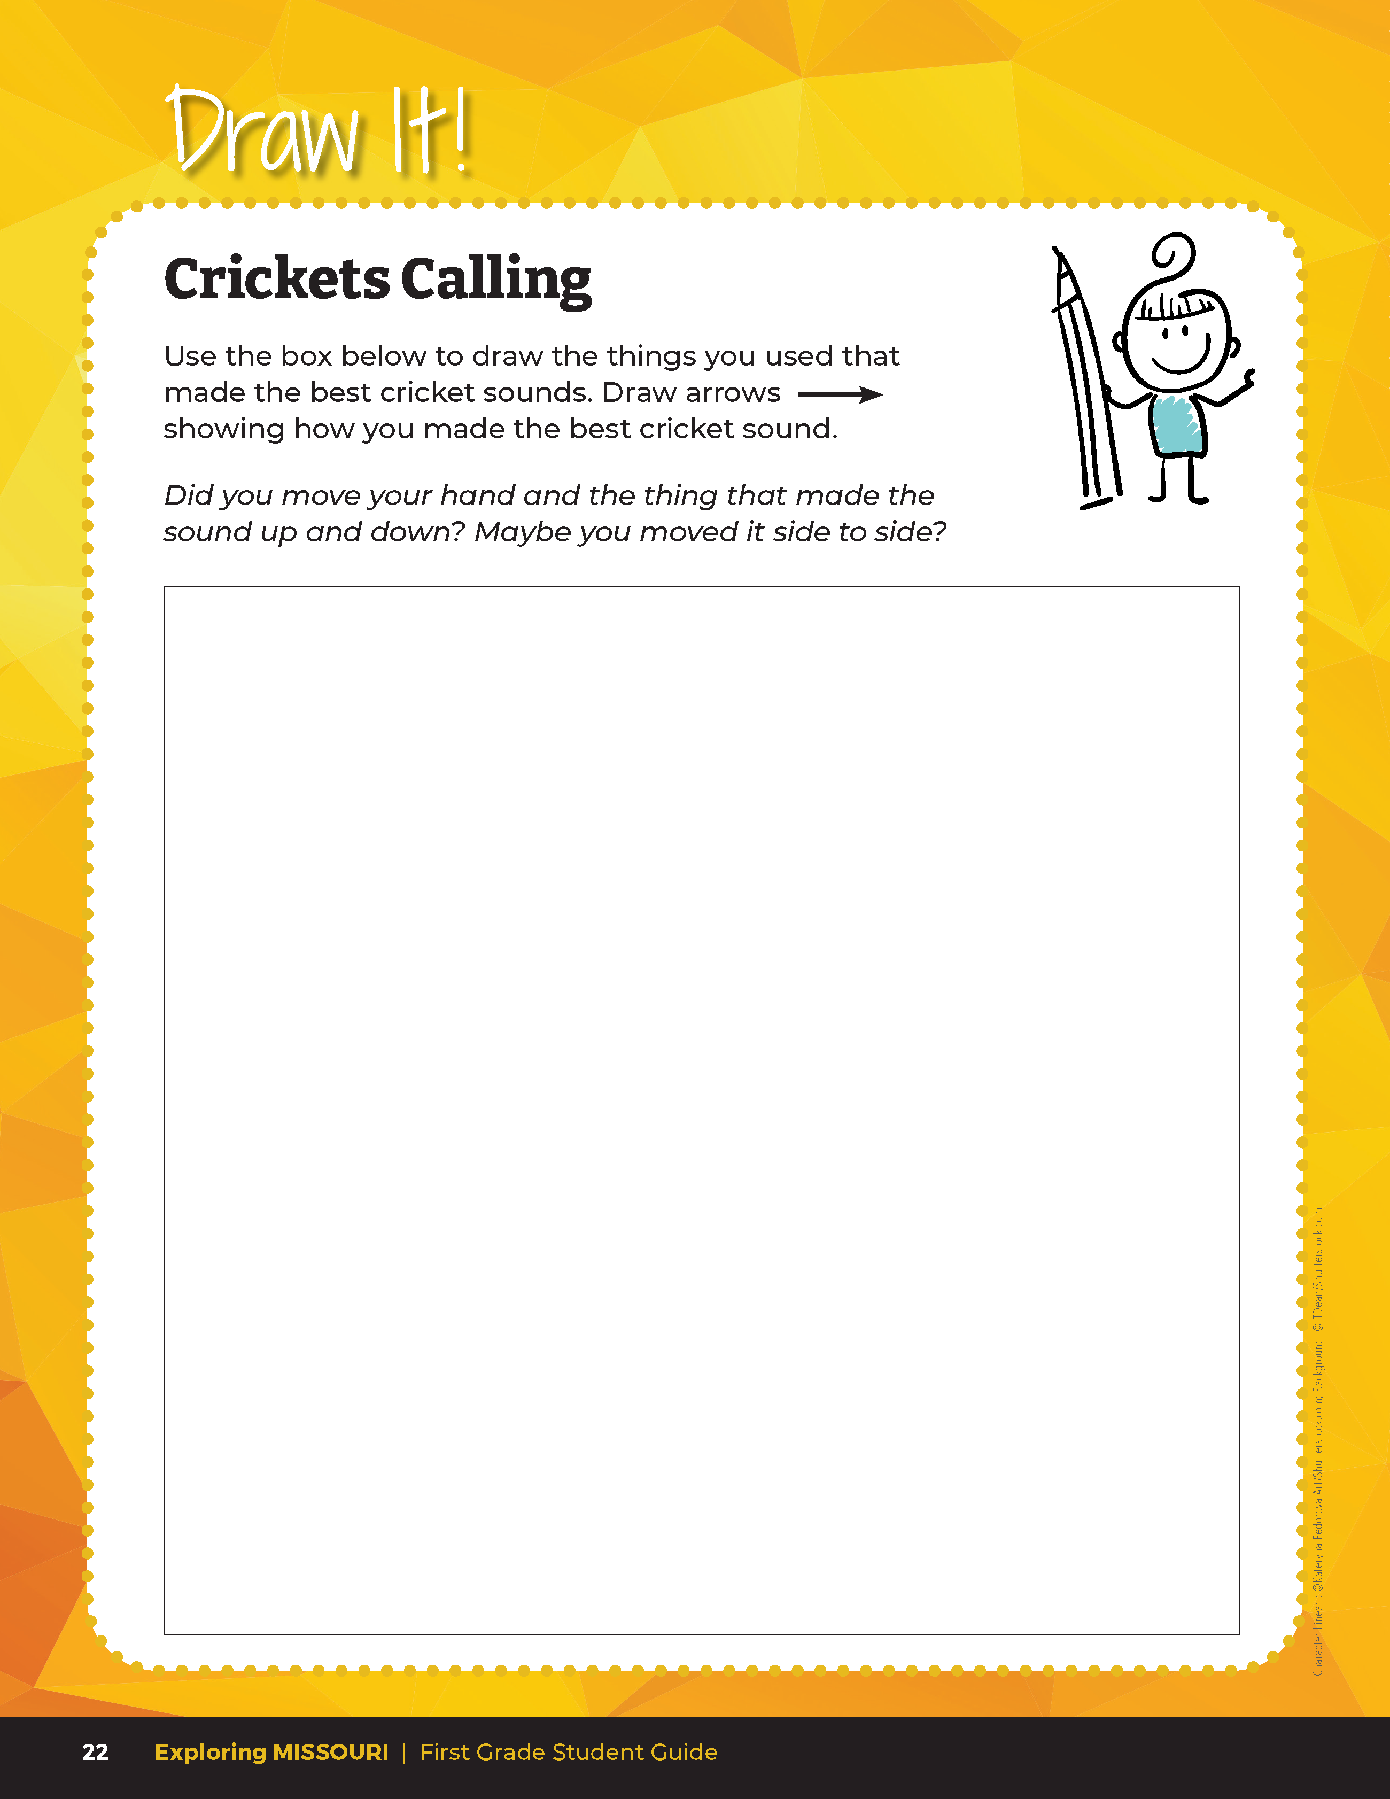

Draw the things you used that made the best cricket sounds. Draw arrows showing how you made the best cricket sounds.
2A
Exploring Missouri – 2A Cricket Calls: Explore
18
Notes:
In the student guide, Draw It! 2A Crickets Calling on Page 22, students will draw the materials they used to make the best cricket sounds. They will also draw arrows showing the movement used to make those sounds. Example can be a student drawing a can and a pencil with an up and down arrow to show the pencil moving up and down the can.

Slide 19
What did everyone choose to draw?
2A
Exploring Missouri – 2A Cricket Calls: Explore
19
Notes:
Students will share their drawings with the class or with a partner. If students finish early, they can use the additional 2A Crickets Calling Handout on page 43 of the Teacher Guide and draw another method they used to make sounds.

Slide 20
How did we make sound by rubbing our hands and using the cans?
2A
Exploring Missouri – 2A Cricket Calls: Explain
20
Notes:
Describe the method of making sounds using movement. It starts with a vibration from an object.

Slide 21
Let's watch the Crickets Chirping Video on mute!
Link:
https://www.youtube.com/watch?v=s4noWAYNIN8
2A
Exploring Missouri – 2A Cricket Calls: Explain
21
Notes:
Let’s watch the Crickets Chirping video again on mute. Chirping Crickets | MISSOURI DEPARTMENT OF CONSERVATION

Slide 22
How is the cricket moving?
2A
Exploring Missouri – 2A Cricket Calls: Explain
22
Notes:
If you look closely, you will notice small, tiny vibrations. It is these vibrations that help the cricket to make the sound.

Slide 23
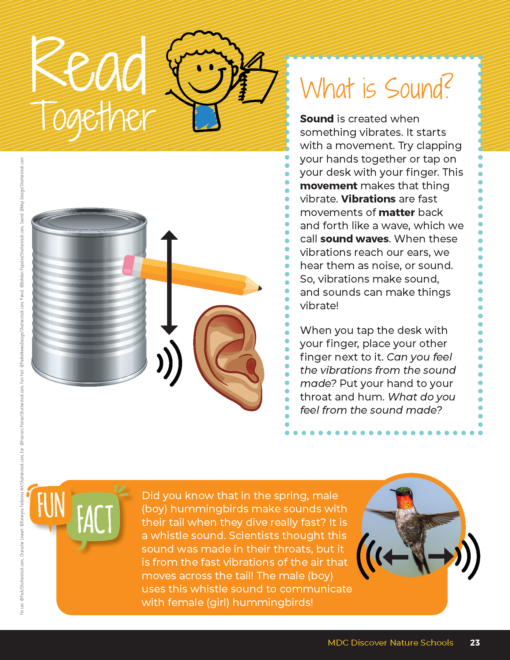
What is Sound?
Sound is created when something vibrates. It starts with a movement. Try clapping your hands together or tap on your desk with your finger. This movement makes that thing vibrate. Vibrations are fast movements of matter back and forth like a wave, which we call sound waves. When these vibrations reach our ears, we hear them as noise, or sound. So, vibrations make sound, and sounds can make things vibrate.
2A
Exploring Missouri – 2A Cricket Calls: Explain
23
Notes:
Have students open their student guide, Read Together 2A What Is Sound? section on Page 23.

Slide 24
What is Sound?
When you tap the desk with your finger, place your other finger next to it.
Can you feel the vibrations from the sound made?
Put your hand to your throat and hum.
What do you feel from the sound made?
2A
Exploring Missouri – 2A Cricket Calls: Explain
24
Notes:
Have students open their student guide, Read Together 2A What Is Sound? section on Page 23.

Slide 25
When rubbing a pencil across the can, what was vibrating?
Did you notice the can and the pencil were both vibrating?
2A
Exploring Missouri – 2A Cricket Calls: Explain
25
Notes:
We can hear because our ears “catch” sound. Sound vibrates our eardrums and tells our brains there is sound. Vibrations are fast movements of matter back and fourth. When rubbing a pencil across the can, what was vibrating? Did you notice the can and the pencil were both vibrating? Try it again and notice how both the can and the pencil make your hands feel. So, vibrations make sound, and sounds can make things vibrate!

Slide 26
2A
Exploring Missouri – 2A Cricket Calls: Explain
26
Notes:
Read the Fun Fact from the Read Together 2A page together.

Slide 27
Play the Hummingbird Diving Display video!
Link:
https://youtu.be/yQUkdp9YCpU?si=yDNLiuVC4wuOYkQe
2A
Exploring Missouri – 2A Cricket Calls: Explain
27
Notes:
Play the Hummingbird Diving Display video from the MDC Teacher Portal that demonstrates the male diving to make the high-pitched whistle sound.

Slide 28
Can you hear the whistle from the male?
What do you think he is saying to the female?
2A
Exploring Missouri – 2A Cricket Calls: Explain
28
Notes:
Answers will vary. (The display is to attract a mate.)

Slide 29
Go outside:
How does the vibration sound?
2A
Exploring Missouri – 2A Cricket Calls: Elaborate
29
Notes:
Go outside and gently rub small sticks together or on the bark of trees.

Slide 30
How does the hollow log sound different than a live tree?
2A
Exploring Missouri – 2A Cricket Calls: Elaborate
30
Notes:
Find a hollow log and thump it with a small stick. Thump a live tree.

Slide 31
Can you feel vibrations?
How and where else can you create vibrations?
2A
Exploring Missouri – 2A Cricket Calls: Elaborate
31
Notes:
Tap two small sticks together or place one hand on the hollow log and tree.
Encourage students to explore both outside and in the classroom with various materials.

Slide 32
How do you think crickets make their sounds?
What movement do you see?
What is vibrating?
2A
Exploring Missouri – 2A Cricket Calls: Elaborate
32
Notes:
While outside listen for crickets. You may also observe purchased crickets within a terrarium or clear container. When you hear a cricket, make observations of the movement noticed. Focus on the wing movement.
How do you think crickets make their sounds? What movement do you see? What is vibrating? (Crickets make the chirping sounds by rubbing their wings together.)

Slide 33
Let's watch the crickets chirping video one more time!
Link:
https://www.youtube.com/watch?v=s4noWAYNIN8
2A
Exploring Missouri – 2A Cricket Calls: Elaborate
33
Notes:
Share the Crickets Chirping video again with the class.

Slide 34
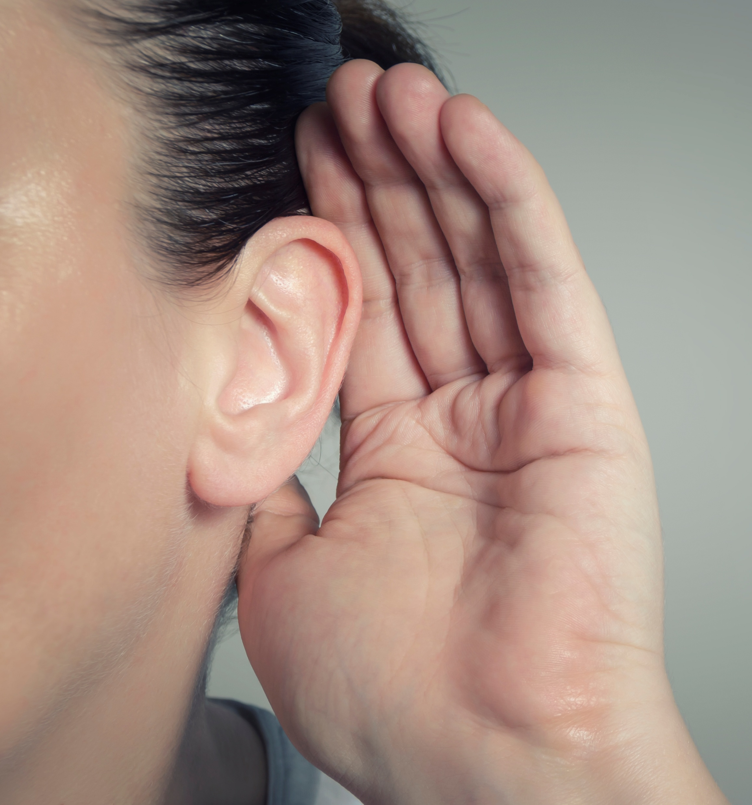
What is vibrating in the video?
How is this sound reaching our ears?
2A
Exploring Missouri – 2A Cricket Calls: Elaborate
34

Slide 35
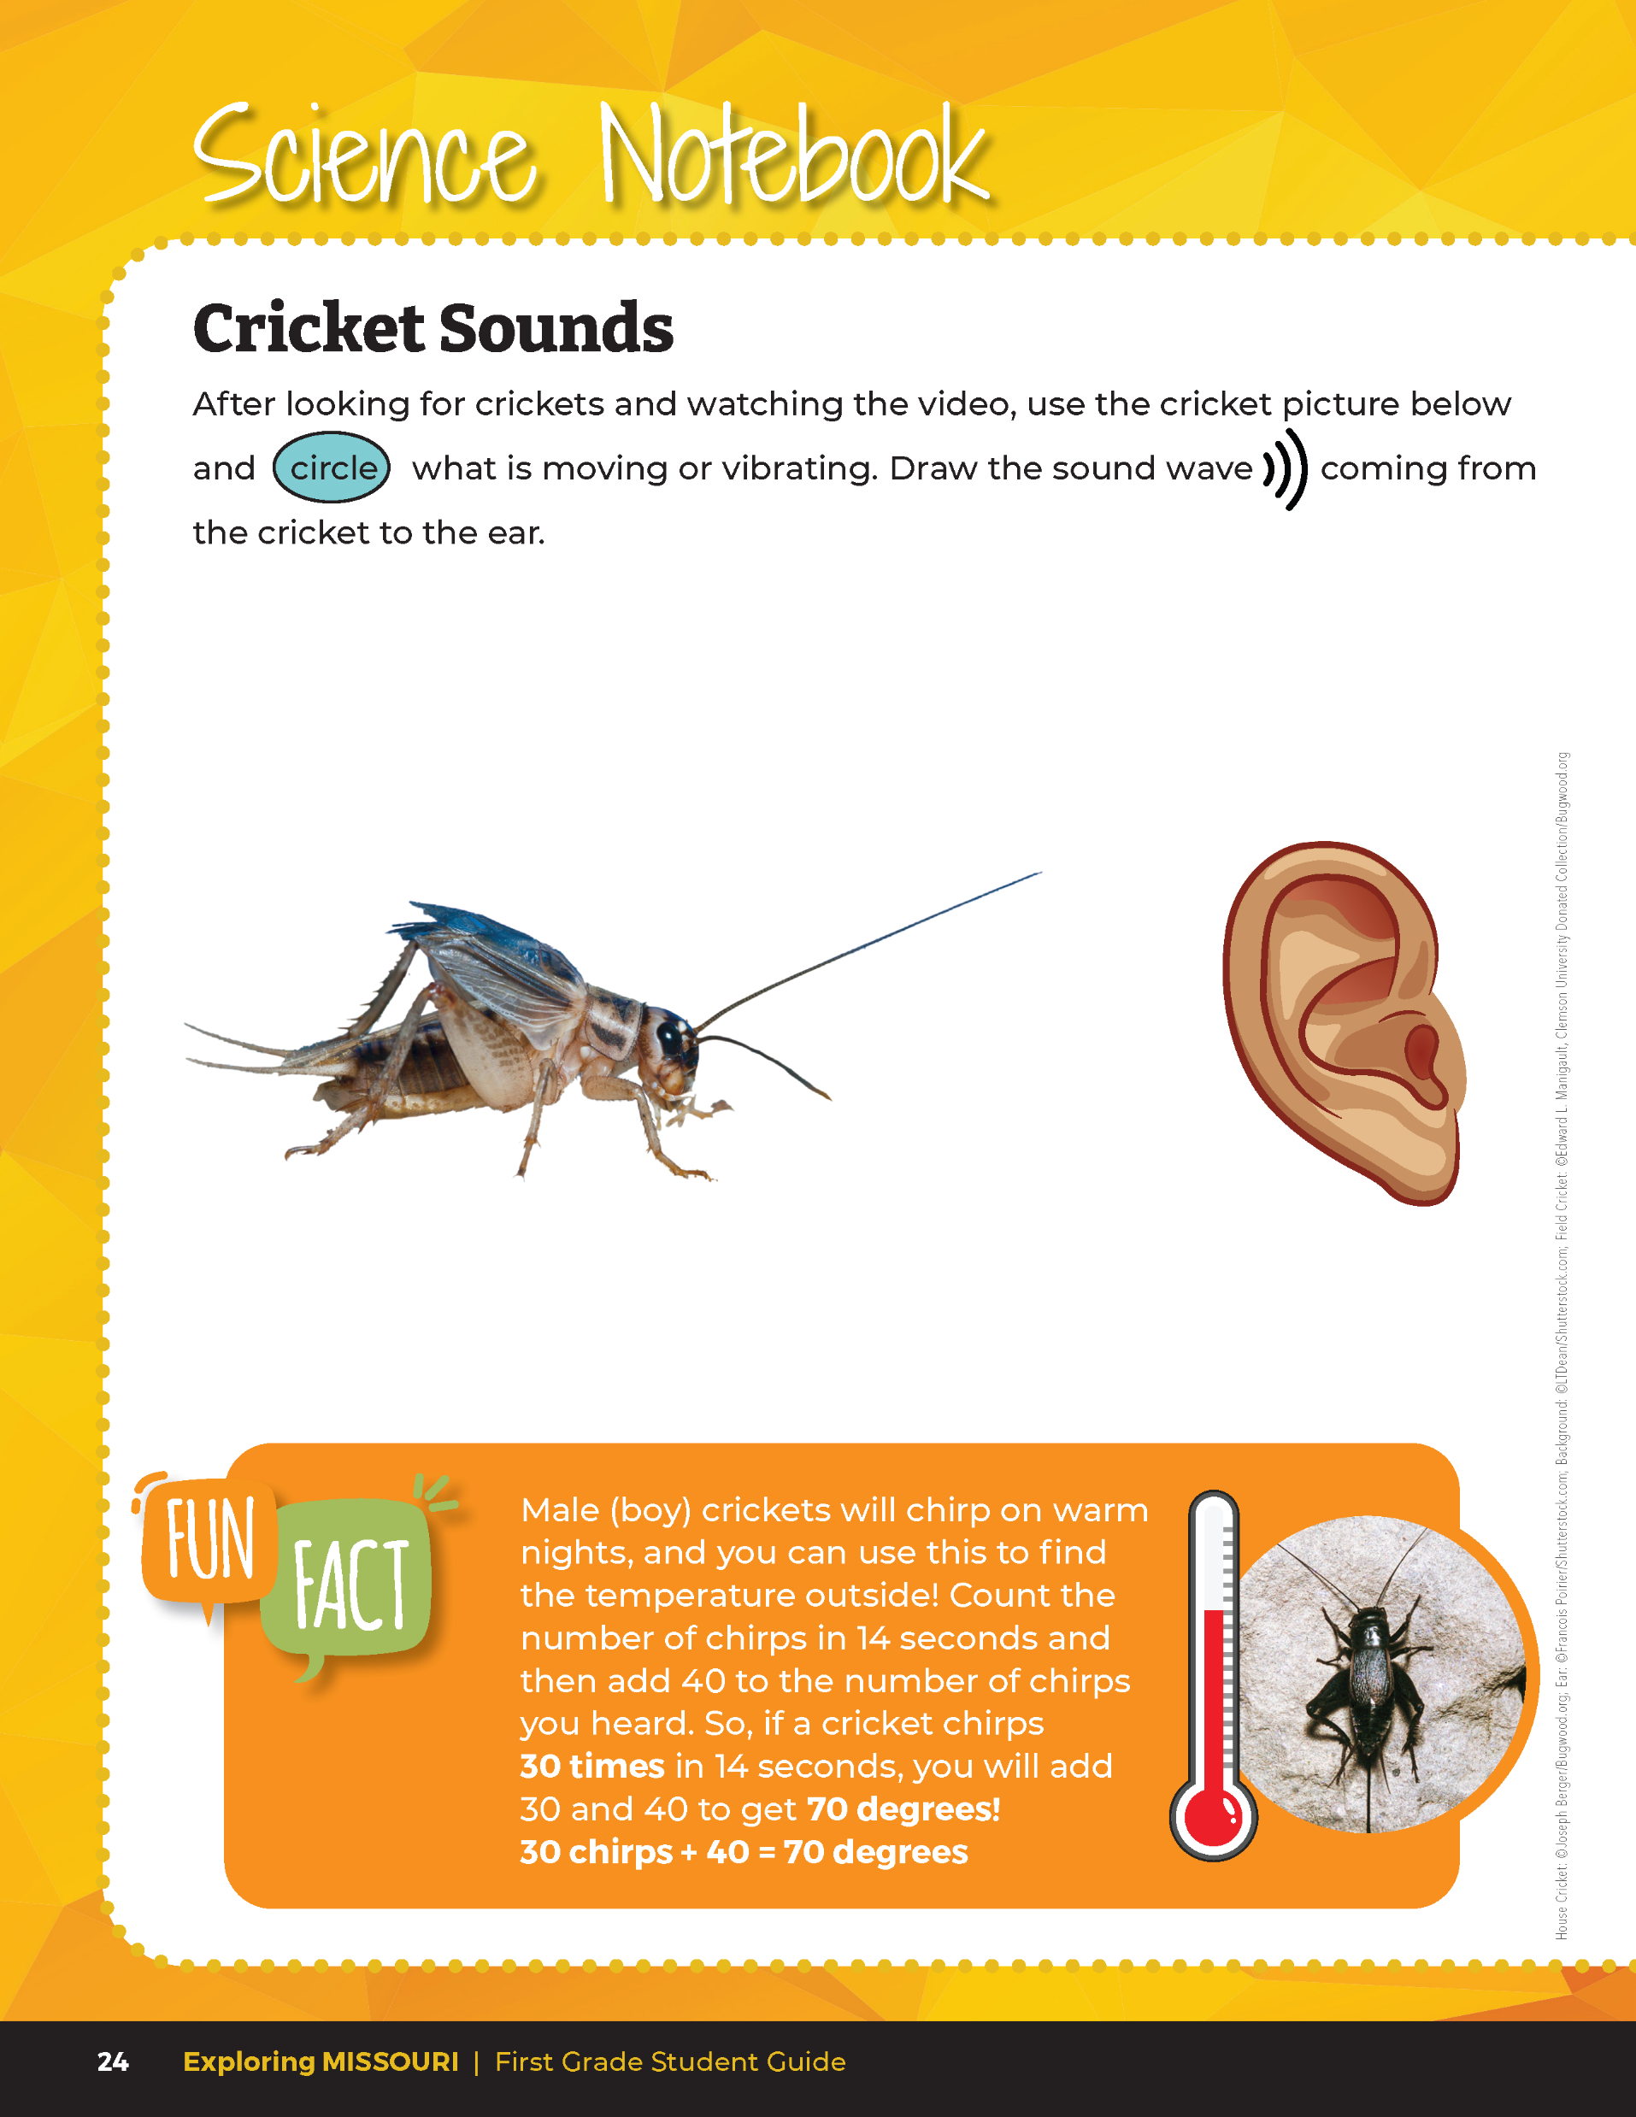

Circle the part of the cricket that is moving or vibrating and then draw the sound wave coming from the cricket to the human ear.
2A
Exploring Missouri – 2A Cricket Calls: Elaborate
35
Notes:
Have students open their student guide to Science Notebook 2A Cricket Sounds section on Page 24. Using either the live cricket observations or observations from the video, students will circle the part of the cricket that is moving or vibrating, and then draw the sound wave coming from the cricket to the human ear.
Teacher Note: The movement or vibration of the cricket wings is very interesting. You can choose to share the following information with your class: At the base of the forewing of a cricket, there is a thick, ridged vein that acts like a file. The upper surface of the forewing is hardened, like a scraper. When the male cricket calls for a female, he lifts his wings and pulls the file of one wing across the scraper of another.

Slide 36
2A
Exploring Missouri – 2A Cricket Calls: Elaborate
36

Slide 37
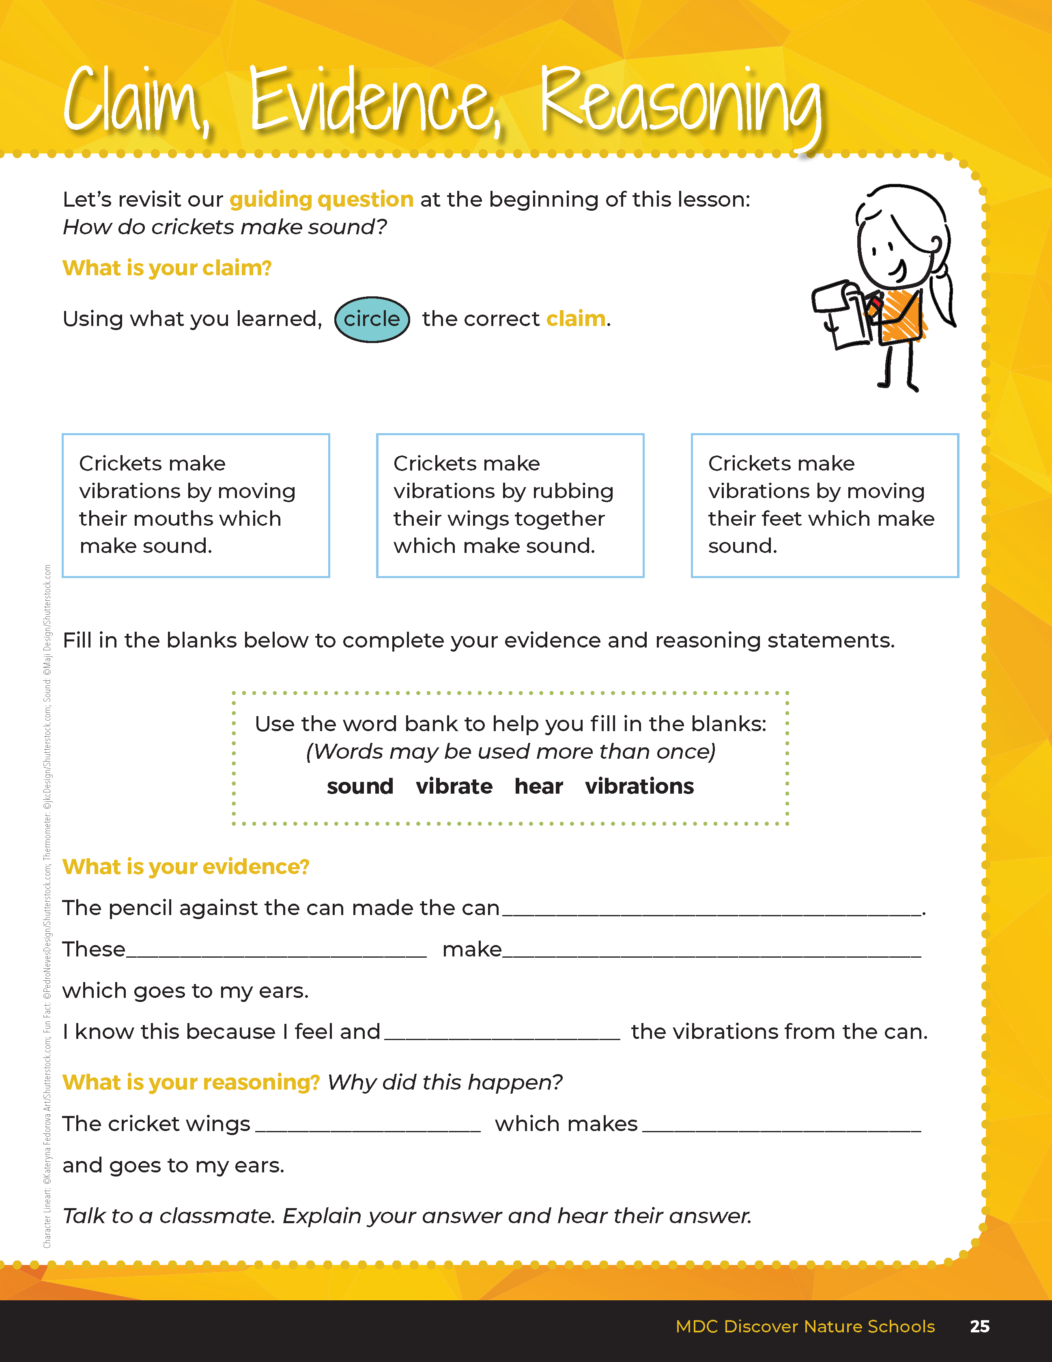
Guiding Question:
How do crickets make sounds?
2A
Exploring Missouri – 2A Cricket Calls: Elaborate
37
Notes:
After exploring the concept of sound and vibration, have students open their student guides to the Claim, Evidence, Reasoning section on Page 25. Discuss the page with the students – read the guiding question and then explain what the students need to do to answer the questions (circle the correct claim and fill in the blanks.)

Slide 38
Answers
vibrate
vibrations
sound
hear
vibrate
sound
2A
Exploring Missouri – 2A Cricket Calls: Elaborate
38
Notes:
Rubric:
3 (Meets) – Students can define and identify that sound is produced by vibrations. Students circle the correct claim, write the correct evidence statement, and identify the correct reason.
2 (Partially meets) – Students can define that a sound is made but do not connect it to vibration or movement. Two of the three components of CER are correct.
1 (Doesn’t meet) – Students cannot answer the above questions. One of the three components of CER is correct.

