Slide 1
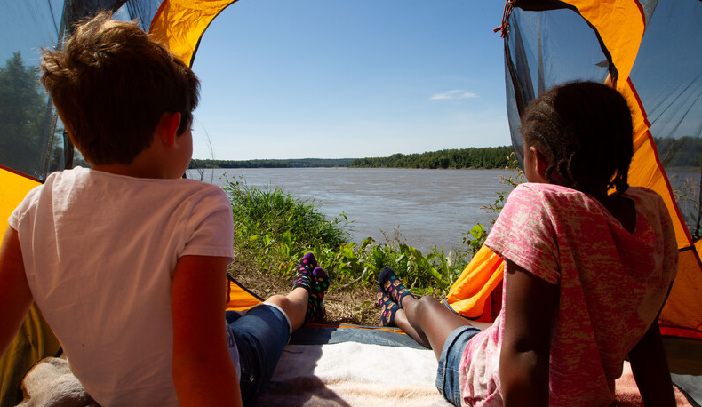

Life and Land in
MISSOURI
Unit 1 Review

Slide 2
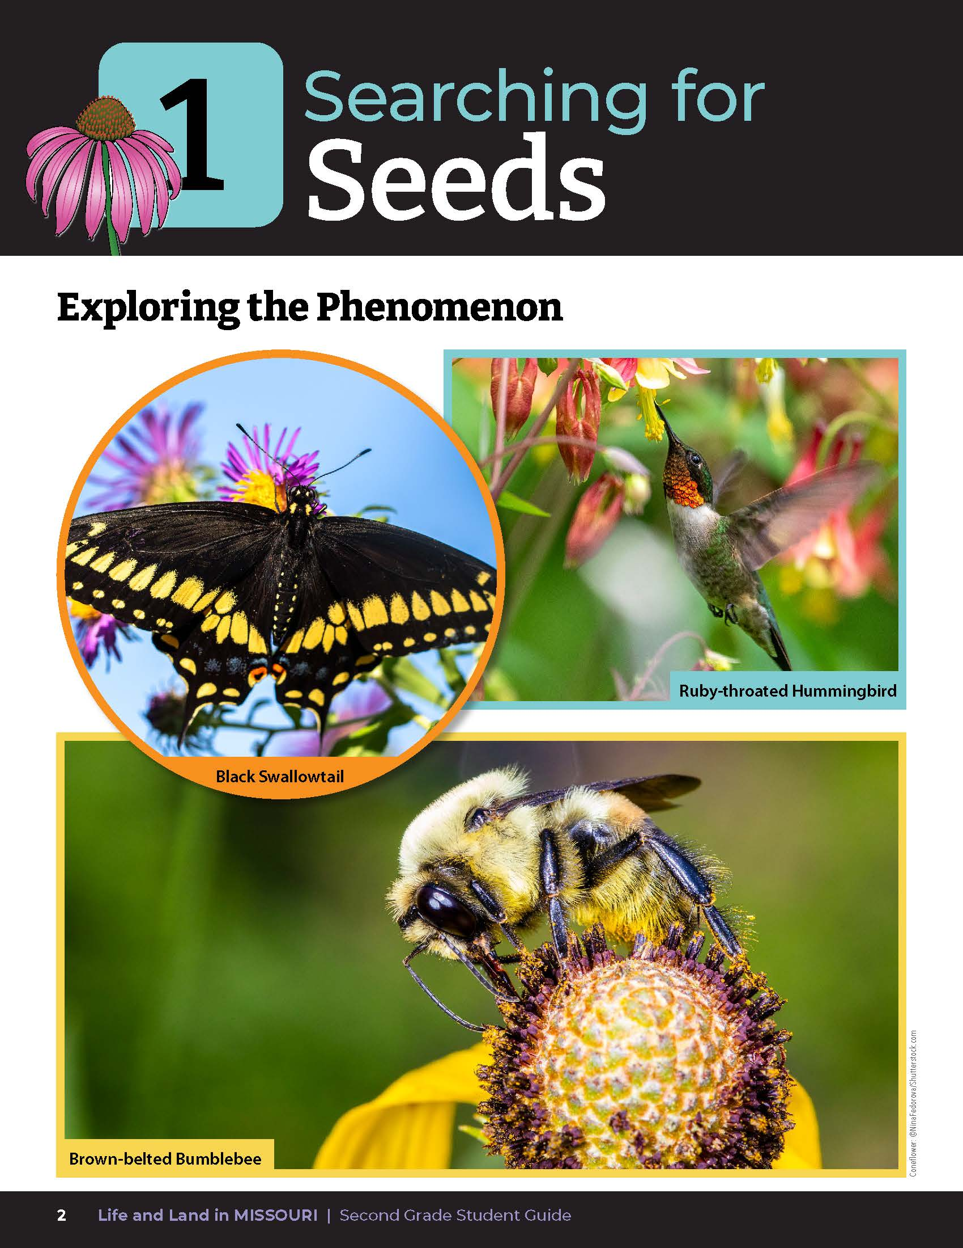
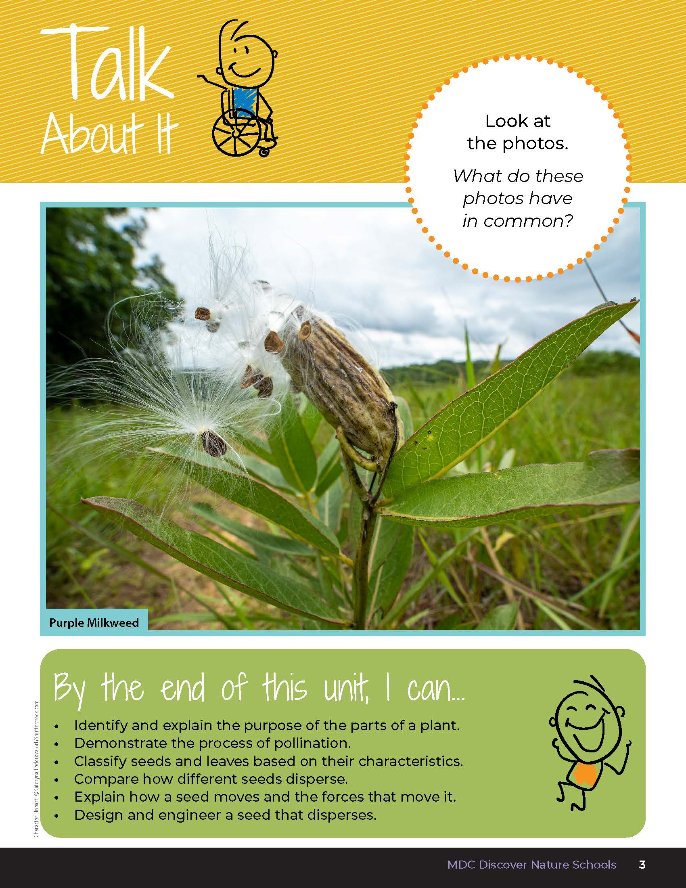
1
Life and Land in Missouri– Unit 1 Review
2
Notes:
Have students turn to Unit 1 Exploring the Phenomenon and the Talk About It section on pages 2-3. Using the pictures at the beginning of the lesson, have students turn and talk to a classmate and describe what is happening in each of the photos.

Slide 3
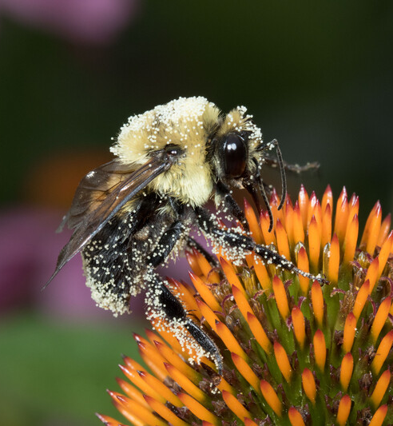
What is pollination?
1
Life and Land in Missouri– Unit 1 Review
3
Notes:
(The process including wind, water, and animal movement that allows plants to reproduce and make more plants.)
Animal in Picture: Brown-belted Bumble Bee; Plant in Picture: Purple Coneflower

Slide 4
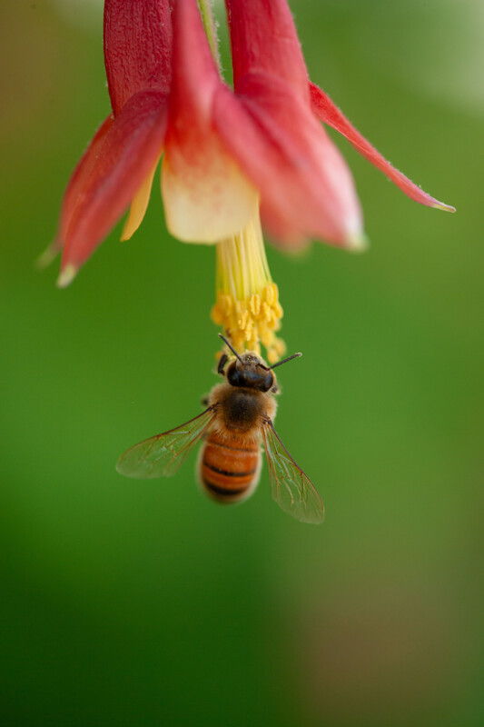
Why do pollinators need to pollinate plants?
1
Life and Land in Missouri– Unit 1 Review
4
Notes:
(Pollinators help move pollen from plant to plant which helps plants to reproduce.)
Animal in Picture: Honeybee; Plant in Picture: Columbine

Slide 5
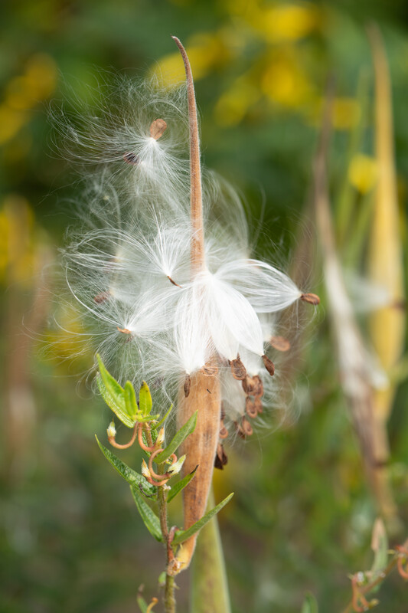
How do seeds disperse and why is this important?
1
Life and Land in Missouri– Unit 1 Review
5
Notes:
(Seeds are scattered in many different ways, such as by wind, water, or animals. Seeds need space to grow and so they need to scatter.)
Plant in Picture: Butterfly Milkweed seeds

Slide 6
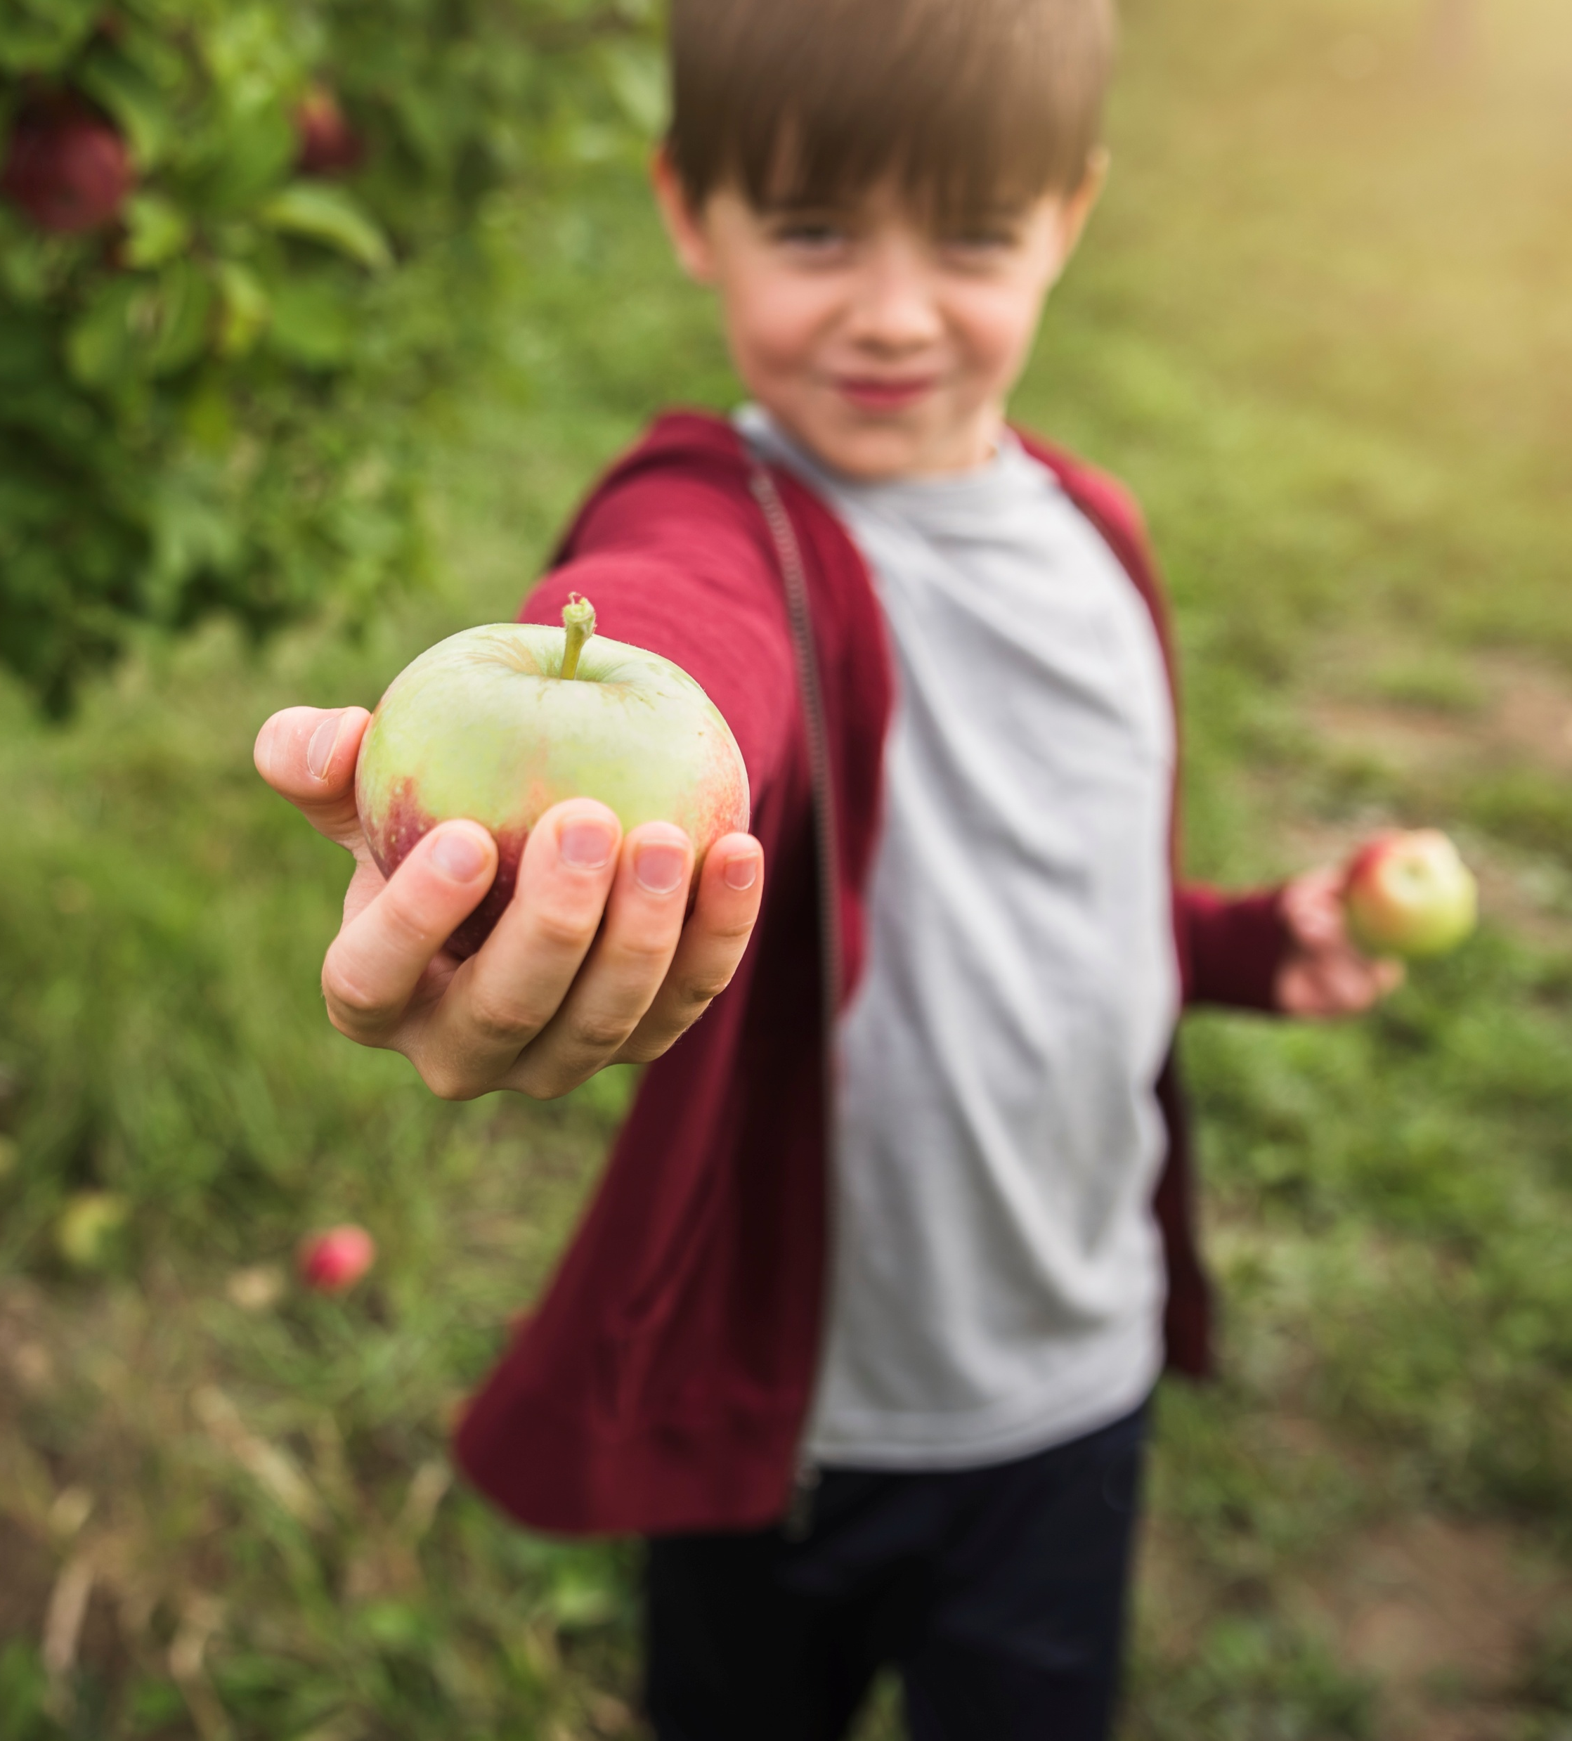
What would happen to us as humans if the pollinators were gone or if seeds only dispersed in one place?
1
Life and Land in Missouri– Unit 1 Review
6
Notes:
(Plants would not grow. And we eat plants to survive.)\
Rubric:
3 (Meets) – Student explains the process of pollination through different methods and that is allows plants to reproduce and make more plants. Student explains that pollinators help move pollen from plant to plant which helps plants to reproduce. Student describes the methods of seed dispersal and that seeds need space to grow to survive. Student explains that plants would not grow and that we would not be able to eat the plants which we need to survive.
2 (Partially meets) – Student somewhat explains the process of pollination through different methods and that it allows plants to reproduce and make more plants. Student somewhat explains that pollinators help move pollen from plant to plant which helps plants to reproduce. Student somewhat describes the methods of seed dispersal and that seeds need space to grow to survive. Student somewhat explains that plants would not grow and that we would not be able to eat the plants which we need to survive.
1 (Doesn’t meet) – Student does not offer any explanation of the process of pollination or any method of seed dispersal.

Slide 7
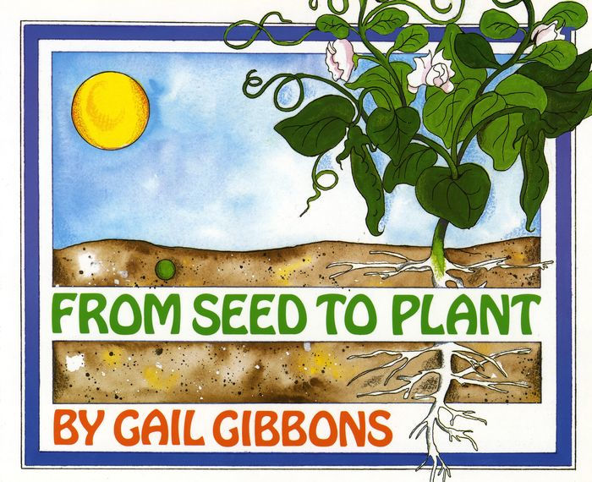
Read the book From Seed to Plant by Gail Gibbons.
Read Aloud:
https://youtu.be/TLEns2oCd6U?si=34cVAZGDlnraO7Ic
1
Life and Land in Missouri– Unit 1 Review
7

Slide 8
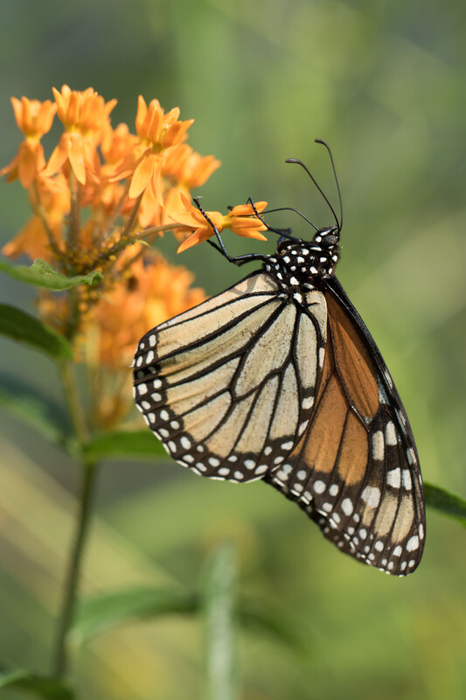
What helps the flowers reproduce?
1
Life and Land in Missouri– Unit 1 Review
8
Notes:
(Pollination.)
Animal in Picture: Monarch butterfly; Plant in Picture: Butterfly Milkweed

Slide 9
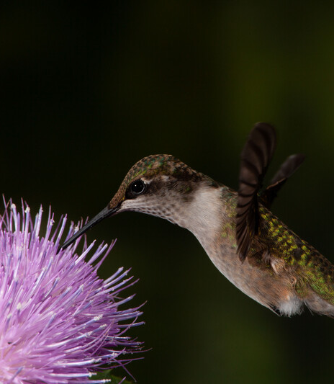
What pollinators visited the flowers in the book?
1
Life and Land in Missouri– Unit 1 Review
9
Notes:
(Bees, insects, and hummingbirds.)
Animal in Picture: Ruby-throated Hummingbird

Slide 10
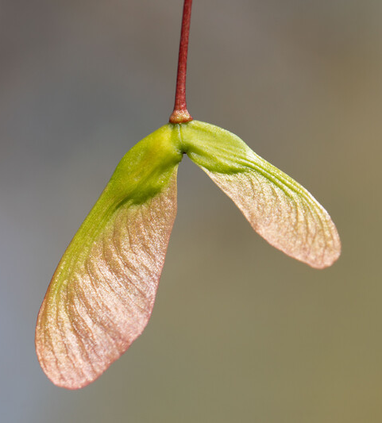
What helped seeds to disperse?
1
Life and Land in Missouri– Unit 1 Review
10
Notes:
(Seeds falling to the ground, seeds that may burst out, water and wind carrying the seeds, animals, and people.)
Plant in Picture: Maple Tree seeds

Slide 11
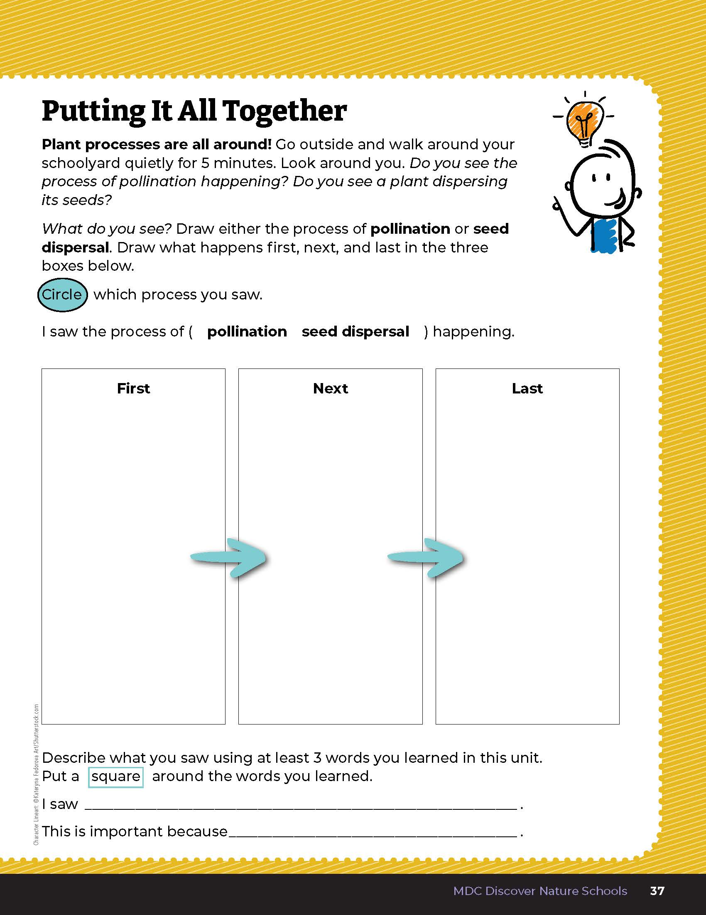
Draw one of the following: pollination or seed dispersal
1
Life and Land in Missouri – Unit 1 Review
11
Notes:
Students will go outside and either walk around the schoolyard for 5 minutes or find one place to sit quietly. Using the Putting It All Together section on Page 37, students will draw either a process of pollination happening or the process of seed dispersal. Students will identify the process as either pollination or seed dispersal by circling the correct answer and will use at least 3 vocabulary terms to describe what they saw while outside.
Rubric:
3 (Meets) – Student drawing shows either the process of pollination starting with the pollinator on the plant, describing what it is collecting, and then moving to another plant; or student drawing shows the process of seed dispersal starting with the parent plant dropping a seed, what seed dispersal method is taking the seed, and where it ends up. Student circles the correct process drawn and uses at least 3 vocabulary terms correctly when describing the process.
2 (Partially meets) – Student drawing shows some of the components of pollination or seed dispersal. Student circles the correct process drawn and uses 1-2 vocabulary terms correctly when describing the process.
1 (Doesn’t meet) – Student drawings shows very few of the components of pollination or seed dispersal. Student may or may not circle the correct process drawn and does not use any of the vocabulary terms correctly when describing the process.

Slide 12

Optional: Cross-Curricular Extension
English Language Arts
Write a marketing advertisement to sell your favorite native Missouri seed. Be sure to use descriptive words to describe the characteristics of the seed and how it disperses.
Write a persuasive letter to the mayor to encourage planting native plants for pollinators in city parks.
1
Life and Land in Missouri– Unit 1 Review
12
Notes:
Write a persuasive letter to the mayor to encourage planting native plants for pollinators in city parks.
Write a marketing advertisement to sell your favorite native Missouri seed. Be sure to use descriptive words to describe the characteristics of the seed and how it disperses.

Slide 13
Optional: Cross-Curricular Extension
Math
Using a walnut and a ball of equal size, measure out 5 feet and roll them. Time how long it takes each to cross the finish line.
Do all walnuts roll at the same speed?
Sort and count items based on similarities. Record your data. Can the items be sorted more than once based on different characteristics? If so, sort, count, and record again. Create a bar graph that represents on set of data.
1
Life and Land in Missouri– Unit 1 Review
13

Slide 14
Optional: Cross-Curricular Extension
Art
Create thumbprint insects and flowers. Have students begin with a thumbprint using ink or finger paints and then add insect body parts and flower petals with markers, crayons, paint, or construction paper.
1
Life and Land in Missouri– Unit 1 Review
14

Slide 15
Optional: Cross-Curricular Extension
Outdoor Skills and Citizen Science
Choose a native plant in your schoolyard to study through the year. Participate in Project Budburst at budburst.org and document seasonal changes as a class. Visit the MDC Teacher Portal for more information.
Participate in The Great Sunflower Project. Visit the MDC Teacher Portal for more information.
Identify each nature item you have sorted. What type of plant did the leaves come from? Reference MDC’s online Field Guide from the MDC Teacher Portal.
1
Life and Land in Missouri– Unit 1 Review
15

