Slide 1
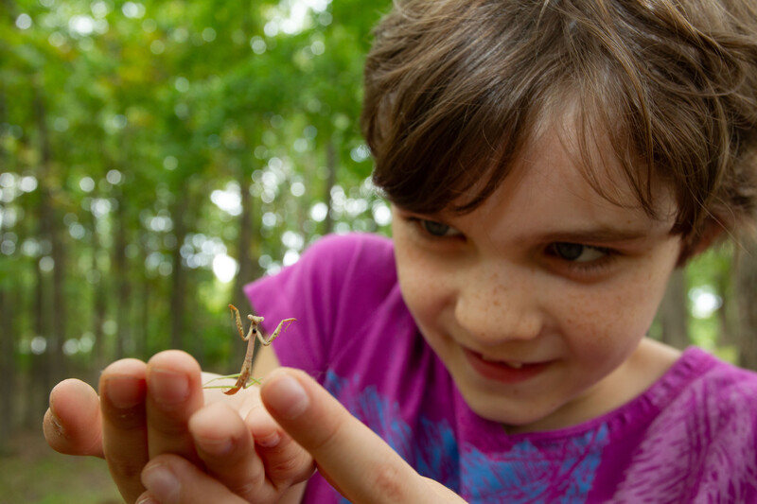

Exploring
MISSOURI
Unit 1 Review

Slide 2
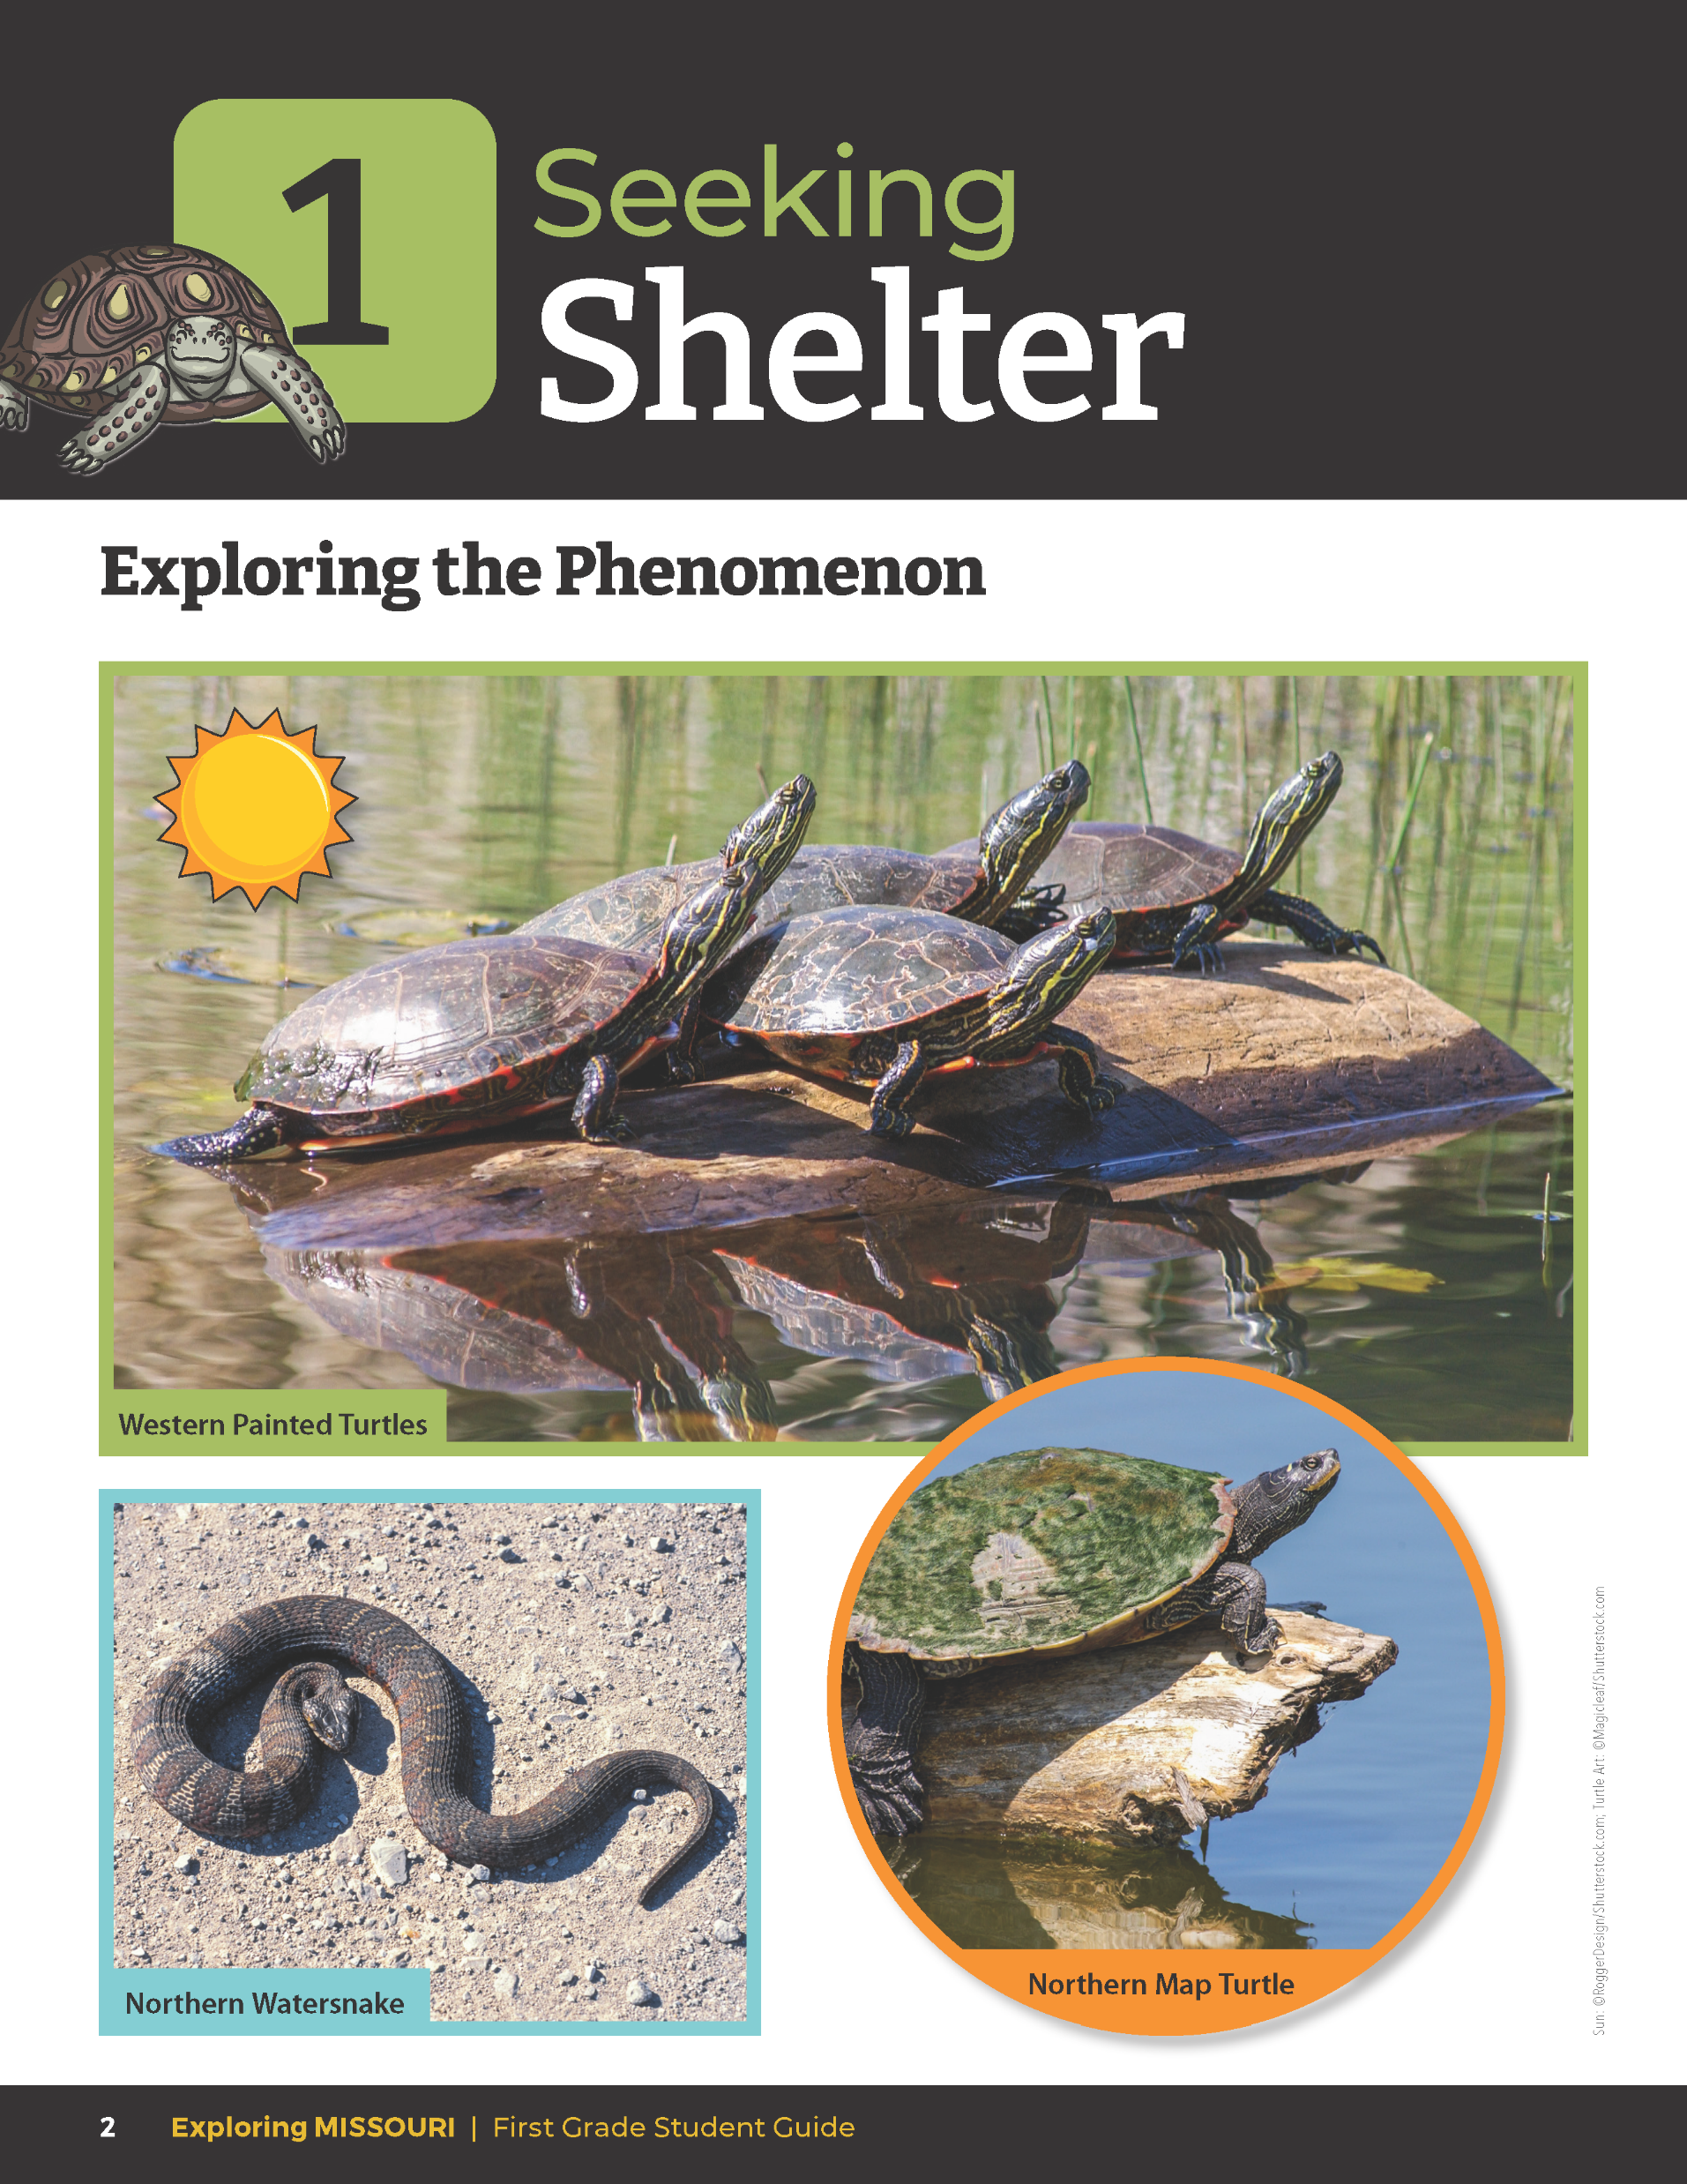
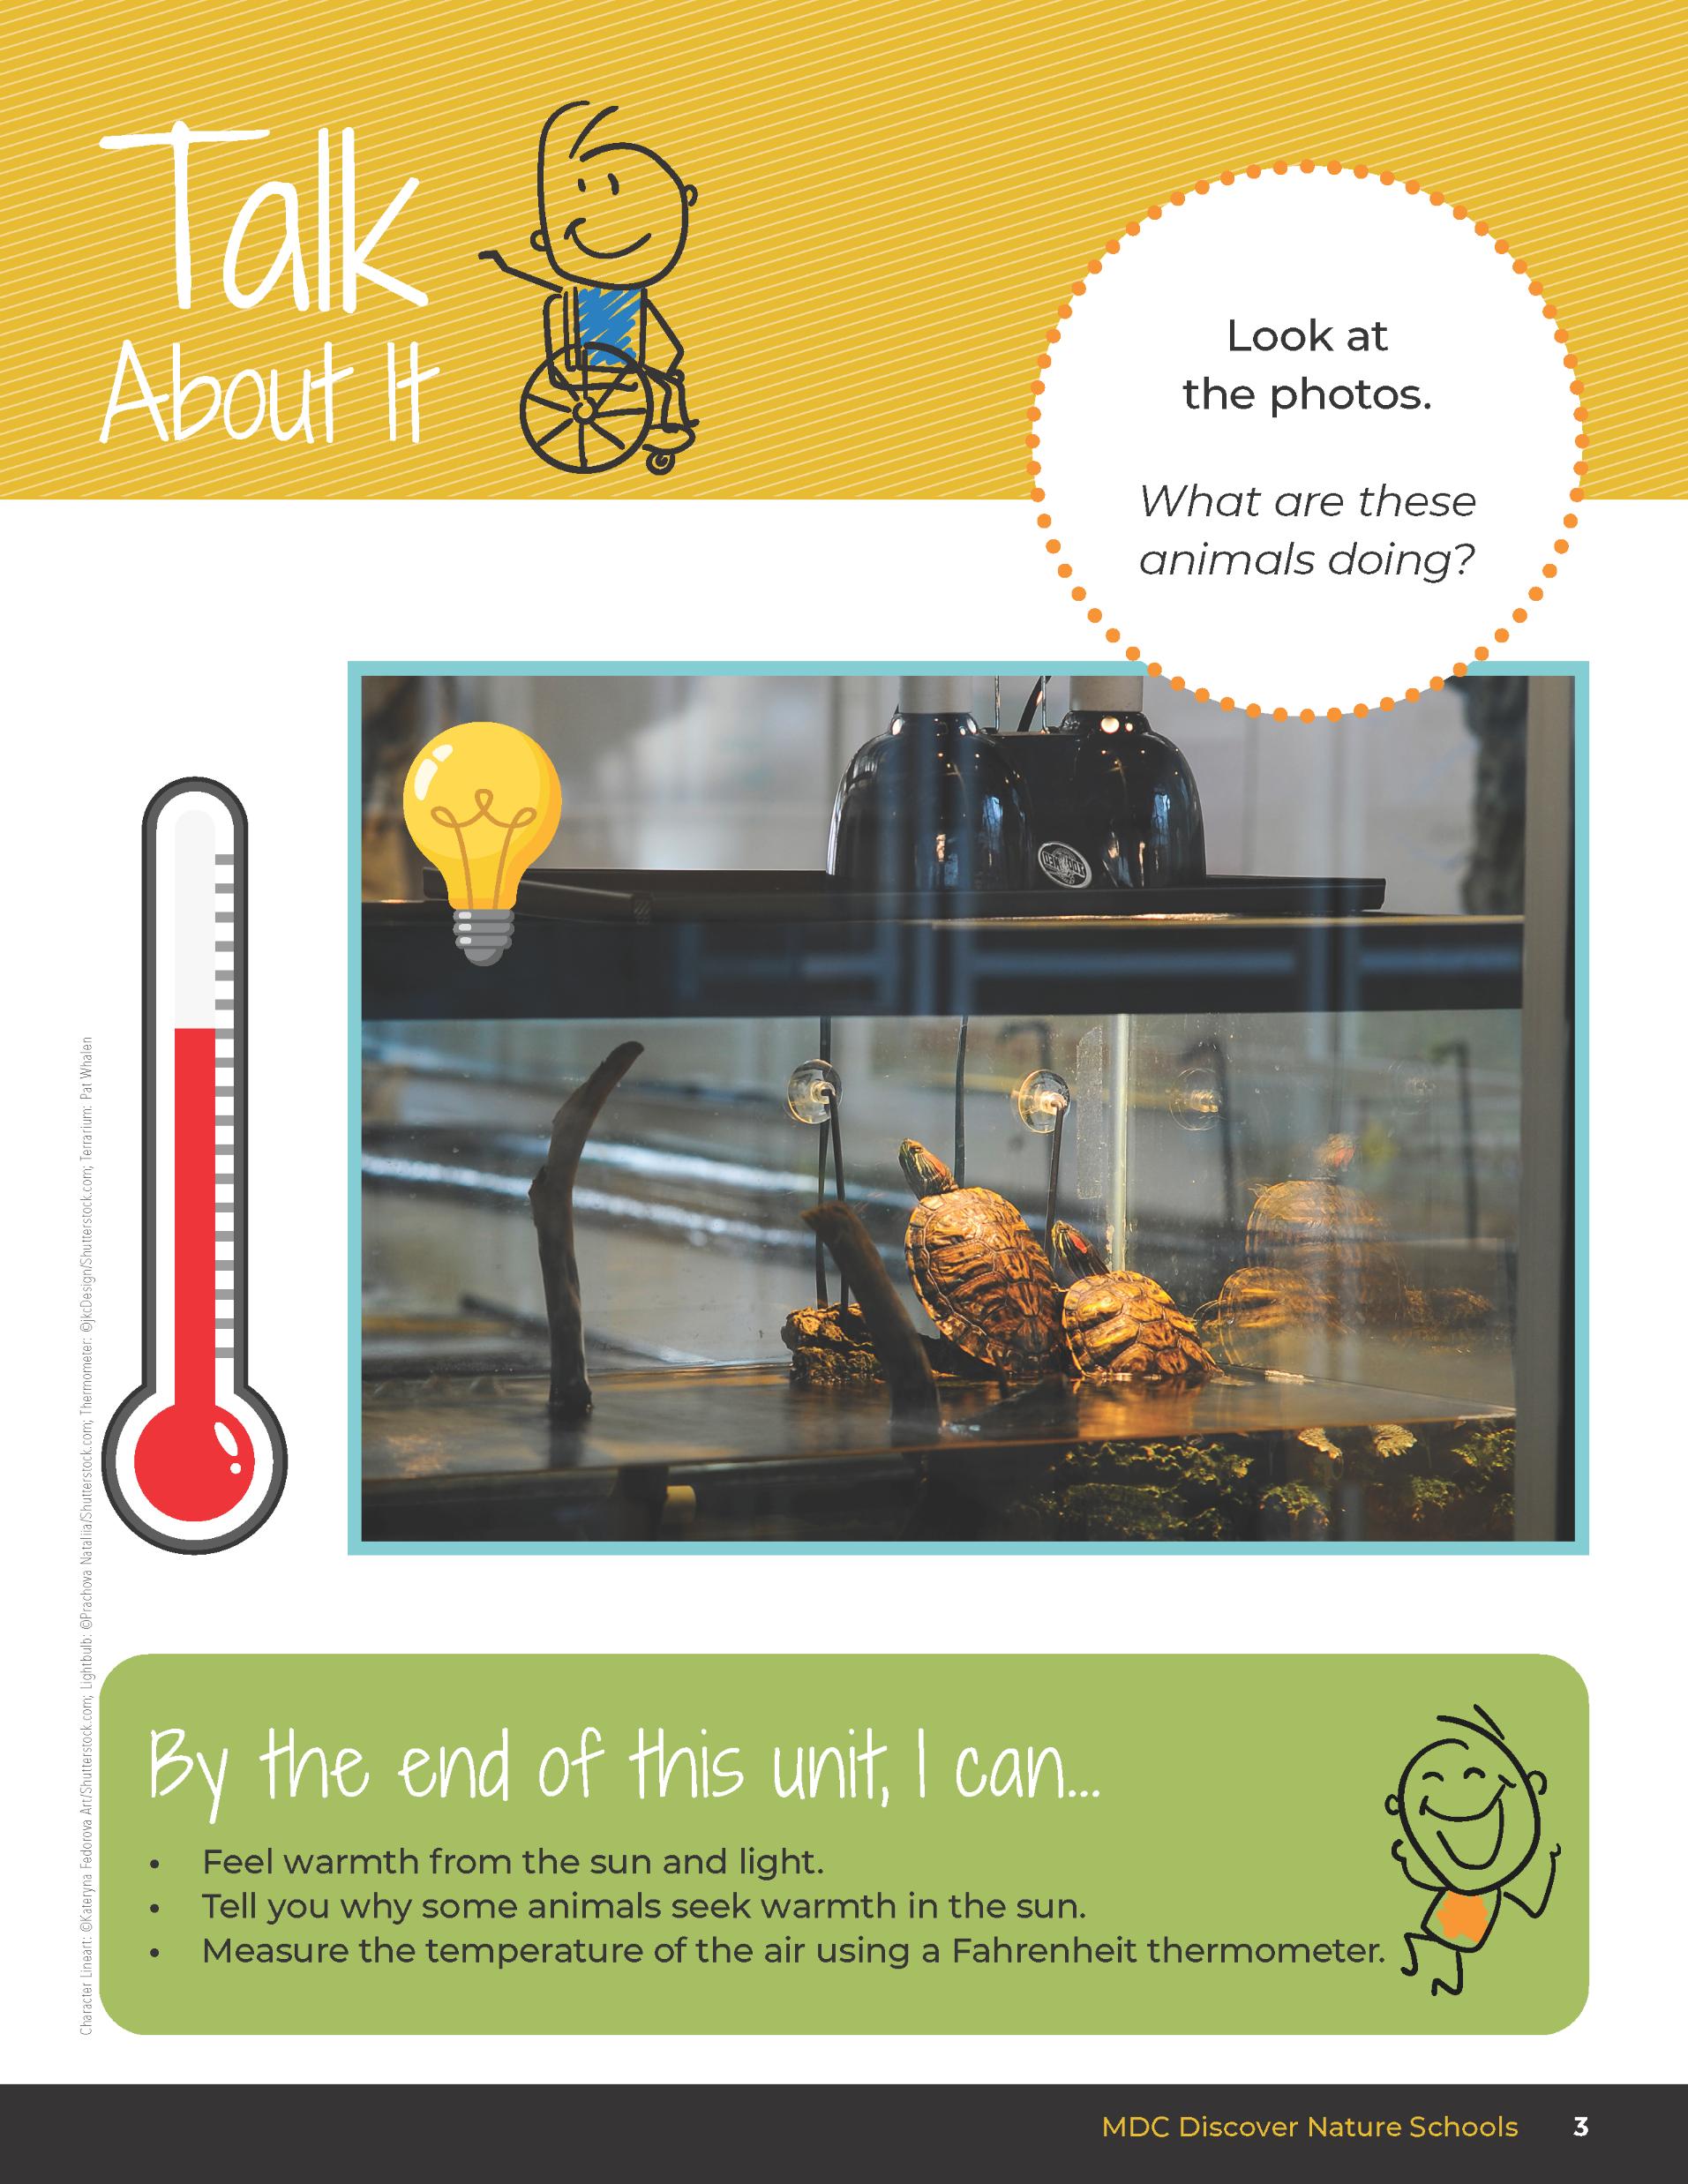
What are the sources of heat these animals are using and why?
1
Exploring Missouri – Unit 1 Review
2
Notes:
Have students turn to the Unit 1 Exploring the Phenomenon Talk About It section on pages 2-3. Using the pictures at the beginning of the lesson, what are the sources of heat these animals are using to survive and why? Students will talk to their partner and share out loud.
Rubric:
3 (Meets) – Student references both heat sources and that the animal is cold-blooded and needs a heat source to survive.
2 (Partially Meets) – Student references only one heat source and/or does not state that the animal is cold-blooded.
1 (Doesn’t Meet) – Student does not reference either heat source and does not refer to the animal being cold-blooded.

Slide 3
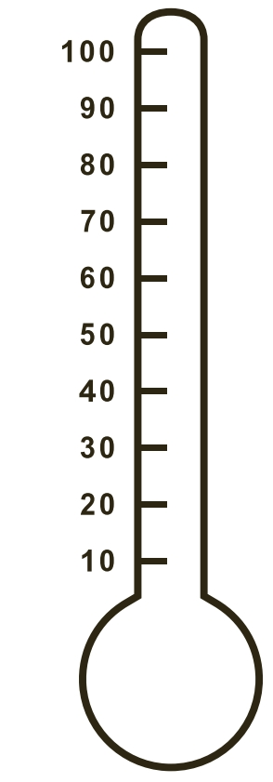
Go outside:
In your groups, visit various locations in the schoolyard and identify what locations are hotter and cooler.
1
Exploring Missouri – Unit 1 Review
3
Notes:
Distribute thermometers to groups of three to four students. Have students visit various locations in the schoolyard. Have them identify what locations are more and less hot. Visit a variety of locations including the grass, sidewalk, asphalt, playground, and under a tree.

Slide 4
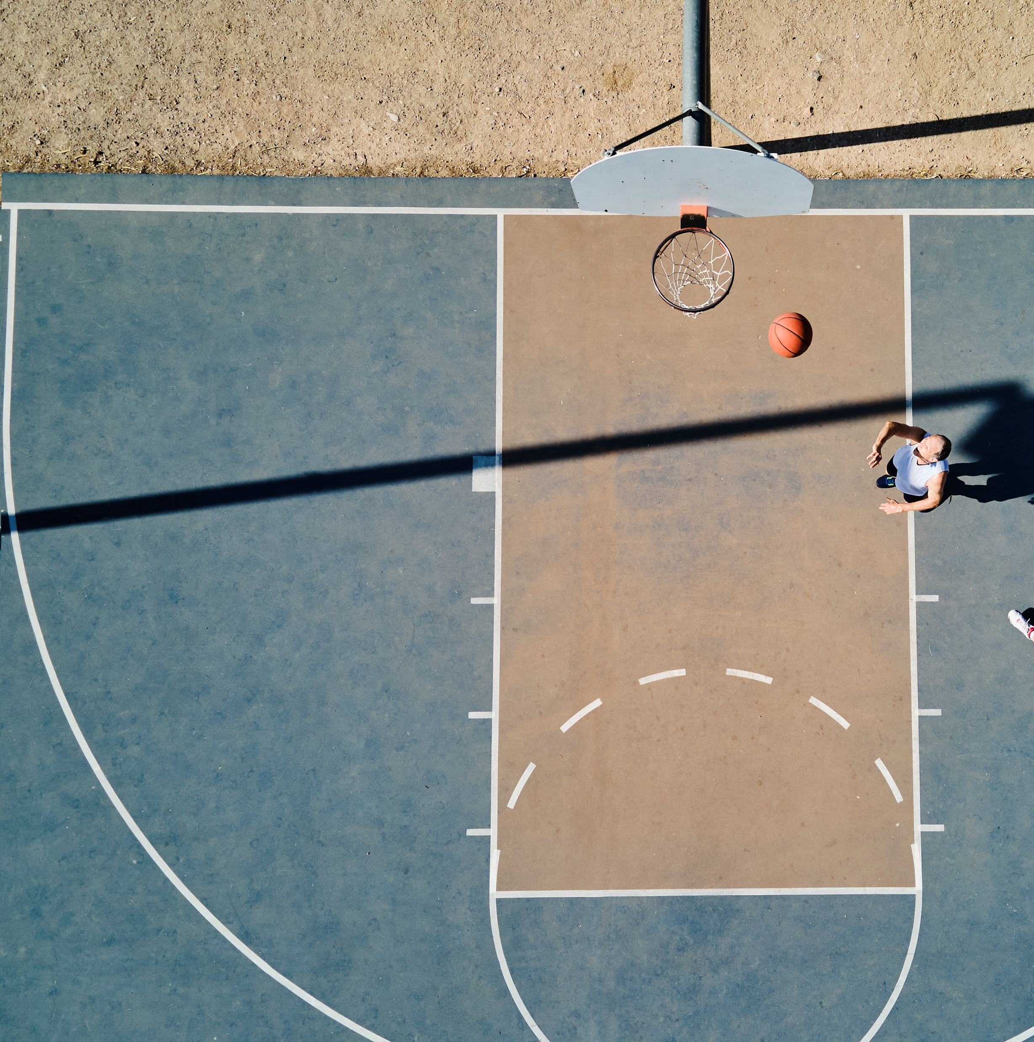
What places feel the hottest? Why?
1
Exploring Missouri – Unit 1 Review
4

Slide 5

What places feel the coolest? Why?
1
Exploring Missouri – Unit 1 Review
5

Slide 6
What makes one place warmer than the other?
1
Exploring Missouri – Unit 1 Review
6

Slide 7

Going back to yesterday, what are the sources of heat in areas that are the hottest?
1
Exploring Missouri – Unit 1 Review
7

Slide 8
Write the temperature on a sticky note and place it on the schoolyard map where you found it to be the warmest.
86
1
Exploring Missouri – Unit 1 Review
8
Notes:
Refer to the map of the schoolyard on the board from the day before. Using sticky notes with one per student, have students write the temperature on the sticky note and place it onto the map where they found it to be warmest. Have them explain to the class why this is the warmest place in the schoolyard and identify the heat source that makes it the warmest.

Slide 9
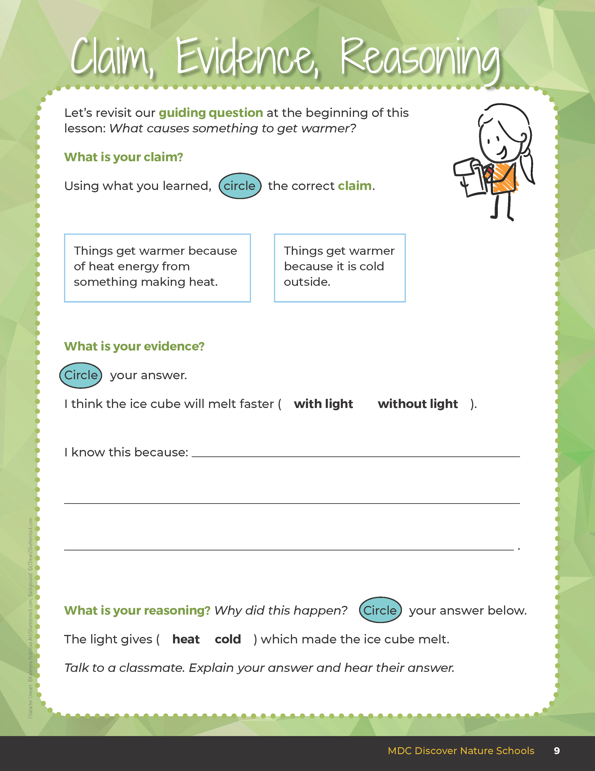
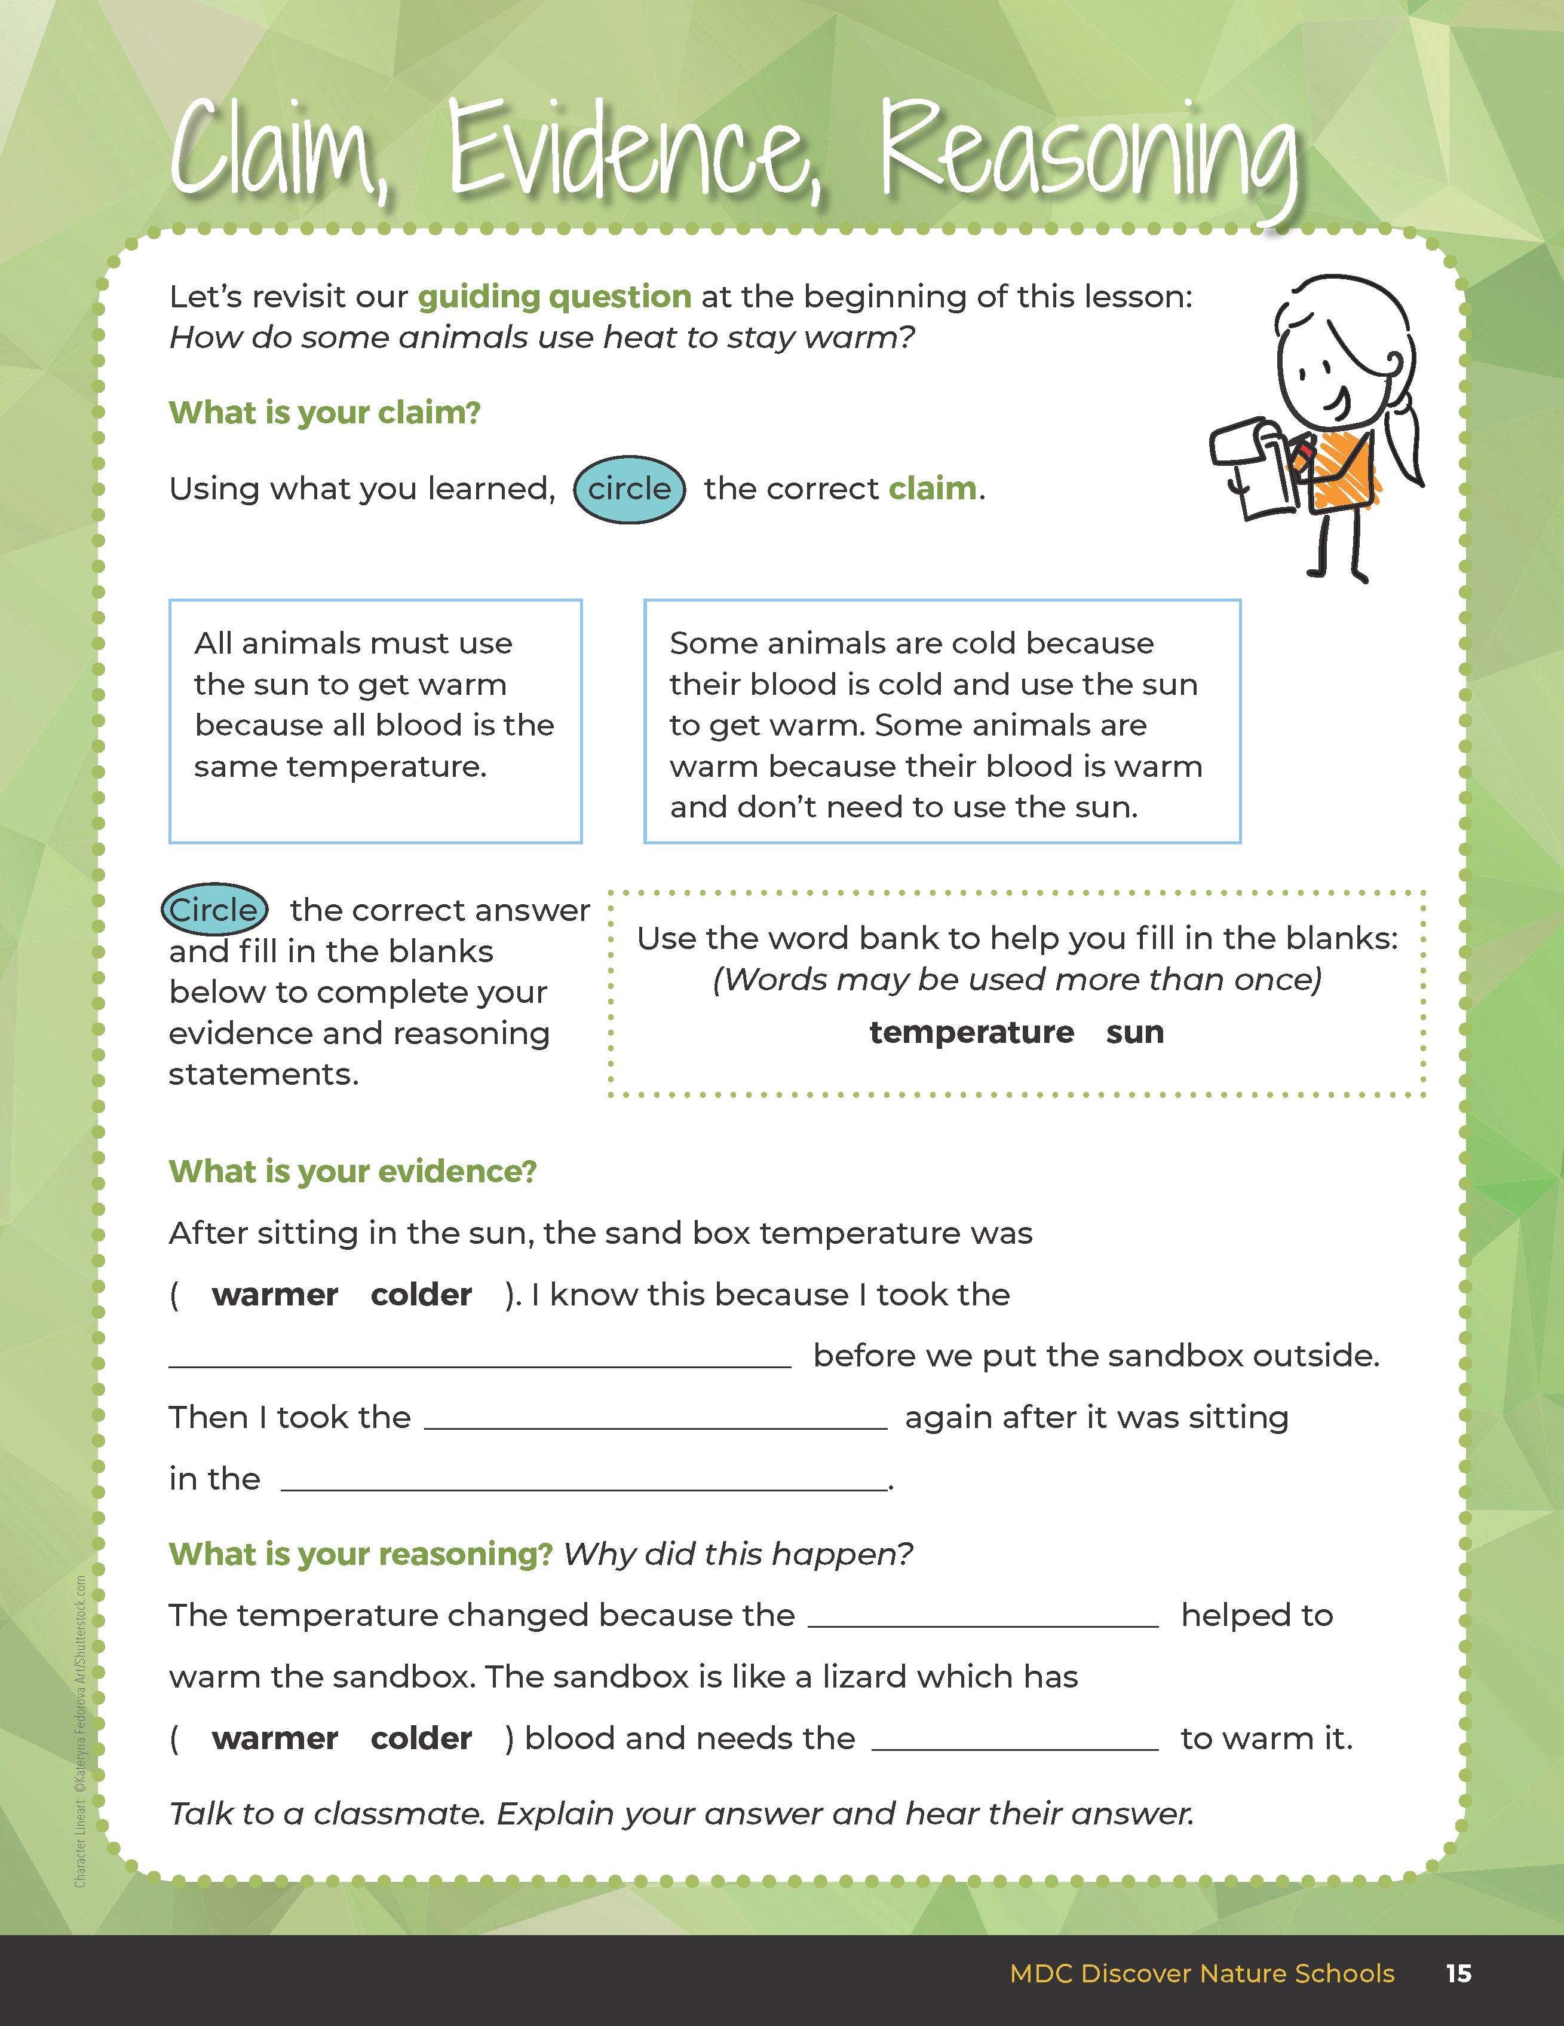
Explain to the class why this is the warmest place in the schoolyard and identify the heat source that makes it the warmest.
1
Exploring Missouri – Unit 1 Review
9
Notes:
Have them explain to the class why this is the warmest place in the schoolyard and identify the heat source that makes it the warmest. Students should use past Claim, Evidence, Reasoning pages from their student guide to help them with their answer.

Slide 10
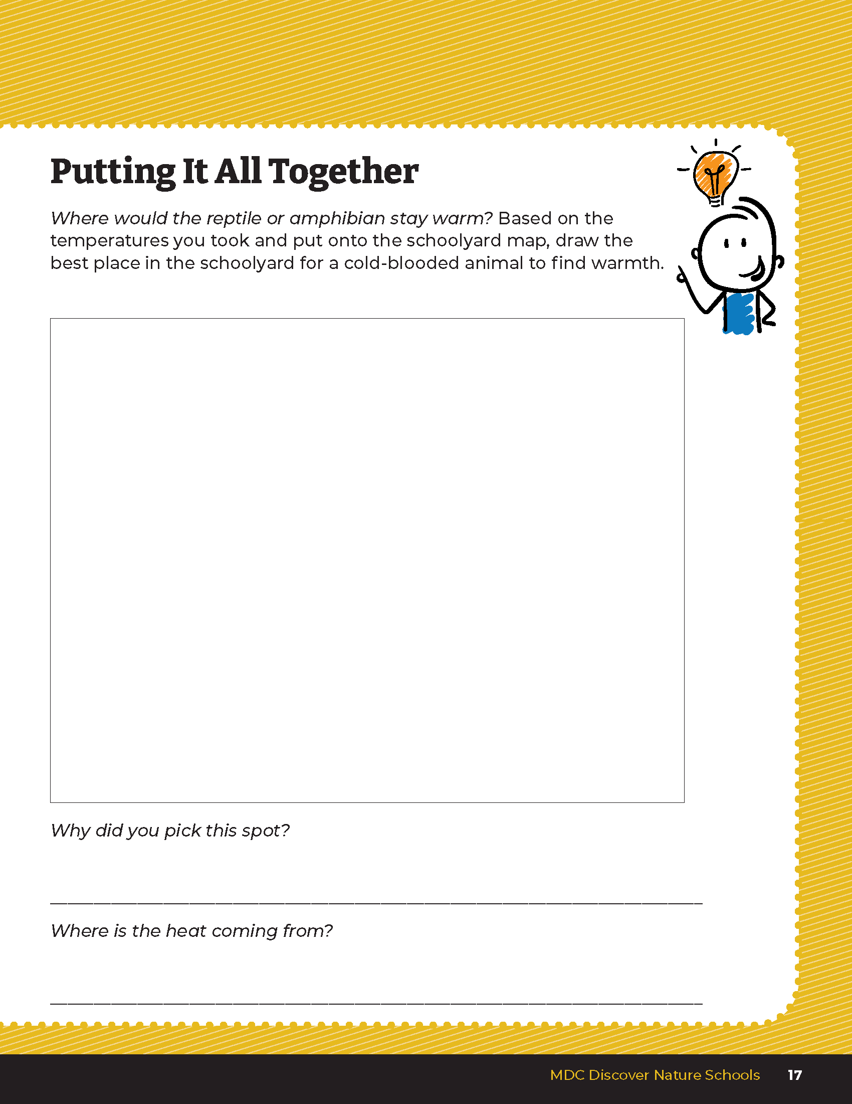
Draw the best place in the schoolyard for a reptile or amphibian to stay warm.
1
Exploring Missouri – Unit 1 Review
10
Notes:
Using the classroom schoolyard map, they will draw and write their answer in their student guide, Unit 1 Putting It All Together section on Page 17.
Rubric:
3 (Meets) – Student references both heat sources and that the animal is cold-blooded and needs a heat source to survive.
2 (Partially meets) – Student references only one heat source and/or does not state that the animal is cold-blooded.
1 (Doesn’t meet) – Student does not reference either heat source and does not refer to the animal being cold-blooded.

Slide 11
Why did you pick this spot?
Where is the heat coming from?
1
Exploring Missouri – Unit 1 Review
11
Notes:
Class discussion
Rubric:
3 (Meets) – Student references both heat sources and that the animal is cold-blooded and needs a heat source to survive.
2 (Partially meets) – Student references only one heat source and/or does not state that the animal is cold-blooded.
1 (Doesn’t meet) – Student does not reference either heat source and does not refer to the animal being cold-blooded.

