Slide 1
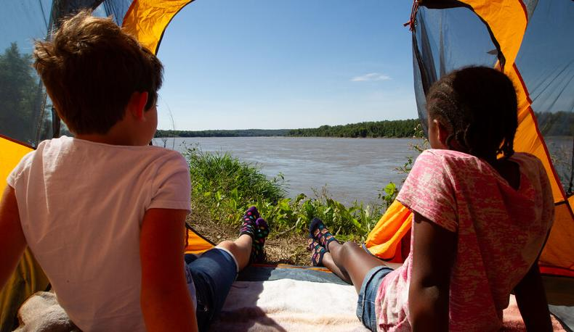

Life and Land in
MISSOURI
1F: Seed Engineers

Slide 2
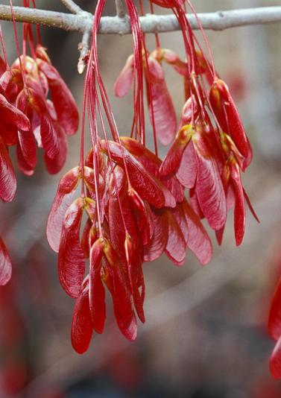
Guiding Question:
How can I build a seed that disperses?
1F
Life and Land in Missouri – 1F Seed Engineers: Engage
2
Notes:
Plant in Picture: Winged Red Maple Tree seeds

Slide 3
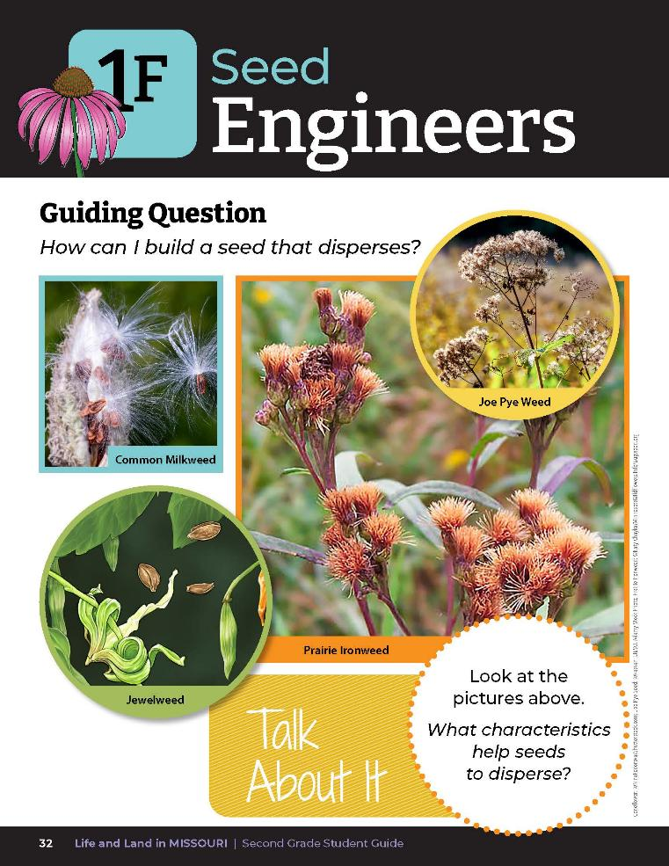
Let’s go outside to collect seeds!
1F
Life and Land in Missouri – 1F Seed Engineers: Engage
3
Notes:
Guiding Question: How can I build a seed that disperses?
Teacher Note: If milkweed pods are not in season at the time of this lesson, display the Milkweed Seeds video and photos from the MD Teacher Portal. Have students role play how they would cause the milkweed seeds to disperse (by blowing).
https://youtu.be/meF2qnIU5hA
https://www.youtube.com/watch?v=RpYV9kPYvOw
https://monarchbutterflygarden.net/harvest-milkweed-seeds-no-fluff/
Take students outside to collect milkweed, jewelweed, Joe Pye weed or ironweed seeds. Images of these flowers and seeds can be found in the student guide on the Lesson 1F Seed Engineers introduction page.

Slide 4
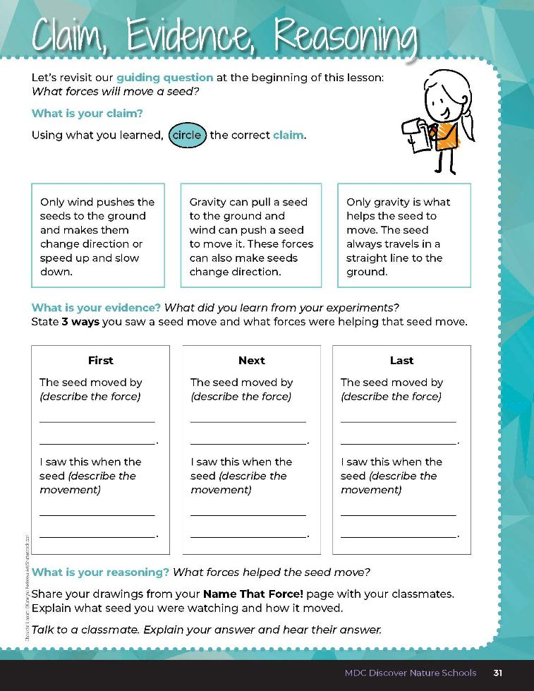
What did we learn previously about how seeds travel?
1F
Life and Land in Missouri – 1F Seed Engineers: Engage
4
Notes:
While outside, as the following question:
What did we learn previously about how seeds travel? Students can refer to their 1D Claims, Evidence, Reasoning page on Page 25.

Slide 5
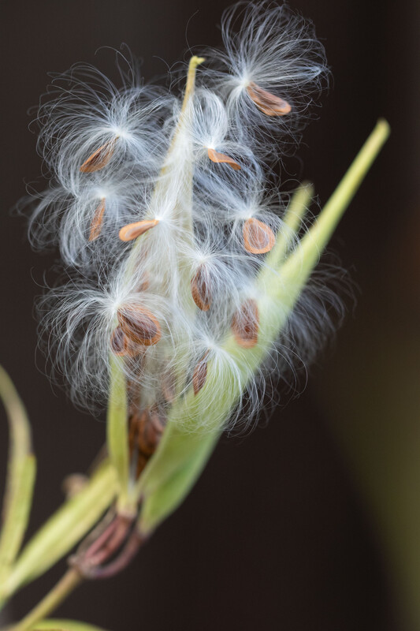
Today we will explore seeds that float through the air and design a seed that will travel.
1F
Life and Land in Missouri – 1F Seed Engineers: Explore
5
Notes:
Hold up a milkweed seed head and a handful of sunflower seeds. Today we will explore seeds that float through the air and design a seed that will travel.
Plant in Picture: Swamp Milkweed seeds

Slide 6
Blow the milkweed seed as far as you can.
Watch carefully and figure out how and why these seeds float through the air.
1F
Life and Land in Missouri – 1F Seed Engineers: Explore
6
Notes:
While outside, use a milkweed pod that has dried and split open. Hand out seeds and ask students to blow them as far as they can.
Tell students to watch carefully and figure out how and why these seeds float through the air.

Slide 7

Would sunflower seeds float the same way?
1F
Life and Land in Missouri – 1F Seed Engineers: Explore
7
Notes:
Ask students if sunflower seeds would float the same way. Throw the sunflower seeds in the air and see what happens.
Plant in Picture: Sunflower

Slide 8
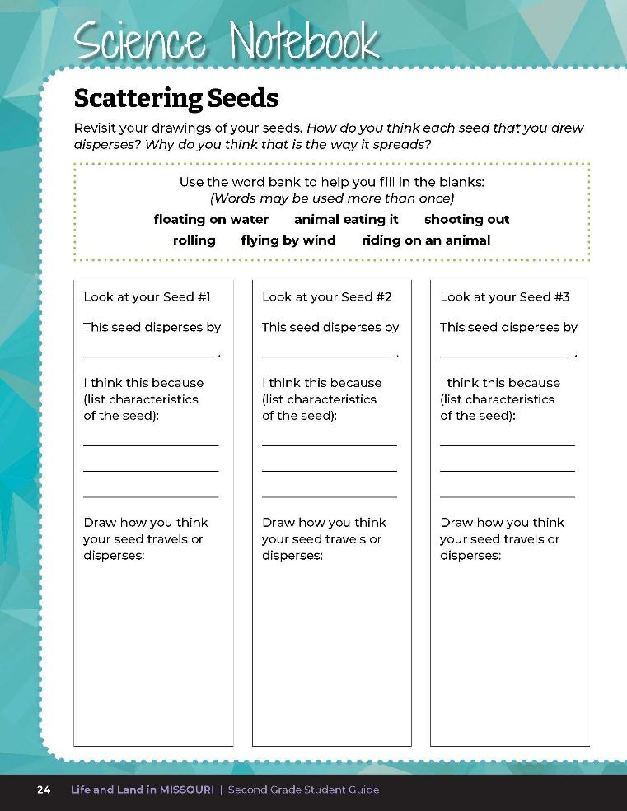
What seed dispersal methods did we learn about in the Seeds and Socks lesson?
1F
1F
Life and Land in Missouri – 1F Seed Engineers: Explore
8
Notes:
Have students open their student guides to Science Notebook 1D Scattering Seeds on Page 24.
Review:
Flying by wind – a maple tree’s helicopters, a dandelion’s fuzzy parachute
Floating on water – lotus, horse chestnut, cockleburs (burdock), cattail
Animals eating it – black cherry, raspberries, blackberries are eaten by animals, and distributed when animals poop
Riding on an animal – Queen Anne’s lice, partridge pea catch on animal fur or people’s clothing.
Shooting out seeds – locust trees, witch hazel, wahoo, violet, jewelweed
Rolling – acorns, pecans, black walnuts

Slide 9
Do any seeds have more than one way to disperse? Why?
1F
Life and Land in Missouri – 1F Seed Engineers: Explore
9

Slide 10
Why do seeds need to disperse?
1F
Life and Land in Missouri – 1F Seed Engineers: Explain
10
Notes:
Let’s review. Why do seeds need to disperse? (Seeds must scatter, or disperse, so they have enough space in order to grow.)

Slide 11
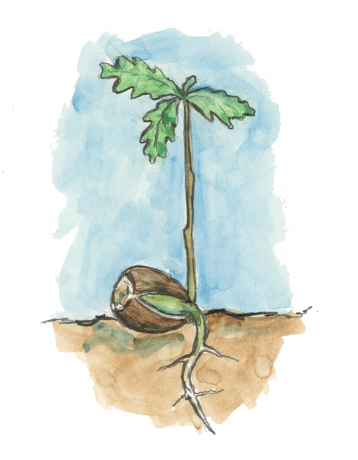
What does a seed need to grow?
1F
Life and Land in Missouri – 1F Seed Engineers: Explain
11
Notes:
(For seeds to grow, they need the right conditions. Each species needs a certain amount of sunlight, air, water, and nutrients from the soil.)
Plant in Illustration: Oak tree growing from acorn

Slide 12
If it is competing with a larger plant, who is going to win?
1F
Life and Land in Missouri – 1F Seed Engineers: Explain
12
Notes:
If a seed just drops from the parent, it might compete with the parent for its needs. If it is competing with a larger plant, who is going to win? (The parent.)

Slide 13

What characteristics help seeds to disperse?
1F
Life and Land in Missouri – 1F Seed Engineers: Explain
13
Notes:
Flowering plants have developed different dispersal methods. These methods allow plants to spread out and avoid overcrowding. Discuss the Talk About It on Page 32.

Slide 14
You are going to now become Seed Engineers.
1F
Life and Land in Missouri – 1F Seed Engineers: Elaborate
14
Notes:
Seed Dispersal Engineering Activity:
Divide students into at least four small groups. There are four problems to solve below, but problems can be repeated by additional groups. Problems can also be duplicated by more student groups.
Explain to students they are going to now become Seed Engineers. Discuss the role of an engineer as a designer and builder.

Slide 15
Each group will receive a bean or a bead. This is your seed, and you will need to design a method of seed dispersal.
1F
Life and Land in Missouri – 1F Seed Engineers: Elaborate
15
Notes:
Give each group a bean or a bead. Explain that this is their seed, and they will need to design a method of seed dispersal.
Each group will design a method to meet the assigned problem given from the following list. Specify that their design needs to have a primary seed dispersal method, (or main way of dispersing seeds), but their design can have more than one dispersal method to increase the seed’s survival. Assign or allow students to choose the goal to achieve for their experiment.
Problem 1 – seed needs to float in water for at least 3 minutes.
Problem 2 – seed needs to float in the air for at least 5 seconds.
Problem 3 – seed need to stick to a sock and be carried at least 10 seconds.
Problem 4 – seed needs to be thrown at least 15 feet.

Slide 16

Circle the group problem that you will need to solve.
1F
Life and Land in Missouri – 1F Seed Engineers: Elaborate
16
Notes:
Have students turn to Science Notebook 1F Seed Engineering: It’s a Process! on Page 33. Have them circle the group problem that they will need to solve from the list on that page.

Slide 17

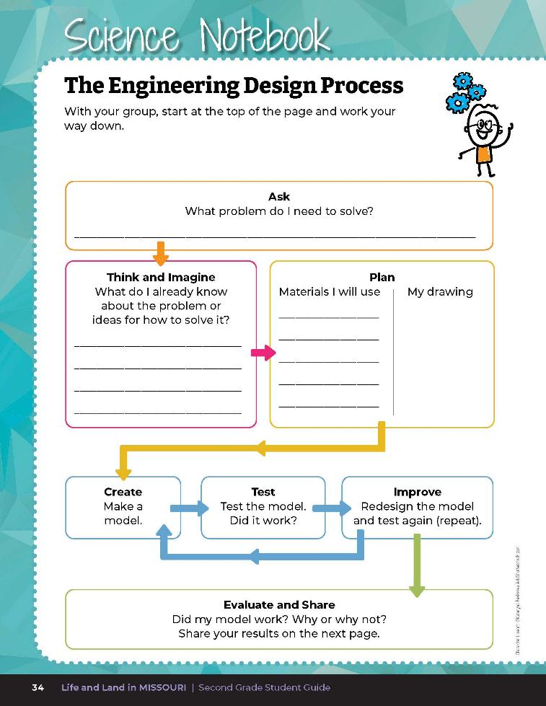
The Engineering Design Process
1F
Life and Land in Missouri – 1F Seed Engineers: Elaborate
17
Notes:
Since this will be their first time building and creating a model to solve a given problem, review the Engineering Design Process with them, starting with the first step of Ask. Refer to the graphic on Page 60 of the Teacher Guide, which is also on Page 34 of the student guide and on the Teacher Portal 1F Engineering Design Process Organizer Handout.pdf
Have them go to the following page and look at the Engineering Design Process together.
Teacher Note: This organizer is color-coded to the graphic from the previous page so they can visually align the steps they are taking.
Allow time for students to find their groups and write their problem they need to solve into the top part of the page. Then give at least 10-15 minutes to discuss ideas among themselves and write them down in the Think and Imagine section. As a group, they will choose one solution they would like to plan. Students should think about appropriate materials that are available to them. Allow time for students to gather materials, list materials used, and draw their plan in the Plan section.
Allow them time to create, test, and improve their model at least 3 times.

Slide 18
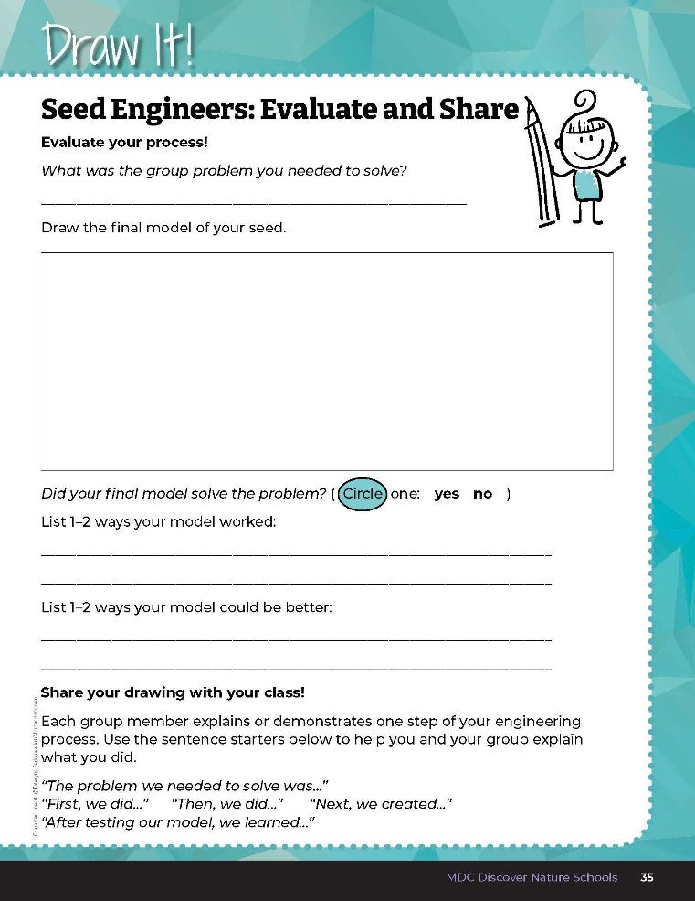

Restate the group problem you needed to solve
Draw the final model of your seed
List 1-2 ways your model worked and 1-2 ways your model did not work
1F
Life and Land in Missouri – 1F Seed Engineers: Evaluate
18
Notes:
After at least 3 trials and modifications, have students refer to the Draw It! 1F Seed Engineers: Evaluate and Share section on Page 35. Students will restate the group problem they needed to solve and draw the final model of their seed. Did their final model solve the problem given to the group? What worked? What did not work? Students should list 1-2 ways their model worked and 1-2 ways their model did not work.

Slide 19
1F
Life and Land in Missouri – 1F Seed Engineers: Evaluate
19
Notes:
Let each group demonstrate and explain their seed dispersal method, showing how it works. They can follow the sentence prompts on the Draw It! 1F Seed Engineers: Evaluate and Share page, dividing speaking roles among group members. Prompts can be written on the board and include:
“The problem we needed to solve was…” “First, we did…” “Then, we did…” “Next, we created…” “After testing our model, we learned…”
Evaluate each method according to the appropriate criteria.
Rubric:
4 (Exceeds) – Student group correctly explains the problem they need to solve, displays and demonstrates the seed they built, explains 2 ways why their model worked and 2 ways why their model did not work. Each member of the group speaks.
3 (Meets) – Student group correctly explains the problem they needed to solve, displays and demonstrates the seed they built, explains 1 way why their model worked and 1 way why their model did not work. Almost every member of the group speaks.
2 (Partially meets) – Student group somewhat correctly explains the problem they needed to solve, may or may not display or demonstrate the seed they built, explains 1 way why their model worked and 1 way why their model did not work. Half of the group members speak.
1 (Doesn’t meet) – Student group does not correctly explain the problem they needed to solve , does not display or demonstrate the seed they built, may or may not explain 1 way their model worked or 1 way their model did not work. Only one group member speaks.

Slide 20
Each group member explains or demonstrates one step of the engineering process. Follow the sentence prompts.
1F
Life and Land in Missouri – 1F Seed Engineers: Evaluate
20
Notes:
Let each group demonstrate and explain their seed dispersal method, showing how it works. They can follow the sentence prompts on the Draw It! 1F Seed Engineers: Evaluate and Share page, dividing speaking roles among group members. Prompts can be written on the board and include:
“The problem we needed to solve was…” “First, we did…” “Then, we did…” “Next, we created…” “After testing our model, we learned…”
Evaluate each method according to the appropriate criteria.
Rubric:
4 (Exceeds) – Student group correctly explains the problem they need to solve, displays and demonstrates the seed they built, explains 2 ways why their model worked and 2 ways why their model did not work. Each member of the group speaks.
3 (Meets) – Student group correctly explains the problem they needed to solve, displays and demonstrates the seed they built, explains 1 way why their model worked and 1 way why their model did not work. Almost every member of the group speaks.
2 (Partially meets) – Student group somewhat correctly explains the problem they needed to solve, may or may not display or demonstrate the seed they built, explains 1 way why their model worked and 1 way why their model did not work. Half of the group members speak.
1 (Doesn’t meet) – Student group does not correctly explain the problem they needed to solve , does not display or demonstrate the seed they built, may or may not explain 1 way their model worked or 1 way their model did not work. Only one group member speaks.

Slide 21
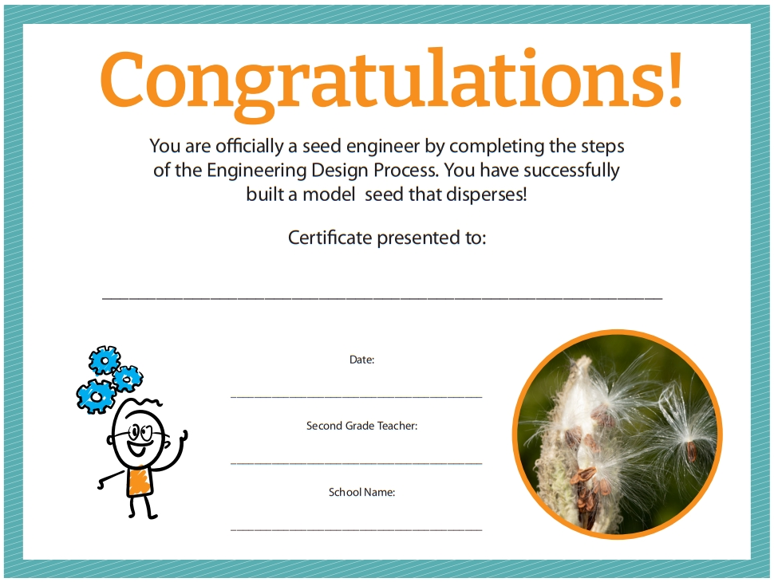
1F
Life and Land in Missouri – 1F Seed Engineers: Evaluate
21
Notes:
Teacher Note: For a fun achievement-learning celebration, teacher can copy or print a Certificate of Engineering Achievement to celebrate students becoming Seed Engineers. Certificates can be printed from MDC Teacher Portal or copied from the teacher guide. 1F Certificate of Engineering Achievement.pdf

