Slide 1
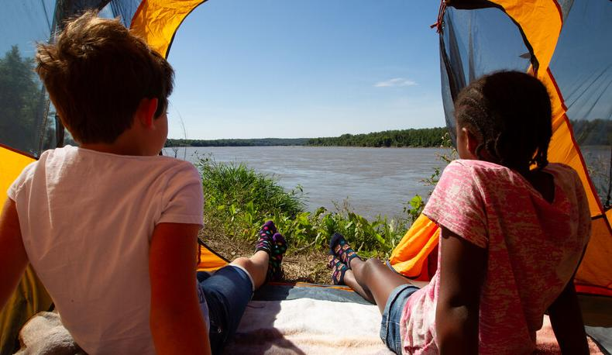

Life and Land in
MISSOURI
1E: Seeds and Forces

Slide 2
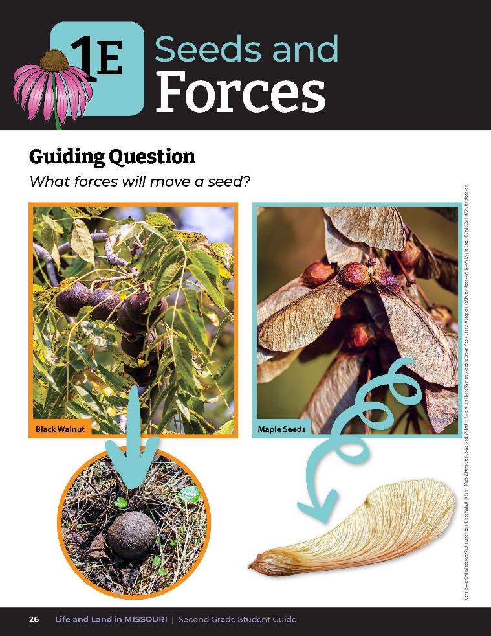
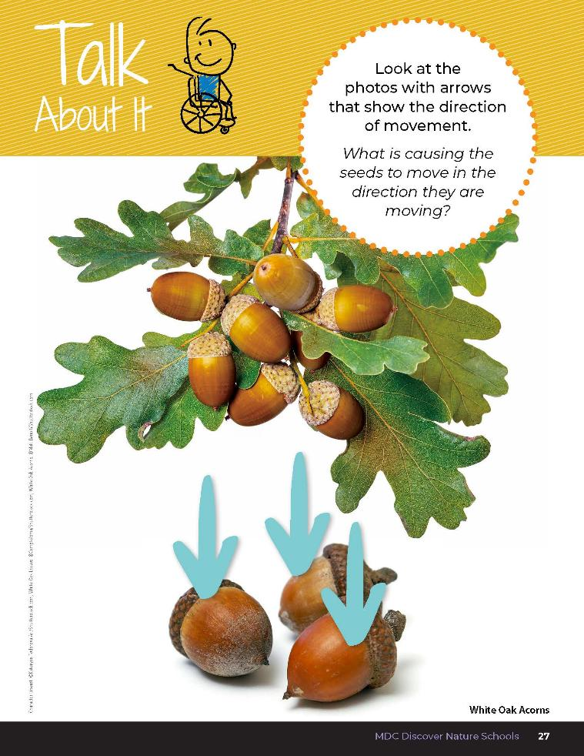
1E
Life and Land in Missouri – 1E Seeds and Forces: Engage
4
Notes:
Guiding Question: What forces will move a seed?
Refer to the photos of the different seeds and their direction of movement in the student guide Lesson 1E Seeds and Forces introduction pages 26-27.

Slide 3
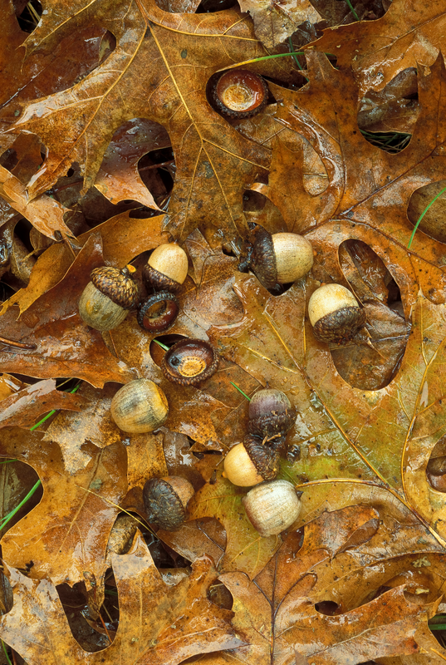
How did this seed get here?
Can seeds change directions as they fall from a tree?
1E
Life and Land in Missouri – 1E Seeds and Forces: Engage
3
Notes:
Go outside with your students and look under a tree for seeds that have dropped. How did this seed get here? Can seeds change directions as they fall from a tree? Allow students time to brainstorm ideas.
Plant in Picture: Shumard oak tree leaves and acorns

Slide 4
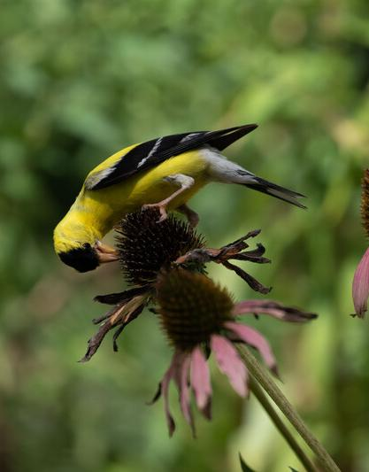
What forces will move a seed?
This is what we will investigate today.
1E
Life and Land in Missouri – 1E Seeds and Forces: Engage
4
Notes:
Read the guiding question together. What forces will move a seed? This is what we will investigate today.
Animal in Picture: American Goldfinch; Plant in Picture: Purple Coneflower

Slide 5
What is causing the seeds to move in the direction they are moving?
1E
Life and Land in Missouri – 1E Seeds and Forces: Engage
5
Notes:
Discuss the Talk About It. Look at the photos with arrows that show the direction of movement. What is causing the seeds to move in the direction they are moving? Allow students time to share what they know and record observations.

Slide 6
Let’s set up our own Plinko Board!
1E
Life and Land in Missouri – 1E Seeds and Forces: Explore
6
Notes:
Have students bring a smaller seed such as an acorn and a larger seed such as a walnut inside.
Plinko Board Test
In groups, have students set up their own Plinko board:
Distribute 2 cardboard pieces per student group (Teacher Note: Have students put the cardboard pieces back-to-back to keep push pins from coming through.)
Distribute markers so students can draw a tree on one side of their cardboard.
Distribute 1 container of push pins to put on the tree. These are the “branches.”

Slide 7
How do seeds change directions as they fall?
1E
Life and Land in Missouri – 1E Seeds and Forces: Explore
8
Notes:
(Student responses could be wind, water or if they bounce.)

Slide 8
When seeds fall from trees, do they usually fall straight down?
1E
Life and Land in Missouri – 1E Seeds and Forces: Explore
9

Slide 9
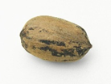
What will happen if I drop this seed from the top of the board?
Where do you think it will stop?
1E
Life and Land in Missouri – 1E Seeds and Forces: Explore
10
Notes:
Let’s pretend this Pinko board is a tree with many branches. What will happen if I drop this seed from the top of the board? Where do you think it will stop? Have students write the seed name on a sticky note and place where they think the seed will stop. Have students drop their seed and then point to where the seed stopped.
Optional: Students can paint their seed immediately before dropping the seed through their Pinko board. The wet paint will leave a trail that will clearly show the path the seed took as it traveled through the board.
Plant in Picture: Pecan Tree nut

Slide 10
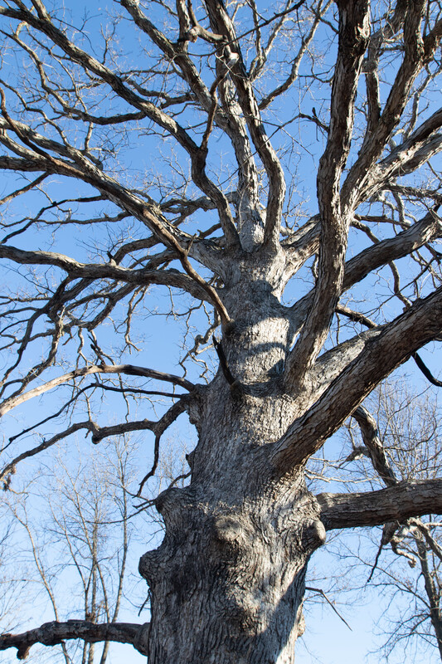
Where did the seed stop? Why?
What is causing the seed to fall and is it falling in a straight line or changing directions?
1E
Life and Land in Missouri – 1E Seeds and Forces: Explore
11
Notes:
(The seed is changing directions because of where it is hitting the branch.)

Slide 11
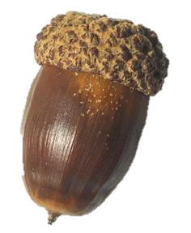
Can we stop a seed from reaching the ground with paper?
1E
Life and Land in Missouri – 1E Seeds and Forces: Explore
12
Notes:
Seed vs. Paper Test
Let’s do another test. Can we stop a seed from reaching the ground with paper? Have student stand on a chair and drop an acorn from face height. Have another student hold out a piece of copy paper near the student’s feet to represent leaves.
Plant in Picture: White Oak Tree acorn

Slide 12
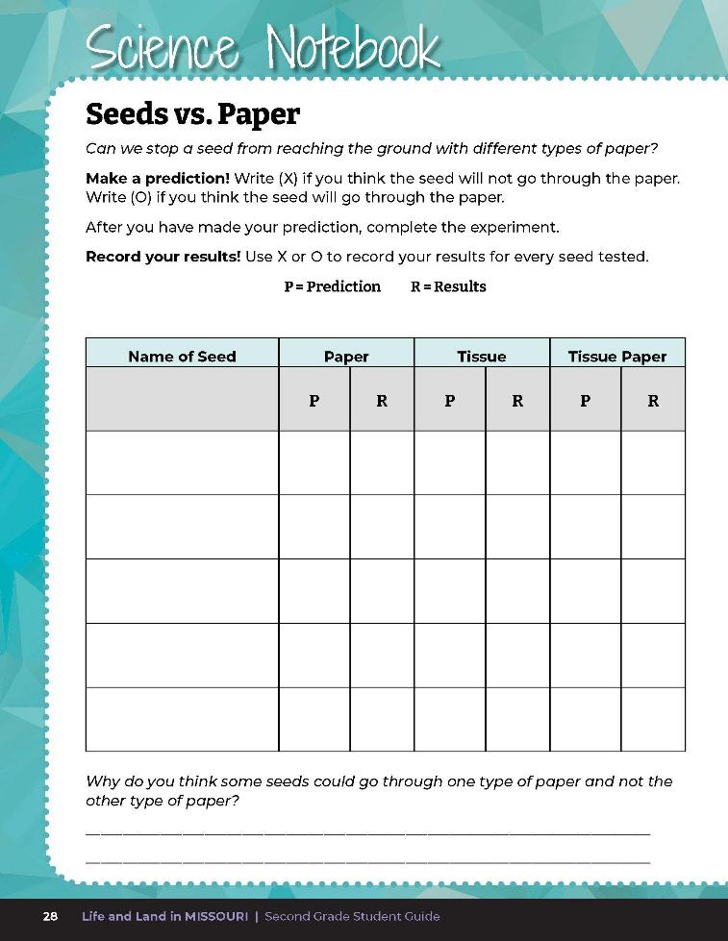
Make a prediction!
1E
Life and Land in Missouri – 1E Seeds and Forces: Explore
13
Notes:
Allow students to make predictions in their Science Notebook 1E Seed vs. Paper chart on Page 28.

Slide 13
What happened?
Record your results!
1E
Life and Land in Missouri – 1E Seeds and Forces: Explore
14
Notes:
The student on the chair will drop the seed. What happened? Record results on the Science Notebook page.

Slide 14
What if the paper was a little thinner?
Would that stop the seed?
1E
Life and Land in Missouri – 1E Seeds and Forces: Explore
15

Slide 15
Conduct the same experiment using the tissue and then using the tissue paper.
Record results.
1E
Life and Land in Missouri – 1E Seeds and Forces: Explore
16
Notes:
Conduct the same experiment using tissue and then using the tissue paper. Record results.

Slide 16
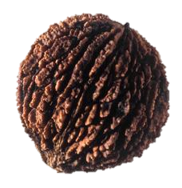
What if we tested another seed that is a little heavier like a walnut?
1E
Life and Land in Missouri – 1E Seeds and Forces: Explore
17
Notes:
Plant in picture: Black Walnut Tree nut

Slide 17
Perform the same series of tests with a walnut.
1E
Life and Land in Missouri – 1E Seeds and Forces: Explore
18

Slide 18
What happened to the paper?
Did the walnut go through each piece? Why?
1E
Life and Land in Missouri – 1E Seeds and Forces: Explore
19

Slide 19
Continue to perform the same test for the different seeds collected.
1E
Life and Land in Missouri – 1E Seeds and Forces: Explore
20

Slide 20
What different forces are at work here to make these seeds drop or change directions?
1E
Life and Land in Missouri – 1E Seeds and Forces: Explore
21
Notes:
Allow students time to brainstorm. Write student ideas on the board.

Slide 21
What forces will move a seed?
1E
Life and Land in Missouri – 1E Seeds and Forces: Explain
22
Notes:
Let’s revisit our guiding question: What forces will move a seed? Allow students time to talk to their small groups and discuss the different forces at work.

Slide 22

Read the book Give It a Push! Give It a Pull!: A Look at Forces by Jennifer Boothroyd.
Read Aloud:
https://youtu.be/0nFM4FtSqnI?si=WSRBigdvwub4bRxI
Epic Link:
https://www.getepic.com/book/53846839/give-it-a-push-give-it-a-pull-a-look-at-forces
1E
Life and Land in Missouri – 1E Seeds and Forces: Explain
23
Notes:
Read the book Give It a Push! Give It a Pull!: A Look at Forces by Jennifer Boothroyd.

Slide 23

What does the wind do to the leaves?
How is that the same for our seeds?
1E
Life and Land in Missouri – 1E Seeds and Forces: Explain
24
Notes:
As you read the book, ask students to relate their observations back to the seed.

Slide 24
What does gravity do to move the paper airplane?
How is that the same for seeds when they fall?
1E
Life and Land in Missouri – 1E Seeds and Forces: Explain
25

Slide 25
How is the ball bouncing back from the wall or stopping the ball?
How is this like the seed bouncing through branches?
1E
Life and Land in Missouri – 1E Seeds and Forces: Explain
26

Slide 26
What happens when a larger object, like a walnut, moves through the branches of a tree?
1E
Life and Land in Missouri – 1E Seeds and Forces: Explain
27
Notes:
Plant in Picture: Black Walnut Tree seed

Slide 27
Force is a push or pull. Forces happened throughout the experiment. The branch or peg pushes against the seed as the seed hits the branch and it goes down on the board.
1E
Life and Land in Missouri – 1E Seeds and Forces: Explain
28
Notes:
Let’s put some words to our seeds and how they move and revisit our questions again. Allow students time to discuss the different forces at work. Student ideas should include the vocabulary terms below. If students are struggling with assigning vocabulary terms, write the terms on the board and discuss as a class where they noticed these different forces at work.

Slide 28
Gravity pulls the seed toward the Earth, making the seed move or drop to the ground.
1E
Life and Land in Missouri – 1E Seeds and Forces: Explain
29

Slide 29
Gravity made the two seeds drop in a straight line, but the push of the peg when the seed hit it caused the seed to change direction.
1E
Life and Land in Missouri – 1E Seeds and Forces: Explain
30

Slide 30

The walnut, which weighs more than the acorn, could break through the paper, or “leaves,” because it had a greater force.
1E
Life and Land in Missouri – 1E Seeds and Forces: Explain
31
Notes:
Plants in Picture: Black Walnut Tree seed and Shingle Oak acorn

Slide 31
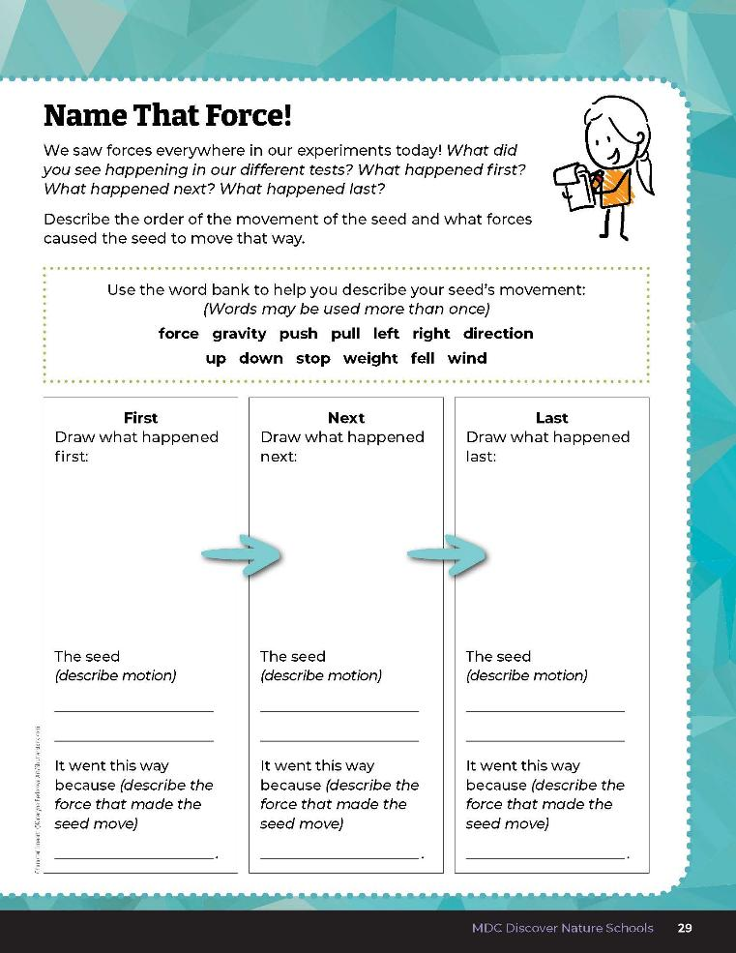

Describe the order of the movement of the seed and what forces caused the seed to move that way.
1E
Life and Land in Missouri – 1E Seeds and Forces: Explain
32
Notes:
Have students order their observations from the time the seed dropped into the Plinko board to when it stopped. Discuss the order of events and how the different forces caused the seed to move and in what way (effect). Have students open their student guide to Science Notebook 1E Name that Force! On Page 29 and write their causes and effects in the order discussed.

Slide 32
Let’s go outside and explore the forces that we see.
Find a quiet spot and sit for 3 minutes.
Listen and observe what you see moving outside.
1E
Life and Land in Missouri – 1E Seeds and Forces: Elaborate
33
Notes:
Let’s go outside and explore the forces that we see. Allow students to find a quiet spot and sit for 3 minutes. Listen and observe what they see moving outside.

Slide 33
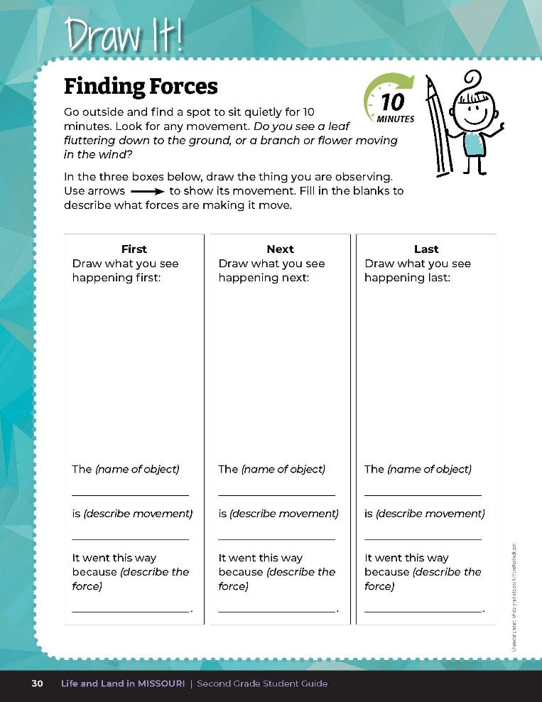

Draw the forces at work and explain how they are moving an object.
1E
Life and Land in Missouri – 1E Seeds and Forces: Elaborate
33
Notes:
In Draw it! 1E Finding Forces on student guide Page 30, students will draw the forces at work and explain how they are moving an object. Students will draw at least 3 ways the object is moving. Using the concepts they have learned to describe movement (force, push, pull, gravity, direction), the students will write an explanation of the movement under each picture. If a student completes this task quickly, they can use the additional Draw It! Finding Forces handout.

Slide 34
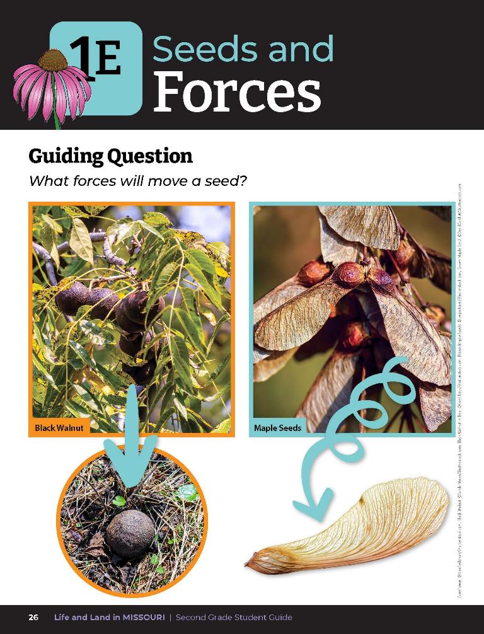
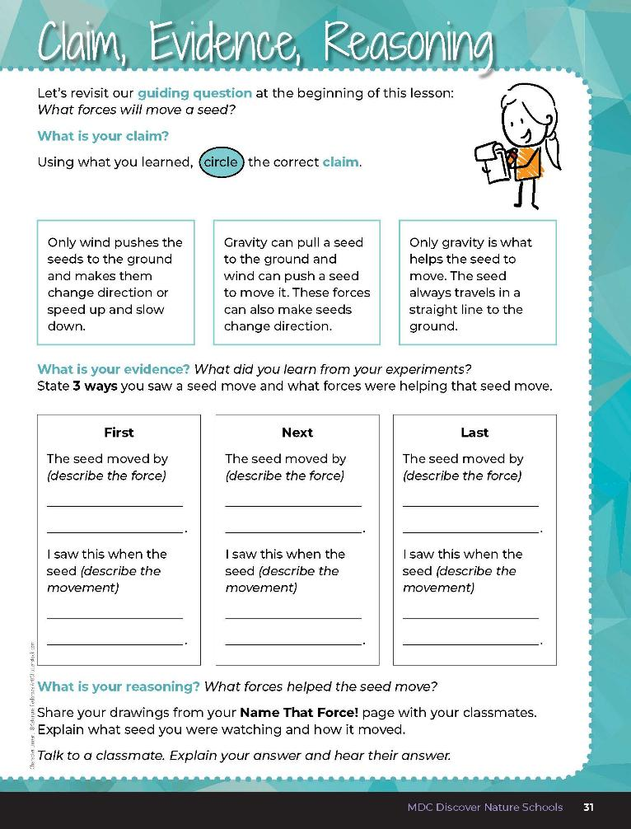
1E
Life and Land in Missouri – 1E Seeds and Forces: Evaluate
34
Notes:
After exploring the concept of how seeds disperse, have students open their student guides to the Claim, Evidence, Reasoning section on Page 31. Guide students through the page by reviewing each section as a class and revisiting the scientific concepts learned to help answer each section.
Guiding Question: What forces will move a seed?

Slide 35
1E
Life and Land in Missouri – 1E Seeds and Forces: Evaluate
35
Notes:
Rubric:
4 (Exceeds) – Student circles the correct claim, writes all 3 examples of evidence into the blanks, and verbalizes the correct reasoning.
3 (Meets) – Student circles the correct claim, writes at least 2 examples of evidence into the blanks, and somewhat verbalizes the correct reasoning.
2 (Partially meets) – Student circles the correct claim, writes at least 1 example of evidence into the blanks, and somewhat verbalizes the correct reasoning.
1 (Doesn’t meet) – Student does not provide the correct claim or evidence and does not verbalize the correct reasoning.

Slide 36


Answers
1E
Life and Land in Missouri – 1E Seeds and Forces: Evaluate
36
Notes:
Rubric:
4 (Exceeds) – Student circles the correct claim, writes all 3 examples of evidence into the blanks, and verbalizes the correct reasoning.
3 (Meets) – Student circles the correct claim, writes at least 2 examples of evidence into the blanks, and somewhat verbalizes the correct reasoning.
2 (Partially meets) – Student circles the correct claim, writes at least 1 example of evidence into the blanks, and somewhat verbalizes the correct reasoning.
1 (Doesn’t meet) – Student does not provide the correct claim or evidence and does not verbalize the correct reasoning.

